Slide 1
BPM-bellows assembly impedance analysis
何天龙、姚海艳
20260415

Slide 2
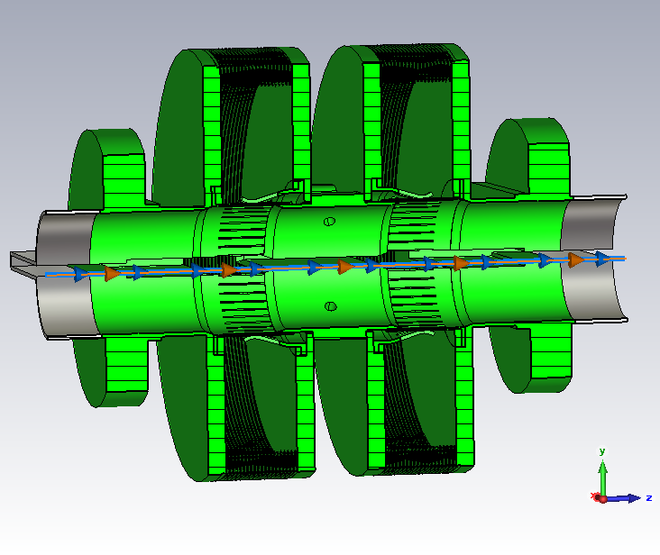
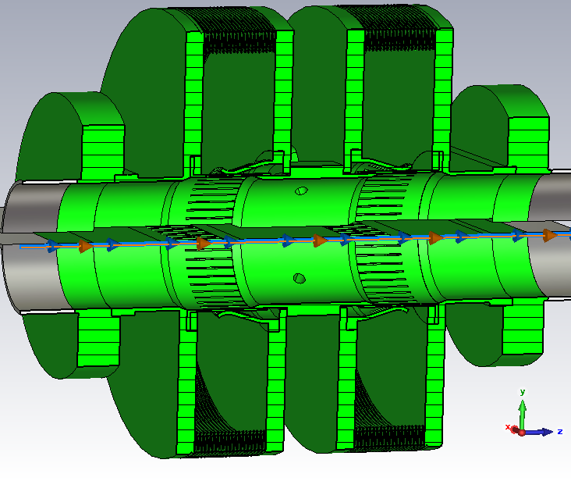
前室不屏蔽 vs 屏蔽

Slide 3
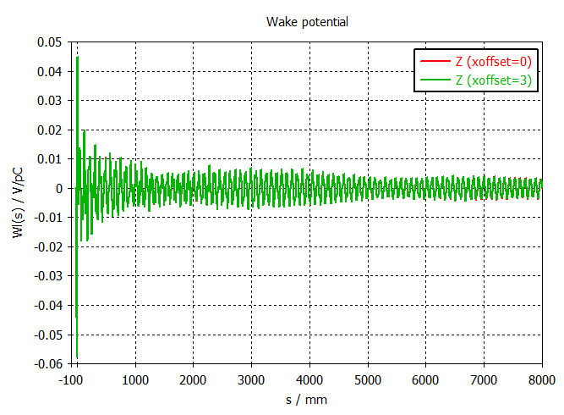
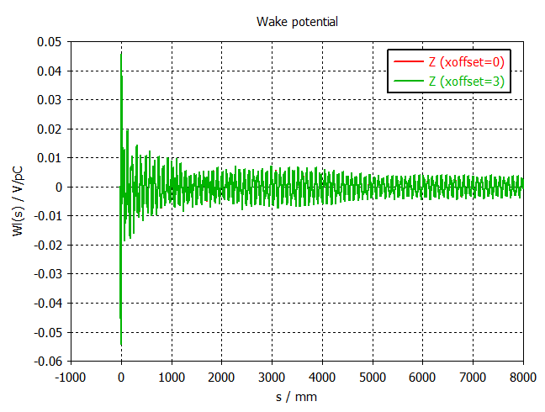
纵向尾势/阻抗
前室不屏蔽 vs 屏蔽

Slide 4
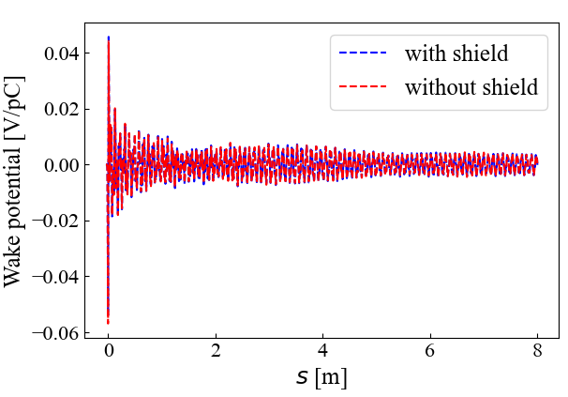
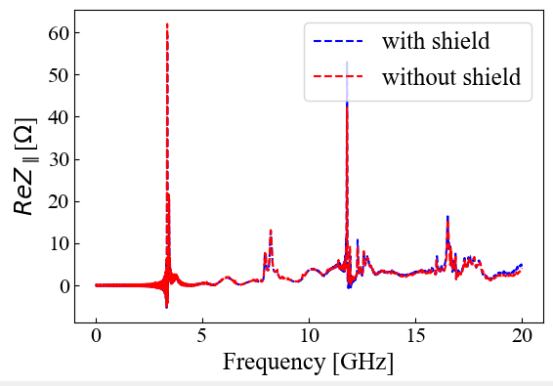
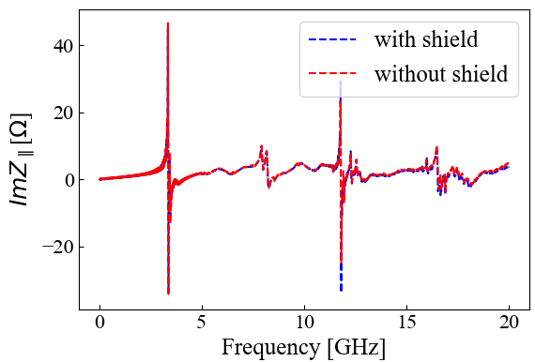
纵向尾势/阻抗
 | 有效阻抗[mOhm]
束团长度[mm] | 有屏蔽 | 无屏蔽
5 | 0.2762 | 0.2877
6 | 0.2952 | 0.3070
7 | 0.3103 | 0.3224
8 | 0.3227 | 0.3351
9 | 0.3335 | 0.3460
10 | 0.3430 | 0.3557
 | 损失因子[mV/pC]
束团长度[mm] | 有屏蔽 | 无屏蔽
5 | 23.058 | 23.444
6 | 15.771 | 16.162
7 | 11.281 | 11.616
8 | 8.444 | 8.715
9 | 6.575 | 6.792
10 | 5.281 | 5.456
8.34 * 8.5 * 2 = 142 W
8.34 * 5.3 * 2 = 88 W

Slide 5
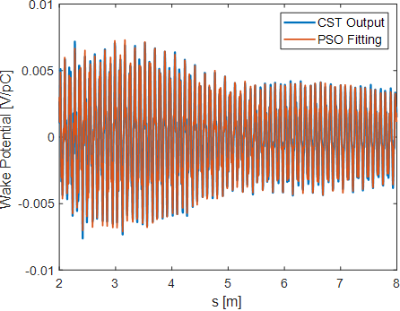
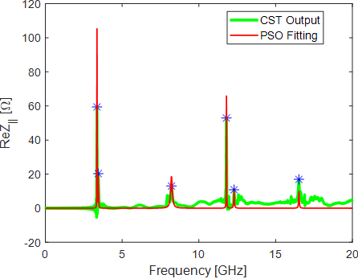
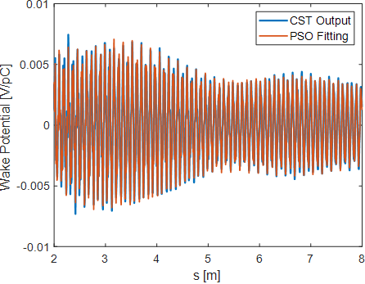
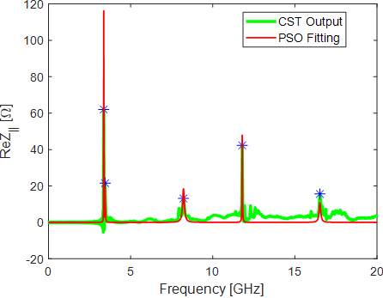
纵向尾势/阻抗
前室屏蔽
f[GHz] | R/Q[Ω] | Q | R[Ω]
3.364 | 0.312 | 335.80 | 104.64
3.448 | 0.166 | 108.26 | 17.92
8.216 | 0.281 | 65.98 | 18.52
11.795 | 0.095 | 695.69 | 65.81
12.292 | 0.038 | 263.08 | 10.00
16.518 | 0.028 | 355.19 | 9.87
前室不屏蔽
f[GHz] | R/Q[Ω] | Q | R[Ω]
3.363 | 0.311 | 372.05 | 115.78
3.447 | 0.145 | 129.69 | 18.74
8.217 | 0.281 | 65.74 | 18.45
11.795 | 0.102 | 471.51 | 47.86
16.524 | 0.076 | 142.08 | 10.78

Slide 6
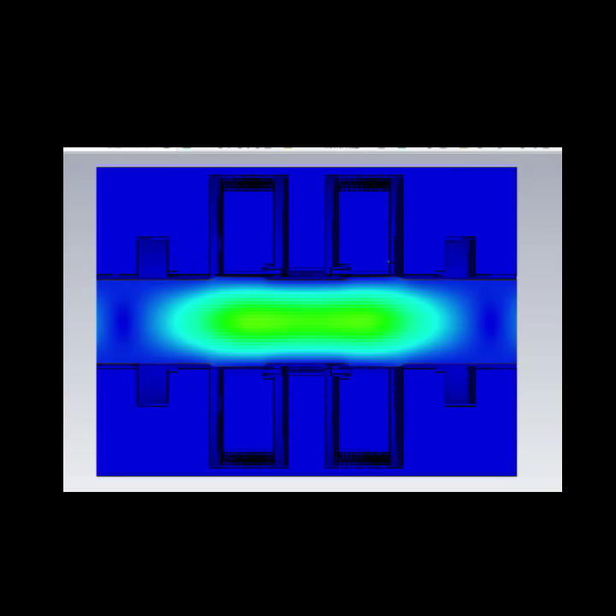
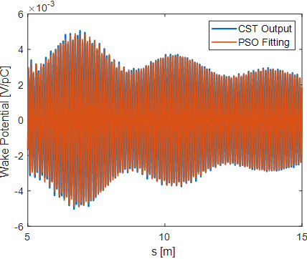
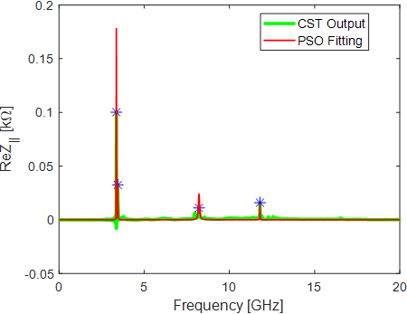
纵向尾势/阻抗
本征模结果和场分布
f[GHz] | R/Q[Ω] | Q | R[Ω]
3.371 | 1.020 | 589.90 | 601.70
前室不屏蔽
5-15m
f[GHz] | R/Q[Ω] | Q | R[Ω]
3.366 | 0.278 | 637.81 | 177.50
3.451 | 0.158 | 205.84 | 32.56
8.217 | 0.168 | 113.87 | 19.18
11.794 | 0.022 | 646.64 | 14.42
3-15m
f[GHz] | R/Q[Ω] | Q | R[Ω]
3.366 | 0.276 | 648.22 | 178.58
3.451 | 0.151 | 211.40 | 31.99
8.217 | 0.054 | 148.32 | 8.01
11.794 | 0.024 | 622.91 | 15.07

Slide 7
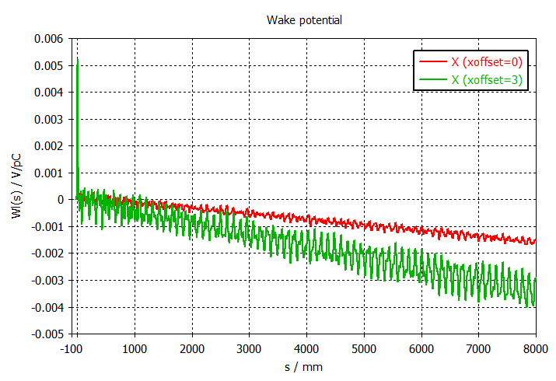
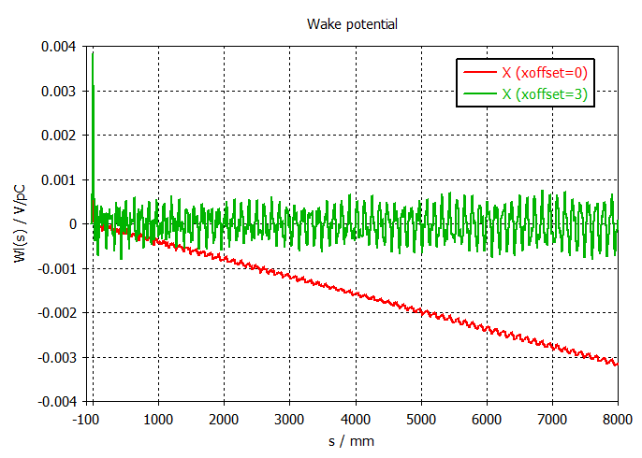
X向尾势/阻抗
前室不屏蔽 vs 屏蔽

Slide 8
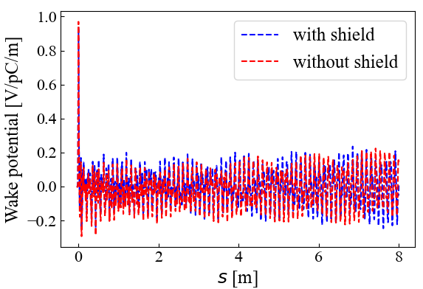
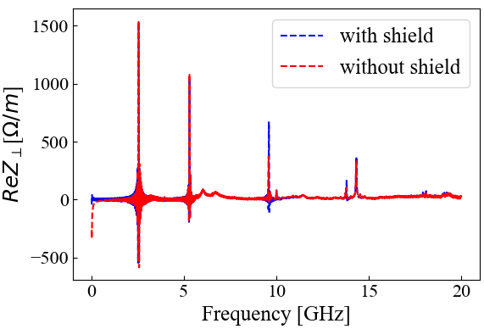
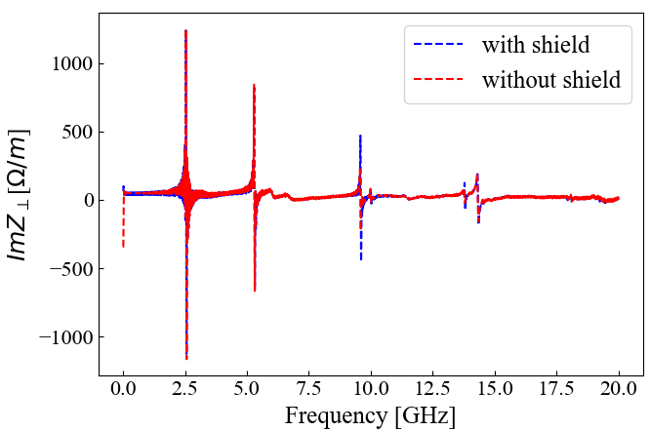
X向尾势/阻抗

Slide 9
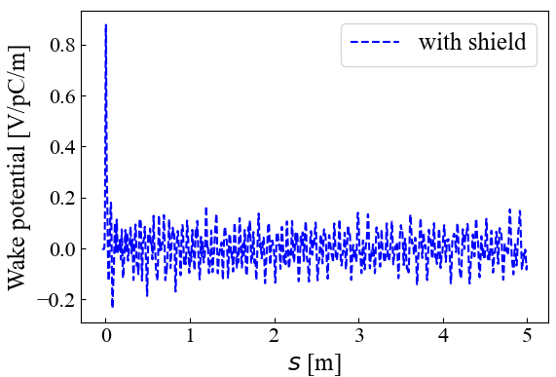
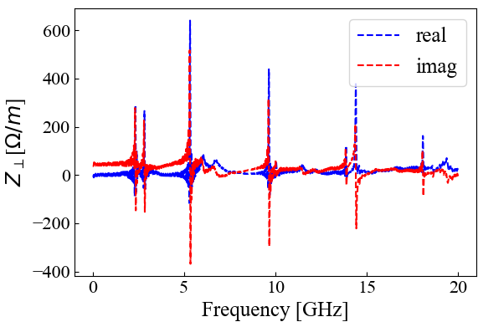
Y向尾势/阻抗

