Slide 1
Weekly Meeting
4.21 Shi Zhou

Slide 2
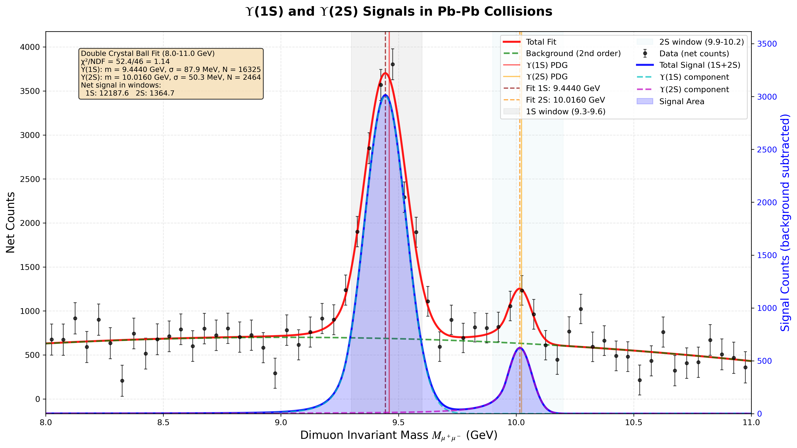


Slide 3
