Slide 1
Group Meeting
Jianjie Peng
2026/4/21

Slide 2

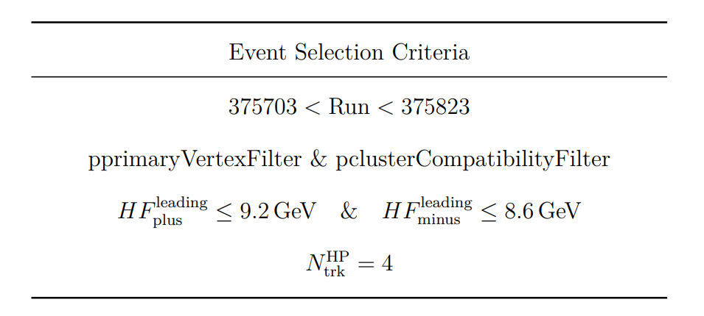
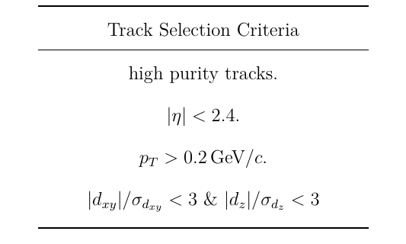
Dataset and Event Selection
Counts After Selection
HIRun2023A：24494
HIRun2025A：178223
7.24
@2025 Pb-Pb 5.36 TeV
Era (OMS): HIRun2025A
DAS: /HI*/HIRun2025A-PromptReco-v1/AOD
HLT_HIUPC_ZeroBias_SinglePixelTrack_MaxPixelTrack_v*
HLT_HIUPC_ZeroBias_SinglePixelTrackLowPt_MaxPixelCluster400_v*

Slide 3
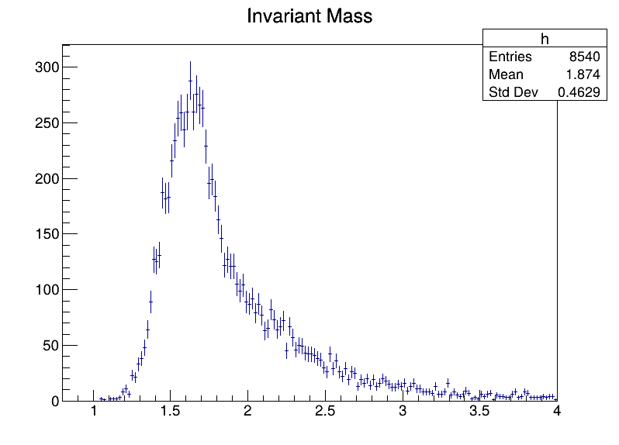
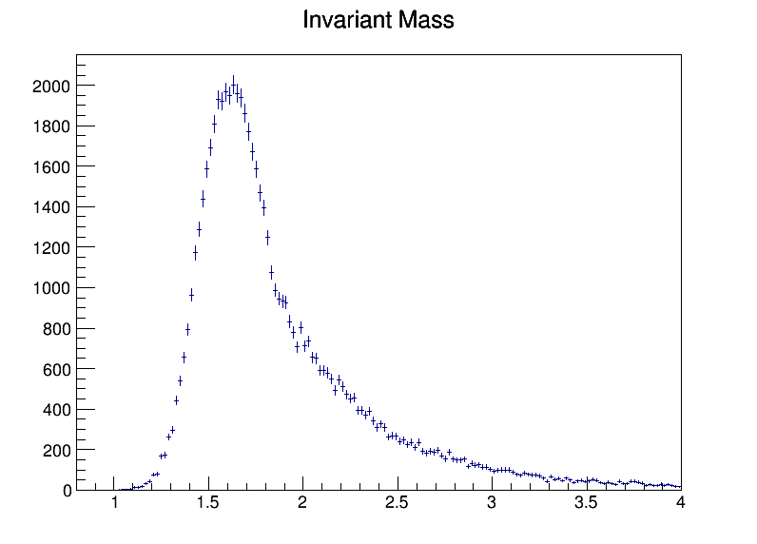
Mass Spectrum
2023
2025
ρ(1450) 2³S₁ ρ(1700) 1³D₁
ρ(2150) 2³D₁?

Slide 4
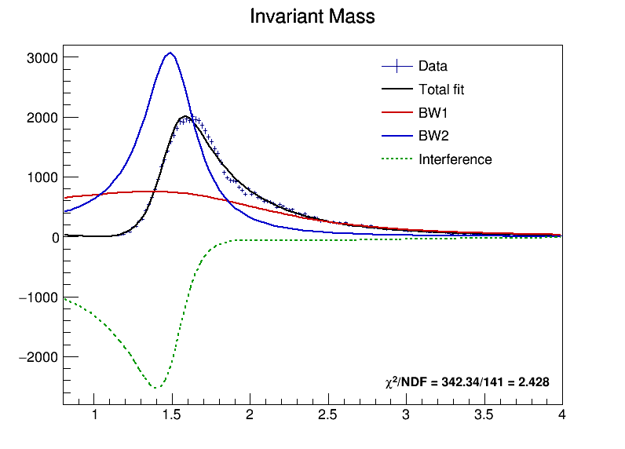


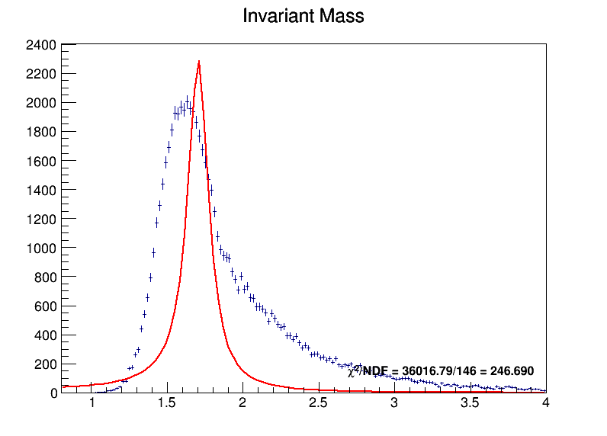
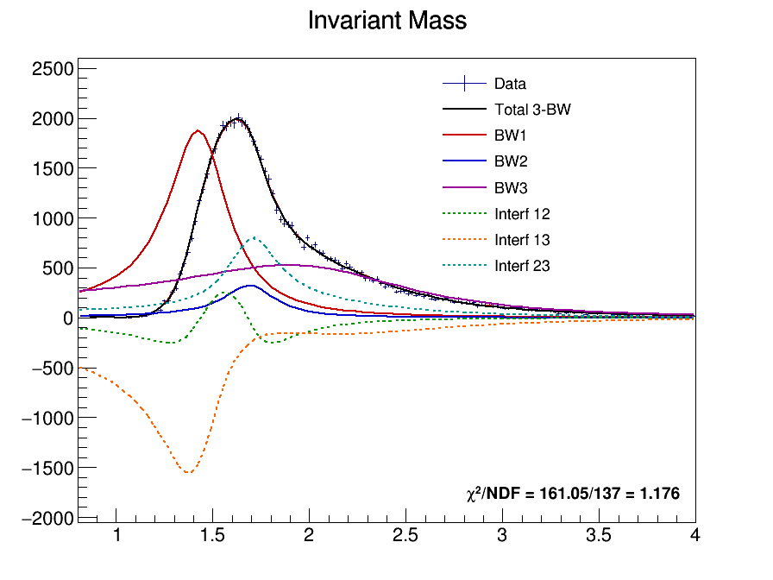
Mass Fit

Slide 5

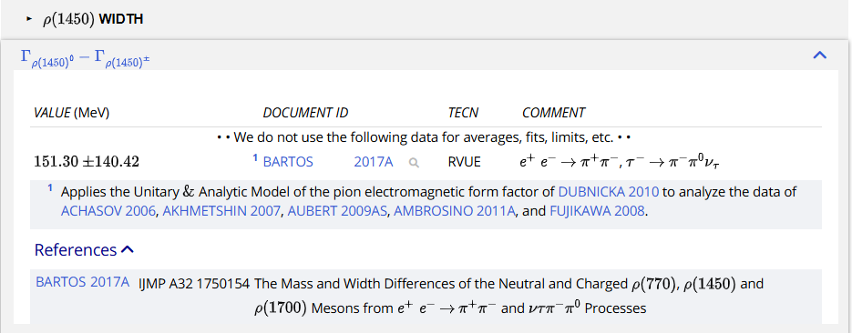
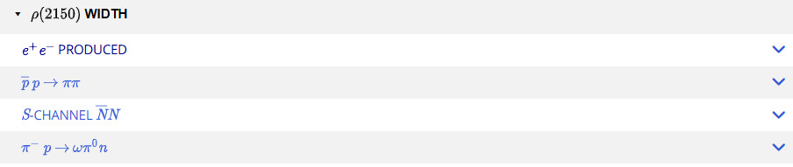
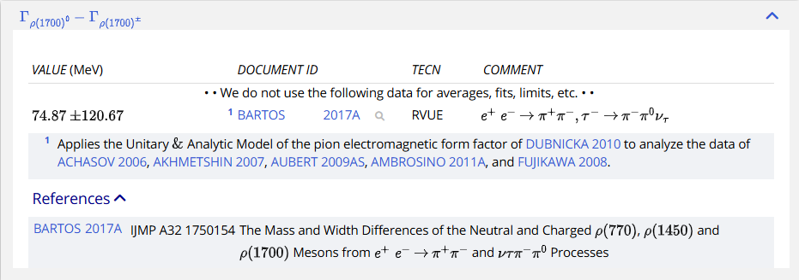
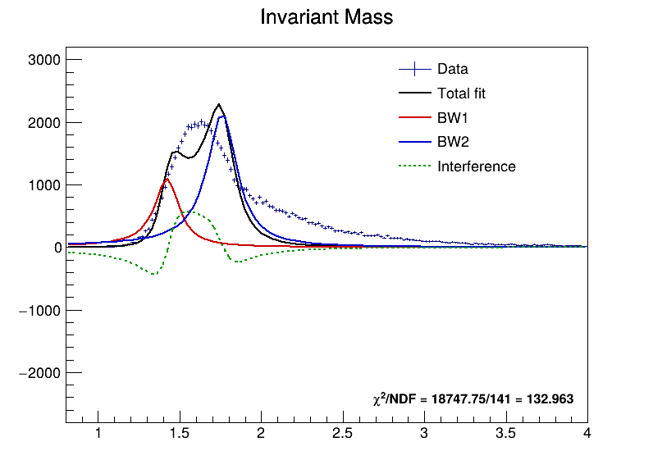
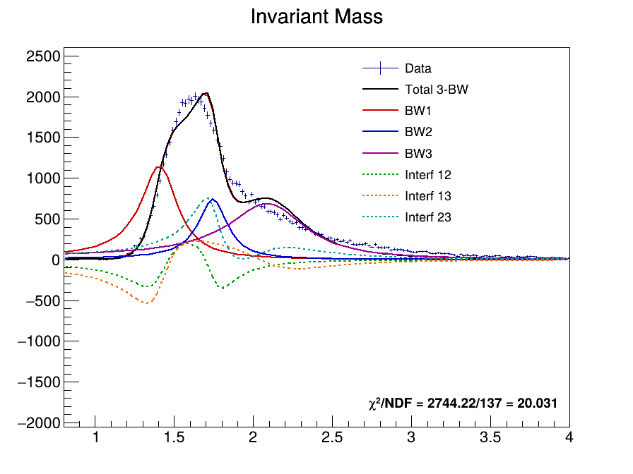
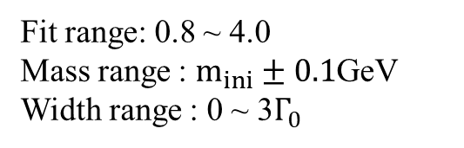
PDG Initials
Fit range: 0.8 ~ 4.0
Mass range : $m_{ini}±0.1$GeV
Width range : 0 ~ 3$Γ_{0}$

Slide 6
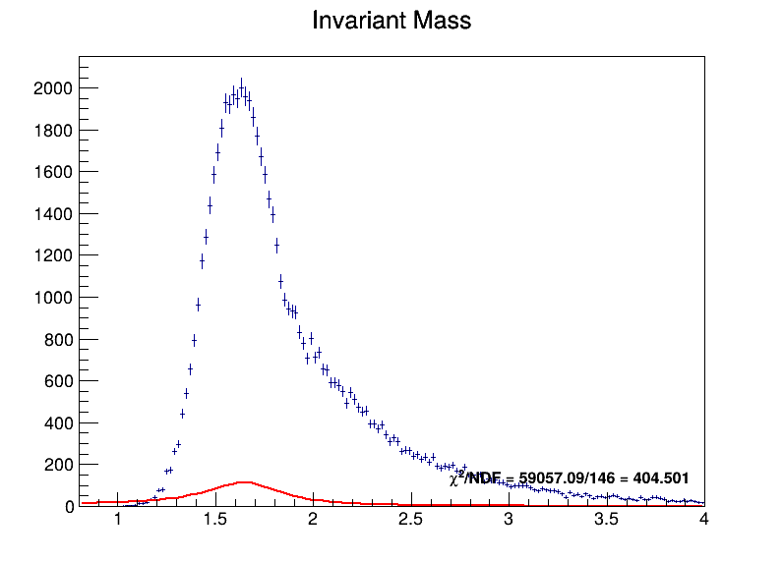
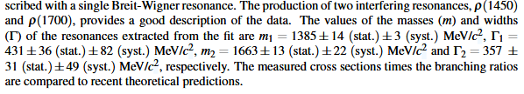
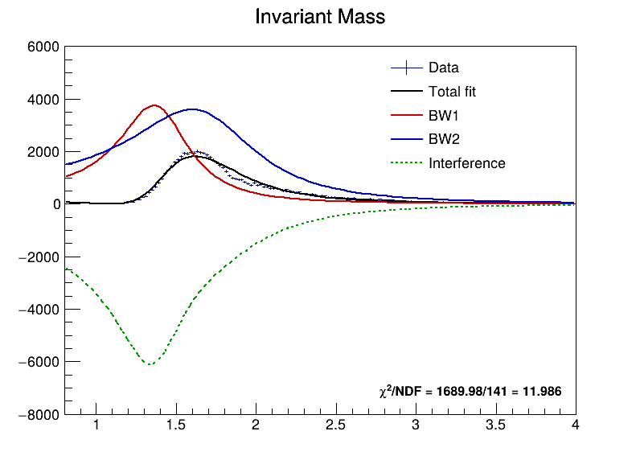
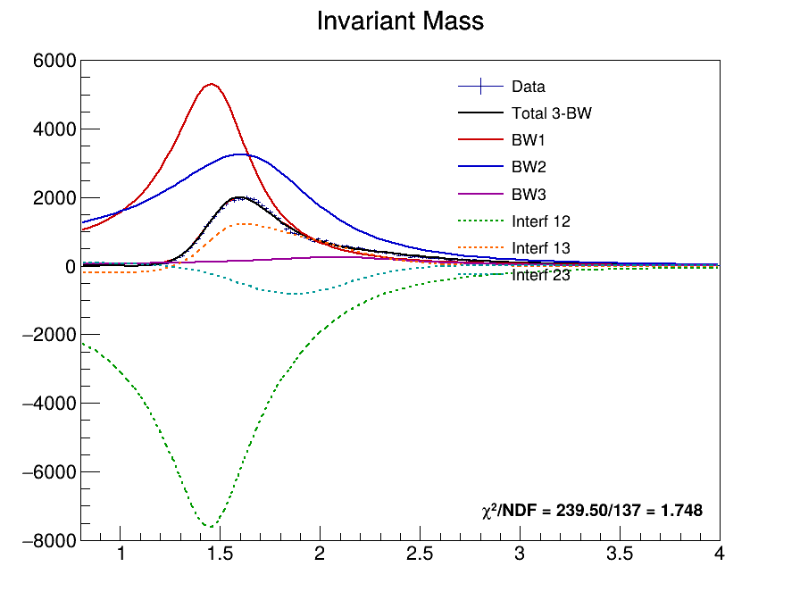
ALICE 2024 Initials
Fit range: 0.8 ~ 4.0
Mass range : $m_{ini}±0.1$GeV
Width range : 0 ~ 3$Γ_{0}$

Slide 7
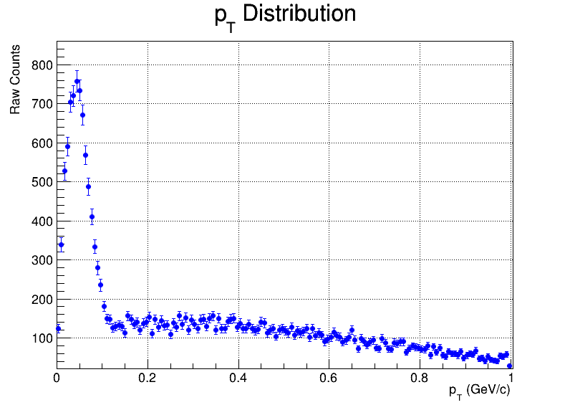
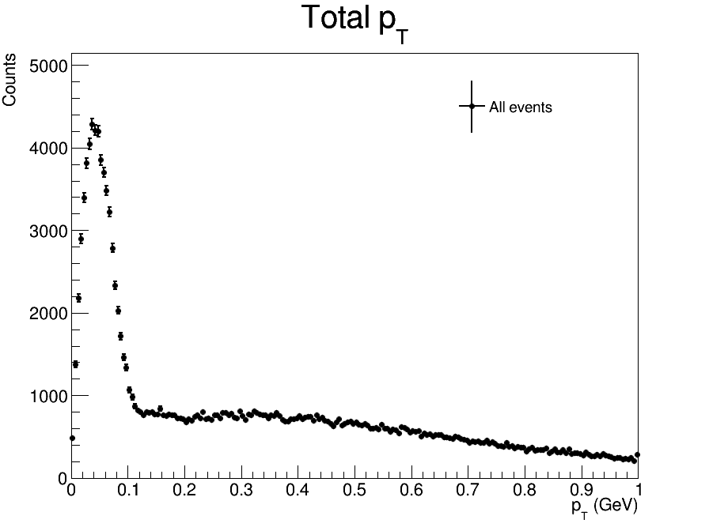
pT spectrum
2023
2025

Slide 8
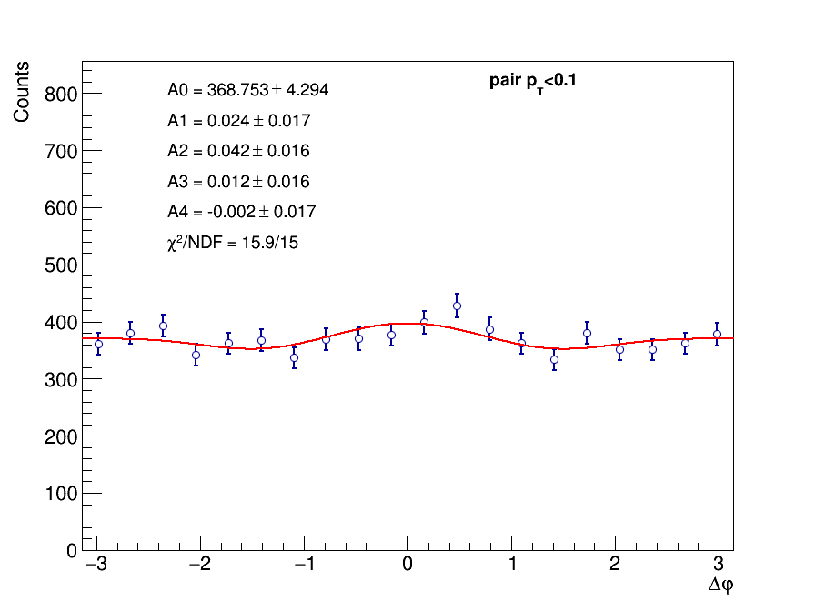
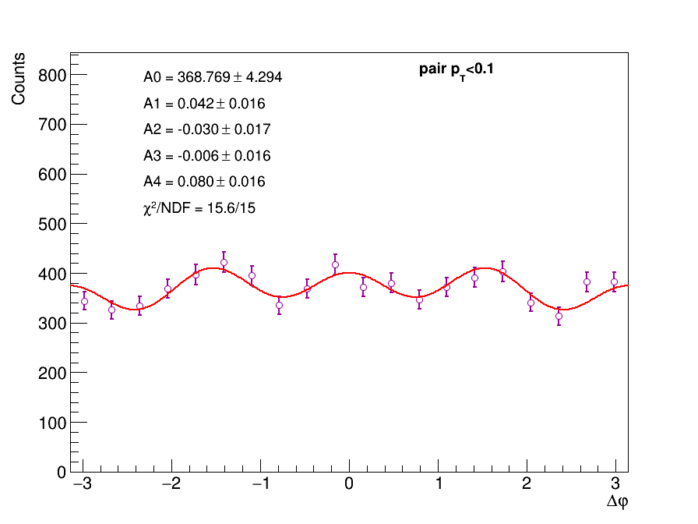
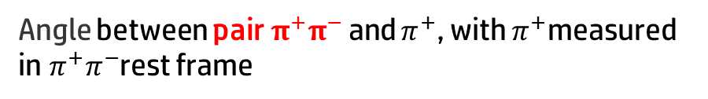

Double Scattering Modulation pT<0.1
Angle between pair$π^{+}π^{−}$and $π^{+}$, with $π^{+}$measured in$π^{+}π^{−}$rest frame
Closest${{ π}^{+}π^{−}\text{pair} to m}_{ρ_{0}}=0.77GeV$
The other pair

Slide 9
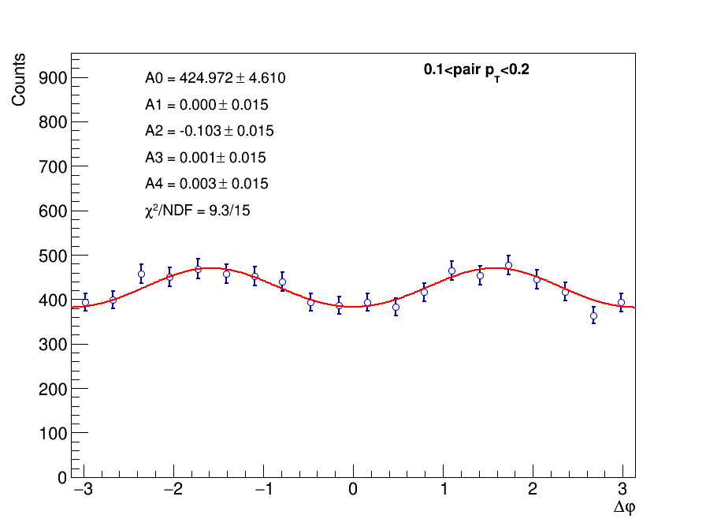
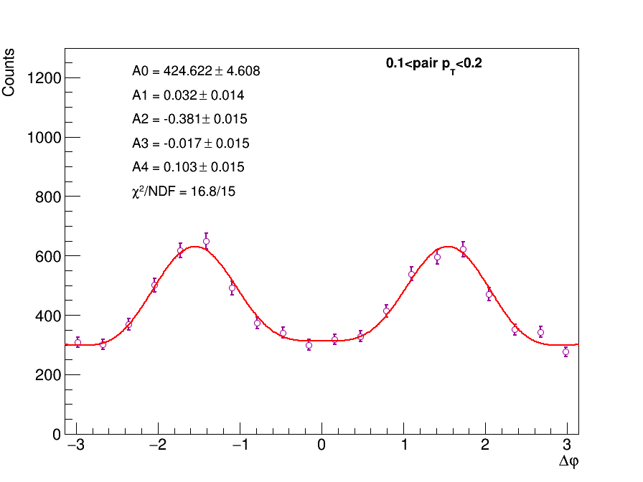
0.1<pT<0.2
Angle between pair$π^{+}π^{−}$and $π^{+}$, with $π^{+}$measured in$π^{+}π^{−}$rest frame
Closest${{ π}^{+}π^{−}\text{pair} to m}_{ρ_{0}}=0.77GeV$
The other pair

Slide 10
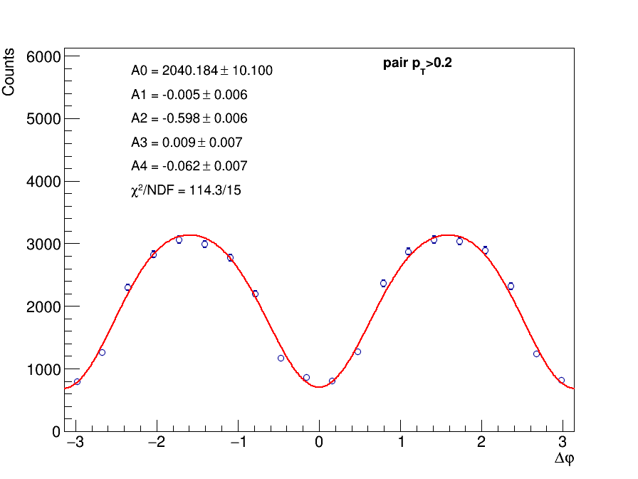
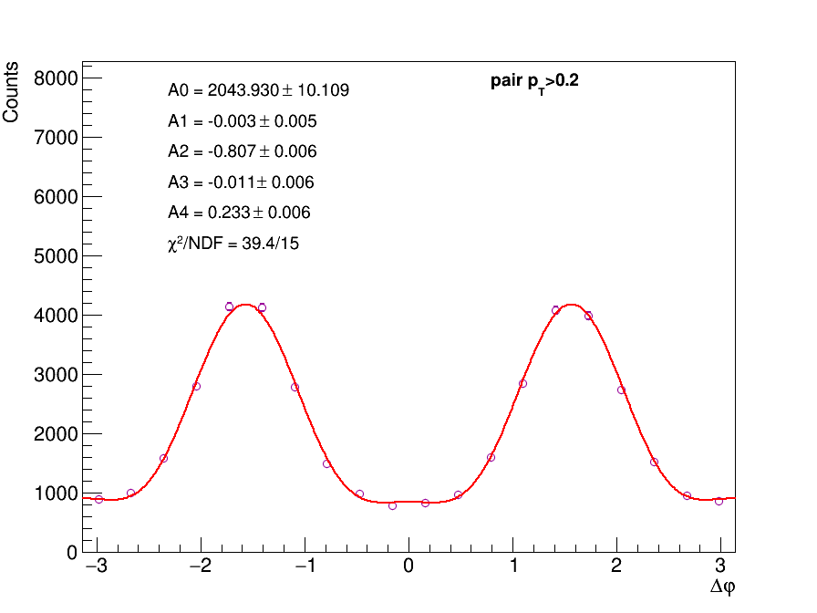
0.2<pT
Angle between pair$π^{+}π^{−}$and $π^{+}$, with $π^{+}$measured in$π^{+}π^{−}$rest frame
Closest${{ π}^{+}π^{−}\text{pair} to m}_{ρ_{0}}=0.77GeV$
The other pair

Slide 11
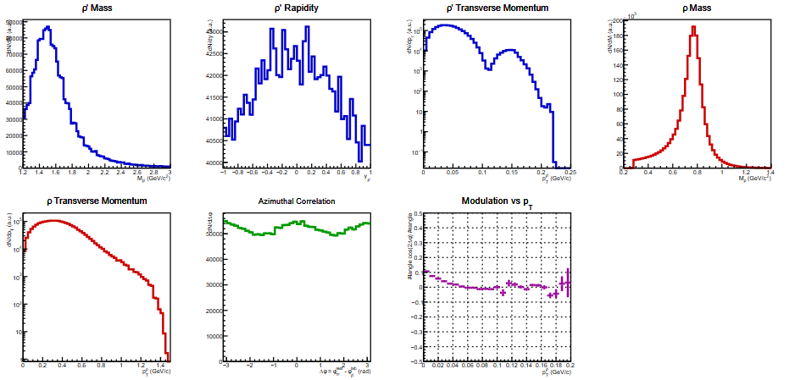
4pi generation

Slide 12
Thanks for Listening!
Thanks for Listening!

Slide 13
Backup

Slide 15
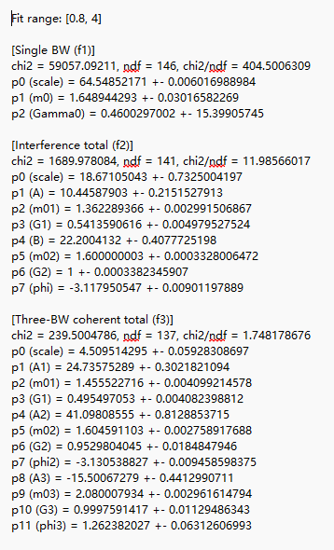
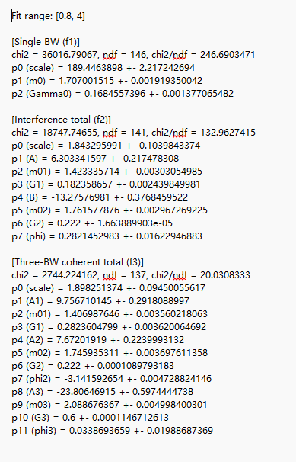
PDG Initials
ALICE 2024 Initials

Slide 16
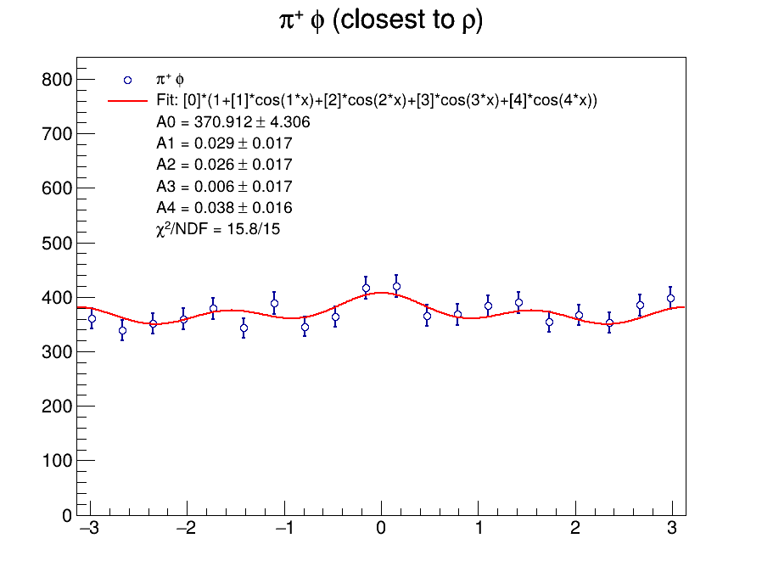
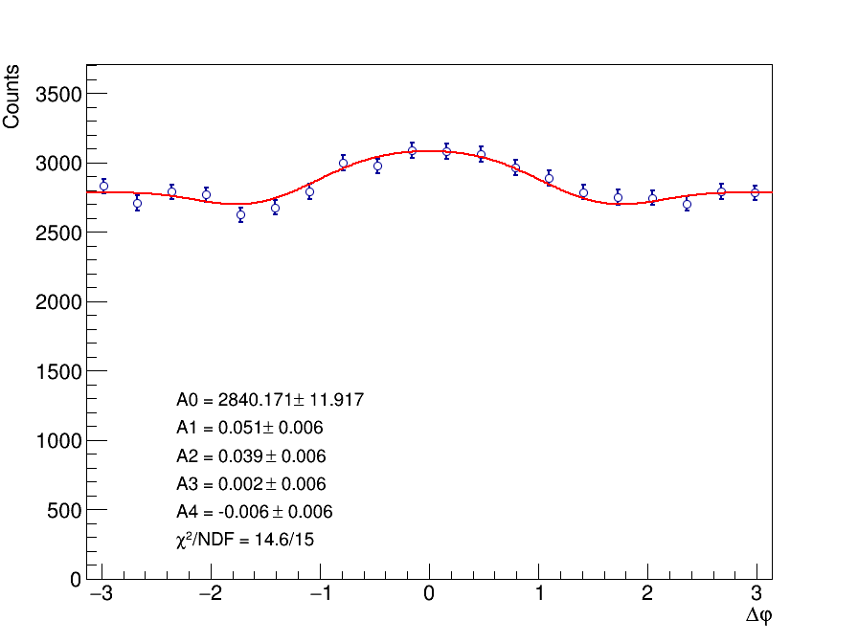
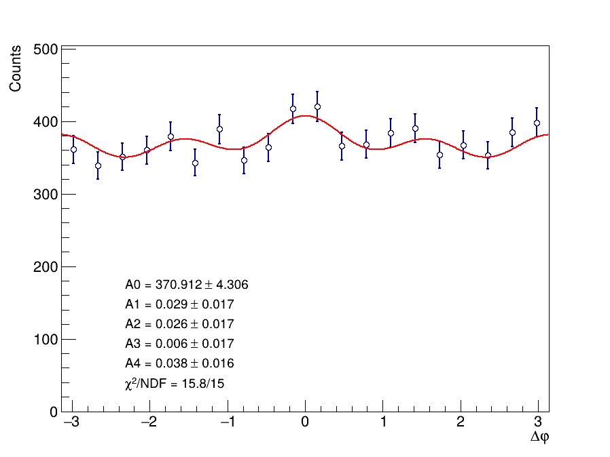
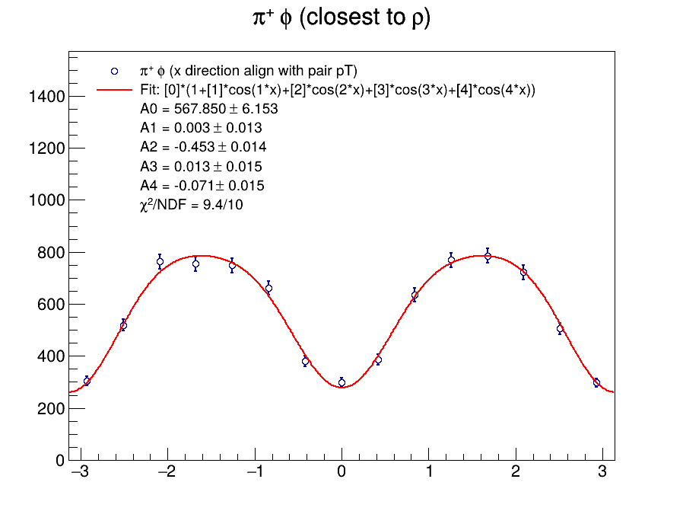

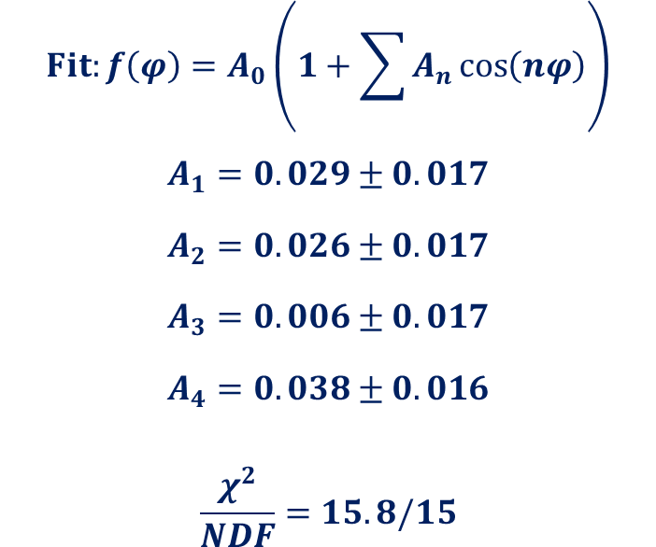

Closest${{ π}^{+}π^{−}\text{pair} to m}_{ρ_{0}}=0.77GeV$
Angle between $ρ^{′}$ and $π^{+}$, with $π^{+}$measured in$π^{+}π^{−}$rest frame
2023
2025
Closest${{ π}^{+}π^{−}\text{pair} to m}_{ρ_{0}}=0.77GeV$
$$Fit:f\left(φ\right)=A_{0}\left(1+\sum{A_{n}\cos\left(nφ\right)}\right)$$
$$A_{1}=0.029±0.017$$
$$A_{2}=0.026±0.017$$
$$A_{3}=0.006±0.017$$
$$A_{4}=0.038±0.016$$
$$\frac{χ^{2}}{NDF}=15.8/15$$

Slide 17
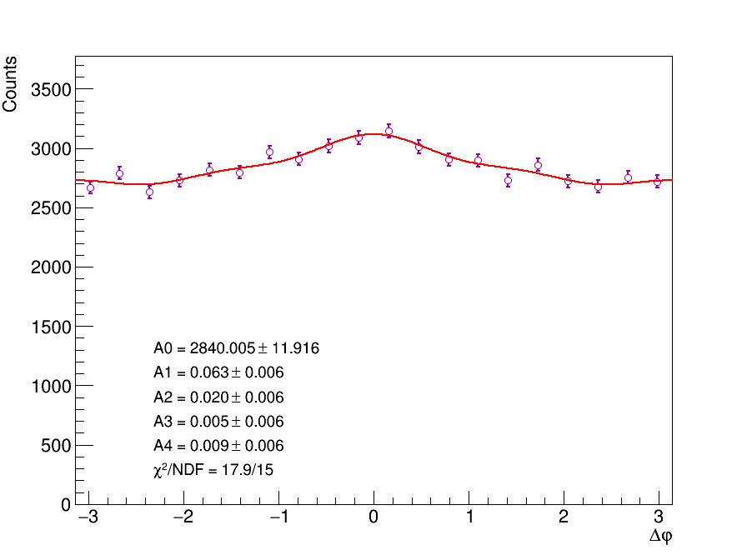
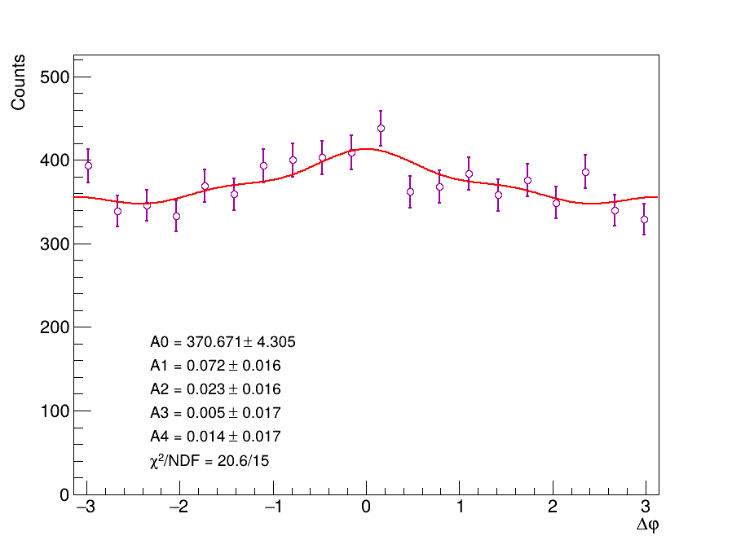
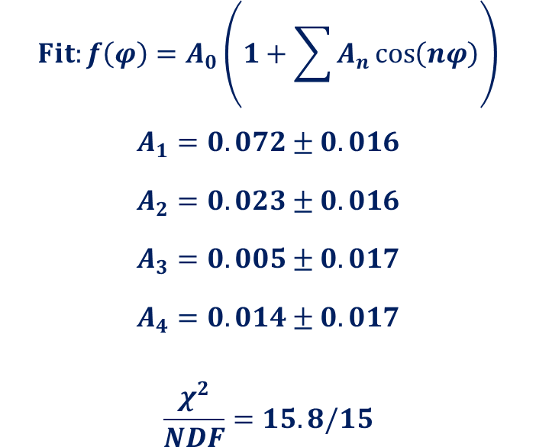
The other pair
Angle between $ρ^{′}$ and $π^{+}$, with $π^{+}$measured in$π^{+}π^{−}$rest frame
The other pair
2023
2025
$$Fit:f\left(φ\right)=A_{0}\left(1+\sum{A_{n}\cos\left(nφ\right)}\right)$$
$$A_{1}=0.072±0.016$$
$$A_{2}=0.023±0.016$$
$$A_{3}=0.005±0.017$$
$$A_{4}=0.014±0.017$$
$$\frac{χ^{2}}{NDF}=15.8/15$$

Slide 18
Closest${{ π}^{+}π^{−}\text{pair} to m}_{ρ_{0}}=0.77GeV$
Angle between $ρ^{′}$ and $π^{+}$, with $π^{+}$measured in$π^{+}π^{−}$rest frame
2023
2025
Closest${{ π}^{+}π^{−}\text{pair} to m}_{ρ_{0}}=0.77GeV$
$$Fit:f\left(φ\right)=A_{0}\left(1+\sum{A_{n}\cos\left(nφ\right)}\right)$$
$$A_{1}=0.029±0.017$$
$$A_{2}=0.026±0.017$$
$$A_{3}=0.006±0.017$$
$$A_{4}=0.038±0.016$$
$$\frac{χ^{2}}{NDF}=15.8/15$$

Slide 19
The other pair
Angle between $ρ^{′}$ and $π^{+}$, with $π^{+}$measured in$π^{+}π^{−}$rest frame
The other pair
2023
2025
$$Fit:f\left(φ\right)=A_{0}\left(1+\sum{A_{n}\cos\left(nφ\right)}\right)$$
$$A_{1}=0.072±0.016$$
$$A_{2}=0.023±0.016$$
$$A_{3}=0.005±0.017$$
$$A_{4}=0.014±0.017$$
$$\frac{χ^{2}}{NDF}=15.8/15$$

