Slide 1

CEPC ScW-ECAL Energy Resolution
李想
2025.4.17
Notes:
Today, I will present my work on improving the ECAL energy resolution using machine learning.

Slide 2
motivation：
Attempt to improve the ECAL energy resolution using ML
strategy:
Layer level data:Train an MLP;
Hit level data: Train a CNN+LSTM;
Evaluate the performance in terms of energy resolution and linearity
Notes:
Our primary objective is to enhance the ECAL energy resolution using machine learning techniques. We evaluate two parallel strategies: a layer-level Multi-Layer Perceptron (MLP) and a hit-level CNN+LSTM architecture. We then compare their performance against the standard energy-sum method

Slide 3
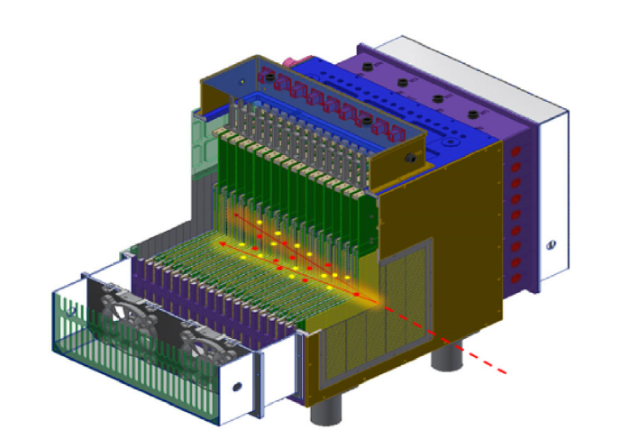
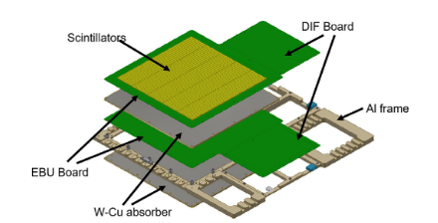
ScW-ECAL：
Super-layer
Scintillaters+W-Cu absorber+EBU Bord+DIF Bord+AI frame
Prototype
Over 22 radiation lengths (X₀)
32 super-layer
Transverse sensitive area dimensions of approximately 22 × 22 cm²
Target energy resolution：better than ∼ 15% /√E [GeV]
Notes:
The study focuses on the ScW-ECAL prototype, which consists of 32 super-layers .Each single layer consists of scintillators, aTungsten-Copper (W-Cu) absorber, EBU and DIF boards, and an aluminum frame."

Slide 4
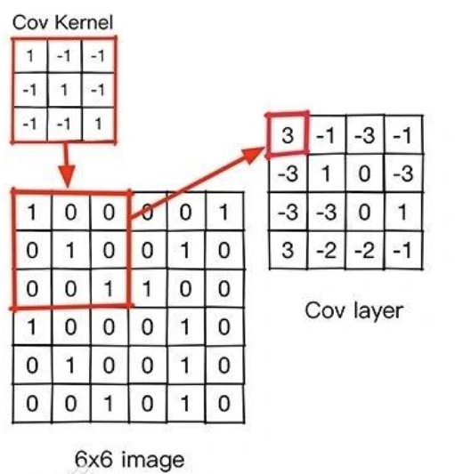
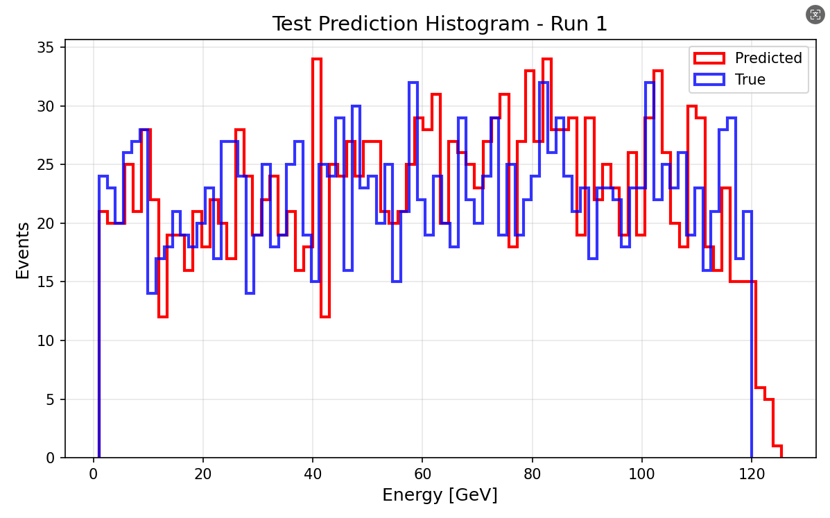
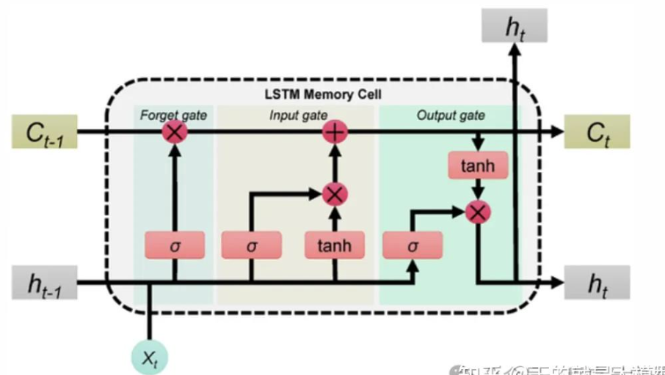
CNN+LSTM Trian (12000)
Input(hit level data):
HIt_ENERGY
Output:
Predicted Energy
CNN (Convolutional Neural Network)
Samples:
MC: 1-120GeV (12000) Continuous e-
Data split
train_frac = 0.7
val_frac = 0.15
test_frac = 0.15
Read the hit image of the super layer
LSTM (Long Short-Term Memory)
Learn the development of shower at different levels
lr =1e-4
batch_size =256
epochs =150
weight_decay =1e-4
optimizer ="adamw"
Input and Output（rellative error <2%）
Notes:
We also explored a deep learning approach using a CNN+LSTM network to directly process hit energy images. The goal is to learn the spatial and longitudinal development of the clusters. However, due to computational constraints, this initial test was limited to a dataset of 12,000 samples.

Slide 5
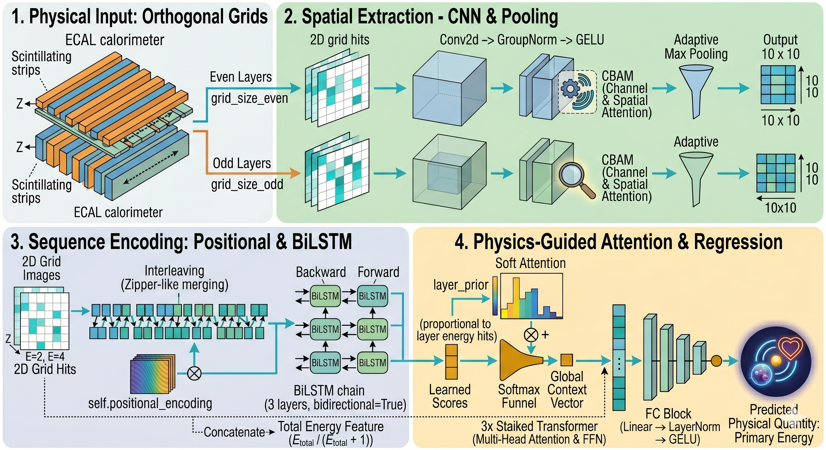
CNN+LSTM Trian (1200000)
Notes:
We also explored a deep learning approach using a CNN+LSTM network to directly process hit energy images. The goal is to learn the spatial and longitudinal development of the clusters. However, due to computational constraints, this initial test was limited to a dataset of 12,000 samples.

Slide 6
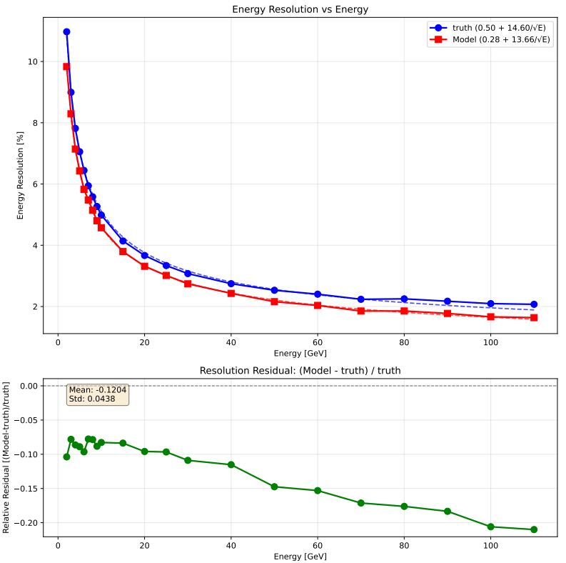
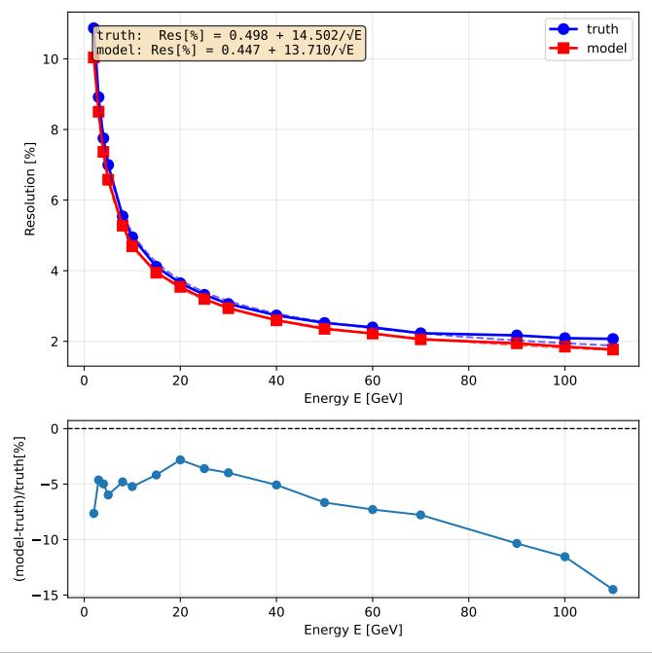
CNN+LSTM Result VS MLP ECAL (12000)
Energy Resolution CNN+LSTM
Energy Resolution MLP
Discrete energy points：
[2.0, 3.0, 4.0, 5.0, 6.0, 7.0, 8.0, 9.0, 10.0, 15.0, 20.0, 25.0, 30.0, 40.0, 50.0, 60.0, 70.0, 80.0, 90.0, 100.0, 110.0]GeV
Truth = Total deposited energy (MC)
Notes:
When comparing both models trained on the same restricted 12,000-sample dataset, the CNN+LSTM architecture demonstrates a clear advantage over the standard MLP. Despite the limitations of data starvation, the CNN+LSTM model achieves better energy resolution and more stable linearity. This suggests a potentially superior capability in extracting complex spatial and longitudinal shower features directly from the raw hit data.

Slide 7
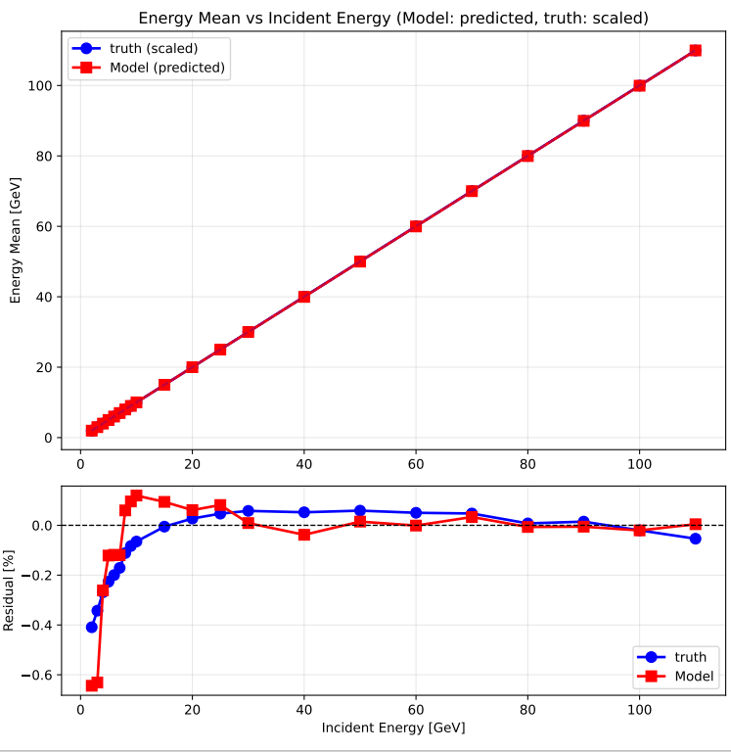
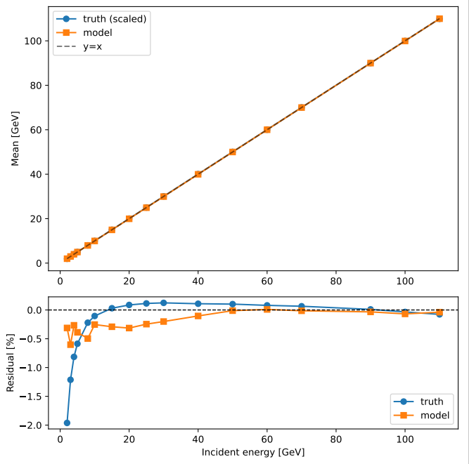
CNN+LSTM Result VS MLP ECAL (12000)
Linearity CNN+LSTM
Linearity MLP
Discrete energy points：
[2.0, 3.0, 4.0, 5.0, 6.0, 7.0, 8.0, 9.0, 10.0, 15.0, 20.0, 25.0, 30.0, 40.0, 50.0, 60.0, 70.0, 80.0, 90.0, 100.0, 110.0]GeV
Truth = Total deposited energy (MC)
Notes:
Turning to the linearity evaluation on the same 12,000-sample dataset, the CNN+LSTM model once again outperforms the standard MLP. While both models exhibit some residual fluctuations due to the limited data volume, the CNN+LSTM maintains a noticeably more stable and accurate linear response across the energy spectrum. This further confirms its superior capability to capture complex physical correlations directly from the raw hit-level data

Slide 8
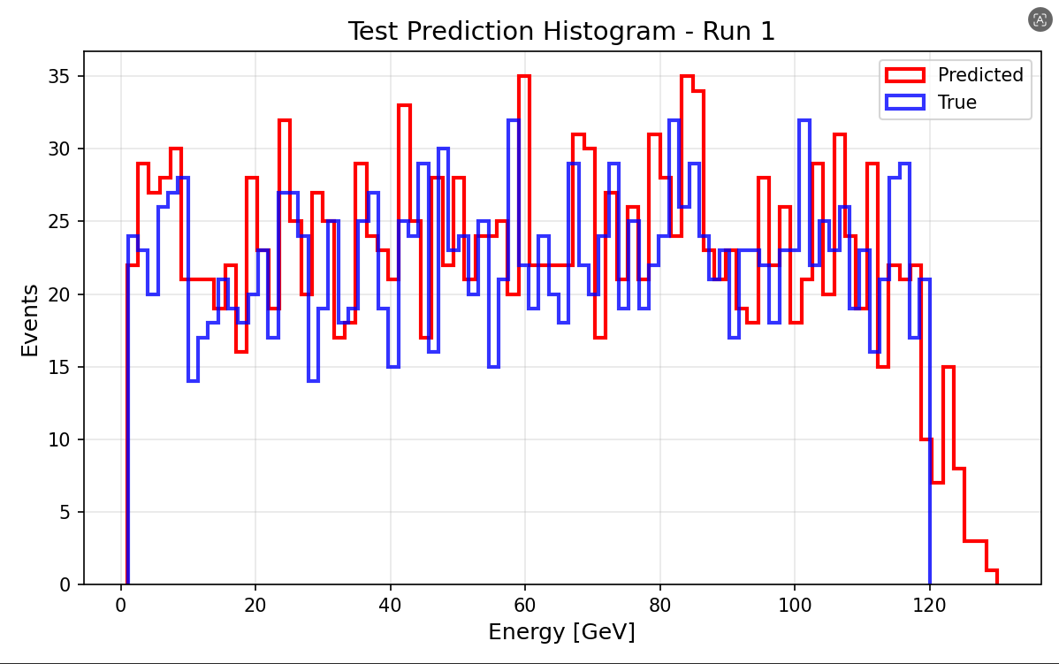
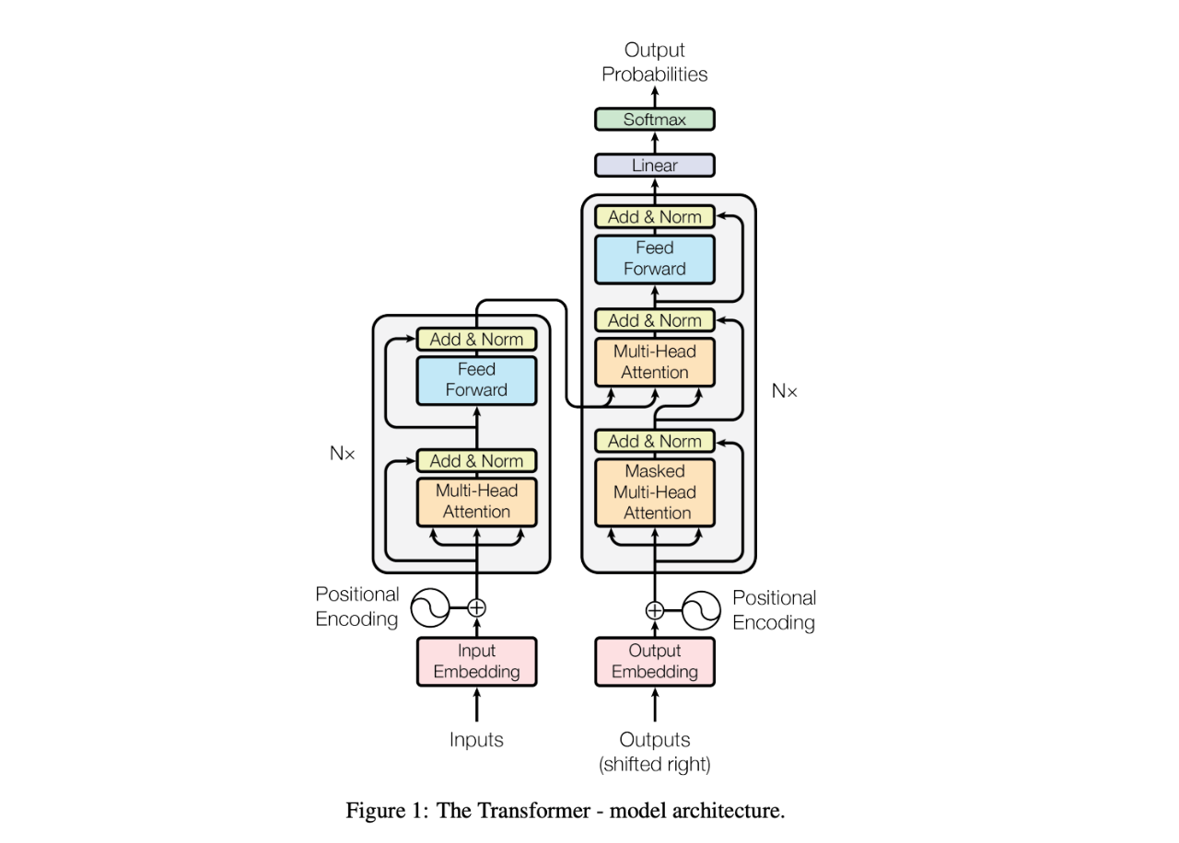
CNN+Transformer Trian (12000)
Input(hit level data):
HIt_ENERGY
Output:
Predicted Energy
CNN (Convolutional Neural Network)
Samples:
MC: 1-120GeV (12000) Continuous e-
Data split
train_frac = 0.7
val_frac = 0.15
test_frac = 0.15
Read the hit image of the super layer
Transformer
Learn the development of shower at different levels
lr =1e-4
batch_size =256
epochs =150
weight_decay =1e-4
optimizer ="adamw"
Input and Output（rellative error <1%）
Notes:
We also explored a deep learning approach using a CNN+LSTM network to directly process hit energy images. The goal is to learn the spatial and longitudinal development of the clusters. However, due to computational constraints, this initial test was limited to a dataset of 12,000 samples.

Slide 9
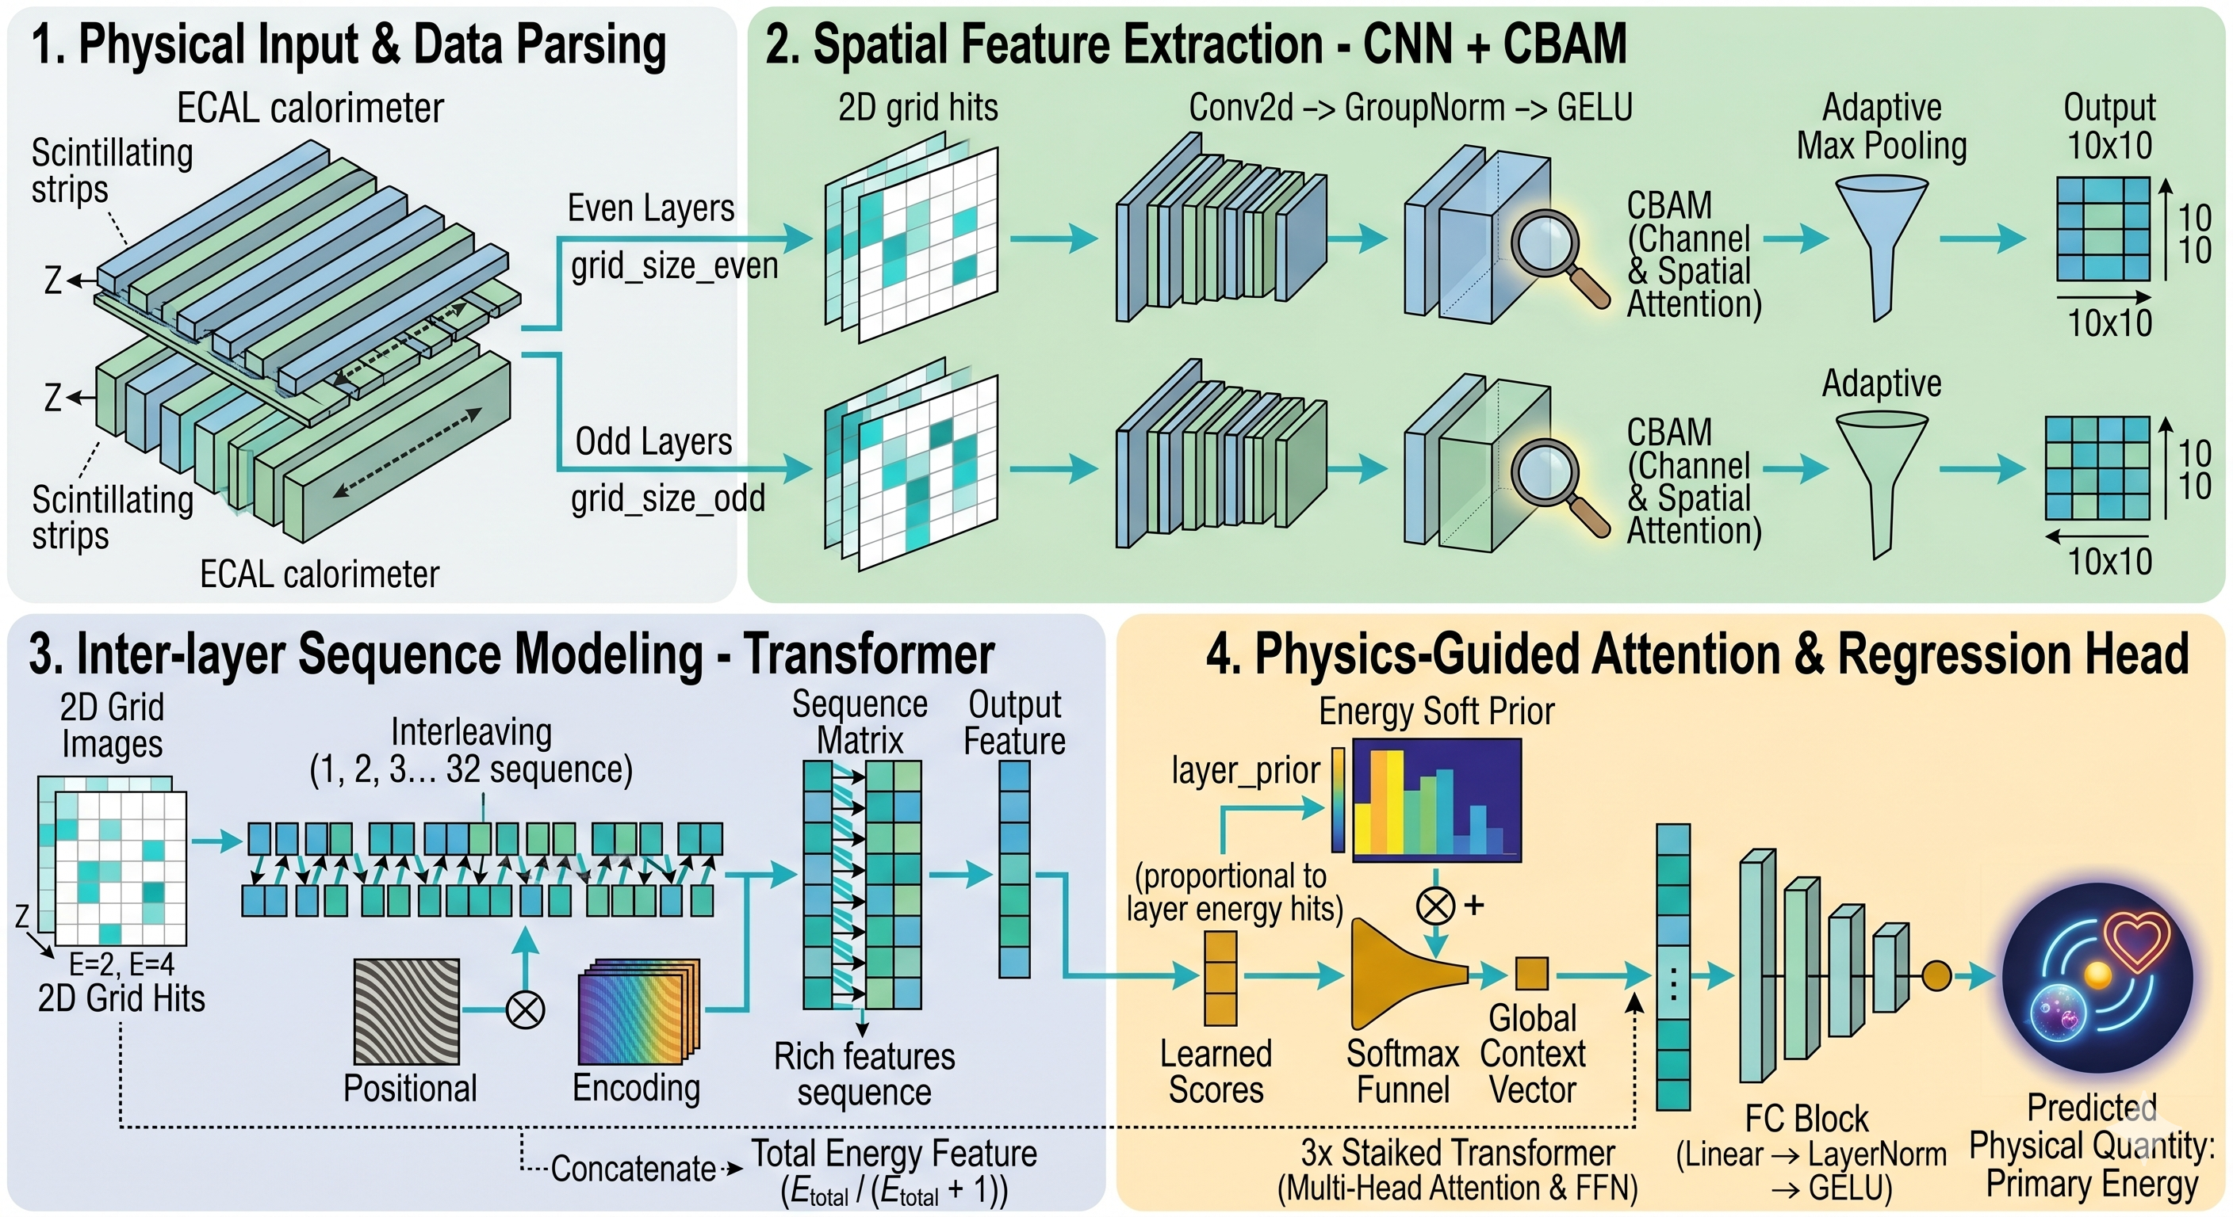
CNN+Transformer Trian (12000)
Notes:
We also explored a deep learning approach using a CNN+LSTM network to directly process hit energy images. The goal is to learn the spatial and longitudinal development of the clusters. However, due to computational constraints, this initial test was limited to a dataset of 12,000 samples.

Slide 10
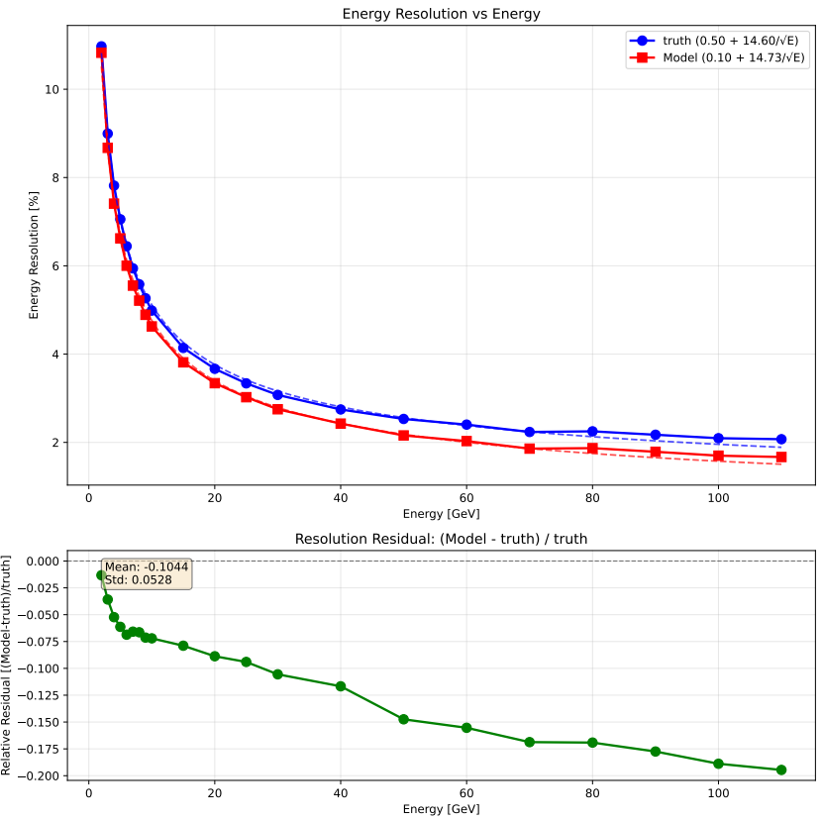
CNN+Transformer Result VS MLP ECAL (12000)
Energy Resolution CNN+Transformer
Energy Resolution MLP
Discrete energy points：
[2.0, 3.0, 4.0, 5.0, 6.0, 7.0, 8.0, 9.0, 10.0, 15.0, 20.0, 25.0, 30.0, 40.0, 50.0, 60.0, 70.0, 80.0, 90.0, 100.0, 110.0]GeV
Truth = Total deposited energy (MC)
Notes:
When comparing both models trained on the same restricted 12,000-sample dataset, the CNN+LSTM architecture demonstrates a clear advantage over the standard MLP. Despite the limitations of data starvation, the CNN+LSTM model achieves better energy resolution and more stable linearity. This suggests a potentially superior capability in extracting complex spatial and longitudinal shower features directly from the raw hit data.

Slide 11
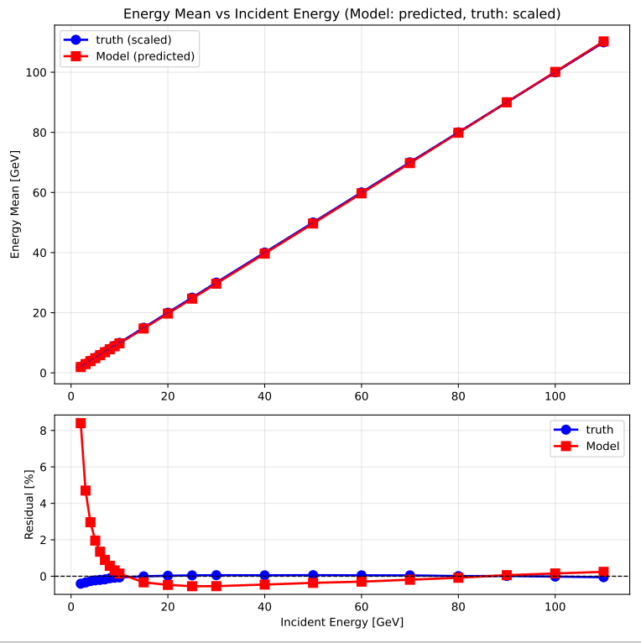
CNN+Transformer Result VS MLP ECAL (12000)
Linearity CNN+Transformer
Linearity MLP
Discrete energy points：
[2.0, 3.0, 4.0, 5.0, 6.0, 7.0, 8.0, 9.0, 10.0, 15.0, 20.0, 25.0, 30.0, 40.0, 50.0, 60.0, 70.0, 80.0, 90.0, 100.0, 110.0]GeV
Truth = Total deposited energy (MC)
Notes:
Turning to the linearity evaluation on the same 12,000-sample dataset, the CNN+LSTM model once again outperforms the standard MLP. While both models exhibit some residual fluctuations due to the limited data volume, the CNN+LSTM maintains a noticeably more stable and accurate linear response across the energy spectrum. This further confirms its superior capability to capture complex physical correlations directly from the raw hit-level data

Slide 12
Summary
The hit-level CNN+LSTM architecture demonstrates significant potential;
The sample size remains a decisive factor for the performance of such machine learning models.
Next step
CNN+LSTM run HCAL
Update Tramsformer
Notes:
In conclusion, while the hit-level CNN+LSTM architecture demonstrates significant theoretical potential, sample size remains the absolute decisive factor for performance. Moving forward, we plan to scale our CNN+LSTM training to 1.2 million samples and explore Transformer-based architectures

Slide 13
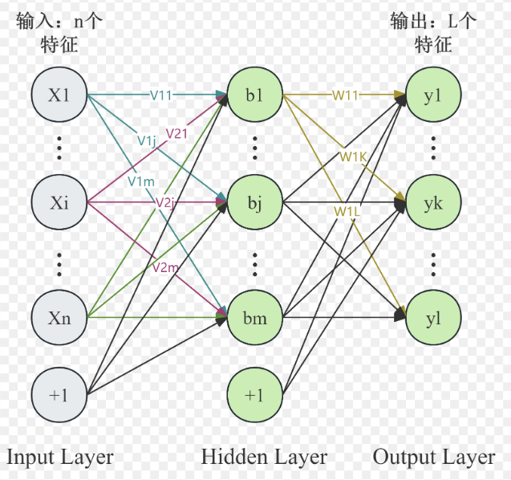
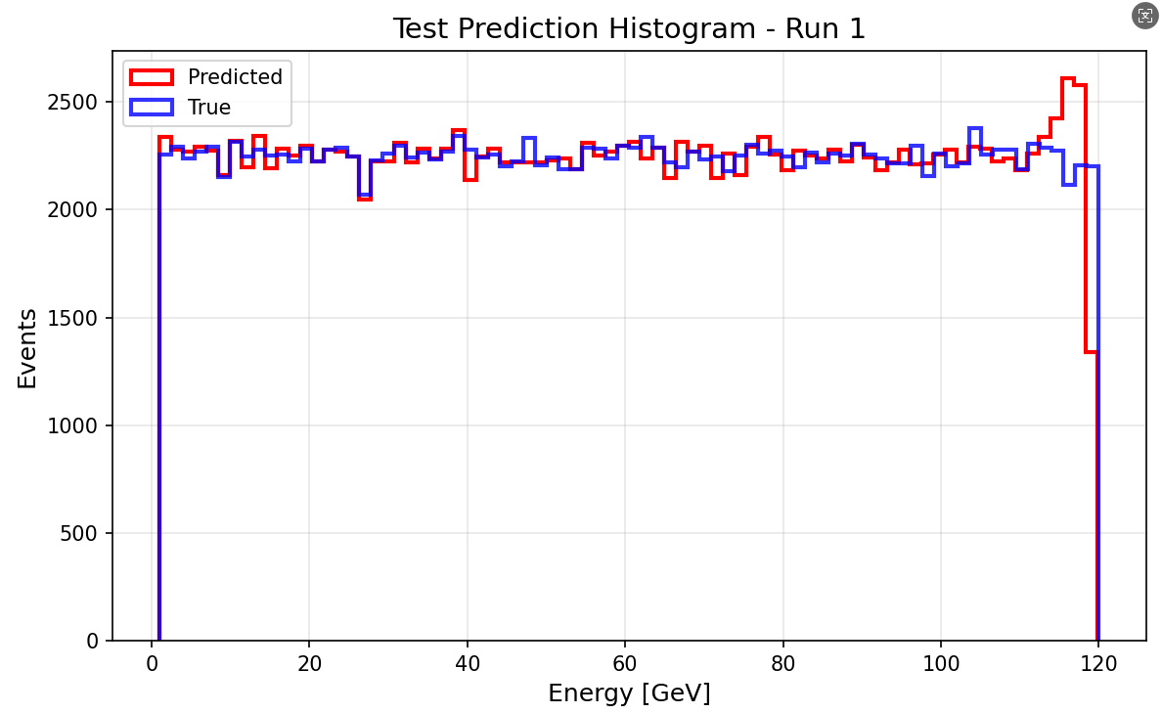
M(ulti) L(ayer) P(erceptron) Trian
Input(Layer level data):
Energy(E) of per layer(32)
Hit_no(N) of per layer(32)
E/N of perlayer(32)
Total_deposited_energy(1)
Output:
Predicted Partical Energy
Samples:
MC: 1-120GeV e-(12000000) Continuous
Data split
train_frac = 0.7
val_frac = 0.15
test_frac = 0.15
[1024,512,256,128]
lr =0.5e-4
batch_size =64
epochs =100
weight_decay =1e-4
optimizer ="adamw"
Input and Output（relative error <2%）
Notes:
For the layer-wise MLP model, the inputs consist of 97 features: energy, hit counts, and energy-to-hit ratios for each of the 32 layers, plus the total deposited energy. To ensure robust learning, the model is trained on a comprehensive dataset of 12 million continuous Monte Carlo samples ranging from 1 to 120 GeV.

Slide 14
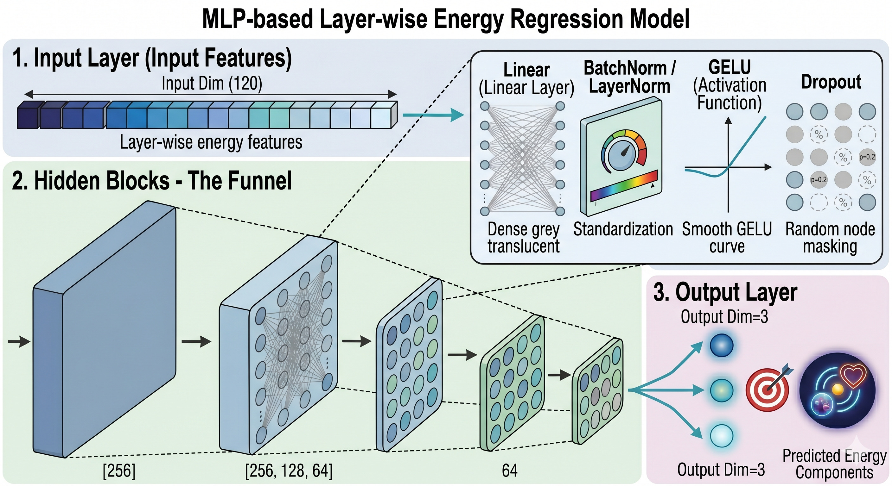
MLP Trian (12000)
Notes:
We also explored a deep learning approach using a CNN+LSTM network to directly process hit energy images. The goal is to learn the spatial and longitudinal development of the clusters. However, due to computational constraints, this initial test was limited to a dataset of 12,000 samples.

Slide 15
M(ulti) L(ayer) P(erceptron) Result
Energy Resolution
Linearity
Improvement:
discrete energy points: 7%
total resolution boost: 6%
Discrete energy points：
[2.0, 3.0, 4.0, 5.0, 6.0, 7.0, 8.0, 9.0, 10.0, 15.0, 20.0, 25.0, 30.0, 40.0, 50.0, 60.0, 70.0, 80.0, 90.0, 100.0, 110.0]GeV
Truth = Total deposited energy (MC)
Notes:
. Compared to the true total deposited energy, the MLP achieves a 7% resolution improvement at discrete energy points and a 6% overall resolution boost. Additionally, the model maintains a highly accurate linear response with minimal residuals.

Slide 16
M(ulti) L(ayer) P(erceptron) Result ECAL
Linearity
Discrete energy points：
[2.0, 3.0, 4.0, 5.0, 6.0, 7.0, 8.0, 9.0, 10.0, 15.0, 20.0, 25.0, 30.0, 40.0, 50.0, 60.0, 70.0, 80.0, 90.0, 100.0, 110.0]GeV
Truth = Total deposited energy (MC)
Improvemented
Notes:
In contrast to the resolution, no comparable enhancement was observed in the energy linearity.

Slide 17
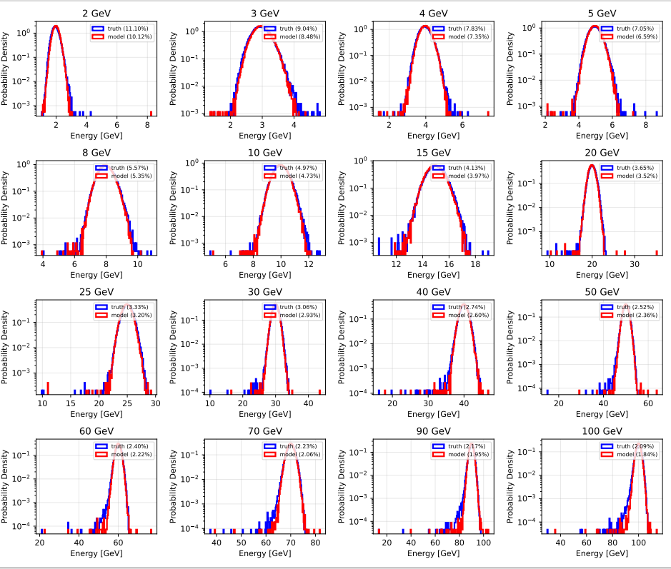
M(ulti) L(ayer) P(erceptron) Result ECAL
Truth = Total deposited energy (MC)
Notes:
In contrast to the resolution, no comparable enhancement was observed in the energy linearity.

Slide 18
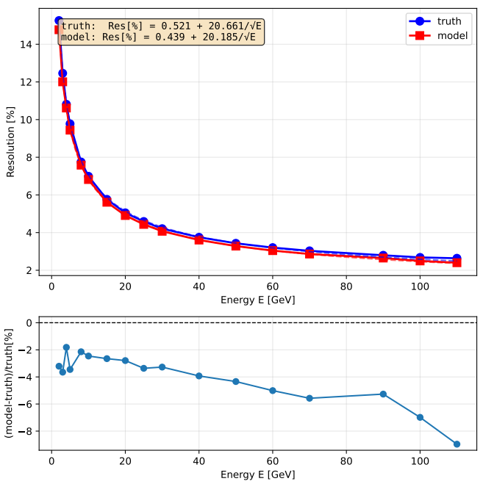
M(ulti) L(ayer) P(erceptron) Result HCAL
Energy Resolution
Discrete energy points：
[2.0, 3.0, 4.0, 5.0, 6.0, 7.0, 8.0, 9.0, 10.0, 15.0, 20.0, 25.0, 30.0, 40.0, 50.0, 60.0, 70.0, 80.0, 90.0, 100.0, 110.0]GeV
Truth = Total deposited energy (MC)
Improvement:
discrete energy points: 5%
total resolution boost: 2%
Notes:
As you can see here, the MLP model gives much better energy resolution than the baseline, which I labeled as 'truth'. If you look at the bottom panel,we see a consistent improvement of about 5% across discrete energy points. Overall, this gives us a total resolution boost of 9%.

Slide 19
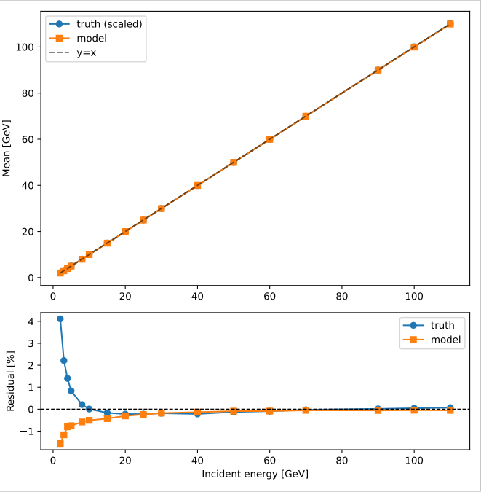
M(ulti) L(ayer) P(erceptron) Result HCAL
Linearity
Discrete energy points：
[2.0, 3.0, 4.0, 5.0, 6.0, 7.0, 8.0, 9.0, 10.0, 15.0, 20.0, 25.0, 30.0, 40.0, 50.0, 60.0, 70.0, 80.0, 90.0, 100.0, 110.0]GeV
Truth = Total deposited energy (MC)
Improvemented
Notes:
In contrast to the resolution, no comparable enhancement was observed in the energy linearity.

Slide 20
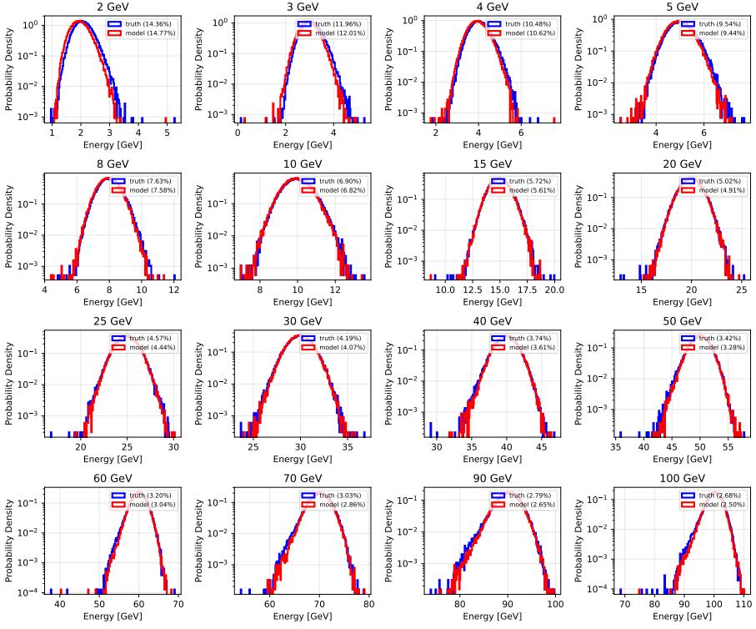
M(ulti) L(ayer) P(erceptron) Result HCAL
Truth = Total deposited energy (MC)
Notes:
In contrast to the resolution, no comparable enhancement was observed in the energy linearity.

Slide 21
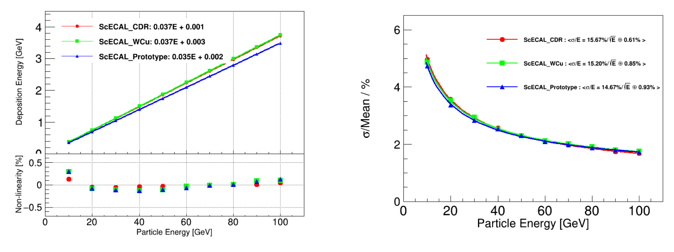
back up
Notes:
Since several layers have no data, the total number of channels is over 4000. After applying the Hough transform, more than 3000 channels have data entries exceeding 2200. However, after the fitting procedure, the number of good channels drops to fewer than 200.

Slide 22
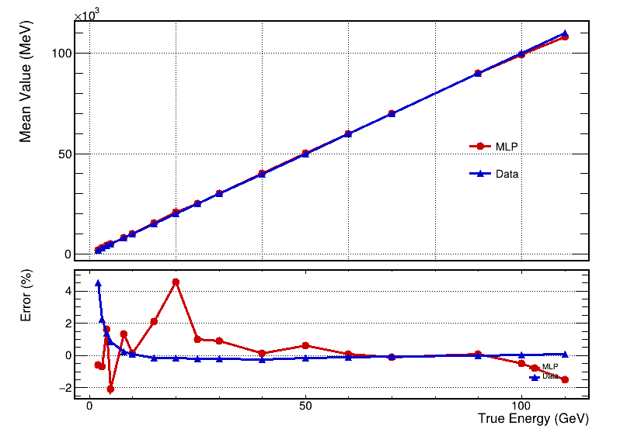
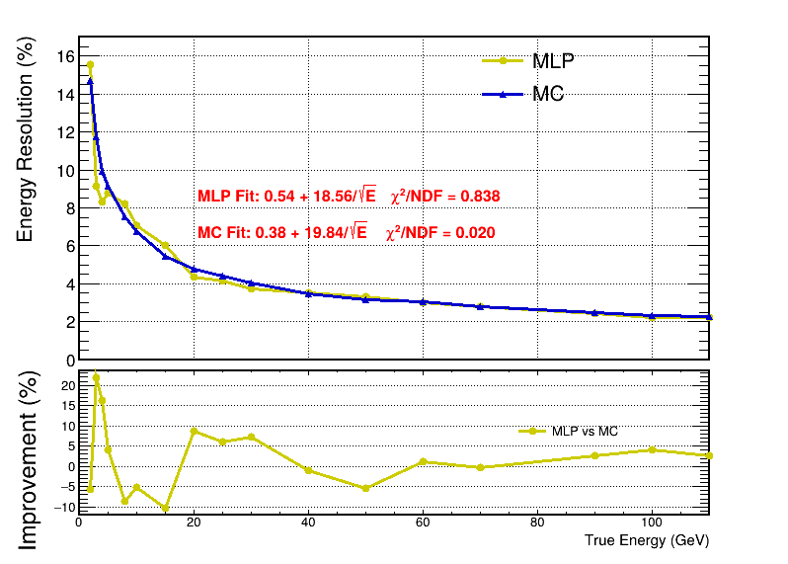
back up
borong HCAL e-
Notes:
Since several layers have no data, the total number of channels is over 4000. After applying the Hough transform, more than 3000 channels have data entries exceeding 2200. However, after the fitting procedure, the number of good channels drops to fewer than 200.

Slide 23
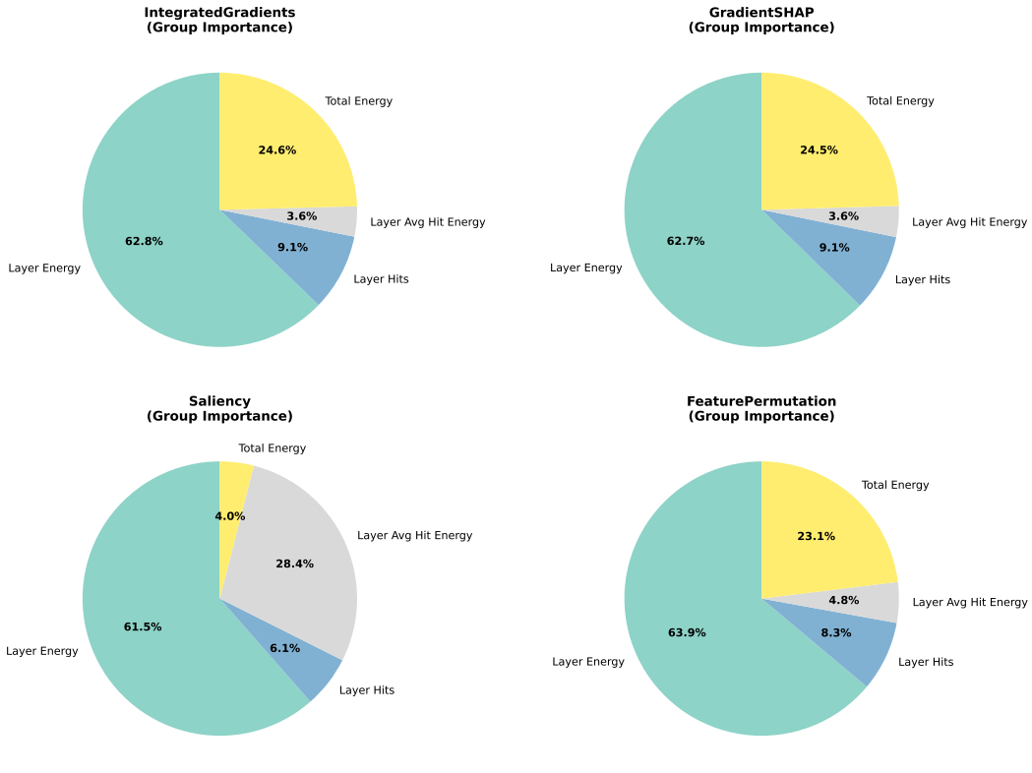
M(ulti) L(ayer) P(erceptron)
Method | What you are asking the model
Integrated Gradients | “Along the path from nothing to this input, who helped you the most?”
Gradient SHAP | “If I repeat the experiment many times, who is important on average?”
Saliency | “If I slightly touch you right now, who reacts the most?”
Permutation | “If I remove you, does the model fall apart?”
Notes:
In contrast to the resolution, no comparable enhancement was observed in the energy linearity.

Slide 24
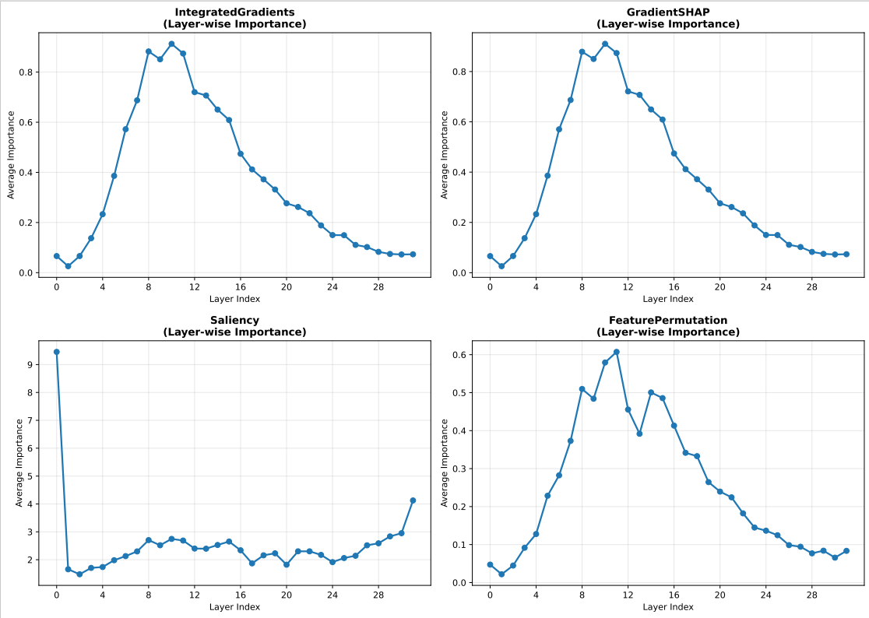
M(ulti) L(ayer) P(erceptron)
Method | What you are asking the model
Integrated Gradients | “Along the path from nothing to this input, who helped you the most?”
Gradient SHAP | “If I repeat the experiment many times, who is important on average?”
Saliency | “If I slightly touch you right now, who reacts the most?”
Permutation | “If I remove you, does the model fall apart?”
Notes:
In contrast to the resolution, no comparable enhancement was observed in the energy linearity.

Slide 25
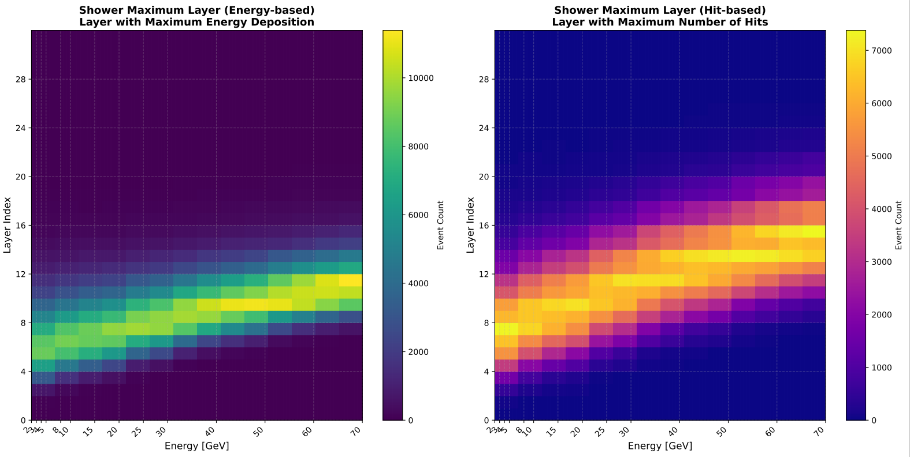
M(ulti) L(ayer) P(erceptron)
Notes:
In contrast to the resolution, no comparable enhancement was observed in the energy linearity.

Slide 26
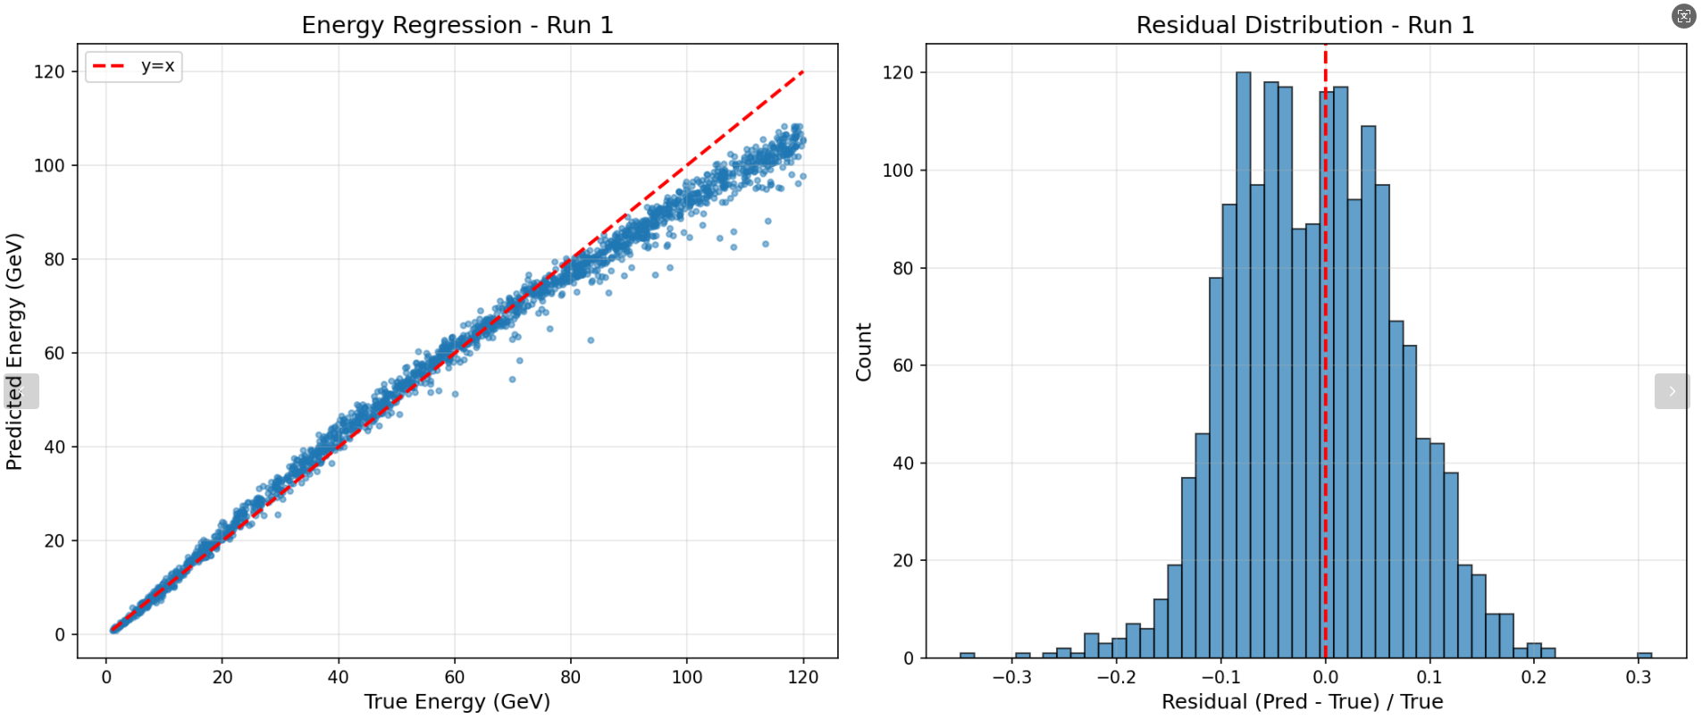
back up
Samples:12000（MLP）
Notes:
Since several layers have no data, the total number of channels is over 4000. After applying the Hough transform, more than 3000 channels have data entries exceeding 2200. However, after the fitting procedure, the number of good channels drops to fewer than 200.

Slide 27
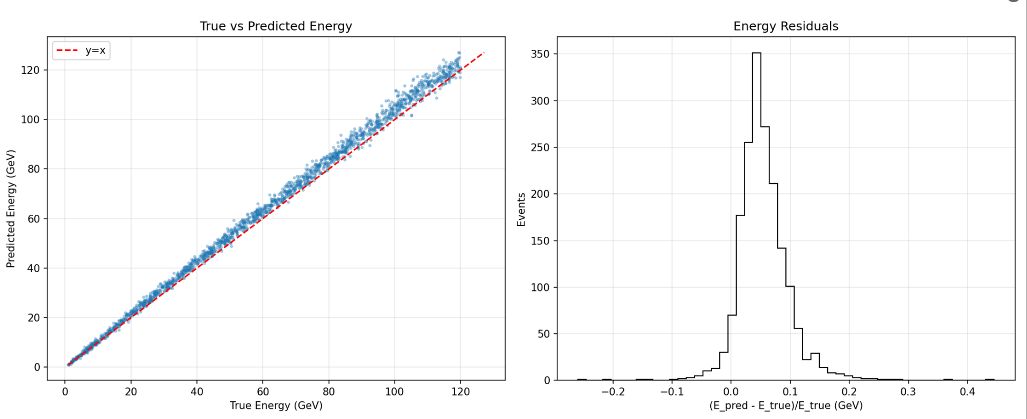
back up
Samples:12000（CNN+LSTM）
Notes:
Since several layers have no data, the total number of channels is over 4000. After applying the Hough transform, more than 3000 channels have data entries exceeding 2200. However, after the fitting procedure, the number of good channels drops to fewer than 200.

Slide 28
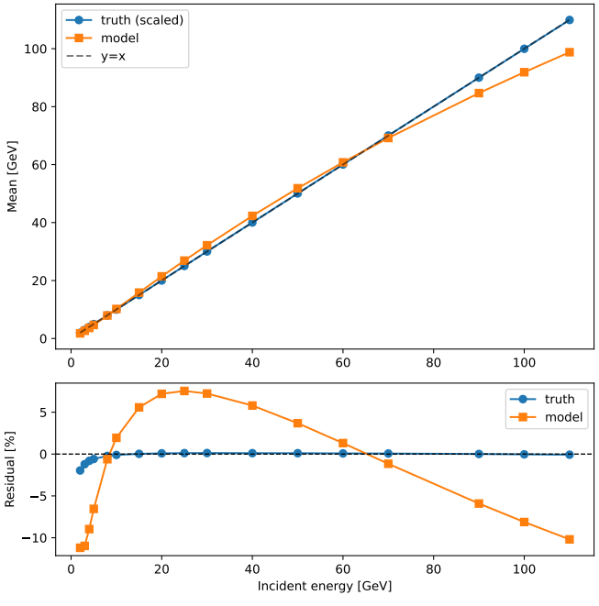
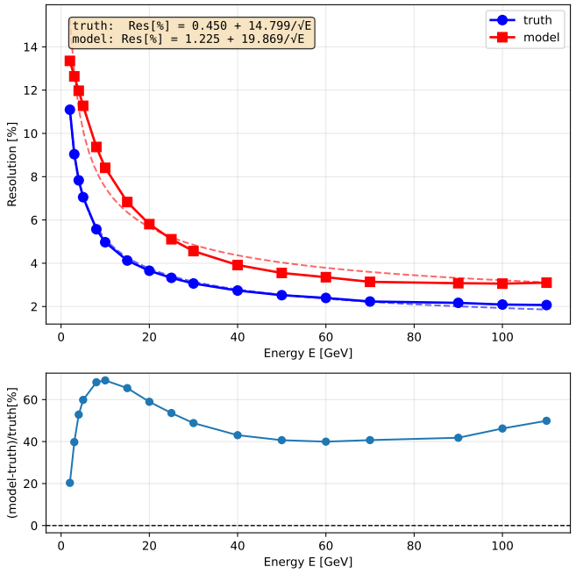
back up
Samples:12000（MLP）
Notes:
Since several layers have no data, the total number of channels is over 4000. After applying the Hough transform, more than 3000 channels have data entries exceeding 2200. However, after the fitting procedure, the number of good channels drops to fewer than 200.

Slide 29
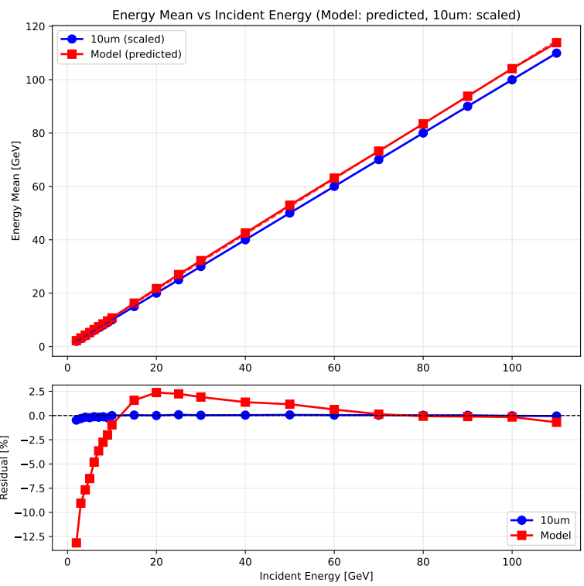
back up
Samples:12000（CNN+LSTM）
Notes:
Since several layers have no data, the total number of channels is over 4000. After applying the Hough transform, more than 3000 channels have data entries exceeding 2200. However, after the fitting procedure, the number of good channels drops to fewer than 200.

