Slide 1
Group Meeting
Jianjie Peng
2026/4/14

Slide 2
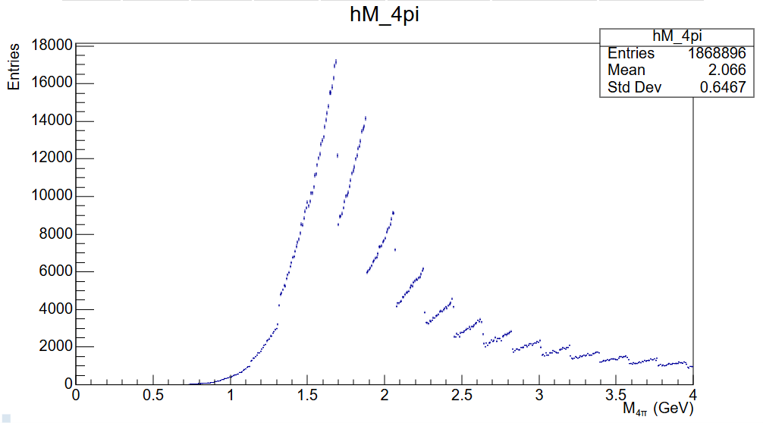
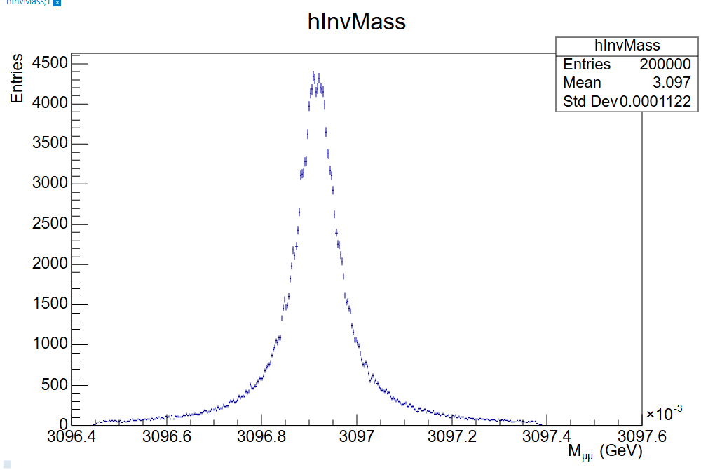
StarLight

Slide 3
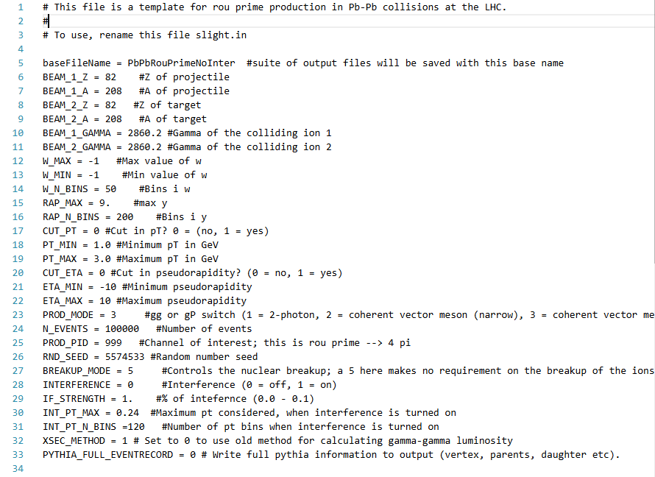

Slide 4
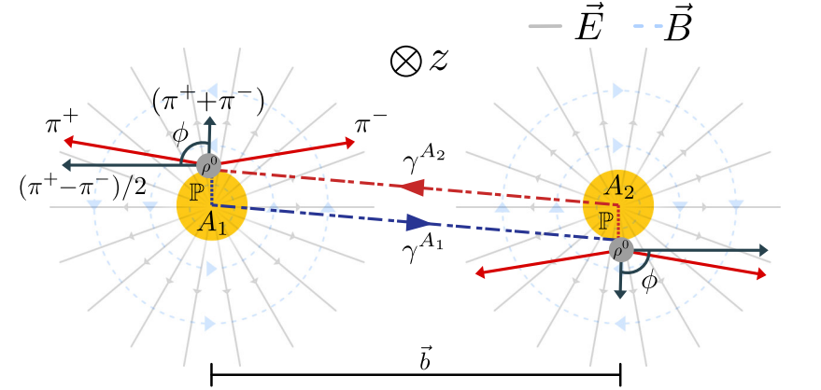
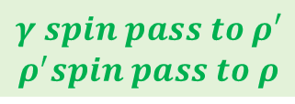

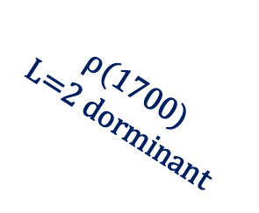
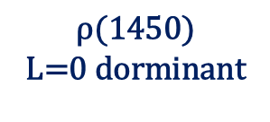







$$Polarization Angular Distribution$$
$$\text{ρ}\text{(1450)}$$
$$\text{L}\text{=0 }\text{dorminant}$$
$$γ spin pass to ρ′$$
$$ρ^{′}spin pass to ρ$$
$$1+a cos(2φ)$$
$ρ^{′}→$ $ρσ/f_{0}→(ππ)_{P}(ππ)_{S}$
$σ/f_{0}{ :0}^{+}$
$$\text{ρ}\text{(}\text{1700}\text{)}$$
$$\text{L}\text{=2 }\text{dorminant}$$
azimuthal cos(2ϕ) modulation in the momentum distribution with respect to the polarization direction
$$smaller a \&$$
$$higher oder$$
$$\vec{J}=\vec{S_{ρ}}+\vec{L}$$
the polarization transfer is diluted and re-distributed among helicity components
$$ρ^{′}→a_{1}π\text{/}h_{1}π\text{/}π(1300)π→(ρπ)π→4π$$
${2(ρ}_{0}→$ $ππ)$
$$γ spin pass to ρ_{0}$$
$$1+a cos(2φ)$$
the superposition of different L components maps an otherwise simple linear polarization pattern into a more complex angular structure.
azimuthal cos(2ϕ) modulation in the momentum distribution with respect to the polarization direction

Slide 5

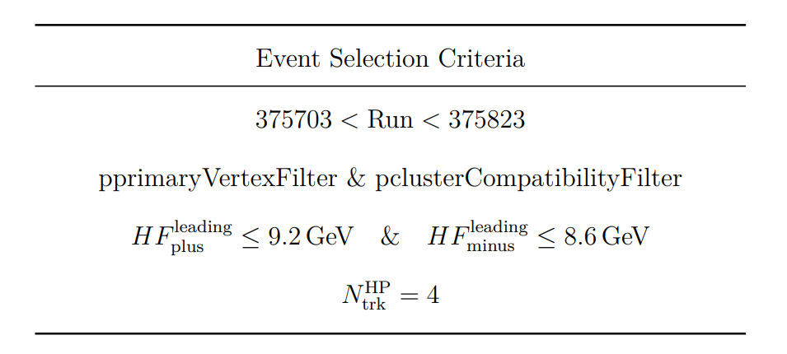
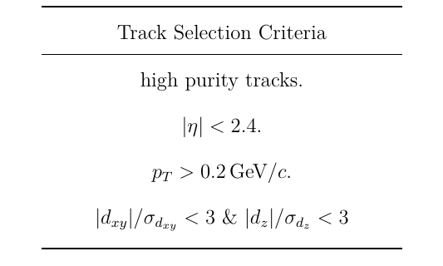
Dataset and Event Selection
Counts After Selection
HIRun2023A：24494
HIRun2025A：178223
7.24
@2025 Pb-Pb 5.36 TeV
Era (OMS): HIRun2025A
DAS: /HI*/HIRun2025A-PromptReco-v1/AOD
HLT_HIUPC_ZeroBias_SinglePixelTrack_MaxPixelTrack_v*
HLT_HIUPC_ZeroBias_SinglePixelTrackLowPt_MaxPixelCluster400_v*

Slide 6
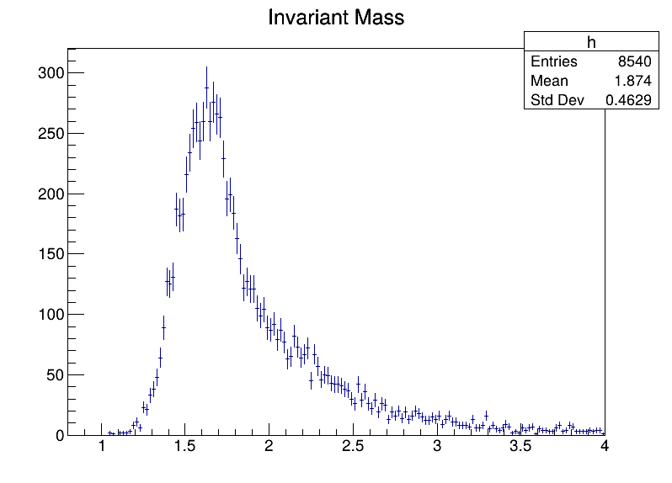
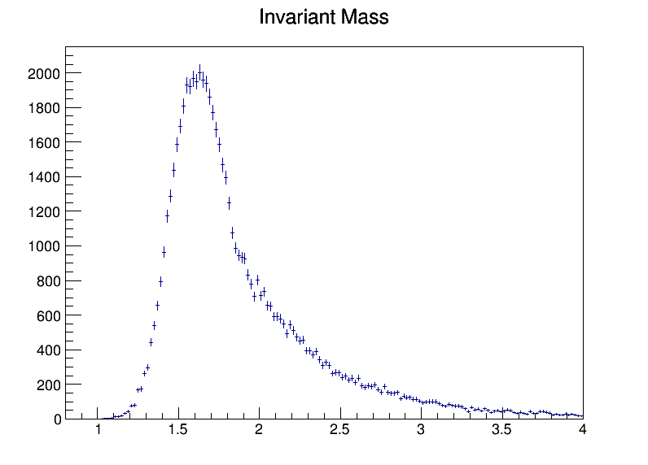
Mass Spectrum
2023
2025
ρ(1450) 2³S₁ ρ(1700) 1³D₁
ρ(2150) 2³D₁?

Slide 7
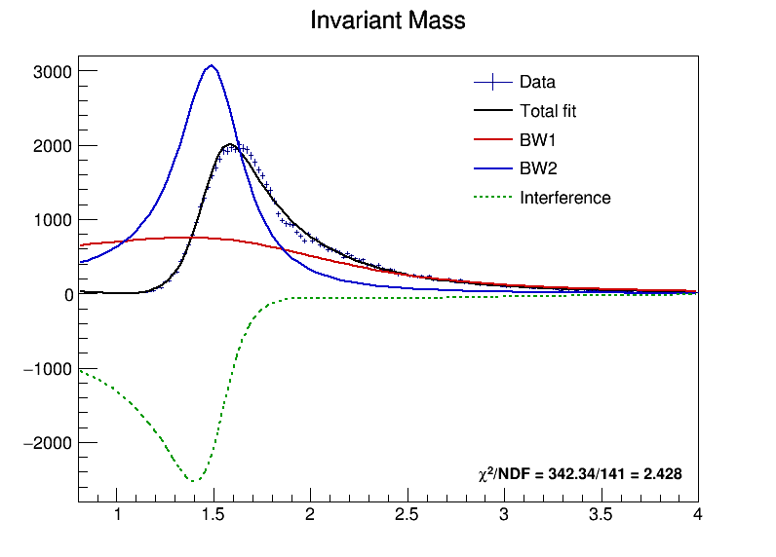


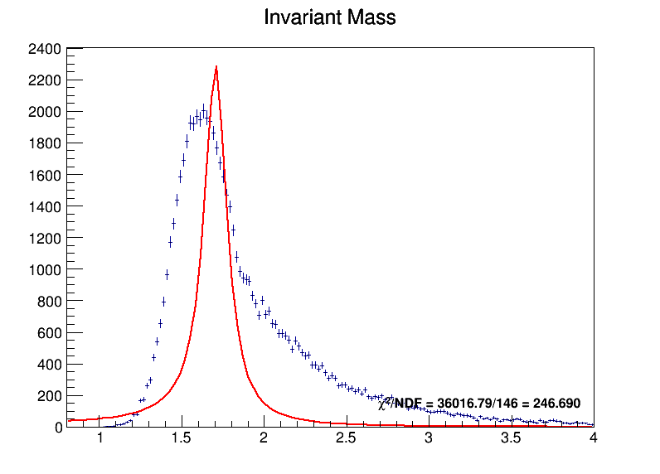
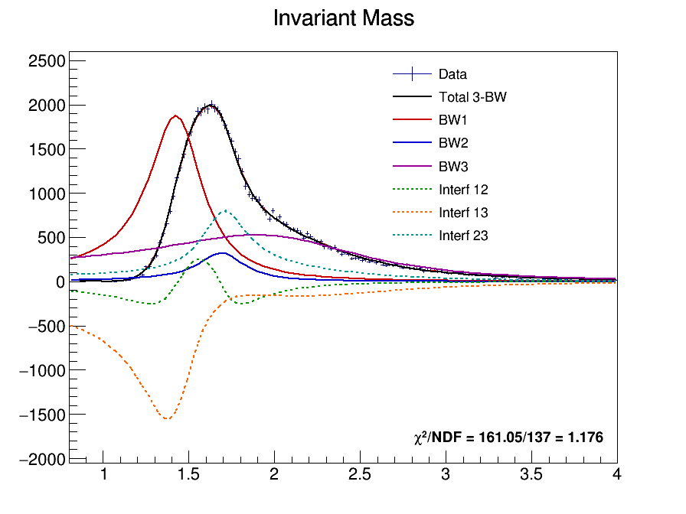
Mass Fit

Slide 8
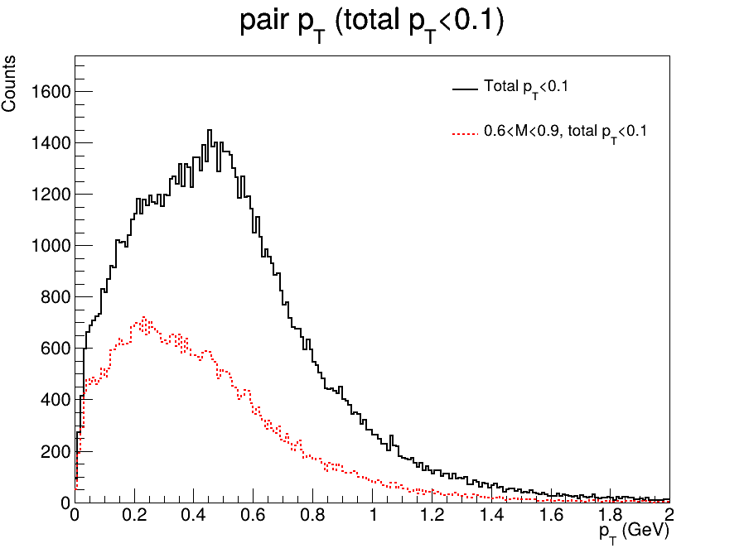

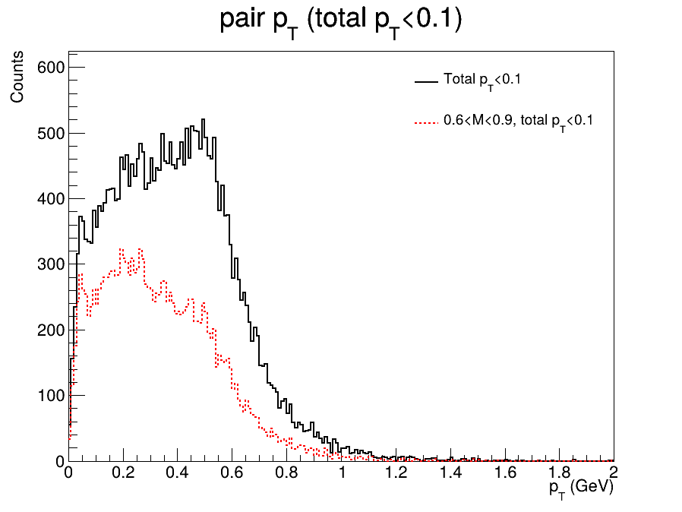
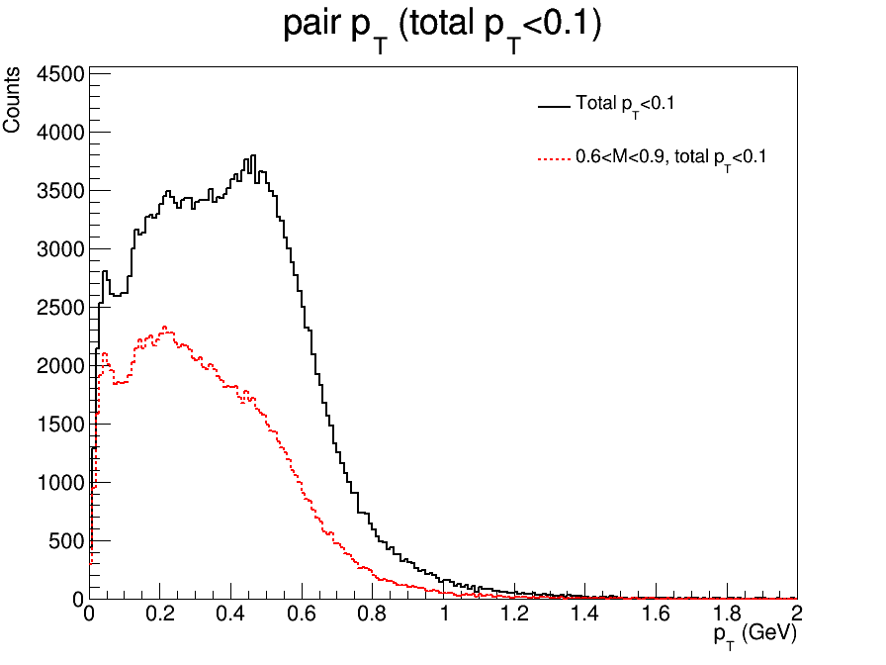
Pair pT
2023
2025

Slide 9
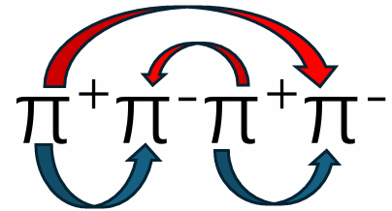
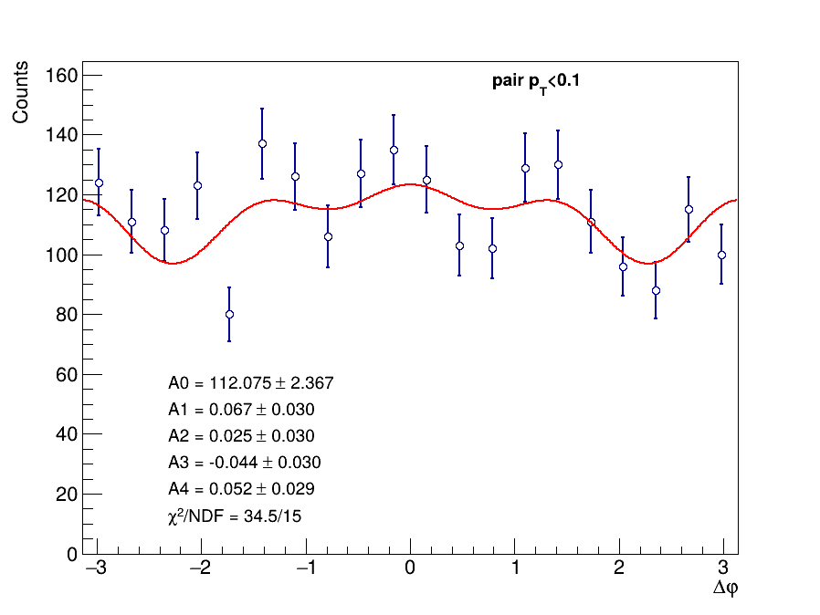
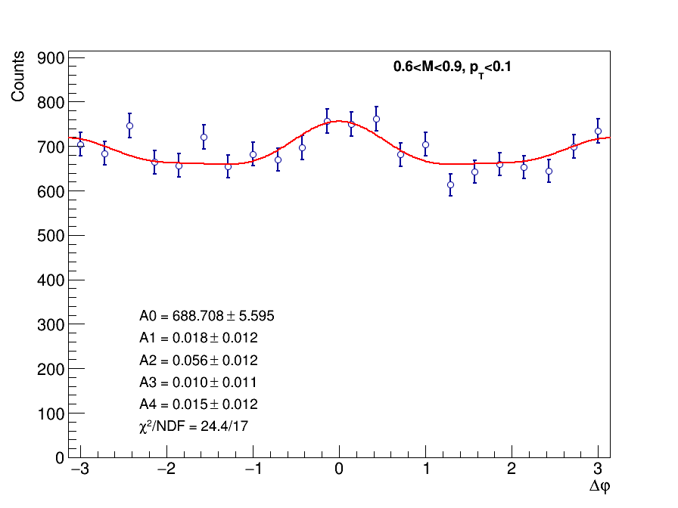
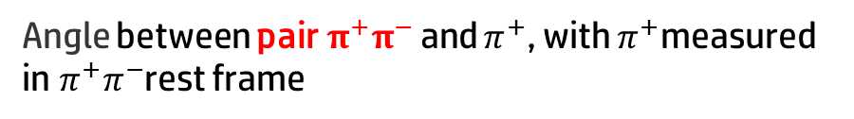

Double Scattering Modulation
Angle between pair$π^{+}π^{−}$and $π^{+}$, with $π^{+}$measured in$π^{+}π^{−}$rest frame
both pair 0.6<$m_{ππ}$<0.9
2023
2025

Slide 10
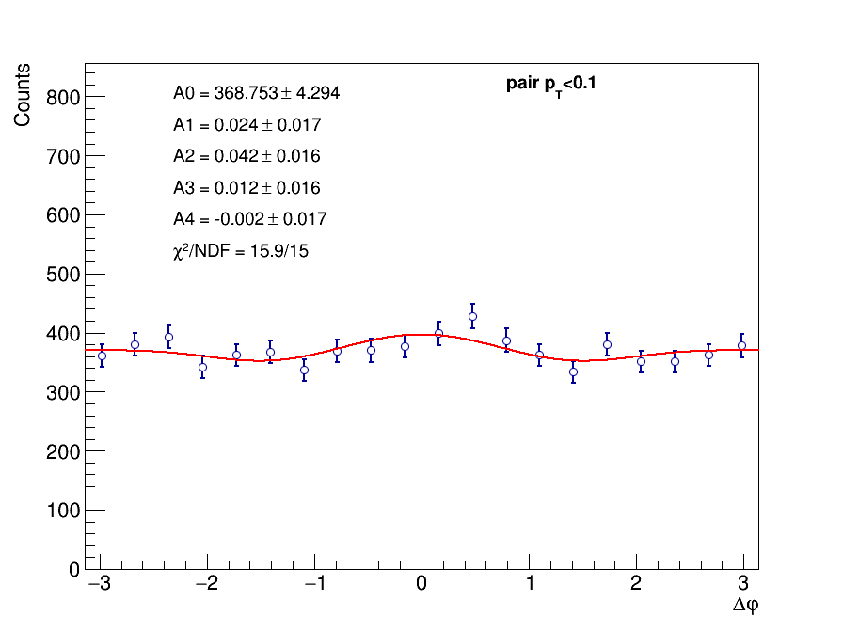
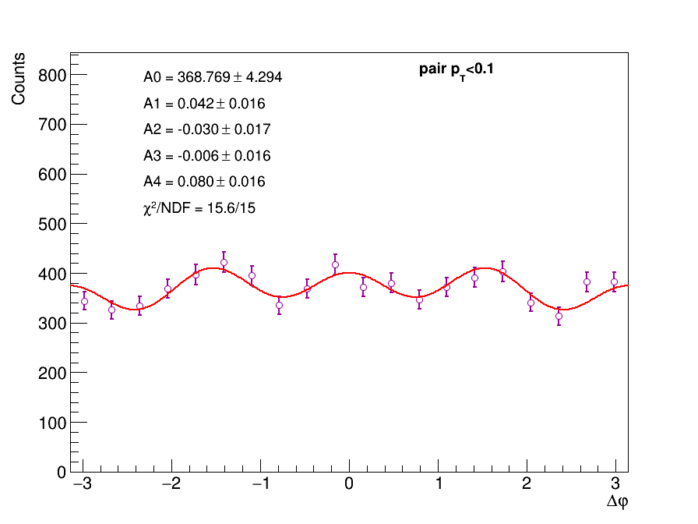

Double Scattering Modulation pT<0.1
Angle between pair$π^{+}π^{−}$and $π^{+}$, with $π^{+}$measured in$π^{+}π^{−}$rest frame
Closest${{ π}^{+}π^{−}\text{pair} to m}_{ρ_{0}}=0.77GeV$
The other pair

Slide 11
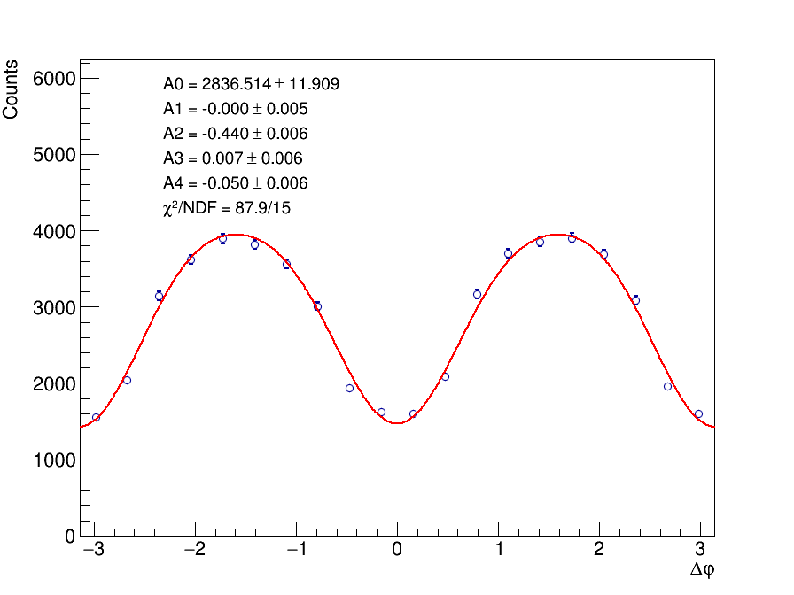
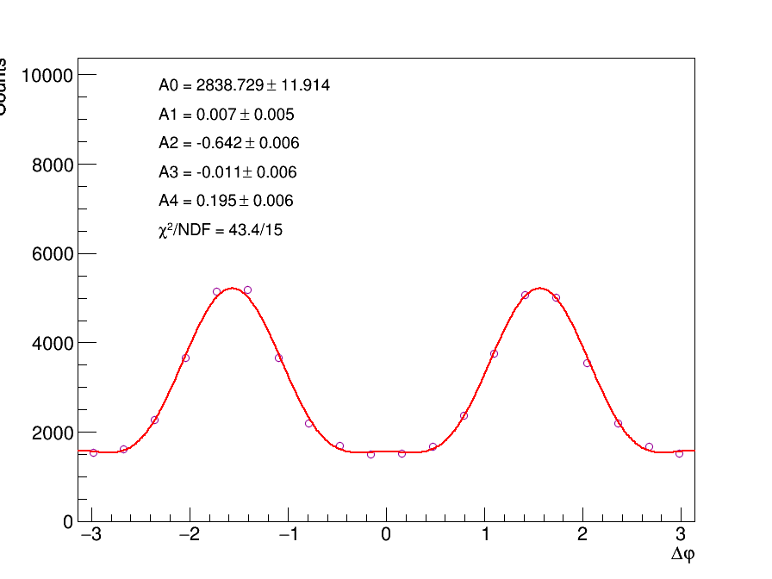
No pT cut
Angle between pair$π^{+}π^{−}$and $π^{+}$, with $π^{+}$measured in$π^{+}π^{−}$rest frame
Closest${{ π}^{+}π^{−}\text{pair} to m}_{ρ_{0}}=0.77GeV$
The other pair

Slide 12
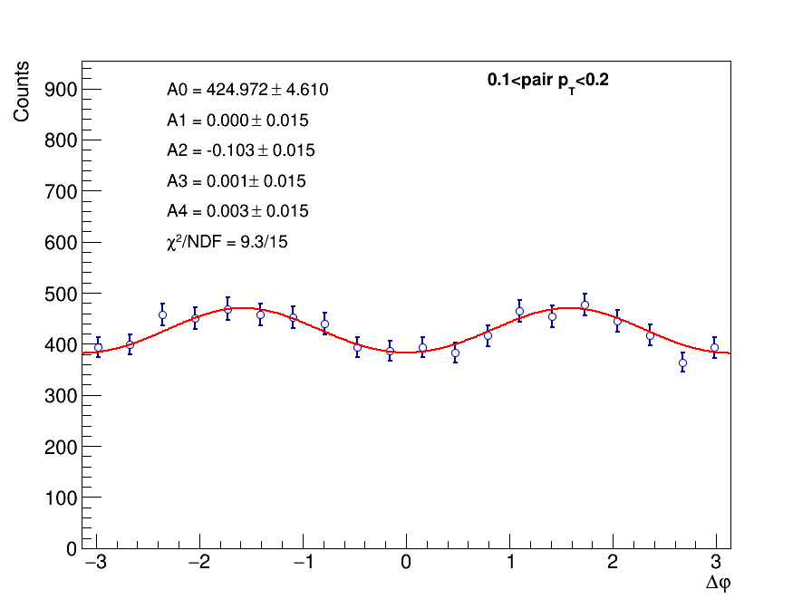
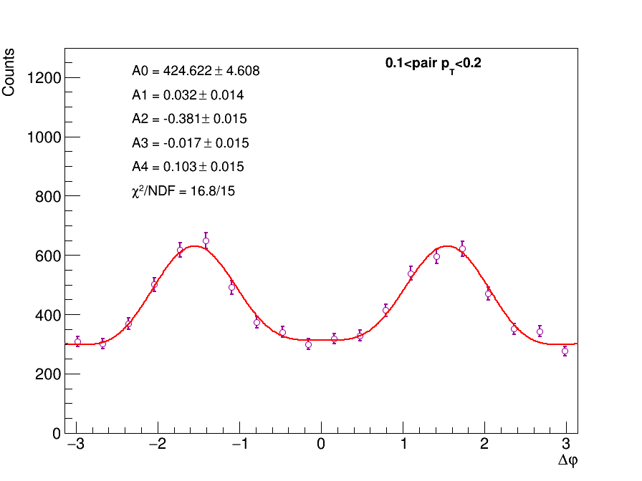
0.1<pT<0.2
Angle between pair$π^{+}π^{−}$and $π^{+}$, with $π^{+}$measured in$π^{+}π^{−}$rest frame
Closest${{ π}^{+}π^{−}\text{pair} to m}_{ρ_{0}}=0.77GeV$
The other pair

Slide 13
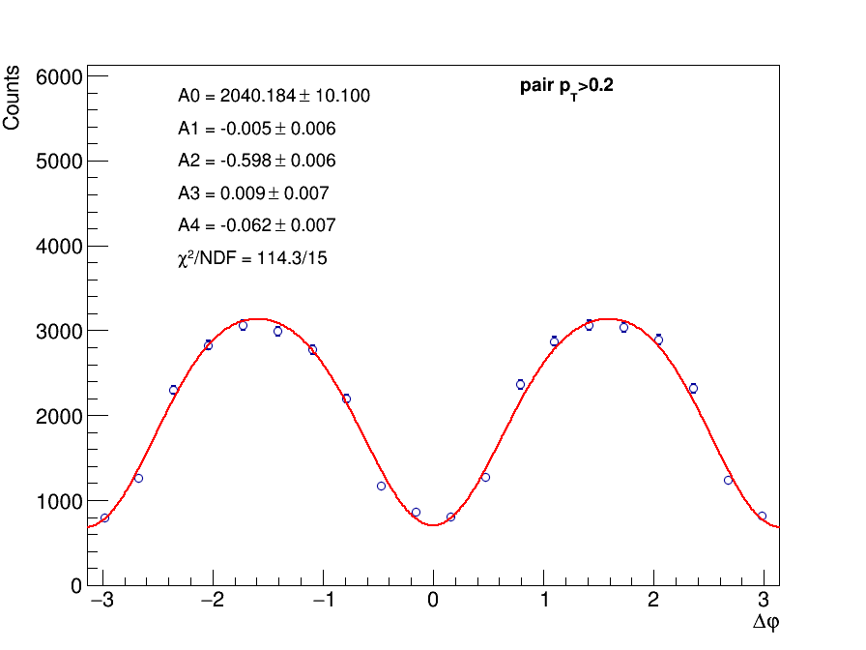
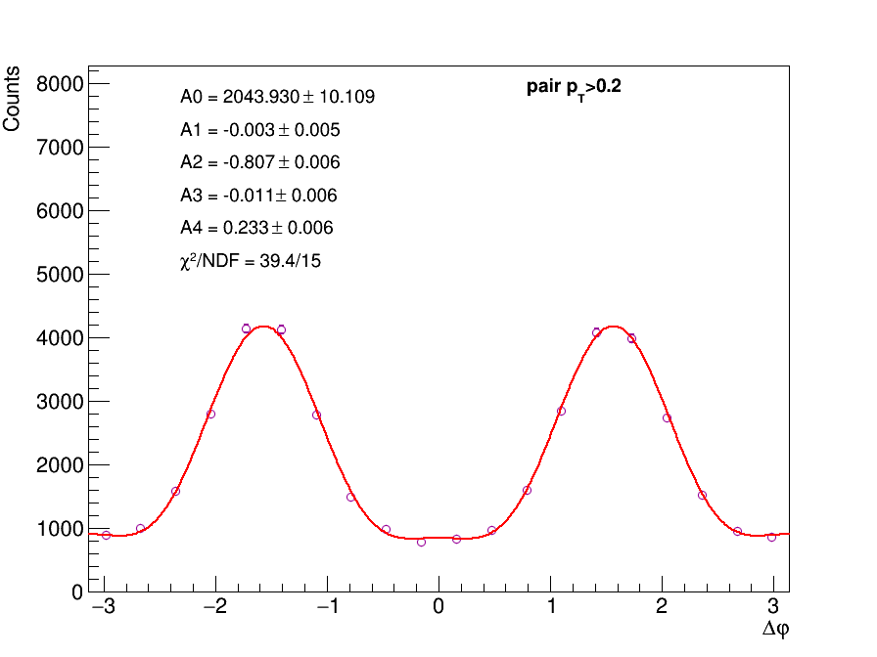
0.2<pT
Angle between pair$π^{+}π^{−}$and $π^{+}$, with $π^{+}$measured in$π^{+}π^{−}$rest frame
Closest${{ π}^{+}π^{−}\text{pair} to m}_{ρ_{0}}=0.77GeV$
The other pair

Slide 14
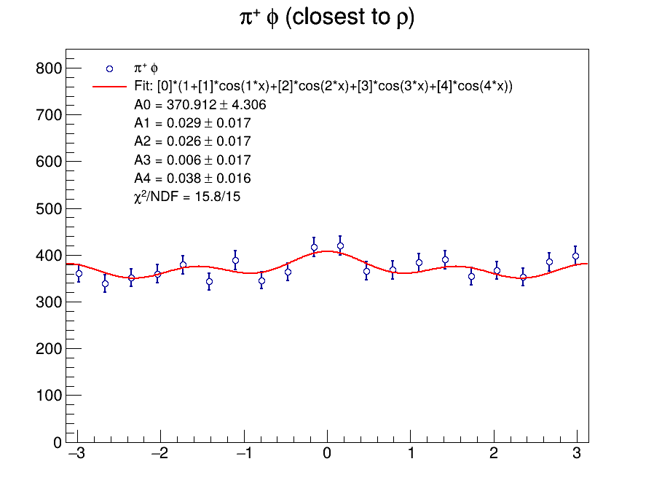
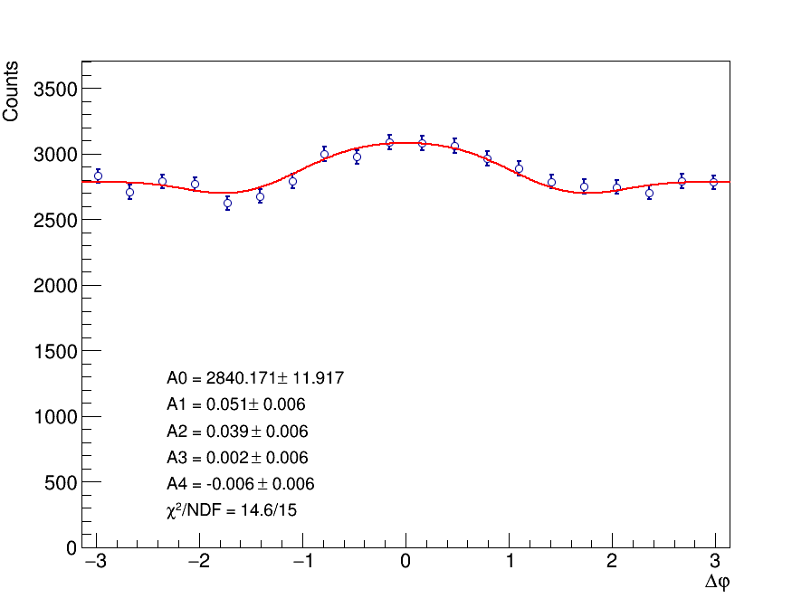
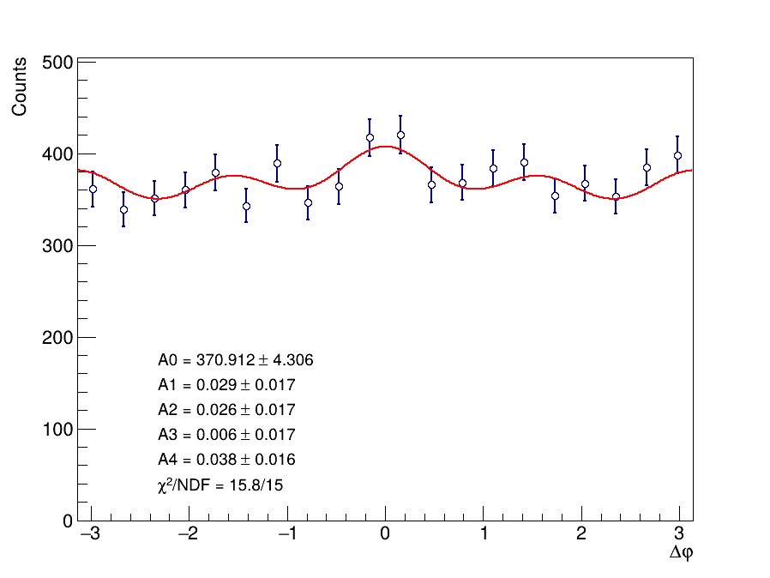
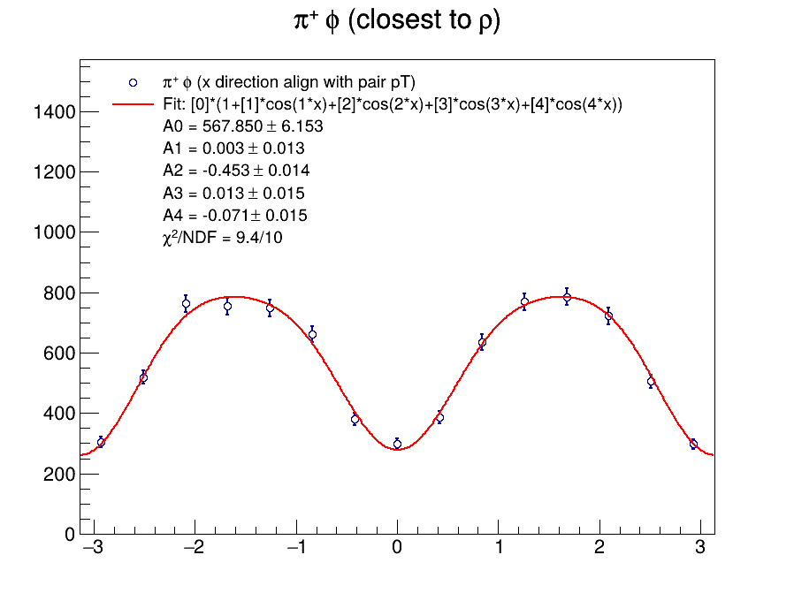

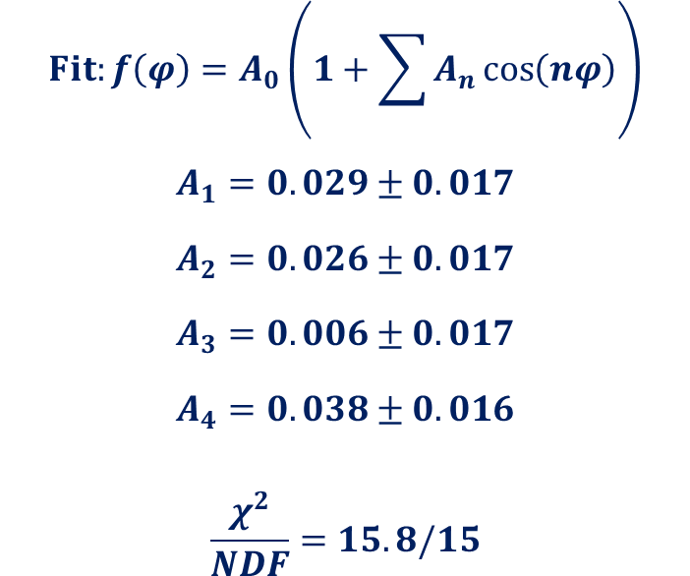

Closest${{ π}^{+}π^{−}\text{pair} to m}_{ρ_{0}}=0.77GeV$
Angle between $ρ^{′}$ and $π^{+}$, with $π^{+}$measured in$π^{+}π^{−}$rest frame
2023
2025
Closest${{ π}^{+}π^{−}\text{pair} to m}_{ρ_{0}}=0.77GeV$
$$Fit:f\left(φ\right)=A_{0}\left(1+\sum{A_{n}\cos\left(nφ\right)}\right)$$
$$A_{1}=0.029±0.017$$
$$A_{2}=0.026±0.017$$
$$A_{3}=0.006±0.017$$
$$A_{4}=0.038±0.016$$
$$\frac{χ^{2}}{NDF}=15.8/15$$

Slide 15
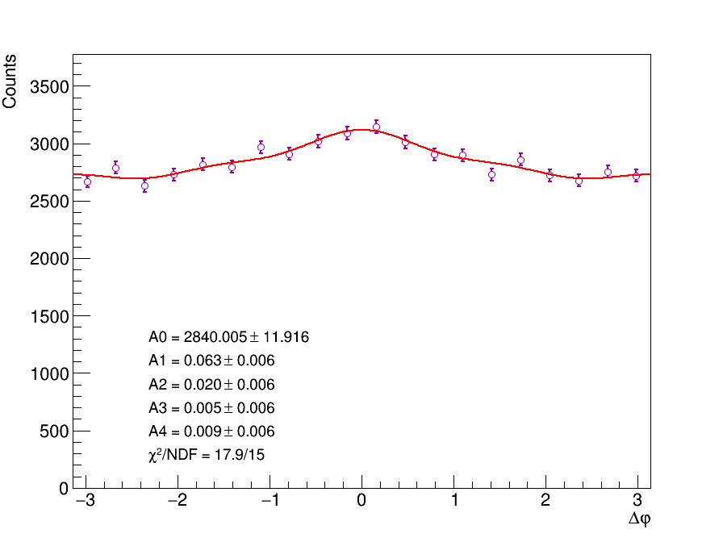
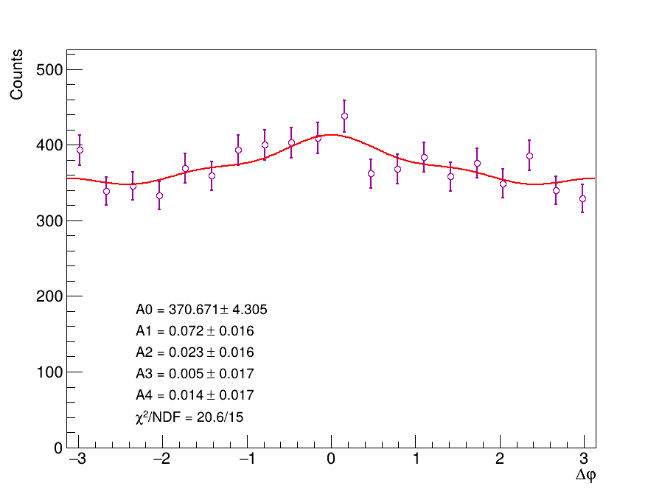
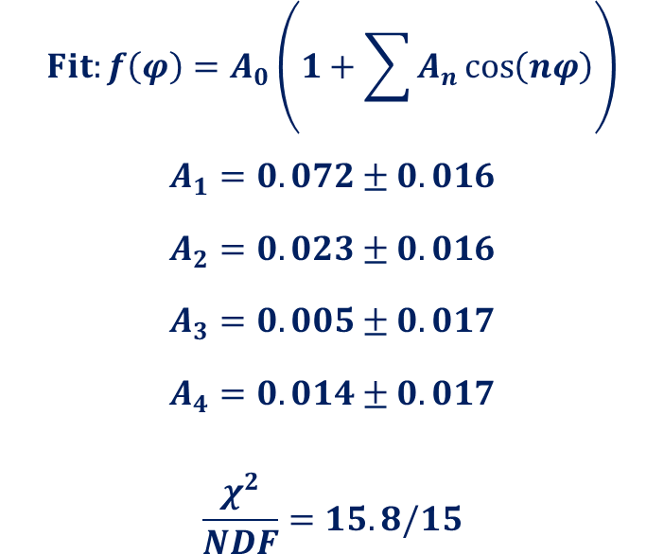
The other pair
Angle between $ρ^{′}$ and $π^{+}$, with $π^{+}$measured in$π^{+}π^{−}$rest frame
The other pair
2023
2025
$$Fit:f\left(φ\right)=A_{0}\left(1+\sum{A_{n}\cos\left(nφ\right)}\right)$$
$$A_{1}=0.072±0.016$$
$$A_{2}=0.023±0.016$$
$$A_{3}=0.005±0.017$$
$$A_{4}=0.014±0.017$$
$$\frac{χ^{2}}{NDF}=15.8/15$$

Slide 16
Thanks for Listening!
Thanks for Listening!

Slide 17
Backup

Slide 18
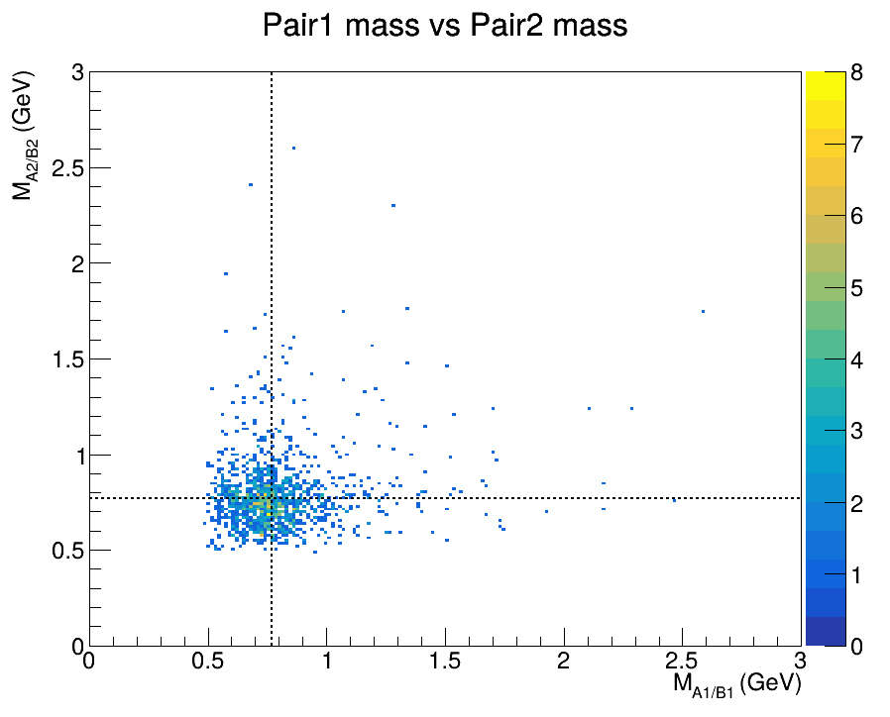



Different Mass Category
$$m_{ρ_{0}}=0.77GeV$$
0.6 < $m_{ππ}$ < 0.9

Slide 19
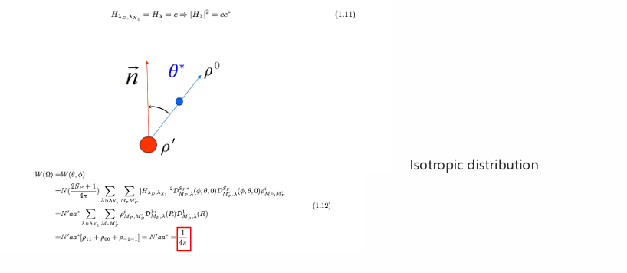
𝝆^′→ 𝝆𝝈/𝒇_𝟎

Slide 20
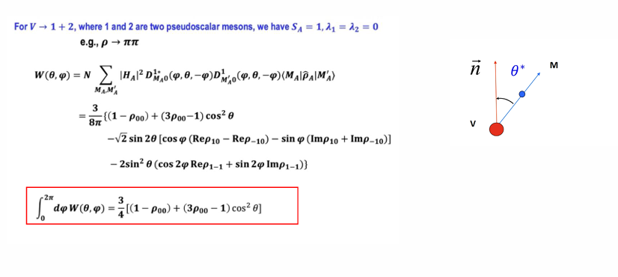
$$ρ→ππ$$

Slide 21
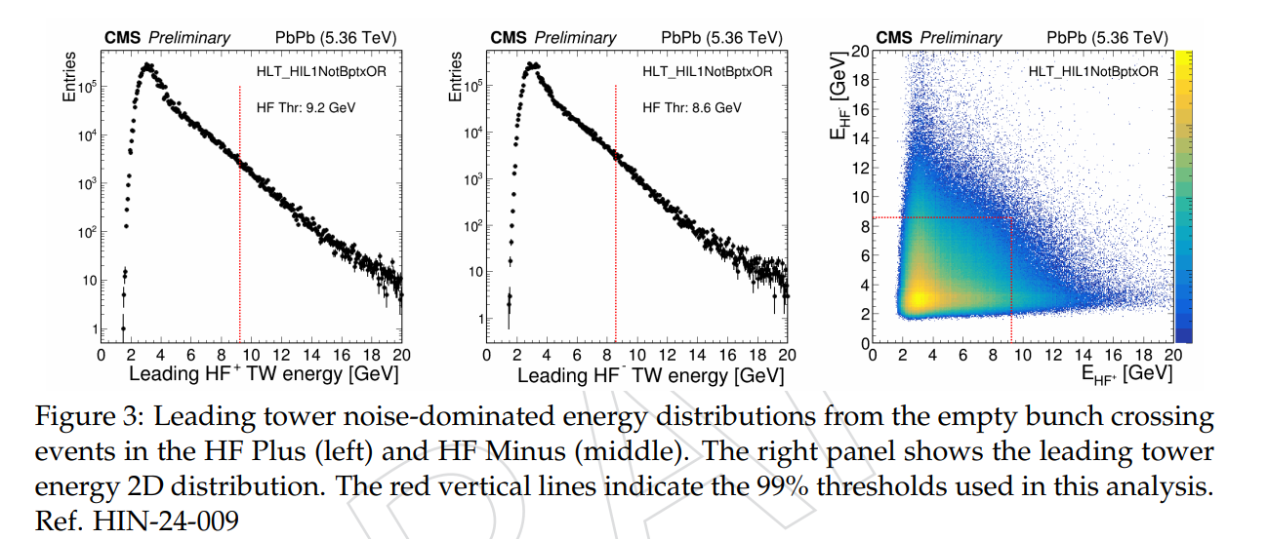
HF cut
T. C. Collaboration, “Description and performance of track and primary-vertex 613 reconstruction with the cms tracker”, Journal of Instrumentation 9 (October, 2014) 614 P10009–P10009, doi:10.1088/1748-0221/9/10/p10009.
2023 empty bunch crossing (”No BPTX”) data samples

Slide 22
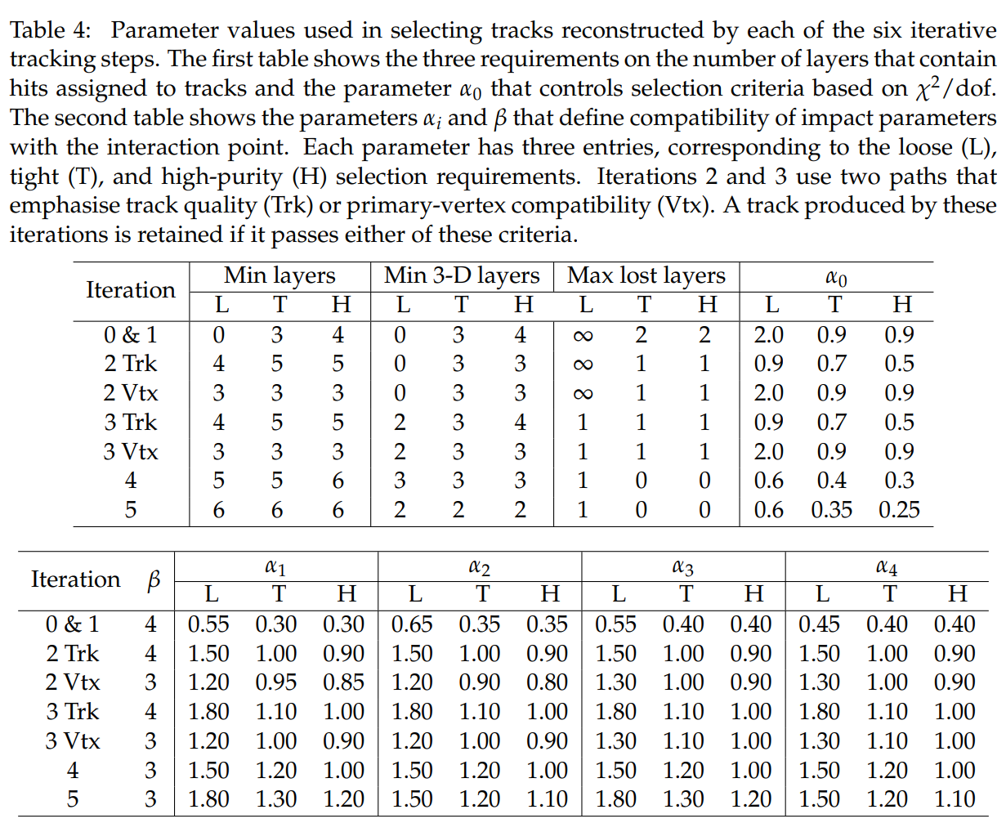
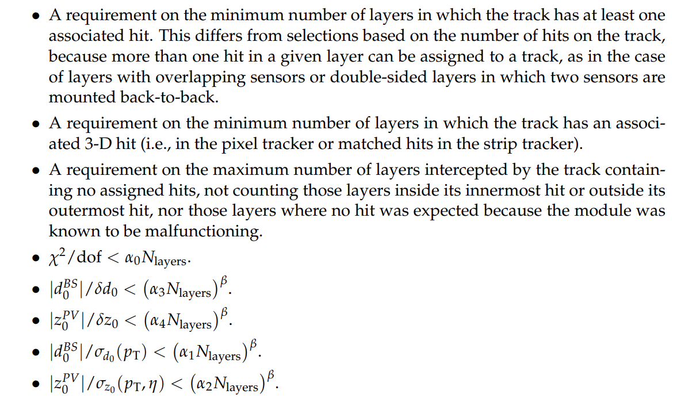
highPurity Track
T. C. Collaboration, “Description and performance of track and primary-vertex 613 reconstruction with the cms tracker”, Journal of Instrumentation 9 (October, 2014) 614 P10009–P10009, doi:10.1088/1748-0221/9/10/p10009.
Tracks are selected on the basis of the
number of layers that have hits,
whether their fit yielded a good χ 2/dof,
and how compatible they are with originating from a primary interaction vertex.
“slightly lower efficiency but much lower backgrounds.”

Slide 23
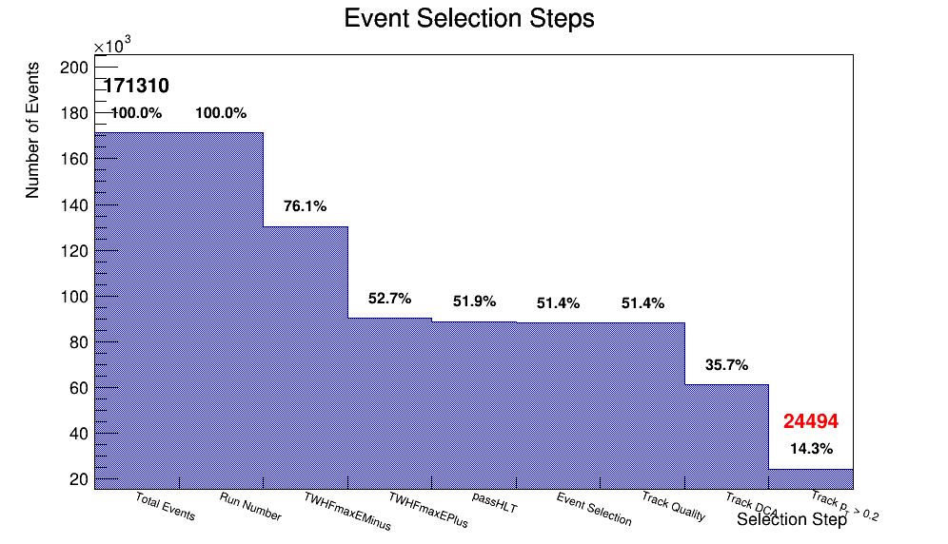
Dataset and Event Selection

Slide 24
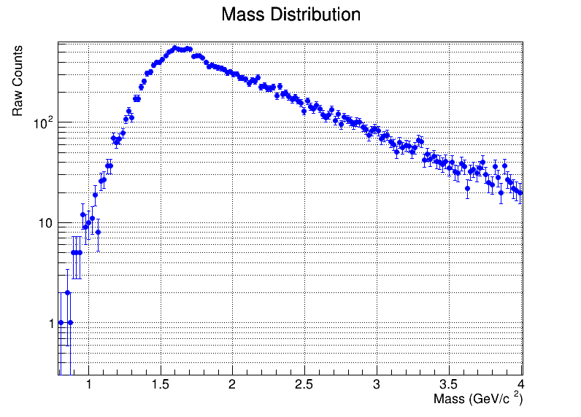
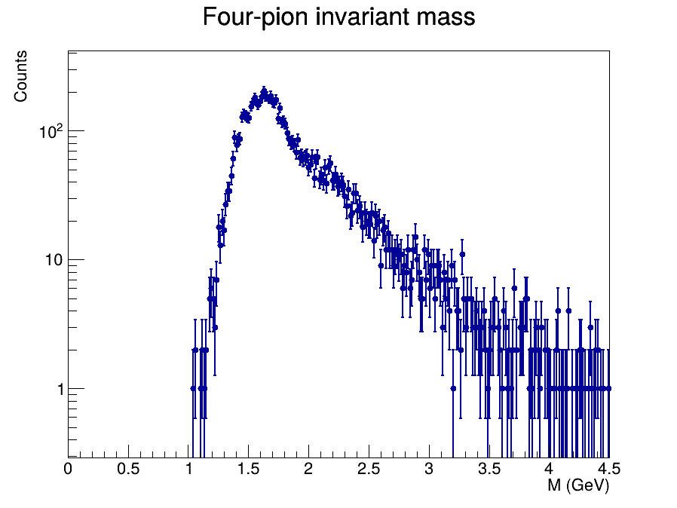
pT<0.1 mass(right)

Slide 25
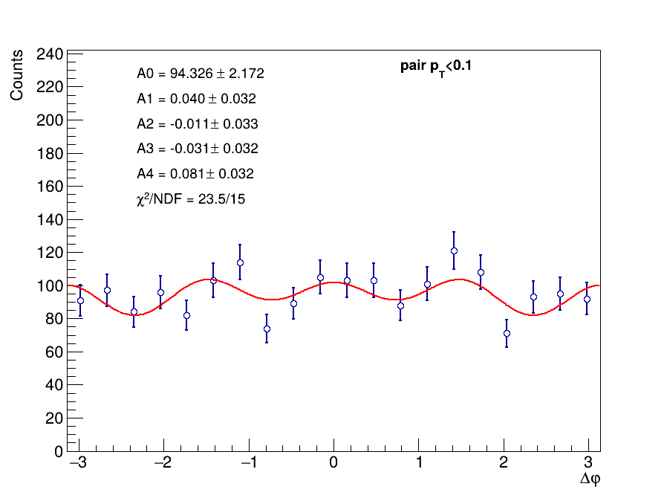
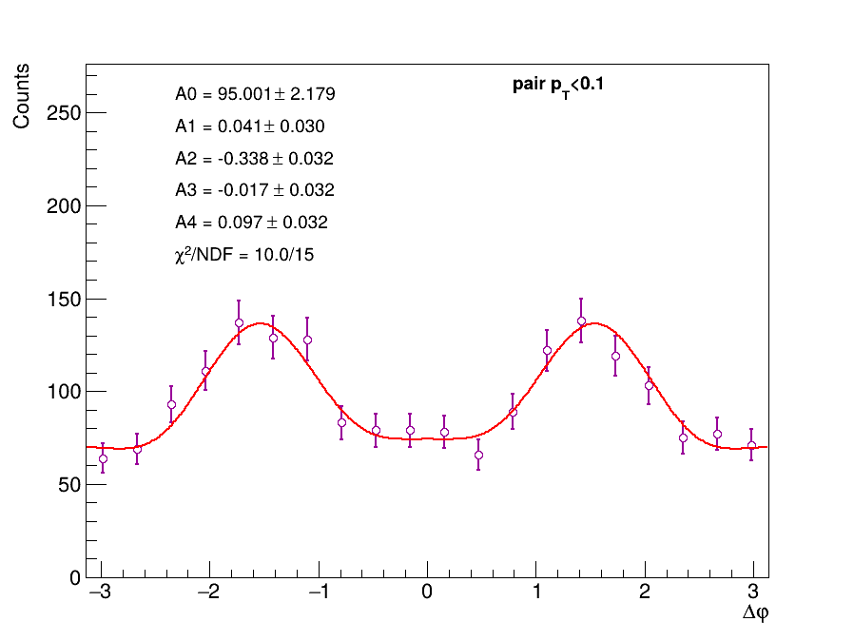

Double Scattering Modulation
Angle between pair$π^{+}π^{−}$and $π^{+}$, with $π^{+}$measured in$π^{+}π^{−}$rest frame
Closest${{ π}^{+}π^{−}\text{pair} to m}_{ρ_{0}}=0.77GeV$
The other pair

Slide 26
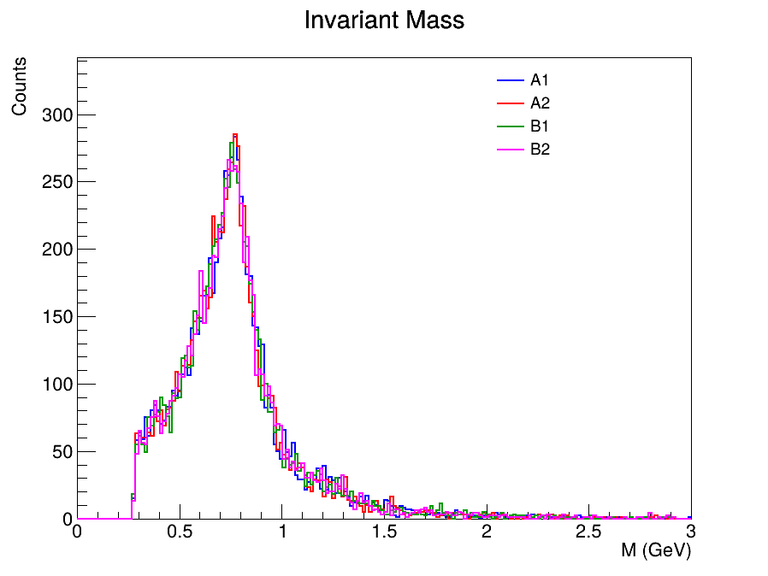

Slide 27
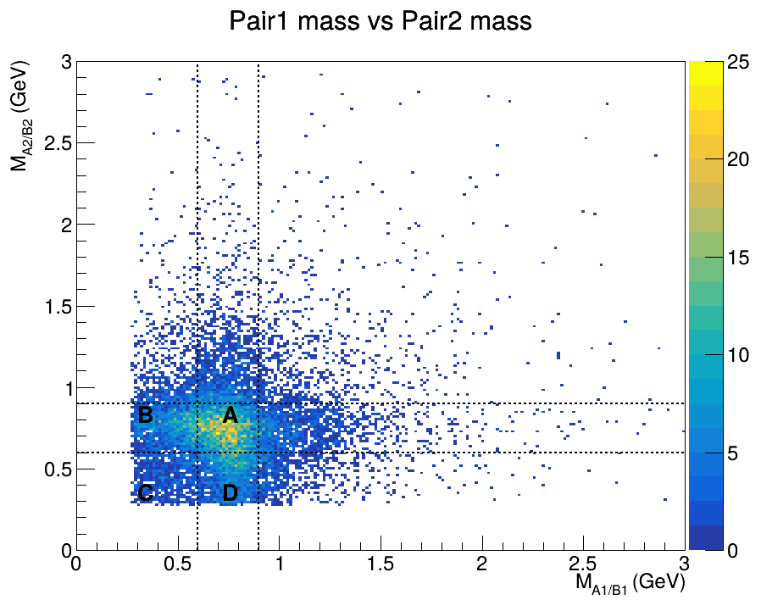





Different Mass Category
B
A
$$m_{ρ_{0}}=0.77GeV$$
$$ρ_{0}+π^{+}π^{−}$$
$$ρ_{0}+ρ_{0}$$
$$π^{+}π^{−}+π^{+}π^{−}$$
$$ρ_{0}+π^{+}π^{−}$$
C
D

Slide 28








Transverse Momentum Distribution
B
A
C
D

Slide 29




Separate mass cat pair pT

Slide 30




Separate mass cat pair pT

Slide 31






Region A & C
Angle between $ρ^{′}$ and $π^{+}$, with $π^{+}$measured in$π^{+}π^{−}$rest frame
A : both 0.6<$m_{ππ}$<0.9
C : both $m_{ππ}$<0.6
Fit : $f\left(φ\right)=A_{0}\left(1+\sum{A_{n}\cos\left(nφ\right)}\right)$

Slide 32






Region B & D
B & D : 0.6<$m_{ππ}$<0.9
B & D : both $m_{ππ}$<0.6

Slide 33


Region A & C
Angle between pair$π^{+}π^{−}$and $π^{+}$, with $π^{+}$measured in$π^{+}π^{−}$rest frame
A : both 0.6<$m_{ππ}$<0.9
C : both $m_{ππ}$<0.6

Slide 34
Region B & D
B & D : 0.6<$m_{ππ}$<0.9
B & D : both $m_{ππ}$<0.6

Slide 35



Mass Window for $ρ$
Angle between $ρ^{′}$ and $π^{+}$, with $π^{+}$measured in$π^{+}π^{−}$rest frame
$${{ π}^{+}π^{−} with 0.6 GeV<m}_{pair}<0.9 GeV$$
The other pair

