Slide 1
Weekly Report
L.Wang

Slide 2
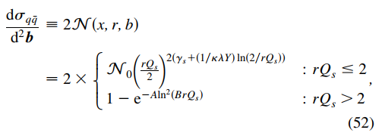
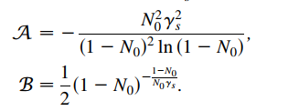

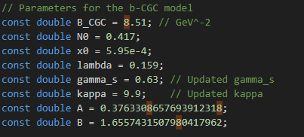
Xin’s idea: change the proton shape to He4 shape and test its contribution for B_D(slope value).
Can’t use Wood-Saxon distribution directly(for the continuity of the N) !

Slide 3
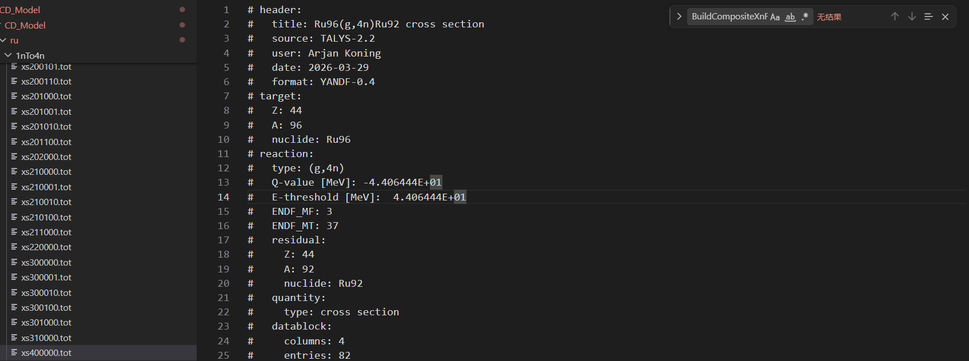
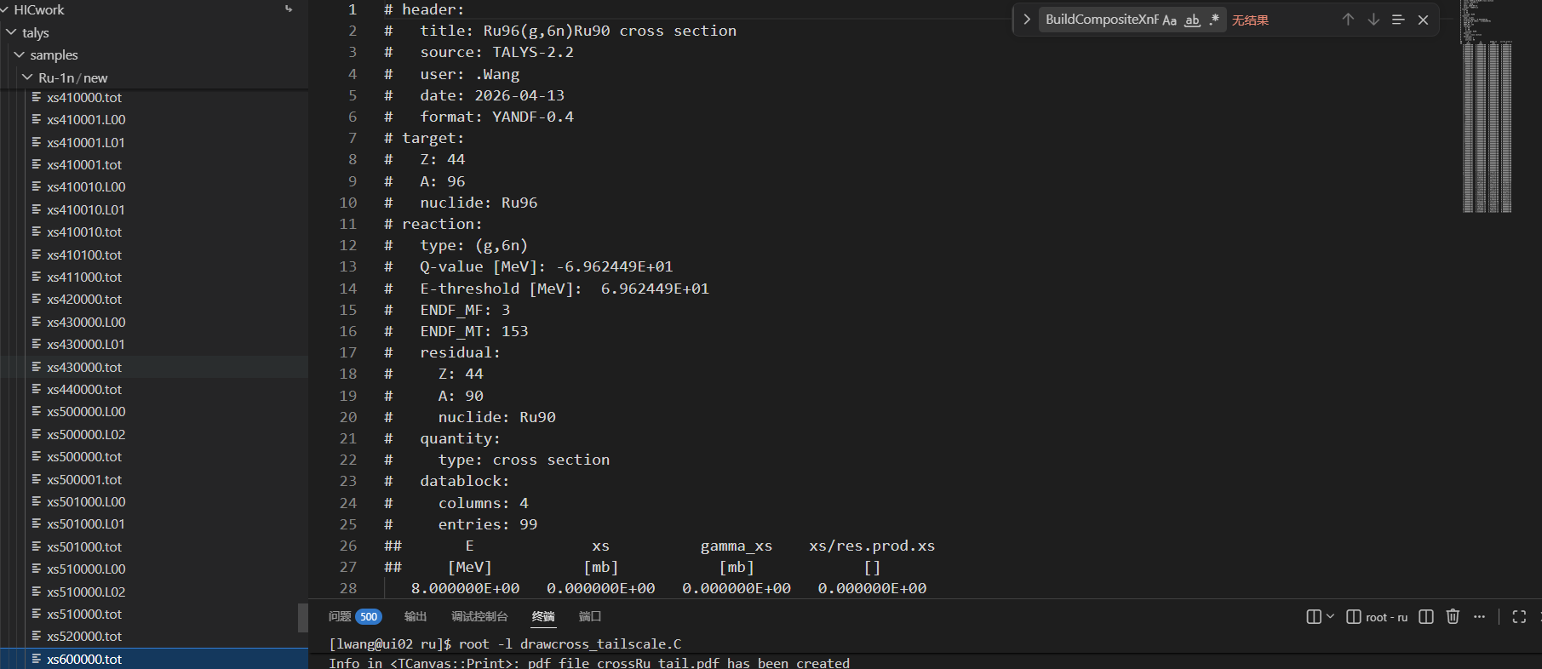
Huda’s cross section from Talys.
Mine(till to 6n for Ru and 8n for Zr).

Slide 4
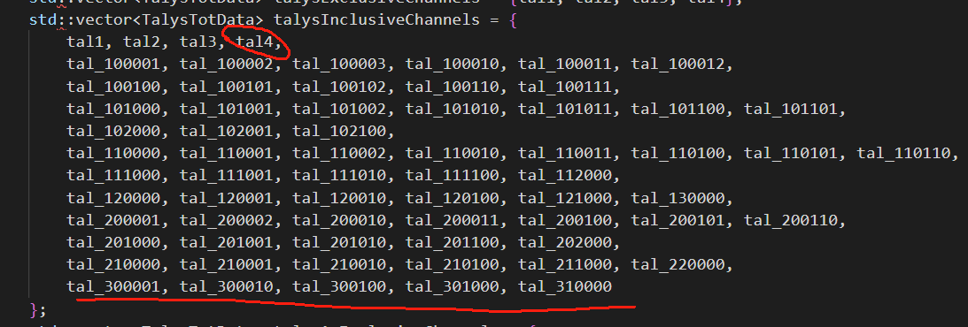

Slide 5
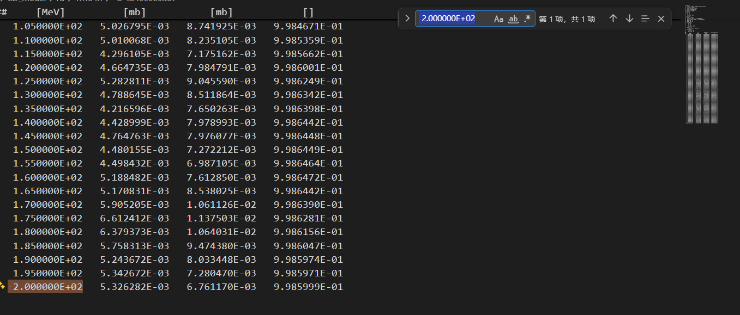
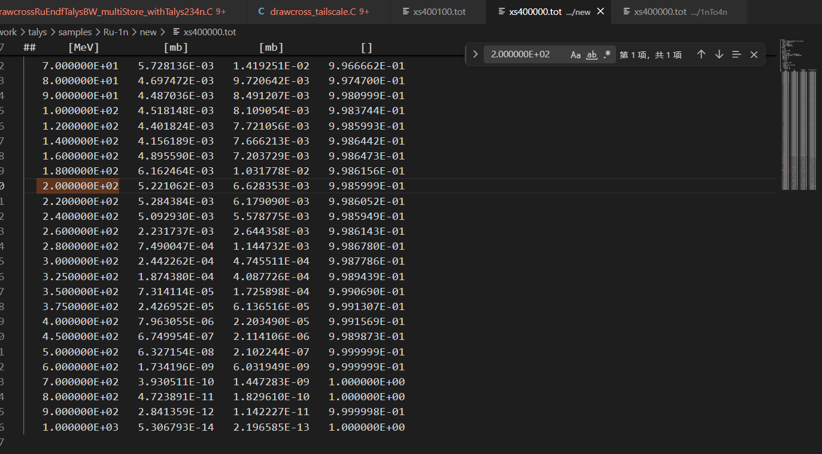

Slide 6
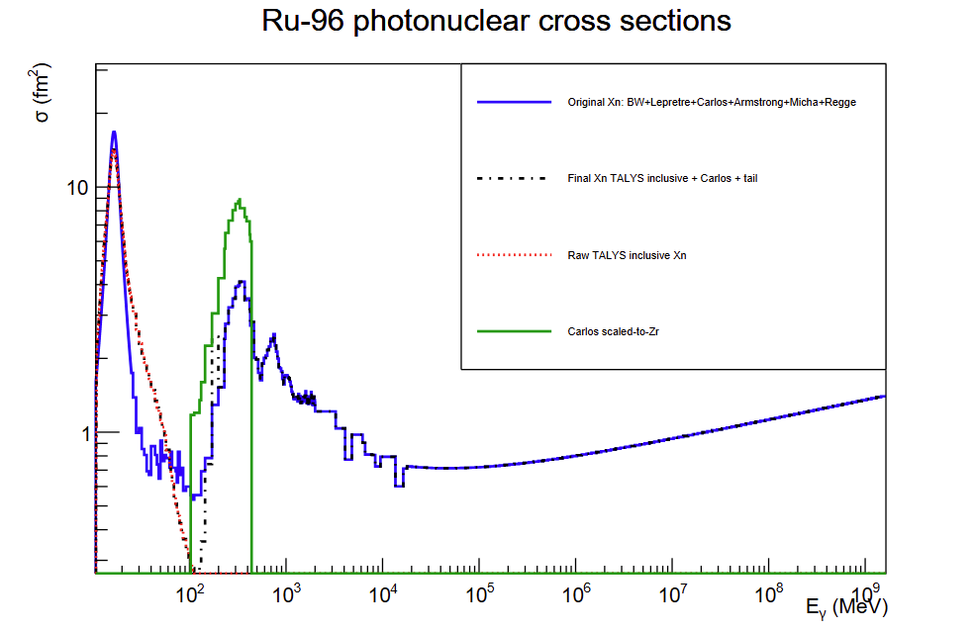
If it is rational?

Slide 7
THANKS

