Slide 1

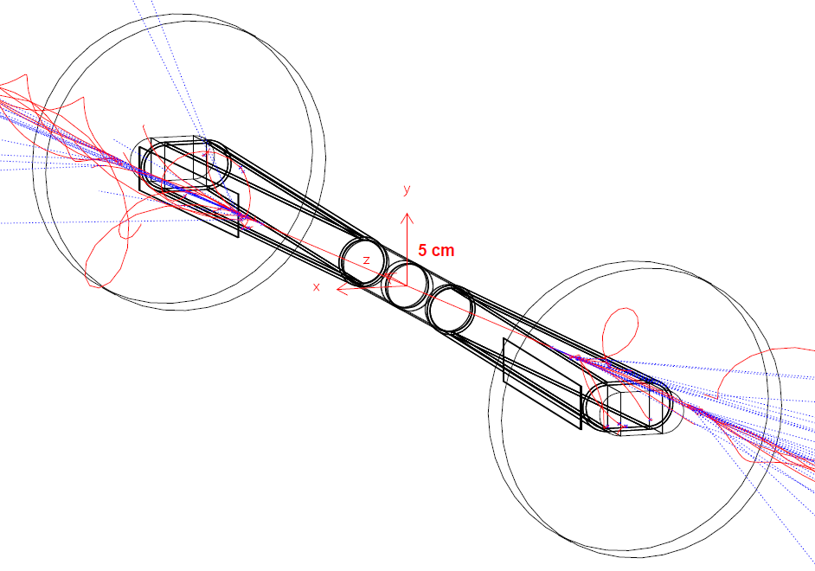
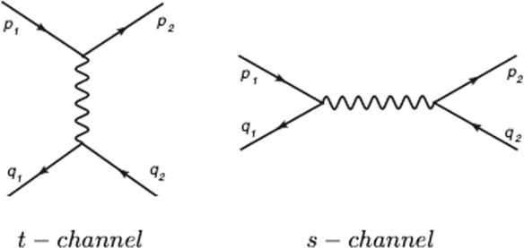
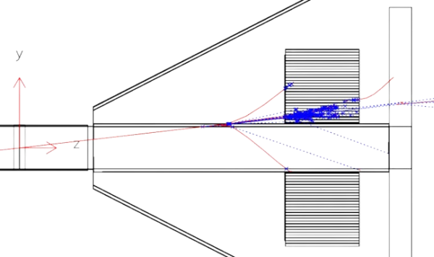
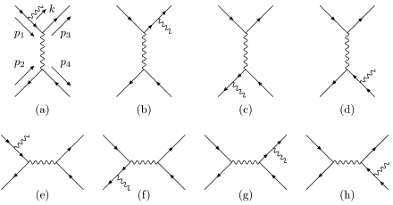
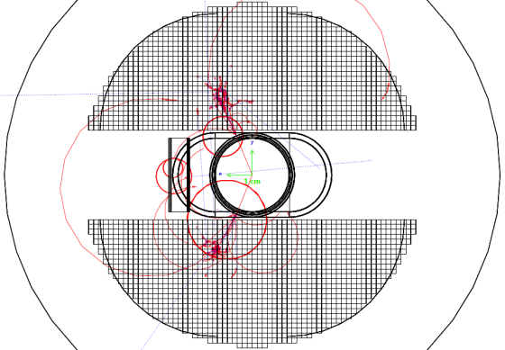


https://indico.pnp.ustc.edu.cn/event/6293/
2026 超级陶粲装置研讨会
Precision test of QED on
radiative Bhabha photons
侯书云Suen Hou
Academia Sinica
2026.07.02
Radiative Bhabha elastic scattering
Forward Detector
LO
NLO

Slide 2
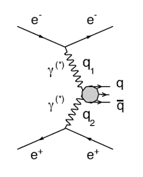
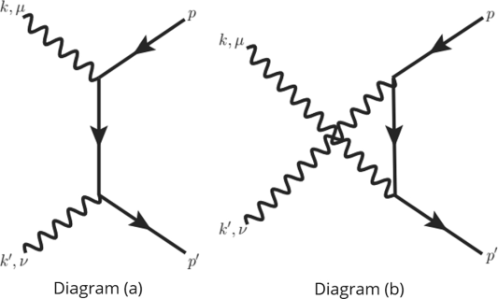
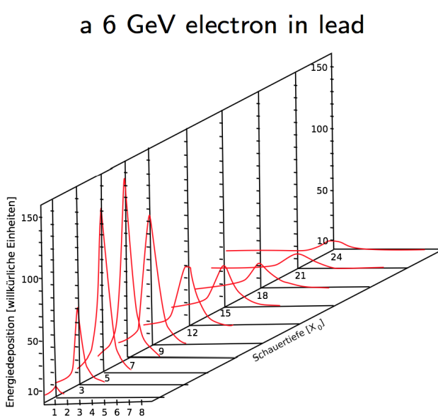
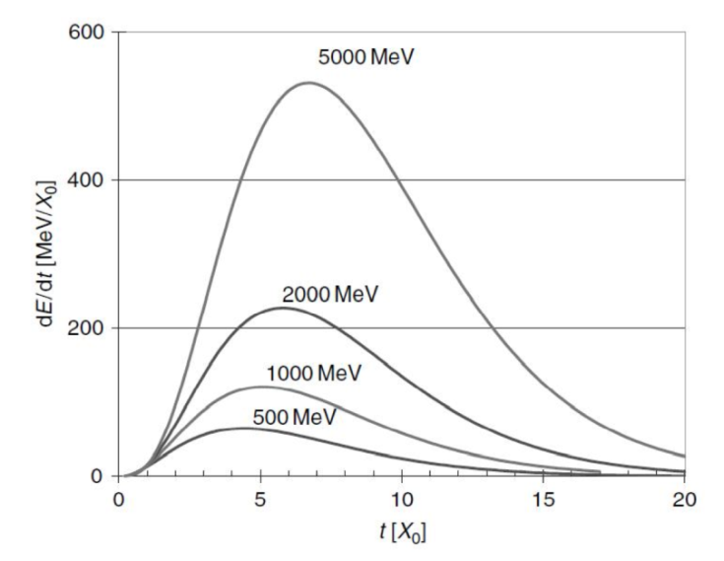
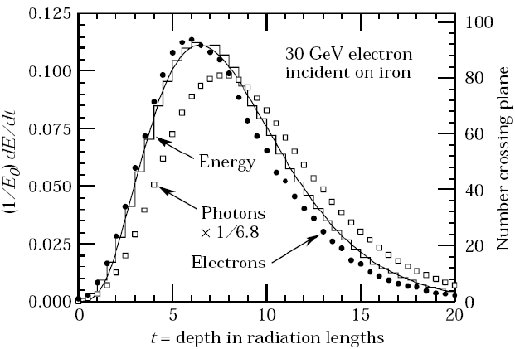
QED processes at e⁺e⁻ colliders
Bhabha elastic scattering
Two photon interaction
two-photon fusion
two-photon pair
Bhabha elastic scattering
Beam background: Sync. Radiation, IP Bremsstrahlung
Electromagnetic Shower, Calorimetry
Energy profile
Longo 1975
Particle flow

Slide 3
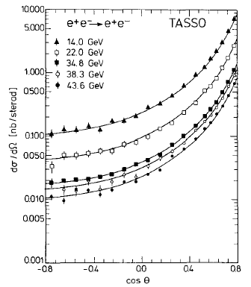
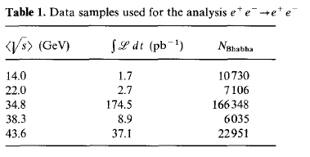
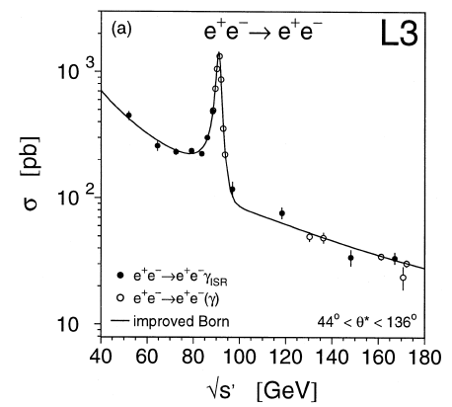
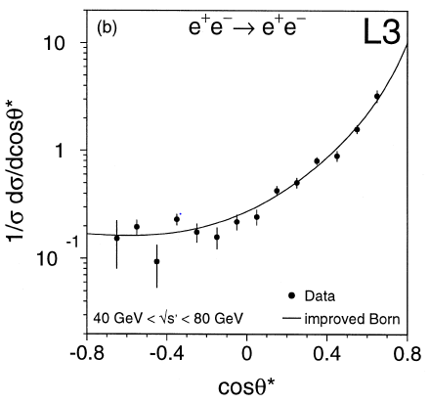
Bhabha experimental results
e⁺e⁻ → e⁺e⁻ (γ)
TASSO Bhabha
Systematic error ~3%
√s = 12 - 47 GeV
[ 1988, ZPC 37, 171]
[1998, PLB 439, 183]
L3 radiative Bhabha
with ISR
Systematic error
at ~1% level
√s= 50 ~ 170 GeV,
232 pb⁻¹, 2856 event

Slide 4
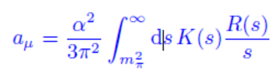



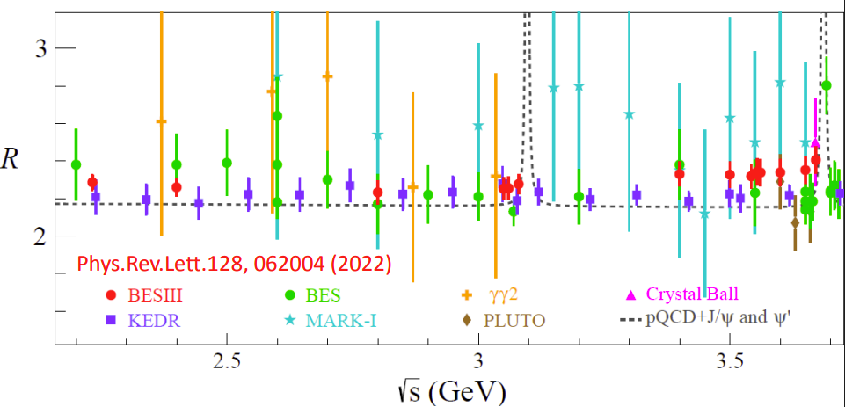
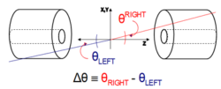
Bhabha Luminosity for SM, R ratio
Luminosity L is derived by
Bhahha event counting
Bhabha detected for
a pair of back-back electrons,
precision θ of e,e(γ) in fiducial region
R(s) ratio for SM predictions
Requiring precision on
a_{μ} = (g_{μ}-2)/2 and Δα_{had}(M_{Z})
e⁺e⁻ → e⁺e⁻(nγ)
BESII in 2–5 GeV, precision 6%
BESIII 2022 3%

Slide 5


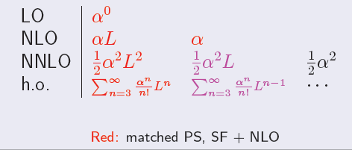

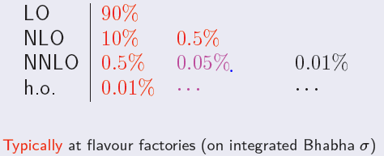
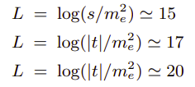
Radiative Bhabha, NLO, NNLO
e⁺e⁻ → e⁺e⁻ (nγ)
Methods used for multiple photon corrections
SF: analytical collinear QED Structure Functions
YFS exponentiation Small angle, 0.054% BHLUMI (LEP)
YFS exponentiation Large ange, BHWIDE (LEP)
PS: Parton Shower, Large angle 0.1% BabaYaga@NLO
Flavor Factories
e⁺e⁻ collision luminosity
collinear log :
Luminosity errors:
Experiment
Theory
C.M. Carloni Calame
ECFA Higgs CERN 2021
collinear log :
G. Montagna
Ustron, 2015
Large angle @ Flavor
Small angle @ LEP
Small angle @ t—t thresh.

Slide 6
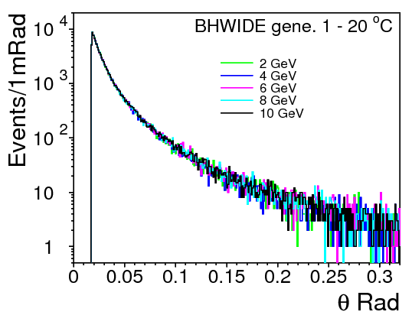
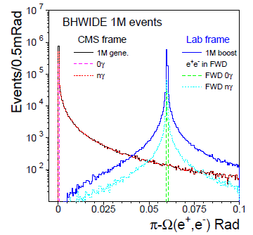
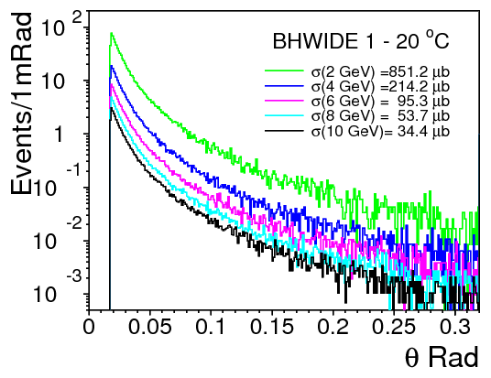
Bhabha: e⁺e⁻ → e⁺e⁻(nγ) √s dependency
BHWIDE center-of-mass
√s = 2 - 10 GeV, θ range 1 – 20º
θ distribution: well overlapped
Cross section much higher at lower √s
º
e⁺e⁻ back-to-back
60 mRad beam-crossing boost
Delta/tails for 0γ/nγ events
º

Slide 7
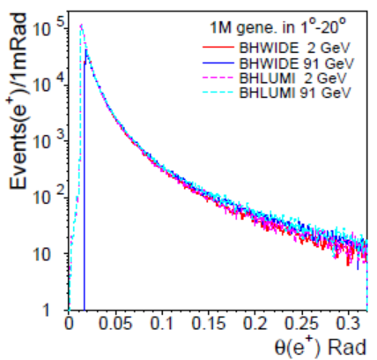
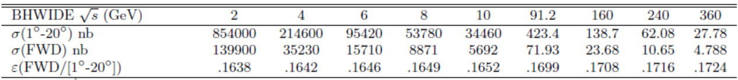
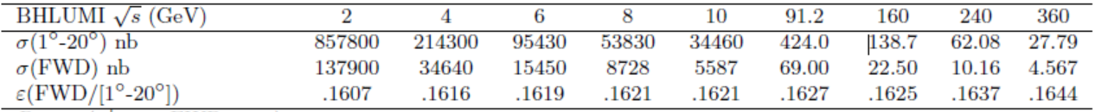
Bhabha: e⁺e⁻ → e⁺e⁻(nγ) cross section
BHLUMI/BHWIDE CM-frame
YFS algorithm for radiation
Compare cross section in 1° - 20°
BHLUMI E_{γ} > 10⁻⁴ Ebeam
BHWIDE E_{γ} > 10⁻⁵ Ebeam
BHWIDE is for “Large Angle” region > 6°
t-channel effect contributes ?
CM-frame cross section agrees ~0.1%
FSTD Forward Det. ➔ ~ 2 % deviation
effect c

Slide 8
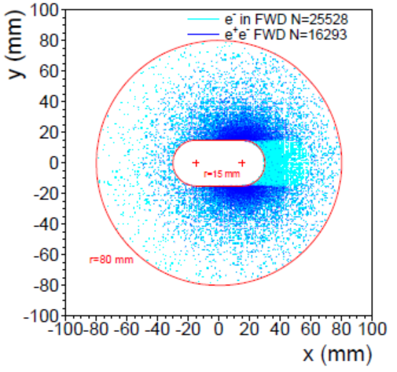
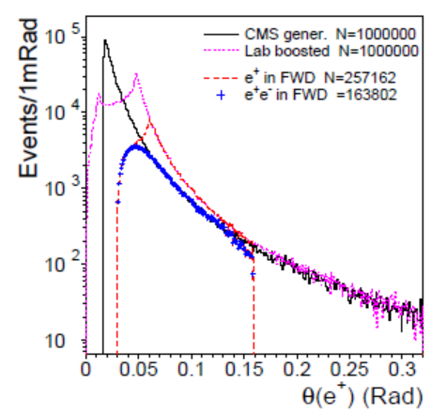
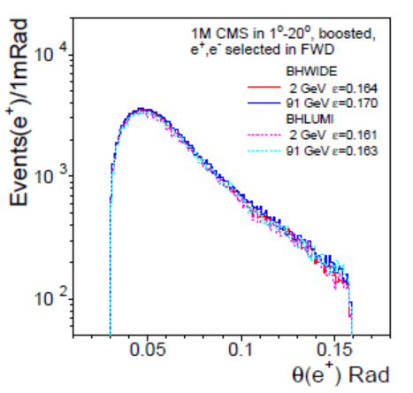
Bhabha STCF FWD acceptance
Accepted in FWD @z=500mm
Forward Det. (FWD) acceptance
both e⁺ e⁻ detected in in FWD
@|z|= 500mm
off beampipe Ø = 30 mm; r < 80mm
60 mRad beam-crossing boost
w.r.t. CM generated in 1-20º
acceptance: ε ~ 16.3 %
Theta of e+, gen. to FWD accepted
FWD accepted, BHWIDE/BHLUMI
√s = 2 GeV

Slide 9
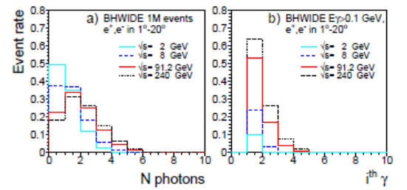
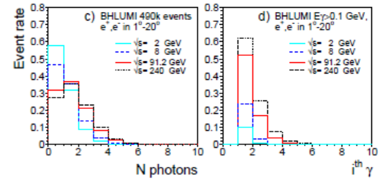
Radiative Bhabha e⁺e⁻(nγ)
BHLUMI/BHWIDE radiative Bhabha
QED radiation calculated with YFS exponentiation
nγ in Poisson distribution
BHLUMI Eγ cut = 1 x 10⁻⁴ x E_{beam} BHWIDE Eγ cut = 1 x 10⁻⁵ x E_{beam}
Count photons detectable Eγ > 0.1 GeV
Photons nγ rates well consistent with BHLUMI/BHWIDE
nγ event rates
BHWIDE
BHLUMI
Default
Eγ > 0.1 GeV
Default
Eγ > 0.1 GeV

Slide 10
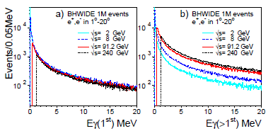
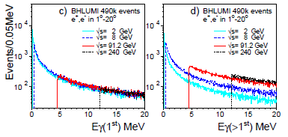
Radiative Bhabha e⁺e⁻(nγ)
BHLUMI/BHWIDE radiative Bhabha
➔ 1st energetic photon, same rates, indep. of √s
event rates vs Eγ, near threshold ~20 MeV
well consistent with BHLUMI/BHWIDE
2nd energetic photon, higher rates with √s
BHWIDE Eγ
BHLUMI Eγ
1st photon 2nd photon
1st photon 2nd photon

Slide 11
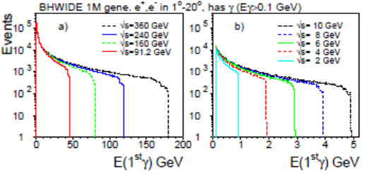
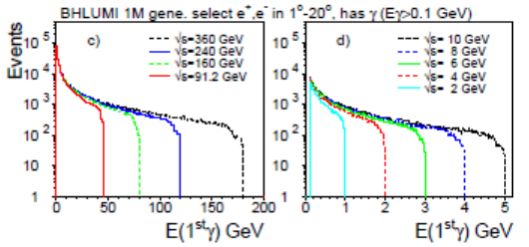
Radiative Bhabha e⁺e⁻(nγ)
BHLUMI/BHWIDE radiative Bhabha
Most energetic energy event rates
events vs Eγ, at allowed range indept of √s
Eγ range reaching E_{beam}
Eγ, 1st photon in events > 0.1 GeV
BHWIDE
BHLUMI

Slide 12
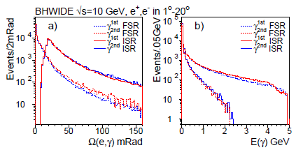
Detecting radiative radiative photons
Bhabha scattering, highest event rates @ flavor, Higgs factories
BHLUMI .037% precision
QED basics
Radiation by YFS exponentiation
applied in all QED radiation ➔ photons look alike
➔ Beam background shall look like Bhabha radiation ??
e⁺e⁻ → e⁺e⁻(nγ)
Photons
ordered by Eγ
ISR/FSR by
Open Angle Ω(e,γ)
closer to incident/scatter e±
√s = 10 GeV

Slide 13
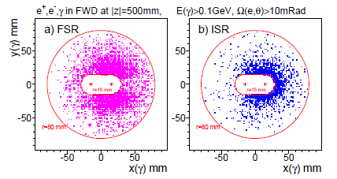
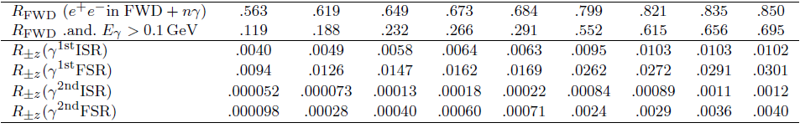
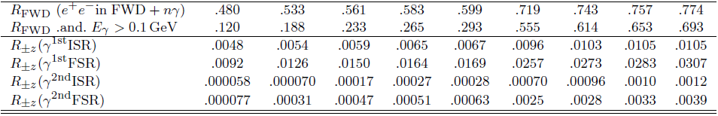
Rad-Bhabha photons e⁺e⁻ → e⁺e⁻(nγ)
Detect rad-Bhabha e⁺,e⁻, γ^{1st}, γ^{2nd}
FWD acceptance:
off-pipe φ30mm, x_{c}=±15mm, r<80mm
γ selection:
Eγ > 0.1 GeV,
opening angle Ω(e±,γ^{1st})>10 mRad
event rate in Bhabha
to both e⁺,e⁻ detected in FWD
either z-side, e± with γ^{1st} γ^{2ndt} measured
√s =10 GeV e± γ^{1st} (FSR) e± γ^{1st} (ISR)
BHWIDE
Ω(eγ)>10mR
Eγ>0.1 GeV
BHLUMI
Ω(eγ)>10mR
Eγ>0.1 GeV

Slide 14
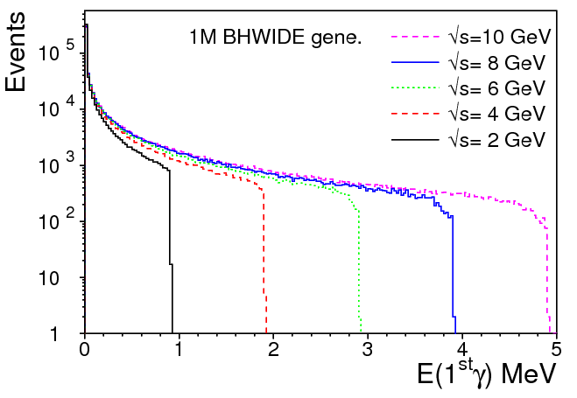
Perspective for measuring Bhabha @ STCF
BHWIDE √s = 2 – 10 GeV
scattered e± > 0.1 GeV; Ω(e⁺e⁻) : 0-π
CMS generted for σ(1-20º)
Acceptance e⁺e⁻ in FWD = 16.5%
Both e⁺e⁻ fall in FWD
event ratio with
0/nγ generated
γ^{1st} Eγ>0.1 GeV, Ω(e±,γ^{1st})>10 mR
Detected in each z-side | √s = | 10 GeV | 8 GeV | 6 GeV | 4 GeV | 2 GeV
both e⁺e⁻ in FWD | e±,0γ | 56.1 % | 57.1 % | 59.1 % | 61.6 % | 66.0 %
 | e±,nγ | 43.9 % | 42.9 % | 40.9 % | 38.4 % | 34.0 %
e±,γ^{1s} in FWD E_{γ}> 0.1GeV, Ω(e±,γ^{1st})>10mR | e±,γ^{1s} | ISR 0.63 % FSR 1.69 % | ISR 0.64 % FSR 1.62 % | ISR 0.58 % FSR 1.47 % | ISR 0.50 % FSR 1.26 % | ISR 0.40 % FSR 0.94 %

Slide 15
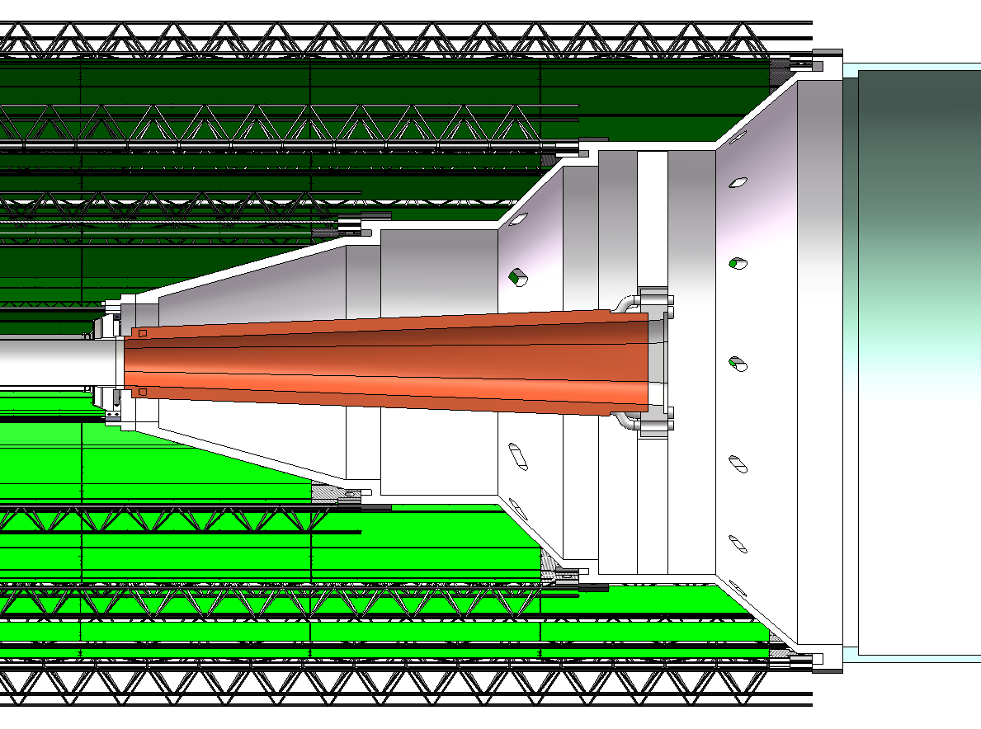
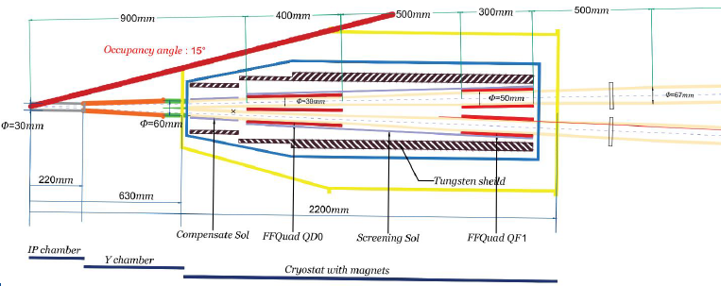
Forward Calorimeter @ STCF
60 – 240 mRad (3.4º-14º), Z = 350 – 500 mm
Precision QED radiative Bhabha to better than 10⁻³
e/γ by Si-det + Crystal
2D, Si strip, 50 μm pitch
LYSO, 2x2 mm², 50 mm long

Slide 16
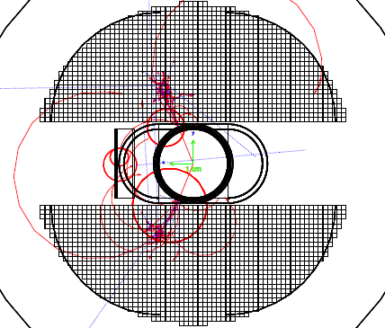
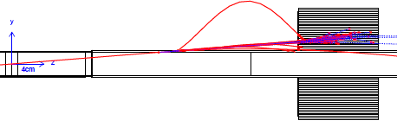
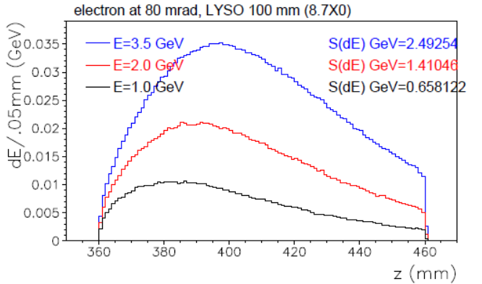
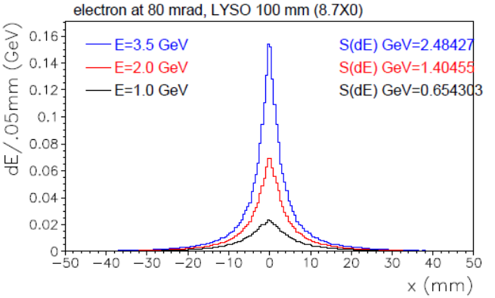
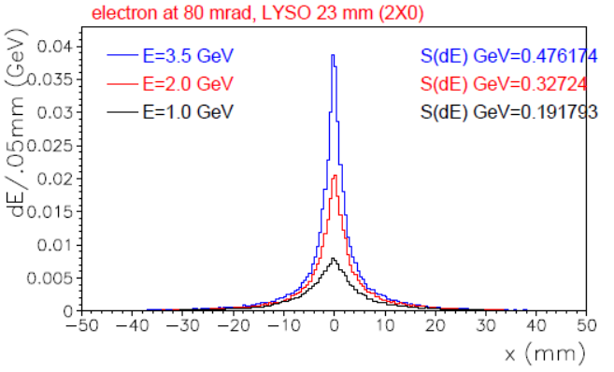
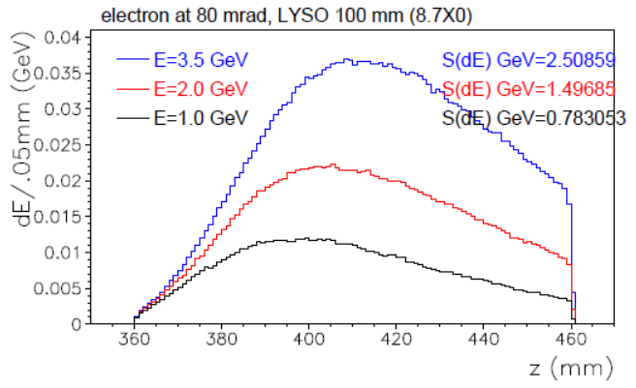
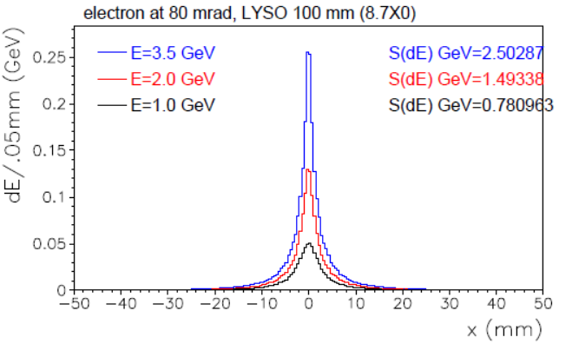
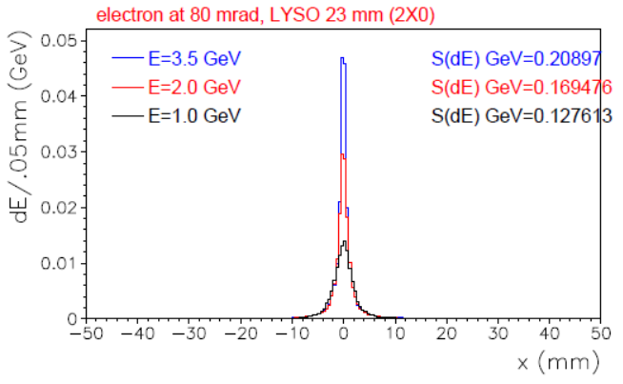
GEANT
3.5 GeV e⁻ 80 mrad passing 2 mm Cu pipe (1.84 X⁰)
Preshower occurs
Cu 2mm pipe 1.74 X0 @80mrad, Sum dE/dx per event
8.7 X0
2 X0
1.74 X0
Al 2mm pipe 0.28 X0 @80mrad
0.28 X0
8.7 X0
2 X0

Slide 17






2 mm Be pipe, mini pipe materials
Be pipe to minimize electron shower
in forward/tracking volume
Si before LYSO,
No. of incident charge tracks in Si : 1.18/e-
Most secondaries <10 MeV
>100 MeV cut ➔ 1% contamination
1.183 charged tracks
per electron
E of charged
secondaries
3.5 GeV e⁻ 60mrad, 2 mm Be pipe (0.094 X⁰)
Be 2mm pipe 0.071 X0 @80mrad, Sum dE/dx per event
0.071X0

Slide 18
Discussion
Proposal for detecting QED radiative photons
Forward Bhabha high statstics
Better than 10-3 prevision
Forward detector within ITKM cone
Si + LYSO for e/γ measurements
Be beam pipe
Minimized preshower
minimum upstream background to tracking volume

