Slide 1



Accelerating Data Processing for the PandaX-20T Experiment
Zhiqing Huang 黄芷晴
Shanghai Jiao Tong University
July 2, 2026

Slide 2
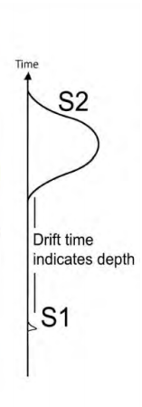
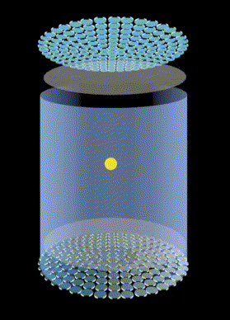
PandaX: Searching for Dark Matter and Neutrinos
Searches for dark matter and neutrinos
Uses a dual-phase xenon time projection chamber (TPC)
Detects S1 and S2 light signals

Slide 3
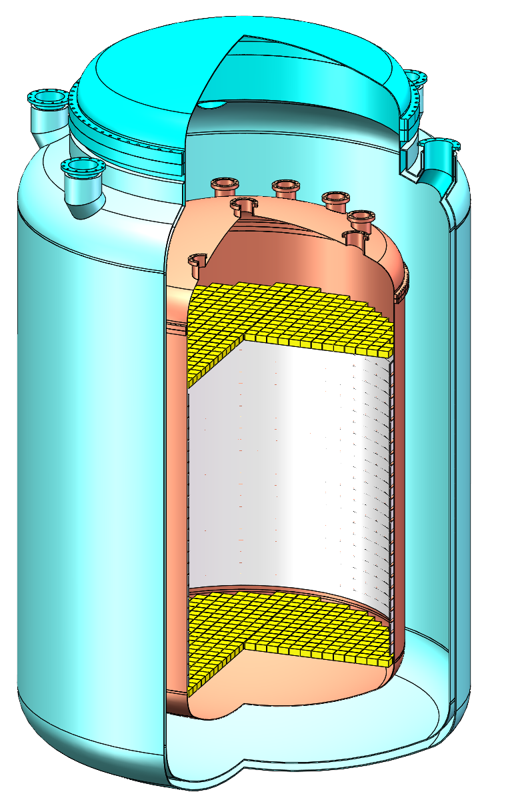
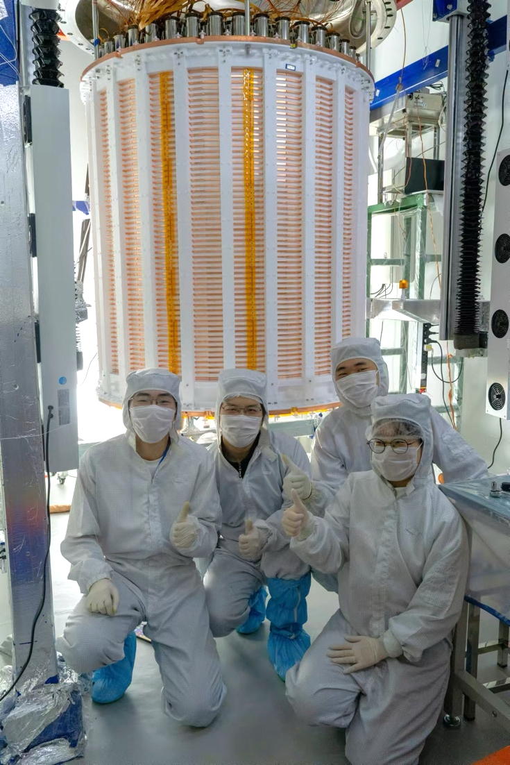
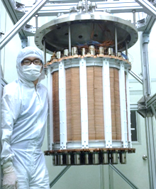
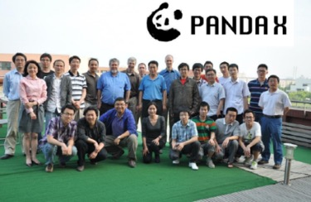
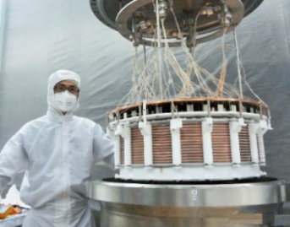
PandaX Pathway
Increasing sensitive target volume
Lowering radioactive background
PandaX-xT
20 tonne -> 47 tonne
PandaX-4T
3.7 tonne
PandaX-II
580 kg
PandaX-I
120 kg
PandaX initiated
2009
2010-2014
2015-2019
2020-2026
2027-

Slide 4
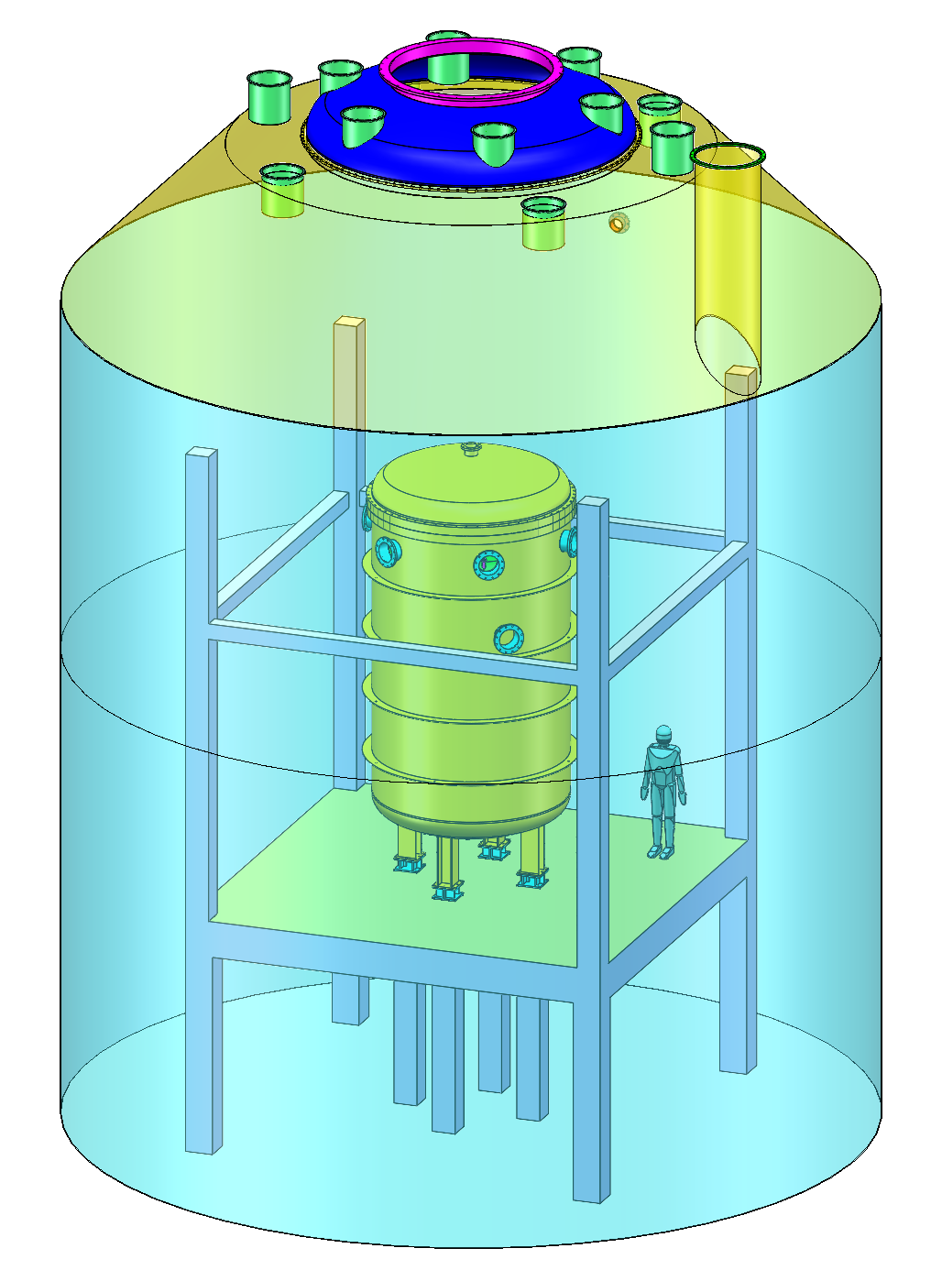
PandaX-20T Overall Design
• Dual-phase liquid xenon TPC
• ~3000 PMT readout channels
2-inch PMTs on top, 3-inch PMTs on bottom
• Titanium cryostat with liquid-scintillator veto
• Ultrapure water shielding and veto

Slide 5
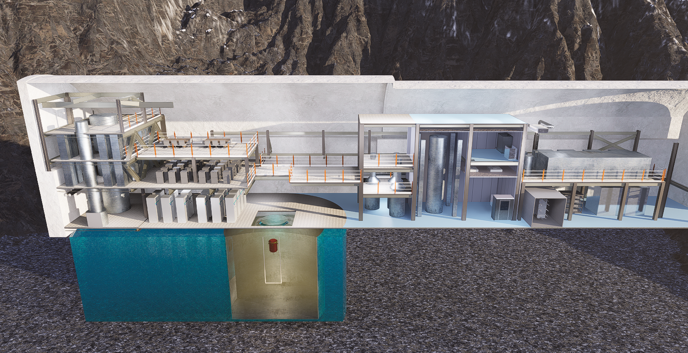
Layout of Infrastructure Renovation at CJPL
Cryogenics and recirculation
Electronics and DAQ
Liquid xenon storage
Rn removal system
Distillation tower
Rn-free clean room
Ultra-pure water system

Slide 6
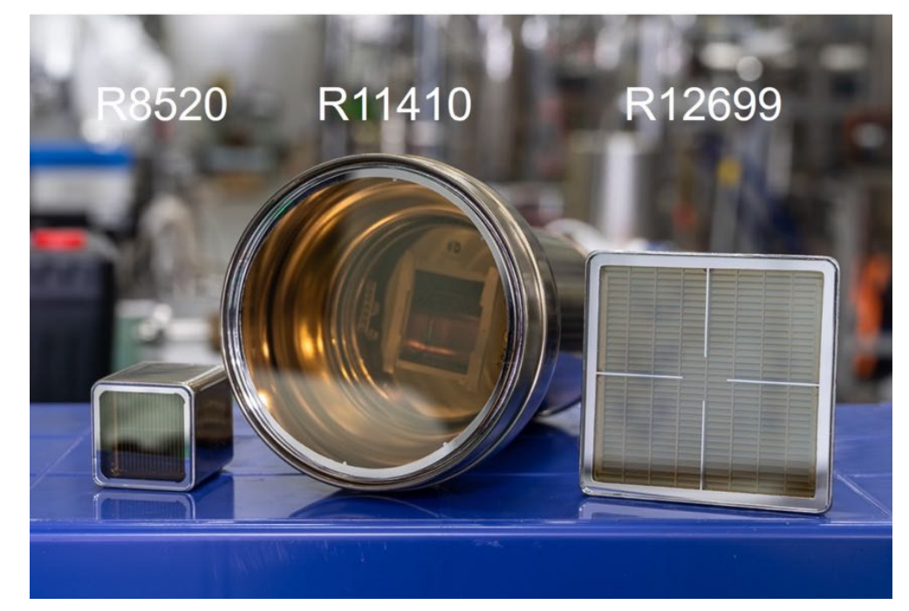
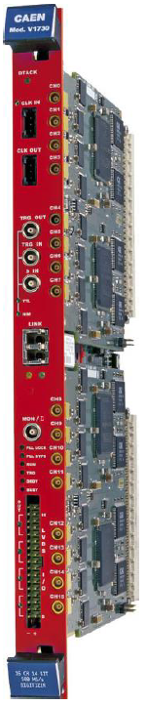
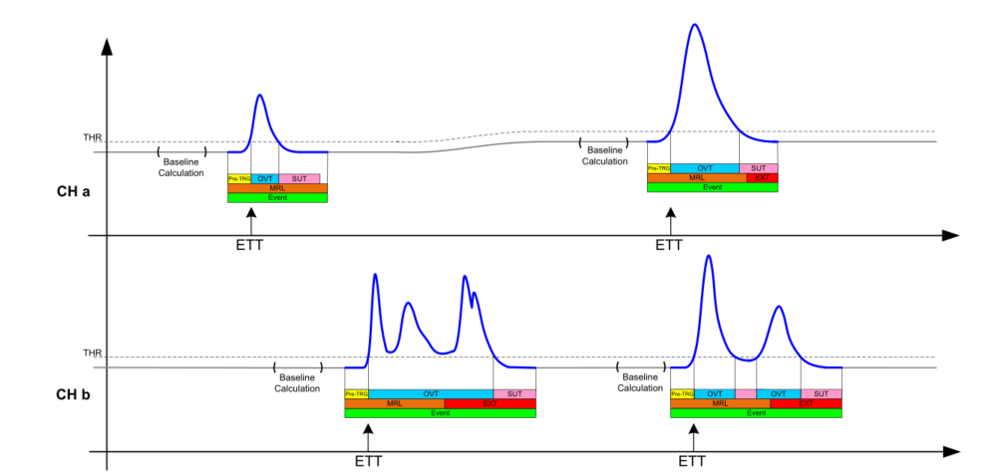
What Data Is Recorded
~3000 PMT channels
Digitizer
Self-triggered readout
Initial stage: 300 MB/s
Calibration runs: up to 1.6 GB/s
Can the DAQ keep up with this data rate?

Slide 7
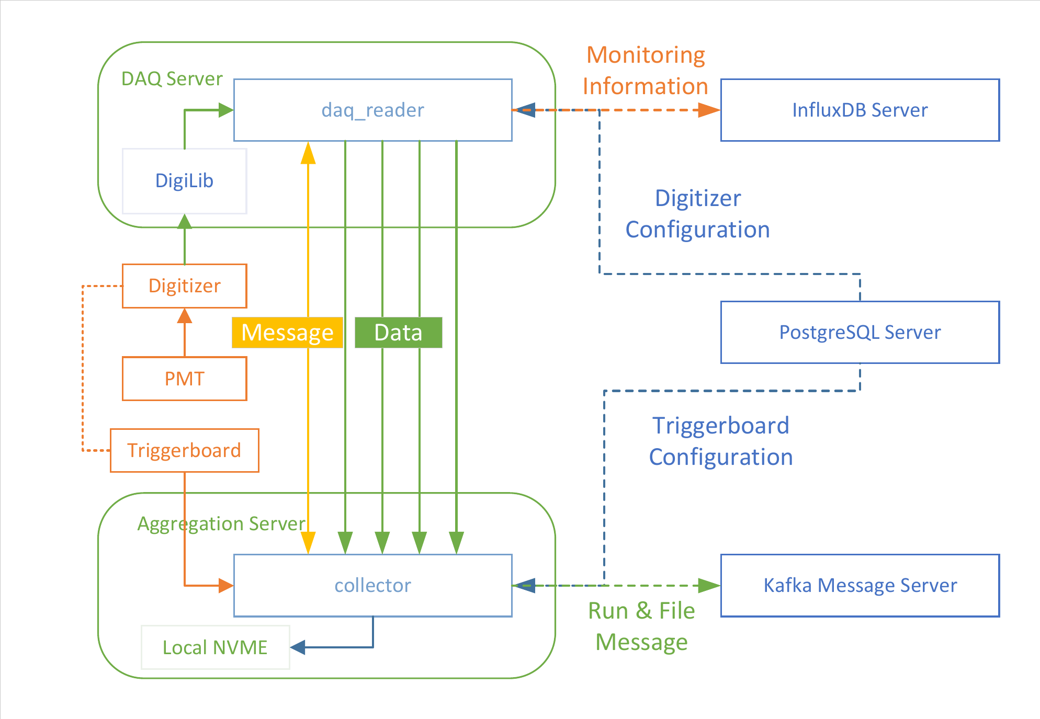
Adaptable Unified Real-time Online Readout Architecture (AURORA)
New framework AURORA is built for 20T

Slide 8
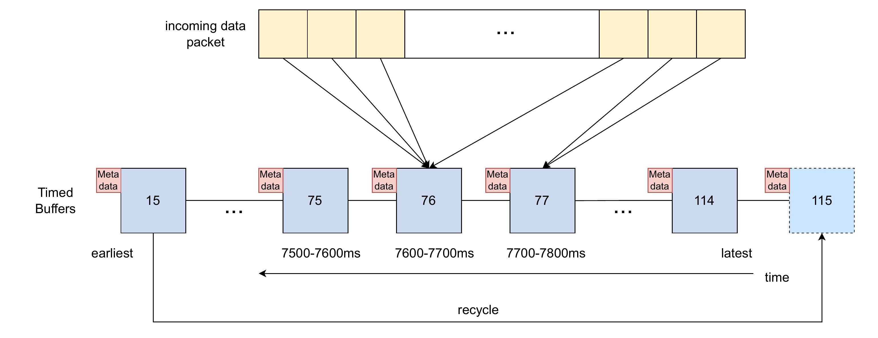
Buffers shift with time
Fixed number of timed buffers for data package storage
Delayed sorting and output

Slide 9
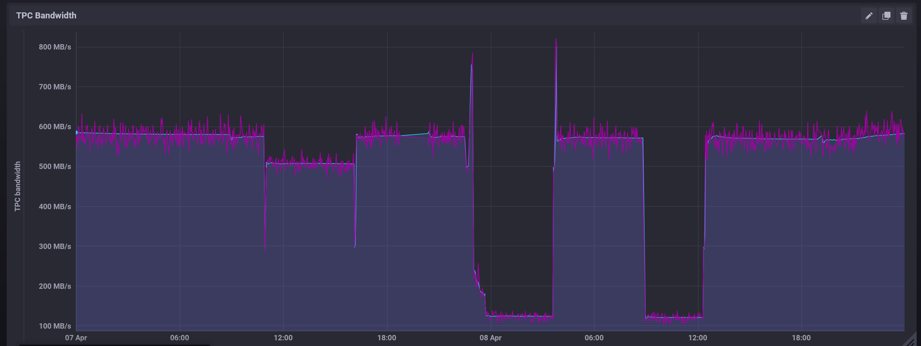
Performance of AURORA
Performance results
  Benchmarks confirm >3 GB/s throughput for key steps
  Maintained 1.4 GB/s sustained throughput with zero data loss
Recent data taking of PandaX-4T
Deployed in the final PandaX-4T high-rate calibration campaigns as well as in the TDLI test platform

Slide 10
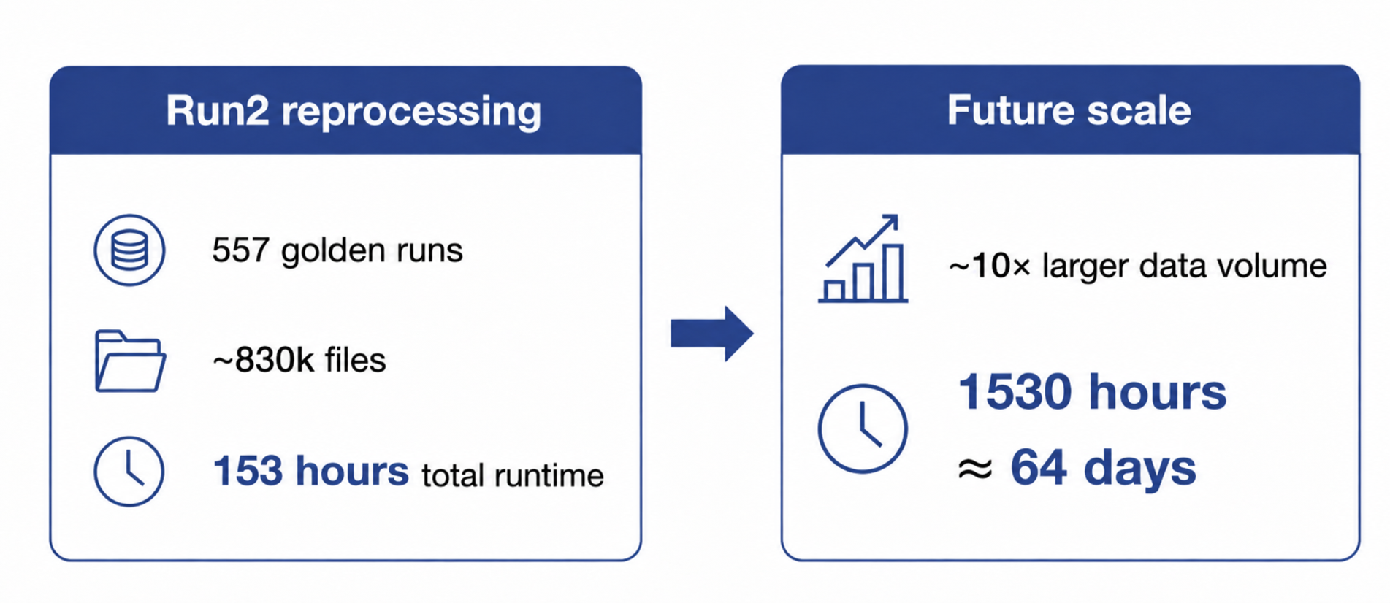
Scaling Challenge for Data Reconstruction

Slide 11
Data Processing and Reconstruction Flow
Raw data
Signal data
Physical event data
Physical event ROOT
  Calibration
  Hit finding
  Clustering
  Signal building
  Signal tagging
  Signal pairing
  Convert to ROOT
For physics analysis

Slide 12
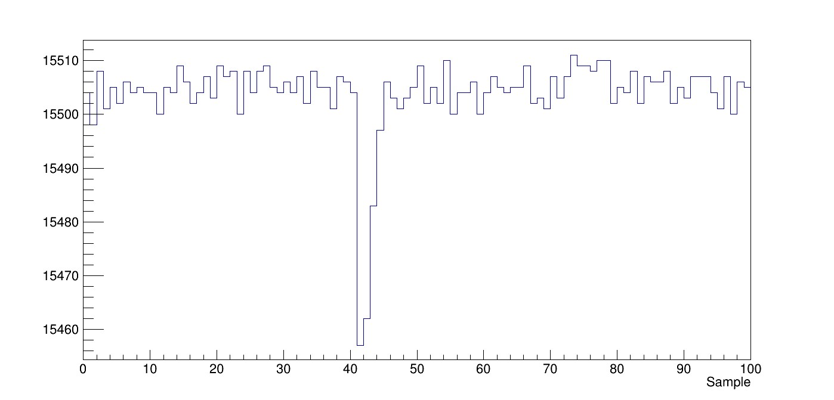
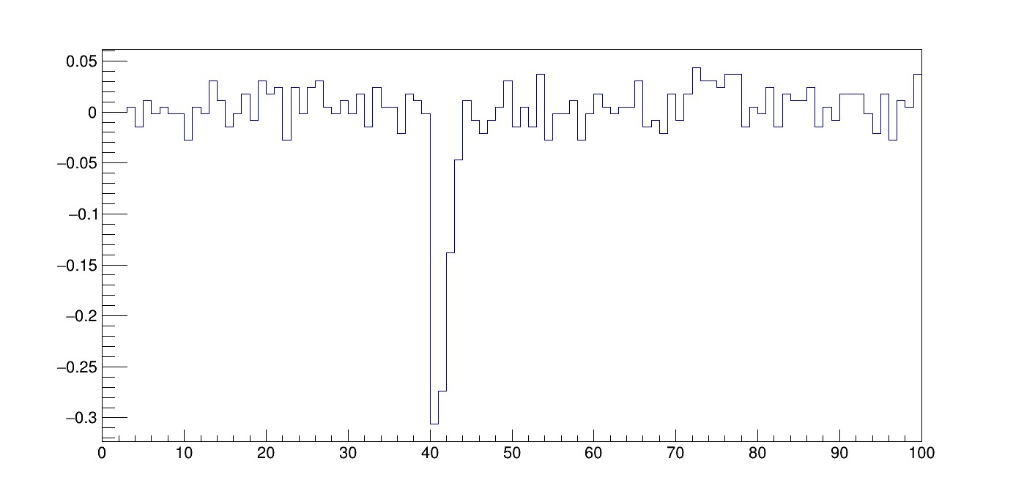
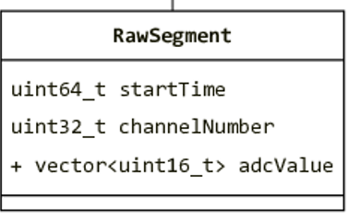
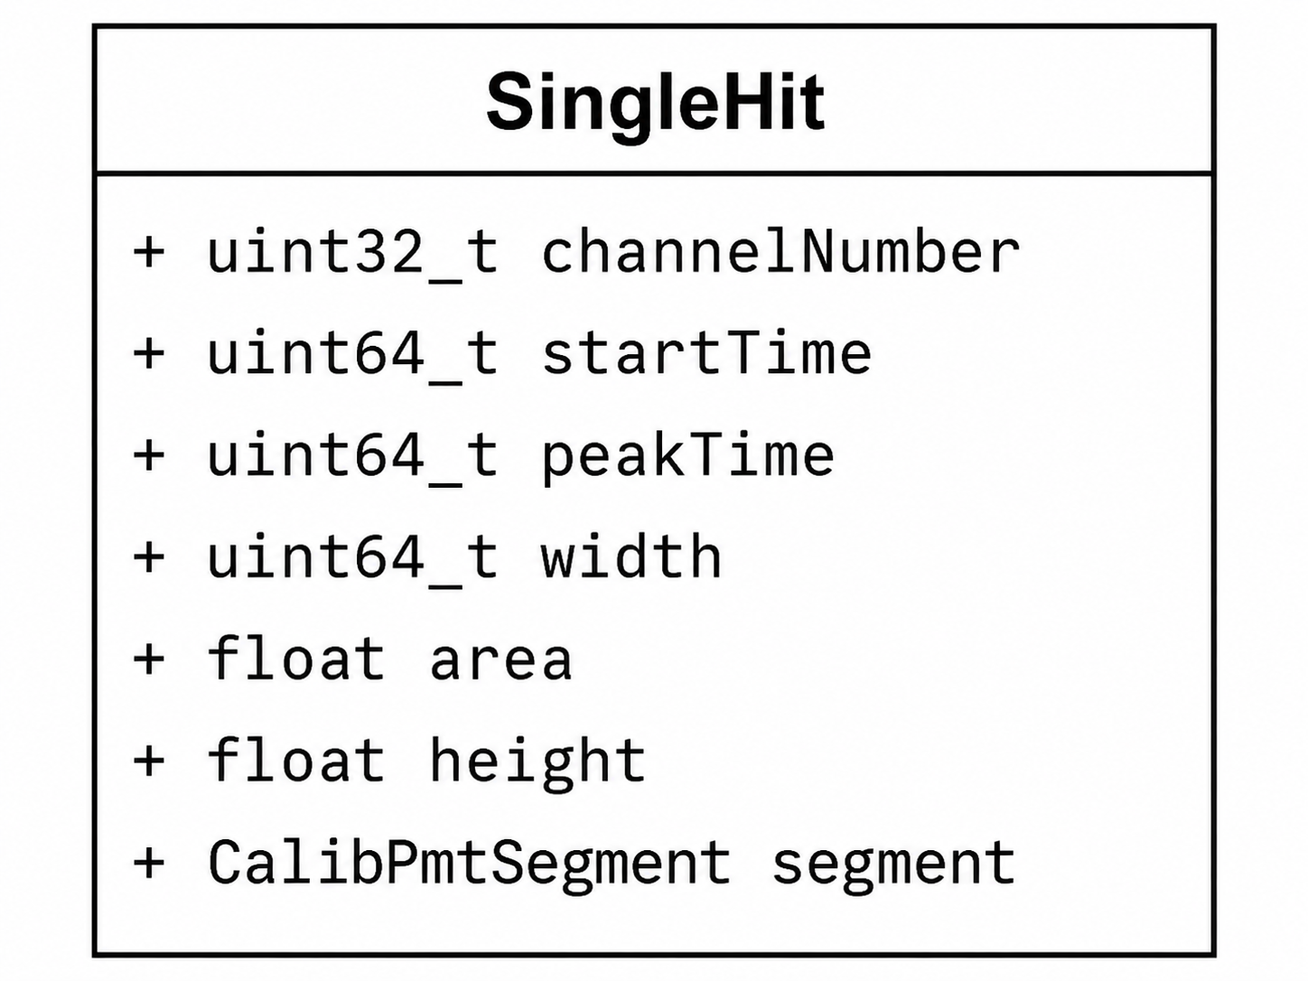
Waveform Calibration and Hit Finding
Calibration
• Baseline subtraction
• Gain correction
• Timing correction
Hit finding
• Threshold-based pulse search
• Area, height, width calculation
raw
calibrated

Slide 13
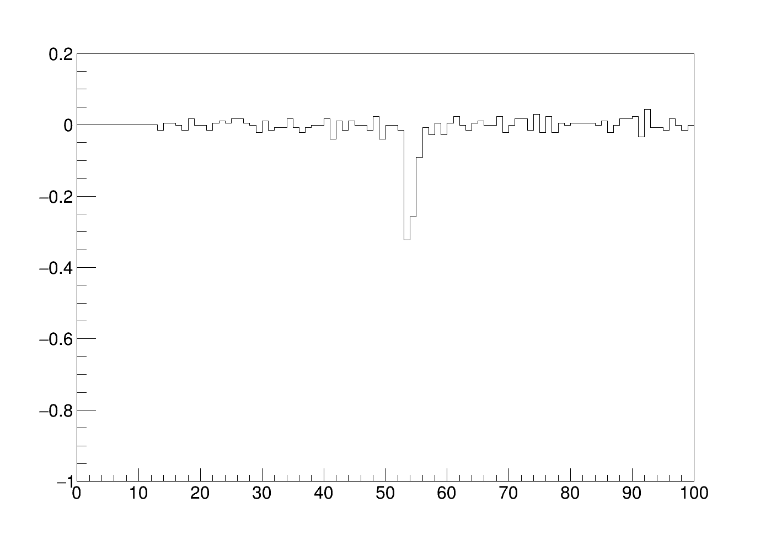
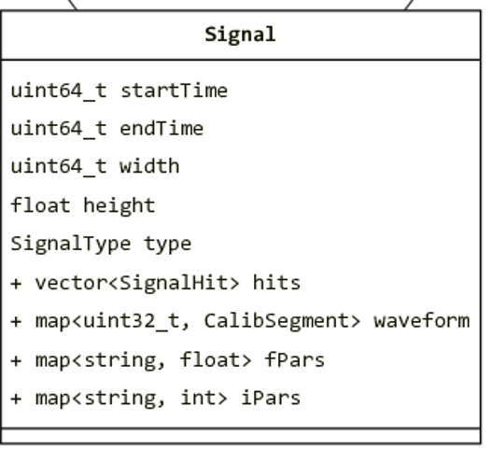
From Hits to Tagged Signals
Signal building
Build aggregate waveforms
Calculate charge, height, width, etc.
Hit clustering
Group nearby hits in time
Signal tagging
Identify S1, S2, Sparking, etc.

Slide 14
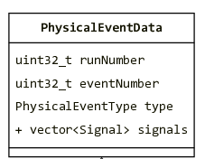
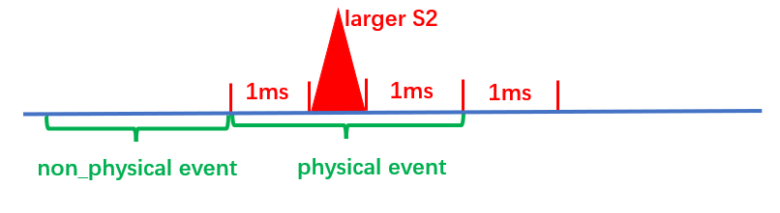
Physical Event Building
Input: continuous, time-ordered tagged signals
Dominant S2 defines a drift-time event window
Signals inside the window form a physical event
S2

Slide 15
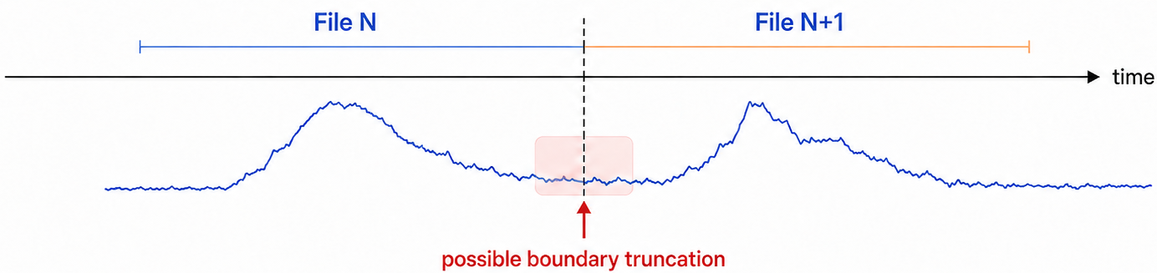
Why Redesign P4-Chain Processing?
File-boundary effects
File-by-file processing may split or truncate signals near file boundaries.
Processing speed
Larger data volume increases reconstruction workload.

Slide 16
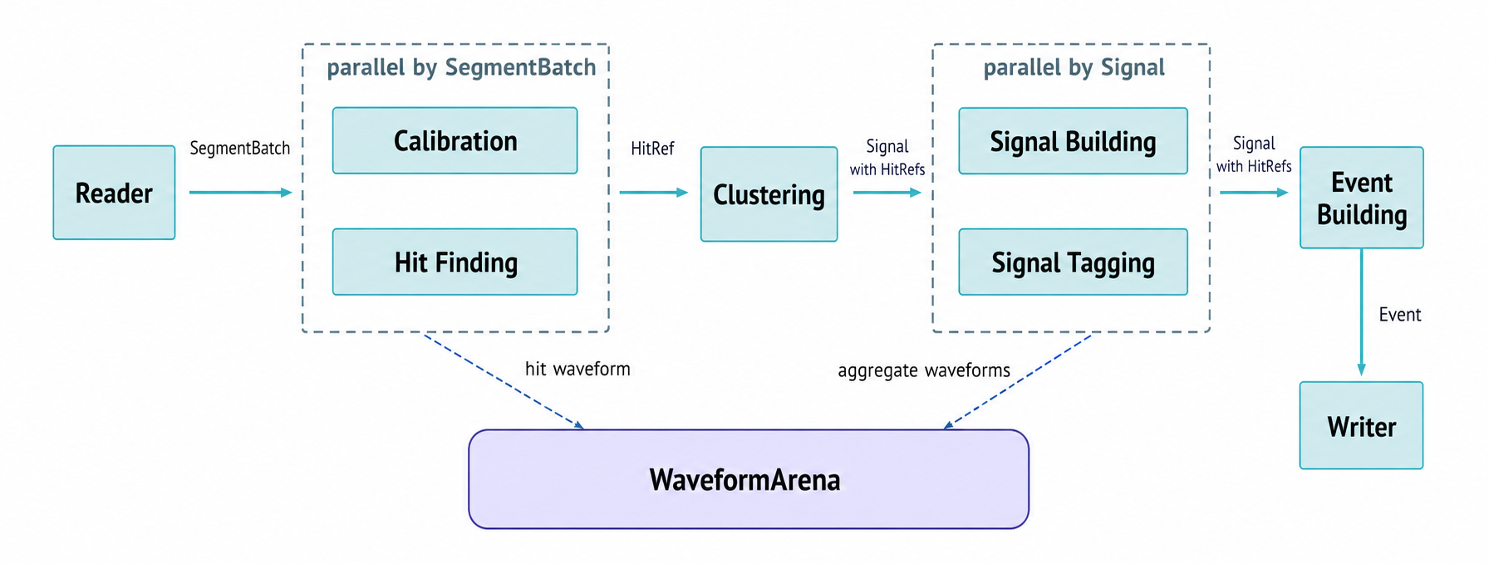
Run-Based Streaming Parallel Pipeline
Run-based streaming input
Parallelize independent reconstruction steps
Ordered clustering and event building

Slide 17
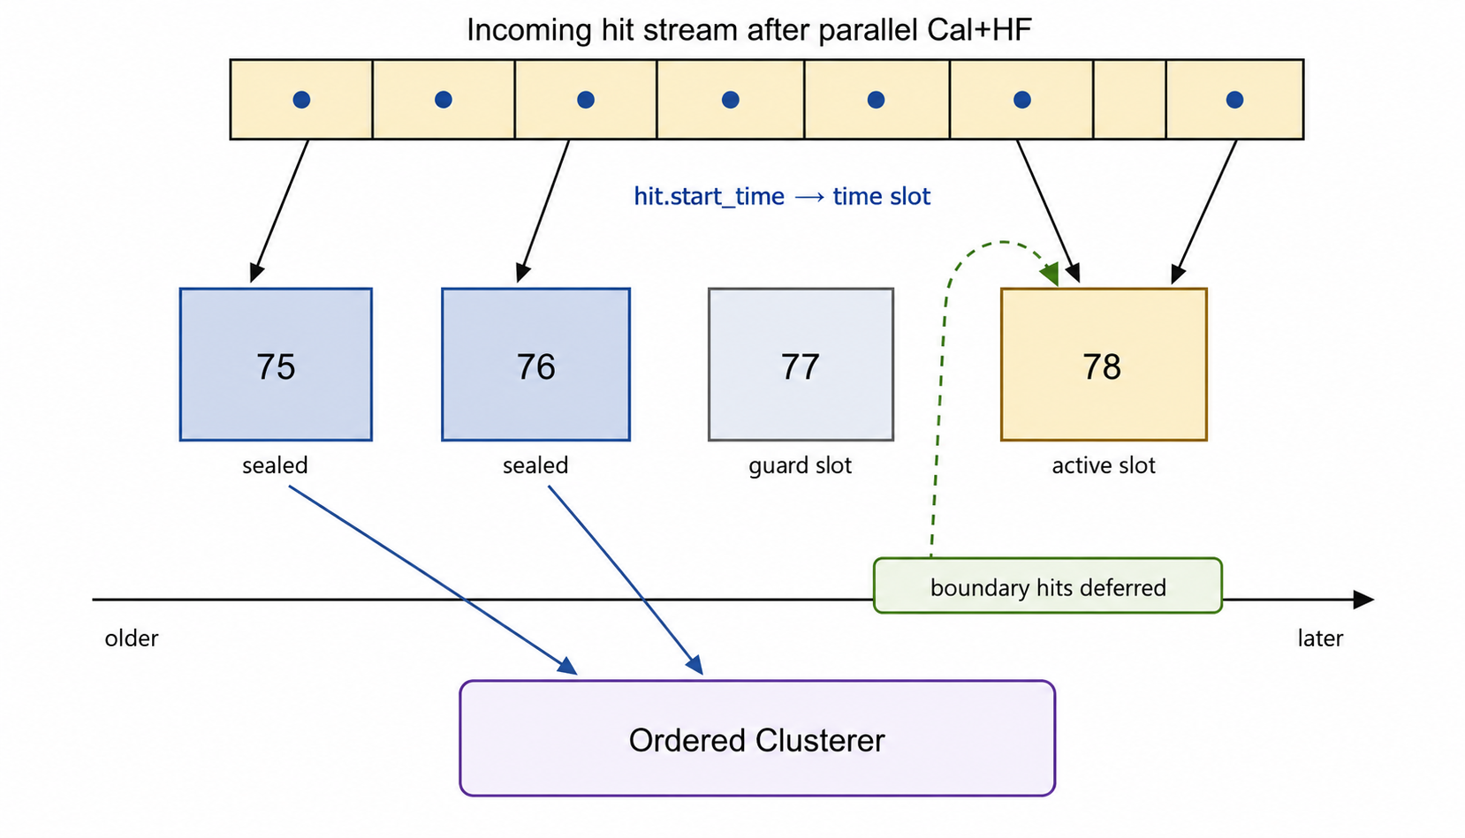
Time-Ordered Hit Dispatch
hit stream
...
slot
...
...
75-76ms
76-77ms
77-78ms
78-79ms
time
Clustering
time-ordered hits
hit scale: ~10 ns
time
gap > threshold
Signal 1
Signal 2
signal scale: ~10–100 ns

Slide 18
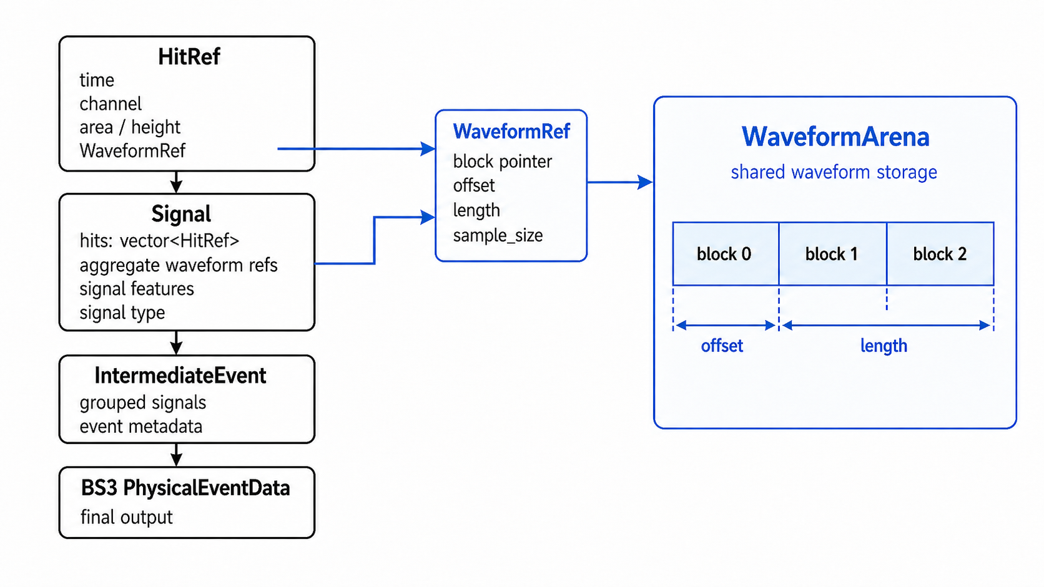
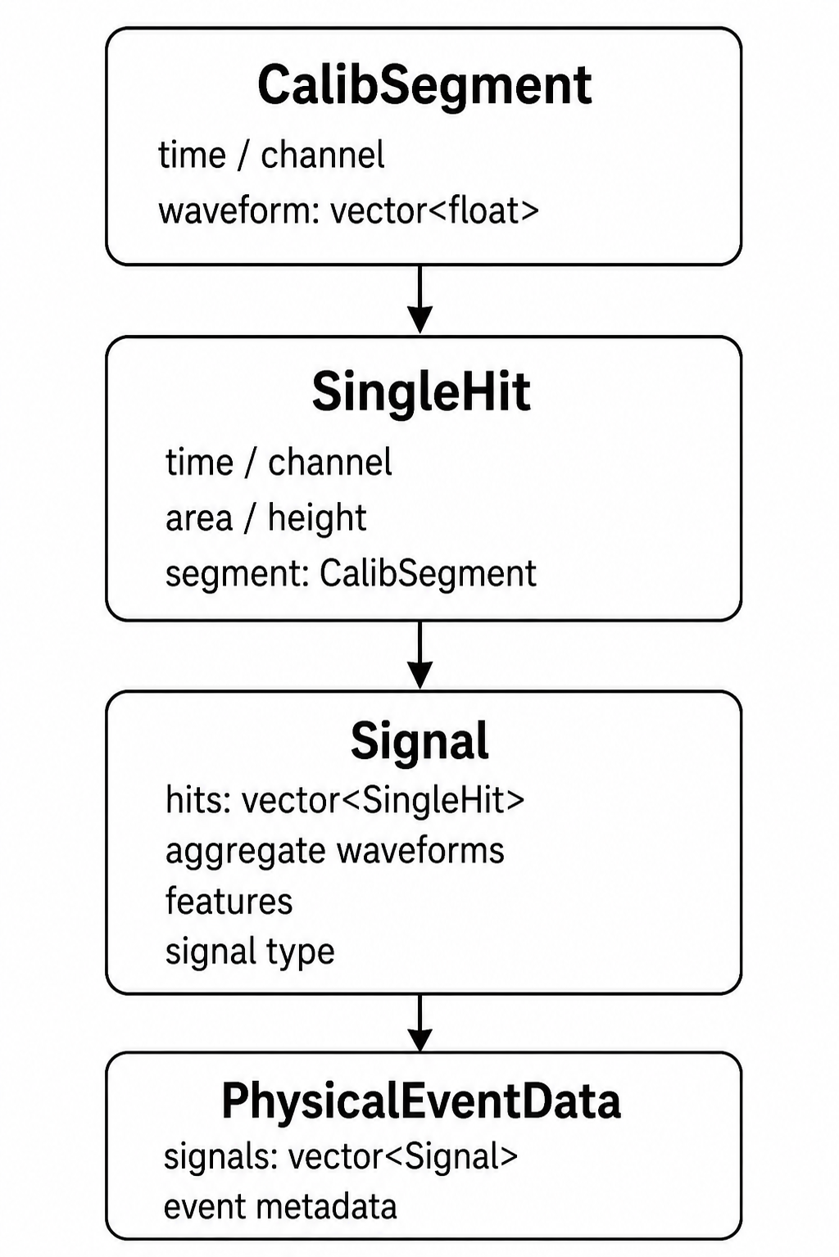
Lightweight Internal Representation
Lightweight objects in the hot path
WaveformRef avoids repeated waveform copies
BS3 objects are built only at the output boundary

Slide 19
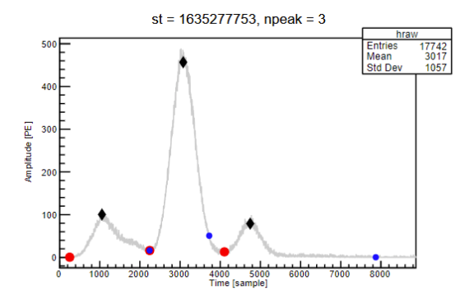
Signal Division

Slide 20
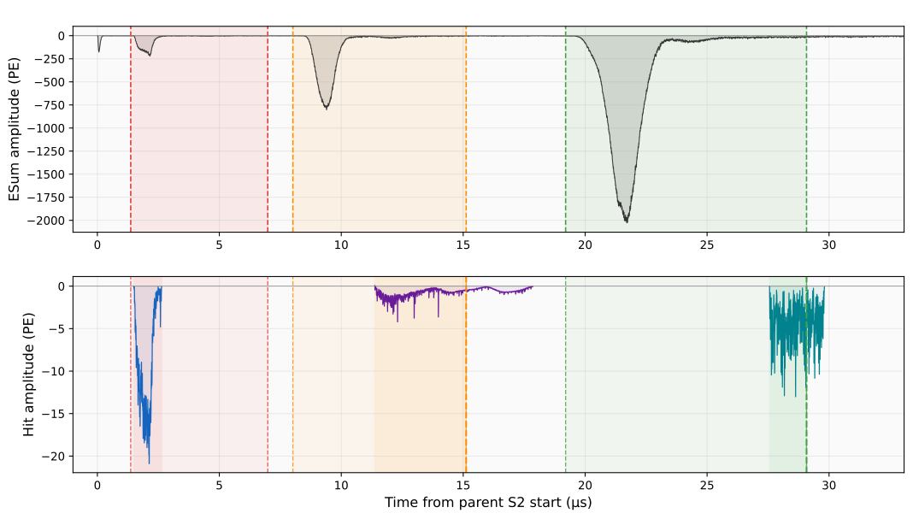
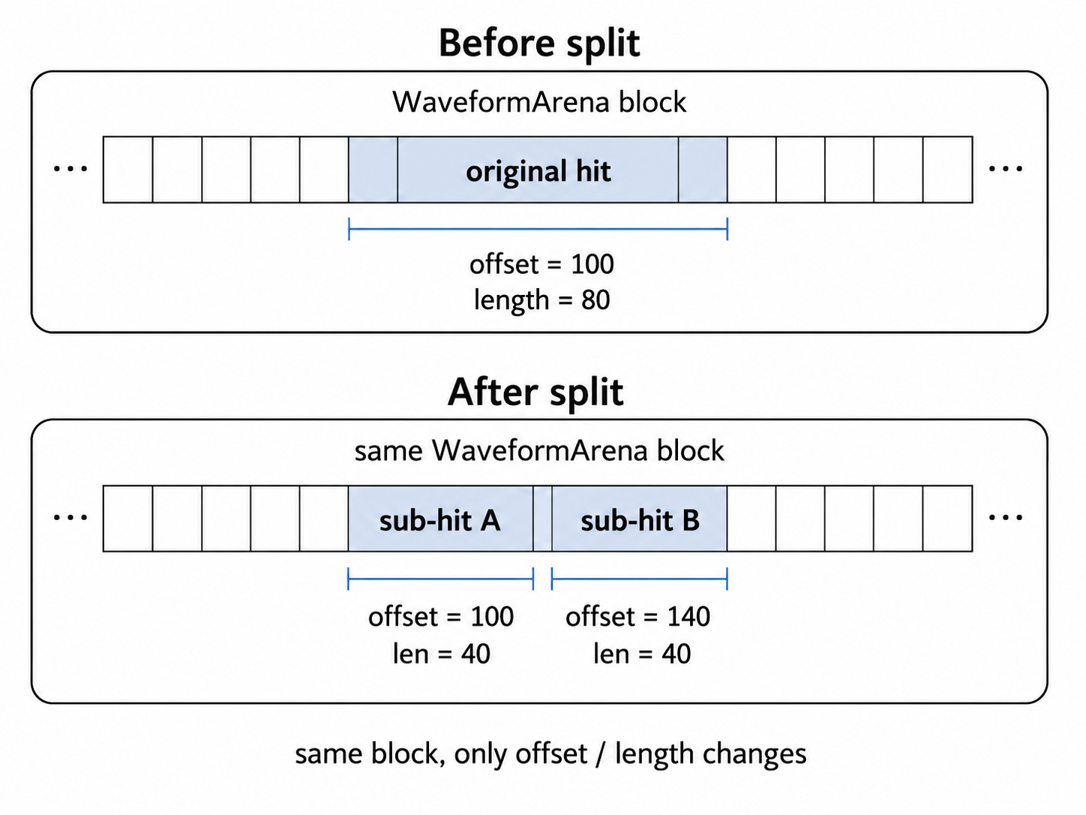
Faster Signal Division with WaveformRef
Old HitSplit
• Copies waveform slices
• Rebuilds split-hit objects
• Requires extra container mutation
New HitSplit
• Updates WaveformRef offset / length
• Avoids waveform sample copy
sub-signal 1
sub-signal 2
sub-signal 3
hit 1
hit 2
hit 3
offset = 100 length=80
offset = 100 length=40
offset = 140 length=40

Slide 21
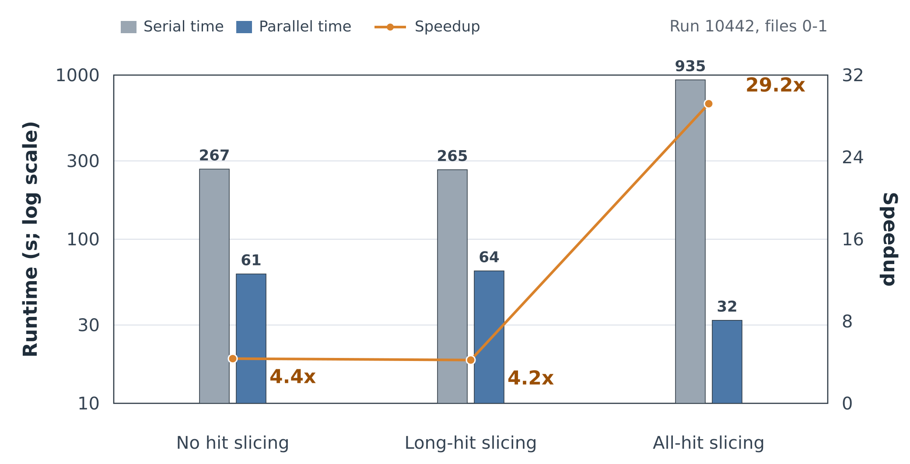
Validation and Performance Improvement
Validation
Consistent with the original P4-Chain output.
Performance
Significant speedup observed
~3 CPU cores utilized
Peak memory below ~1.1 GB

Slide 22
Summary and Outlook
Summary
PandaX-20T requires faster and more scalable reconstruction.
P4-Chain was redesigned into a run-based streaming parallel pipeline.
Validation and benchmarks confirm consistency and speedup.
Outlook
• Online supernova neutrino alert
• Real-time data quality monitoring

Slide 23
Thank you for your attention!

