Slide 1


STCF基于RDataFrame并行物理分析框架
杨莹 李腾 黄性涛
山东大学
STCF 2026
2026.7.2
Notes:
Hello, everyone. My name is Yang Ying .Thank you for joining me. The topic I am reporting on is “STCF Parallelized Analysis Framework”

Slide 2

01 研究背景
02 物理需求和框架设计
目录
03 应用与验证
04 性能检测
Notes:
I've divided my talk into Four sections:

Slide 3
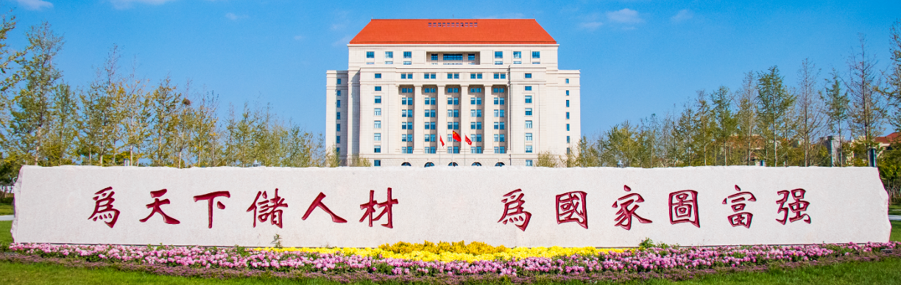
1
研究背景
Notes:
First section :Motivation

Slide 4
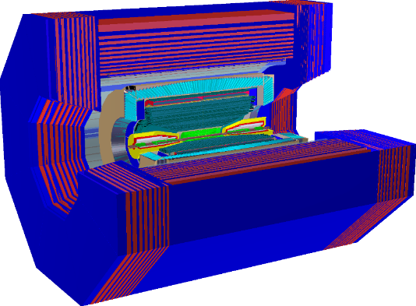
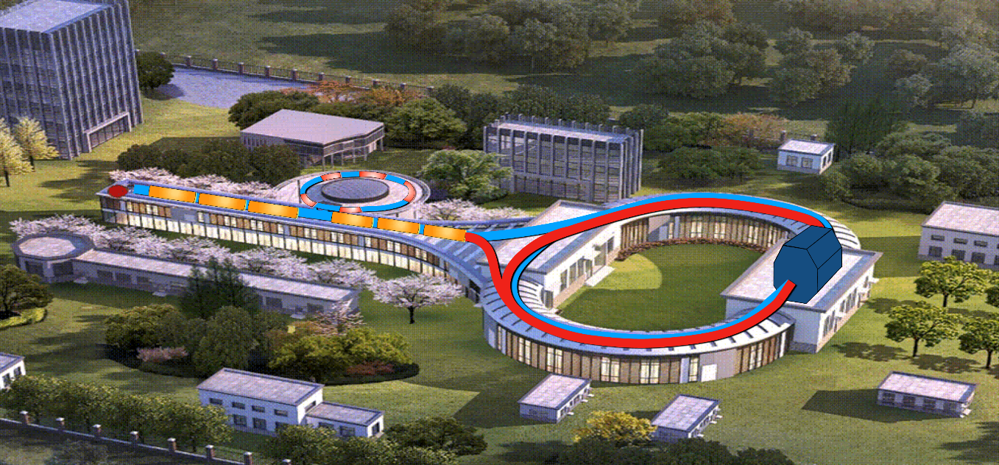

STCF(Super Tau Charm Facility)
物理目标：精确测量τ轻子、粲夸克相关物理过程。
核心参数：能量范围覆盖 2 - 7 GeV，峰值亮度高达0.5$×{10}^{35}$ ${cm}^{−2}s^{−1}$。
数据挑战：海量数据实时产生，每年原始数据量达数百PB级。
Notes:
The super τ-charm facility (STCF) is an electron−positron collider proposed by the Chinese particle physics community. It is designed to operate in wider energy range from 2 to 7 GeV with higher peak luminosity of zore poit five multiply ten to the thirty-five cm−2·s−1 or higher. It is about one hundred higher than BEPCII.The STCF will produce a data sample about a factor of 100 larger than that of the present τ-charm factory — the BEPCII, providing a unique platform for exploring the asymmetry of matter-antimatter (charge-parity violation), in-depth studies of the internal structure of hadrons and the nature of non-perturbative strong interactions, as well as searching for exotic hadrons and physics beyond the Standard Model. Its total trigger rate as well as the data rate are expected to be approximately 400 kHz and 30.4 GB/s respectively
数百PB量级

Slide 5
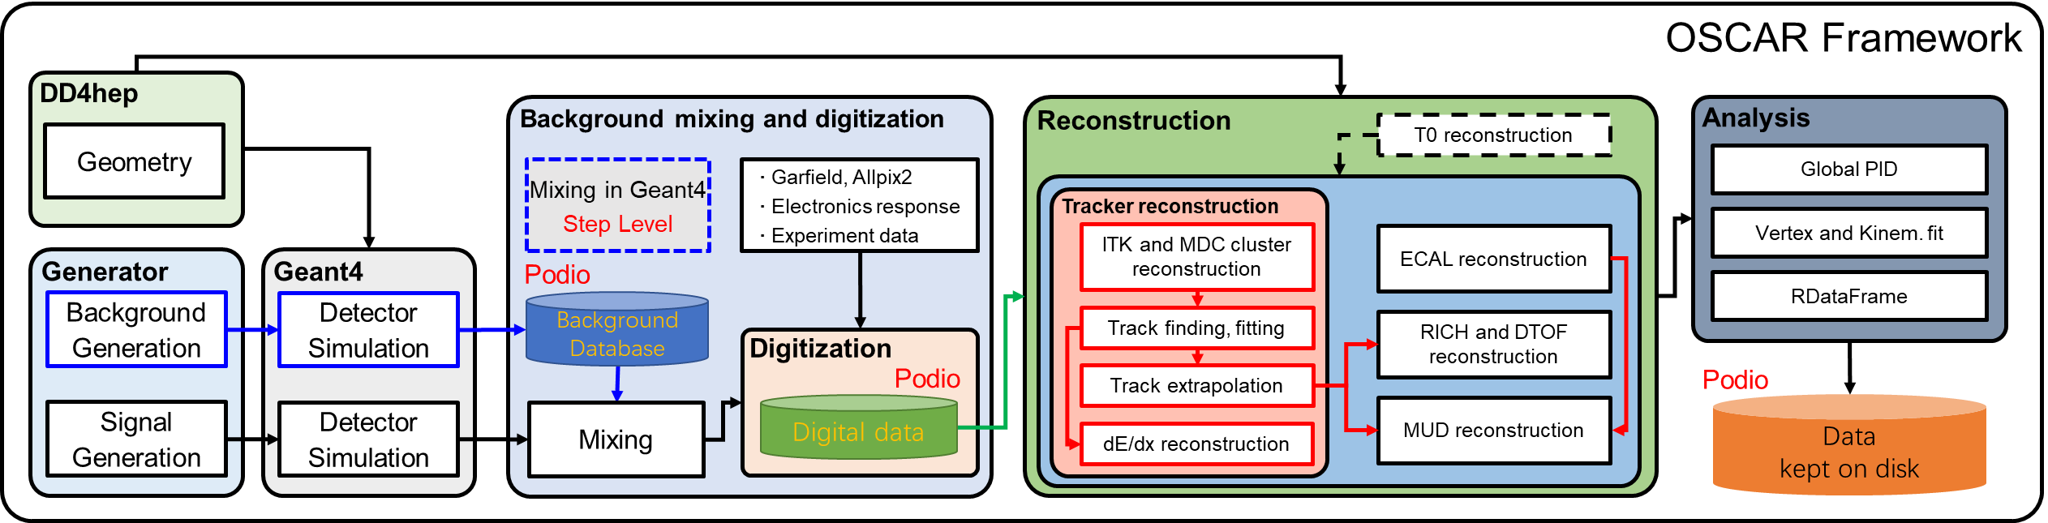
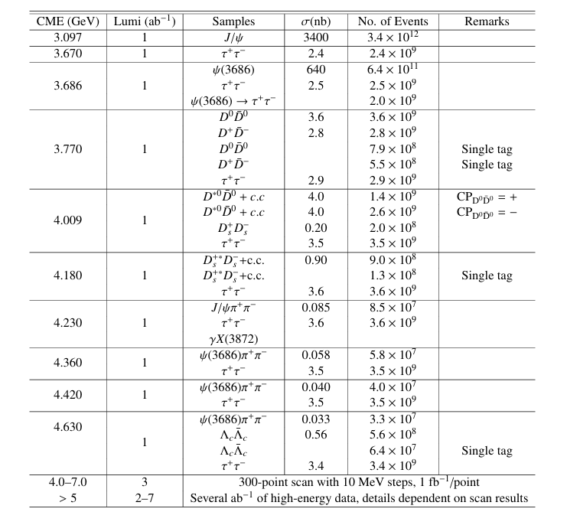
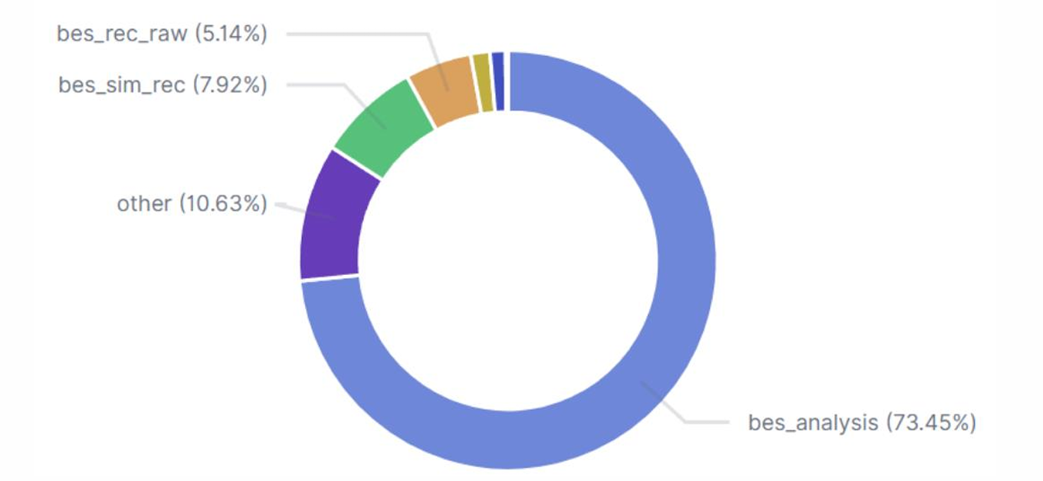
OSCAR(Offline Software for Super Tau-Charm Facility)
OSCAR ：
覆盖从探测器模拟、本底混合数字化到数据重建的完整离线处理链路。
核心挑战一：物理分析中海量数据的高效处理
  传统串行模式失效，需构建高并发并行分析框架，突破I/O瓶颈与算力调度限制，保障物理分析数据处理时效性。
核心挑战二：高精度物理结果
  顶点拟合等算法计算密集，需优化底层实现与资源分配，在有限算力下确保结果的精度与可靠性。
2024年BESIII计算资源使用情况
BES 图片来源：
https://indico.ihep.ac.cn/event/22334/contributions/157038/attachments/78289/97385/BESIII_Offline_Software_Chengdu_202405.pdf
Notes:
According to the design of the STCF, wider Energy Range,higher luminosity ,higher total trigger rate and data rate,and to achieve physics goals, Offline Software System of Super Tau-Charm Facility (OSCAR) is designed .Now ,OSCAR can implement Detector Simulation,Digitization and Background Mixing
,Reconstructionraw .The whole data processing chain has been built. Physics Analysis as the last but not least step for STCF .It faces unprecedented large amount of data to analyze .From this pictue ,we can see the number of events from STCF will almost reach ten to the eight ,even reach ten to the twelve.As I said last silde we also faces unprecedented precision measurement to achieve.Processing large amounts of data has become a new challenge!
物理分析中的占用时间和占比

Slide 6
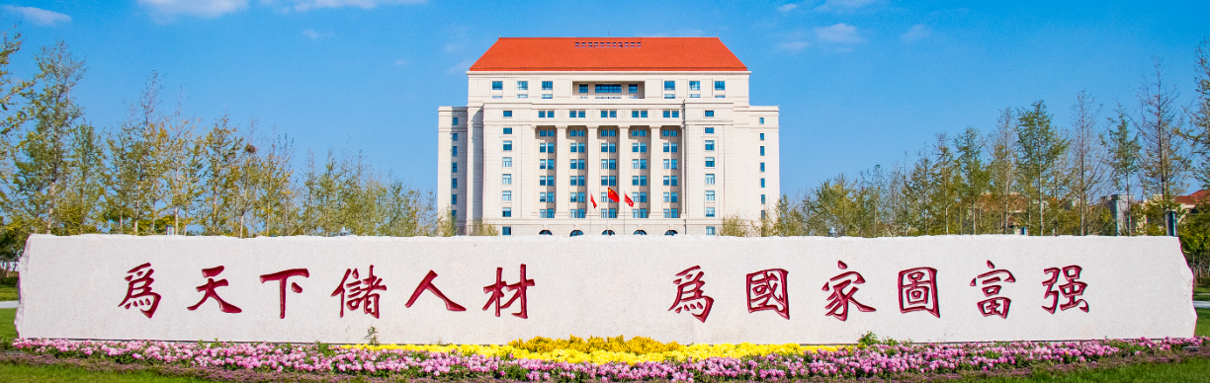
2
物理需求和框架设计

Slide 7

需求分析
挑战与目标
📊 挑战：海量数据
面对PB级实验数据，处理效率亟待提升
🎯 目标：高精度结果
确保物理分析的准确性与可重复性
💾 存储兼容
无缝处理ROOT数据文件
💻 硬件适配
多核CPU与GPU：充分利用并行算力
技术选型
ROOT::RDataFrame
CERN ROOT库中的模块
软件集成
分析工具复用：灵活接口
👤 用户易用
极简交互：透明化处理

Slide 8

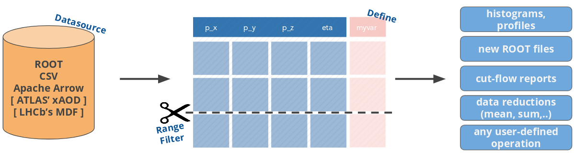
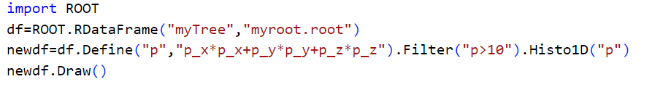
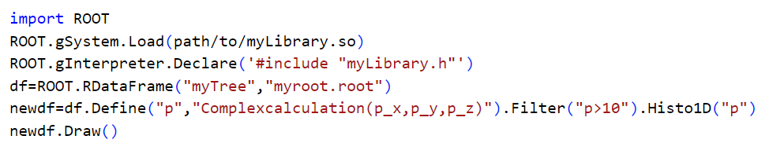
ROOT::RDataFrame:声明式编程
声明式编程模型：用户只需描述数据分析的目标（“做什么”），无需关心底层数据遍历、循环控制等具体实现（“怎么做”）。
传统函数编程
便捷访问 ROOT 数据
用户透明
便于集成
Notes:
极致简化开发：大幅减少样板代码，让代码结构更清晰，极大降低了分析代码的编写难度与后期维护成本。
聚焦物理逻辑：解放用户精力，使其专注于物理分析本身的逻辑构建，而非底层编程细节。

Slide 9
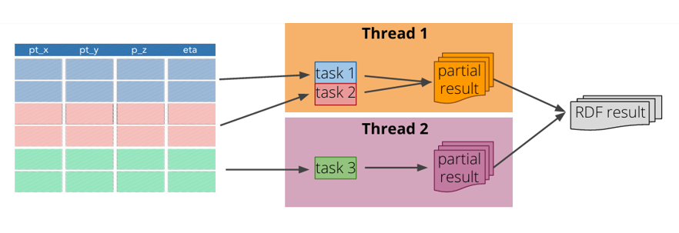
ROOT::RDataFrame:并行实现
Intel TBB 内核调度：内部集成Intel TBB并行库，实现任务的动态拆分与智能调度。
多核自动并行化：任务自动分发至CPU多核心执行，充分利用硬件资源提升计算效率。
零并行代码成本：用户无需掌握并行编程，现有代码自动获得并行加速能力。
多线程并行
Notes:
Second ,RDataFrame supports parallel computing.It divides data into different chunks.Then based on code we write ,it generate tasks and submit different thread. And task scheduling is done by Intel Threading Building Blocks (TBB library).
To trun on parallel computing ,we only need a single global switch ROOT::EnableImplicitMT();So RDataFrame meet all us requirements.

Slide 10
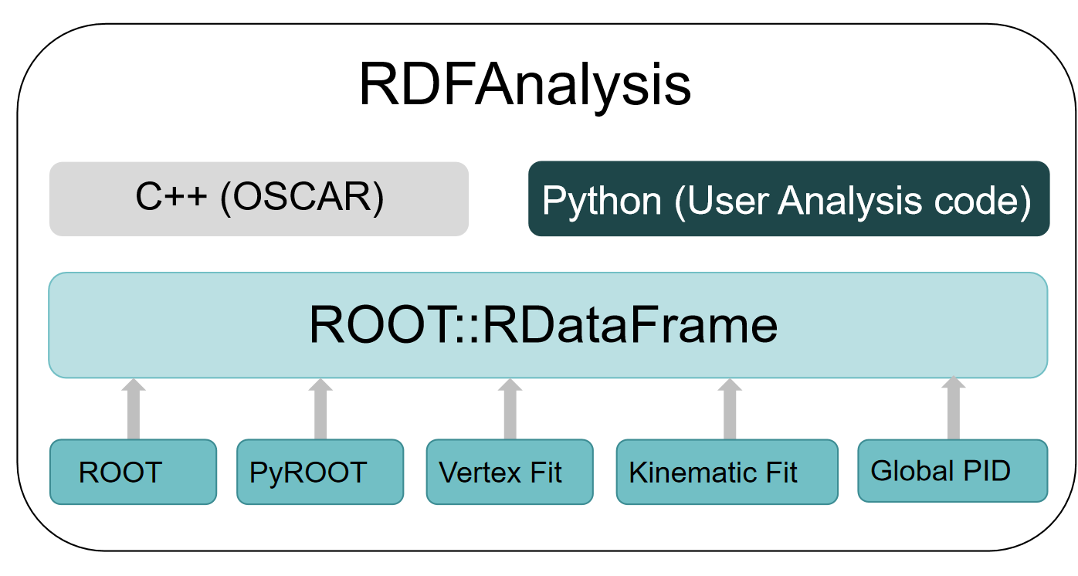
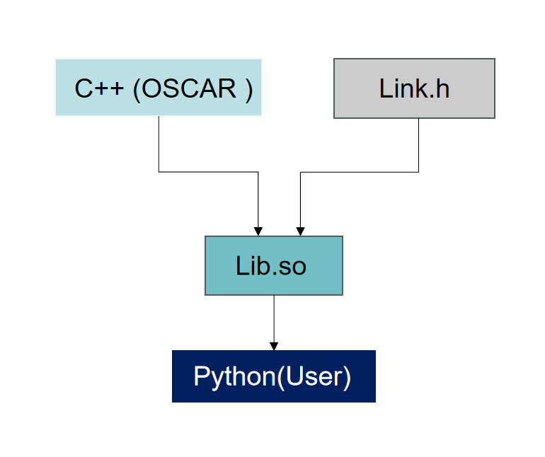
RDFAnalysis (RDataFrame analysis framework)
双语言支持：同时提供高性能 C++ 底层接口与简洁易用的 Python 上层接口，兼顾计算效率与开发灵活性。
核心物理工具集成：封装 Vertex Fit、Kinematic Fit、GlobalPID 核心高能物理分析工具。
混合编程范式兼容：完美融合传统函数式编程与现代声明式编程风格，适配不同开发者场景需求。
Notes:
Based on RDataFrame ,we bulid analysis framework RDFAnalysis for STCF. We use C++and Python programming .Users use python , while the underlying functions use C++.We have linked vertex Fit and Kinematic Fit tools. The method we used is by combining declarative programming with traditional functional programming .Use Dynamic Library to achieve in python use C++code.
OCSAR（C++）和用户程序（Python）

Slide 11
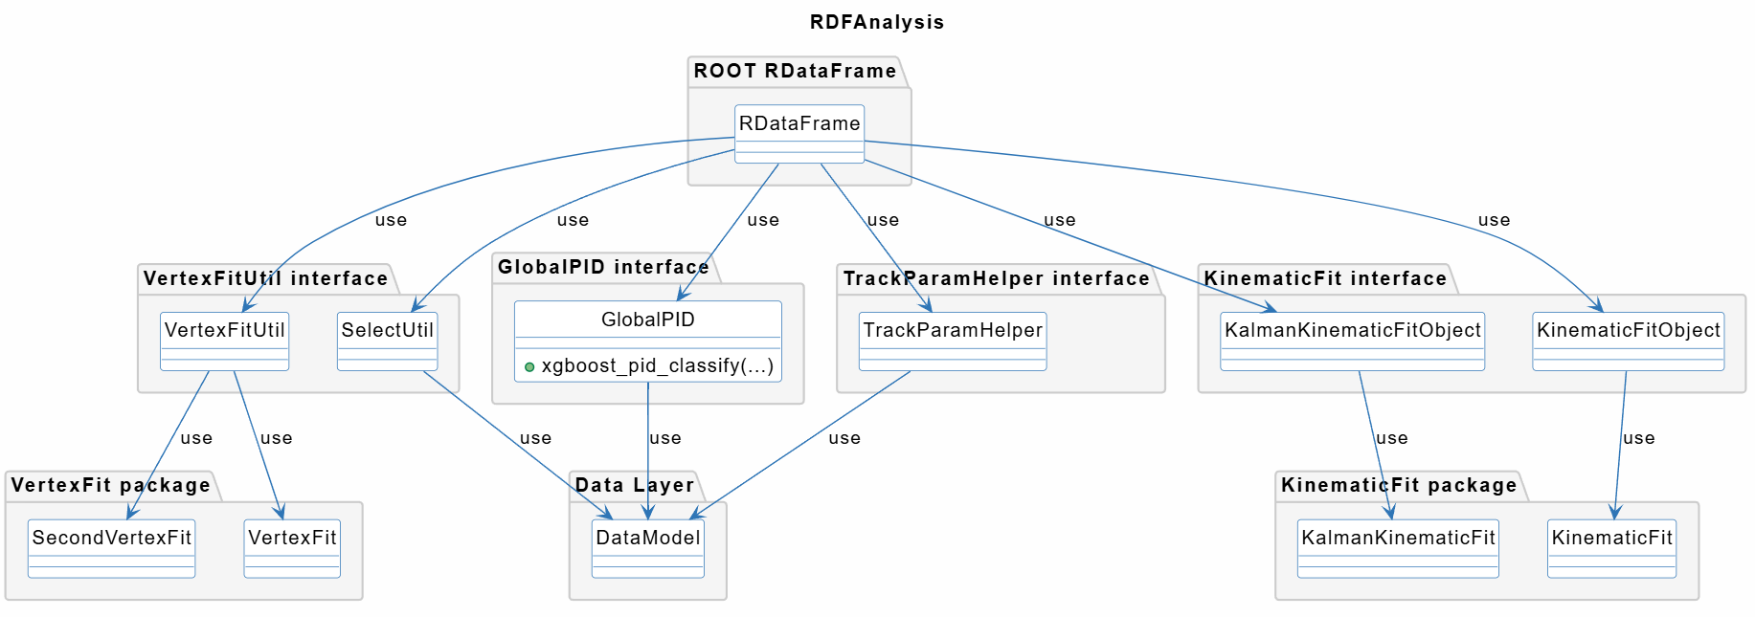
RDFAnalysis 接口设计
TrackParamHelper：封装径迹数据结构，提供便捷的径迹参数访问，简化物理量调用流程。
VertexFitUtil：集成顶点拟合核心算法，提供用户接口。
KinematicFit：实现运动学约束拟合功能，提供用户接口。
GlobalPID：特征值提取，融合多种探测器信息，获得五粒子鉴别概率。

Slide 12
RDFAnalysis 接口设计: KinematicFit VertexFit
OSCAR
Jacobian
matrix
Track:
Pos and mom of first rec hit and its cov matrix
Track:
Helix parameters and its cov matrix
STCF
RecData
Obj layer
WTrackParameter
pos
4-mom at poca
err matirx
Vertex fit and Kinematic fit
Photon:
Position and energy in calorimeter
Poca:Point of Closest Approach
RDFAnalysis
Track :
data transformation
same as OSCAR
Track:
WTrackParameter
Get Fit Object
Fit
STCF
RecData
Data layer
Parameter Extraction
Photon:
Position and energy in calorimeter
Vertex Fit and Kinematic Fit
Photon:
AddTrack interface
Notes:
So based on interfaces design in OSCAR , we design RDFA interfaces. In oscar , track and photo parameter are from Object layer to achieve vertexfit and kinematic fit.The biggest difference between RDFAnalysis and OSCAR is data access layer .So we design parameter extraction method from Data layer. Next prossecc is same as OSACR.Then in Vertex Fit and Kinematic Fit ,for Track we design get_WTrackParameter interfaces for photo we add AddTrack interface to Get Fit Object and Fit.

Slide 13
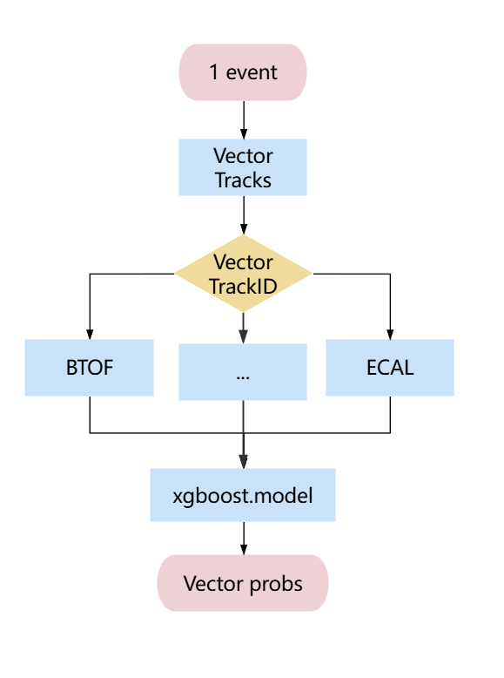
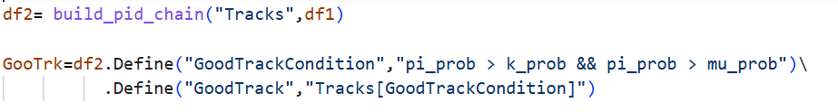
RDFAnalysis 接口设计：GlobalPID
在探测器数据中，每条径迹都有一个唯一的 `TrackID`
GlobalPID 通过 `TrackID` 将不同探测器的数据关联起来
获取每条Track对应的dEdX, BTOF，DTOF，MUD，ECAL，Track信息
提取特征值传入模型
得到PID鉴别结果：5粒子概率
用户使用示例
传入需要做PID鉴别的径迹
定义好径迹条件
应用条件到径迹中
Notes:
Baesd on physics analysis process ,total interfaces can be divided into three parts . select vertex Fit and Kinematic Fit.
such as Track selection interface select_chargeTrack ,users can set range of momentum and particle id in Oscar from 0-4 is e,u,pi,k,p. and get track index

Slide 14
3
应用举例与验证

Slide 15
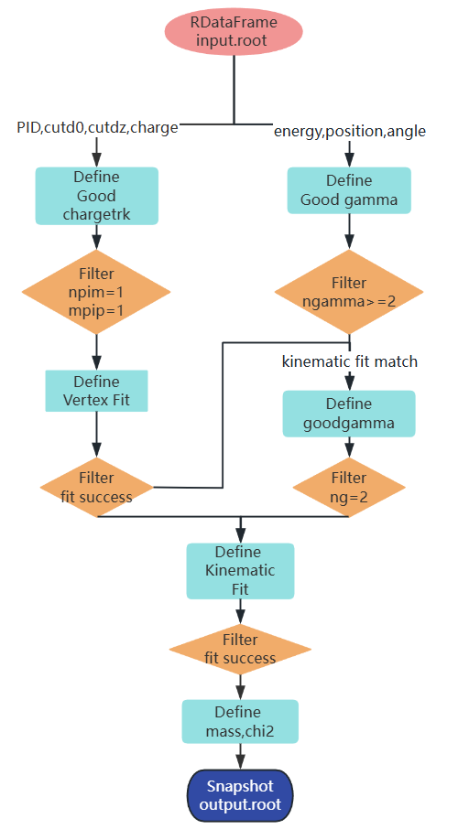
分析算法示例： $J/ψ→ρπ^{0}→π^{−}π^{+}γγ$
物理分析流程图
核心代码片段
# 1. 环境配置与初始化
config = {"input_file": "...", "model_path": "...", "thread":4}
set_model_path(config["model_path"])
ROOT.EnableImplicitMT(config["thread"])
# 2. 数据读取 (RDataFrame)
df = ROOT.RDataFrame("events", config["input_file"])
# 3. 径迹选择 & PID分析
df1 = build_track_chain(df, 2)
df2 = build_pid_chain("TrackerRecTrackCol", df1)
# 4. 好径迹筛选 (π⁺π⁻)
df3 = df2.Define("GoodPimtrk", "...pi_prob > k_prob...")\
.Define("GoodPiptrk", "...pi_prob > k_prob...")\
.Define("Pip", "TrackerRecTrackCol[GoodPiptrk]")\
.Define("Pim", "TrackerRecTrackCol[GoodPimtrk]")\
.Filter("Pim.size() == 1 && Pip.size() == 1")
# 5. 顶点与运动学拟合
df4 = df3.Define("pimwtrk", get_wtrack("Pim[0]", 2))\
.Define("pipwtrk", get_wtrack("Pip[0]", 2))
df6 = df4.Define("vertexfit", get_vfit("pipwtrk", "pimwtrk"))\
.Filter("vertexfit.Fit(0)")
df7 = df6.Define("kfit", "KinematicFitObject(3.097, ...)")\
.Filter("kfit->Fit()")
# 6. 结果输出
df7.Snapshot("events", "output.root", ["m_mrho_afterfit", ...])
Global PID
设置筛选径迹条件
应用筛选径迹条件
数据类型转换WTrackParamter
https://git.ustc.edu.cn/oscar1/rdfanalysis
Notes:
Good track信息

Slide 16
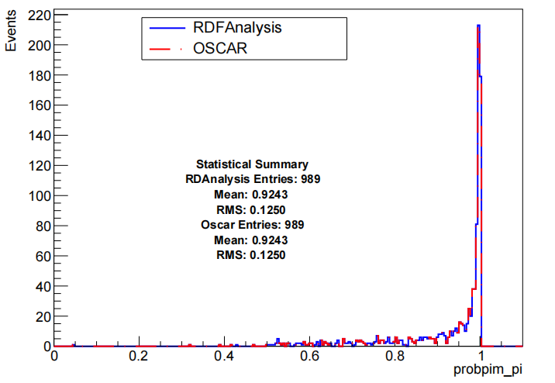
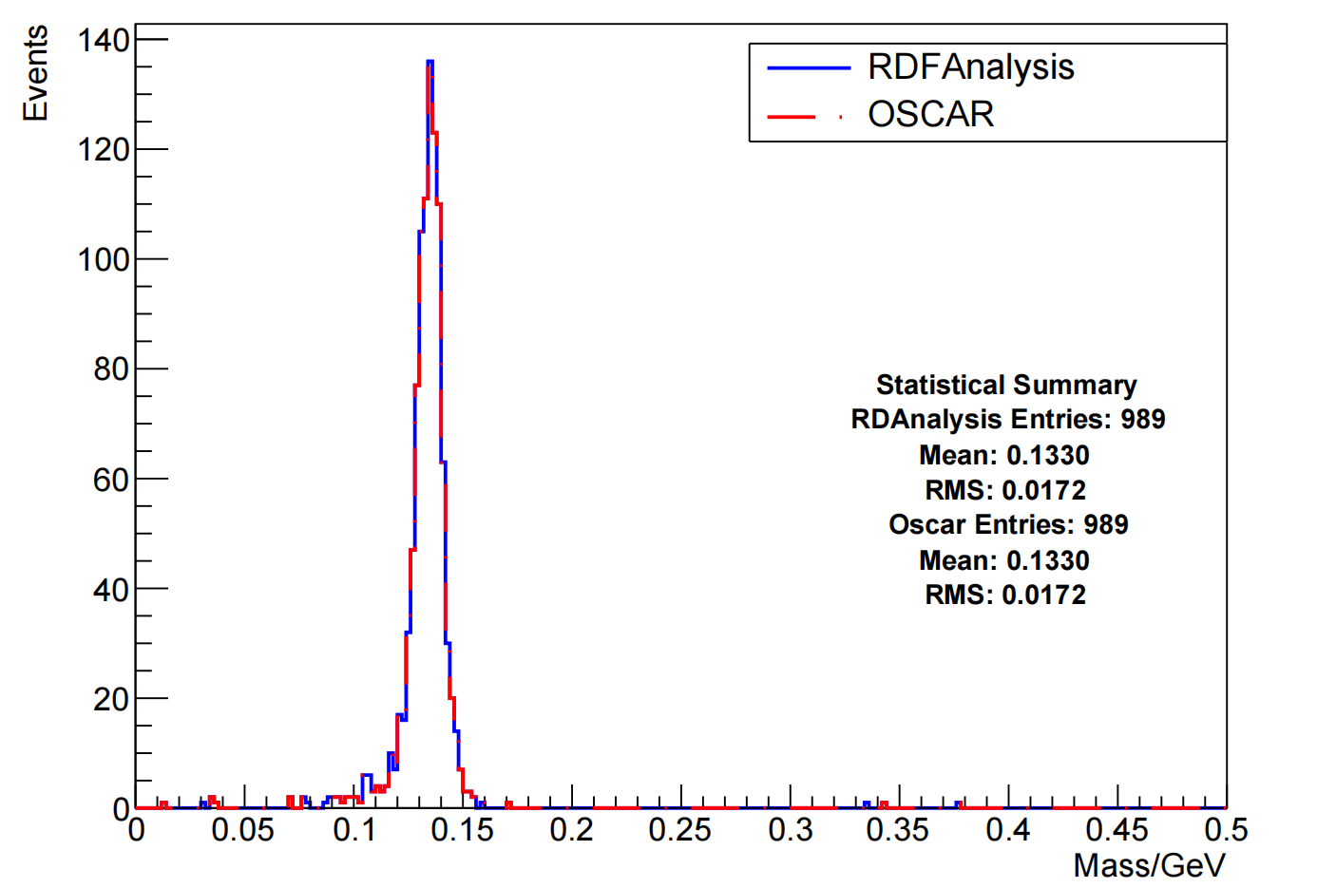


$$J/ψ→ρπ^{0}→π^{−}π^{+}γγ$$
挑选的$π^{−}$粒子为$π$的概率值
$π^{0}$质量谱
mass$π^{0}$
Notes:
User Page ,user can set cut condition and number of thread and charge particle infromation to achieve physics analysis like this . Execute code ,we compare mass of pi0 from RDFAnalysis and OSACR . Look this page, it is same so the correctness of interface is proved.

Slide 17
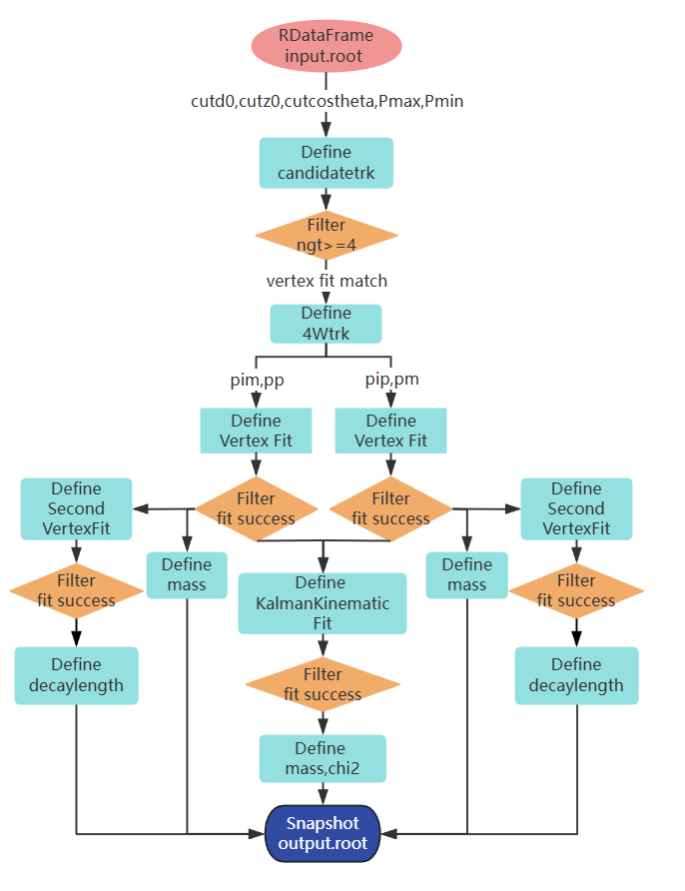
$$J/ψ→Λ\overline{Λ}→pπ^{−}\overline{p}π^{+}$$
核心代码片段
# 1. 数据读取与环境初始化
df =ROOT.RDataFrame("events","input.root")
# 2. 径迹参数定义 (底层提取)
df = df.Define("trk_d0","TrackParamHelper::getD0ForHypoPivotIP (...)")
.Define("trk_z0","TrackParamHelper::getZ0ForHypoPivotIP (...)")
.Define("trk_mom","TrackParamHelper::getMomForTrack (...)")
# 3. 粒子筛选与物理对象构建
df = df.Define(“GoodPtrk”,“trk_d0<3 && trk_z0<5&&trk_mom>0.5…")
.Define("TrackPm","TrackerRecTrackCol[GoodPtrk]")
# 4. 顶点拟合
df = df.Define("vfit","VertexFitUtil::get_vfit(...)")
.Filter("vfit.Fit(0)")
# 5. 运动学拟合
df = df.Define("kfit","KalmanFitUtil::get_kfit(...)")
.Define("mass_lam","VertexFitUtil::get_massafterkfit(kfit,0,1)")
# 6. 结果输出
df.Snapshot("lambda_result.root", ["decayL","mass_lam",...])
物理分析流程图
https://git.ustc.edu.cn/oscar1/rdfanalysis

Slide 18
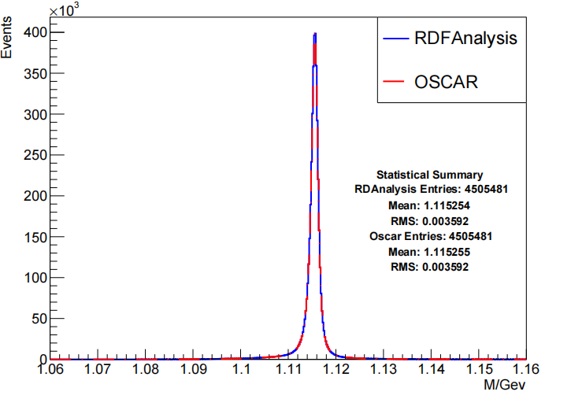
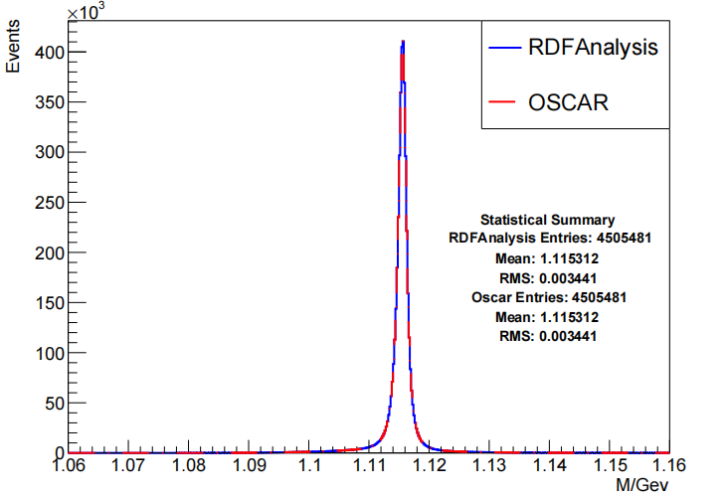

$$J/ψ→Λ\overline{Λ}→pπ^{−}\overline{p}π^{+}$$
10 million events
顶点拟合
运动学拟合
mass $Λ$
mass $Λ$
Notes:
input 1*107events ,We compare mass of Lambda in RDFAnalysis and OSCAR .Look at this two picture ,we can easliy find Whether after vertex fit or Kinematic fit , the result is the same.so vertex fit and Kinematic fit interfaces are right.

Slide 19
4
性能测试

Slide 20
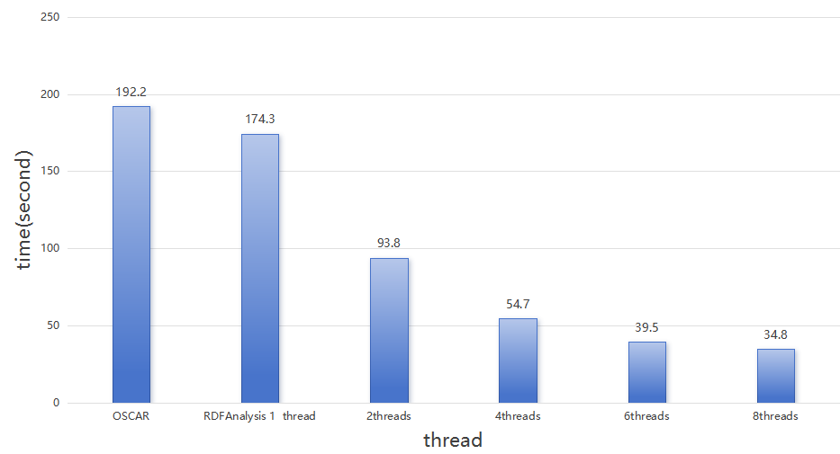

性能分析
20万 events
4线程下，处理速度提升251%
受限于数据读取速度和任务调用等必须串行进行的任务，8线程下速度提升不明显
Notes:
Use the code of j/psi->Lambda Lambdabar ,we use one file which has 2*10^5 events . Use muti-thread ,we can fiind the time is less more .But not meeting expectations .After performace analysis by pref , we find on 8 threads , almost half of time is used in mallco call .We think that’s because too much intermediate variable . So next we will Optimize interface.It is worth noting that muti-thread is not almighty(all might).Amdahl’s law tells us .The improvement of running speed depends on the proportion of the parallelizable part, and the time cost of data distribution and management in the serial part is inevitable.
性能提升

Slide 21
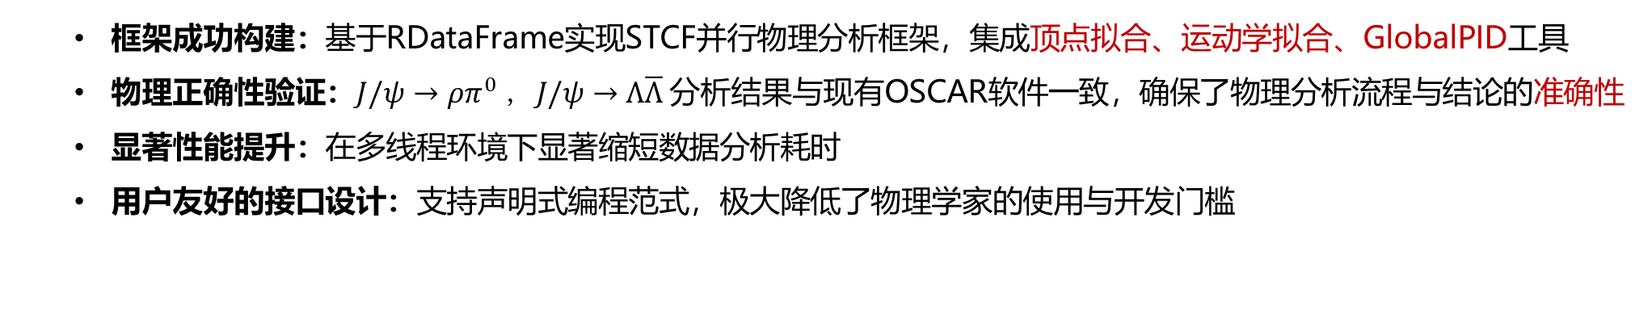
总结
  框架成功构建：基于RDataFrame实现STCF并行物理分析框架，集成顶点拟合、运动学拟合、GlobalPID工具
  物理正确性验证：$J/ψ→ρπ^{0} ，J/ψ→Λ\overline{Λ}$ 分析结果与现有OSCAR软件一致，确保了物理分析流程与结论的准确性
  显著性能提升：在多线程环境下显著缩短数据分析耗时
  用户友好的接口设计：支持声明式编程范式，极大降低了物理学家的使用与开发门槛
展望
模型深度适配：深入对接物理分析专用数据模型，优化数据读写与处理逻辑，进一步释放框架性能潜力
工具生态扩展：持续集成D-tagging等关键物理分析工具，完善框架功能矩阵，覆盖更多研究场景

Slide 22

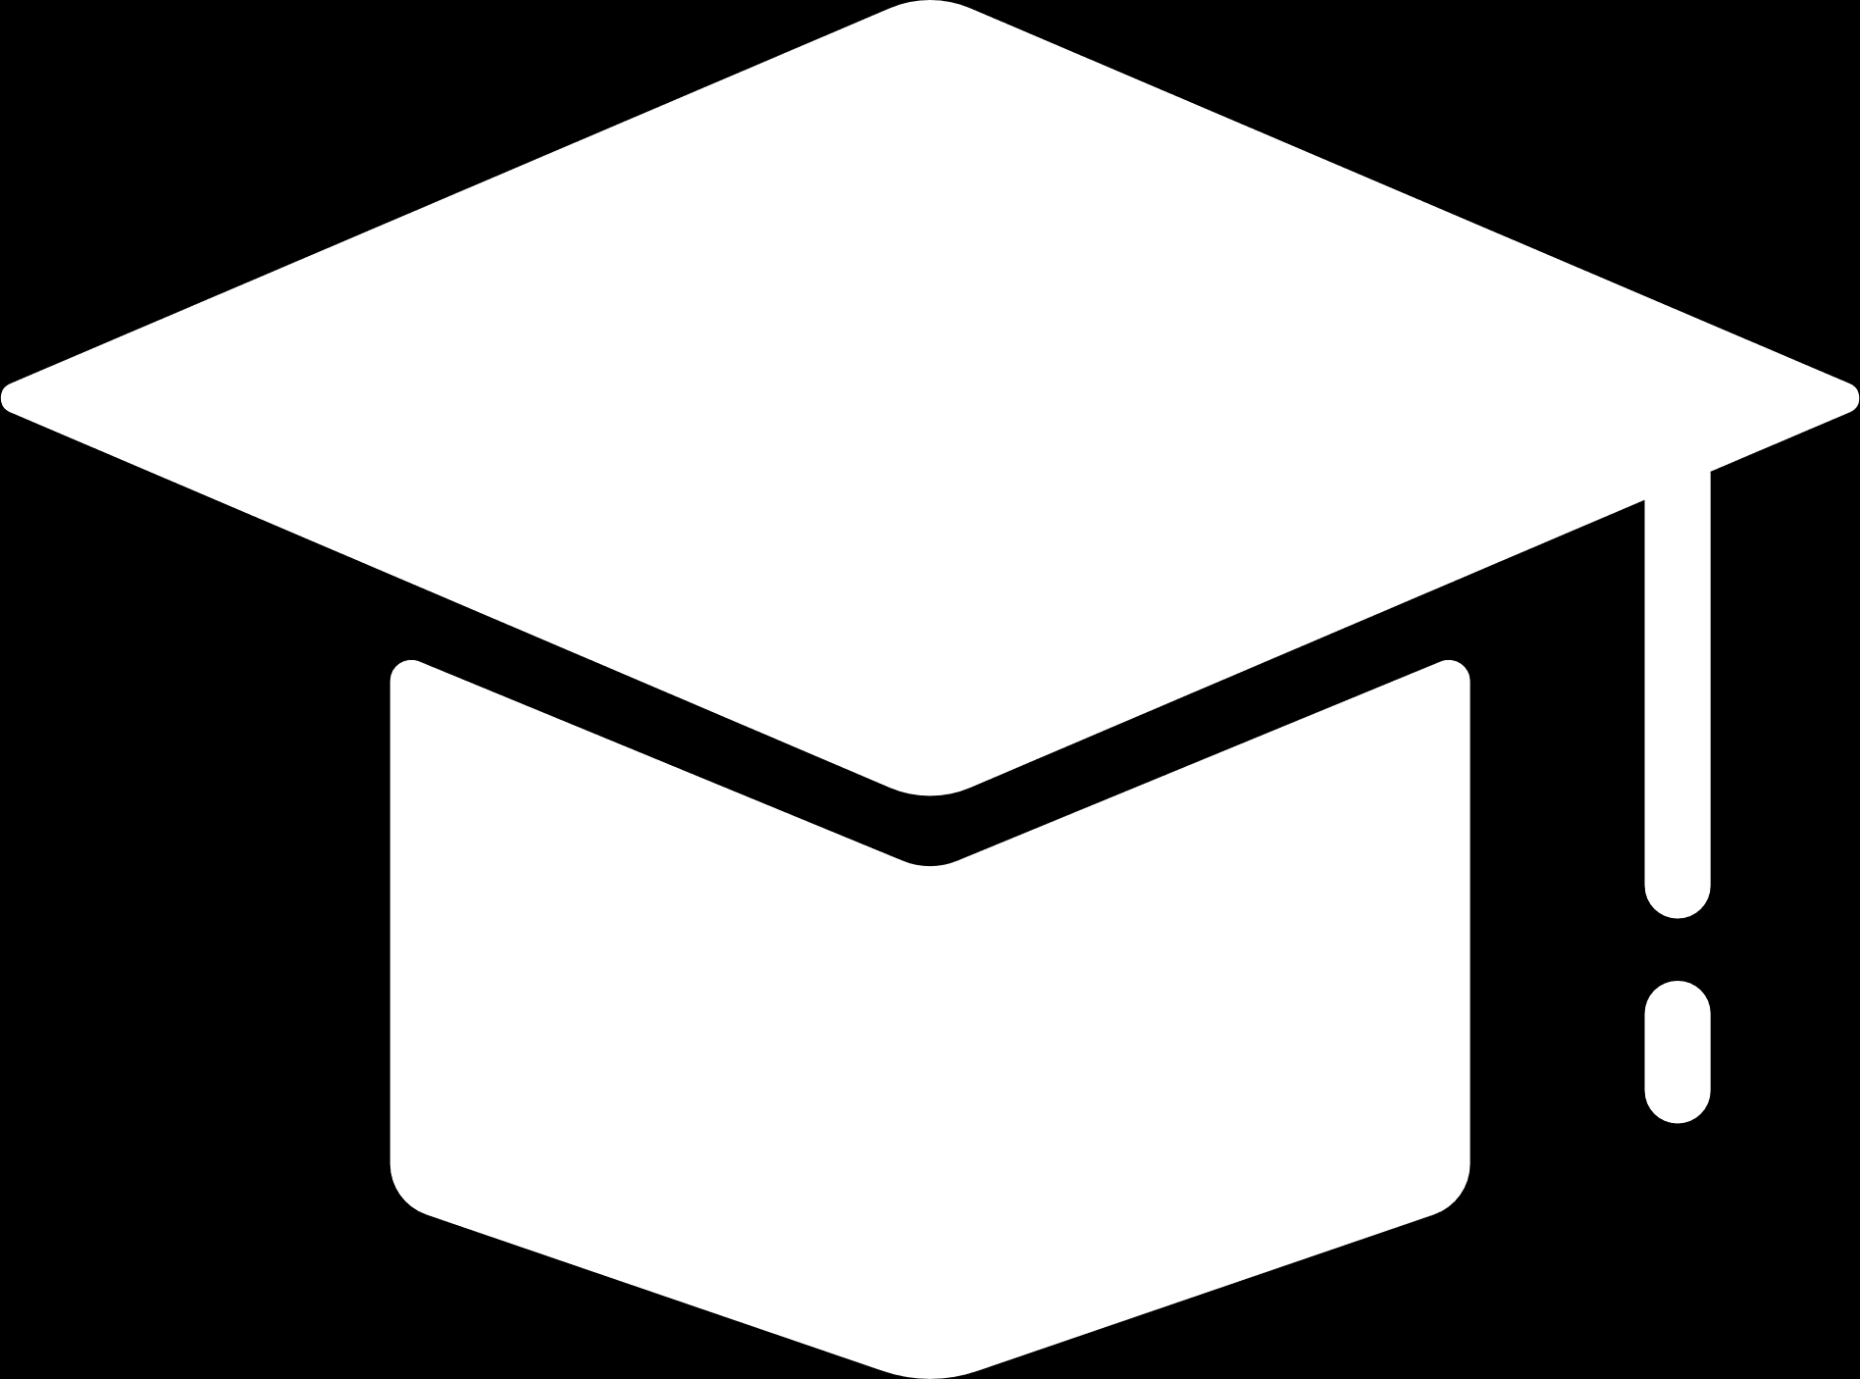
THANKS!
Reporter:杨莹
Date：2026.7.2

Slide 23
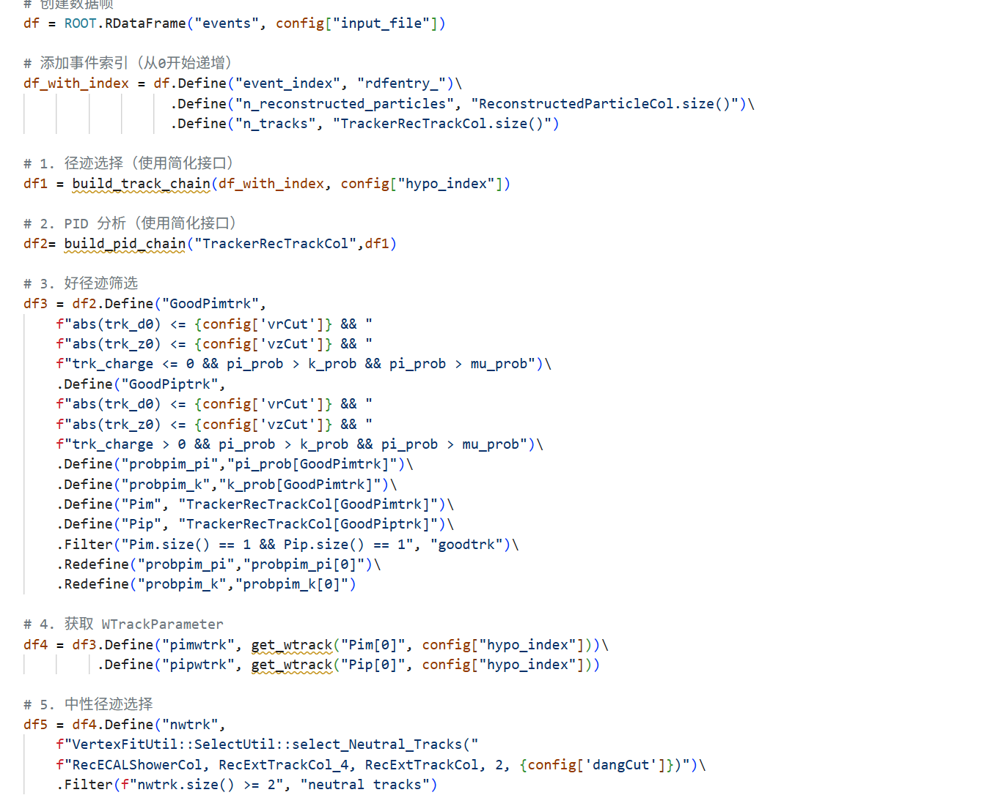
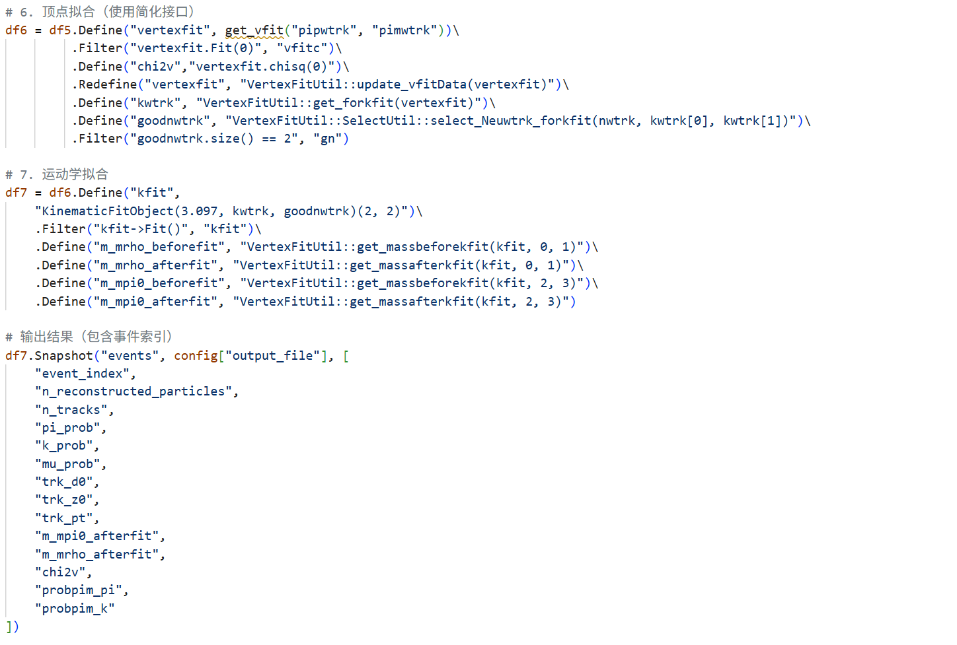
分析算法示例： $J/ψ→ρπ^{0}→π^{−}π^{+}γγ$
Notes:
This is detailed code ,we use get_2wtrk_byWLpid interface by set particle id and cut in zy and z get charge track ,and by cut_min angle to get neutral track .For charge tracks get Vertexfit Object ,use charge track finally get neutal track, then to do kinematic fit.

Slide 24
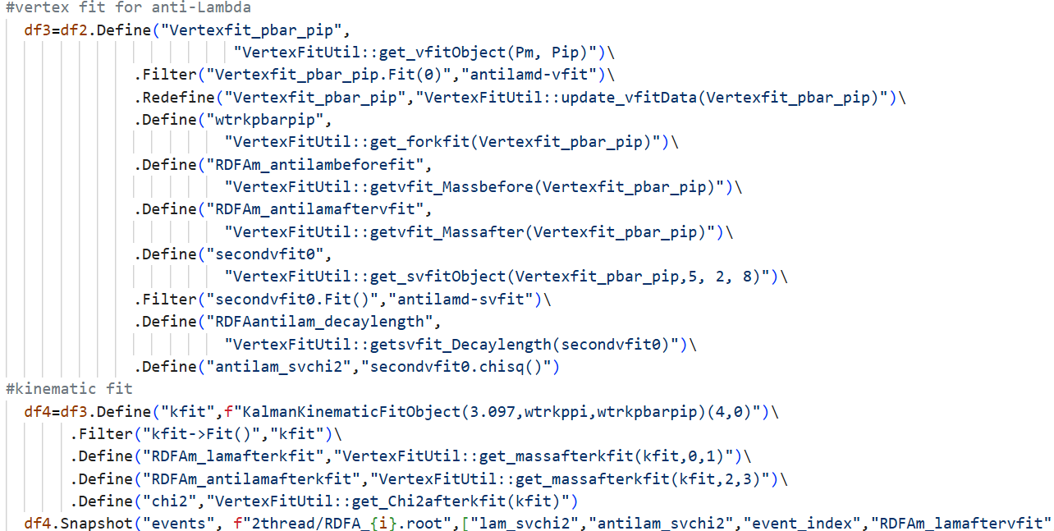
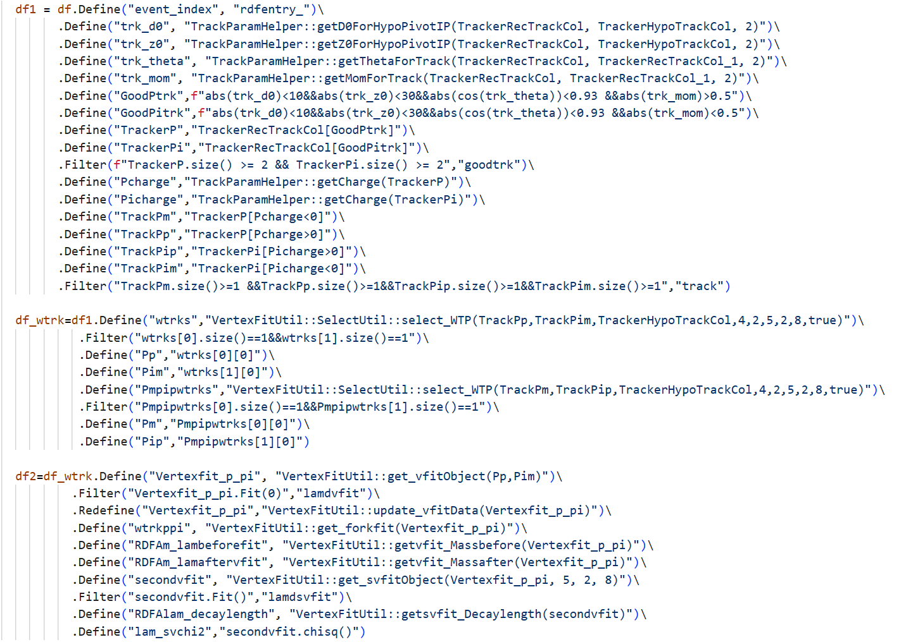
Analysis Codes and Python scripts for $J/ψ→Λ\overline{Λ}→pπ^{−}\overline{p}π^{+}$
Notes:
Next sampel is J/psi decays to Lambda Lambdabar .First we use cutxy ,cutz,and cutcostheta , and momute range to select charge track index .Then we match best charge tracks in vertex and get WTrackParameter data .Next to do vertex fit get data and then to Kinematic Fit.

Slide 25
需求分析
存储方式:ROOT
便捷访问 ROOT data
硬件需求：多核CPU和GPU
并行多线程
海量数据
高精度结果
ROOT
RDataFrame
软件需求:物理分析工具
运动学拟合，顶点拟合
接口便于集成物理分析工具
用户需求：物理过程
数据处理对用户透明且操作简单
Notes:
First, requirment analysis .let’s think what we need for new analysis frame ? According to Large volum data and high precision results,First ,we think about data storage method is ROOT ,so the frame need to access to ROOT data easily.Second, according to hardware Multi-core CPUs and GPU,multi-threading is necessary. To conducte physics analysis,common analysis tools : kinematic fit and vertex fit is must ,so the frame should be easily integrated with common analysis tool.Finally ,think user, it should be transparent for user.Because we need easy access to ROOT data ,so we found the frame in ROOT software.RDataFrame is
so Suitable.Reasons are next .

Slide 26
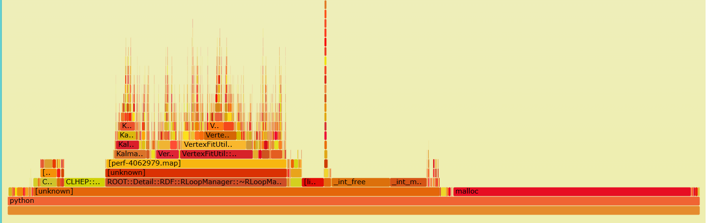
Pref CPU Flame Graph (8 threads)
proportion:34.3% 323e9

