Slide 1


Validation System for OSCAR
Guoping Liu, Teng Li
Shandong University
2026超级陶粲装置研讨会, 西安, July 2, 2026

Slide 2
Outline
Background
Validation System
  Dashboard
  AI interpretation
Summary

Slide 3
Background

Slide 4
Software validation
In large HEP collaborations, validation is organized and largely automated:
Dedicated validation / release teams coordinate workflows and review
Layered checks (complementary, not interchangeable):
Unit tests, Integration tests
Performance and regression (cf. LHCbPR)
Release validation (RelVal): it answers whether physics outputs still match a reference release
Software validation catches issues at different levels:
Wrong physics — silent regressions in reconstruction, efficiencies, resolutions, backgrounds
Build & runtime failures — compile errors, crashes
Computing performance — CPU, memory, throughput
Code quality — regressions in modules and APIs
Critical for HEP software:
Developers — find problems early (on commit / in CI)
Releases — sign off new versions quickly, reliably, and correctly
Evolving detector R&D (STCF): sub-detector and simulation changes may also shift validation plots — validation should track software and design iteration together.
Leveraging AI — research potential
Release validation produces hundreds to millions of performance plots. Fully manual review is slow and easy to miss subtle regressions.AI could help interpret plots in release context, prioritize suspicious cases in large batches, and link anomalies to software changes — toward richer diagnosis than comparison alone.

Slide 5
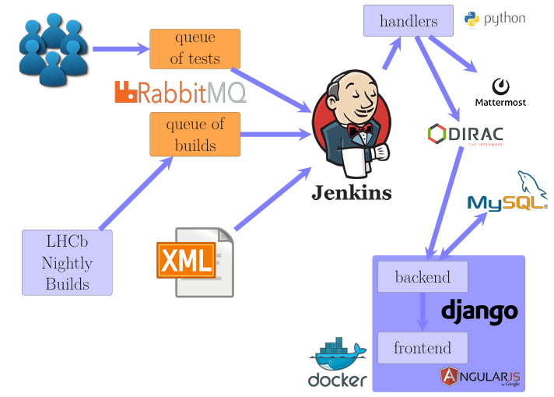
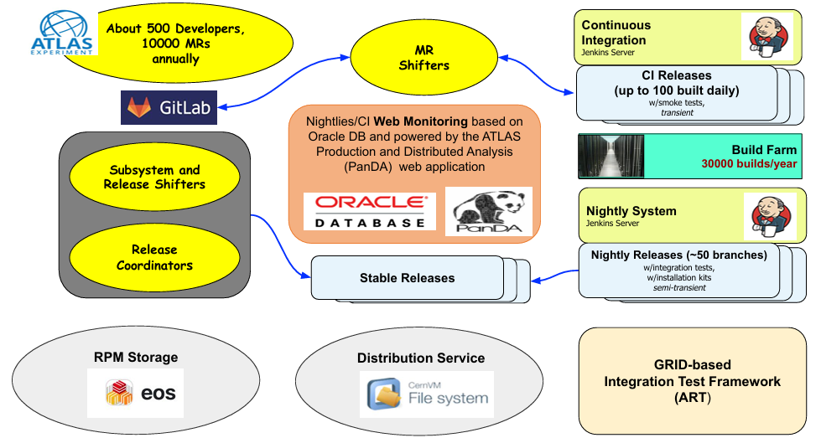
Software validation
Validation of Software Releases for CMS (CERN CDS)
CMS CompOpsRelVal (TWiki)
CMS PyReleaseValidation (TWiki)
ART — ATLAS Release Tester using the Grid (CHEP2020)
Operational Intelligence in ATLAS CI
ATLAS software & computing Run 3 (EPJ C, 2024)
ATLAS Software Build System Infrastructure
LHCbPRworkflow,
EPJ Web of Conferences 214, 05014 (2019)
Offline Software Development Workflow at a Glance,
Joint experiment meeting, February 6, 2025

Slide 6
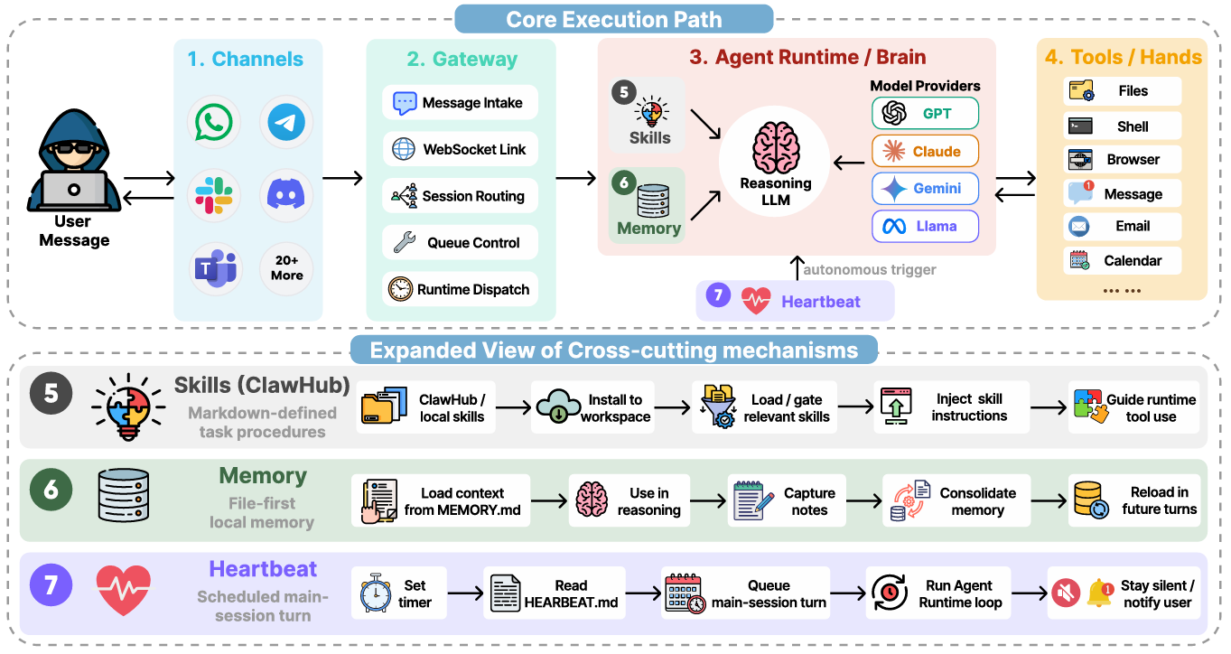
Agent-OpenClaw
AI Chat
LLM API
Prompt
Context
Coding Agent
Vibe coding
AI assistant
Harness
Loop
ChatGPT
Gemini
Claude
Qwen
……
Wang, Z. et al. (2026).
Copilot
Cursor
Claude code
Gemini cli
OpenClaw
Harmes
CodeX
WorkBuddy
Autonomous agents powered by large language models are moving from curated demos to persistent, open-world deployment.

Slide 7
Validation System

Slide 8
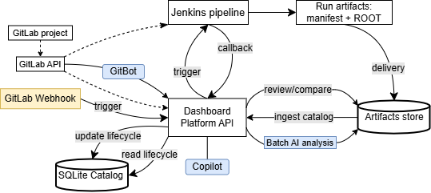
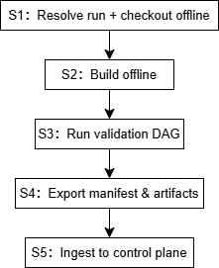
Validation System (Architecture)
Validation runs: Build OSCAR, run full-chain physics tasks, export performance plots.
Review platform: Browse results, compare Current vs Reference, track runs to sign-off.
Control plane (validation-insight): React + FastAPI + SQLite — trigger, lifecycle, Review/Compare.
Execution plane (hep_container): Jenkins + S1–S5 pipeline → manifest + ROOT artifacts.
Jenkins pipeline

Slide 9
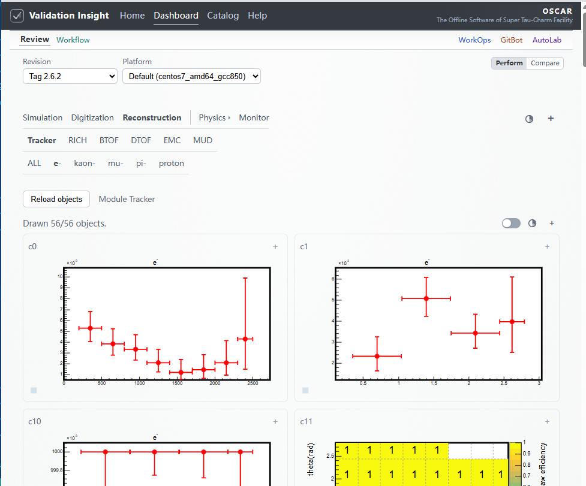
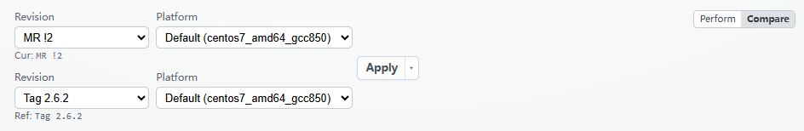
Dashboard - Review
Performance review and Current/Reference on ingested validation artifacts.
Realized: Reconstruction, Physics (Decay process), Monitor (running performance).
Detector and task tabs driven by manifest (task tree, root file).
Support:
  Add plot data to Copilot chat
  Per-plot AI grade overlay

Slide 10
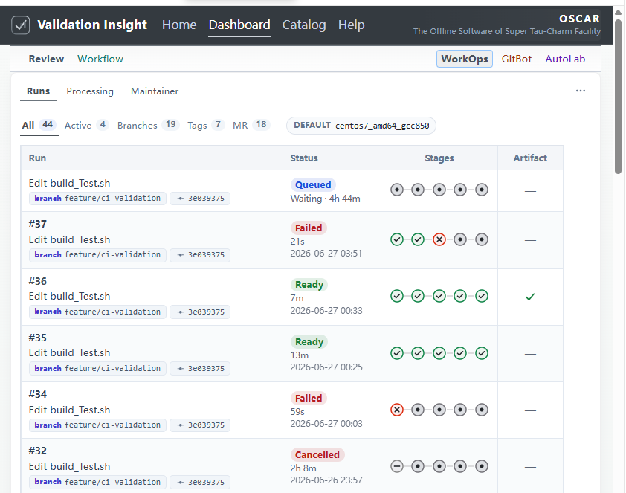
Dashboard - WorkOps
Runs: lifecycle tracking, delivery status, Sync & Ingest fallback
Processing: ROOT → JSON → AI Grade → AI Review batch pipeline
Compare pairs: AI Compare for Review-scoped A/B runs
Maintainer: manual Jenkins trigger (operator override)
Execution plane:
Jenkins + Snakemake on HEP cluster
Note: Queued runs: executor at LZU cannot outbound HTTPS to the control plane — cross-site network constraint, not an application bug.

Slide 11
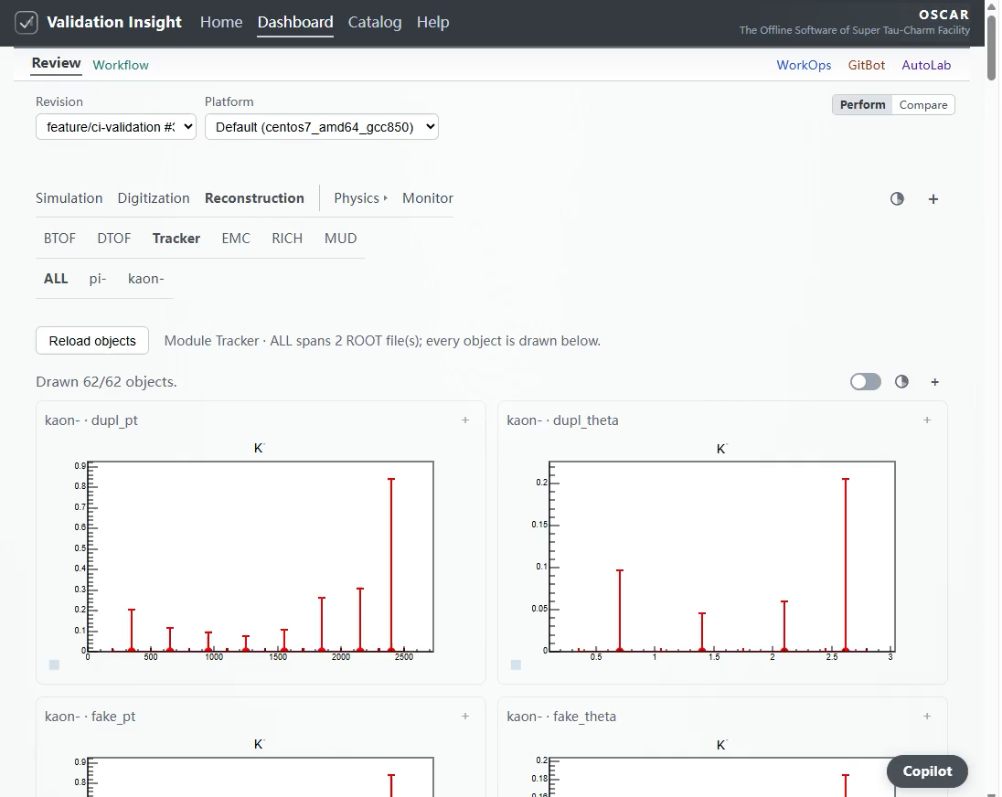
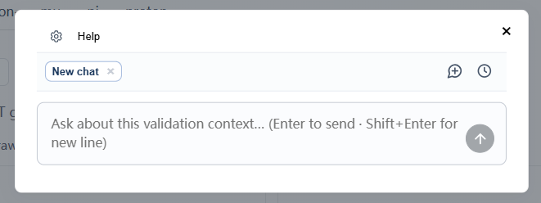
AI Interpretation
Developed Copilot:
In-dashboard assistant on Review & Compare
Context engineering — OpenAI-style text messages: user question + plot refs; histogram digests and validation context in XML system prompts.
Dockerized deployment with configurable Agent/LLM
Roadmap: trace plot anomalies across the full validation chain for root-cause hints

Slide 12
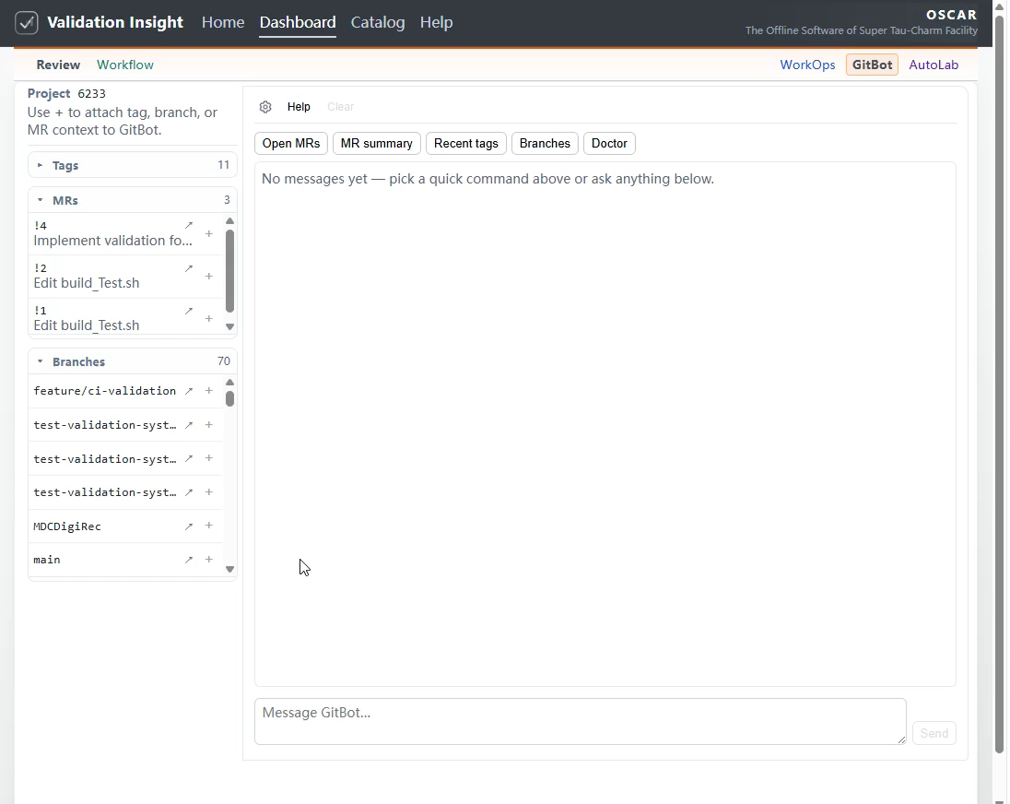
AI Interpretation
Developed GitBot:
GitLab integration — query merge requests, tags, branches, and pipelines via natural language and quick actions.
Repo context — bound to the active software repository (oscar1/offline).
MR comments — post validation summaries and review comments on merge requests (implemented); production requires a Project Access Token so comments appear under the GitLab project bot identity.

Slide 13
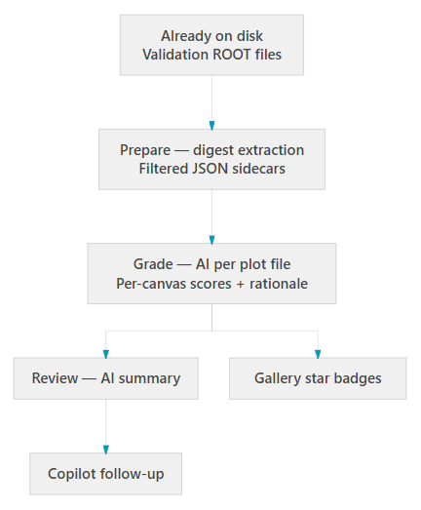
AI Interpretation– Batch analysis
Whole-run screening — Automated triage across all performance plots in one workflow.
Structured evidence, lasting outputs
Per-plot scores and a run-wide report from filtered JSON — not screenshots.
Gallery overlays; optional follow-up in Copilot.

Slide 14
Summary

Slide 15
Summary
Full-chain physics validation — Representative tasks and performance plots as primary evidence for reconstruction / simulation quality.
Performance regression — Systematic Current vs Reference comparison to spot efficiency, shape, and stage-level changes before sign-off.
AI assists reviewers — Batch plot grading and run-wide plot analysis after ingest; interactive Copilot for selected plots; GitBot for GitLab MR / CI context.
Toward GitLab MR integration (planned) — Automated trigger and MR comments with validation results and AI-assisted summaries for human reviewers.

Slide 16
backup

Slide 17
Motivation
Ensures Correctness of Physics Results：Validates software updates against "Golden Samples" using rigorous statistical tests (e.g., KS/Chi-squared) to guarantee that core physical conclusions remain unchanged.
Enhances Code Quality & Robustness：Deploys automated regression and unit tests to catch defects early in development, enforcing high coding standards and long-term maintainability.
Guarantees Performance & Stability：Monitors CPU/memory usage to detect performance regressions and memory leaks, ensuring efficient throughput for processing large-scale experimental data.
Leverages AI for Deep Insights；
Addresses the challenge of manually reviewing hundreds of performance plots, a task prone to human fatigue and oversight. AI excel at analyzing these vast visual datasets, identifying complex correlations and offering superior root-cause analysis capabilities.

Slide 18
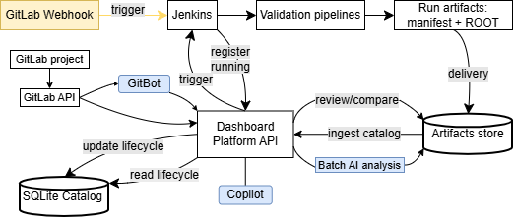
Validation System (Architecture)
Execution plane (hep_container): Jenkins + S1–S5 pipeline → manifest + ROOT artifacts
Control plane (validation-insight): React + FastAPI + SQLite — trigger, lifecycle, Review/Compare
GitLab: software ref via API (Launch choose tag/MR); Webhook auto-trigger — planned (yellow)
AI-assisted: Copilot, GitBot, batch analysis on ingested artifactsc
Focused RelVal: split planes · Docker · SQLite
Schema handoff: manifest + ROOT → ingest
One UI: lifecycle · Review · Compare
Post-ingest AI: Copilot · GitBot · WorkOps

Slide 19
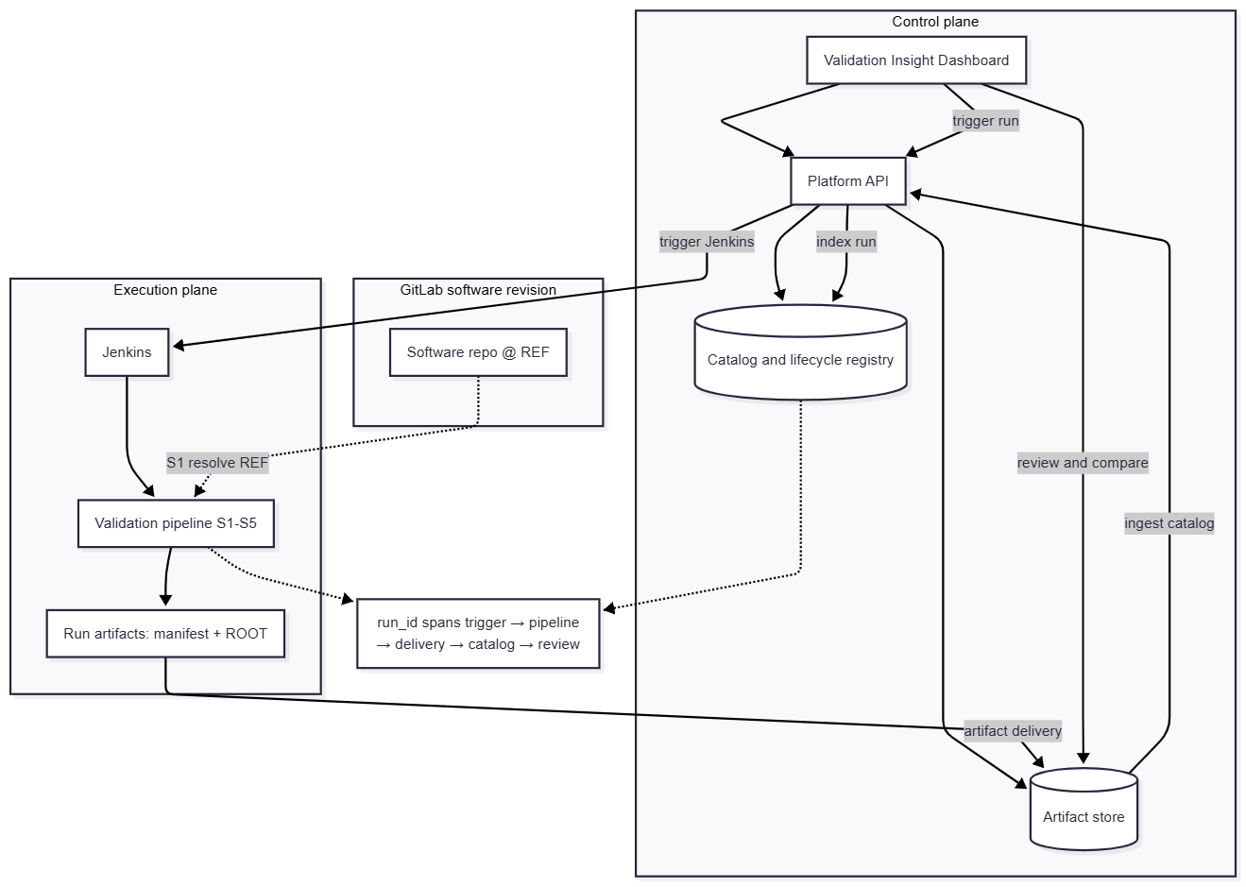
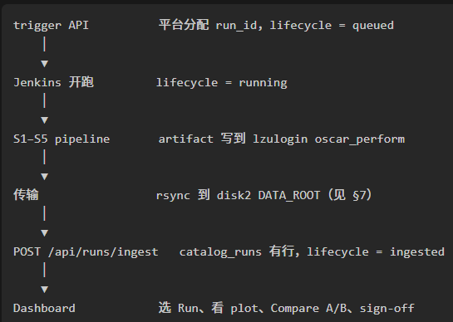
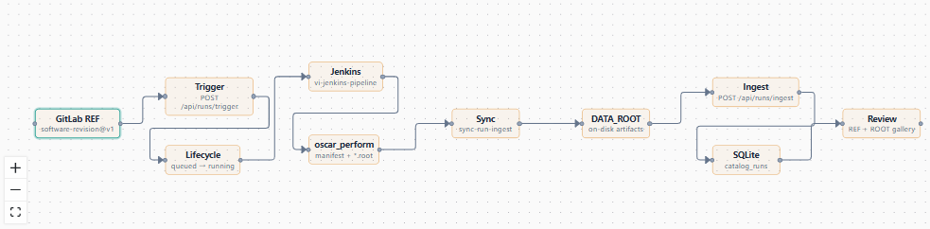
Validation workflow

Slide 20
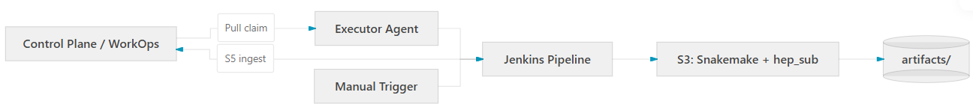
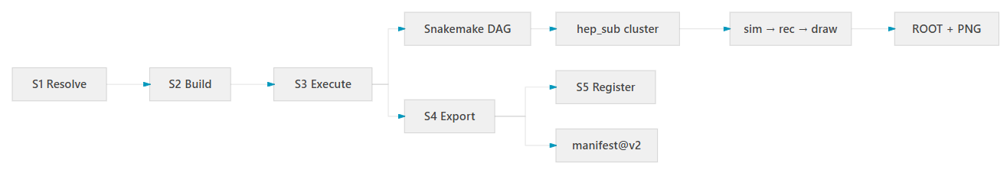
Execution Plane
Execution plane: Jenkins + Snakemake on HEP cluster infrastructure
System Flow
Pipeline (S1–S5)

Slide 21
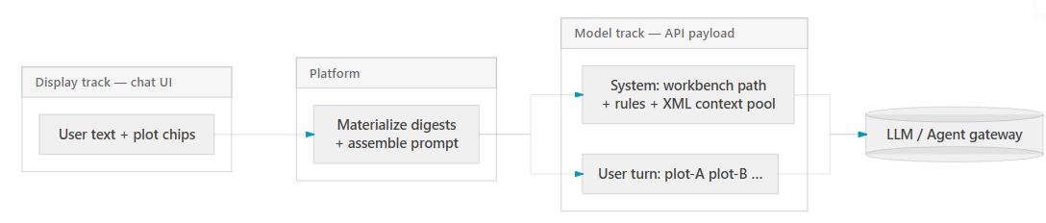
AI Interpretation– Copilot details
Interactive depth — The operator attaches one or a few plots from the gallery and asks follow-up questions; Copilot complements batch run-wide analysis.
Dual-track context — The chat UI keeps the user’s original wording; the outbound request uses short plot references in the user turn and moves full histogram data into the system prompt.
Structured digest, not vision — The platform materializes filtered ROOT JSON on the server; messages are text-only (no screenshots or multimodal API).
Grounded answers — Responses must cite attached plots and use only injected data — no invented metrics or sign-off conclusions.
Notes:
用户在画廊里点「加号」挂上关心的图，在对话框里用自然语言提问——这是上面的 Display track，界面上保留用户的原文和 plot chip。
中间经过 Platform：服务端把 ROOT 图 materialize 成过滤后的结构化 JSON，再组装成发给模型的 prompt。这里不用截图、也不走视觉多模态，而是读直方图、效率图等的数值摘要。
下面 Model track 是实际 API 载荷：System 里放工作台路径、规则和 XML 包裹的上下文数据池；User 那一轮则收成短的 plot 引用，比如 plot-A、plot-B，和 System 里的数据块一一对应。这就是 双轨：给人看的和给模型用的分开，但引用关系对齐。
最后进 LLM 或 Agent 网关，流式返回回答。约束是：只依据注入的数据作答，要引用所附的图，不编造指标。如果前面 Batch 已经跑过全局 Review，也可以把摘要带进 Copilot 继续深挖某几张可疑图。

Slide 22
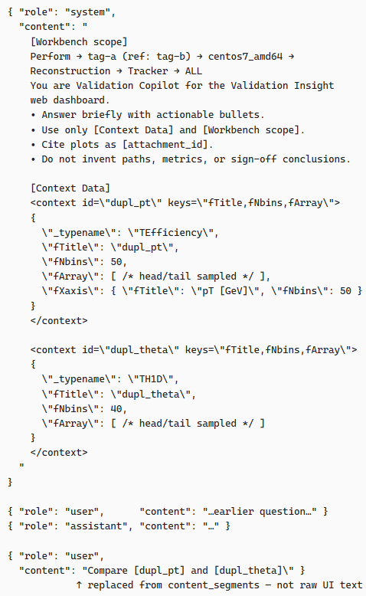
AI implementation – Copilot details
OpenAI-Compatible Message Format
  Standard { role, content } message array.
  Text only — no screenshots, no image_url, no vision API.
Dual-Track Representation (Display ≠ Model)
Layered System Prompt
  [Workbench scope] — breadcrumb workflow path (e.g. Perform → tag → platform → category).
  Instructions — role, tone, citation rules, anti-hallucination constraints.
  [Context Data] — XML-wrapped structured JSON pool.
XML Tags Delimit Data Boundaries
Server-Side Materialize (Not Client Upload)
Human vs. Model Perception

Slide 23
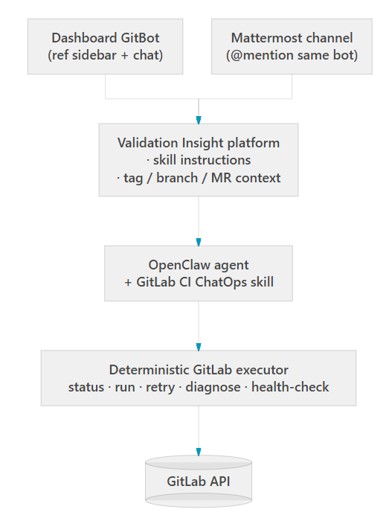
AI implementation – GitBot details
One agent, two entry points — Dashboard GitBot and Mattermost invoke the same OpenClaw agent and the GitLab CI ChatOps skill.
Skill-driven behavior — Agent rules, dashboard instructions, quick commands, and a deterministic command executor all live in one skill bundle (not ad-hoc prompts).
Auditable replies — Actions go through the packaged executor with branch policy guards; answers follow Execution Facts → Diagnosis & Next Step (no fabricated pipeline results).

Slide 24
Dashboard - WorkOps
Problems
Under Pull dispatch, the executor must reach the control plane via outbound HTTPS (poll + callback).
Hard constraint | Target (HEP norm) | Current pilot
Executor outbound HTTPS to control plane | Poll + callback reachable from login node | Outbound timeout → runs stuck Queued, work halted
Control plane on trusted network | Intranet / edu / alliance VPN, HTTPS 443 | Interim public IP:8501, outside HEP trusted path
Cross-institution MOU | Written agreement: egress, URL, port 443 | Not in place yet
Action needed: Host the control plane on an edu/alliance-reachable URL, or allow LZU egress to PLATFORM_URL:443 — then the same stack can serve SPD and other experiments.
Notes:
WorkOps Queued 是因为兰州大学执行节点 访问不了 控制面 HTTPS，poll 和 callback 都失败。专业做法是把控制面放在 联盟/内网可达 的地址上；我们 pilot 还在公网过渡态，且 executor 出站被拦。这是 跨机构网络 问题，不是验证软件坏了。」

Slide 25
AI implementation – Batch analysis
Batch, not chat — Operators select runs (or compare pairs) and run Prepare → Grade → Review; the system processes hundreds of plots without hand-picking each one.
Structured data, not screenshots — ROOT objects are filtered to compact JSON sidecars on disk; the LLM reads numeric histogram summaries, not gallery images.
Three-stage pipeline — Prepare materializes digests (no LLM) → Grade scores each canvas (LLM or heuristic fallback) → Review synthesizes a run-wide report (one LLM call).
Durable, reusable outputs — Grades and summaries are written beside the data, drive gallery star overlays and compare indicators, and can continue in Copilot for follow-up questions.

