Slide 1
STCF EndCap RICH:
From Simulation to Performance
Speaker: Qingyuan Huang
On behalf of the RICH Detector Group

Slide 2
Contents
EndCap RICH in STCF Spectrometer
Simulation and Digitization
Reconstruction
Performance Evaluation
Summary

Slide 3
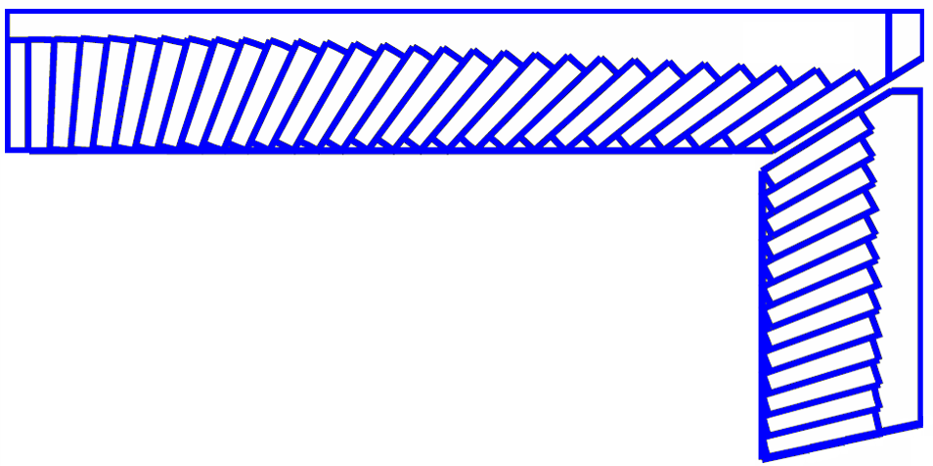
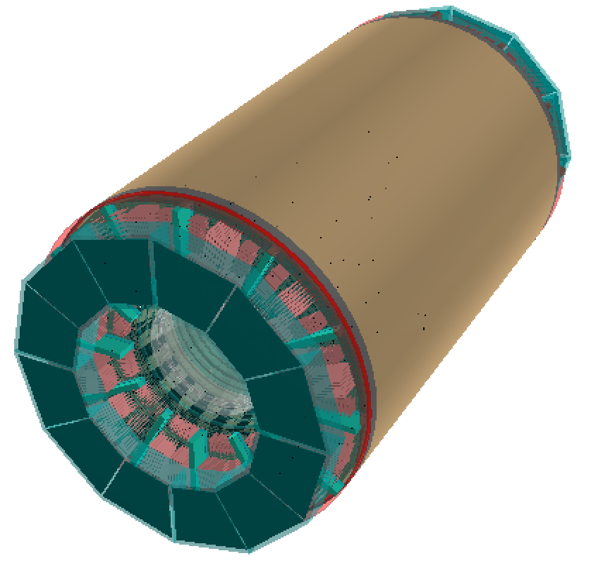
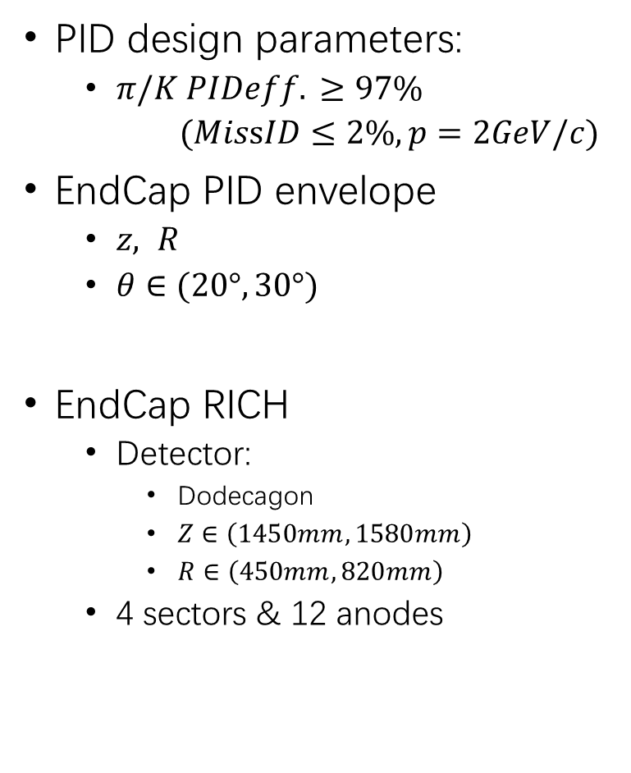
EndCap RICH in STCF Spectrometer
PID design parameters:
  $π/K PIDeff. ≥97\%$
  $(MissID≤2\%,p=2GeV/c)$
EndCap PID envelope
  $z, R$
  $θ∈(20°,30°)$
EndCap RICH
  Detector:
    Dodecagon
    $Z∈\left(1450mm,1580mm\right)$
    $R∈\left(450mm,820mm\right)$
  4 sectors & 12 anodes
~135 cm
30°
131 cm
ECAL
95 cm
PID
20°
85.1 cm
82 cm
MDC
PID
15°
48 cm
~36 cm
MDI
144 cm
164 cm
liquid Radiator
10mm
3mm
Quartz
105mm
Anode

Slide 4
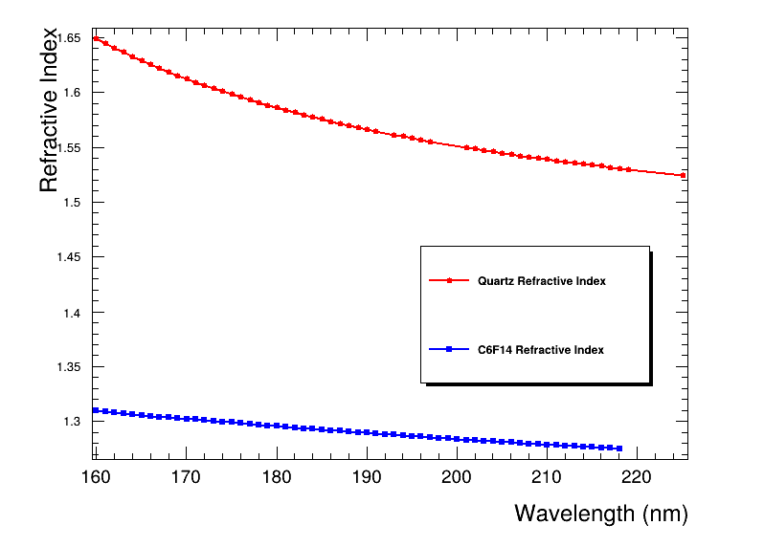
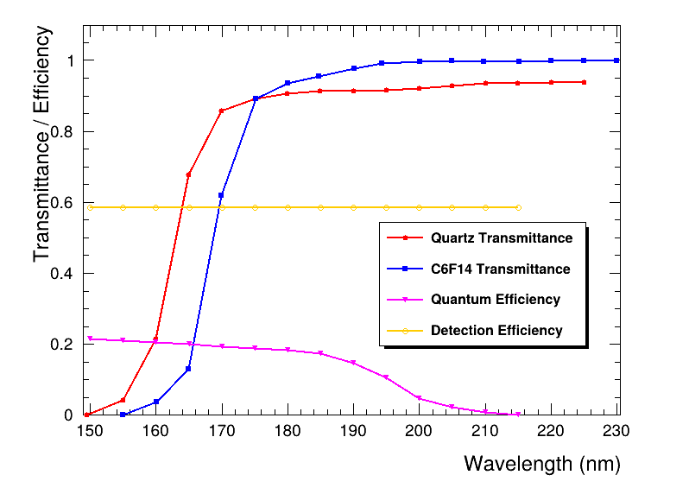
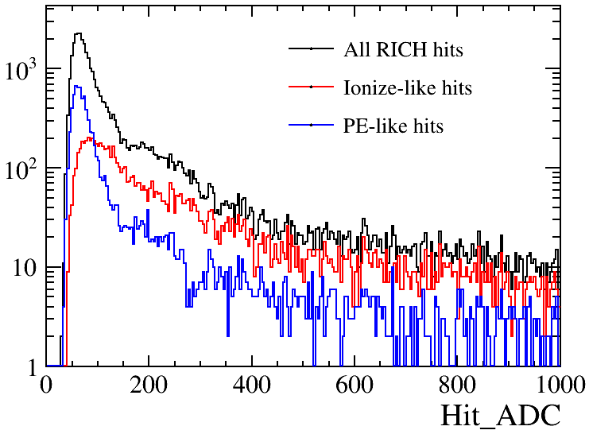
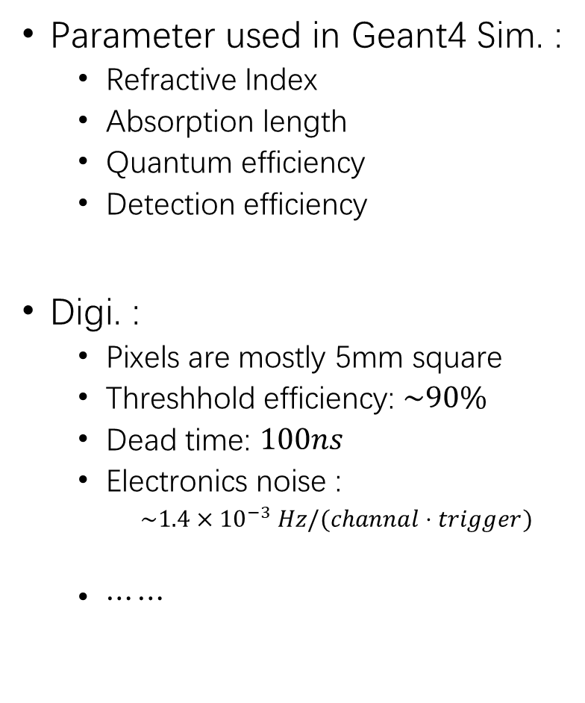

Simulation and Digitization
Parameter used in Geant4 Sim. :
  Refractive Index
  Absorption length
  Quantum efficiency
  Detection efficiency
Digi. :
  Pixels are mostly 5mm square
  Threshhold efficiency: $\sim 90\%$
  Dead time: $100ns$
  Electronics noise :
    $\sim 1.4×{10}^{−3} Hz/(channal⋅trigger)$
  $⋯⋯$
$$anode plane$$

Slide 5
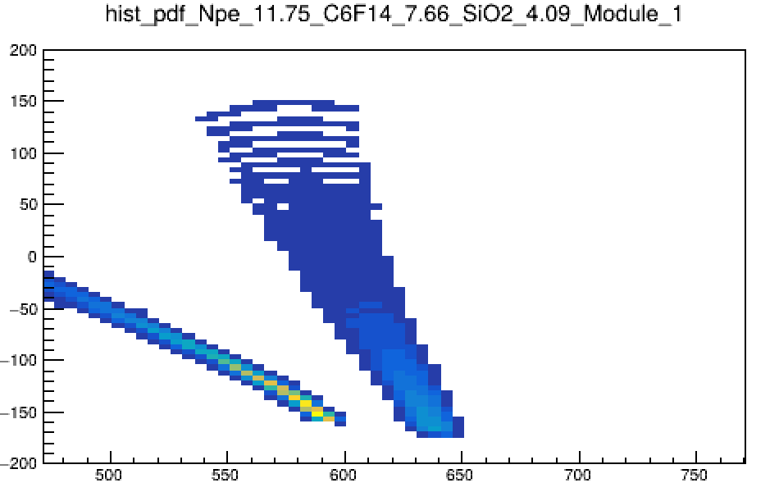
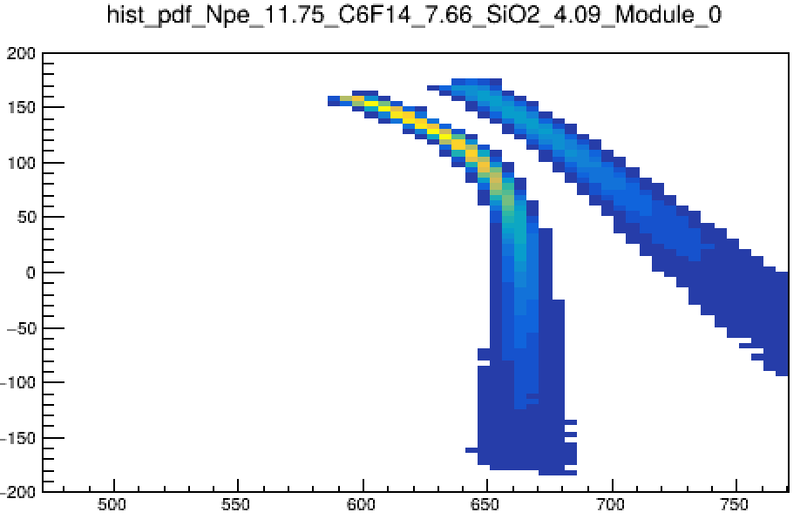






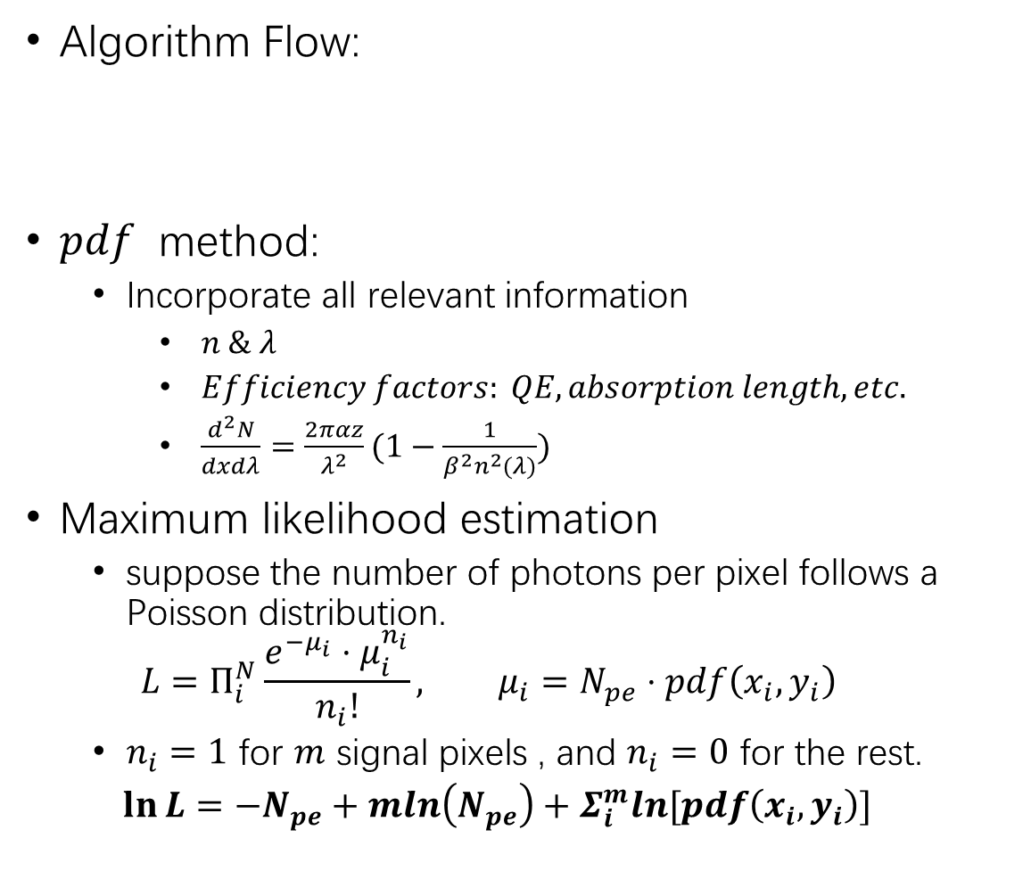







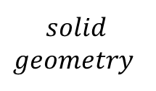




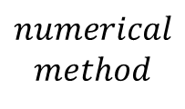
Reconstruction
$$x$$
Algorithm Flow:
$pdf$ method:
  Incorporate all relevant information
    $n \& λ$
    $Efficiency factors: QE, absorption length, etc.$
    $\frac{d^{2}N}{dxdλ}=\frac{2παz}{λ^{2}}(1−\frac{1}{β^{2}n^{2}(λ)})$
Maximum likelihood estimation
  suppose the number of photons per pixel follows a Poisson distribution.
  $$L=Π_{i}^{N}\frac{e^{−μ_{i}}⋅μ_{i}^{n_{i}}}{n_{i}!}, μ_{i}=N_{pe}⋅pdf\left(x_{i},y_{i}\right)$$
  $n_{i}=1$ for $m$ signal pixels , and $n_{i}=0$ for the rest.
  $\ln{L}=−N_{pe}+mln\left(N_{pe}\right)+Σ_{i}^{m}ln⁡[pdf\left(x_{i},y_{i}\right)]$
$$\vec{k_{photon}}$$
$$solid$$
$$geometry$$
$$MDC:External Track$$
$$Cherenkov pdf$$
$$MLE$$
$$numerical$$
$$method$$
$$φ_{c}$$
$$ρ$$
$$φ_{i}$$
$$\left(x_{spark},y_{spark},0\right)$$
$$\vec{P_{trk}}$$
$$θ_{c}$$
$$θ_{i}$$
$$z$$
$$\vec{V_{normal}}$$
$$y$$
$$\left(x_{spark},y_{spark},−Δz \right)$$
$$Global Coordinate$$
$$pdf for a single Track across two anodes$$

Slide 6
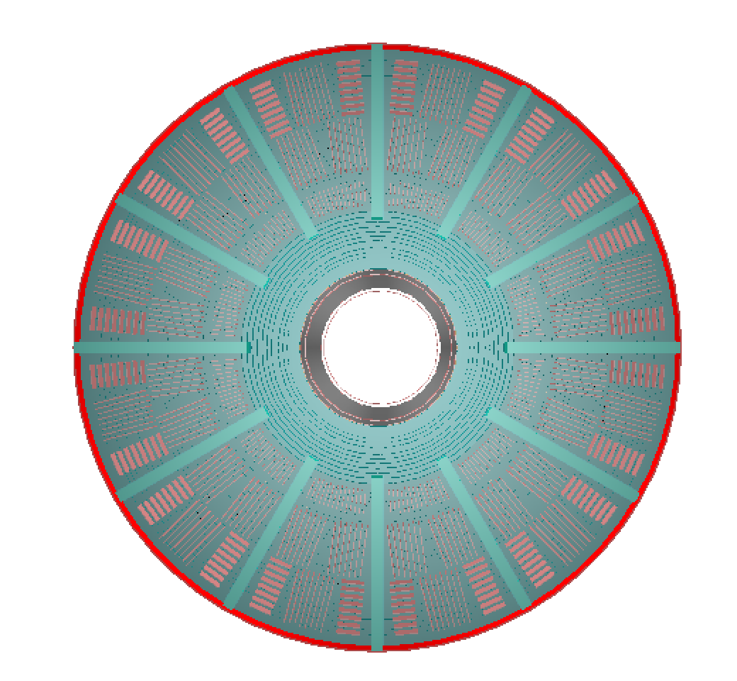
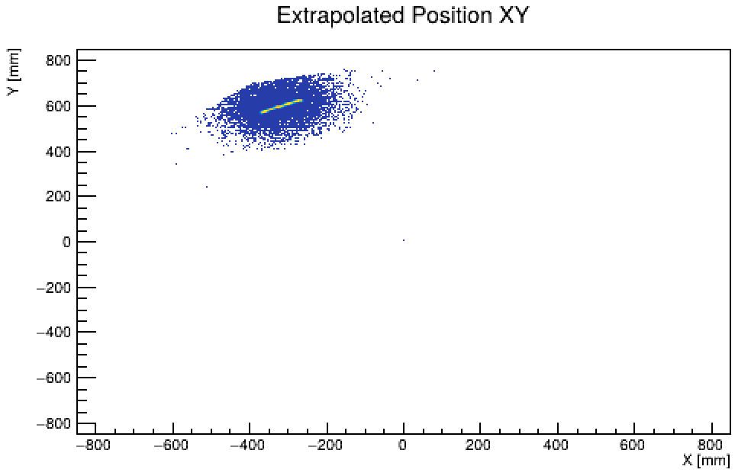
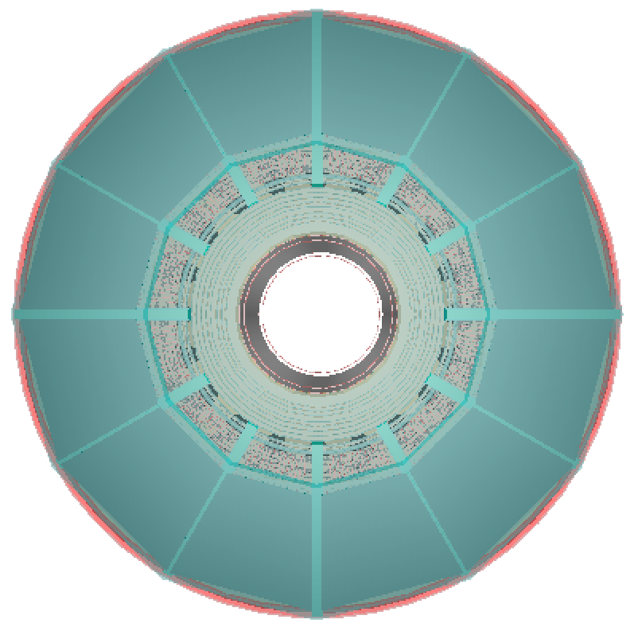
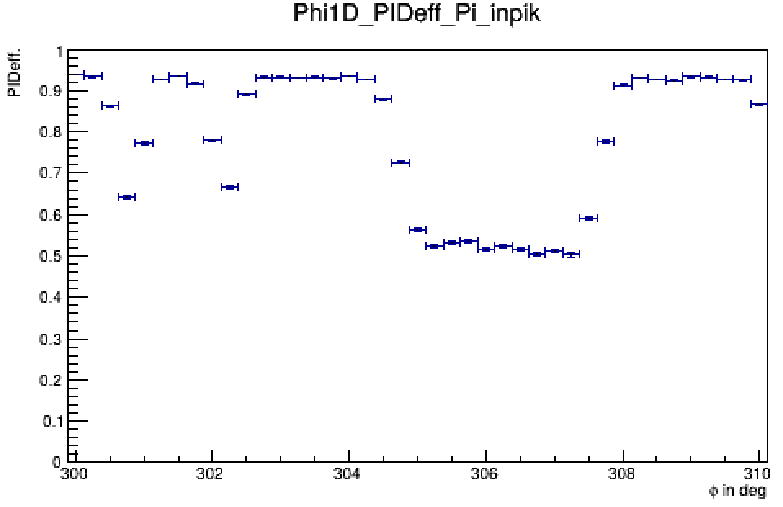















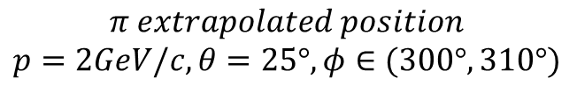





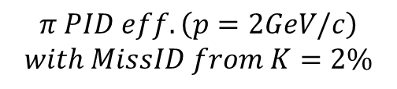
Performance evaluation
Mechanism:
Factors affecting PID efficiency:
  Refractive index $n\left(λ\right)$ , Pixel size , etc.
  Track extrapolation accuracy
Sensitive to the material budget of MDC endcap
$$Cerenkov Hit$$
$$ExtTrack$$
$$RICH PID$$
$$m_{π}/m_{K}$$
$$ep$$
$$β_{π}/β_{K}$$
$$cosθ_{c}=\frac{1}{nβ}$$
$$ExtTrack$$
$$θ_{c}$$
$$θ_{c}$$
$$\vec{P}=γm_{0}cβ$$
$$Cherenkov Hit(x,y,z)$$
$$Al$$
$$C_{6}F_{14}$$
$$Anode$$
$$glass$$
$$SiO_{2}$$
$$Ar$$
MDC EndCap
Electronics
MDC Cable & Girder
RICH gap
$$π PID eff.\left(p=2GeV/c\right)$$
$$with MissID from K=2\%$$
$$π extrapolated position$$
$$p=2GeV/c, θ=25°,φ∈(300°,310°)$$
$$EndCap RICH$$

Slide 7
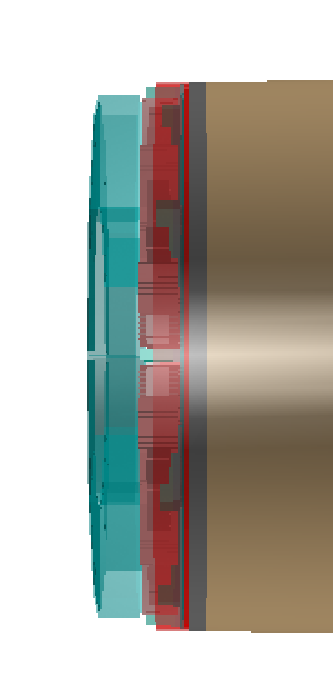
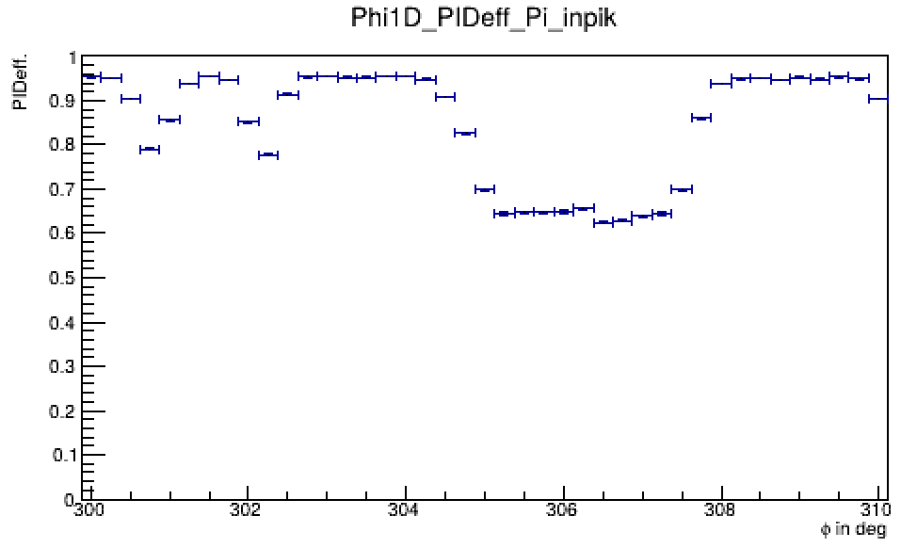
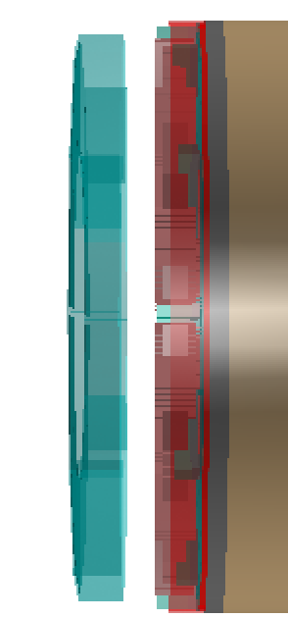
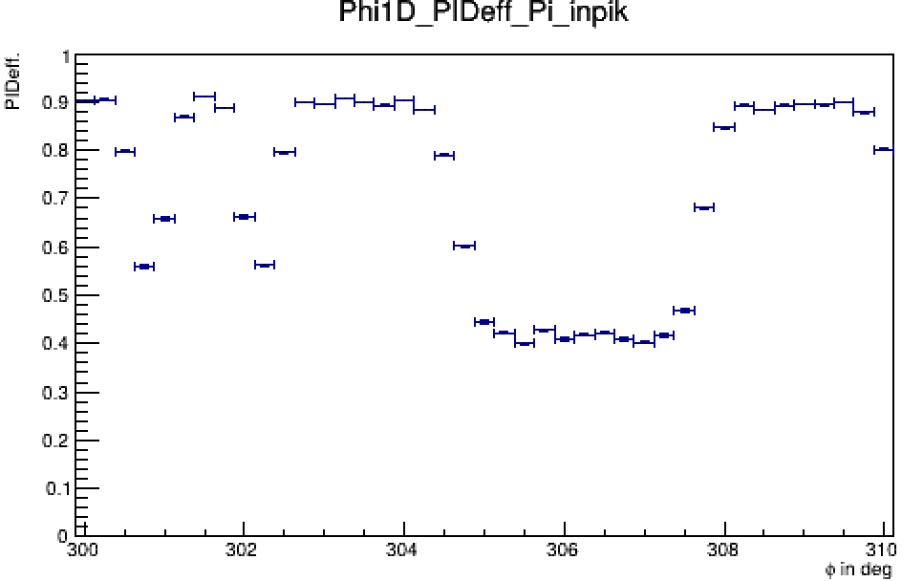
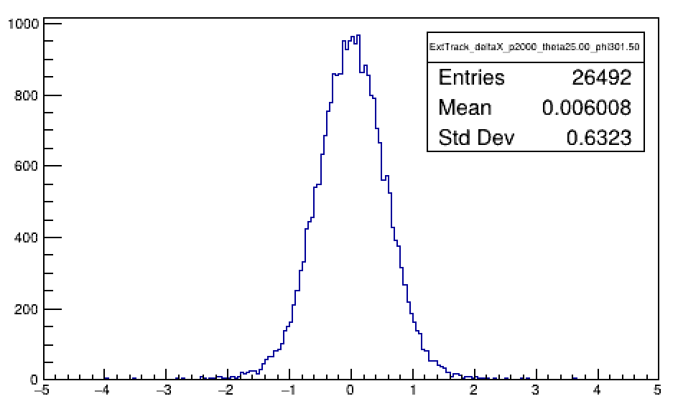
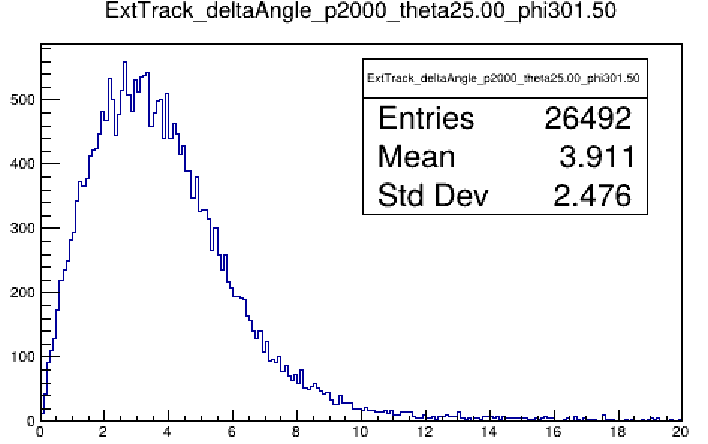
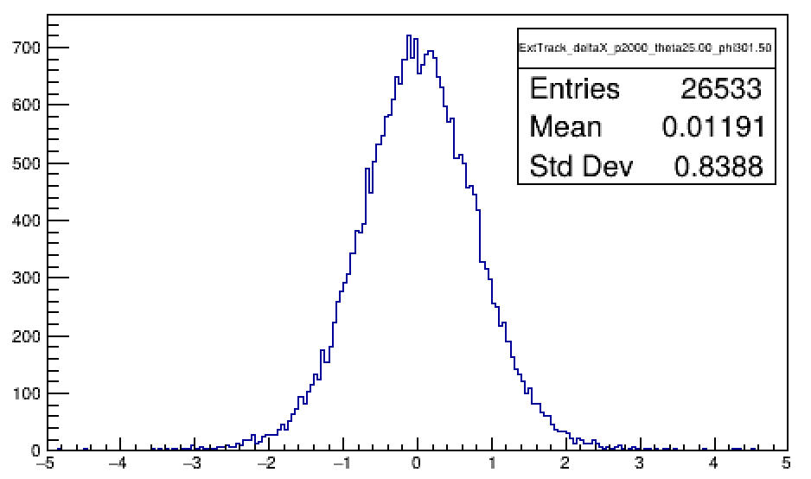
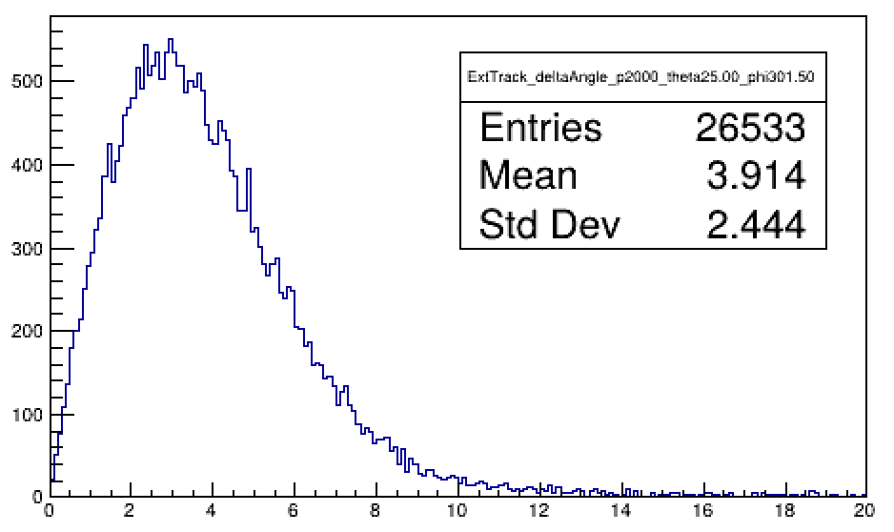
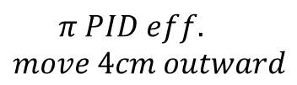




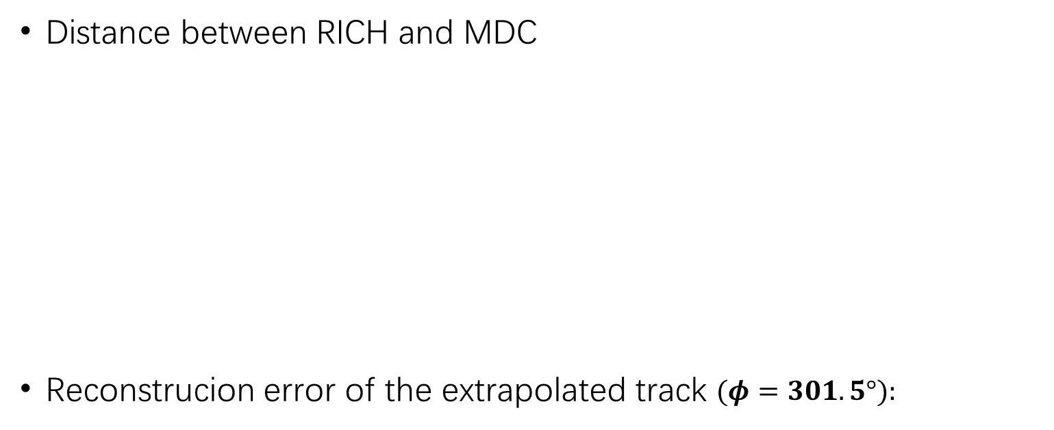


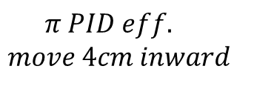


Performance evaluation
Distance between RICH and MDC
Reconstrucion error of the extrapolated track $(φ=301.5°):$
$$π PID eff.$$
$$move 4cm inward$$
$$π PID eff.$$
$$move 4cm outward$$
$$mm$$
$$mrad$$
$$mm$$
$$mrad$$
$$Δx$$
$$Δα$$
$$Δx$$
$$Δα$$

Slide 8
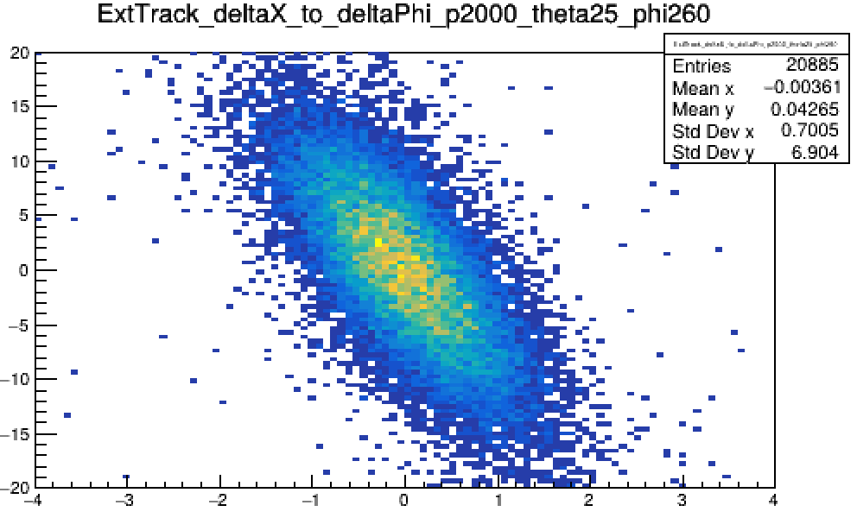
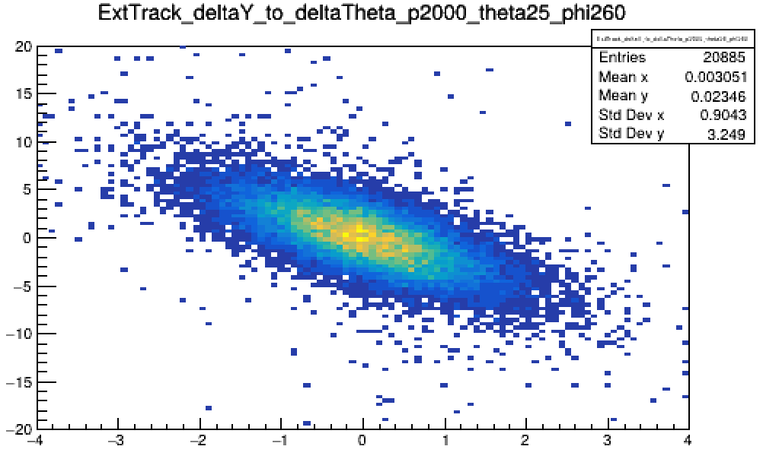
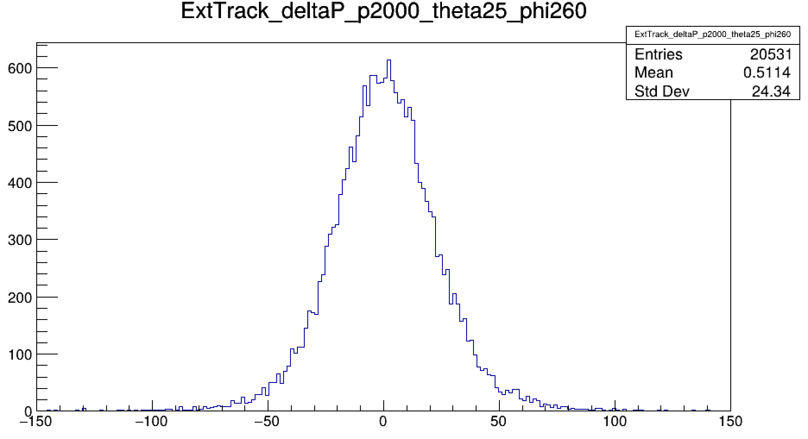








Performance evaluation
How tracking resolution impact on PID performance
  5D-Error Hist:$\left[Δx , Δy , Δθ , Δφ ,Δ\left|\vec{p}\right|\right]$
    $π , p=2GeV/c , θ=25° , φ=260°$
  RICH $→$ numerical algorithms + MLE $→$ Monte Carlo smearing
$$Δφ / mrad$$
$$Δθ/mrad$$
$$Δx / mm$$
$$Δy/mm$$
$$Δ\left|\vec{p}\right|/ MeV⋅c^{−1}$$
$$with MCTruth ExtTrack$$
$with MCTruth ExtTrack+Gaussian smearing (σ)$
$$PIDeff.$$
$with MCTruth ExtTrack+Gaussian smearing (Cov. Matrix)$
$with MCTruth ExtTrack+histogram−based inverse CDF sampling$
$with MDC Rec. ExtTrack$

Slide 9
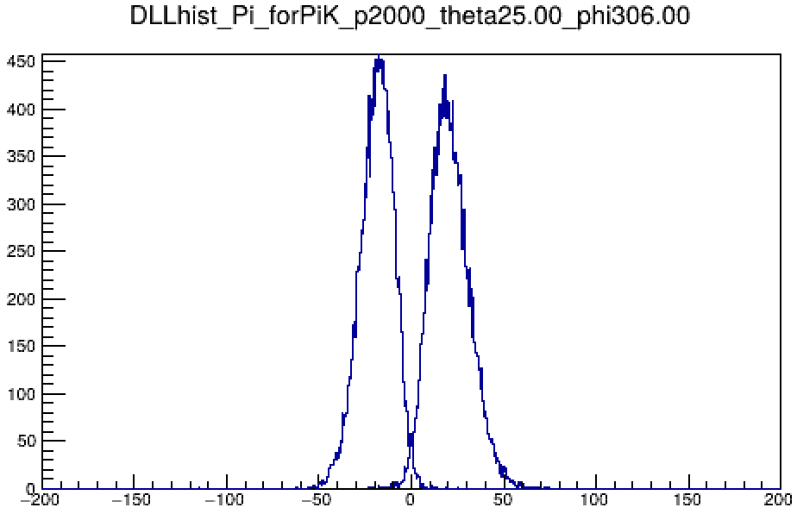
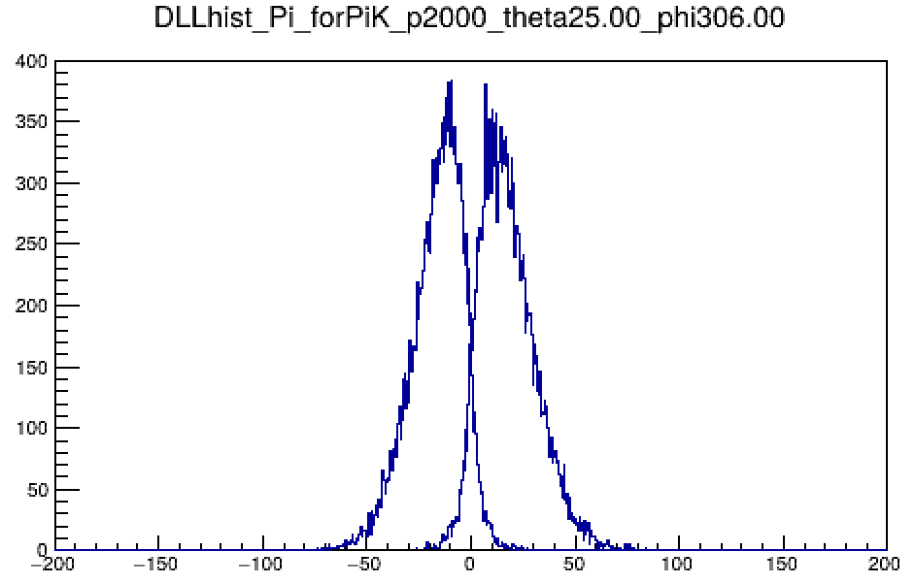
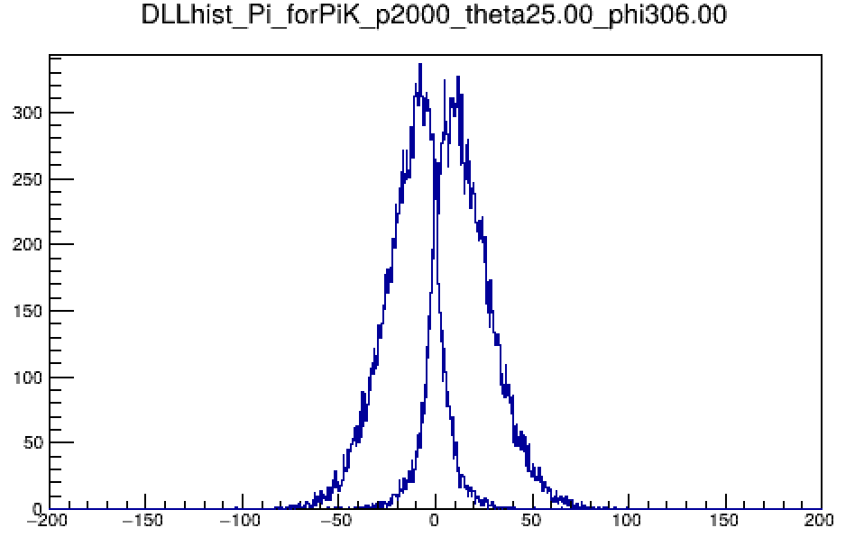
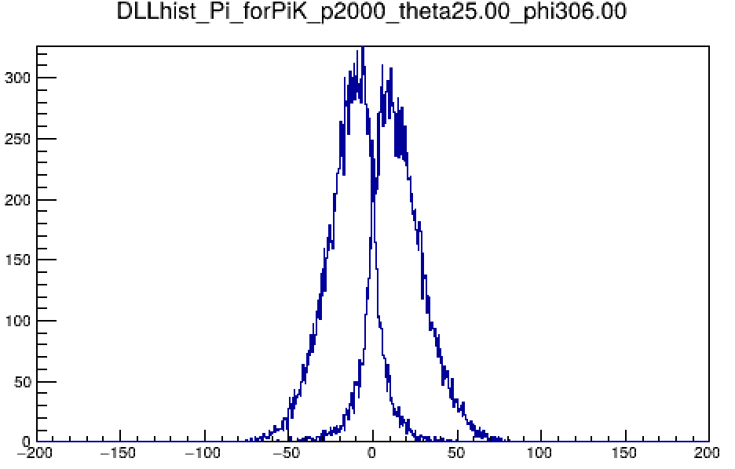
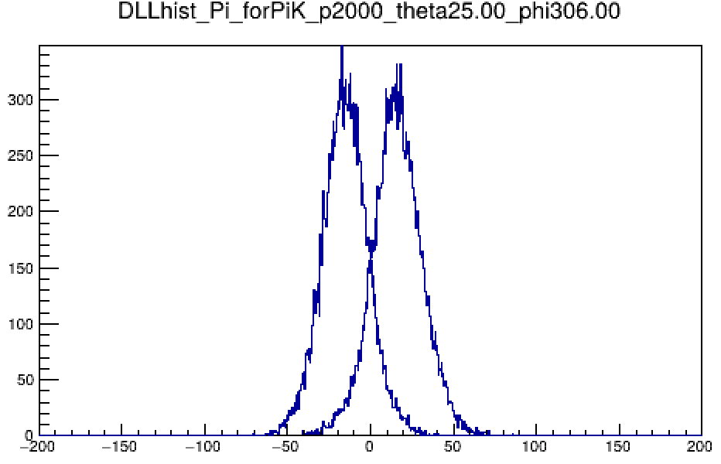
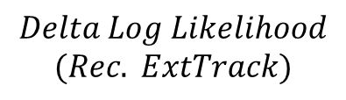
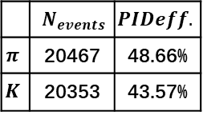
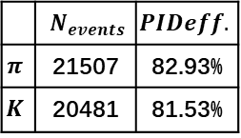
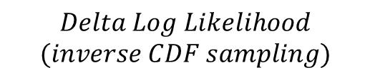
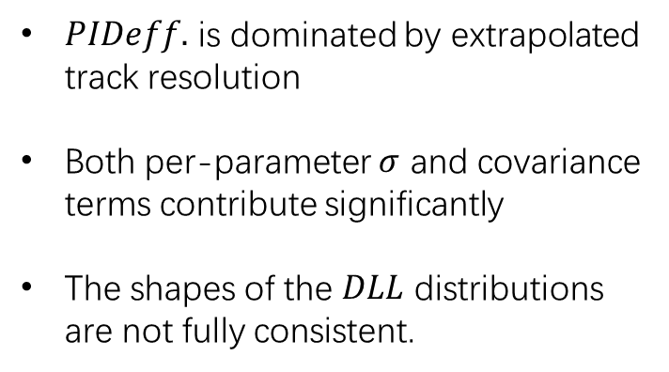
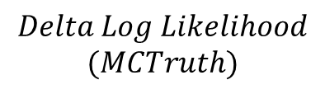
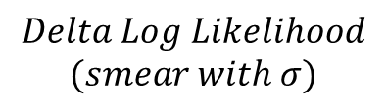
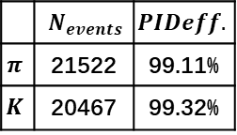
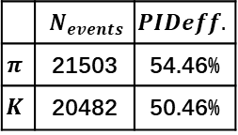
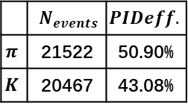
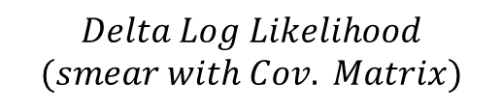
Performance evaluation
Sim. : $p=2GeV/c±50MeV/c, θ=25°±0.125° , φ=306°±0.125°$
Cut: $\left|Δx\right|, \left|Δy\right|≤10mm, \left|Δθ\right|≤50mrad , \left|Δφ\right|≤100mrad ,\left|Δ\left|\vec{p}\right|\right|≤200MeV$
 | $$N_{events}$$ | $$PIDeff.$$
$$π$$ | 21522 | 99.11%
$$K$$ | 20467 | 99.32%
 | $$N_{events}$$ | $$PIDeff.$$
$$π$$ | 21507 | 82.93%
$$K$$ | 20481 | 81.53%
 | $$N_{events}$$ | $$PIDeff.$$
$$π$$ | 21503 | 54.46%
$$K$$ | 20482 | 50.46%
$$Delta Log Likelihood$$
$$(MCTruth)$$
$$Delta Log Likelihood$$
$$(smear with σ)$$
$$Delta Log Likelihood$$
$$(smear with Cov. Matrix)$$
 | $$N_{events}$$ | $$PIDeff.$$
$$π$$ | 20467 | 48.66%
$$K$$ | 20353 | 43.57%
 | $$N_{events}$$ | $$PIDeff.$$
$$π$$ | 21522 | 50.90%
$$K$$ | 20467 | 43.08%
$PIDeff.$ is dominated by extrapolated track resolution
Both per-parameter $σ$ and covariance terms contribute significantly
The shapes of the $DLL$ distributions are not fully consistent.
$$Delta Log Likelihood$$
$$(inverse CDF sampling)$$
$$Delta Log Likelihood$$
$$(Rec. ExtTrack)$$

Slide 10














Performance evaluation
Effective coverage angle:
  $θ∈(20°,28°)$
  Dodecagon
  Cherenkov photon propagates within a forward-pointing cone
Cherenkov Photon Hit Map:
  $π , p=2GeV/c , φ=264°$
$$π PID eff. (p=2GeV/c)$$
$$φ∈(0,360°)$$
$$θ=20°$$
$$θ=26°$$
$$θ=27°$$
$$θ=28°$$
$$θ=29°$$

Slide 11





Performance evaluation
Geometric shadowing effect
$π/K seperation$
$$θ in deg$$
$$π PID eff.$$
$$with MissID from K=2\%$$
$$Momentum(MeV/c)$$
Cherenkov ring overlap
π (C₆F₁₄) vs K (quartz)

Slide 12




Performance evaluation
$K/P seperation$
$$θ in deg$$
$$K PID eff.$$
$$with MissID from Proton=2\%$$
$$Momentum(MeV/c)$$

Slide 13



Summary
Design specifications for the STCF end-cap PID detector:
  $PIDeff. ≥97\% \&\& MissID≤2\%$
The $π/K$ PID performance of RICH fails to meet the requirements with the current structure:
  Main cause: sensitive to the material budget of the MDC end-cap and the resolution of extrapolated tracks
Future directions for simulation studies:
  Insert a low-material-budget tracking detector between the MDC end-cap and the RICH detector
Reference Tracking Detector

Slide 14
BackUp

Slide 15

$EndCap RICH$
设探测器有M个像素，第k个像素上，期望光子数为 $μ_{k}$
$${N_{pe}=Σ_{k}^{M}μ}_{k}, μ_{k}=N_{pe}⋅pdf(x_{hit},y_{hit})$$
每个像素的击中数$n_{k}$独立地服从泊松分布$Possion(n_{k};μ_{k})$, 当一条径迹入射，总概率：
$$Likelihood=Π_{k}^{M}\frac{e^{−μ_{k}}⋅μ_{k}^{n_{k}}}{n_{k}!}$$
  有击中的像素：$n_{k}≥1 , P_{pad}=\frac{e^{−μ_{k}}⋅μ_{k}^{n_{k}}}{n_{k}!}$
  无击中的像素：$n_{k}=0, P_{pad}=e^{−μ_{k}}$
如果某径迹总共在m个pad上产生了信号，
$$Likelihood=Π_{k}^{m}\frac{e^{−μ_{k}}⋅μ_{k}^{n_{k}}}{n_{k}!}⋅Π_{k}^{M−m}e^{−μ_{k}}=Π_{k}^{M}e^{−μ_{k}}⋅Π_{k}^{m}\left(\frac{μ_{k}^{n_{k}}}{n_{k}!}\right)$$
假设这m个pad上，接收到的切伦科夫光子都分别为1 $(n_{k}=1)$
$$Likelihood=Π_{k}^{M}e^{−μ_{k}}⋅Π_{k}^{m}\left(μ_{k}\right)=Π_{k}^{M}e^{−μ_{k}}⋅N_{pe}^{m}⋅Π_{k}^{m} pdf\left(x_{hit},y_{hit}\right)$$
$$=e^{−Σ_{k}^{M}μ_{k}}⋅N_{pe}^{m}⋅Π_{k}^{m} pdf\left(x_{hit},y_{hit}\right)=e^{−Npe}⋅N_{pe}^{m}⋅Π_{k}^{m} pdf\left(x_{hit},y_{hit}\right)$$
对数似然值：$lnL=−Npe+mln\left(Npe\right)+Σ_{k}^{m}ln⁡[pdf\left(x_{hit},y_{hit}\right)]$

Slide 16






$EndCap RICH$
协方差矩阵：
$$Σ=\left[\begin{matrix}σ_{x}^{2} & Cov\left(x,y\right) & Cov\left(x,θ\right) & Cov\left(x,φ\right) & Cov\left(x,P\right) \\ Cov\left(y,x\right) & σ_{y}^{2} & Cov\left(y,θ\right) & Cov\left(y,φ\right) & Cov\left(y,P\right) \\ Cov\left(θ,x\right) & Cov\left(θ,y\right) & σ_{θ}^{2} & Cov\left(θ,φ\right) & Cov\left(θ,P\right) \\ Cov\left(φ,x\right) & Cov\left(φ,y\right) & Cov\left(φ,θ\right) & σ_{φ}^{2} & Cov\left(φ,P\right) \\ Cov\left(P,x\right) & Cov\left(P,y\right) & Cov\left(P,θ\right) & Cov\left(P,φ\right) & σ_{P}^{2}\end{matrix}\right]$$
$Cov\left(i,j\right)=\frac{1}{N−1}Σ_{k=1}^{N}(x_{i,k}−{\overline{x}}_{i})(x_{j,k}−{\overline{x}}_{j})$

Slide 17

$EndCap RICH$
去除散点，$Cut$：
$$\text{abs(deltaX) > 20 || abs(deltaY) > 20 || abs(deltaTheta) > 40 || abs(deltaPhi) > 80 || abs(deltaP) > 200)}$$

Slide 18













$EndCap RICH$
$$MCTruth$$
$$MCTruth$$
$CovMatrix smear$
$$MCTruth$$
$$5D−ErrorHist sampling$$
$$RecExtTrack$$
 | $$π$$ | $$K$$
$$N_{events}$$ | 20531 | 18958
$$PIDeff.$$ | 99.57% | 99.41%
 | $$π$$ | $$K$$
$$N_{events}$$ | 20541 | 18950
$$PIDeff.$$ | 98.06% | 98.09%
 | $$π$$ | $$K$$
$$N_{events}$$ | 19115 | 16435
$$PIDeff.$$ | 95.38% | 95.26%
 | $$π$$ | $$K$$
$$N_{events}$$ | 20531 | 18958
$$PIDeff.$$ | 95.68% | 95.55%
$\left[Δx , Δy , Δθ , Δφ ,Δ\left|\vec{p}\right|\right]$的$σ, Cov.,非$高斯成分 都有一定贡献
Notes:
模拟经过MDC横梁的点，更有说服力。在backup里补充σ，协方差，非高斯尾巴的细节

