Slide 1

STCF BTOF Simulation, Digitization and Reconstruction
Speaker : Teng Ma

Slide 2
OutLine
Introduction
Optimization
Full-Chain Analysis
--- Simulation
--- Digitization
--- Reconstruction
Summary

Slide 3
_{Introduction}

Slide 4
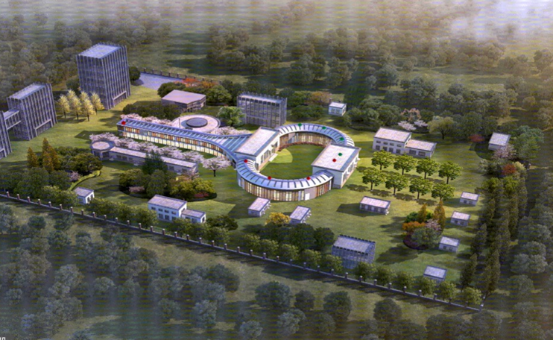
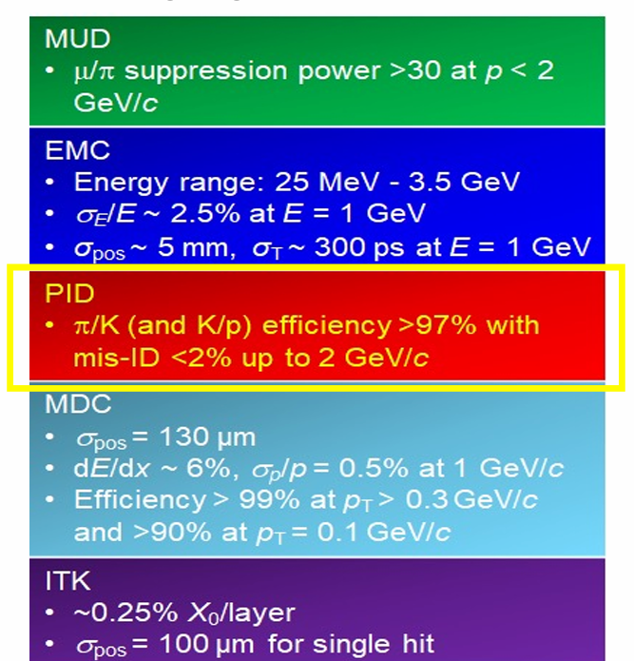
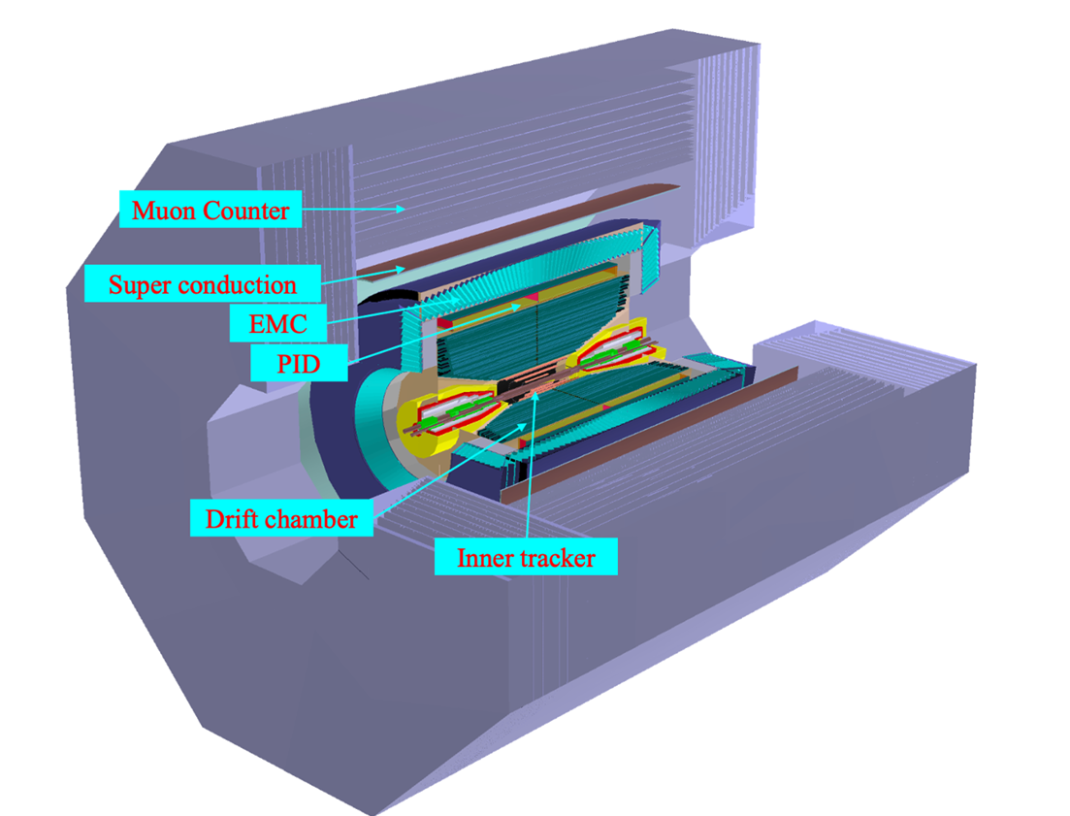
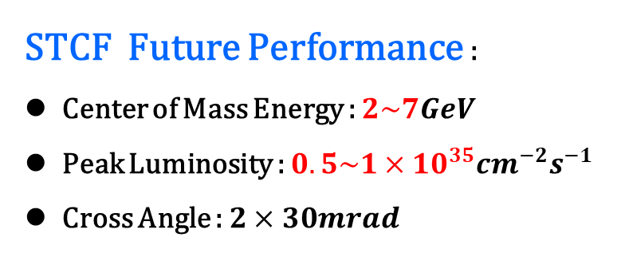
STCF Introduction
STCF Future Performance :
Center of Mass Energy : $2\sim 7GeV$
Peak Luminosity : $0.5\sim 1×{10}^{35}{cm}^{−2}s^{−1}$
Cross Angle : $2×30mrad$

Slide 5
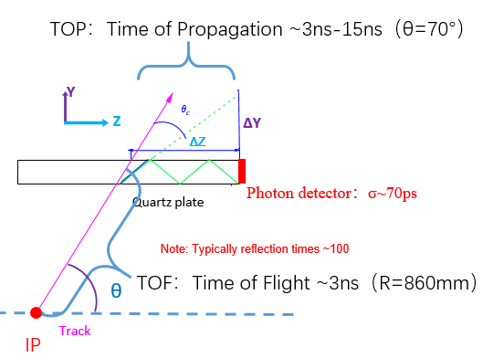
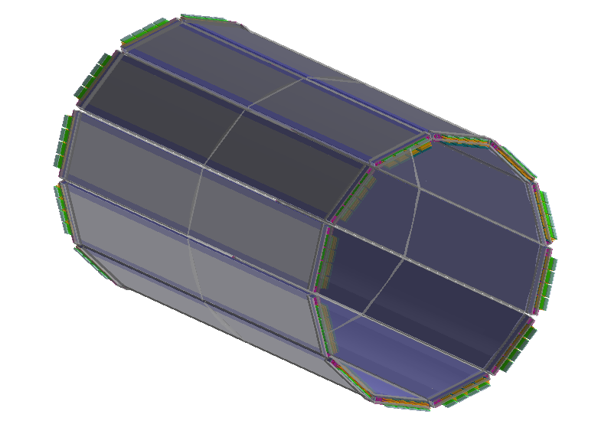
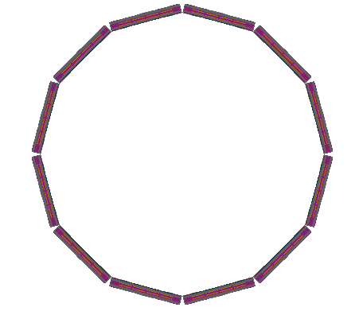
BTOF Introduction
High time precision acquired with MCP-PMT
Dispersion effect need to be reduced (Add wavelength filter)
Consistent with electronics of DTOF detector
(R~885mm)

Slide 6
_{Optimization}

Slide 7
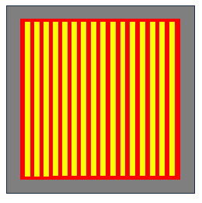
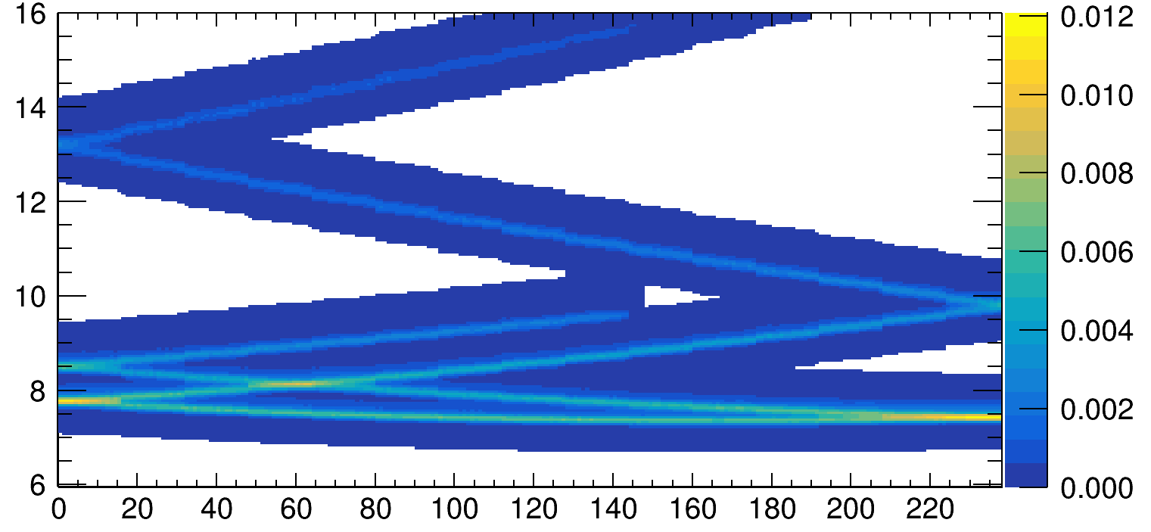
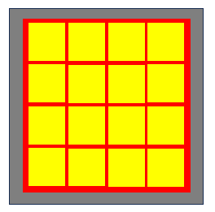
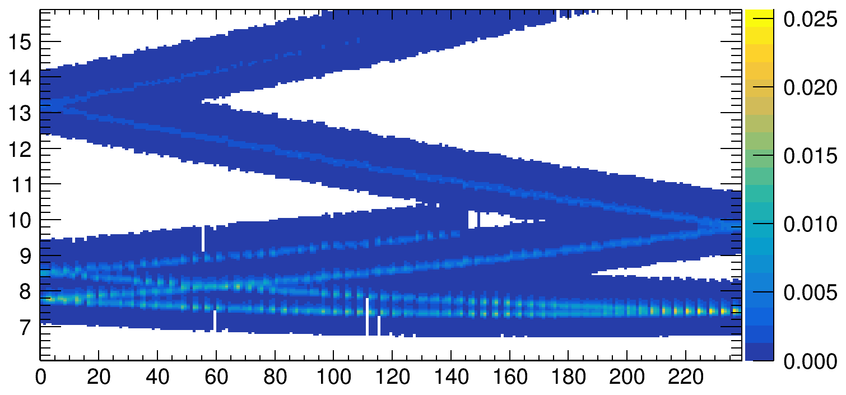
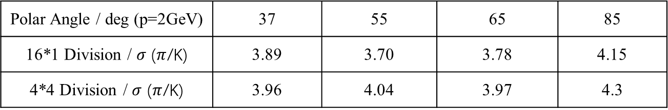
Pixels Optimization
Polar Angle / deg (p=2GeV) | 37 | 55 | 65 | 85
16*1 Division / $σ$ ($π$/K) | 3.89 | 3.70 | 3.78 | 4.15
4*4 Division / $σ$ ($π$/K) | 3.96 | 4.04 | 3.97 | 4.3

Slide 8
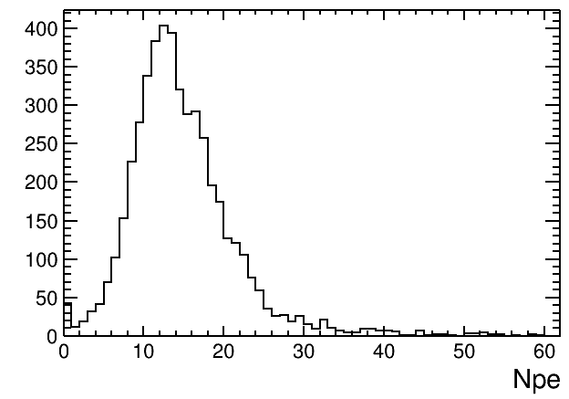
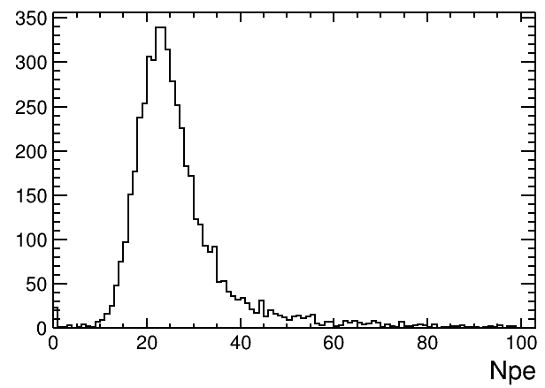

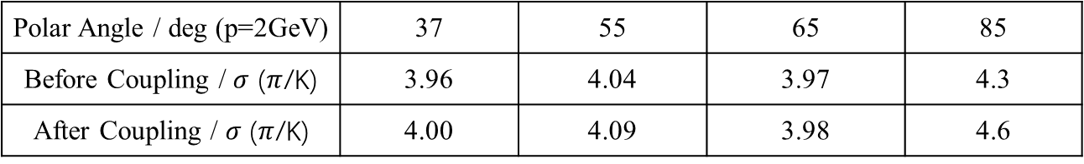
Geometry Optimization
In each sector, two silicon quartzs are connected with grease instead of absorbing coat on inner side.
Performance when large polar angle is hoped to be improved.
Much improved!
$N_{pe}$ Comparison (85$°$ polar angle)
Polar Angle / deg (p=2GeV) | 37 | 55 | 65 | 85
Before Coupling / $σ$ ($π$/K) | 3.96 | 4.04 | 3.97 | 4.3
After Coupling / $σ$ ($π$/K) | 4.00 | 4.09 | 3.98 | 4.6

Slide 9
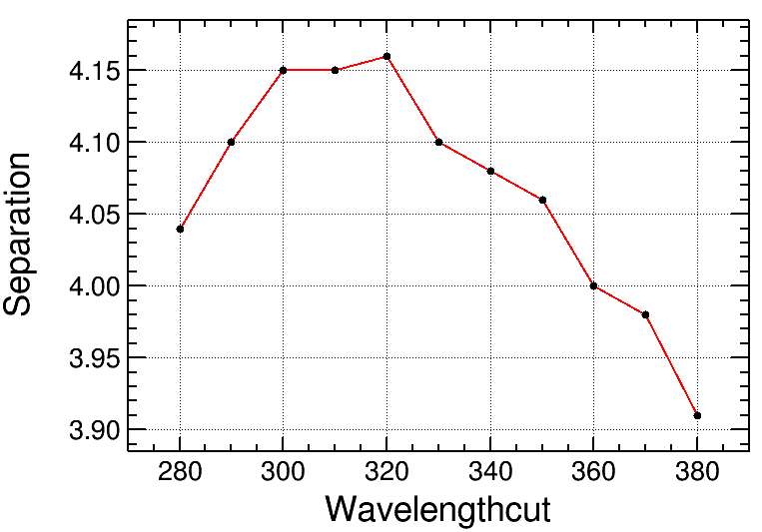
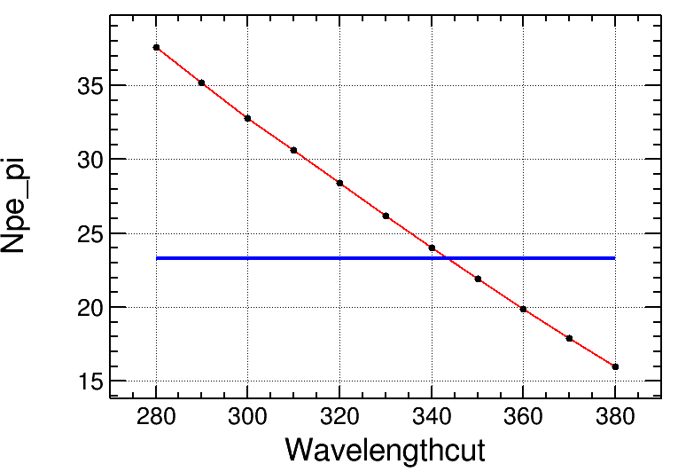
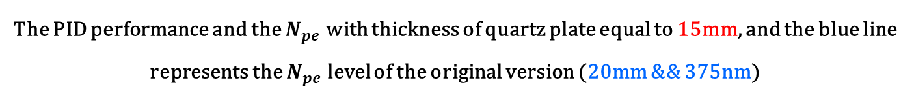
Geometry change
To reduce the material and ensure eough number of photon electron, the thickness of quartz plate is reduced to 15mm, and the wavelength cut is chosen to be 320nm.
The PID performance and the $N_{pe}$ with thickness of quartz plate equal to 15mm, and the blue line represents the $N_{pe}$ level of the original version (20mm && 375nm)

Slide 10
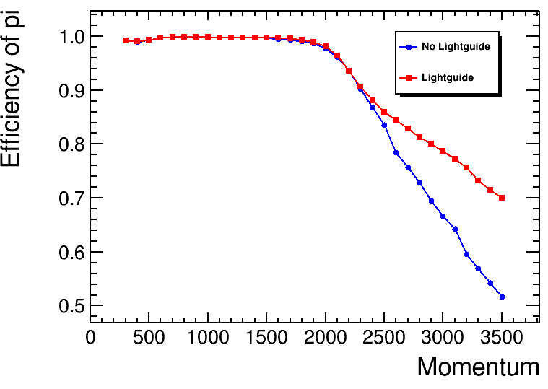
Geometry Optimization
An extra optical expansion is added on the outer side of the quartz plate
Performance at high momentum will be obviously improved.
15mm
Θ=65°
Φ=90°
25mm

Slide 11

Full-Chain Analysis
Geometry
Bkg mix
Simulation
Digitization
Manager
Electronic
RunAction
Time-walk effect
PDHit
EventAction
PD information after Digi
Dead time
TrackingAction
BarHit
Digi Parameter
SteppingAction
$T_{0}$ Uncertainty
Reconstruction

Slide 12
Simulation

Slide 13
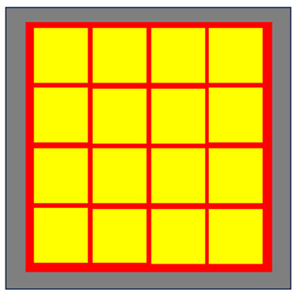
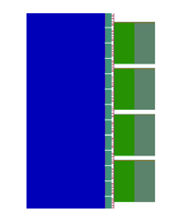

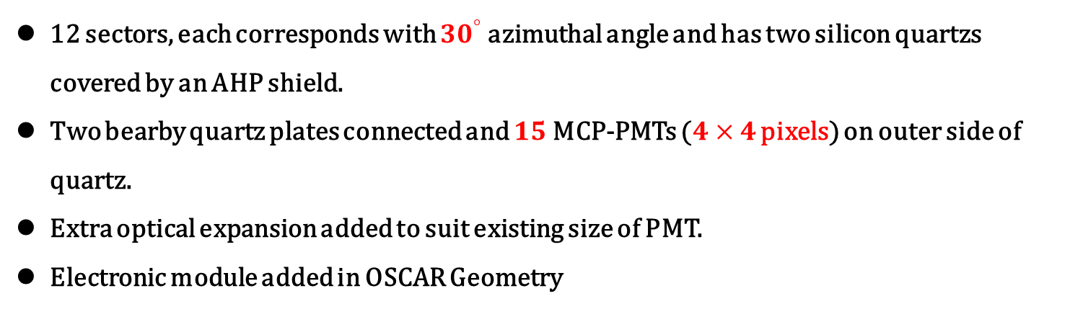
BTOF Geometry
12 sectors, each corresponds with ${30}^{°}$ azimuthal angle and has two silicon quartzs covered by an AHP shield.
Two bearby quartz plates connected and $15$ MCP-PMTs ($4×4$ pixels) on outer side of quartz.
Extra optical expansion added to suit existing size of PMT.
Electronic module added in OSCAR Geometry
80mm
80mm
450mm
15mm
1515mm

Slide 14
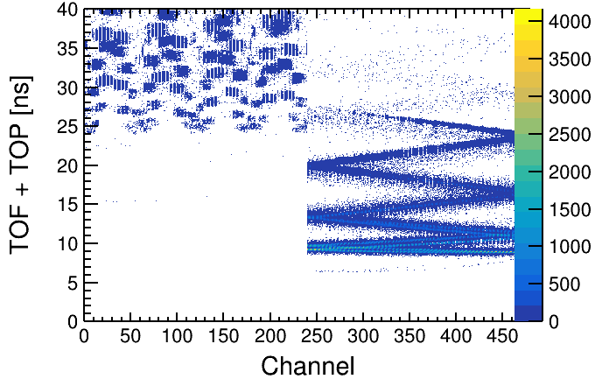
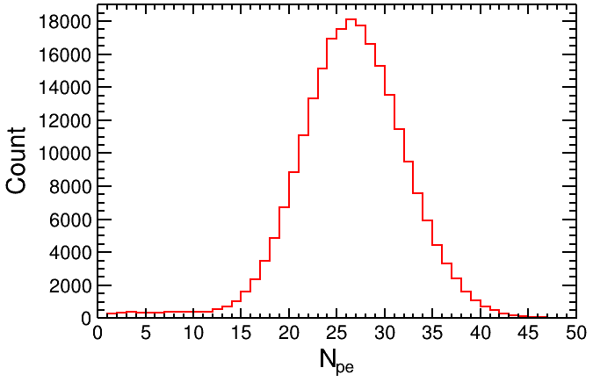
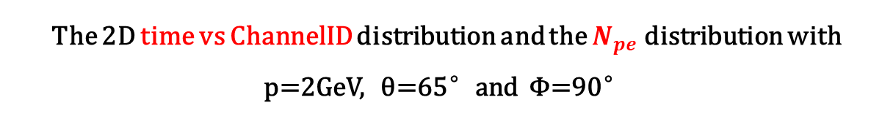
Simulation Result
The 2D time vs ChannelID distribution and the $N_{pe}$ distribution with p=2GeV, θ=65°and Φ=90°

Slide 15
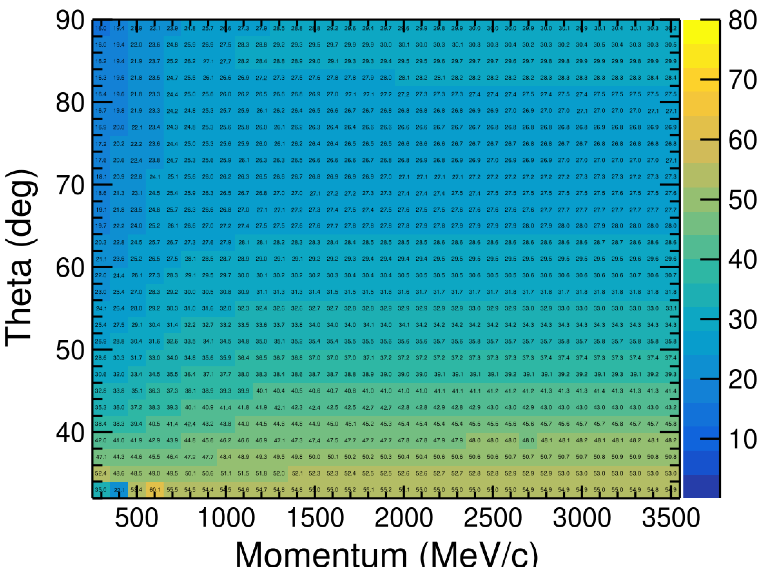

$N_{pe}$Distribution
$N_{pe}$ distribution of pion

Slide 16
_{Di}gitization

Slide 17
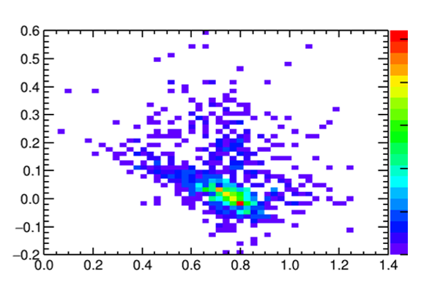
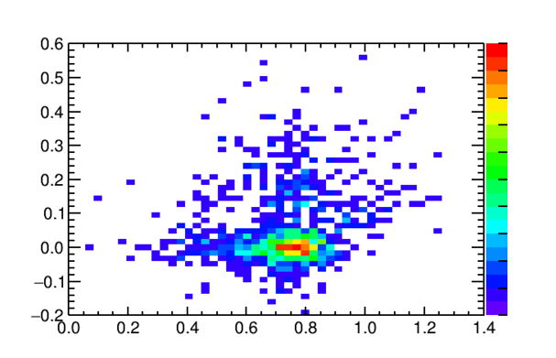
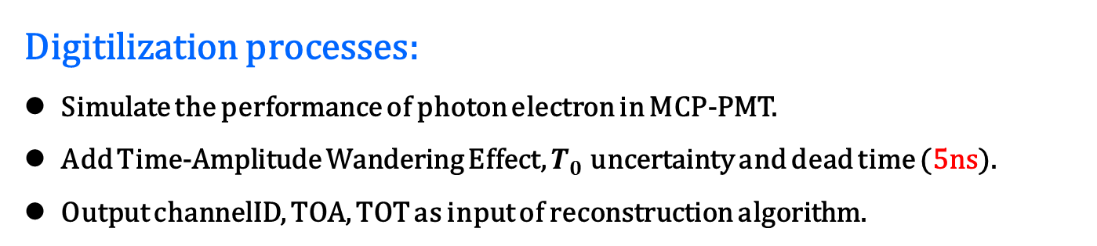
BTOF Digitilization
Digitilization processes:
Simulate the performance of photon electron in MCP-PMT.
Add Time-Amplitude Wandering Effect, $T_{0}$ uncertainty and dead time (5ns).
Output channelID, TOA, TOT as input of reconstruction algorithm.
Digitilization parameters:
TOT = TOTDis->GetRandom() (3 Gauss)
TTS = TTSDis->GetRandom() (2 Gauss)
TOTtru = TOT + Gaus(0, 10ps)
TOTMEAN = 780ps TOT_CALIPAR = 0.35
TOA = time + TTS + (TOTtru - TOTMEAN) * TOTCALIPAR
TOA-Timetru : TOT
TOA-Timetru : TOT
(after correction)

Slide 18
_{Reconstruction}

Slide 19
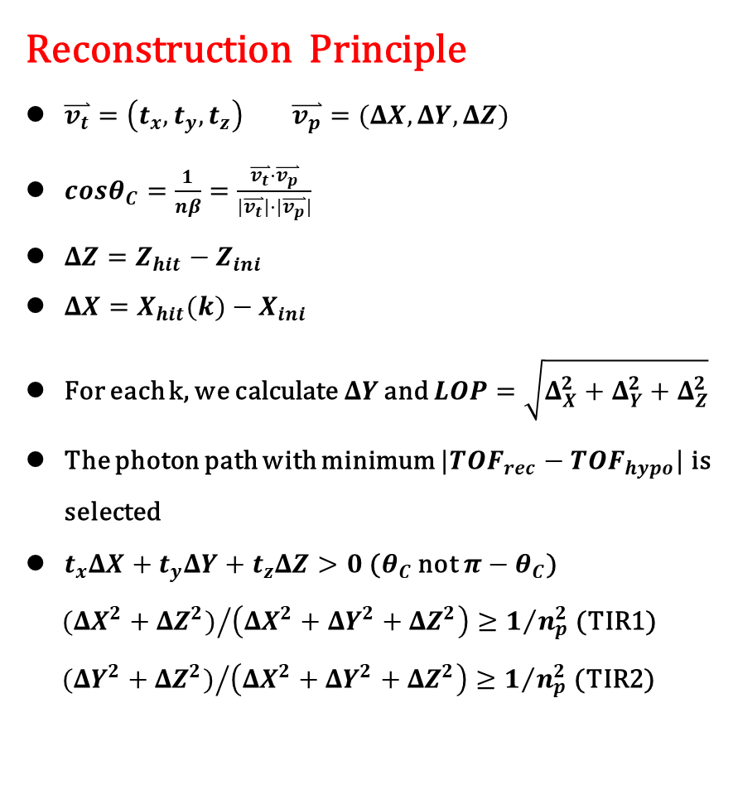
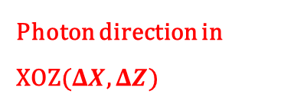



Timing Method
Reconstruction Principle
$\overset{⃑}{v_{t}}=\left(t_{x},t_{y},t_{z}\right) \overset{⃑}{v_{p}}=(ΔX, ΔY,ΔZ)$
$cosθ_{C}=\frac{1}{nβ}=\frac{\overset{⃑}{v_{t}}⋅\overset{⃑}{v_{p}}}{|\overset{⃑}{v_{t}}|⋅|\overset{⃑}{v_{p}}|}$
$ΔZ=Z_{hit}−Z_{ini}$
$ΔX=X_{hit}(k)−X_{ini}$
For each k, we calculate$ΔY$ and $LOP=\sqrt{Δ_{X}^{2}+Δ_{Y}^{2}+Δ_{Z}^{2}}$
The photon path with minimum $|{TOF}_{rec}−{TOF}_{hypo}|$ is selected
$t_{x}ΔX+t_{y}ΔY+t_{z}ΔZ>0$ ($θ_{C}$ not $π−θ_{C}$)
${({ΔX}^{2}+{ΔZ}^{2})}/{\left({ΔX}^{2}+{ΔY}^{2}+{ΔZ}^{2}\right)≥1/{n_{p}^{2}}}$ (TIR1)
${({ΔY}^{2}+{ΔZ}^{2})}/{\left({ΔX}^{2}+{ΔY}^{2}+{ΔZ}^{2}\right)≥1/{n_{p}^{2}}}$ (TIR2)
Photon direction in XOZ($ΔX$, $ΔZ$)
$$k_{1}$$
$$k_{0}$$
$$k_{−1}$$
XOZ Plane

Slide 20
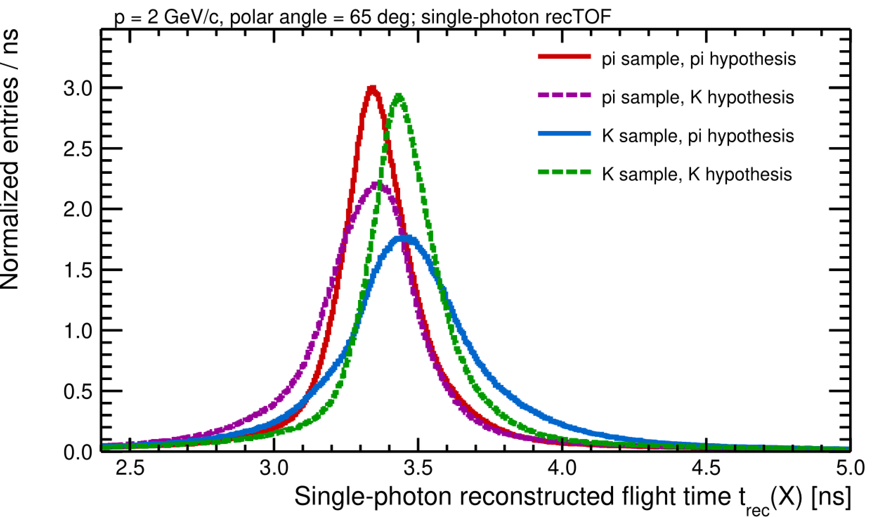
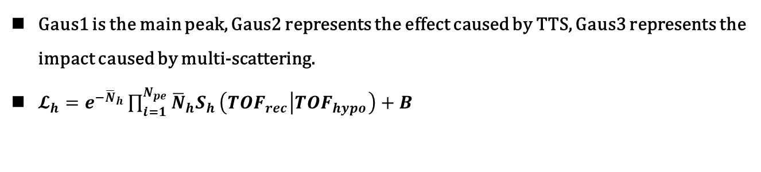
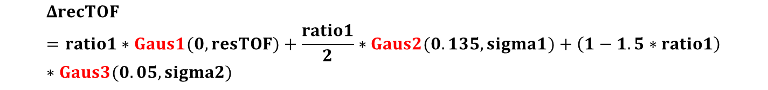
Timing Method
$Δ$recTOF (${TOF}_{rec}−{TOF}_{hypo}$) distribution can be described with 3 Gauss model :
$$ΔrecTOF=ratio1∗Gaus1(0,resTOF)+\frac{ratio1}{2}∗Gaus2(0.135,sigma1)+\left(1−1.5∗ratio1\right)∗Gaus3(0.05,sigma2)$$
Gaus1 is the main peak, Gaus2 represents the effect caused by TTS, Gaus3 represents the impact caused by multi-scattering.
$𝓛_{h}=e^{−{\overline{N}}_{h}}\prod_{i=1}^{N_{pe}}{{\overline{N}}_{h}S_{h}}\left({TOF}_{rec} | {TOF}_{hypo}\right)+B$

Slide 21
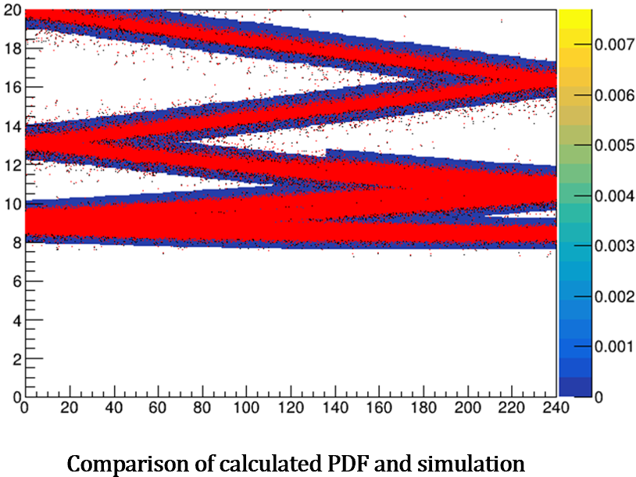
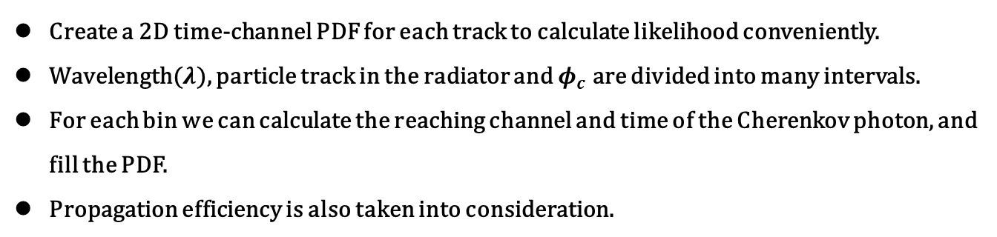
Imaging Method
Create a 2D time-channel PDF for each track to calculate likelihood conveniently.
Wavelength($λ$), particle track in the radiator and $φ_{c}$ are divided into many intervals.
For each bin we can calculate the reaching channel and time of the Cherenkov photon, and fill the PDF.
Propagation efficiency is also taken into consideration.
The red dots and COLZ PDF represent simulation data and calculated PDF
Good agreement between calculated pattern and simulation

Slide 22
PID Performance

Slide 23
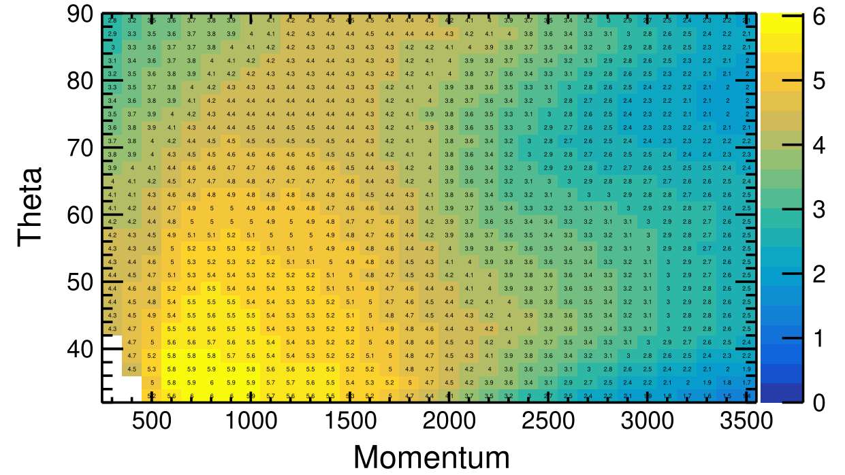
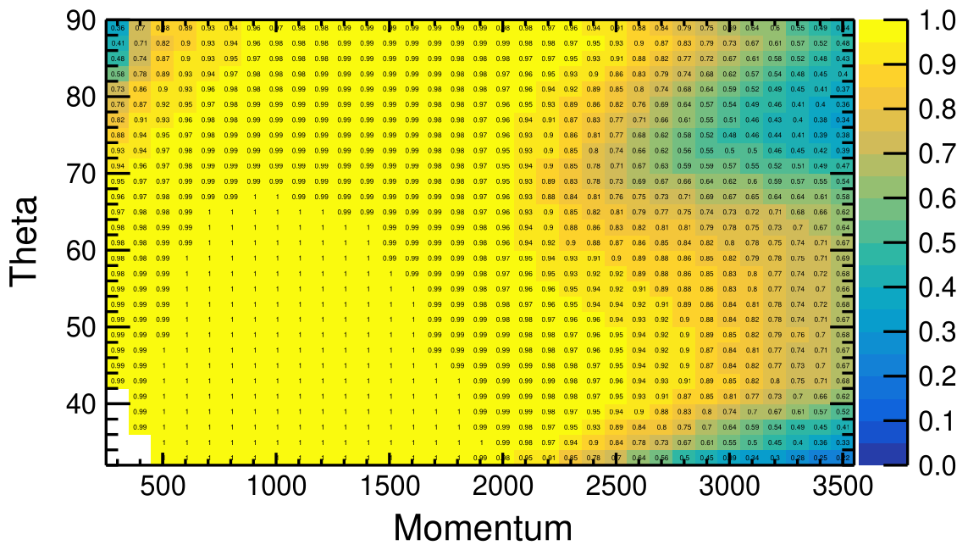
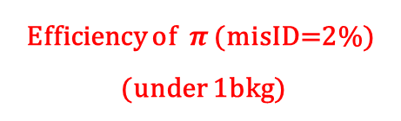
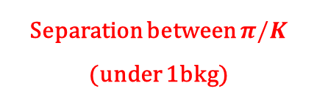

Performance between $π/K$
Separation between $π/K$
(under 1bkg)
Efficiency of $π$ (misID=2%)
(under 1bkg)

Slide 24
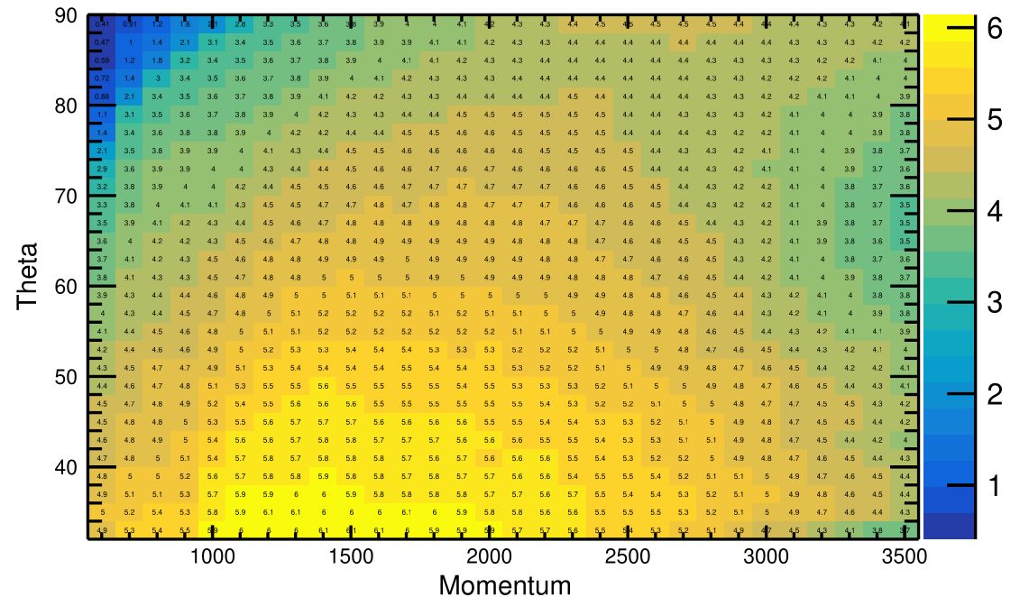
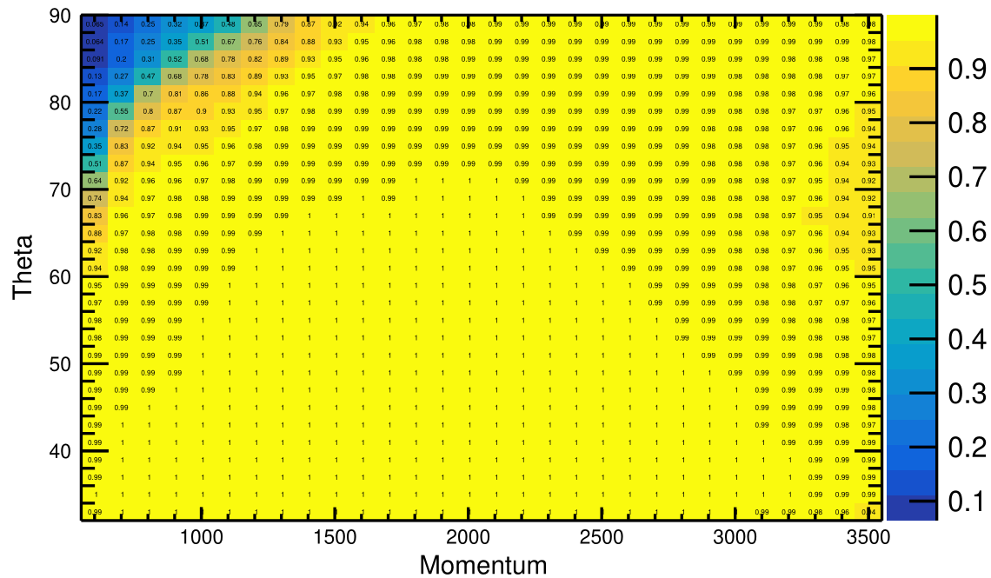
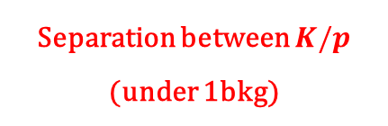

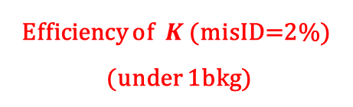
Performance between $K/p$
Separation between $K/p$
(under 1bkg)
Efficiency of $K$ (misID=2%)
(under 1bkg)

Slide 25

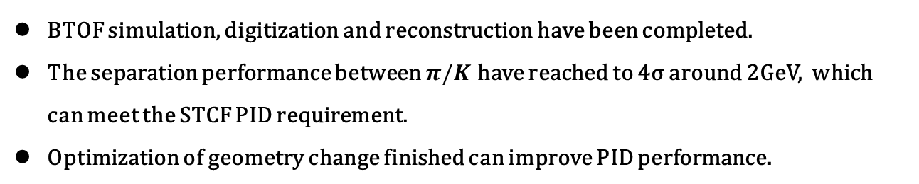
Summary
BTOF simulation, digitization and reconstruction have been completed.
The separation performance between $π/K$ have reached to 4σ around 2GeV, which can meet the STCF PID requirement.
Optimization of geometry change finished can improve PID performance.

Slide 26
Back Up

Slide 27
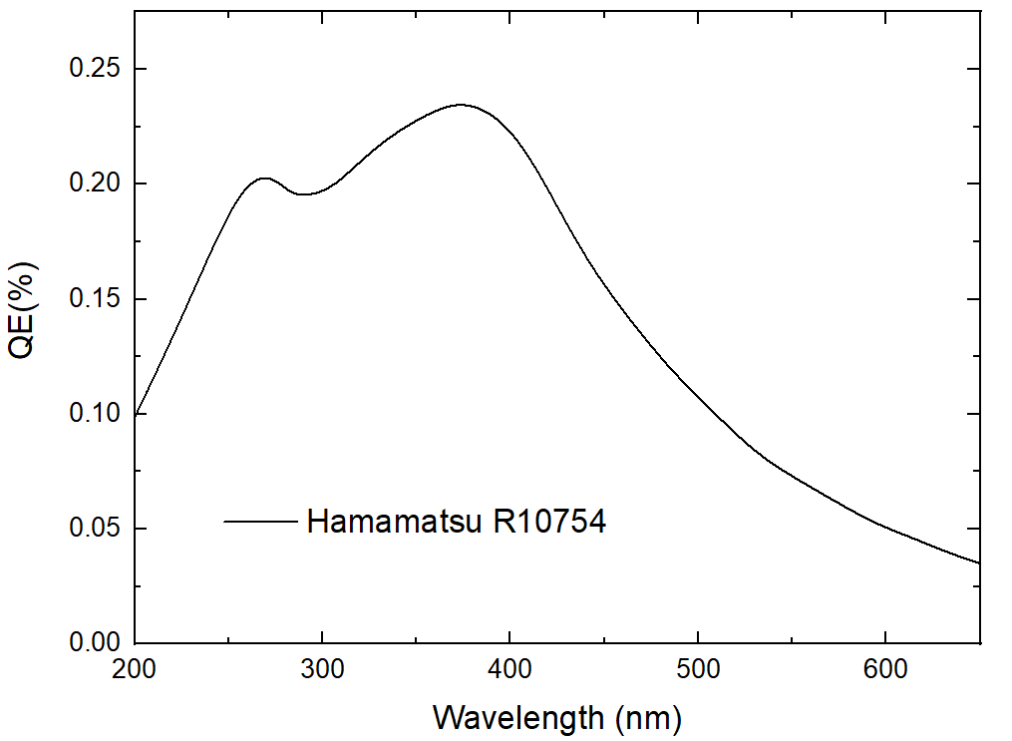
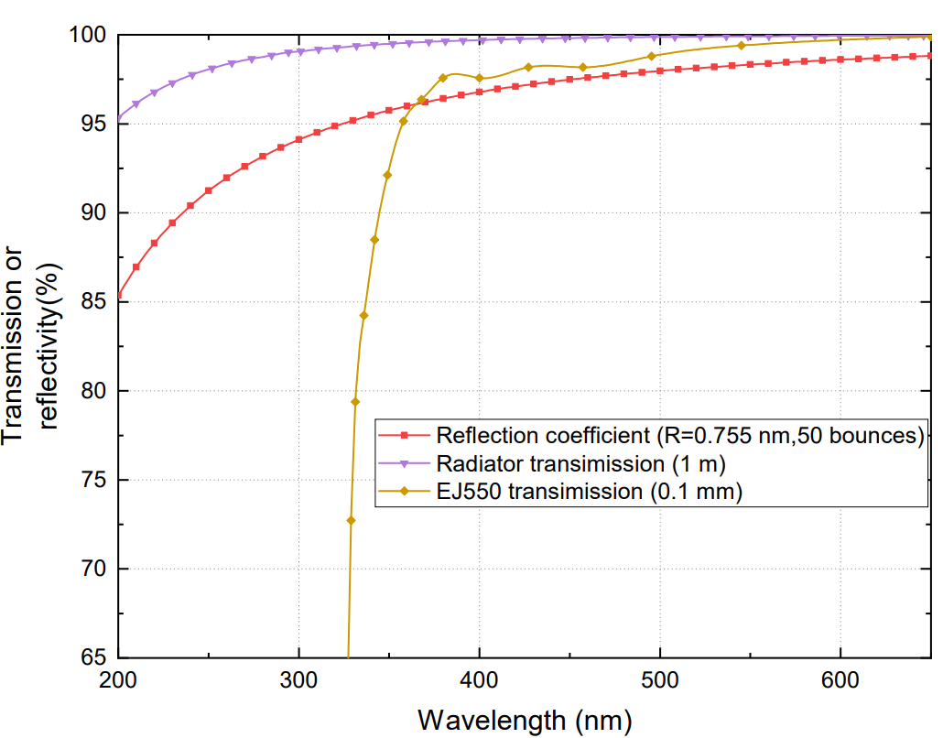
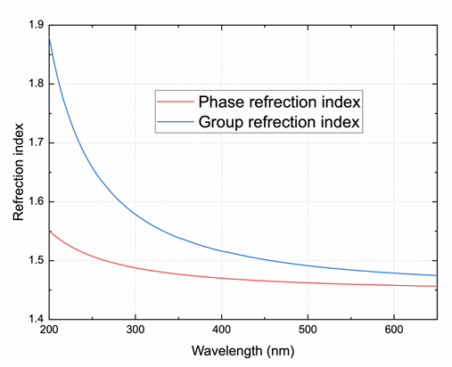
Simulation Parameter
Cherenkov photon with wavelength less than 320nm is neglected to reduce dispersion

