Slide 1
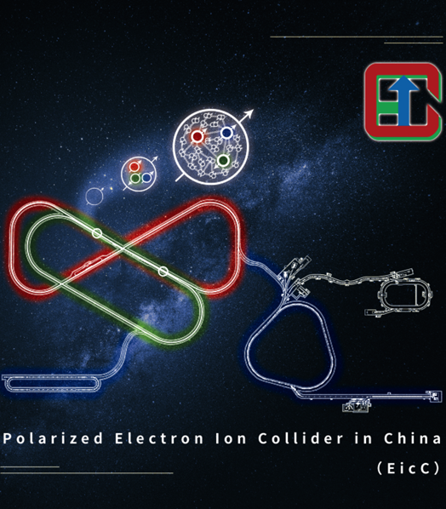


Introduction of Polarized Electron ion Collider in China-EicC
Aiqiang Guo (IMP, CAS)
On behalf of EicC working group
STCF Workshop - July 01-05 2026 @ XiAn

Slide 2
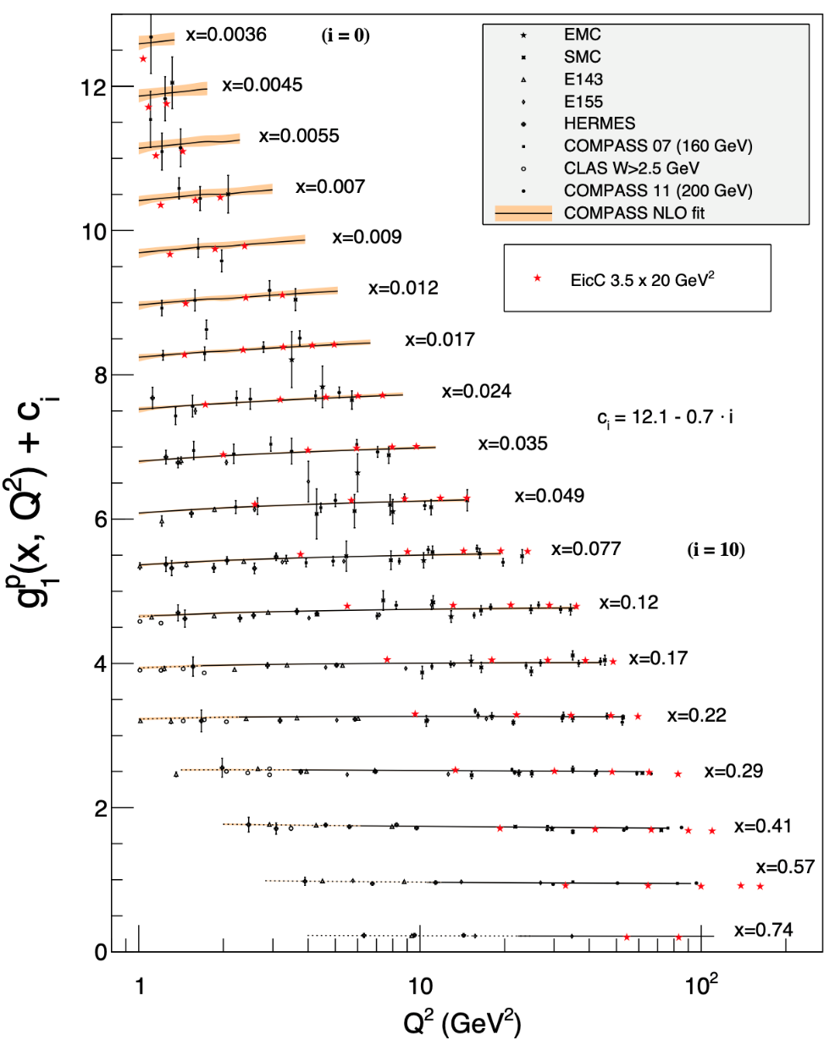
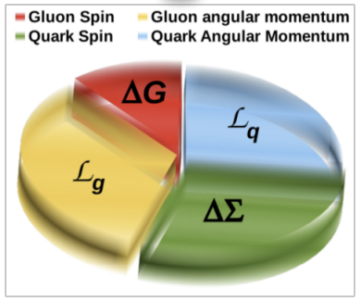
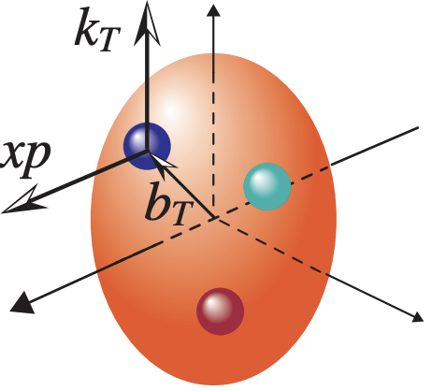

Nucleon spin crisis
Spin decomposition:
$S_{tot}=\frac{1}{2}= \frac{1}{2}∆Σ+∆G+$ $𝓛_{q}+𝓛_{g}$
Quark spin
Gluon spin
Quark angular momentum
Gloun angular momentum
Accurate measurement of the nucleon polarization structure functions to determine the contributions of quark and gluon spins.
Through three-dimensional tomographic imaging studies of the nucleon structure, researchers probe the transverse motion of quarks and gluons to investigate their orbital angular momentum.
$Understand the origin of the nucleon spin!$

Slide 3
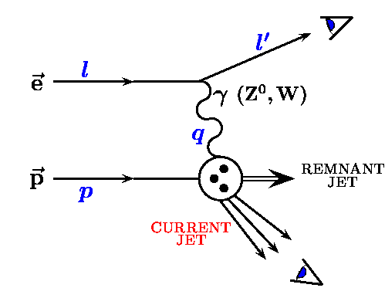
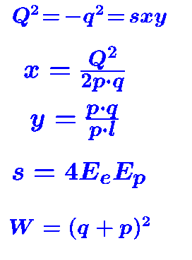
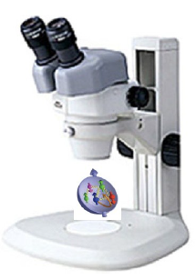
Lepton-Nucleon Scatterings
QED tool to study QCD nature of the nucleon
[1]
QED probe is clean
α_{EM} ~1/137 with broad Q coverage
One-photon exchange approximation:
~1% accuracy
Detection scale is determined by Q²:
1GeV² ~ nucleon size
[3]
[2]
Observe scattered electron/muon [1] → inclusive
Observe current jet/hadron [1]+[2] → semi-inclusive
Observe remnant jet/hadron as well [1]+[2]+[3] → exclusive
Electron Ion Collider (EIC), regarded as a “super electron microscope”

Slide 4
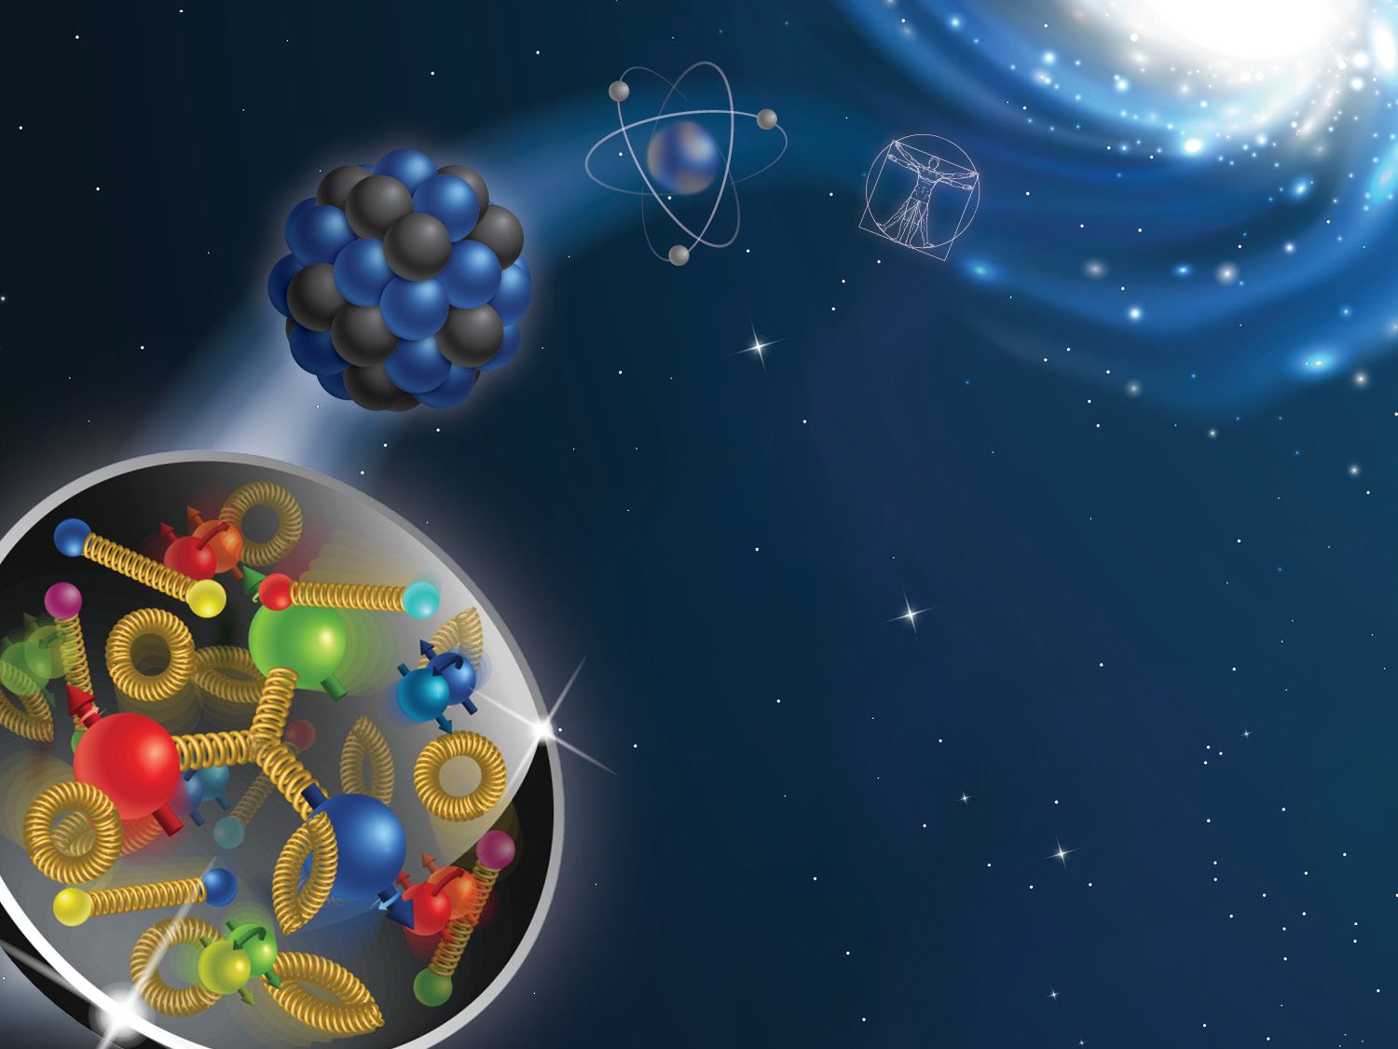
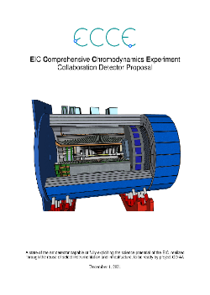


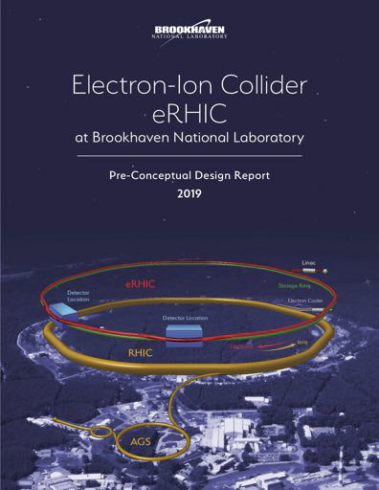
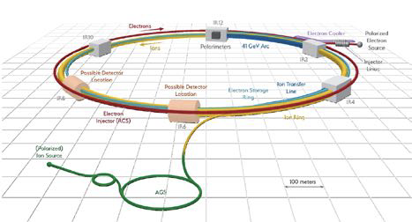
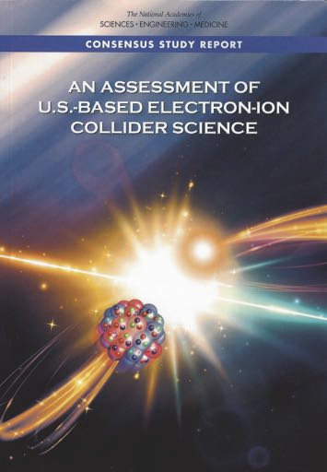


Status of development in US
Electron-ion collider (EIC)
center-mass-energy~100 GeV
2005: discussion in community
2007, 2015: Long Range Plan in the US
2015: EIC white paper
2019.12：EIC approved（BNL）
2020: EIC CDR
2021: EIC TDR
2022: Detector Design Fixed
2024: Start to build
2030: Data taking
2021
2020
2019
2018
2015
2022年3月
Fix the detector
2015
~1200 reserchers, ~230 institutes,
31 contries
US national labs:
ANL/BNL/JLAB/LANL/LBNL/ORNL

Slide 5
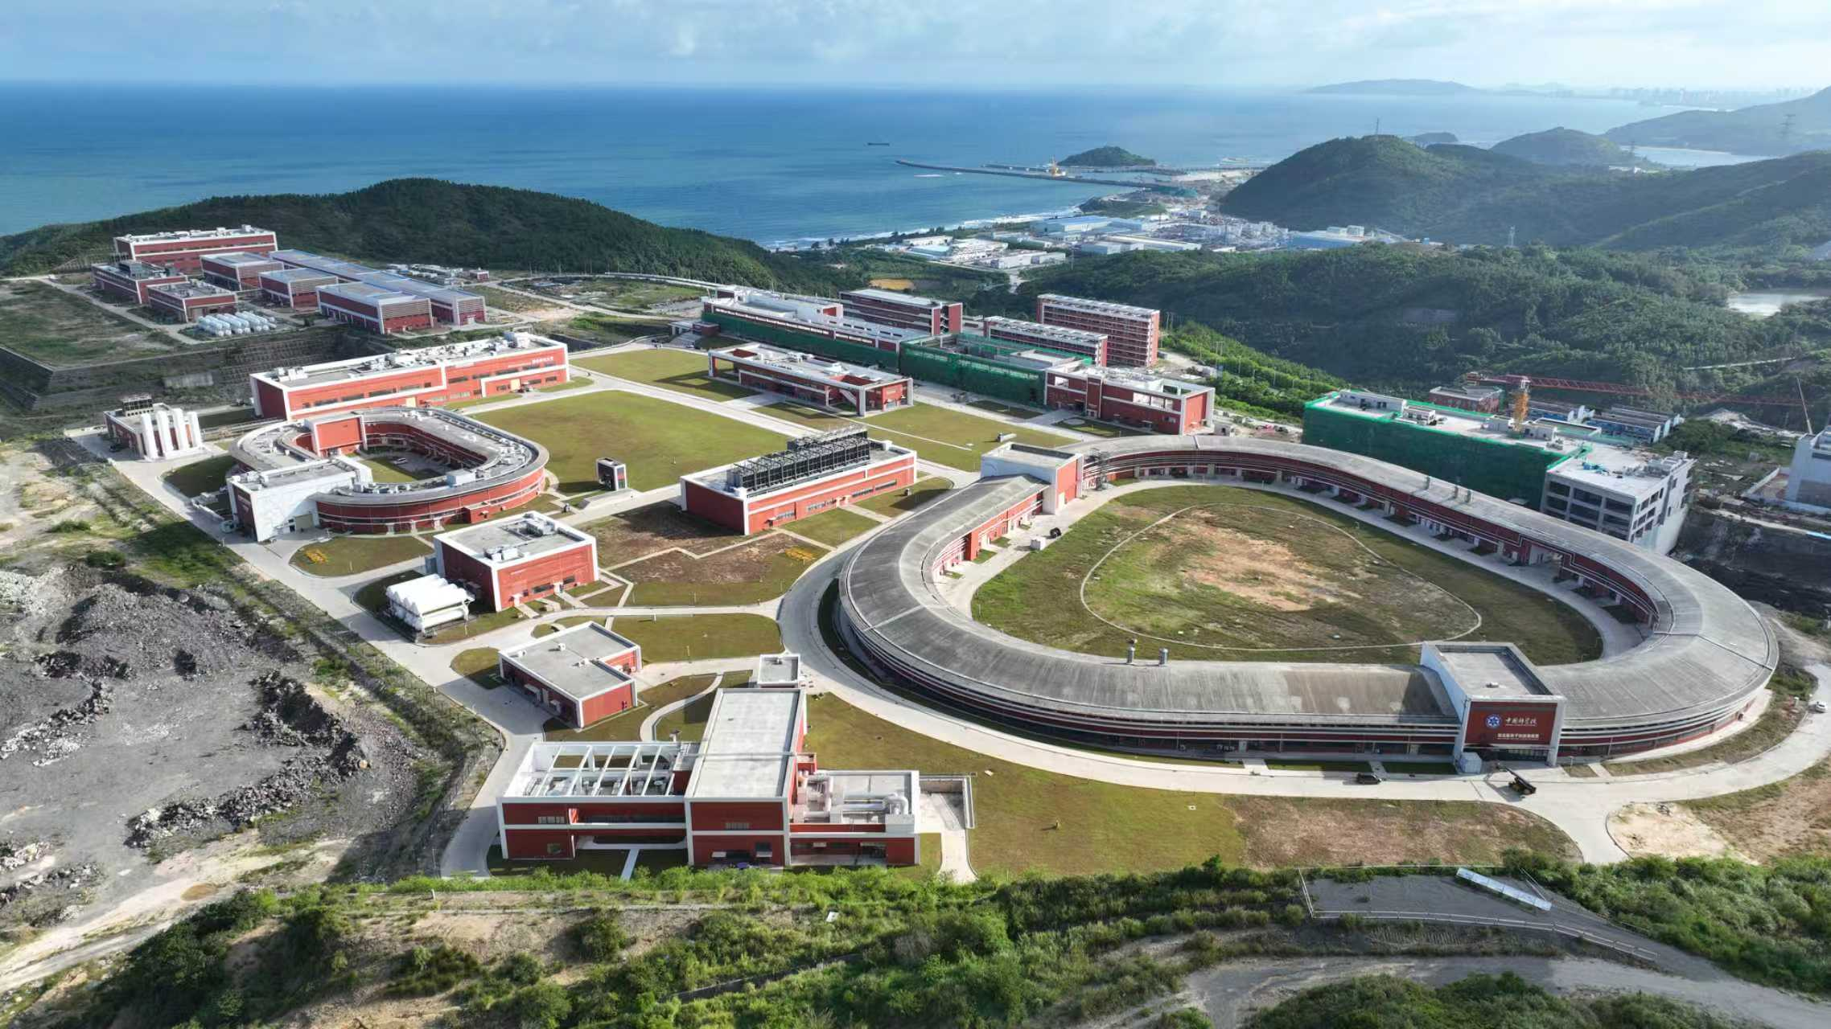
High Intensity heavy-ion Accelerator Facility (HIAF)
广东 惠州
Booster Ring:
Circumference: 569 m
Rigidity: 34 Tm
Accumulation
Cooling & acceleration
HIAF for atomic physics, nuclear physics, applied research in biology and material science etc.
HFRS
SRing
Completed in 2025!
iLinac
Superconducting Ion Linac:
Length: 180 m
Energy: 17 MeV/u (U³⁴⁺)
  CW and pulse modes
BRing
Two-plane painting injection scheme
Fast ramping rate operation

Slide 6
HIAF beam parameters
Ion | Intensity (ppp) | Kine_Energy (GeV/u)
²³⁸U³⁵⁺ | 2.0×10¹¹ | 0.84
²³⁸U⁷⁶⁺ | 5.0×10¹⁰ | 2.5
¹²⁹Xe²⁷⁺ | 3.6×10¹¹ | 1.4
⁷⁸Kr¹⁹⁺ | 5.0×10¹¹ | 1.7
⁴⁰Ar¹²⁺ | 7.0×10¹¹ | 2.3
¹⁸O⁶⁺ | 8.0×10¹¹ | 2.6
p | 5.0×10¹² | 9.3

Slide 7
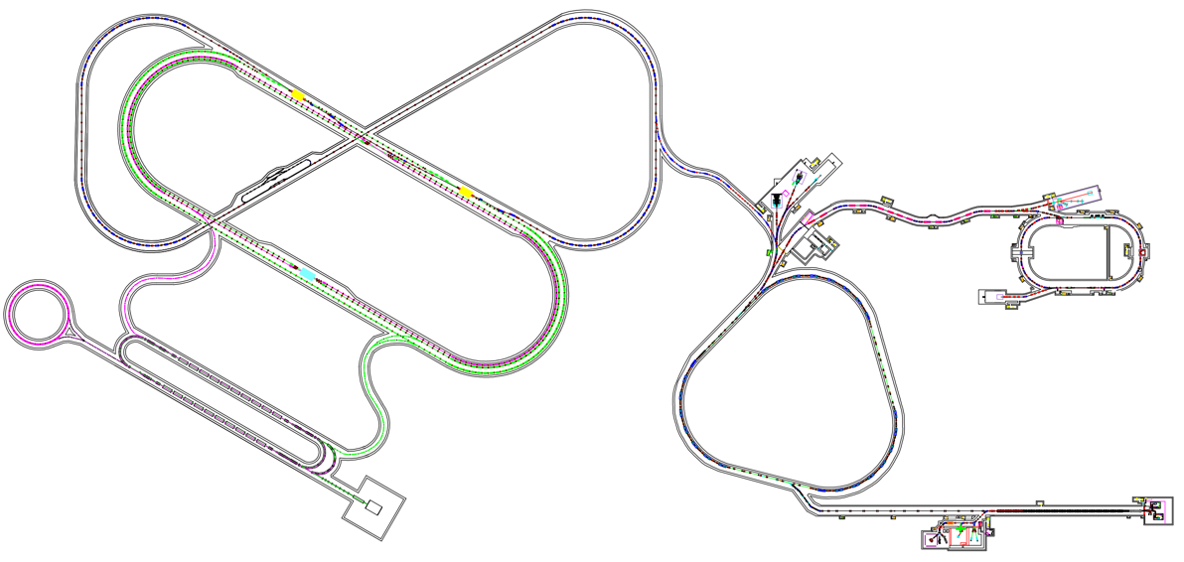
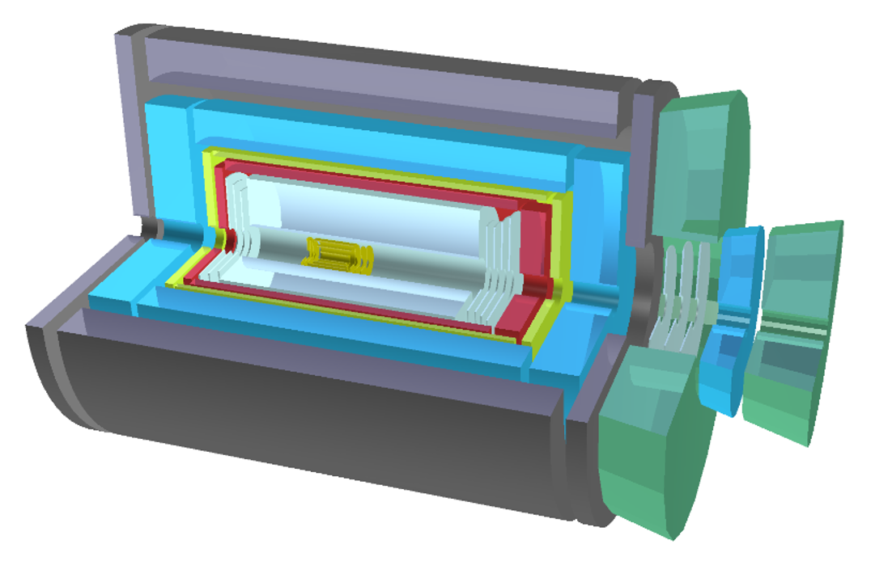


Development in China-HIAF&EicC
中国电子–离子对撞机(EicC)
2012:Discussion in community
2020.2,2021.6:white paper(CN,EN)
2021-2023:CDR
Institutes：~45
EicC
EicC 离子环
HFRS
SRing
As part of the long-term planning project for major scientific and technological infrastructure in particle physics and nuclear physics, the project has undergone two international expert reviews and one domestic expert review.
EicC 电子环
BRing
HIAF
$\sqrt{s}$: 16.7 GeV
iLinac
SECR
Proton & ion
Electron
电子注入器
EicC’s advantages (to EIC-US)：
The energy is in the sea quark region, closer to nuclear physics
Nearer to the threshold for the production of heavy quarkonium
HIAF：
Completed by the end of 2025, it will provide the world's highest-intensity pulsed heavy ion beams, creating unique conditions for the construction of the EicC
http://www.j.sinap.ac.cn/hjs/CN/Y2020/V43/I2/20001
https://journal.hep.com.cn/fop/EN/10.1007/s11467-021-1062-0

Slide 8
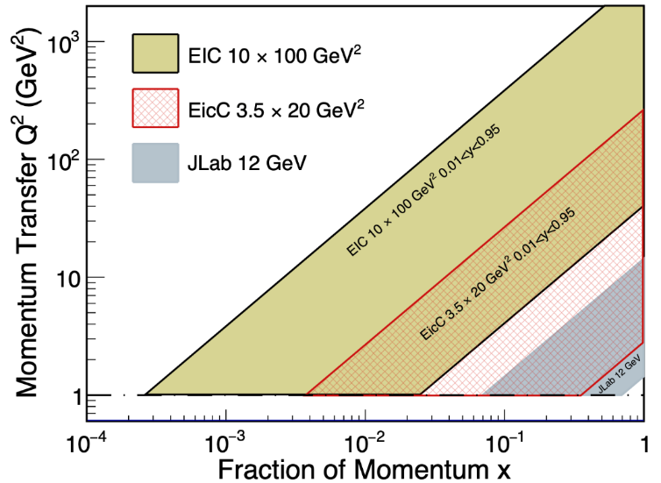
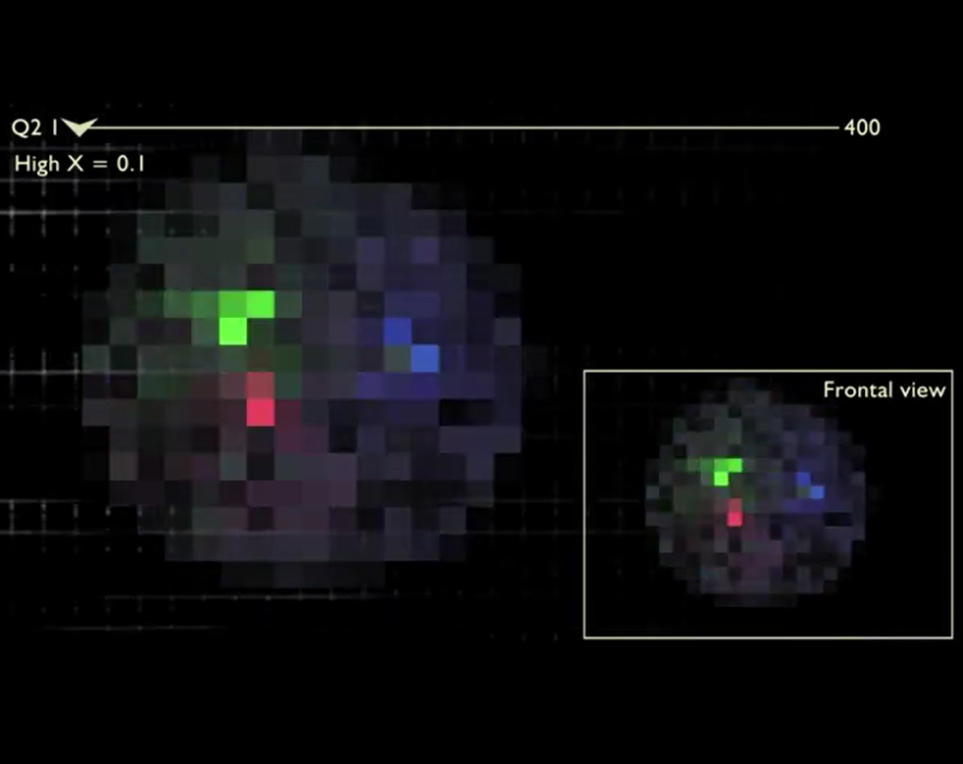
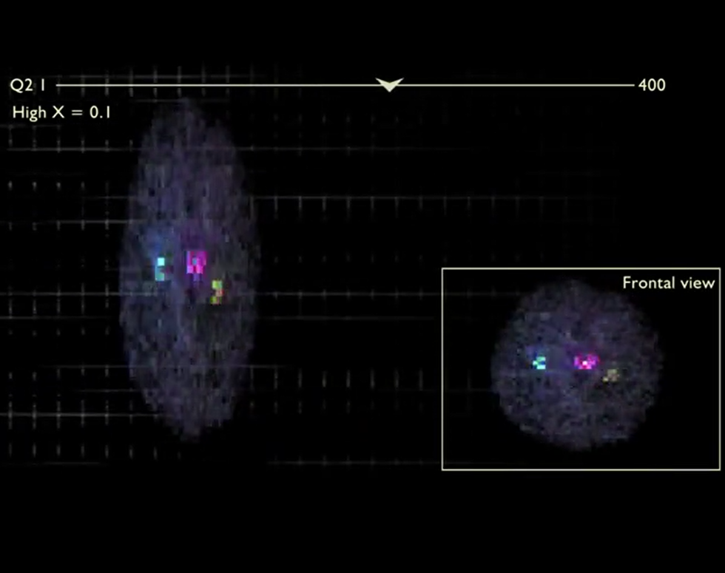
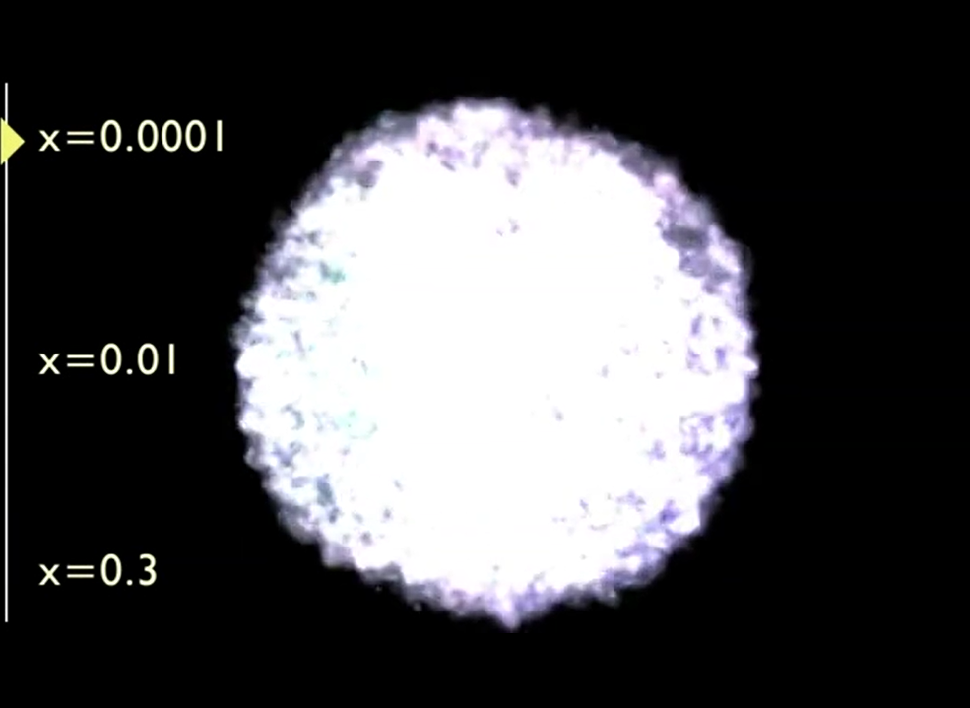
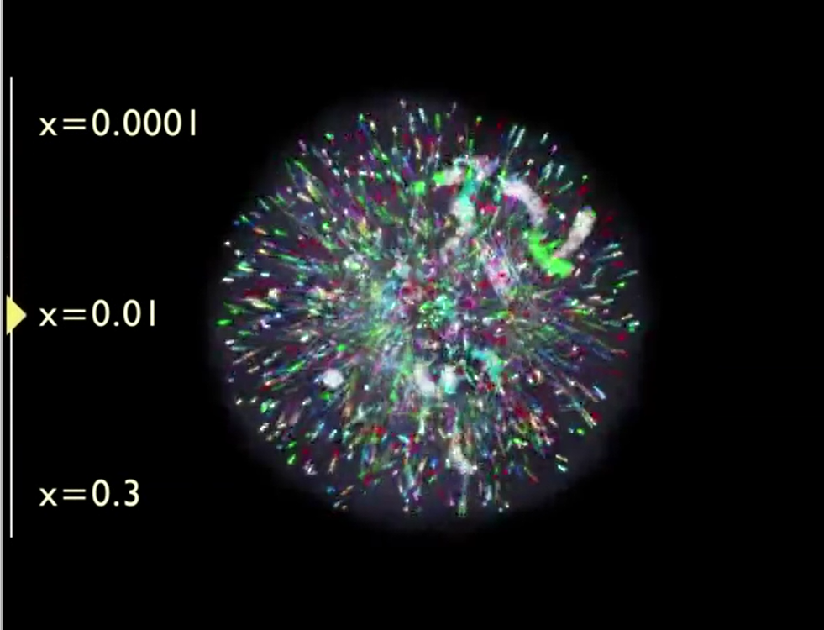

Relation between EicC and EIC
Different x, different inner plot
Wild Q² coverage：
  QCD evolution
  Non-perturbative →perturbative
Gluon-dominated
Gluon + sea quark
Flavor quark

Slide 9
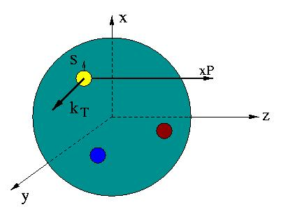
Unified view of nucleon structure
W_{p}^{u}(x,k_{T},r ) Wigner distributions (X. Ji)
5D Dist.
d³r
d²k_{T} dr_{z}
TMD PDFs f₁^{u}(x,k_{T}), .. h₁^{u}(x,k_{T})‏
GPDs/IPDs
3D imaging
dx &
Fourier Transformation
d²k_{T}
d²r_{T}
Form Factors
G_{E}(Q²),
G_{M}(Q²)‏
PDFs
f₁^{u}(x), .. h₁^{u}(x)‏
1D

Slide 10
Unified view of nucleon structure
W_{p}^{u}(x,k_{T},r ) Wigner distributions (X. Ji)
5D Dist.
d³r
d²k_{T} dr_{z}
TMD PDFs f₁^{u}(x,k_{T}), .. h₁^{u}(x,k_{T})‏
GPDs/IPDs
3D imaging
dx &
Fourier Transformation
d²k_{T}
d²r_{T}
Form Factors
G_{E}(Q²),
G_{M}(Q²)‏
PDFs
f₁^{u}(x), .. h₁^{u}(x)‏
1D
Experimentally

Slide 11
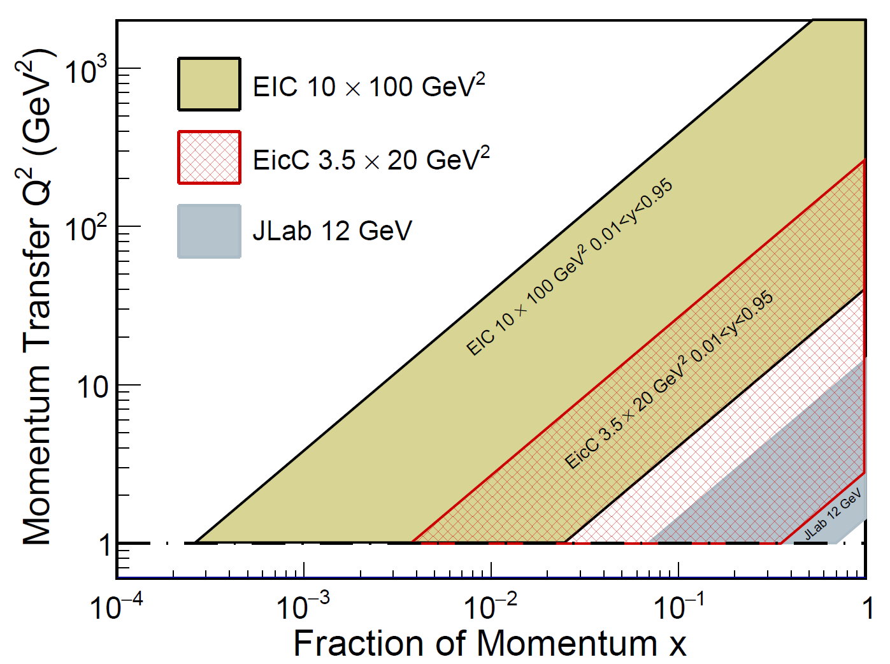
Highlighted physics topics
Spin of the nucleon: 1D, 3D
  polarized electron + polarized proton/light nuclei
Partonic structure of nuclei and the parton interaction with the nuclear environment
  unpolarized electron + unpolarized various nuclei
Exotic states with c/cbar, b/bbar (BESIII community in China)
Mass of the nucleon

Slide 12
Highlighted physics topics
Spin of the nucleon: 1D, 3D
  polarized electron + polarized proton/light nuclei
Partonic structure of nuclei and the parton interaction with the nuclear environment
  unpolarized electron + unpolarized various nuclei
Exotic states with c/cbar, b/bbar (BESIII community in China)
Mass of the nucleon

Slide 13
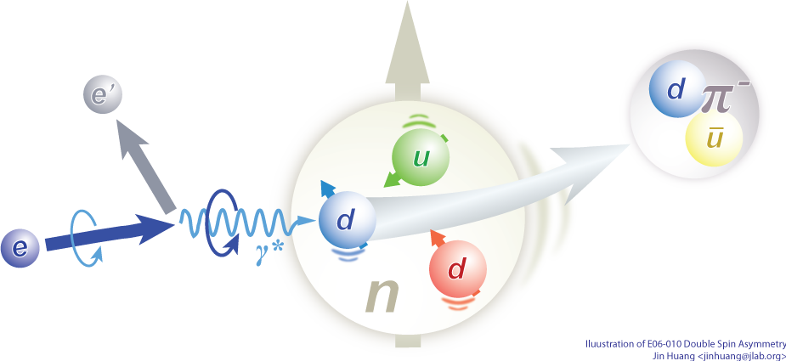

SIDIS processes for flavor decompositions
Electron-proton scattering
Pion/Kaon
Fragmentation Functions
Experimental observable: polarized structure functions g1
input
input
Leading Order picture
Extracted nucleon structure information: polarized PDFs (helicity distribution)

Slide 14
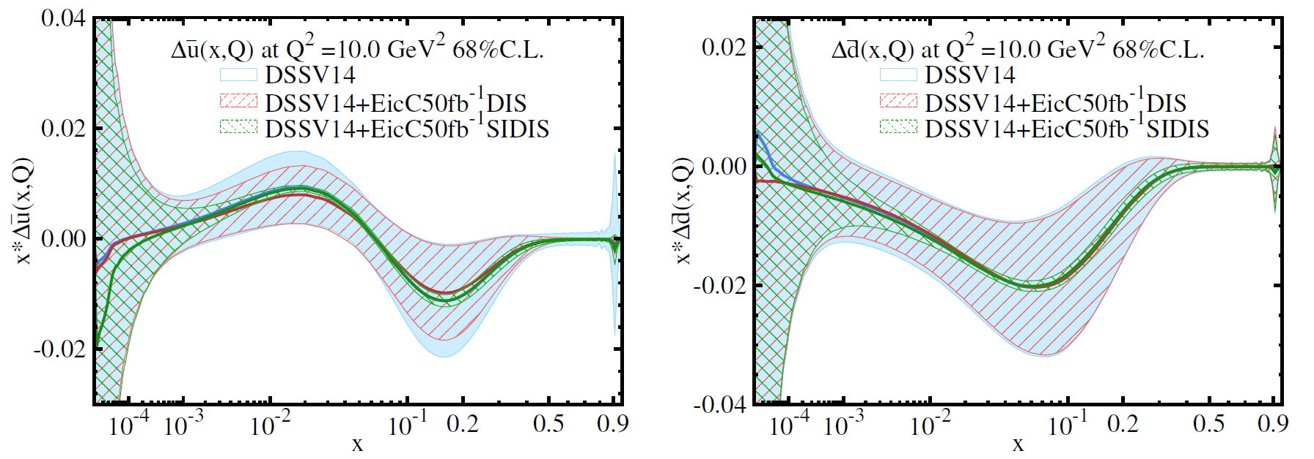
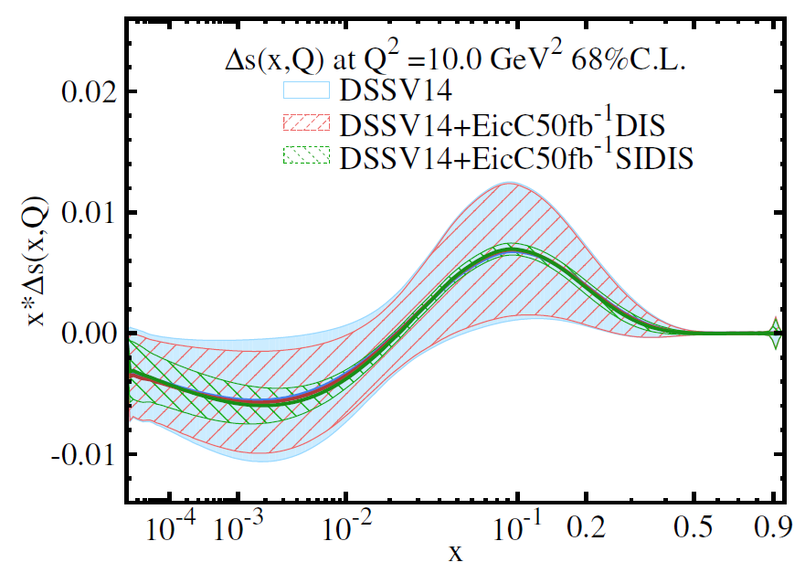
Spin of the nucleon-helicity distribution
A NLO impact study
See arXiv:2103.10276
JHEP08(2021)034
EicC white paper

Slide 15
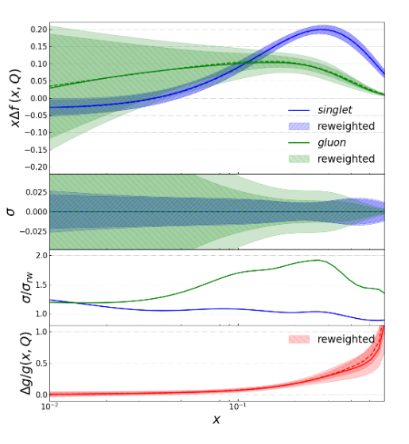
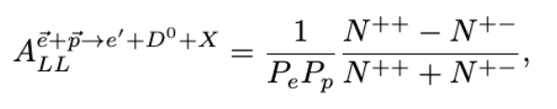
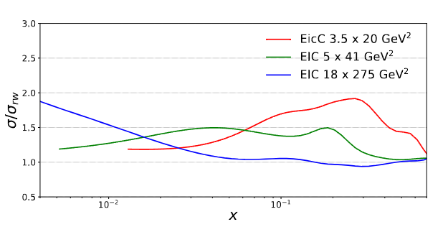
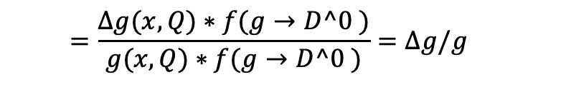
Gluon helicity distribution
One can perform double spin asymmetry ALL measurements in the e+p → e′ +D⁰ +X process to access the gluon helicity distribution:
$$=\frac{∆g(x,Q)∗f(g→D^0 )}{g(x,Q)∗f(g→D^0 )}=∆g/g$$
With lower center-of-mass energy, the EicC will push the measurement in the relatively high-x region, where ∆g/g is supposed to be larger compared to the small-x region.

Slide 16




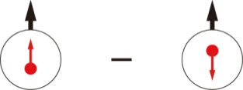
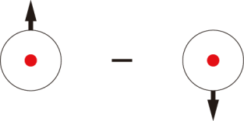
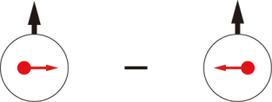

Spin-dependent TMDs (Leading-Twist )
 |  | Quark polarization
 |  | Unpolarized (U) | Longitudinally Polarized (L) | Transversely Polarized (T)
Nucleon Polarization | U
 | L
 | T
f₁ =
h₁⊥ =
Boer-Mulders
g₁ =
h_{1L}⊥ =
Helicity
Worm Gear
h₁ =
f _{1T}⊥ =
Transversity
g_{1T} =
Sivers
Worm Gear
h_{1T}⊥ =
Pretzelosity
Nucleon Spin
Quark Spin
Survive the k_{T} integration, yield 1D pdfs
Left items: The correlation between parton transverse momentum and the spin of quarks
Notes:
Add the meaning of each item
Why we have 2 empty boxes ??

Slide 17
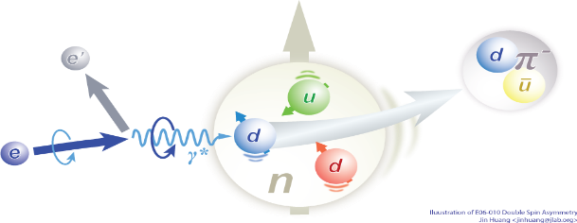
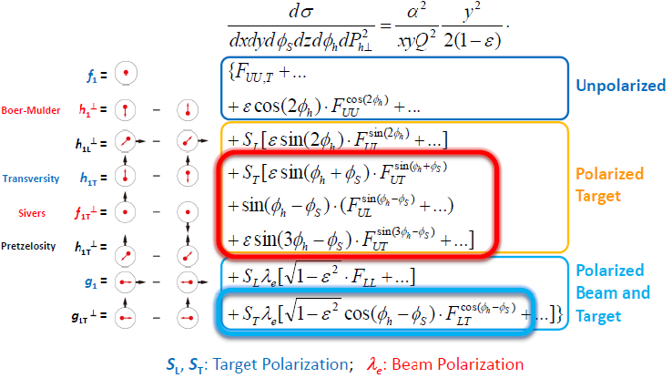
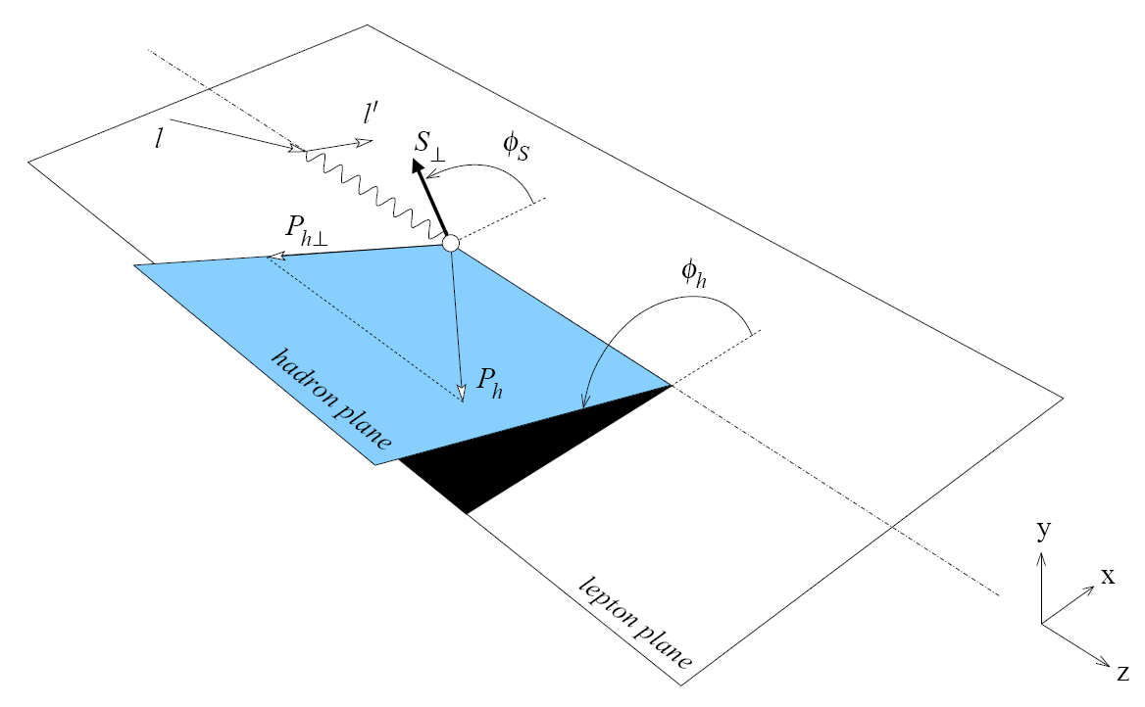
TMDs in SIDIS Cross Section
Target SSA, beam-target DSA measurements

Slide 18
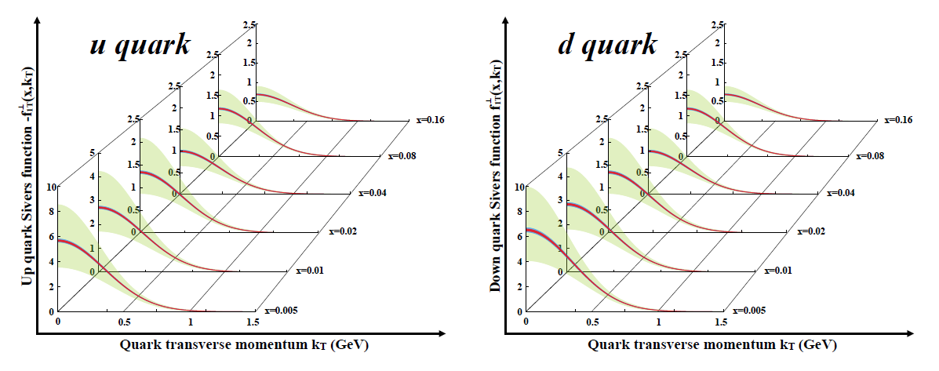
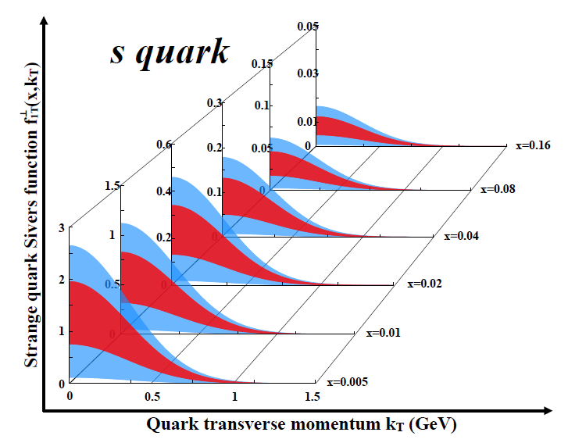
Spin structure of the nucleon-TMDs
u/d Sivers EicC vs world data
LO analysis
EicC SIDS data:
Pion(+/-), Kaon(+/-)
ep: 3.5 GeV X 20 GeV
eHe-3: 3.5 GeV X 40 GeV
Pol.: e(80%), p(70%), He-3(70%)
Lumi: ep 50 fb⁻¹, eHe-3 50 fb⁻¹
Green: Current accuracy
Red: stat. error only
Blue: sys. Error included
EicC, precise measurements.
sea quark Sivers function dynamically generated via Spin depenendent odderon
leads to a unique predication for s-quark: quark and anit-quark Sivers functions flip sign
H. Dong, D. X. Zheng, J. Zhou, 2018

Slide 19
Highlighted physics topics
Spin of the nucleon: 1D, 3D
  polarized electron + polarized proton/light nuclei
Partonic structure of nuclei and the parton interaction with the nuclear environment
  unpolarized electron + unpolarized various nuclei
Exotic states with c/cbar, b/bbar (BESIII community in China)
Mass of the nucleon

Slide 20
Problems for cold nuclear matter effect
arXiv:2107.12401

Slide 21
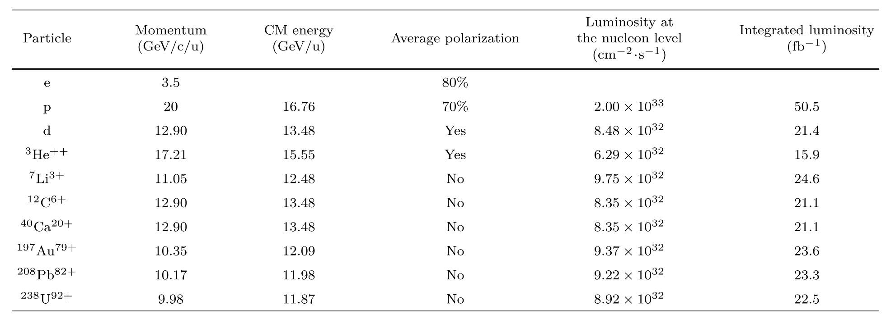
Problems for cold nuclear matter effect
arXiv:2107.12401

Slide 22

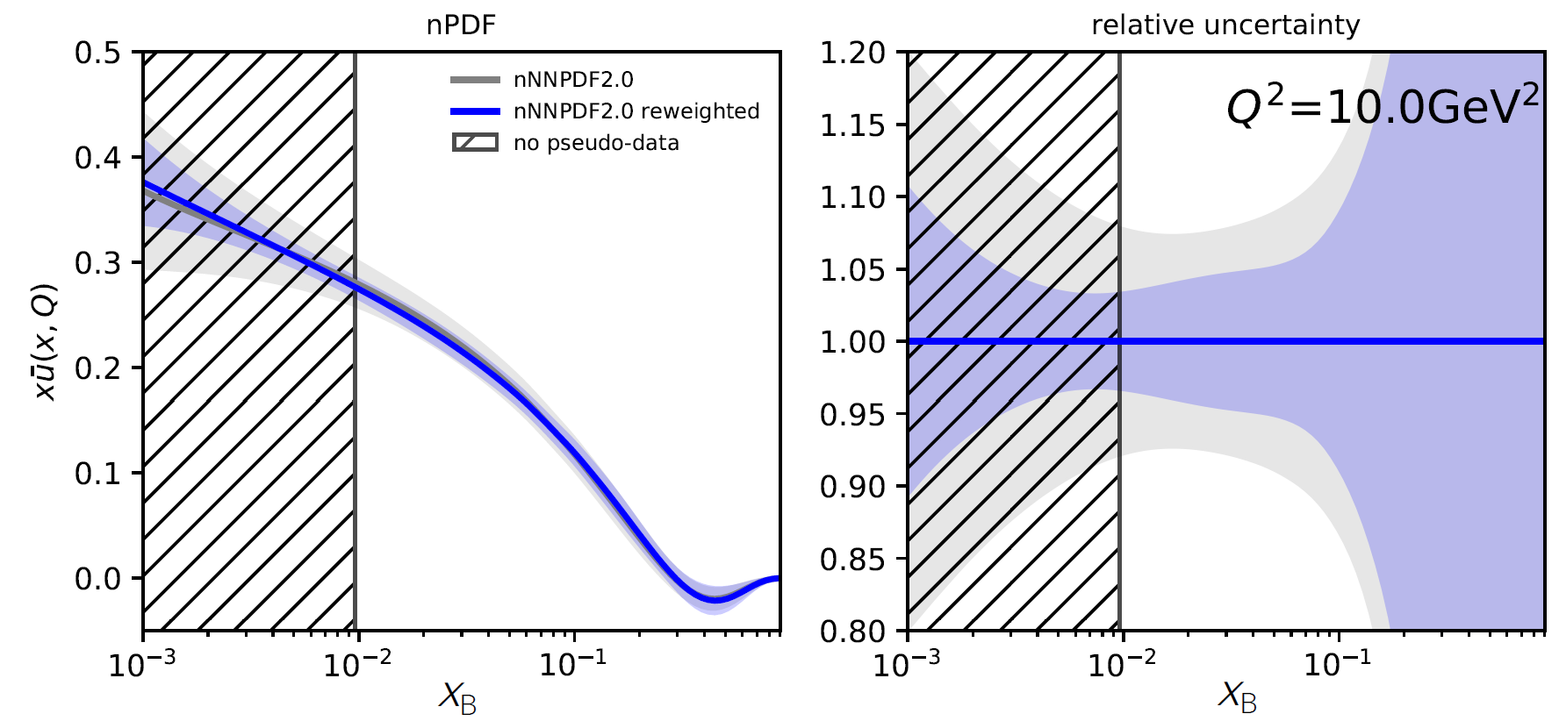
Nuclear PDFs study with ion beam
EicC coverage
With only a few hours of running

Slide 23
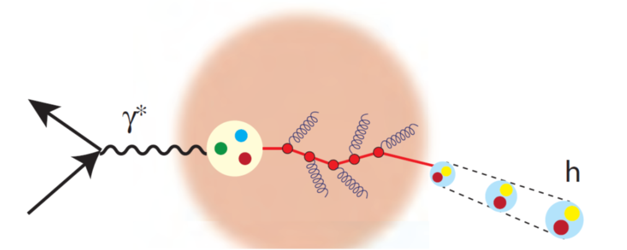
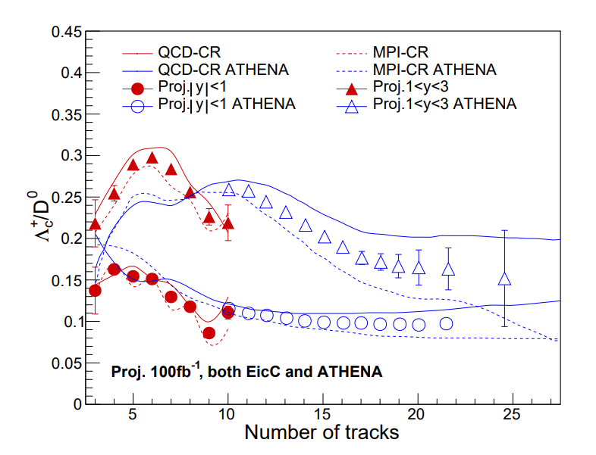
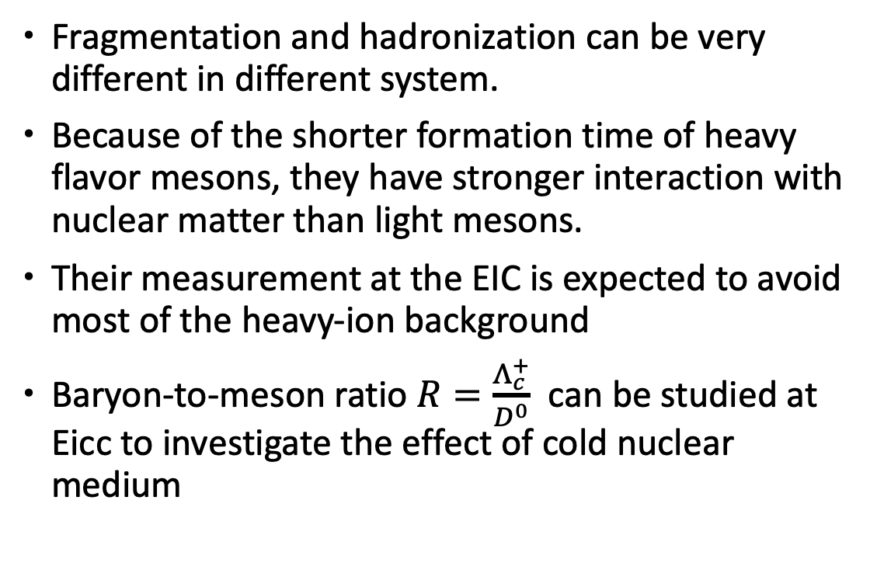
Charm in-medium modification and hadronization at the EicC
Fragmentation and hadronization can be very different in different system.
Because of the shorter formation time of heavy flavor mesons, they have stronger interaction with nuclear matter than light mesons.
Their measurement at the EIC is expected to avoid most of the heavy-ion background
Baryon-to-meson ratio $R=\frac{Λ_{c}^{+}}{D^{0}}$ can be studied at Eicc to investigate the effect of cold nuclear medium
Patron fragmentation varies with different system.
Data is produced by pythia8 and two fragmentation model (QCD-CR and MPI-CR) are used.

Slide 24
Highlighted physics topics
Spin of the nucleon: 1D, 3D
  polarized electron + polarized proton/light nuclei
Partonic structure of nuclei and the parton interaction with the nuclear environment
  unpolarized electron + unpolarized various nuclei
Exotic states with c/cbar, b/bbar (BESIII community in China)
Mass of the nucleon

Slide 25
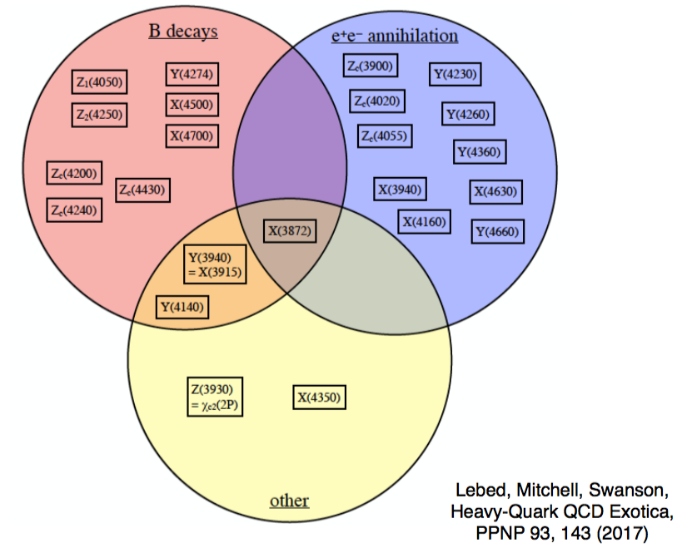
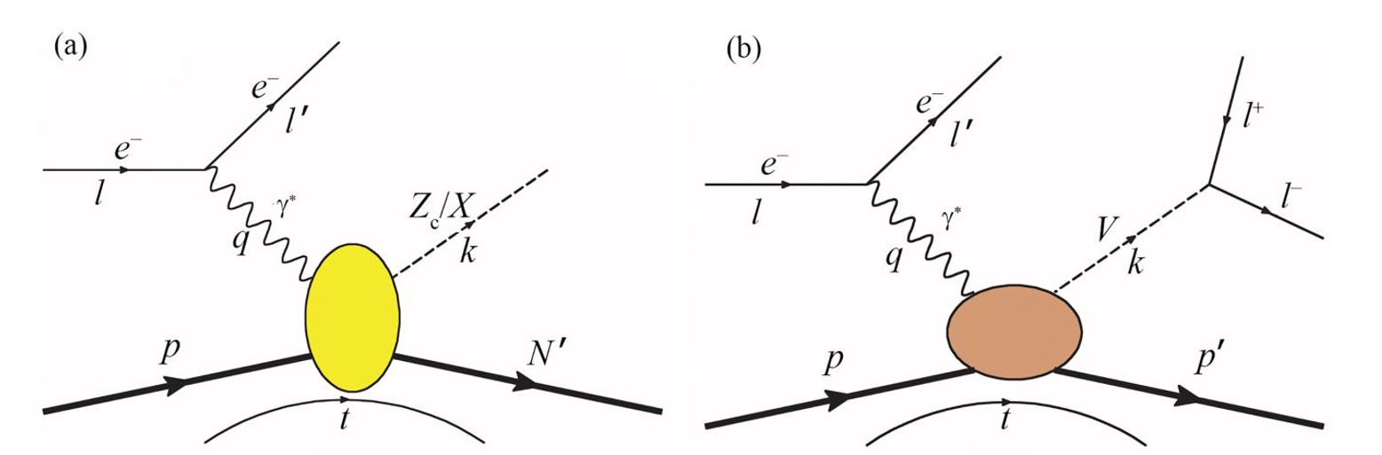
Study of quarkonium at EicC
Study the exotic states from new production mechanism is crucial to pin down their nature
EicC as a unique electron-ion collider has many advantages
  Larger cross section compared to e+e- collision
  Smaller background compared to pp and pp collisions
  Polarized beams: pin down the quantum numbers JP
  No triangle singularity

Slide 26
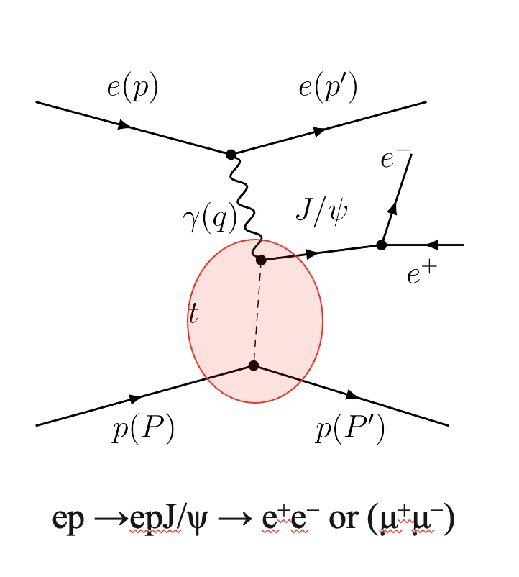
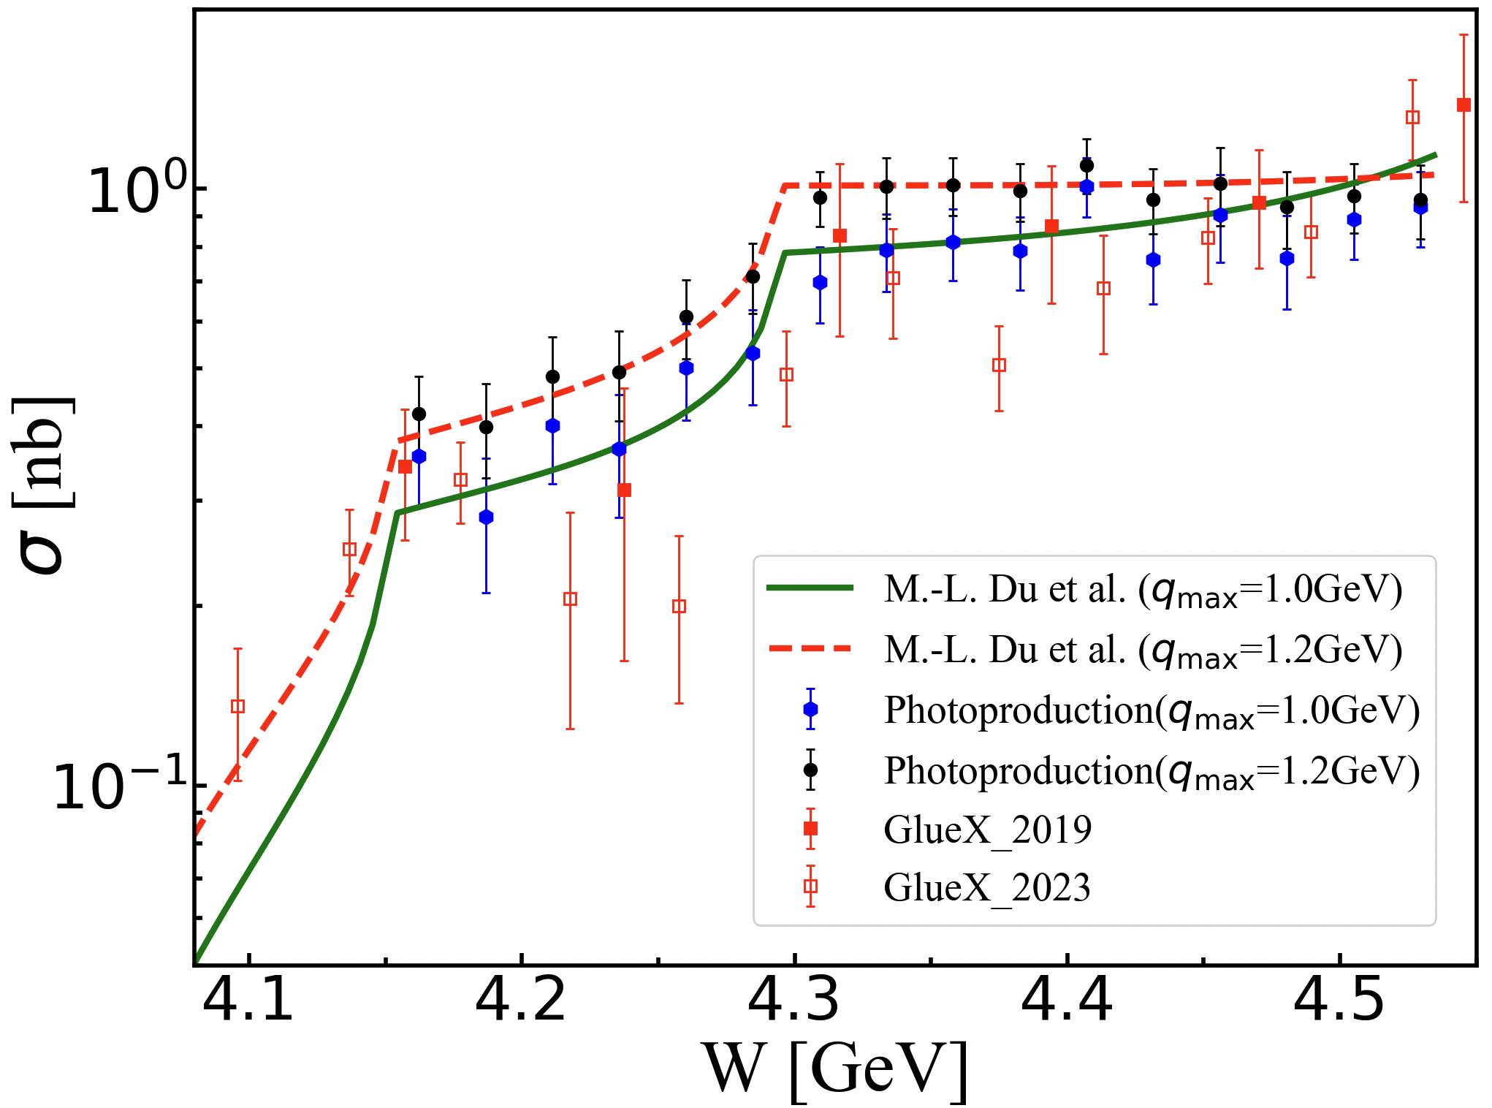

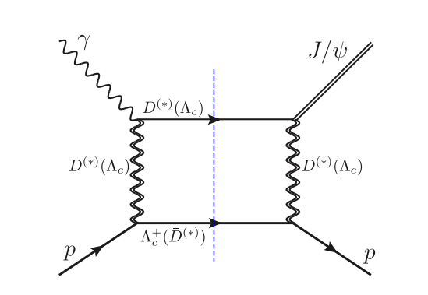
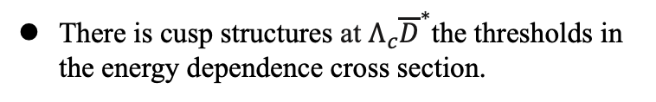
Physical projection at EicC
(arXiv:2009.08345)
There is cusp structures at $Λ_{c}{\overline{D}}^{∗}$the thresholds in the energy dependence cross section.
？？

Slide 27
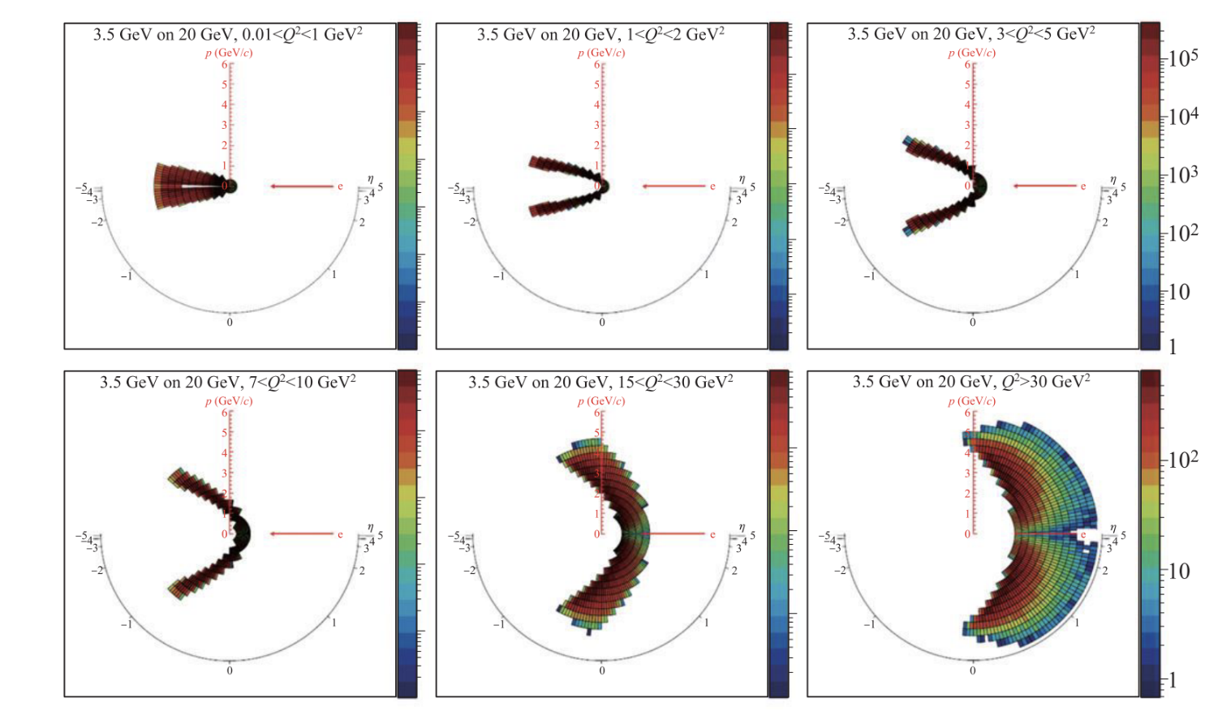
Detector Requirements
The primary physics topic is spin physics, we need to explore the DIS, SIDIS, DVCS etc.
the scattered electrons provide crucial information to most of processes
Kinematics of the scattered electron at various Q²

Slide 28
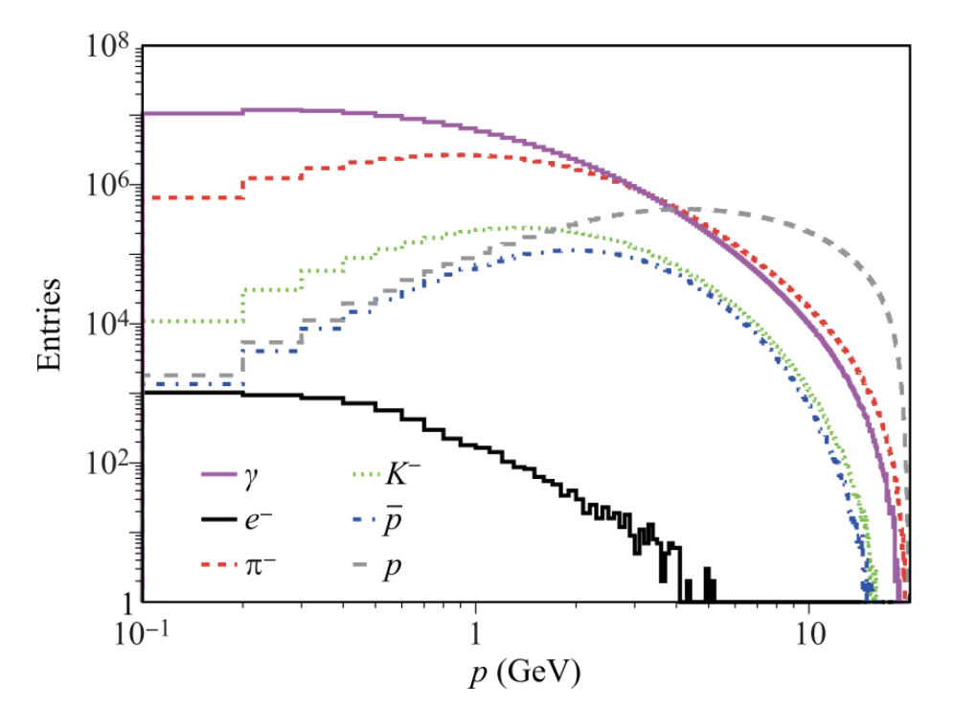
Detector Requirements
The primary physics topic is spin physics, we need to explore the DIS, SIDIS, DVCS etc.
the scattered electrons provide crucial information to most of processes
The hadrons in the final states are essential for SIDIS, HF, etc.
Kinematics of the scattered electron at various Q²

Slide 29


The EicC detector

Slide 30

The EicC detector
Vertex and tracking detecter

Slide 31









EicC vertex&tracking detector design
The 3rd generation MAPS
Pixel size：~20x20$μm$
Material budget：0.05%
The 1st generation Monolithic Active Pixel Sensors （MAPS）
Pixel size ：~30x30$μm$
Material budget：0.85%
MPGD
Pitch size：~150$μm$
Material budget：1%

Slide 32



The ﻿Monolithic Active Pixel Sensors (MAPS).
  Based on domestically developed technology, we have developed the fully-functional MAPS chip MIC6_V3 with similar performance as ALPIDE chip.
  Key features:
    ﻿high granularity: pixel size: ~30 $μm$
    High speed: integration time: 5~10 $μs$
    Low Power Consumption： ～30mW/cm² ~low material
1.5x3.0 cm

Slide 33









Modularized structure
Power bus
Stave module structure
FPC
2x7 chip array
Cooling board
Length in Z (mm): 1477.5 mm (NICA ITS outer layer)
HIC module No. in stave: 2 $×$ 7 (NICA ITS outer layer)
Stave material budget: ~0.85% X₀
Support
~1.5m, ~ 80g

Slide 34





Micromegas detector
Feature
high granularity: spatial resolution: ~ 65 $μm$
High speed: 100~200 kHz/cm²
Electron beam test（5GeV at DESY）
X-Y 2D readout
Efficiency：>98%
σ_{X}=65 μm
σ_{Y}=65 μm
Jianxin Feng, Zhiyong Zhang, Jianbei Liu et al., NIM-A 989 (2021) 164958.
Micromegas prototype 40x40 cm

Slide 35






The performance
Momentum resolution
电子束流
离子束流
DCA resolution
Primary vertex residual

Slide 36

The EicC detector
PID system

Slide 37






Barrel DIRC for PID
Detector of Internal Reflection Cherenkov lights (DIRC):
DIRC achieve PID through reconstructing their Cherenkov angles, by measuring the transit time and exit position/angle of Cherenkov photons induced by different particles.
Consisted of fused silica(n=1.47) as Cherenkov radiator and MCP-PMTs as photosensor array
Compact structure as barrel detector
Achieve 3σ π/K separation up to 6 GeV/c with angle resolution ~ 1mrad
Reference from “Simulation, Reconstruction, and Design Optimization for the PANDA Barrel DIRC”, 2016
refractive index of synthetic fused silica with n = 1.47
Reference from PANDA & EIC
2026/7/3

Slide 38




mRICH: Lens-based Focusing Aerogel Detector Design
Lens-Based mRICH Design
Modular RICH is a Cherenkov detector based on aerogel radiator.
It uses a Fresnel lens to generate focusing effect to improve position resolution.
It has compact and flexible structure, and PID power with large momentum coverage.
Sensor plane
focal length 7.62cm (3”)
2026/7/3
Notes:
photosensors’ pixel size is 3 mm and the tracking angle resolution is 1 mrad

Slide 39




The EicC detector
ECal

Slide 40




Ecal Design in Simulation
General design of whole Ecal Detector.
Cesium Iodide (CsI) crystal is applied in e-endcap, Shashlik style is applied in both barrel and ion-endcap
The actual distances of the two endcaps to IP depend on the available space of the EicC design
Shashlik module
Z=2.4 m
Z=-1.5m +
R=0.9m
CsI module
 | EMC | type | z/r[m] | Length[cm],X₀ | Coverage[cm] | pseudorapidity | Tower size
EicC | e-endcap | CsI | Z=-1.5 | 30, 16X₀ | 15.0<r<128 | (-3.0, -1.0) | 4.0*4.0(front)
 | barrel | Shashlik | R=0.9 | 45, 16X₀ | -105.8<z<187.5 | (-1.0, 1.5) | 4.0*4.0 (front)
 | Ion-endcap | Shashlik | Z=2.4 | 45, 16X₀ | 24.0<r<113 | (1.5, 3.0)

Slide 41
Module (7x7) array simulation result
Ye Tian (IMP)
Shashlik simulation result
CsI simulation result
Energy resolution
Energy resolution
Position resolution
Position resolution

Slide 42



Shashlik ECal cosmic ray test result
Ye Tian (IMP)
Assembled Shashlik module
Shashlik module measuring with cosmic ray
Horizontal test setup
Module
Trigger scintillator

Slide 43

The Far forward detector
FFD

Slide 44



The far forward detector
Photon and Neutron
detection
Charged particle

Slide 45

Luminosity and polarization monitor

Slide 46

Simulation framework & software
Structure of EiccRoot
Top level: ROOT, Virtual MC, etc.
Middle level: FairRoot framework manages the general infrastructure with simulation and tasks
EiccRoot: implementation of the EicC detector sim. and rec. inside FairRoot framework
Notes:
FairRoot is a software framework mainly for high energy and nuclear physics experiments.
FairRoot is developed based on ROOT. In this plot, the top level shows the common used softwares, such as ROOT and Geant4. FairRoot depends on these softwares.
The middle level shows the structure of FairRoot. It manages the general infractructure with simulation and tasks.
The bottom level shows the specific experiment implementation using FairRoot. Currently, there are many experiments using FairRoot, such as PANDA, CBM, and EicC.

Slide 47






Lab developement
Clean rooms of ISO6 and ISO7 (in total of 200 m²) for detector assembling @ lanzhou
~350 m² lab in Huizhou
Budget: ~2M/per year from IMP

Slide 48
Timeline
2021: EicC white paper published,
2024: Aim to finish the Conceptual Design Report (CDR) of EicC
2025: HIAF produce its first beam
18 | 19 | 20 | 21 | 22 | 23 | 24 | 25 | 26 | 27 | 28 | 29 | 30 | 31 | 32 | 33 | 34 | 35 | 36 | 37 | 38 | 39 | 40
十三五 |  |  | 十四五 |  |  |  |  | 十五五 |  |  |  |  | 十六五 |  |  |  |  | 十七五
HIAF
Accelerator
HIAF-U
EicC
CEE@CSR
Detector
H-NS DEMO
H-NS construction
H-NS run
EicC
H-NS DEMO running at HIAF

Slide 49
Summary
An electron-ion collider has been proposed in China, based on the further upgrade of HIAF
Moderate energy (electron beam 3.5 GeV, proton beam 20 GeV) covers the region (𝑥) between us-EIC and JLab
High precision measurements of nucleon structures
Many interesting physics topics are under development and studying
Research and development of the EicC detectors are ongoing,
The Concept Design Report (CDR) is finished in 2025.
Thanks!

Slide 50

Office area in Huizhou, Guangdong ready to be used

Slide 51
Backup

Slide 52


Structure functions and PDFs : Polarized case
Only scattered leptons are detected
Experimental observables
PDFs
Quark-Parton Model
QPM
Polarized pdfs
Helicity distribution ∆q=q↑(x) - q↓(x)
beam/target helicity flips

Slide 53


Flavor decompositions
With pure ү exchange in inclusive DIS:
Hmm … No third kind
of nucleon … No...
Assumption: SU(3) flavor symmetry
  Additional inputs from β-decay of neutron and hyperons
Δu + Δd -2 Δs
Δu + Δd
A way out:
SIDIS measurements: with the initial quark flavor tagged
    Fragmentation Functions needed

Slide 54



Probing gluon distributions
quarks
gluon
﻿orbital angular momenta
Heavy-flavor quarks produced at leading-order via boson-gluon fusion
Investigate charm production + constraints to gluon (n)PDF
  - High-x_{B} charm production offers more constraint w.r.t. inclusive-only measurements

Slide 55


Impact on the proton gluon PDF
Impact on the unpolarized proton gluon PDF g(x, Q2) using reweighting techniques.
We focus on the most recent CTEQ PDF set .
Impact on CTEQ singlet Σ and gluon g PDFs using a NLO computation.

Slide 56

Gluon helicity distribution
One can perform double spin asymmetry ALL measurements in the e+p → e′ +D⁰ +X process to access the gluon helicity distribution:
$$=\frac{∆g(x,Q)∗f(g→D^0 )}{g(x,Q)∗f(g→D^0 )}=∆g/g$$
With lower center-of-mass energy, the EicC will push the measurement in the relatively high-x region, where ∆g/g is supposed to be larger compared to the small-x region.

Slide 57



The TMDs
PDF 1D
TMD PDF 3D
A. Bacchetta, F. Conti, M. Radici, Phys.Rev. D78 074010 (2008)

Slide 58

Separation of Collins, Sivers and Pretzelosity through azimuthal angular dependence
UT: Unpolarized beam + Transversely polarized target
→TMD: Transversity
→TMD: Sivers
→TMD: Pretzelosity

Slide 59
J/Psi production at EicC

Slide 60


J/ψ production at EicC
J/ψ production is important to study
  Multi-quark states (Pc)
  Kinematic effect (CUSP)
ep →epJ/ψ → e⁺e⁻ or (μ⁺μ⁻)

Slide 61




Simulation setup
Detection efficiency
We adopt eSTARLight event generator with two improvements at near-threshold
With the input of t-dependent photoproduction cross sections, the differential cross section of exclusive meson electroproduction:
$$\frac{dσ_{ep→eVp}}{dQ^{2}dydt}=Γ_{T}\left(1+εR_{L}\right)f(Q^{2})\frac{dσ_{γp→eVp}}{dt}$$
t dependence of the γp → J/ψp differential cross section as indicated on the figure.

Slide 62
Upsilon production at EicC

Slide 63
Exotic states production at EicC

Slide 64



Proton mass study
Lattice QCD calculation by Yang et al, 2018
?
EicC coverage

