Slide 1

Synergy between LHCb and STCF programs
Wenbin Qian
University of Chinese Academic of Sciences
2026/07/03
On behalf of LHCb Collaboration
超级陶粲装置研讨会, 2026, 西安
2026/07/03
UCAS, Wenbin Qian
1

Slide 2
Outline of the talk
Introduction
Complementary in CKM physics
Synergy in rare decay measurements
Common interests in exotic particle studies
Conclusions
2026/07/03
UCAS, Wenbin Qian

Slide 3
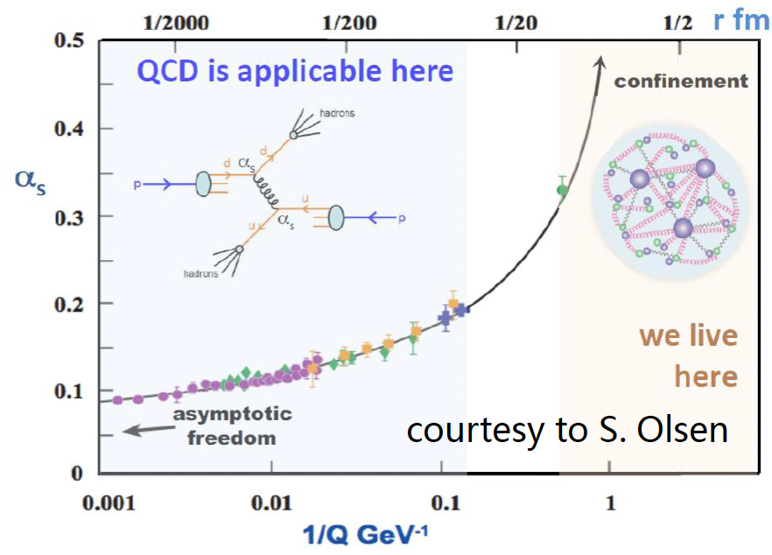
Common physics interests
SM model very successful;
Still an effective theory, many unexplained phenomena;
Most related to flavor and hadron physics: STCF and LHCb can contribute
Understanding QCD at low energy
New Physics hunting
Properties of QCD confinement
Structures of hadrons
Matter and antimatter asymmetry observed in the Universe
Origin of dark matter? New particles or new forces? Flavor hierarchy
Non-perturbative!
2026/07/03
UCAS, Wenbin Qian
3

Slide 4
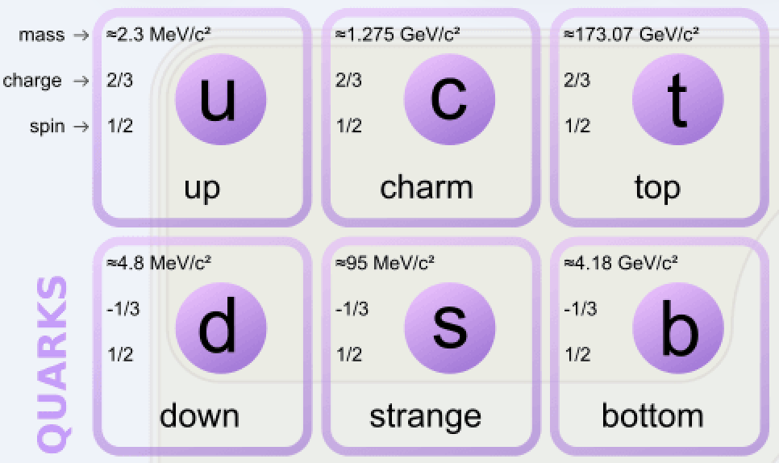
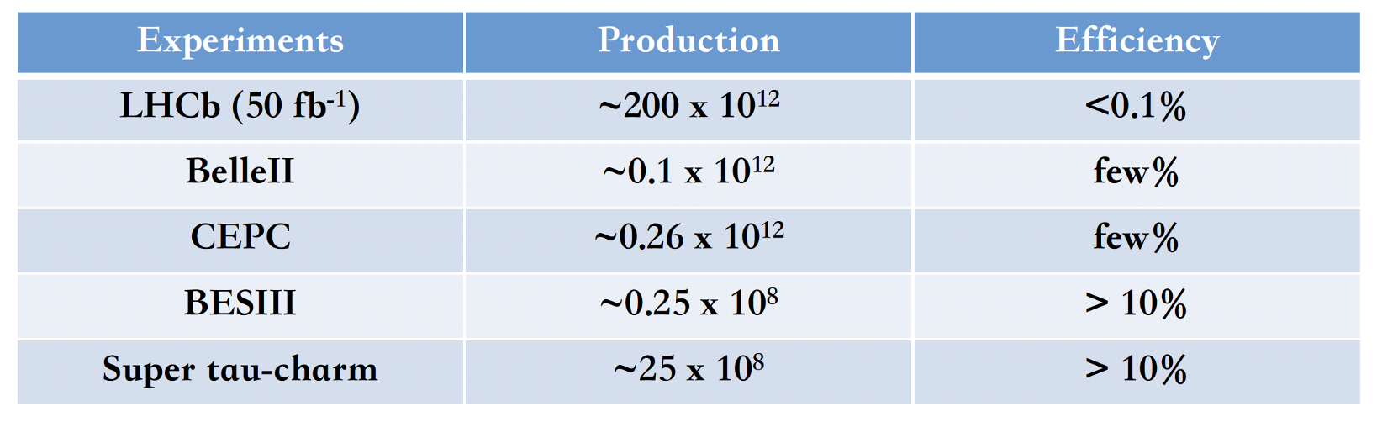
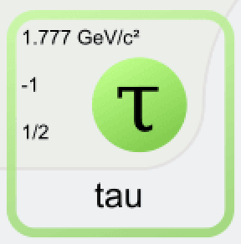

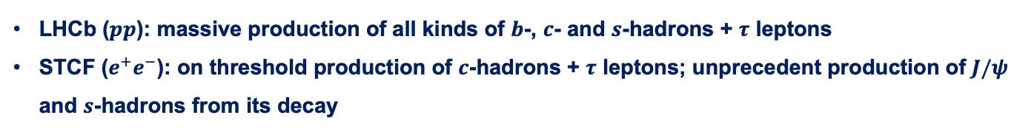
Complementary physics programs
Production environment
LHCb ($pp$): massive production of all kinds of $b$-, $c$- and $s$-hadrons + $τ$ leptons
STCF ($e^{+}e^{−}$): on threshold production of $c$-hadrons + $τ$ leptons; unprecedent production of $J/ψ$ and $s$-hadrons from its decay
$D$ mesons
Detection abilities
LHCb: specialized in charged final states and with high precision vertexing
STCF: both charged and neutral final states + kinematic constraints for missing particles
2026/07/03
UCAS Wenbin Qian
4

Slide 5
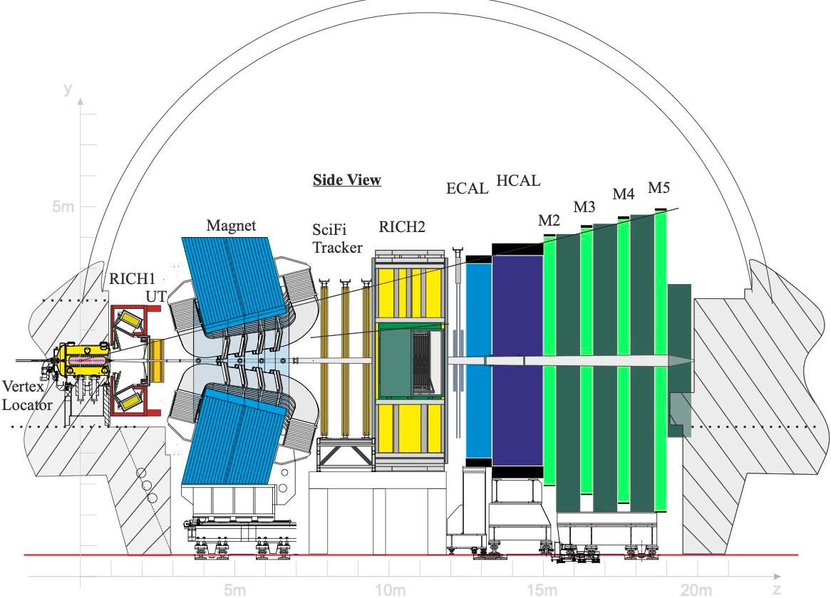
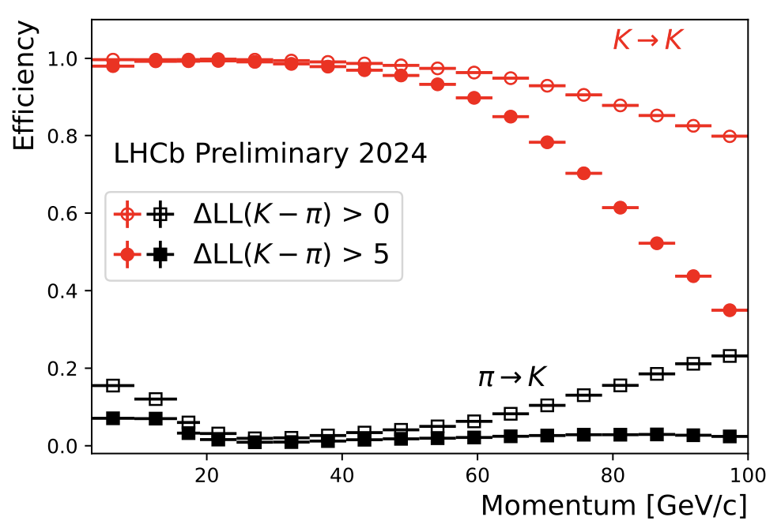
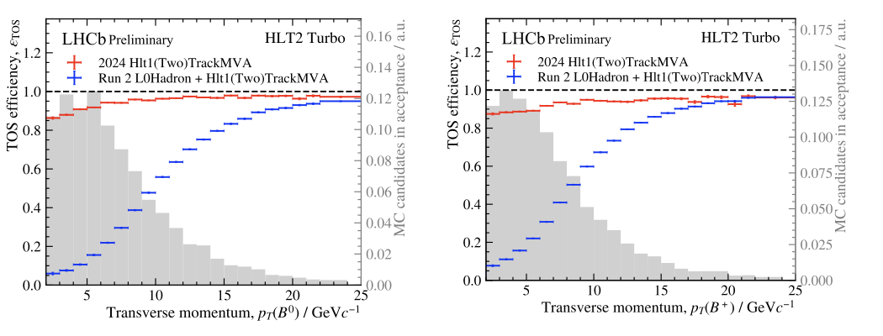
New LHCb detector at Run 3
Similar detector performance than Run1+2 on PID, track reconstruction and vertexing
More importantly, full software trigger ➜ better performance on hadronic final states
New pixel Velo
New UT
New SciFi
Removed M1 and new readout
Similar PID performance
Twice trigger efficiencies (hadronic)
Removed PS/SPD and new readout
New RICH optics and PMs
2026/07/03
UCAS, Wenbin Qian
5

Slide 6
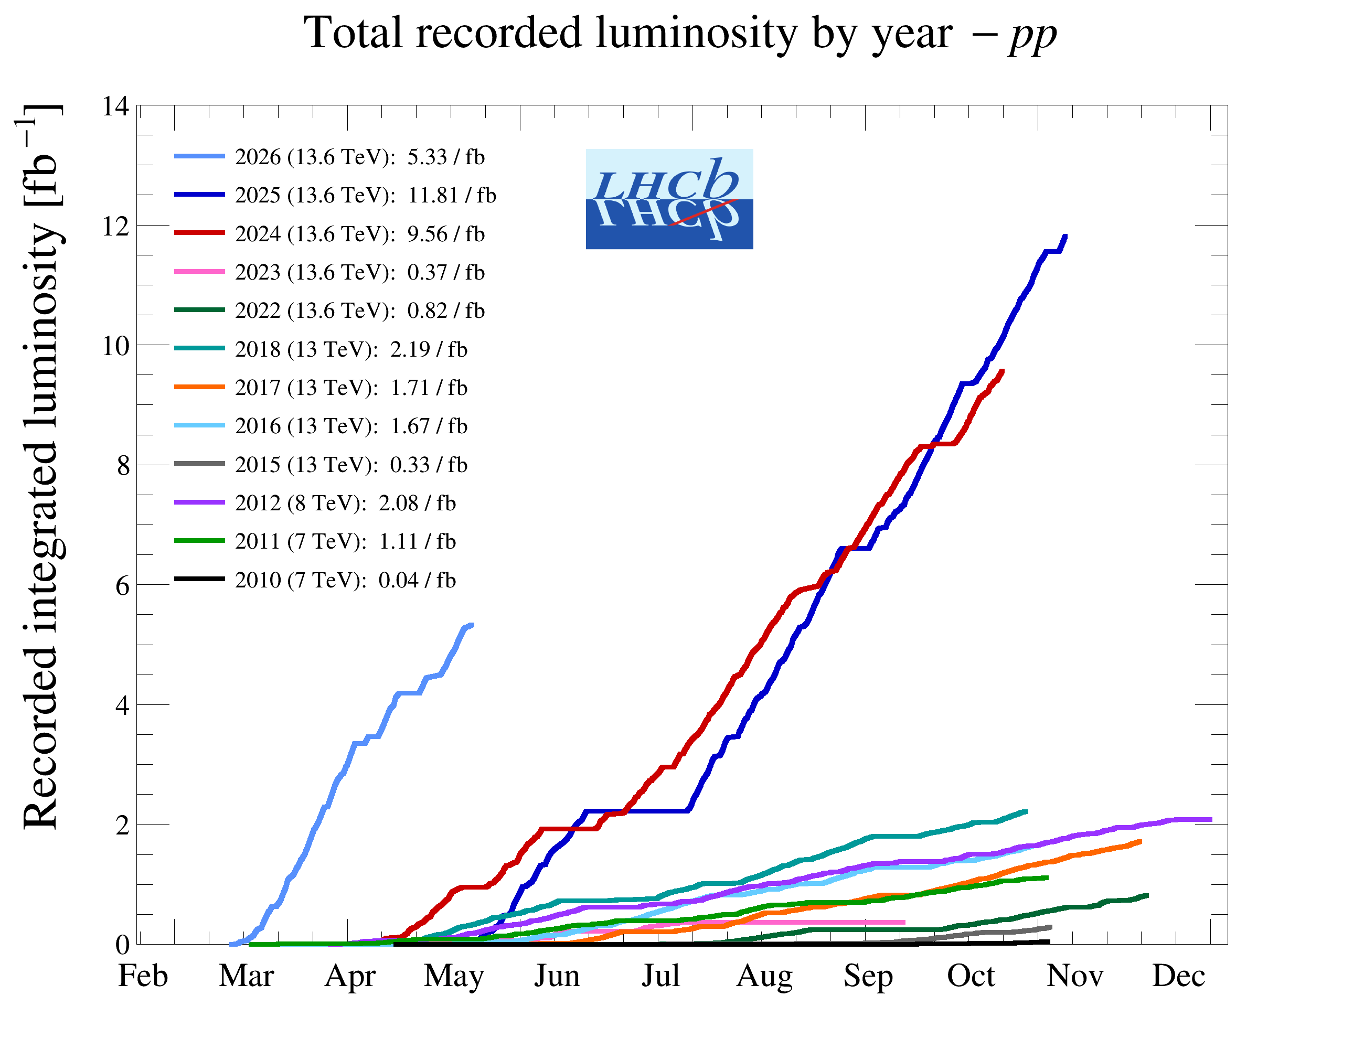
The LHCb status
Run 1:
  2011 (7 TeV): 1 fb⁻¹
  2012 (8 TeV): 2 fb⁻¹
Run 2:
  2015-2018 (13 TeV): 6 fb⁻¹
Run 3:
  2024 (13.6 TeV): 9.56 fb⁻¹
  2025 (13.6 TeV): 11.81 fb⁻¹
  2026 (13.6 TeV): 5.33/fb⁻¹
Operates at $×5$ higher instantaneous luminosity
1 year @ Run 3 > Run 1+2; + increase in efficiencies
2026/07/03
UCAS, Wenbin Qian
6

Slide 7
Outline of the talk
Introduction
Complementary in CKM physics
Synergy in rare decay measurements
Common interests in exotic particle studies
Conclusions
2026/07/03
UCAS, Wenbin Qian

Slide 8
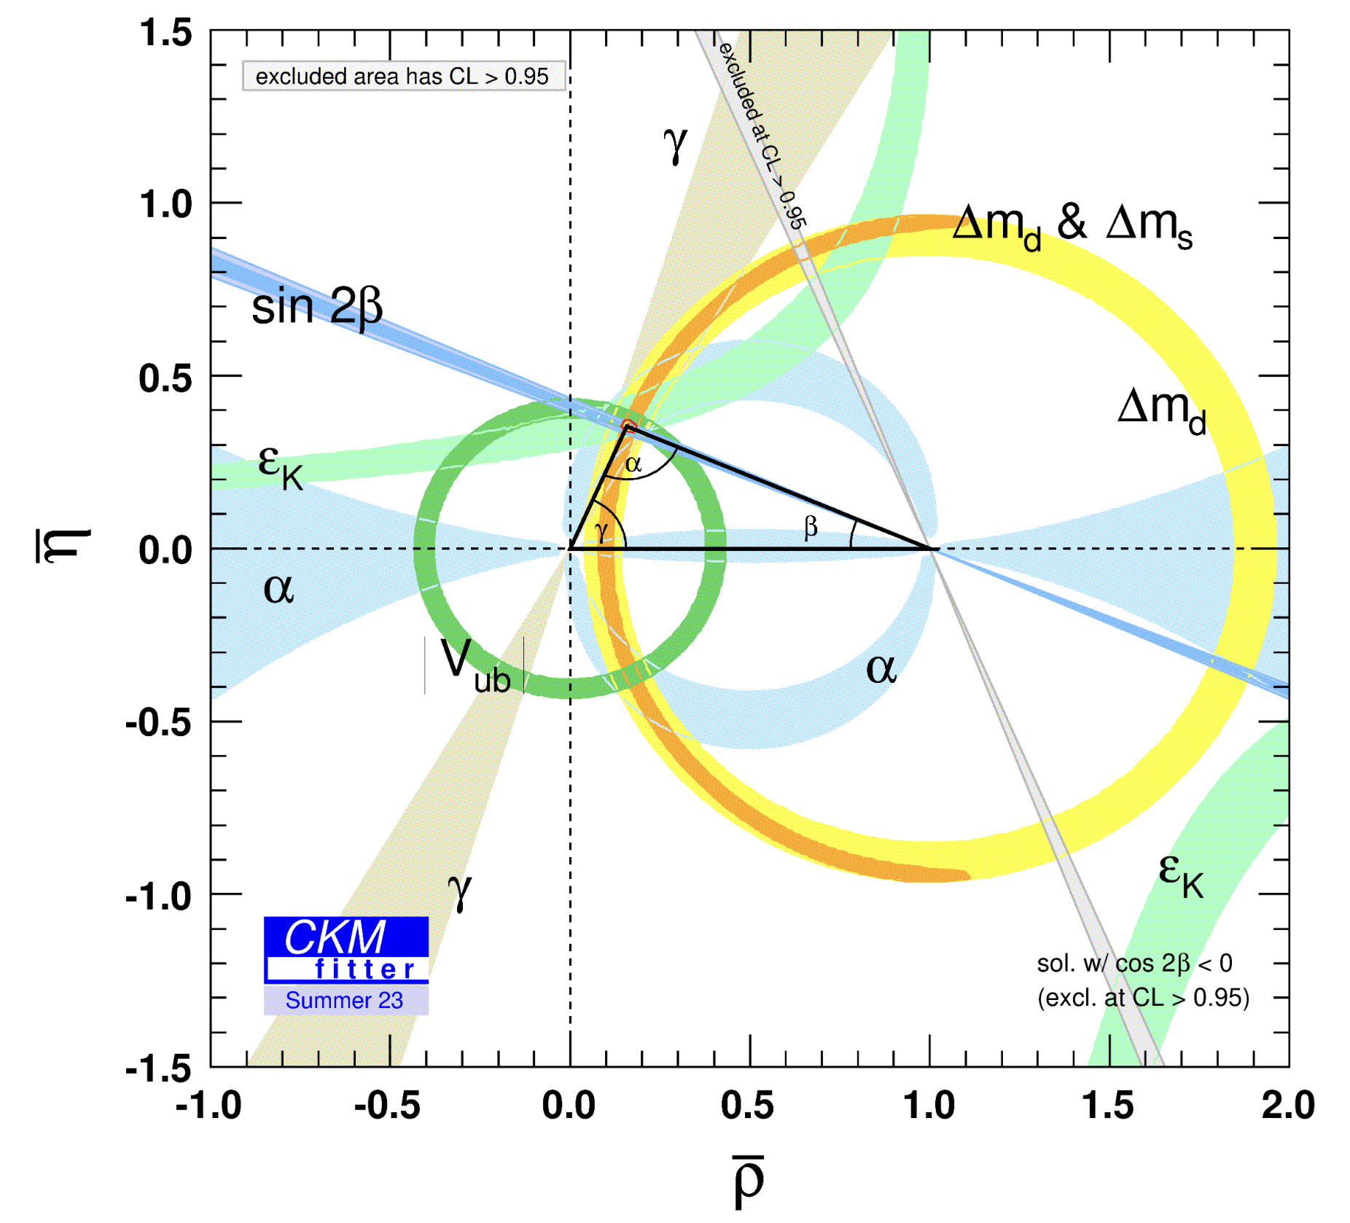
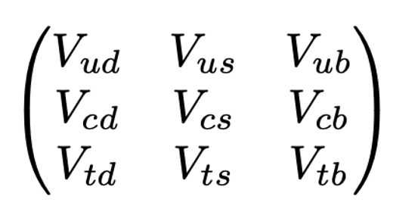
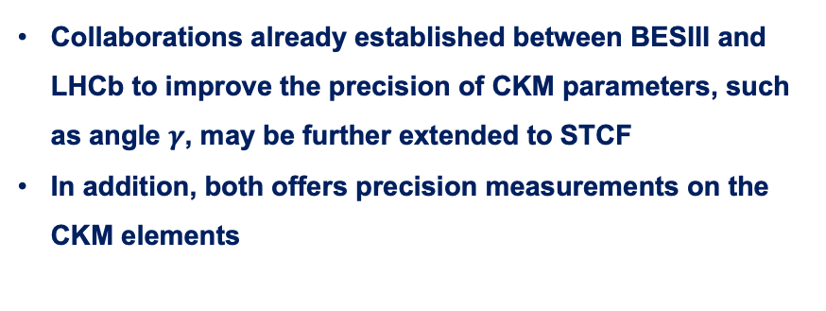
CKM physics
Unitarity test remains one of the main directions to probe NP beyond SM
Precision essential to constrain NP scenarios
Collaborations already established between BESIII and LHCb to improve the precision of CKM parameters, such as angle $γ$, may be further extended to STCF
In addition, both offers precision measurements on the CKM elements
STCF
LHCb
2026/07/03
UCAS Wenbin Qian
8

Slide 9
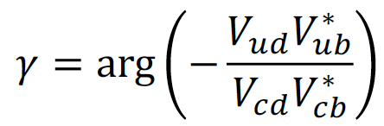




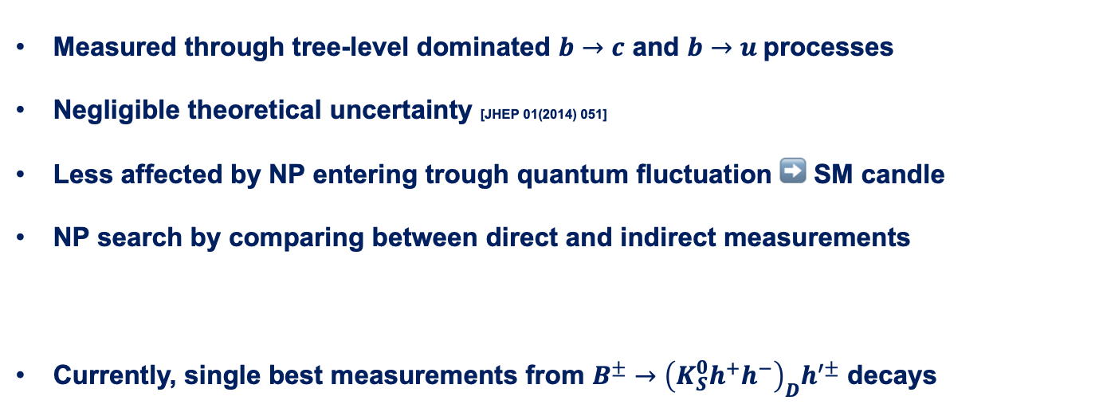
CKM angle $γ$
Measured through tree-level dominated $b→c$ and $b→u$processes
Negligible theoretical uncertainty [JHEP 01(2014) 051]
Less affected by NP entering trough quantum fluctuation ➡️ SM candle
NP search by comparing between direct and indirect measurements
Currently, single best measurements from $B^{±}→{\left(K_{S}^{0}h^{+}h^{−}\right)}_{D}h^{′±}$ decays
$$γ_{ind.}={\left({66.16}_{−3.20}^{+0.78}\right)}^{∘}$$
[CKMfitter 2025]
$$γ_{dir.}={\left(62.8±2.6\right)}^{∘}$$
[LHCb-CONF-2025-003]
$$γ_{GGSZ}={\left({68.7}_{−5.1}^{+5.2}\right)}^{∘}$$
[LHCb-PAPER-2020-019]
Statistical uncertainty dominated
Sensitivity loss due to binned approach
A novel approach developed using unbinned MI method
2026/07/03
UCAS Wenbin Qian
9

Slide 10
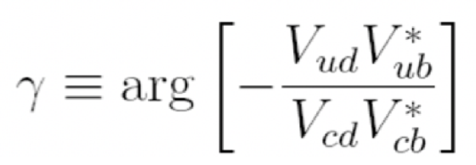
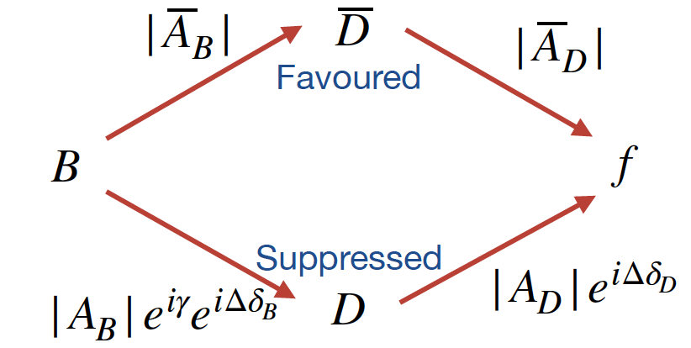



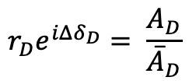







Joint measurement between LHCb and BESIII
$b→c:$
$$\overline{A}\left(D\right):{\overline{D}}^{0}→f$$
$$r_{D}e^{iΔδ_{D}}= \frac{A_{D}}{{\overline{A}}_{D}}$$
$$A\left(D\right):D^{0}→f$$
$$D^{0}(\vec{p})$$
$b→u:$
$γ$ measurements
$$ψ\left(3770\right)$$
First joint analyses between LHCb and BESIII collaborations
QC data
$$\overline{D^{0}}(−\vec{p})$$
2026/07/03
UCAS Wenbin Qian
10

Slide 11
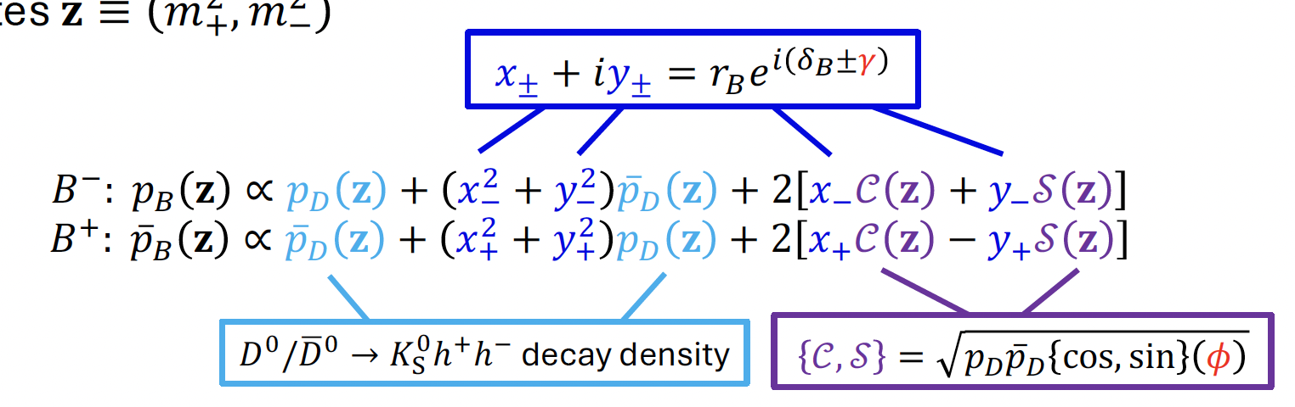
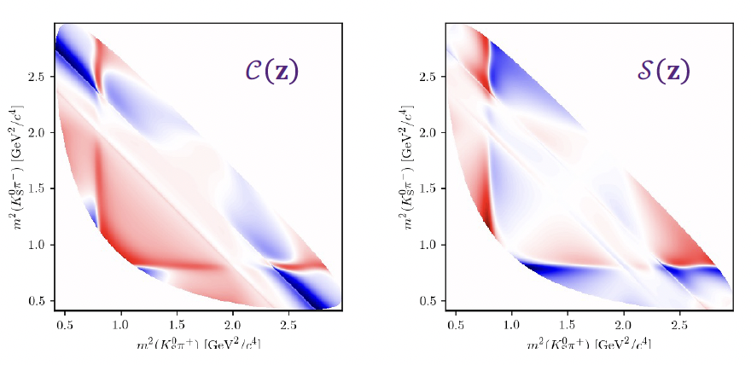
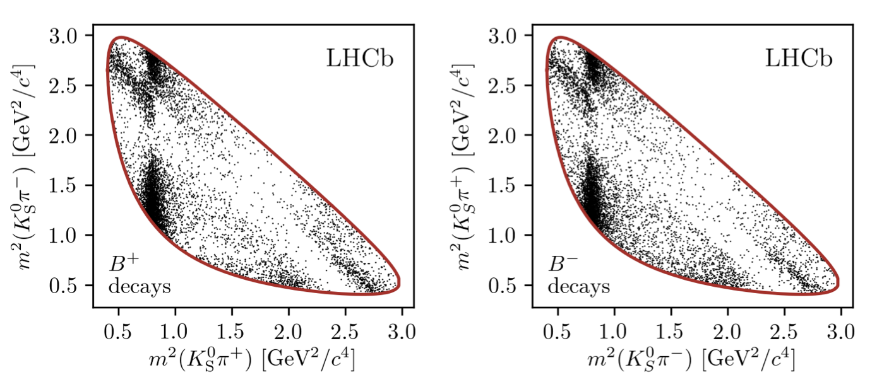
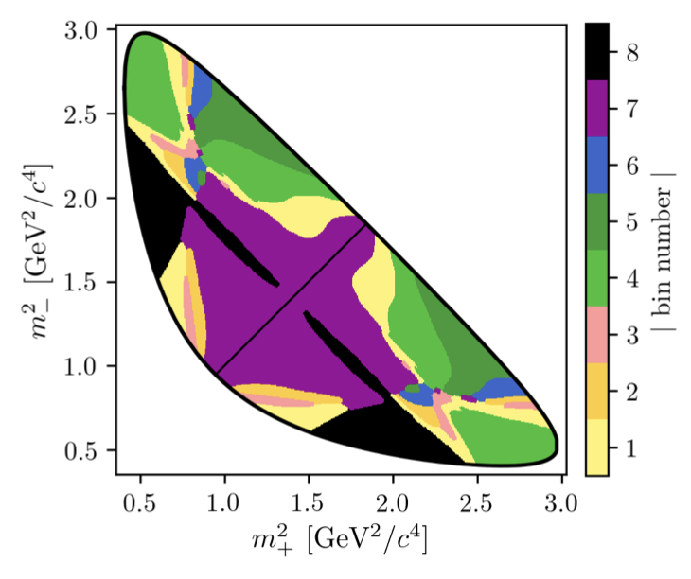
Logic of the new method (1)
Novel approach: fourier transformation
[EPJC78 (2018) 2, 121]
Density difference indicates CP violation
Traditional method: binning
~10% loss of sensitivity
2026/07/03
UCAS Wenbin Qian
11

Slide 12
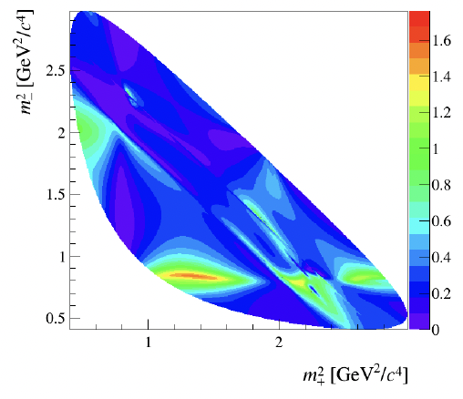
Logic of the new method (2)
Novel approach: fourier transformation
[EPJC78 (2018) 2, 121]
Density difference indicates CP violation
Only considering phase information
A further weight added to take into account amplitude, purity, efficiency information
2026/07/03
UCAS Wenbin Qian
12

Slide 13
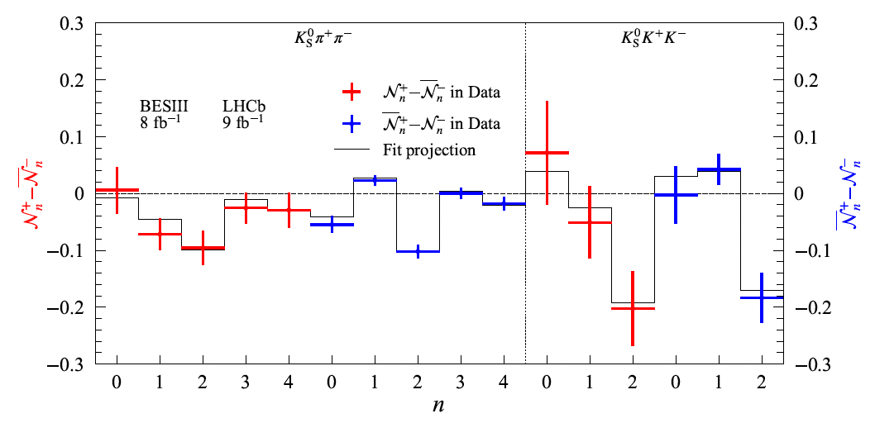
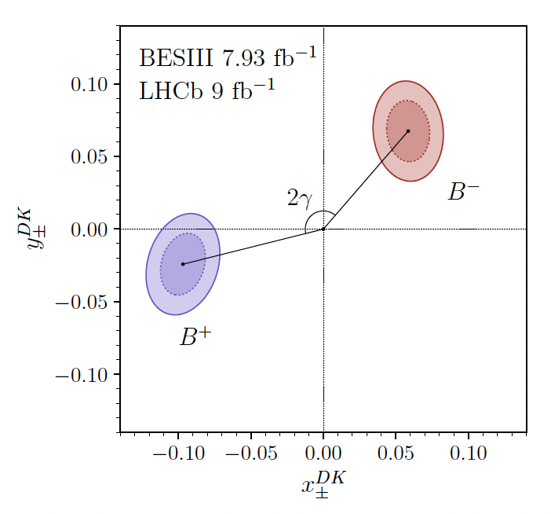
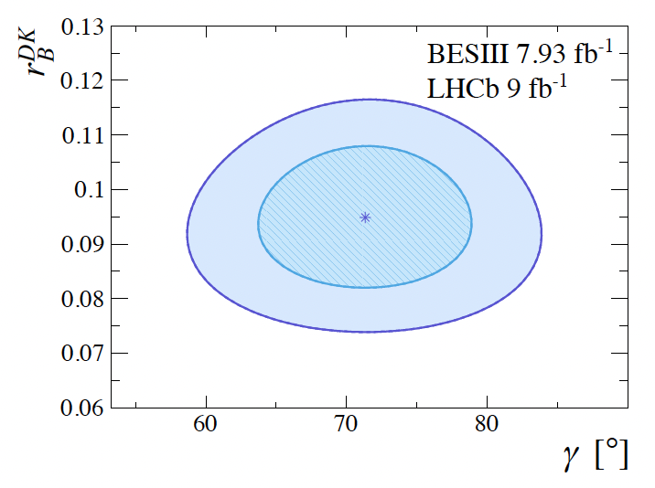
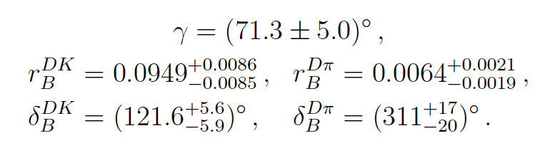
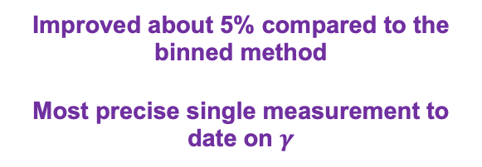
CP observables and results
Observables from B decays, indicating CP violation effects
Results on $γ$ and strong parameters
Improved about 5% compared to the binned method
Most precise single measurement to date on $γ$
Opens new possibilities for $γ$ measurements in other multibody decays
2026/07/03
UCAS Wenbin Qian
13

Slide 14
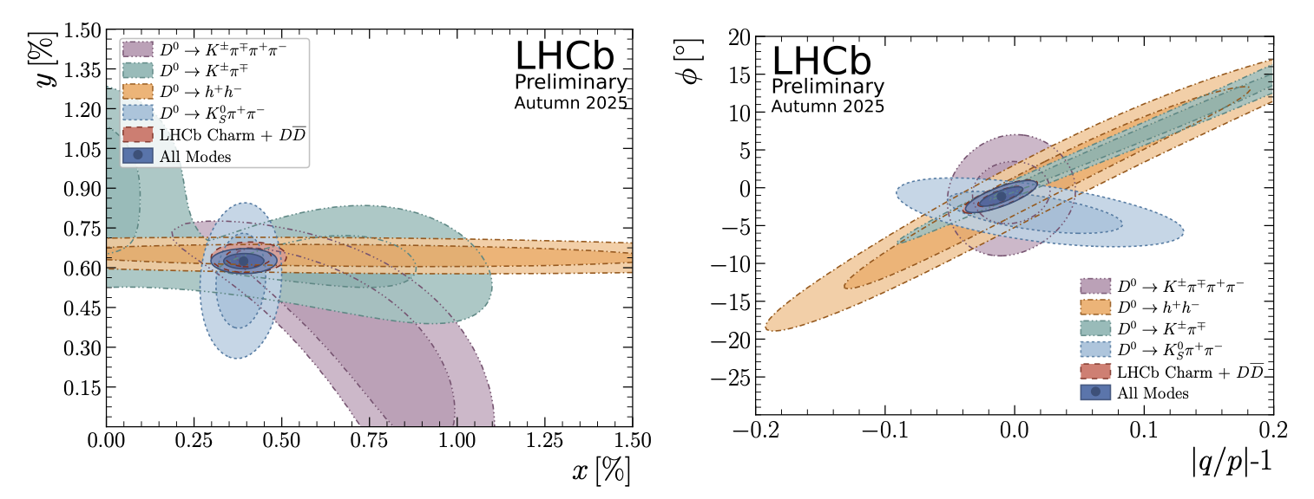
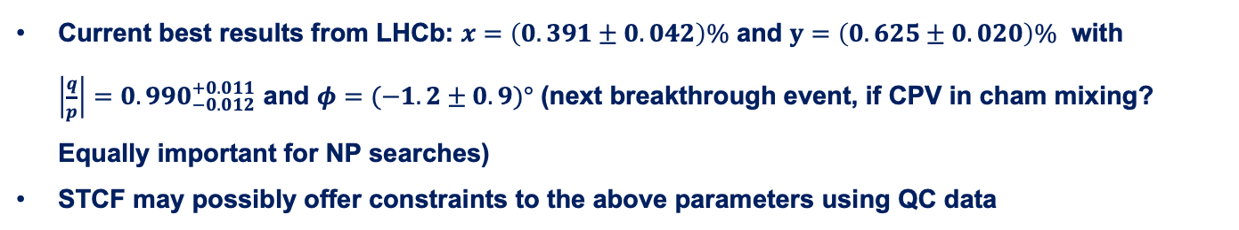
D mixing parameters
LHCb-CONF-2025-003
Strong parameters also essential for determine charm mixing parameters and CP violation quantities
Current best results from LHCb: $x=\left(0.391±0.042\right)\%$ and $y=\left(0.625±0.020\right)\%$ with
$\left|\frac{q}{p}\right|=0.990_{−0.012}^{+0.011}$ and $φ=(−1.2±0.9)°$ (next breakthrough event, if CPV in cham mixing? Equally important for NP searches)
STCF may possibly offer constraints to the above parameters using QC data
2026/07/03
UCAS Wenbin Qian
14

Slide 15
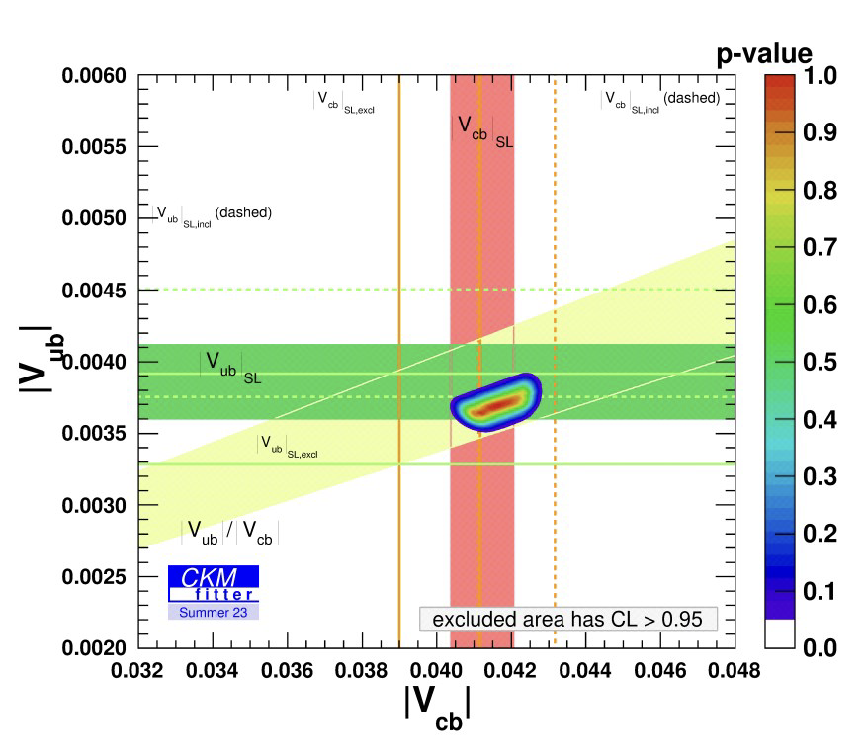
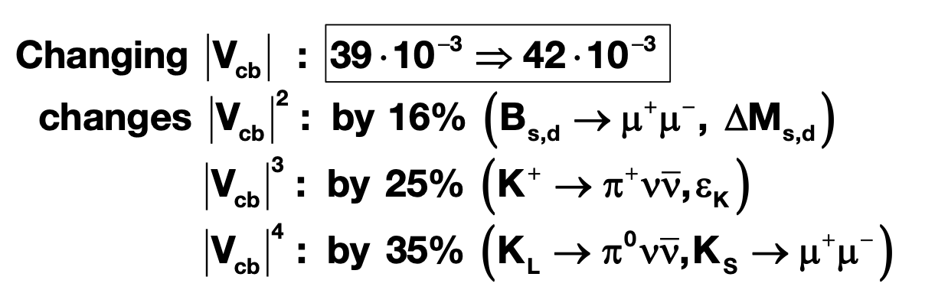

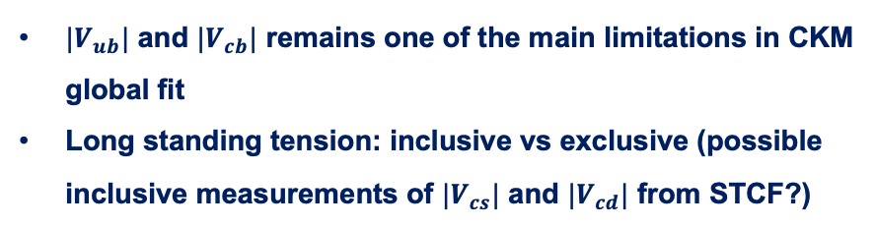
$$\left|V_{ub}\right|, |V_{cb}|$$
$|V_{ub}|$ and $|V_{cb}|$ remains one of the main limitations in CKM global fit
Long standing tension: inclusive vs exclusive (possible inclusive measurements of $|V_{cs}|$ and $|V_{cd}|$ from STCF?)
inclusive
Disaster for new physics searches if CKM elements not precise
exclusive
CKMfitter group (http://ckmfitter.in2p3.fr)
From A. Buras
LHCb also plays a leading role despite difficulties in reconstructing missing particles and more precise in measuring ratios
PRL 126 (2021) 081804, JHEP 12 (2020) 124, PRD 101 (2020) 072004, NP 11 (2015) 743
2026/07/03
UCAS, Wenbin Qian
15

Slide 16
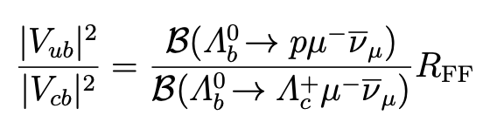
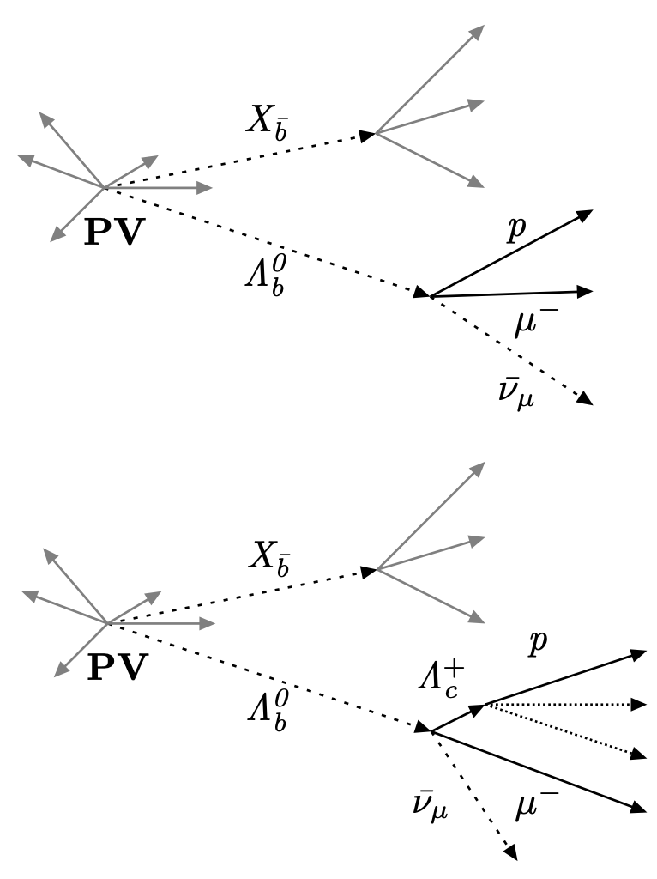
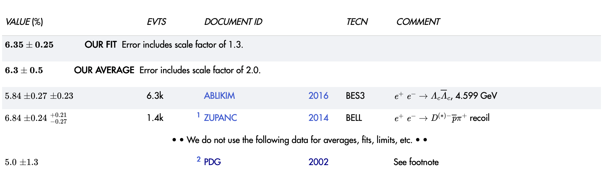
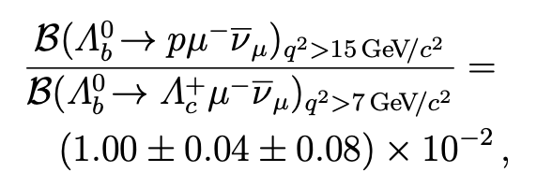


$\left|V_{ub}\right|, |V_{cb}|$: inputs from STCF
Nature Physics 11 (2015) 743
Ratio between $\left|V_{cb}\right|$ and $|V_{ub}|$ determined using $Λ_{b}^{0}→pμ^{−}{\overline{ν}}_{μ}$ and $Λ_{b}^{0}→Λ_{c}^{+}μ^{−}{\overline{ν}}_{μ}$
Inputs from LQCD
$Λ_{c}^{+}$ reconstructed in $pK^{+}π^{−}$ final states, thus branching fraction essential inputs
$$5.0±1.3$$
Tension seen between BESIII and Belle measurements
Uncertainties still large
Contributing half of systematic uncertainties
2026/07/03
UCAS, Wenbin Qian
16

Slide 17
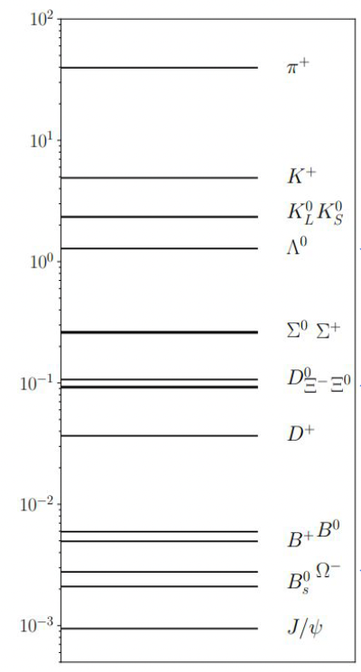
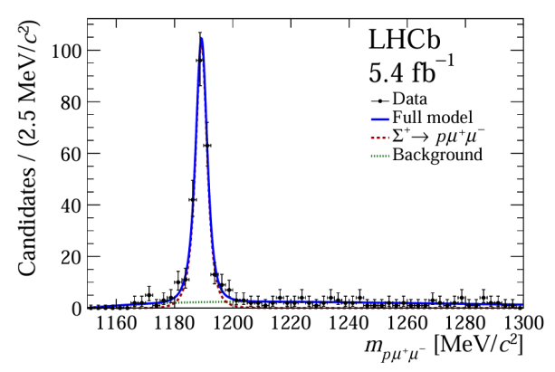
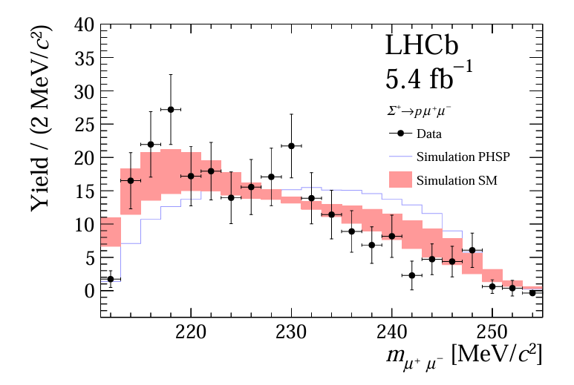
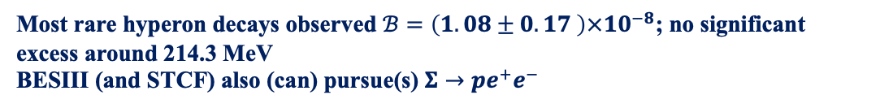
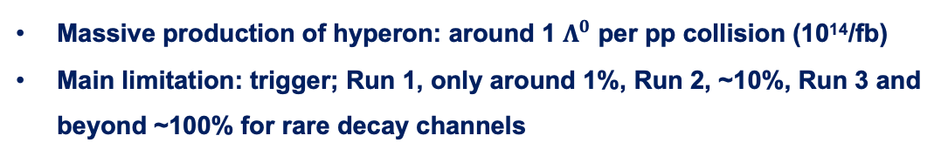
LHCb: a hyperon factory
PRL 135 (2025) 051801
Multiplicity per pp collision
Massive production of hyperon: around 1 $Λ^{0}$ per pp collision (10¹⁴/fb)
Main limitation: trigger; Run 1, only around 1%, Run 2, ~10%, Run 3 and beyond ~100% for rare decay channels
$s→u$ FCNC process: SM ~ $10^{−8}$ (dominantly by long distance)
Most rare hyperon decays observed $ℬ=\left(1.08±0.17 \right)×10^{−8}$; no significant excess around 214.3 MeV
BESIII (and STCF) also (can) pursue(s) $Σ→pe^{+}e^{−}$
2026/07/03
UCAS Wenbin Qian
17

Slide 18
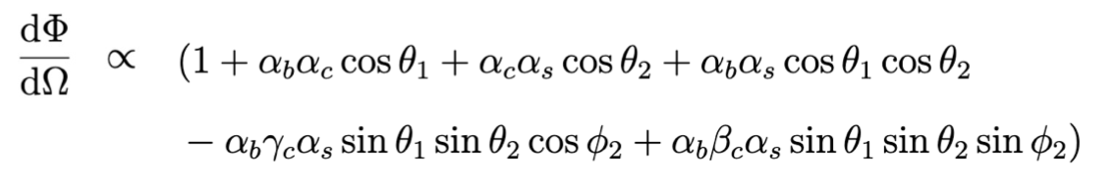
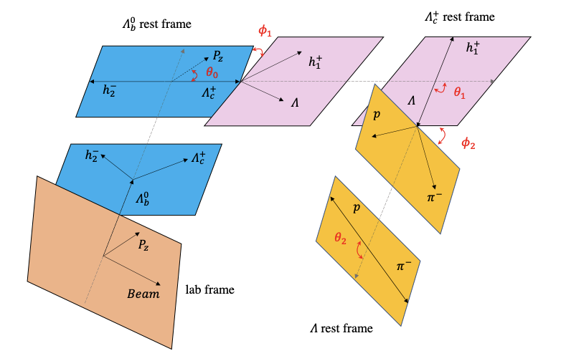
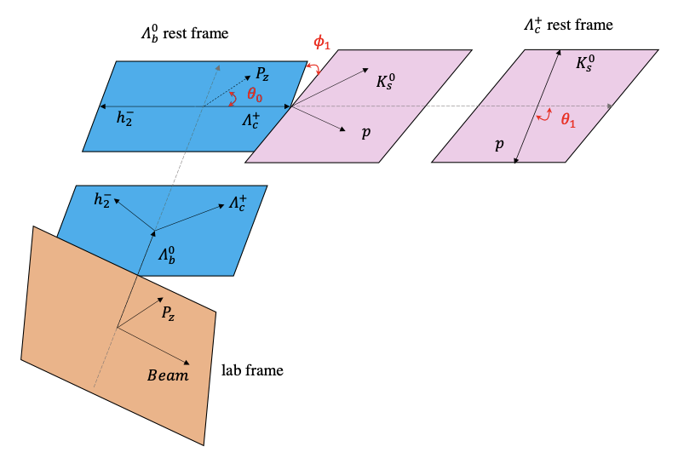
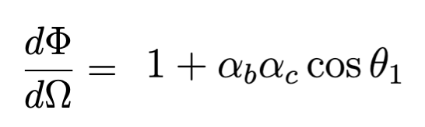







Decay parameter measurements
PRL 133 (2024) 261804
Massive hyperons can also be used to measure CP violation
Various sources: from b, from c and prompt produced
$$Λ_{b}^{0}→Λ_{c}^{+}{(→Λh^{+})h}^{−}, Λ→pπ^{−}$$
$$Λ_{b}^{0}→Λ_{c}^{+}{(→pK_{S}^{0})h}^{−}$$
$$α_{b}:Λ_{b}^{0}→Λ_{c}^{+}h^{−}$$
$$α_{c}:Λ_{c}^{+}→pK_{S}^{0}$$
$$α_{b}:Λ_{b}^{0}→Λ_{c}^{+}h^{−}$$
$$α_{c},β_{c},γ_{c}:Λ_{c}^{+}→Λh^{+}$$
$$α_{s}:Λ→pπ^{−}$$
2026/07/03
UCAS Wenbin Qian
18

Slide 19
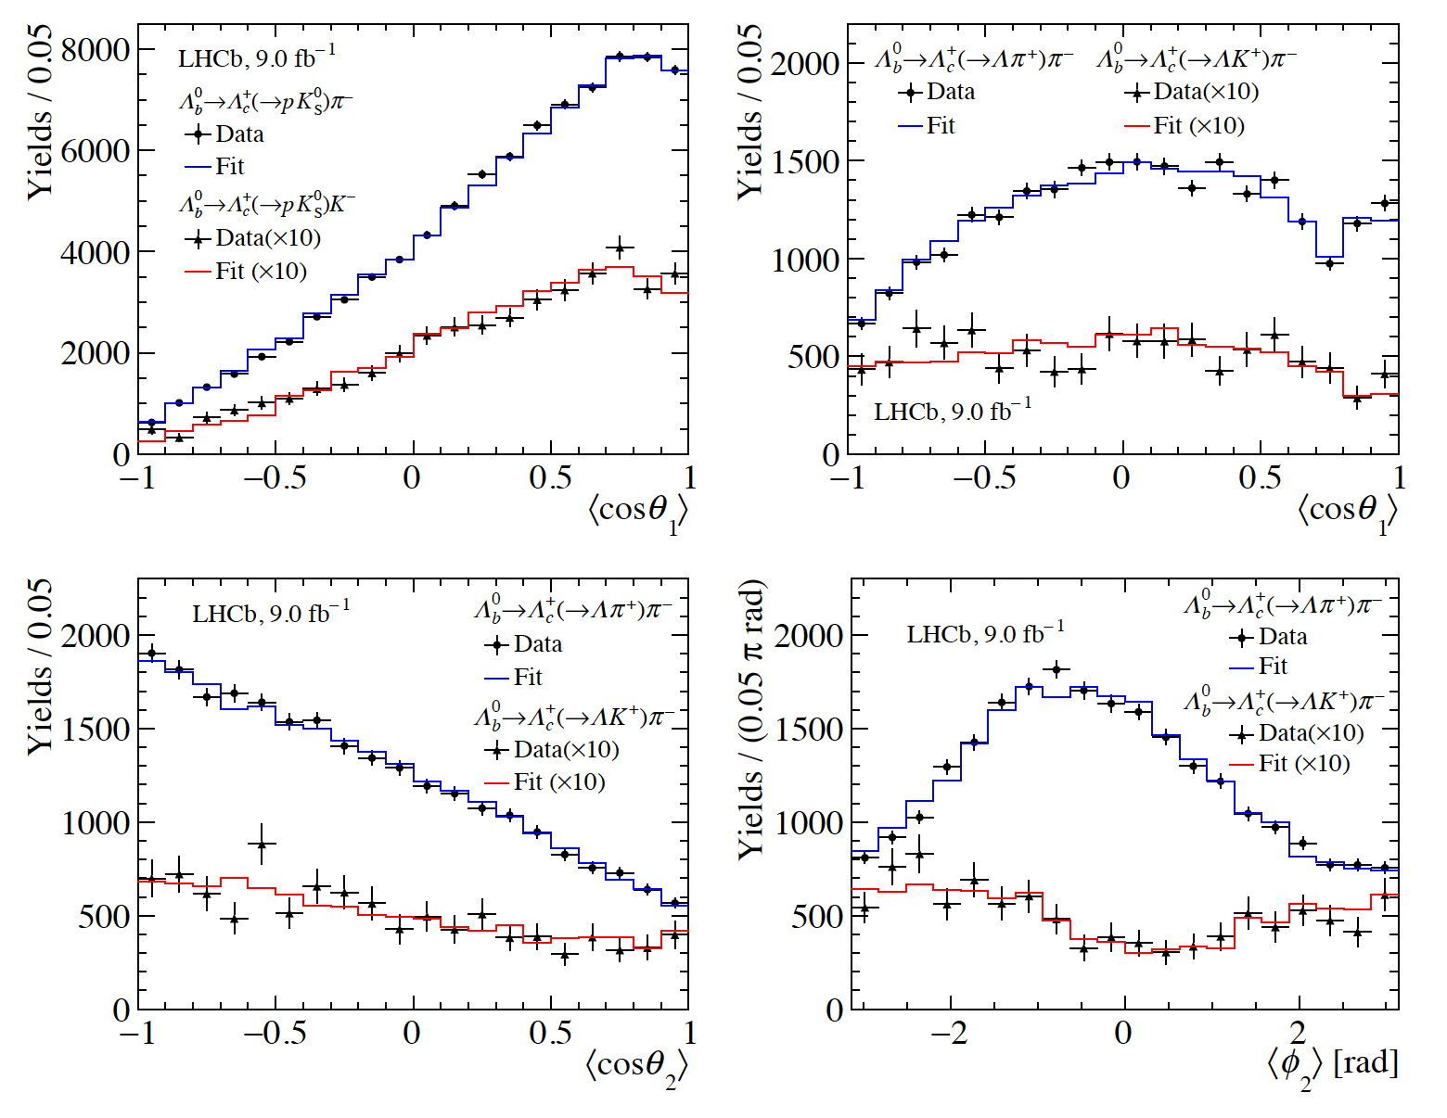
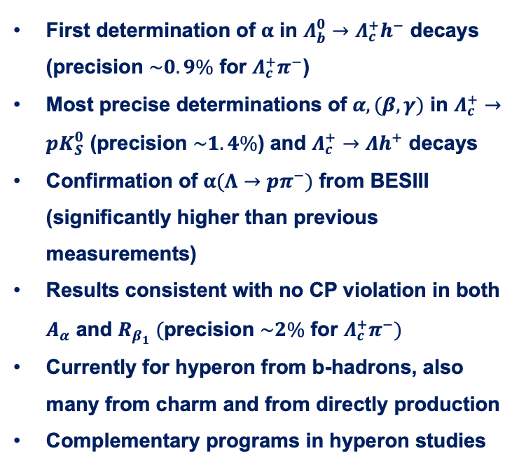












Results of decay parameters
PRL 133 (2024) 261804
$$Λ_{b}^{0}→Λ_{c}^{+}(→pK_{S}^{0})h^{−}$$
$$Λ_{b}^{0}→Λ_{c}^{+}{\left(→Λh^{+}\right)π}^{−}$$
First determination of $α$ in $Λ_{b}^{0}→Λ_{c}^{+}h^{−}$ decays (precision $\sim 0.9\%$ for $Λ_{c}^{+}π^{−}$)
Most precise determinations of $α,(β,γ)$ in $Λ_{c}^{+}→pK_{S}^{0}$ (precision $\sim 1.4\%$) and $Λ_{c}^{+}→Λh^{+}$ decays
Confirmation of $α(Λ→pπ^{−})$ from BESIII (significantly higher than previous measurements)
Results consistent with no CP violation in both $A_{α}$ and $R_{β_{1}} (\text{precision} \sim 2\% \text{for} Λ_{c}^{+}π^{−})$
Currently for hyperon from b-hadrons, also many from charm and from directly production
Complementary programs in hyperon studies
$$Λ_{b}^{0}→Λ_{c}^{+}π^{−}$$
$$Λ_{c}^{+}→Λπ^{+}$$
$$Λ_{b}^{0}→Λ_{c}^{+}K^{−}$$
$$Λ_{c}^{+}→ΛK^{+}$$
$$Λ_{c}^{+}→Λπ^{+}$$
$$Λ_{c}^{+}→Λπ^{+}$$
$$Λ_{c}^{+}→ΛK^{+}$$
$$Λ_{c}^{+}→ΛK^{+}$$
$$Λ_{b}^{0}→Λ_{c}^{+}{\left(→Λh^{+}\right)π}^{−}$$
$$Λ_{b}^{0}→Λ_{c}^{+}{\left(→Λh^{+}\right)π}^{−}$$
2026/07/03
UCAS Wenbin Qian
19

Slide 20
Outline of the talk
Introduction
Complementary in CKM physics
Synergy in rare decay measurements
Common interests in exotic particle studies
Conclusions
2026/07/03
UCAS, Wenbin Qian

Slide 21
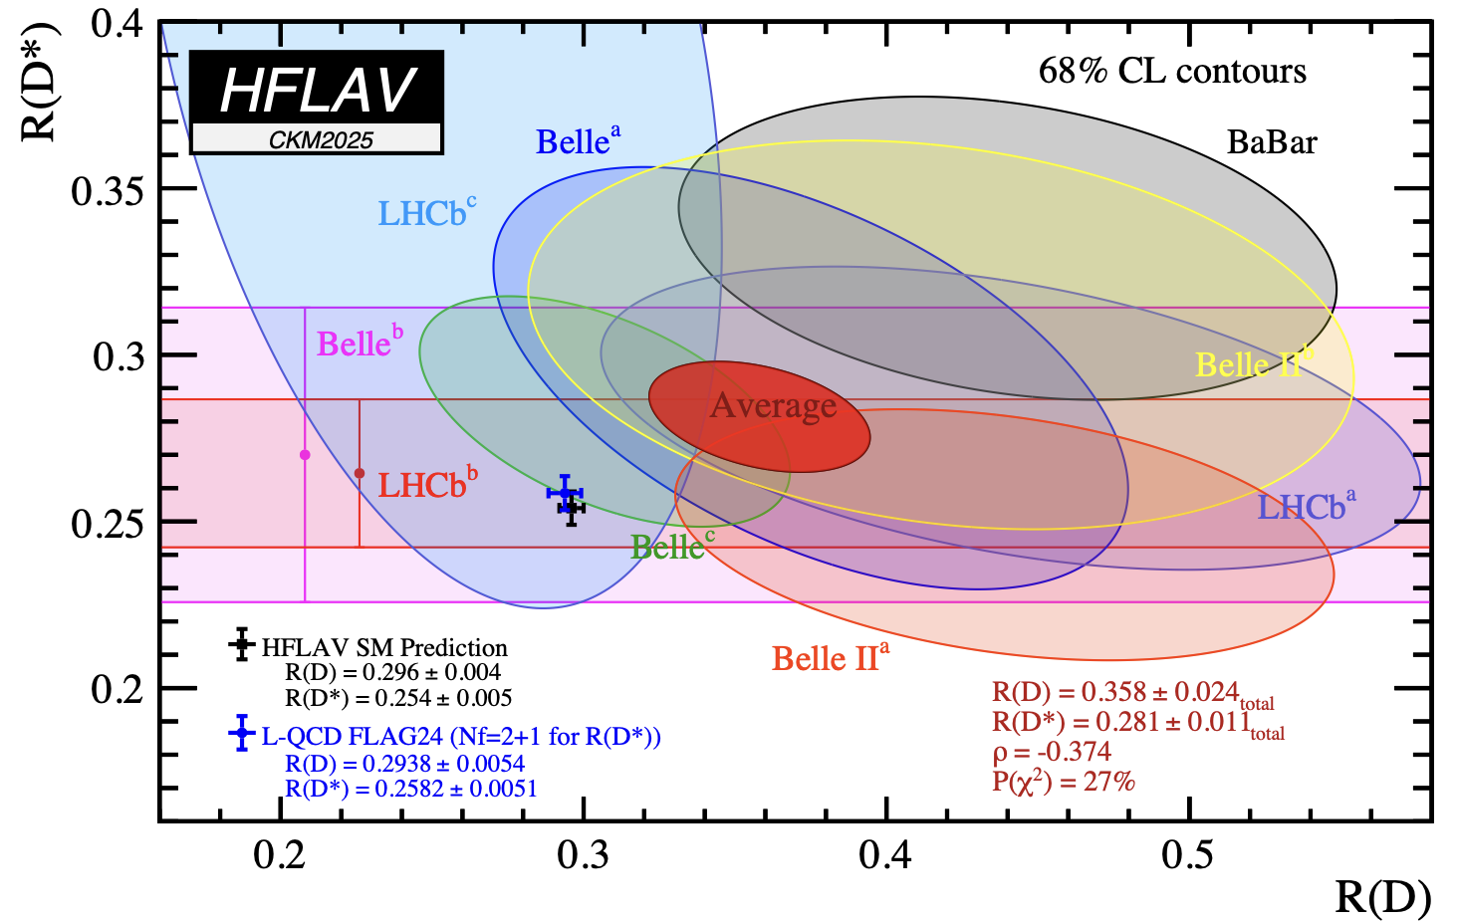
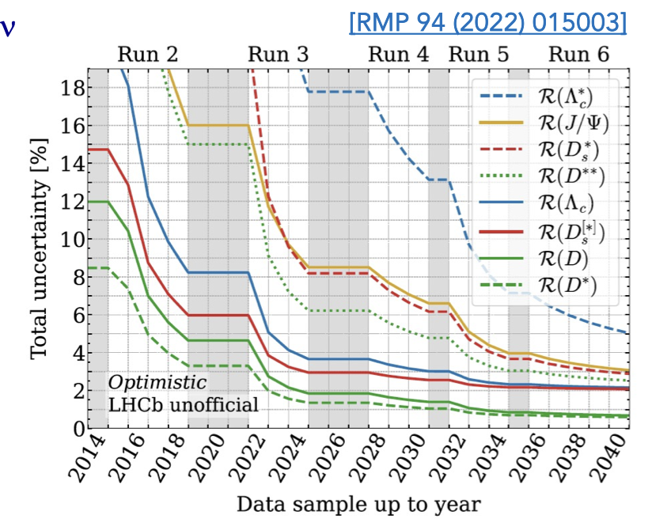


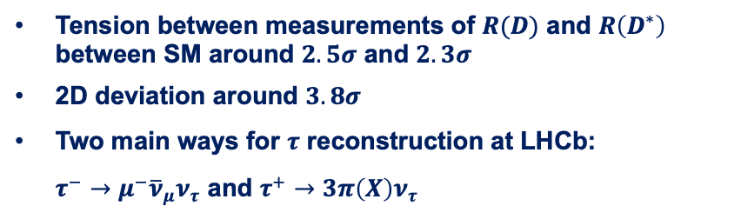

$R(D^{(∗)})$ measurements
PRL 134 (2025) 061801
PRD 108 (2023) 012018
Tension between measurements of $R(D)$ and $R\left(D^{∗}\right)$ between SM around $2.5σ$ and $2.3σ$
2D deviation around $3.8σ$
Two main ways for $τ$ reconstruction at LHCb:
$τ^{−}→μ^{−}{\overline{ν}}_{μ}ν_{τ}$ and $τ^{+}→3π\left(X\right)ν_{τ}$
Recent LHCb results using 2 fb⁻¹ data from Run2:
Muonic:
Hadronic:
Future precisions down to around 1%
Main background, double charmed background with $D_{s}^{+}→3πX$
2026/07/03
UCAS, Wenbin Qian
21

Slide 22






Contributions from $D_{s}^{+}$ decays
PRD 108 (2023) 012018
$τ→3πν_{τ}$ mainly through $a_{1}^{+}(→ρ^{0}π^{+})$ while $D_{s}^{+}→3π(X)$ mainly through $η^{(′)}$ with small $a_{1}$ contribution
Anti-$D_{s}^{+}$ BDT, trained using $B^{0}→D^{∗−}τ^{+}ν_{τ}$ and $D_{s}^{+}→3π(X)$ simulation samples, to reject (distinguish) $D_{s}^{+}$ background (Information from $D_{s}^{+}$ decays thus crucial)
Data-driven method (reversed anti-$D_{s}^{+}$ cut)：STCF inputs very helpful here
Systematic uncertainties due to $D_{s}^{+}$ decays contribute to 1/3 of the total one
fit
Similarly, information from $D$ decays also needed, though smaller than $D_{s}^{+}$
2026/07/03
UCAS, Wenbin Qian
22

Slide 23







Photon polarization
PRL 112 (2014) 161801
Photon from $b→sγ$ predominantly left-handed; significant right-handed component indicates NP
Up-down asymmetry proportional to photon polarization
$$B^{+}→K^{+}π^{+}π^{−}γ$$
Fit performed to extract $A_{ud}$ in four different regions
Non-zero photon polarization discovered with a significance of 5.2 $σ$
2026/07/03
UCAS, Wenbin Qian
23

Slide 24






Photon polarization: BESIII inputs
To extract $λ_{γ}$, $f_{h}=Im\left[\vec{n}∙\left(\vec{J}×{\vec{J}}^{∗}\right)\right]/{\left|\vec{J}\right|}^{2}$needed
$$×{10}^{−2}$$
PRL 125 (2020) 051802
Proposed to use up-down asymmetry in $D→K_{1}\left(1270\right)e^{+}ν_{e}$ to extract $f_{h}$ in region 1: ${A′}_{ud}=4f_{h}/3$
${A′}_{ud}=0.01±0.11$
Consistent with SM prediction ($0.092±0.022$), however, still statistically limited, STCF data needed
PRL 135 (2025) 091801
2026/07/03
UCAS, Wenbin Qian
24

Slide 25
Outline of the talk
Introduction
Complementary in CKM physics
Synergy in rare decay measurements
Common interests in exotic particle studies
Conclusions
2026/07/03
UCAS, Wenbin Qian

Slide 26



Particle zoo 2.0
Many new hadrons discovered since the discovery of $χ_{c1}(3872)$ in 2003: renaissance and revolution?
30 new hadrons
LHC (mainly LHCb)
BESIII
+ 17 new hadrons from Belle (>35 from its start)
> 20 new hadrons since 2022 (only selected ones are shown)
Complementary between $e^{+}e^{−}$ and $b$-decay + $pp$ environments (small overlaps)
More than 140 new hadrons
2026/07/03
UCAS, Wenbin Qian
26

Slide 27









A history of understanding
$c\overline{c}(X)$ + $c\overline{s}(X)$
More states
Better understanding
Unified model for all hadrons?
$$c\overline{c}g$$
$$c\overline{c}$$
+
$$c\overline{c}qq$$
+
+
$$c\overline{c}$$
$$qq$$
+ …
Particle X =
$$cq$$
$$\overline{c}q$$
2026/07/03
UCAS, Wenbin Qian
27

Slide 28





Structure of $χ_{c1}(3872)$：global efforts
Properties extensively studied, usually leading to different conclusions
Mass: very close to $D^{0}{\overline{D}}^{∗0}$, $m_{D^{0}}+m_{{\overline{D}}^{∗0}}−m_{χ_{c1}\left(3872\right)}=0.01±0.14$ MeV
Width: narrow width (0.1~1 MeV)
$J^{PC}$: $1^{++}$
Decay: $D^{0}{\overline{D}}^{∗0}$ (~35%), $J/ψω$ (~4%), $J/ψρ$ (~3%)
Production: $pp, p\overline{p}, B$ decays, $pP$b, PbPb
Molecular like
Charmonium like
$$c\overline{c}$$
+
$$c\overline{c}qq$$
+
$$cq$$
$$\overline{c}q$$
+
$$c\overline{c}$$
$$qq$$
$χ_{c1}(3872)$ =
Can we determine contributions of different components?
2026/07/03
UCAS, Wenbin Qian
28

Slide 29















Structure of $χ_{c1}(3872)$
JHEP 11 (2024) 121
PRL 124 (2020) 242001
$$J/ψ$$
$$ψ(2S)$$
Photon to probe its structure
$${ψ→μ}^{+}μ^{−}$$
$${ψ→e}^{+}e^{−}$$
$<0.59 @$ 90 C.L.
$$c\overline{c}$$
$$D{\overline{D}}^{∗}$$
$$1.67±0.25$$
2026/07/03
UCAS, Wenbin Qian
29

Slide 30





Observation of $T_{c\overline{c}\overline{s}1}$
PRL 127 (2021) 082001
PRL 126 (2021) 102001
BESIII observed a narrow state: $T_{c\overline{c}\overline{s}1}{\left(3985\right)}^{+}$ decaying into $D_{s}^{+}{\overline{D}}^{∗}+\overline{D}D_{s}^{∗+}$ with quark content $c\overline{c}s\overline{u}$
Similarly, LHCb observed two broad states: $T_{c\overline{c}\overline{s}1}{\left(4000\right)}^{+}$ and $T_{c\overline{c}\overline{s}1}{\left(4220\right)}^{+}$ with same quark content
$m\left(Z_{cs}{\left(4000\right)}^{+}\right)=\left(4003±6_{−14}^{+ 4}\right)$ MeV
$Γ\left(Z_{cs}{\left(4000\right)}^{+}\right)=(131±15±26)$ MeV
Whether the two same states or not still under debate
If the same, future data to test its underlying mechanics?
2026/07/03
UCAS, Wenbin Qian
30

Slide 31




CP violation in $Λ_{b}^{0}→J/ψph$ decays
Science Bulletin 71 (2026) 547
$Λ_{b}^{0}→J/ψpπ^{−}$
A significance of 3.3$σ$, when combining with Run 1 result, it reaches 3.9$σ$
$Λ_{b}^{0}→J/ψpK^{−}$
CP violation seen in a channel where pentaquark is found!
2026/07/03
UCAS, Wenbin Qian
31

Slide 32





Amplitude analysis tools
Amplitude analyses: key to flavor physics
AI? QC?
Larger and larger data size: BESIII now collects 10B $J/ψ$ sample; 10$×$ more data from LHCb (~2030); Belle II, 50$×$ Belle (~2030); STCF 100 $×$ more than BESIII
More and more complicated amplitude analyses;
Common languages between different measurements and theorists
？
TF-PWA + COMPWA + LAURA+…
2026/07/03
UCAS, Wenbin Qian
32

Slide 33



CP violation in $B^{+}→K^{+}π^{−}π^{−}$ decays
Around 40 $×$ data than B-factories using only Run 1 data
Advanced techniques in amplitude analyses:
  Three ways to model S-wave: Isobar, K-Matrix, and MI approach (first MI implementation of $Kπ$ and $ππ$ S-wave together)
  Using GLASS to model $Kπ$ S-wave
  Include also $ππ→ππ$ (significant contributions found) and $KK→ππ$ rescattering contributions from dispersive relationship
2026/07/03
UCAS, Wenbin Qian
33

Slide 34




Branching fraction of $B^{+}→K_{0}^{∗}\left(1430\right)π^{+}$
Different predictions from pQCD[EPJC50 (2007) 877] and QCDf[PRD87 (2013) 114001]
Two solutions from Belle measurements, one agree with pQCD, other with QCDf; the one with larger branching fraction presented in later Belle paper
BaBar also favors larger branching fraction (pQCD)
Predictions with QCDf agree better with $B→K_{0}^{∗}\left(1430\right)[η^{\left(′\right)},ρ,ω,φ]$
Our results favors QCDf!
Two improvements:
  Larger datasets: same model as Belle also favor QCDf
  Model improvements: GLASS instead of LASS
LASS: $a_{ER}=1, φ_{nonres}=0$
$$φ_{ER}=0$$
2026/07/03
UCAS, Wenbin Qian
34

Slide 35



Extra benefit: $f_{X}(1300)$
With LASS parameterization, BaBar and Belle also need a scalar $f_{X}(1300)$
In Belle study[PRD71 (2005) 092003]，different spin-parity tried, $1^{−}$gives best NLL while $0^{+}$ consistent with $f_{0}(1370)$
$$J^{P}$$ | Mass (MeV) | Width (MeV) | NLL
$0^{+}$(solution1, L) | $$1369±26$$ | $$185±52$$ | -4041.8
$0^{+}$(solution2, S) | $$1400±28$$ | $$165±48$$ | -4024.4
$$1^{−}$$ | $$1330±19$$ | $$210±48$$ | -4048.1
$$2^{+}$$ | $$1337±38$$ | $$85±31$$ | -4013.0
In BaBar study[PRD78 (2008) 012004]， $0^{+}$gives a mass consistent with $f_{0}(1500)$ with $m=1479±8$ MeV and $Γ=80±19$ MeV, while $1^{−}$ also fits well with mass consistent with $ρ(1450)$
Fit fraction of $f_{X}(1300)$ in Belle varies from 3.7% to 6.7%, while in BaBar, it is around 1.3%
Theoretical interpretations: known scalar $f_{0}(1370)$ or $f_{0}(1500)$; Artefact from glueball; unknown scalar etc.
2026/07/03
UCAS, Wenbin Qian
35

Slide 36




Our results on $f_{X}(1300)$
Our results when using LASS model, also need $f_{X}(1300)$ with $m=1454±2$ MeV and $Γ=120±5$ MeV
Model | $$Δ(−2NLL)$$
LASS + $f_{X}(1300)$ (free mass + width) | $$1521$$
LASS + $f_{0}\left(1370\right)+f_{0}(1500)$ (fixed mass + width) | $$1598$$
BETTER
Our results when using GLASS
  No need to include $f_{X}(1300)$
  $Δ(−2NLL)$ more than 1500 better
  FF$\left(f_{0}\left(1370\right)\right)=\left(16.8±1.0±0.8\right)\%$
  FF$\left(f_{0}\left(1500\right)\right)=\left(1.9±0.2±0.3\right)\%$
2026/07/03
UCAS, Wenbin Qian
36

Slide 37
Prospects on flavor physics programs
Belle II
0.4 ab⁻¹
1 ab⁻¹
10 ab⁻¹
50 ab⁻¹
250 ab⁻¹
2019-2022
2024-2032
Run 1
LS1
Run 2
LS2
Run 3
upgrade
2015-2018
2019-2022
2022-2026
2027-2029
2030-2033
2034-2035
2036-future
Run2
LS2
Run3
LS3
Run4
LS4
Run5-6
Phase I
Upgrade
Phase Ib
Upgrade
Phase II
Upgrade
LHCb
20+ fb⁻¹
50 fb⁻¹
300 fb⁻¹
HL-LHC
CMS/ATLAS
200 fb⁻¹
3000 fb⁻¹
BESIII/super $τ$-charm/CEPC
BEPCII upgrade + running of super $τ$-charm/CEPC
2026/07/03
UCAS, Wenbin Qian

Slide 38
Conclusion
Physics programs of LHCb and BESIII, STCF complementary to each other
Communications and cooperations important for understanding of fundamental questions
Thank you for your attention!
2026/07/03
UCAS, Wenbin Qian

Slide 39




Weights and BESIII inputs
Why weights works? Equation holds when multiplying both sides by the same constant
BESIII QC data: $ψ\left(3770\right)→D\overline{D}$
Example: CP tagged $K_{S}^{0}h^{+}h^{−}$
2026/07/03
UCAS Wenbin Qian
39

Slide 40





Separation between SVP and $K^{∗}(892)$
LASS: $a_{ER}=1, φ_{nonres}=0$
$$φ_{ER}=0$$
$K^{∗}(892)$ separated following (as close as RBW):
2026/07/03
UCAS, Wenbin Qian
40

