Slide 1


正负电子对撞机上超子的衰变研究
周小蓉
中国科学技术大学
2026.6.20-7.5
中国科学院西安光学精密机械研究所

Slide 2
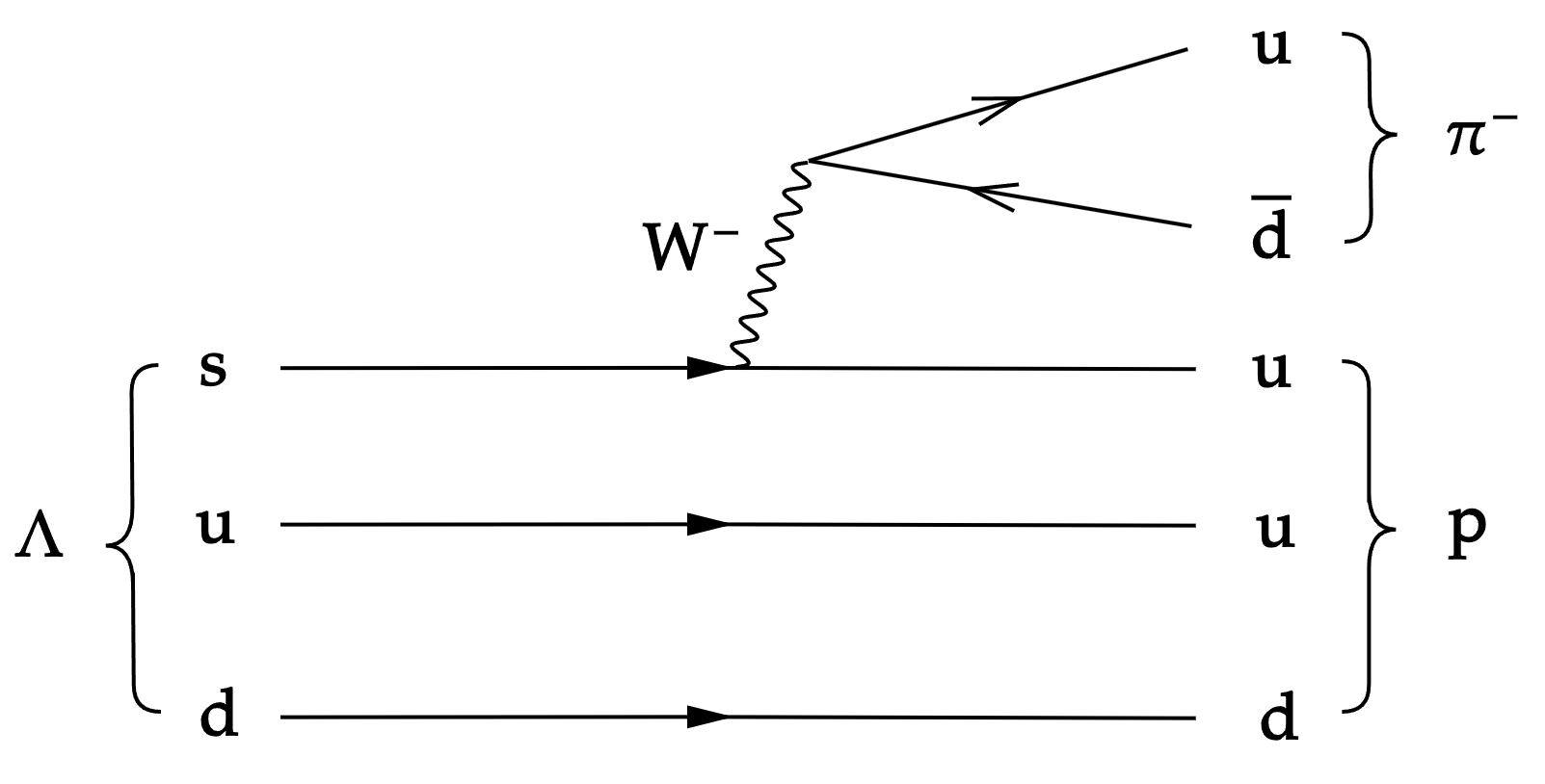
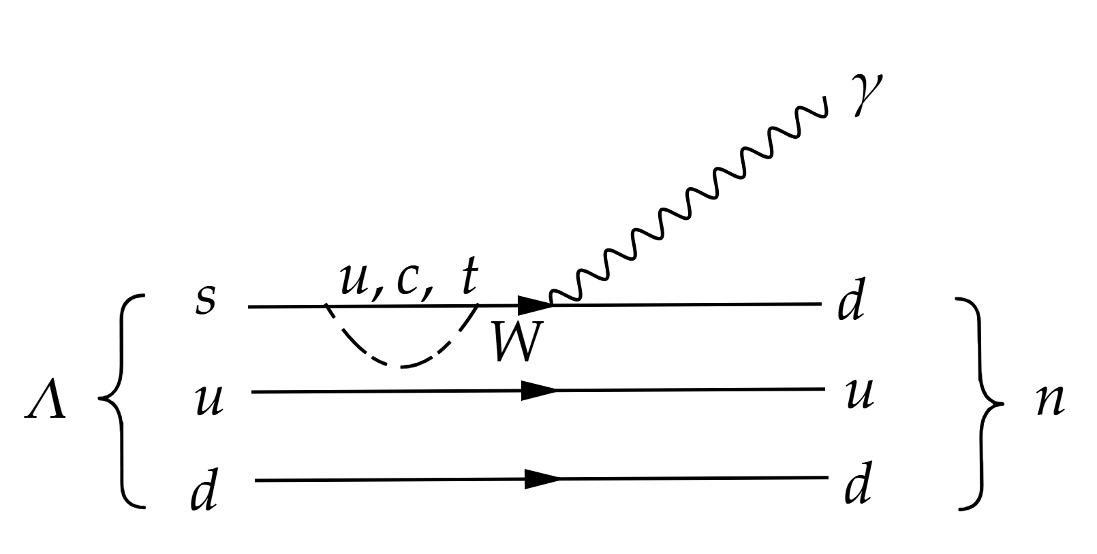
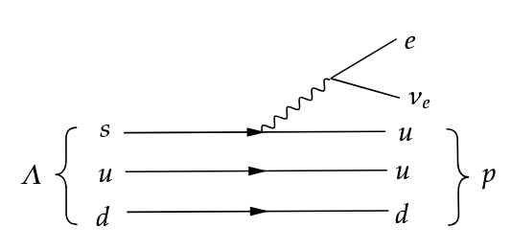
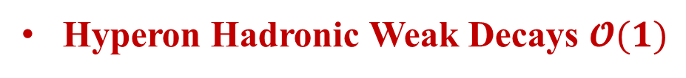
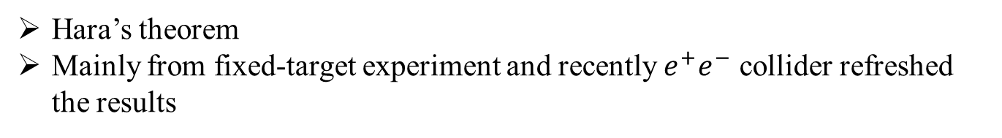
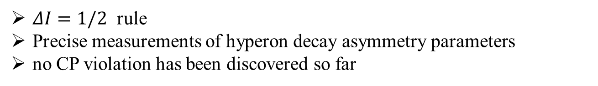
Hyperon decay
Hyperon Hadronic Weak Decays $𝓞(1)$
$ΔI=1/2$ rule
Precise measurements of hyperon decay asymmetry parameters
no CP violation has been discovered so far
Hyperon Hadronic Weak Decays $𝓞({10}^{−3})$
Hara’s theorem
Mainly from fixed-target experiment and recently $e^{+}e^{−}$ collider refreshed the results
Hyperon Semileptonic Decays $𝓞({10}^{−3})$
参考周俊贤、韩许报告
Cabibbo angle anomaly
Extracting form factors, testing lepton universality, and searching for new physics

Slide 3
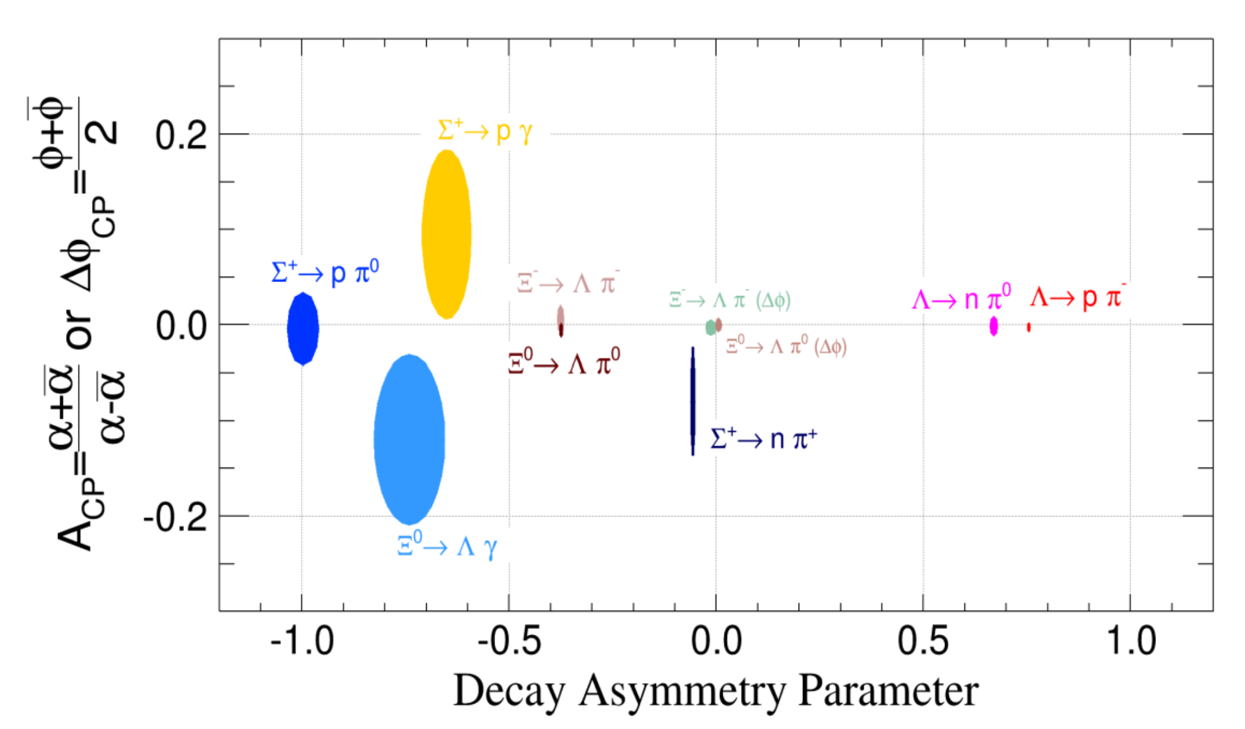
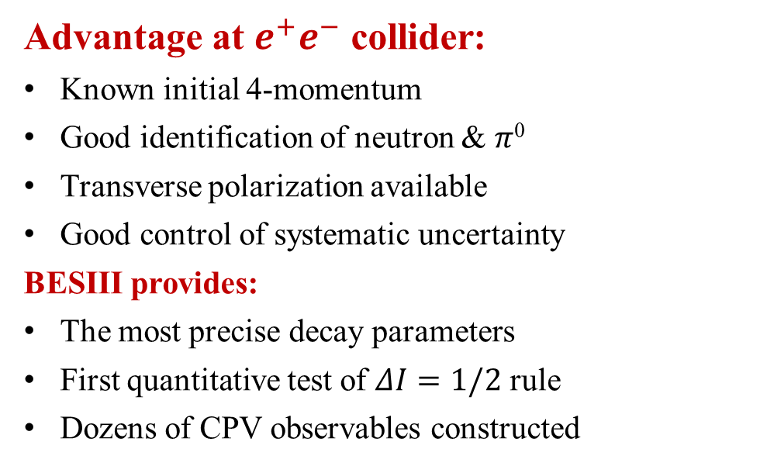
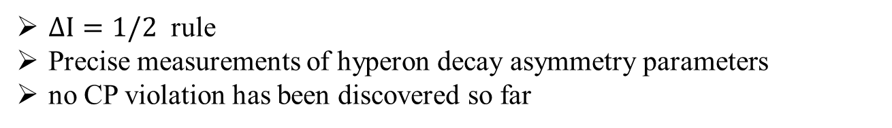
Hyperon hadronic decay
Hyperon Hadronic Weak Decays $𝓞(1)$
$ΔI=1/2$ rule
Precise measurements of hyperon decay asymmetry parameters
no CP violation has been discovered so far
Advantage at $e^{+}e^{−}$ collider:
Known initial 4-momentum
Good identification of neutron & $π$⁰
Transverse polarization available
Good control of systematic uncertainty
BESIII provides:
The most precise decay parameters
First quantitative test of $ΔI=1/2$ rule
Dozens of CPV observables constructed

Slide 4
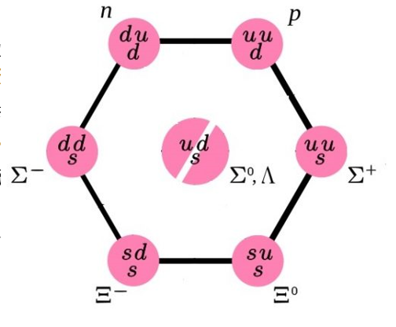
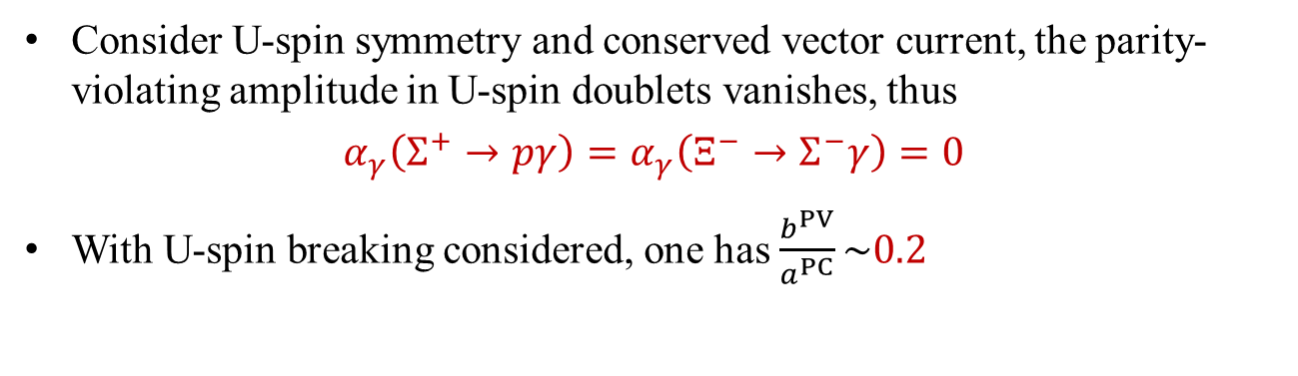

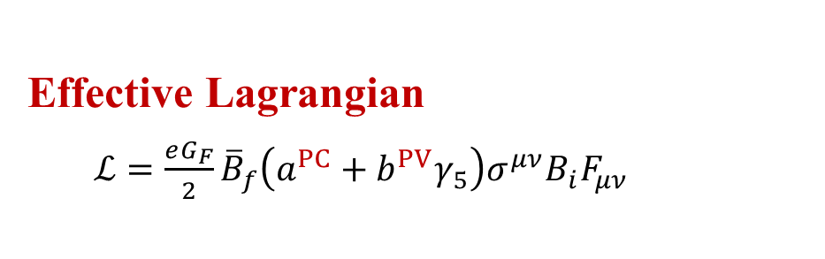
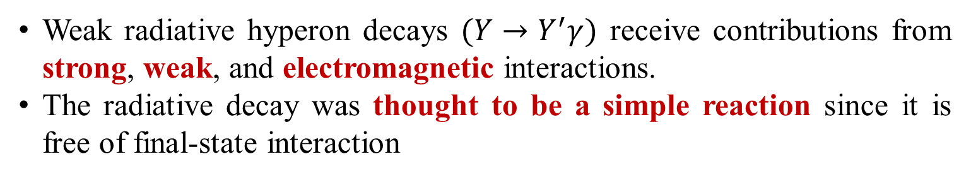
Weak Radiative Hyperon Decay
Weak radiative hyperon decays $(Y→Y^{′}γ)$ receive contributions from strong, weak, and electromagnetic interactions.
The radiative decay was thought to be a simple reaction since it is free of final-state interaction
Effective Lagrangian
$ℒ=\frac{eG_{F}}{2}{\overline{B}}_{f}\left(a^{PC}+b^{PV}γ_{5}\right)σ^{μν}B_{i}F_{μν}$
Observables:
  $Γ=\frac{e^{2}G_{F}^{2}}{π}\left({\left|a\right|}^{2}+{\left|b\right|}^{2}\right)∙{\left|\vec{k}\right|}^{3}$
  $α_{γ}=\frac{2Re(ab^{∗})}{{\left|a\right|}^{2}+{\left|b\right|}^{2}}$
The “Hara theorem” （1964）:
Consider U-spin symmetry and conserved vector current, the parity-violating amplitude in U-spin doublets vanishes, thus
$$α_{γ}\left(Σ^{+}→pγ\right)=α_{γ}\left(Ξ^{−}→Σ^{−}γ\right)=0$$
With U-spin breaking considered, one has $\frac{b^{PV}}{a^{PC}}\sim 0.2$

Slide 5
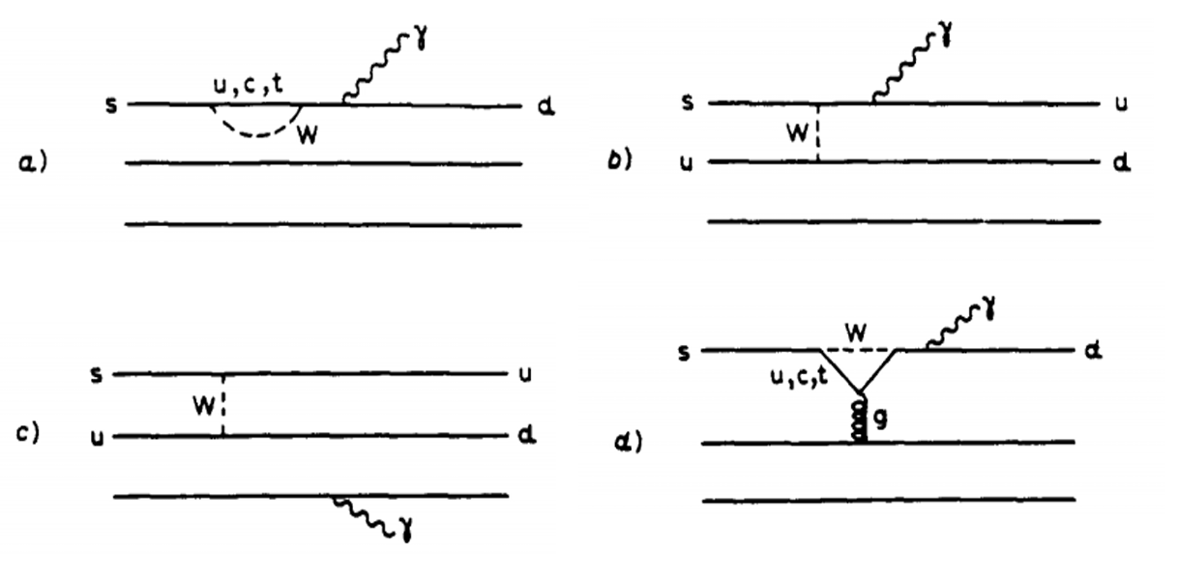
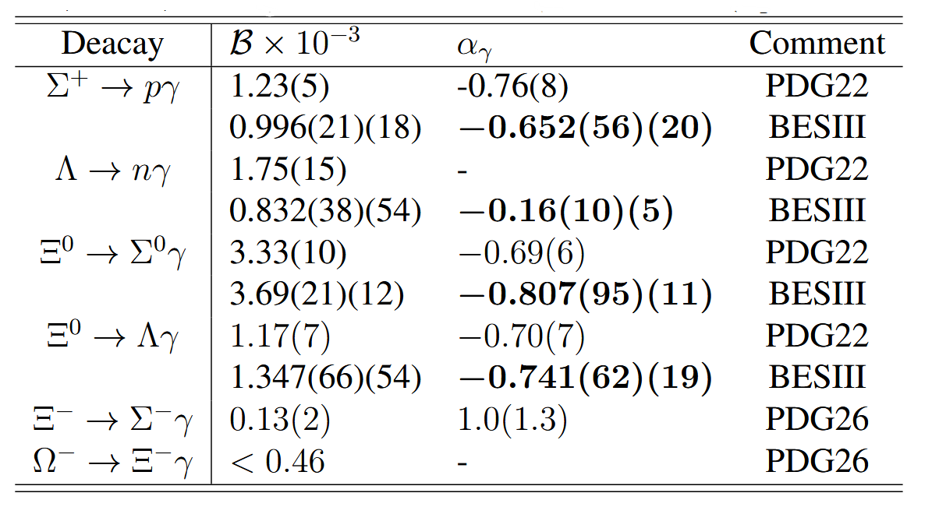
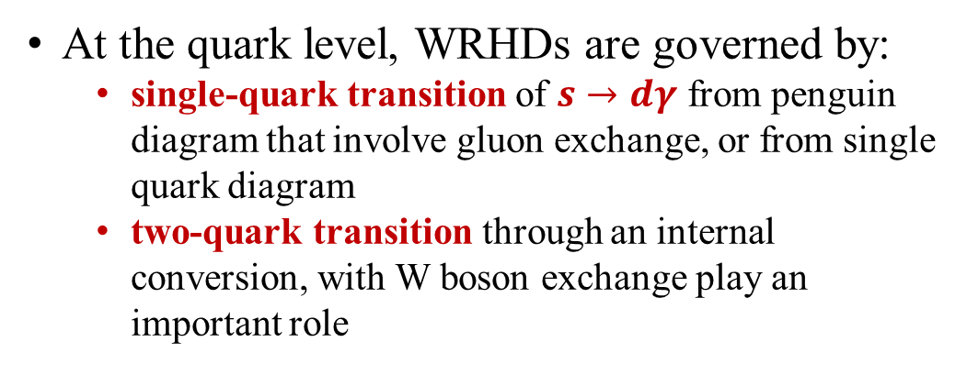
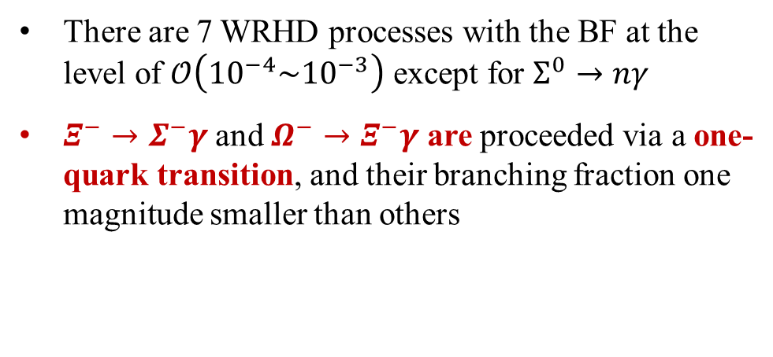
Weak Radiative Hyperon Decay
At the quark level, WRHDs are governed by:
  single-quark transition of $s→dγ$ from penguin diagram that involve gluon exchange, or from single quark diagram
  two-quark transition through an internal conversion, with W boson exchange play an important role
There are 7 WRHD processes with the BF at the level of $𝒪\left({10}^{−4}\sim {10}^{−3}\right)$ except for $Σ^{0}→nγ$
$Ξ^{−}→Σ^{−}γ$ and $Ω^{−}→Ξ^{−}γ$ are proceeded via a one-quark transition, and their branching fraction one magnitude smaller than others
$Σ^{0}→nγ$ is suppressed by the dominant radiative process $Σ^{0}→Λγ$
Notes:
The radiative decay was thought to be a simple reaction since it is free of final-state interaction.

Slide 6
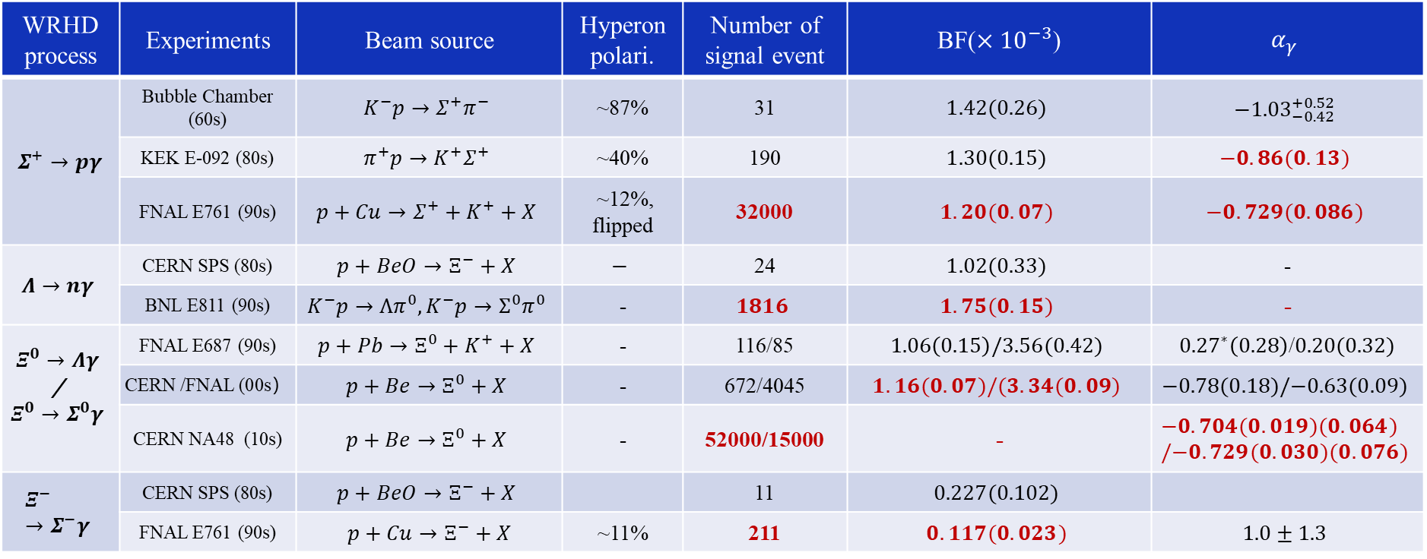
Experiment status of WRHDs at fixed-target
Fixed-target experiments laid the foundation for hyperon decay studies from 1960s to 2010s
WRHD process | Experiments | Beam source | Hyperon polari. | Number of signal event | BF($×{10}^{−3}$) | $$α_{γ}$$
$Σ^{+}→pγ$ | Bubble Chamber (60s) | $$K^{−}p→Σ^{+}π^{−}$$ | ~87% | 31 | $$1.42(0.26)$$ | $${−1.03}_{−0.42}^{+0.52}$$
 | KEK E-092 (80s) | $$π^{+}p→K^{+}Σ^{+}$$ | ~40% | 190 | $$1.30(0.15)$$ | $$−0.86(0.13)$$
 | FNAL E761 (90s) | $$p+Cu→Σ^{+}+K^{+}+X$$ | ~12%, flipped | 32000 | $$1.20(0.07)$$ | $$−0.729(0.086)$$
$$Λ→nγ$$ | CERN SPS (80s) | $$p+BeO→Ξ^{−}+X$$ | $$−$$ | 24 | $$1.02(0.33)$$ | -
 | BNL E811 (90s) | $$K^{−}p→Λπ^{0},K^{−}p→Σ^{0}π^{0}$$ | - | $$1816$$ | $$1.75(0.15)$$ | -
$$Ξ^{0}→Λγ$$ / $$Ξ^{0}→Σ^{0}γ$$ | FNAL E687 (90s) | $$p+Pb→Ξ^{0}+K^{+}+X$$ | - | 116/85 | $$1.06\left(0.15\right)/3.56(0.42)$$ | ${0.27}^{∗}\left(0.28\right)$/$0.20(0.32)$
 | CERN /FNAL (00s） | $$p+Be→Ξ^{0}+X$$ | - | 672/4045 | $$1.16(0.07)/(3.34(0.09)$$ | $$−0.78(0.18)/−0.63(0.09)$$
 | CERN NA48 (10s) | $$p+Be→Ξ^{0}+X$$ | - | 52000/15000 | - | $$−0.704(0.019)(0.064)/−0.729(0.030)(0.076)$$
$$Ξ^{−}→Σ^{−}γ$$ | CERN SPS (80s) | $$p+BeO→Ξ^{−}+X$$ |  | 11 | $$0.227(0.102)$$
 | FNAL E761 (90s) | $p+Cu→Ξ^{−}+X$ | ~11% | 211 | $$0.117(0.023)$$ | $$1.0±1.3$$
Notes:
Within the quark model framework,
two-quark transitions (Fig. 1 a), where a W boson is
exchanged between two quarks of the initial baryon,
are believed to play an important role in 22+ ~PT,

Slide 7
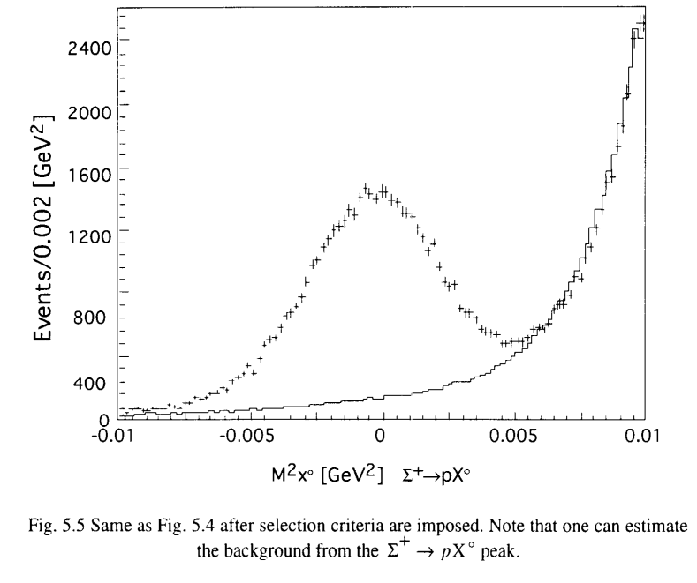
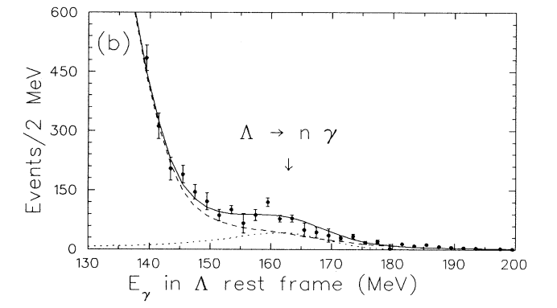
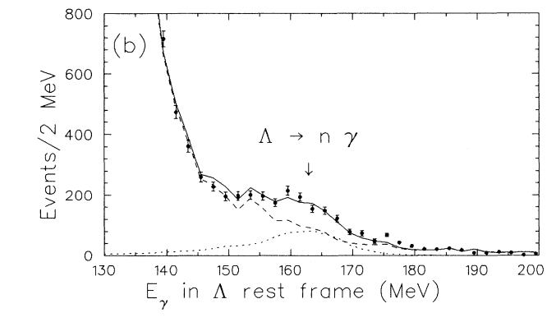
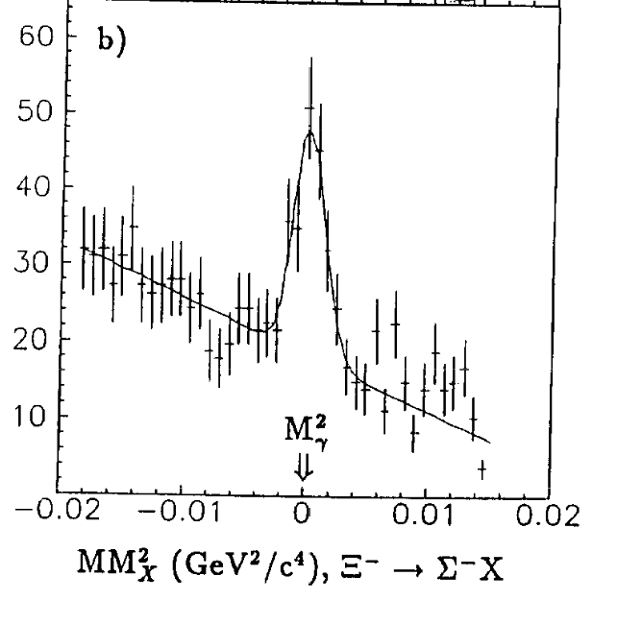
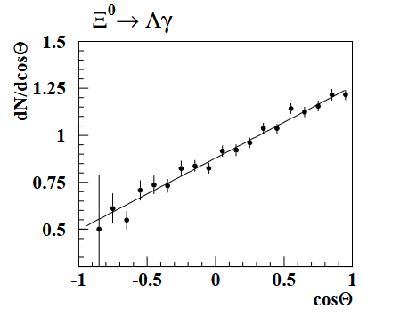
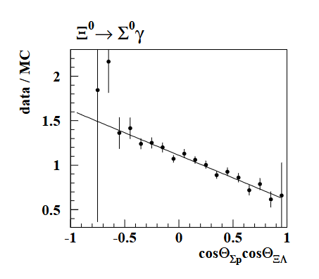
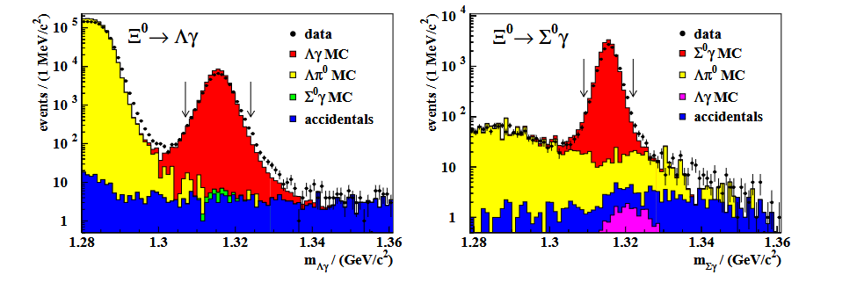

Experiment status of WRHDs at fixed-target
E761, PRL68, 3004 (1992)
BNL E811 PRD47,799 (1993)
Phys. Rev. Lett. 72, 808 (1994)
3-gam events
4-gam events
NA48, PLB 693 (2010) 241-248
Notes:
Within the quark model framework,
two-quark transitions (Fig. 1 a), where a W boson is
exchanged between two quarks of the initial baryon,
are believed to play an important role in 22+ ~PT,

Slide 8
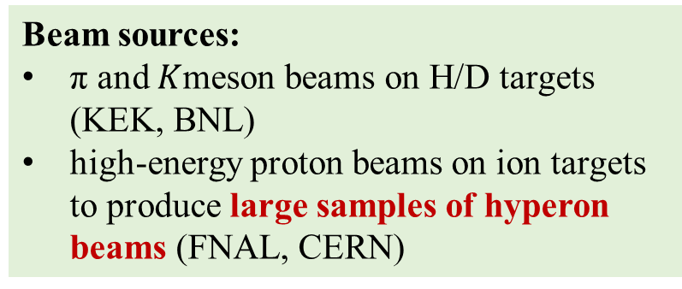
WRHDs at fixed-target experiments
Fixed-target experiments laid the foundation for hyperon decay studies from 1960s to 2010s
Beam sources:
π and $K$meson beams on H/D targets (KEK, BNL)
high-energy proton beams on ion targets to produce large samples of hyperon beams (FNAL, CERN)
Polarization of hyperons:
Theoretically calculable, but with limited precision due to various experimental effects.
Analysis method:
BF relied on relative measurements
Asymmetry parameters extracted via 1D angular distribution fits
Hyperon species:
Typically focused on one type of hyperon, predominantly producing positive particles.
Notes:
to produce large samples of hyperon beams.
hydrogen/deuterium

Slide 9
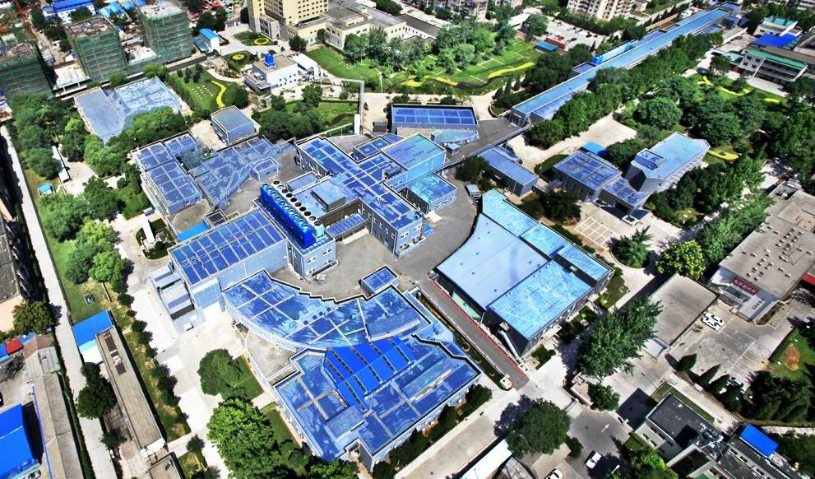
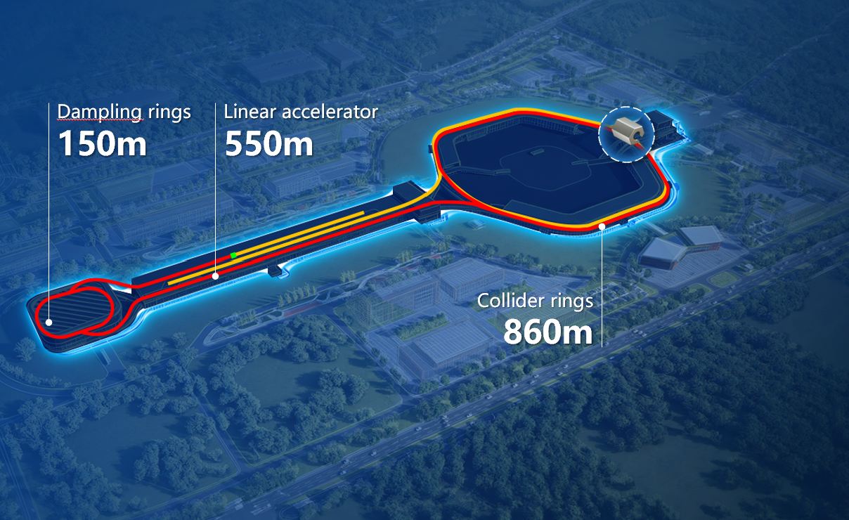
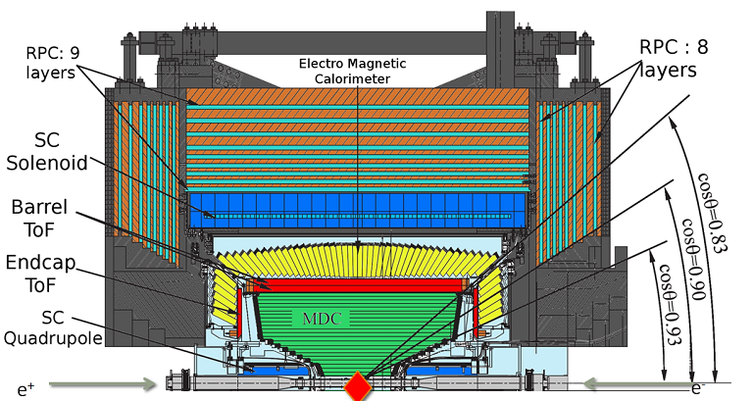
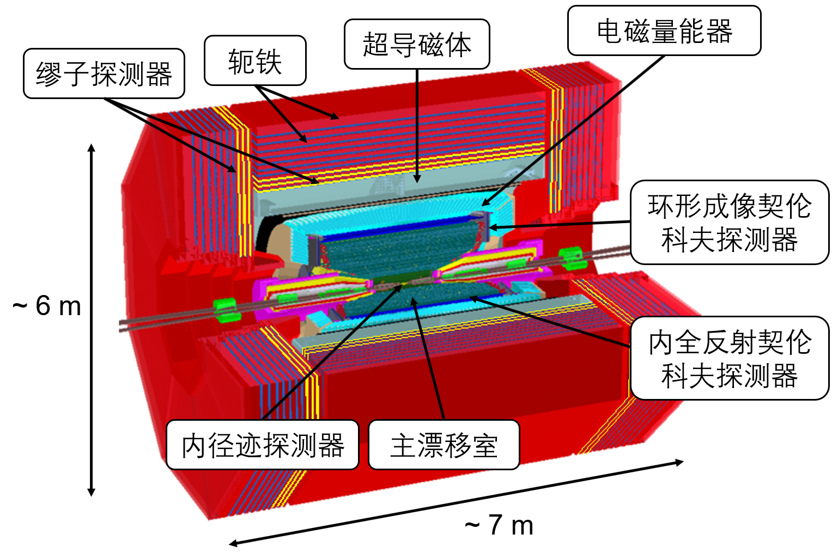


Opportunities at $e^{+}e^{−}$ colliders
BESIII has collected 10 billion $J/ψ$ and 2.7 billion $ψ(3686)$ events
STCF will collect trillions of $J/ψ$ and $ψ(3686)$
Charmonium has a ~0.1% branching fraction of decaying to hyperons
Storage ring ~240 m
Linac ~200 m
BESIII detector

Slide 10
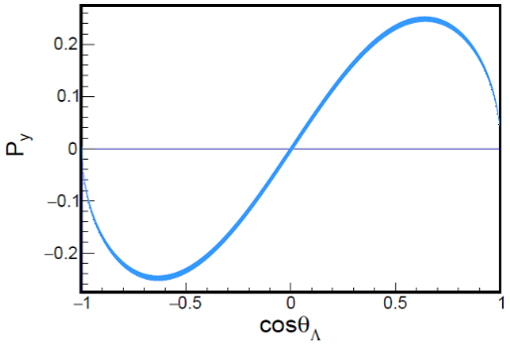
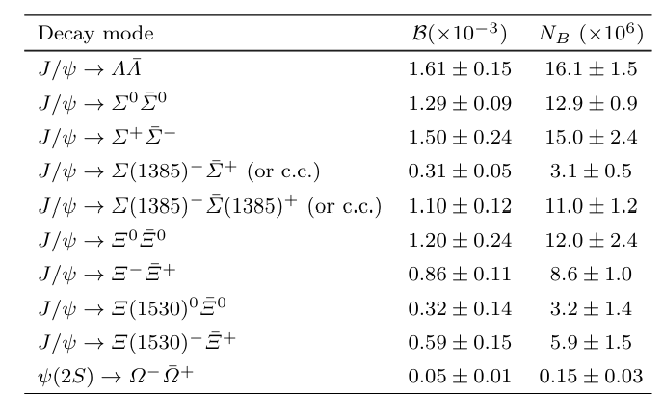



Advantages at $e^{+}e^{−}$ colliders
BESIII has collected 10 billion $J/ψ$ and 2.7 billion $ψ(3686)$ events
STCF will collect trillions of $J/ψ$ and $ψ(3686)$
Charmonium has a ~0.1% branching fraction of decaying to hyperons
Hyperon species:
Various of hyperon and anti-hyperons can be produced via the $ψ→Y\overline{Y}$
Polarization:
The well-defined topology of hyperon production allows for a well determined polarization
Analysis methods:
Absolute measurement of the BF is available via Double-tag method, which helps cancel systematic uncertainties
Asymmetry parameters can be extracted by a multi-dimensional angular distribution

Slide 11
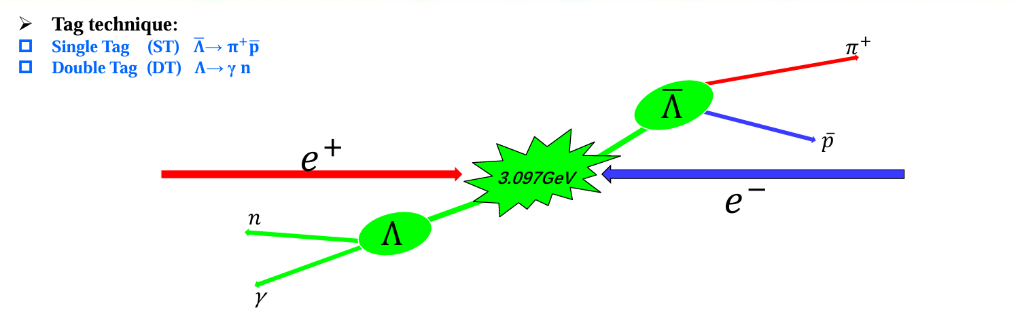
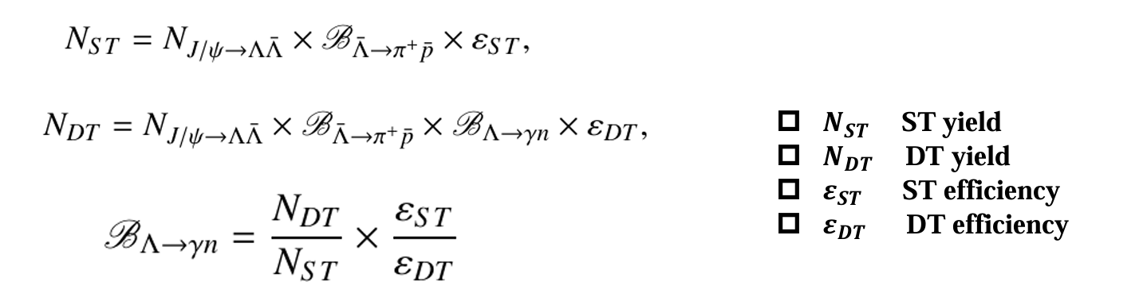
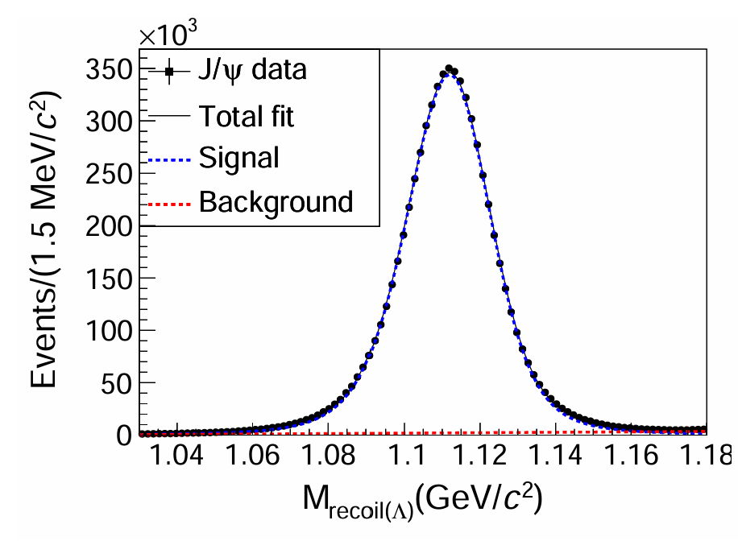
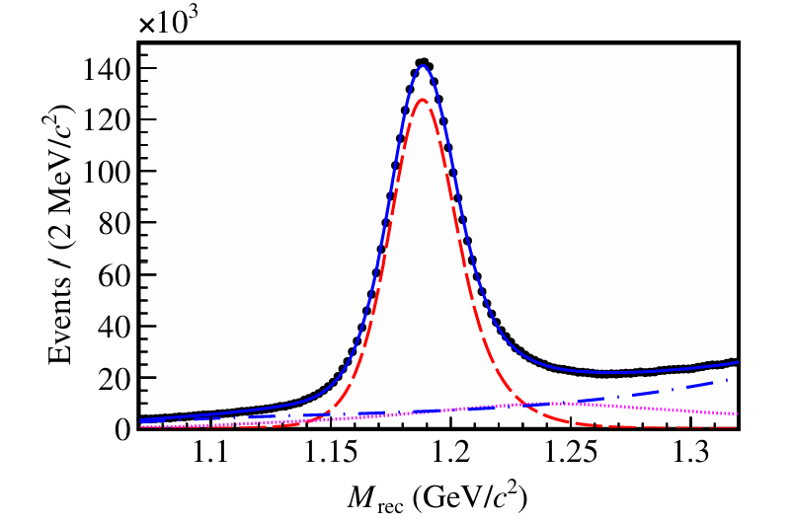
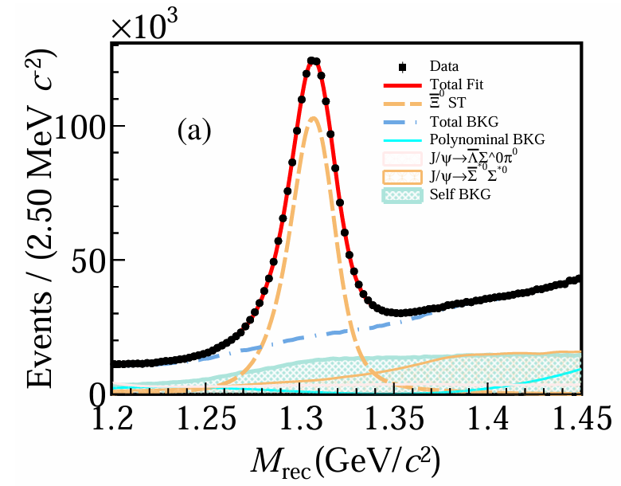
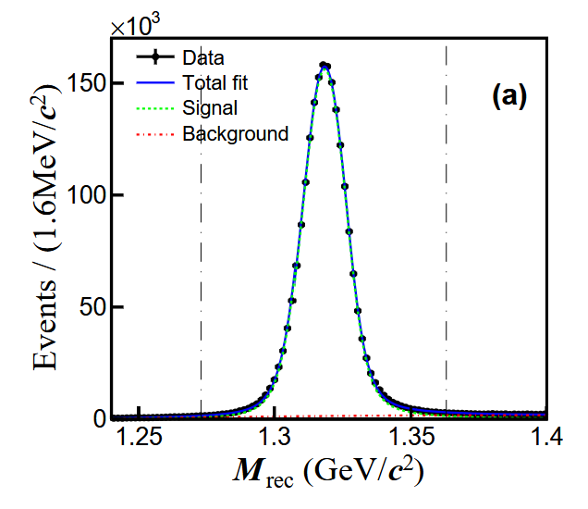

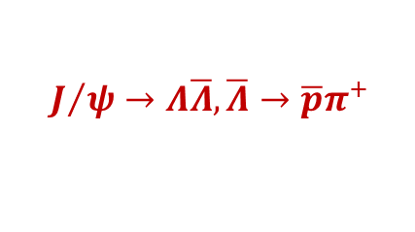
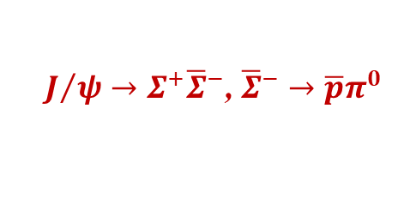

Double-tag method
$$J/ψ→Λ\overline{Λ},\overline{Λ}→\overline{p}π^{+}$$
$$J/ψ→Σ^{+}{\overline{Σ}}^{−}\text{, }{\overline{Σ}}^{−}→\overline{p}π^{0}$$
$J/ψ→Ξ^{0}{\overline{Ξ}}^{0}$, ${\overline{Ξ}}^{0}→\overline{Λ}π^{0}$
$J/ψ→Ξ^{−}{\overline{Ξ}}^{+}$, ${\overline{Ξ}}^{+}→\overline{Λ}π^{+}$

Slide 12
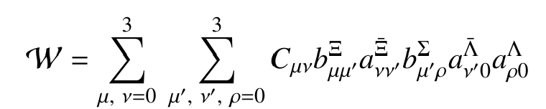
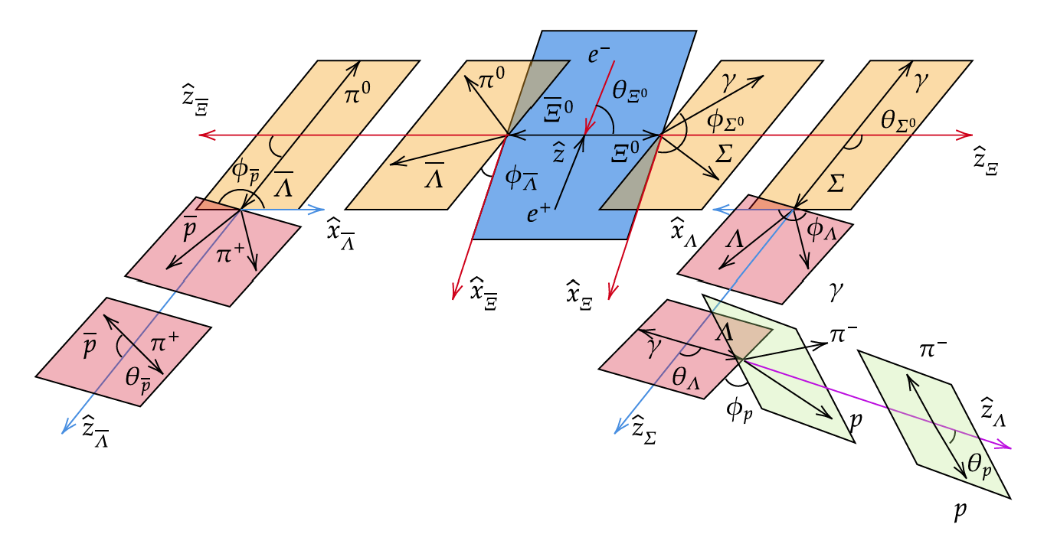
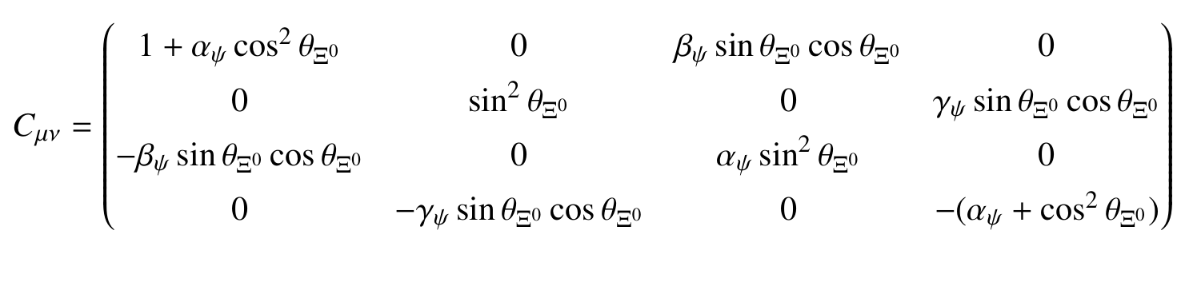
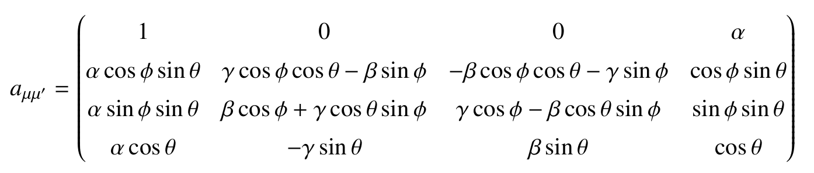
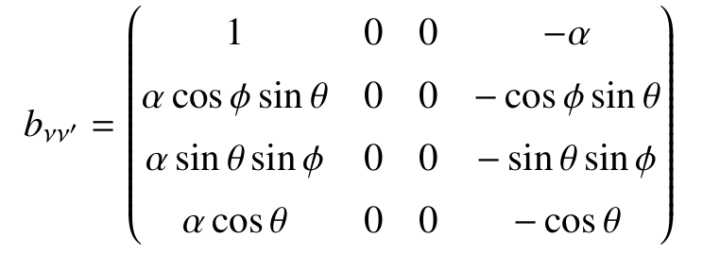


Joint angular analysis
Take $e^{+}e^{−}→J/ψ→Ξ^{0}{(→Σ^{0}γ)\overline{Ξ}}^{0} (→\overline{Λ}π^{0})$ as an example:
Complete angular distribution
For $J/ψ→Ξ^{0}{\overline{Ξ}}^{−}$
  For ${\frac{1}{2}}^{+}→{\frac{1}{2}}^{+}+0^{−}$decay ($Ξ^{0}→Λπ^{0}$)
  For ${\frac{1}{2}}^{+}→{\frac{1}{2}}^{+}+1^{−}$decay ($Ξ^{0}→Σ^{0}γ$)
The multi-dimensional distributions from hyperon-pair production at $e^{+}e^{−}$collisions involve tens to hundreds of terms, and are fitted by maximizing the likelihood.

Slide 13
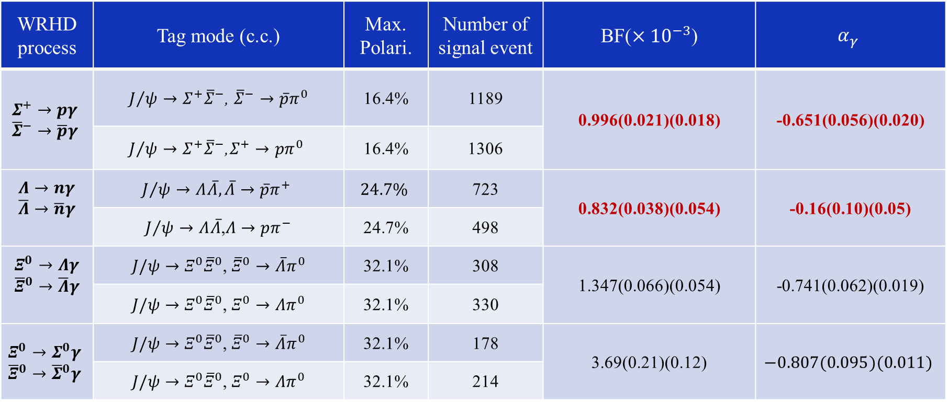
Experiment status of WRHDs at BESIII
WRHD process | Tag mode (c.c.) | Max. Polari. | Number of signal event | BF($×{10}^{−3}$) | $$α_{γ}$$
$$Σ^{+}→pγ$$ $${\overline{Σ}}^{−}→\overline{p}γ$$ | $J/ψ→Σ^{+}{\overline{Σ}}^{−}$, ${\overline{Σ}}^{−}→\overline{p}π^{0}$ | 16.4% | 1189 | 0.996(0.021)(0.018) | -0.651(0.056)(0.020)
 | $$J/ψ→Σ^{+}{\overline{Σ}}^{−}\text{,}Σ^{+}→pπ^{0}$$ | 16.4% | 1306
$$Λ→nγ$$ $$\overline{Λ}→\overline{n}γ$$ | $$J/ψ→Λ\overline{Λ},\overline{Λ}→\overline{p}π^{+}$$ | $$24.7\%$$ | 723 | 0.832(0.038)(0.054) | -0.16(0.10)(0.05)
 | $J/ψ→Λ\overline{Λ}$,$Λ→pπ^{−}$ | 24.7% | 498
$$Ξ^{0}→Λγ$$ $${\overline{Ξ}}^{0}→\overline{Λ}γ$$ | $J/ψ→Ξ^{0}{\overline{Ξ}}^{0}$, ${\overline{Ξ}}^{0}→\overline{Λ}π^{0}$ | 32.1% | 308 | 1.347(0.066)(0.054) | -0.741(0.062)(0.019)
 | $J/ψ→Ξ^{0}{\overline{Ξ}}^{0}$, $Ξ^{0}→Λπ^{0}$ | 32.1% | 330
$$Ξ^{0}→Σ^{0}γ$$ $${\overline{Ξ}}^{0}→{\overline{Σ}}^{0}γ$$ | $J/ψ→Ξ^{0}{\overline{Ξ}}^{0}$, ${\overline{Ξ}}^{0}→\overline{Λ}π^{0}$ | 32.1% | 178 | 3.69(0.21)(0.12) | $$−0.807(0.095)(0.011)$$
 | $J/ψ→Ξ^{0}{\overline{Ξ}}^{0}$, $Ξ^{0}→Λπ^{0}$ | 32.1% | 214

Slide 14
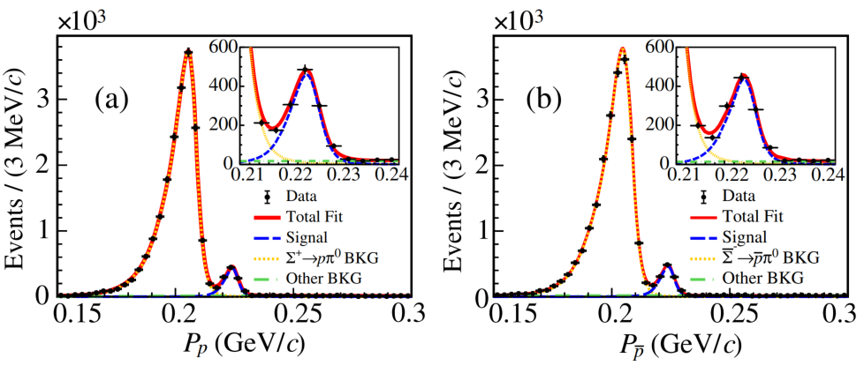
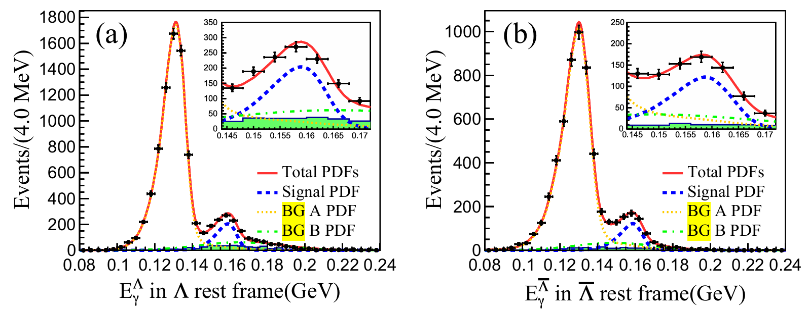






Experiment status of WRHDs at BESIII
$$Σ^{+}→pγ \& Σ^{+}→pγ$$
$$Λ→nγ \& \overline{Λ}→\overline{n}γ$$
$$Ξ^{0}→Λγ \& {\overline{Ξ}}^{0}→\overline{Λ}γ$$
$$Ξ^{0}→Λγ \& {\overline{Ξ}}^{0}→\overline{Λ}γ$$

Slide 15





Experiment status of WRHDs at BESIII
PRL130, 211901 (2023)
PRL 129, 212002 (2022)
    Non-pQCD effect plays an essential role, various low-energy effective theories predicts WRHDs
    WRHDs offer constraints on low-energy constants within effective theories (e.g., ChPT), which in turn affects the theoretical inputs for semi-leptonic and non-leptonic weak decays
ChPT II
4.2σ
5.6σ
Sci.Bull. 70 (2025) 454-459
arXiv: 2512.03877
Notes:
The accuracies of the BF and α_{γ} are improved by 78% and 34%
The measured BF is lower than the world average value by 4.2σ

Slide 16





Prospect of $Ξ^{−}→Σ^{−}γ$ at BESIII
The interest of the radiative decay $Ξ^{−}→Σ^{−}γ$ has been emphasized by many theoretical models as it is a U-spin doublet and single quark transition. Recent EOMS $χ$PT model predicts the decay asymmetry falls within (-0.18, 0.38)
Sci. Bull. 67, 2298 (2022)
At BESIII, expected number of $Ξ^{−}→Σ^{−}γ$can be calculated by $N_{Ξ}^{tag}∙ε_{Σ^{−}γ}∙ℬ_{Σ^{+}γ}$
  $N_{Σ^{−}γ}^{exp}≈100$ events
The expected uncertainty of BF and decay asymmetry are $δ_{𝓑(Ξ^{−}→Σ^{−}γ)}≈10\%$ and $Δ_{α_{γ}(Ξ^{−}→Σ^{−}γ)}≈0.3$

Slide 17







Test of CP symmetry in WRHDs
CP violation observables in radiative decay:
Extensive experimental studies on 𝐾, 𝐷 and 𝐵 meson radiative decays
Not yet studied in hyperon radiative decays. Sources different from pionic decay
May be significantly enhanced by NP up to 𝒪(10%) (PRL109 (2012), 171801, JHEP 01 (2013) 027, JHEP 04 (2017) 027, JHEP 08 (2017) 09
SM on $Σ^{+}→pγ$ | $$Δ_{CP}$$ | $$A_{CP}$$
PRD51,2271 | $${10}^{−5}−{10}^{−4}$$
Comm. Theor. Phys. 19.475 |  | $${10}^{−5}−{10}^{−4}$$
arxiv:2312.17568 | $$2×{10}^{−5}$$
First attempt of CPV probe in $Σ^{+}→pγ$ :
CPV probe in $Ξ^{0}→Λγ$
$${ A}_{CP}, Ξ^{0}→Λγ$$

Slide 18





Constraint of WRHDs to new physics
Experimental study of $Σ^{+}→pμ^{+}μ^{−}$:
LHCb, PRL135 (2025) 5, 051801
HyperCP（00s) | LHCb（10s） | LHCb（20s)
3 events | 10.2 events | 237 events
$$ℬ=({8.6}_{−5.4}^{+6.6})×{10}^{−8}$$ | $$ℬ=(2.2±0.7)×{10}^{−8}$$ | $$𝓑=(1.08±0.17)×{10}^{−8}$$
The theoretical prediction of $Σ^{+}→pμ^{+}μ^{−}$is dominated by long-distance contribution in SM: $Σ^{+}→pγ^{∗}→pμ^{+}μ^{−}$
BESIII measurement of $Σ^{+}→pγ$ refines the form factors a and b, which improves SM predictions and limits NP parameter space
A. Roy et al.,arXiv: 2404.15268

Slide 19

Summary
WRHDs, a Sixty-Year journey: from Hara theorem to QCD-based models, and from fixed-target to $e^{+}e^{−}$ colliders
BESIII offer clear advantages in absolute branching fraction measurement, where significant discrepancies observed for $Σ^{+}→pγ$ and $Λ→nγ$, and deliver superior precision on decay asymmetries
The next generation $e^{+}e^{−}$ collider, STCF, will play an essential role in precise determination of the hyperon decays, that will offer improved constraints and predictions for physics beyond the SM

Slide 20
Thank you

