Slide 1

曹 须
Spin density matrix of baryon-antibaryon pairs
with P & CP violation including electron mass
2026年6月30~7月5日
超级陶粲装置研讨会
中国科学院西安光学精密机械研究所

Slide 2
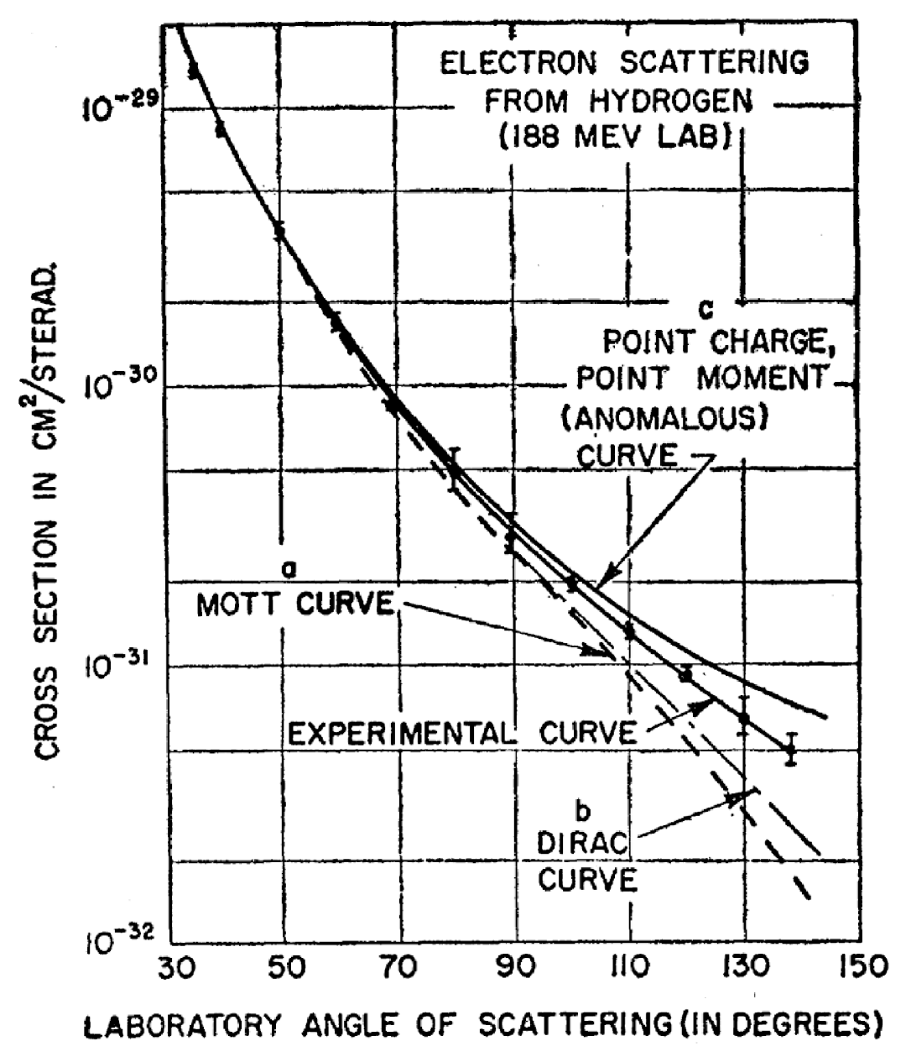
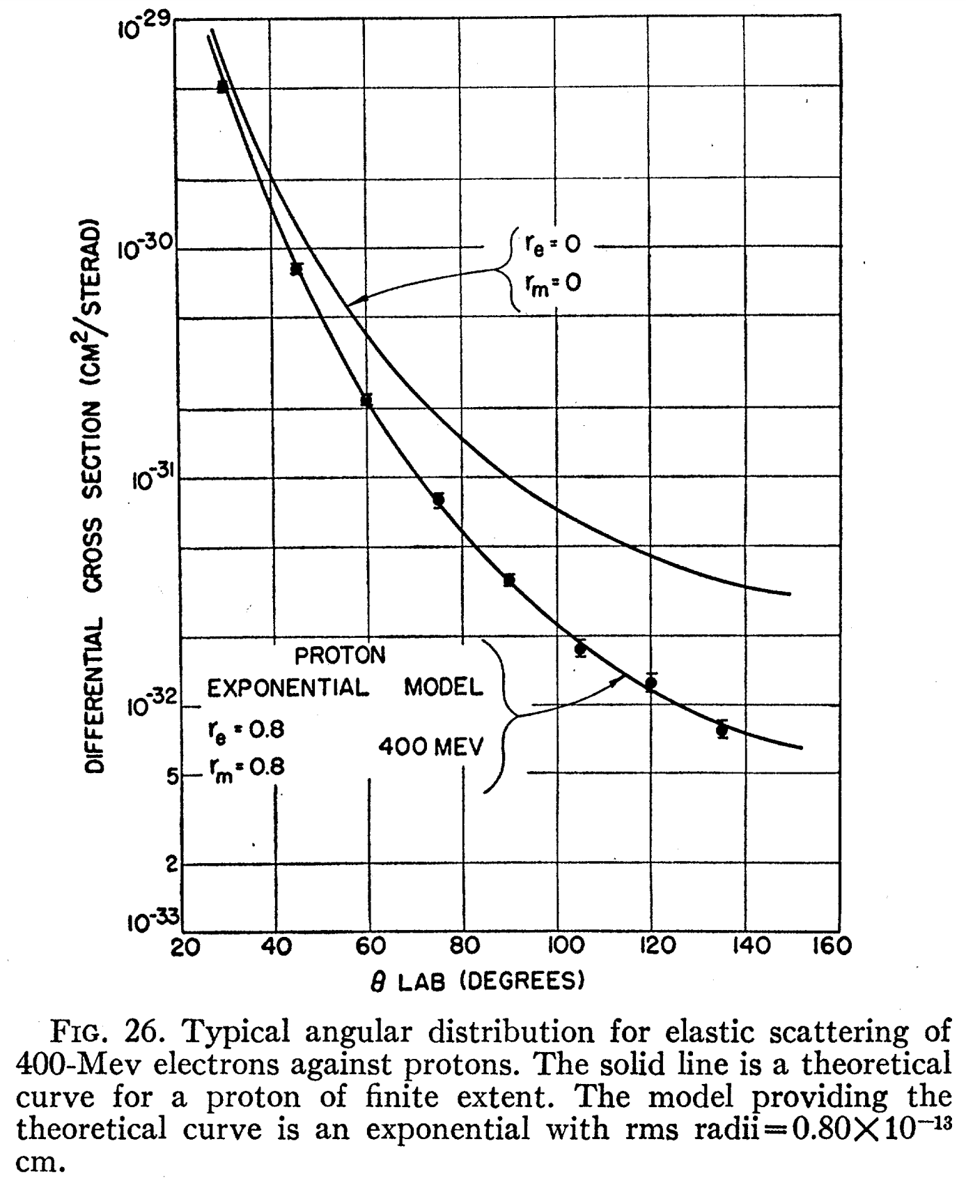
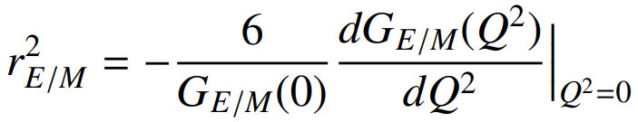
Introduction
R. Hofstadter, Rev. Mod. Phys. 1956，28：214
1961 Nobel Prize in Physics (together with Rudolf Mössbauer)
"for his pioneering studies of electron scattering in atomic nuclei and for his consequent discoveries concerning the structure of nucleons“
Timelike
spacelike
= ( 0.84 fm ) ²
Notes:
Historically,
The “deep inelastic scattering experiments” have beautifully revealed the quark and gluon 1D substructure of nucleon and nuclei. (Form factors)
Though QCD has achieved tremendous successes during this period,
we don’t fully understand the confinement and asymptotic freedom of QCD yet.
Nowadays we investigate the 3D structure of hadrons and nuclei with the ultimate goal to understand the origin of the mass and spin of nucleon.
TMD probed by the inclusive process is to study How is proton’s spin correlated with the motion of the quarks/gluons

Slide 3
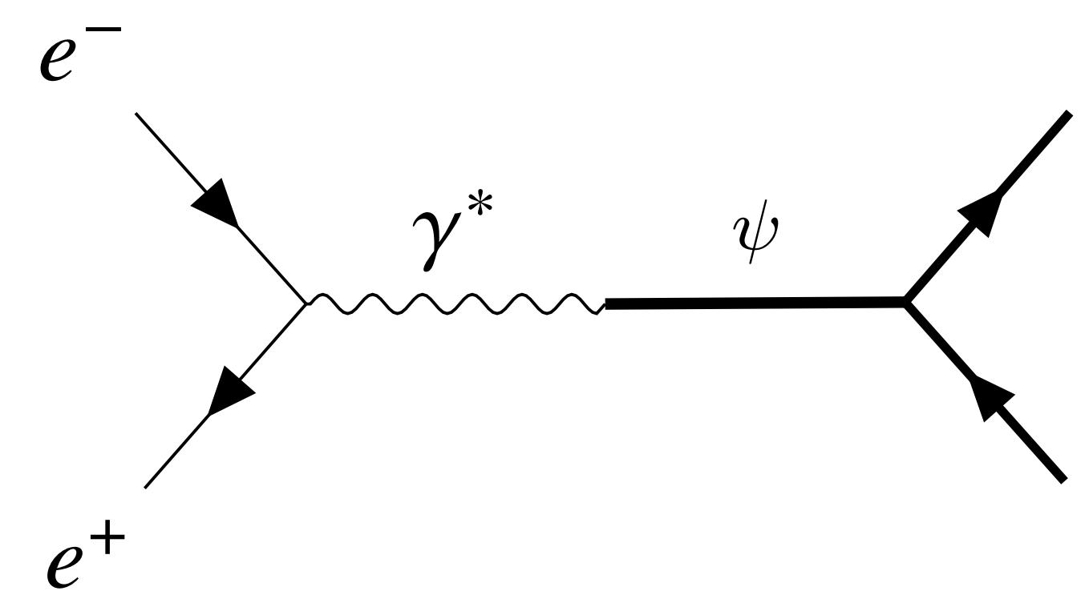
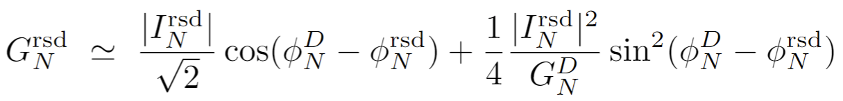
Introduction
Dynamic origin of surprising periodic oscillation in timelike region? vector meson above-threshld!
A. Bianconi and E. Tomasi-Gustafsson, Phys. Rev. Lett. 114, 232301 (2015)
Jian-Ping Dai, XC, H. Lenske, PRD105(2022)L071503;PLB 846(2023)138192
˂˂
Nature Phys. 17 (2021) 1200

Slide 4
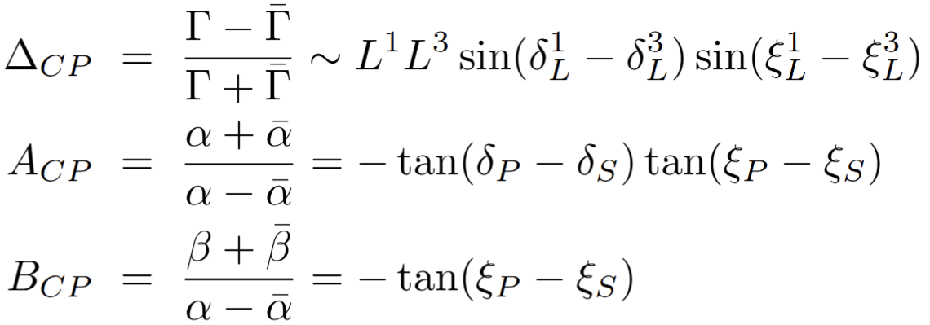
Hyperon decay and CP violation
Hyperon decay as a polarimeter:
T. D. Lee and C.-N. Yang, Phys. Rev. 108, 1645 (1957)
The amplitude for a spin-1/2 hyperon decaying into a spin-1/2 baryon and a spin-0 meson:
Decay parameters:
Lee-Yang formula
Strong and weak phase
J. F. Donoghue and S. Pakvasa, Phys. Rev. Lett. 55, 162 (1985)
J. F. Donoghue, X.-G. He, and S. Pakvasa, Phys. Rev. D 34, 833 (1986)
The transition amplitudes L = S, P of hyperon can be decomposed as
while for the the antihyperon c.c. decay
Leading to hyperon CT violation test

Slide 5
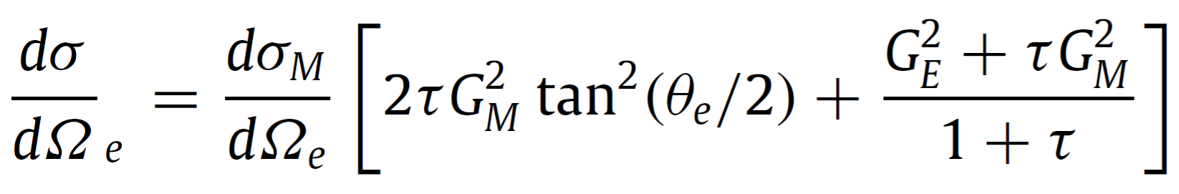
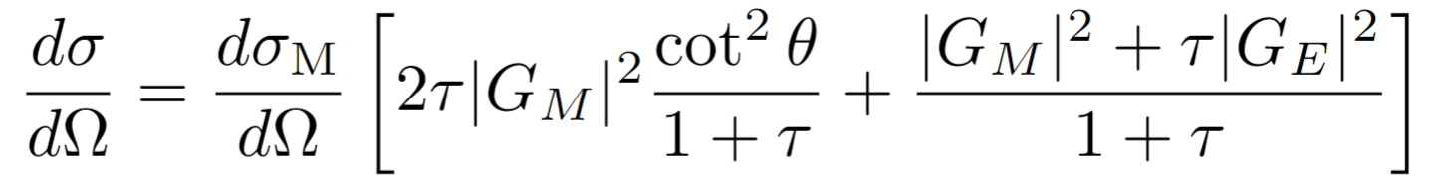
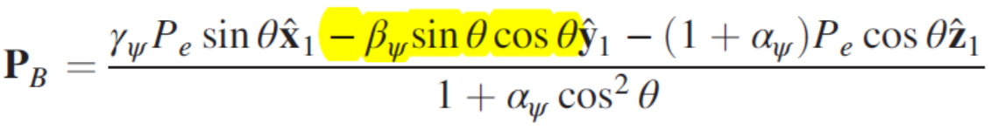
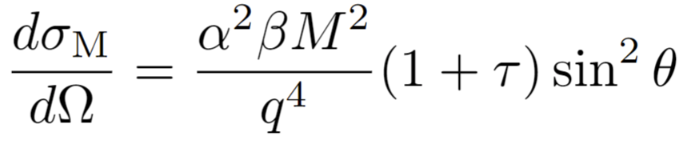
Introduction
Surprisingly, study of polarization effects in timelike region appears until 1996
A. Z. Dubnickova, S. Dubnicka, and M. P. Rekalo, Nuovo Cim. A 109, 241 (1996)
S. J. Brodsky, C. E. Carlson, J. R. Hiller, and D. S. Hwang, Phys. Rev. D 69, 054022 (2004)
E. Tomasi-Gustafsson, F. Lacroix, C. Duterte, and G. I. Gakh, Eur. Phys. J. A 24, 419 (2005)
H. Chen and R.-G. Ping, Phys. Rev. D 76, 036005 (2007)
G. Fäldt, A. Kupsc, Phys. Lett. B 772, 16 (2017)
…… polarization observables are quite different between:
see Xu Cao, Yu-tie Liang, Rong-Gang Ping, Ping, Phys. Rev. D 110, 014035 (2024) for transversely Polarized beams
finally leading to the most precise
test of hyperon CP violation
at BESIII: Nature 606, 64 (2022)
 | space-like (lab.) | time-like (c.m.)
Unpolarized
Long. electron
Long. both beams |  | Nothing New

Slide 6

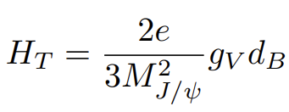
Introduction
P and CP violation in the charmonium coupling to the baryon pairs:
X.-G. He, J. P. Ma, and B. McKellar, Phys. Rev. D 47,R1744 (1993); X.-G. He, J. P. Ma, and B. McKellar, Phys. Rev. D 49, 4548 (1994)
X. G. He and J. P. Ma, Phys. Lett. B 839, 137834 (2023); Y. Du, X.-G. He, J.-P. Ma, and X.-Y. Du, Phys. Rev. D110, 076019 (2024)
K.-B. Chen, X.-G. He, J.-P. Ma, and X.-B. Tong, Phys. Rev. Lett. 136, 051902 (2026)
…Probing hyperon electric dipole moments with a full angular analysis:
F. Zhang, Y. Gao, and L. Huo, Phys. Lett. B 681, 237 (2009); F. Zhang, Y.-N. Gao, and L. Huo, Chin. Phys. Lett. 27, 051101 (2010)
J. Fu, H.-B. Li, J.-P. Wang, F.-S. Yu, and J. Zhang, Phys. Rev. D 108, L091301 (2023)
R. T. Ovsiannikov, A. Y. Korchin, and E. Kou, Eur. Phys. J. C 85, 1264 (2025)
STCF enhances the statistical sensitivity of hyperon EDM measurements by 2 orders of magnitude
Why spin density matrix including electron mass?
Chun-Qiu Zhao, XC, Jian-Ping Dai, arXiv:2512.19085 [hep-ph]
Constructing the explicit SDM is not a strictly necessary step for calculating the full helicity amplitudes
Searching for extremely small signals requires a systematic understanding of all sources of small Standard Model corrections, including finite-electron-mass effects and QED corrections beyond the leading order
… explicitly separate and identify the contributions arising from P and CP violation and the finite electron mass
… directly used to investigate the quantum entanglement of hyperon-antihyperon pairs

Slide 7
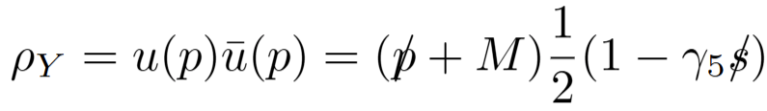
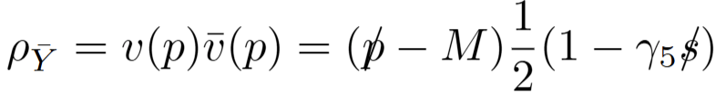
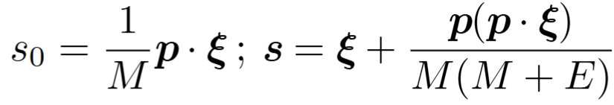
Spin projection operator
…… calc. polarization and correlation in a covariant way
SDM of electron/positron: {½ × ½}
… inserting into the transition amplitude (One-Photon exchange):
with proper definition of polarization vector:
Transverse beam Polarization Longitudinal beam Polarization
N. H. Buttimore and E. Jennings, Eur. Phys. J. A 31(2007)9
G. I. Gakh and E. Tomasi-Gustafsson, Nucl. Phys. A761(2005)120; Y.-S. Tsai, Phys. Rev. D 12, 3533 (1975)
F. Bletzacker and H. T. Nieh, PhysRevD.14.1251 (1976); K.-i. Hikasa, Phys. Rev. D 33, 3203 (1986)
asymmetric e collider HERA: the first ep collider

Slide 8

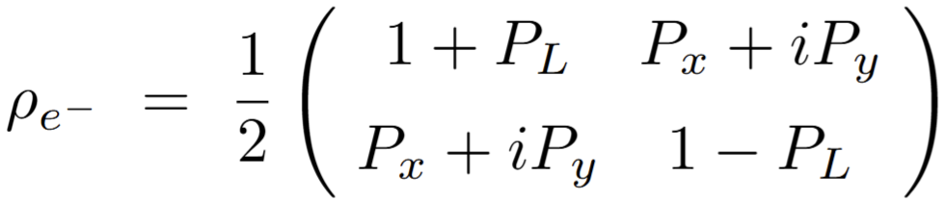
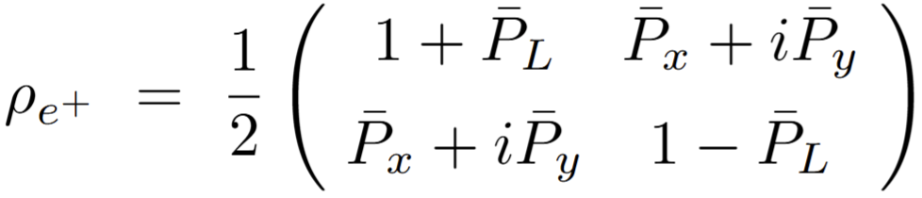
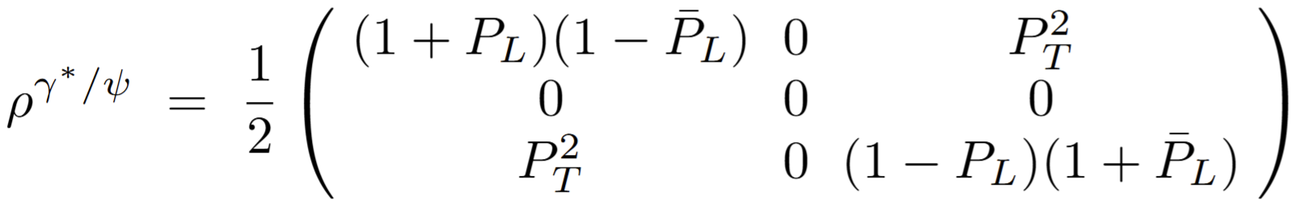
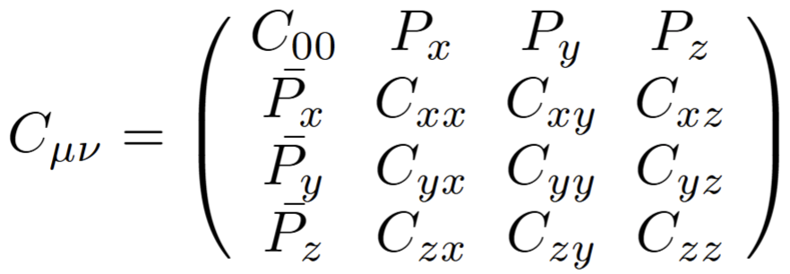
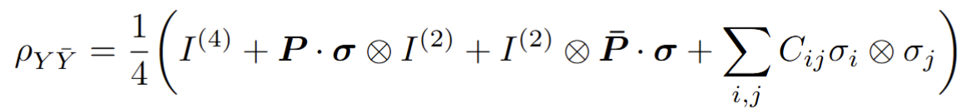
Spin Density Matrix
…… carries the information on how the particle has actually been produced
SDM of electron/positron: {½ × ½}
SDM of photon/Charmonium: {1 0 -1}
(One-Photon exchange, m_{e}=0)
SDM of Baryon-antibaryon pairs: (½ × ½)×(½ × ½)
Elliot Leader, Spin in Particle Physics; U. Fano, Rev. Mod. Phys. 55, 855 (1983)
asymmetric e collider HERA: the first ep collider

Slide 9
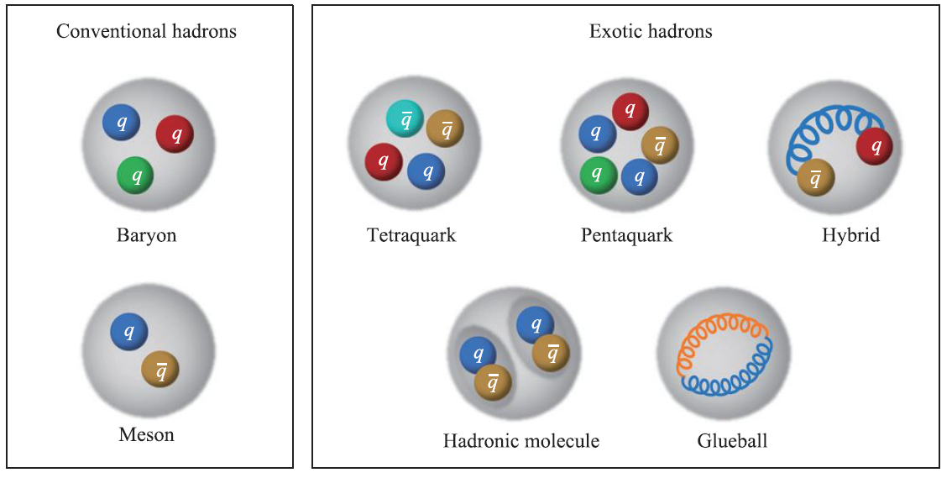
xsection
Longitudinally Polarized electron/positron Beams
Transversely Polarized electron/positron Beams
eliminates enhanced finite-me term

Slide 10
Variables
Usual electromagnetic form factors:
P violation & electric form factors:
CP violation & electric form factors:
P violation & CP violation:
P violation & magnetic form factors… α~1
CP violation & magnetic form factors…
3 relative phases,4 ξ among 6 are independent

Slide 11
Long. Polarized beams
electron/positron beams are both long. polarized

Slide 12
Trans. Polarized beams
electron/positron beams are both trans. Polarized
new
new

Slide 13


Decouple P violation & CP violation
How to decouple CP& P violation
How to isolate P violation, however, with suppression
electron mass correction is recommended to be considered at STCF
BESIII at J/ψ, arXiv:2506.19180
translate to our variables

Slide 14

Quantum Entanglement
Octet hyperon-antihyperon pairs: Qubits in particle physics
For elementary pairs: polarization = 0 for τ⁺τ⁻ and μ⁺μ⁻
Schrodinger' steering: the nonlocal ability of local measurements performed on one subsystem of an entangled particle pair to influence the quantum state of another subsystem: M.D. Reid, Phys. Rev. A 40 (1989) 913
Negativity: 2-qubit system is separable if and only if its partially transposed density matrix with respect to either subsystem is positive semidefinite (Peres-Horodecki Criterion)
Wootters' concurrence is an entanglement monotone: a measure for the entanglement
Wootters, Phys. Rev. Lett. 80, 2245 (1998)
maximal entanglement:
BESIII, Nature Commun. 16(2025) 4948
Discord: how much a physical system’s state deviates from classical descriptions

Slide 15
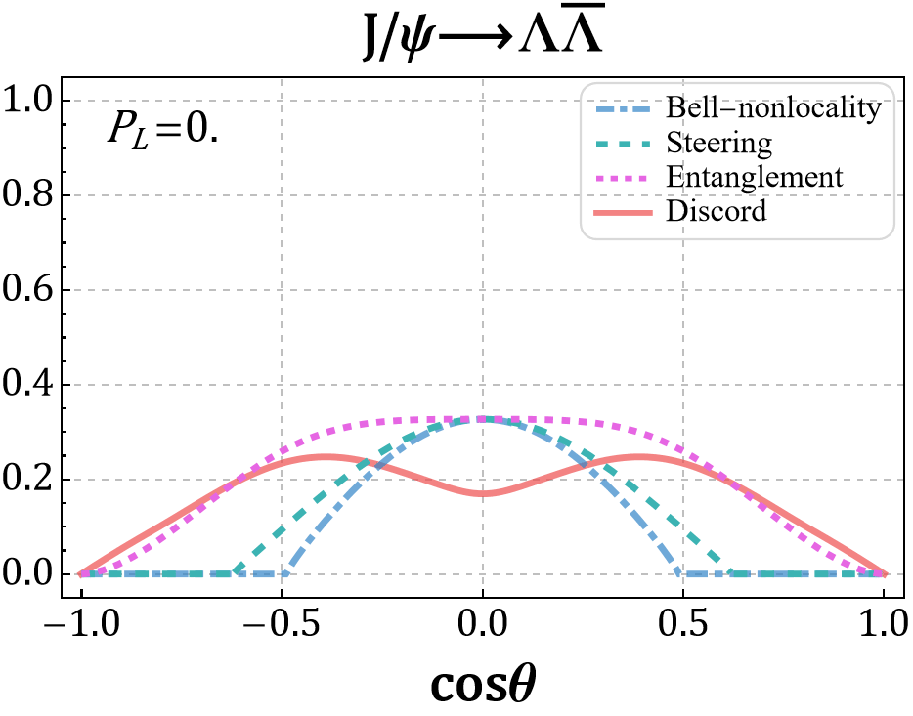
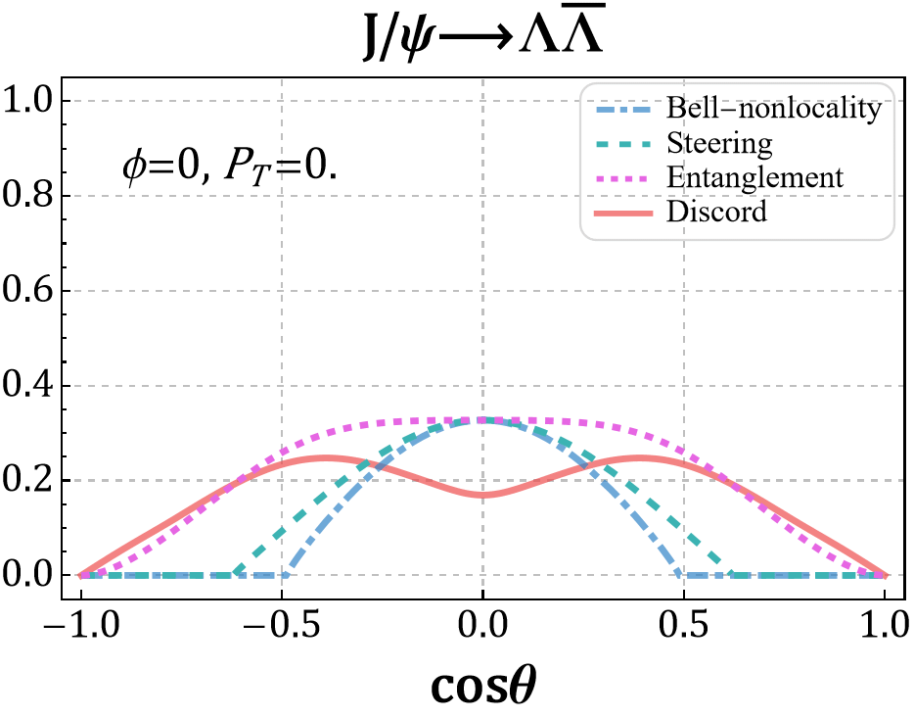
Polarized beams enhance entanglement
Loopholes: Test of local-realistic theories via Bell's inequality at colliders? Abel:1992kz,Dreiner:1992gt,Li:2024luk
Anyway, theoretical discussion on entanglement is interesting:
Hong-Wei Zhang, Xu Cao, and Tai-Fu Feng, Phys. Rev. D 113, 114022 (2026) & arXiv:2605.19642; Cong Li, XC et al., 2602.10398
Maximal entanglement appeared when maximal transverse polarization of beams
w/o considering electron mass & P & CP violation

Slide 16



Polarized beams enhance entanglement
Loopholes: Test of local-realistic theories via Bell's inequality at colliders? Abel:1992kz,Dreiner:1992gt,Li:2024luk
Anyway, theoretical discussion on entanglement is interesting:
Hong-Wei Zhang, Xu Cao, and Tai-Fu Feng, Phys. Rev. D 113, 114022 (2026) & arXiv:2605.19642; Cong Li, XC et al., 2602.10398
entanglement & discord responds minimally to beam long. pol, yet significantly to beam trans pol.
w/o considering electron mass & P & CP violation

Slide 17
Summary and Perspective
Good thing (Hyperon) comes in pairs
Spin density matrix of baryon-antibaryon pairs in electron-positron annihilation with P and CP violation including electron mass
… enabling the identification of clean observables to probe extremely subtle signals
… clarifying the precision at which finite-me corrections must be accounted for:
electron mass correction is recommended to be considered at STCF
Polarization of lepton beams enhance the entanglement of hyperon pairs
…w/o considering electron mass & P & CP violation
Thank You !

Slide 18
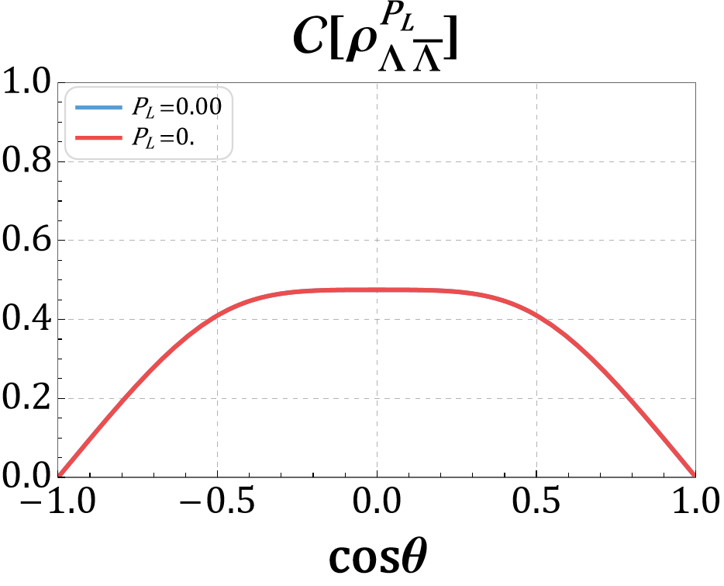
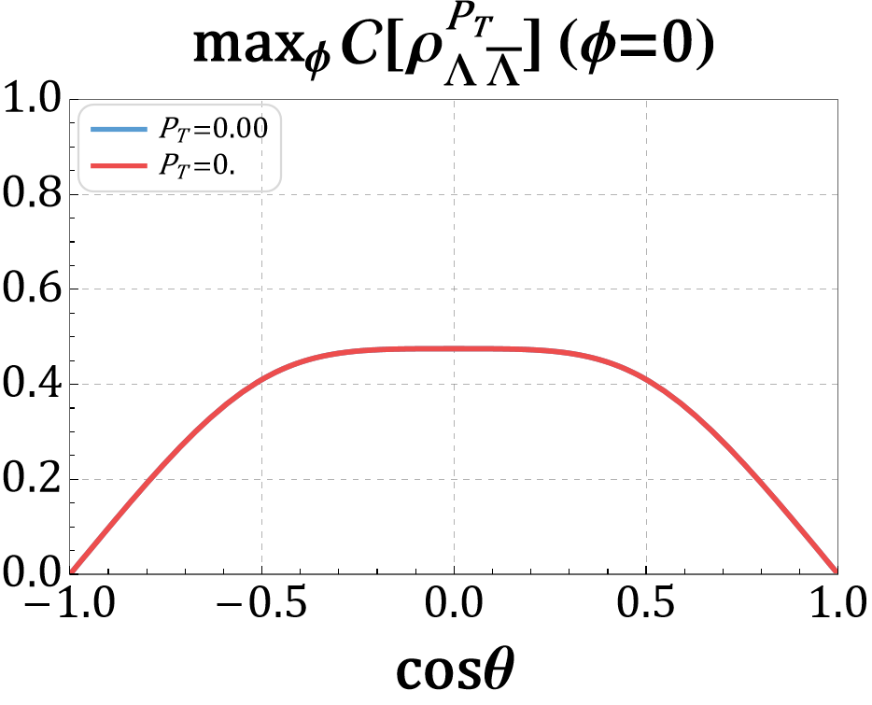

Transversely Polarized beams
Loopholes: Test of local-realistic theories via Bell's inequality at colliders? Abel:1992kz,Dreiner:1992gt,Li:2024luk
Anyway, theoretical discussion on entanglement is insteresting:
Hong-Wei Zhang, Xu Cao, and Tai-Fu Feng, to appear soon
The Concurrence $\max_{θ, φ}C\left[ρ_{Y\overline{Y}}^{P_{T}}\right] are$ enhanced with the transverse polarization of beams
Maximal entanglement (C=1) has appeared at $P_{T}=1$ at = 0, π (Λ)

Slide 19
Polarized beams enhance entanglement
Loopholes: Test of local-realistic theories via Bell's inequality at colliders? Abel:1992kz,Dreiner:1992gt,Li:2024luk
Anyway, theoretical discussion on entanglement is interesting:
Hong-Wei Zhang, Xu Cao, and Tai-Fu Feng, Phys. Rev. D 113, 114022 (2026) & arXiv:2605.19642
Maximal entanglement appeared when maximal transverse polarization of beams
w/o considering electron mass & P & CP violation

Slide 20
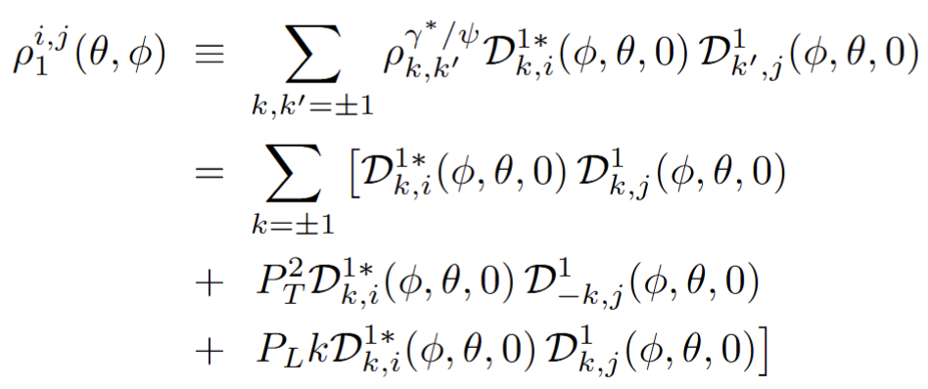
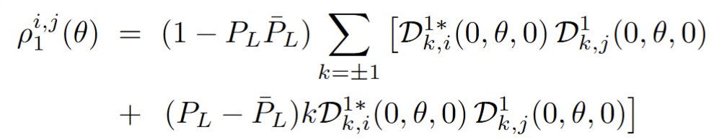
Long.&Trans. Polarized beams
Comparison of Transversely and Longitudinal Polarized Beams
incoherent sum same helicity:
mix diff. helicity:
incoherent subtract same helicity:
electron/positron beams are both long. polarized
…. introduce no new observables

Slide 21
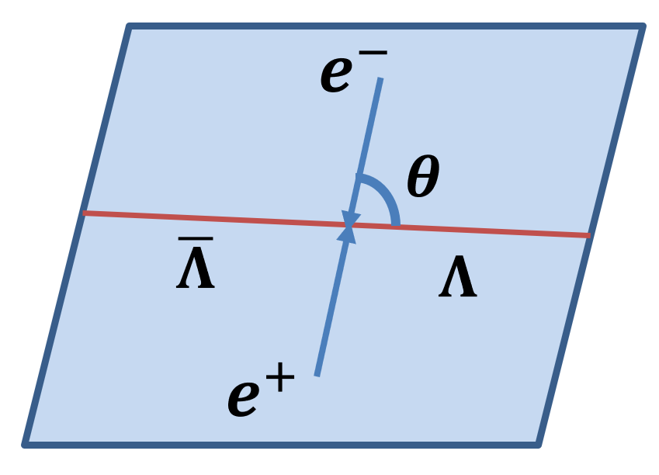

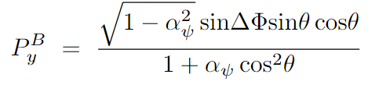
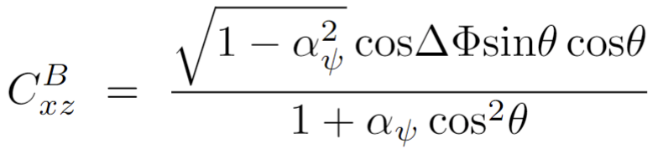

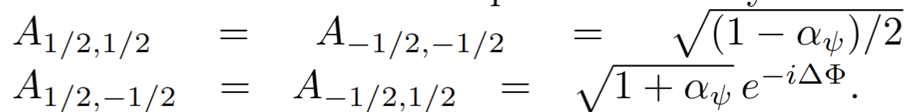
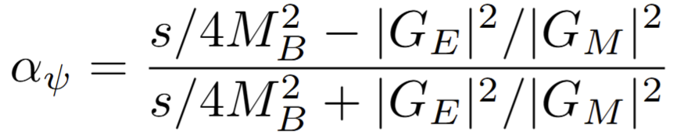
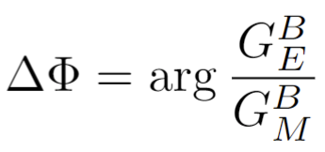
Unpolarized beams
Known Fact of Unpolarized Beams: measure the hyperon/anti-hyperon decay simultaneously
with
S.U. Chung, Phys.Rev.D 57 (1998) 431
H. Chen, R.-G. Ping, Phys. Rev. D 76, 036005 (2007)
G. Fäldt, Andrzej Kupsc, Phys.Lett.B 772, 16 (2017)
E. Perotti, G. Fäldt, A. Kupsc, S. Leupold, and J. J. Song, Phys. Rev. D 99, 056008 (2019).

Slide 22
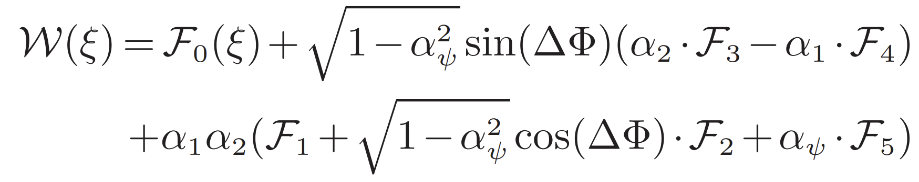
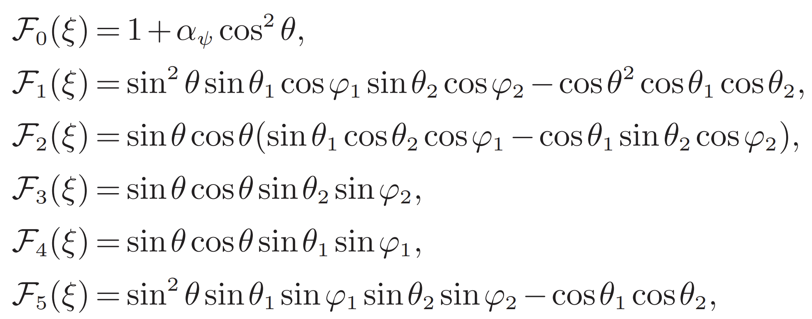
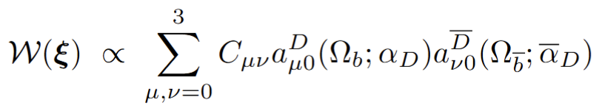
Unpolarized beams
Known Fact of Unpolarized Beams: measure the hyperon/anti-hyperon decay simultaneously
H. Chen, R.-G. Ping, Phys. Rev. D 76, 036005 (2007)
Göran Fäldt, Andrzej Kupsc, Phys.Lett.B 772, 16 (2017)
Hyperon decay as a polarimeter to probe hyperon CP violation

Slide 23
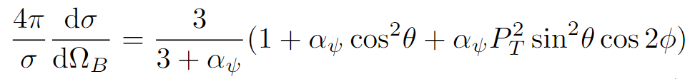
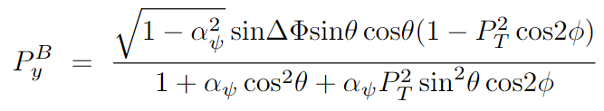
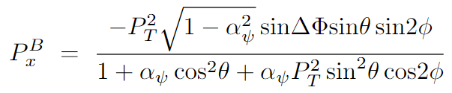
Transversely Polarized beams
Forgotten Facts of Transversely Polarized electron/positron Beams
Integrating out the azimuthal angle is equal to P_{T} = 0
Xu Cao, Yu-tie Liang, Rong-Gang Ping, Ping, Phys. Rev. D 110, 014035 (2024)
Alternative: Zhe Zhang, Tianbo Liu, Rong-Gang Ping, et al. 110 (2024) 074019; Phys.Rev.D 112 (2025) 096012

Slide 24
Transversely Polarized beams
Forgotten Facts of Transversely Polarized electron/positron Beams
Integrating out the azimuthal angle is equal to P_{T} = 0
Xu Cao, Yu-tie Liang, Rong-Gang Ping, Ping, Phys. Rev. D 110, 014035 (2024)

Slide 25
Transversely Polarized beams
Forgotten Facts of Transversely Polarized electron/positron Beams
Integrating out the azimuthal angle is equal to P_{T} = 0
Xu Cao, Yu-tie Liang, Rong-Gang Ping, 2404.00298 [hep-ph]

Slide 26
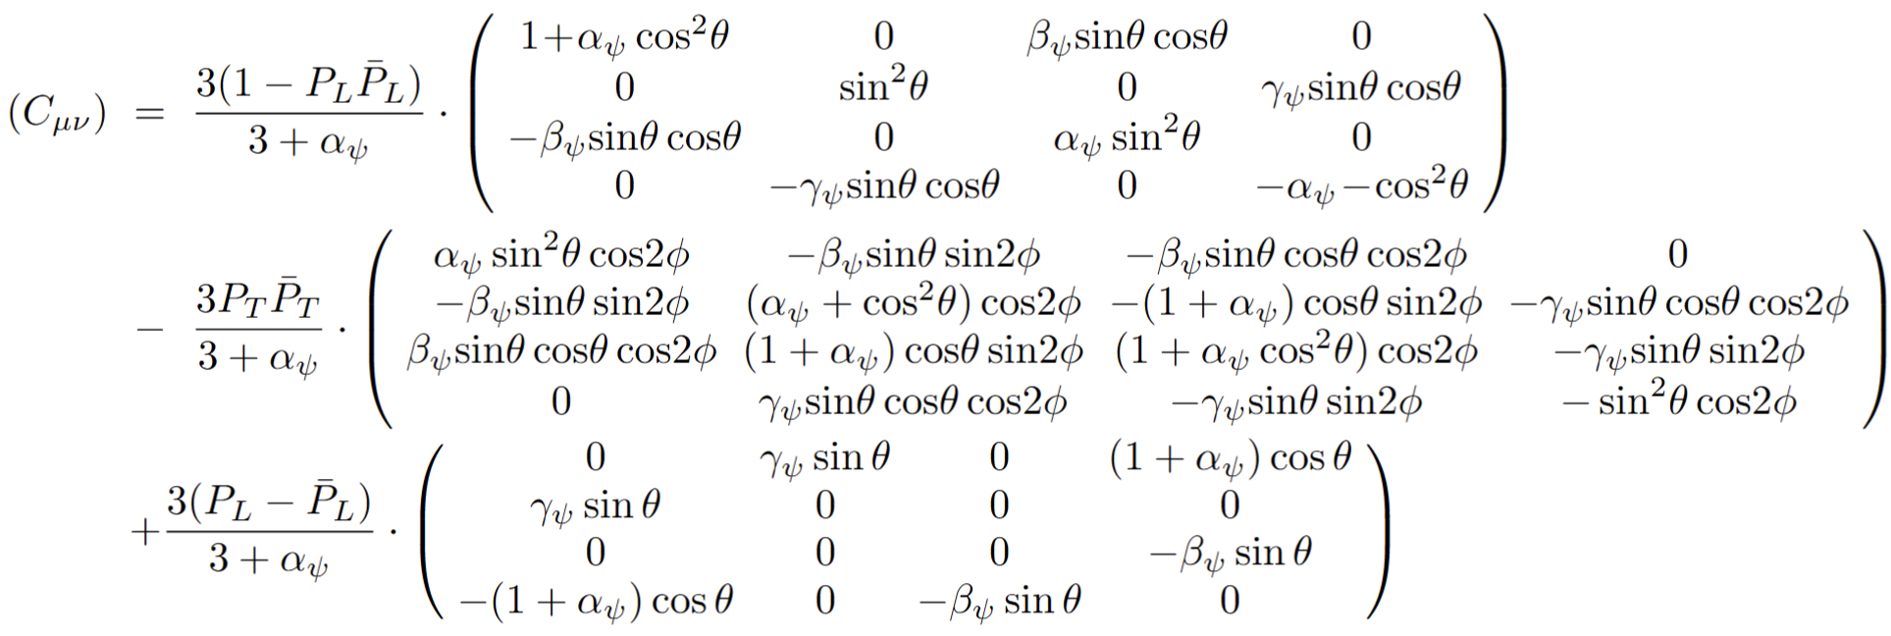
Long.&Trans. Polarized beams
Comparison of Transversely and Longitudinal Polarized Beams
with the polarization vectors of leptons
and the spin density matrix
Xu Cao, Yu-tie Liang, Rong-Gang Ping, 2404.00298 [hep-ph]
N. Salone, P. Adlarson, V. Batozskaya, A. Kupsc, S. Leupold, and J. Tandean, Phys. Rev. D 105, 116022 (2022)

Slide 27
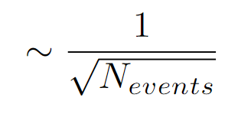

L & T Polarized beams
Useful for improving the sensitivity of measurements
Xu Cao, Yu-tie Liang, Rong-Gang Ping, 2404.00298 [hep-ph]
N. Salone, P. Adlarson, V. Batozskaya, A. Kupsc, S. Leupold, and J. Tandean, Phys. Rev. D 105, 116022 (2022)

Slide 28

Introduction
Decomposition of the polarization vectors into a longitudinal components in the direction of the electron/positron momentum and transverse components with respect to a fixed coordinate system
G. Moortgat-Pick et al. Physics Reports 460(2008)131
Concurrence $\max_{θ}C[ρ_{Y\overline{Y}}^{P_{L}}]$

Slide 29
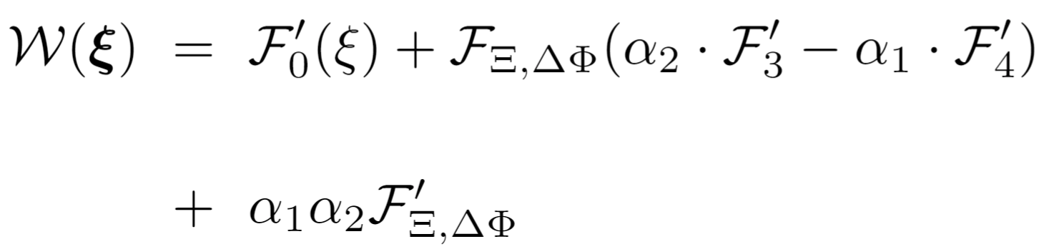
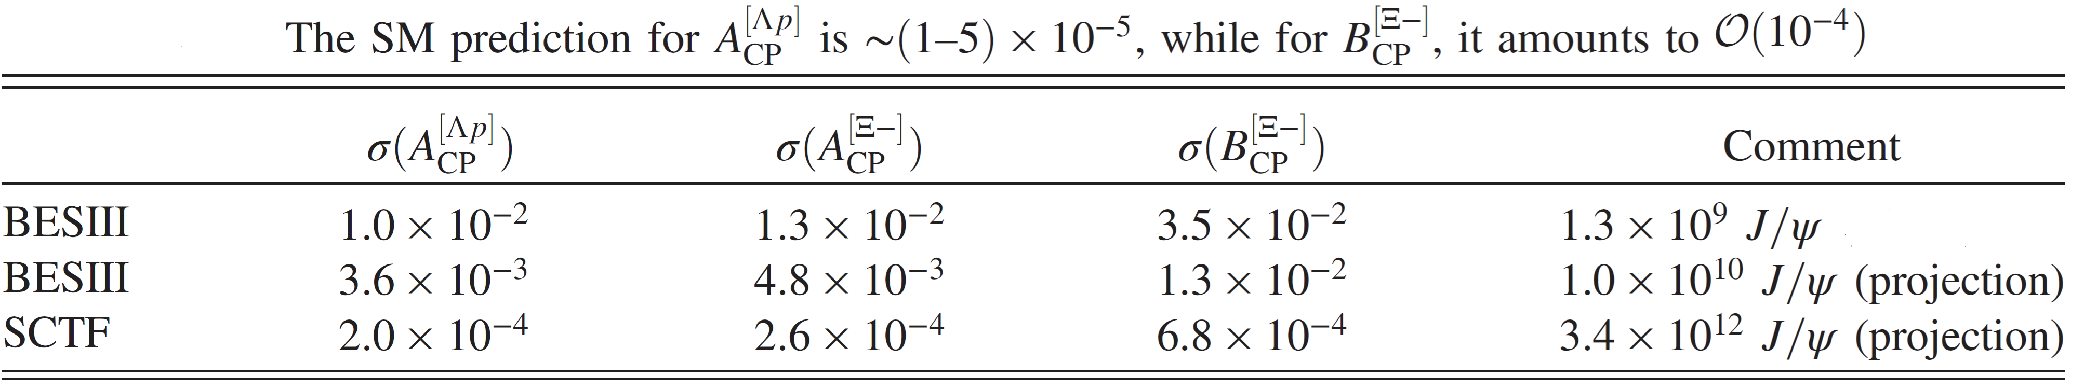
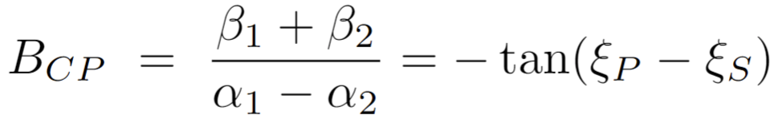
Probe CP violation via Transversely Polarized beams
Known Fact of Unpolarized Beams: measure the hyperon/anti-hyperon decay simultaneously
E. Perotti, G. Fäldt, A. Kupsc, et al., Phys. Rev. D 99,056008 (2019)
P.-C. Hong, R.-G. Ping, T. Luo, X.-R. Zhou, H. Li,
Chin. Phys. C 47, 093103 (2023)
Scattering angle only, no info. in azimuthal angle?
Cascade decay is much more complicated:

Slide 30
Wigner D-function
Two-particle states is their projection on angularmomentum eigenstates
Elisabetta Perotti, Göran Fäldt, Andrzej Kupść, et al., Phys.Rev.D 99 (2019) 5, 056008

Slide 31
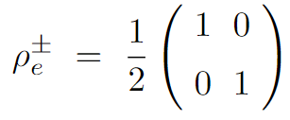
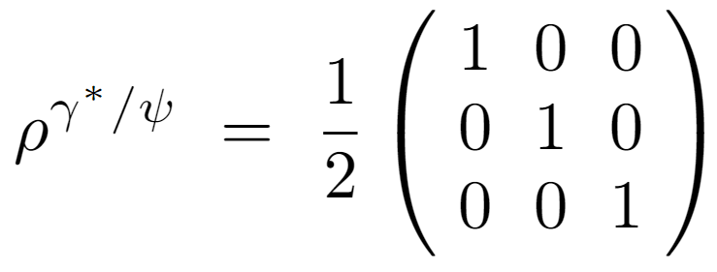
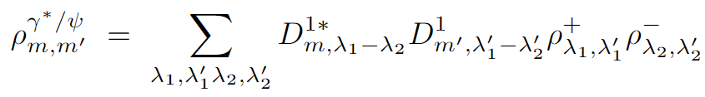
Unpolarized beams
Forgotten Facts of Transversely Polarized electron/positron Beams
1 = ½ - (-½) 0 = ½ - ½ 0 = -½ - (-½) -1 = -½ - ½
If.amp 1 1 1 1
Xu Cao, Yu-tie Liang, Rong-Gang Ping, Phys. Rev. D 110, 014035 (2024)

Slide 32

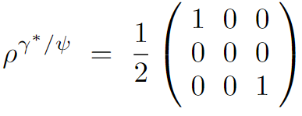
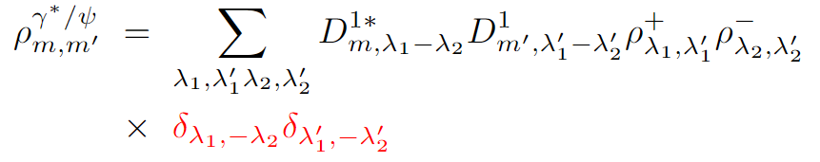
Unpolarized beams
Forgotten Facts of Transversely Polarized electron/positron Beams
1 = ½ - (-½) 0 = ½ - ½ 0 = -½ - (-½) -1 = -½ - ½
In fact 1 1 1 1
Xu Cao, Yu-tie Liang, Rong-Gang Ping, Phys. Rev. D 110, 014035 (2024)
Notes:
Mark Thomson - Modern Particle Physics-Cambridge University Press (2013)
the chiral eigenstates are the same as the helicity eigenstates for both particle and antiparticle spinors,
feature of QED related to the chiral nature of the interaction.
Hence, in general, the solutions to the Dirac equation which are also eigenstates of γ5 are identical to the massless helicity eigenstates.

Slide 33
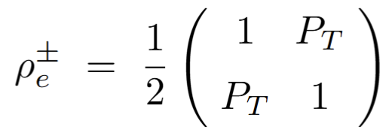

Transversely Polarized beams
Forgotten Facts of Transversely Polarized electron/positron Beams
1 = ½ - (-½) 0 = ½ - ½ 0 = -½ - (-½) -1 = -½ - ½
In fact 1 1 1 1
Xu Cao, Yu-tie Liang, Rong-Gang Ping, Phys. Rev. D 110, 014035 (2024)

Slide 34


Long.&Trans. Polarized beams
Longitudinal and Transversely Polarized electron/positron Beams
1 = ½ - (-½) 0 = ½ - ½ 0 = -½ - (-½) -1 = -½ - ½
In fact 1 1 1 1
Xu Cao, Yu-tie Liang, Rong-Gang Ping, Phys. Rev. D 110, 014035 (2024)
N. Salone, P. Adlarson, V. Batozskaya, A. Kupsc, S. Leupold, and J. Tandean, Phys. Rev. D 105, 116022 (2022)

