Slide 1


超级陶粲装置对撞环物理设计进展
邹 野
中国科学技术大学
STCF对撞环物理设计系统
2026.07.01，西安

Slide 2
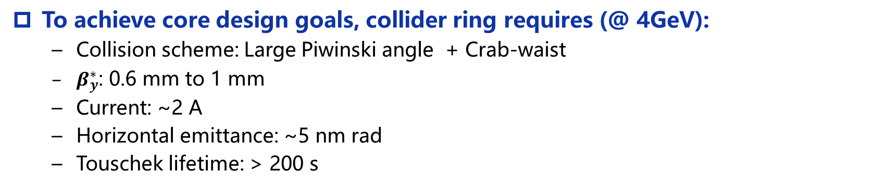
STCF对撞环设计目标与主要挑战
Core design goals:
  CoM energy: 2-7 GeV
  Luminosity: > 0.5×10³⁵ cm⁻² s⁻¹ @ 4 GeV
  Upgrading potential: higher luminosity
To achieve core design goals, collider ring requires (@ 4GeV):
  Collision scheme: Large Piwinski angle + Crab-waist
  $β_{y}^{∗}$: 0.6 mm to 1 mm
  Current: ~2 A
  Horizontal emittance: ~5 nm rad
  Touschek lifetime: > 200 s
P. Raimondi
Key challenges:
  Very strong nonlinear effect: small dynamic aperture and momentum acceptance
  High current, low energy, small emittance: strong collective effect (Touschek effect, IBS, beam-beam, impedance, etc.)
  Very short Touschek lifetime: Large beam loss, large background and SC magnets quenching

Slide 3
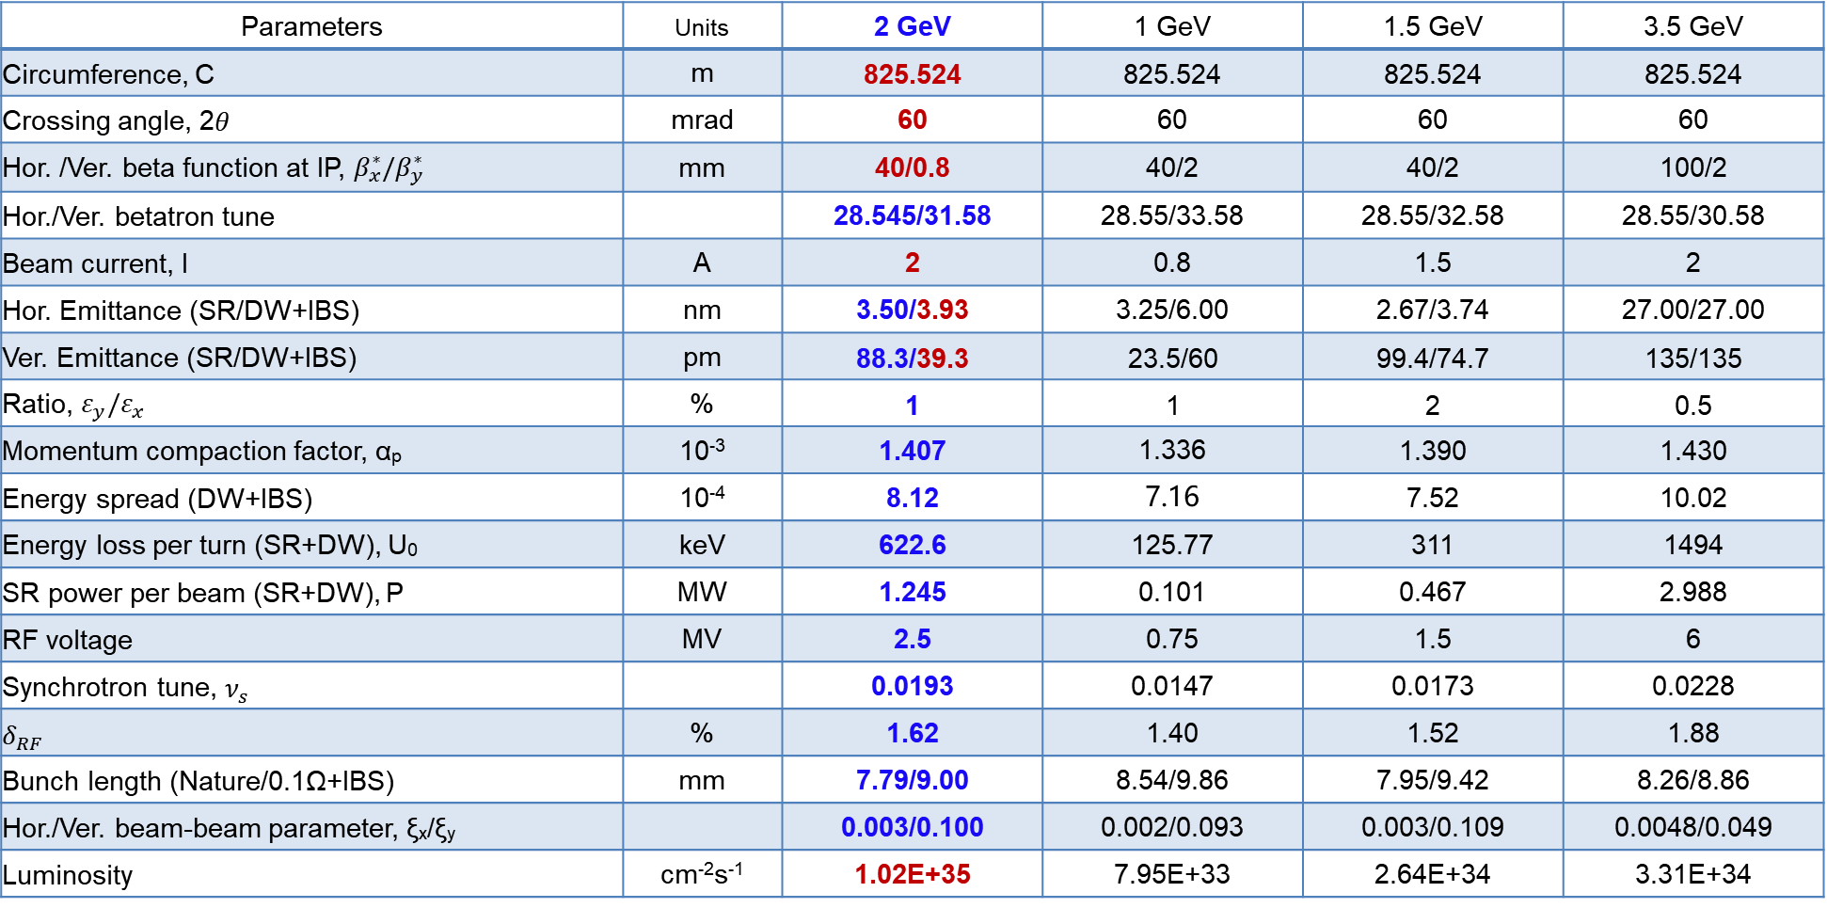
关键物理参数（V5）
Parameters | Units | 2 GeV | 1 GeV | 1.5 GeV | 3.5 GeV
Circumference, C | m | 825.524 | 825.524 | 825.524 | 825.524
Crossing angle, 2$θ$ | mrad | 60 | 60 | 60 | 60
Hor. /Ver. beta function at IP, $β_{x}^{∗}/β_{y}^{∗}$ | mm | 40/0.8 | 40/2 | 40/2 | 100/2
Hor./Ver. betatron tune |  | 28.545/31.58 | 28.55/33.58 | 28.55/32.58 | 28.55/30.58
Beam current, I | A | 2 | 0.8 | 1.5 | 2
Hor. Emittance (SR/DW+IBS) | nm | 3.50/3.93 | 3.25/6.00 | 2.67/3.74 | 27.00/27.00
Ver. Emittance (SR/DW+IBS) | pm | 88.3/39.3 | 23.5/60 | 99.4/74.7 | 135/135
Ratio, $ε_{y}/ε_{x}$ | % | 1 | 1 | 2 | 0.5
Momentum compaction factor, α_{p} | 10⁻³ | 1.407 | 1.336 | 1.390 | 1.430
Energy spread (DW+IBS) | 10⁻⁴ | 8.12 | 7.16 | 7.52 | 10.02
Energy loss per turn (SR+DW), U₀ | keV | 622.6 | 125.77 | 311 | 1494
SR power per beam (SR+DW), P | MW | 1.245 | 0.101 | 0.467 | 2.988
RF voltage | MV | 2.5 | 0.75 | 1.5 | 6
Synchrotron tune, $ν_{s}$ |  | 0.0193 | 0.0147 | 0.0173 | 0.0228
$$δ_{RF}$$ | % | 1.62 | 1.40 | 1.52 | 1.88
Bunch length (Nature/0.1Ω+IBS) | mm | 7.79/9.00 | 8.54/9.86 | 7.95/9.42 | 8.26/8.86
Hor./Ver. beam-beam parameter, ξ_{x}/ξ_{y} |  | 0.003/0.100 | 0.002/0.093 | 0.003/0.109 | 0.0048/0.049
Luminosity | cm⁻²s⁻¹ | 1.02E+35 | 7.95E+33 | 2.64E+34 | 3.31E+34
Notes:
We have 4 energy point. Luminosity is around 10^35. large momentum compaction and energy spread. Other energy point lower No more than 1 orders of magnitude.

Slide 4
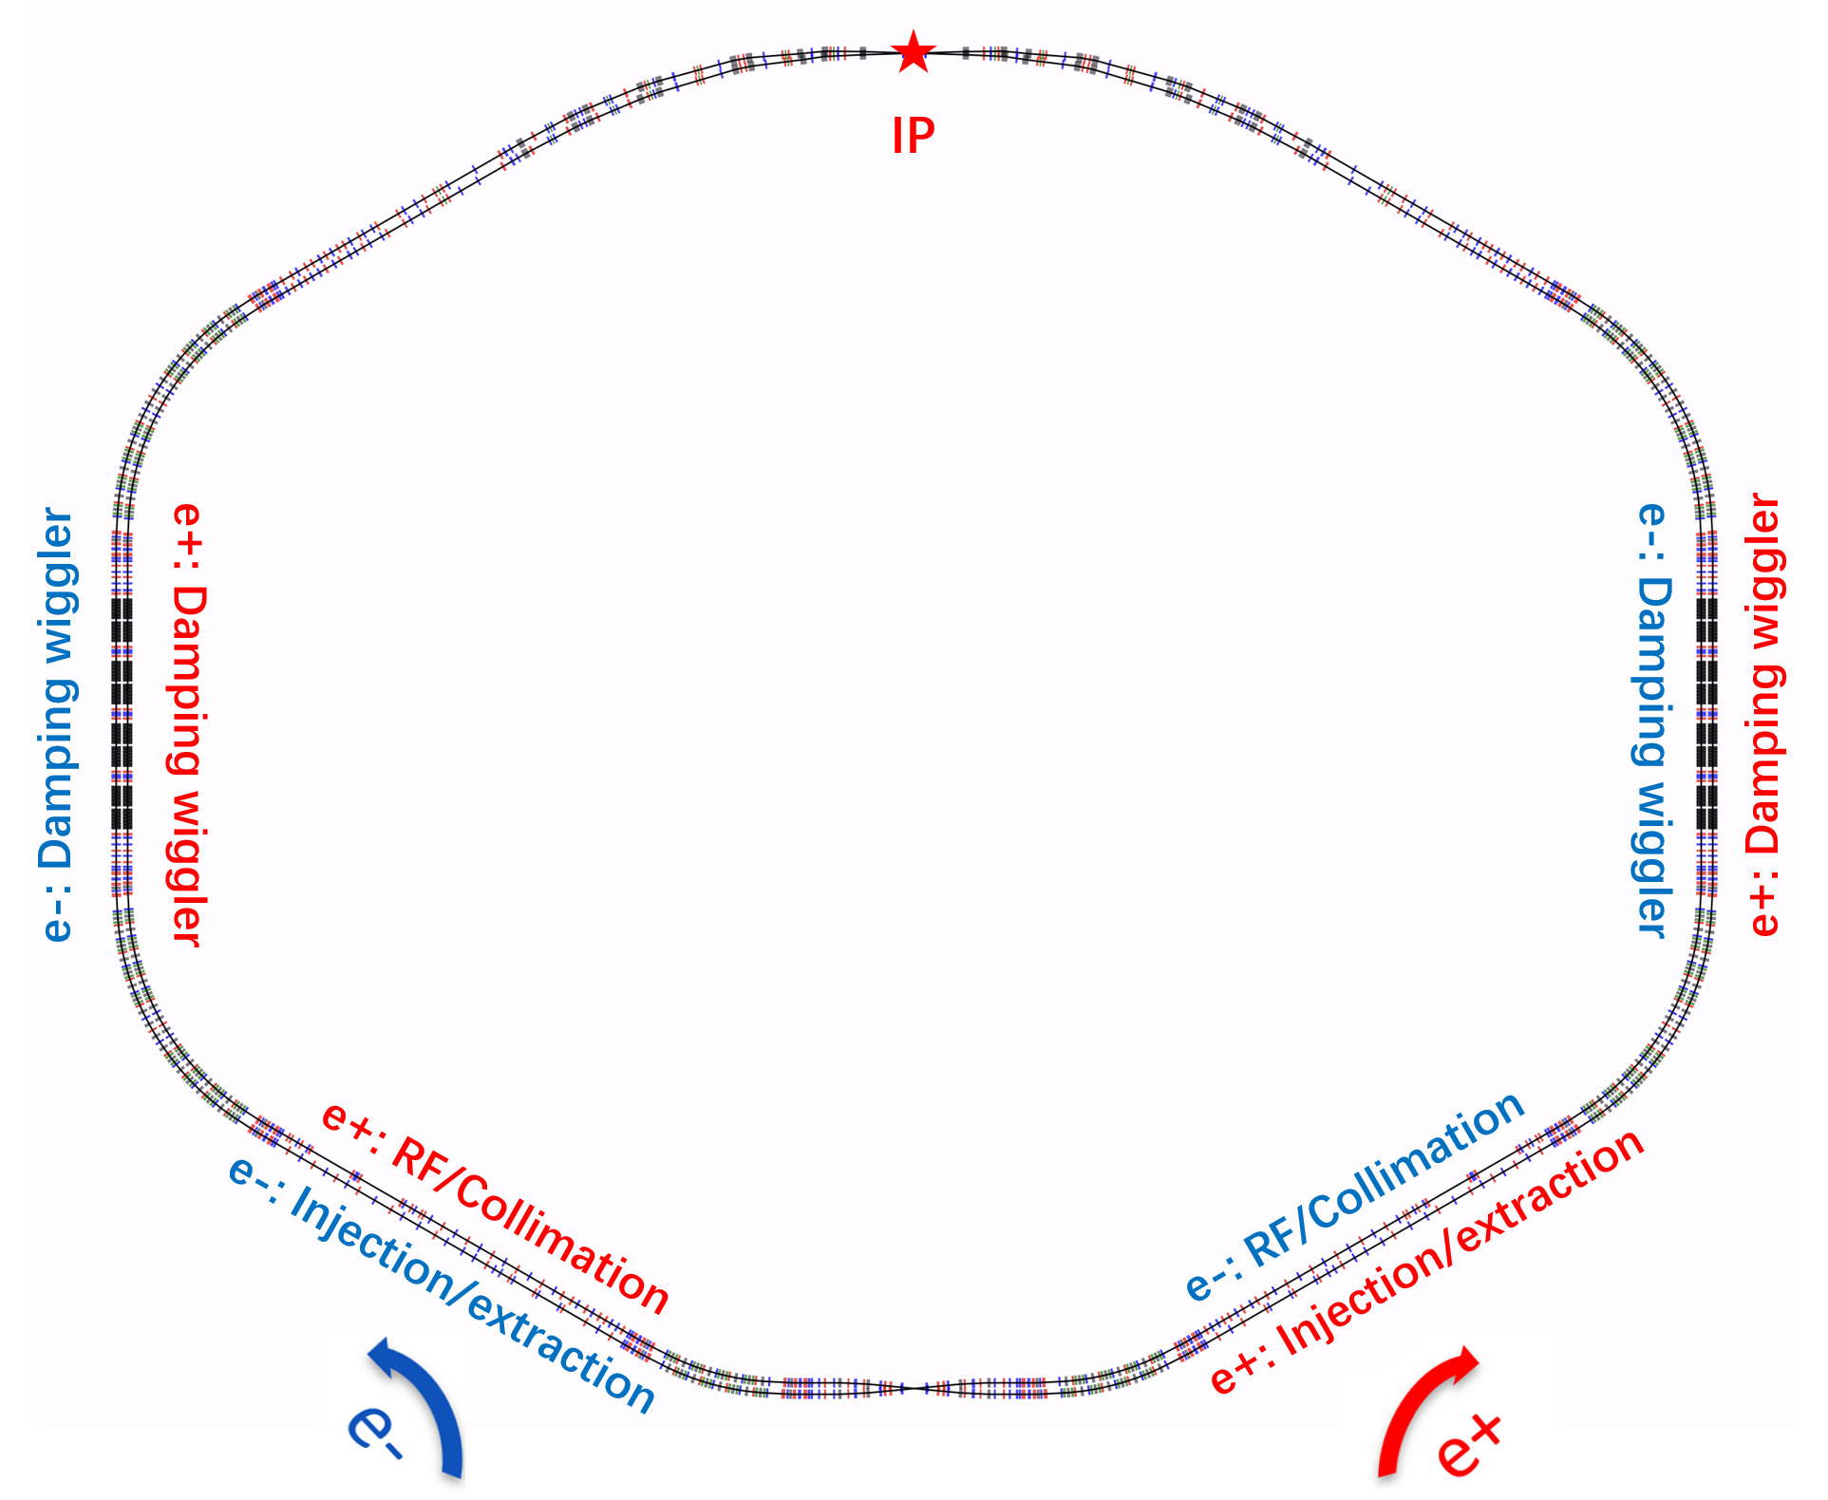
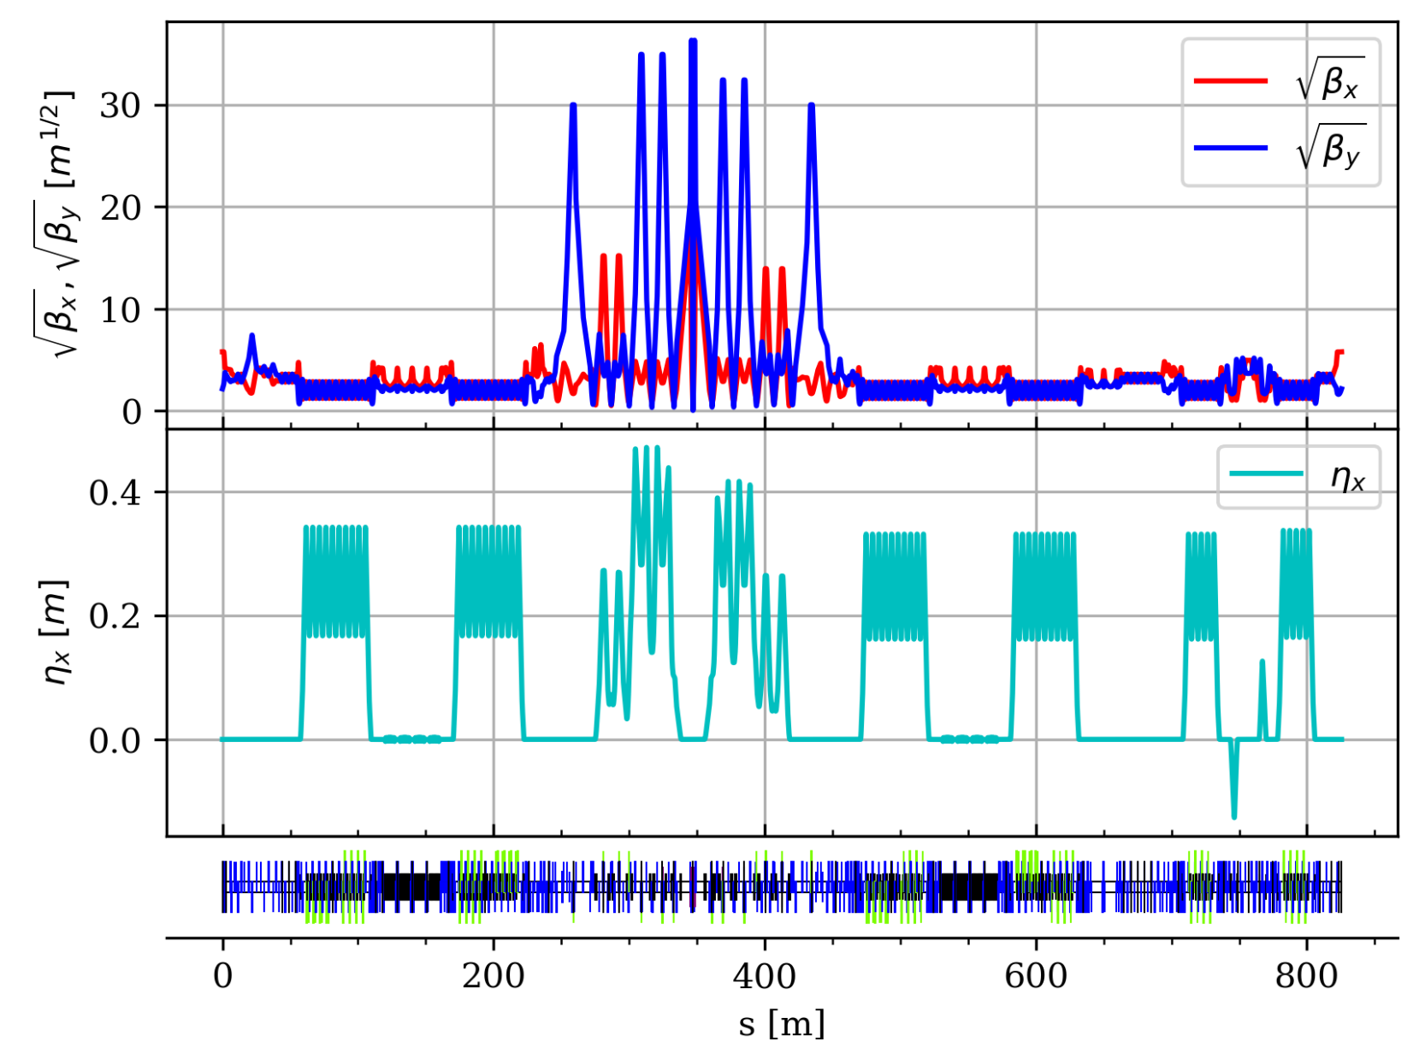
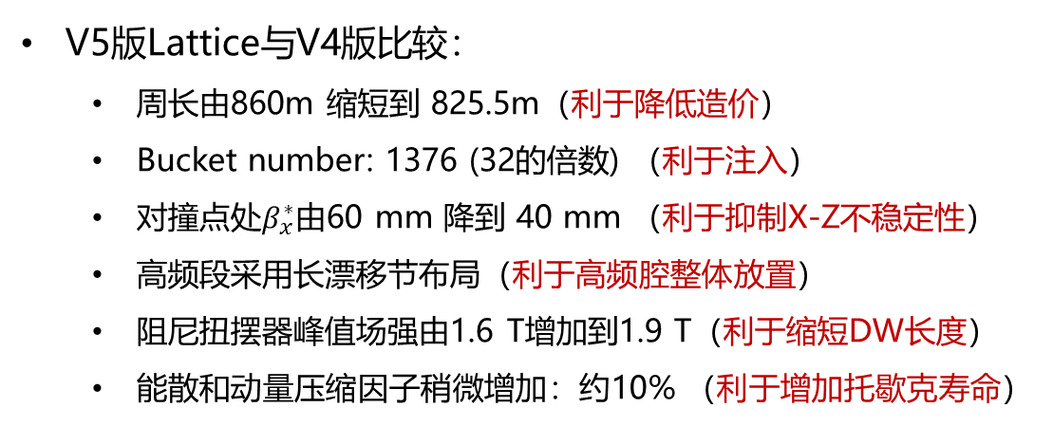
Lattice布局和光学函数 (V5)
V5版Lattice与V4版比较：
  周长由860m 缩短到 825.5m（利于降低造价）
  Bucket number: 1376 (32的倍数) （利于注入）
  对撞点处$β_{x}^{∗}$由60 mm 降到 40 mm （利于抑制X-Z不稳定性）
  高频段采用长漂移节布局（利于高频腔整体放置）
  阻尼扭摆器峰值场强由1.6 T增加到1.9 T（利于缩短DW长度）
  能散和动量压缩因子稍微增加：约10% （利于增加托歇克寿命）
Touschek寿命较V4版本综合提升约40%
能量(GeV) | 2 | 1 | 1.5 | 3.5
亮度(cm⁻²s⁻¹) | 1.02E+35 | 7.95E+33 | 2.64E+34 | 3.31E+34
Touschek寿命(s) | 364 | 267 | 371 | 10972
Y. Zou*, L. Zhang, T. Liu, et al., Optics design of the Super Tau-Charm Facility collider rings, Nucl. Instrum. Methods Phys. Res. A, 1084 (2026) 171191

Slide 5
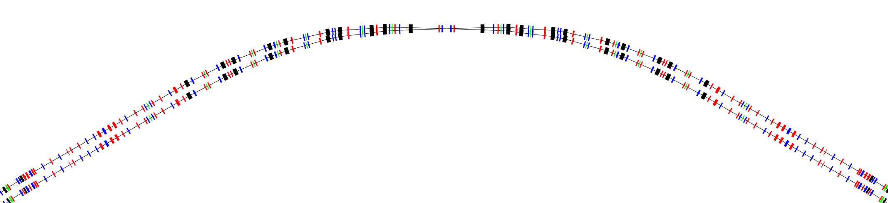
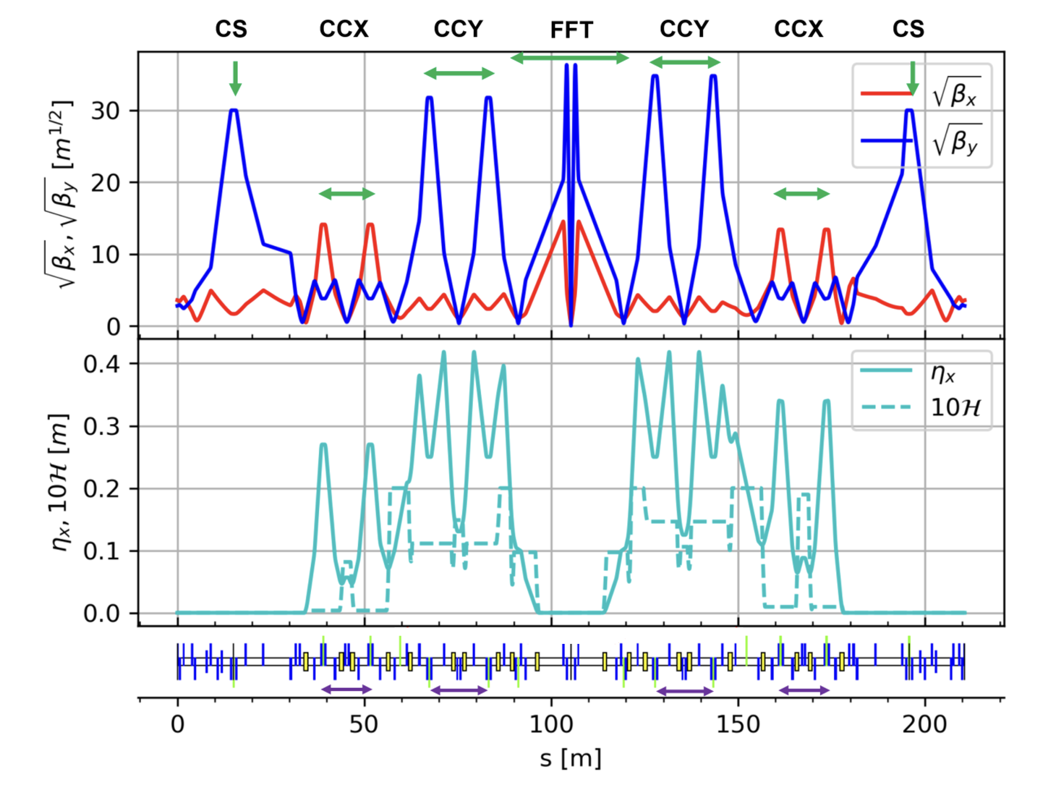
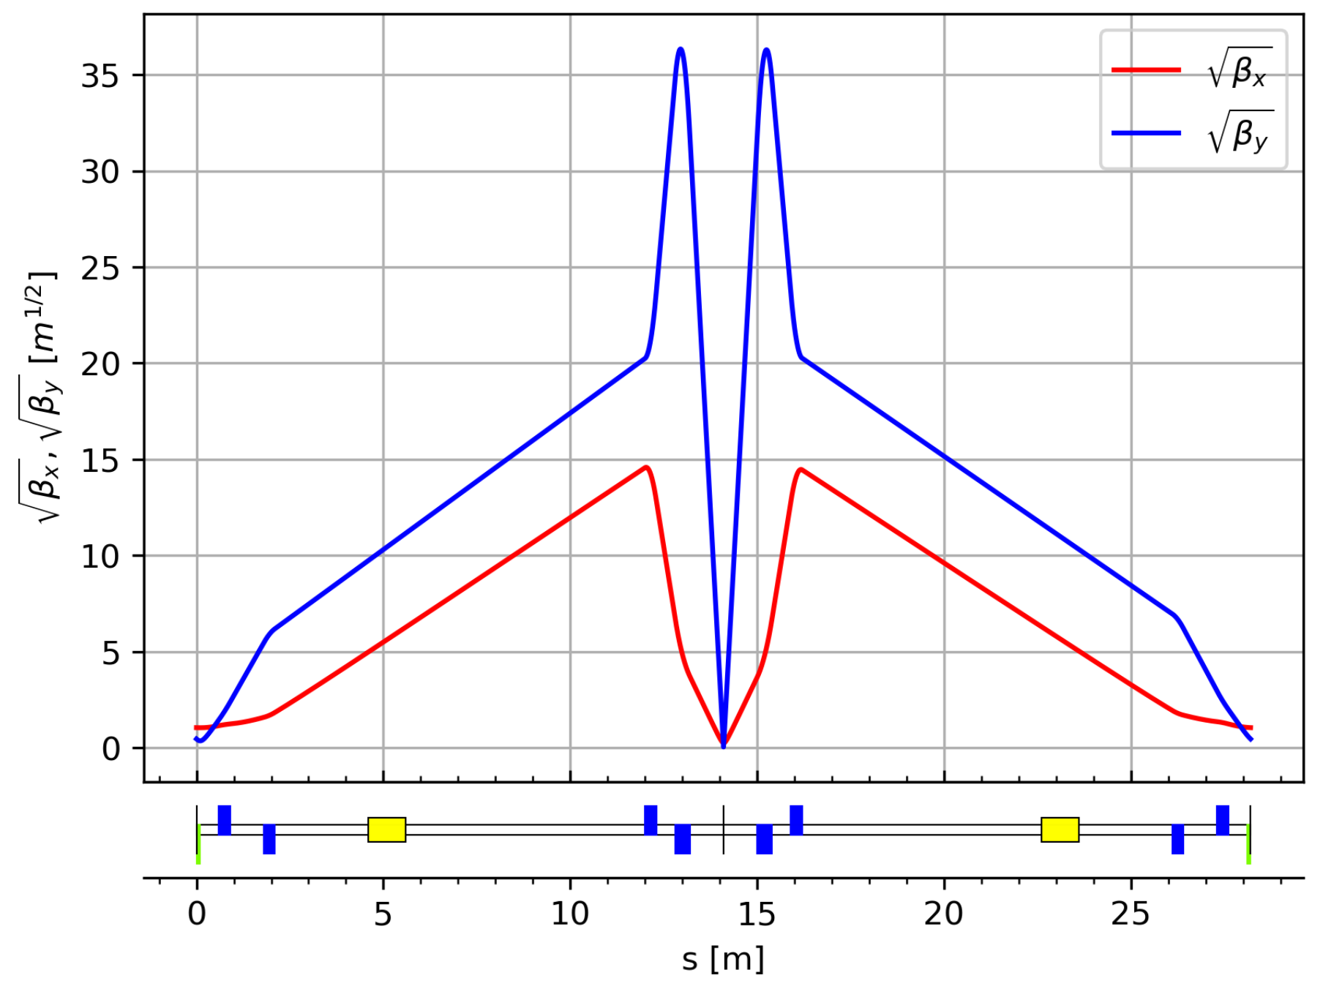


对撞区物理设计
详见张林浩报告
Modular design → flexible for optics design and local chromaticity correction
  Final Focus Telescope (FFT), Chromaticity Correction (CCY、CCX), and Crab Sextupoles (CS)
  FFT: small β function ($β_{y}^{∗}$ =0.8 mm, $β_{x}^{∗}$=40 mm) and bunch size at IP ($σ_{y}$= 180 nm, $σ_{x}$=12.5 μm)
  CCY/CCX: sextupole pairs, large β, large dispersion, exact –I map →reduce sextupole strength
  CS: phase advance to IP (μ_{𝑥} = 6π, μ_{𝑦} = 5.5π); β_{y}>> β_{x} →reduce sextupole strength (k₂ =16.94 m⁻³)
  IR Bending angle 60°: weak bending magnet (B0) closest to IP, to avoid synchrotron radiation at IP
Crab sext.
IP
Crab sext.
$$K2L=±\frac{1}{2θβ_{y}^{∗}β_{y}}\sqrt{\frac{β_{x}^{∗}}{β_{x}}}$$
L. Zhang*, T. Liu, Y. Zou* et al., Design and integration of a crab-waist interaction region for the Super Tau-Charm Facility, Nucl. Sci. Tech. (已接收)

Slide 6
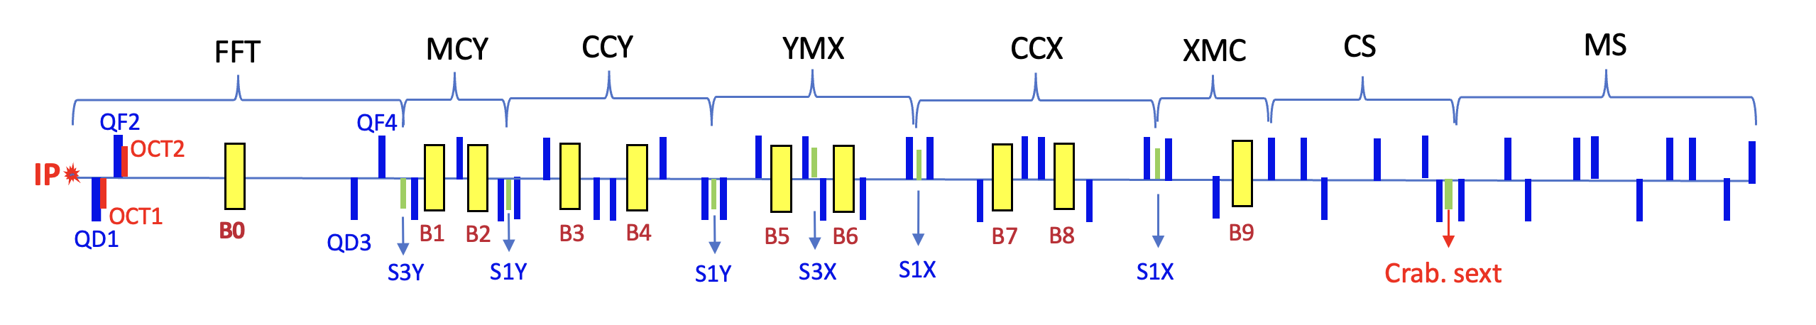
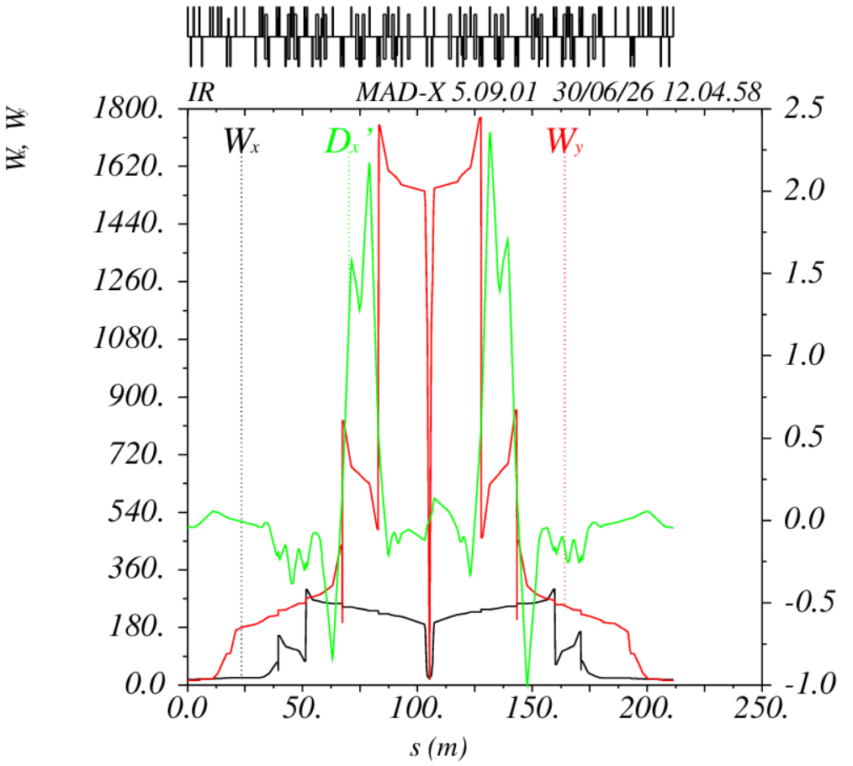
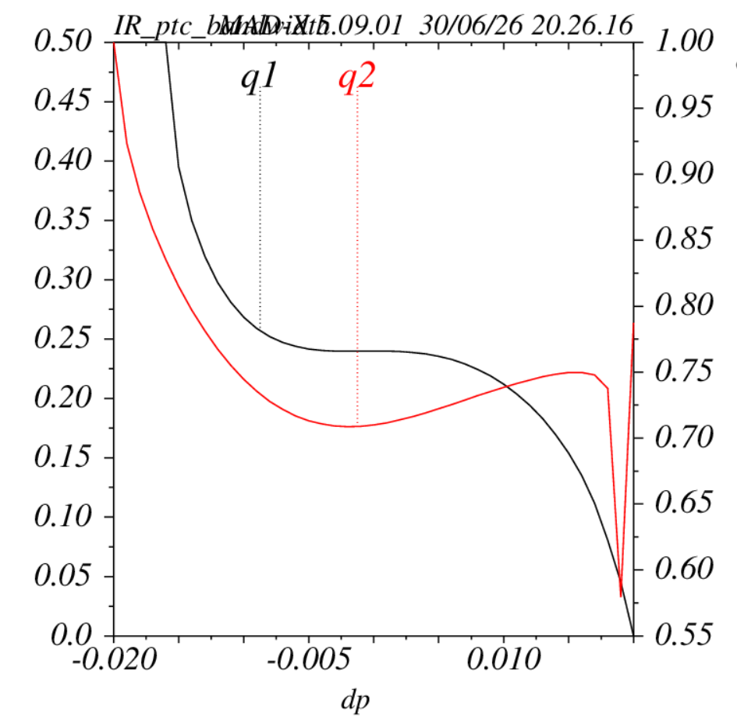
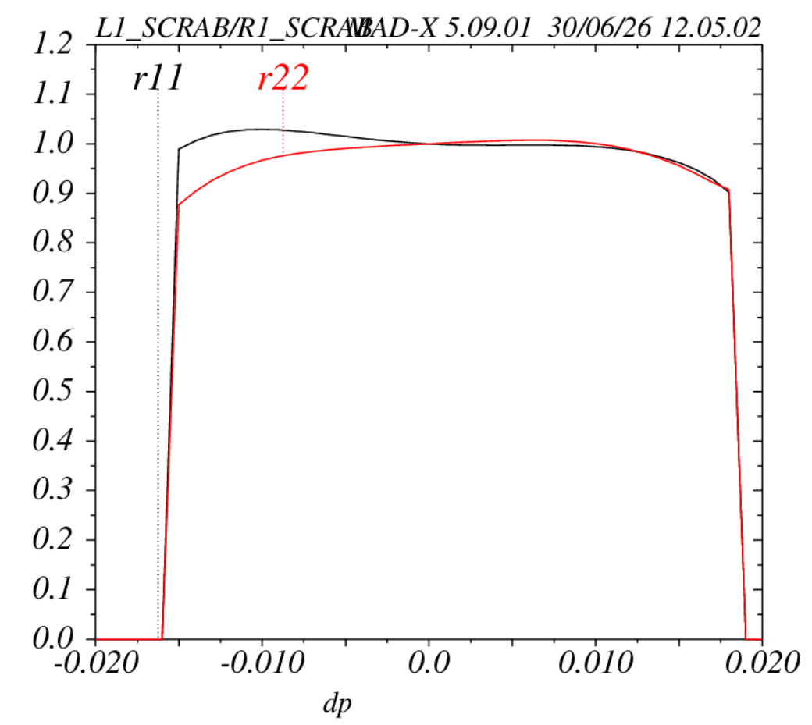
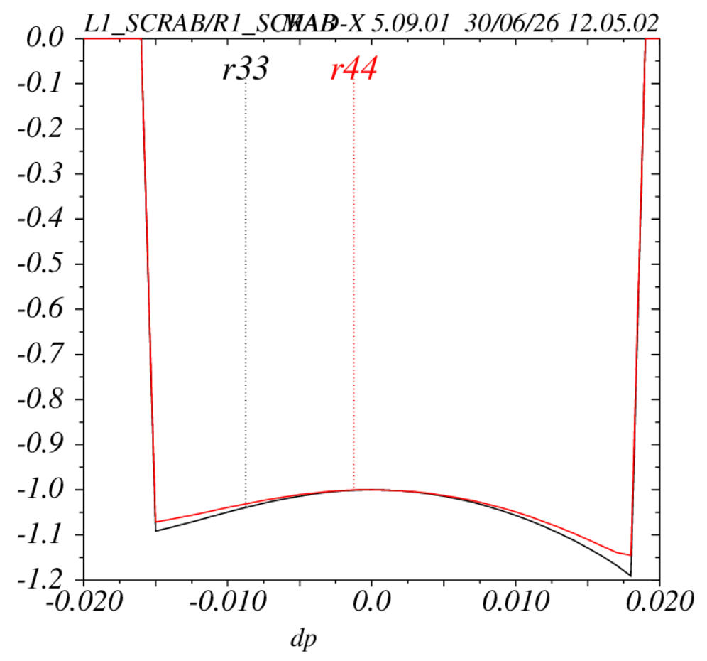
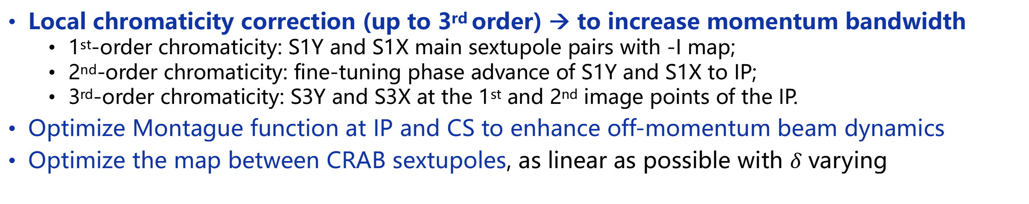
对撞区非线性动力学优化
详见张林浩报告
Local chromaticity correction (up to 3rd order) → to increase momentum bandwidth
  1st-order chromaticity: S1Y and S1X main sextupole pairs with -I map;
  2nd-order chromaticity: fine-tuning phase advance of S1Y and S1X to IP;
  3rd-order chromaticity: S3Y and S3X at the 1st and 2nd image points of the IP.
Optimize Montague function at IP and CS to enhance off-momentum beam dynamics
Optimize the map between CRAB sextupoles, as linear as possible with $δ$ varying

Slide 7
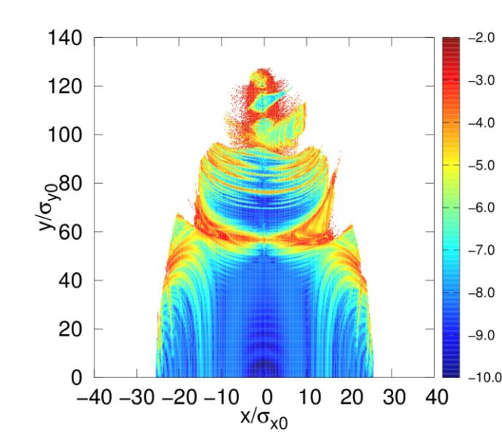
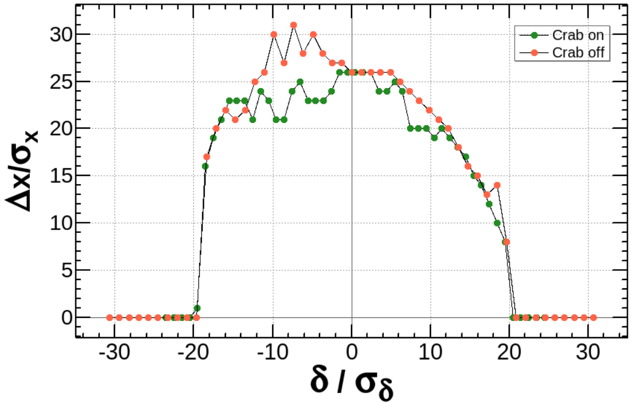
全环非线性动力学优化
MADX/SAD for the lattice design, SAD/PAMKIT (MOGA) for global nonlinear optimization
Resonant driving terms (RDTs) could be well cancelled with paired sextupoles with –I map
Fringe fields effect affects the nonlinear beam dynamics
Compensation: add octupole coils in IR to compensate the fringe fields effect
Frequency map analysis (FMA) shows no dangerous resonance within DA
With fringe fields： DA: Hor. > 25 $σ_{x}$, Ver. >120 $σ_{y}$ ; DA: Hor. >15 $σ_{x}$@ 10 $σ_{δ}$
DA w/o fringe fields
DA w/ fringe fields
Off-Mom. DA w/ fringe fields

Slide 8
局部动量孔径与Touschek寿命
LMA without BPM errors
Local momentum acceptance (LMA) evaluated by Elegant
Lower H function to increase LMA by linear optics design
Fringe fields affect LMA, with octupole compensation
BPM errors affect LMA and Touschek lifetime
Touschek lifetime: 364 s with crab sextupoles on and fringe fields compensation with ideal lattice and 245 s with misalignment and BPM errors
LMA with BPM errors
Touschek Lifetime (s) | Ideal lattice | with misalignment errors
No BPM errors | 364 | 297
With BPM errors | – | 245

Slide 9
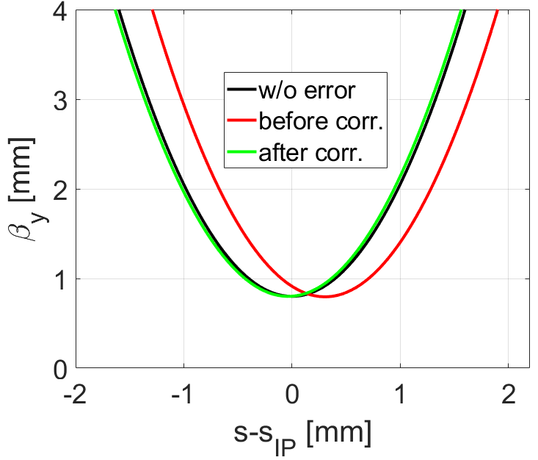
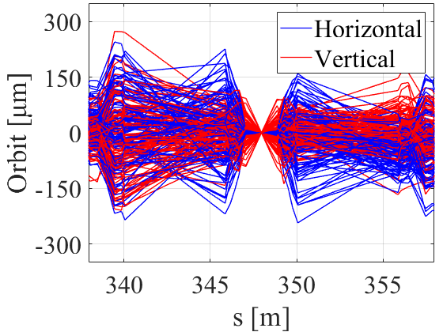
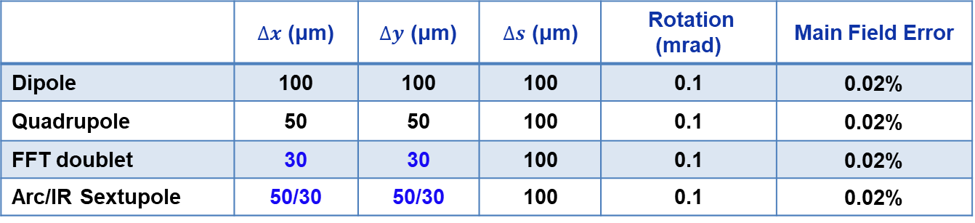
误差分析与校正
详见鲍楗聪报告
误差分析、BPM与校正子布局
  对撞区超导四极磁铁与六极磁铁较敏感，将误差控制在较小范围内
  单个环有401个BPM，266个水平校正子，255个垂直校正子，94个斜四极磁铁
校正策略和流程：
  首圈轨迹校正：SVD + 轨迹响应矩阵
  全环轨道和色散校正: SVD + Dispersion Free Steering (DFS)
  IP点轨道和色散校正: SVD with weight factor (Hor./Ver. orbit, RMS: 0.22/0.04 μm, Hor./Ver. dispersion deviation, RMS: 0.22/0.02 mm)
  光学耦合校正: Linear optics from closed orbits (LOCO)
  β_{y}* 校正: K-modulation (Hor./Ver. β-beat, RMS: 0.4%/1.4%)
β_{y}* correction
Closed orbit correction
 | $∆x$ (μm) | $∆y$ (μm) | $∆s$ (μm) | Rotation (mrad) | Main Field Error
Dipole | 100 | 100 | 100 | 0.1 | 0.02%
Quadrupole | 50 | 50 | 100 | 0.1 | 0.02%
FFT doublet | 30 | 30 | 100 | 0.1 | 0.02%
Arc/IR Sextupole | 50/30 | 50/30 | 100 | 0.1 | 0.02%
P. Yang*, J. Bao, Y. Zou* et al., Error effect analysis and correction for the Super Tau-Charm Facility collider rings, MPLA (审稿中)

Slide 10
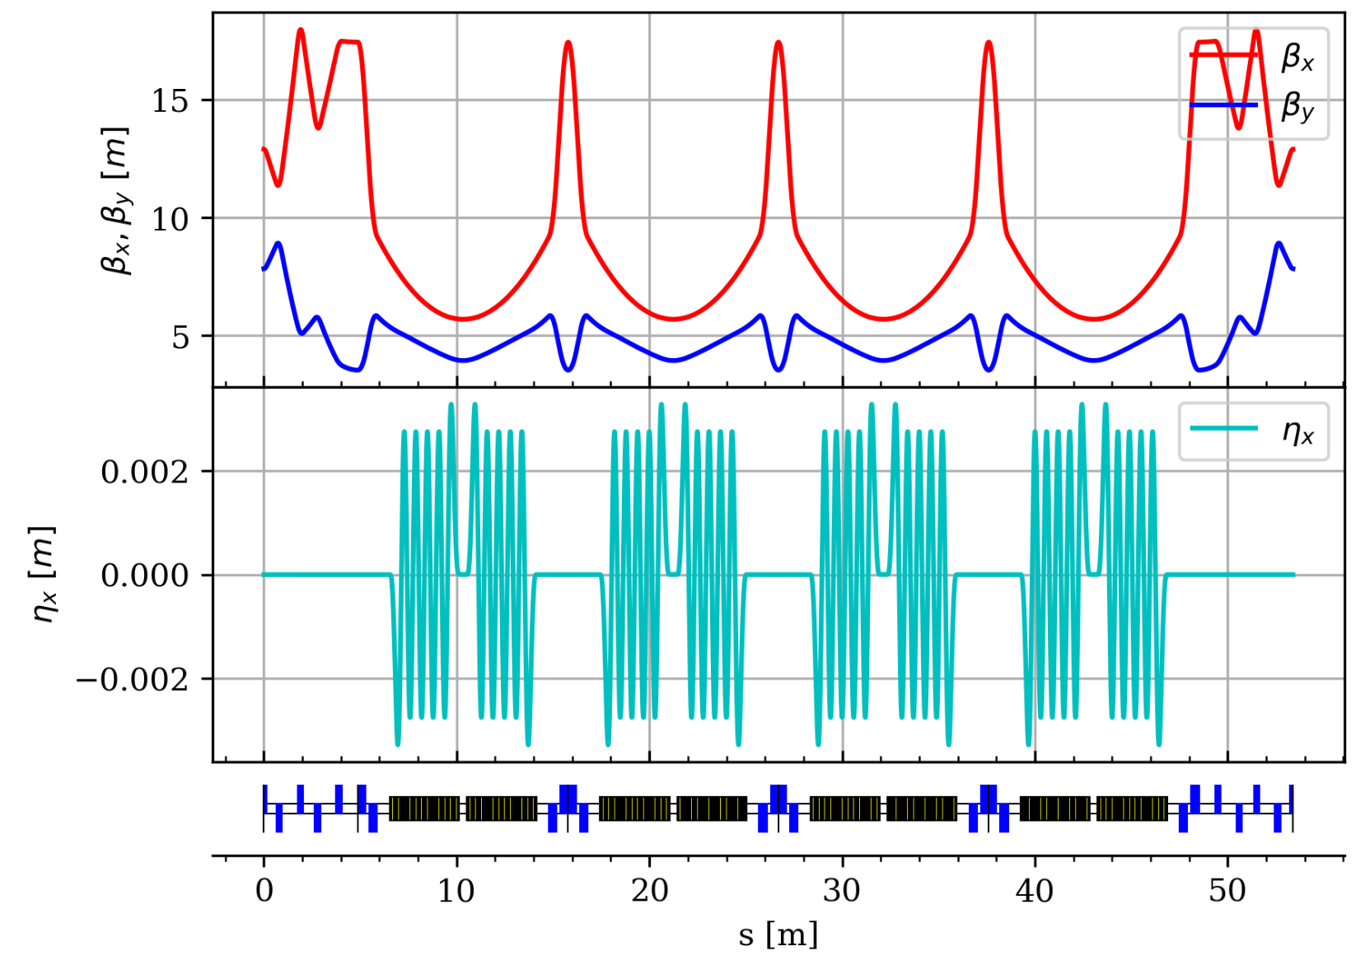
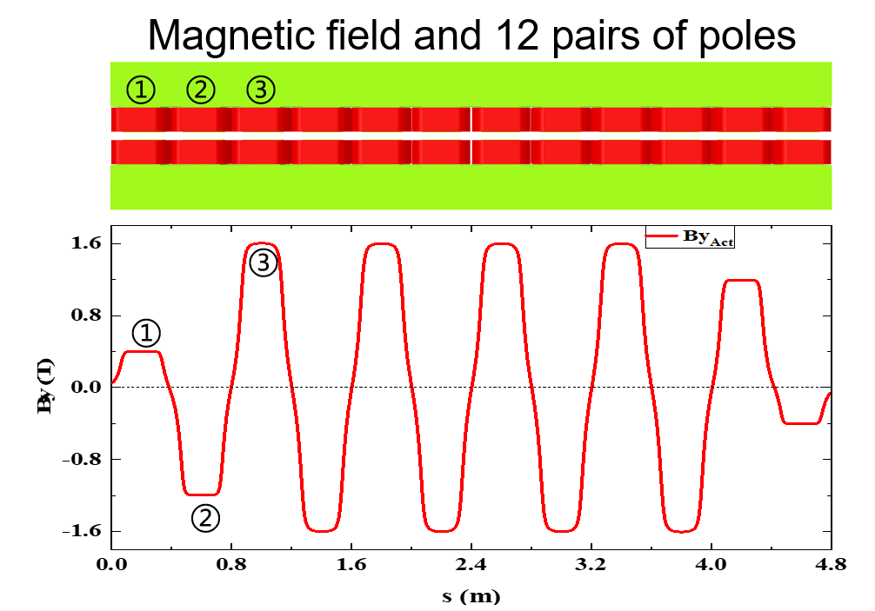
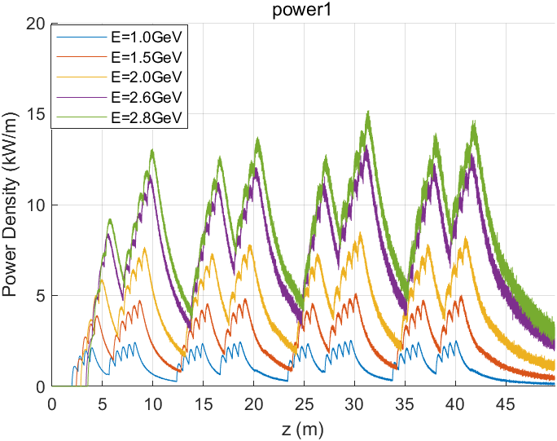
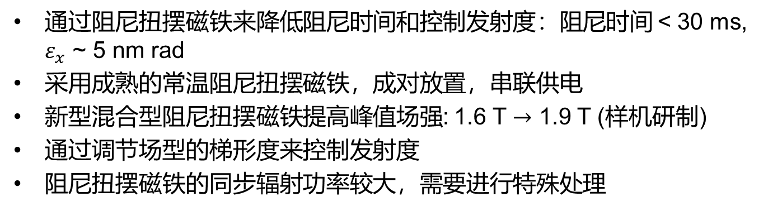
阻尼扭摆磁铁与发射度控制
通过阻尼扭摆磁铁来降低阻尼时间和控制发射度：阻尼时间 < 30 ms, $ε_{x}$ ~ 5 nm rad
采用成熟的常温阻尼扭摆磁铁，成对放置，串联供电
新型混合型阻尼扭摆磁铁提高峰值场强: 1.6 T $→$ 1.9 T (样机研制)
通过调节场型的梯形度来控制发射度
阻尼扭摆磁铁的同步辐射功率较大，需要进行特殊处理
E(GeV) | τ₀(ms) | τ_{u}(ms) | ε_{x0}(nm) | ε_{x}(nm)
1 | 553.3 | 43.8 | 2.35 | 6.00
1.5 | 163.9 | 26.6 | 4.97 | 3.74
2 | 69.2 | 17.7 | 8.83 | 3.93
3.5(DW off) | 12.9 | 12.9 | 27.00 | 27.00
H. Li, Y. Zou*, L. Zhang et al., Impact of wiggler field profiles on key beam parameters in the Super Tau-Charm Facility, NIM-A (审稿中)
邹野、周昊、唐靖宇、张林浩、石才土，混合型阻尼扭摆磁铁，发明专利，ZL 202511747436.1

Slide 11
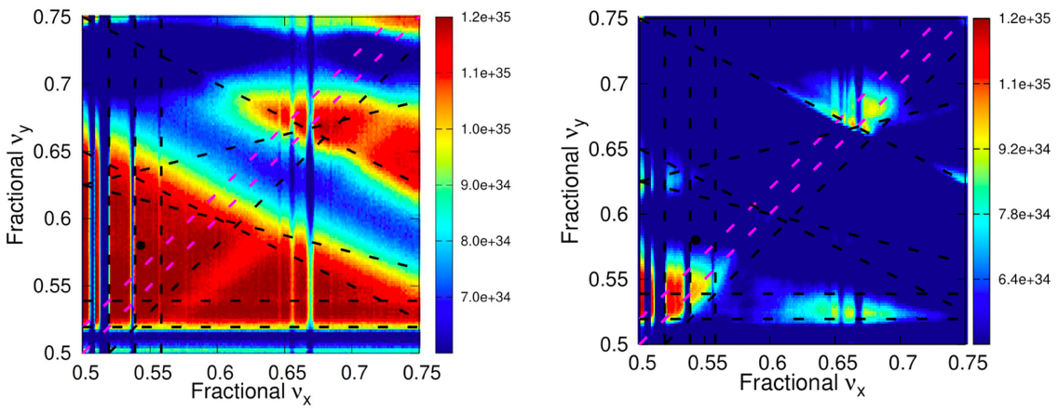
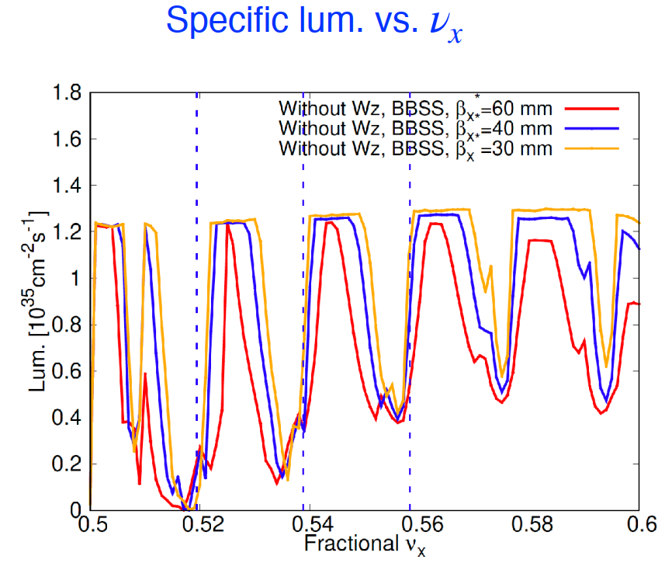
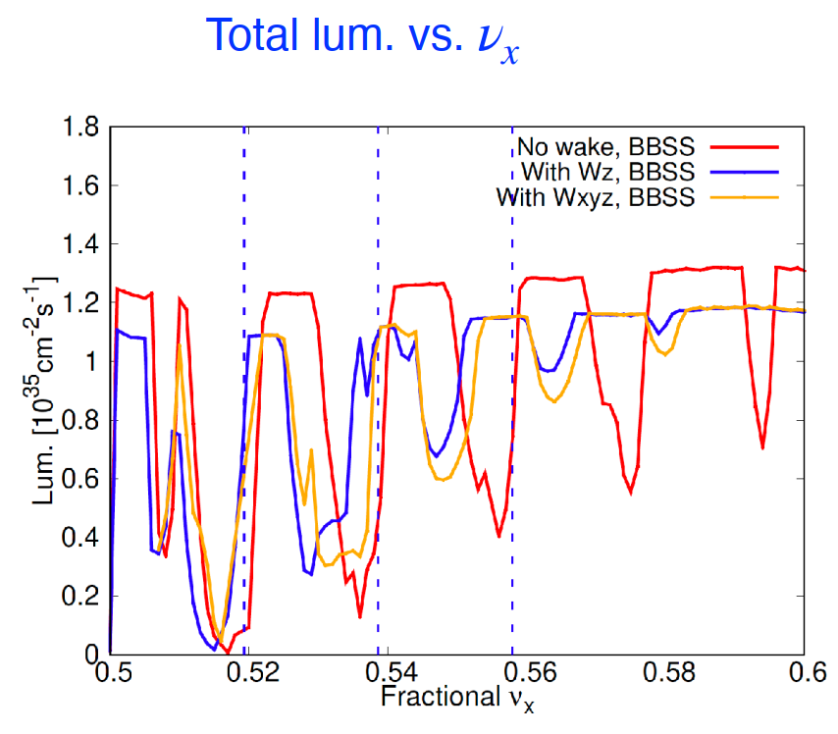
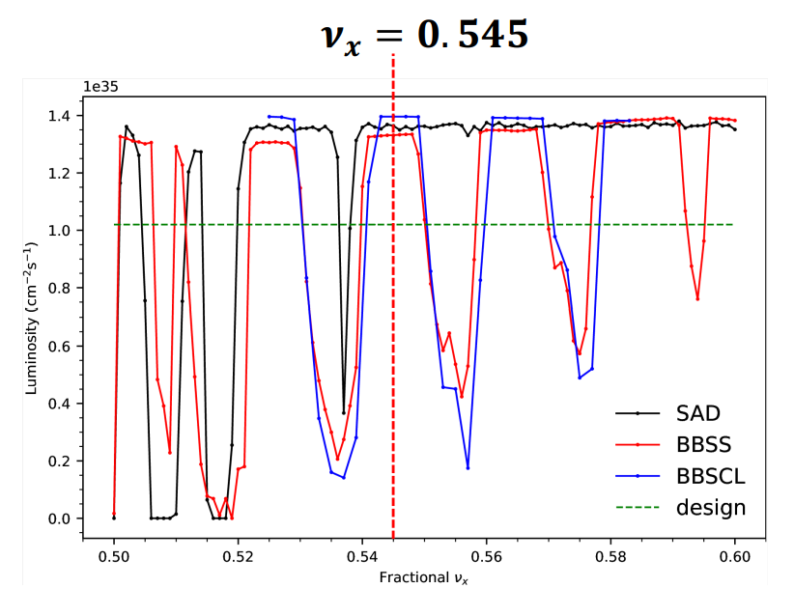
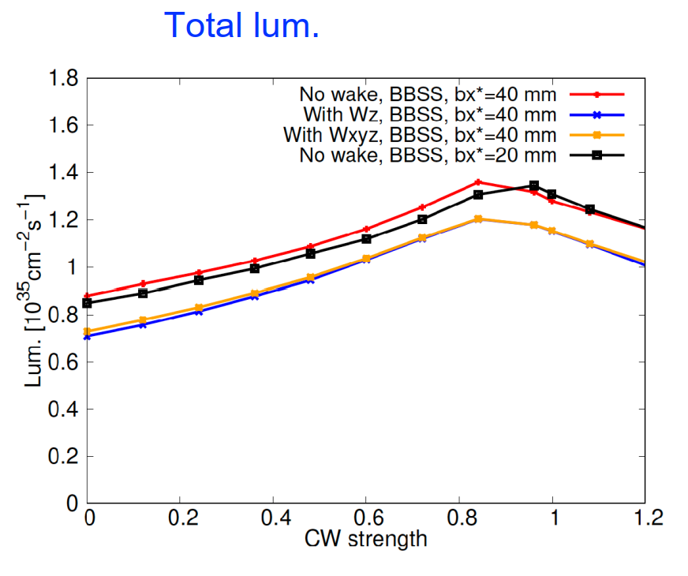
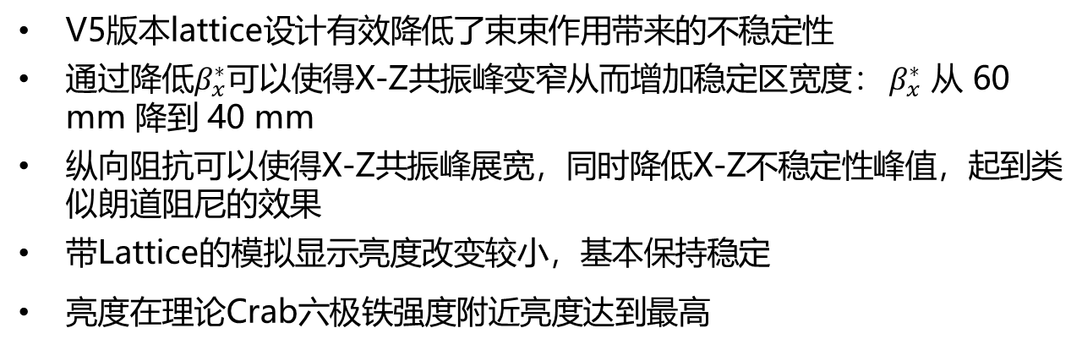
束束相互作用
V5版本lattice设计有效降低了束束作用带来的不稳定性
通过降低$β_{x}^{∗}$可以使得X-Z共振峰变窄从而增加稳定区宽度： $β_{x}^{∗}$ 从 60 mm 降到 40 mm
纵向阻抗可以使得X-Z共振峰展宽，同时降低X-Z不稳定性峰值，起到类似朗道阻尼的效果
带Lattice的模拟显示亮度改变较小，基本保持稳定
亮度在理论Crab六极铁强度附近亮度达到最高
w/ crab waist
w/o crab waist
S. Li, D. Zhou et al., Revisiting beam-beam-driven resonances in crab-waist colliders, Nucl. Instrum. Methods Phys. Res. A, Vol. 1091, 171714 (2026）
S. Li, D. Zhou et al., Investigating luminosity optimization in STCF with crab waist scheme by beam-beam simulation, Modern Physics Letters A, Vol. 39, 2440013 (2024)
Notes:
Simulations with beam-beam shows that coherent X-Z instability strongly affects luminosity performance, which need to be avoided. Can be the reference for the future lattice design. Longitudinal impedance can widen resonances, which is not good, the stable region is narrowed. But it also reduces the strengths probably due to landau damping. Impedance modeling for full evaluation of impedance effects is under study.

Slide 12
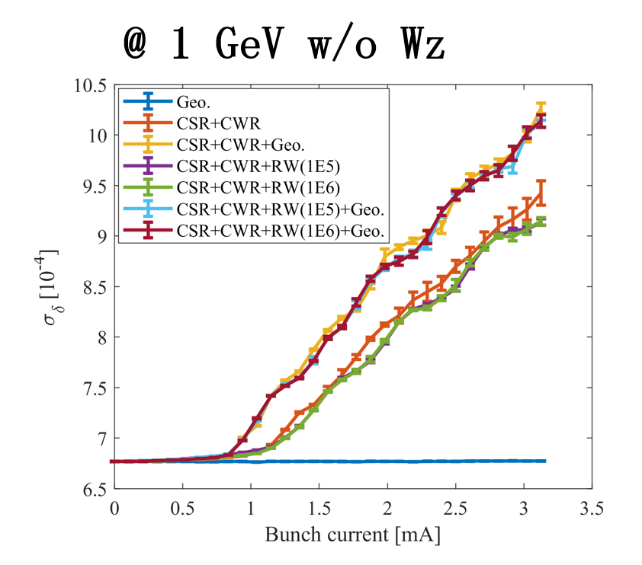
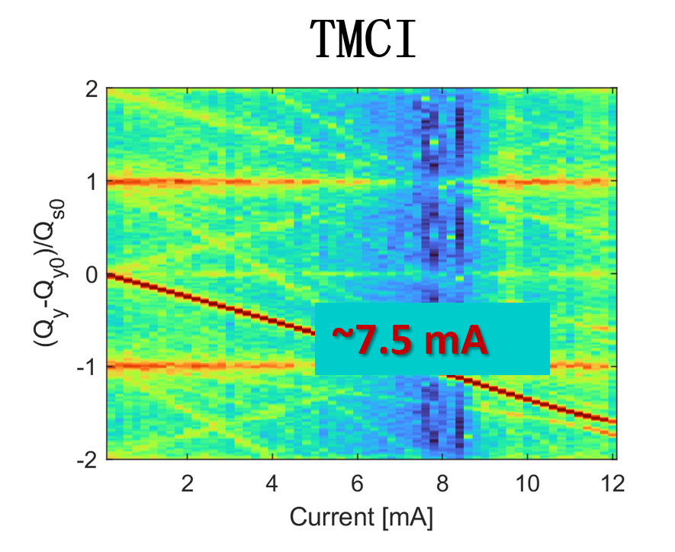
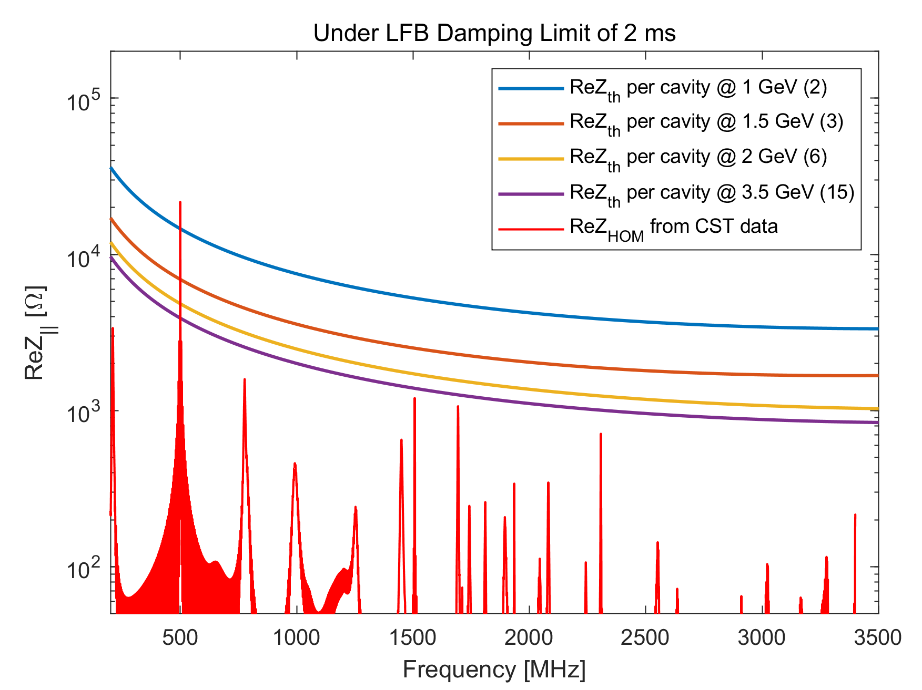
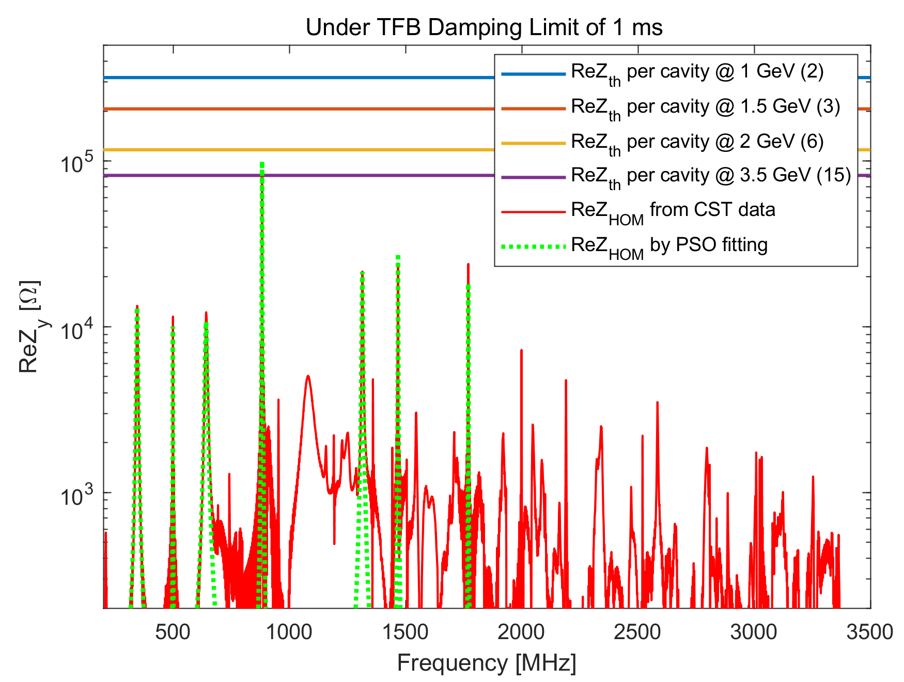
  束流集体效应
详见何天龙报告
单束团不稳定性
微波不稳定性在1GeV时主要由CSR和CWR主导, NEG 镀膜的电导率也会有轻微影响
横向模耦合不稳定性阈值较高，比较安全，主要是因为准直器孔径相对较大
多束团不稳定性
抑制高次模导致的纵向耦合束团不稳定性需要纵向2ms反馈系统
横向耦合束团不稳定性需要横向反馈系统，其中抑制高次模导致的需要1ms，壁阻抗需要0.5ms，离子效应需要0.4 ms，总体需要的横向反馈系统 <0.4 ms
纵向高次模
横向高次模
T. He*, Y. Zou* et al., Impact of coherent wiggler radiation impedance in Tau-Charm factories, Phys. Rev. Accel. Beams, 28 (2025) 101002
L. Zhang, T. Liu, S.Y. Li, Y. Zou*, Q. Luo*, J.Y. Tang, Longitudinal beam dynamics and collective effects at the STCF collider rings, Modern Physics Letters A, Vol. 39, 24440008 (2024)

Slide 13
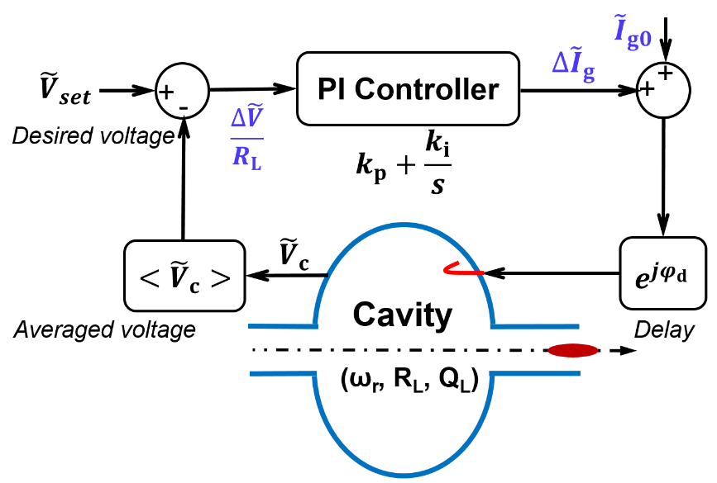
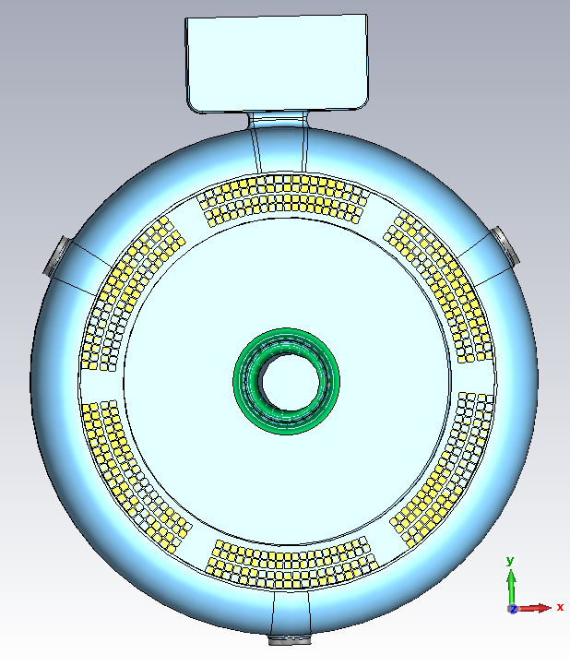
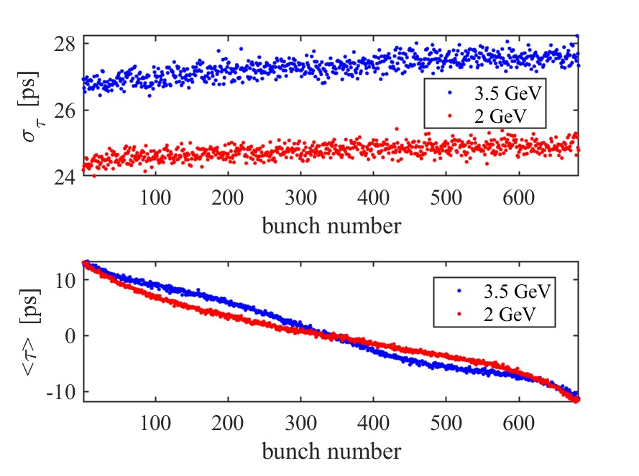
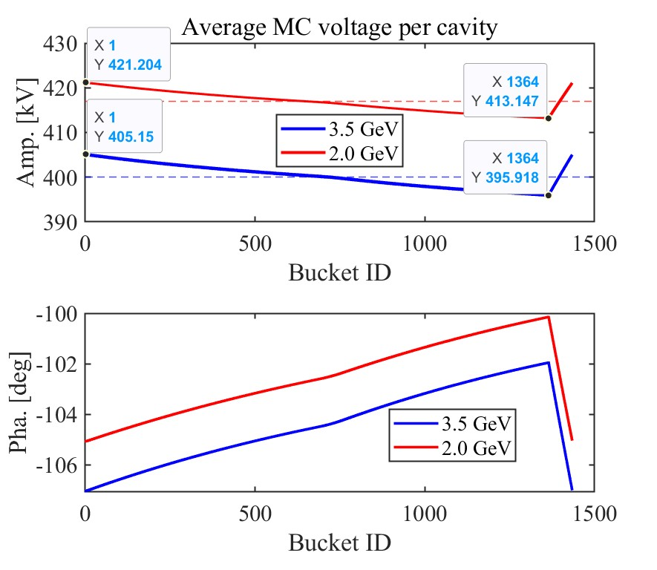
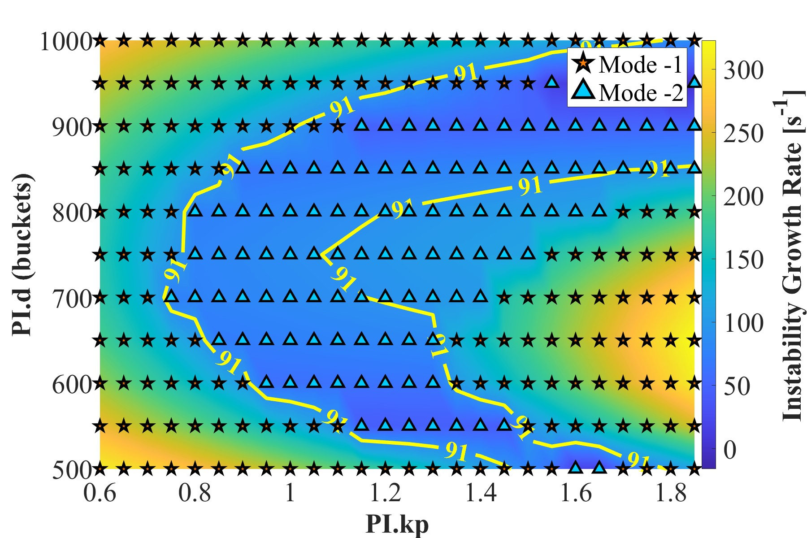
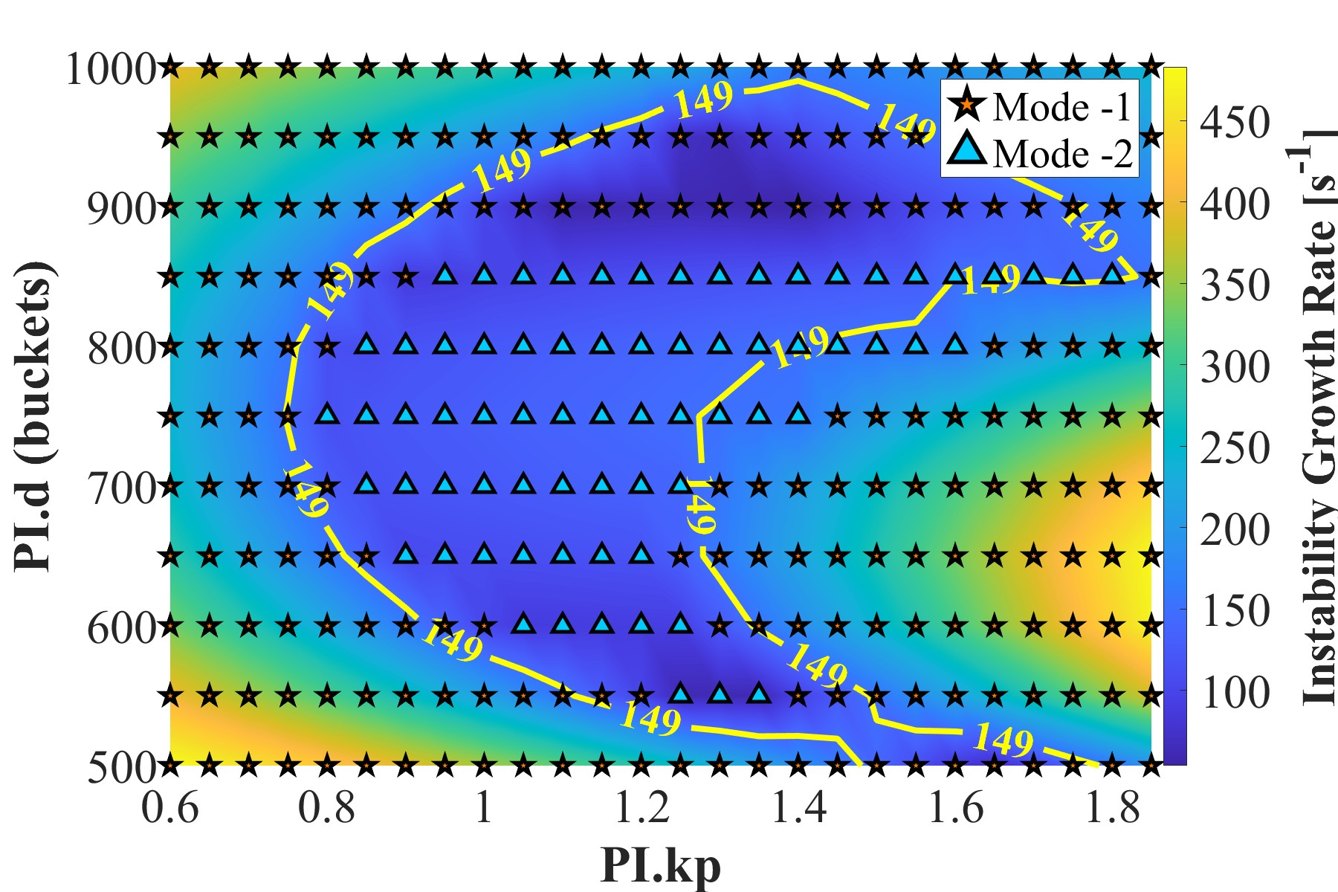
束-腔相互作用
详见何天龙报告
使用TM020常温高频腔：降低了总R/Q值，能够抑制由加速模驱动的低阶耦合模不稳定性。
在没有反馈的情况下，-1模存在显著风险。通过选取适当的PI反馈参数，成功使其稳定。
由5%填充间隙引起的瞬态束流负载效应仍在可控范围内，预计对亮度的的影响可忽略不计
TM020 HOM-damped cavity
PI Control
Bunch transients
Cavity voltage transients
@ 2 GeV w/ PI feedback
@ 3.5 GeV w/ PI feedback
W. Liang, T. He* et al., Beam instability induced by the RF Cavity accelerating modes and its suppression in the Super Tau-Charm Facility, Phys. Rev. Accel. Beams (已接收)

Slide 14
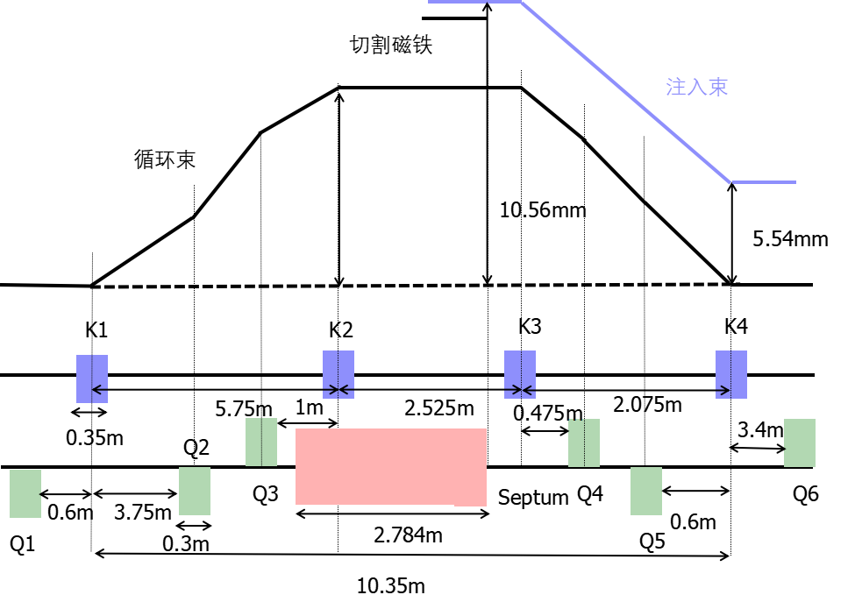
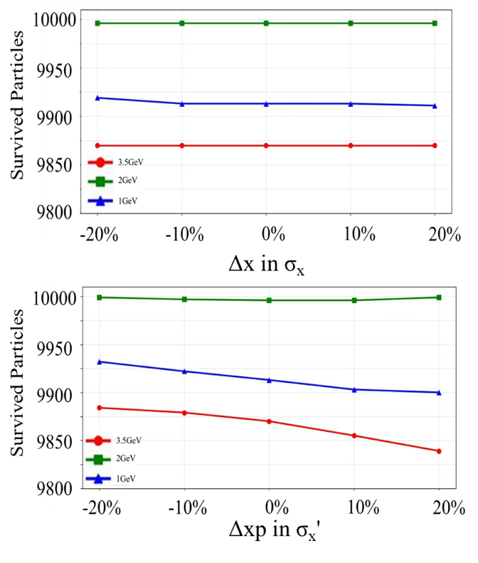
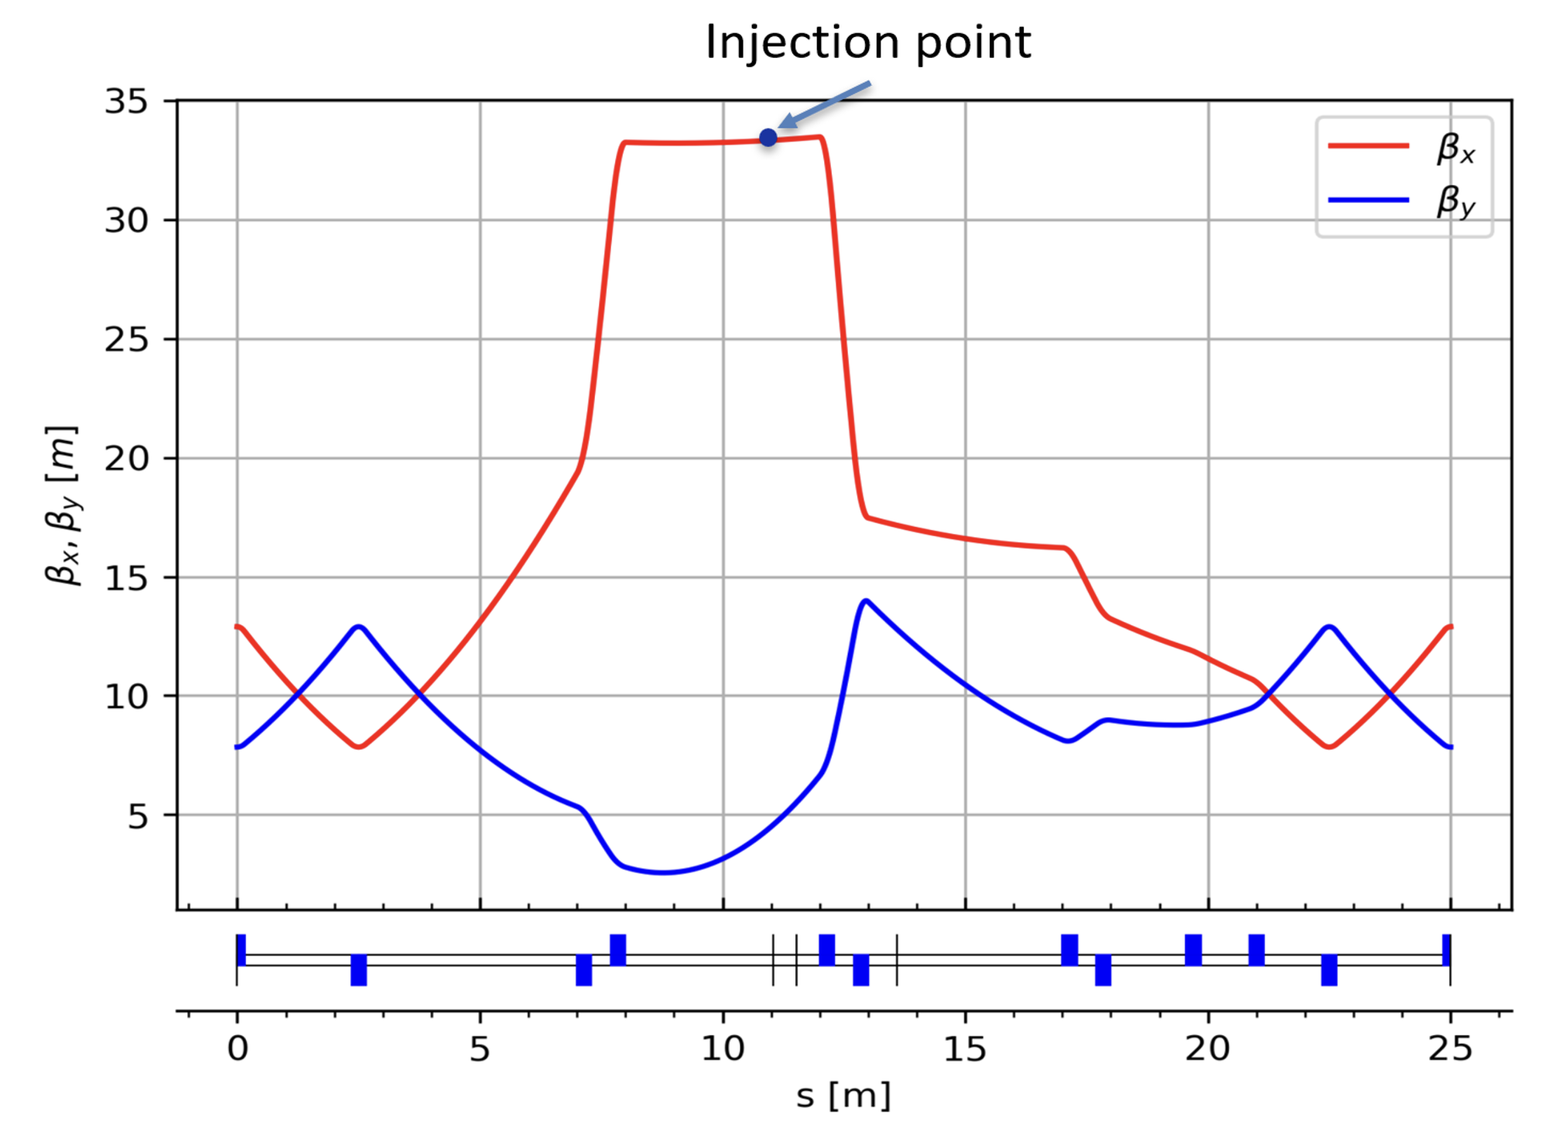
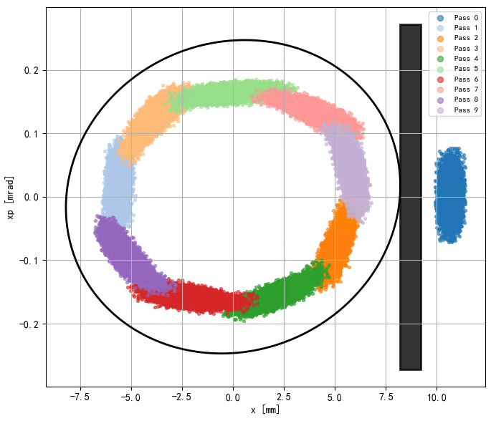
束流注入
兼容离轴注入与置换注入的光学设计
离轴注入方案作为基准方案。
局部凸轨系统（约5 mm），薄切割磁铁厚度（1 mm）
考虑注入点的抖动后，依旧有较高的注入效率（注入效率大于95%）
束束作用对注入效率的影响将在后续的模拟中考虑（Xsuite）
Phase space distribution for injection beam @ 2GeV

Slide 15
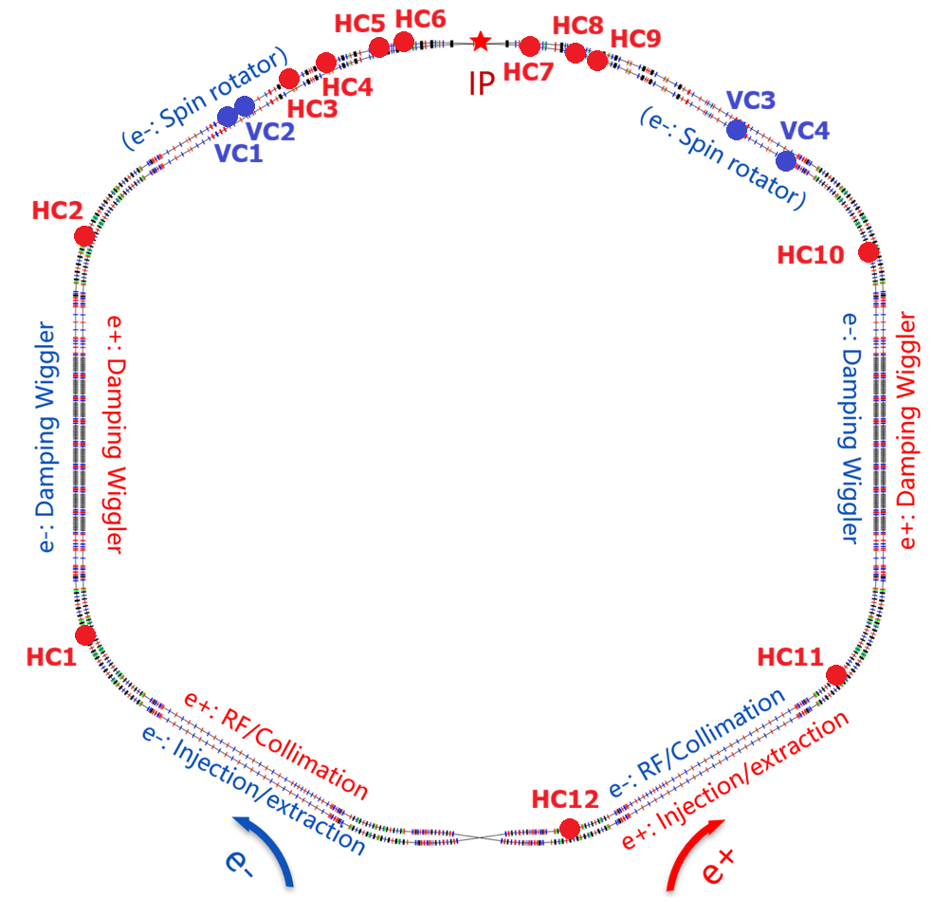
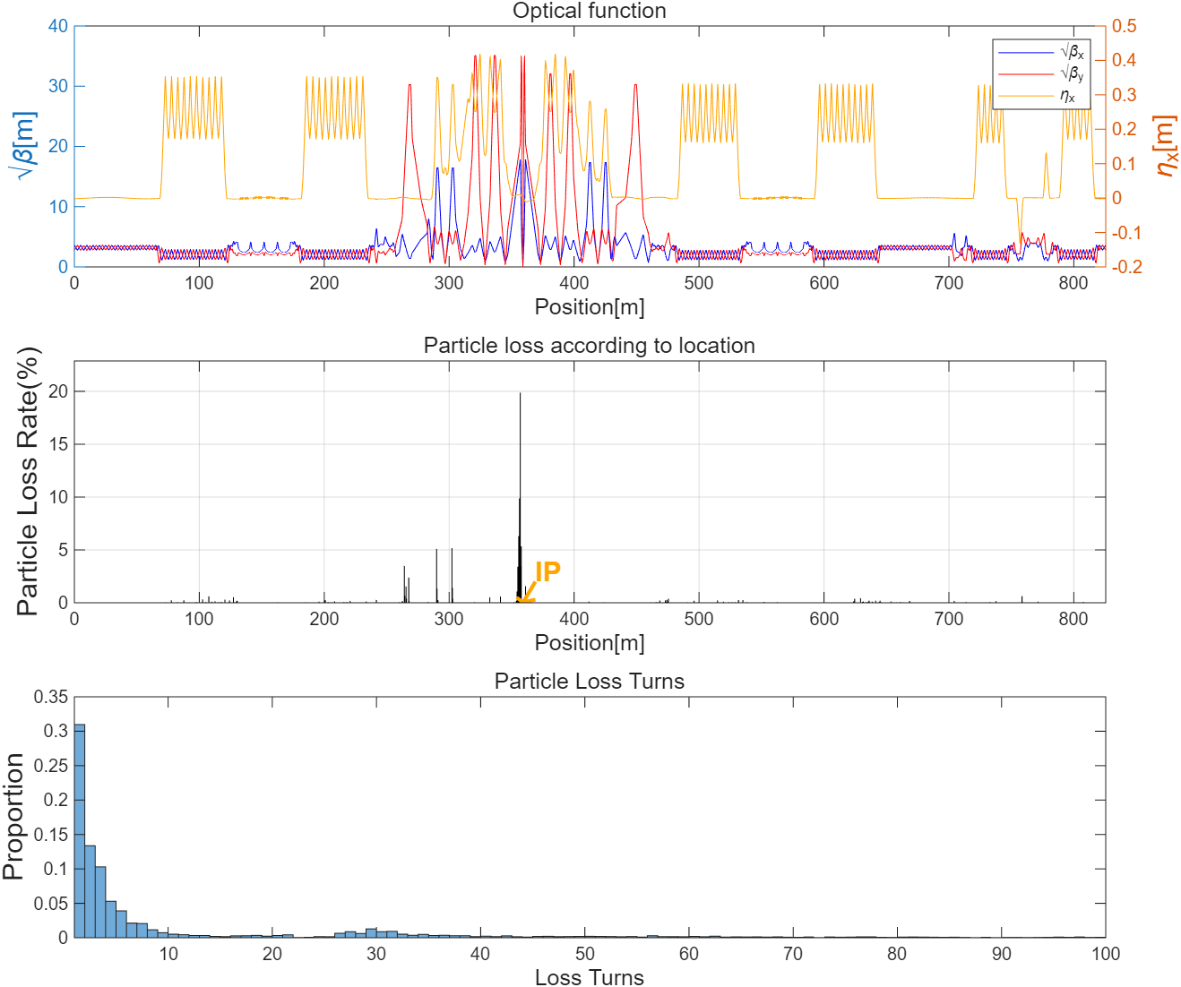
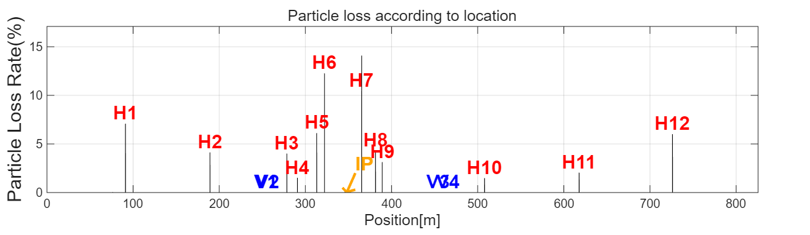
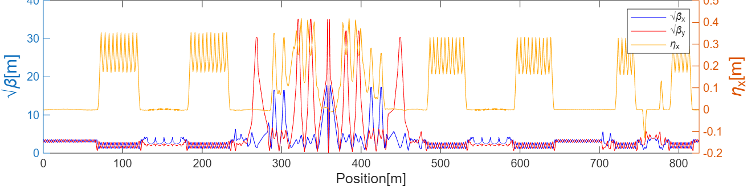
束流准直
束流准直系统：控制束流损失的关键方法
束流损失：对STCF极具挑战性（高亮度、短Touschek寿命）
Touschek散射效应：最重要的束流损失因素
无准直器时，约57.5%的粒子损失发生在IR（对撞区）
每个环（正负电子环）配备12个水平和4个垂直准直器，最小半间隙为7 mm
经过准直后，IP（对撞点）±20 m范围内的束流损失约为0.23%
准直效率达到99.39%
Without collimators
With collimators

Slide 16
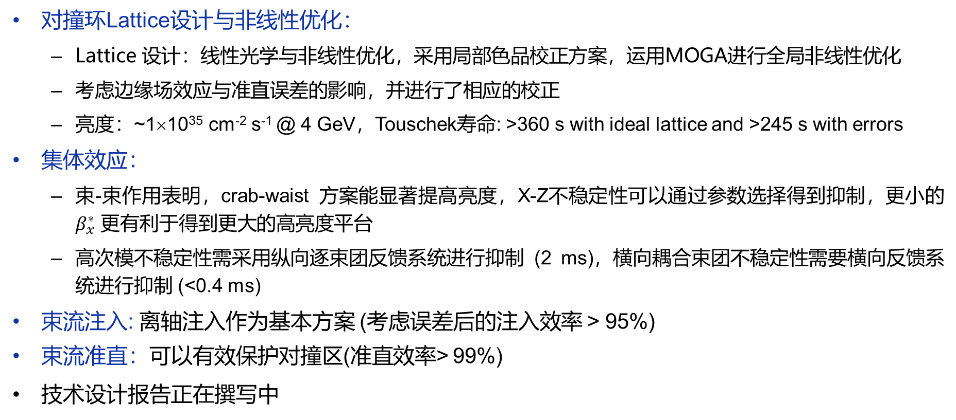
小 结
STCF goals: CoM energy 2~7 GeV, 0.5×10³⁵ cm⁻² s⁻¹ @ 4 GeV, Touschek lifetime > 200 s
对撞环Lattice设计与非线性优化：
  Lattice 设计：线性光学与非线性优化，采用局部色品校正方案，运用MOGA进行全局非线性优化
  考虑边缘场效应与准直误差的影响，并进行了相应的校正
  亮度：~1×10³⁵ cm⁻² s⁻¹ @ 4 GeV，Touschek寿命: >360 s with ideal lattice and >245 s with errors
集体效应：
  束-束作用表明，crab-waist 方案能显著提高亮度，X-Z不稳定性可以通过参数选择得到抑制，更小的 $β_{x}^{∗}$ 更有利于得到更大的高亮度平台
  高次模不稳定性需采用纵向逐束团反馈系统进行抑制 (2 ms)，横向耦合束团不稳定性需要横向反馈系统进行抑制 (<0.4 ms)
束流注入: 离轴注入作为基本方案 (考虑误差后的注入效率 > 95%)
束流准直：可以有效保护对撞区(准直效率> 99%)
技术设计报告正在撰写中

Slide 17
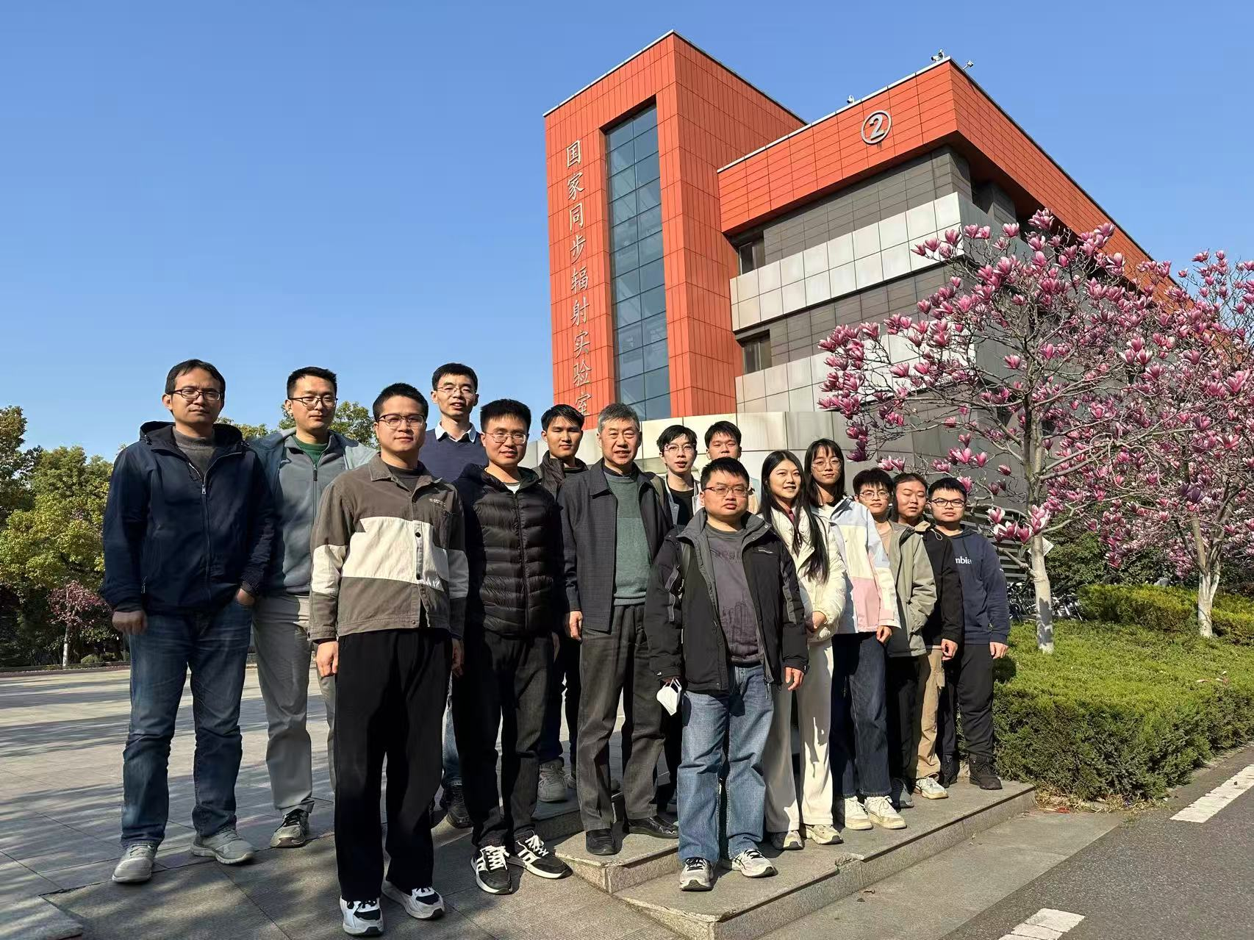




Acknowledgments
STCF collider ring accelerator physics group:
Jingyu Tang, Youjin Yuan, Qing Luo, Linhao Zhang, Demin Zhou (KEK), Weiwei Li, Tianlong He, Penghui Yang, Lei Wang, Tao Liu, Sangya Li, Yihao Mo, Ze Yu, Hangzhou Li, Hao Zhou, Mingxuan Chang, Jiancong Bao, Jiajun Gao, Wenshu Liang
Special thanks to:
Kuanjun Fan and Cheng-Ying Tsai, from HUST
Kazuhito Ohmi, from KEK
Pantaleo Raimondi, from CERN
Anton Bogomyagkov, from BINP

Slide 18
谢谢大家！请各位批评指正！

