Slide 1
ATLAS Phase-II Upgrade Thin-gap RPC
Front-End Electronics
1
Hao Liang
On behalf of the ATLAS China Muon team
University of Science and Technology of China

Slide 2
Outline
Background and Motivation
Characteristics of Thin-Gap RPCs
Front-End Electronics Schemes
Design Validation, Production Plan, and QA/QC
Summary

Slide 3
01
Background and Motivation

Slide 4
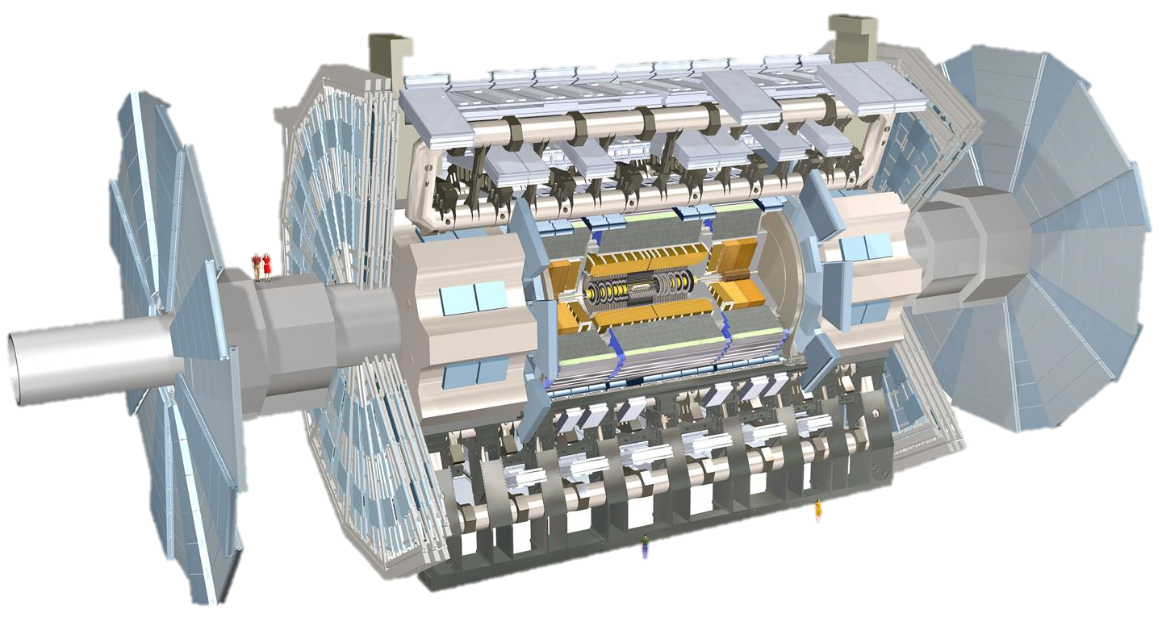
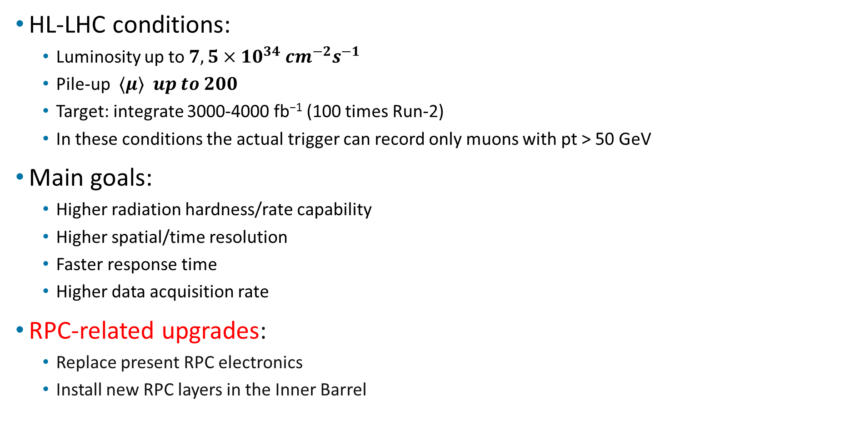
Upgrade of the ATLAS detector
HL-LHC conditions:
  Luminosity up to $7,5×{10}^{34}{ cm}^{−2}s^{−1}$
  Pile-up ⟨𝝁⟩ 𝒖𝒑 𝒕𝒐 𝟐𝟎𝟎
  Target: integrate 3000-4000 fb⁻¹ (100 times Run-2)
  In these conditions the actual trigger can record only muons with pt > 50 GeV
Main goals:
  Higher radiation hardness/rate capability
  Higher spatial/time resolution
  Faster response time
  Higher data acquisition rate
RPC-related upgrades:
  Replace present RPC electronics
  Install new RPC layers in the Inner Barrel

Slide 5
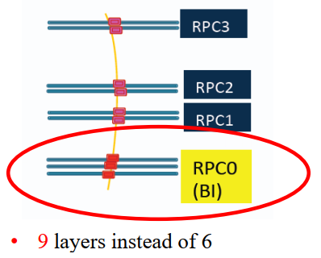
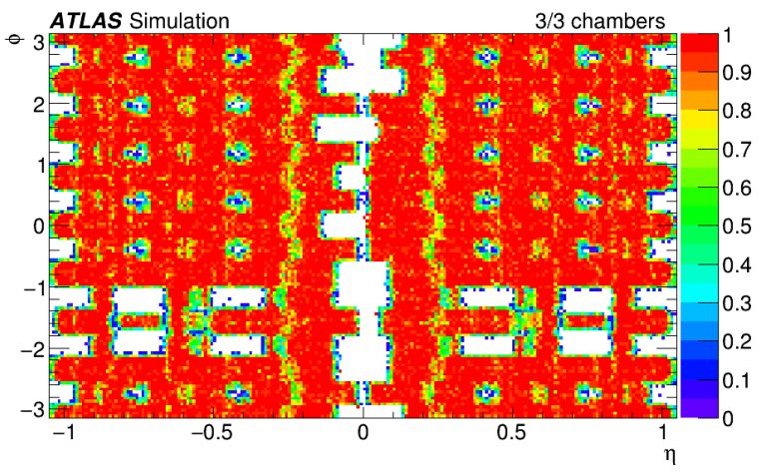
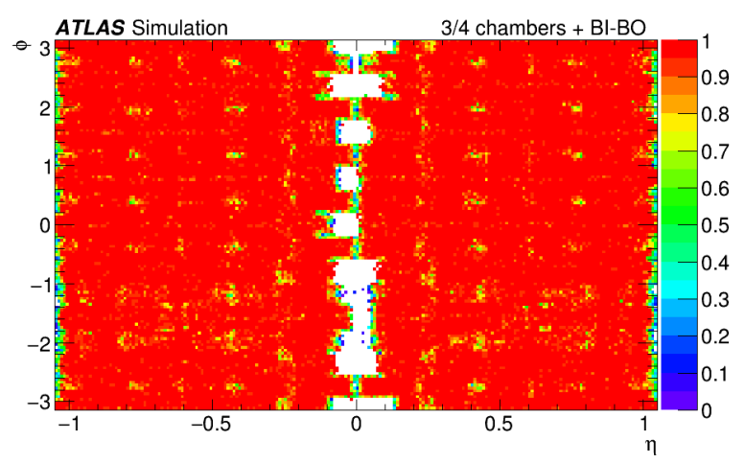
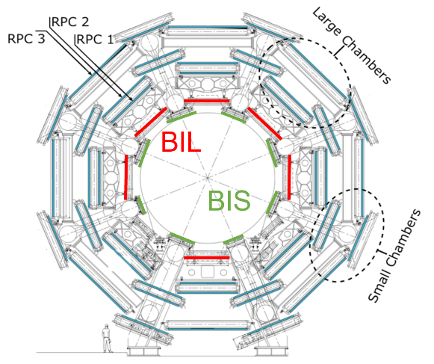
Muon RPC upgrade for Phase-II
Limitations of current RPC system
  Rate capability: ~ 100 Hz/cm²
  Lifetime: 10 years @ LHC → lower efficiency
  The acceptance holes due to support structures
The desire for additional BI layers for HL-LHC
  Three layers of RPC in BI region
  Thin-gap design with higher rate capability and longevity
  Fix most of the acceptance holes
  Increase redundancy and flexibility
678 singlets，1054 m² effective area
~70,000 electronics channels
Trigger efficiency：70% ➔ 90%
BOMBOR

Slide 6
02
Characteristics of Thin-Gap RPCs

Slide 7
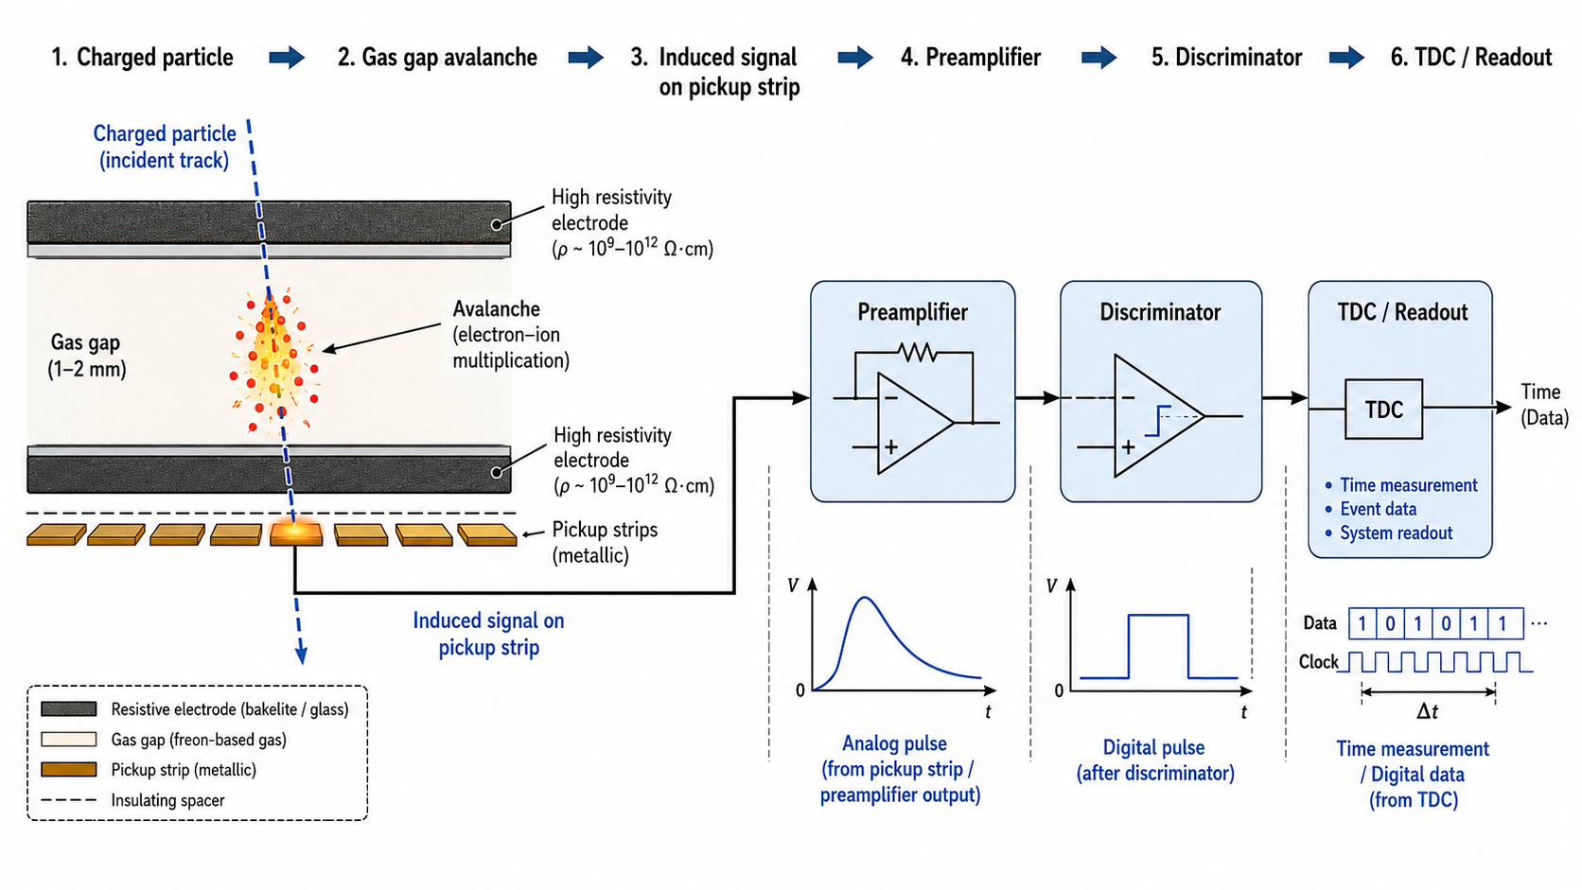
Signal Formation and Readout Chain
Notes:
高能物理实验中的首次大面积应用

Slide 8
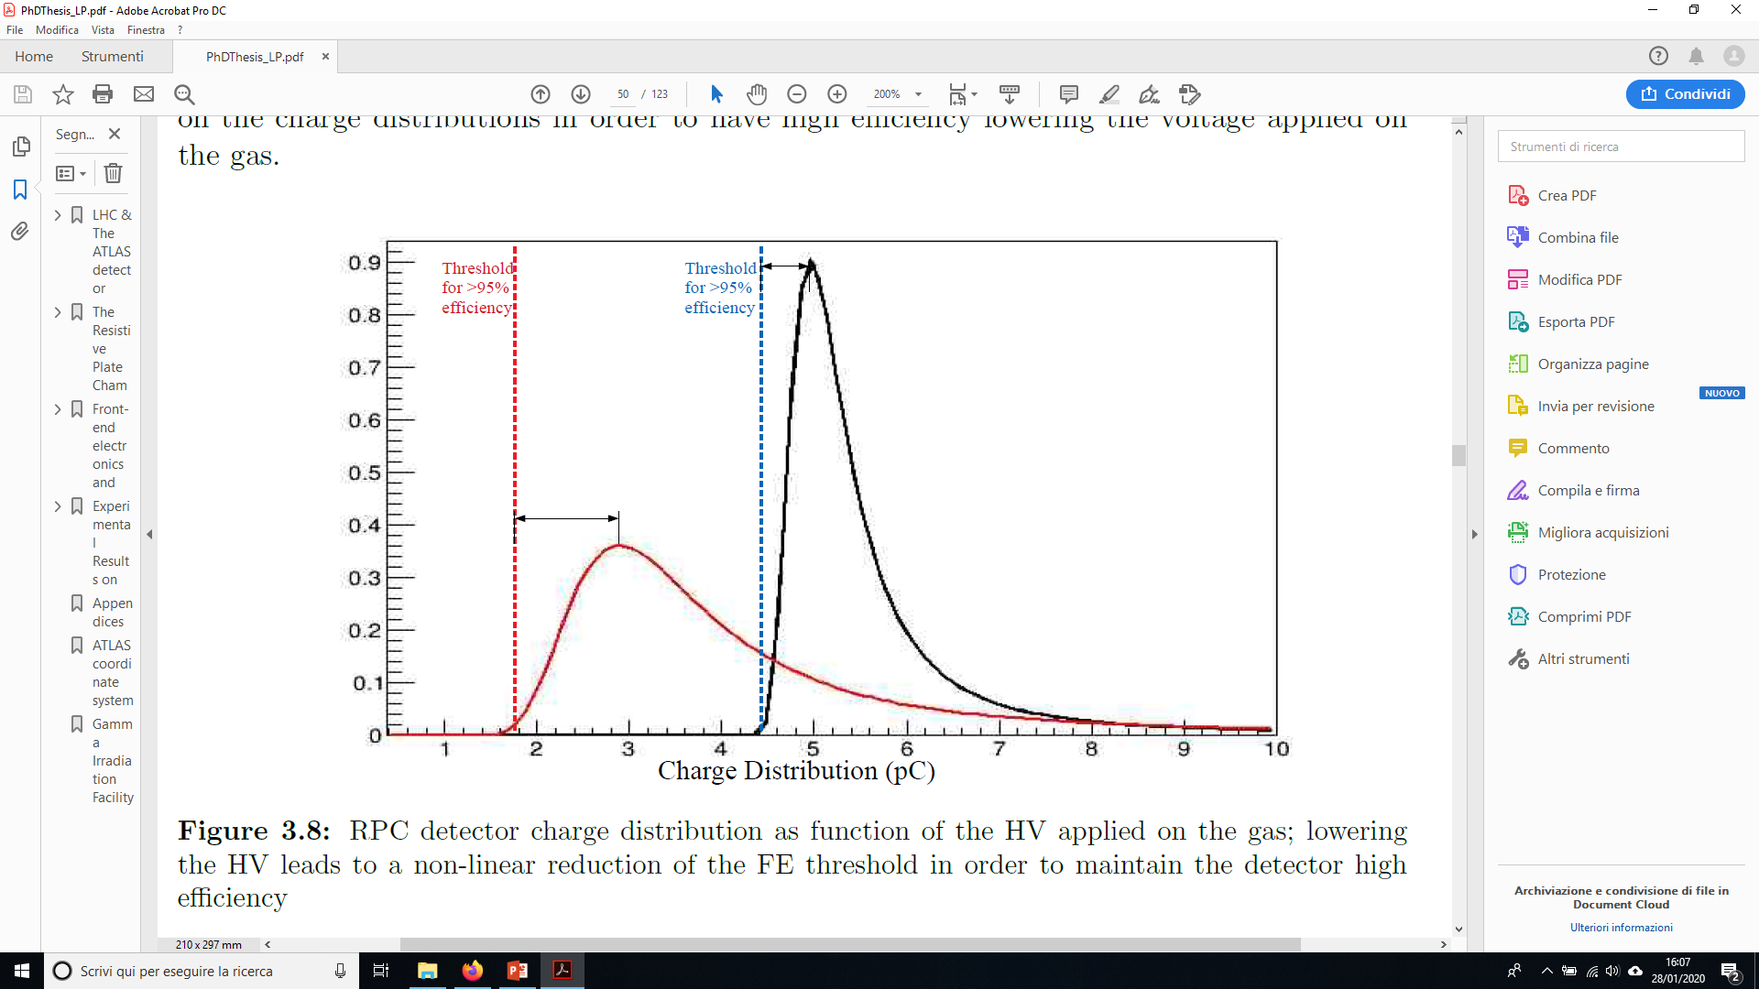
Technical scheme of thin-gap RPC detector
BI RPC singlet layout
Sketch of the RPC charge distribution
Low ε_{r} filler
Bakelite: 2 mm→1.5 mm
HV 1
HV 2
12 mm
HV 2 < HV 1
Gap size: 2 mm→1 mm
Counts
η,η ReadOut
Readout panel
Copper strip/GND
Bakelite electrode
Gas gap
Charge distribution (a.u.)
Detector change | Impact | FE requirement
Thinner bakelite | ↓ voltage drop, ↑ rate | Low noise, stable gain
1 mm gas gap | ↓ charge, ↑ lifetime | High gain, low threshold
Honeycomb panel | ↑ flatness, ↑ resolution | Impedance match, low reflection
η–η readout | Saves φ-side space | <100 ps TDC, low skew
Low-charge mode | ↓ ageing, ↑ rate | High SNR, stable threshold
Specifications：
  Rate：>1 kHz/cm²
  Longevity：>10y@HL-LHC
  Spatial resolution：<1 cm
  Time resolution：~ 0.5 ns
Takeaway: Thin-gap RPC improves rate capability and longevity, but requires a more sensitive and low-noise front-end.
Notes:
高能物理实验中的首次大面积应用

Slide 9
03
Front-End Electronics Schemes

Slide 10
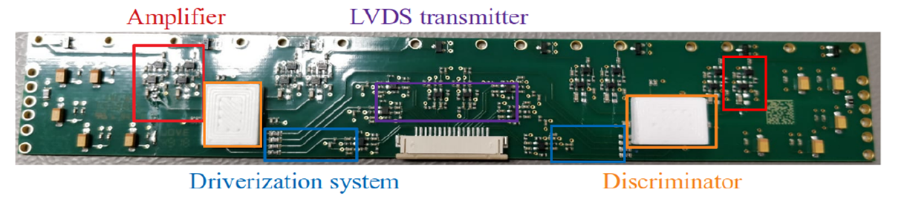
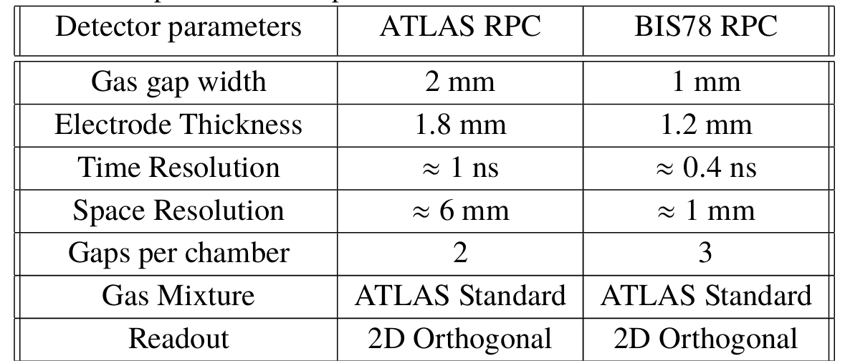
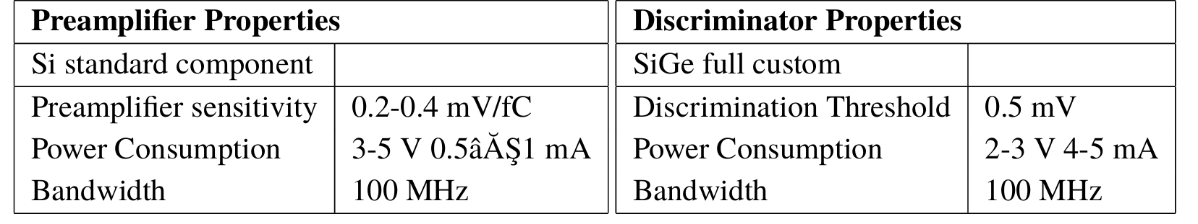
Scheme 1: BIS78 FE Board
Pilot Design for Thin-Gap RPC
Test results
Cosmic-ray result | >95% efficiency; ~330 ps corrected time resolution
Noise | 0.3–0.5 Hz/cm², below 1 Hz/cm² requirement
High-rate result | Up to ~9 kHz/cm² with low-threshold setting
Takeaway: BIS78 demonstrates that thin-gap RPCs can operate at much lower charge and higher rate only if the FE electronics provides very low threshold, high SNR, fast timing, and strong noise shielding.
Reference: L. Pizzimento, Performance of the BIS78 RPC detectors, arXiv:2006.09722, 2020.
Notes:
高能物理实验中的首次大面积应用

Slide 11
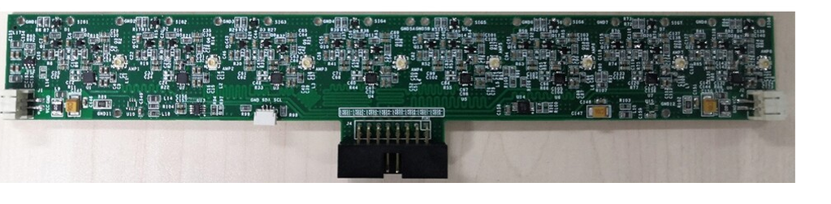
Scheme 2: Thin-Gap RPC FE
Target signal
• hundreds of μV • ~5 ns pulse • high rate
Front-end structure
RPC
strip
ESD
protection
18 Ω
matching
2-stage
BFP650 CE amp
Polarity
selection
LTC6754
discriminator
LVDS
output
Measured performance
82 V/V
0.4 mV/fC
154 MHz
<700 μV RMS
~10 ps
>20 MHz/ch
95%, 484 ps
Voltage gain
Charge gain
Bandwidth
Noise
Jitter
Rate
Cosmic test
Unique point
low-cost discrete SiGe:C solution (~$5/ch)
Meaning
electronics gain enables low-charge thin-gap RPC double-end readout
Reference: J. J. Ge et al., Development of a front-end electronics for thin-gap resistive plate chamber, JINST 16, T11004, 2021.
Notes:
高能物理实验中的首次大面积应用

Slide 12
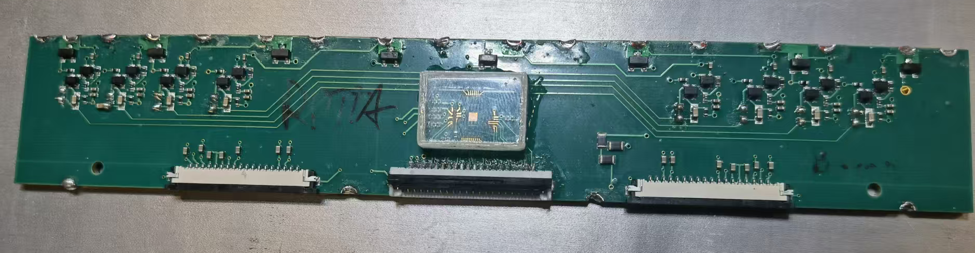
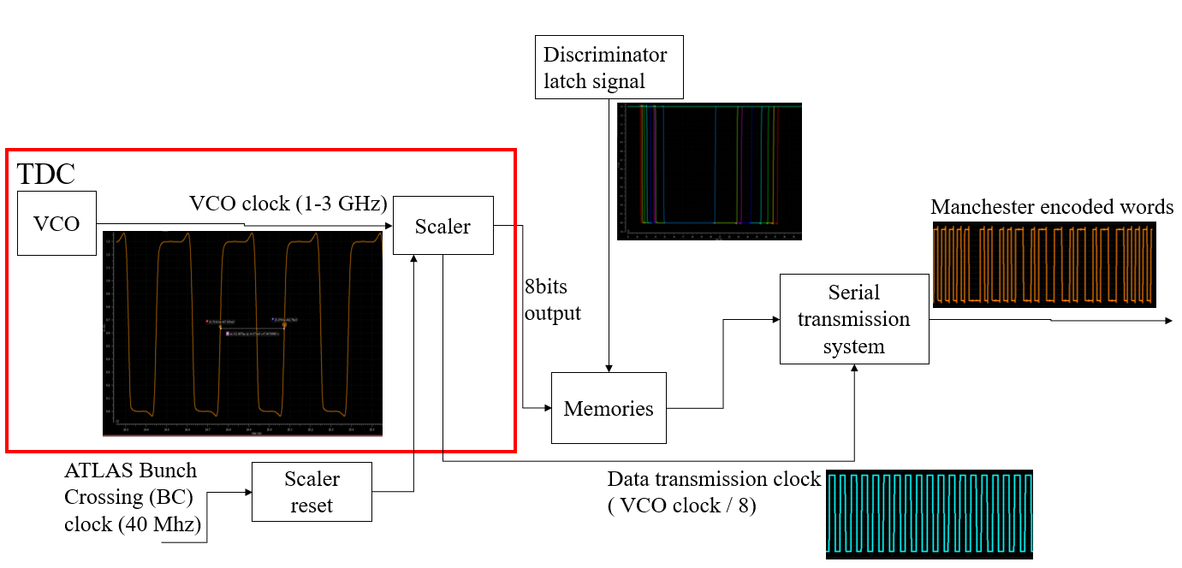
Scheme 3: ATLAS BI FE — Mixed Si-BJT + SiGe ASIC
RPC
Induced signal
FE board
FE ASIC
Signal
for the
DAQ
Serializer, Manchester encoder,
Driver
Si-BJT preamplifier
Si-Ge HBT
discriminator
Si-Ge HBT
TDC
Test Results
Low threshold: 1–2 fC effective charge threshold.
Rate capability: up to ~10 kHz/cm².
Timing: ~80 ps resolution.
Radiation tolerance: ToT and VCO responses remain stable after 10¹³ n/cm² irradiation.
Significance
The work proves that thin-gap RPCs can operate with lower avalanche charge while maintaining high rate capability, precise timing, and radiation-tolerant readout for ATLAS Phase-II.
ASIC Overview
Source: Luca Pizzimento, ATL-MUON-SLIDE-2024-412; NIM A 1069, 169892 (2024).
Notes:
高能物理实验中的首次大面积应用

Slide 13
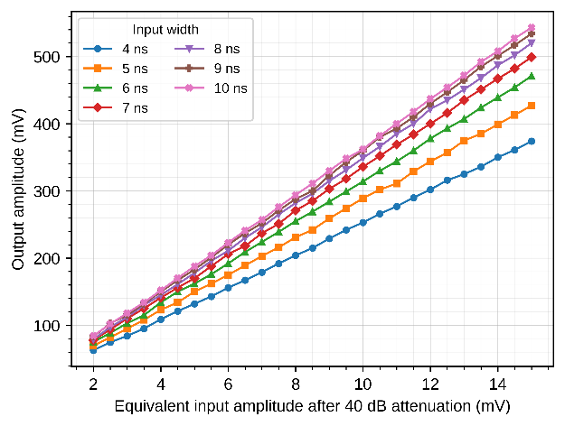
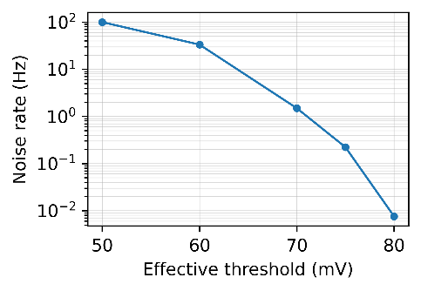
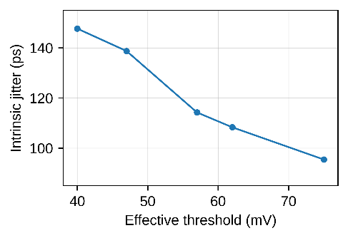
Scheme 4: USTC Discrete Prototype
8-channel board-level platform
  One-stage current-feedback gain
  Programmable threshold + LVDS output
  FPGA Fast-OR for trigger studies
Key test results
Unique points
- Combines analog gain, DAC threshold and FPGA logic on one board
- Accessible prototype platform: easy threshold scans, debugging and Fast-OR studies
2–15 mV
24.1–35.5 V/V
75–85 mV
linear input range
voltage gain
low-noise region
0.05 Hz
<100 ps
3.907 ns
noise rate @ 79 mV
jitter @ 75 mV
Fast-OR latency
A practical bridge between discrete transistor FE studies and fully integrated ASIC readout.
Notes:
高能物理实验中的首次大面积应用

Slide 14
03
Design Validation, Production Plan, and QA/QC

Slide 15
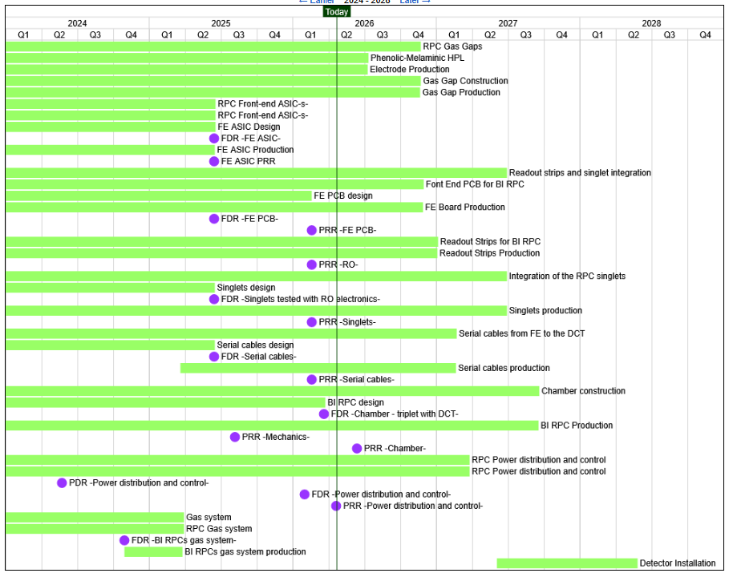
Design Validation, Production Plan, and QA/QC
The FEB addressed issues
  Delay of the board design and test → USTC offered an FPGA readout system for FEE test.
  Fine-tune the working parameters and extra Faraday cage shielding for noise control.
  Restrictions of chips to USTC → FE board procured by USTC & chip bonding by HK.
China contributions
FE board: 5000 (>50%)
“the backup solution”
RPC
Induced signal
FE board
FE ASIC
Signal
for the
DAQ
Serializer, Manchester encoder,
Driver
Si-BJT preamplifier
Si-Ge HBT
discriminator
Si-Ge HBT
TDC
Qualification method of the FEE – Done
FEE production and qualification – 1000 pre-production
  Mass production will start after the Review in June.
  To be finished by the end of 2026.
Notes:
高能物理实验中的首次大面积应用

Slide 16
05
Summary

Slide 17
Summary and Outlook
Motivation
Phase-II RPC upgrade targets higher rate capability, reduced acceptance holes and a more powerful muon trigger.
Detector impact
Thin-gap RPCs improve rate and ageing performance but make the signal smaller, faster and more sensitive to electronics noise.
FE priority
The front end must deliver high SNR, stable thresholds, precise timing, low latency and full-data readout compatibility.
Next steps
Finalize architecture, validate with detectors, close timing/noise margins, and implement production-grade QA/QC.
Outlook: use detector-level efficiency, noise occupancy, timing and integration tests to converge on the final FE design and production plan.
Notes:
高能物理实验中的首次大面积应用

Slide 18
Thanks!
Questions and suggestions are welcome.
July 2, 2026
20

