Slide 1

CEPC ECAL Energy Resolution
李想
2025.1.6
Notes:
Today, I will present my work on improving the ECAL energy resolution using machine learning.

Slide 2
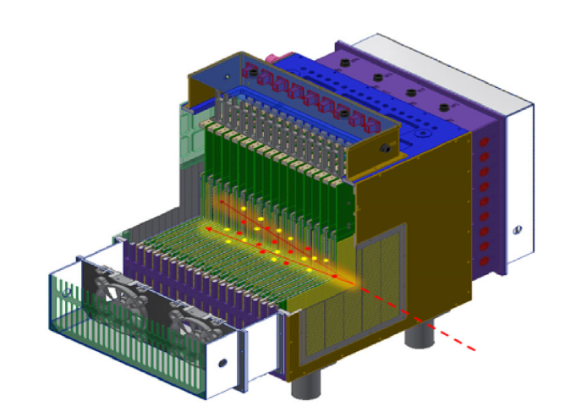
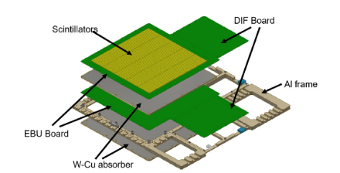
ScW-ECAL：
Super-layer
Scintillaters+W-Cu absorber+EBU Bord+DIF Bord+AI frame
Prototype
Over 22 radiation lengths (X₀)
32 super-layer
Transverse sensitive area dimensions of approximately 22 × 22 cm²
Target energy resolution：better than ∼ 15% /√E [GeV]
Notes:
So, the motivation is to improve the ECAL energy resolution using an MLP.
Here is my strategy: I take the layer-wise energies as inputs and train the model to predict the true particle energy. In the end, I compare the MLP's resolution and linearity with the standard energy-sum method to see the improvement.

Slide 3
motivation：
Attempt to improve the ECAL energy resolution using an MLP
strategy:
Use the layer-wise energy feature as inputs;
Layer level data:Train an MLP;
Hit level data: Train a CNN+LSTM+Attention;
Evaluate the performance in terms of energy resolution and linearity, and compare with the standard energy-sum method.
Notes:
So, the motivation is to improve the ECAL energy resolution using an MLP.
Here is my strategy: I take the layer-wise energies as inputs and train the model to predict the true particle energy. In the end, I compare the MLP's resolution and linearity with the standard energy-sum method to see the improvement.

Slide 4
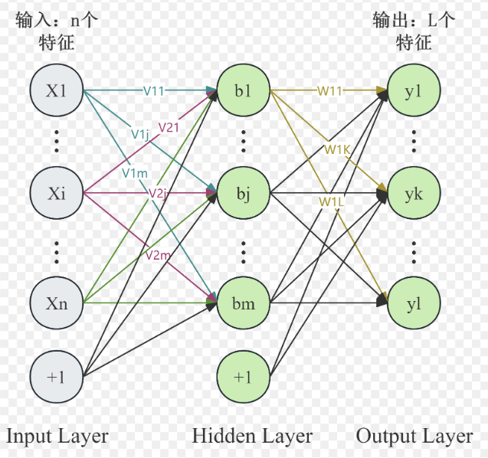
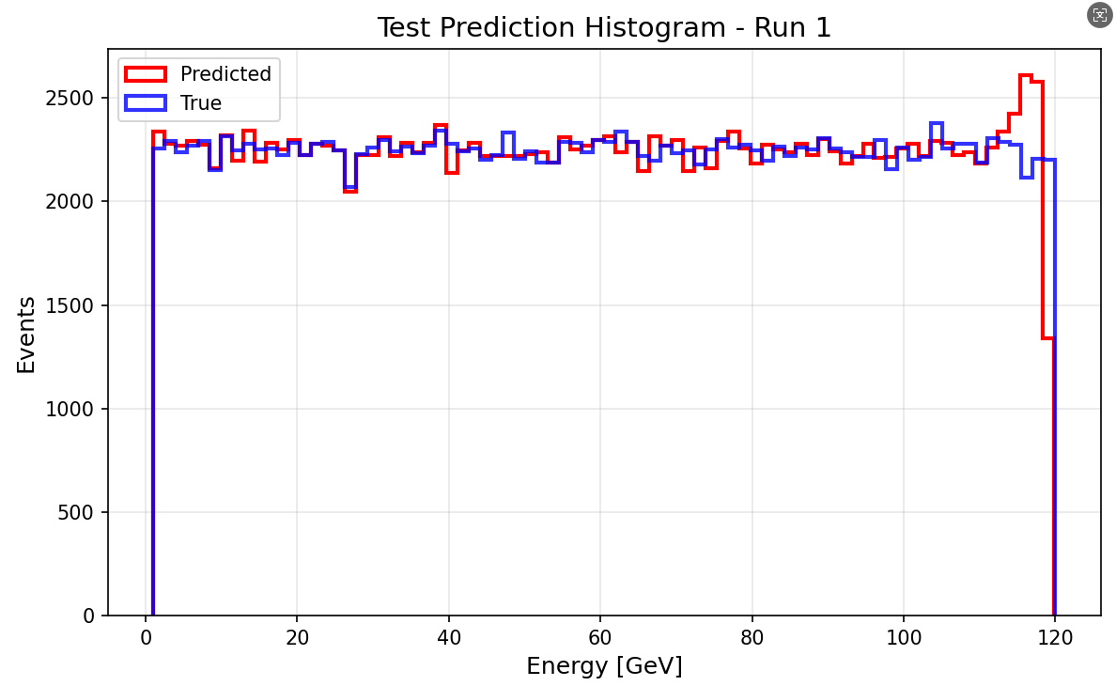
M(ulti) L(ayer) P(erceptron) Trian
Input:
  Energy(E) of per layer(32)
  Hit_no(N) of per layer(32)
  E/N of perlayer(32)
  Total_deposited_energy(1)
Output:
  Predicted Energy
Samples:
MC: 1-120GeV (12000000) Continuous
Data split
train_frac = 0.7
val_frac = 0.15
test_frac = 0.15
[1024,512,256,128]
lr =0.5e-4
batch_size =64
epochs =100
weight_decay =1e-4
optimizer ="adamw"
Input and Output（rellative error <2%）
Notes:
This slide shows the MLP we use for ECAL energy reconstruction.
As inputs, we use the energy deposited in each ECAL layer, the number of hits per layer, the energy per hit, and also the total deposited energy.
These inputs describe how the electromagnetic shower develops along the detector.
The model is trained on Monte Carlo samples from 1 to 35 GeV, with about 120,000 events，which were divided into training, validation, and test sets.

Slide 5
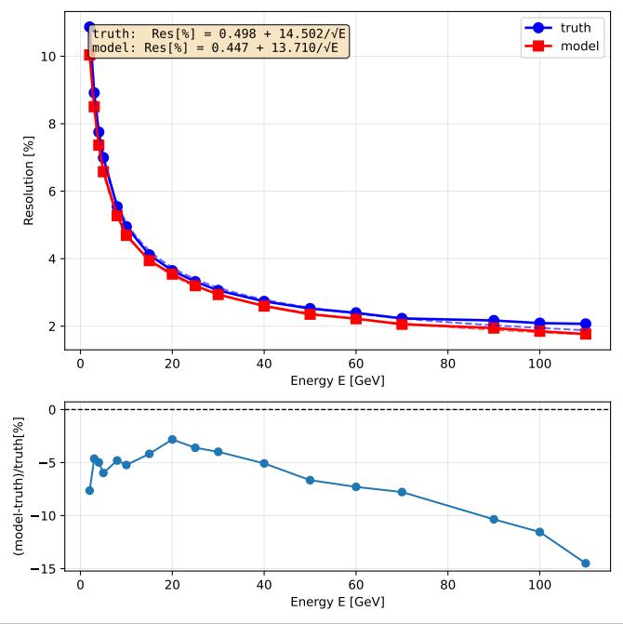
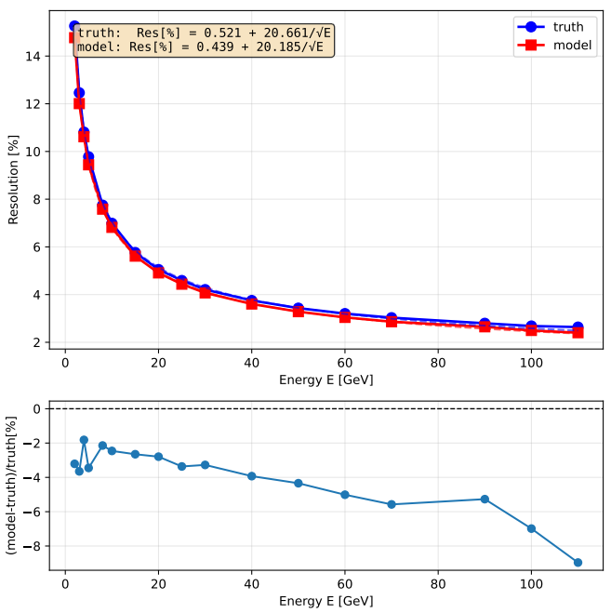
M(ulti) L(ayer) P(erceptron) Result ECAL & HCAL
Energy Resolution ECAL
Energy Resolution HCAL
Improvement:
discrete energy points: 7%
total resolution boost: 6%
Improvement:
discrete energy points: 5%
total resolution boost: 2%
Discrete energy points：
[2.0, 3.0, 4.0, 5.0, 6.0, 7.0, 8.0, 9.0, 10.0, 15.0, 20.0, 25.0, 30.0, 40.0, 50.0, 60.0, 70.0, 80.0, 90.0, 100.0, 110.0]GeV
Truth = Total deposited energy (MC)
Notes:
As you can see here, the MLP model gives much better energy resolution than the baseline, which I labeled as 'truth'. If you look at the bottom panel,we see a consistent improvement of about 5% across discrete energy points. Overall, this gives us a total resolution boost of 9%.

Slide 6
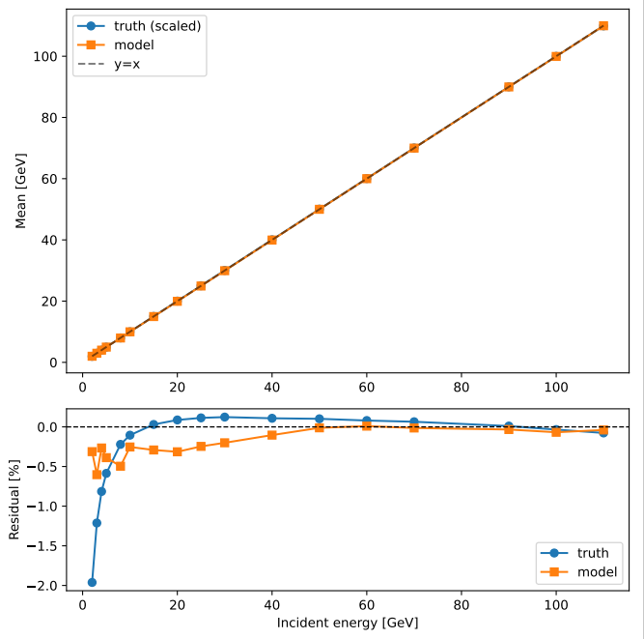
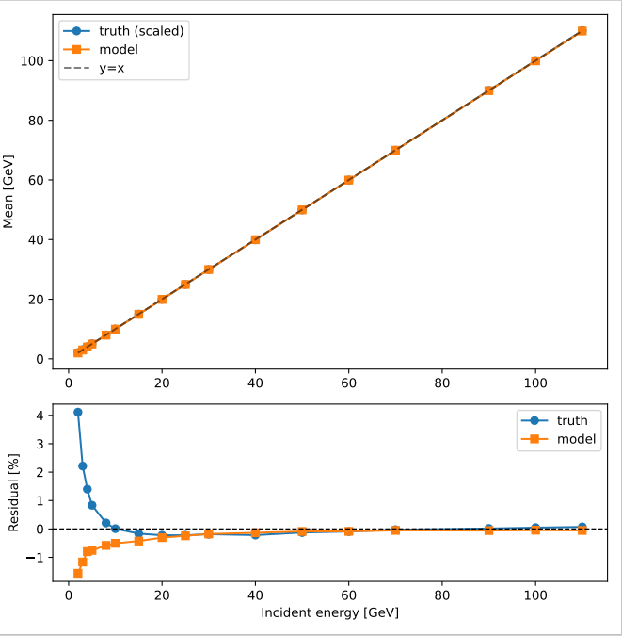
M(ulti) L(ayer) P(erceptron) Result ECAL & HCAL
Linearity ECAL
Linearity HCAL
Improvement:
discrete energy points: 5%
total resolution boost: 2%
Discrete energy points：
[2.0, 3.0, 4.0, 5.0, 6.0, 7.0, 8.0, 9.0, 10.0, 15.0, 20.0, 25.0, 30.0, 40.0, 50.0, 60.0, 70.0, 80.0, 90.0, 100.0, 110.0]GeV
Truth = Total deposited energy (MC)
Notes:
As you can see here, the MLP model gives much better energy resolution than the baseline, which I labeled as 'truth'. If you look at the bottom panel,we see a consistent improvement of about 5% across discrete energy points. Overall, this gives us a total resolution boost of 9%.

Slide 7
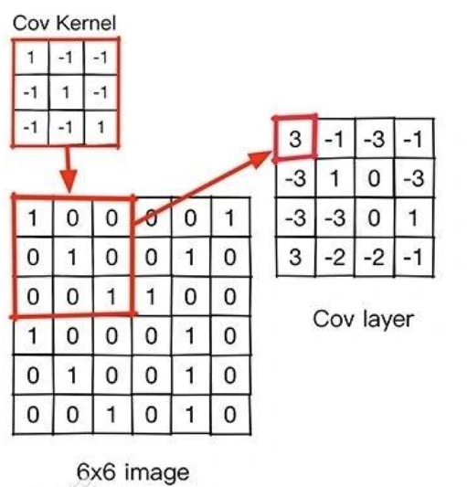
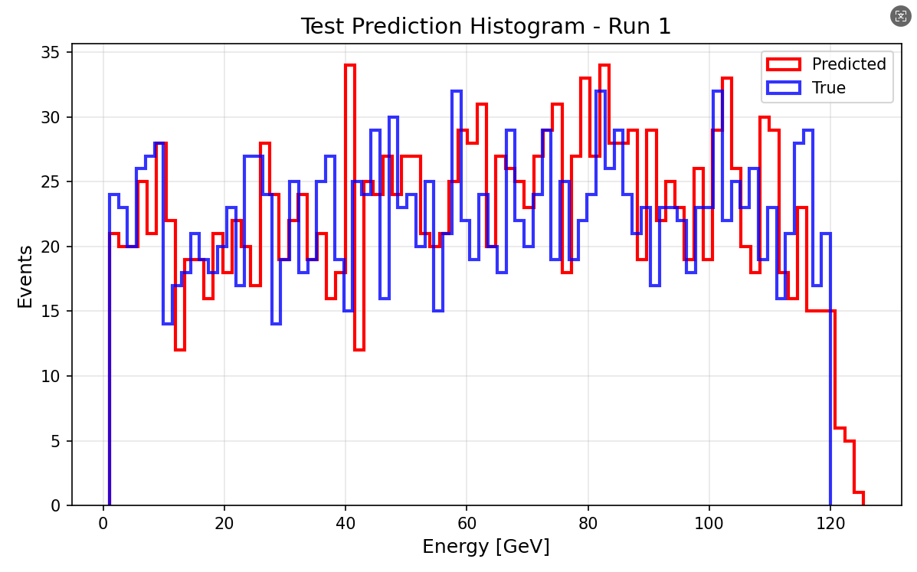
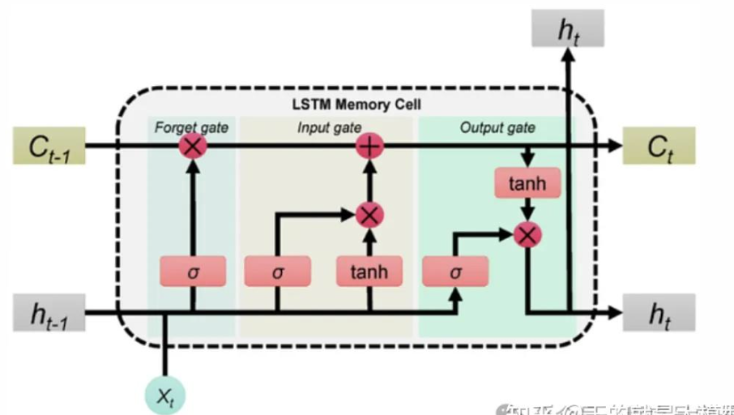
CNN+LSTM Trian (12000)
Input:
HIt_ENERGY
Output:
  Predicted Energy
CNN (Convolutional Neural Network)
(12000)
MC: 1-120GeV (12000) Continuous
Data split
train_frac = 0.7
val_frac = 0.15
test_frac = 0.15
Read the hit image of the super layer
LSTM (Long Short-Term Memory)
Learn the development of clusters at different levels
lr =1e-4
batch_size =256
epochs =150
weight_decay =1e-4
optimizer ="adamw"
Input and Output（rellative error <2%）
Notes:
This slide shows the MLP we use for ECAL energy reconstruction.
As inputs, we use the energy deposited in each ECAL layer, the number of hits per layer, the energy per hit, and also the total deposited energy.
These inputs describe how the electromagnetic shower develops along the detector.
The model is trained on Monte Carlo samples from 1 to 35 GeV, with about 120,000 events，which were divided into training, validation, and test sets.

Slide 8
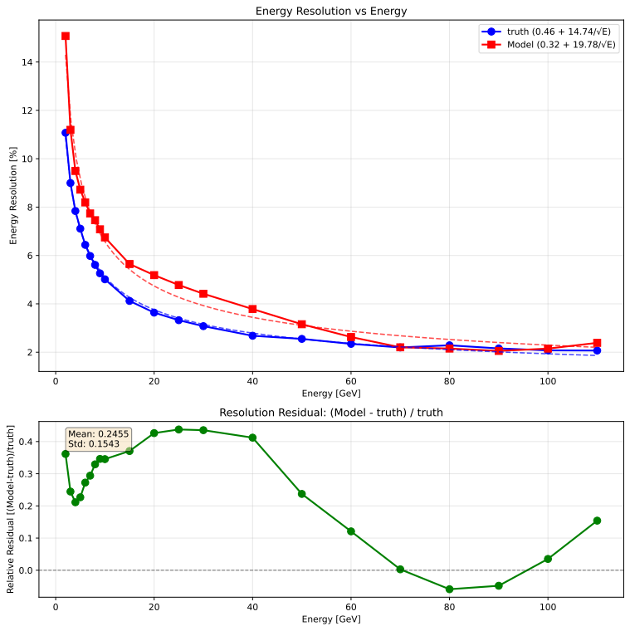
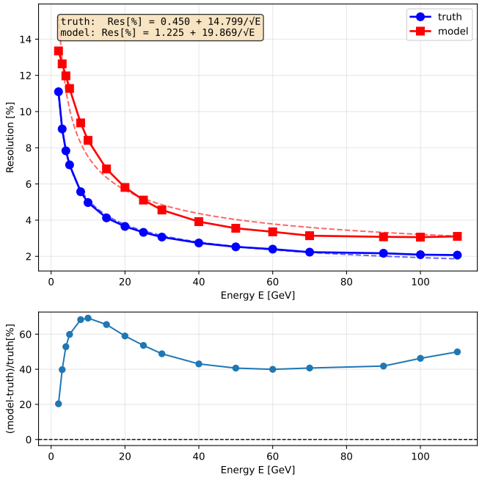
CNN+LSTM Result VS MLP ECAL (12000)
Energy Resolution CNN+LSTM
Energy Resolution MLP
Discrete energy points：
[2.0, 3.0, 4.0, 5.0, 6.0, 7.0, 8.0, 9.0, 10.0, 15.0, 20.0, 25.0, 30.0, 40.0, 50.0, 60.0, 70.0, 80.0, 90.0, 100.0, 110.0]GeV
Truth = Total deposited energy (MC)
Notes:
As you can see here, the MLP model gives much better energy resolution than the baseline, which I labeled as 'truth'. If you look at the bottom panel,we see a consistent improvement of about 5% across discrete energy points. Overall, this gives us a total resolution boost of 9%.

Slide 9
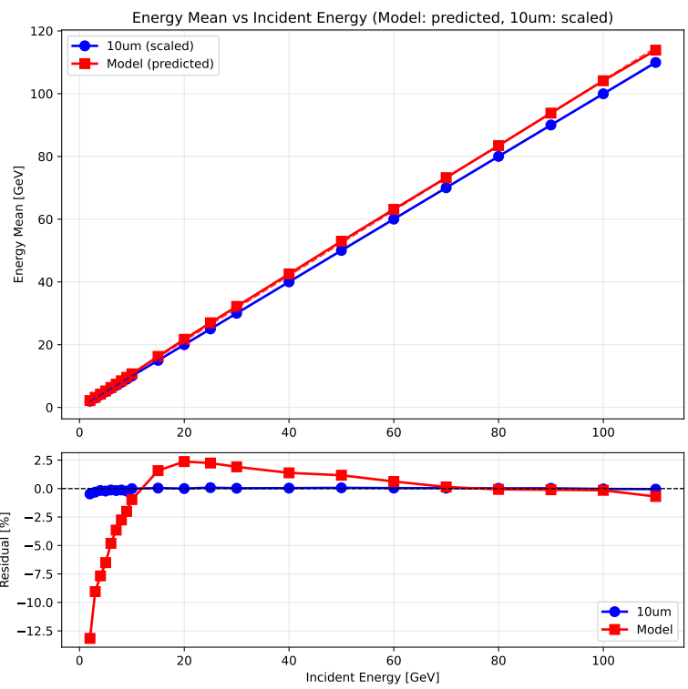
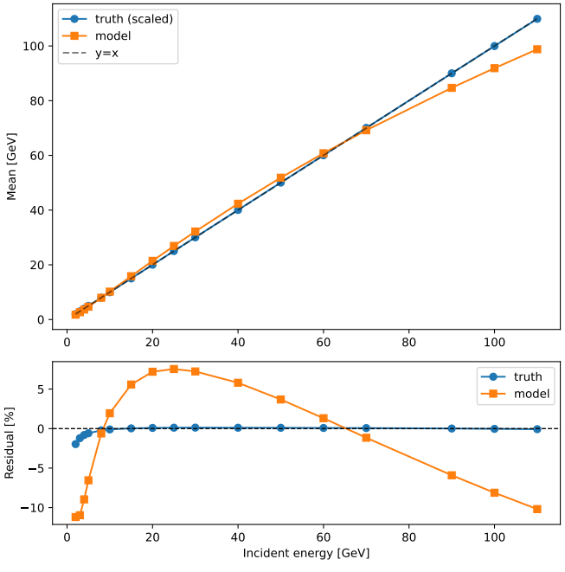
CNN+LSTM Result VS MLP ECAL (12000)
Linearity CNN+LSTM
Linearity MLP
Discrete energy points：
[2.0, 3.0, 4.0, 5.0, 6.0, 7.0, 8.0, 9.0, 10.0, 15.0, 20.0, 25.0, 30.0, 40.0, 50.0, 60.0, 70.0, 80.0, 90.0, 100.0, 110.0]GeV
Truth = Total deposited energy (MC)
Notes:
As you can see here, the MLP model gives much better energy resolution than the baseline, which I labeled as 'truth'. If you look at the bottom panel,we see a consistent improvement of about 5% across discrete energy points. Overall, this gives us a total resolution boost of 9%.

Slide 10
Summary
The hit-level CNN+LSTM architecture demonstrates significant potential;
The sample size remains a decisive factor for the performance of such machine learning models.
Next step
CNN+LSTM run sample 1200000
Try Tramsformer
Notes:
The application of an MLP to the ECAL energy reconstruction resulted in an approximate 9% improvement in energy resolution. However, the energy linearity did not exhibit a similar enhancement. In the next step, we aim to improve the energy linearity. To achieve this, we plan to extend the training energy range to 80 GeV.

Slide 11
M(ulti) L(ayer) P(erceptron) Result ECAL
Linearity
Discrete energy points：
[2.0, 3.0, 4.0, 5.0, 6.0, 7.0, 8.0, 9.0, 10.0, 15.0, 20.0, 25.0, 30.0, 40.0, 50.0, 60.0, 70.0, 80.0, 90.0, 100.0, 110.0]GeV
Truth = Total deposited energy (MC)
Improvemented
Notes:
In contrast to the resolution, no comparable enhancement was observed in the energy linearity.

Slide 12
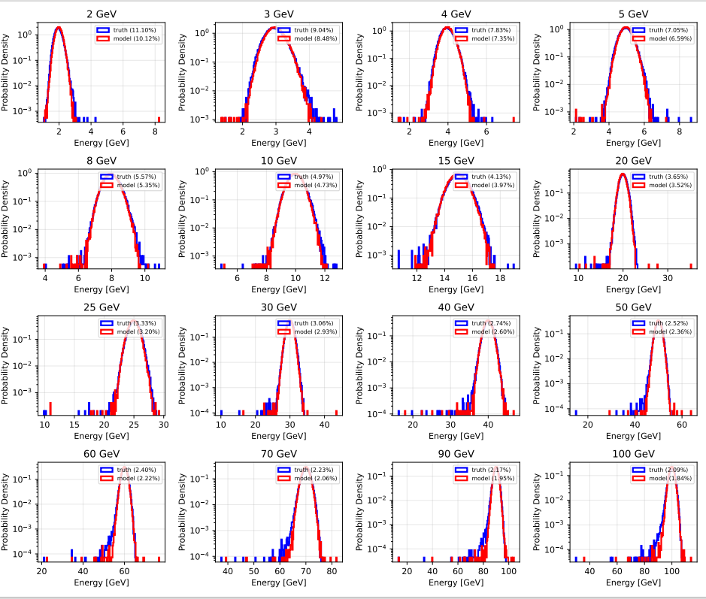
M(ulti) L(ayer) P(erceptron) Result ECAL
Truth = Total deposited energy (MC)
Notes:
In contrast to the resolution, no comparable enhancement was observed in the energy linearity.

Slide 13
M(ulti) L(ayer) P(erceptron) Result HCAL
Energy Resolution
Discrete energy points：
[2.0, 3.0, 4.0, 5.0, 6.0, 7.0, 8.0, 9.0, 10.0, 15.0, 20.0, 25.0, 30.0, 40.0, 50.0, 60.0, 70.0, 80.0, 90.0, 100.0, 110.0]GeV
Truth = Total deposited energy (MC)
Improvement:
discrete energy points: 5%
total resolution boost: 2%
Notes:
As you can see here, the MLP model gives much better energy resolution than the baseline, which I labeled as 'truth'. If you look at the bottom panel,we see a consistent improvement of about 5% across discrete energy points. Overall, this gives us a total resolution boost of 9%.

Slide 14
M(ulti) L(ayer) P(erceptron) Result HCAL
Linearity
Discrete energy points：
[2.0, 3.0, 4.0, 5.0, 6.0, 7.0, 8.0, 9.0, 10.0, 15.0, 20.0, 25.0, 30.0, 40.0, 50.0, 60.0, 70.0, 80.0, 90.0, 100.0, 110.0]GeV
Truth = Total deposited energy (MC)
Improvemented
Notes:
In contrast to the resolution, no comparable enhancement was observed in the energy linearity.

Slide 15
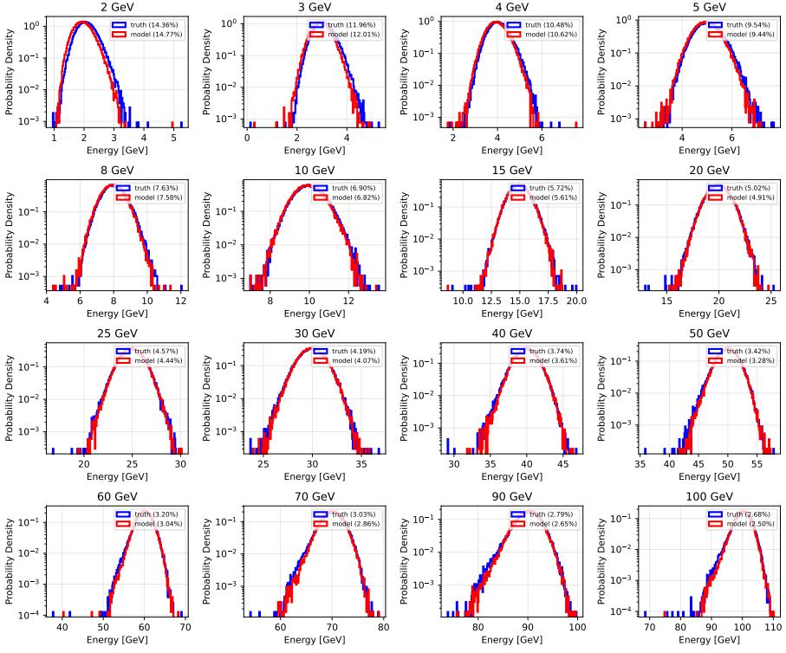
M(ulti) L(ayer) P(erceptron) Result HCAL
Truth = Total deposited energy (MC)
Notes:
In contrast to the resolution, no comparable enhancement was observed in the energy linearity.

Slide 16
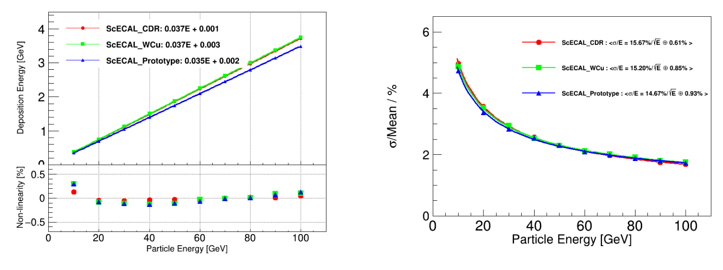
back up
Notes:
Since several layers have no data, the total number of channels is over 4000. After applying the Hough transform, more than 3000 channels have data entries exceeding 2200. However, after the fitting procedure, the number of good channels drops to fewer than 200.

Slide 17
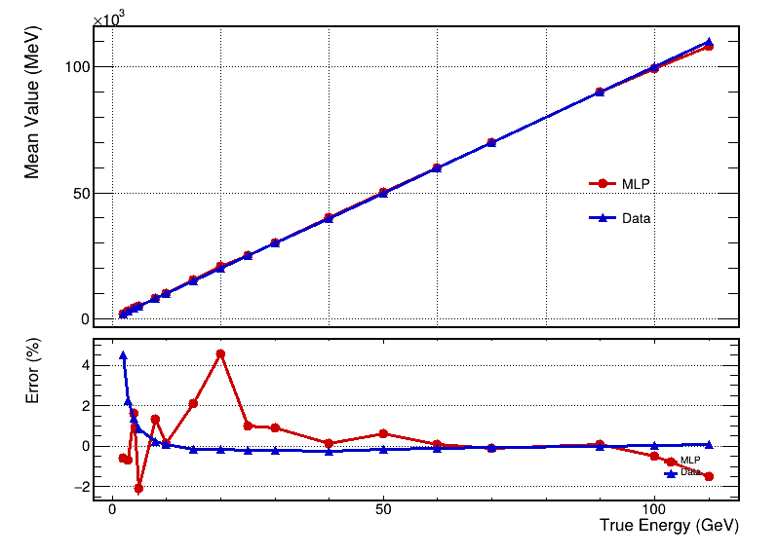
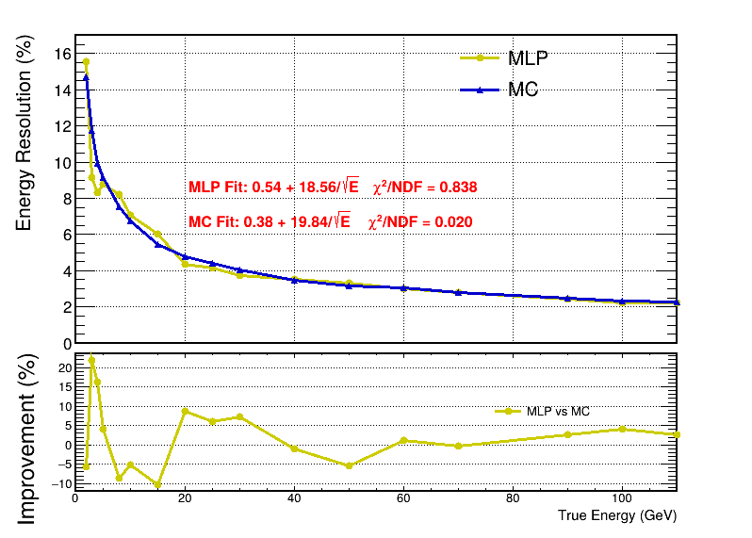
back up
borong HCAL e-
Notes:
Since several layers have no data, the total number of channels is over 4000. After applying the Hough transform, more than 3000 channels have data entries exceeding 2200. However, after the fitting procedure, the number of good channels drops to fewer than 200.

Slide 18
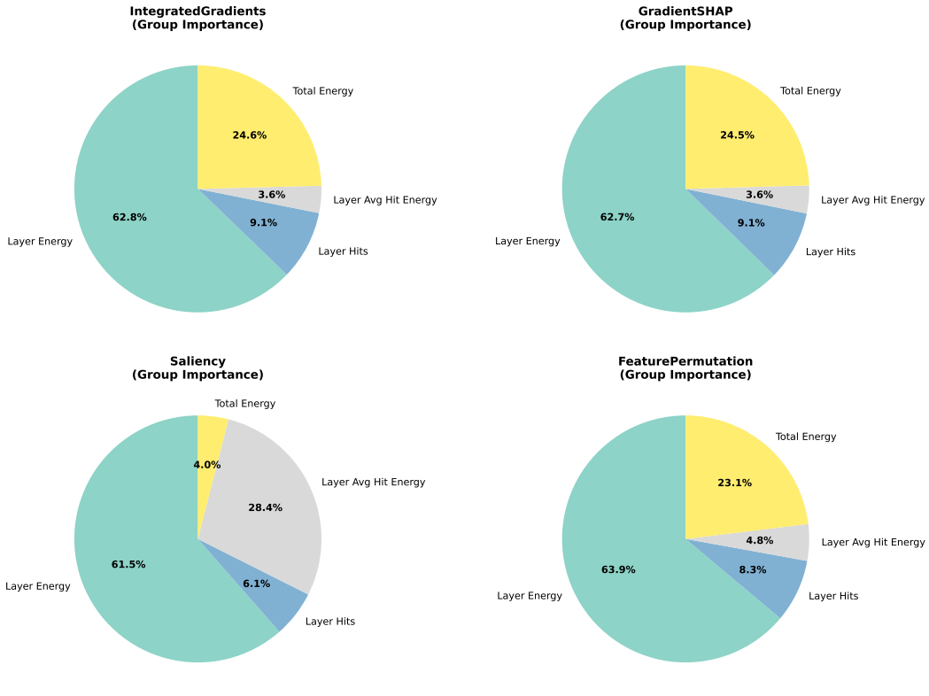
M(ulti) L(ayer) P(erceptron)
Method | What you are asking the model
Integrated Gradients | “Along the path from nothing to this input, who helped you the most?”
Gradient SHAP | “If I repeat the experiment many times, who is important on average?”
Saliency | “If I slightly touch you right now, who reacts the most?”
Permutation | “If I remove you, does the model fall apart?”
Notes:
In contrast to the resolution, no comparable enhancement was observed in the energy linearity.

Slide 19
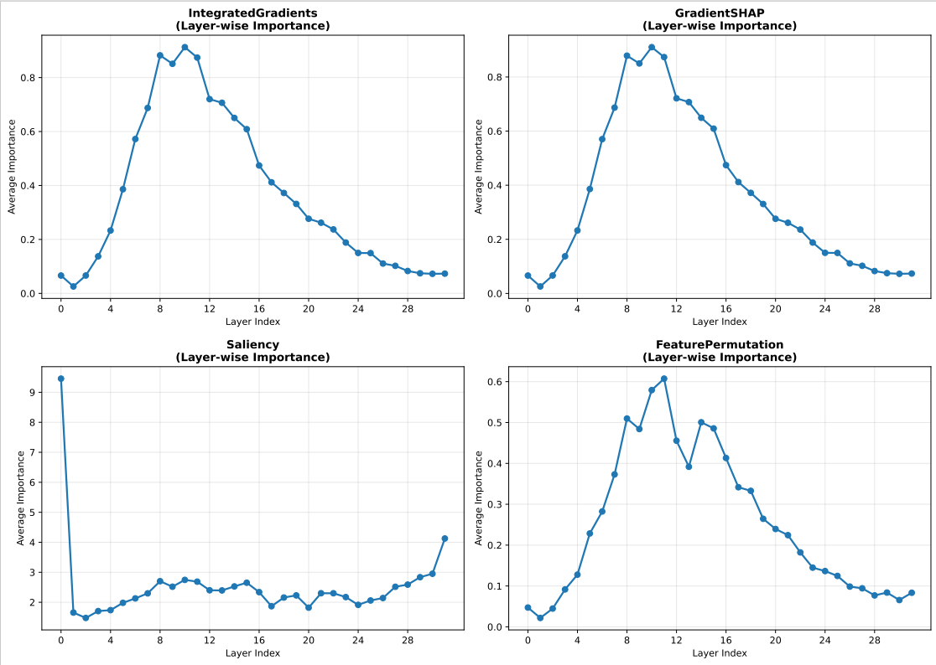
M(ulti) L(ayer) P(erceptron)
Method | What you are asking the model
Integrated Gradients | “Along the path from nothing to this input, who helped you the most?”
Gradient SHAP | “If I repeat the experiment many times, who is important on average?”
Saliency | “If I slightly touch you right now, who reacts the most?”
Permutation | “If I remove you, does the model fall apart?”
Notes:
In contrast to the resolution, no comparable enhancement was observed in the energy linearity.

Slide 20
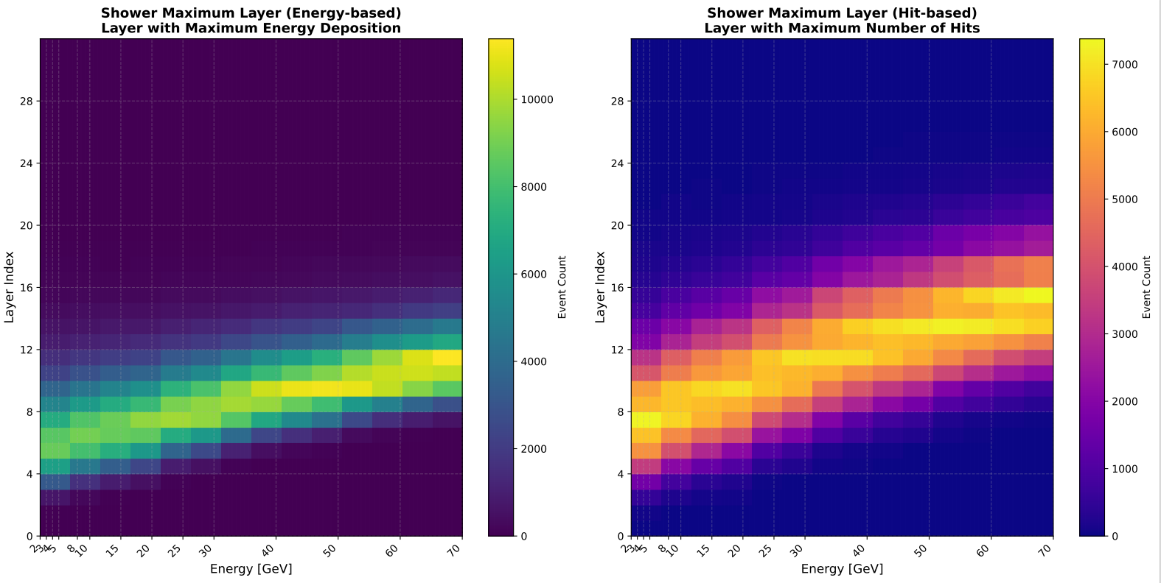
M(ulti) L(ayer) P(erceptron)
Notes:
In contrast to the resolution, no comparable enhancement was observed in the energy linearity.

Slide 21
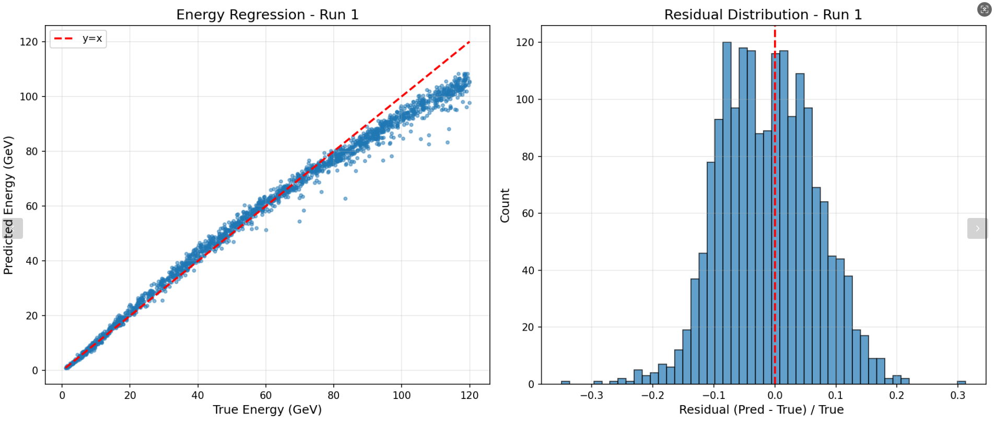
back up
Samples:12000（MLP）
Notes:
Since several layers have no data, the total number of channels is over 4000. After applying the Hough transform, more than 3000 channels have data entries exceeding 2200. However, after the fitting procedure, the number of good channels drops to fewer than 200.

Slide 22
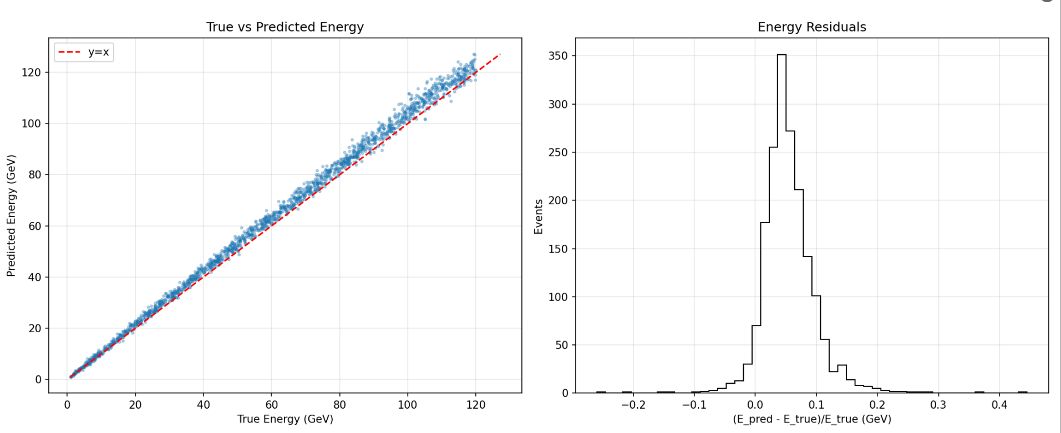
back up
Samples:12000（CNN+LSTM）
Notes:
Since several layers have no data, the total number of channels is over 4000. After applying the Hough transform, more than 3000 channels have data entries exceeding 2200. However, after the fitting procedure, the number of good channels drops to fewer than 200.

Slide 23
back up
Samples:12000（MLP）
Notes:
Since several layers have no data, the total number of channels is over 4000. After applying the Hough transform, more than 3000 channels have data entries exceeding 2200. However, after the fitting procedure, the number of good channels drops to fewer than 200.

Slide 24
back up
Samples:12000（CNN+LSTM）
Notes:
Since several layers have no data, the total number of channels is over 4000. After applying the Hough transform, more than 3000 channels have data entries exceeding 2200. However, after the fitting procedure, the number of good channels drops to fewer than 200.

