Slide 1


Design and development of the readout electronics for the time-of-flight detectors
of the HIAF-HIRIBL beamline
Shihai Wen
Supervisor: Jie Kong
Institute of Modern Physics, Chinese Academy of Sciences
Notes:
Good afternoon, / everyone. //
My name is Shihai Wen, / from IMP. //
Today, / I am pleased to present my research / entitled "Design and Development / of the Readout Electronics / for the Time-of-Flight Detectors / of the HIAF-HIRIBL Beamline." //

Slide 2

1
Research Background
2
HIRIBL-ToF Readout Electronics
CONTENTS
3
Test and Results
4
Summary
Notes:
My presentation / is divided into four parts. //
First, / I will introduce / the research background. //
Second, / I will describe the design / of the ToF readout electronics. //
Third, / I will present / the experimental tests and results. //
Finally, / I will summarize the work / and discuss future plans. //

Slide 3
1
Research Background
Notes:
Let me begin / with the research background. //

Slide 4


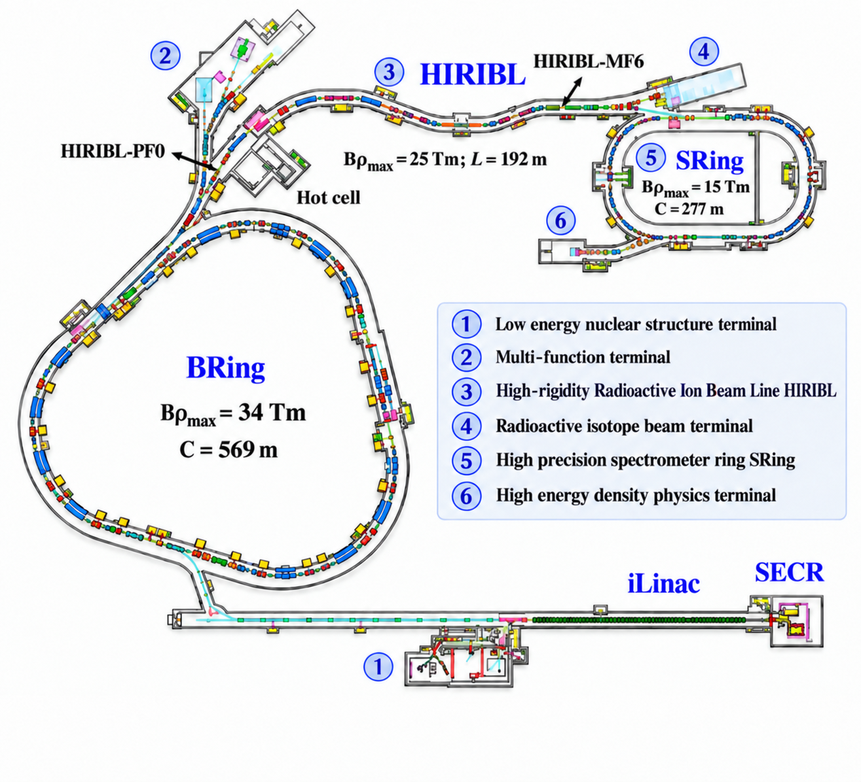
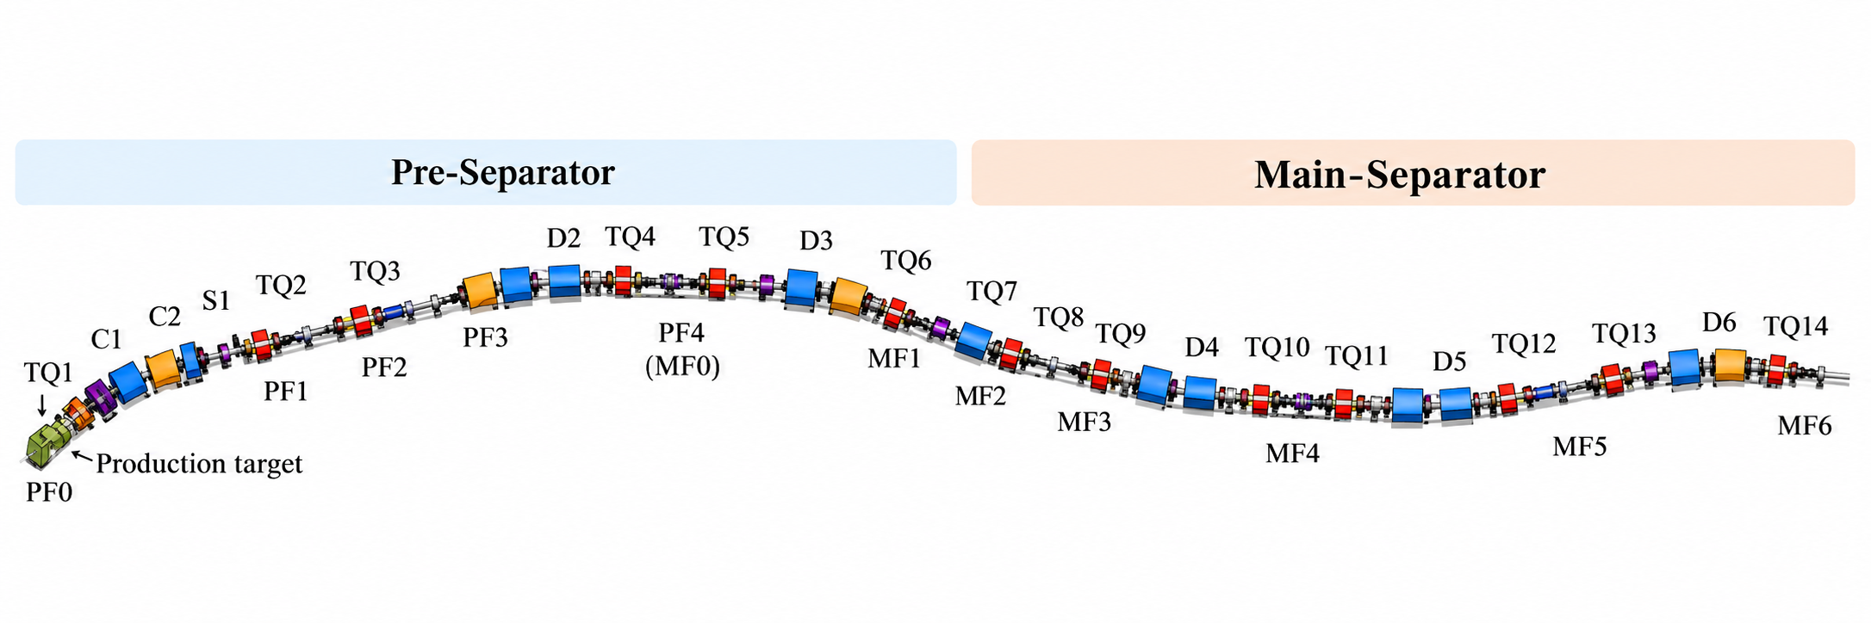
Research Background
HFRS has been officially renamed as HIRIBL.
Beam Line
HIAF-HIRIBL
PID Method
Bρ-ΔE-ToF
ToF Detectors
Plastic scintillator + PMTs
Event Rate
~10⁷ cps
Resolution
< 50 ps RMS
HIRIBL: the world's Longest and Highest-rigidity radioactive beam line
Notes:
The High Intensity Heavy-Ion Accelerator Facility, / is a major scientific facility / for nuclear physics research. //
HIRIBL, / formerly known as HFRS, / is designed as the world's longest / and highest-rigidity radioactive beamline. //
For particle identification, / HIRIBL uses the B-rho, / delta-E, / and time-of-flight method. //
The time-of-flight detectors / consist of plastic scintillators / coupled with photomultiplier tubes. //
The expected event rate / is approximately ten million counts per second, / and the required time resolution / is better than 50 picoseconds. //
These demanding requirements / make the development of high-performance readout electronics / particularly important. //

Slide 5
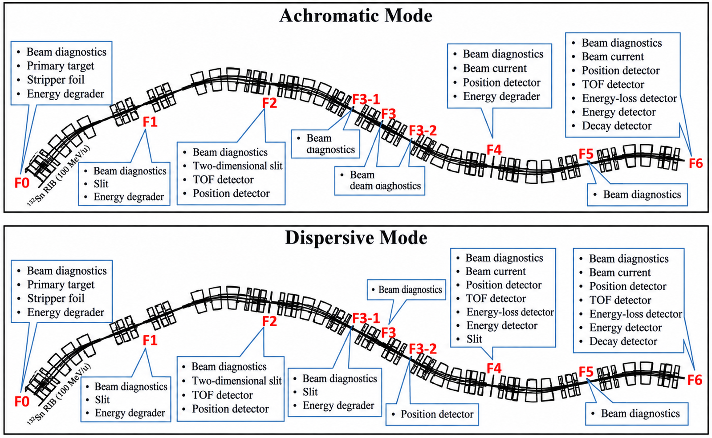
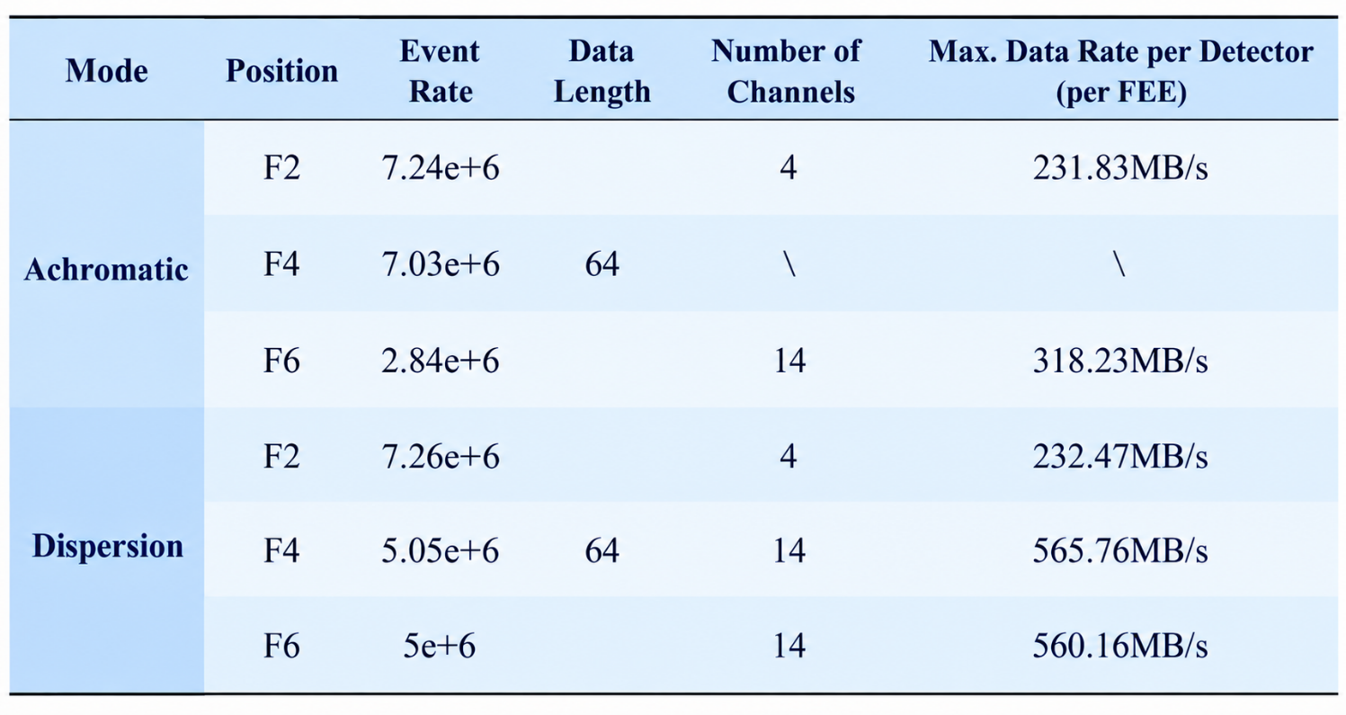
Research Background
Detectors layout on HIRIBL
Estimation of HIRIBL ToF data rate
Research Focus
High time resolution
Excellent resolution
for nuclide identification;
High count rate
Fast response and
accurate processing;
Data compression
Real-time processing
and transmission;
engineering constraints
Temperature and
humidity monitoring;
Notes:
This slide shows / the detector layout / and the estimated data rates / under different operating modes. //
As we can see, / the data rate can reach / several hundred megabytes per second / per detector, / with a maximum estimated value / of approximately 566 megabytes per second. //
Therefore, / our research focuses on / four main challenges. //
The first / is high time resolution, / which is essential / for accurate particle identification. //
The second / is high counting-rate capability, / to process events efficiently. //
The third / is real-time data processing and compression, / to reduce the transmission load. //
And the fourth / is engineering reliability, / including temperature, / humidity, / and operating-status monitoring. //
Our electronics system / was designed to address / these challenges. //

Slide 6
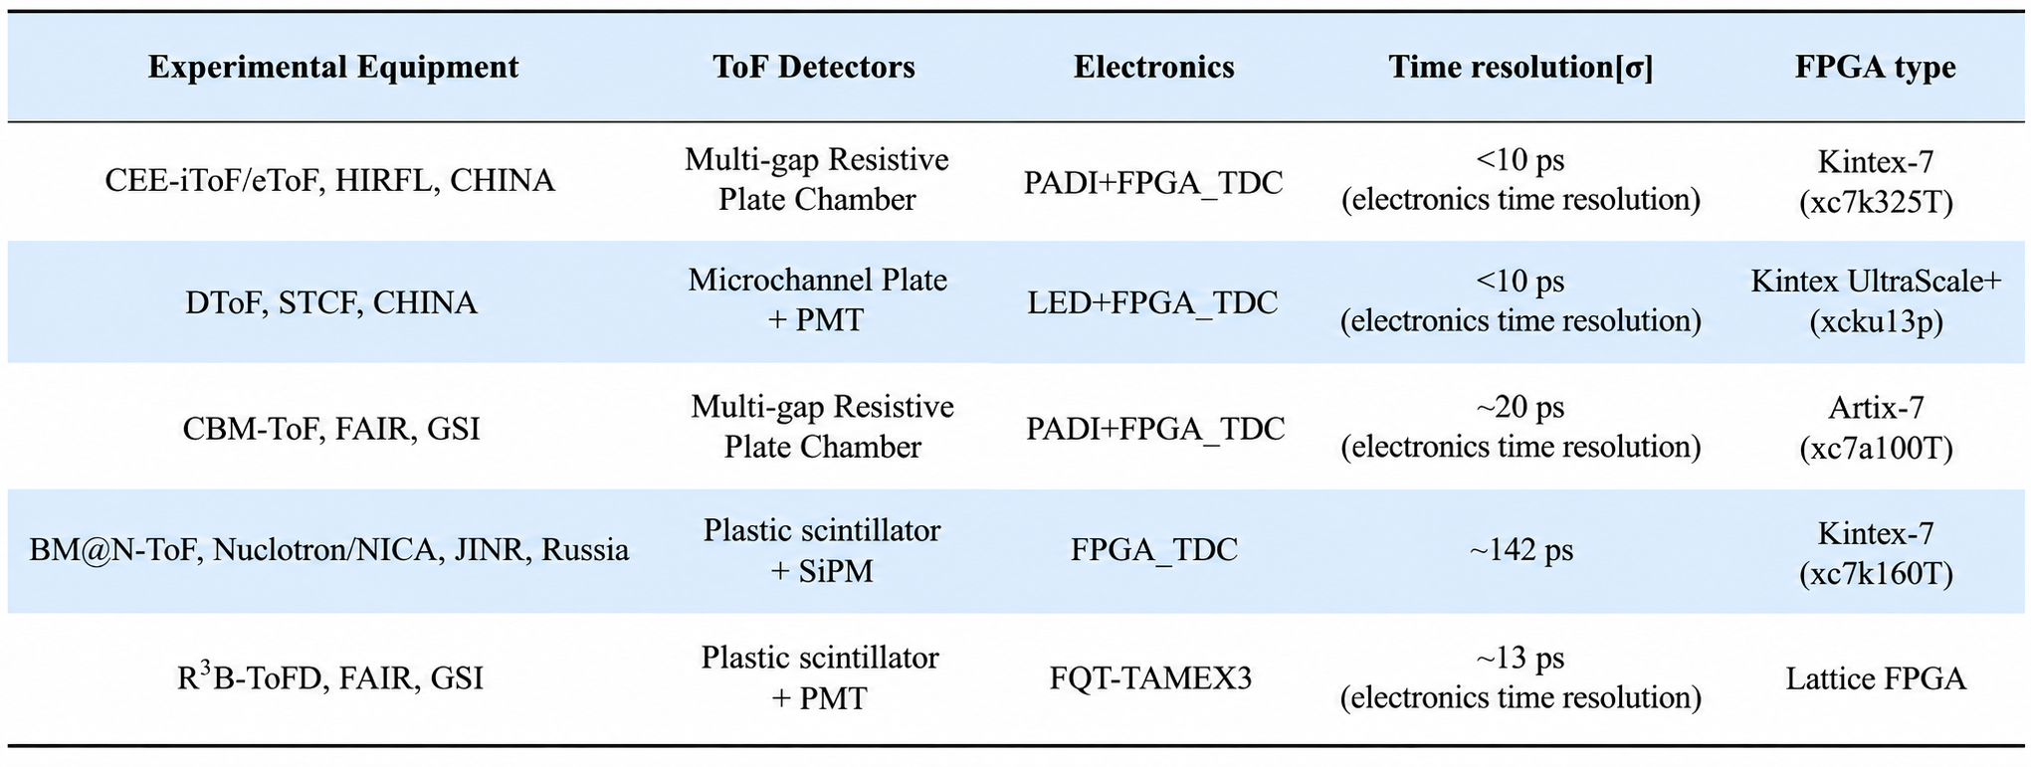
FPGA-based TDC
Current Status of Domestic and International Research:
Notes:
This slide summarizes / several FPGA-based TDC systems / developed for nuclear physics experiments. //
Some systems have achieved / electronic time resolutions / below 10 picoseconds, / while others demonstrate resolutions / of approximately 13 to 20 picoseconds. //
These results show / that FPGA-based TDC technology / is a promising solution / for high-precision time measurements. //
Based on these previous studies, / we developed a multi-channel FPGA-based readout system / specifically for the HIRIBL ToF detectors. //

Slide 7
2
HIRIBL-ToF Readout Electronics
Notes:
Now, / I will introduce / the design and implementation / of our readout electronics. //

Slide 8
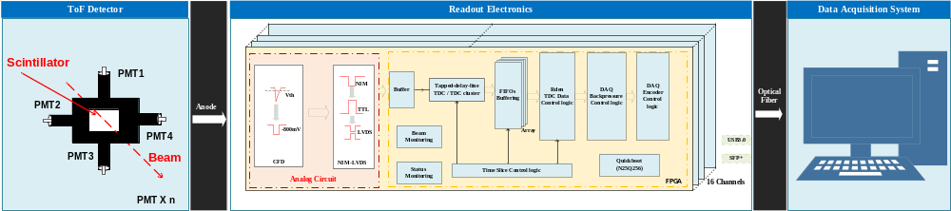
HIRIBL-ToF Readout Electronics
Analog CFD + FPGA-based TDC Digitization
Block diagram of the readout electronics system for the plastic scintillation ToF detector
Notes:
This slide shows / the overall architecture / of the ToF readout system. //
Our design combines / a constant fraction discriminator, / a level converter, / and an FPGA-based TDC. //
The PMT signals / are first processed by the CFD, / which converts analog pulses / into digital timing pulses. //
A level converter transforms / the NIM signals / into LVDS signals. //
Inside the FPGA, / the TDC measures the arrival times, / while additional logic performs / data buffering, / encoding, / and transmission. //
Finally, / the processed data / are transmitted to the data acquisition system, / via optical fiber. //

Slide 9
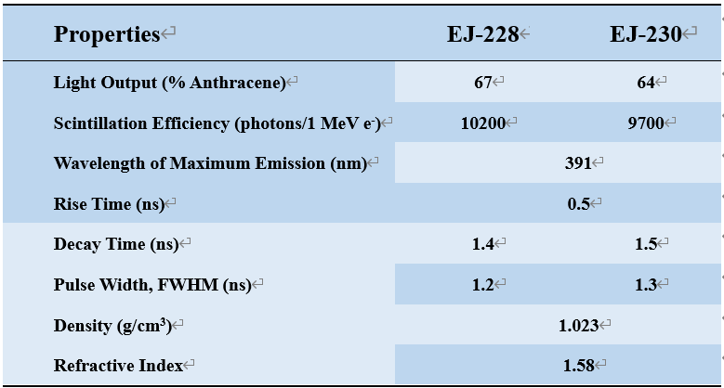
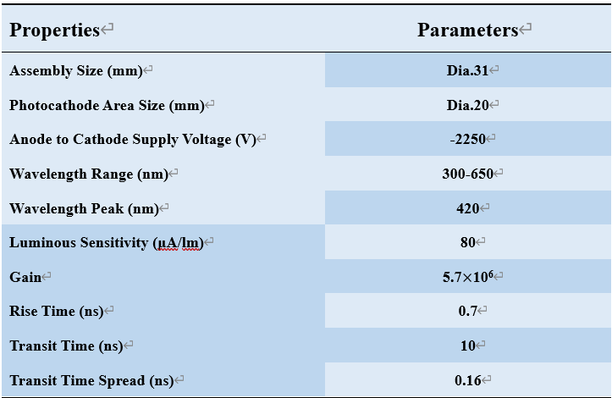
ToF Detectors
The HIRIBL-ToF detector employs a plastic scintillator and PMT readout scheme, utilizing EJ-228 and EJ-230 scintillators from Eljen Technology, respectively, and H6533 PMT assemblies from Hamamatsu.
Parameters of EJ-228 and EJ-230 Plastic Scintillators
Parameters of the H6533 assembly with built-in R4998-PMT
Notes:
For the ToF detectors, / we use EJ-228 / and EJ-230 plastic scintillators / from Eljen Technology, / together with Hamamatsu PMT assemblies. //
The scintillators have fast response characteristics, / with rise times of approximately 0.5 nanoseconds / and pulse widths of around 1.2 to 1.3 nanoseconds. //
The rise time /of the PMT /is approximately 0.7 nanoseconds. //
These fast-response characteristics / are suitable for high-precision timing measurements. //

Slide 10
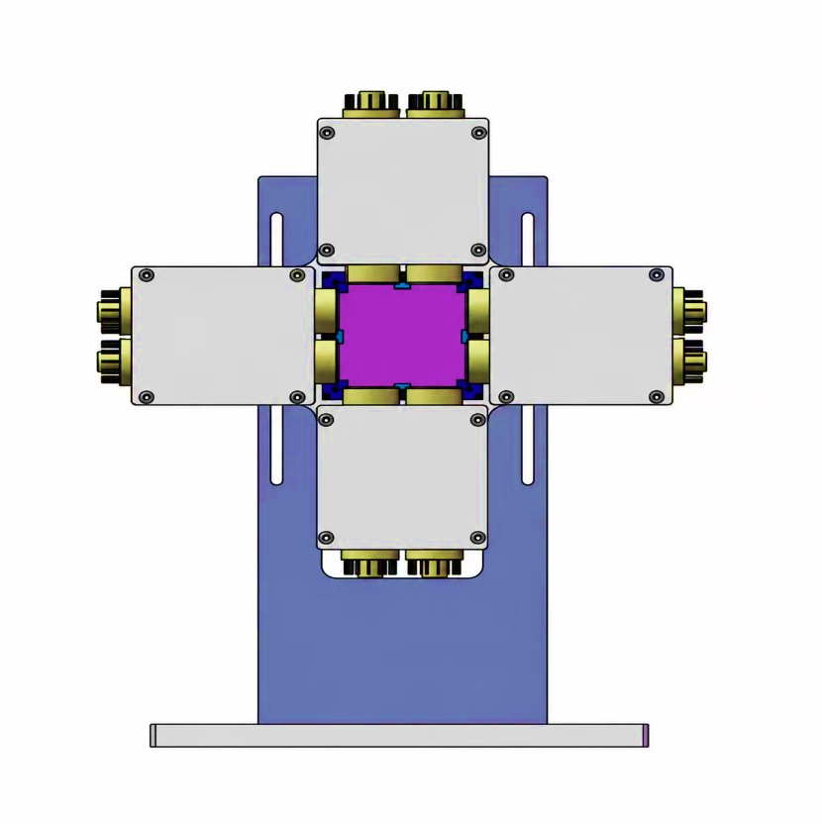
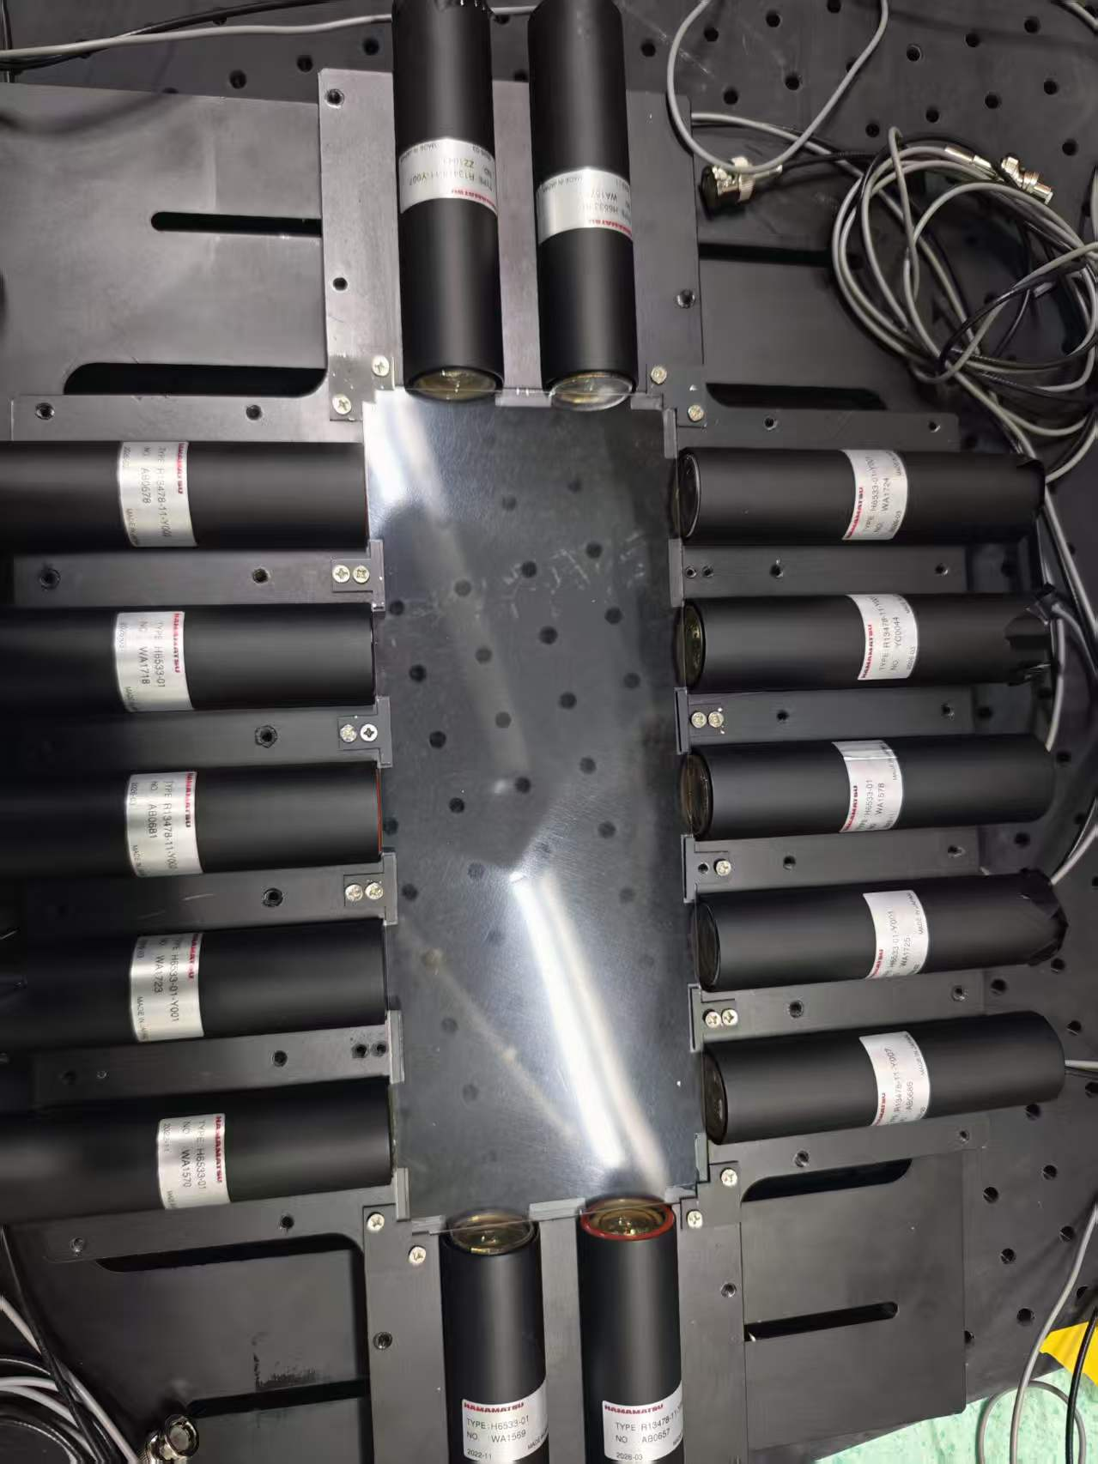
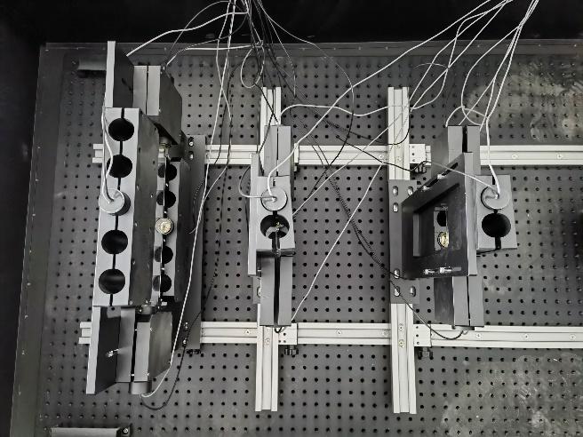
ToF Detectors
The HIRIBL-ToF detector uses plastic scintillators of varying thicknesses with edge-coupled PMTs. This geometry enhances light collection, while averaging timing signals from multiple PMTs per event reduces position-dependent errors and improves overall time resolution.
Small plastic scintillator PMT assembly drawing
HIRIBL-ToF detectors
Notes:
This slide shows / the structure / and photographs / of the ToF detectors. //
The detectors use / plastic scintillators / with different thicknesses / and multiple PMTs / coupled to their edges. //
This arrangement / improves light collection efficiency. //
More importantly, / by averaging the timing signals / from multiple PMTs, / we can reduce the influence / of particle-hit position / on the measured arrival time. //
This helps improve / the overall time resolution / of the detector system. //

Slide 11
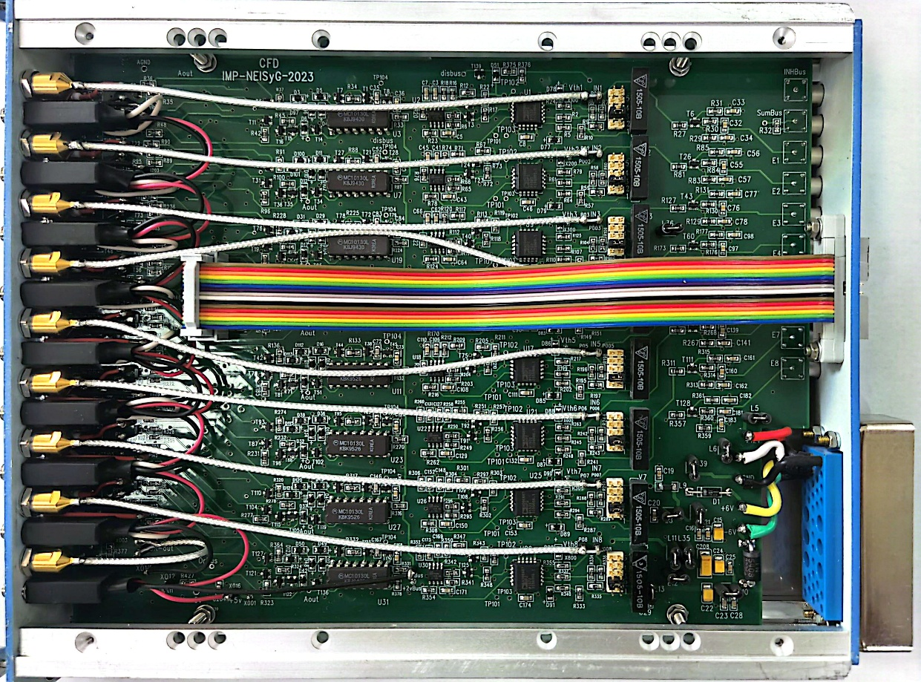
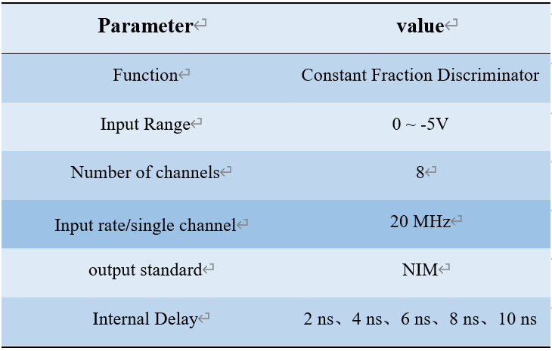
CFD Module
CFD: This discriminator generates digital pulses marking the arrival time of plastic scintillator signals.
8-Channel CFD board
Main parameters of the CFD board
Notes:
The first electronics module / is the constant fraction discriminator. //
Its main function / is to generate timing pulses / from the analog PMT signals. //（see PPT）
Compared with a simple leading-edge discriminator, / the CFD helps reduce timing errors / caused by variations in signal amplitude. //
Our CFD board provides eight independent channels, / with a maximum input rate / of 20 megahertz per channel. //
It accepts negative analog signals / and produces standard NIM outputs. //
Several internal delay settings / are also available / to improve timing performance. //

Slide 12
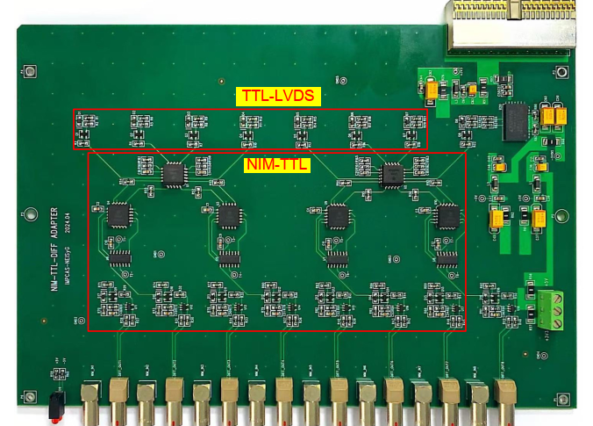
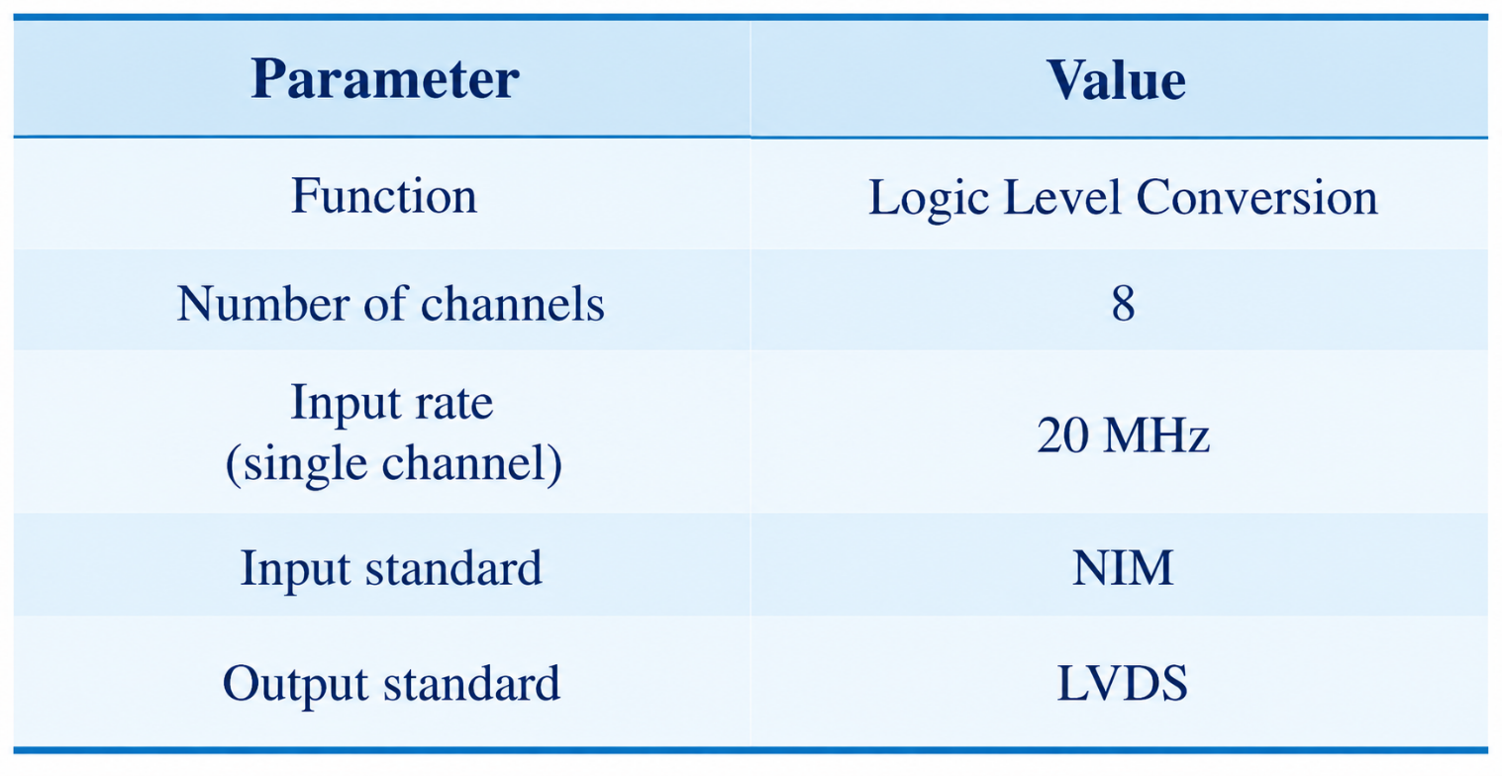
Level Converter
Level Converter Board: Converts CFD output from NIM to LVDS for TDC input via two stages: NIM-to-TTL and TTL-to-LVDS.
8-Channel level converter board
Main parameters of the level converter board
Notes:
Since the CFD produces NIM signals, / while the FPGA-based TDC requires LVDS inputs, / a level conversion stage is necessary. //
We developed / an eight-channel level converter board. //
The conversion is implemented / in two stages: // first from NIM to TTL, / and then from TTL to LVDS. //
The board supports / an input rate of 20 megahertz per channel, / matching the counting-rate capability / of the CFD. //

Slide 13
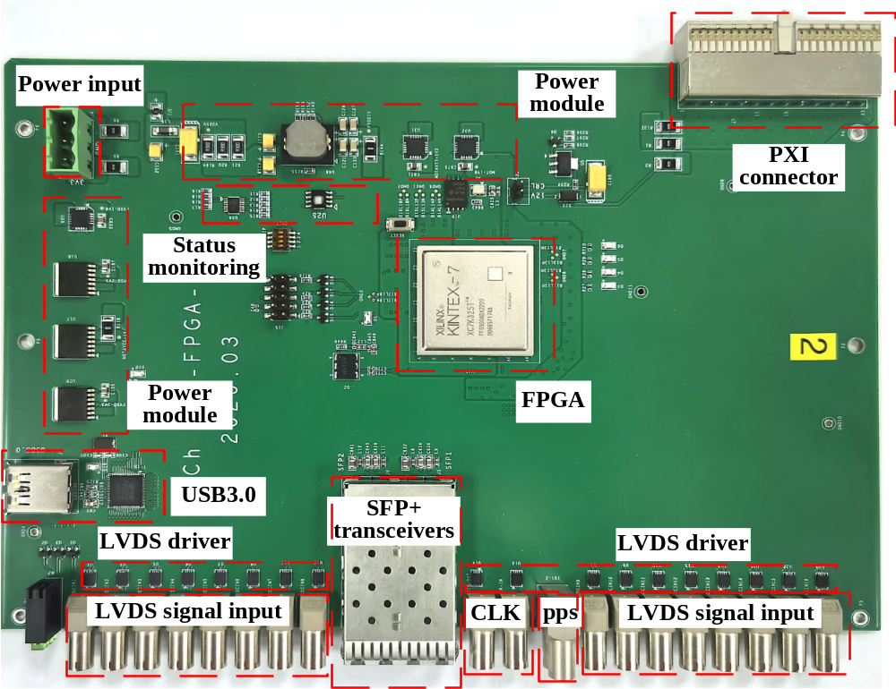
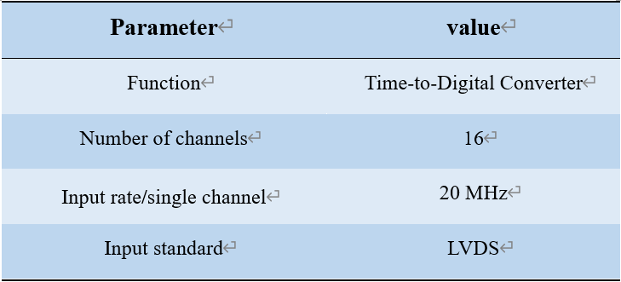
Time-to-Digital Converter
The high-precision TDC measures 16-channel timing with multi-board clock and PPS synchronization. Onboard Flash enables DAQ-based remote updates. The ToF readout supports beam, calibration, and monitoring modes.
16-Channel time-to-digital converter board
Main parameters of the TDC board
Notes:
The TDC board / is the core component / of our readout electronics. //
It contains 16 measurement channels, / each supporting an input rate / of 20 megahertz. //
The board uses an FPGA / to implement high-resolution time measurement / and data processing. //
To support multiple boards operating together, / we designed clock / and pulse-per-second synchronization interfaces. //
In addition, / onboard Flash memory / enables remote logic updates. //
The system / supports three operating modes: // beam mode, / calibration mode, / and monitoring mode. //

Slide 14
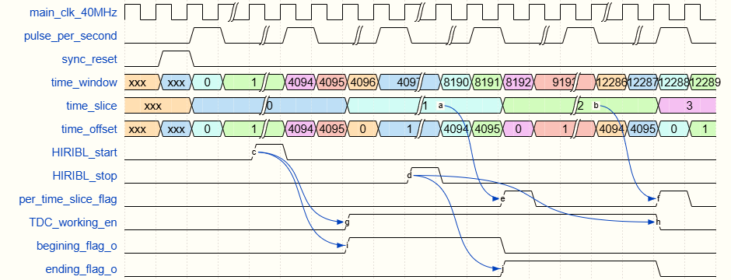
Triggerless Mode
Time-slice-based triggerless operation is adopted, with a time slice width of 102.4 μs. Signals are framed by applying an intra-slice time offset, with a synchronous time slice ID inserted at the end of each slice.
Triggerless mode based on time slice
Notes:
To handle the high event rate, / we designed a triggerless data acquisition mode / based on time slices. //
In this mode, / the system does not need to select events / based on external trigger signals. //
Each time slice / is 102.4 microseconds, / and system packages and transmits data / in units of time slices. //
As shown in the timing diagram, / the system controls / the beginning and ending of data acquisition / and maintains time-slice information. //
This design helps support / continuous data acquisition / and subsequent event reconstruction. //

Slide 15
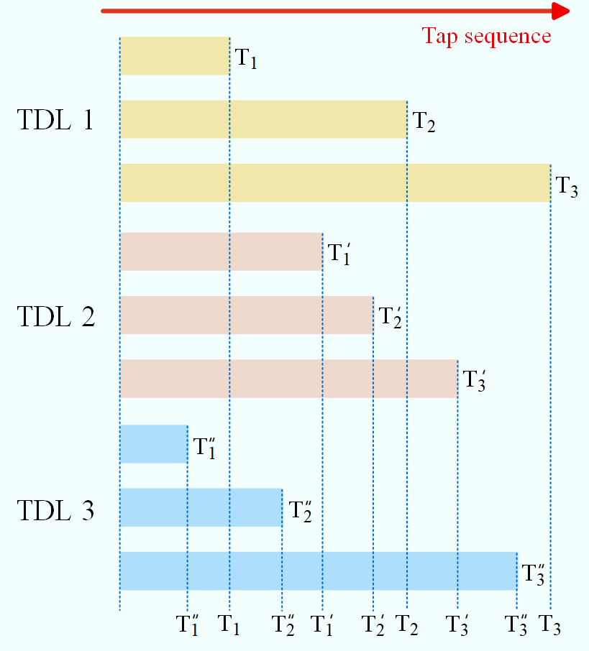
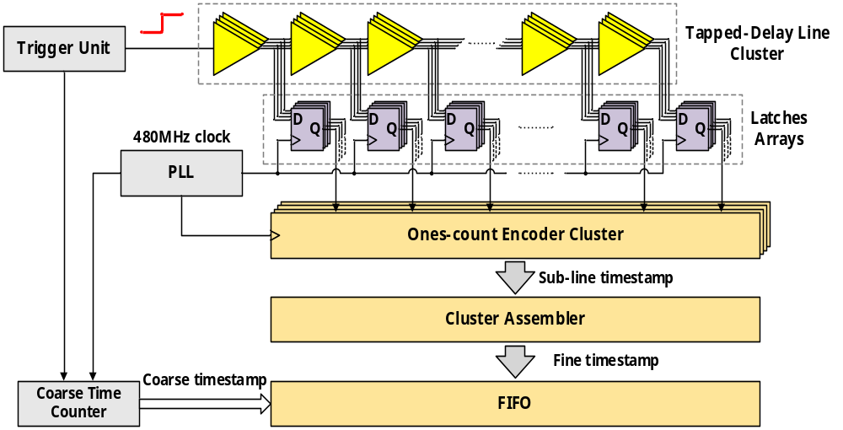
FPGA Logic Design
High time resolution
Multiple tapped delay lines
Schematic of non-uniform tap delays among multiple TDLs
Schematic of the 4-chain TDL-based TDC
Notes:
One of the key challenges / is achieving high time resolution / within the FPGA. //
For this purpose, / we designed a TDC / based on multiple tapped delay lines. //
To improve the time resolution of TDC, / common approaches include / using multiple delay chains for combined measurements / or measuring multiple rising edges / of the same signal. //
In our design, / we adopted a multi-chain TDL architecture / to improve the timing precision. //
The fine timestamp / is then combined with the coarse timestamp / generated by a counter. //
Together, / they provide the timing information / for each detected signal. //

Slide 16
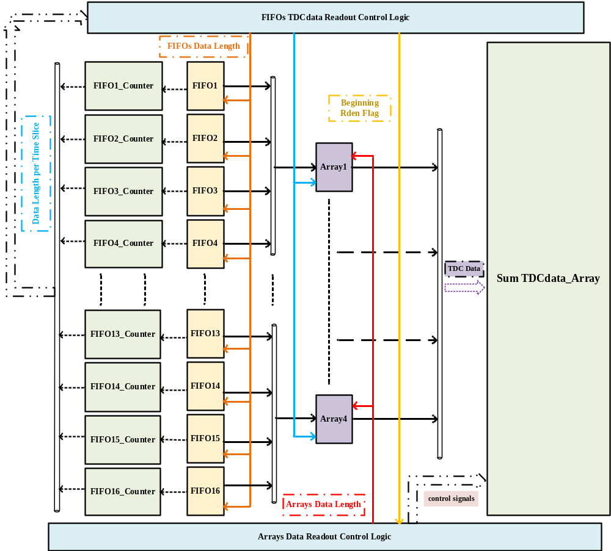
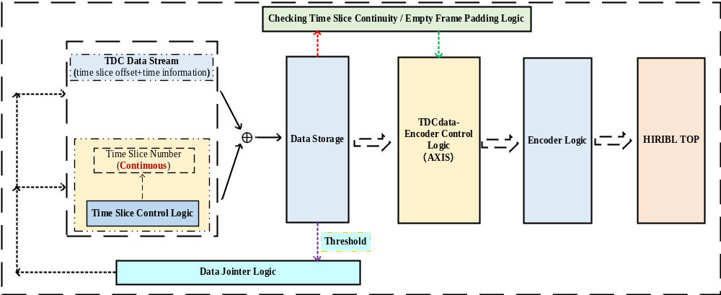
FPGA Logic Design
High count rate
single-channel count rate of $7.8×{10}^{6} cps$
Backpressure and padding frame mechanism
Multi-level cache scheduling and readout mechanism
Notes:
Another important challenge / is processing data / at high counting rates. //
As shown on the left, / we designed a multi-level buffering / and readout structure. //
Timing data / from the 16 TDC channels / are first stored / in separate FIFOs. //
The system then schedules data readout / based on the amount of buffered data / within each time slice. //
The data are packaged and transmitted / to the next stage / following time-first, space-second strategy. //
On the right, / the logic includes time-slice continuity checking, / empty-frame padding, / and backpressure control. //
These functions help ensure / orderly data framing and packaging, / while maintaining continuous and stable system operation / even when data transmission becomes a bottleneck. //

Slide 17
3
Test and Results
Notes:
Next, / I will present / the experimental tests / and the corresponding results. //

Slide 18
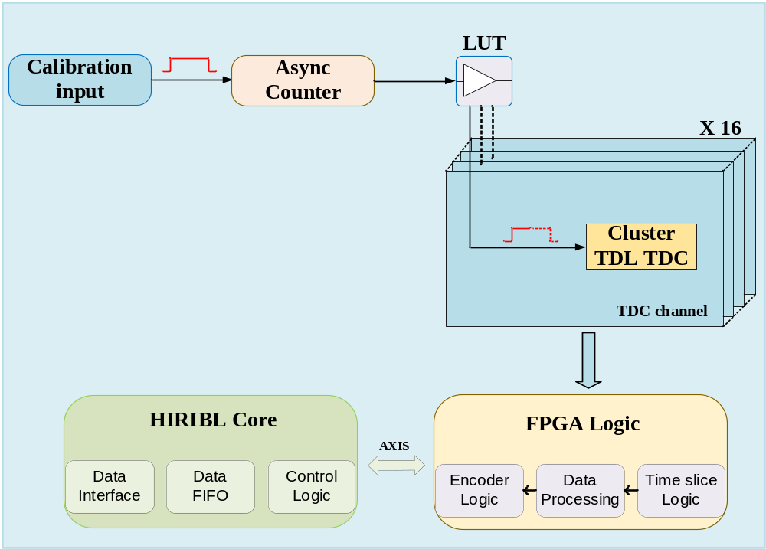
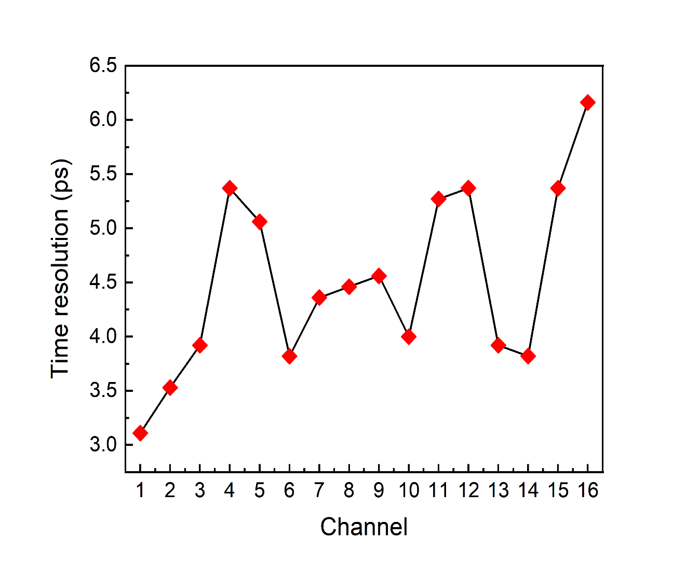
Time resolution (Calibration)
The timing resolution of each channel is better than 6 ps.
Evaluate electronic timing performance excluding the contributions of the detectors.
Generation method of signals in Calibration mode
Intrinsic time resolution of the 16-channel TDC
Notes:
First, / we evaluated the intrinsic timing performance / of the 16-channel FPGA-based TDC. //
In calibration mode, / test signals are generated / using a counter / and sent to the 16 TDC channels / for time measurements. //
The figure on the right shows / the intrinsic time resolution results / for all 16 channels, / with each channel achieving / a time resolution of approximately 6 picoseconds. //
This test allows us to evaluate / the electronic timing performance / independently of the scintillator / and PMT contributions. //

Slide 19
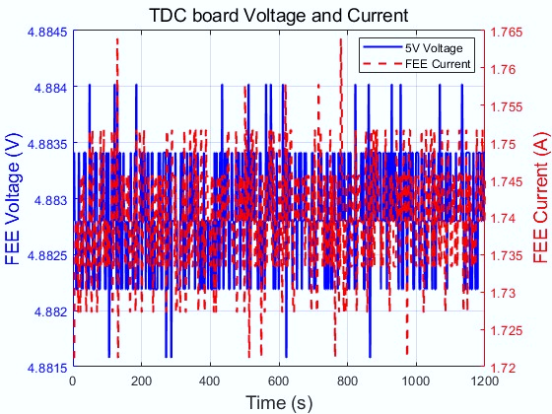
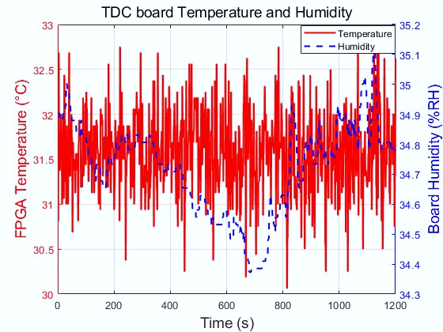
Condition Monitoring
The monitoring system records critical operating parameters, including voltage, current, temperature, and humidity, meeting the engineering design constraints.
FEE voltage and current monitoring results
FEE temperature and humidity monitoring results
Notes:
We also tested / the condition-monitoring functions / of the front-end electronics. //
The monitoring system records / important operating parameters, / including voltage, / current, / temperature, / and humidity. //
The results shown here / demonstrate the system's capability / to acquire these environmental / and electrical parameters. //
These functions are useful / for detecting abnormal operating conditions / and supporting long-term system stability. //

Slide 20
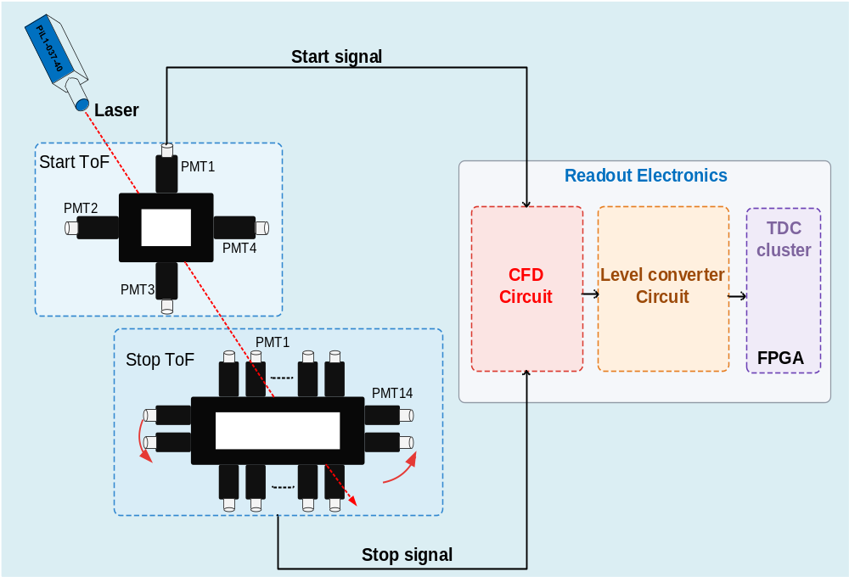
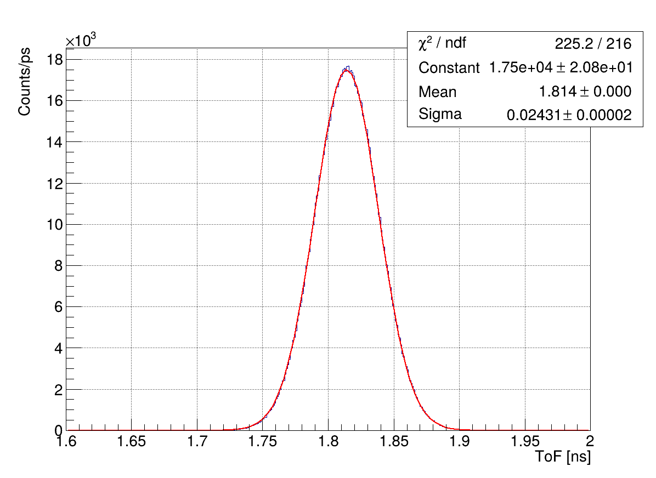
Test with laser
PMT outputs are processed through the complete electronics, including the CFD, level converter, and FPGA-based TDC. The timing resolution in laser tests is 24 ps.
σ=24 ps
Laser Joint test setup
Laser Joint test results
Notes:
Next, / we performed a joint test / using a laser system. //
The laser provides / a controlled optical signal / to the ToF detectors. //
The PMT outputs / are processed through the complete electronics chain, / including the CFD, / level converter, / and FPGA-based TDC. //
This test evaluates / the combined performance / of the detector / and readout electronics. //
As shown in the figure, / the measured time resolution / reaches a standard deviation / of 24 picoseconds. //
This result demonstrates / the excellent timing performance / of the integrated system / under laser-test conditions. //

Slide 21
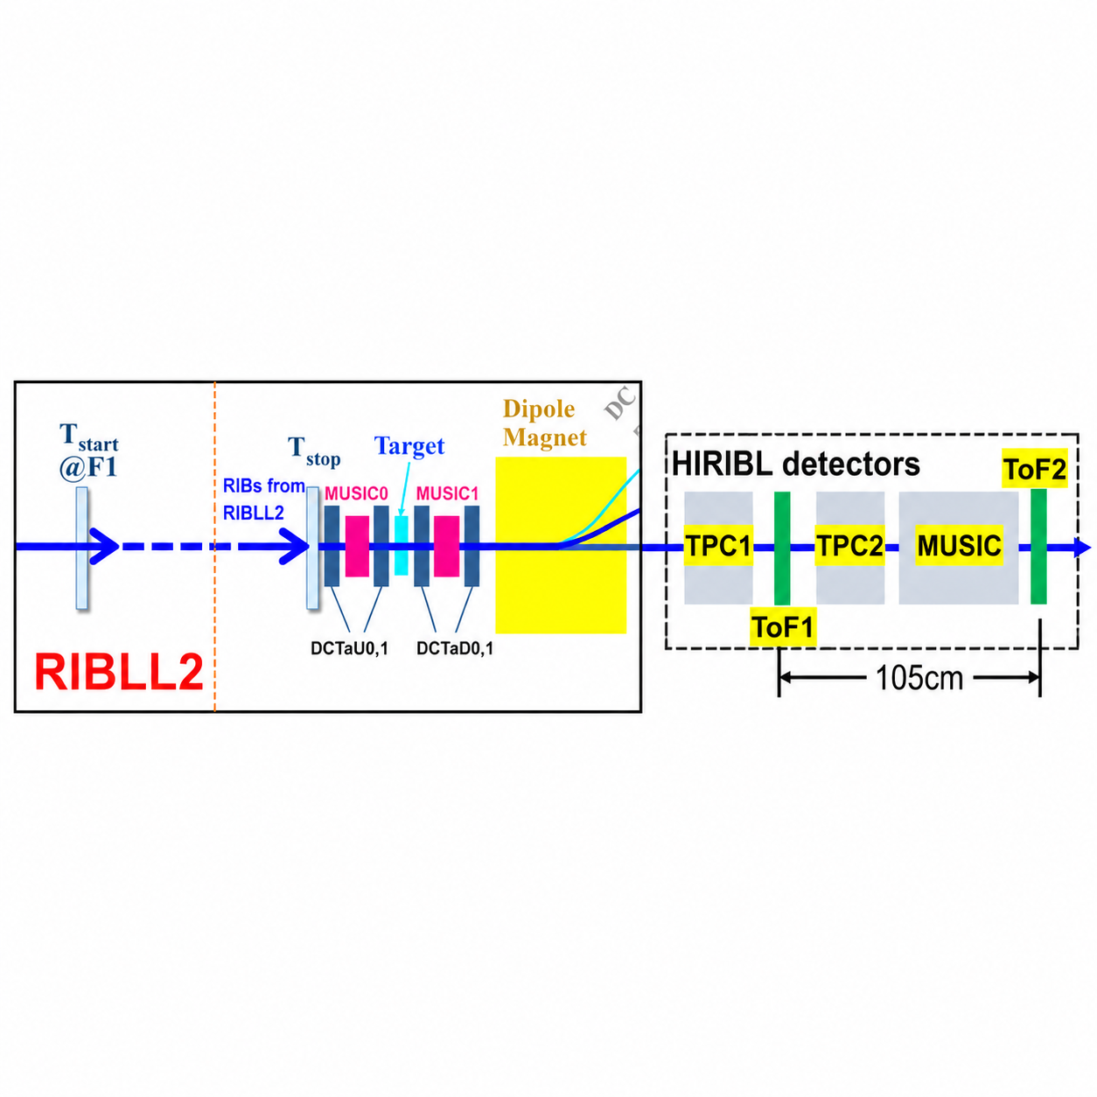
Test with beam
⁴⁰Ar 320 MeV/u beam experiment at the HIRFL-RIBLL2 beamline
start and stop detectors
Detectors layout on RIBLL2
⁴⁰Ar beam test setup
Notes:
To further evaluate the system, / we conducted a heavy-ion beam test / at the HIRFL-RIBLL2 beamline. //
As shown in the experimental setup, / two time-of-flight detectors / were installed as the start and stop detectors. //
This experiment allowed us to evaluate / the complete readout system / with actual heavy-ion signals. //

Slide 22
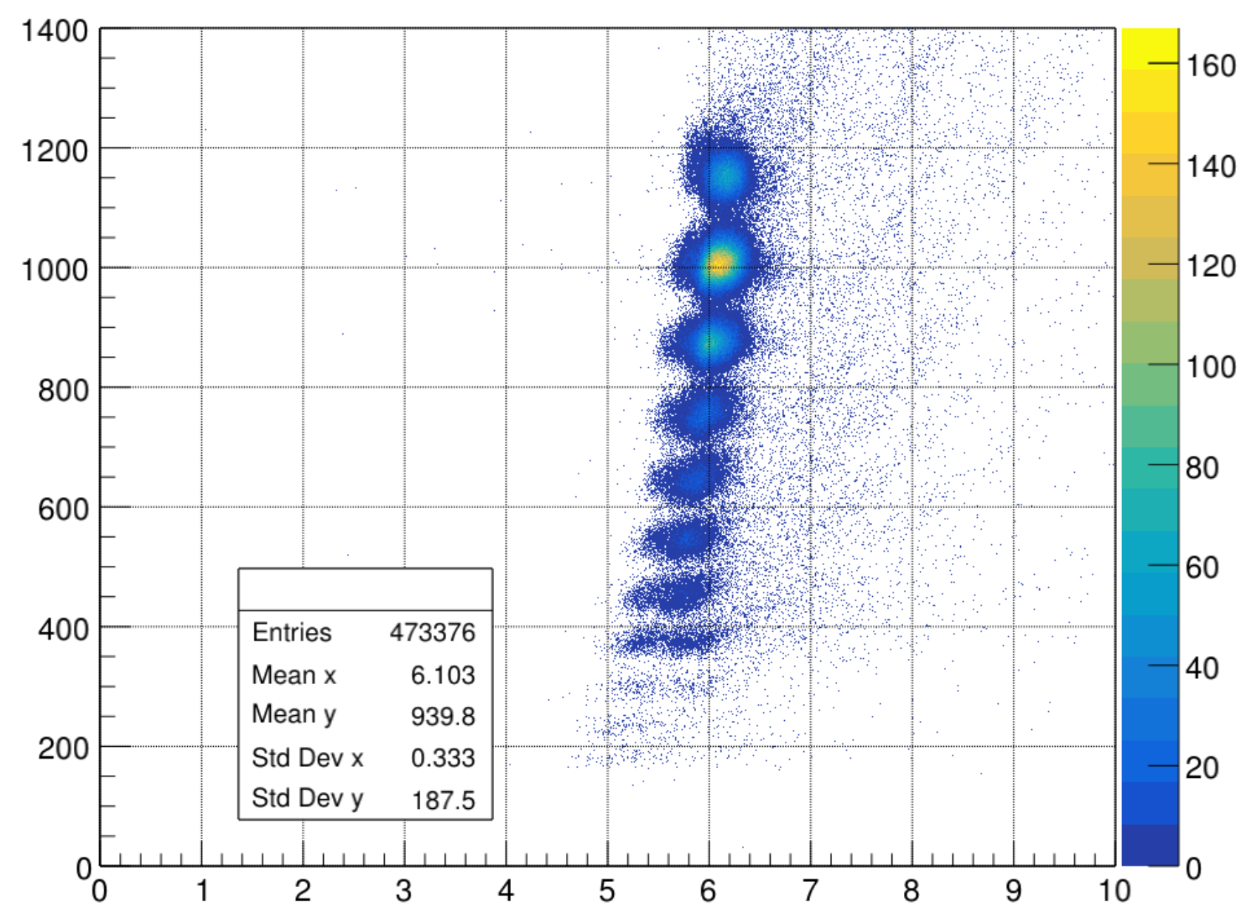
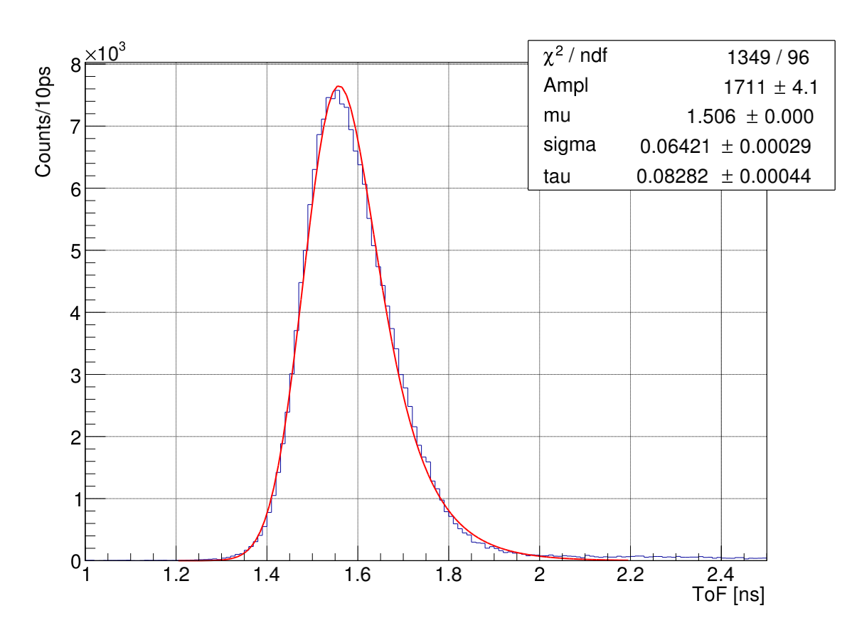
Joint analysis
The ToF information is extracted from the time difference between the start and stop detectors, and the energy loss is measured by the MUSIC detector.
ΔE (a.u.)
σ=64 ps
ToF(ns)
ΔE-ToF (ToF1-ToF2)
⁴⁰Ar beam test results
Notes:
On the left, / the two-dimensional plot / presents the relationship / between energy loss / and time of flight. //
The ToF information / is obtained from the difference / between the start and stop detector measurements. //
The corresponding timing distribution / is shown on the right. //
From the fitted distribution, / we obtained a time resolution / of approximately 64 picoseconds / in standard deviation. //
Although this value is higher / than the laser-test result, / it reflects the performance / under realistic beam conditions, / where additional detector / and experimental effects are present. //
Multiple Sampling Ionization Chamber(MUSIC)

Slide 23
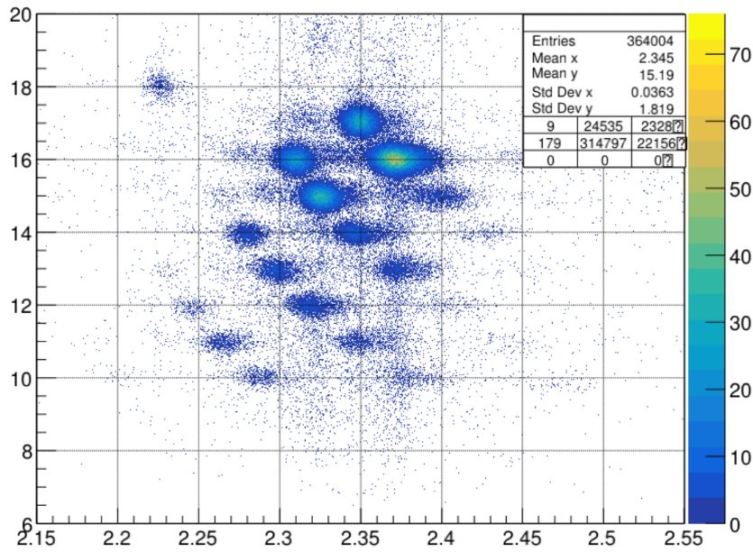
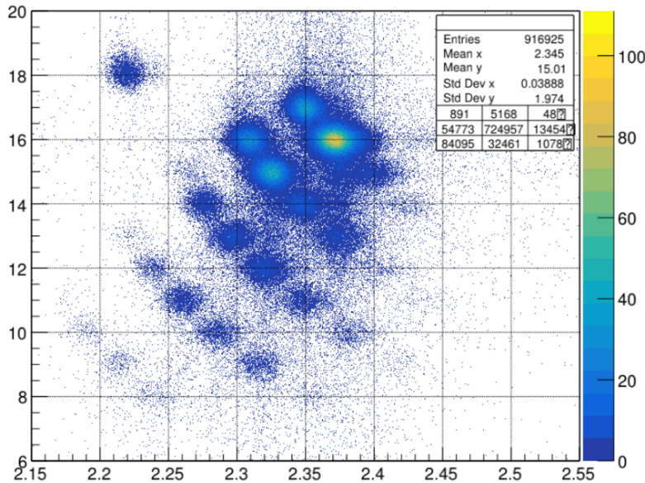
Particle Identification
Particle identification results obtained by HIRIBL and RIBLL2 systems in the same experiment are compared. Argon-40 and Chlorine-40 can be distinguished.
Z
⁴⁰Ar¹⁸⁺
Z
⁴⁰Ar¹⁸⁺
⁴⁰Cl¹⁷⁺
⁴⁰Cl¹⁷⁺
A/Q
A/Q
HIRIBL: Z-A/Q
RIBLL2: Z-A/Q
Notes:
This slide compares / the particle identification / obtained by the HIRIBL and RIBLL2 systems / in the same experiment. //
In the RIBLL2 experimental results, / the argon-40 / and chlorine-40 charge states, / can be distinguished. //
These results demonstrate / that the measured ToF information / can be effectively used / for particle identification, / and that our system achieves better time resolution / than the RIBLL2 ToF readout electronics. //

Slide 24
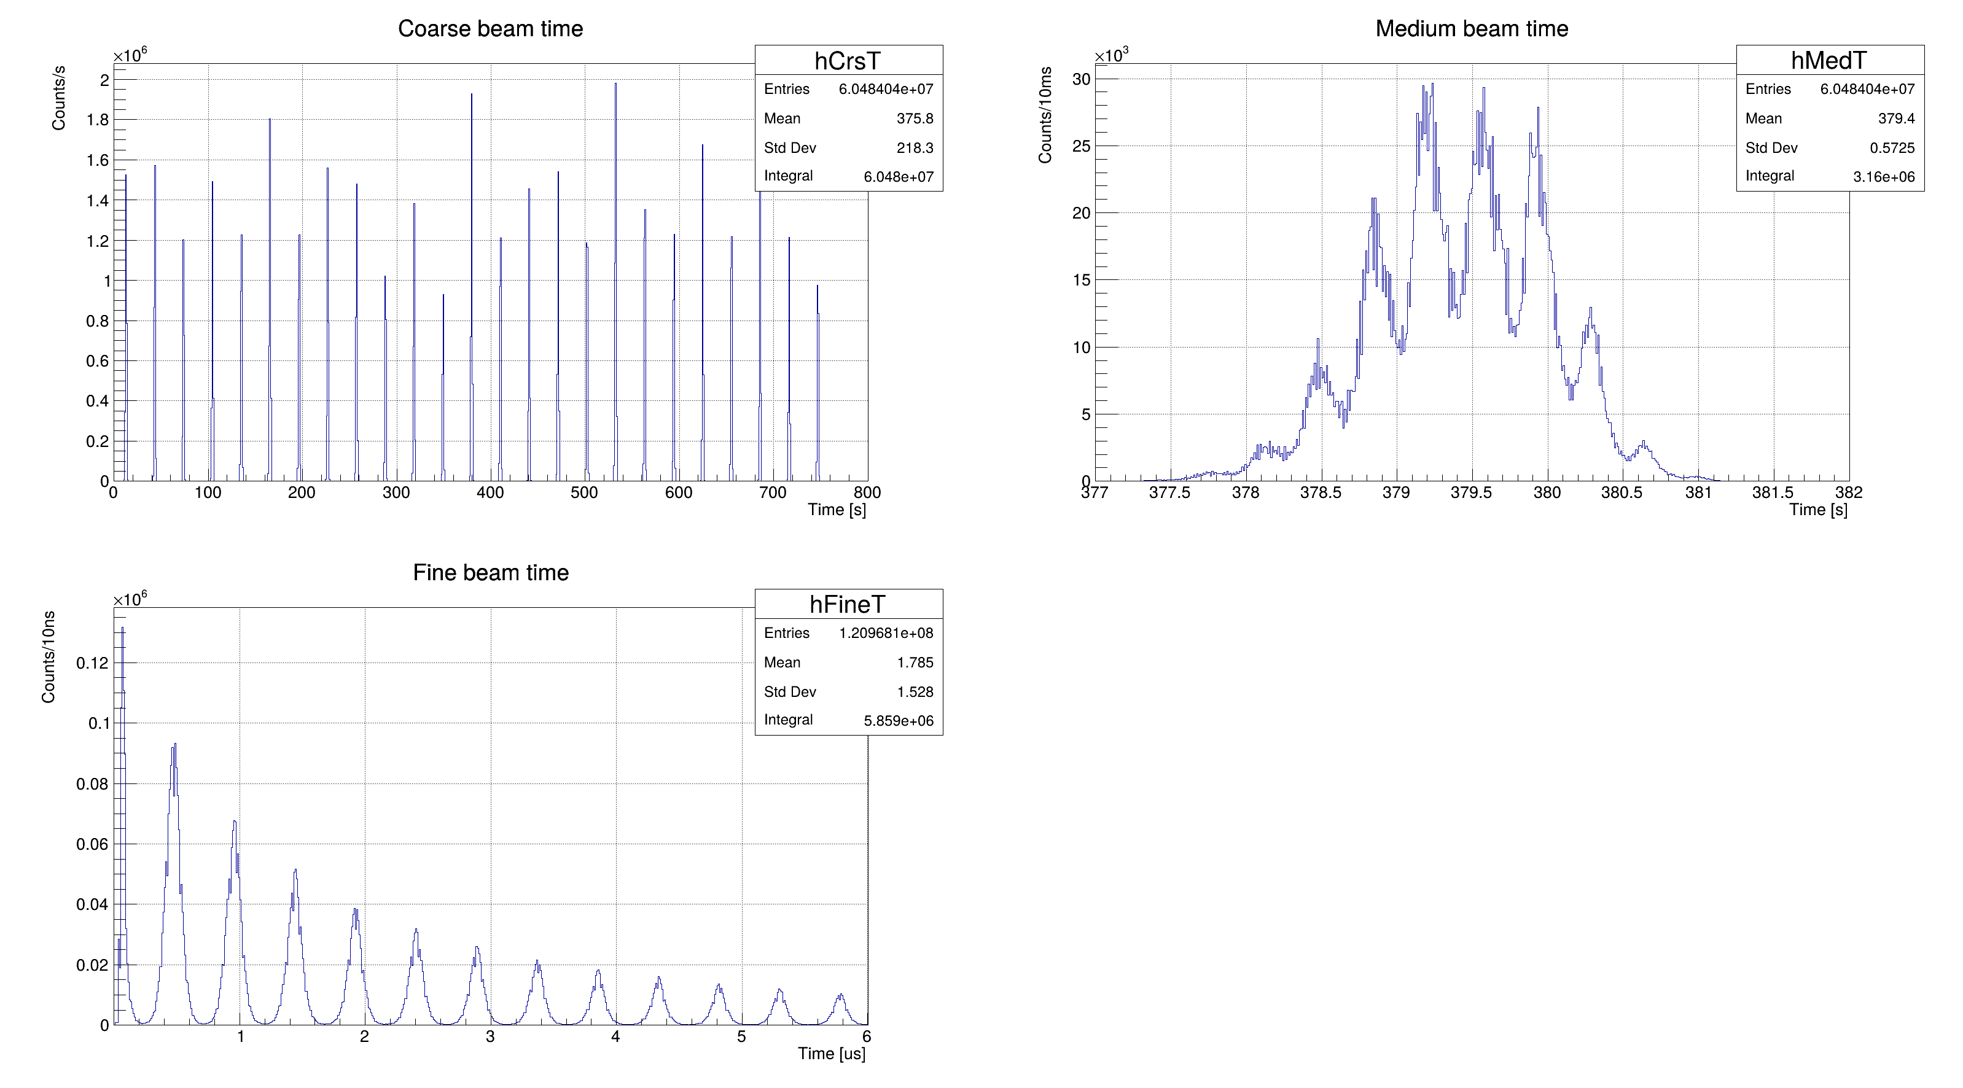
Beam microstructure
30 s
400 ms
~3 s
Single Beam Spill
Beam Period: 30 s
Beam Spill Duration: ~3 s
Intra-spill Microstructure: ~400 ms
6 μs Fine Microstructure:
Period: 480 ns
Fine Bunch Width: 300 ns
f > 1MHz
~300 ns
480 ns
6 μs Beam Microstructure
Notes:
We also investigated / the time structure / of the heavy-ion beam. //
As shown in this slide, / the beam has a period / of approximately 30 seconds, / with each beam spill / lasting around 3 seconds. //
Within a spill, / we observe a microstructure / on the scale of approximately 400 milliseconds. //
At a finer time scale, / the bunch period / is about 480 nanoseconds, / and the bunch width / is approximately 300 nanoseconds. //

Slide 25
4
Summary
Notes:
Finally, / I would like to summarize / this work. //

Slide 26
Summary
These results demonstrate that the developed readout electronics satisfies the requirements of the HIRIBL ToF detector system for high-rate beam experiments.
The next step, we will develop a custom CFD with higher counting rate, improved timing resolution, and LVDS output, while further extending the ToF system to include energy measurement.
Ultimately, we intend to conduct heavy-ion beam experiments at the HIAF-HIRIBL beamline to test its time performance and counting rate metrics.
Notes:
In this work, / we designed and developed / a complete readout electronics system / for the HIRIBL ToF detectors. //
The system combines / analog CFD processing, / NIM-to-LVDS level conversion, / and a 16-channel FPGA-based TDC. //
We also implemented / high-precision timing logic, / triggerless data acquisition, / multi-level buffering, / and condition monitoring. //
Experimental tests demonstrated / a time resolution of 24 picoseconds / in the laser test / and approximately 64 picoseconds / in the heavy-ion beam test. //
These results validate / the functionality / and promising timing performance / of the developed system. //
For future work, / we plan to develop / a customized CFD / with higher counting-rate capability, / improved timing resolution, / and direct LVDS output. //
We also intend / to extend the system / to include energy measurement. //
Finally, / we will conduct / further heavy-ion experiments / at the HIAF-HIRIBL beamline / to evaluate the timing performance / and high-rate capability / under its intended operating conditions. //

Slide 27
Thank You for Your Attention
Questions & Discussion
Presenter：Shihai Wen
Notes:
That concludes / my presentation. //
Thank you very much / for your attention. //
I would be happy / to answer any questions. //

