Slide 1


Study of the Readout Electronics for the Muon Tracking Detector System of the NA60+ Experiment
Chuan Ao Wang, Feng Li and Ge Jin
University of Science and Technology of China INSTR 2026, Hefei, China, 16 October 2026
Notes:
Good afternoon, everyone.
I'm Chuan Ao Wang from the University of Science and Technology of China.
Today, I'll present our work “Study of the Readout Electronics for the Muon Tracking Detector System of the NA60+ Experiment.”

Slide 2
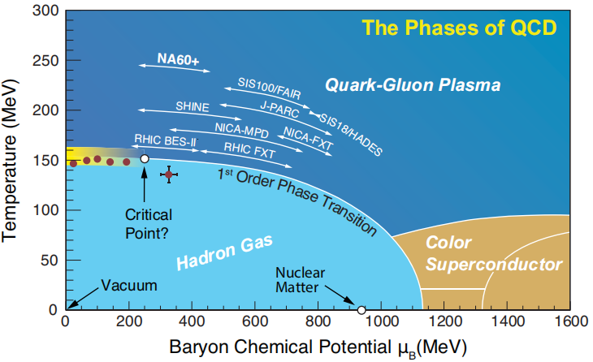
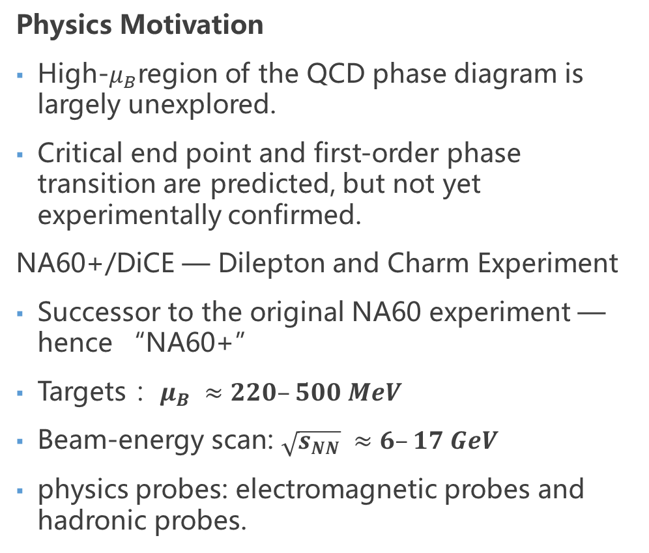
Physics Motivation of NA60+/DiCE
Physics Motivation
High-$μ_{B}$region of the QCD phase diagram is largely unexplored.
Critical end point and first-order phase transition are predicted, but not yet experimentally confirmed.
NA60+/DiCE — Dilepton and Charm Experiment
Successor to the original NA60 experiment — hence “NA60+”
Targets ：$μ_{B} ≈220–500 MeV$
Beam-energy scan: $\sqrt{s_{NN}} ≈6–17 GeV$
physics probes: electromagnetic probes and hadronic probes.
QCD Phase Diagram
Notes:
First, let me briefly introduce the physics motivation of NA60+/DiCE.
As shown in the QCD phase diagram, the region with high baryon chemical potential is still largely unexplored.
A critical end point and a first-order phase transition are predicted in this region, but they have not yet been confirmed experimentally.
NA60+/DiCE stands for Dilepton and Charm Experiment. It is the successor to the original NA60 experiment.
The experiment aims to explore this region through a beam-energy scan at CERN SPS, covering a baryon chemical potential of about 220 to 500 MeV and collision energies of around 6 to 17 GeV.
Both electromagnetic and hadronic probes will be used to study the properties of strongly interacting matter.

Slide 3
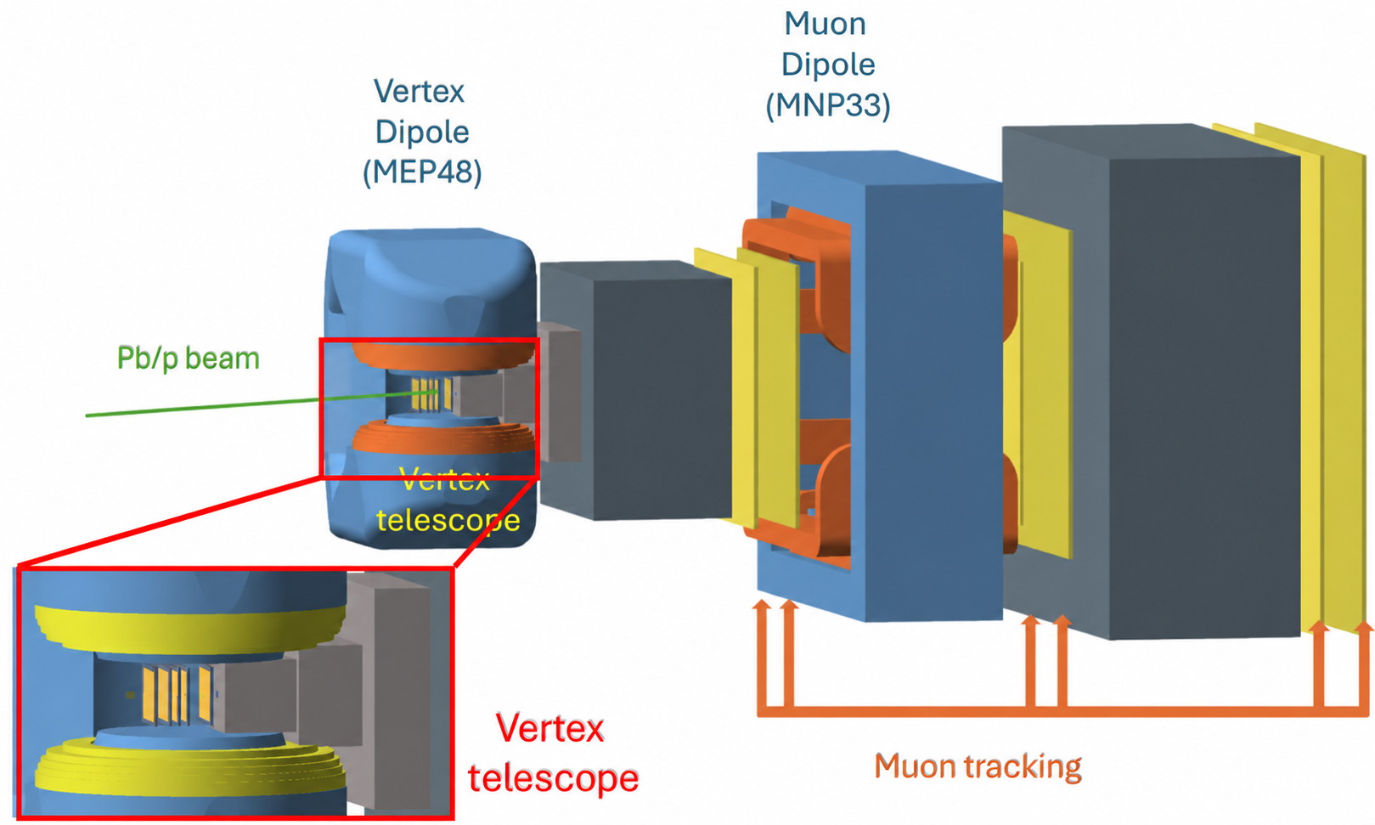
NA60+/DiCE Apparatus
Vertex Spectrometer
5 MAPS stations located upstream of the hadron absorber.
Provides precise tracking and vertex reconstruction.
Muon Spectrometer
6 Muon stations downstream of the absorber.
Measures muon trajectories and momentum through the MNP33 dipole magnet.
Track Matching
Combines vertex and muon tracking information.
Improves dimuon reconstruction for thermal radiation, charm, and quarkonium studies.
NA60+/DiCE Experimental Setup
Notes:
This slide shows the overall experimental setup of NA60+/DiCE.
The experiment has two main tracking systems: the Vertex Spectrometer and the Muon Spectrometer.
The Vertex Spectrometer consists of five silicon pixel stations. It measures particle tracks near the interaction point and provides precise vertex information.
After the hadron absorber, the Muon Spectrometer uses six tracking stations to measure the trajectories of penetrating muons.
By matching tracks from the two spectrometers, we can improve the measurement of muon kinematics and the reconstruction of dimuon pairs.
These measurements are important for physics studies such as thermal radiation, charm production, and quarkonium production.
Since our work focuses on the Muon Spectrometer, I'll introduce this detector in more detail.

Slide 4
Muon Spectrometer Stations
Upstream Tracking
Downstream Tracking
Muon identification
MNP33
dipole
magnet
Muon
Wall
Particles
From collision
Hadron absorber
MS0
MS1
MS2
MS3
MS4
MS5
Measure the track direction after the hadron absorber and before MNP33.
Combined with MS0 and MS1 for momentum determination.
Confirm penetrating tracks for additional muon identification.
Muon Spectrometer Station Functions
Notes:
The Muon Spectrometer contains six stations, from MS0 to MS5.
They can be divided into three groups according to their functions.
First, MS0 and MS1 are located after the hadron absorber and before the MNP33 dipole magnet.
They measure the muon tracks before entering the magnetic field.
Then, the muons pass through the magnet and are deflected by the magnetic field.
MS2 and MS3 measure the tracks after the magnet.
By comparing the track directions before and after the magnetic field, we can determine the muon momentum.
Finally, MS4 and MS5 are located behind the Muon Wall and are mainly used for additional muon identification.

Slide 5
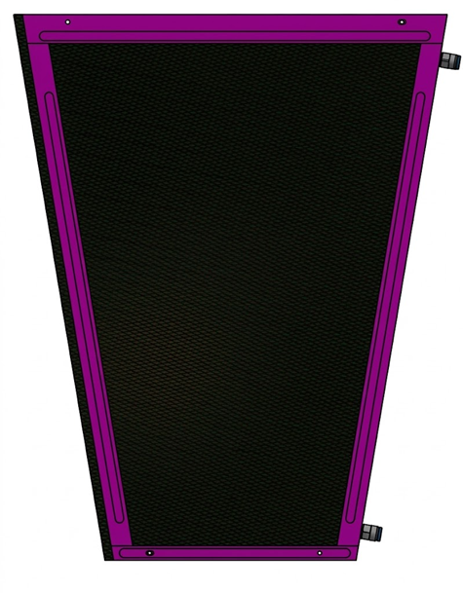
MWPC Detector
MWPCs are adopted for muon station after the hadron absorber.
Two-dimensional strip readout provides precise hit-position measurement.
Large-area MWPCs provide the required tracking capability for the Muon Spectrometer.
MWPC Readout Board
Notes:
For these tracking stations, the experiment uses Multi-Wire Proportional Chambers, or MWPCs.
MWPCs are suitable for covering the large detector area required by the Muon Spectrometer.
The detector uses two-dimensional strip readout to measure the particle hit positions.
To obtain precise position information, the readout electronics need to measure the detector signals accurately.
This is one of the main motivations for developing our MWPC readout system.

Slide 6
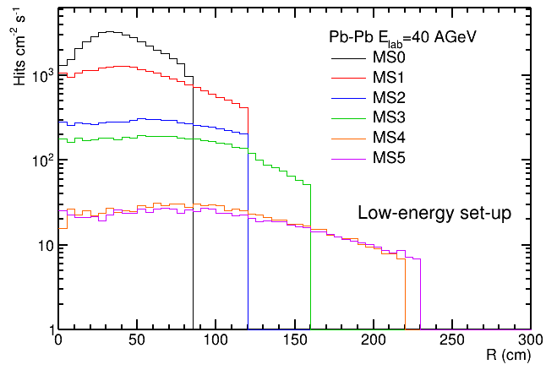
Simulation & Readout Requirements
Particle fluence decreases significantly from MS0 to MS5.
MS0–MS3 require high-precision tracking: spatial resolution of 0.1–0.2 mm in the precision coordinate.
MS0 is the most demanding station, with a peak particle fluence of about 3.5 × 10³ cm⁻² s⁻¹.
Particle Flux Distribution
Notes:
This slide shows the simulation results for the Muon Spectrometer.
As we can see, the particle flux decreases significantly from MS0 to MS5.
MS0 has the highest particle flux, reaching about 3.5 thousand particles per square centimeter per second.
Meanwhile, MS0 to MS3 require high-precision tracking, with a spatial resolution of about 100 to 200 micrometers in the precision coordinate.
So, the readout system needs to provide both precise hit-position measurement and sufficient rate capability.
These requirements guide our readout system design.

Slide 7
Readout Architecture
Front-End Electronics
Interfaces with the MWPC detector and performs front-end signal processing.
Data Acquisition
Collects, processes, and organizes data from multiple front-end channels.
Host-PC Interface
Provides system control, online monitoring, and data management.
MWPC
FEE
DAQ
Host PC
Overall Readout Architecture
Notes:
Now, let's look at the overall readout architecture.
The system consists of three main parts: front-end electronics, data acquisition, and the host PC.
First, the front-end electronics receive and process signals from the MWPC detector.
Then, the DAQ collects and organizes data from multiple front-end channels.
Finally, the data are sent to the host PC for system control, online monitoring, and data storage.
The system also supports communication in the reverse direction for configuration and control.
Next, I'll introduce the main components in more detail.

Slide 8
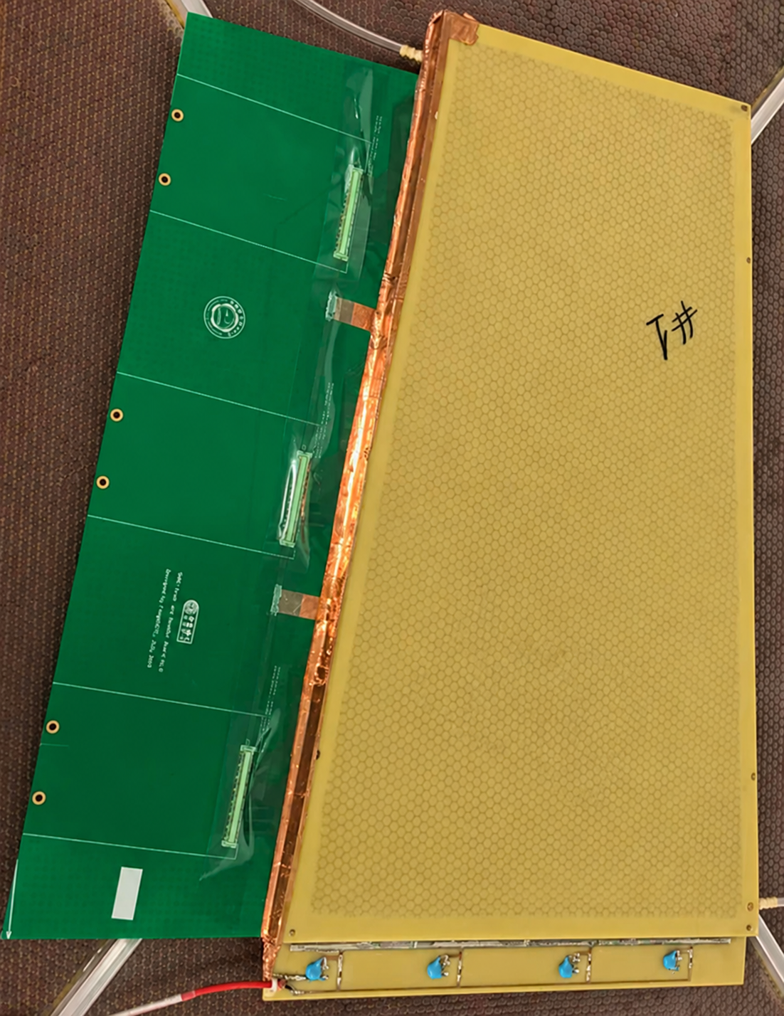
MWPC
Trapezoidal MWPC chamber with 2D strip readout.
Readout board size: 461 mm × 423 mm.
384-channel 2D X/Y readout.
3 connectors: 64 X + 64 Y channels per connector.
MWPC chamber
Notes:
This slide shows the MWPC prototype and its readout board.
The prototype uses a trapezoidal structure and is about half the size of the final readout module.
The readout board measures 461 by 423 millimeters.
It provides two-dimensional X and Y signal readout through three connectors.
Each connector has 64 X signals and 64 Y signals, giving a total of 384 readout signals.
For this prototype, we use three FEE boards to read out these signals.

Slide 9
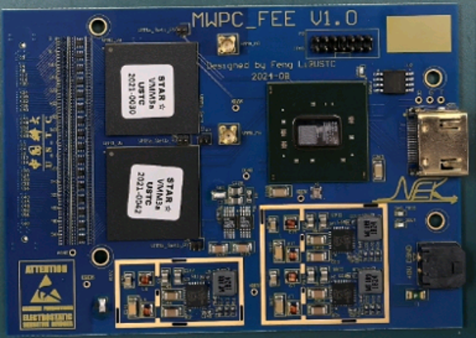
Front-End Electronics
VMM3a-based Front-End
64 channels per VMM3a ASIC.
2 VMM3a ASICs provide 128 channels per FEE.
Charge amplitude are digitized on-chip.
FPGA-based Control and Readout
Kintex-7 FPGA configures the VMM3a ASICs.
Hit information is collected and formatted by the FPGA.
Data are transferred to the DAQ through the FEE interface.
Front-end ASIC x2
Data Processing Chip
Interface to DAQ
VMM3a-Based 128-Channel Front-End Board
Notes:
Next are the front-end electronics.
Each FEE board contains two VMM3a ASICs.
Each VMM3a has 64 channels, so one FEE board provides 128 readout channels.
The VMM3a ASICs handle the detector signals and digitize the charge amplitude and timing information.
A Kintex-7 FPGA is used to configure the VMM3a ASICs, collect the hit data, and organize the data for transmission.
The processed data are then sent to the DAQ through the FEE interface.

Slide 10
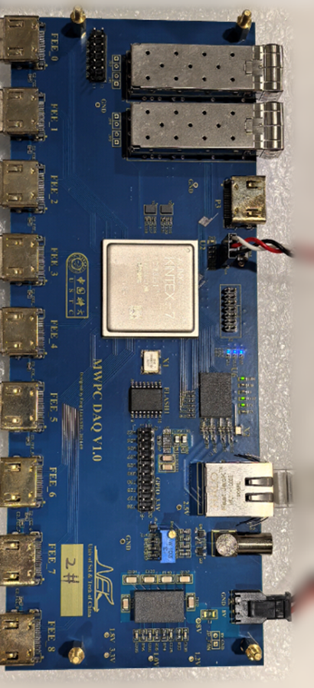
DAQ Board and Data Transmission
Multi-FEE Readout
Supports configuration and readout of multiple FEE boards.
Up to 9 FEE boards in the prototype system.
FPGA-Based Data Processing
Receives and aggregates data from the FEE boards.
FPGA collects and packages data from the FEE boards.
Host-PC Communication
Packaged data are transferred through a Gigabit network interface.
Data are processed and displayed on the host PC.
Data Processing ASIC
FEE Interfaces x9
RJ45
DAQ Board for MWPC Readout
Notes:
The DAQ board collects data from multiple FEE boards.
In the prototype system, it can support up to nine FEE boards.
The FPGA on the DAQ receives data from the front-end boards, combines the data, and packages them for transmission.
The data are then transferred to the host PC through Gigabit Ethernet.
So, the DAQ provides the connection between the front-end electronics and the host-PC software.

Slide 11
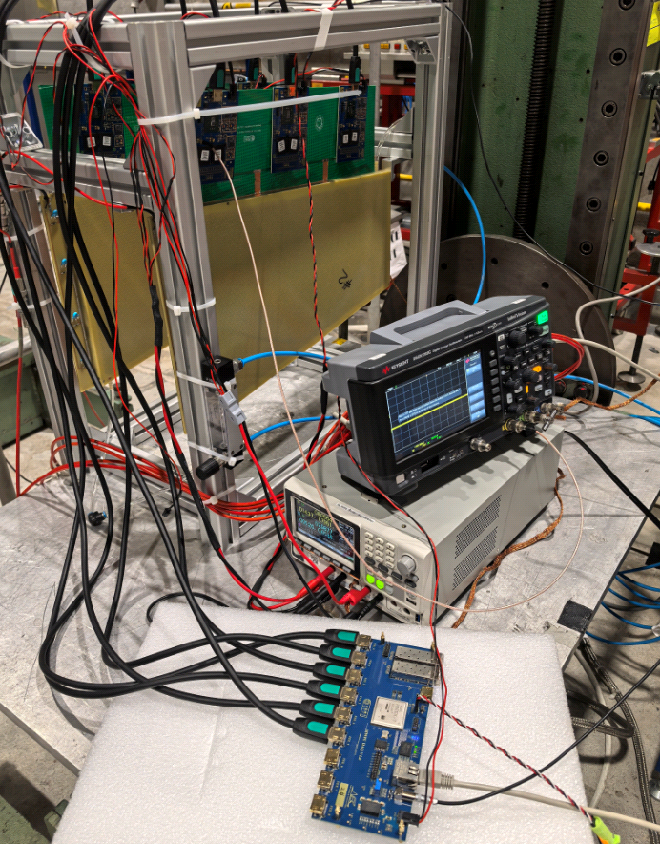

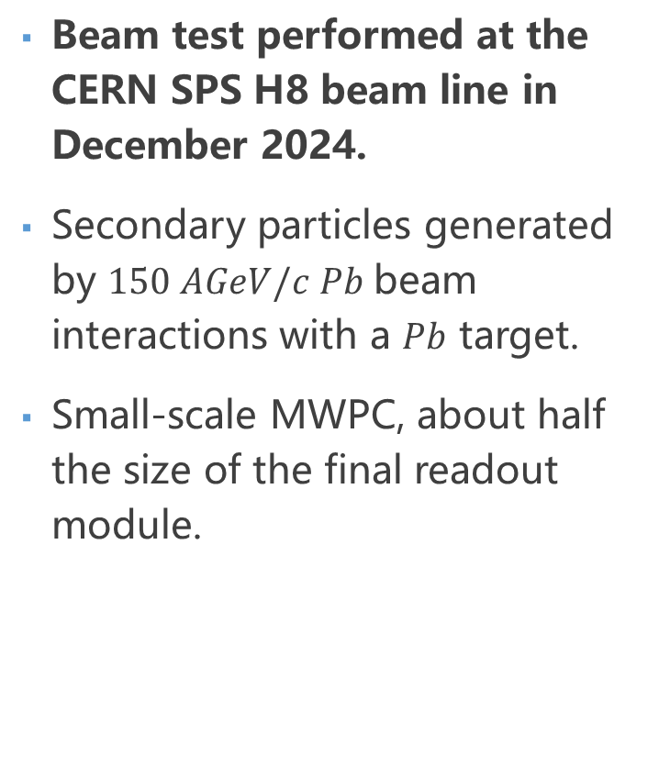
Beam-Test Setup
Beam test performed at the CERN SPS H8 beam line in December 2024.
Secondary particles generated by $150 AGeV/c Pb$beam interactions with a $Pb$ target.
Small-scale MWPC, about half the size of the final readout module.
FEE x6
MWPC x2
11
DAQ
Beam-Test Setup at CERN SPS H8
Notes:
Next, let's move on to the beam test.
We tested the MWPC Prototype-2 system at the CERN SPS H8 beam line in December 2024.
The test used secondary particles produced by interactions of a lead beam with a lead target.
The lead-beam momentum was 150 GeV per c per nucleon.
The setup included two MWPC prototypes, six FEE boards, and a DAQ board.
Each MWPC prototype was connected to three FEE boards.
During the test, we operated the complete readout chain, from detector signal acquisition to data transmission and online monitoring.
The goal was to evaluate the performance of the detector together with the readout electronics.

Slide 12
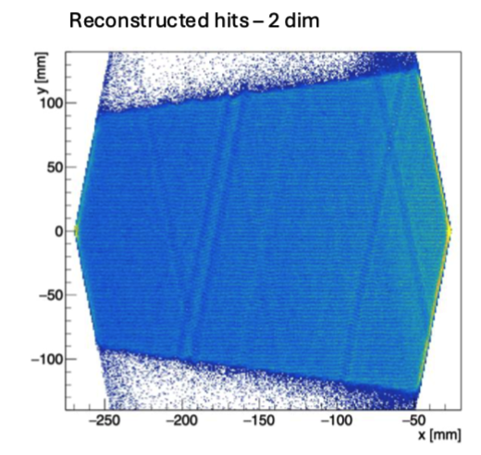
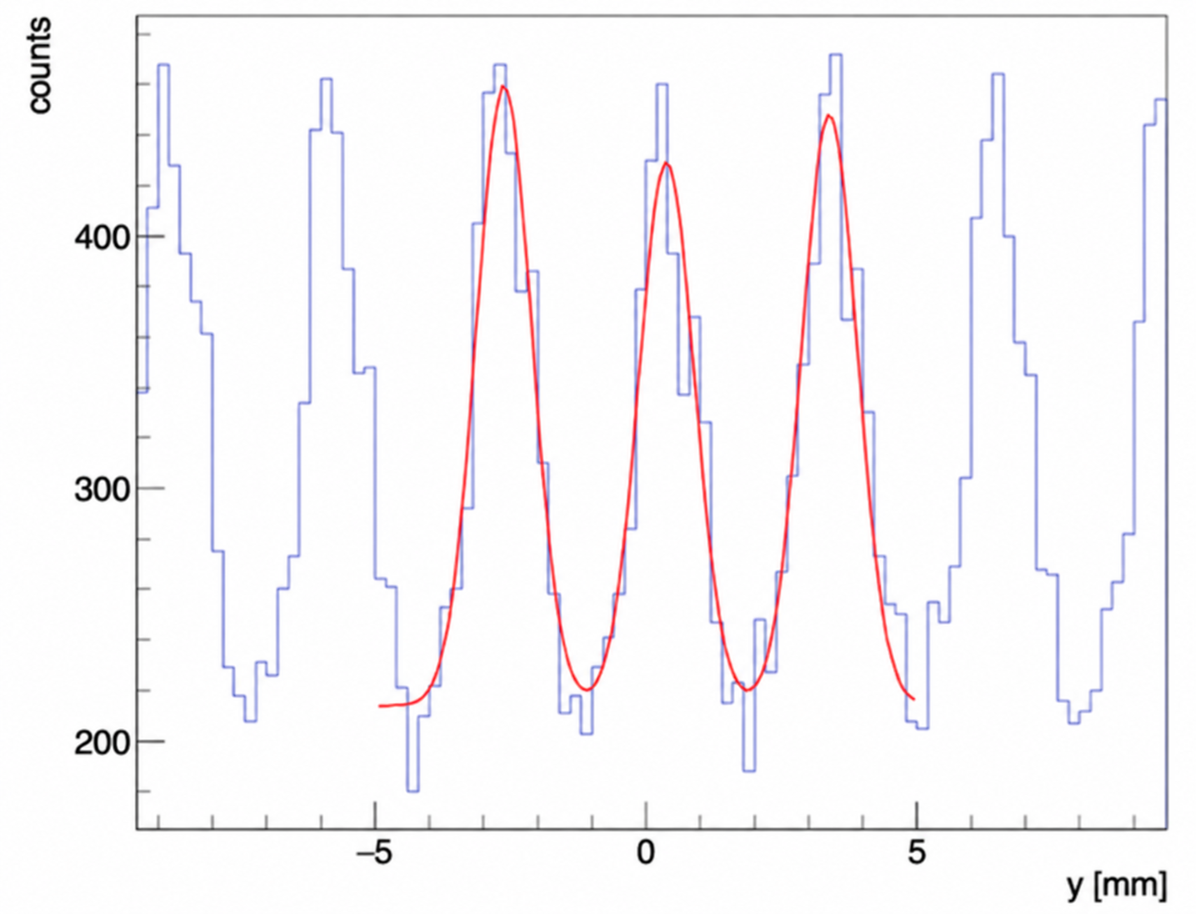
Beam-Test Performance (from collaboration analysis)
Beam-Test Performance
Single-hit spatial resolution: ~100 μm.
Detection efficiency: >97%.
Reconstructed hits – 2 dim
Reconstructed hits – y projection
Notes:
Here are the main results from the beam test, based on the collaboration analysis.
The plots show the reconstructed two-dimensional hit distribution and the hit projection in one coordinate.
Using the strip signals, the hit positions can be determined with high precision.
The results show a single-hit spatial resolution of about 100 micrometers.
The detection efficiency was above 97 percent.
These results show that the MWPC prototype and its readout system performed well during the beam test.
They also provide a good starting point for the development of the upgraded readout system.

Slide 13
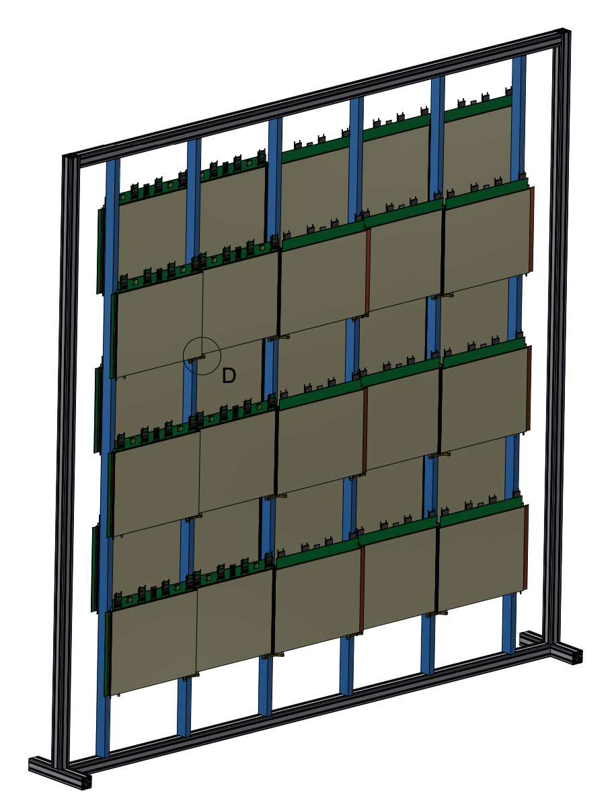
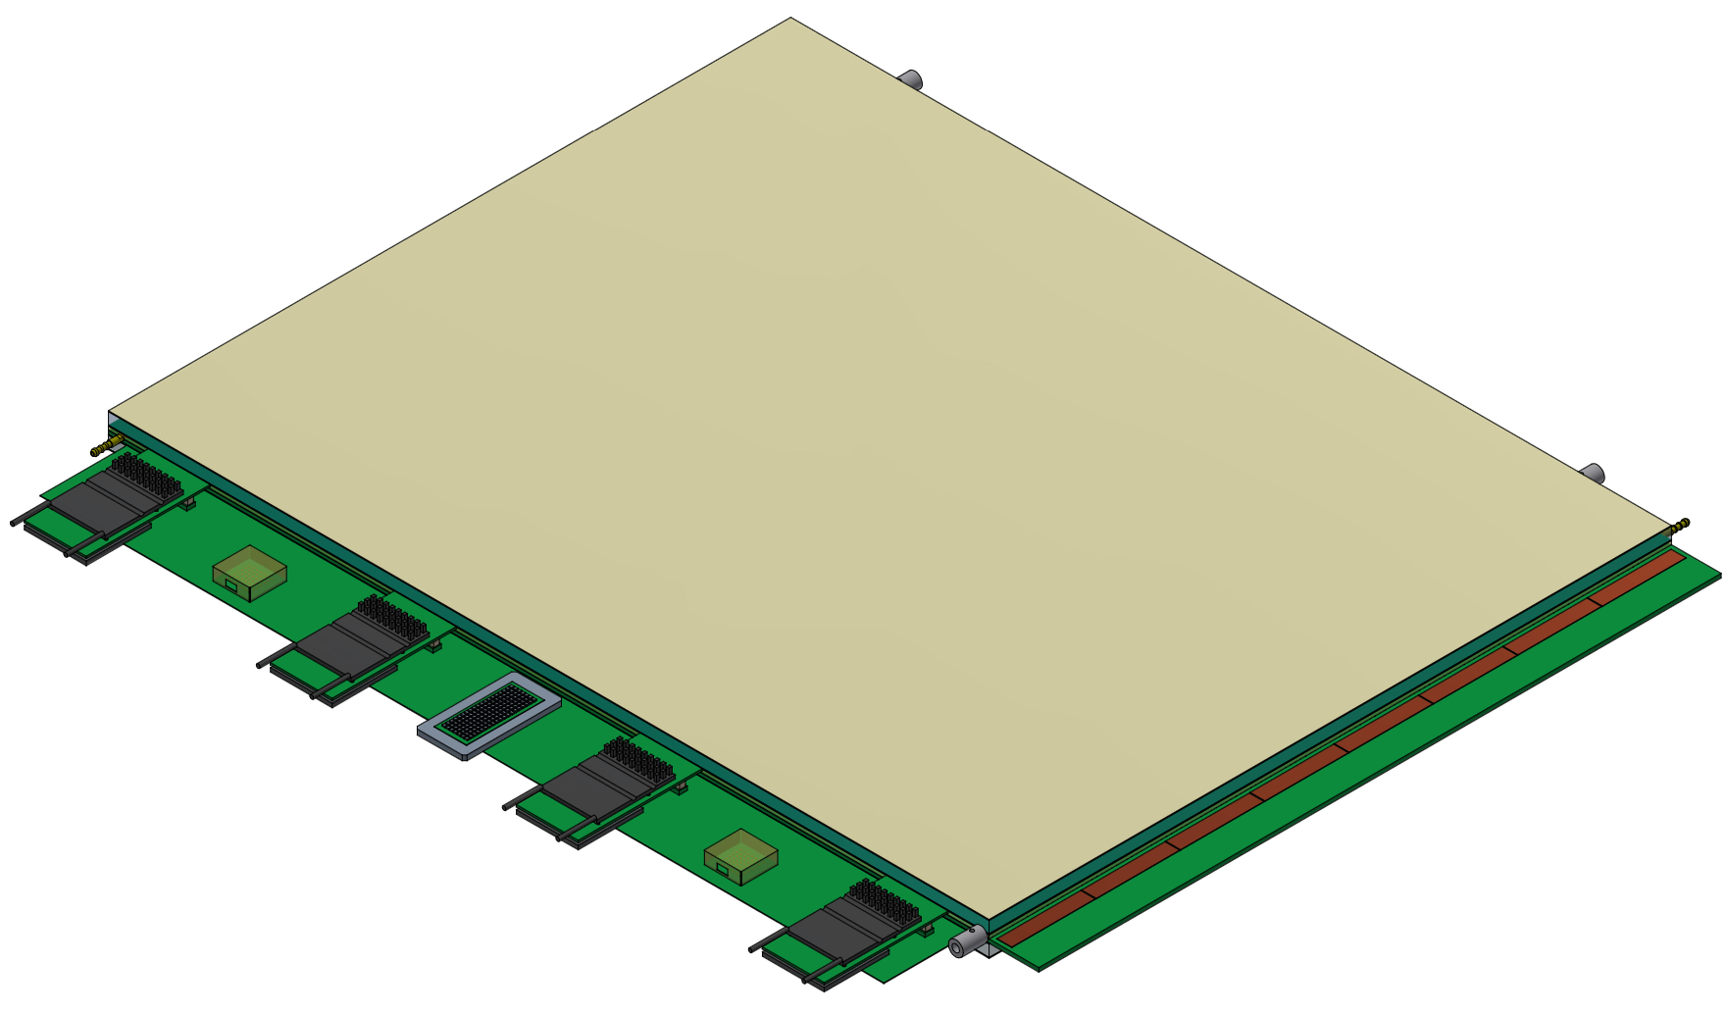
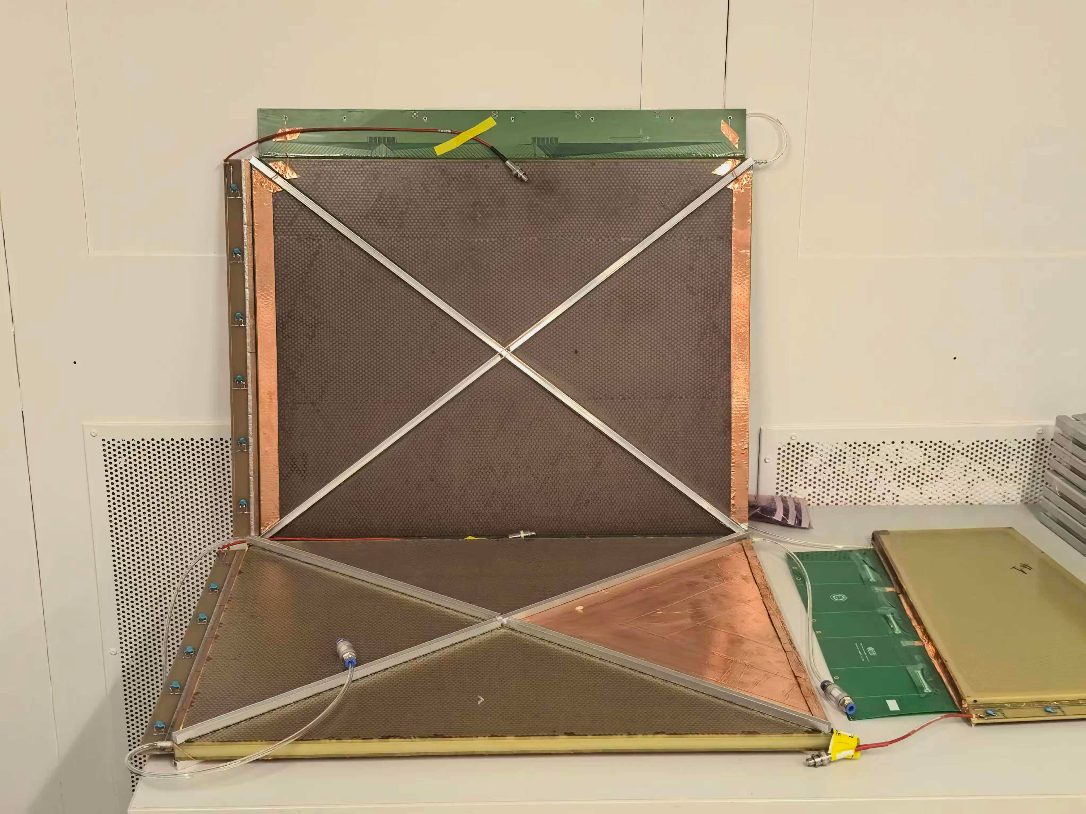
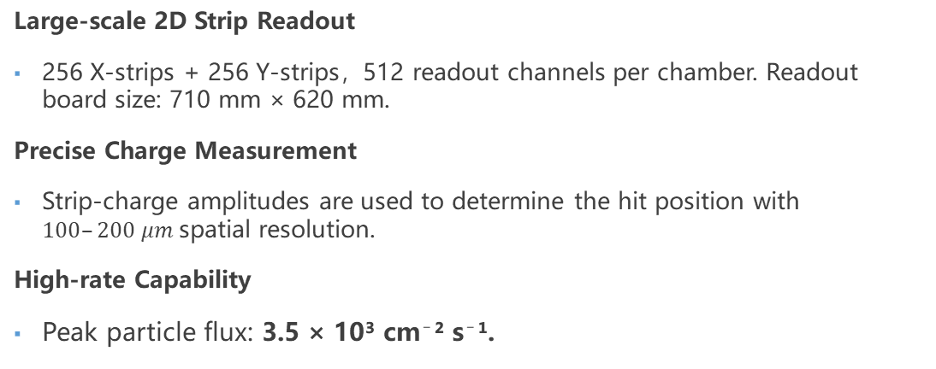
Readout Requirements
Large-scale 2D Strip Readout
256 X-strips + 256 Y-strips，512 readout channels per chamber. Readout board size: 710 mm × 620 mm.
Precise Charge Measurement
Strip-charge amplitudes are used to determine the hit position with $100–200 μm$spatial resolution.
High-rate Capability
Peak particle flux: 3.5 × 10³ cm⁻² s⁻¹.
MS Station Layout
MWPC Readout Module
MWPC chamber
Notes:
After the prototype test, our next step is to develop a larger readout system for the Muon Spectrometer.
For the upgraded system, each MWPC chamber requires 256 X strips and 256 Y strips.
That means 512 readout channels per chamber.
To achieve a spatial resolution of 100 to 200 micrometers, we need to measure the charge amplitudes from the strips.
At the same time, the system needs to handle high particle rates, especially at the upstream stations.
With these requirements in mind, we are developing a new readout architecture.

Slide 14
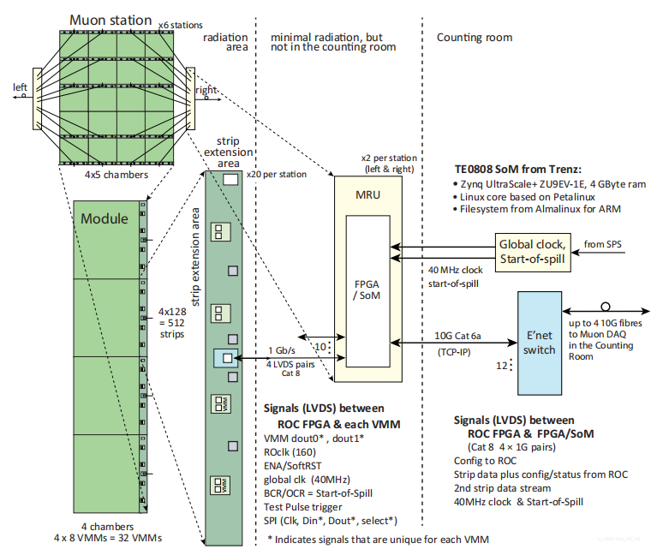
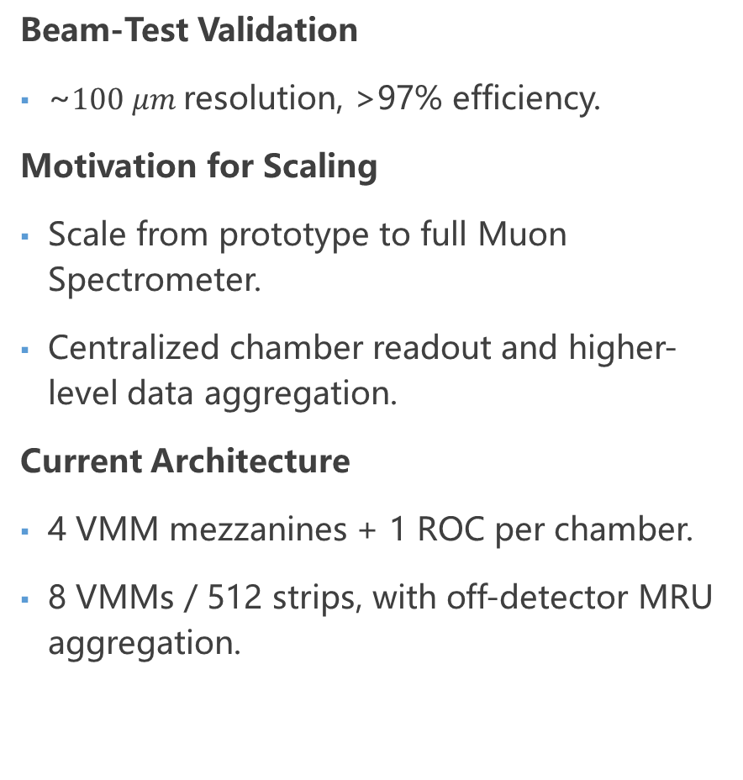
From Beam-Test to Current Readout Architecture
Beam-Test Validation
~$100 μm$resolution, >97% efficiency.
Motivation for Scaling
Scale from prototype to full Muon Spectrometer.
Centralized chamber readout and higher-level data aggregation.
Current Architecture
4 VMM mezzanines + 1 ROC per chamber.
8 VMMs / 512 strips, with off-detector MRU aggregation.
Current Readout Architecture
Notes:
The main change from the beam-test prototype is the move toward centralized chamber-level readout. In the previous system, each FEE board had its own FPGA for configuration and data readout.
In the new design, these functions are moved to a centralized Readout Controller, or ROC.
Each chamber contains four front-end boards with eight VMM ASICs, providing 512 readout channels.
One ROC controls all four front-end boards.
This makes the front-end electronics simpler and helps us expand the system to a larger number of chambers.
For the final system, an additional data-aggregation stage using an MRU is also being considered.

Slide 15
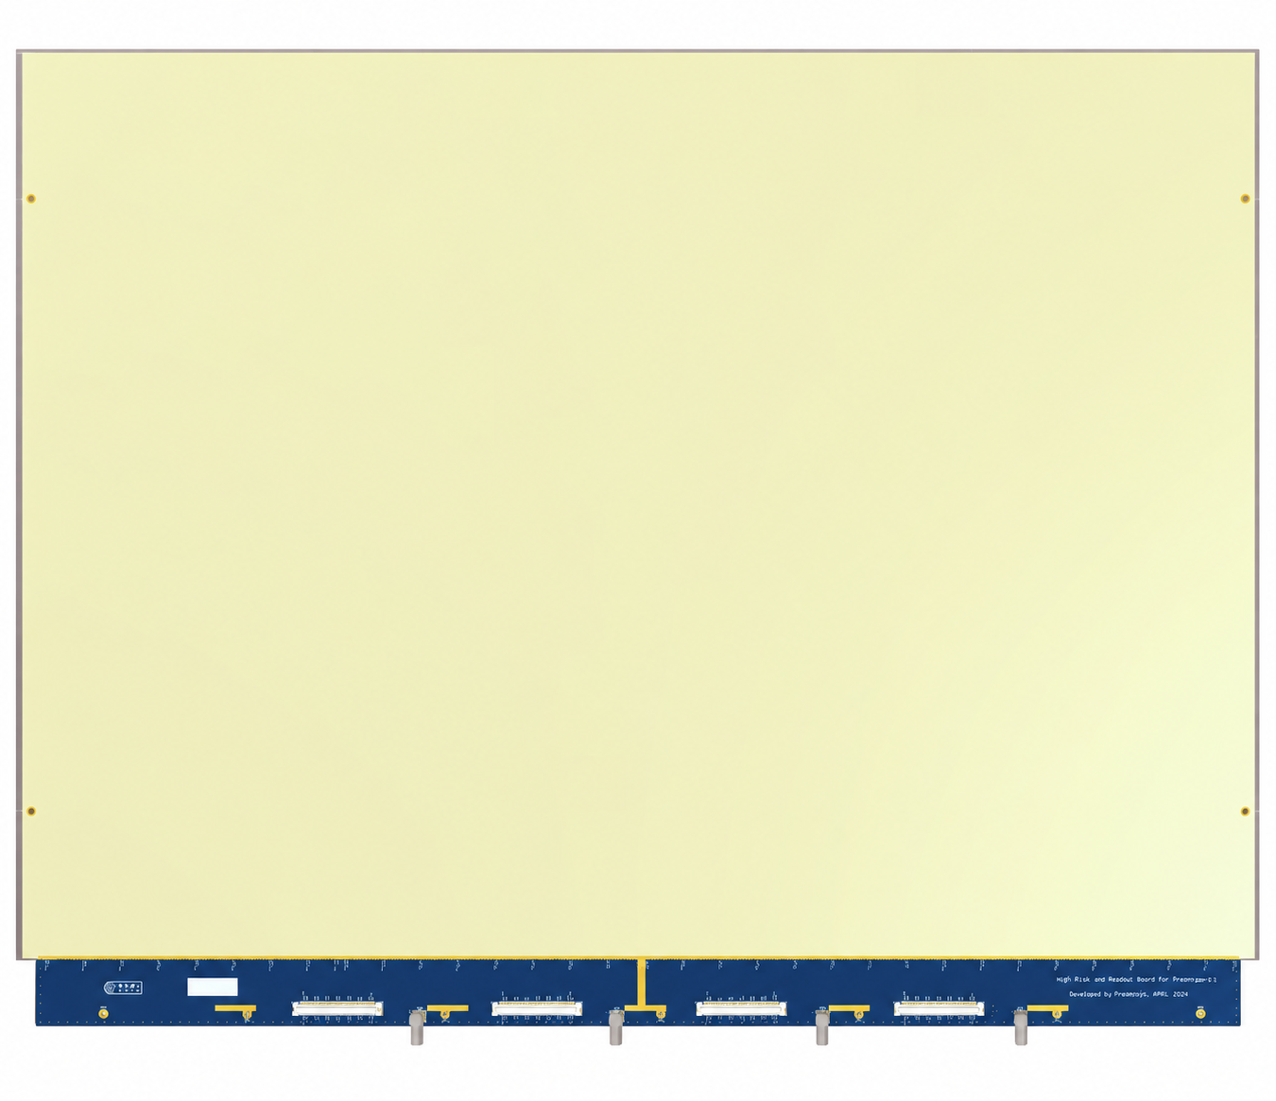
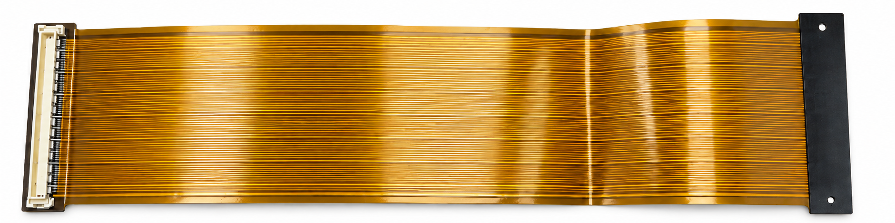
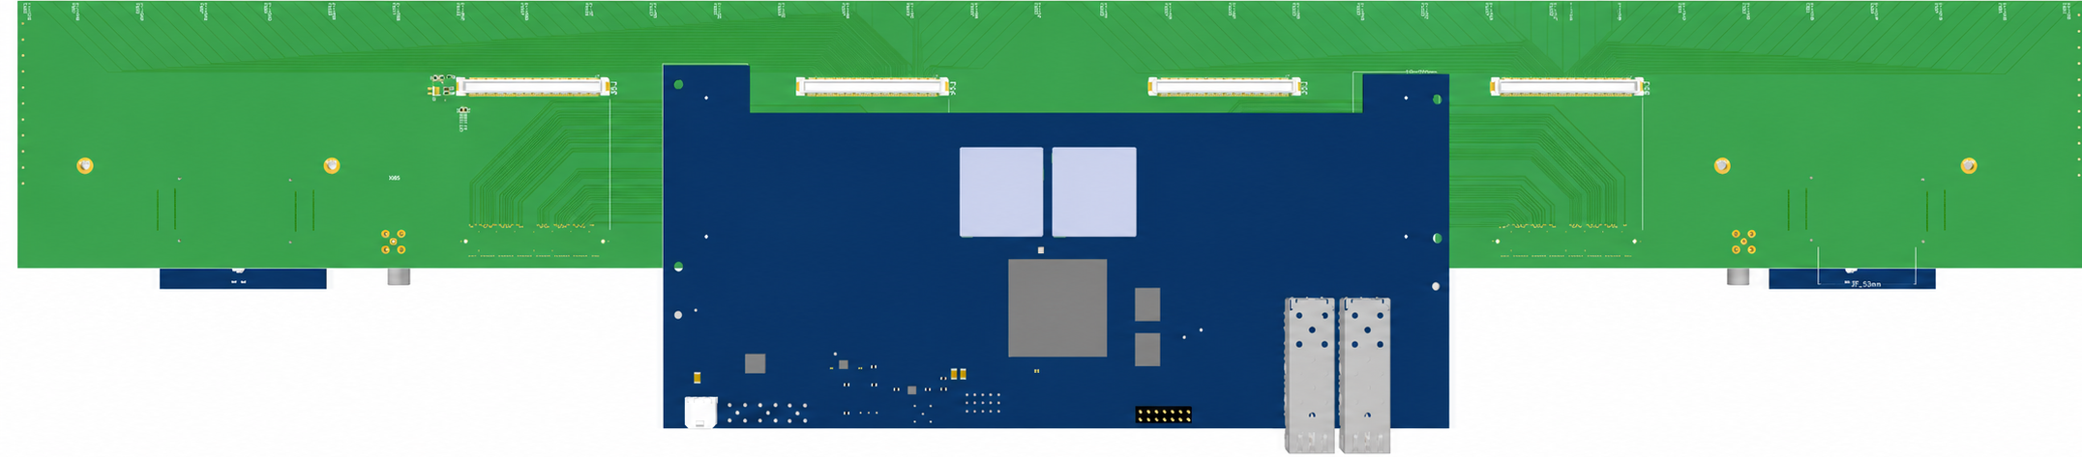
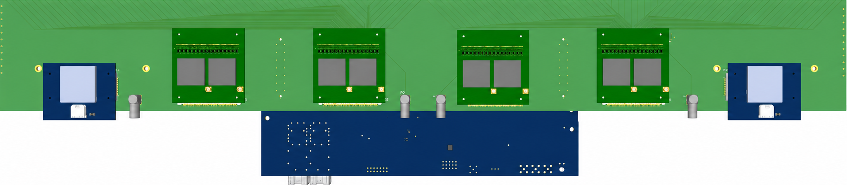
Integrated Chamber Readout System
Flexible Readout Cable
Power
FEE_V3.0 x4
Power
Base board
ROC
Integrated Chamber Readout Electronics
ROC Side
Integrated Chamber Readout Electronics
FEE Side
Notes:
This slide shows the current integrated chamber-level readout system.
The MWPC detector is connected to the front-end electronics through the flexible readout cable, which transfers the detector signals to the FEE boards.
Each chamber consists of four FEE_V3.0 boards and one ROC_V2.0, providing 512 readout channels.
The FEE boards perform front-end signal processing, while the ROC provides centralized configuration, control, and data readout.
The current work focuses on the integration and validation of the complete detector-to-readout chain.

Slide 16
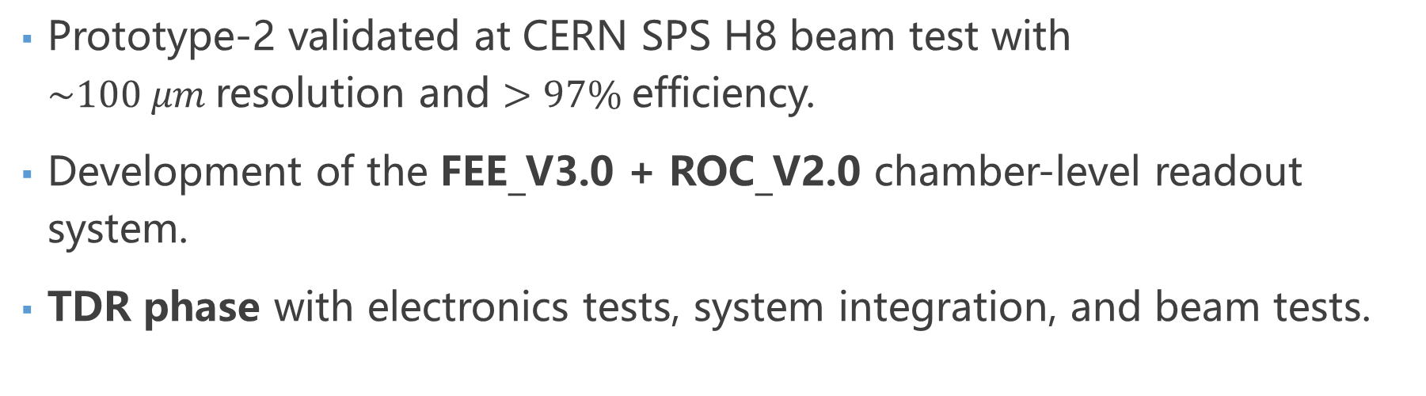
Summary and Outlook
Prototype-2 validated at CERN SPS H8 beam test with $\sim 100 μm$resolution and $>97\%$efficiency.
Development of the FEE_V3.0 + ROC_V2.0 chamber-level readout system.
TDR phase with electronics tests, system integration, and beam tests.
Notes:
To summarize, our work has three main parts.
First, we tested the Prototype-2 readout system at CERN SPS, achieving about 100 micrometers spatial resolution and more than 97 percent detection efficiency.
Second, we are now developing a new chamber-level readout system based on FEE_V3.0 and ROC_V2.0.
Finally, as the project moves toward the Technical Design Report, or TDR, phase, we plan to carry out further electronics tests, system integration, and beam tests.
These efforts will support the development of the final readout system for the NA60+/DiCE Muon Spectrometer.

Slide 17
Thanks！
请提宝贵意见

