Slide 1


The beam-particle monitor for the HIRFL-CSR external target experiment
Chaosong Gao, Ming Yang, Hulin Wang, Jun Liu, Xianglun Wei, Xiangming Sun, On behalf of the CEE Beam Monitor Group
Central China Normal University

Slide 2
Outline
  Introduction
  Beam particle monitor
  Topmetal-CEE ASIC
  Test results
  Summary

Slide 3
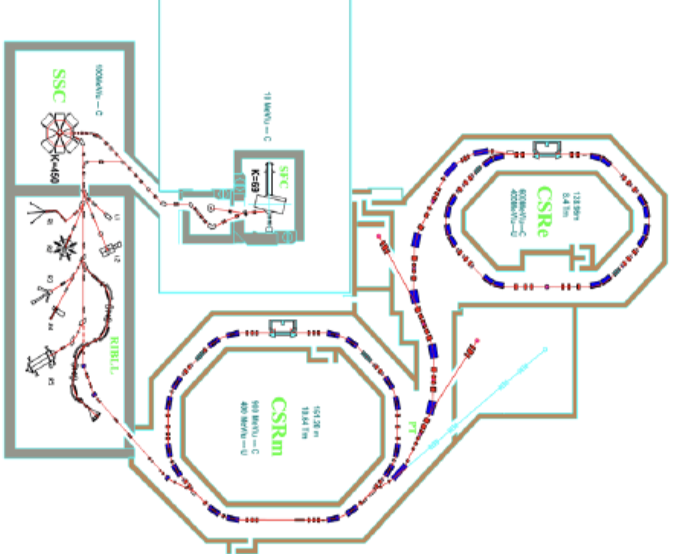
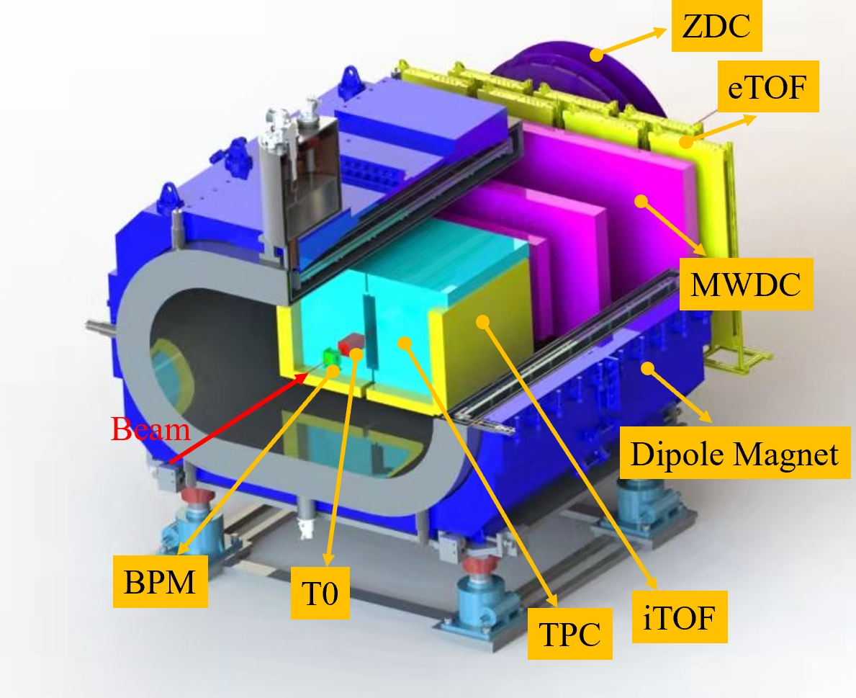
Introduction
Heavy Ion Research Facility in Lanzhou Cooling-Storage-Ring system (HIRFL-CSR)
CSR External-target Experiment (CEE)
Study the properties of nuclear matter at high baryonic density
Fixed target, with heavy-ion (up to U) beam energy: ~0.4 - 1.1 GeV/u
Maximum event rate: 10⁴ s⁻¹

Slide 4
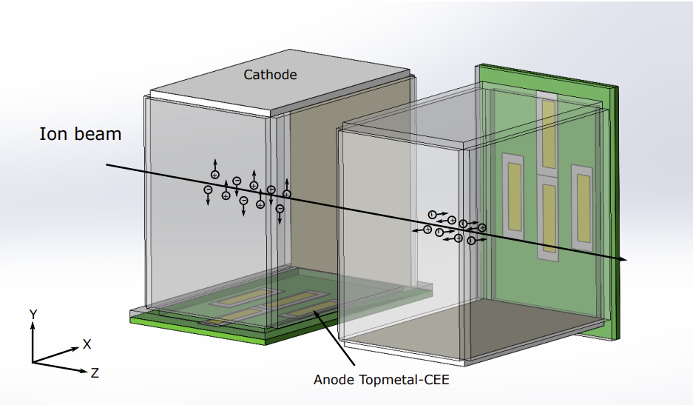
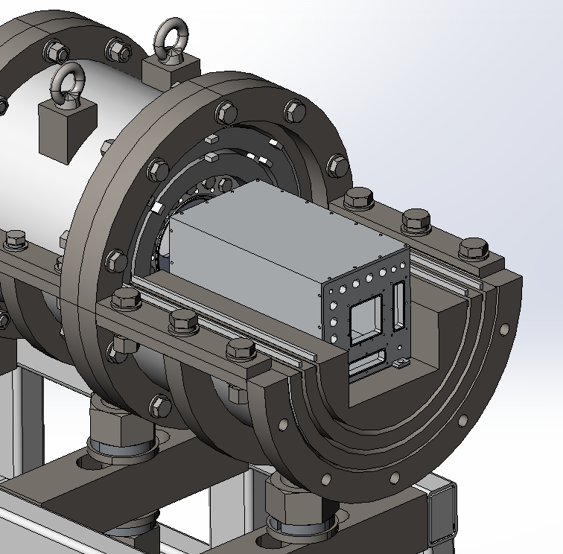
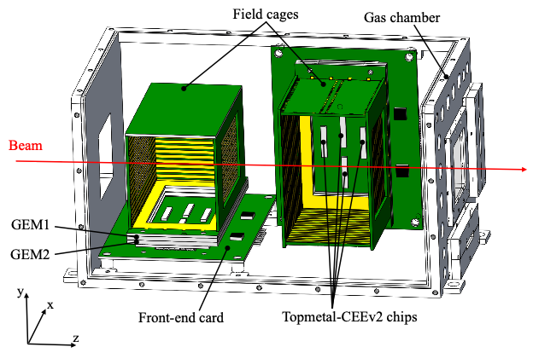
Beam particle monitor (BPM)
BPM:
Placed upstream of the fixed target in a magnetic shield
Measure the position of each beam particle
Two micro-TPCs in a gas vessel, with electric field orthogonal to each other
Main design parameters:
  Position resolution : 50 μm
  Time resolution: 1 μs
  Maximum event rate: ~1 MHz
  Sensitive area: 30×30 mm²
Working principle:
  Ionizing the gas along the path
  Collect the electrons and read out the signals.
  The Y–Z plane provides the Y position
  The X–Z plane provides the X position
  Position measured in two readout planes

Slide 5
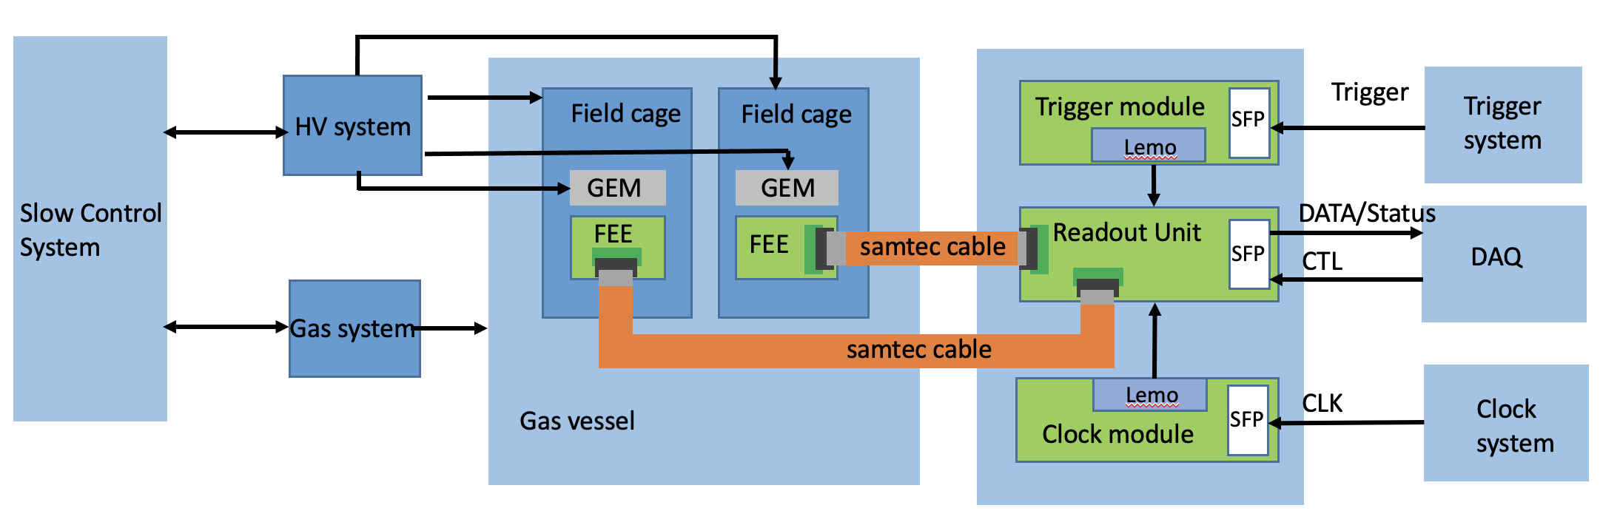
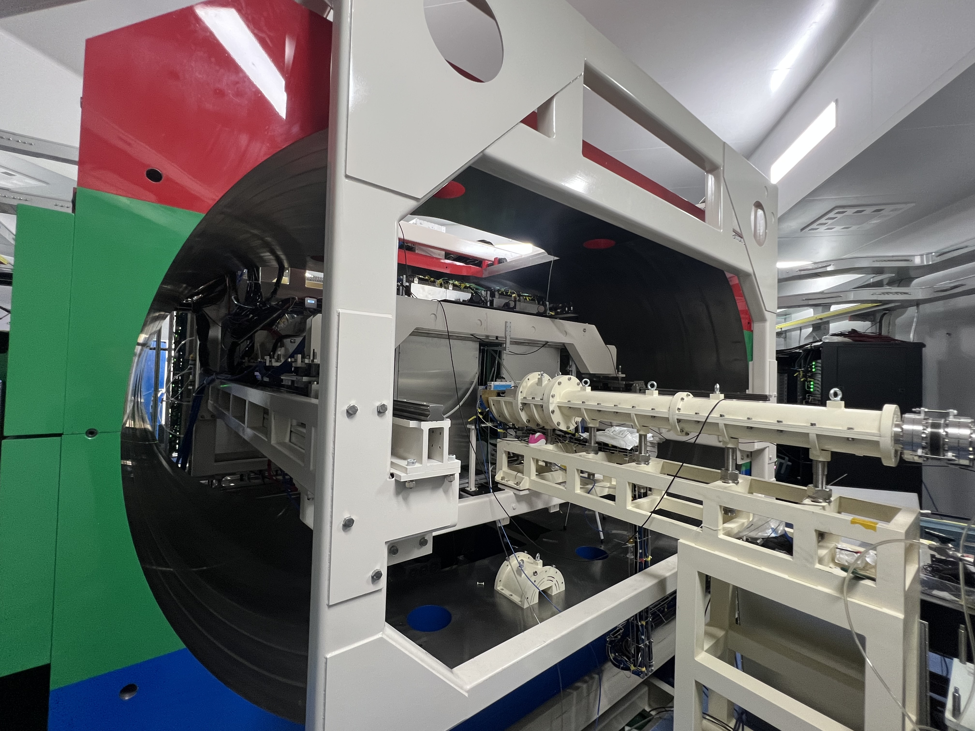
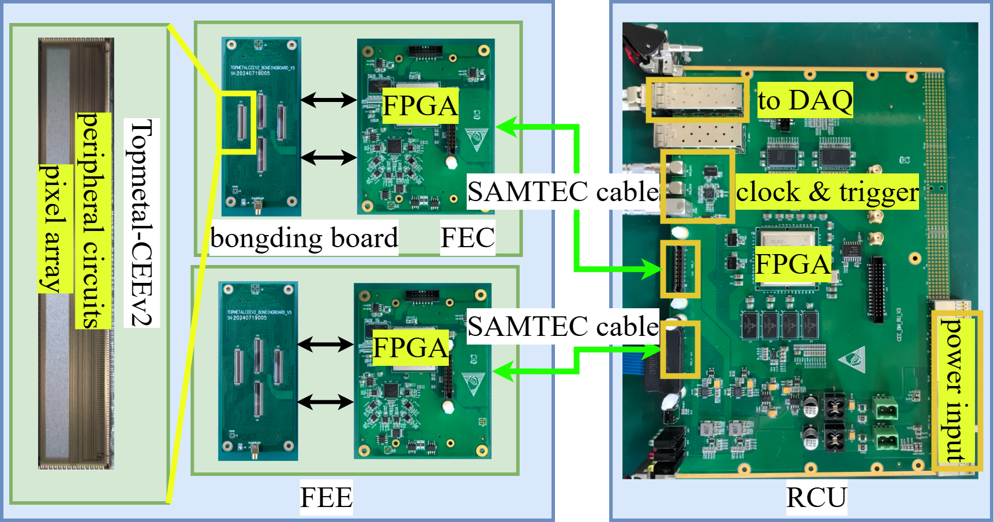
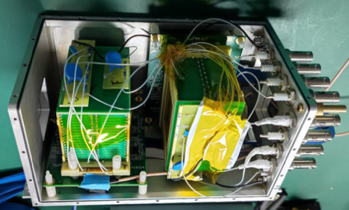
BPM system diagram
Slow control system, detector with front-end electronics, and the back-end electronics.
The entire detector is placed inside a magnetic shielding enclosure.

Slide 6
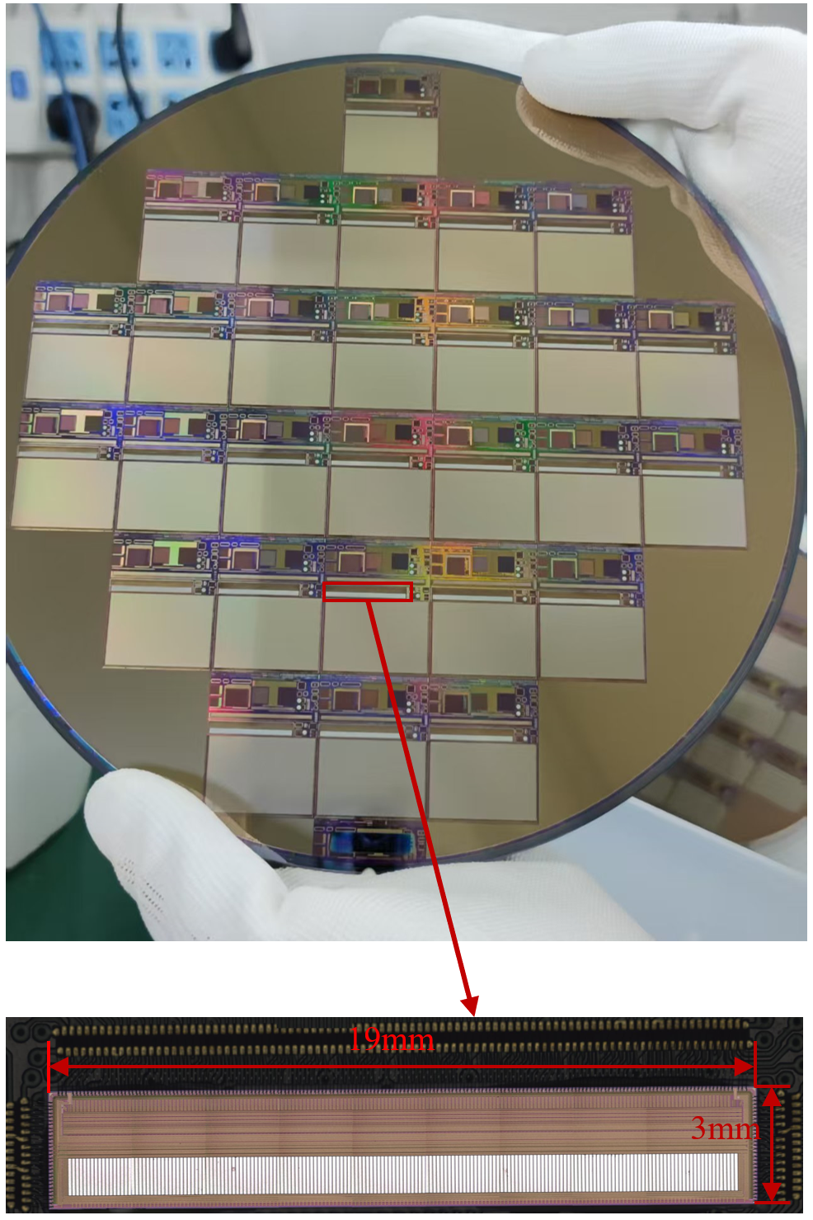
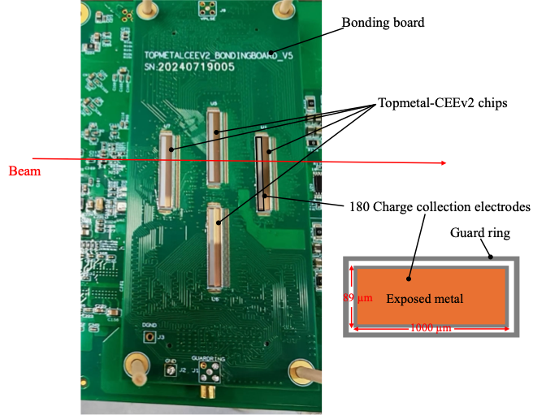
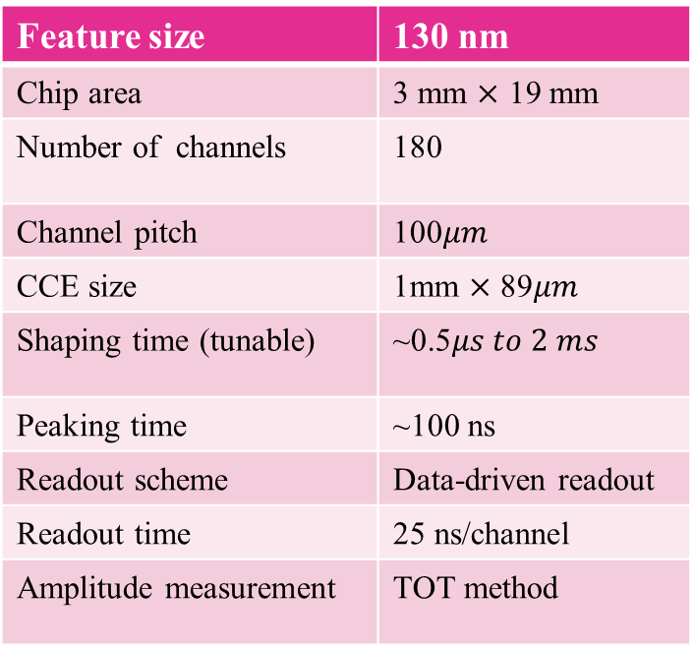
Topmetal-CEE ASIC
Integrate charge collection electrode (CCE) and readout circuitry in single silicon chip
The main features:
Feature size | 130 nm
Chip area | 3 mm $×$ 19 mm
Number of channels | 180
Channel pitch | 100$μm$
CCE size | 1mm $×$ 89$μm$
Shaping time (tunable) | ~0.5$μs to 2 ms$
Peaking time | ~100 ns
Readout scheme | Data-driven readout
Readout time | 25 ns/channel
Amplitude measurement | TOT method
CCE

Slide 7
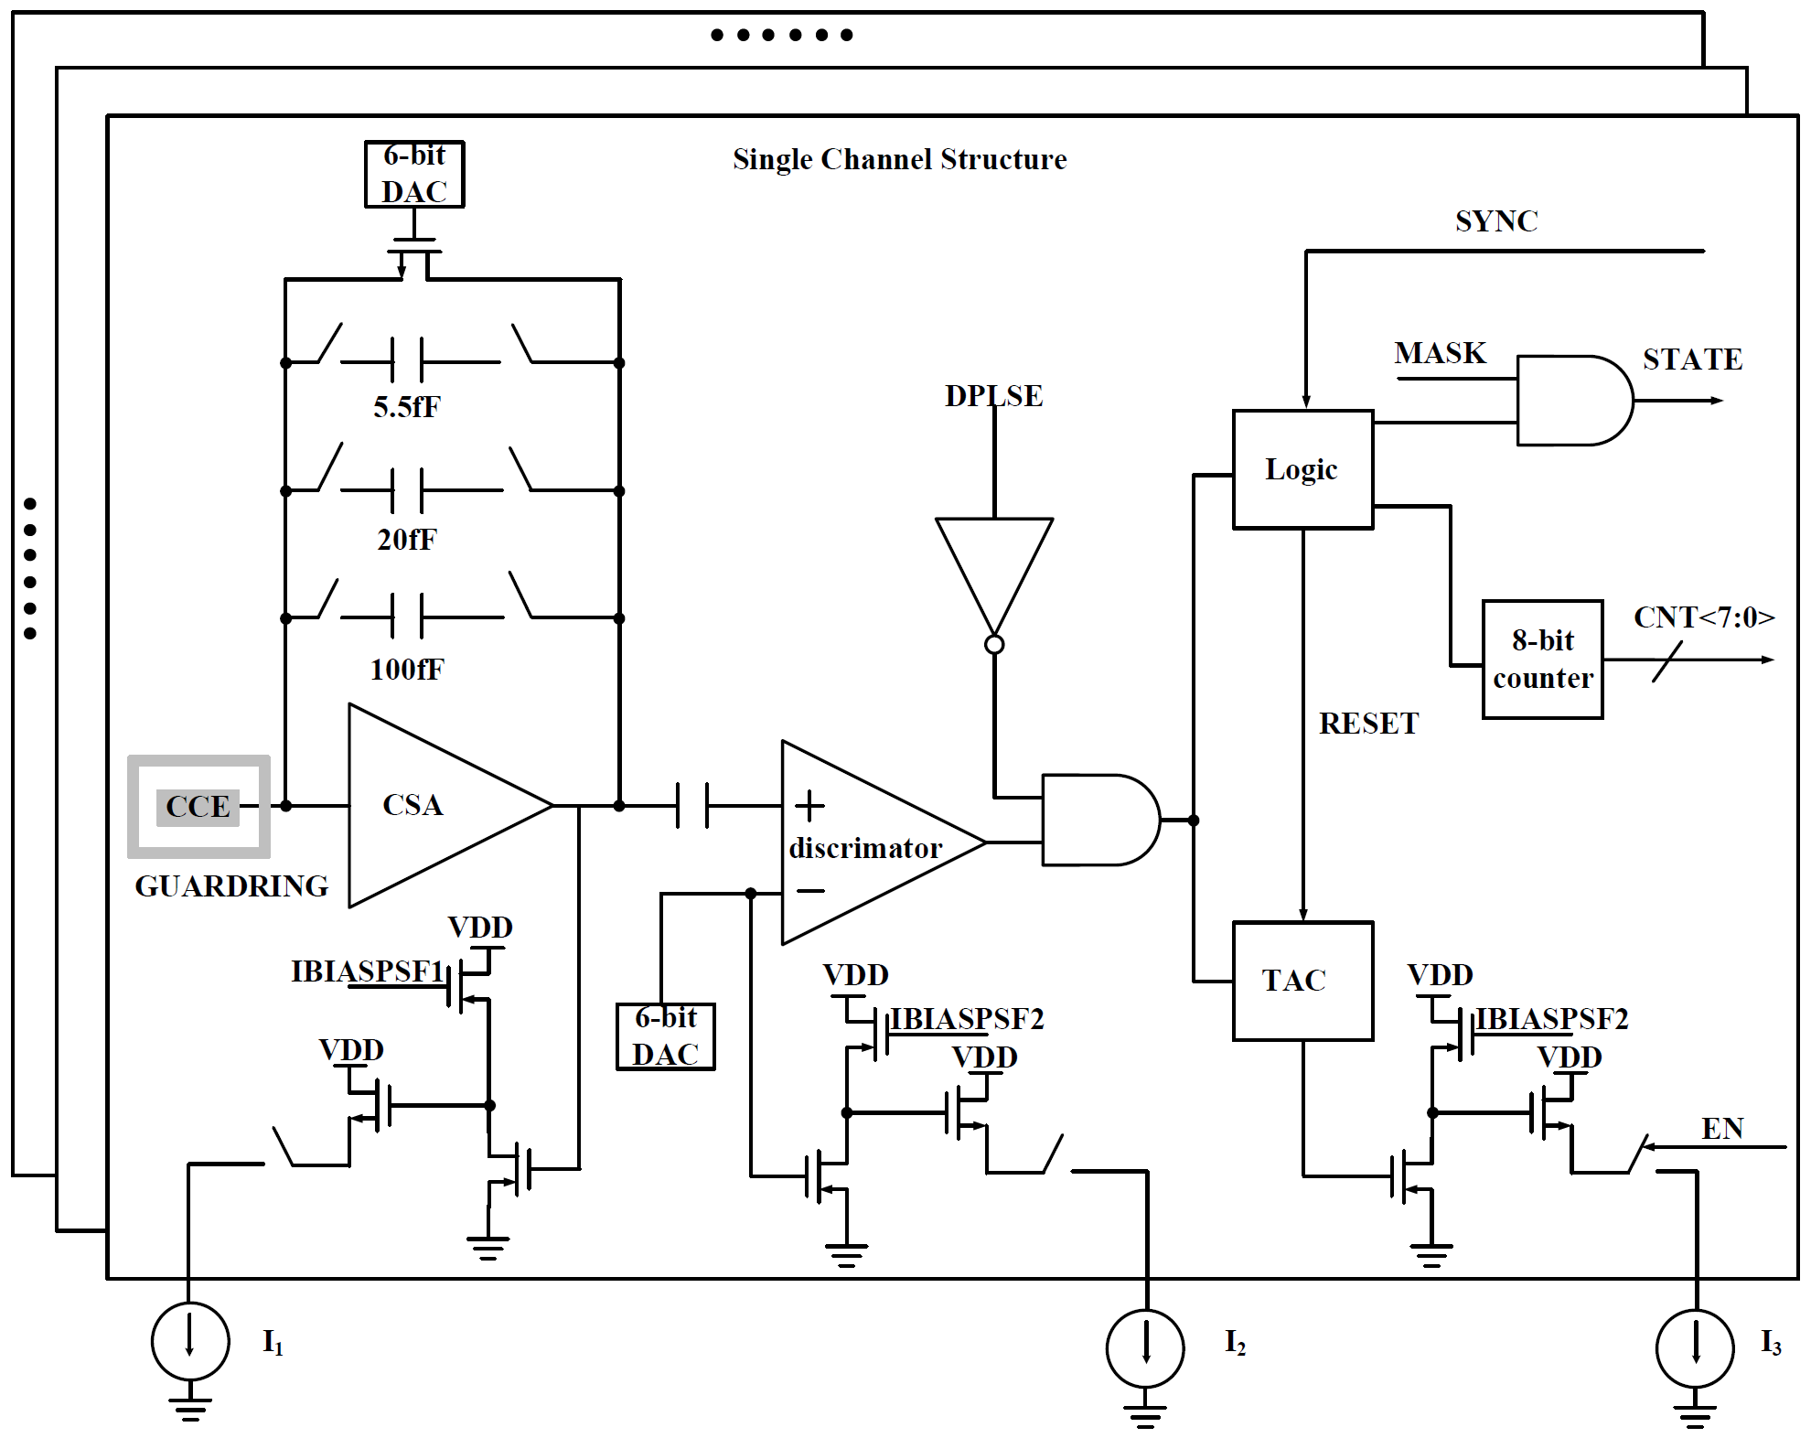
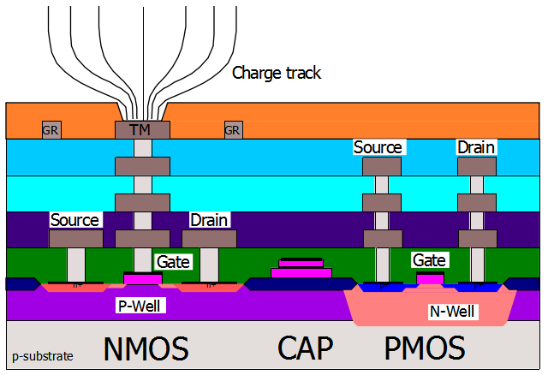
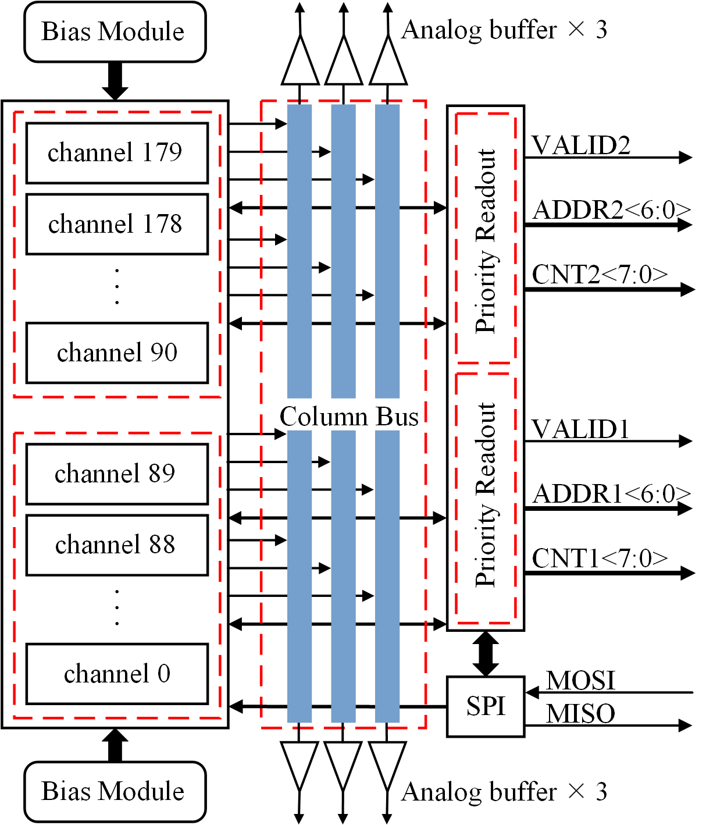
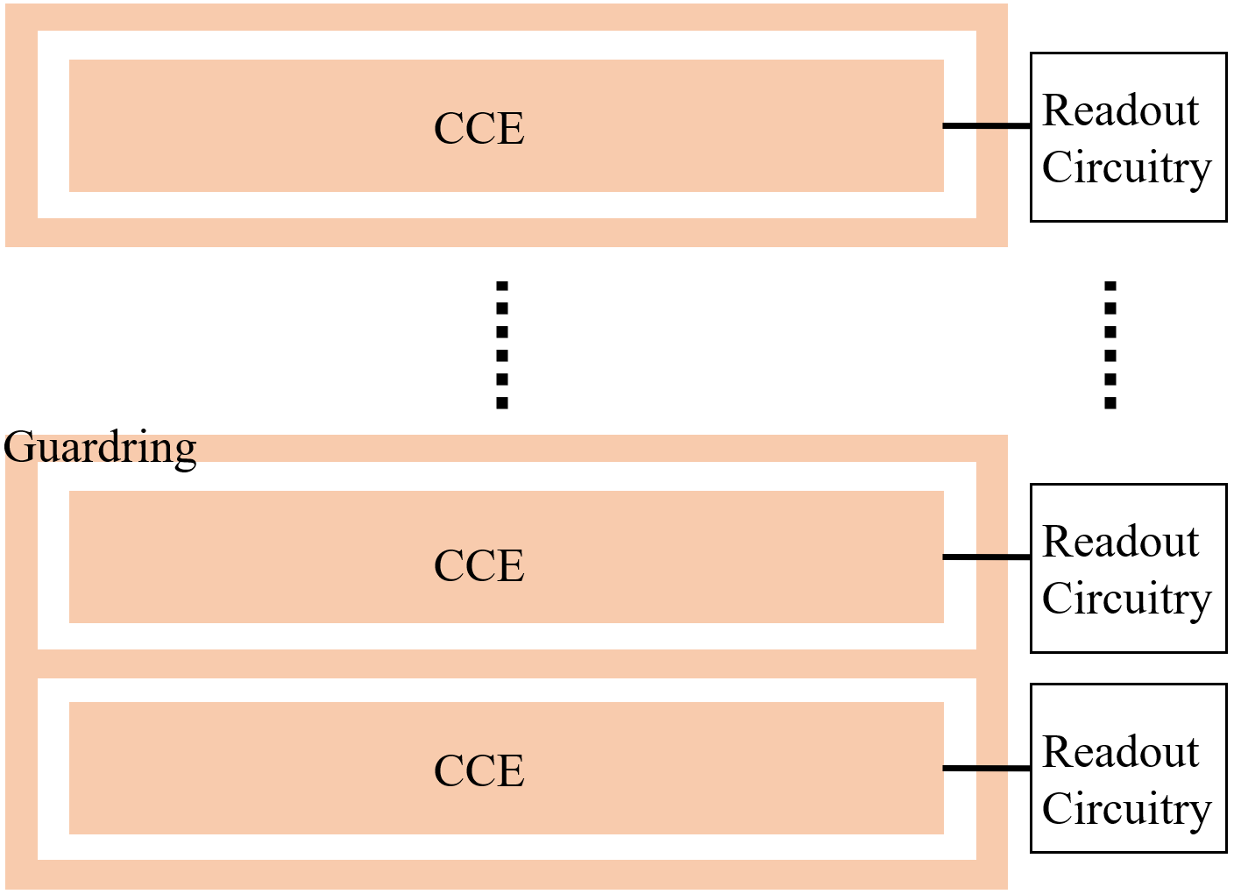
Topmetal-CEE ASIC
Building blocks:
Channel circuitry
  CCE, CSA (three gain modes), discriminator, logic circuit, TDC ,TOT ,6-bit DAC (adjust decay time and threshold voltage)
data-driven readout circuit
  per-channel readout within a clock cycle
  7-bit address
Bias modules
  Voltage and current biases
SPI and analog buffer
  Configuration and analog signal outputs
Top structure
CCE
Channel circuitry

Slide 8
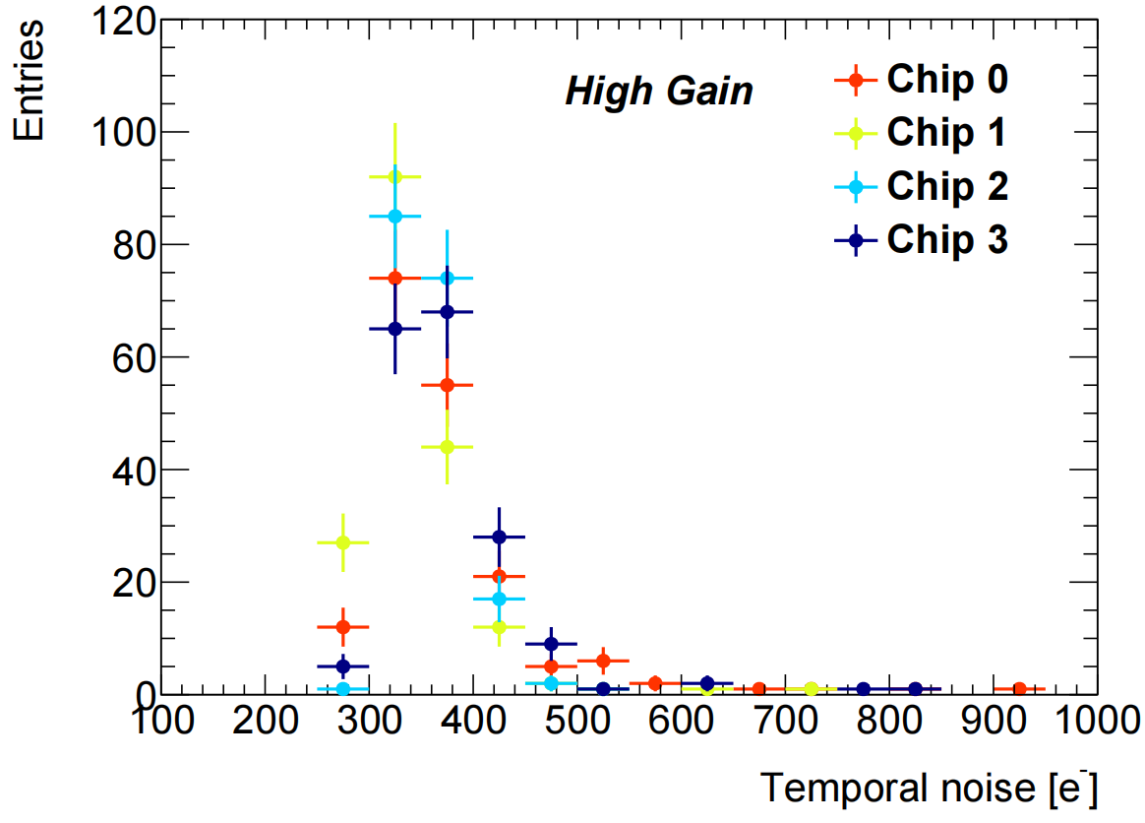
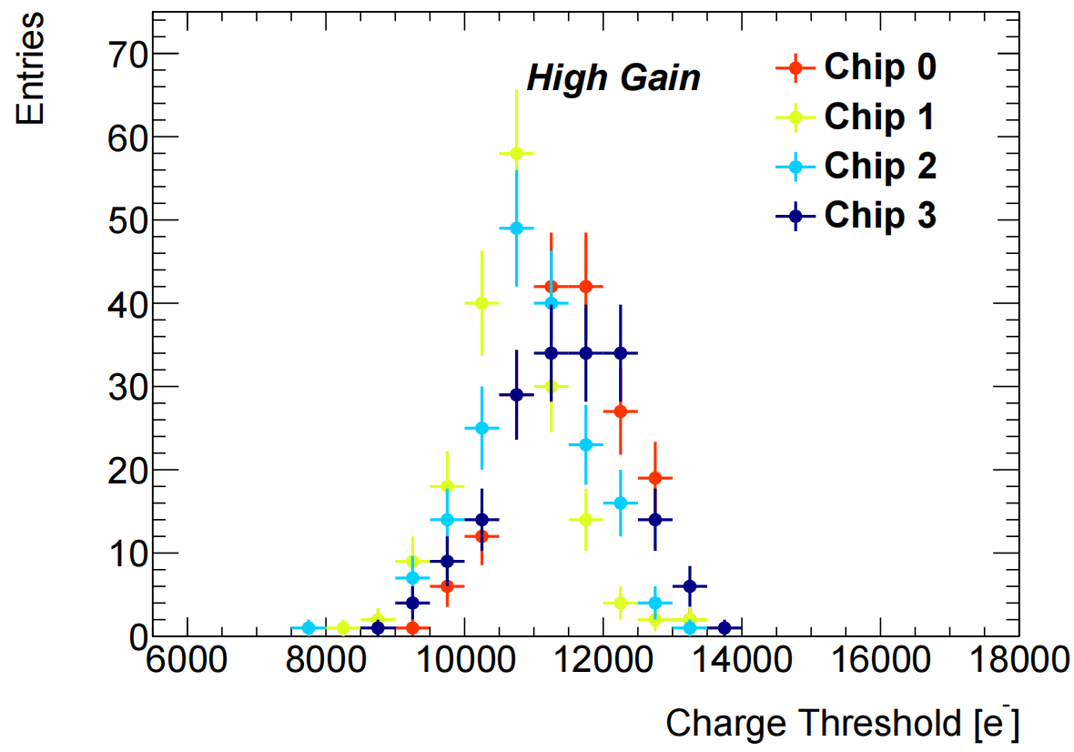
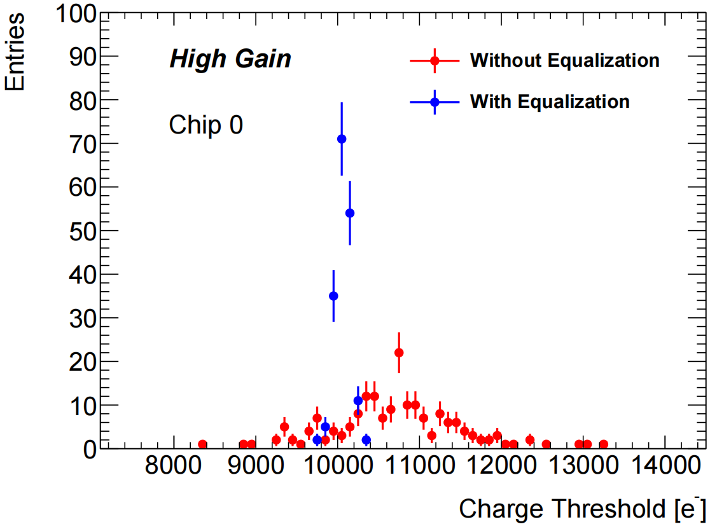
Topmetal-CEE ASIC
Noise distribution:
the temporal noise distribution of all channels for different chips.
The average values vary from 344 e− to 378 e−.
Threshold distribution:
The average values vary from 10698 e− to 11490 e−.
The standard deviations vary from 767 e− to 943 e−.
The standard deviation of the threshold dispersion is reduced from 766 e− down to 97 e−.

Slide 9
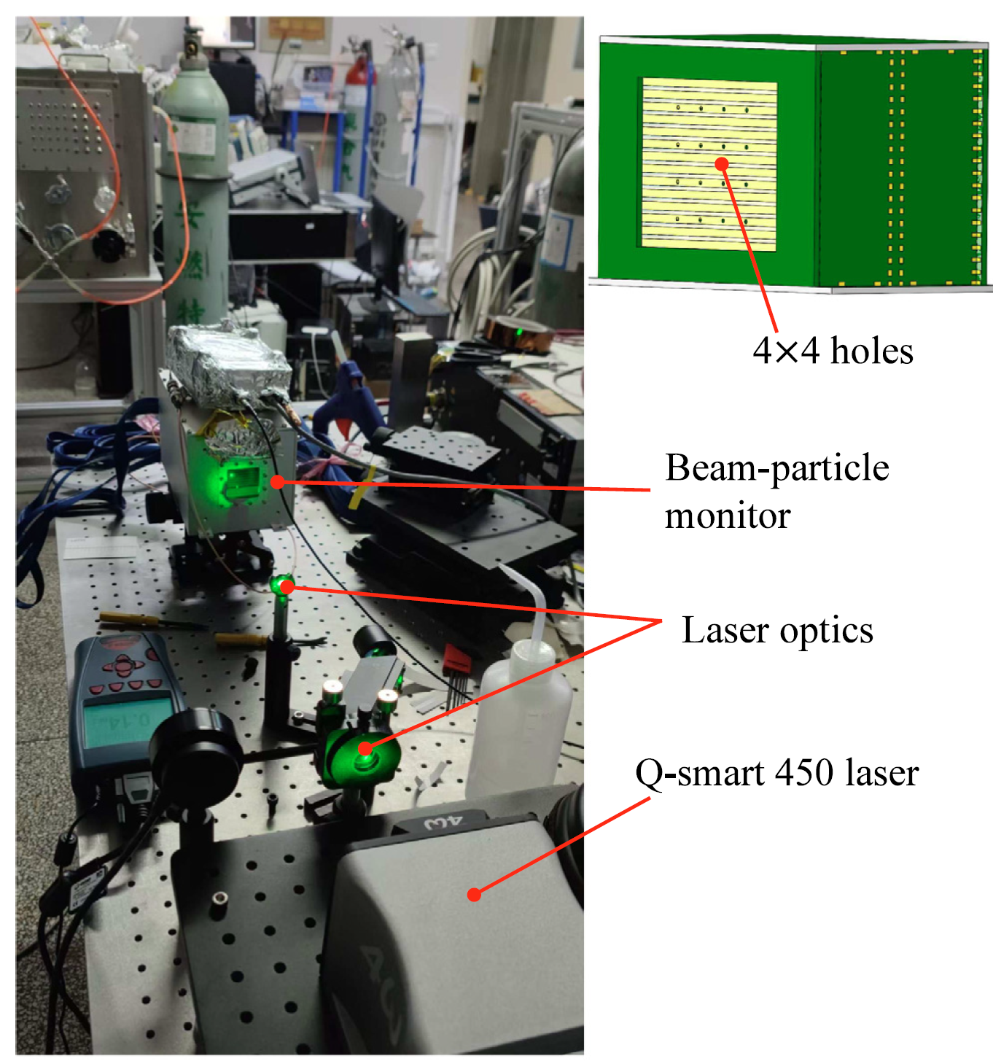
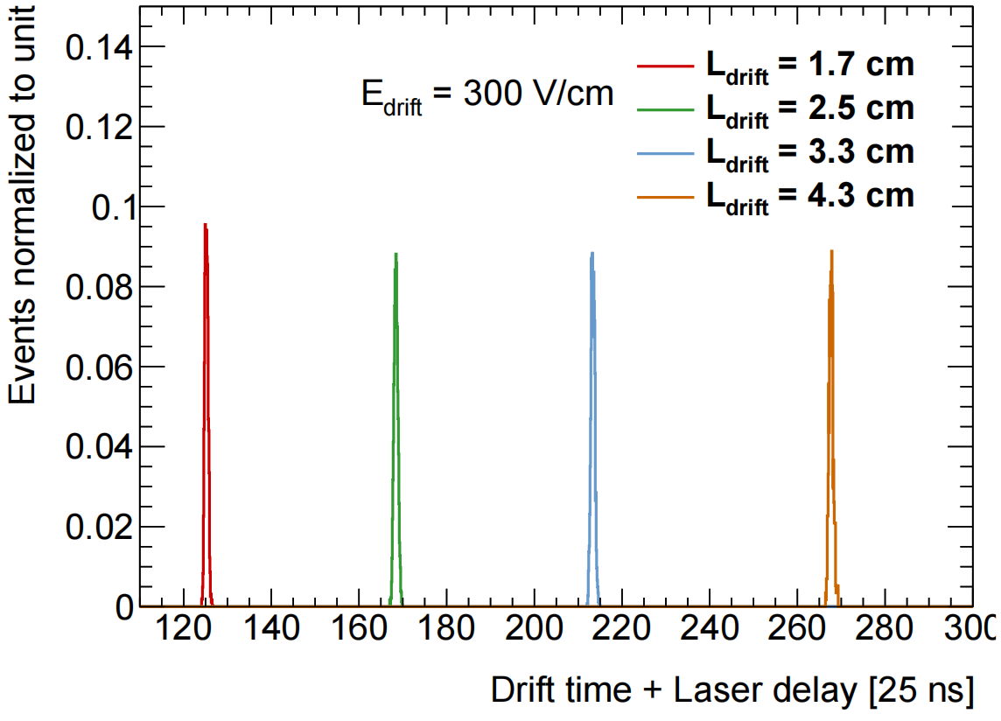
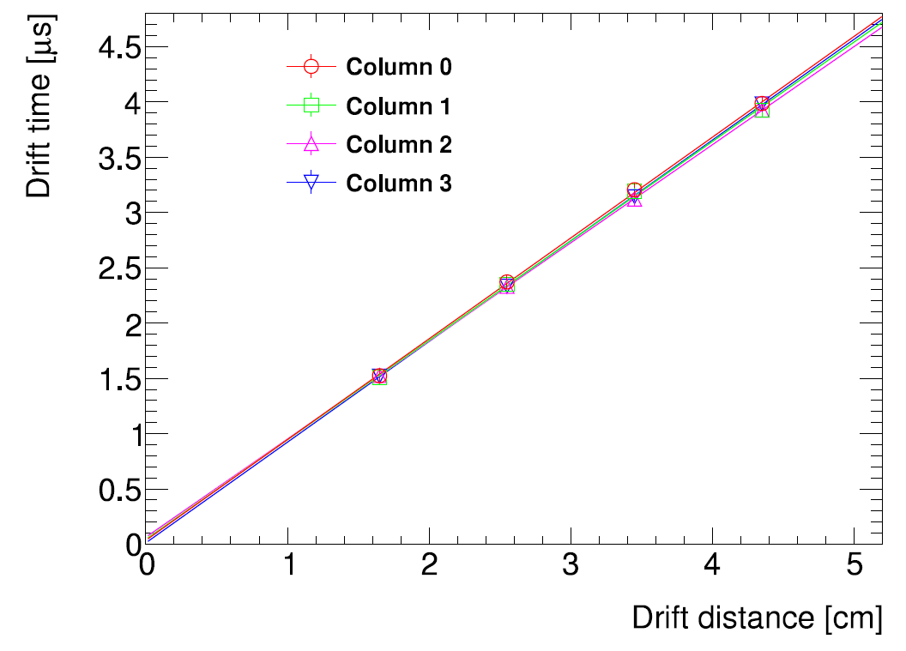
Laser test
Laser tests:
16 small holes arranged in a 4 × 4 square array.
The drift electric field is 300 V/cm.
Gas mixture of Argon(70%) + carbon dioxide (30%)
Laser emitter named Q-smart 450
The drift time is calculated by the difference between the arrival time of the hit and the time of the trigger pulse.
The resolutions of the arrival time vary from 9 ns to 13 ns.
drift velocity：~1.1cm/µs

Slide 10
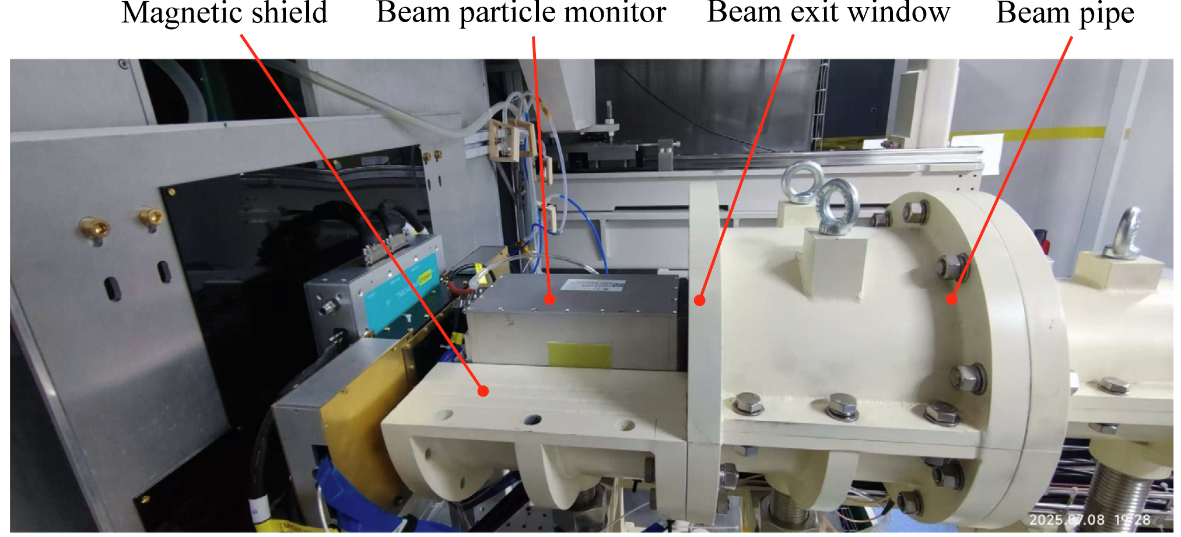
Carbon beam test (Jan. 2026)
1.1 GeV/u C beam, no magnetic field.
Beam-rate scan: ~ 0.01 - 1 MHz.

Slide 11
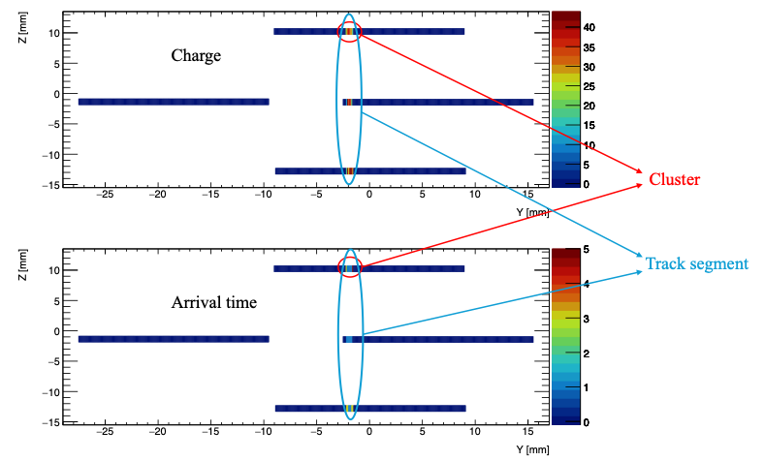
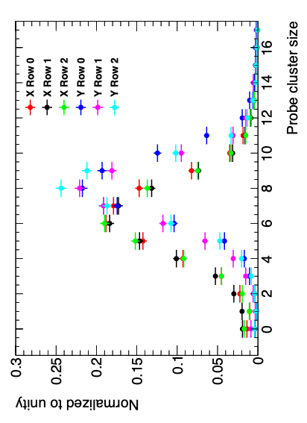
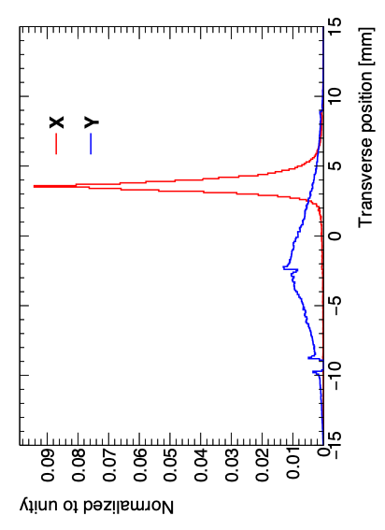
Event reconstruction
Pixels
address + charge + arrival time
↓
group into
Clusters (Neighboring hit pixels)
charge-weighted centroid is calculated for each cluster.
↓
different rows are connected
Track segments
X,Y and arrival time per micro-TPC
↓
Match orthogonal micro-TPCs
Matched pair (Track)
reconstruct the particle position and incident time.→ X, Y, t0
The average cluster size is ~7 pixels

Slide 12
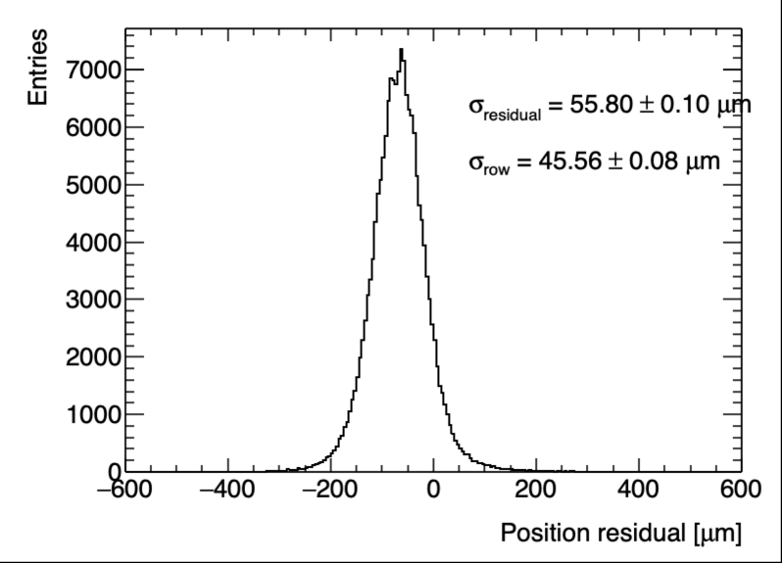
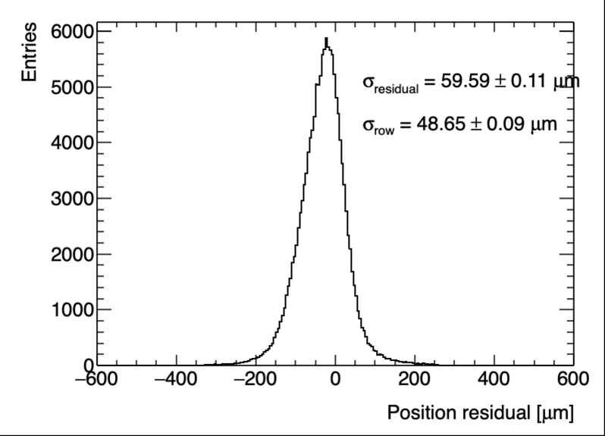
Transverse position resolution
To test the resolutions of transverse position and arrival time, track segments containing clusters in all three pixel rows are utilized.
A reference track is defined by the clusters in two of the three rows, and the reference-track residual is then calculated.
From this residual, we get the single-row resolution, σ_row.
Both single-row resolutions meet the 50 µm target.
X-direction position residual
Y-direction position residual

Slide 13
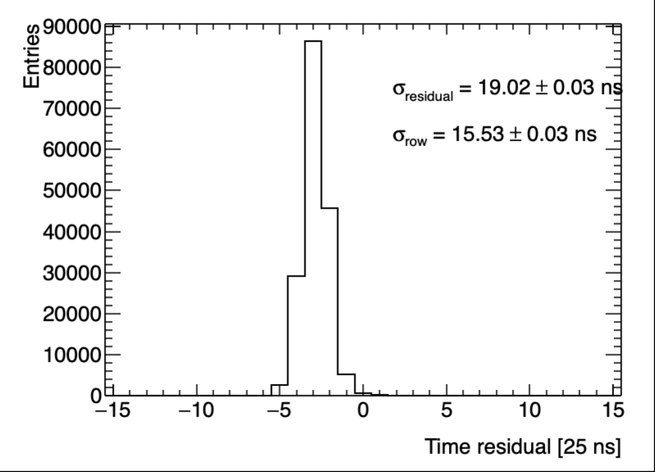
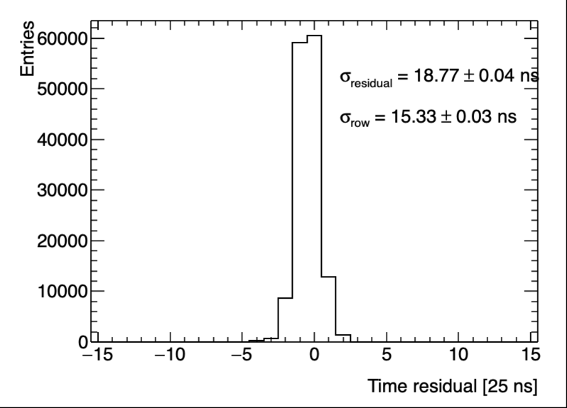
Time resolution
Arrival time resolution: ~15 ns.
X-direction time residual
Y-direction time residual

Slide 14
Summary
A dual micro-TPC/GEM beam monitor with Topmetal-CEE chips reconstructs the X–Y position and absolute incident time of individual beam particles.
The carbon beam test demonstrates <50 µm transverse precision and ~15 ns arrive time resolution.

Slide 15
Thank you for your attentions

