Slide 1
Introduction and Prospects to the 1.6 GeV Proton Test Beam at CSNS
Author: Yuhang Guo, on behalf of HPES R&D Team
Institute of High Energy Physics, CAS
15. OCT. 2026
A Presentation @
2026 International Conference on Instrumentation for Colliding Beam Physics
China · Hefei 12-16. Oct. 2026

Slide 2
Introductions to HPES and CSNS
Beam Parameters of HPES
Devices in HPES Terminal
Milestone and Summaries

Slide 3


China is building its first 1.6 GeV proton test beam.
NEWS

Slide 4
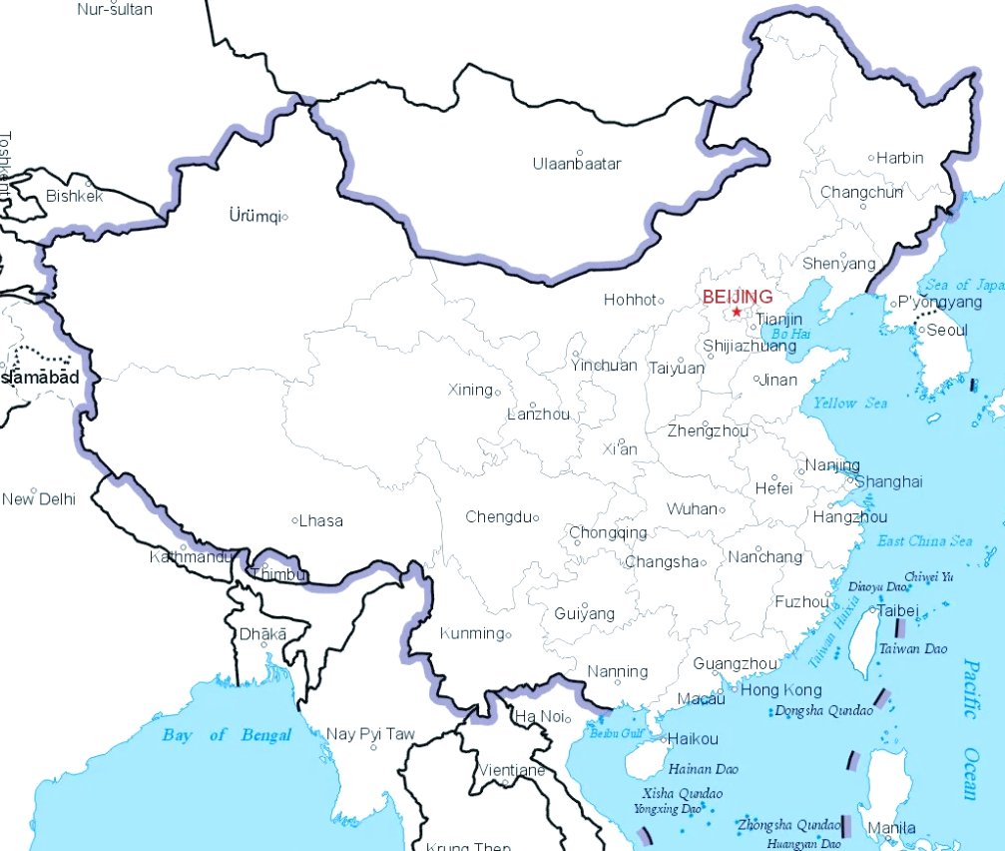
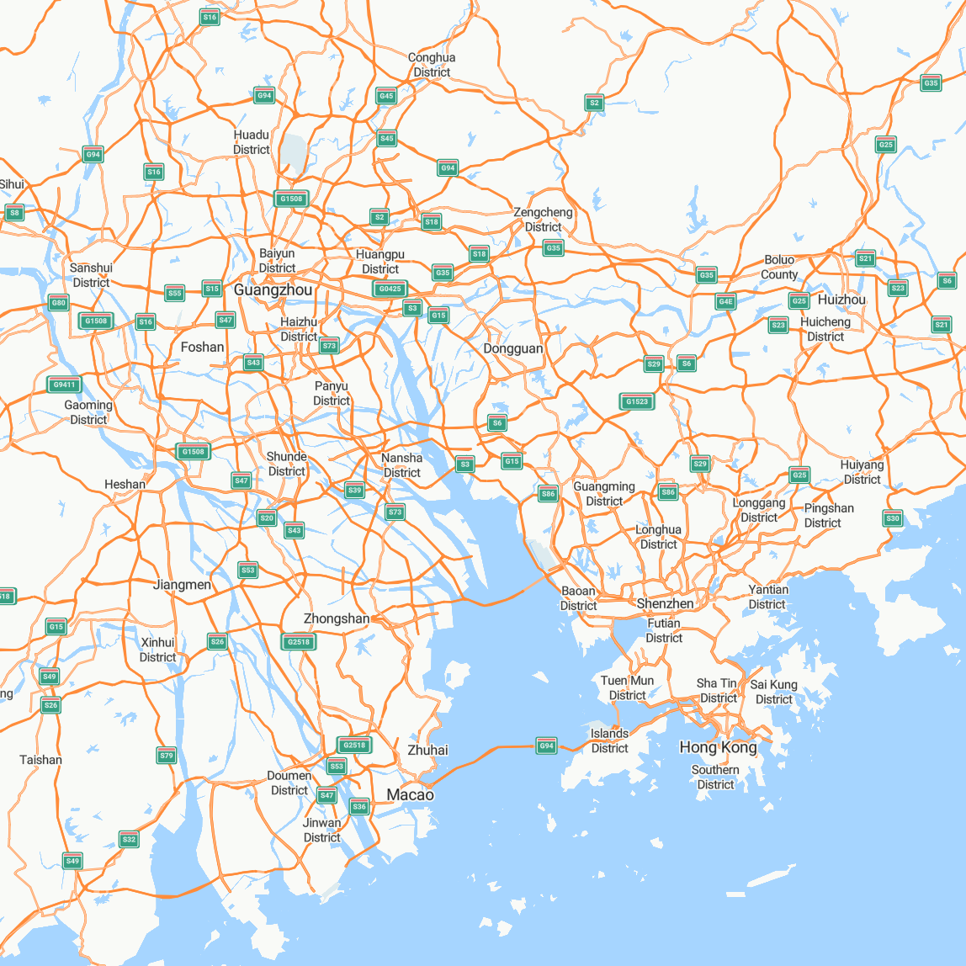


Location of CSNS
CAN
Guangzhou Baiyun Airport
1.5 h driving
1 h driving
SZX
Shenzhen Baoan Airport
2 h driving
HKG
Hongkong Airport
HPES locates at CSNS campus
CSNS can be easily accessed via 3 international airports

Slide 5
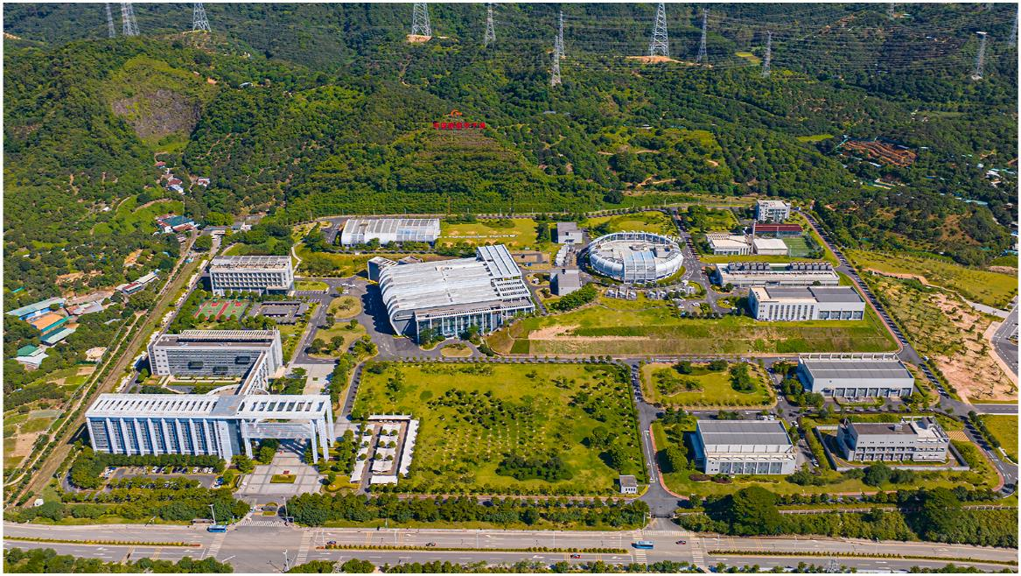
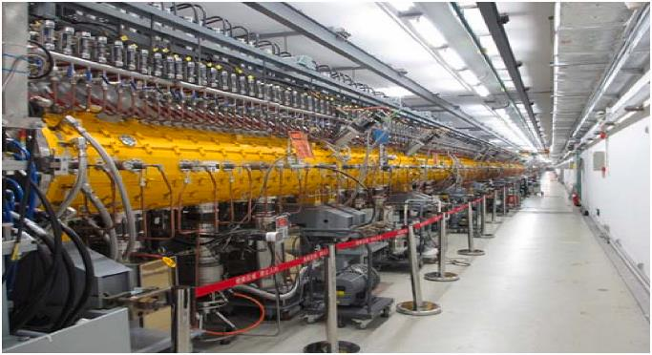
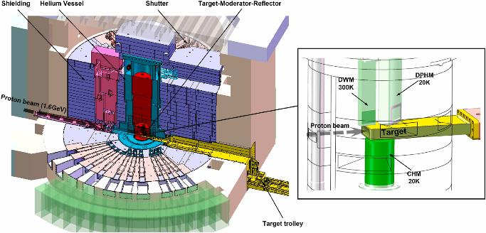
1.1 CSNS
China Spallation Neutron Source (CSNS) @ Dongguan, China.
Run since 2018, power: 185 kW.
We are pushing the second phase of CSNS.
DOI:10.1016/j.nima.2025.170431

Slide 6
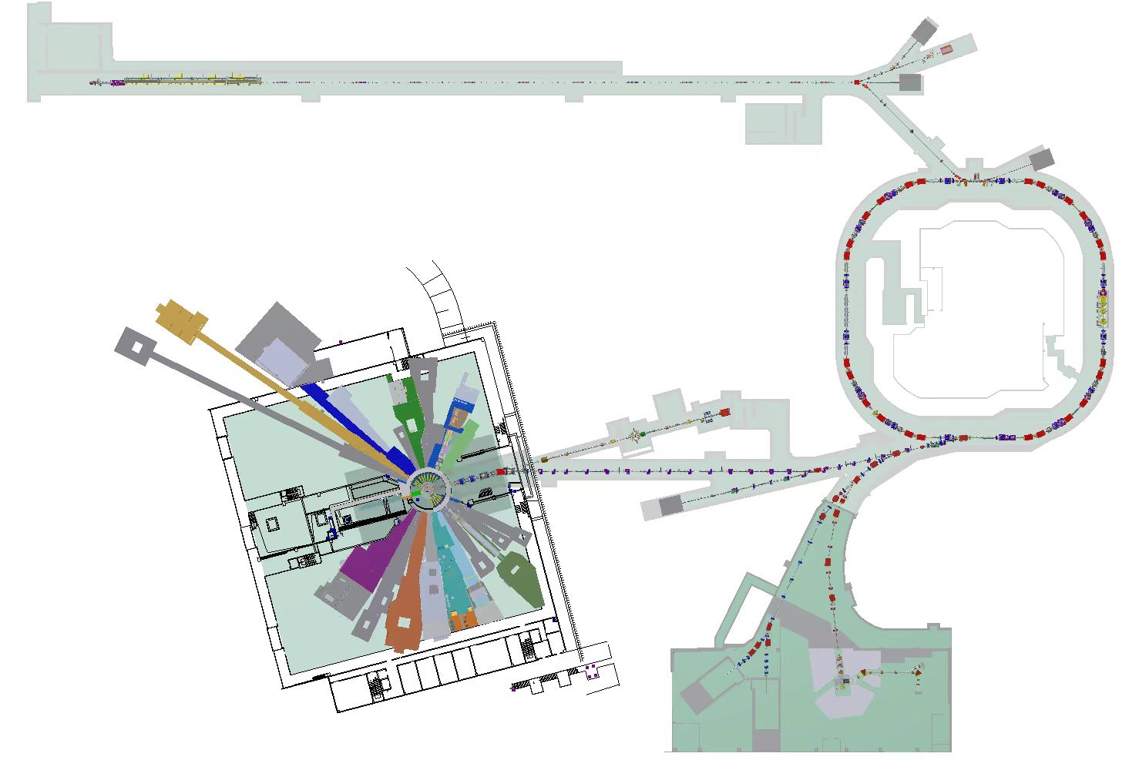
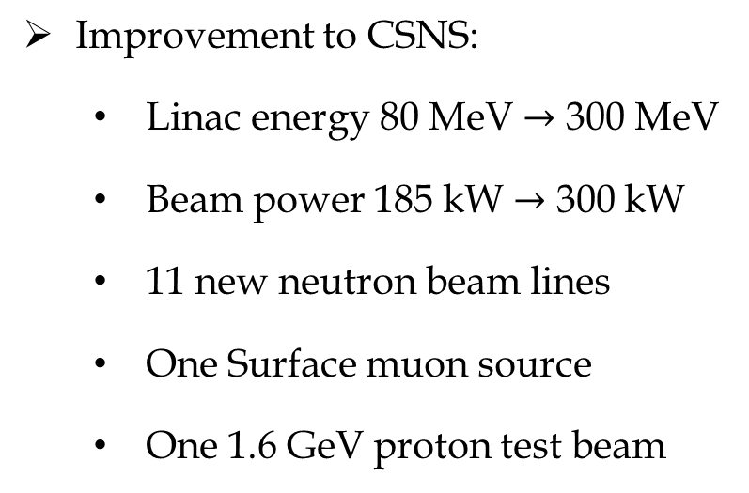
1.2 CSNS-II
Improvement to CSNS:
  Linac energy 80 MeV $→$ 300 MeV
  Beam power 185 kW $→$ 300 kW
  11 new neutron beam lines
  One Surface muon source
  One 1.6 GeV proton test beam
Linac-300 MeV
RCS-500 kW
High-energy Proton-beam Experiment Station (HPES)
First beam delivery: 2029
Neutron spectrometers and terminals-11 to be build

Slide 7
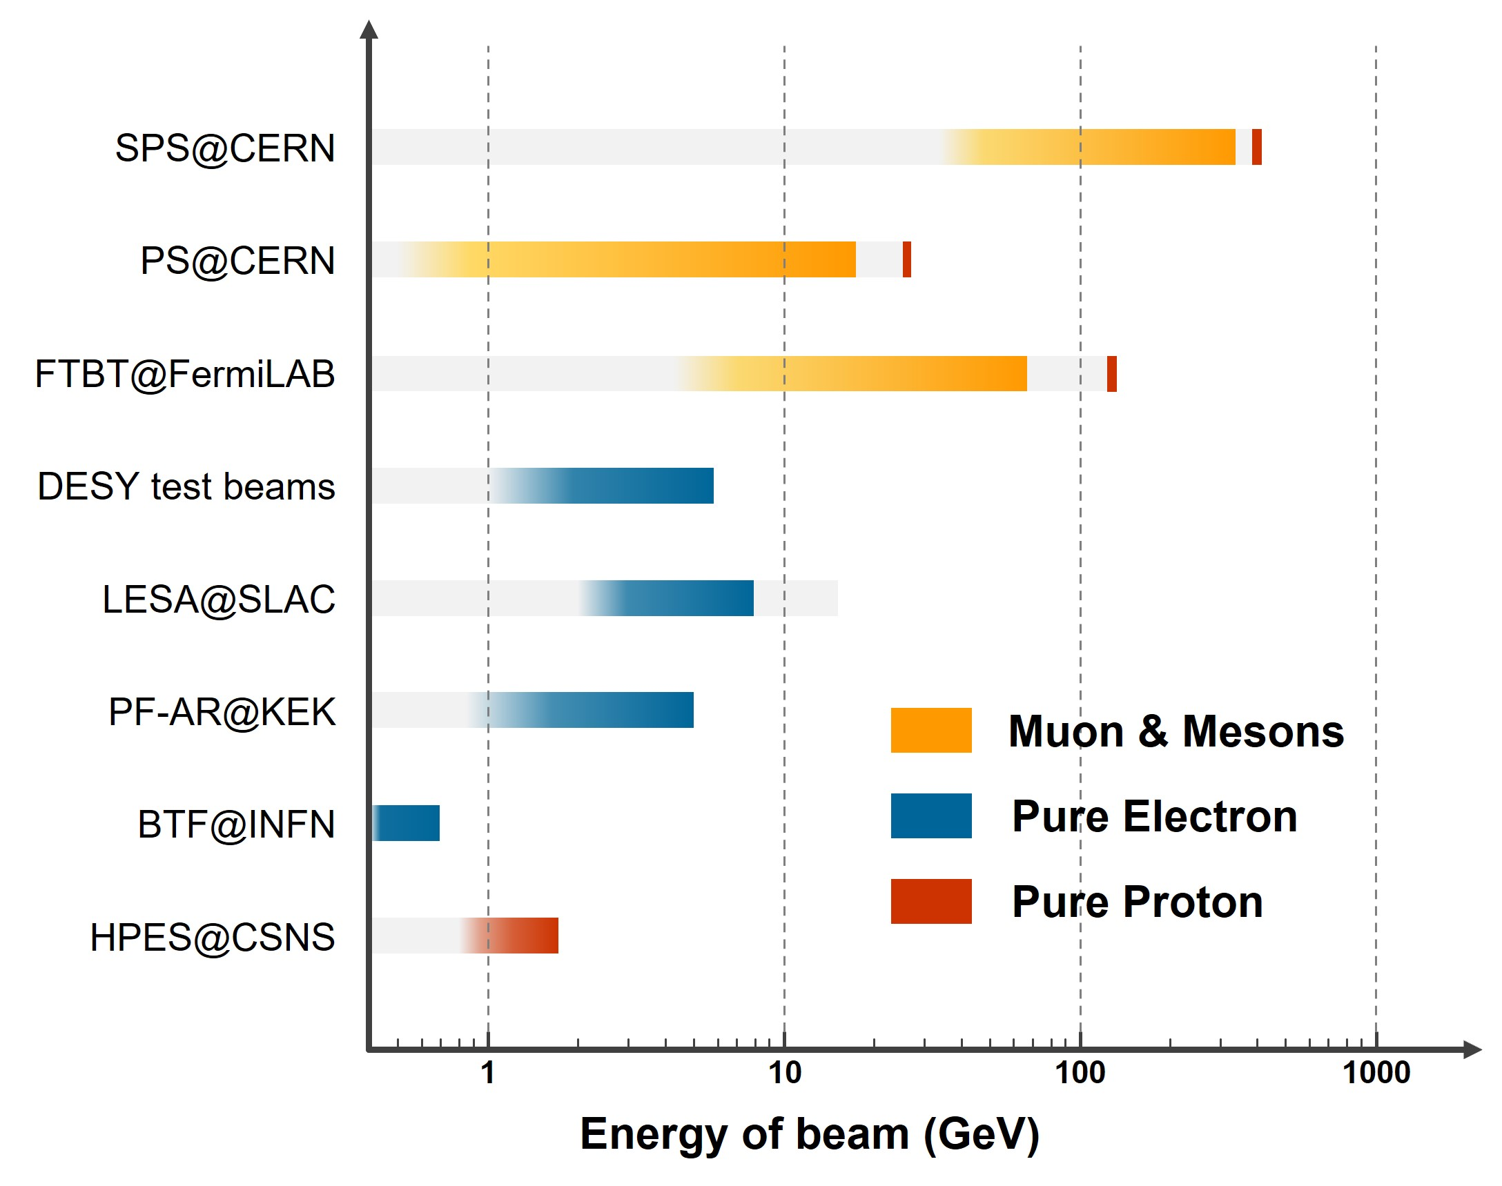
1.3 HPES
High-energy Proton-beam Experiment Station（HPES）
Bird view of HPES beam parameters
First GeV-proton test beam in China.
Flexible proton beam with flux tunable.
Fill the absence of test beam resources in 1 GeV energy region.
Parameters | Designed Values
Primary beam energy | 1.6 GeV
Energy spread | <0.5% @ 1.6 GeV
Tunable energy range | 0.8 – 1.6 GeV
Proton flux | 10³-10⁸ p/s
General Macro-pulse frequency | 25 Hz
Effective macro-pulse frequency | 24 Hz
Macro-pulse length | 1 ms
Interval of micro-pulse | 410 ns

Slide 8
Introductions to HPES and CSNS
Beam Parameters of HPES
Devices in HPES Terminal
Milestone and Summaries

Slide 9
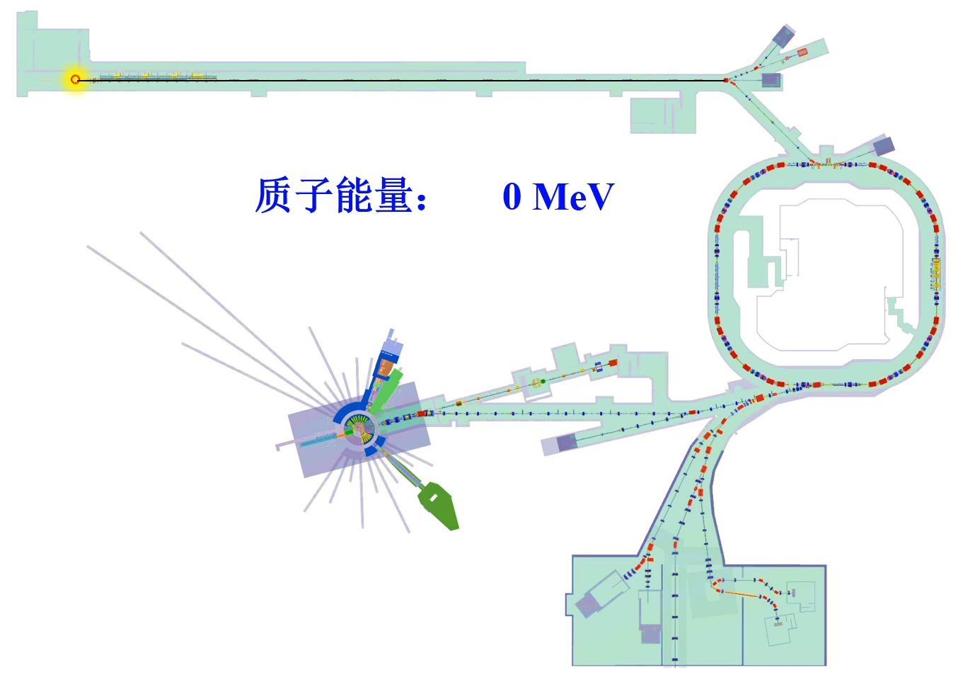
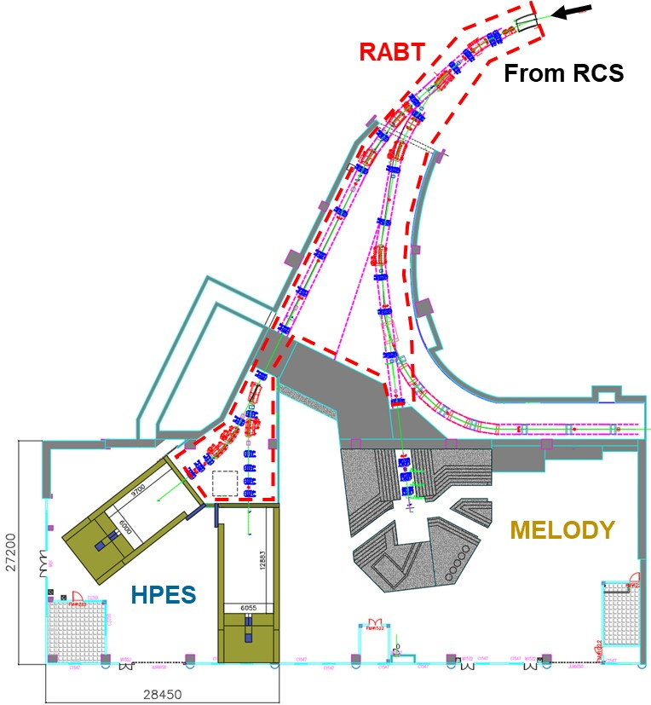
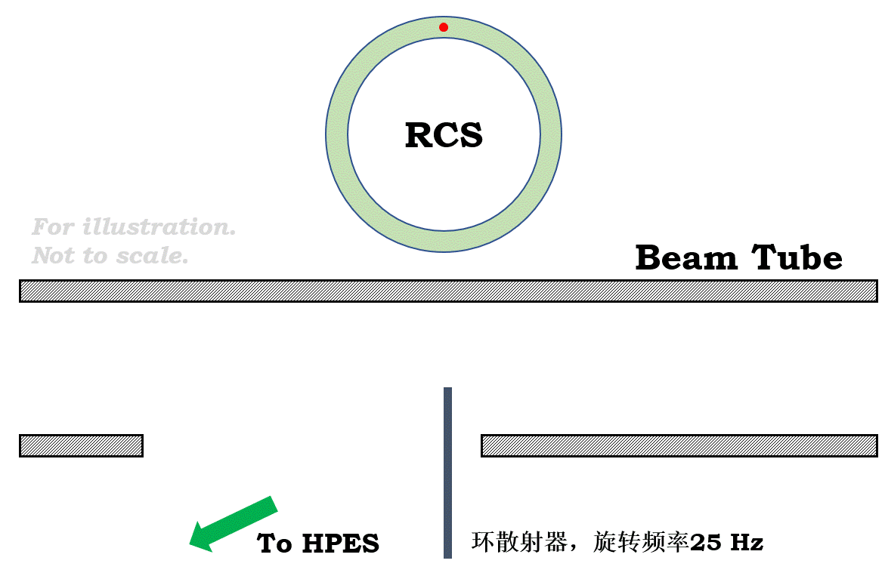
2.1 proton extraction
Proton Energy:
Diagram of the Proton scatter
The proton scatter foil rotates in 25 Hz, synchronous with beam in RCS.
Foil will interact with beam halo when it arrives.
Protons elastic scattering at 20 − 25 mrad will be extracted by a Lamberson Magnet.
Extracted protons delivered by RABT to the TWO terminals of HPES.
DOI: 10.1103/PhysRevAccelBeams.27.070401

Slide 10
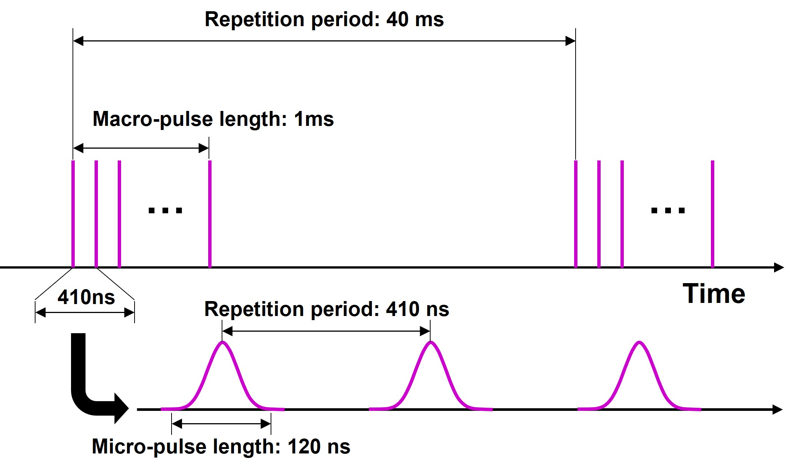
2.2 Time structure
Dual-hierarchy structure:
  Macro pulse frequency 25 Hz (24 Hz effective)
  Macro-pulse length 1 ms，with 39 ms interval.
  Micro-pulse distributed in the macro-pulse.
  Each micro-pulse width is 120 ns cycled by 410 ns.

Slide 11
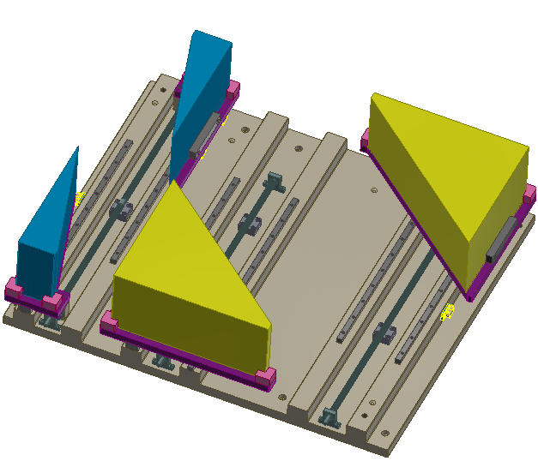
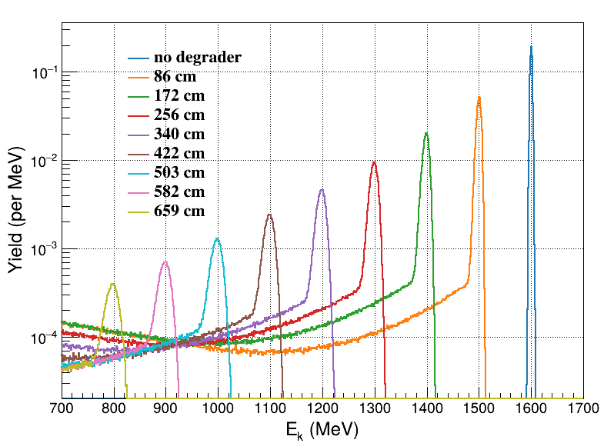
2.3 Proton energy
Energy of primary proton beam: 1.6 GeV.
HPES uses a degrader to tuned beam energy.
Continuous proton energy range: 0.8 – 1.6 GeV.
Degrader
Collimator
Simulated by Geant4

Slide 12
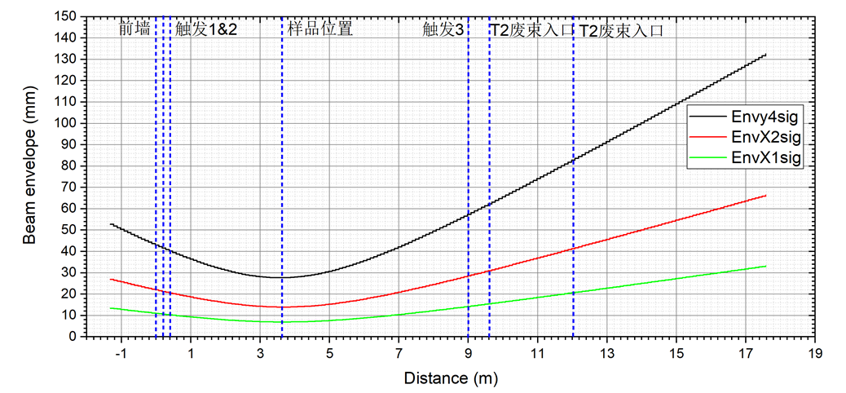
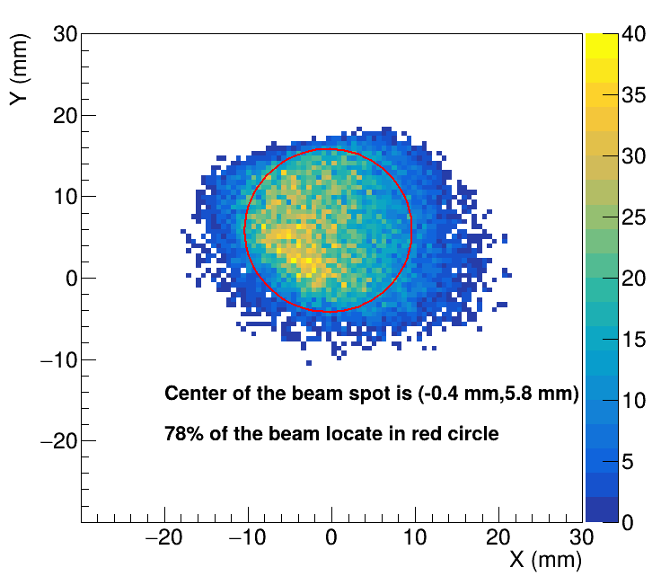
2.4 Proton flux and beam spot
Proton flux and profile of HPES is tunable by collimator and scattering foil.
Flux adjustable in 10³-10⁸ p/s.
The beam spot adjustable in 10×10mm²~100×100mm².

Slide 13
Introductions to HPES and CSNS
Beam Parameters of HPES
Devices in HPES Terminal
Milestone and Summaries

Slide 14
3. Devices in HPES Terminal
HPES is equipped with 7 Detector In Terminal (DIT)：
  Reference DIT: providing reference information of the protons.
  Statistic DIT: providing statistic information of the beam.
Devices |  | Usage
Reference DIT | HEPTel | Provide reference track of protons for tracker test, < 10μm
 | LEMS | Provide reference energy of protons calorimeter test, 1% @ 1.6 GeV.
 | FLASH | Provide reference to the time gate to the DUT, < 1ns.
Statistic DIT | PALET | Measure the profile of the extracted beam.
 | PROUD | Measure the time structure of the extracted beam.
 | BMOS | Monitor the flux of the extracted beam without interception.
 | SEEM

Slide 15
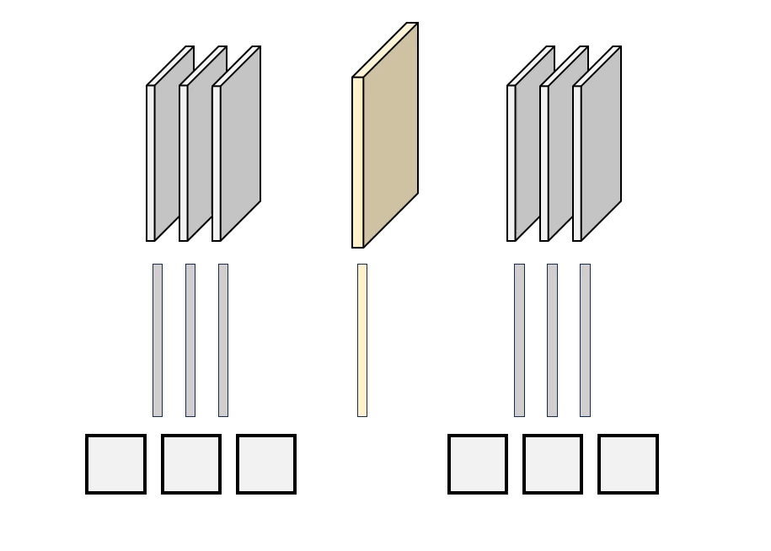
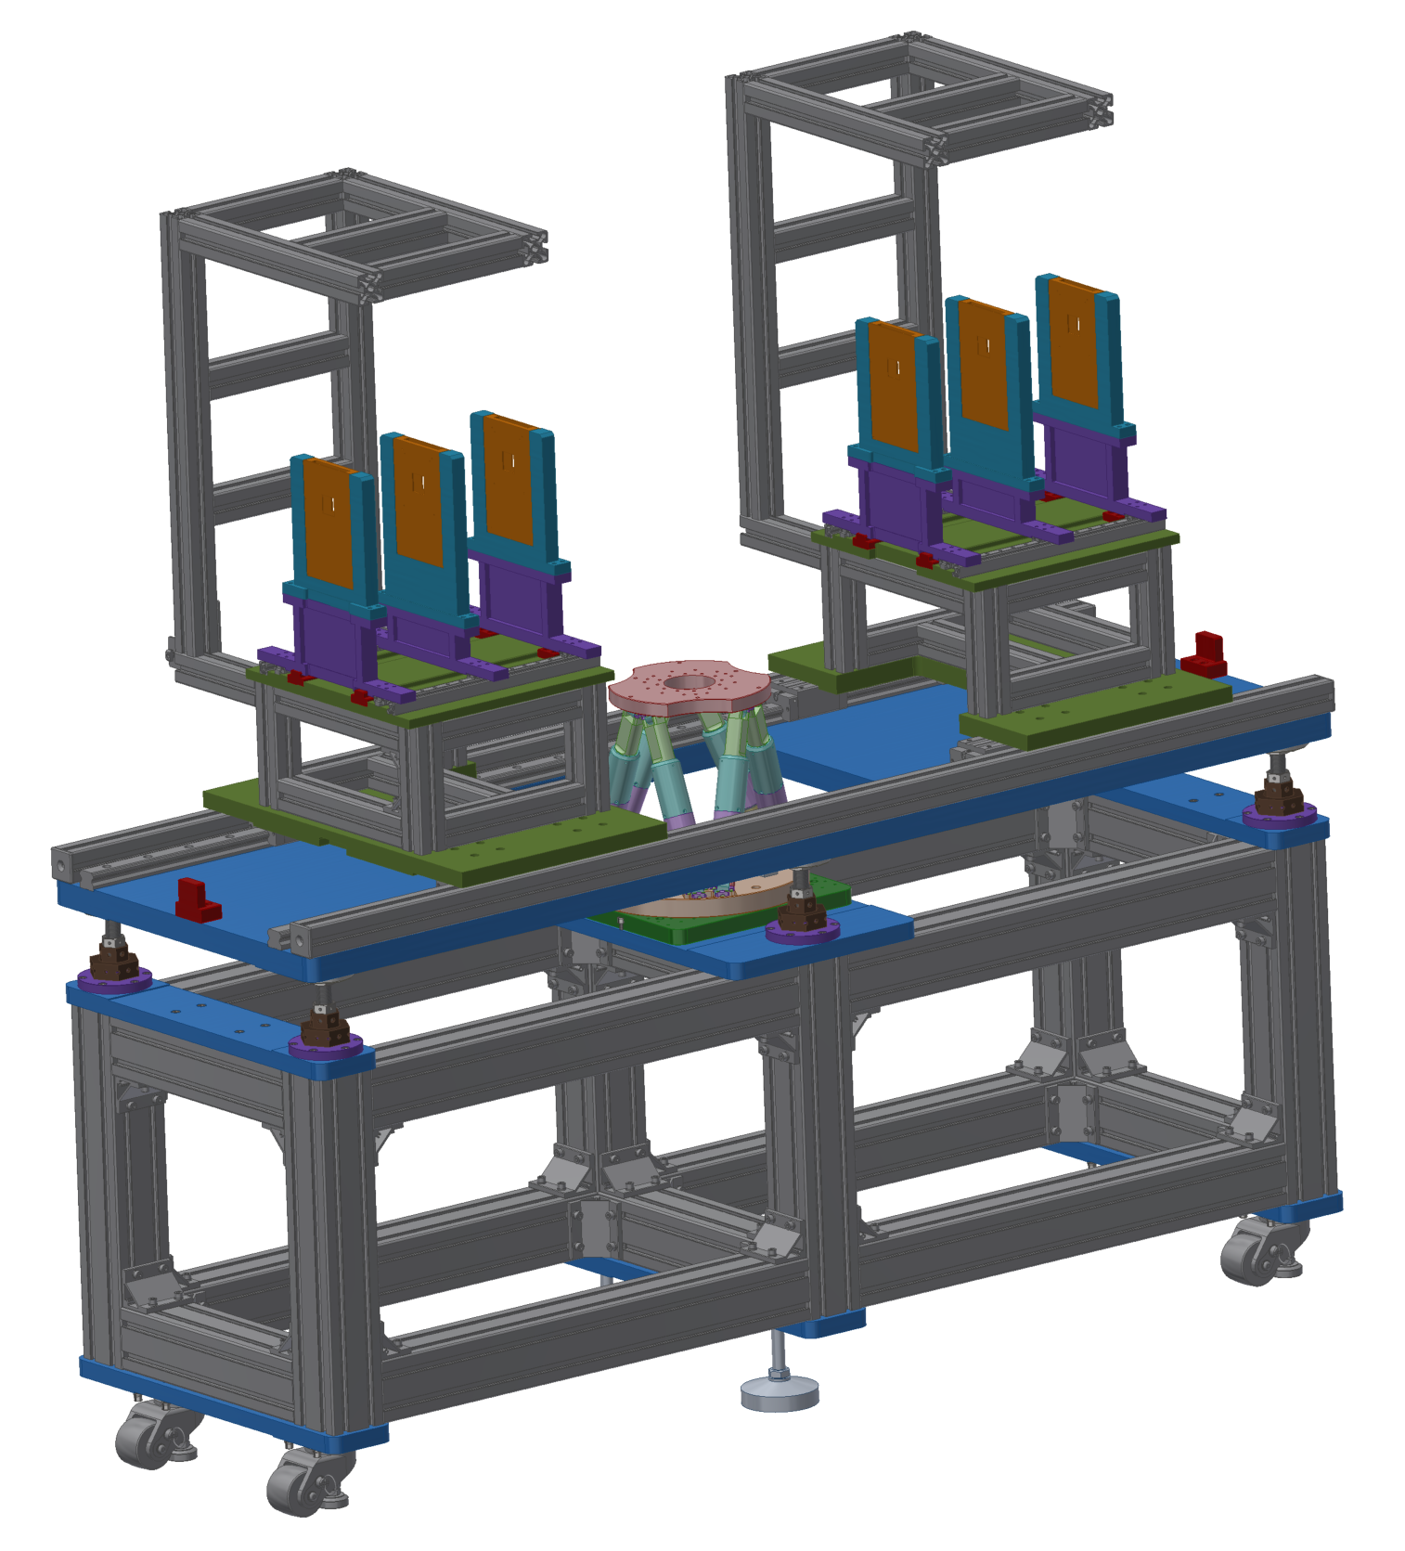
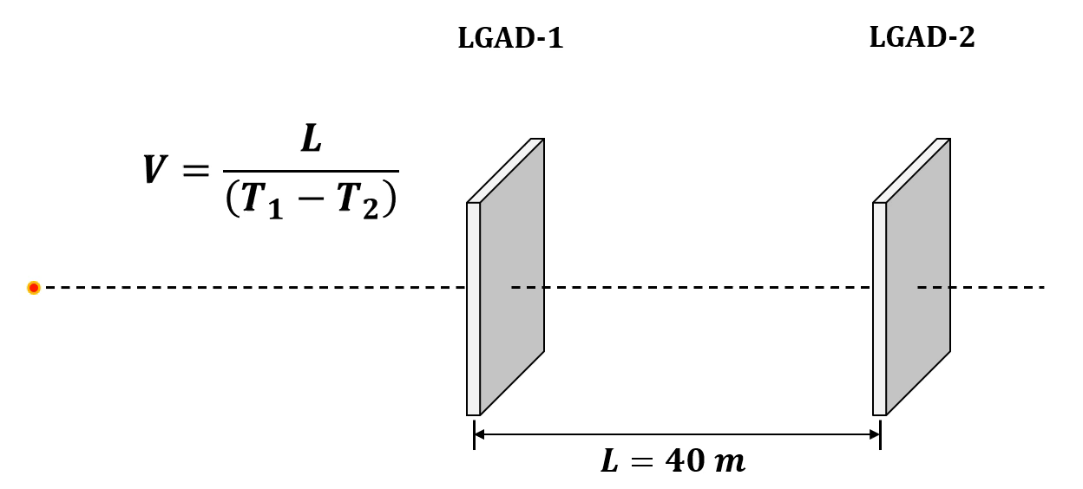
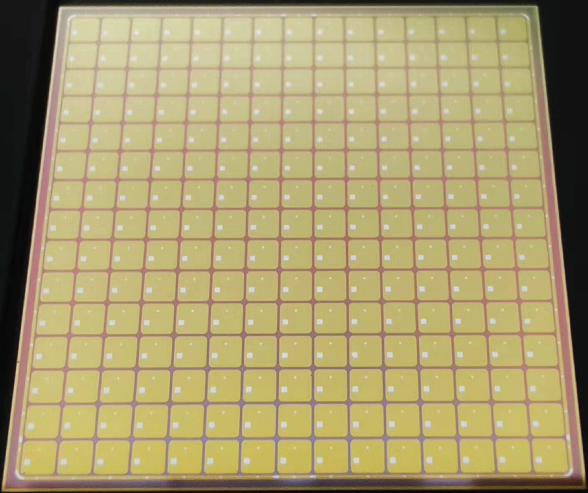
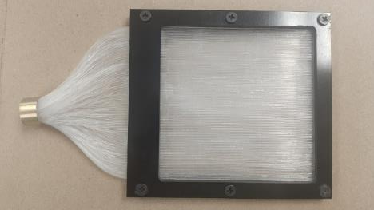
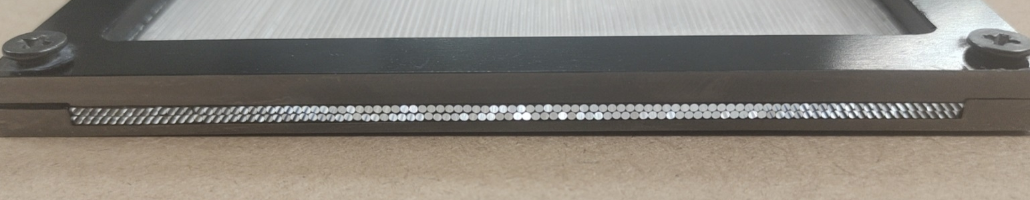
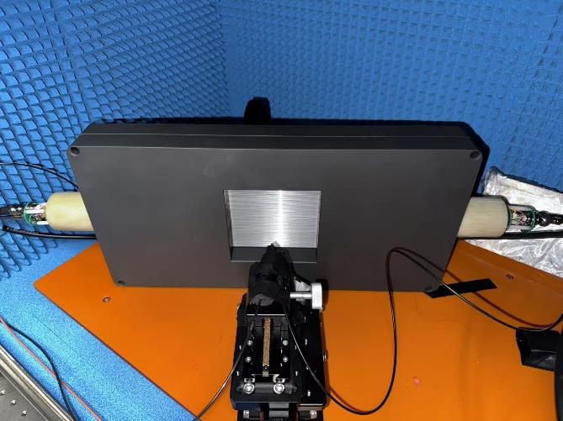
3.1 Reference DIT
TRACK
An EUDET-type proton telescope equipped in HPES.
6 MIMOSA-28, DUT resolution reach < 10 μm.
Telescope resolution is expected reach < 5 μm.
We are also developing a telescope based on Jadepix. Prototype is under test at CERN East Area.
DOI:10.1007/s41365-024-01447-9
ENERGY
A TOF spectrometer developed to measure energy.
2 LGAD, 40 m distance, E res. ~1%@1.6 GeV.
LGAD pixels are bonded in parallel to reduce readout channels.
Timing resolution of each ~ 100 ps.
TIME
A trigger device designed to provide time gate reference.
Scintillator fiber coupled with PMT.
Trigger time spread < 1 ns.
Prototype have been tested at CERN North Area.

Slide 16
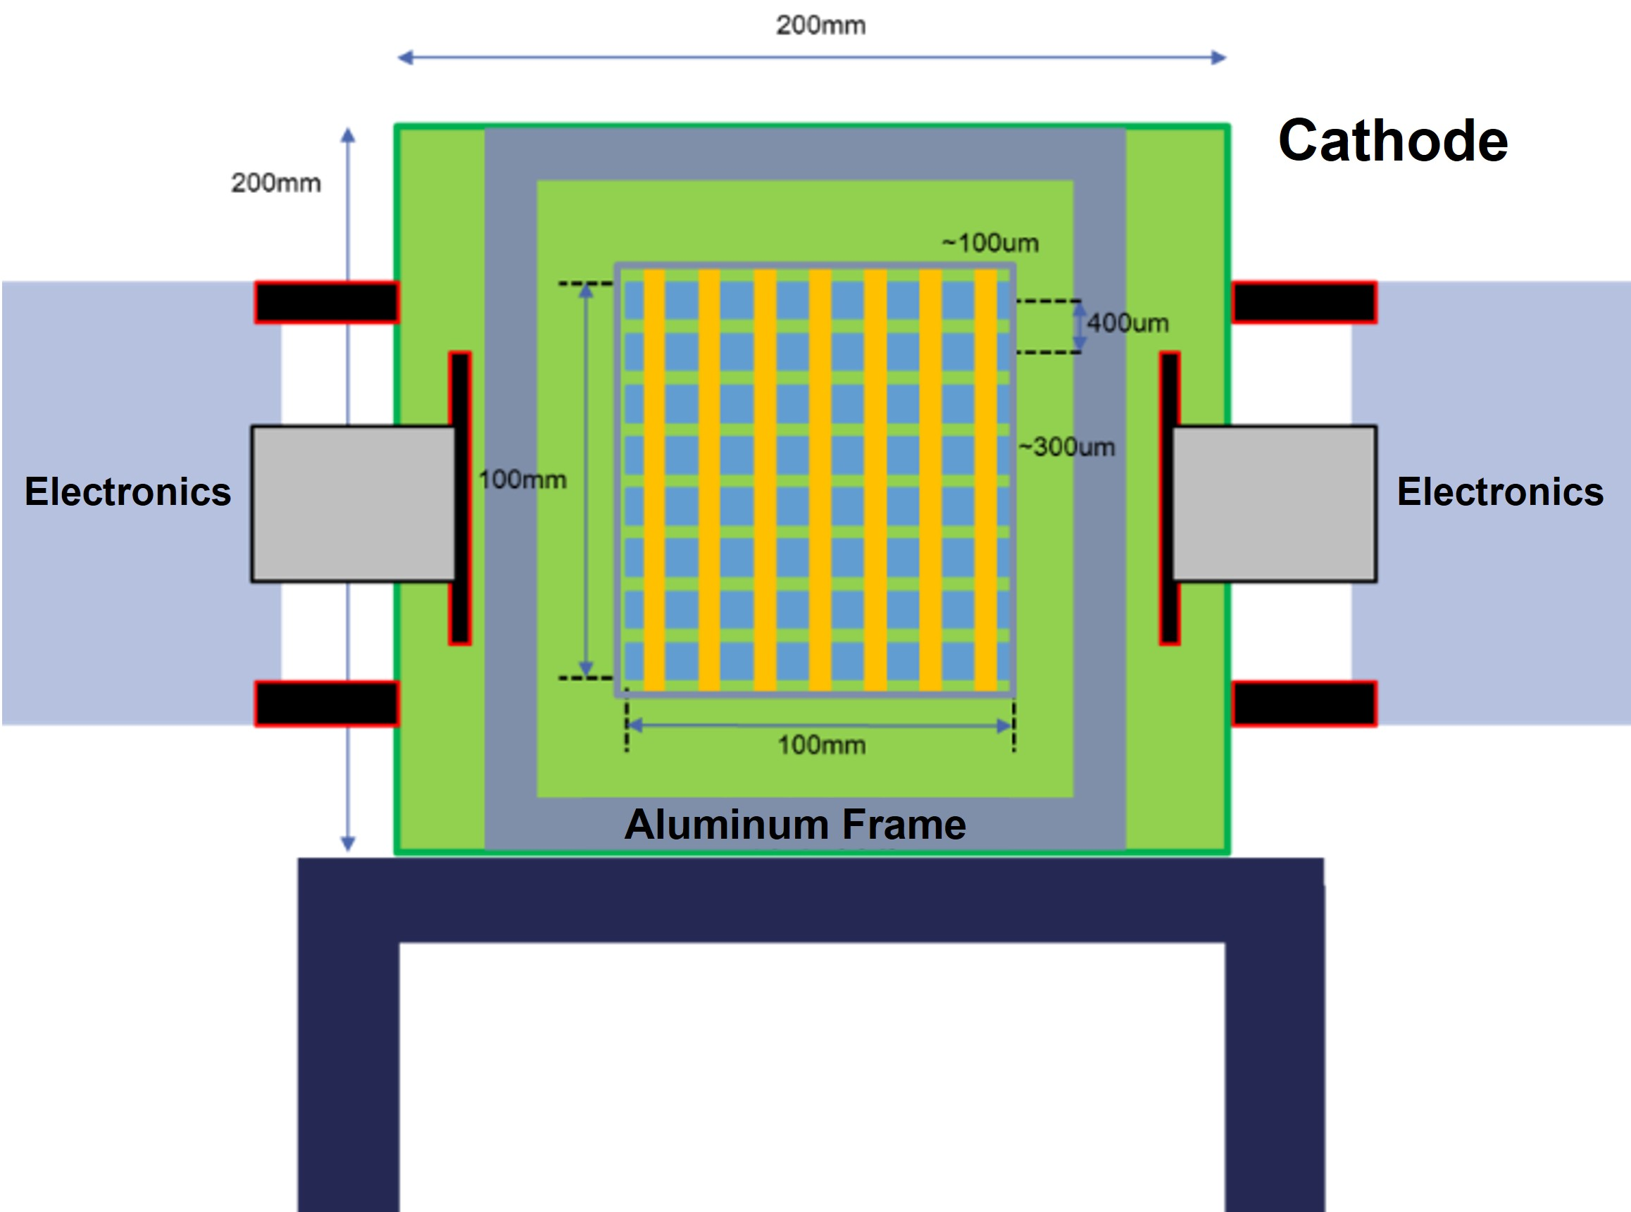
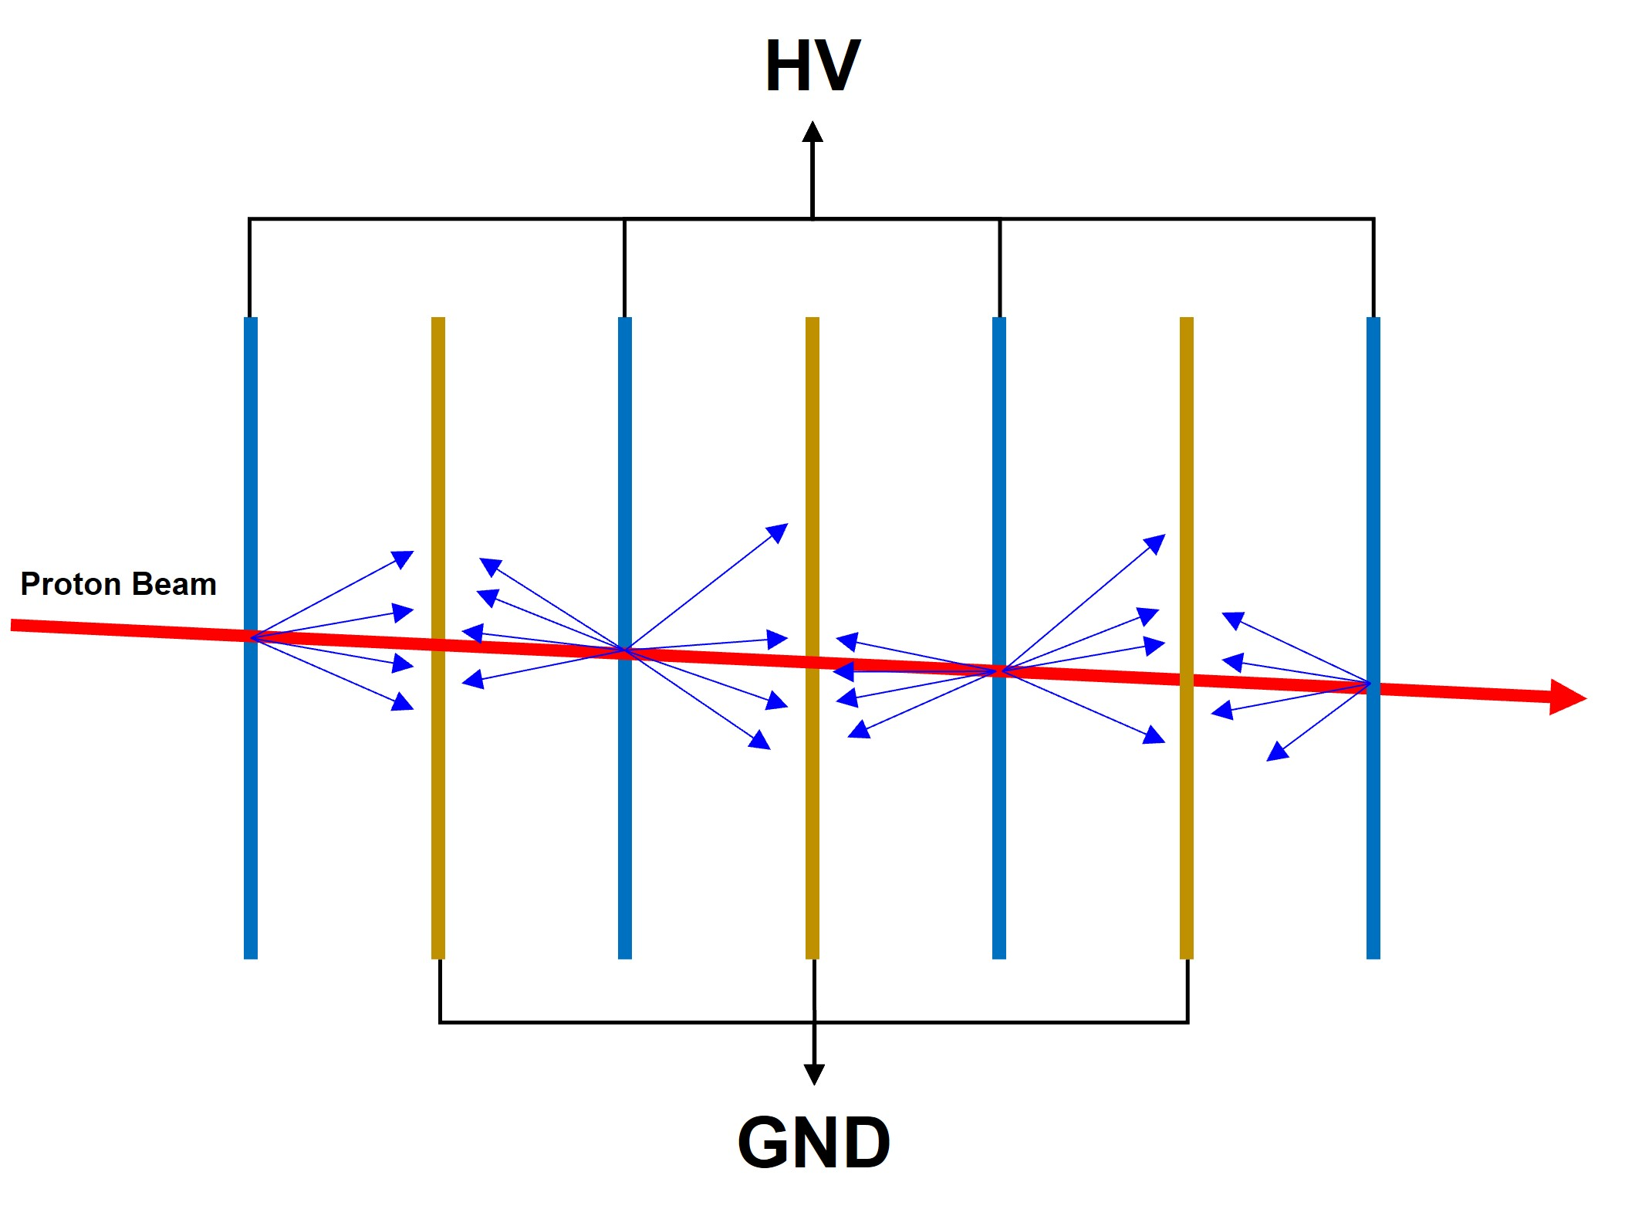
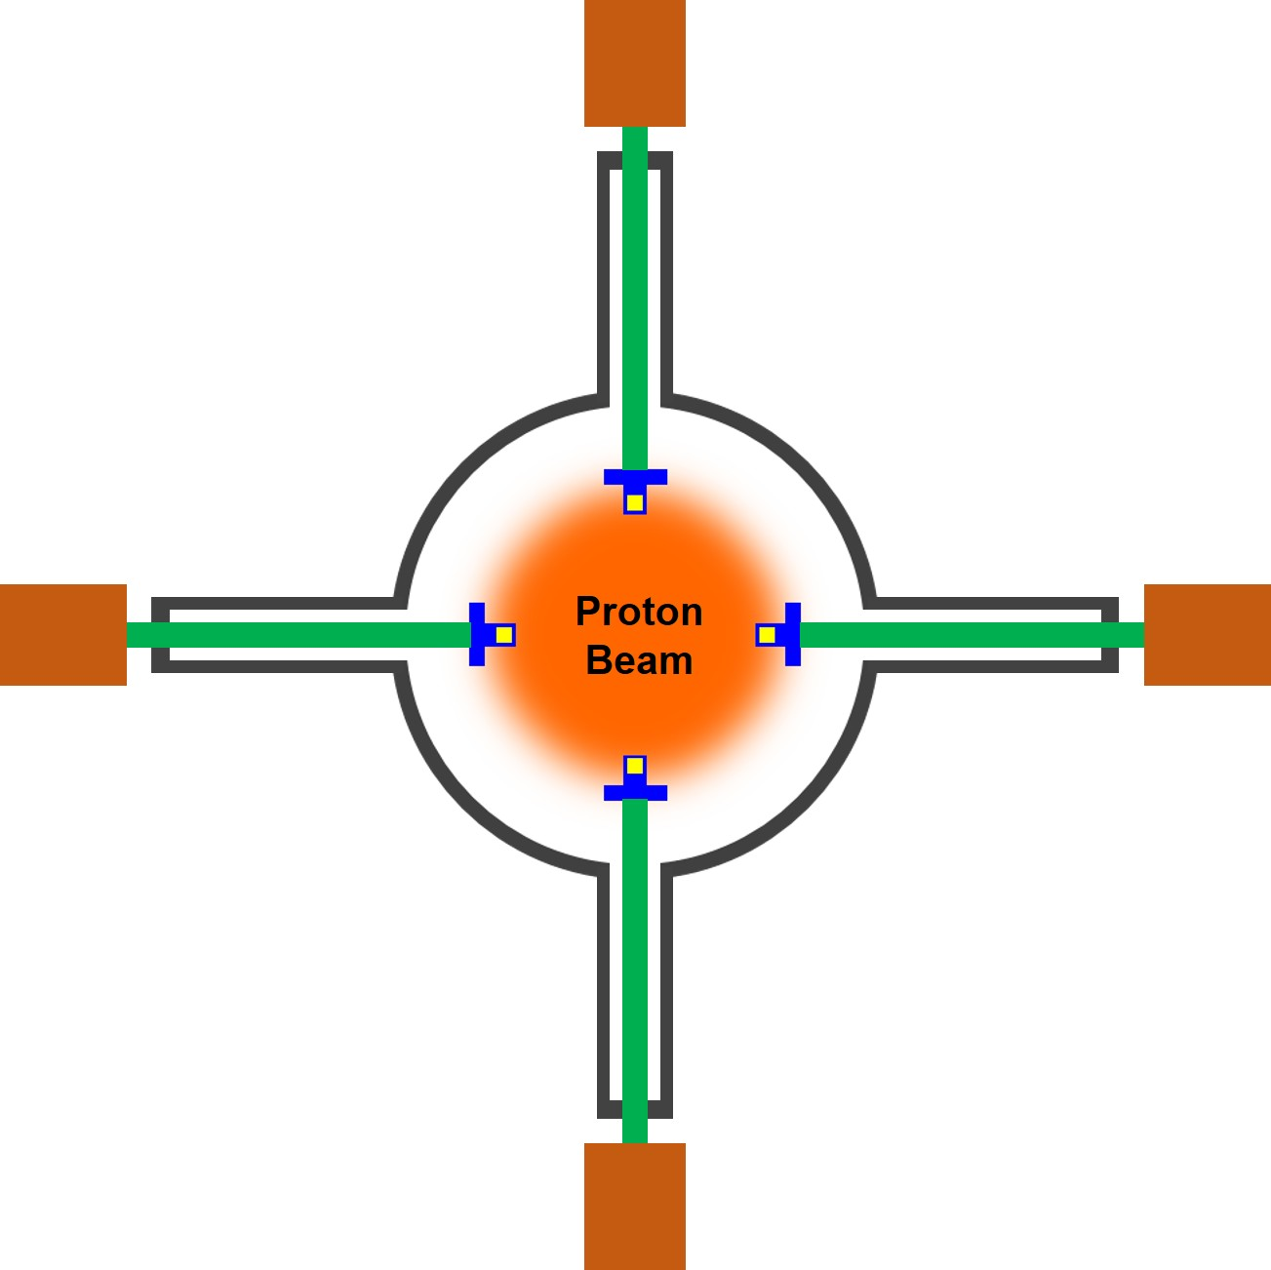
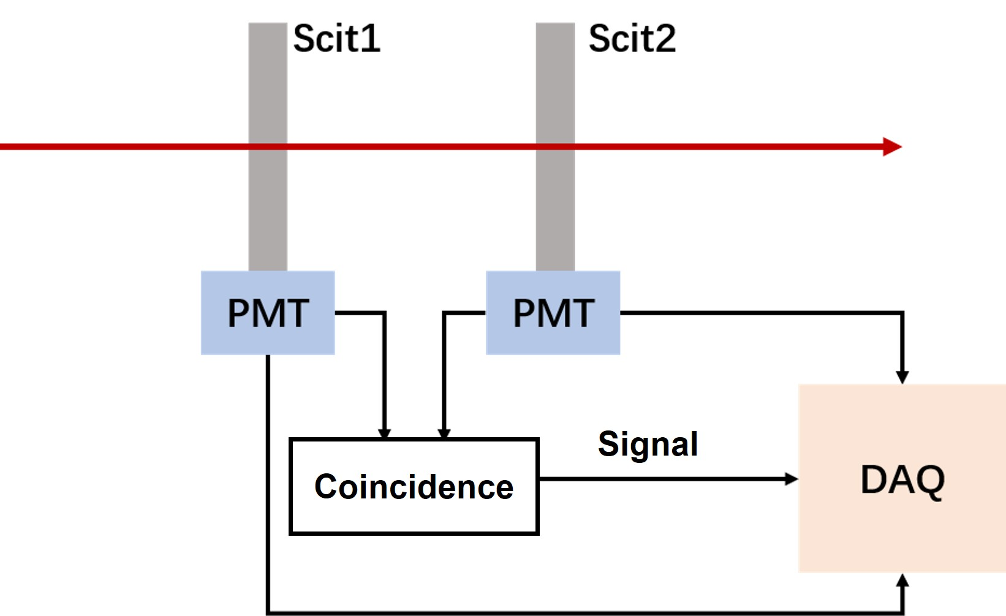
3.2 Statistic DIT
PALET
PROUD
SEEM
BMOS
Profile Detector
Beam Structure Calibrator
Flux Monitor
Flux Monitor
Micromegas
Plastic Scintillator
Aluminum Multiplier
Silicon Carbide
Positioning Res. 0.3 mm
Dyn. range 1-10⁴ p/pulse
Intensity > 1E4 p/s
Intensity < 1E5 p/s

Slide 17
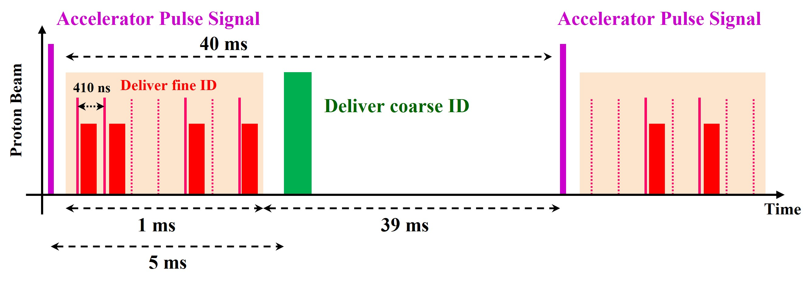
3.3 Trigger Logic Unit
Rigorous alignment proton by proton is required by tracker and calorimeter tests.
A trigger logic unit has been designed in HPES based on AIDA-2020 architecture.
Trigger ID will be fan out to DUT and DIT and packed in data as label of data alignment.
Primary tests have been carried out in SPS.
Trigger
System
LEMS
Trigger
ID
HEPTel
DUT
Type
Time Stamp
Trigger ID
Trigger ID
Data
Event Alignment

Slide 18
Introductions to HPES and CSNS
Beam Parameters of HPES
Devices in HPES Terminal
Milestone and Summaries

Slide 19
4.1 Milestone of HPES construction
2026.12
2027.02
2027.09
2028.07
2029.09
Civilization Complete
Device Installation
Commissioning without beam
Commissioning with beam
Pilot run
HPES Pilot run.
Fist beam delivery.
All devices will be tested without beam
Terminal device installation
Construction of the experiment hall will be finished by summer this year.
Devices installation will then start.
The HPES is expected to delivery its first beam in 2029.
More information will be updated in the future.

Slide 20
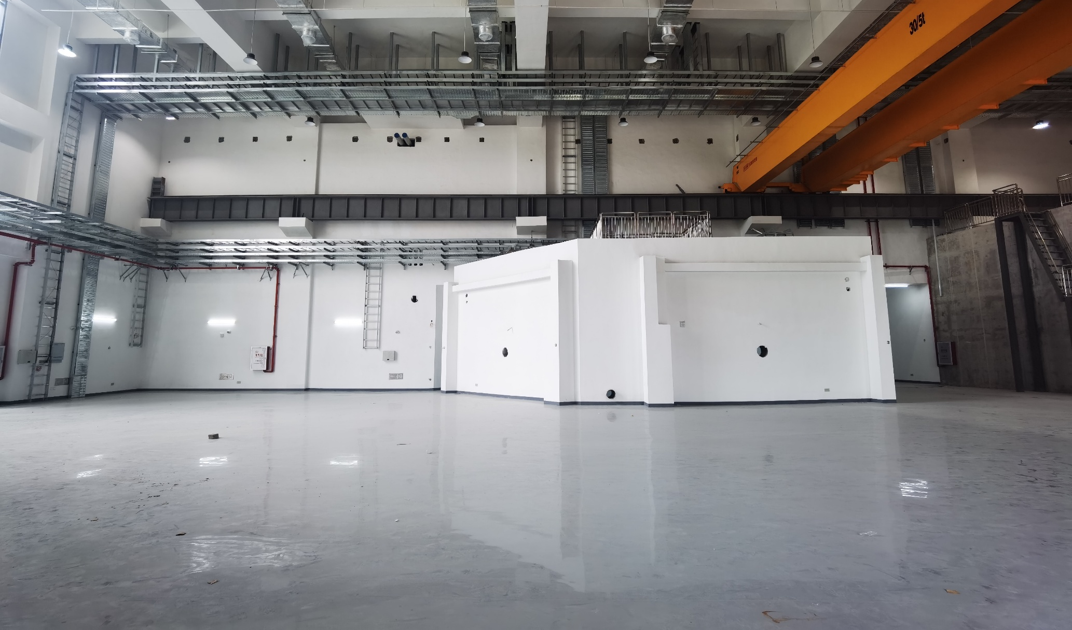
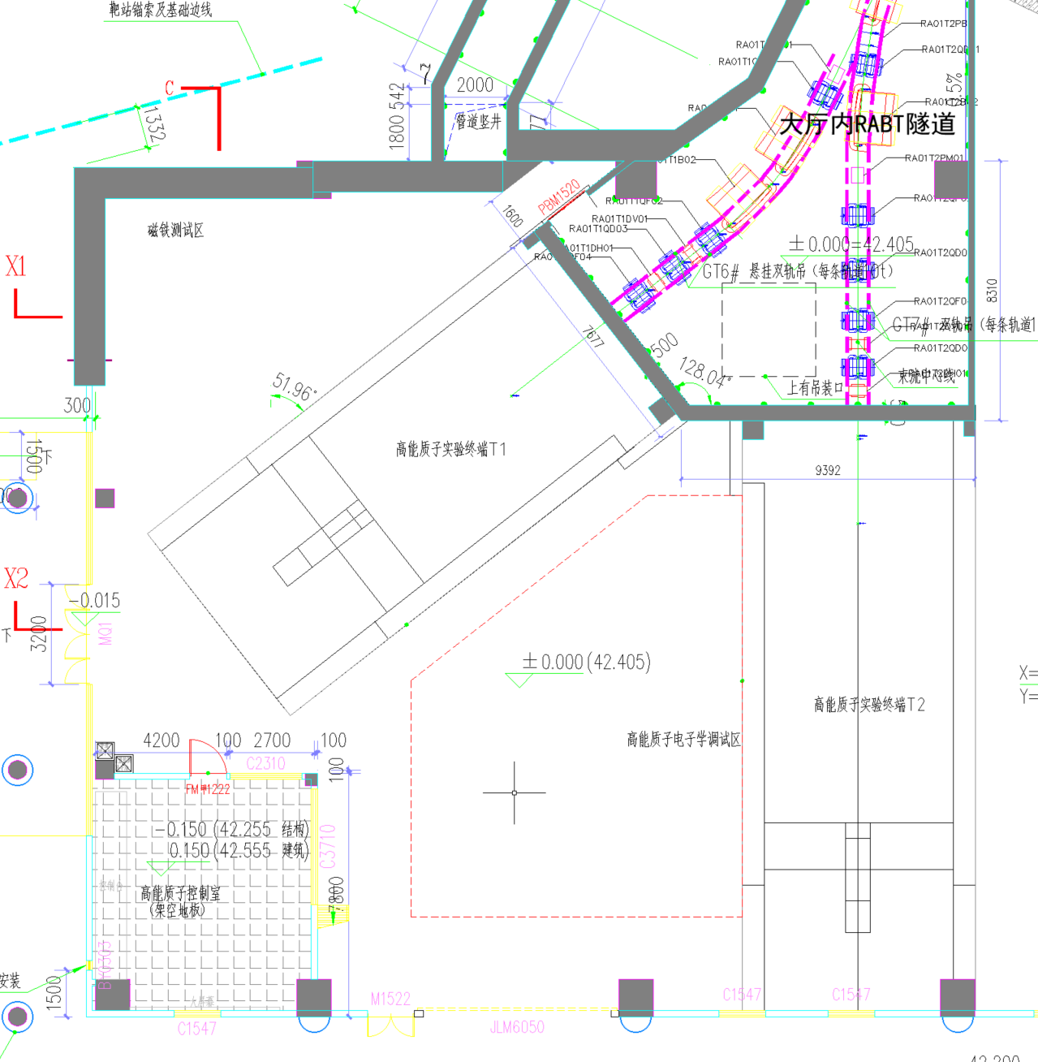
4.2 Recent progress of HPES
View direction
T1
T2
Experiment hall have been finished.
Terminals will be finished by JUN. 2027.

Slide 21
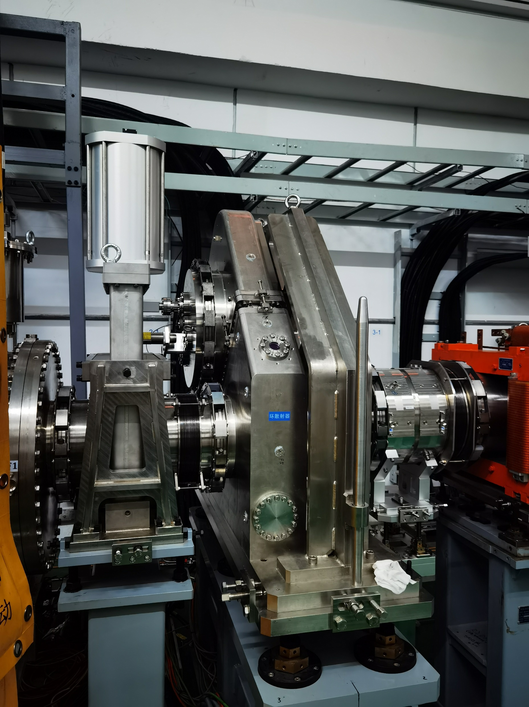
4.2 Recent progress of HPES
The proton scatter has been installed on the RCS of CSNS.
Currently, it is under tuning test.

Slide 22
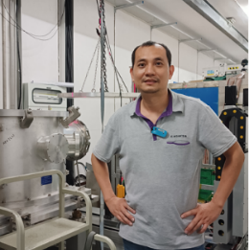


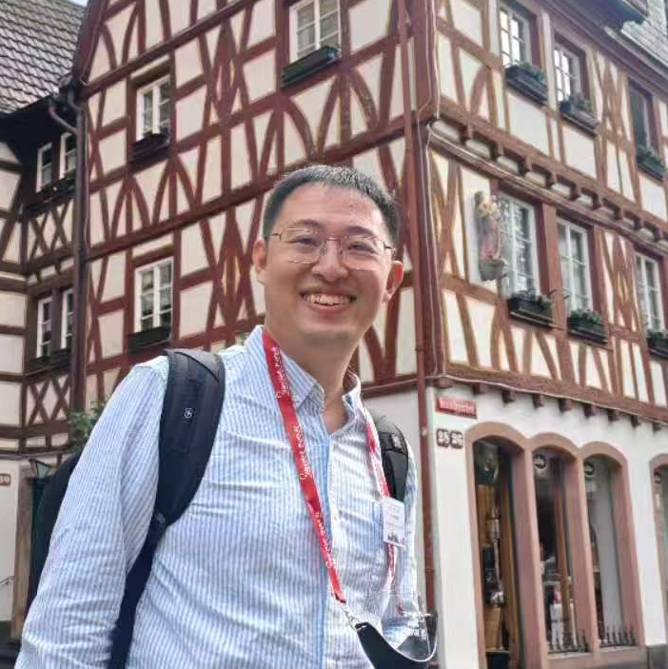

4.3 Team of HPES
HPES will open to everyone. Welcome to contact with us if you are interested.
Director of HPES
JING Hantao / 敬罕涛
jinght@ihep.ac.cn
Team Coordinator
DONG Mingyi / 董明义
dongmy@ihep.ac.cn
Team Coordinator
FAN Ruirui / 樊瑞睿
fanrr@ihep.ac.cn
Beamline Physicist
GUO Yuhang / 郭宇航
guoyh@ihep.ac.cn
User Support
TAN Zhixin / 谭志新
tanzx@ihep.ac.cn
Device Physicist:
QIAN Sen/钱森 | LIANG Zhijun/梁志均 | ZHANG Hongyu/章红宇 | YI Han/易晗
SHI Xin/史欣 | LI Qiang/李强 | LV You/吕游 | LI Mengzhao/李梦朝

Slide 23
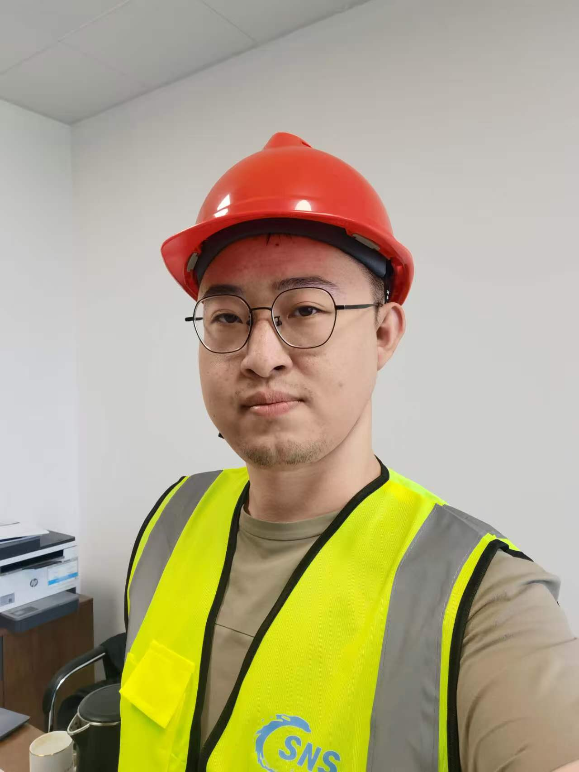
4.4 Summaries
China’s first proton test beam will be completed in 2029.
Multiple DIT have been equipped with HPES in supporting the users:
  Telescopes with resolution < 10 μm.
  Proton energy spectrometer with res. 1% @ 1.6 GeV.
  Trigger device with TLU for data alignment proton by proton.
Beam extraction is under tuning.
Post Doc. position is open. We provide competitive salary. Contact with us if you are interested.
Contact：Yuhang Guo
Phone：+86 18392181025
Email：guoyh@ihep.ac.cn

Slide 24
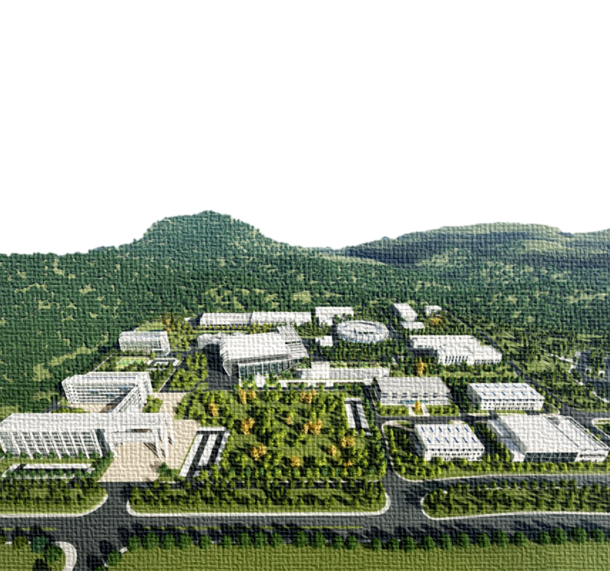

致谢
承蒙厚爱
感谢倾听
Thanks!
中国散裂中子源
China Spallation Neutron Source

