Slide 1
Beam Facilities at China Spallation Neutron Source
Ruirui Fan
Institute of High Energy Physics, CAS

Slide 2
中国散裂中子源
China Spallation Neutron Source

Slide 3
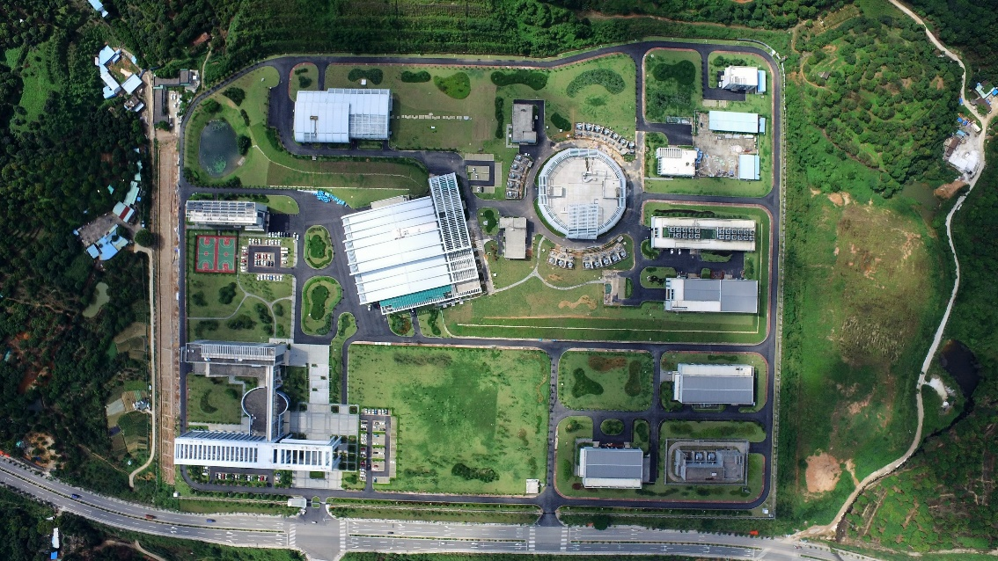

China Spallation Neutron Source
Hefei
Dongguan
bird view of campus

Slide 4
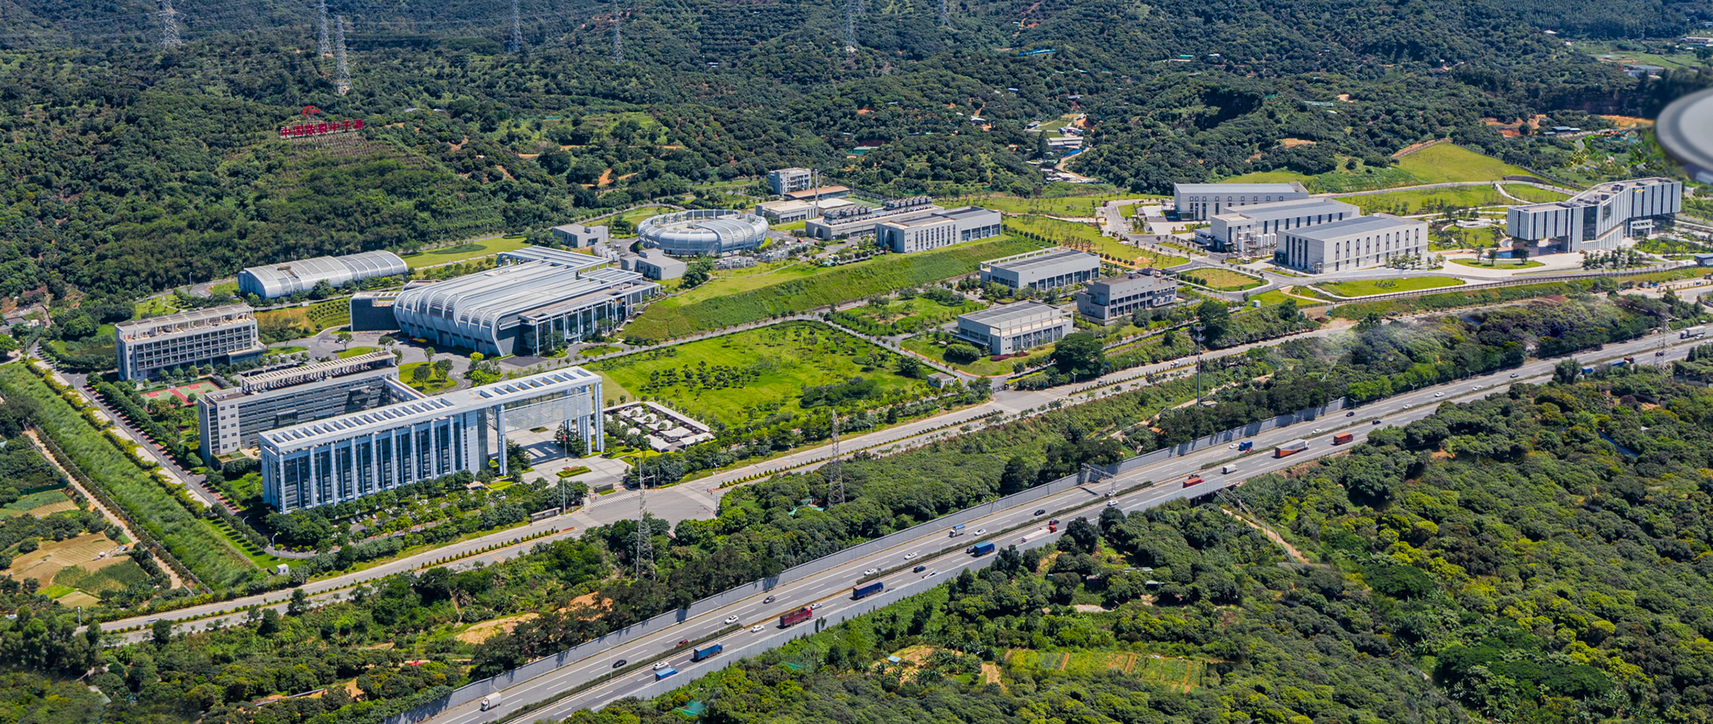
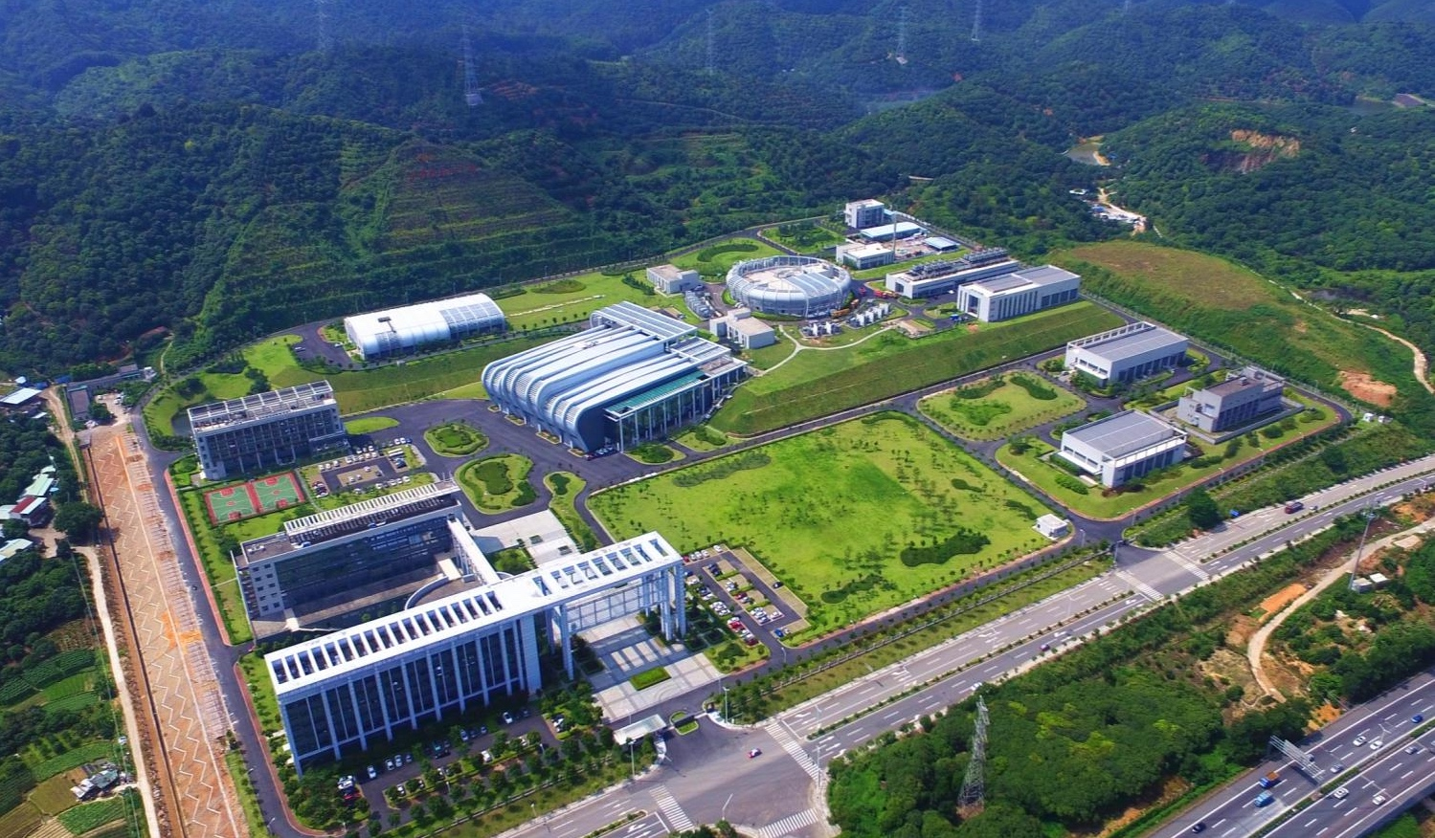

CSNS campus
Proposed at year of 2000
Budget: about 2.2 B CNY
Construction started at Sep. 2011, and finished at Mar. 2018
User program started in Oct. 2018
Beam power increased from 20kW to 185kW
Operation with long user hours and high availability
11 neutron instruments and in user program
Aug. 2024
Aug. 28, 2017
Before ground breaking, May 9, 2009
Notes:
This page shows the evolution of the CSNS campus in Dongguan. We have three key time nodes: the original site photo on May 9, 2009 before ground breaking; the completion status on August 28, 2017; and the latest campus view in August 2024. CSNS was first proposed in 2000, with a total budget of about 2.2 billion Chinese Yuan. Construction started in September 2011 and was completed in March 2018. The formal user program launched in October 2018. Up to now, the beam power has been raised from 20 kW to 185 kW, maintaining long user operation hours and ultra-high availability, with 11 neutron instruments officially open to users.

Slide 5
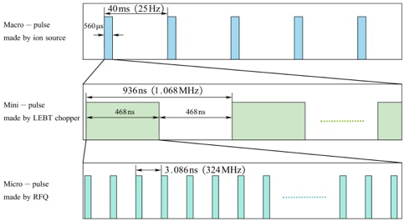
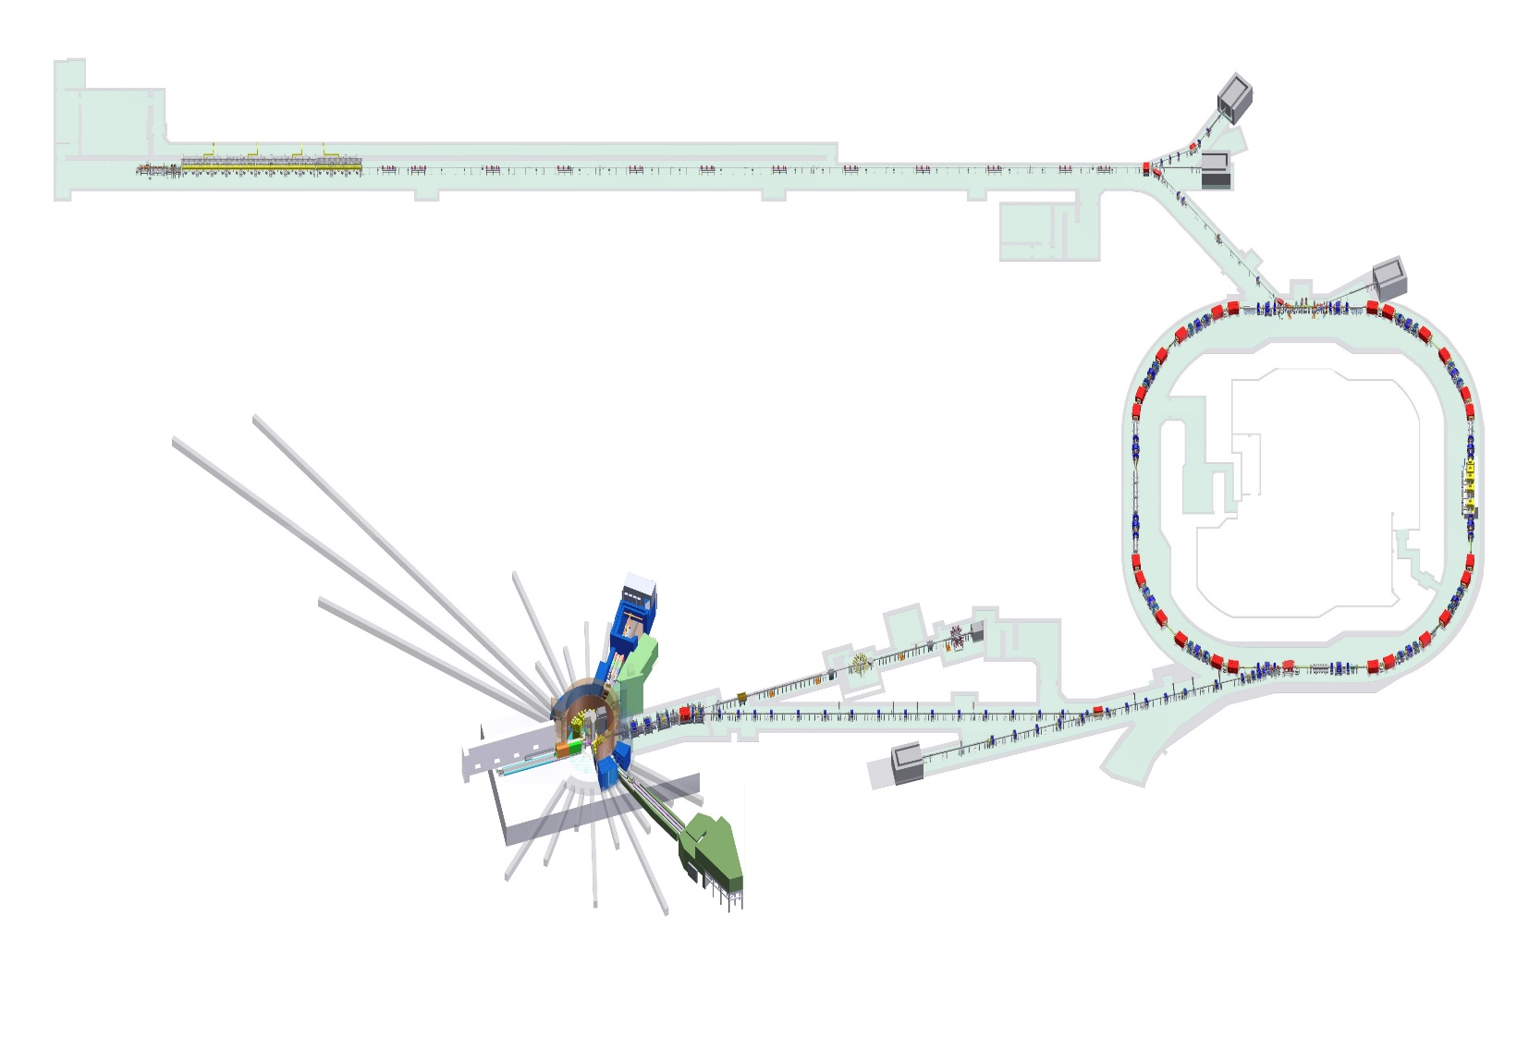
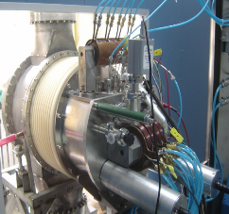
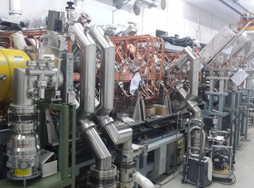
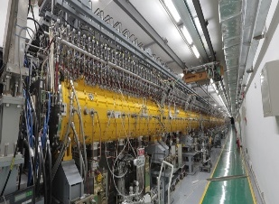
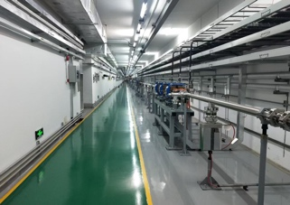
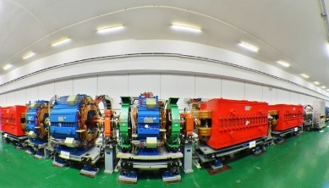
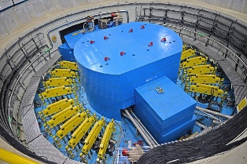
CSNS Facility
0.05 MeV
3 MeV
80 MeV
Ion Source
LEBT
RFQ
MEBT
DTL
LRBT
Beam Power on target [kW] | 100
Proton energy [GeV] | 1.6
Average beam current [uA] | 62.5
Pulse repetition rate [Hz] | 25
Linac energy [MeV] | 80
Linac type | NC
Linac RF frequency [MHz] | 324
Macropulse duty factor | 1.05
RCS circumference [m] | 228
RCS harmonic number | 2
1.6 GeV RCS
RTBT
Target
Notes:
This is the overall accelerator layout of CSNS, including ion source, RFQ, DTL, LEBT, MEBT, LRBT, RCS and tungsten target station. The core design parameters are clearly listed here: target beam power 100 kW, proton energy 1.6 GeV, average beam current 62.5 microamps, repetition rate 25 Hz, linac energy 80 MeV, and RCS circumference 228 meters. We also display the macro-pulse, mini-pulse and micro-pulse time structure formed by the ion source, LEBT chopper and RFQ system respectively.

Slide 6
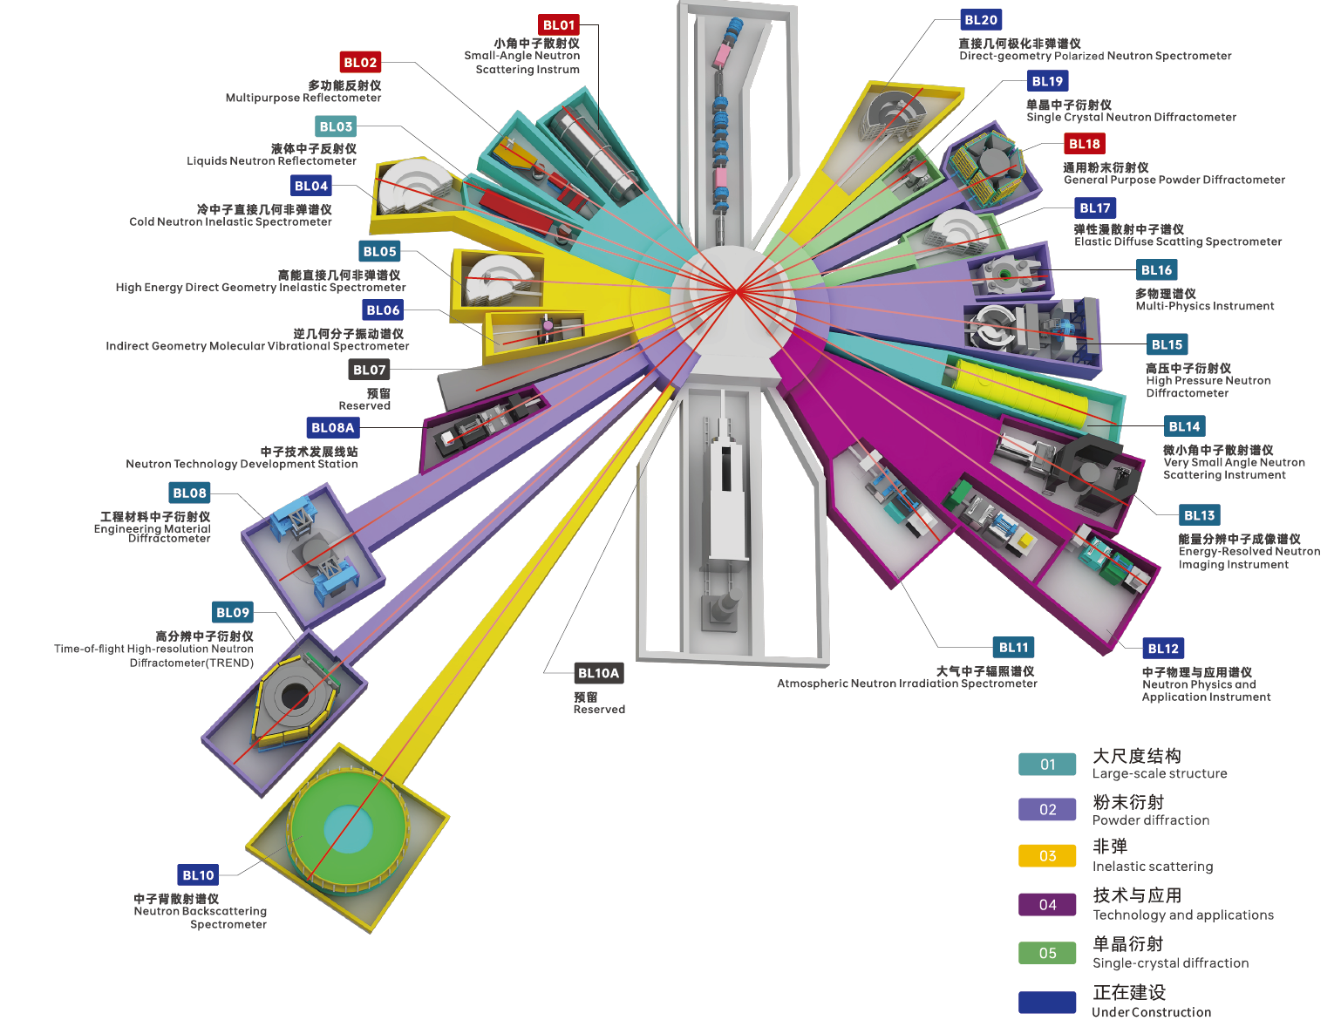
CSNS Instrument Suite
Powder Diffractometer | General Purpose Powder Diffractometer (GPPD)
 | Multi Physics Instrument (MPI)
 | High-resolution Powder Diffractometer (TREND)
 | High pressure diffractometer (HP)
Large Scale | Small Angle Neutron Scattering instrument (SANS)
 | Very Small Angle Neutron Scattering (VSANS)
 | Multi-Purpose Reflectometer (MR)
 | Liquid Neutron Reflectometer (LNR)
Industry Application | Engineering Material Diffractometer (EMD)
 | Energy Resolved Neutron Imaging (ERNI)
 | Atmosphere Neutron Irradiation (ANIS)
Direct Geometry Spectrometer | High energy inelastic spectrometer (HD)
 | Cold Neutron Inelastic Spectrometer (CNIS)
 | Polarized Chopper Spectrometer (PACS)
Indirect Geometry Spectrometer | Molecular Vibration Spectrometer (IMVS)
 | Neutron Backscattering Spectrometer (NUBS)
Single Crystal | Elastic Diffuse Scattering Spectrometer (EDS)
 | Single Crystal Neutron Diffractometer (SCND)
Nuclear physics & technique | Back-streaming white neutrons (Back-n)
 | Neutron Technology Develop Station (NTDS)
 | Neutron Physics & Application Instrument (NPAI)
 | High-energy Proton Experimental Station（HPES）
 | Muon station（MELODY）
Notes:
After CSNS-II completion, the facility will own a complete instrument suite covering powder diffraction, small angle scattering, reflectometer, inelastic spectrometer, single crystal diffraction, nuclear physics and muon/proton experimental stations. Each type has multiple specialized instruments, forming a full-coverage neutron research platform for multidisciplinary demands.

Slide 7
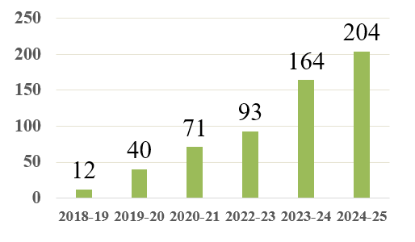
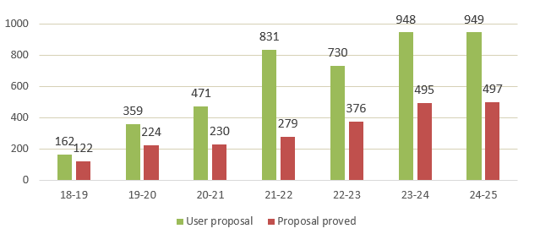
The User Program
https://user.csns.ihep.ac.cn (in both Chinese and English）
Registration user: 10,000+
A total of over 2,500 projects from 268 units were completed, with industry users comprising approximately 9.5% of the total.
Two rounds of proposal calls each year.
User proposal VS. Proposal proved
User publications
Notes:
CSNS has built a bilingual Chinese and English user official website for proposal application and management. Up to now, we have more than 10,000 registered users. A total of over 2,500 research projects from 268 institutions worldwide have been completed, among which industrial users account for about 9.5%. We launch two rounds of project proposals every year. The statistical chart clearly shows the annual number of user proposals and approved projects since 2018.

Slide 8
Research Areas
University：～45%
Research institution：～49%
Enterprise：～6%
Notes:
The user projects cover many research areas. The largest proportion is accounted for by new energy and batteries.

Slide 9

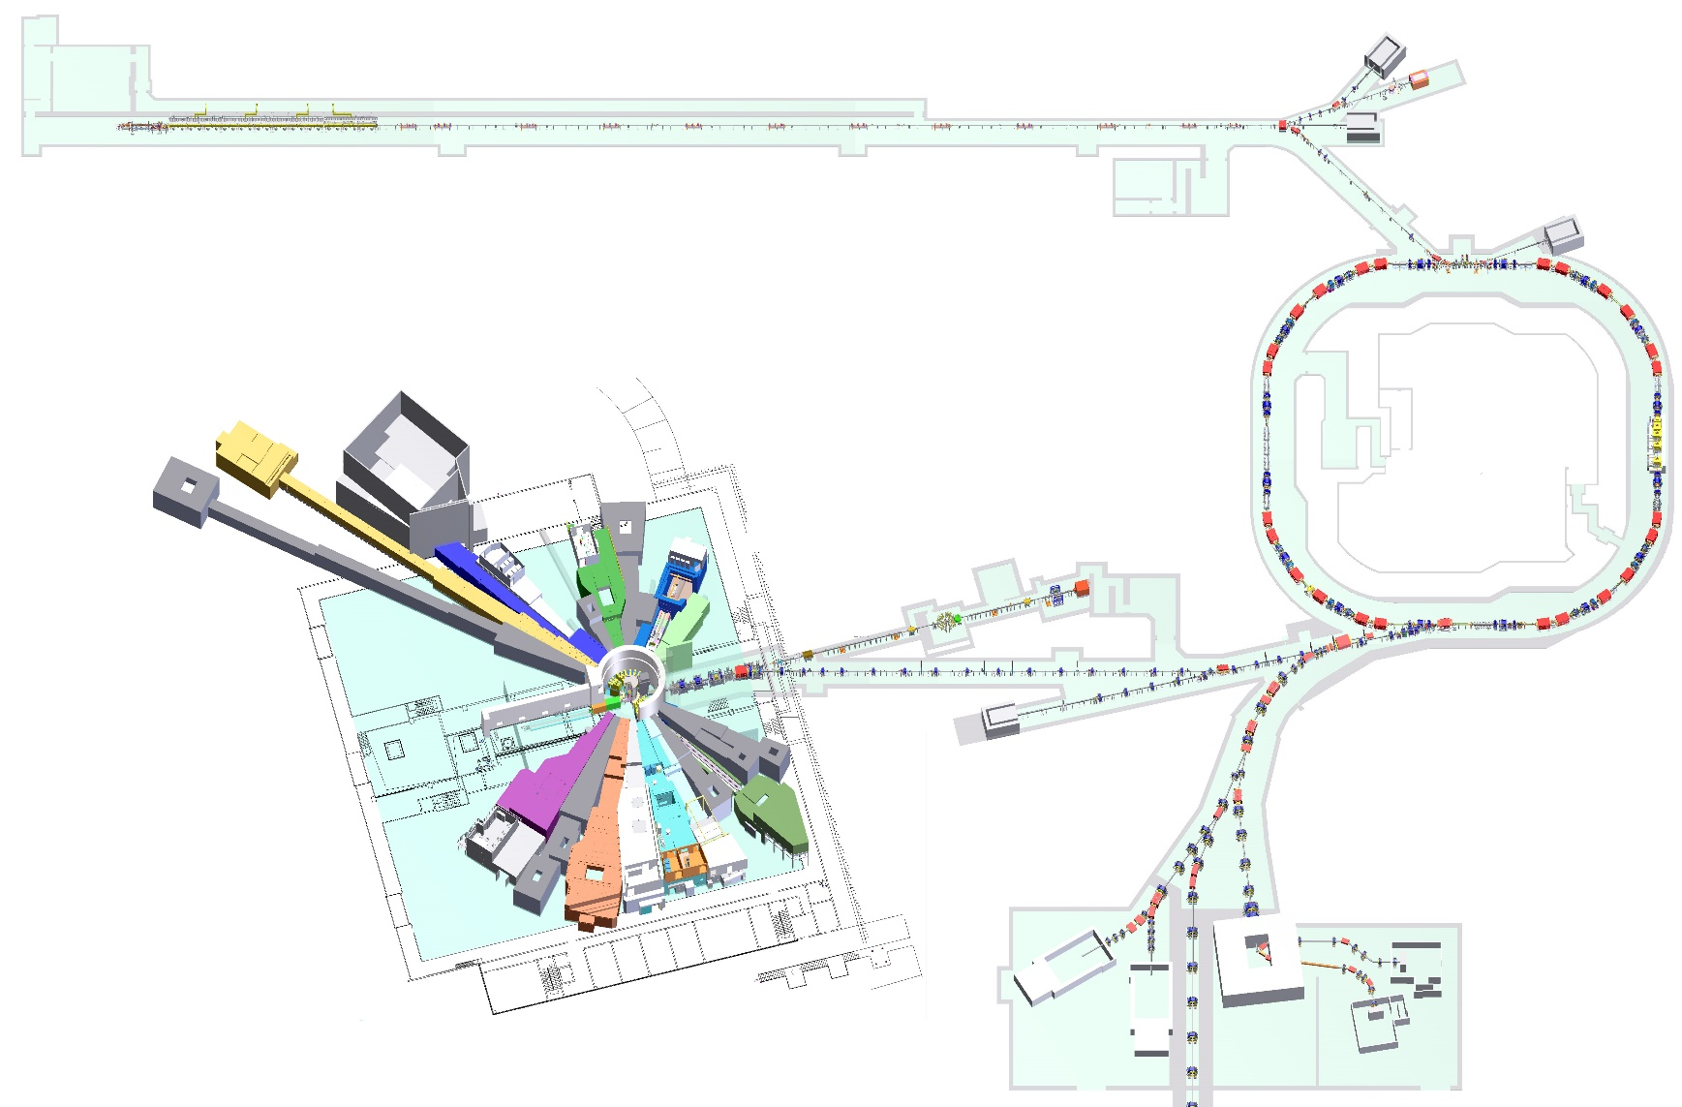
CSNS Beam Expansions Application
Associated Proton beam Experiment Platform 80 MeV proton
Ion source
Linac
White neutron source
~300 MeV neutron
Synchrotron
Proton test beam
1.6 GeV proton
muon source
Notes:
The main research at CSNS (China Spallation Neutron Source) is focused on thermal neutron scattering measurements, corresponding to condensed matter physics and materials science. However, for such a large facility, we have also designed several platforms for extended applications around the accelerator. We have designed and built four beam application platforms, two of which have already been completed. The other two will be constructed within the next six years as part of CSNS-II.

Slide 10
伴生质子束平台
Associated Proton beam Experiment Platform

Slide 11
CSNS Beam Expansions Application
Associated Proton beam Experiment Platform 80 MeV proton
Ion source
Linac
White neutron source
~300 MeV neutron
Synchrotron
Proton test beam
1.6 GeV proton
muon source
Notes:
APEP is located at the end of the linear accelerator and is primarily used for proton irradiation experiments.

Slide 12
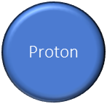
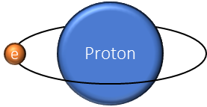
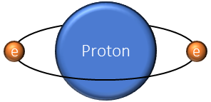
Generation of associated protons
During the acceleration process of negative hydrogen ions, due to collisions with gas molecules in the vacuum pipeline, the outer electrons can be stripped off, resulting in a certain proportion of hydrogen atoms (H⁰) and protons.
APEP
Dipole magnet
DUMP
e
e
e
RCS
By using a dipole magnet to separate the three components, the H⁻ ions are injected into the ring accelerator, H⁰ is directed towards the dump, and the protons are extracted to APEP.
Notes:
During the acceleration process of negative hydrogen ions, due to collisions with gas molecules in the vacuum pipeline, the outer electrons can be stripped off, resulting in a certain proportion of hydrogen atoms (H0) and protons. By using a dipole magnet to separate the three components, the H- ions are injected into the ring accelerator, H0 is directed towards the dump, and the protons are extracted to APEP.

Slide 13
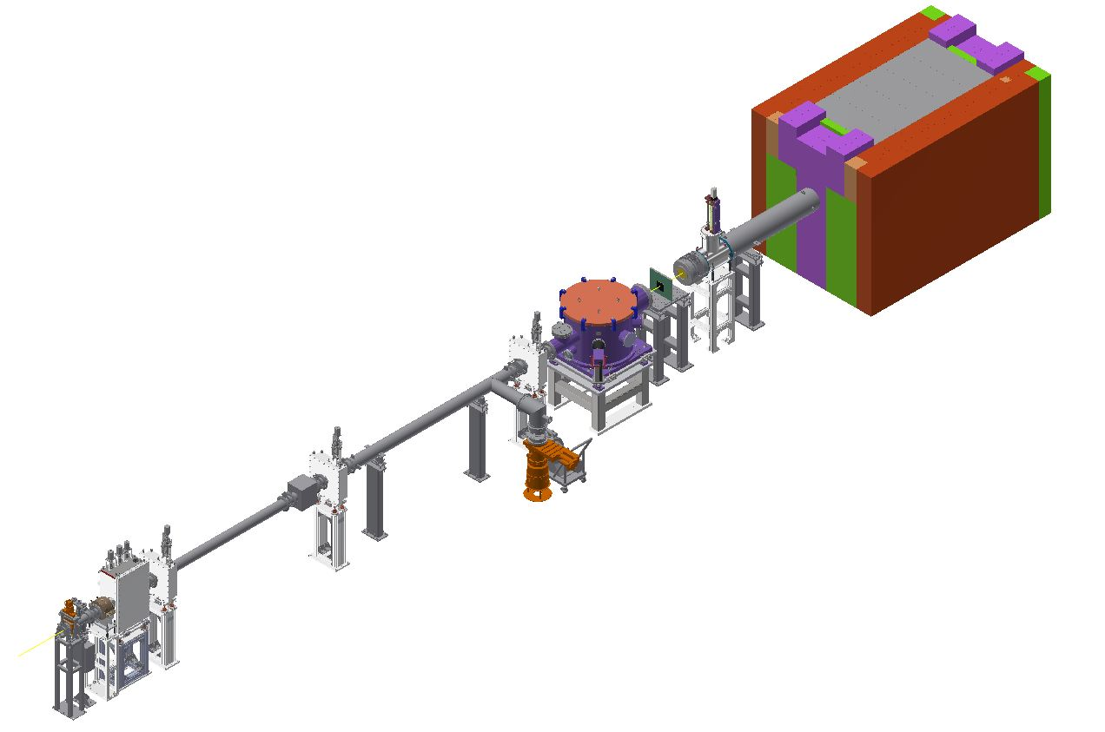
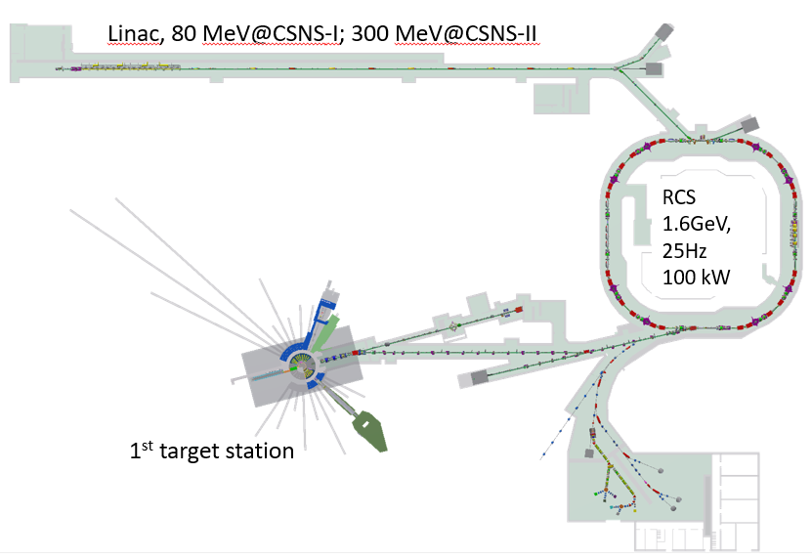
CSNS Associated Proton beam Experiment Platform
When negative hydrogen ion beams are accelerated and transmitted in the LINAC, they interact with the residual gases in the vacuum tube. A small portion of the negative hydrogen ions are stripped into protons and transmitted to the end of the linear accelerator. This is the world's first experimental terminal utilizing accompanying proton beams.
DUMP
Faraday cup
Atmospheric terminal
Vacuum terminal
COl3
Parameters of APEP
Energy：10-80 MeV (FWHM)<8.65% @>30MeV
Spot： 10 x 10 mm² – 50 x 50 mm²（Continuously adjustable, uniformity > 95%）
Flux：10⁵-10¹⁰ p/cm²/s
Monitor：1. CT, Faraday cup and activation foil
Vacuum terminal：vacuum<10⁻³ Pa, 50cm×Ø0.8m, Five test position；
Atmospheric terminal ：Remote-controlled sample holder
Background：<1.4E-4(n)和<3.4E-5(gamma) @20 x 20 mm²
COL2
degrader
Vacuum pump
Vacuum valve
COL1
the beamline is 14 meters.
CT Monitor
Proton
Notes:
A degrader is used to reduce the energy of particles.

Slide 14
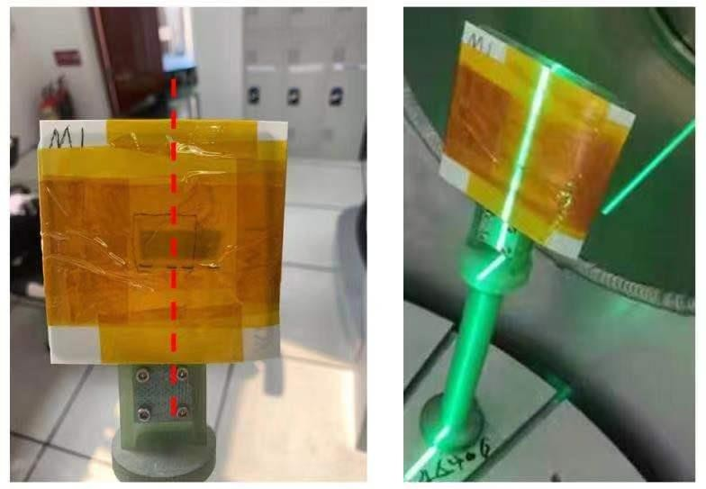
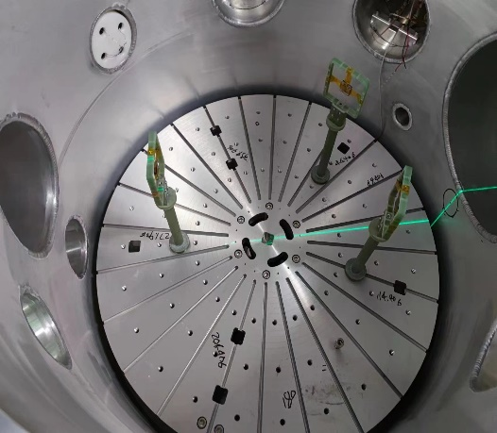
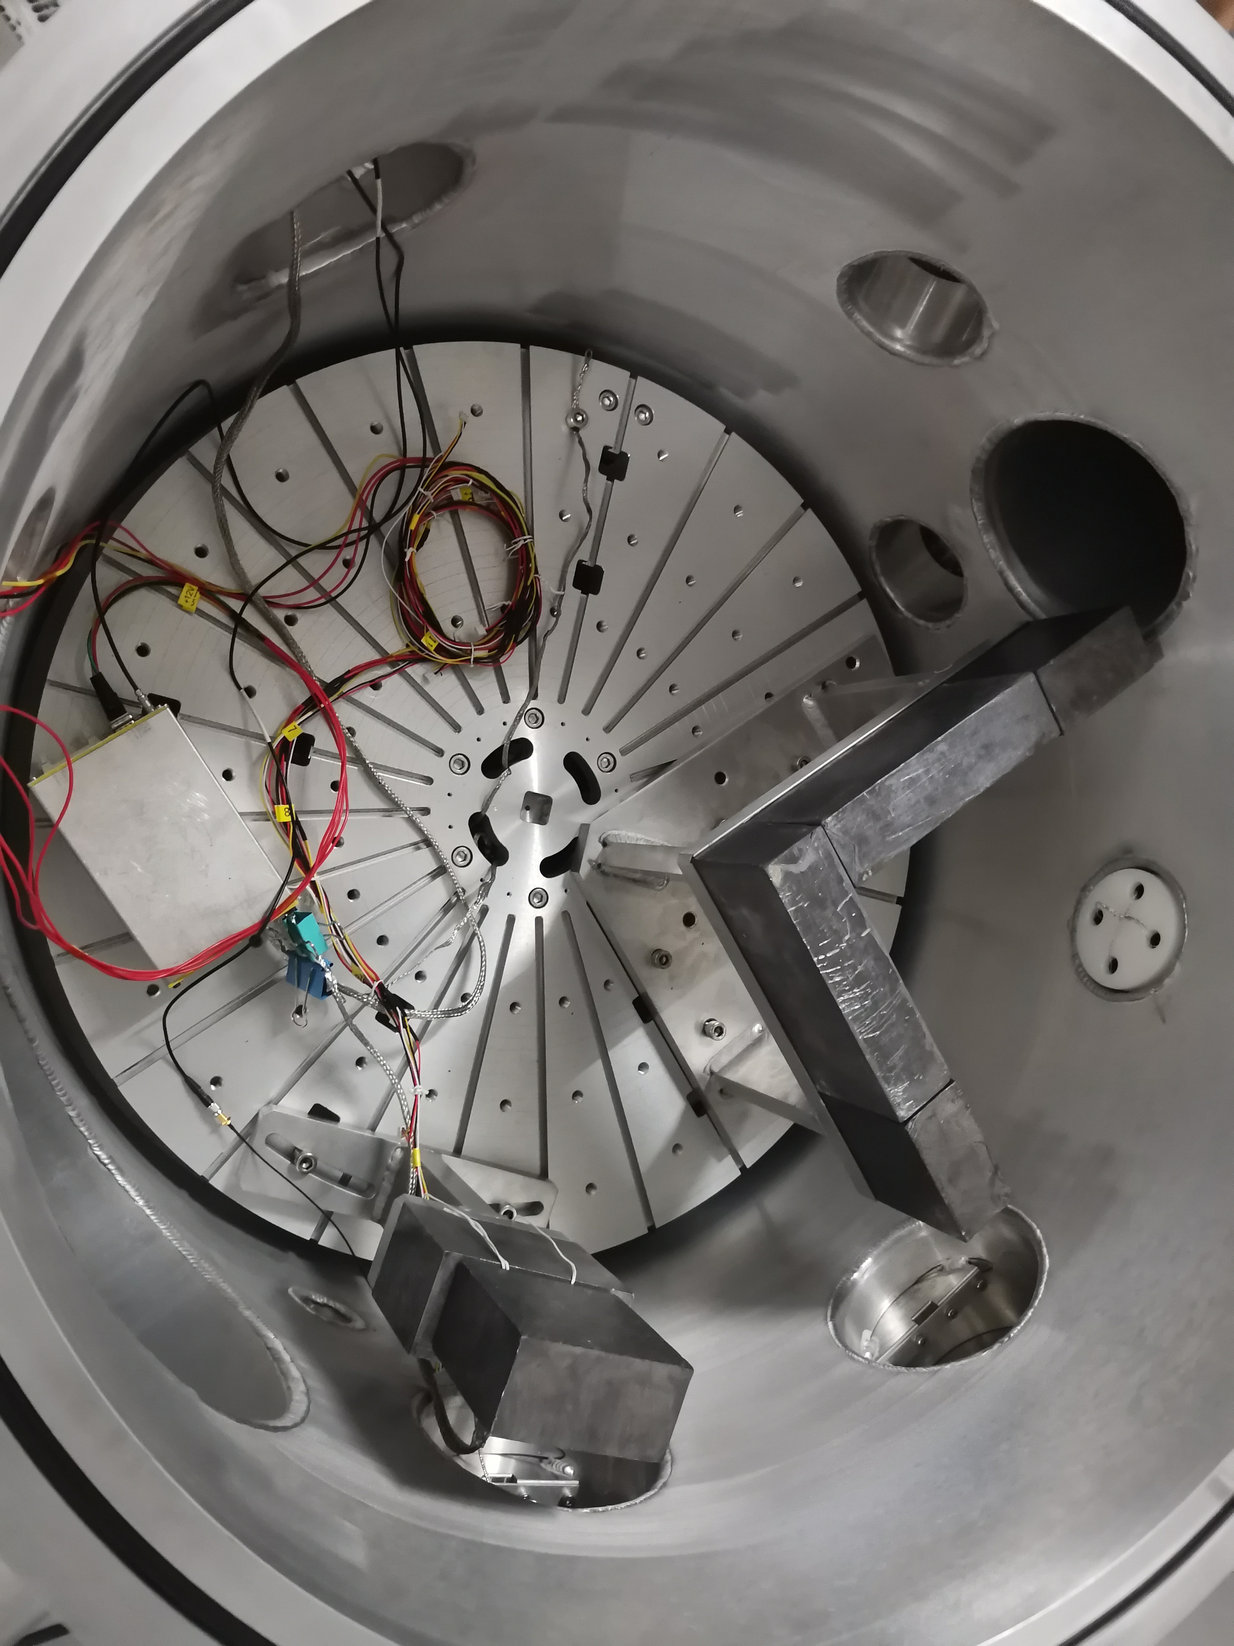
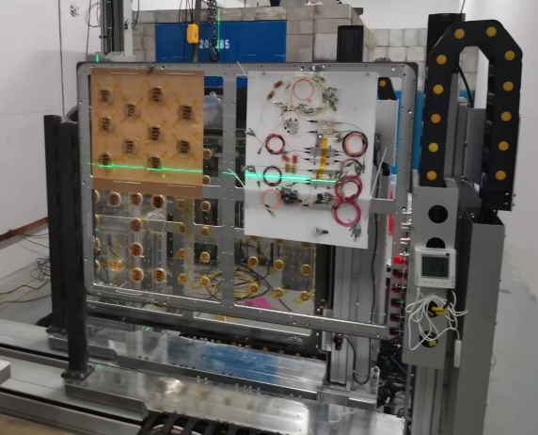
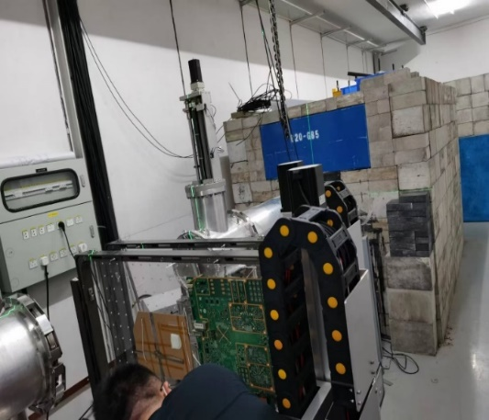
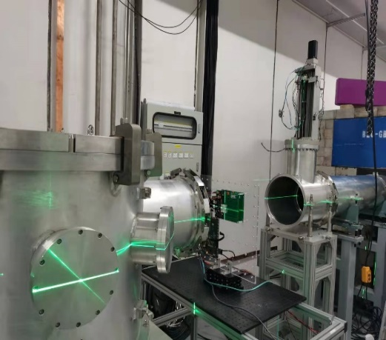

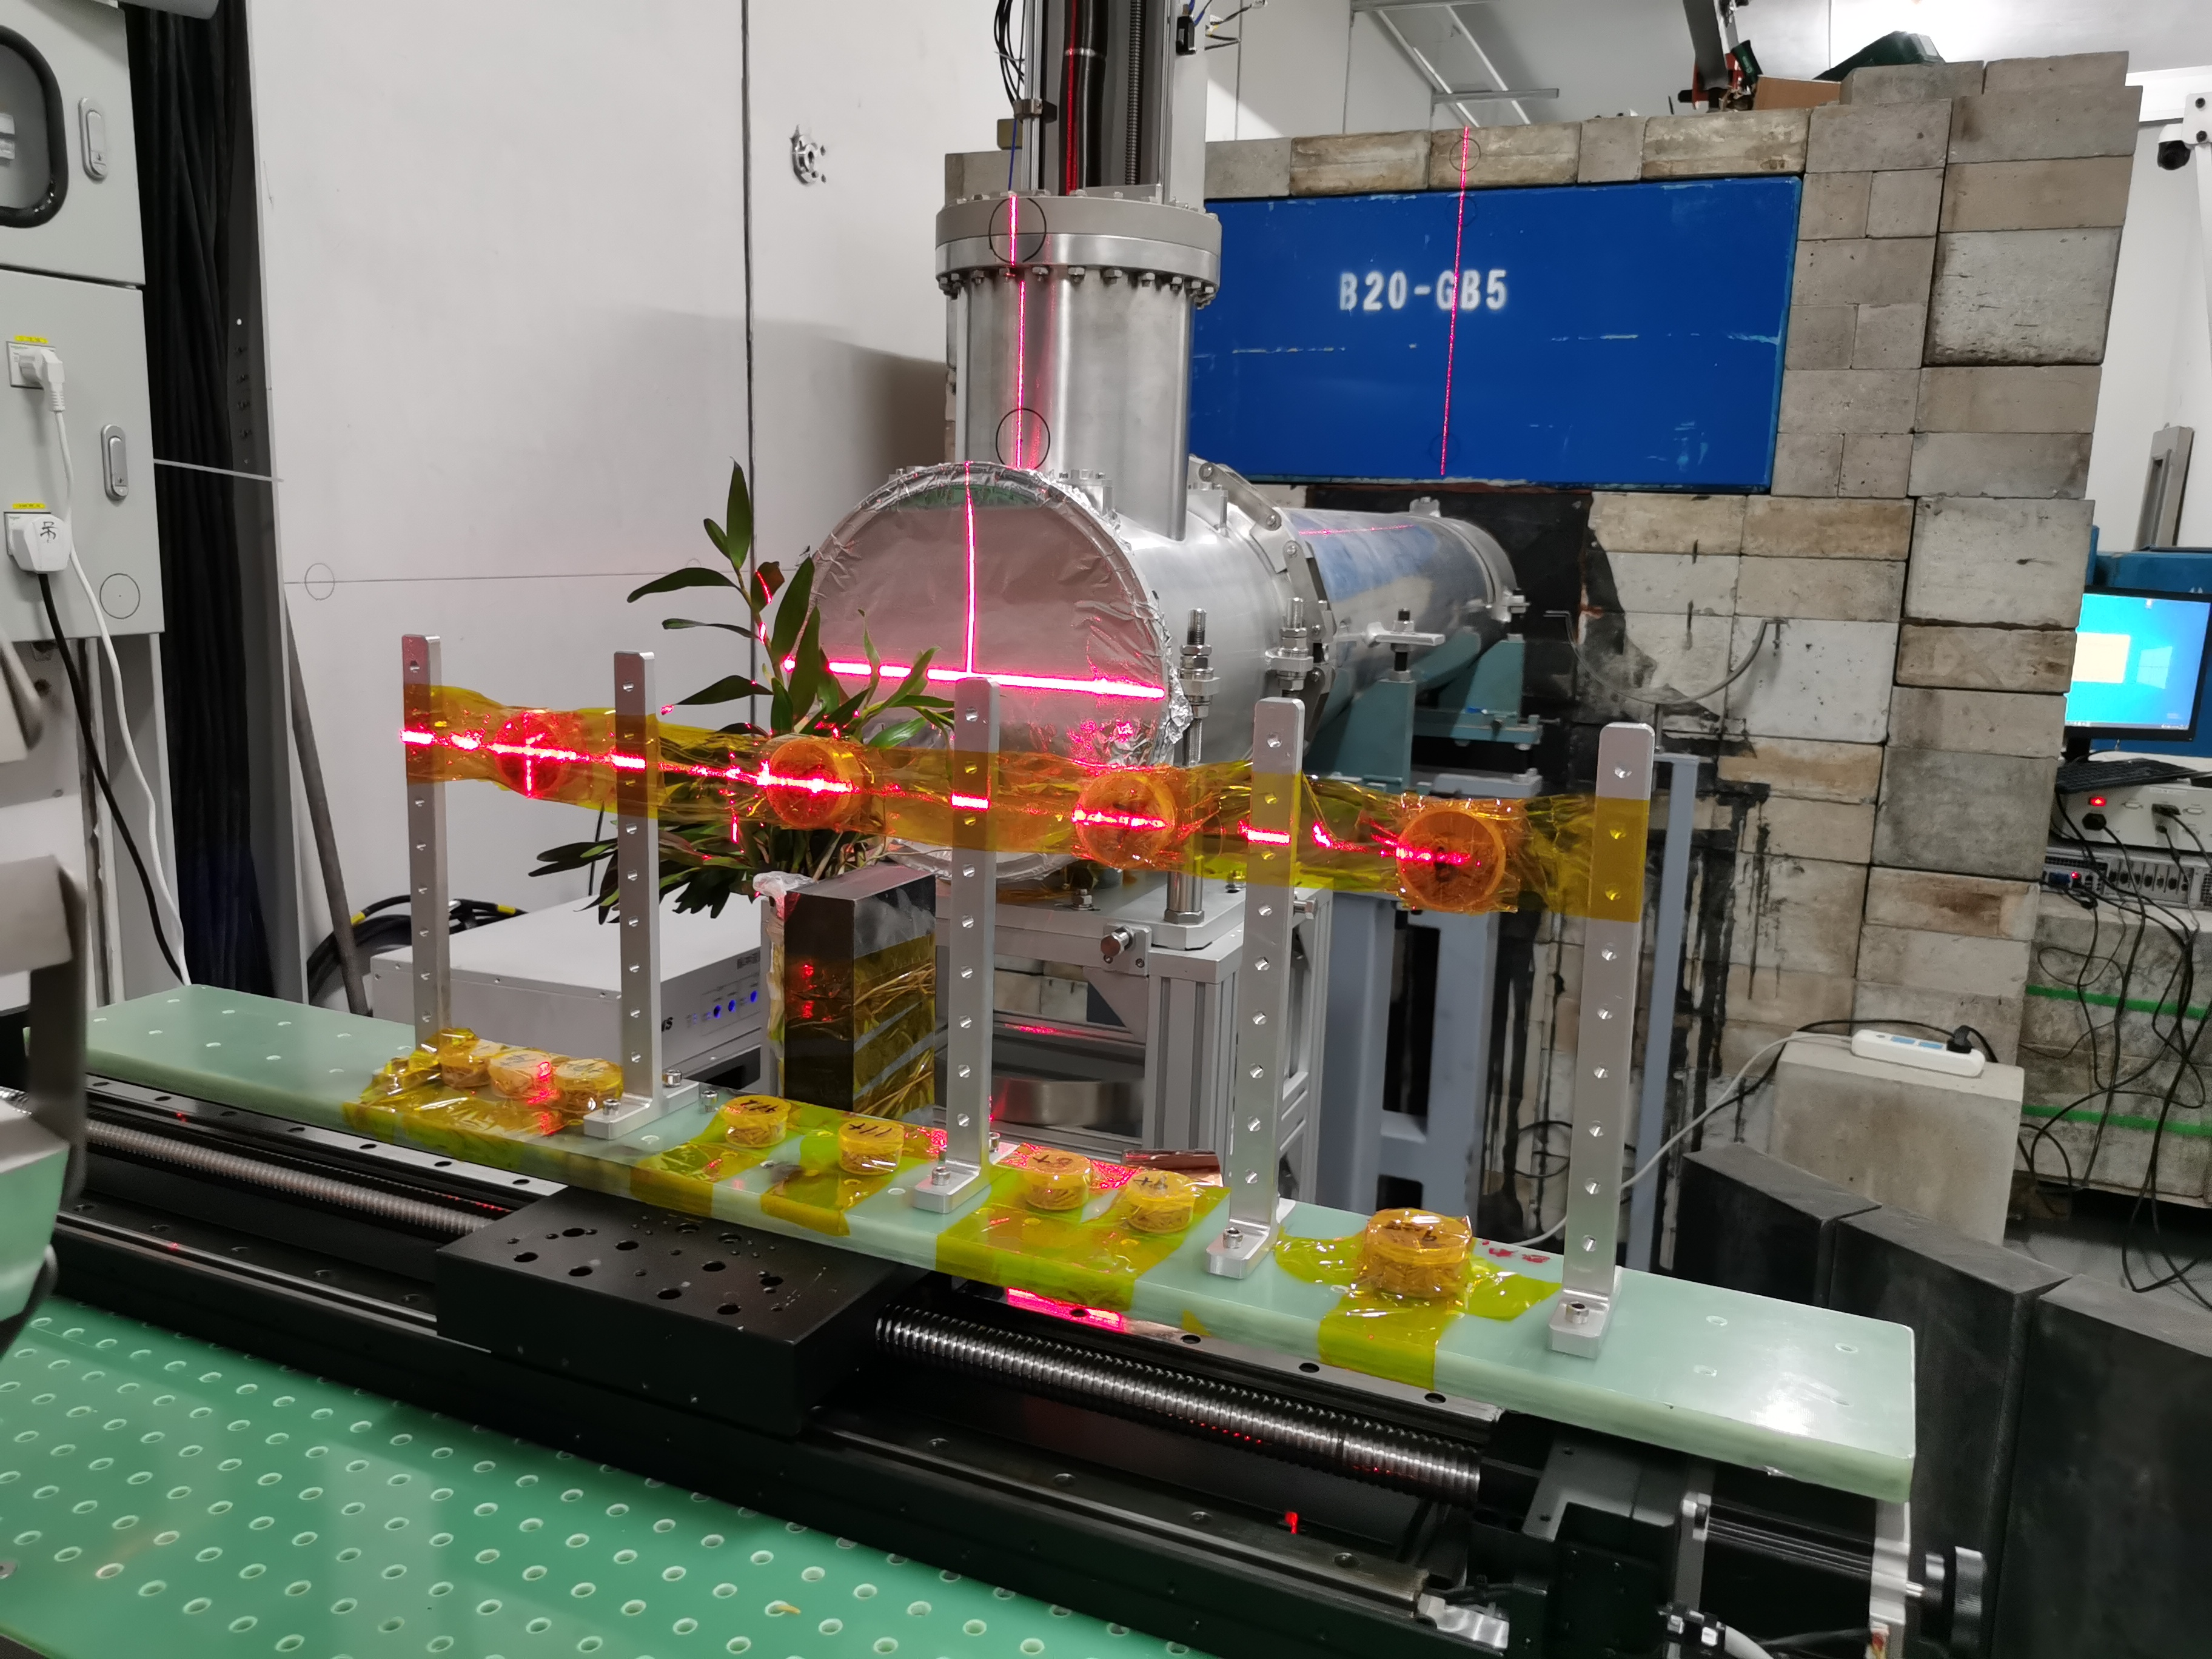
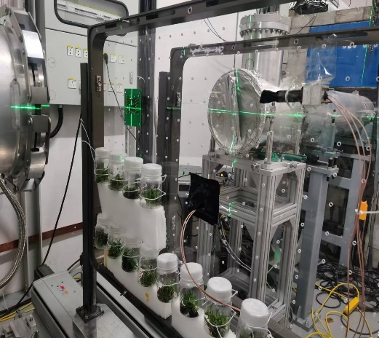
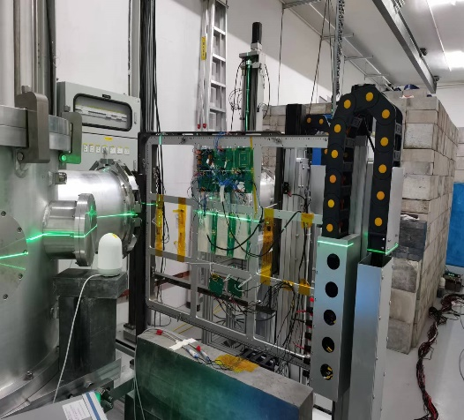
User experiment
APEP began trial operation at the end of 2021.
Each year, it completes over 100 experiments, covering various fields.
*Chips radiation damage; *Material radiation research ; *Detector radiation and calibration ;
*Space Electronics radiation damage; *Radiation-induced mutation breeding;
Detector radiation tests
Si material radiation damage
Radionuclide activity measurements
Detector calibration
Space photoelectric device radiation
ASIC SEE for LHCb detector
ASIC SEE for ATLAS
Radiation-induced mutation breeding
Communication devices radiation

Slide 15
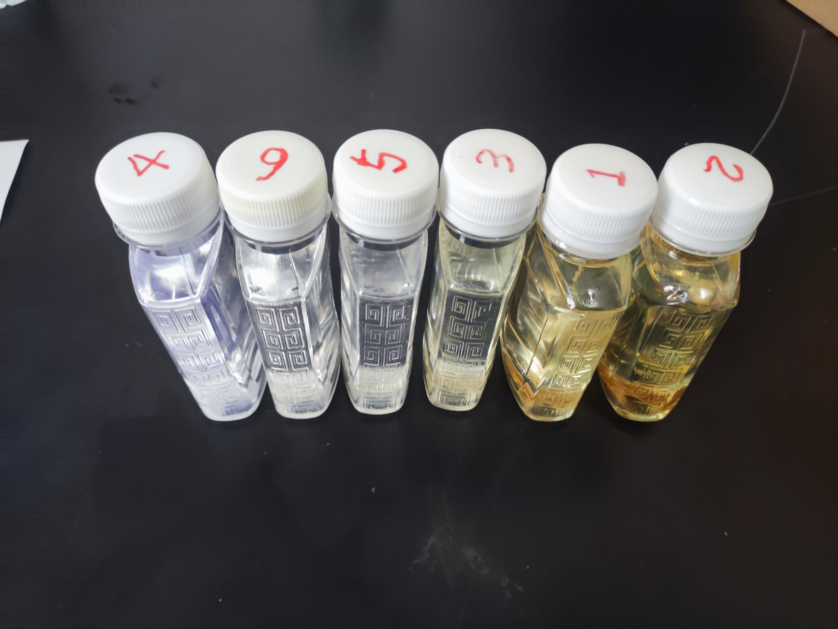
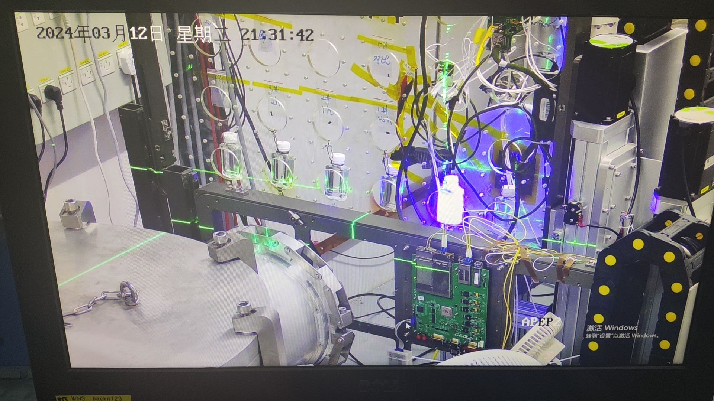
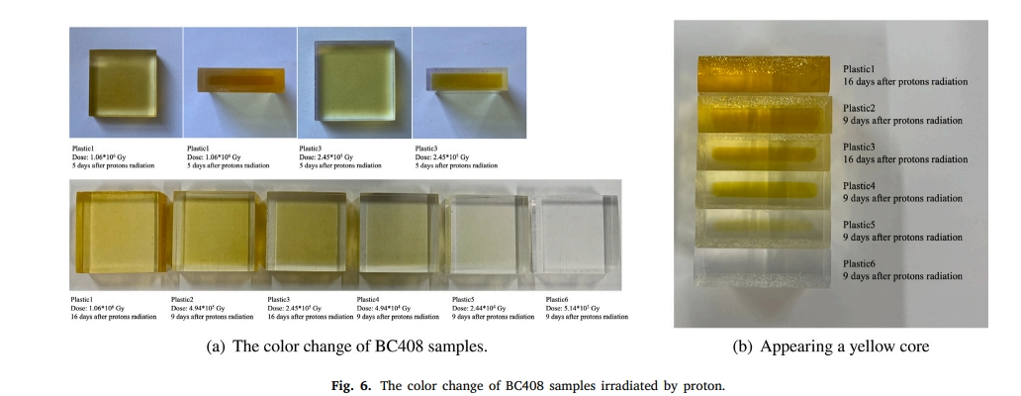
Scintillator irradiation
NIMB 548 (2024) 165247
NIMB 561 (2025) 165628

Slide 16
反角白光中子实验装置
Back-n

Slide 17
CSNS Beam Expansions Application
Associated Proton beam Experiment Platform 80 MeV proton
Ion source
Linac
White neutron source
~300 MeV neutron
Synchrotron
Proton test beam
1.6 GeV proton
muon source
Notes:
Before the protons hit the target, a dipole magnet here deflects the protons by 15°. Since there are no obstructions in the path of the protons to the target, the energy of the white neutrons is also very high. Unlike thermal neutron tunnels, which all face the moderator, the white neutron tunnel directly faces the neutron target.

Slide 18


White neutron source
The name "white neutron" is derived from "white light," which indicates a broad spectrum of wavelengths. Unlike monoenergetic neutron sources, a white neutron source has a very wide energy spectrum.
Gamma flash
neutron
target
TOF
Notes:
It typically involves a pulsed accelerator that accelerates electrons or protons to strike a target. At the moment of impact, we obtain the initial flight time of the neutrons. Neutrons of different energies are produced through spallation reactions or photonuclear interactions, and the neutron energies are then distinguished by their flight times.

Slide 19
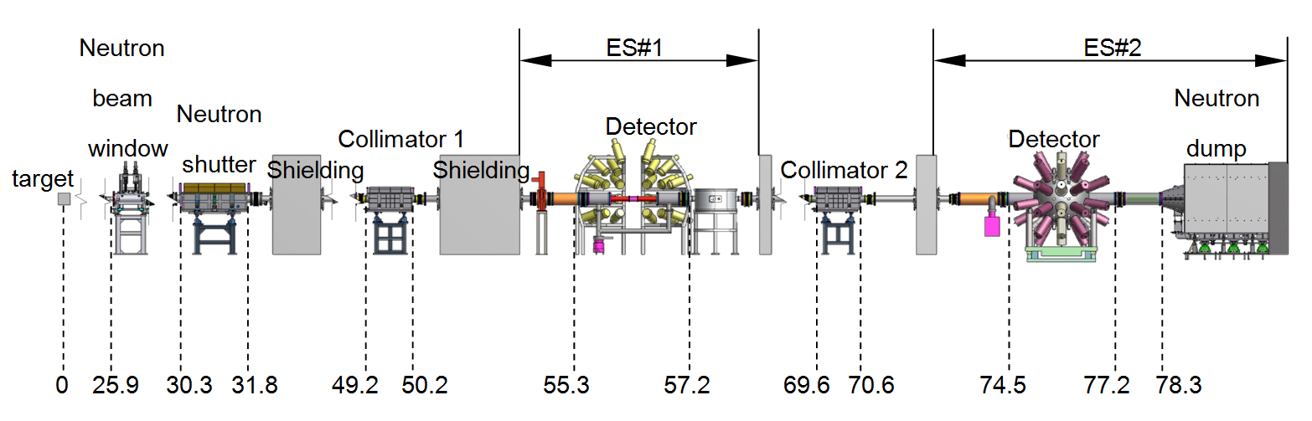
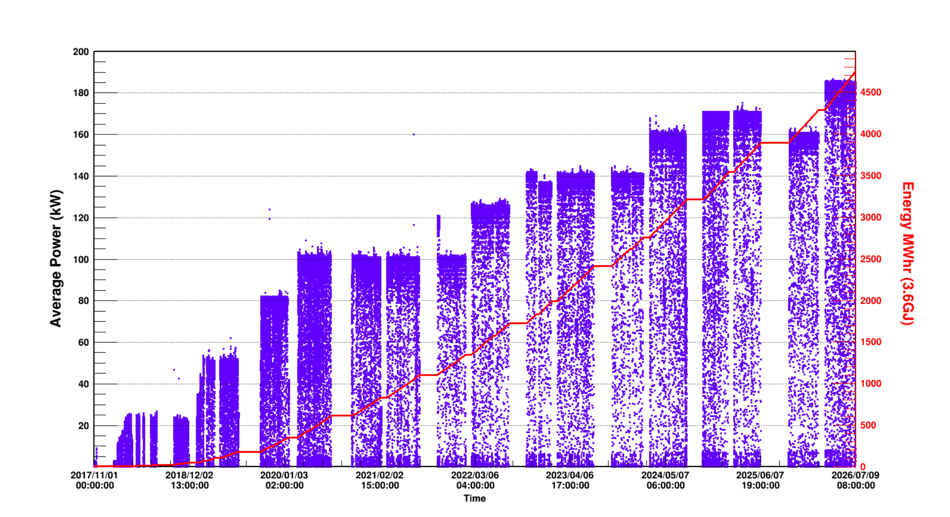
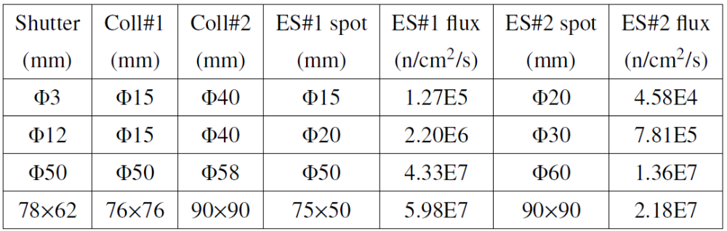
Back-n
Layout of the Back-n
proton
2017 JINST 12 P07022
Eur. Phys. J. A (2019) 55: 115

Slide 20
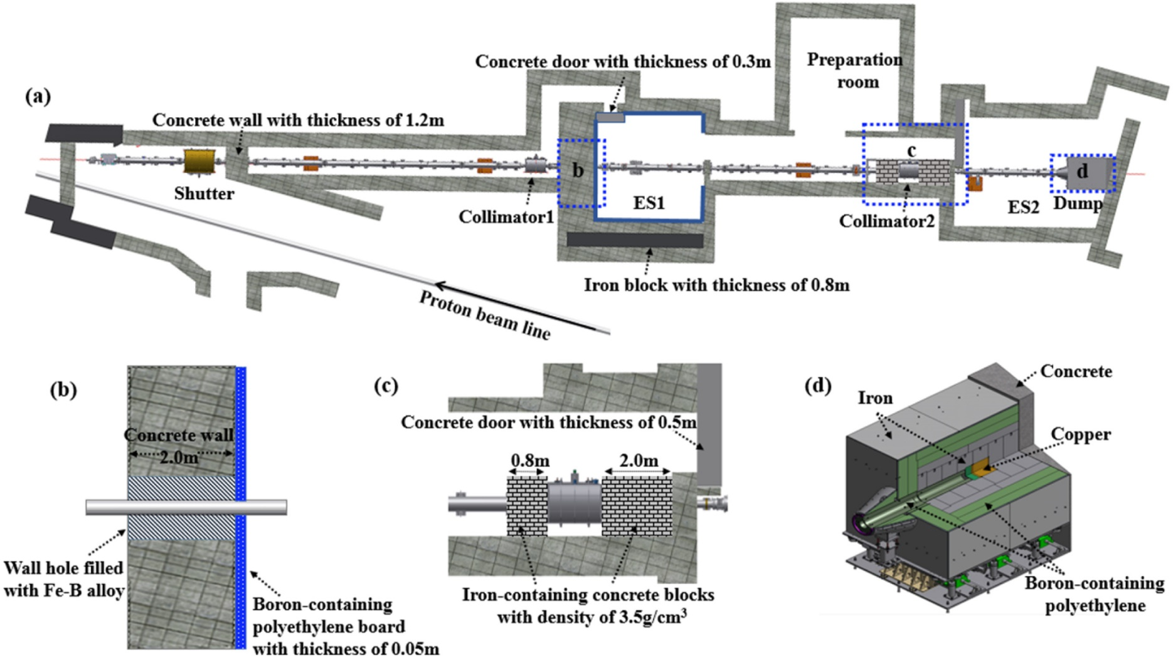
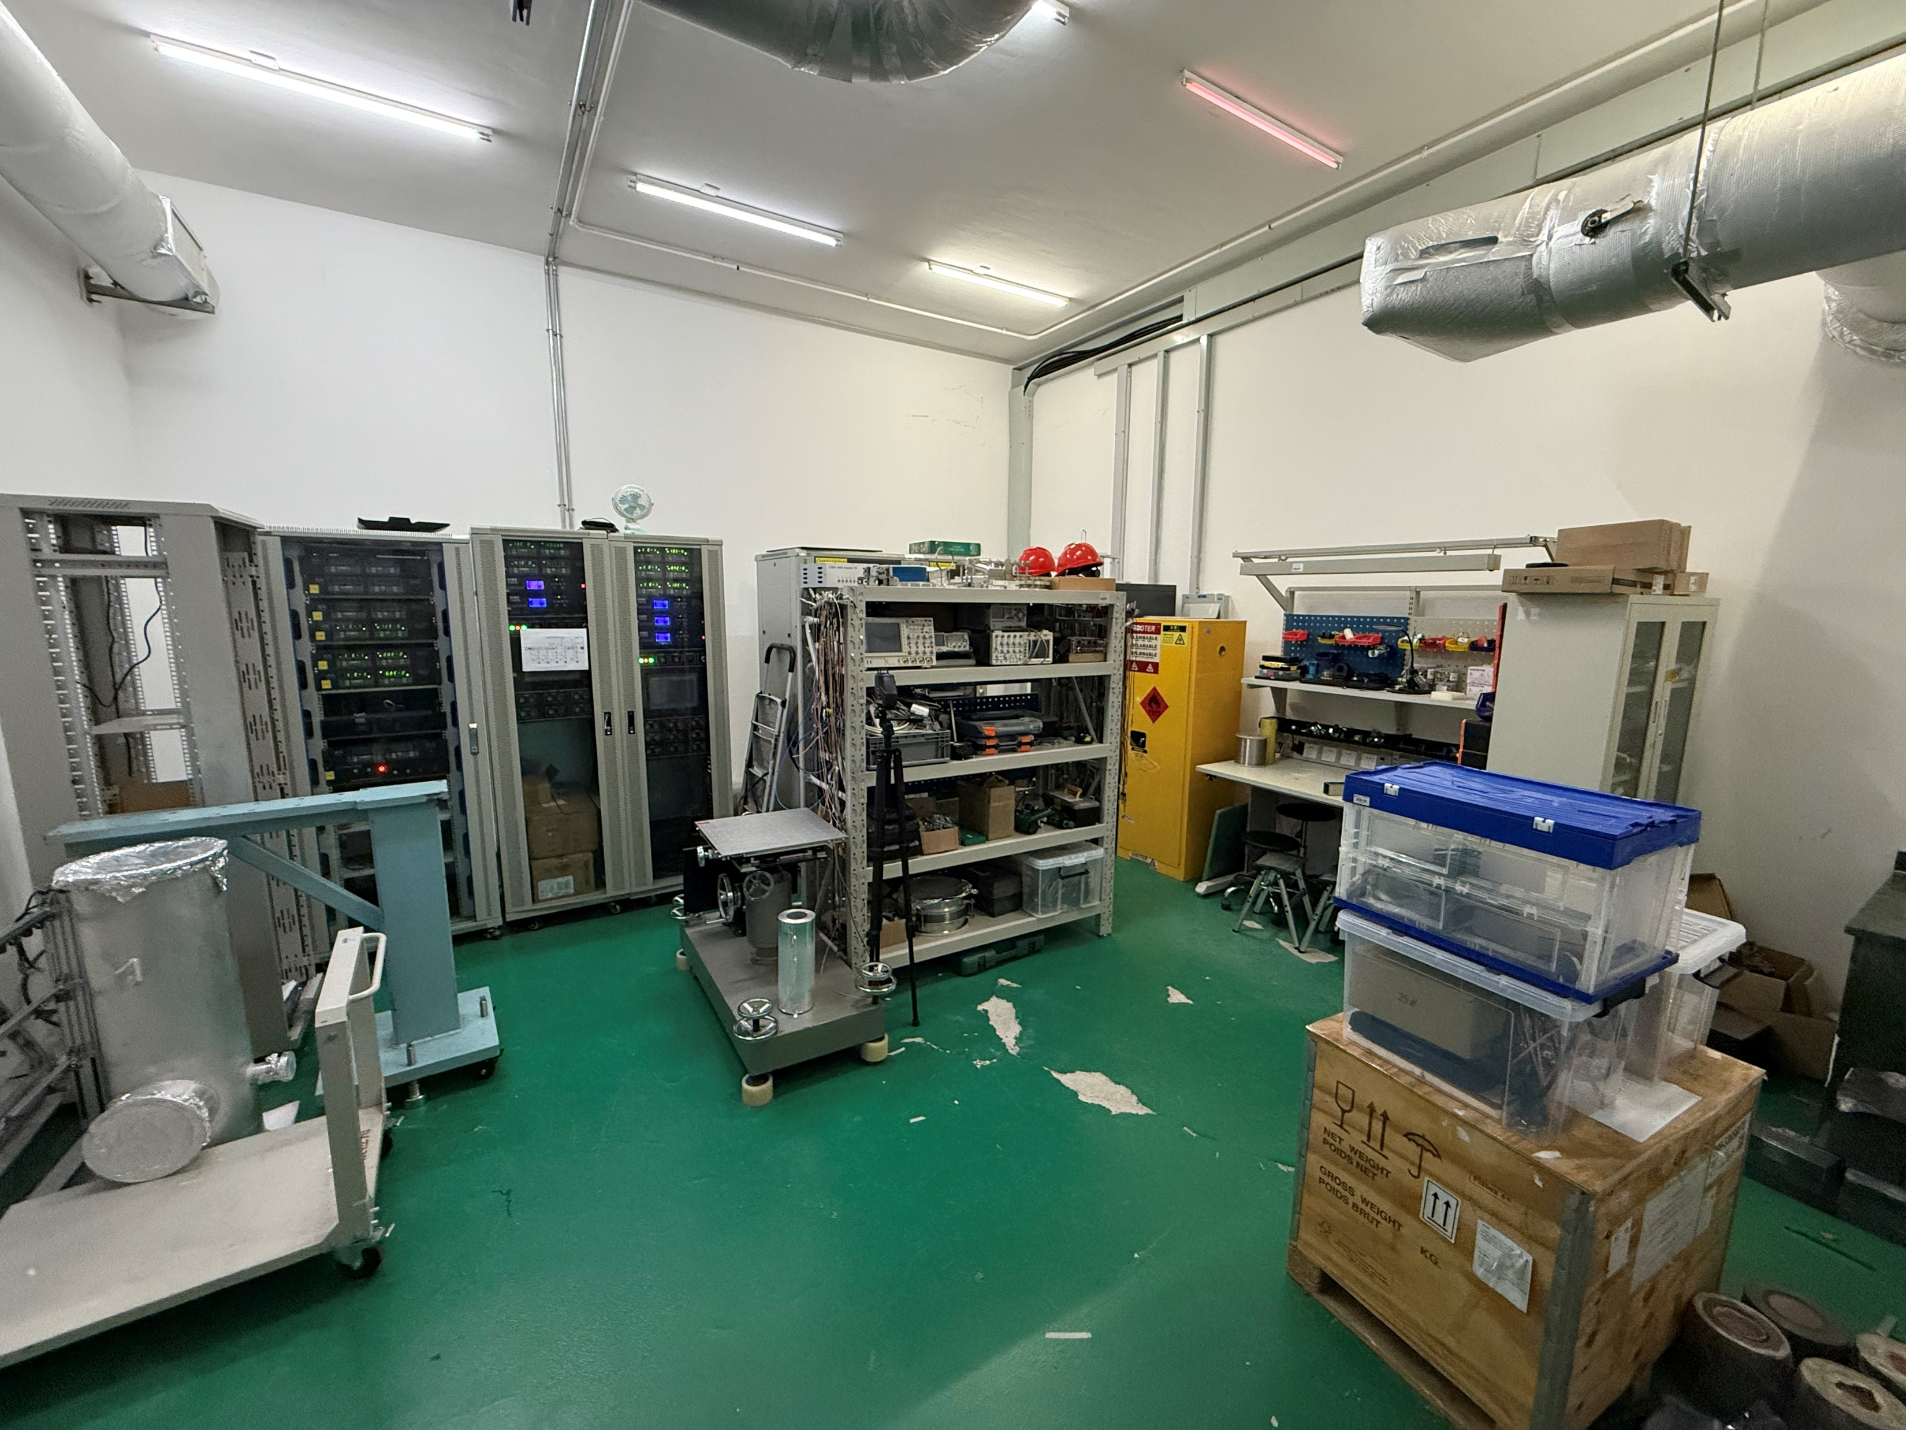
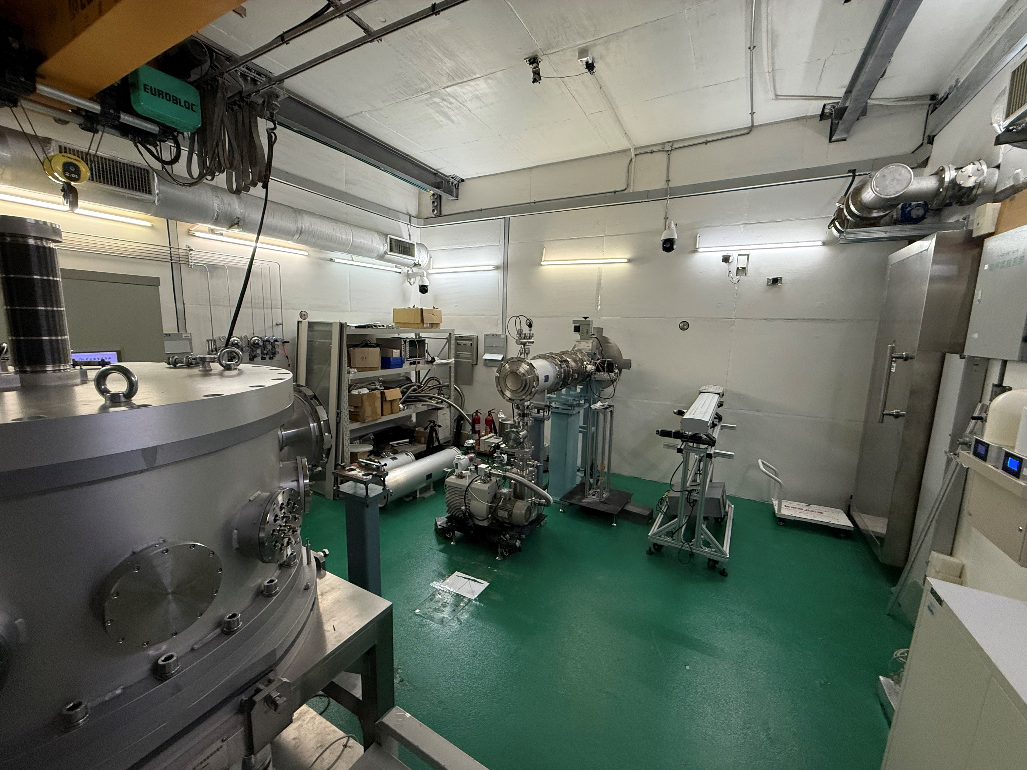
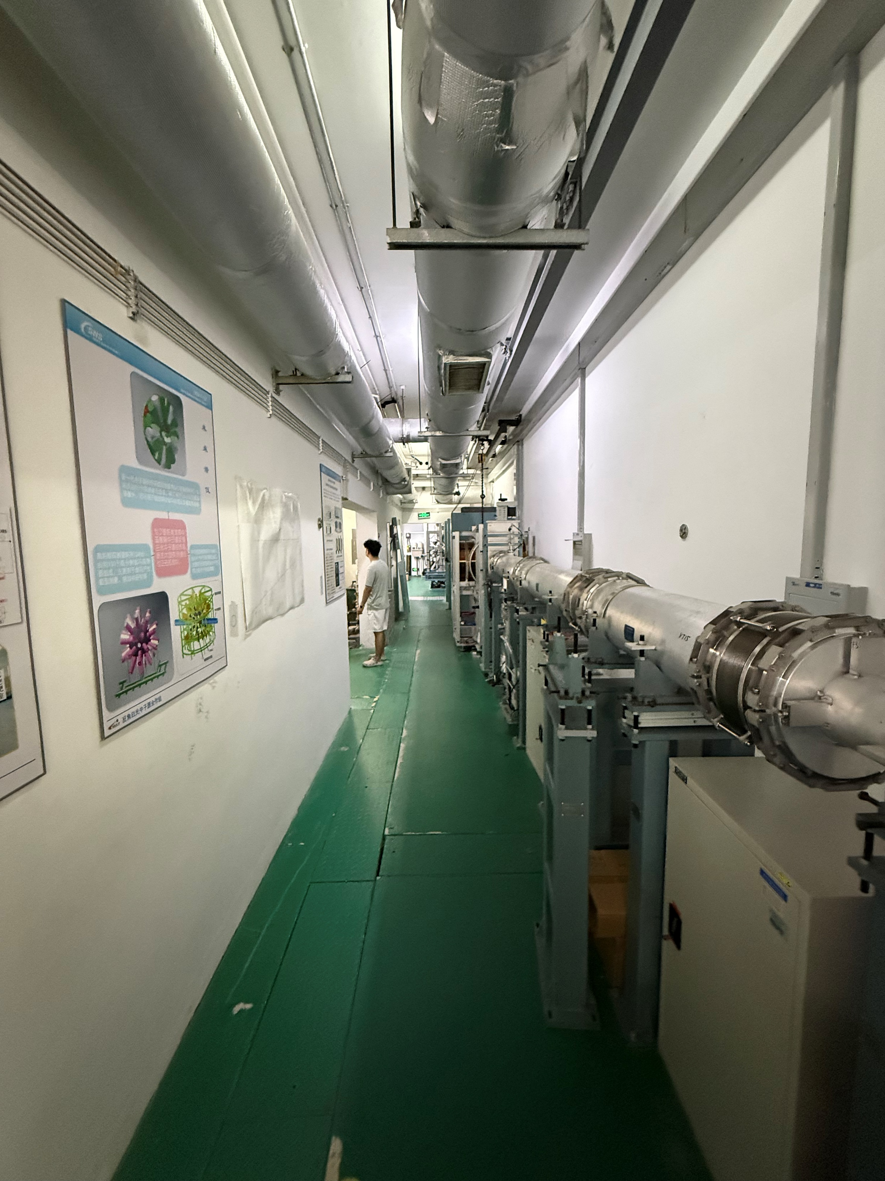
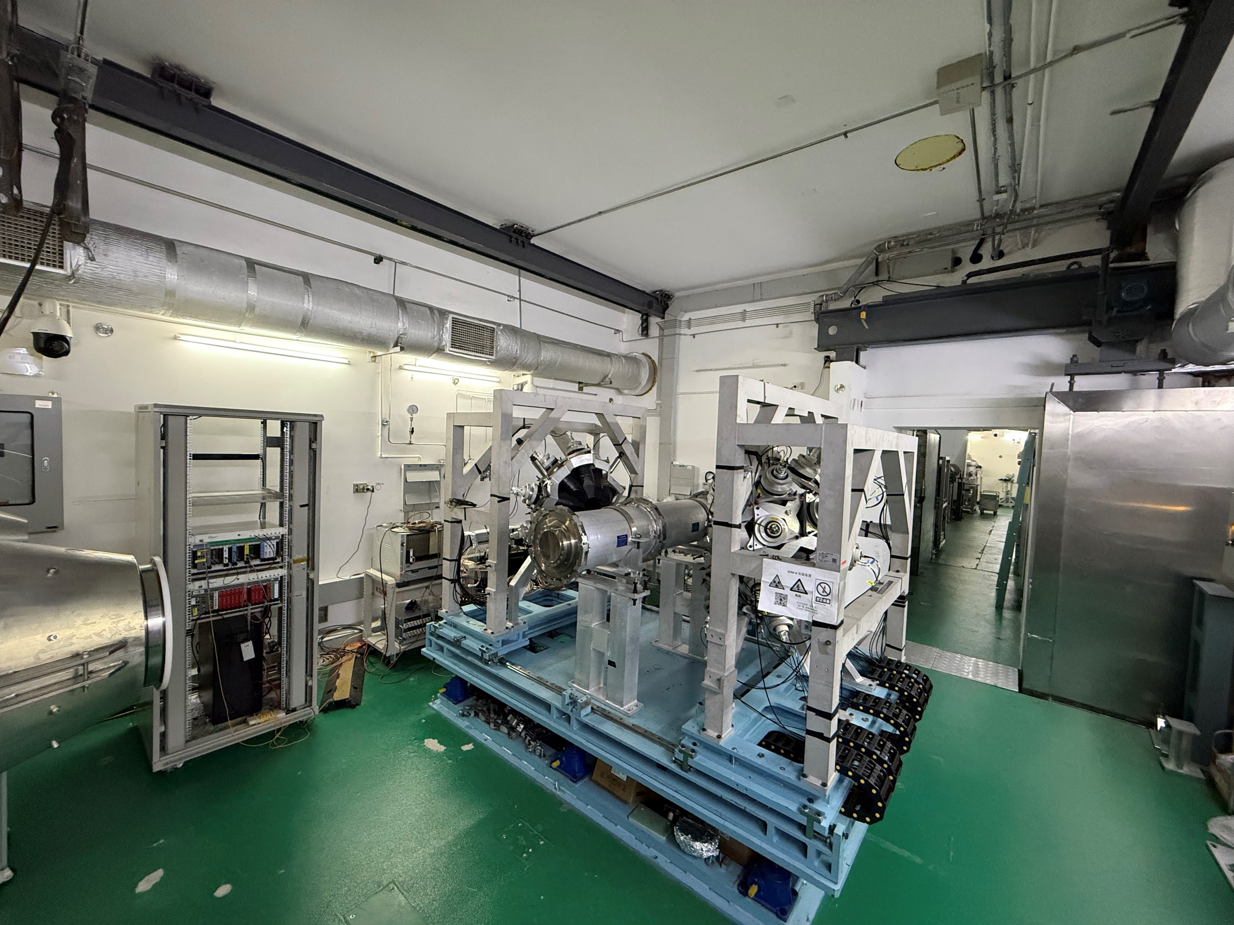
Back-n Tunnel and shielding
Neutron and γ background measurements of the experimental halls at the CSNS back-streaming white neutron source，NIMA Volume 980, 11 November 2020, 164506

Slide 21
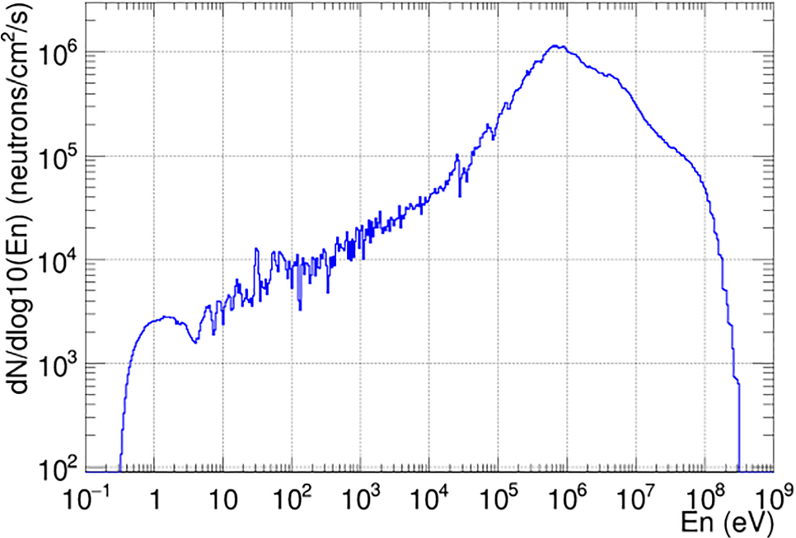
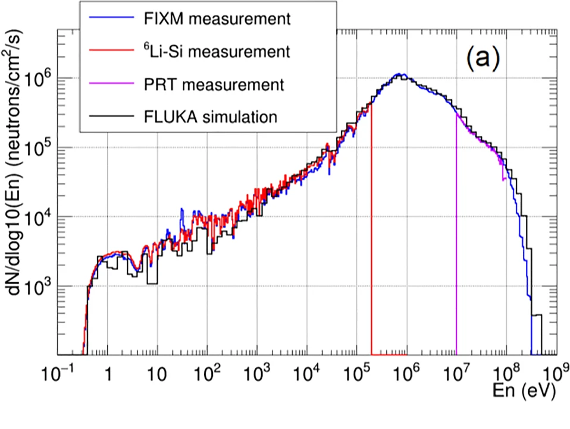
Back-n neutron energy spectrum measurement
Energy range | flux (neutrons/cm²/s)
0.1-1 eV | 4.08×10³
1-10 eV | 1.79×10⁴
10-100 eV | 3.01×10⁴
0.1-1 keV | 5.01×10⁴
1-10 keV | 1.23×10⁵
10-100 keV | 4.30×10⁵
0.1-1 MeV | 2.98×10⁶
1-10 MeV | 2.77×10⁶
10-200 MeV | 6.21×10⁵
Total | 7.03×10⁶
Measurement of the neutron flux of CSNS Back-n ES#1 under small collimators from 0.5 eV to 300 MeV
We used different reference cross-sections to measure the energy spectrum, including: (n, p), ⁶Li(n, t), ²³⁵U(n, f), ²³⁸U(n, f)
Eur. Phys. J. A (2019) 55: 115
Chen, Y., Qiu, Y., Li, Q. et al. Eur. Phys. J. A 60, 63 (2024).

Slide 22
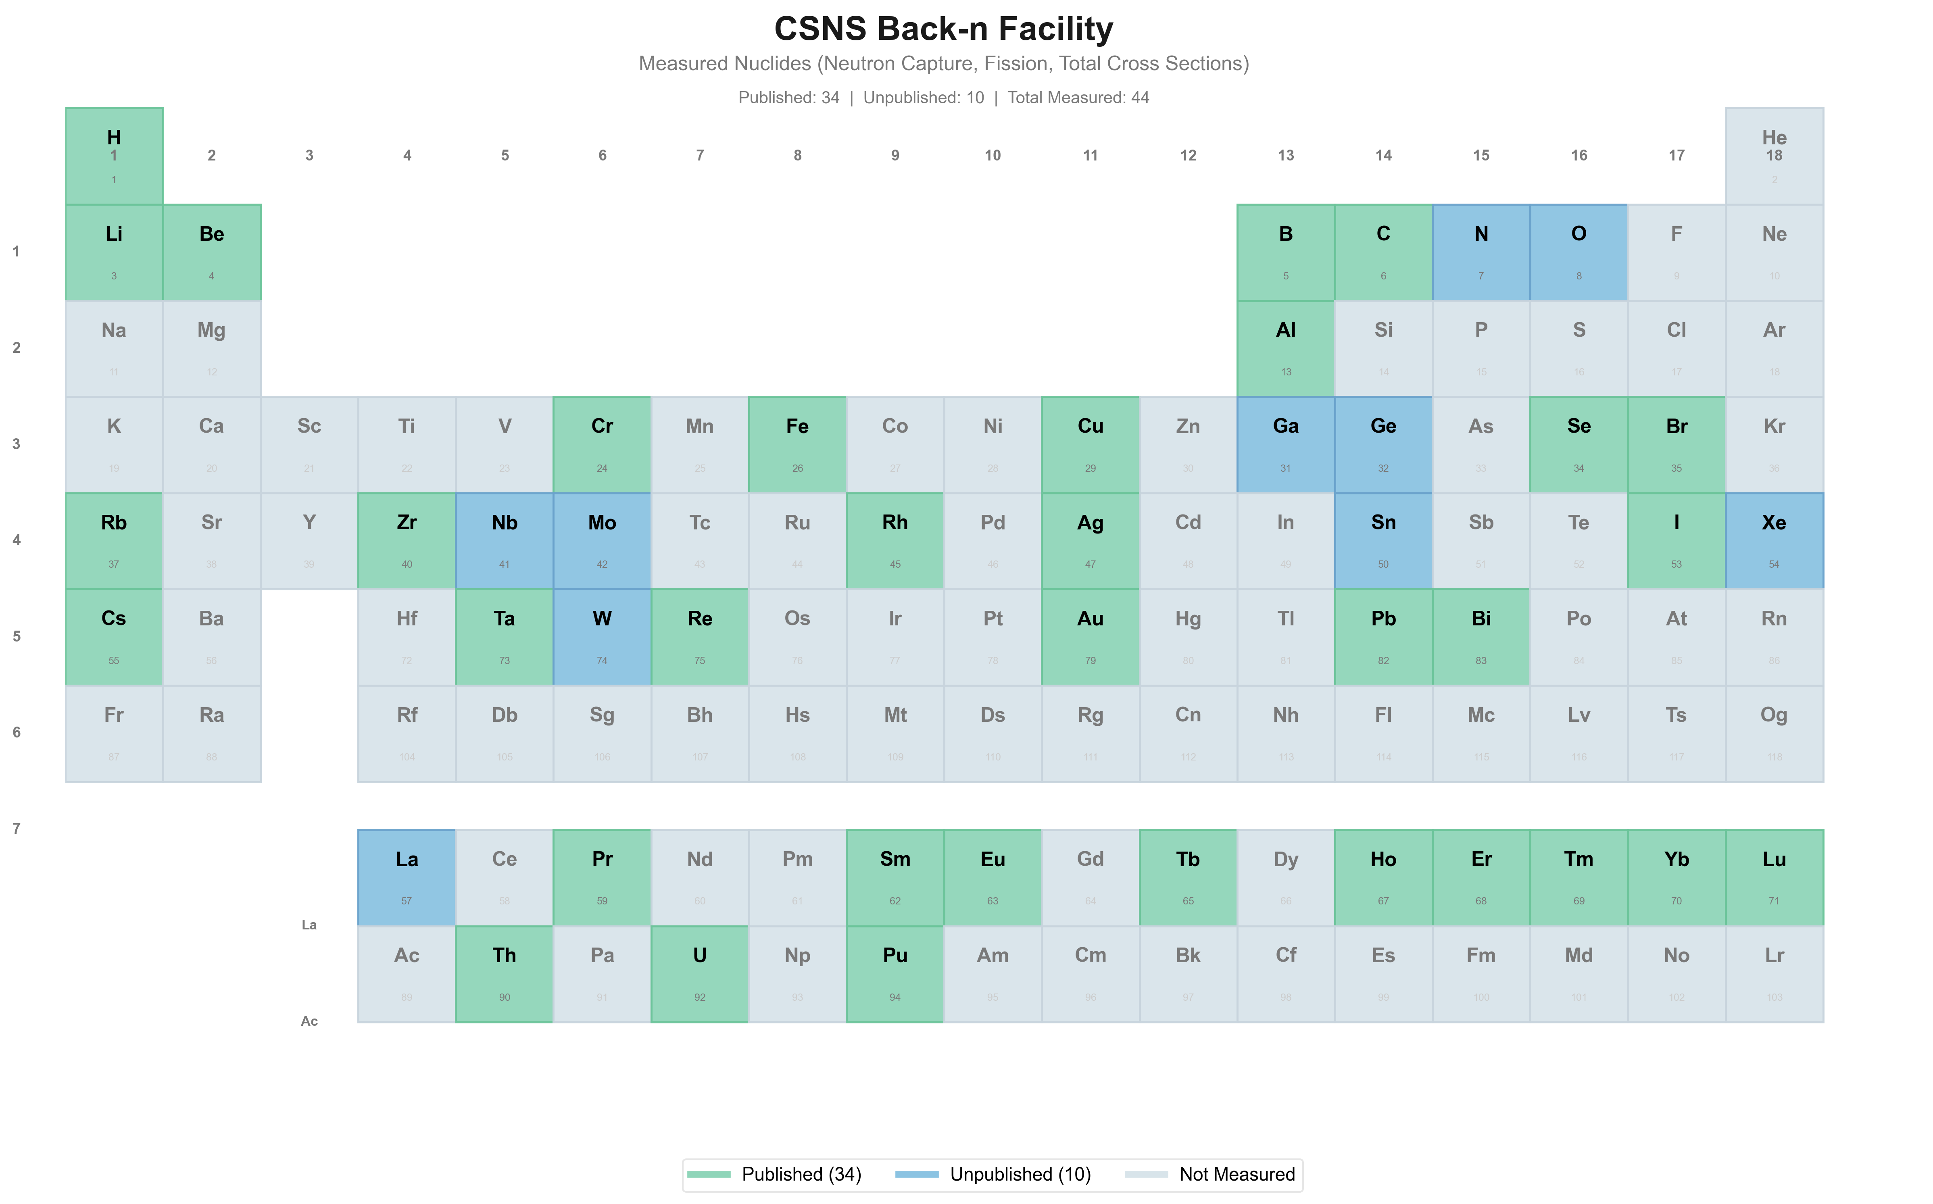
https://user.csns.ihep.ac.cn/backn-publications-standalone/

Slide 23
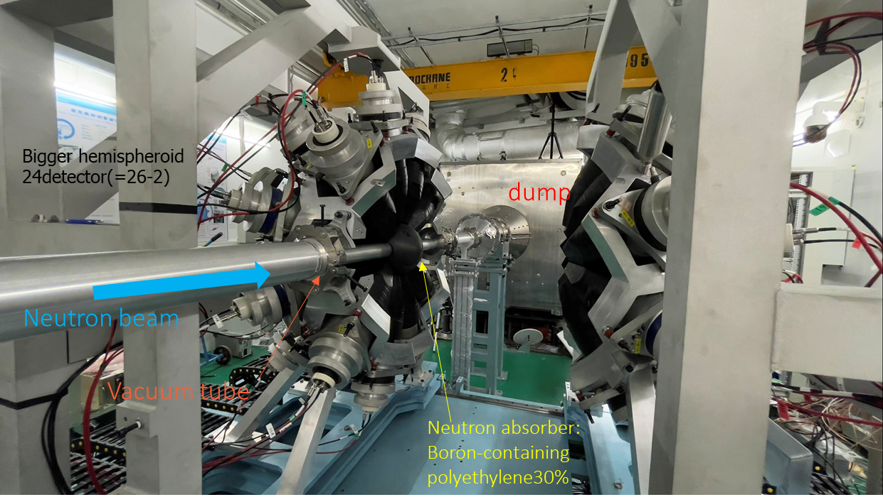
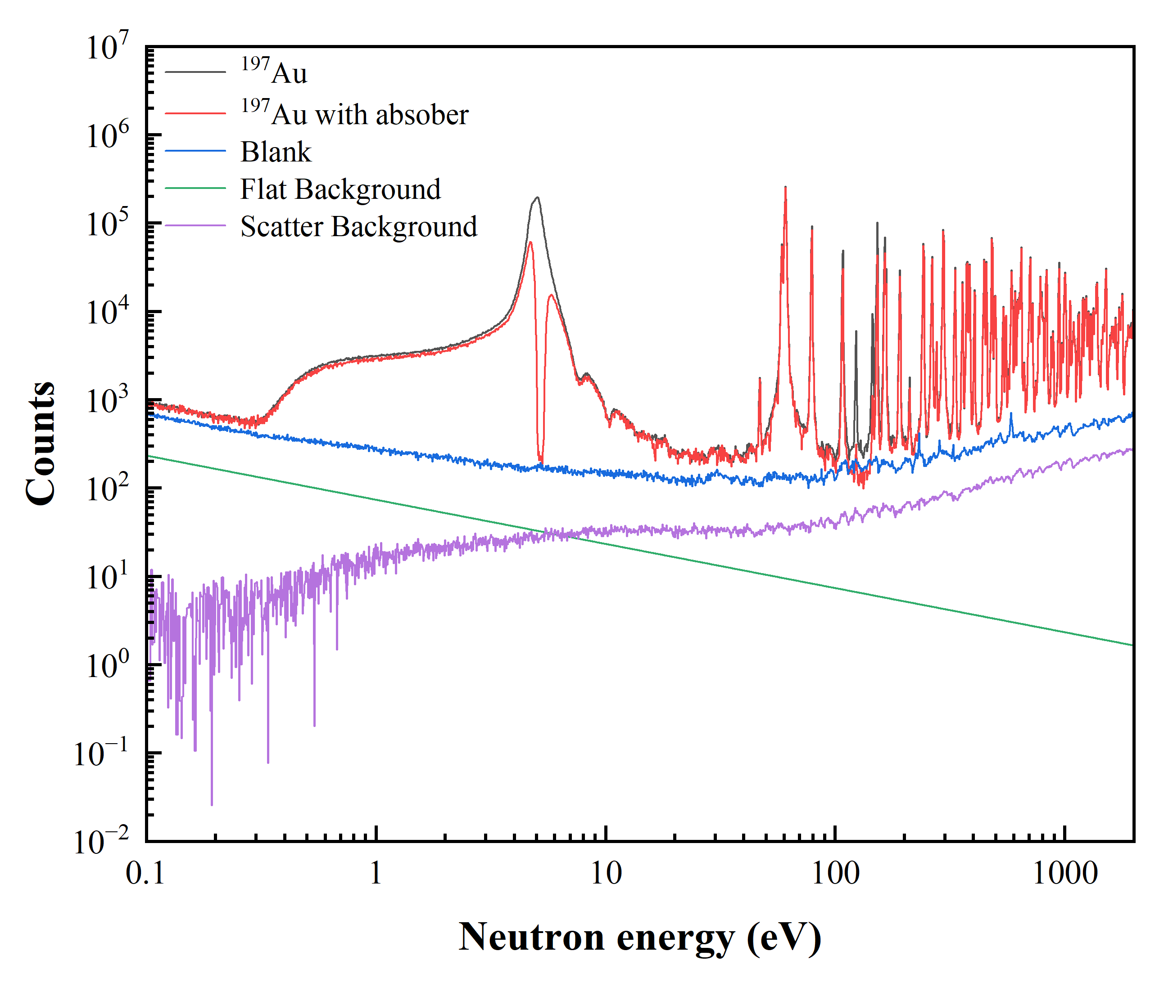
Gamma Total Absorption Facility（GTAF）
Core component:
15-cm-thick BaF₂ crystal, composed of 40 independent detection units
Neutron shielding:
Boron-containing polyethylene absorber
High measurement efficiency:
~90% for gamma rays up to 10 MeV; ~100% for neutron capture events
· By using Cd absorption sheets, the background caused by long-lived nuclides in the environment can be evaluated.
· By measuring the empty target, the background unrelated to the samples can be assessed.
· By measuring the C sample, the background of scattered neutrons caused by the sample can be evaluated.
Courtesy of Guangyuan Luan ( CIAE)
Notes:
Sodium Cobalt Niobium

Slide 24
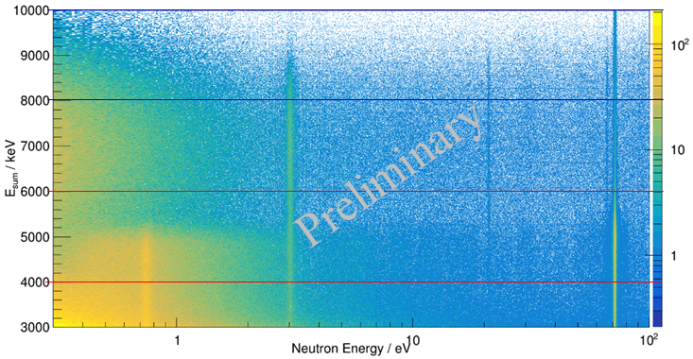
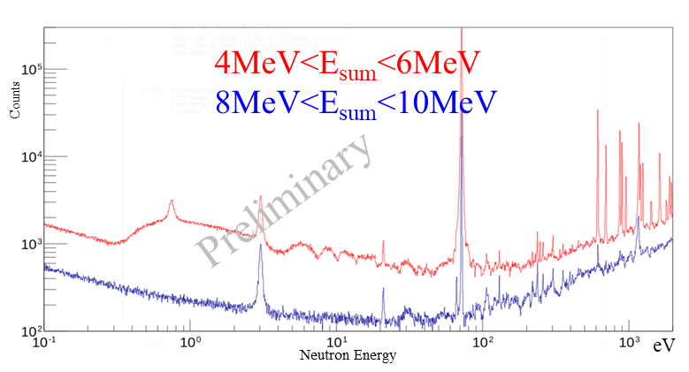
Q-value selection
Q-value of ¹³⁹La(n,γ)： 5161.0keV
Q-value of ¹³⁸La(n,γ)： 8780.3keV

Slide 25
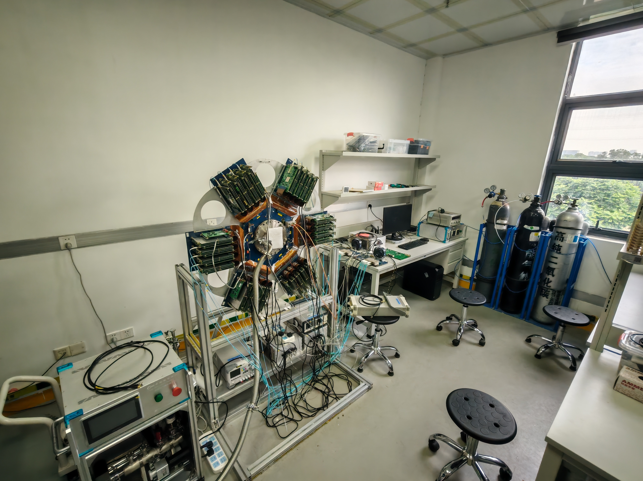
MTPC探测器系统
NIMA 1039 (2022) 167157
Z. Chen et al 2022 JINST 17 P05032
NIMA1058(2024)168912
NIMA 1060 (2024) 169045
Pre-amp
Gas mixture system
Anode board
DAQ
Power supplier
Gas pressure control system
High voltage
Back-n multipurpose TPC

Slide 26
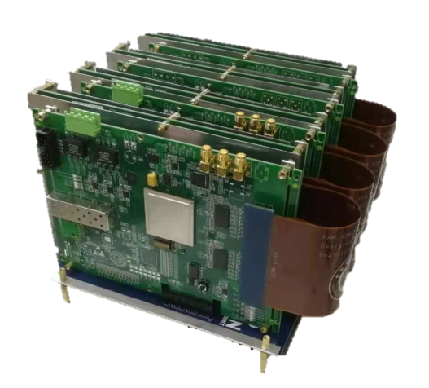
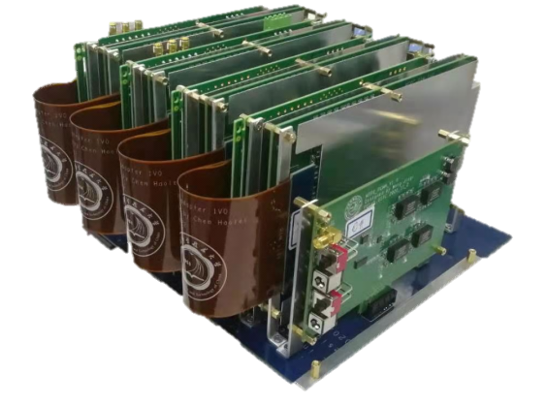



Experiment Setup
Assembled Module (PAM, ACM, PCMM)
DCM
TCM
Electronics:
Sampling frequency: 40 MHz
Sampling time window: 25.6 μs
Total channels: 1521
Courtesy of Han Yi (CSNS)

Slide 27




²³⁵U(n, f) cross section measurement
The distributions of the vertexes of (a) decay α particles from the ²³⁵U sample. (b) fission fragments from the ²³⁵U(n, f) reaction.
Han Yi et al 2026 Chinese Phys. C 50 044004

Slide 28





Nuclide identification radiography (NIR)
sample：
Au、Ag、W、Ta、In
Transmission image
Indium
Tungsten
NIMA 1048, 2023, 167892

Slide 29






Resonance Image system

Slide 30




Image results
铜镜成像
preliminary
preliminary
铁钱成像
空速管成像

Slide 31
缪子源
Melody

Slide 32
CSNS Beam Expansions Application
Associated Proton beam Experiment Platform 80 MeV proton
Ion source
Linac
White neutron source
~300 MeV neutron
Synchrotron
Proton test beam
1.6 GeV proton
muon source

Slide 33


Muon Facilities Worldwide
Major established user facilities
TRIUMF, ISIS, PSI, J-PARC, RCNP
New facilities emerging in Asia
MELODY at CSNS — under construction, project acceptance targeted for 2029/10 with CSNS-II.
Other projects under study
RAON(planning)
RCNP
MELODY@CSNS (constructing)
HIAF/CiADS/SHINE/SULF (planning)
*MELODY: Muon station for sciEnce, technoLOgy and inDustrY

Slide 34


Generation of muons
Notes:
When high-energy protons collide with a target, usually made of materials such as carbon or beryllium, a large number of pions are produced. Pions decay into muons and muon neutrinos. Pions have a spin of 0, so the spins of neutrinos and muons are opposite. Since the spin direction of neutrinos is always opposite to their motion direction, when we observe muons, their spin direction must be in another direction, in other words, they are polarized. Therefore, the corresponding muons can be used as magnetic probes to measure the properties of the local magnetic field of the material.

Slide 35



From CSNS-II Proton Pulses to MELODY Muon Beams
1 out of 25 RCS pulses extracted by a fast kicker
Dedicated 20-kW proton beam on a thick Cu target
LINAC: 300 MeV
Neutron Spallation Target
RCS
1.6 GeV
500 kW
25 Hz
MELODY
1.6 GeV
20 kW
1 Hz
Surface $μ^{+}$ (10⁵~10⁷/s), negative $μ^{−}$(10⁴~10⁶ /s) under construction.
Independent $μ^{+}$ and $μ^{−}$ beamlines support parallel operation.
Decay $μ^{±}$ (~10⁶ /s) channel reserved

Slide 36







Experimental Opportunities at MELODY
Surface $μ^{+}$: 2 terminals (under construction)
SMBT1 for $μSR$
Magnetic, superconducting, energy materials
SMBT2 for R&D
Muon moderation
Laser wakefield acceleration
Detector testing
beam diagnostics
Negative $μ^{−}$: 1 terminal (under construction)
MIXE/elemental analysis
Muonic-atom spectroscopy
$μ^{−}$ nuclear capture
Irradiation/SEE
Decay $μ^{±}$: 2 terminals (reserved)
Deep-penetration $μSR$
Deep-probing MIXE
Muography
Irradiation/SEE
3 beamlines, 5 experimental terminals areas in full layout
From user instruments to beam R&D and future physics

Slide 37



Pulsed Muon Beams: Opportunities and Detector Challenges
High particle density within a short beam pulse
Continuous beam
Pulsed beam
Physics opportunities
Well-defined t₀ for time-resolved measurements
Timing-cuts for uncorrelated background suppression
Delayed-process studies: $μ^{±}$ decay, $μ^{−}$ capture, relaxation dynamics
Detector Challenges
High instantaneous rate
Pile-up and dead time
Prompt flash
Fast recovery and multi-hit readout
These requirements motivate highly segmented detector systems.

Slide 38


µSR Spectrometer
Detector Arrays: 3024 detection units
  Large solid angle coverage: θ₁ (10° ~ 40°)
  Plastic scintillator + PMT/SiPM
Detection units:
  8.8×8.8×40 mm³ plastic scintillator
  6×6 mm² Sensl SiPM
Detector arrays
θ₀
Layout of µSR Spectrometer
Detector arrays

Slide 39








Future Physics Opportunities at MELODY
Muon-capture
nuclear physics
Rare muon processes
True muonium
production and detection
$$μ^{−}+\left(A,Z\right)→ν_{μ}+\left(A,Z−1\right)∗$$
$$Mu\left(μ^{+}e^{−}\right)→\overline{Mu}\left(μ^{−}e^{+}\right)$$
$$TM\left(μ^{+}μ^{−}\right)$$
μ⁺
μ⁻
e⁺
Capture and de-excitation
New physics beyond the standard model: charged lepton flavor violation
Fast and highly segmented tracking detector needed. Low-energy positron tagging
Purely leptonic bound state
Nuclear structure and data
Muon capture and de-excitation process
Spectroscopy & PID needed
Exotic QED bound state, not observed yet
QED precision tests
Tracking and vertexing needed
Planned at $μ^{−}$ terminal
Planned at surface $μ^{+}$terminal 2
Extension required
Physics priorities will evolve with commissioning, experimental R&D and user proposals.
7

Slide 40



MELODY: From Design to Construction
2024/7
Physics Review
2025/7
Engineering Review
2026/9
Civil Construction
Completed
2028/6
Beam Commissioning
2029/10
Project Acceptance
2027/11
System Integration
Core container under fabrication
Experimental hall completed
Target station shielding completed
Surface
Muon
Negative
Muon
Proton Beam
Target

Slide 41
高能质子测试束
HPES

Slide 42
CSNS Beam Expansions Application
Associated Proton beam Experiment Platform 80 MeV proton
Ion source
Linac
White neutron source
~300 MeV neutron
Synchrotron
Proton test beam
1.6 GeV proton
muon source

Slide 43



Motivation: Detector Complex in Collider
1440 chip
15148 chip
68524 unit
~70k piece
Si-Pixel Detector
Si-Strip Detector
PbWO₄ Crystal
Plastic Scintillator
Detector complex in colliders are massive but precise.
Particle trajectory resolution ~ 15 to 20 μm.
Particle energy resolution < 3%.
Particle test beams are essential throughout the entire R&D life-cycle of detectors.
There are currently no such facilities in China.
Name of Facility | Institute | Beamline | Country | Particle Types | Kinetics
CERN SPS North Area | CERN | H2, H4, H6, H8 | Switzerland | protons, muons, electrons, pions | 400GeV/c
CERN SPS North Area | CERN | H2-VLE, H4-VLE | Switzerland | pions, kaons | 80 GeV/c
CERN PS East Area | CERN | T9, T10 | Switzerland | Secondary particles | <15 GeV/c
DESY II TBF | DESY | TB21/22/24 | Germany | electrons | 1.5~6 GeV
FTBF | FermiLAB | -- | USA | protons | 120 GeV
ESTB | SLAC | -- | USA | electrons | 2.5-15 GeV
PF-AR | J-PARC | electron TBL | Japan | electrons | <5.8 GeV
CMS

Slide 44


Introduction to HPES
High-energy Proton-beam Experiment Station（HPES）
First 1.6 GeV proton test beam in China.
Under construction. Pilot run at 2029.
Protons are slow-extracted by a scattering foil.
Strong and Weak beam can be provided.
Proton Energy:
Parameters | Design Value
Energy | 0.8-1.6 GeV
Frequency | 25 Hz
Strong flux | 10⁵-10⁸ p/s
Weak flux | 10³-10⁶ p/s
Slow extraction of proton beam.

Slide 45







DIT Development Progress
TRACK
An EUDET-type proton telescope equipped in HPES.
6 MIMOSA-28, DUT resolution reach < 10 μm.
Telescope resolution is expected reach < 5 μm.
We are also developing a telescope based on Jadepix. Prototype is under test at CERN East Area.
DOI:10.1007/s41365-024-01447-9
ENERGY
A TOF spectrometer developed to measure energy.
2 LGAD, 40 m distance, E res. ~1%@1.6 GeV.
LGAD pixels are bonded in parallel to reduce readout channels.
Timing resolution of each ~ 100 ps.
TIME
A trigger device designed to provide time gate reference.
Scintillator fiber coupled with PMT.
Trigger time spread < 1 ns.
Prototype have been tested at CERN North Area.

Slide 46






Applications of HPES
Tracker Calibration
  Si Pixel/Si Strip/TPC/Drift Chamber
  High position resolution（~10μm）
  Telescope @ HPES would reach 2.7μm.
Calorimeter Calibration
  EM-CAL, H-CAL, Scintillator.
  High energy resolution（3~10%）
  Energy spread of proton: <1% @1.6 GeV.
System-level test to micro-nano chip
  Super computing, intelligent computing and control systems for aerospace applications require micro-nano chips.
  GeV proton beam is preferred to evaluate the radiation resistance by cosmic ray.

Slide 47

Civil Progress of HPES
More Detailed information can be found in Dr Yuhang Guo’ talk.
T1
T2
Experiment hall have been finished.
Terminals will be finished by JUN. 2027.

Slide 48

CERN beam extending applications

Slide 49
CSNS Beam Expansions Application
Associated Proton beam Experiment Platform 80 MeV proton
Ion source
Linac
White neutron source
~300 MeV neutron
Synchrotron
Proton test beam
1.6 GeV proton
muon source
Beam parameters
Beamline | Particle | Energy | flux
Back-n | Neutron | thermal-300 MeV | 1E7 n/cm⁻²/s
APEP | Proton | 80 MeV | 1E9 p/s
POEM | Proton | 1.6 GeV | 1E3 – 1E8 p/s
MELODY | Muon | 4 MeV | 1E5 muon/pulse

Slide 50




















BEAG Team
14 staff, 6 post doc., 2 assistant, 24 students.
FAN R.R.
CHEN Y.H.
JING H.T.
BAO Y.
WU C.
TAN Z.X.
LI Q.
JIANG W.
YI H.
Nikolaos Vassilopoulos
Deputy Director
Group Head
Research Fellow
Research Fellow
Special Research Fellow
Senior Engineer
Associate Research Fellow
Associate Research Fellow
Associate Research Fellow
Associate Research Fellow
LI. Y
LYU Y.
GUO Y.H.
DU H.Y.
DENG Y.F.
FENG M.C.
CHEN C.
ZHU K.F.
YANG Y.Q.
ZHANG M.F.
Associate Research Fellow
Assistant Research Fellow
Assistant Research Fellow
Assistant Research Fellow
Post Doctor
Post Doctor
Post Doctor
Post Doctor
Post Doctor
Post Doctor

Slide 51
Summary
The China Spallation Neutron Source (CSNS) currently operates at 185 kW, providing over 5,000 h/y, with plans to upgrade to 500 kW before 2030.
Beam extension applications at CSNS include medium- and high-energy protons, white neutron beams, and muons—rare beam resources both in China and world—making it an ideal platform for detector calibration and testing.
Future physics experiments and beam measurements under these extended beam will require a large number of advanced detectors and electronic systems. CSNS is an best place for applying various new technologies:
  Higher detection efficiency
  Faster response times
  Finer granularity……
We sincerely welcome everyone in CSNS!

Slide 52


礼
礼
Thanks
Thanks

