Slide 1

Progress and status of HIAF project
The International Conference on Instrumentation for Colliding Beam Physics
( INSTR 2026 )
Jiancheng Yang
On behalf of the HIAF Project Team
Institute of Modern Physics (IMP) , Chinese Academy of Sciences (CAS)
Oct 15, HeFei, China

Slide 2
Outline
Project overview
Challenges, innovations, and breakthroughs
Construction, commissioning, and performance
Summary and perspectives

Slide 3



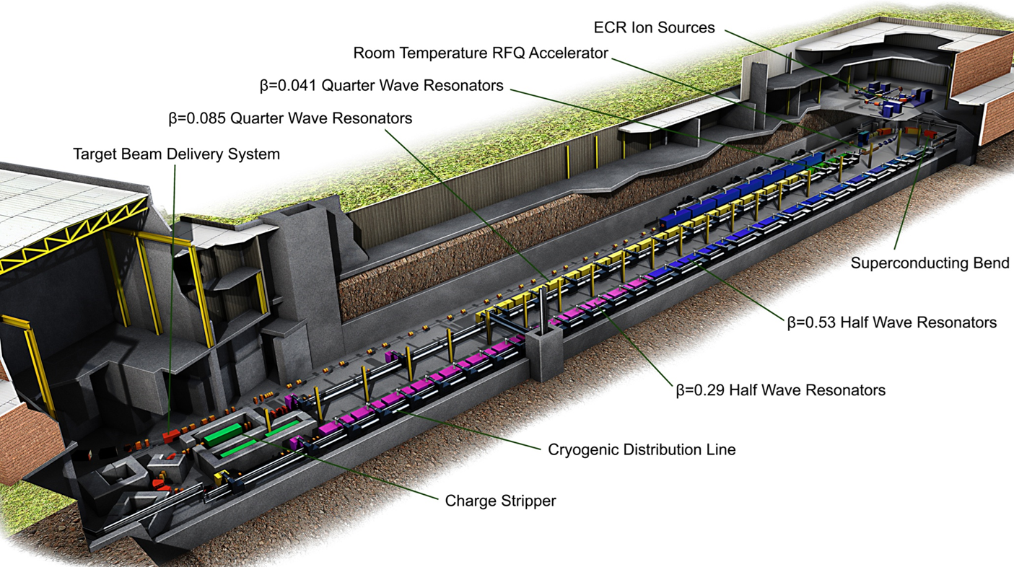

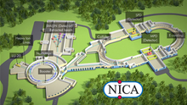
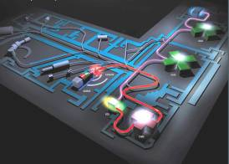
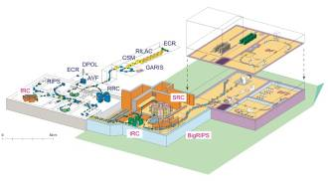
Project overview
Nuclear physics frontier:
Explore the limit of nuclear existence
Study exotic nuclear structure
Understand the origin of the elements
Study the properties of High Energy and Density Matter
Accelerators and use of high intensity heavy-ion beams will be key to solving those questions
FRIB
FAIR
NICA
SPIRAL2
RIBF

Slide 4
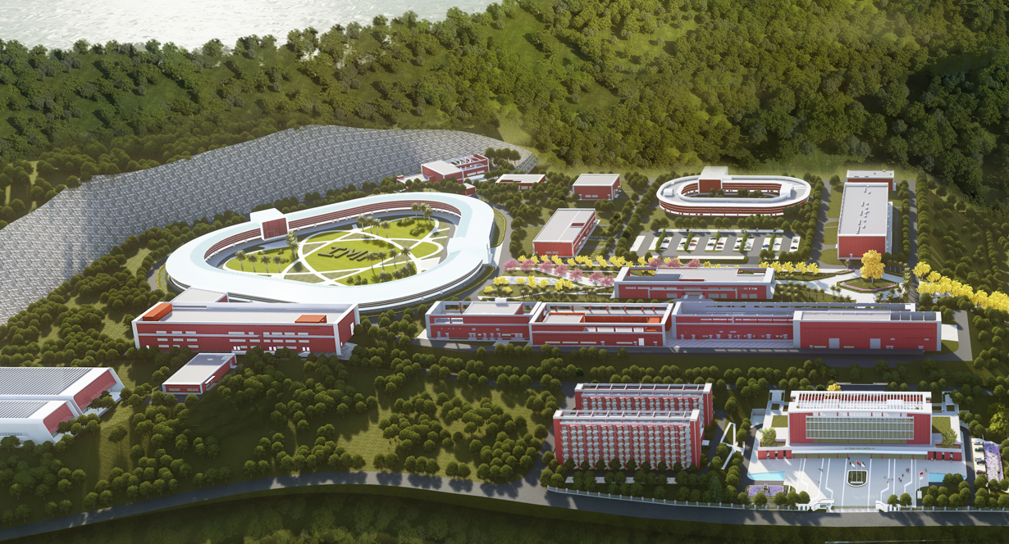
High-Intensity Heavy-Ion Accelerator Facility- HIAF
High-Intensity Heavy Ion Accelerator Facility - HIAF
The major national science and technology infrastructure under construction with the support of both central and local governments
The project was proposed and constructed by IMP, CAS
The total budget is 3.0 billion CNY

Slide 5
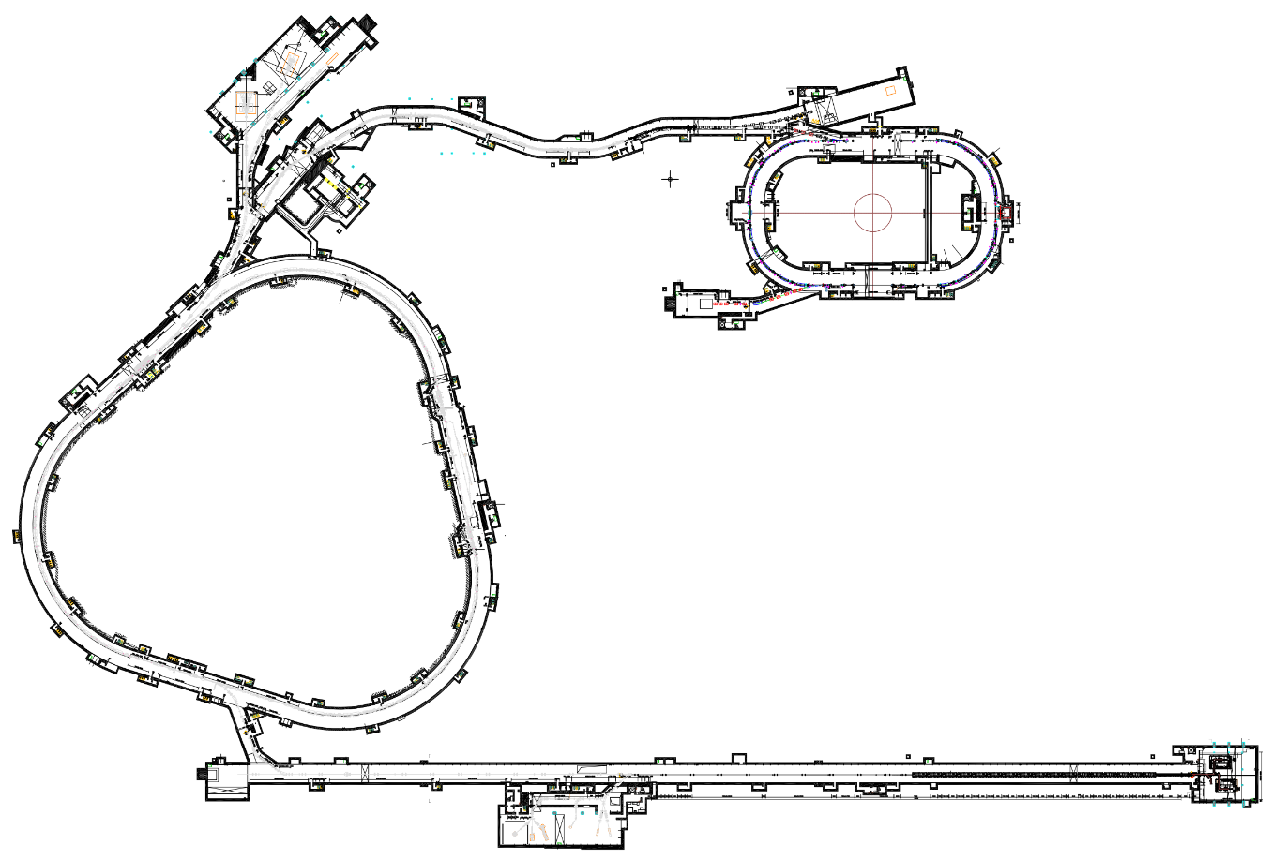
Project overview
The whole layout: accelerator components and experimental terminals
HFRS: Radioactive beam line
6
Experimental terminals
2
3
Low energy nuclear structure terminal
High energy experimental terminal
High energy fragment separator HFRS
High precision spectrometer ring SRing
Electron ion recombination terminal
Radioactive ion beam physics terminal
L: 180m, Bρ: 25 Tm
4
5
BRing
SRing:
Spectrometer ring
Circumference: 277 m
Rigidity: 13-15 Tm
Fast cycle ring
Circumference: 569 m
Rigidity: 34 Tm
iLinac:
Superconducting linac
Length:100 m/300 m
Energy: 17-22 MeV/u(U³⁵⁺⁻⁴⁶⁺)
1
SECR:
Superconducting ECR source

Slide 6
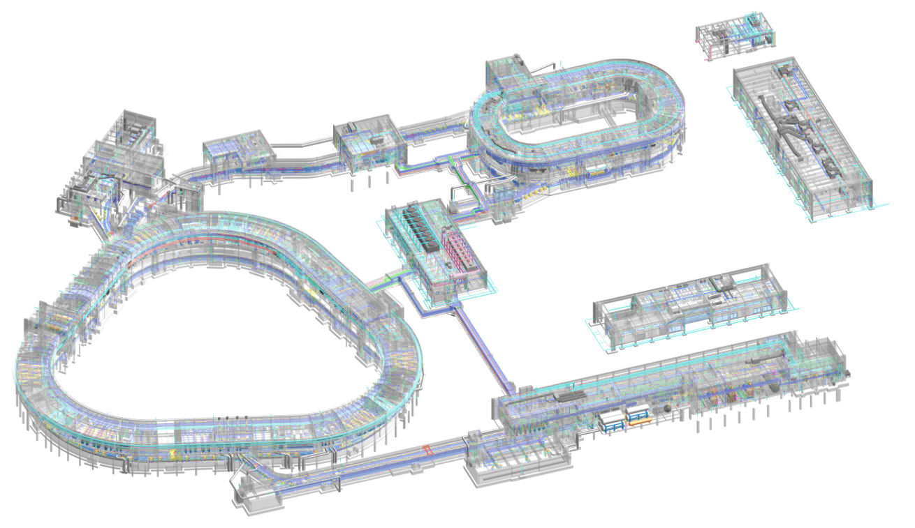
Project overview
4
Radioactive beams physics station
High energy experiment station
HFRS: Radioactive beam line
5
High precision
spectrometer ring
Hyper nuclei physics
Phase diagram of strongly interacting matter
2
3
6
e-ion recombination
spectroscopy
SRing:
Spectrometer ring
Circumference: 277m
Rigidity: 2-15 Tm
BRing
Fast cycle ring
Circumference: 590 m
Rigidity: 34 Tm
SECR:
Superconducting
ECR source
iLinac:
Superconducting linac
1
Low energy nuclear structure and irradiation terminal
Digital-twin-based engineering information modeling (BIM) of HIAF facility

Slide 7

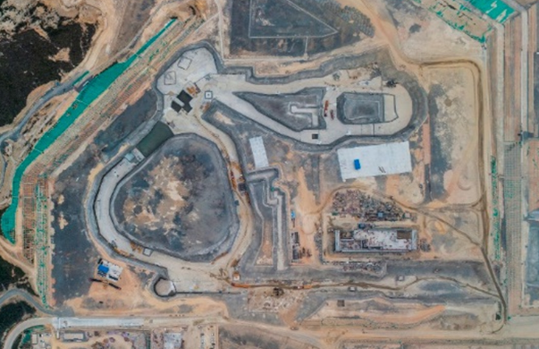
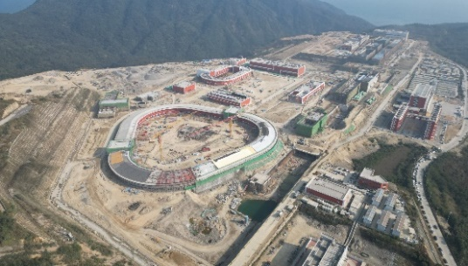
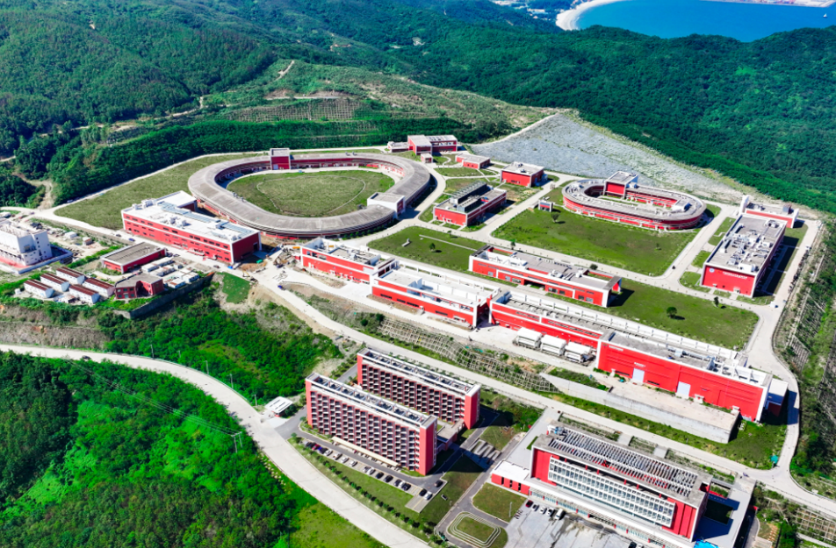

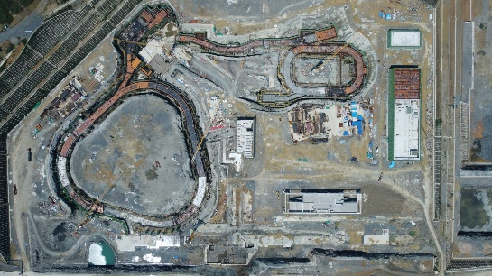
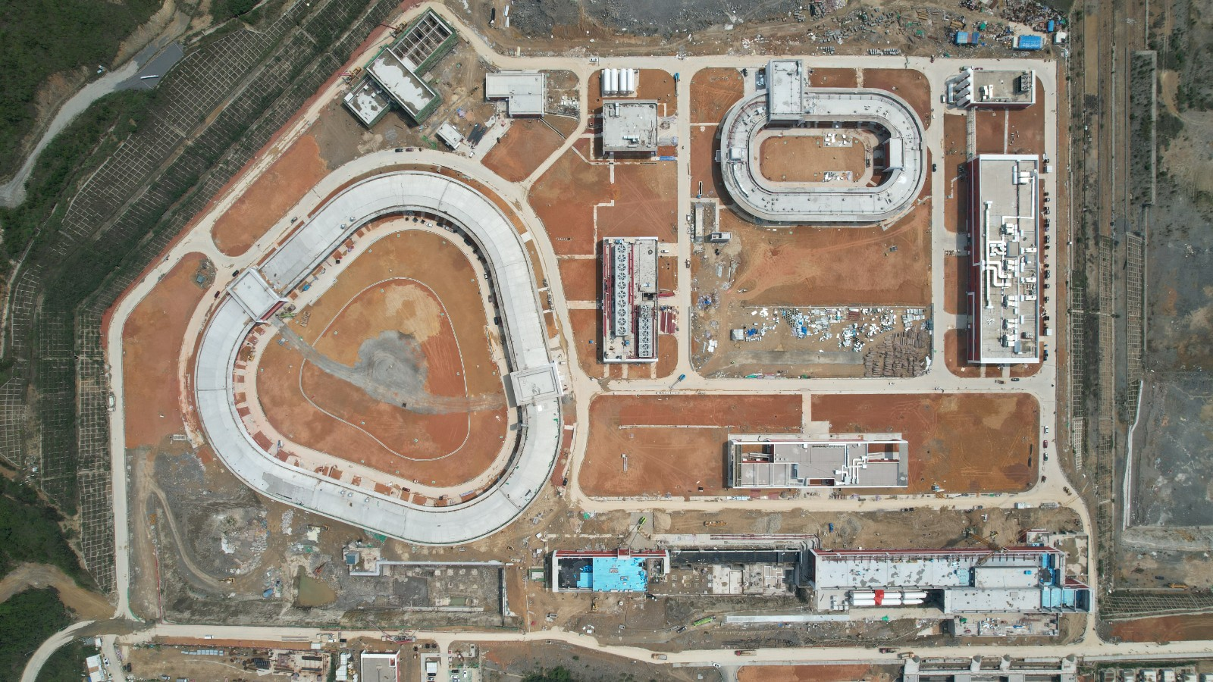
Project overview
Time schedule
7-year construction period since 2019
Beam commissioning
Equipment operation
Key prototype
Equipment bidding
Testing
Auxiliary system
Civil construction began
2019
2020
2021
2022
2023
2024
2025
First key equipment
Batch processing
Installation
Offline commissioning
Achieve design parameters
@2025.11
The key milestones and timelines

Slide 8
Outline
Project overview
Challenges, innovations, and breakthroughs
Construction, commissioning, and performance
Summary and perspectives
Notes:
That's the project overview. Now, let's look at the project challenges, innovations and breakthroughs.
In my talk, firstly I will give a general introduction of the HIAF project, today my talk will mainly focused on the challenges, and a series of innovations and breakthroughs addressing these challenges.
, as well as engineering construction and performance of facility. Finally is summary and future perspectives.
Then is the next step plan and future perspectives and

Slide 9
High intensity ion beam
Features:
High current low energy CW and high intensity high energy pulse beam
 | SECR | iLinac | BRing | HFRS | SRing
Length / circumference (m) | --- | 114 | 569 | 192 | 277
Final energy of U (MeV/u) | 0.014 (U³⁵⁺) | 17 (U³⁵⁺) | 835 (U³⁵⁺) | 800 (U⁹²⁺) | 1100 (U⁹²⁺)
Magnetic rigidity(Tm) | --- | --- | 34 | 25 | 15
Beam intensity of U | 1.7 emA (U³⁵⁺) | 1.0 emA (U³⁵⁺) | 2×10¹¹ppp (U³⁵⁺) 6×10¹¹pps (U³⁵⁺) | ------- | (0.5-1) ×10¹²ppp (U⁹²⁺)
Operation mode | DC | CW or pulse | fast ramping (12T/s, 3Hz) | Momentum-resolution 1100 | DC, deceleration
Emittance or Acceptance (H/V, π·mm·mrad, dp/p) |  | 5 / 5 | 200/100, 0.5% | ±30mrad(H)/±15 mrad(V), ±2% | 40/40, 1.5% (normal mode)

Slide 10
Key challenges
World's most intense pulsed heavy-ion beams
Challenge-1:
Beam dynamics
Institute | Machine | Planned | Achieved | Ion
BNL | AGS Booster |  | 5×10⁹ | Au³²⁺
CERN | LEIR |  | 9×10⁸ | Pb⁵⁴⁺
JINR | NICA Booster | 4×10⁹ | / | Au³²⁺
GSI | SIS18 | 1.0×10¹¹ | ~ 4×10¹⁰ | U²⁸⁺
FAIR | SIS100 | 4.0×10¹¹ | / | U²⁸⁺
IMP | HIAF-BRing | >1.0×10¹¹ | / | U³⁵⁺
IMP | HIAF-SRing | >5.0×10¹⁵ | / | U⁹²⁺
IMP | HIRFL-CSR | 1.0×10⁹ | 1.0×10⁸ | U⁷⁴⁺
leads to
Nonlinear effects
Space charge effects
Collective effects
Dynamic vacuum
limits
Beam production
Low energy manipulation
Fast ramping acceleration
Challenge-2
Technology aspect
Beam intensity
Beam quality

Slide 11
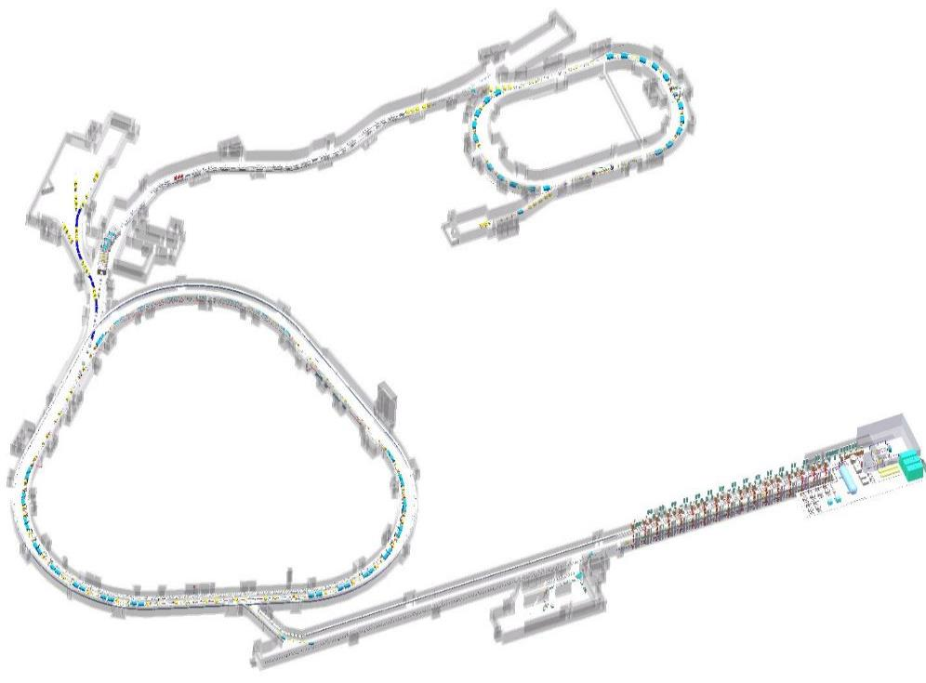
How to achieve the unprecedented heavy ion intensity
Stacking
Innovative stripping stacking longitudinally
Construction
Acceleration
The highest ramping rate 24 T/s
Digital twin engineering construction
SRing
~1×10¹² ppp U⁹²⁺
Accumulation
Novel Dual-plane painting injection
BRing
Commissioning
1~2×10¹¹ ppp U³⁵⁺
SECR
AI-driven control software platform
iLinac
1 emA U³⁵⁺
>1.7 emA U³⁵⁺
Injector
SRF Linac
The Front-End
4th generation ECR

Slide 12
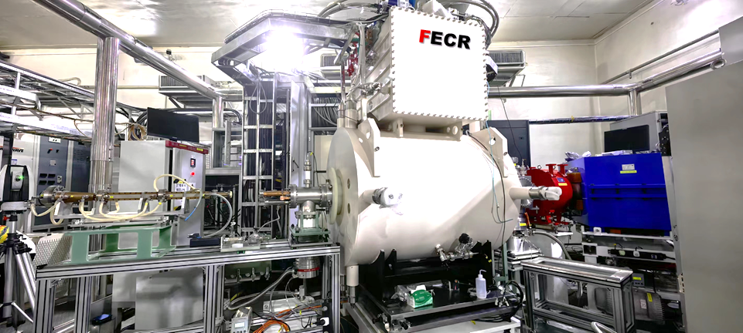
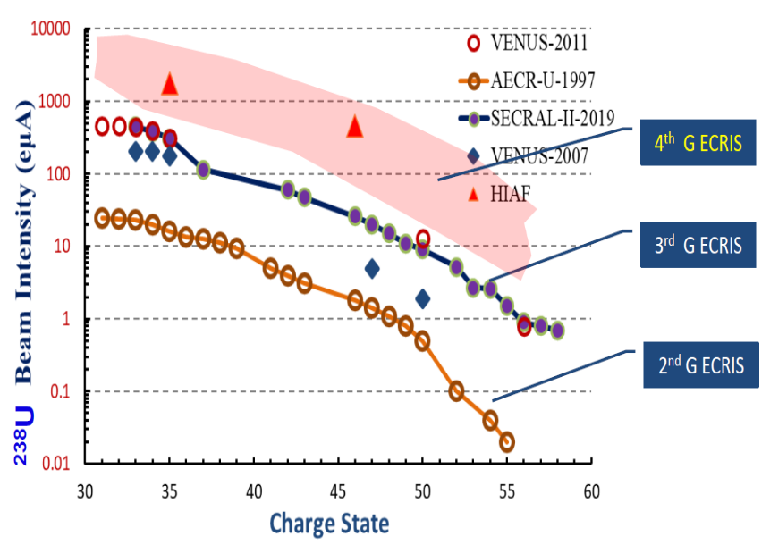
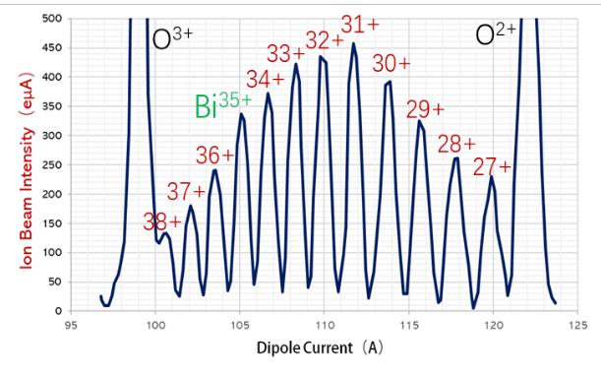
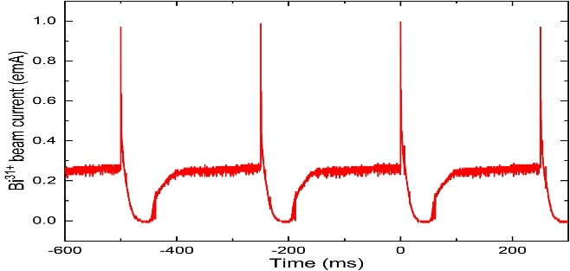
Breakthrough-1:
HCI production
The world's first fourth-generation superconducting ECR ion source
Features：
45/28 GHz Operation
High Power quasi-optical microwave injection
Micro-channel plasma chamber
HIAF goal
Bi³⁵⁺:
beam current is about 350 eμA , the new record of Bi ion.
Bi³¹⁺:
the peak current of pulse beam reached 1emA
Variation＜2%
Innovative afterglow operation

Slide 13
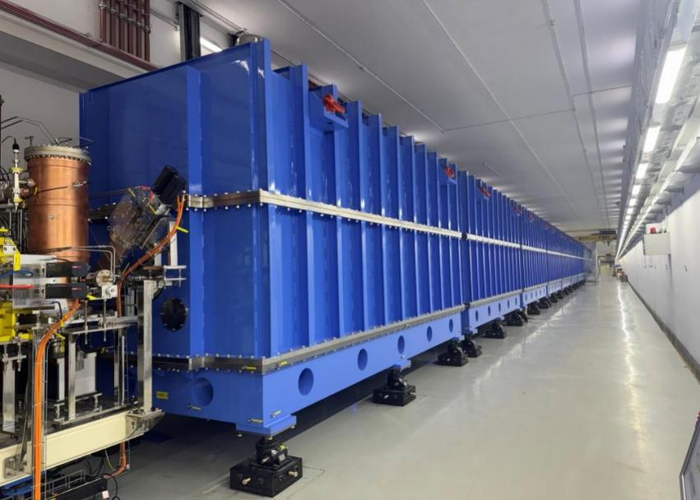
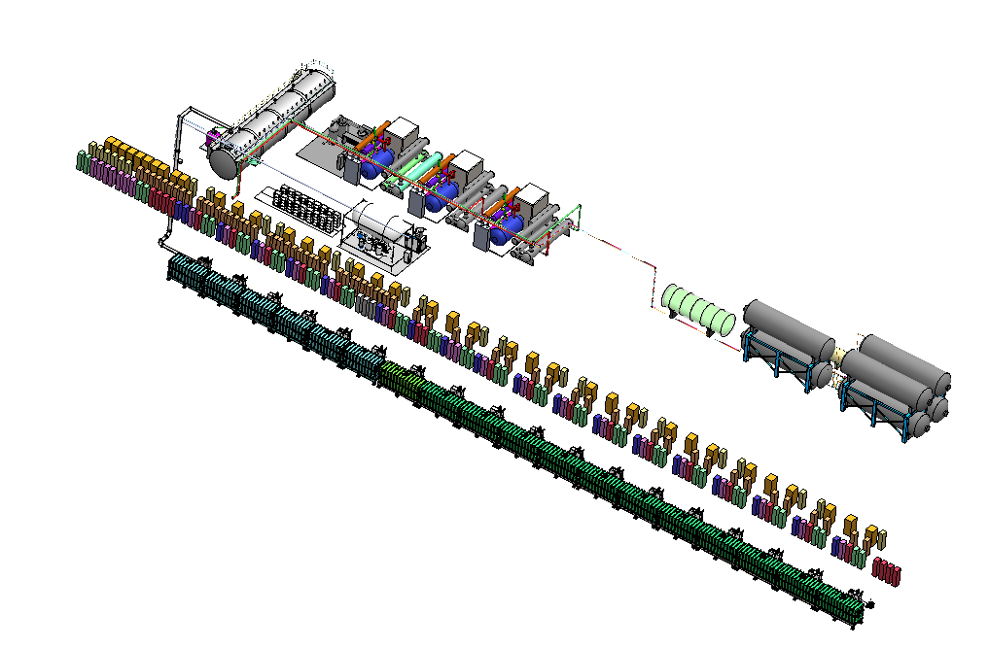
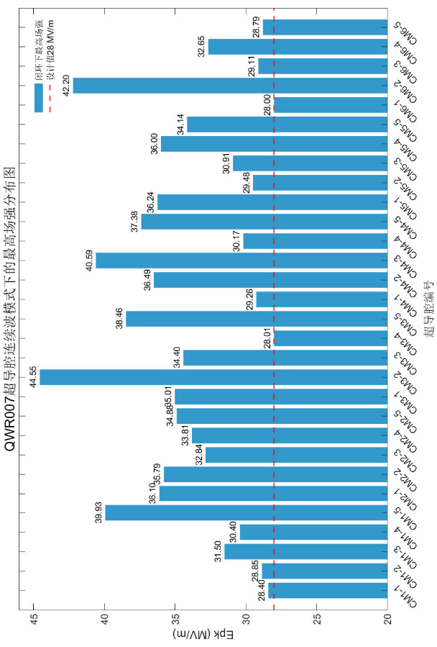
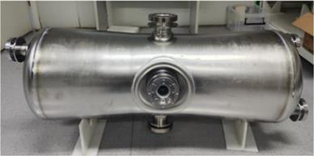
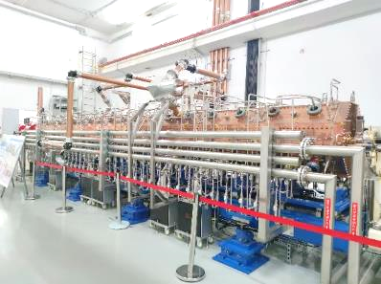
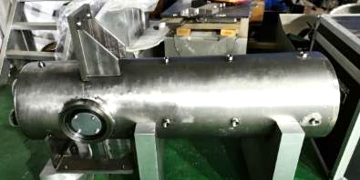
Breakthrough-2:
SRF linac injector
mA level highly charged heavy ion beam
Pulsed, 1.7 emA U
CW, 1.0 emA U
QWR 007
HWR 015
0.8 MeV/u CW RFQ
Average E_{pk} = 33.8 MV/m；20.7% > designed

Slide 14
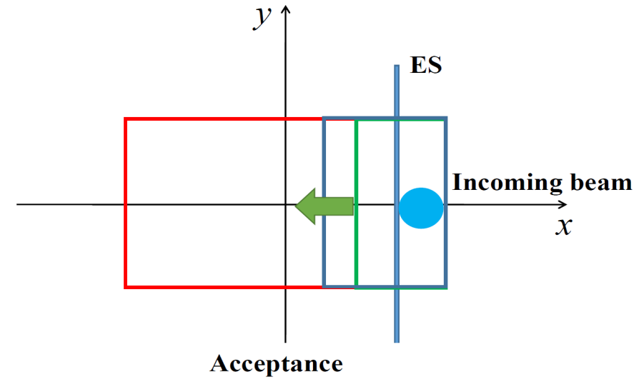
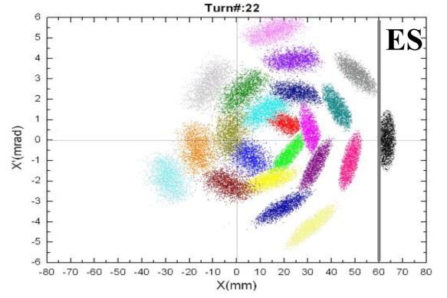
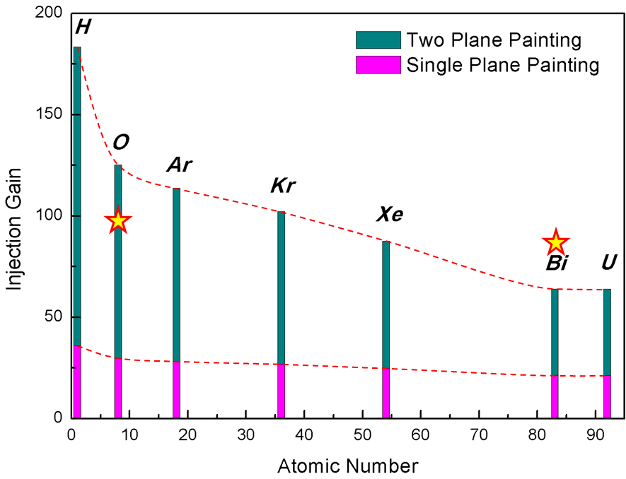
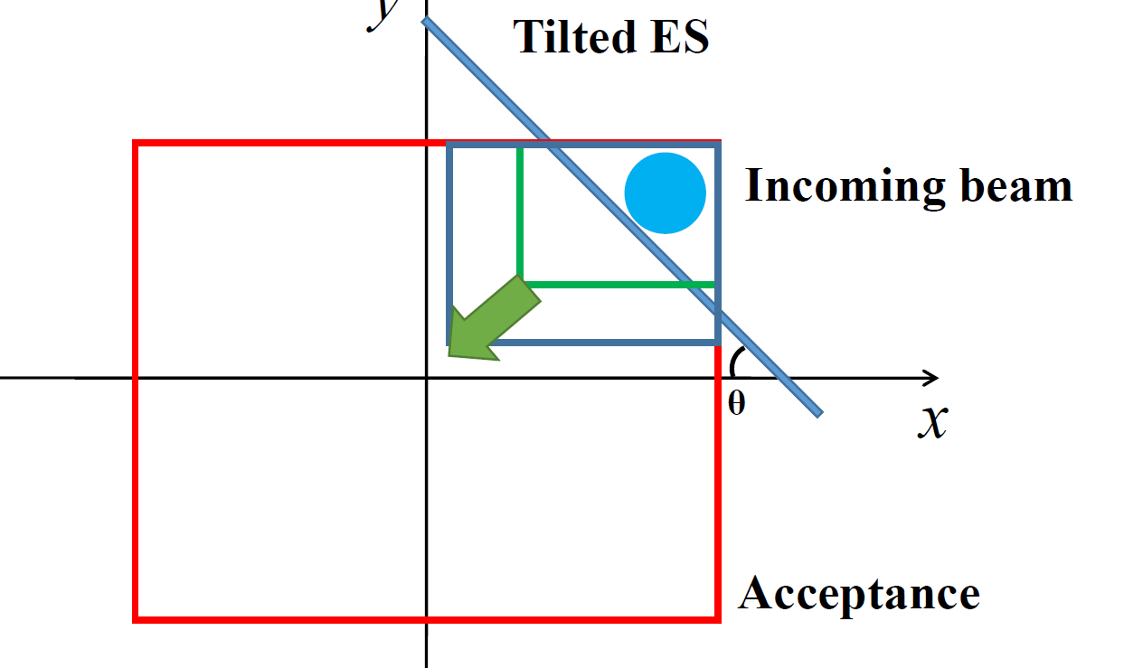
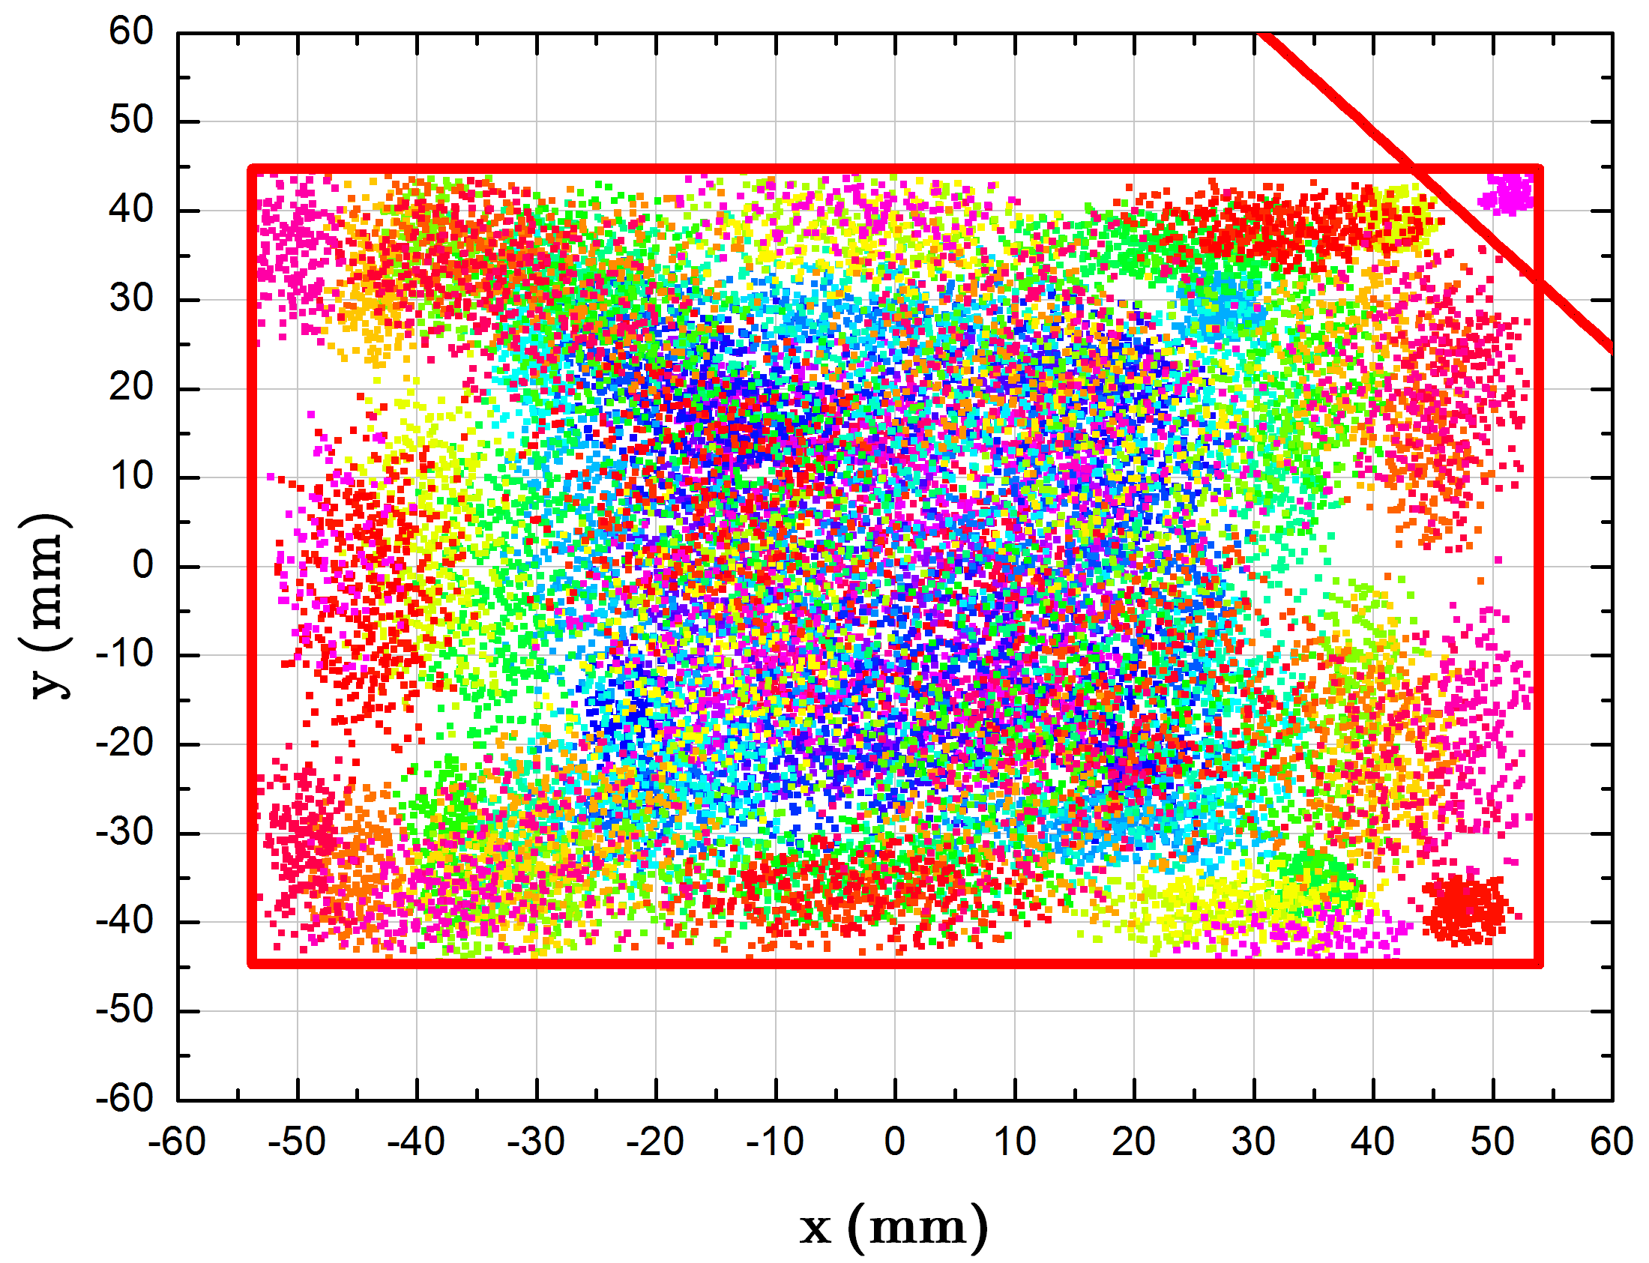
Breakthrough-3:
New beam accumulation scheme
Novel dual planes painting injection
Both the horizontal and vertical painting simultaneous using the tilted E-Septum
Conventional multi-turn injection
2.0 ×10¹¹ with two planes painting, nearly 10 times over the conventional multi-turn injection
Dual planes painting injection

Slide 15
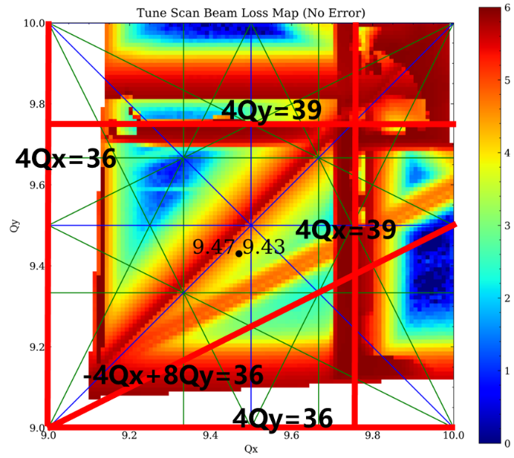
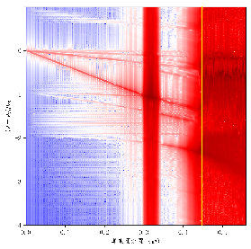
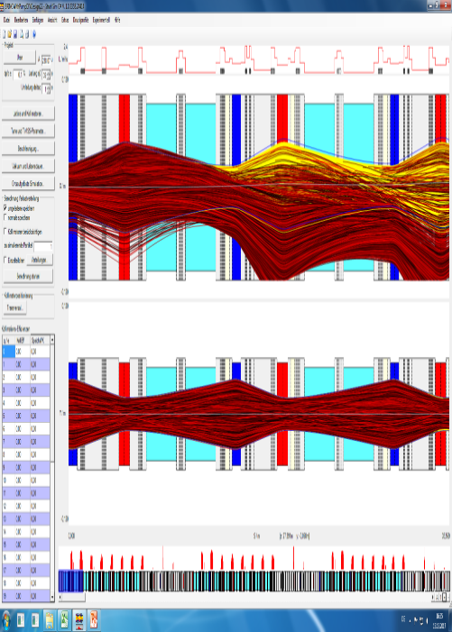
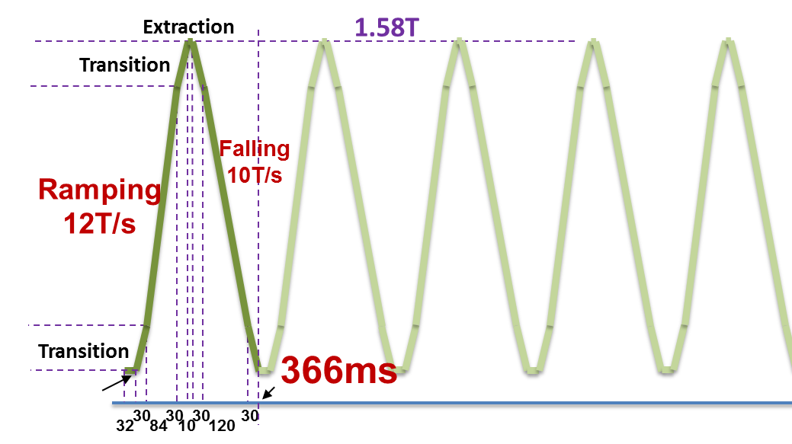
Breakthrough-4:
High-ramping-rate beam acceleration
Why? High intensity ion beam effects dominated beam loss
Space
charge
Collective
instability
Dynamic
vacuum
Beam should be launched to the high energy as quickly as possible
Challenges for fast ramping acceleration
Fast ramping rate mode
Power supply
RF system
Vacuum chamber

Slide 16
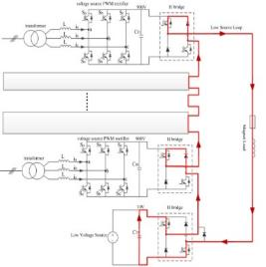
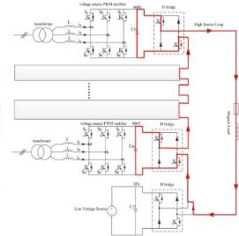
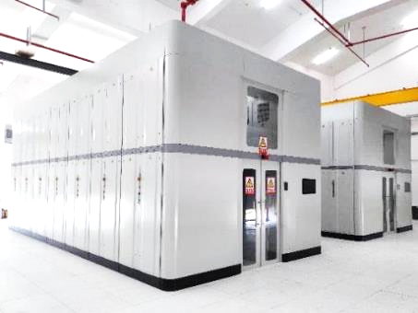
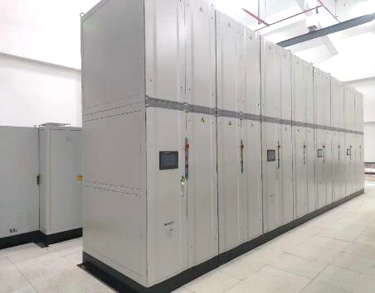
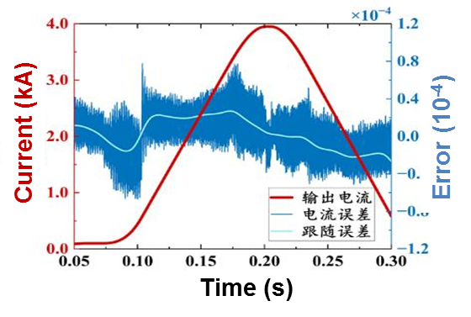
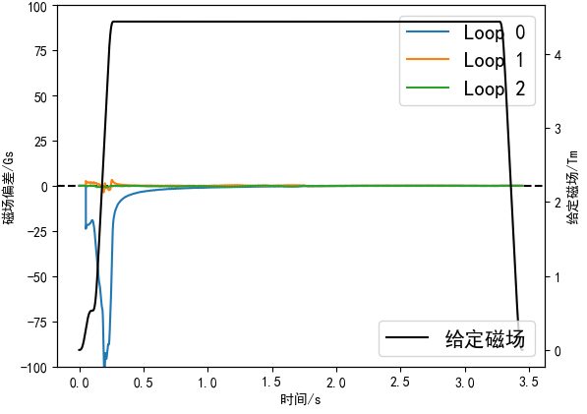
Fast ramping rate full energy storage PS
Innovative topology：
A full energy storage system including 350 power converters has been built
Energy from capacitor tank to magnet load
Energy from magnet load to capacitor tank
( variable forward excitation, full energy storage, PWM rectification technology )
Excellent performance, and power consumption is reduced to 10% of traditional
Power requirement (MVA) | Conventional | Energy storage
Bendng magnet | 180 | 15
Quadruple magnet | 50 | 6
Total of BRing | 250 | 41
Total of HIAF | 297 | 88
100Gs→<±1Gs
Ramping rate > 40000A/s,
Tracking error< ±9.6 e-5
Dynamic magnet field correction

Slide 17
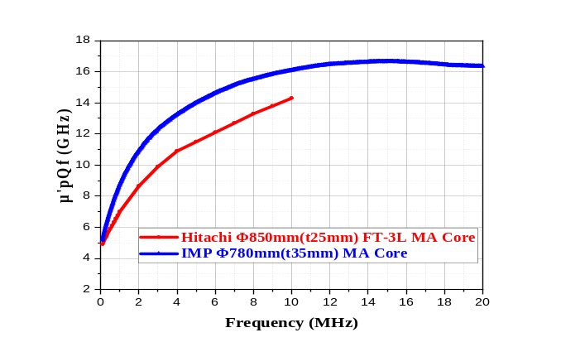
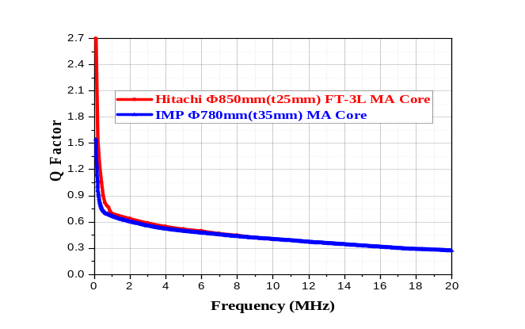
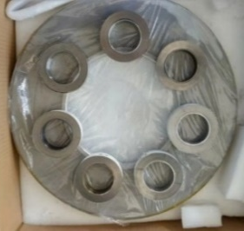
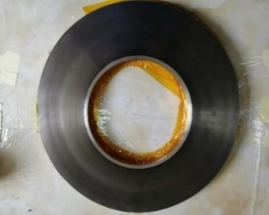
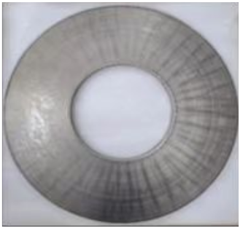
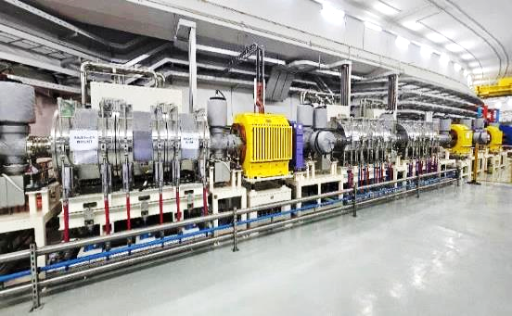
Magnetic alloy core loaded RF
Breakthrough in MA Loaded Cavity
18um ribbon
18um ribbon
14um ribbon
95×65×25mm
460×230×25mm
780×360×35mm
World-leading level
Over ten years exploration
Facilities | Voltage (kV) | Length (m) | Gradient(kV/m)
JPARC-RCS | 41 | 1.78 | 23
JPARC-MR | 46.7 | 1.78 | 26.2
SIS18 | 50 | 2 | 25
HIAF-BRing | 70 | 2 | 35
Total RF voltage: 350kV
Ranks among the best in the world
MA loaded RF system in the tunnel

Slide 18
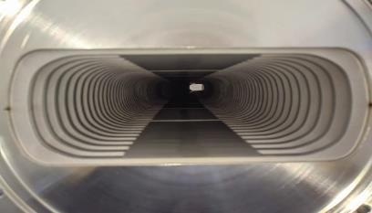
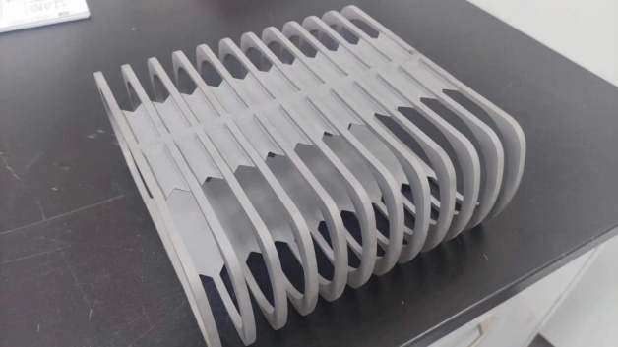
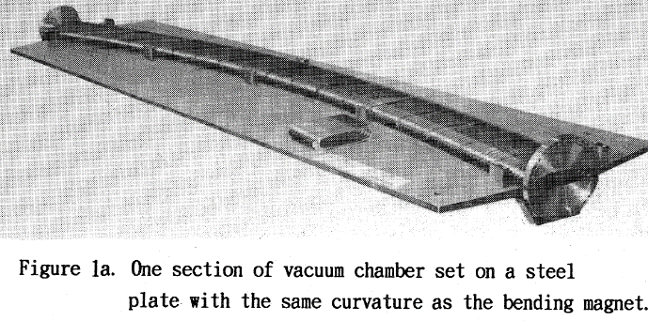
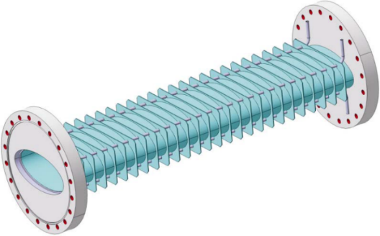
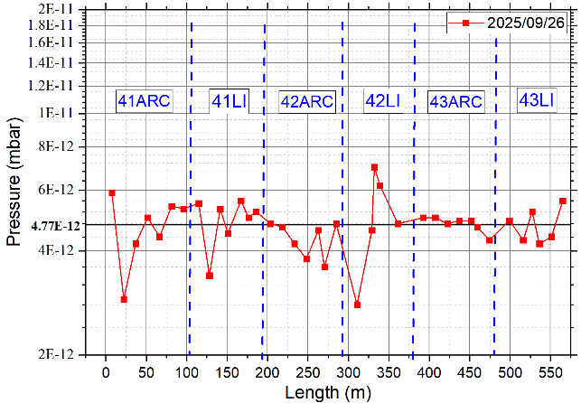
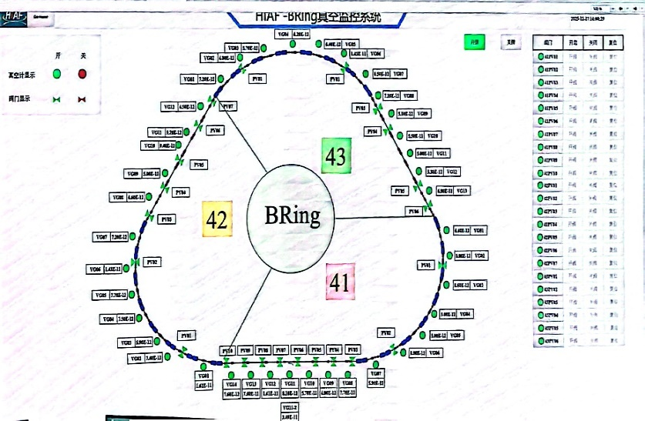
Thin-walled vacuum chamber
Thin-wall chambers: Keep eddy currents at a tolerable level
Novel scheme of IMP
HIMAC - Japan
GSI - Germany
Stainless steel-0.3mm
Stainless steel-0.3mm
Rib-15mm,one side
3D-printed CT4 titanium alloy cage
Cage: 4 mm one side
Reinforcing ribs
Thin-wall chamber supported by cage
This is the highest vacuum level ever reported for synchrotron facilities
Static vacuum
pressure
Dynamic vacuum level of high intensity
4.7×10⁻¹²
mbar
1×10⁻¹¹ ~
5×10⁻¹² mbar

Slide 19






Breakthrough-4:
High-ramping-rate beam acceleration
The non-resonant acceleration rate reaches 24 T/s, three times the fastest rate reported internationally.
HIRFL-CSR, China
HIT, Germany
SIS12, Germany
HIAF，China
0. 5 T/s
1. 5 T/s
8~10 T/s
1
100
0.1
1 T/s
2 T/s
10
Ramp rate of the magnetic field （T/s）
24 T/s
Reducing high-intensity-dominated beam loss from 13% to 3%
HIMM, China
HIMAC, Japan

Slide 20
Outline
Project overview
Challenges, innovations, and breakthroughs
Construction, commissioning, and performance
Summary and perspectives

Slide 21






Engineering Construction
Digital Twins for high-quality and efficient construction of large scale scientific project
Digital-twin-driven construction
Create new models for engineering construction
Through a End-to-End Digital closed loop
High intensity Heavy ion accelerator -HIAF
Digital Twin collaborative platform
Design
Manufacturing
Installation
Management
The standardized design of non-standard equipment is rapidly iterated
Digital-driven modular prefabrication boosts efficiency
Three-dimensional virtual visualization of assembly optimization processes
Full-chain data sharing for dynamic decision-making

Slide 22



Engineering Construction
Civil construction
Occupies 80 acres, total construction area 58,000 m²,
BRing building
SRing building
Cryo center
Testing&Assembly hall
Linac building
Central control building
10 above-ground building and a 2-kilometer-long underground tunnel at a depth of 13 meters

Slide 23









Engineering Construction
Tunnel installation
Full Digital Instruction
HiRIBL (HFRS)
SRing
Ion Sources
BRing
BRing Injection Line
iLinac
RFQ
The period for a 2-kilometer beam line has been shortened from 2-3 years to 8 months

Slide 24



Machine Commissioning
AI-driven beam control platform
A new full-stack intelligent software system for communication, control, storage, and analysis
Internationally pioneering
high-speed communication protocol CV-Link
Innovative
big data access and analytics LA-DB
High reliability distributed intelligent control system LACCS
Increase the transmission rate by five times
Big data access speed is 10 times faster
Dynamic control performance is enhanced by 20 times
International
67s
CV-Link
3s
The entire chain guarantees the security of data for the accelerator's large scientific facility and core research experiments, with high performance

Slide 25




Machine Commissioning
HIAF implementation: integration 141 beam dynamics, 3,559 large-scale devices, and 230,000 control variables for joint commissioning
Full cover of all accelerator nodes
Implantation of beam dynamic operation
It delivers real-time data processing, automatic control, and AI-based debugging - for large-scale accelerators.

Slide 26



Machine Commissioning
The full commissioning, spanning a 2-kilometer-long beamline, was completed in only 16 hours — a new record for large-scale scientific facilities
Bring Beam
Heavy-ion Accelerator Fires Up
Science, 6 NOVEMBER 2025, P.559
The successful commissioning of HIAF was promptly reported in Science

Slide 27




Excellent performance
New records for heavy ion beam intensity
O
HIAF束流指标
Increased
by a factor of 3
Xe
Increased
by a factor of 3
Bi
Increased
by a factor of 8

Slide 28






Excellent performance
World first: nuclear mass precision improved from 10⁻⁷ to 10⁻⁸
①
HIAF-Spectrometer Ring
(SRing)
γ_{t} = 1.43 (IMS mode)
$$\frac{σ(m)}{m}\sim \frac{11 keV}{202 u}\sim 5.8×{10}^{−8}$$
②
In two-TOF mode:
$$\sim {10}^{−7}$$
$$\sim {10}^{−8}$$

Slide 29


First Scientific Achievement
High precision spectrometer ring SRing
The new nuclide ¹⁵³Hf was discovered.
Approximately 35 new nuclear masses were simultaneously determined in 12h
World's first discovery of a new nuclide via a storage ring —
conventionally discovered with gas-filled recoil or radioactive beam separators

Slide 30



First Scientific Achievement
Low energy nuclear structure terminal
Precise determination of the half-life of the extremely short-lived nuclide ²⁴²Fm: 4.17 μs, clarifying the inconsistency in the international ²⁴²Fm half-life data
Nuclear Physics A 255 (1975) 509
Response < 1.0 μs
²⁴¹Fm@Dubna
Half life: 800μs
Response 100 μs
Eur. Phys. J. A 37, 177-183(2008)
GSI
Half life：N/A
Response 20 μs
²⁴²Fm@HIAF Half life: 4.17μs

Slide 31




First Scientific Achievement
High energy fragment separator HFRS
First identification of neighboring nuclides of ²⁰⁰Pb, produced by ²⁰⁹Bi fragmentation
Offering key data for heavy-nucleus cross-section predictions.
¹⁰⁸Sn
¹⁰⁵Cd
²⁰⁰Pb identification
²⁰⁰Pb Decay γ

Slide 32
Outline
Project overview
Challenges and innovations
Engineering construction and performance
Summary and perspectives

Slide 33

Summary and perspective
HIAF has successfully achieved its design goals — and established world-leading capabilities in high-intensity heavy-ion beams
Ongoing efforts are focused on
Beam dynamics study and machine performance improvement
Reliable and high efficiency operation for users
New techniques implementation for higher intensity
Intensity goal with stripping stacking
HIAF intensity goal
Intensity world records
Notes:
Now ongoing efforts are focused on ………,
In particular, in the next step we will implement a unique longitudinal stripping stacking scheme, which will increase the beam intensity by a factor of several.
as well as new techniques implementation for higher intensity, there are
The next ion scheduled for commissioning is uranium ion, here is the specified design intensity for Uranium beam.

Slide 34

Summary and perspective
High energy hall: polarized proton beam
(1)
⑧
(2)
④
③
HFRS
(3)
⑤
SRing
⑥
(1) Hyper nuclear physics
(2) Phase diagram of strongly interacting matter
(3) Irradiation research
⑨
BRing
Ions | Energy (GeV/u) | Intensity (ppp)
p | 9.3 | 1.0×10¹³
¹⁸O⁶⁺ | 4.3 | 6.0×10¹¹
⁷⁸Kr¹⁹⁺ | 1.7 | 4.0×10¹¹
²³⁸U³⁵⁺ | 0.85 | 2.0×10¹¹
SECR
⑦
①
②
iLinac

Slide 35


CNUF-An upgrade project for the HIAF and CiADS
China advanced NUclear physics research Facility
Sub-critical lead-bismuth eutectic (LBE) fast reactor
Scientific motivation:
The limit of existence of nuclides
Nuclear matter phase structure
Strong-field QED effect
Spin decomposition and origin of mass
High-energy-density physics
New physics beyond SM
EicC
ISOL
Consists of p-Ring, e-Ring and beam injectors, realizes dual-polarized high intensity electron ion collision, with full energy beam injection and rapid replacement based on e-injector and BRing-S.
HIAF-U
Upgrade HIAF with 200MeV/u iLinac, superconducting synchrotron BRing-S and the merging ring MRing, providing high-intensity, high-quality ion beams from proton to uranium.
Driven by the high power proton beam from CiADS Linac, producing high intensity neutron-rich nuclides and be post-accelerated by HIAF-U.
Notes:
For future, an upgrade project CNUF is proposed based on HIAF, CNUF is abbreviation of China advanced nuclear physics research facility. The gray areas and lines show the facilities are under construction, the orange shows the update programs. It is consisted of ISOL、HIAF-U and EicC.

Slide 36




CNUF-An upgrade project for the HIAF and CiADS
EicC: Dual-polarized high-luminosity electron-ion collider in the sea quark energy region.
Spin decomposition & nucleon mass origin
E_{cm}=15-20 GeV, Lumi=(5-6) ×10³³ cm⁻²s⁻¹
U.S.EIC 10×100 GeV²
EicC 5×25 GeV²
JLab 12 GeV
Electron: 5 GeV, 4.5×10¹³ ppp, 80% polarization
Proton: 25GeV, 4×10¹⁴ ppp, 70% polarization
Ion: d (polarized), ³He (polarized) to Uranium
p-Ring: 86.5Tm, 500MHz RF
e-Ring: 16.7Tm, 500MHz RF
EicC at a sweet spot to systematically study the behavior of sea quarks.
EIC-US is a higher energy machine with an emphasis on low and moderate-x region for gluon.
Combining the measurements at both colliders will provide systematically controlled physics interpretation
Mode: rapid replacement head-on collision
Integrated Lumi.=150-200 fb⁻¹
Notes:
The third is the EicC, EicC is Dual-polarized high luminosity electron-ion collider, the design center of mass energy is 15-20 GeV, the peak luminosity is about (5-6) ×10³³ cm⁻²s⁻¹. We hope the integrated luminosity can reach 150-200fb⁻¹. Compare with EIC of US,

Slide 37

HIAF in the early morning light, is only at the dawn of what it can achieve!
So we welcome researchers from the global scientific community — to explore the possibilities with us.
Thanks for your attention!

Slide 38

HIAF and CiADS
CiADS
China Initiative Accelerator Driven System
Superconducting proton linear accelerator
High power lead-bismuth eutectic (LBE) spallation target
HIAF
High-Intensity Heavy Ion Accelerator Facility
Sub-critical lead-bismuth eutectic (LBE) fast reactor
Notes:
Besides the HIAF, there is another facility CiADS in the same campus. CiADS is China Initiactive Accelerator Driven System. It consists of

Slide 39



CNUF-An upgrade project for the HIAF and CiADS
ISOL ( Isotope Separation On-Line ):
MW-class high-power proton beam to produce high-intensity neutron-rich nuclides and surface muon
Exploring the limit of existence of nuclides
Mode: ISOL + iLinac + BRing-N
Neutron-rich nuclides generation online (~10¹⁶ fis./s)
Post-acceleration by iLinac and Bring-N (>100 MeV/u)
Generate extremely neutron-rich secondary beams
Muon research and μSR application
Mode: CiADS + high power target
High intensity surface muon (~10¹² μ/s)
Muon moderation and μSR
Future muon factory and collider
 | FRIB | PSI | ESS | CiADS
BEAM | H to U | p | p | p
Mode | CW | CW | CW | CW
Energy (GeV) | >0.2 | 0.59 | 2.5 | 0.5
Current (mA) | - | 2.44 | 2 | 5
Power (MW) | 0.4 | 1.44 | 5.0 | 2.5
Notes:
Isol will be constructed based on the MW-class high-power proton beam of CiADS. You can find in this table, CiADs can provide 2.5MW proton to produce high-intensity neutron-rich nuclides and surface muon.
Muon Spin Rotation/Relaxation/Resonance，利用缪子自旋特性在原子尺度上研究物质结构的方法统称。

Slide 40

CNUF-An upgrade project for the HIAF and CiADS
HIAF-U: Multi-functional high-intensity accelerator facility from p to U
Nuclear matter, hypernuclei and η/μ research
Muon research
Mode: BRing-S (fast/slow ext. p-U) + fixed target
High-intensity high-power beam
Nuclear matter phase transition research
Hypernuclei, η/μ physics, Λ polarization
Nuclear matter Hypernuclei Research
MRing
Ion-ion merging
HIAF & HIAF-U
High-energy-density physics
SRing
BRing-N: 34Tm, 569m, 3Hz
SRing: 17(25)Tm, 270.5m, accumulation/compression
BRing-S: 86Tm, 3Hz, superconducting
MRing: 45Tm, superconducting, beam merging
Strong-field QED effect experiment
BRing-N/S
Mode: MRing&SRing merging collision
E_{cm}=4-10 MeV/u, Lumi.>4×10²⁶ cm⁻²s⁻¹
Super strong e-field exceed Schwinger limit for low-background e-p pairs generation
ISOL
iLinac up to 200MeV/u
Facility | Beam (GeV/u) |  | Intensity (ppp)
FAIR | 2.7 | ²³⁸U²⁸⁺ | 5×10¹¹
NICA | 4.5 | ¹⁹⁷Au³²⁺ | 4×10⁹
FNAL | 8.0 | p | 6.8×10¹³
HIAF | 0.8 | ²³⁸U²⁸⁺ | 5×10¹¹
 | 1.1 | ²³⁸U⁹²⁺ | 1×10¹²
HIAF-U | 3.0 | ²³⁸U³⁵⁺ | 2×10¹²
 | 9.1 | ²³⁸U⁹²⁺ | 3×10¹²
 | 25 | p | 4×10¹⁴
High-energy-density physics
Mode: BRing-N/S&MRing + beam manipulation
2MJ, ns-scale short bunches
Multimodal fixed target experiments
HEDM in strong shock wave region to create extreme matter states
Notes:
HIAF-U is proposed on the HIAF, For HIAF-U, iLinac energy will update to 200MeV, a superconducting synchrotron with rigidity of 86 Tm and a superconducting storage ring for beam merging will be constructed. With these update programs both beam intensity and energy will increase significantly. HIAF-U will focus on

