Slide 1
Electro-magnetic Energy Reconstruction of Highly Granular Calorimeter Using Machine Learning
Xiang Li
University of Science and Technology of China
On behalf of the CEPC Calorimeter working group
INSTR 2026 October 12-16
Notes:
Good afternoon, everyone.
My name is Xiang Li, from the University of Science and Technology of China.
Today, I will present our recent study on machine-learning-based Electro-magnetic energy reconstruction for a highly granular calorimeter.
各位老师、同学大家好，我叫李想，来自中国科学技术大学。我今天汇报的题目是基于机器学习的高颗粒度量能器能量重建.

Slide 2
Outline
Introduction and AHCAL Prototype
Beam Tests and Simulation
Electro-magnetic Energy reconstruction
  CNN+LSTM: Electronic Saturation effect modeling
Notes:
My talk is organized into three parts.
First, I will briefly introduce the CEPC calorimeter prototype and the beam-test data.
Then, I will discuss the differences between simulation and Beam test data, especially for high-energy electrons.
Finally, I will present our calibration strategy and machine-learning-based energy reconstruction results.
报告中我会先介绍 CEPC 和高颗粒度量能器的物理背景，然后介绍 AHCAL 样机和 CERN 束流测试数据。再分别介绍ML在强子能量重建和电子能量重建上的表现；电子能量重建主要使用CNN+LSTM的模型，并对电子学饱和重新建模并修正

Slide 3
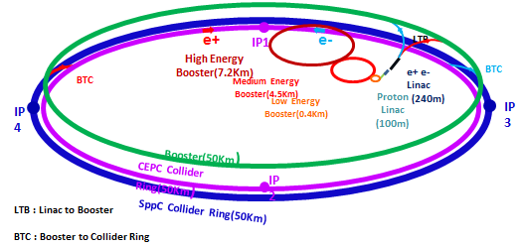
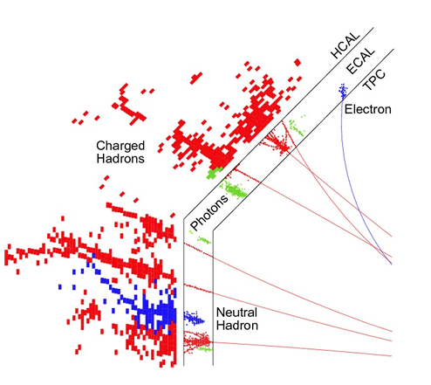
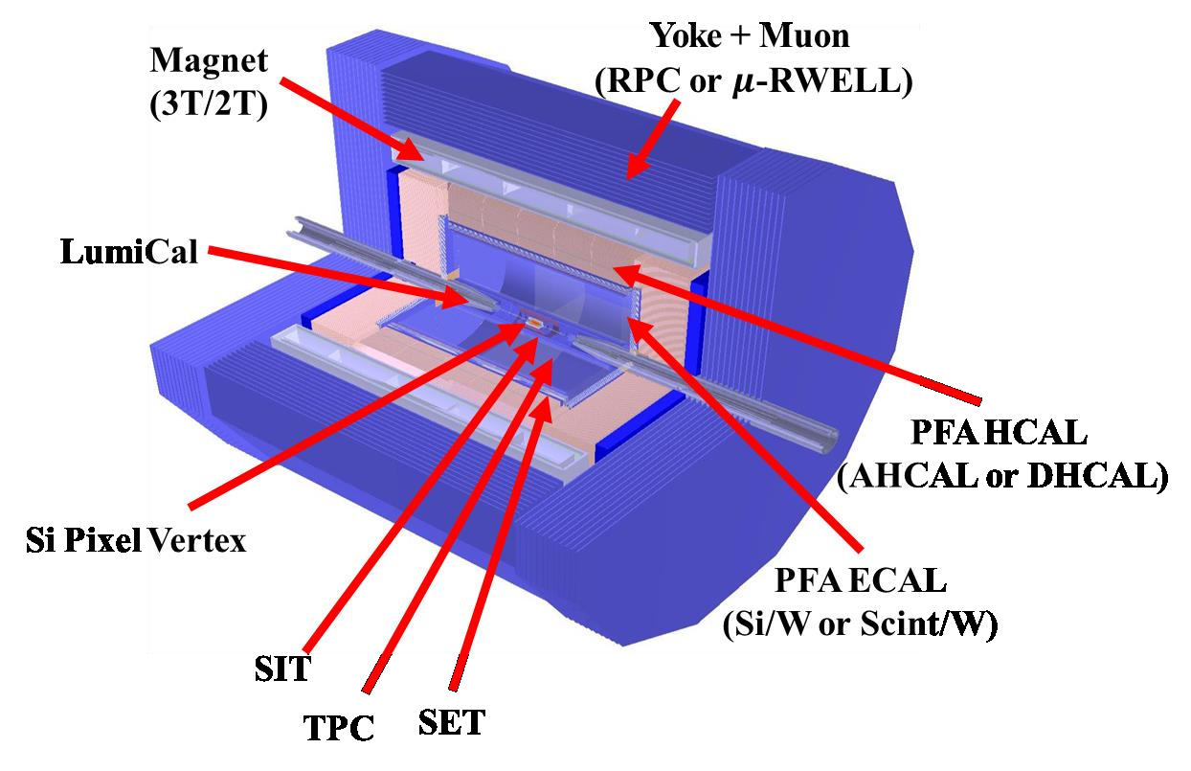
Introduction
Circular Electron Positron Collider (CEPC)
  E_{cm} ≈ 240 GeV (Higgs mode)
  luminosity ~ 8.3×10³⁴ cm⁻²s⁻¹ (higgs mode)
  challenges: jet energy resolution 3%~4%
Particle Flow Algorithm (PFA)
  Good track finding
  Good shower partition
      High granularity
      High energy resolution
Notes:
The CEPC, has a center-of-mass energy about 240 GeV in Higgs mode.
The target jet energy resolution is around 3% to 4%.
To achieve this goal, the Particle Flow Algorithm (PFA) has several key requirements, including good track finding and good shower separation.
This means we need a calorimeter with high granularity and good energy resolution.
CEPC，也就是环形正负电子对撞机，在 Higgs 模式下的质心能量大约为 240 GeV，喷注能量分辨能力，目标是 3%~4%。为了达到这一目标，粒子流算法， 提出了三个关键要求：好的 track finding，好的簇射分区，这对探测器提出高颗粒度以及良好的能量分辨率。

Slide 4
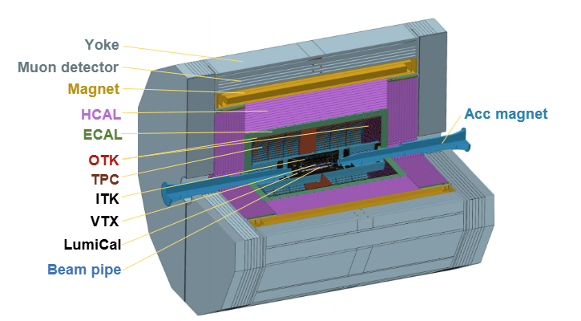
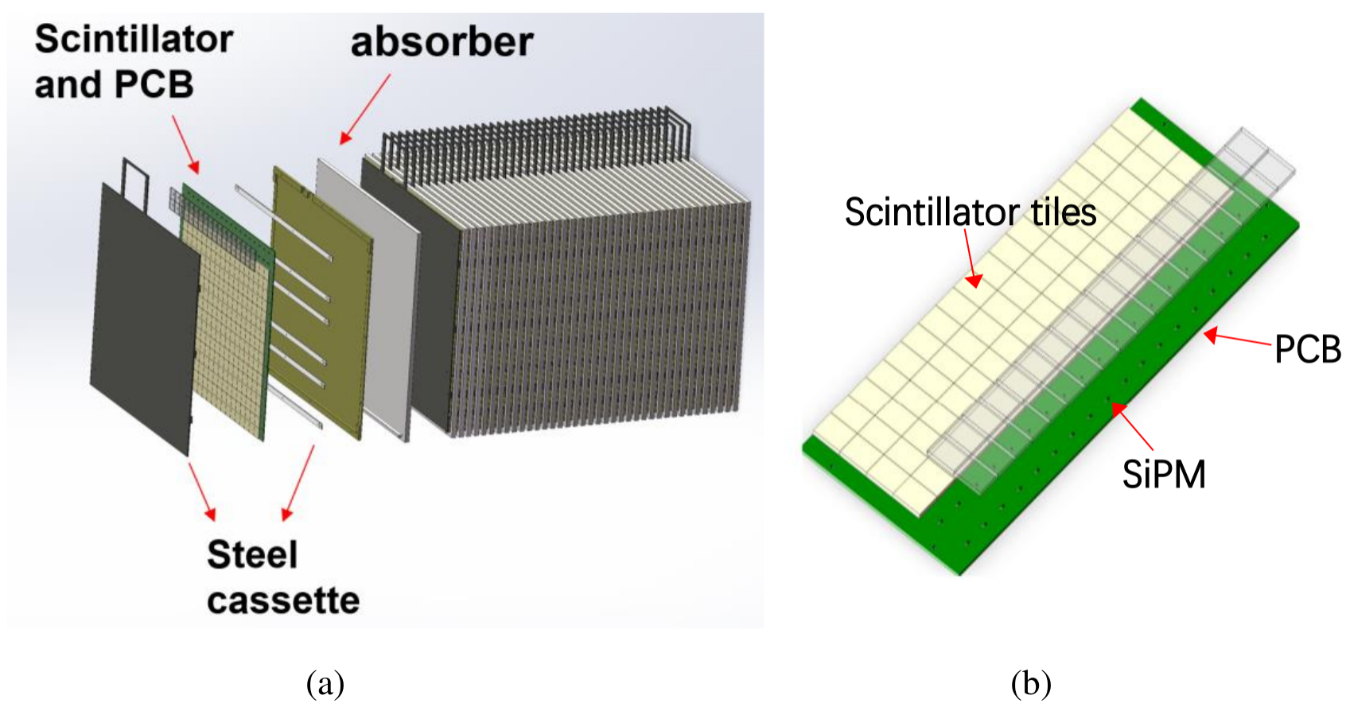
AHCAL Prototype
An Analogue readout Hadronic Calorimeter prototype has been developed
A sampling calorimeter :sampling fraction of about 1%–2%
Total layers | 40
Sensitive area | 72cm*72cm
Granularity | 4cm*4cm*0.3cm
Total channels | 12960
NIL | 4.6
Energy Resolution | <60%@ 1 GeV（Hadron）
Weight | 5.0T
AHCAL
Prototype
Notes:
Next, I'd like to introduce the AHCAL prototype used in this work.
It is an analog hadron calorimeter with a sampling fraction of about 1% to 2%.
It uses plastic scintillators as the sensitive material and steel as the absorber.
The prototype has 40 layers, with a total depth of 4.6 nuclear interaction lengths.
Each layer contains 18 by 18 cells, and each cell has a size of 4 by 4 by 0.3 centimeters.
下面介绍本工作使用的AHCAL 样机。本样机为模拟读出的采样型量能器，采样比1%–2%。它采用塑料闪烁体作为灵敏介质，铁作为吸收体。整个样机一共有 40 层，核作用长度为4.6，每层18*18个灵敏单元，每个cell大小为4cm*4cm*0.3cm。该样机共有 12960 个cell。

Slide 5
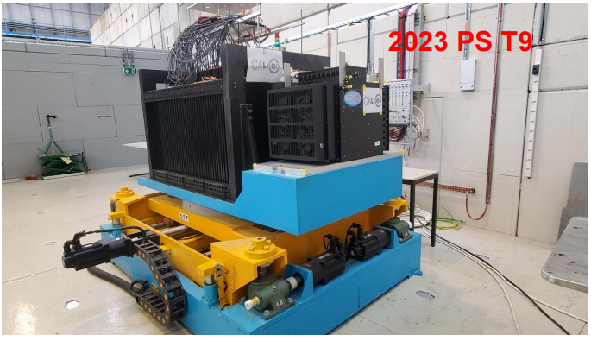
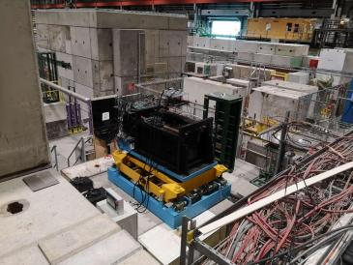
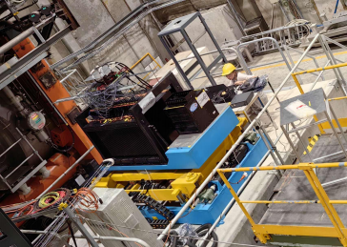
Beam Tests
Beam tests have been done at CERN
muon position scan( 100GeV/c )
Pion ( 1-120 GeV/c )
Electron ( 1-120 GeV/c )
Calorimeter Calibration
  Pedestal Calibration
  High-Lowgain Calibration
  MIP Calibration
  SPE Calibration
2022 SPS H8
2023 SPS H2
Notes:
We carried out a beam test at CERN.
We used electron and hadron beams with momenta ranging from 1 to 120 GeV/c to study the energy response of the AHCAL.
我们在 CERN 进行的束流测试。我们使用了 1 到 120 GeV/c 的电子束和强子束，对 AHCAL 的能量响应进行测试。在数据处理之前，需要完成一系列标定，包括 pedestal 、high-low gain 、MIP 以及 SPE 标定。

Slide 6
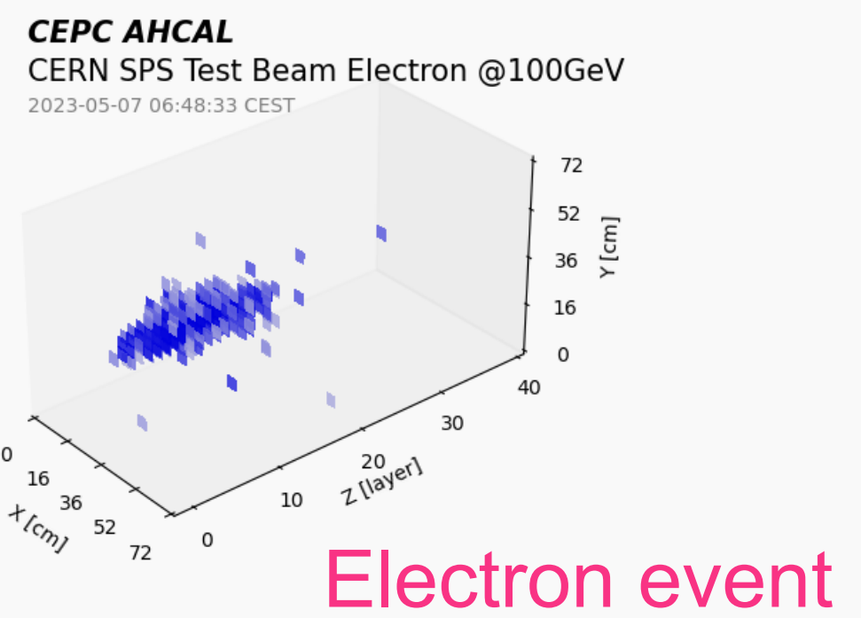
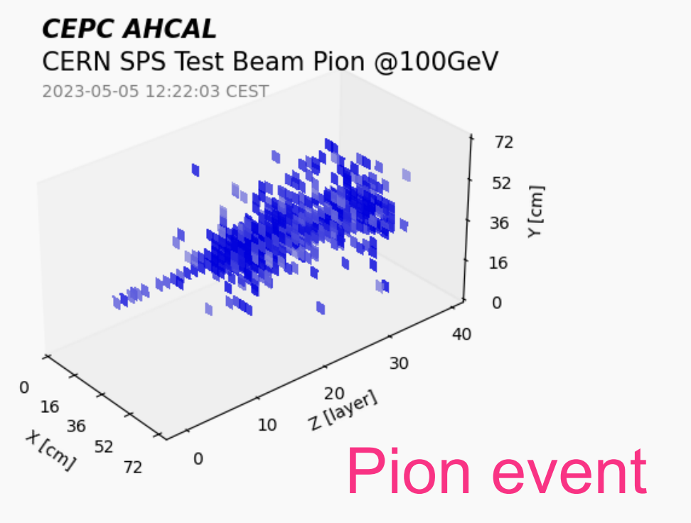
Motivation
Electro-magnetic energy reconstruction
Reliable electro-magnetic energy reconstruction:
  Providing a useful reference for subsequent studies of more complex hadronic showers
Notes:
Reliable electromagnetic energy reconstruction provides a useful reference for studies of more complex hadronic showers, motivating further improvements in energy resolution.

Slide 7
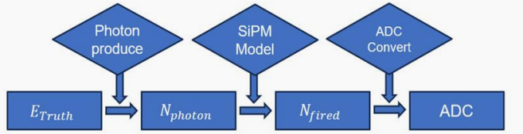
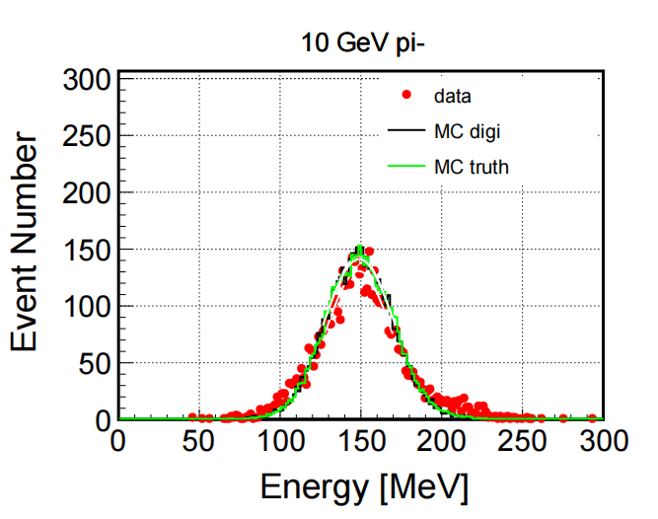
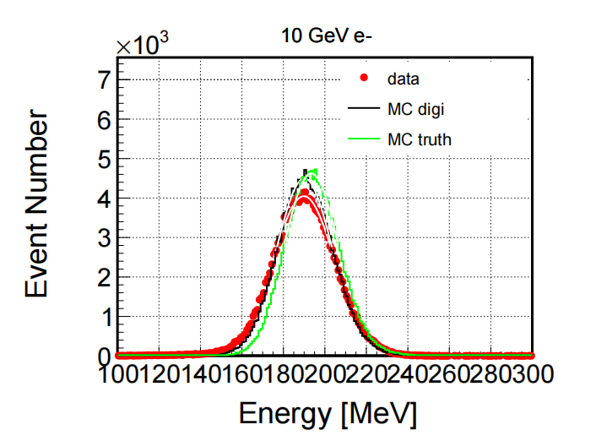
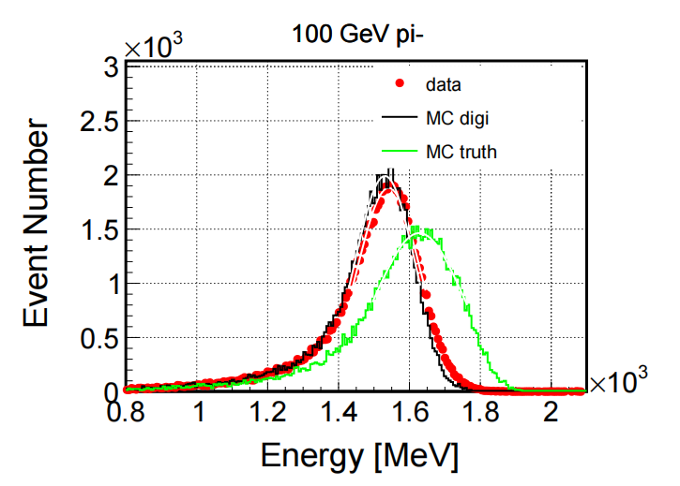
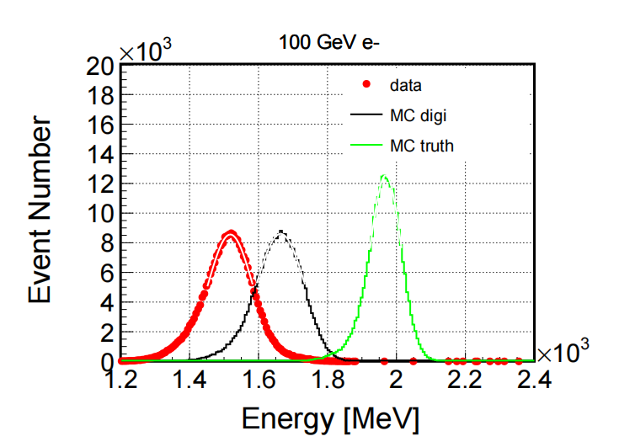
Simulation and Data
MC_truth: Raw MC simulation
  Geant4 simulation: standalone AHCAL prototypes’geometry
MC_digi: After Digitization
  Scintillator non-uniformity
  SiPM response: SiPM saturation and fluctuations
Data: Beam-test data
Hadron
Electron
Good agreement between MC-digi and beam-test data is achieved for hadrons and low-energy electrons.
For high-energy electrons, noticeable simulation-to-data discrepancies emerge.
Notes:
On this slide, we compare the MC simulation with the beam test data.
We use three sets of results: MC truth in green, beam test data in red, and MC digi in black.
In the simulation process, we use Geant4 simulation: standalone AHCAL prototypes geometry
In the digitization process, we mainly consider the non-uniformity of the scintillator and the saturation of the SiPM.
The four plots on the right show the energy distributions for pions and electrons at different energies.
As we can see, MC digi agrees well with the beam test data for hadrons and low-energy electrons.
However, for 100 GeV electrons, there is still a clear bias between the simulation and the data, even after digitization.
This means we still need to improve our digitization for high-energy electrons.
这一页展示的是蒙特卡洛模拟与束流实验数据的对比情况。
首先，我们使用了三组数据：第一组是原始蒙特卡洛模拟结果，也就是图中的绿色曲线 MC_truth；第二组是实际束流实验数据，对应红色的数据点；第三组是经过数字化处理后的蒙特卡洛模拟结果，也就是黑色曲线 MC_digi。
在数字化过程中，我们主要考虑了两个因素：一是闪烁体光响应的非均匀性，二是 SiPM 的饱和效应以及统计涨落，使模拟结果更加接近真实探测器的响应。
右侧四幅图分别展示了不同能量下强子和电子的能量分布。其中，左侧是 10 GeV 和 100 GeV 的 π⁻，右侧是 10 GeV 和 100 GeV 的电子。
可以看到，对于强子和低能电子，经过数字化处理后的模拟结果与实验数据符合得比较好，说明我们的数字化模型能够较好地描述这些情况下的探测器响应。
但是，对于右下角的 100 GeV 高能电子，虽然数字化处理使模拟结果向实验数据靠近，但两者之间仍然存在比较明显的偏差。

Slide 8
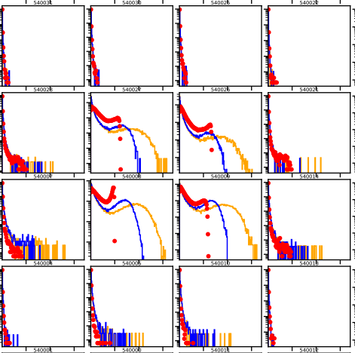
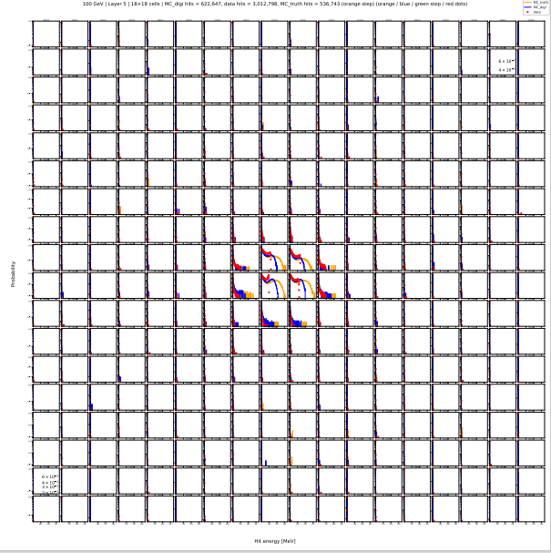
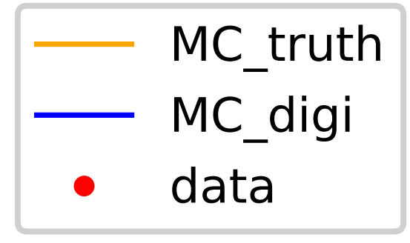
Cell level difference
Comparison of MC_truth MC_digi Data
Electron
100 GeV | Layer 5 | 18×18 cells
Ø MC_truth
• Raw MC simulation
Ø MC_digi
• After SiPM non-linearity
Ø Data
• Beamtest data (SPS)
Possible sources of difference
Electronic Saturation Effect and Cell nonuniformity
Beam center and Beam size
.......
Notes:
This slide shows the differences between the three datasets at the cell level.
Here, we use 100 GeV electrons as an example and compare the 18 by 18 cells in the fifth layer.
In these plots, the orange lines represent MC truth, the blue lines represent MC digi, and the red points represent beam test data.
Since the beam spot is relatively small, most of the energy is deposited in the central region.
As we can see, for most cells near the edges, the energy distributions are quite similar.
However, for the central cells, there are clear differences among the three datasets.
After including the SiPM non-linearity, MC digi becomes closer to the real data, but some differences still remain.
These differences may come from several factors, including electronics saturation.
.这一页展示了在 cell level 上这三类数据的差异。例子选取的是 100 GeV 电子，在第 5 层的 \(18 \times 18\) 个 cell 上进行比较。由于束流测试束斑较小，能量沉积主要集中在中间区域。从中心区域的若干 cell，可以看到不同数据在沉积分布形状上存在明显差异。
三者之间的差异可能来自多个方面，包括电子学饱和效益，以及束流中心和束斑大小的差异。我们的目标是理解这些差异以及想办法消除这些差异。我们想要通过一个饱和函数来描述电子学的饱和效应，并通过不同cell对应a,b来描述cell的非均匀性

Slide 9
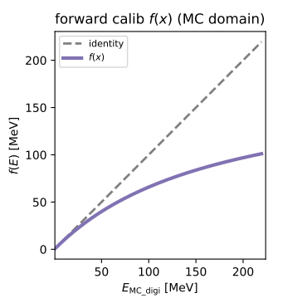
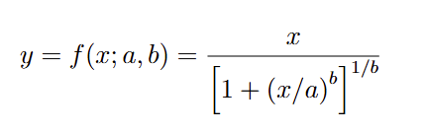
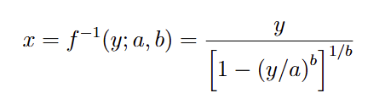
Electro-magnetic Energy reconstruction
Characterize the detector response and Improve the energy resolution
Using model: CNN+LSTM
Key Hypothesis: The discrepancy between MC_digi and Real Data mainly stems from electronics Saturation effect
Electronic Saturation effect modeling digitization function
a: determines the asymptotic saturation scale
b: controls the transition from the linear to the saturated regime.
Inverse function to correct electronic Saturation effect
a=176.4 MeV b=1.0503
Notes:
Our work has two main goals.
The first is to better understand the detector response and improve the digitization process, so that MC digi becomes closer to the real data.
The second is to use machine learning to improve the electron energy resolution of the HCAL.
Here, we mainly focus on electronics saturation and cell non-uniformity.
We assume that the difference between MC digi and real data mainly comes from electronics saturation.
To describe this effect, we use a saturation function and its inverse function to convert between MC digi and data.
The plot on the left shows an example of this saturation function. The function has two parameters, a and b. Parameter a determines the saturation level, while b controls how quickly the response becomes saturated.
Our strategy has two steps.
First, we use a CNN-LSTM model to learn the spatial and longitudinal features of the showers.
Then, we use feedback from the model, together with constraints from the energy distributions, to calibrate a and b for center cell.
In this way, we aim to reduce the sim-to-real gap and improve electron energy reconstruction.
我们的第一个目标是理解探测器响应，并尽可能改进模拟的数字化流程，使 MC_digi 更接近真实数据。第二个目标是尝试利用机器学习提升 HCAL 对电子的能量分辨率。
我们关注的主要问题是饱和效应和cell的非均匀性，尤其是假设 MC_digi 和真实 data 之间的差异主要来自电子学的饱和效应。PPT 中给出了电子学饱和效应数字化函数及其逆函数来完成MC_digi和data的相互转换。整体策略是：首先使用 hit-level 的机器学习模型，特别是 CNN+LSTM，学习 shower 的空间和纵向发展信息；然后利用模型反馈和分布约束来校准每个 cell 的参数 \(a,b\)。

Slide 10
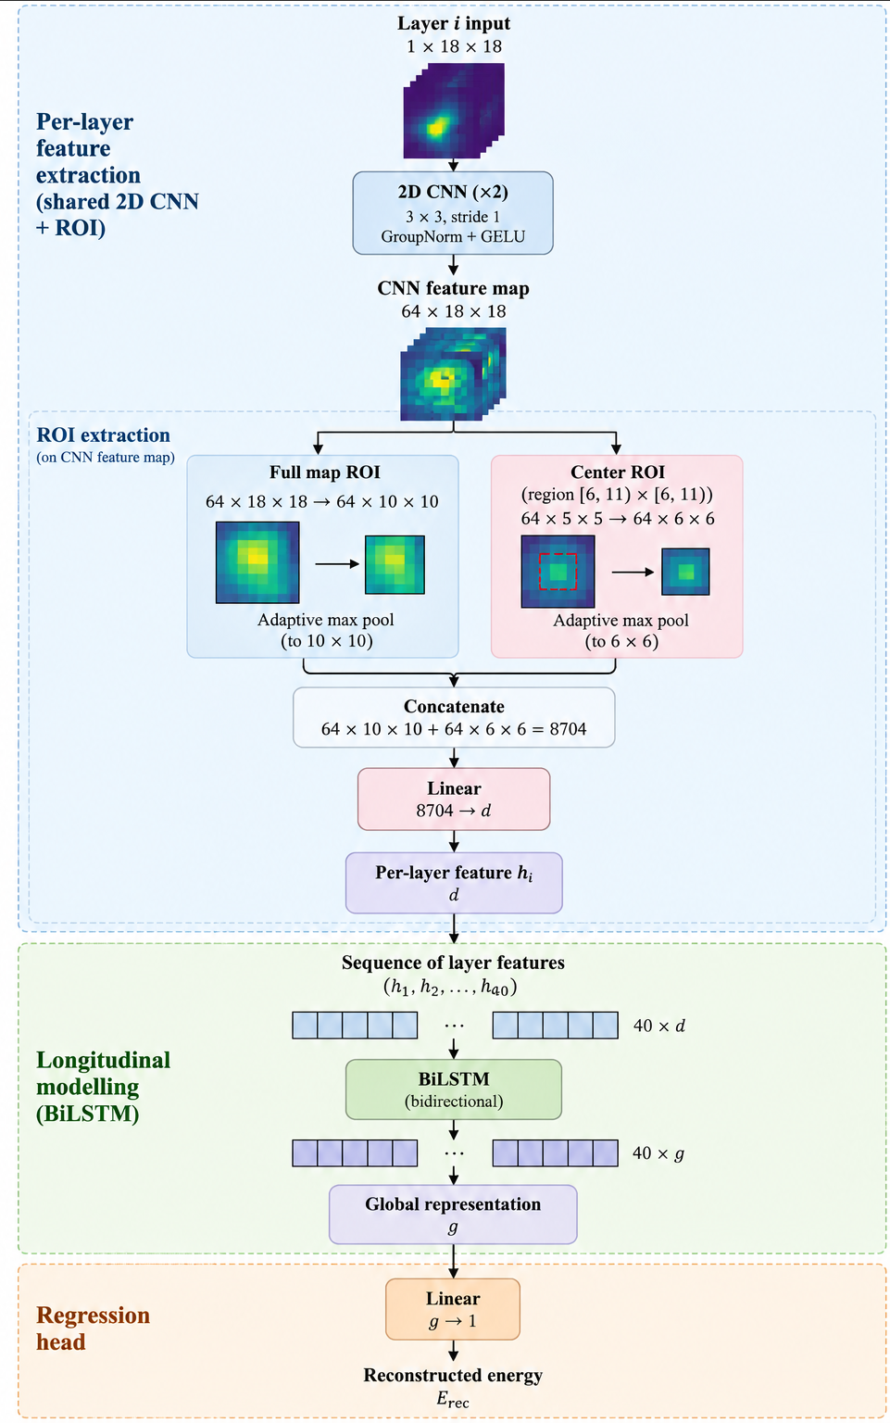
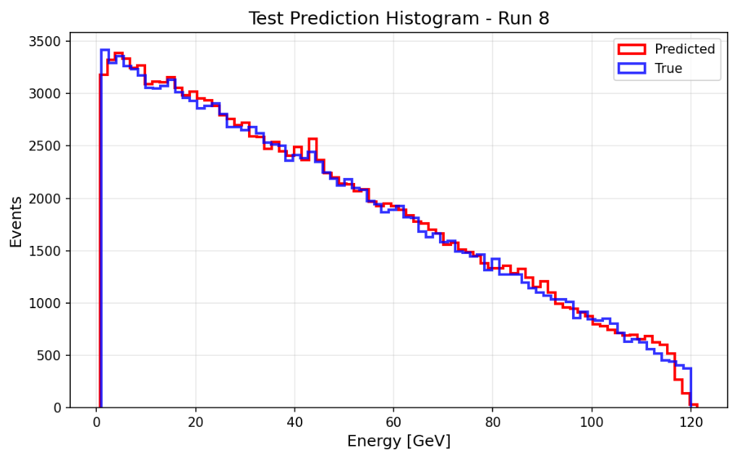
Calib cell level parameter a,b
Step 1: Train CNN+LSTM model
Samples: MC_digi: 1-120GeV (12000000) Continuous e-
CNN：Extracts spatial features from the hit maps of individual layers
BiLSTM：Models longitudinal shower development across layers
Low-energy events produce fewer hits per event.More events are needed
As a result, the MC_digi dataset follows a trapezoidal event distribution.
Notes:
Next, I'll introduce how we calibrate the cell-level parameters a and b.
Step one is to train a stable CNN-LSTM model.
First, we train the model on the MC digi dataset, using about 1.2 million electron events with continuous energies.
Since low-energy events usually produce fewer hits, we need more events at low energies for stable training.
As a result, we use a trapezoidal event distribution for the MC digi dataset.
Now, let's look at the CNN-LSTM model architecture.
The CNN processes the hit image from each layer and extracts local spatial features.
The LSTM then learns how the shower develops across different layers.
By combining CNN and LSTM, the model can learn both the spatial and longitudinal features of the shower.
下面介绍Calib cell level parameter a,b的方法，Step 1: Stabel CNN+LSTM model
我们首先在MC_digi: 上进行训练，使用了大约 120 万个连续能量电子事例。Low-energy events produce fewer hits per event.More events are needed
As a result, the MC_digi dataset follows a trapezoidal event distribution.
下面介绍我们使用 CNN+LSTM 模型结构。CNN 部分用于读取每个 layer 的 hit image，从中提取局部空间特征。LSTM 部分用于学习 shower 在不同层之间的簇射发展。

Slide 11

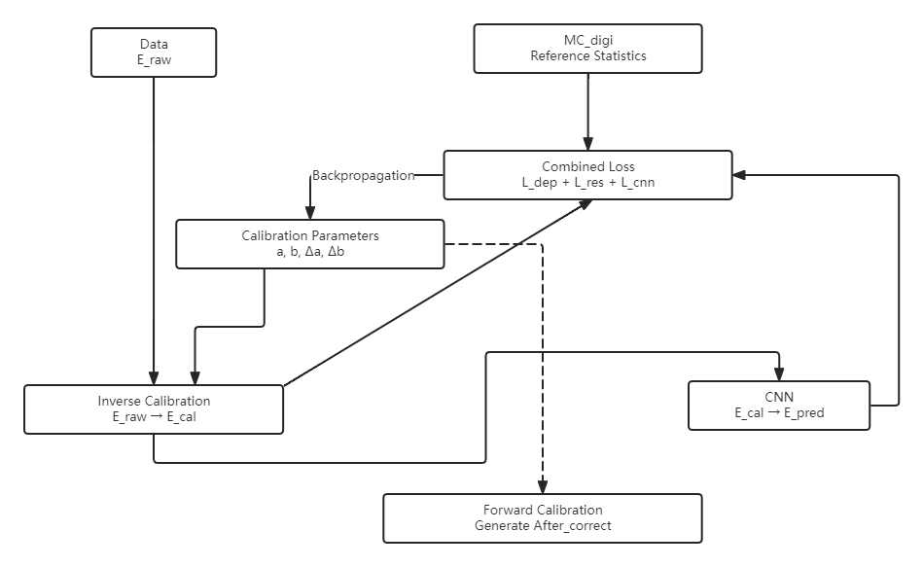




Calibration of cell level parameter
Step 2: Using Inverse function to make data approach MC_digi.
SPS e- data 80,100,120 GeV
Total Loss：
MC_digi 80,100,120 GeV
Reference Loss：
Minimize the discrepancy of energy resolution with the MC_digi and data.
CNN Energy Prediction Loss ：
Evaluates the accuracy of the network's macroscopic physical prediction.
Cell-level Deposition Loss：
Constrains the energy deposition distribution at the microscopic (per-cell) level.
Notes:
Next, step two is to calibrate the real data using the inverse saturation function.
Here, we use 80, 100, and 120 GeV electron data from the SPS beam test, where the electronics saturation effect is quite significant.
We use MC digi samples at the same energies as our reference.
During training, we feed the real data into the CNN-LSTM model.
The CNN-LSTM model is frozen, which means its weights are not updated. The only trainable parameters are a and b for center cells.
These parameters are used in the inverse saturation function to convert each data hit into an MC-digi-like hit.
Our total loss function has three parts.
The first is the reference loss, which keeps the learned parameters close to physical expectations, such as the energy resolution.
The second is the CNN energy prediction loss, which ensures that the corrected hits follow the expected shower development patterns.
The third is the cell-level deposition loss, which helps match the energy deposition distributions at the cell level.
By combining these three losses, we can optimize the calibration parameters a and b for center cells.
In this way, we aim to reduce the difference between real data and MC digi at both the energy reconstruction level and the cell level.
第二步，我们使用逆函数对真实 data 的 hit 能量进行校正，使校正后的 data 在分布上接近 MC_digi。这里使用的真实数据是 SPS 电子束的 80、100 和 120 GeV 样本，他们的电子学报饱和效应明显。对应的参考样本是相同能量点的 MC_digi。把data数据作为CNN+LSTM的input。z在训练过程中CNN+LSTM 骨架冻结 各个参数不可学习，可学习的是校准参数 \(a,b\)。这些参数通过逆函数作用在每个data_ hit 上，将data_hit 数据转换为MC_digi hit 数据 。
总损失函数由三部分组成。第一是 reference loss，用来约束学到的参数不要偏离物理参考太远比如能量分辨；第二是 CNN energy prediction loss，用来保证网络的能量回归结果正确；第三是 cell-level deposition loss，用来约束微观 cell 层面的能量沉积分布。通过这三个损失联合优化，最终得到每个 cell 的校准参数 \(a,b\)。

Slide 12

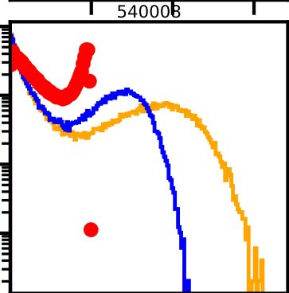
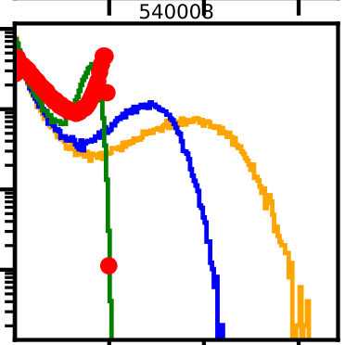
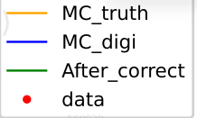
Calibration of cell level parameter
Result：Apply parameter a,b
100 GeV | Layer 5 | Cell 540008
MeV
MeV
After applying the saturation model, the MC-digi cell-energy spectrum moves toward the beam-test data.
Notes:
Here, we take 100 GeV electrons as an example and focus on cell 540008 in the fifth layer.
We compare three datasets: the original MC truth,the bule mc digi, thec green corrected results for mc digi (After_correct), and the real beam test data.
From the cell-level distributions on the right,after applying the cell-level calibration parameters a and b, the corrected distribution becomes closer to the real data.
This shows that our calibration method can partly modelize the electronics non-linearity and reduce the difference between simulation and real data.
这里以 100 GeV 电子、第 5层中心Cell 540008 cell 为例，比较原始 MC_digi、校正后的 After_correct 以及真实 data。
从左侧的 cell-level 分布可以看到，原始 MC_digi 与 data 在中心区域存在明显差异。应用 cell-level \(a,b\) 参数后，After_correct 的分布整体向 data 靠近，说明校准参数确实能够修正部分电子学非线性和响应差异。

Slide 13
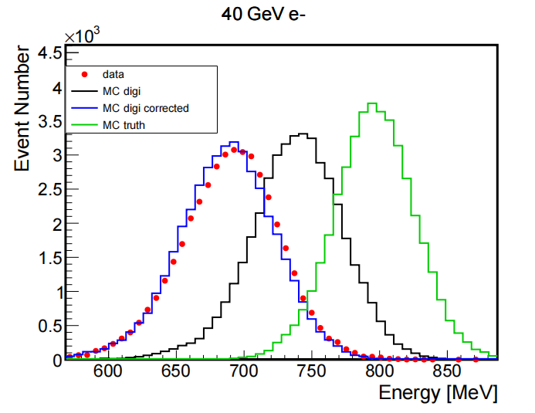
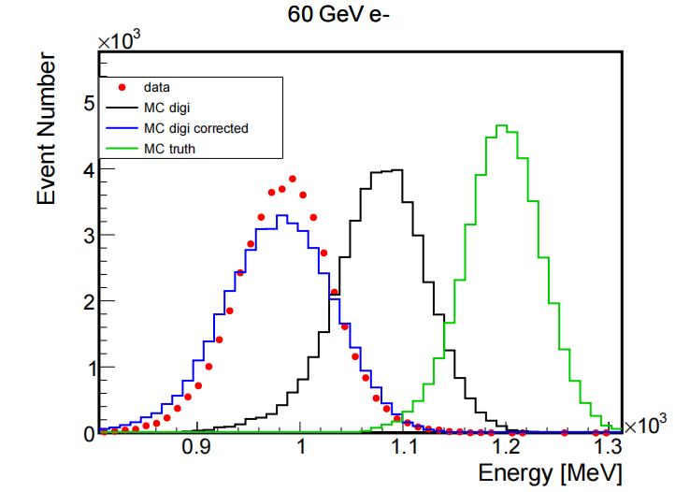
Energy spectrum
The saturation-effect model brings MC-digi into better agreement with beam-test data, especially at high energies.
Differences in beam center and beam size prevent a perfect match between MC_digi_correct and data
Notes:
During training, we only used 80, 100, and 120 GeV electron samples.
Now, let's look at the energy distributions for 40 and 60 GeV electrons, which were not used in training.
As we can see, there is a clear bias between the original MC digi, shown in black, and the real data, shown in red.
After applying our electronics saturation correction, the blue curve becomes much closer to the real data, and the bias is almost completely removed.
However, there are still some differences between the corrected MC digi and the real data.
This is mainly because, besides electronics non-linearity, there are also differences in the beam center and beam spot size between simulation and data.
These differences cannot be fully corrected by cell-level calibration alone.
So, in the next step, we plan to use domain adaptation to further reduce the remaining sim-to-real gap.
训练时我们所用的energy point 为80 100 120 ，现在我们展示在40GeV 60GeV 的电子能谱，可以看到原来黑线MC_digi与红点data明显的bias,在经过电子学饱和建模后的蓝线，bias完成修正。不过，我们也可以看到 MC_digi_correct 和 data 之间仍然不是完全一致。主要原因是除了电子学非线性之外，真实 data 和模拟之间还存在 beam center 和 beam size 的差异。这类差异不是单纯的 cell response 校准就能完全修正的，因此后续还需要引入 domain adaptation 方法进一步处理残余差异。

Slide 14
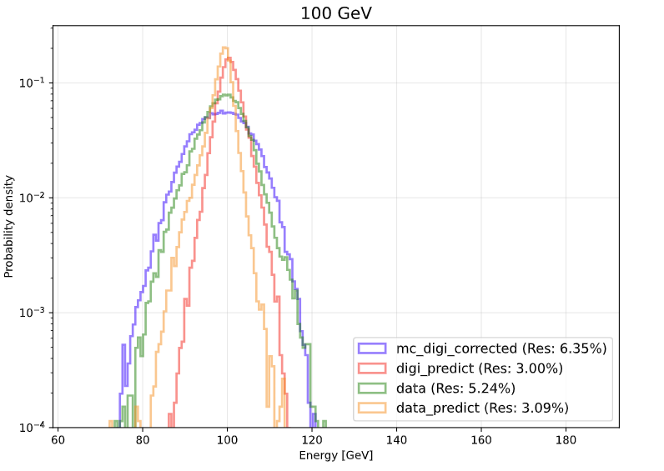
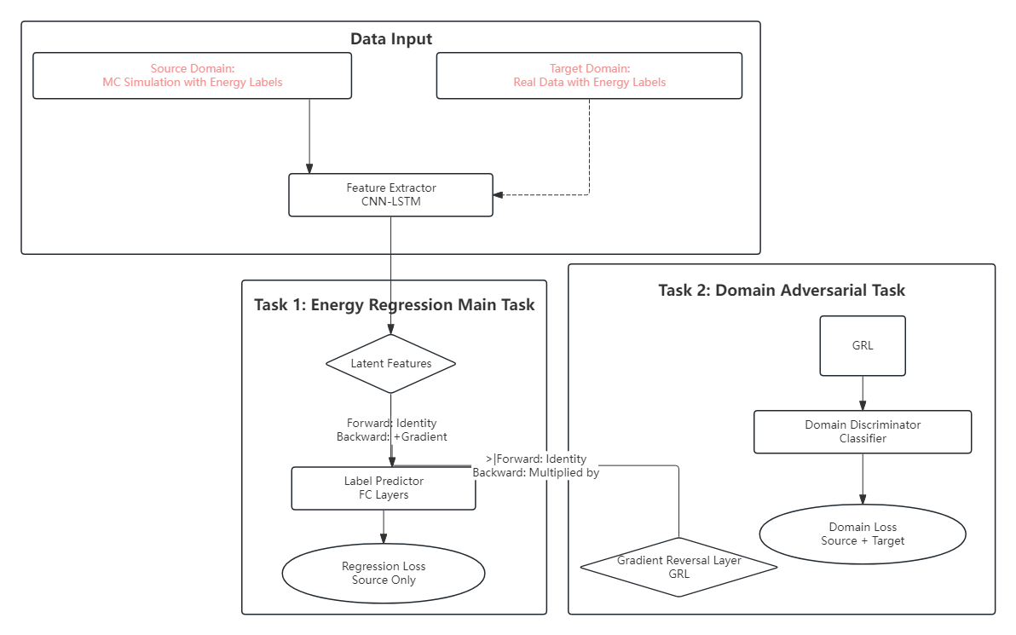

Retrain CNN+LSTM
Result：Retrain CNN+LSTM to improve Electro-magnetic energy resolution for data
    DANN（Domain-Adversarial Neural Network）
Samples: MC_digi_corrected: 1-120GeV (400000) Continuous e-
    Data: PS and SPS [ 1-120] GeV Discret energy
Preserves Core Physics: Retains essential information for accurate energy prediction (satisfies Label Predictor).
Acts as an "Eraser": Wipes away both MC "simulation fingerprints" and Data "real noise."
Notes:
We use two types of training samples.
The first is the corrected MC digi dataset, with about 400,000 electron events at continuous energies from 1 to 120 GeV.
The second is the real beam test data from PS and SPS, with discrete energy points from 1 to 120 GeV.
The main idea of DANN is to train the feature extractor to achieve two goals.
First, it needs to keep the important physical features for accurate energy prediction.
Second, it tries to reduce the domain differences between MC and real data.
On the right, we show the energy distribution for 100 GeV electrons.
As we can see, after DANN training, the energy resolution of the real data is significantly improved.
This shows that DANN can help reduce the sim-to-real gap and improve electron energy reconstruction.
为了进一步解决 MC 和 data 之间残余的 sim-to-real gap，我们引入了 DANN，也就是 Domain-Adversarial Neural Network。
训练样本包括两类：第一类是校正后的 MC_digi_corrected，能量范围为 1 到 120 GeV，大约 40 万个连续能量电子事件；第二类是真实 data，包括 PS 和 SPS 束流测试中 1 到 120 GeV 的离散能量点。
DANN 的核心思想是让特征提取器同时满足两个目标。第一，它要保留与能量预测相关的核心物理信息，使模型能够准确预测入射能量。第二，它要尽可能消除 MC 和 data 的域差。右侧展示了100GeV的能谱图，可以看到，经过模型学习，data的能量分辨也有了很大的提升。

Slide 15
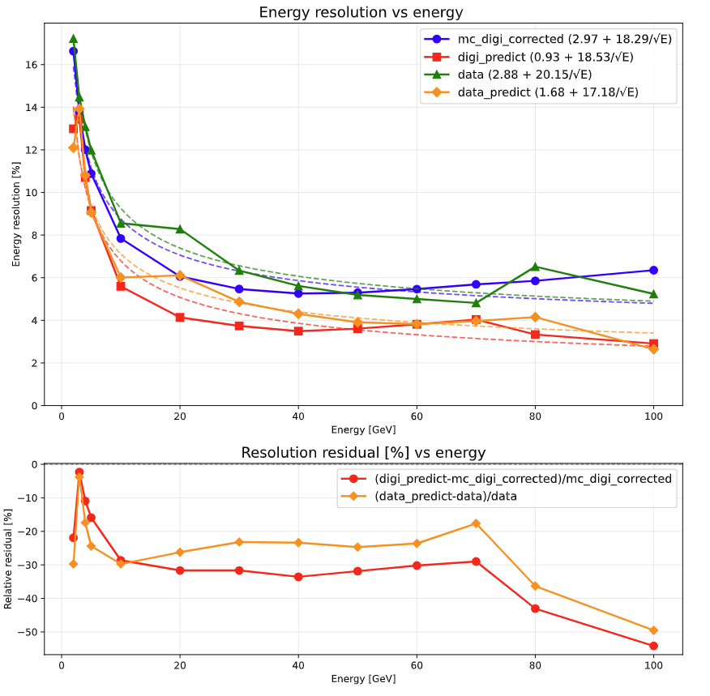
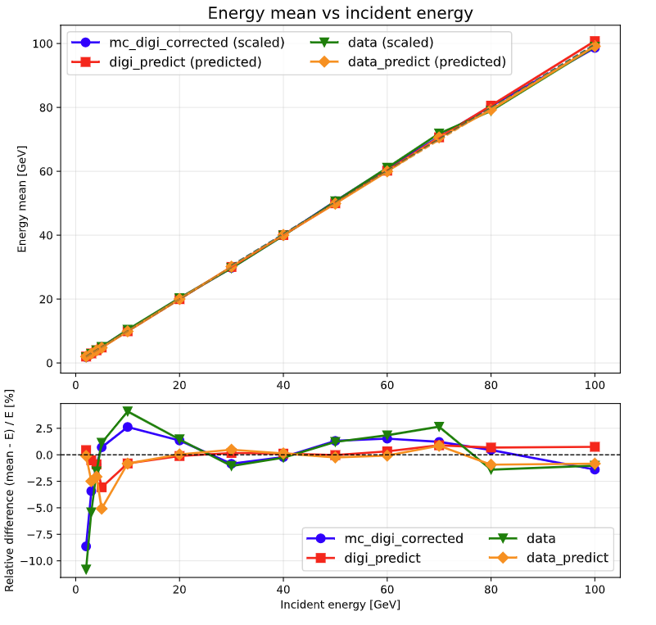
Retrain CNN+LSTM
Key Performance: Achieved a 24.2% improvement in Electro-magnetic energy resolution for data. High Energy component significantly improved.
Key Performance: The Electro-magnetic energy linearity has significantly improved.Linearity error kept within 5%
Notes:
After cell-level calibration and DANN retraining, the energy resolution of real data is significantly improved across different energy points.
Overall, we achieve a 24.2% improvement on average, with even larger improvements at high energies.
On the right, we show the energy linearity results.
As we can see, the predicted energy shows good linearity, with the deviation kept within 5%.
This means our model not only improves the energy resolution, but also maintains good energy linearity.
经过 cell-level 校准和 DANN 重新训练后，模型在真实 data 不同能量点上的能量分辨率都有明显提升。整体提升约为 20%，在高能区可有更大的提升。
右侧展示的是能量线性度结果。可以看到，预测能量有能好的线性度，线性误差被控制在 5% 以内。这说明模型不仅改善了分辨率，也保持了较好的能量线性。

Slide 16
Summary
Electro-magnetic Energy reconstruction
  Calibration & DANN Strategy
    Explored CNN+LSTM for CEPC AHCAL energy reconstruction.
    Inverse Calibration: Applied at the cell level to correct electronics non-linearity, aligning real data with simulation.
    DANN Integration: Addressed residual discrepancies between MC and Data.
  Beam data results:
    Resolution: Improved by 24.2% for Beam data, High Energy component significantly improved..
    Linearity: Significantly enhanced, with the linearity error successfully kept within 5%.
Notes:
Finally, let me summarize our work.
We developed a cell-level calibration method to reduce the gap between simulation and real data.
We then introduced DANN to further improve energy reconstruction.
As a result, the energy resolution improved by 24.2% on average, while the linearity error remained within 5%.
最后总结一下本工作。首先，在 CEPC AHCAL 的高颗粒度读出中，探测器非线性、闪烁体非均匀性以及束流中心和束斑大小差异会导致明显的 MC-data gap。这种差异会影响机器学习模型从MC迁移到真实数据时的表现。
针对这个问题，我们首先探索了 CNN+LSTM 用于 AHCAL 电子能量重建，并在 MC_truth 和 MC_digi 上验证了模型的有效性。随后，我们提出了 cell-level inverse calibration 方法，通过学习每个 cell 的参数 \(a,b\)，修正电子学非线性，使真实 data 和 MC_digi 在cell-level 能量沉积分布上更加一致。最后，我们引入 DANN 处理残余的域差异，使模型在保留能量预测信息的同时，减少对 MC 或 data 特有特征的依赖。
最终结果显示，在真实 data 上，能量分辨率平均提升约 20%，在高能区可有更大的提升；同时能量线性度显著改善，线性误差控制在 5% 以内。
谢谢大家，欢迎各位老师和同学批评指正。

Slide 17
Thank You for Your Attention!
Email: [lixiang0427@mail.ustc.edu.cn]
Notes:
That's all for my presentation. Thank you for your attention, and I'm happy to take any questions or suggestions.

Slide 18
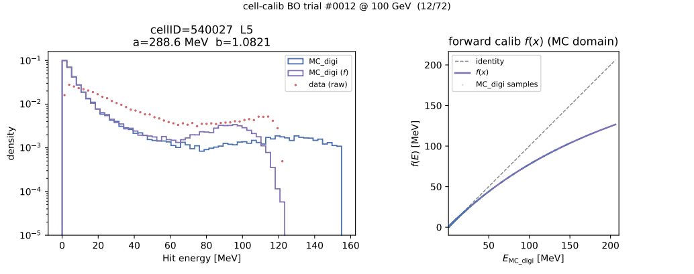
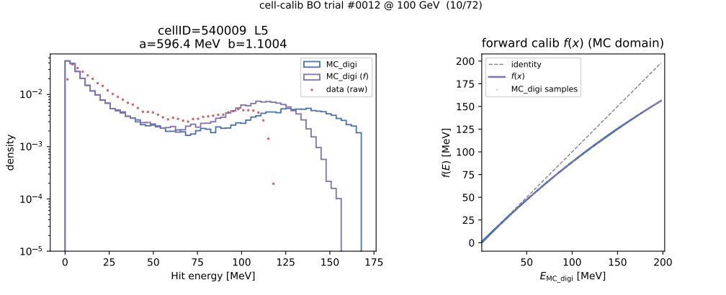
Calib cell level parameter a,b

Slide 19
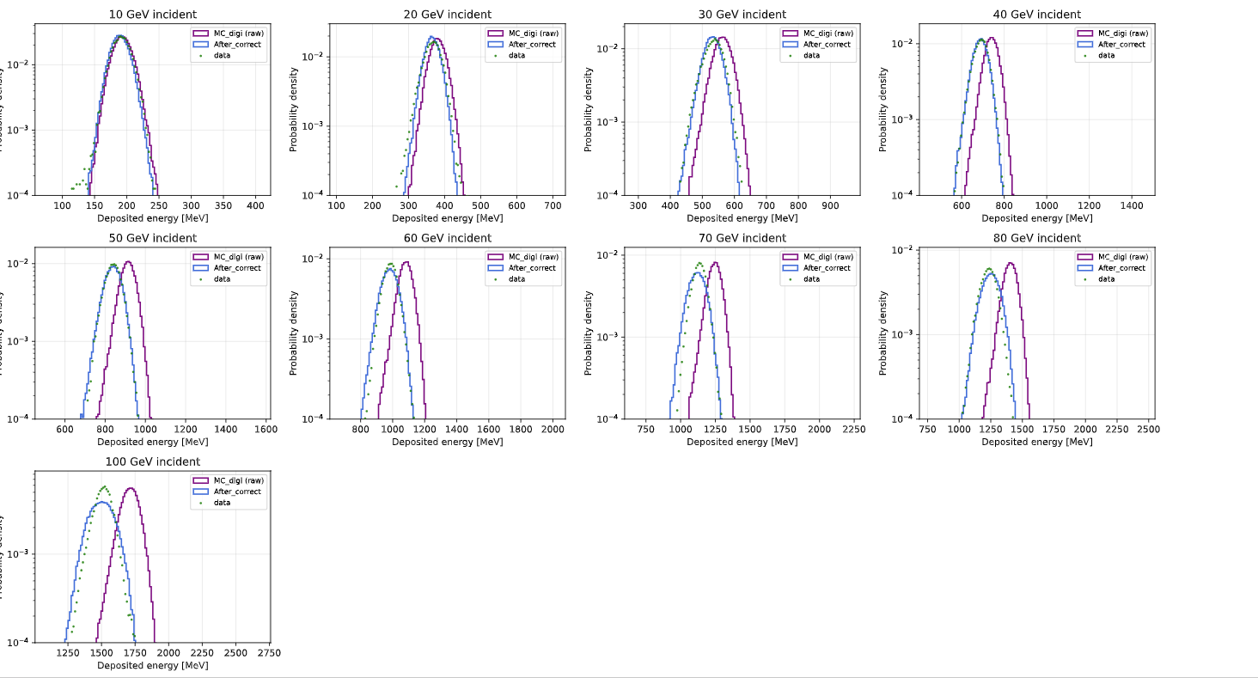
Response-modeled MC_digi

Slide 20
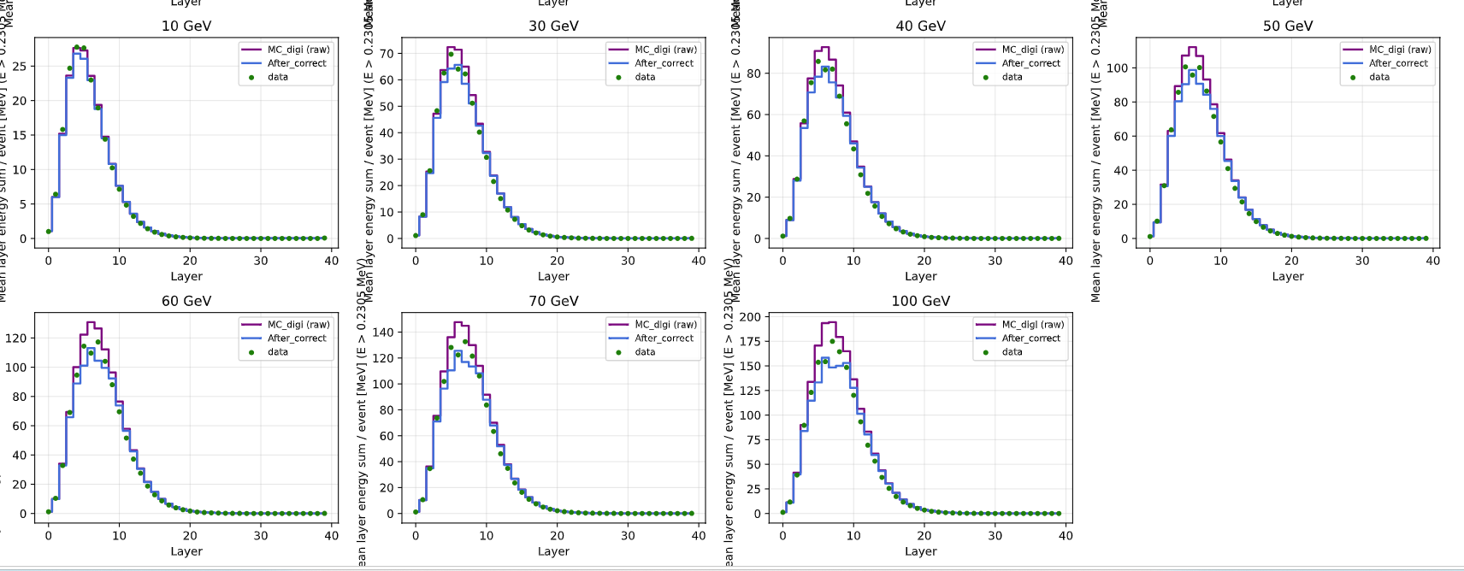
Response-modeled MC_digi

Slide 21
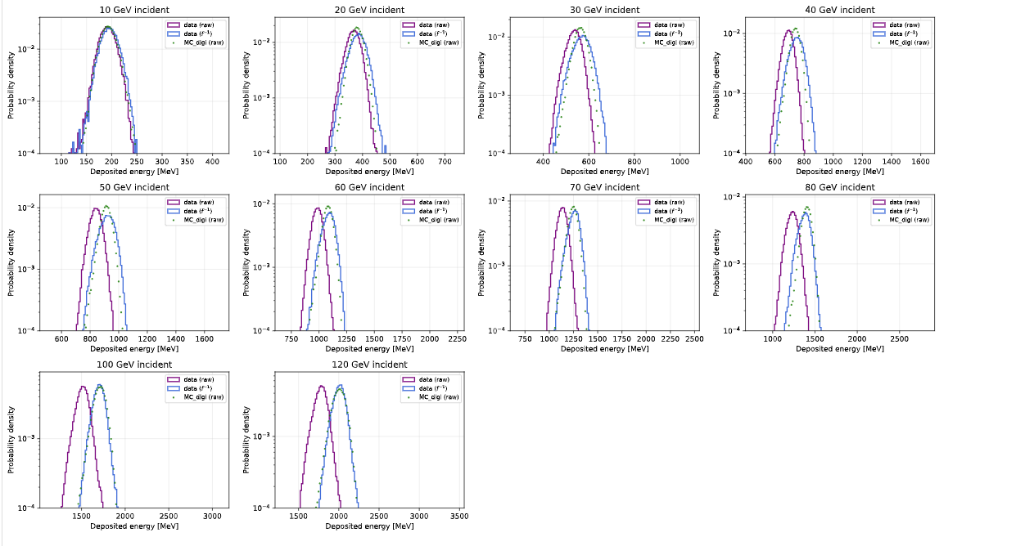
Corrected Data

Slide 22
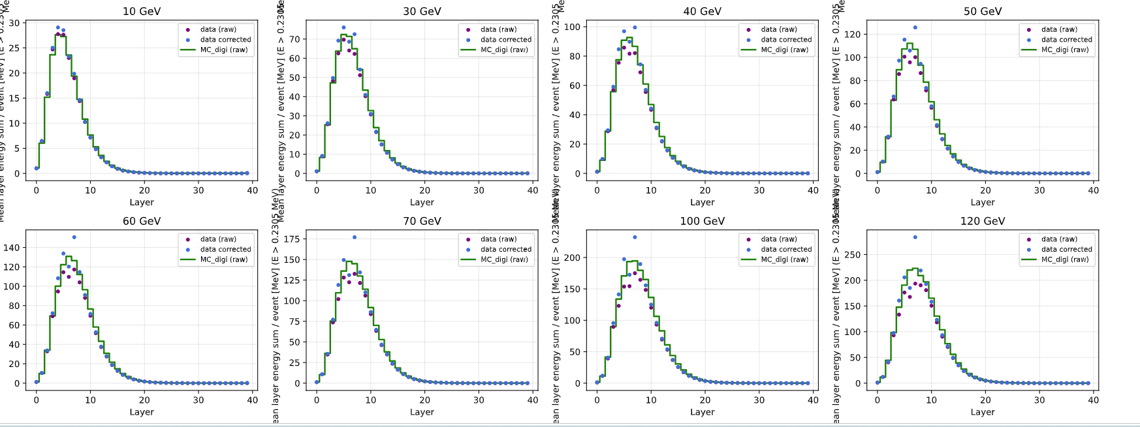
Corrected Data

Slide 23
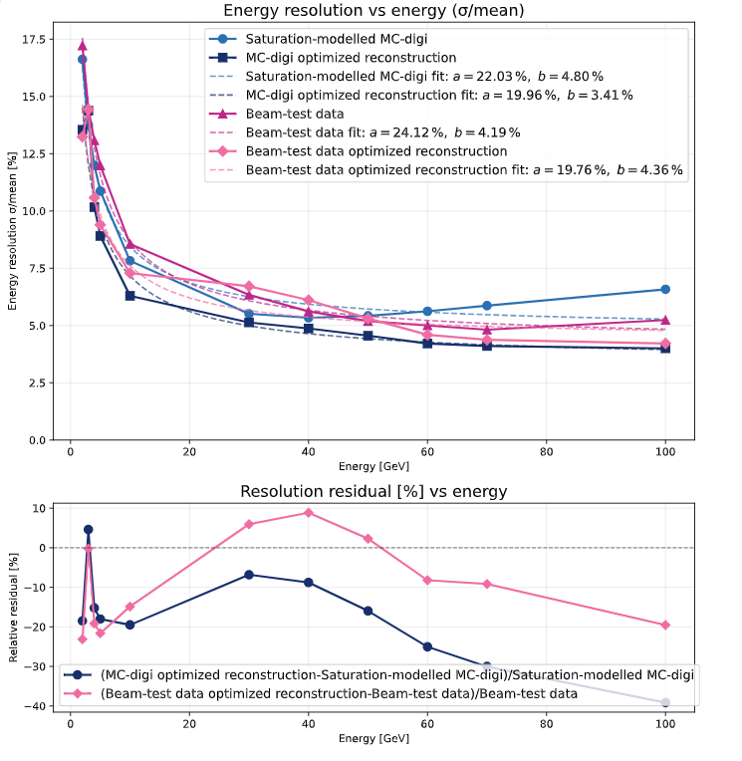
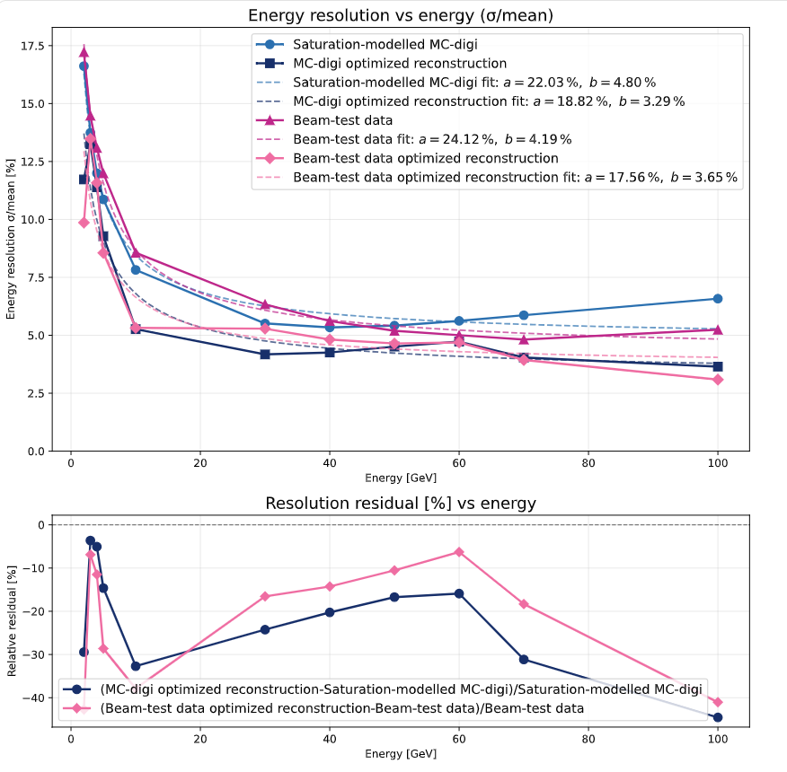
Target regression weight
"finetune_two_stage_dann_tgt_reg_weight": 0.38704931647041524,
"finetune_two_stage_dann_tgt_reg_weight": 0.609,

Slide 24
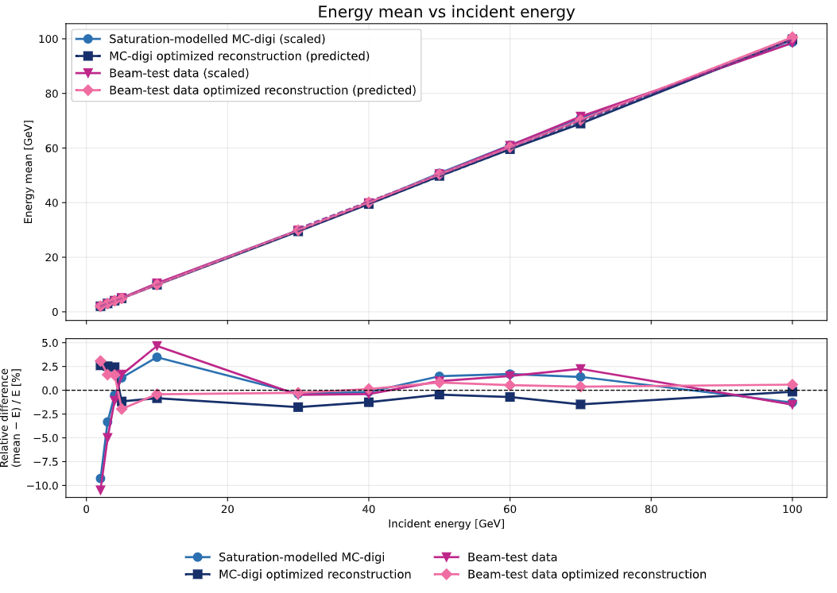
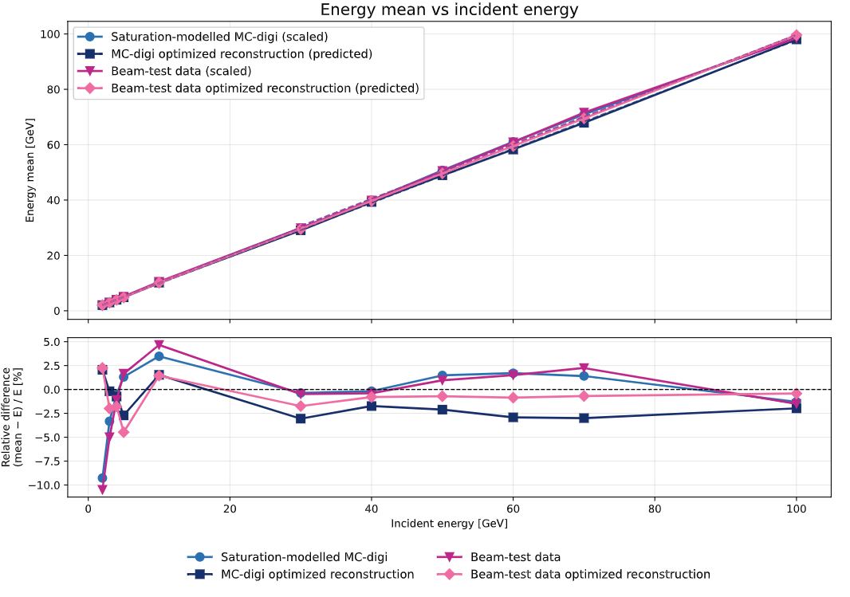
Target regression weight
"finetune_two_stage_dann_tgt_reg_weight": 0.38704931647041524,
"finetune_two_stage_dann_tgt_reg_weight": 0.609,

Slide 25
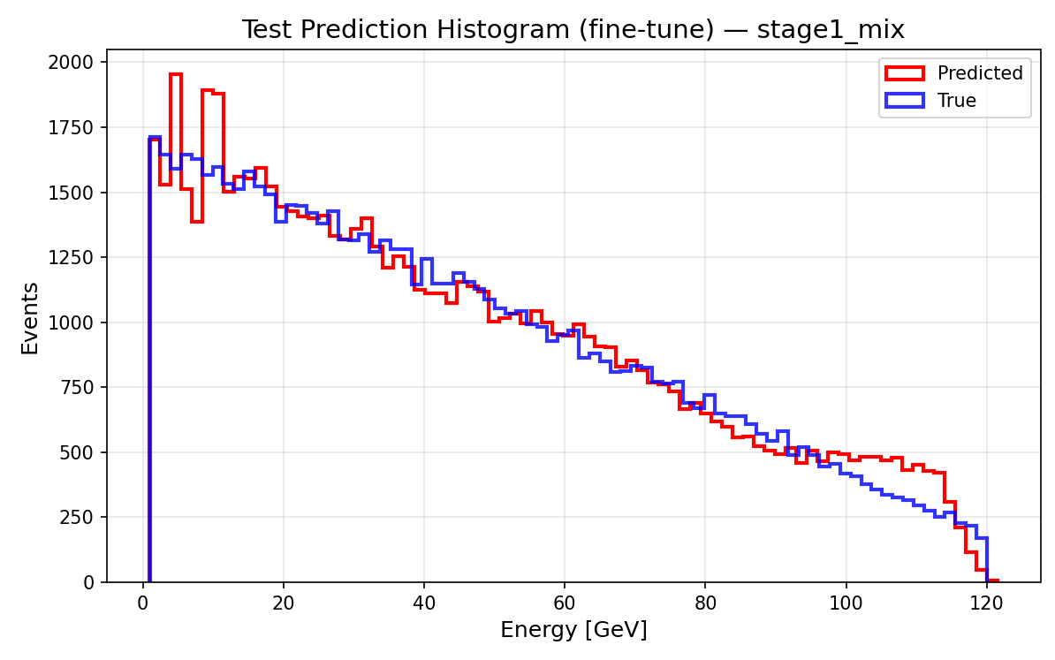
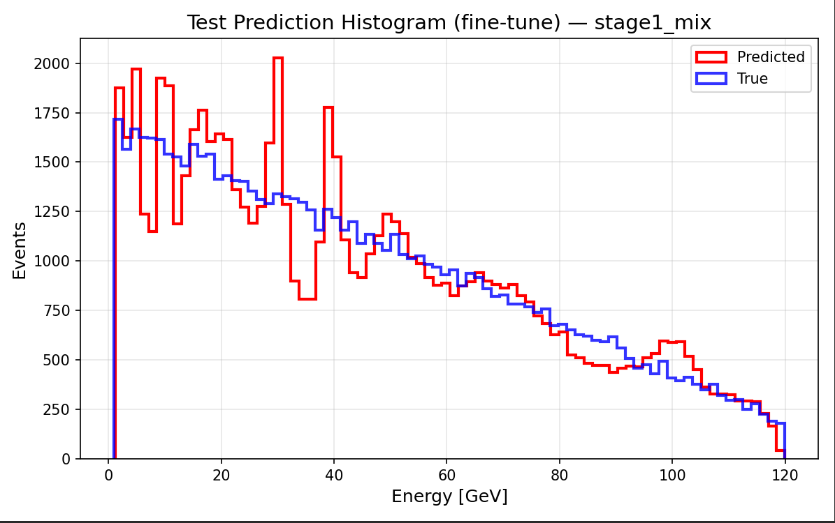
Target regression weight
"finetune_two_stage_dann_tgt_reg_weight": 0.38704931647041524,
"finetune_two_stage_dann_tgt_reg_weight": 0.609,

