Slide 1



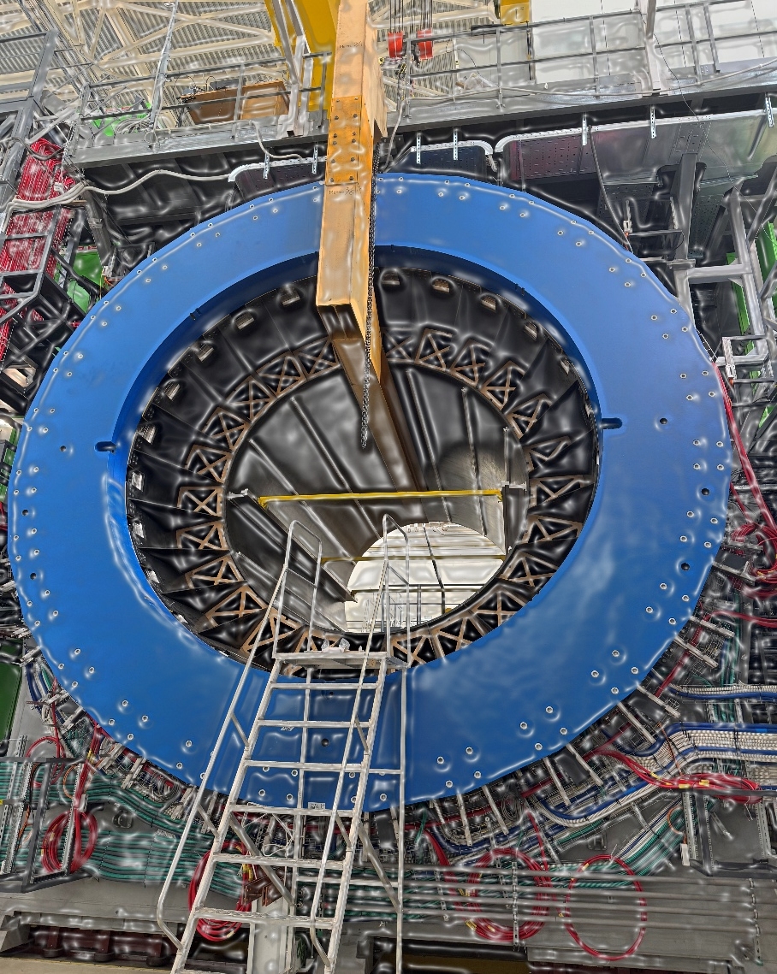
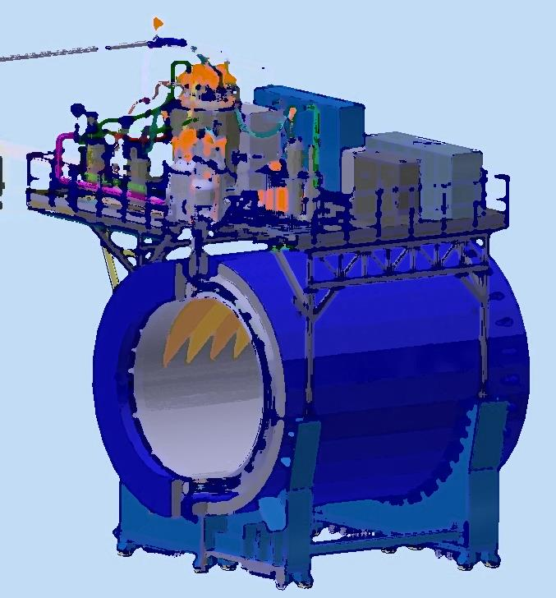
Super conductor magnet of Multi-Purposed Detector MPD for NICA complex. Technical parameters and infrastructure of the magnet.
The 2026 International Conference on Instrumentation for Colliding Beam Physics (INSTR 2026)
From drawing
to magnet
Speaker: K. Mukhin
on behalf of the MPD magnet launch group
USTC, Hefei, China
12-16/10/2026

Slide 2
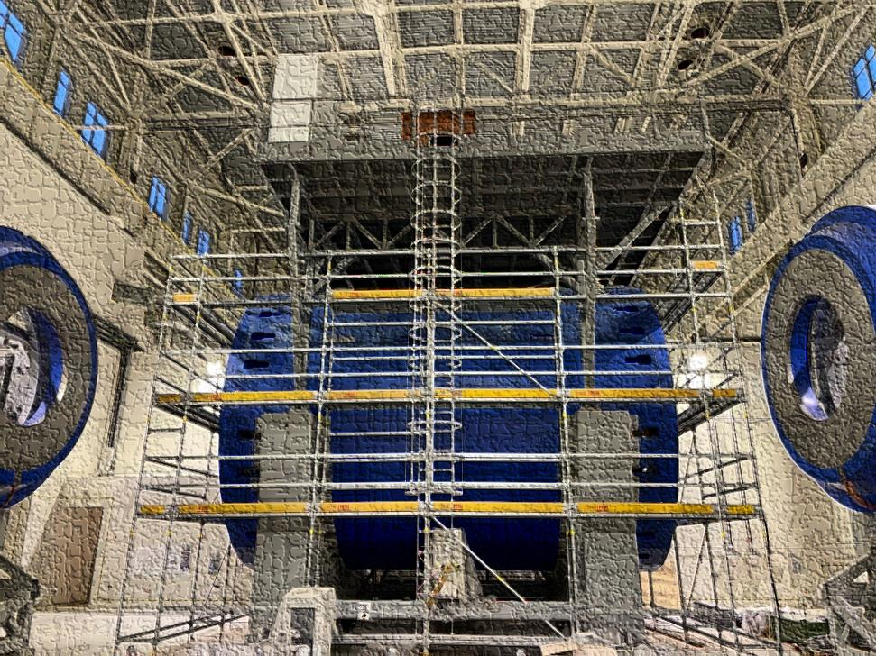
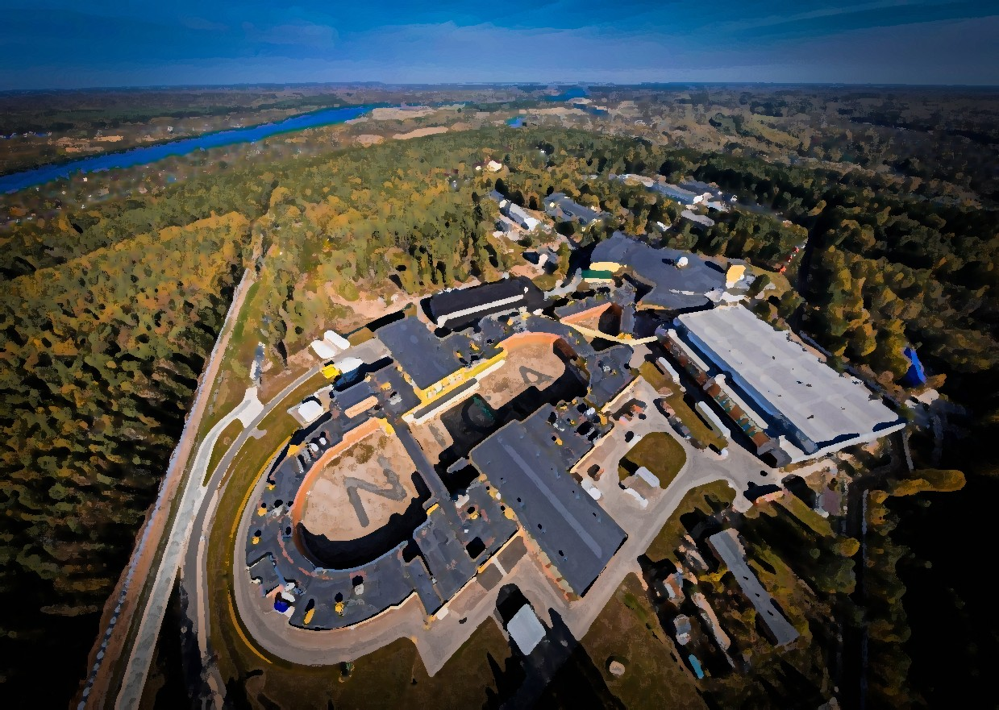
Plan of talk
NICA collider complex
MPD
Magnet construction and some parameters
-Power supply of magnet coil
-Cryogenic system and cooling process
-Feld mapping at 0,2 – 0,5 T
Plans

Slide 3
Chapter 1
Nuclotron based Ion Collider fAcility
NICA complex

Slide 4
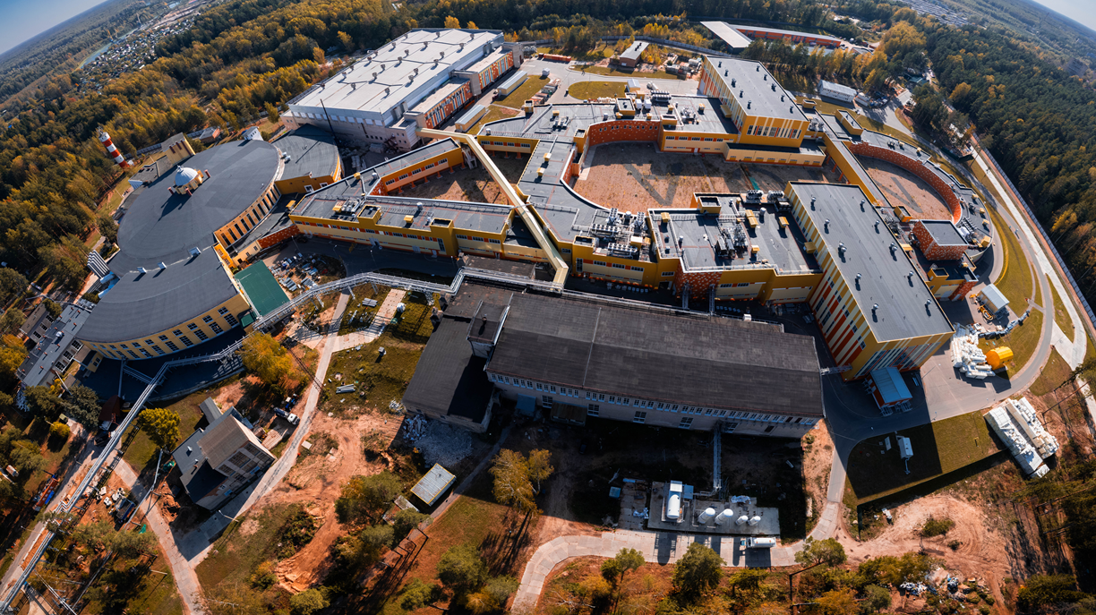
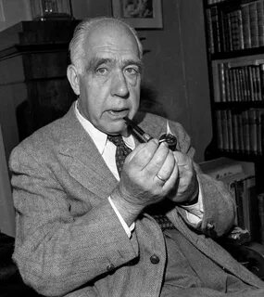
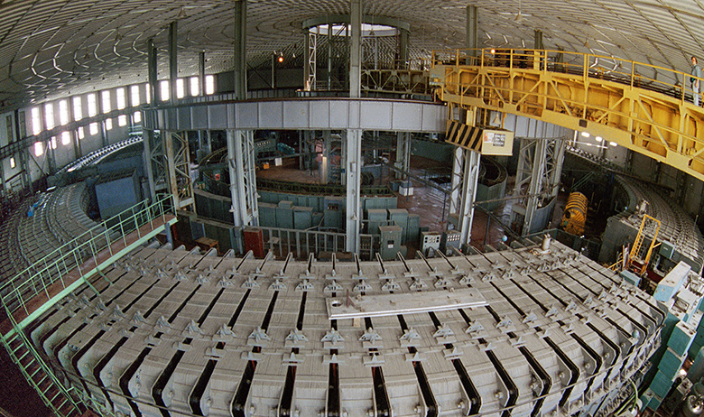
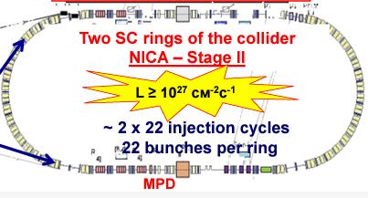
NICA complex and MPD
NILS BOR (1961):
It took great courage, foresight, and, I would say, courage to create such a gigantic and modern instrument.
Start operation in 1957
Proton beam by 10 GeV
Total weight – 36 000 Tons
BM@N
SPD
Booster
Nuclotron
N I C A
MPD

Slide 5
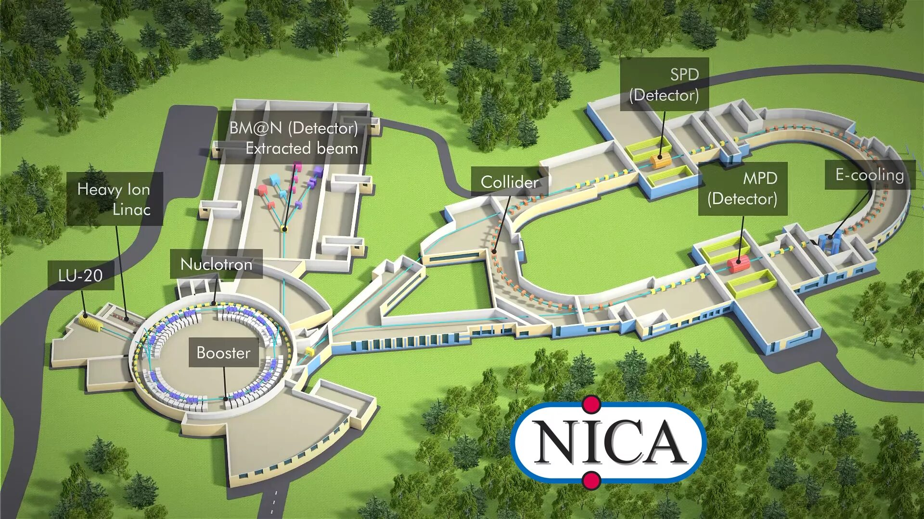
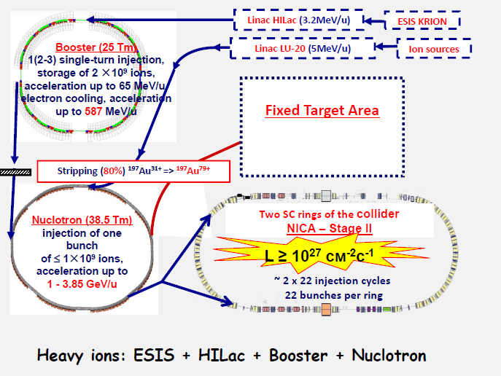
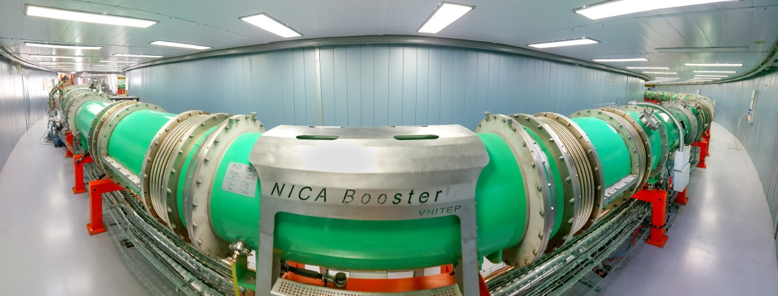
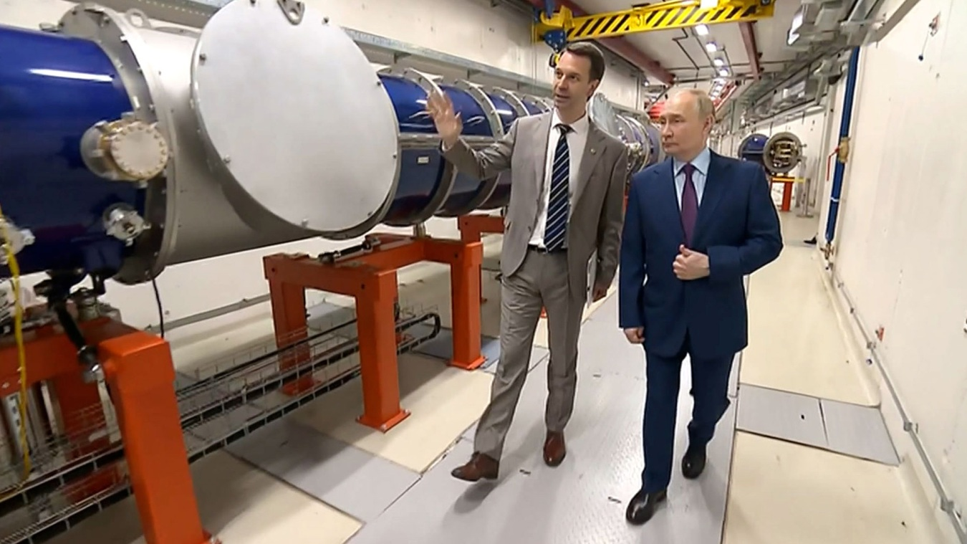
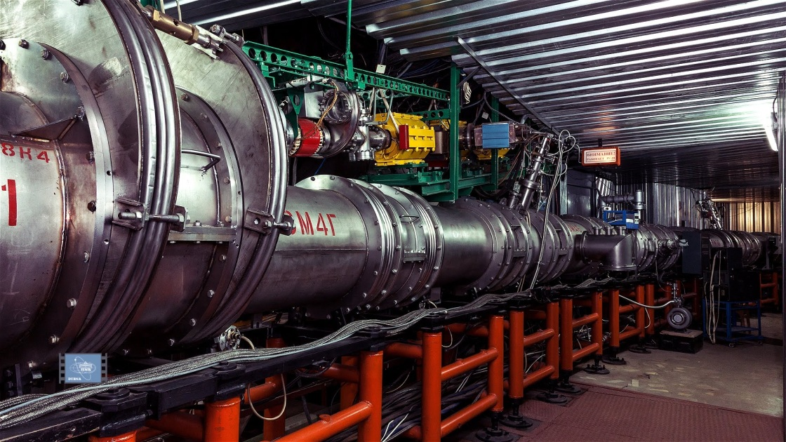
Scheme of Nuclotron based Ion Collider fAcility

Slide 6
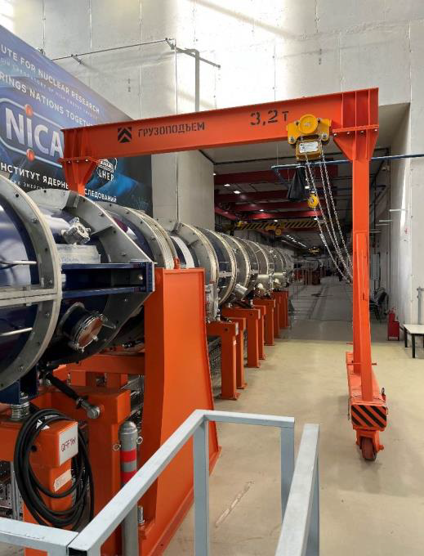
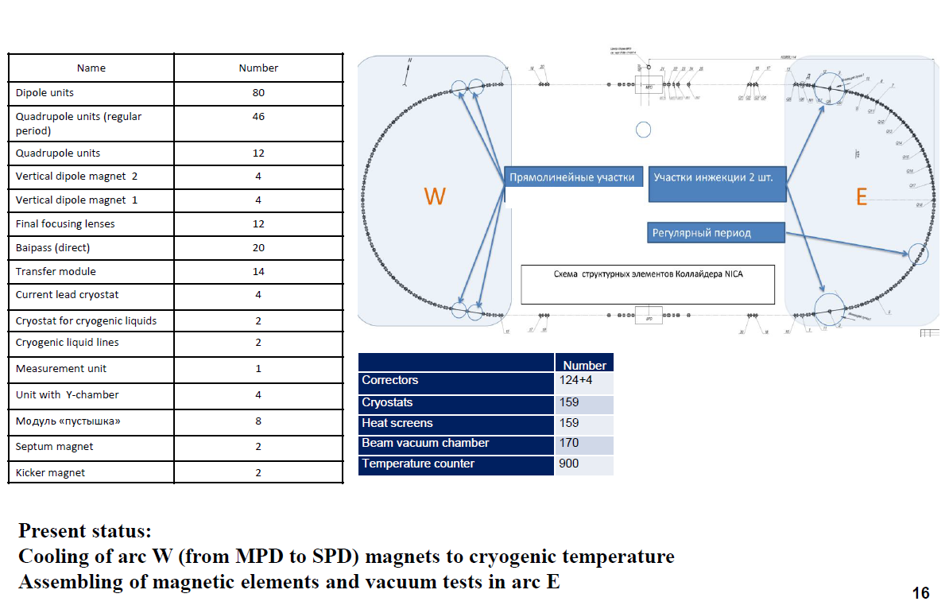
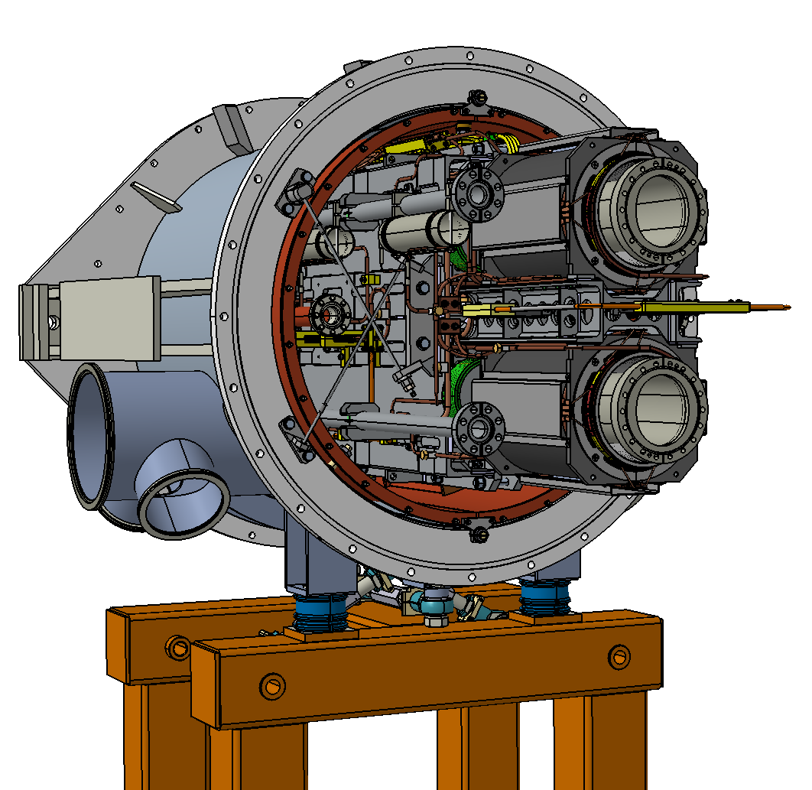
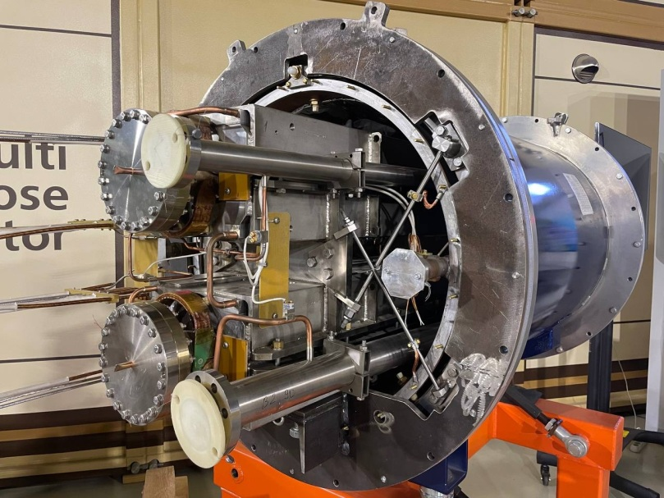
Collider elements

Slide 7
Chapter 2
Multi-Purpose Detector
MPD at NICA complex

Slide 8
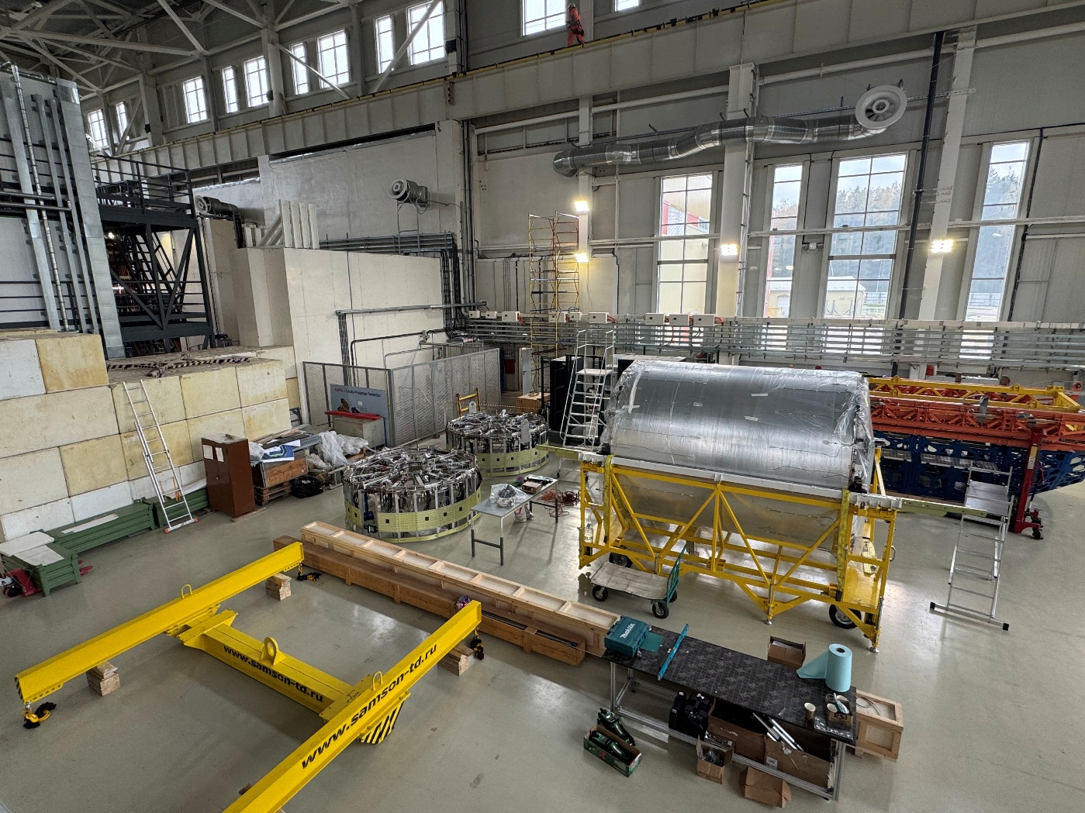
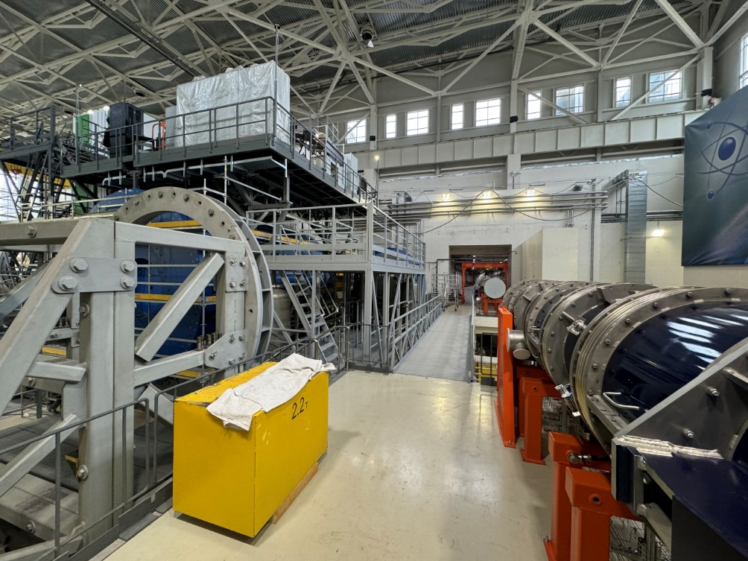
MPD in NICA complex
BM@N
SPD
Booster
Nuclotron
N I C A
MPD

Slide 9
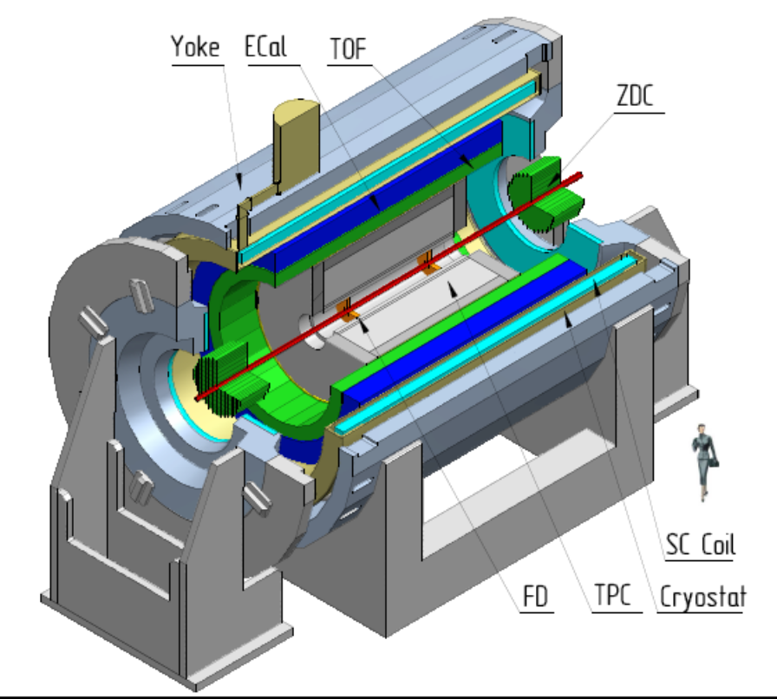
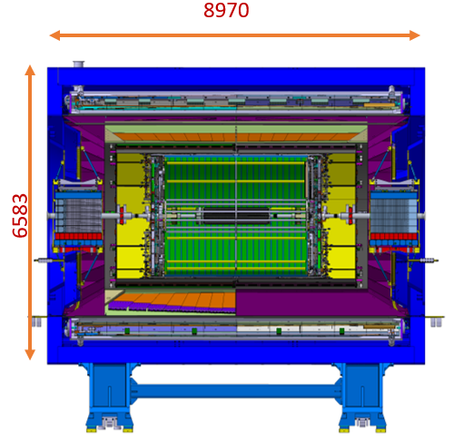
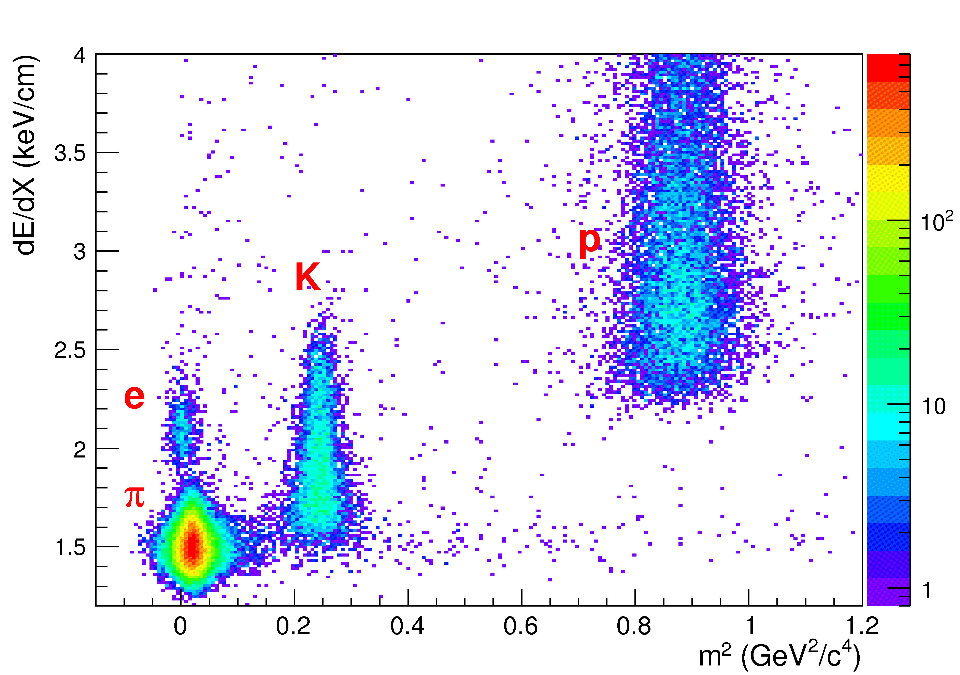
MPD detector
The Multi-Purpose Detector (MPD) is a is a 4π spectrometer to be used for studying charged hadrons, electrons, and photons generated in heavy ion collisions at energies provided by the NICA collider of the Joint Institute for Nuclear Research (Dubna)
Its main scientific purpose is to search for novel phenomena in the baryon-rich region of the QCD phase diagram by means of colliding heavy nuclei in the energy range of 4 GeV<√sNN<11GeV. The new experimental program at the NICA-MPD will fill a niche in its the energy scale and the results will bring about a deeper insight into hadron dynamics and multiparticle production in the high baryon density domain.
Main elements of detector (first stage)
Yoke – still jacket for magnetic field formation.
Solenoid – supper conducting solenoid by 4.5 K temperature operation based on Nb/Ti supper conducting cable.
Time Projection Chamber (TPC) - for trajectory register and particle identification.
Time of Flight (ToF) – for registration a time of particle coming, identification with TPC cooperation.
Electro-magnetic CaLorimeter (ECal) – enables precise spatial and energy measurements of photons and electrons.
Forward Hadron CaLorimeter (FHCaL) – enables of the geometry of the collision (centrality, reaction plane) and participates in the organization of the trigger.
Particle identification capability

Slide 10
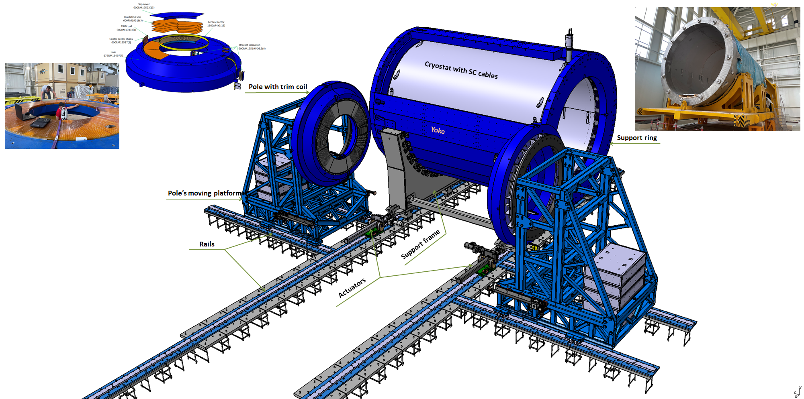
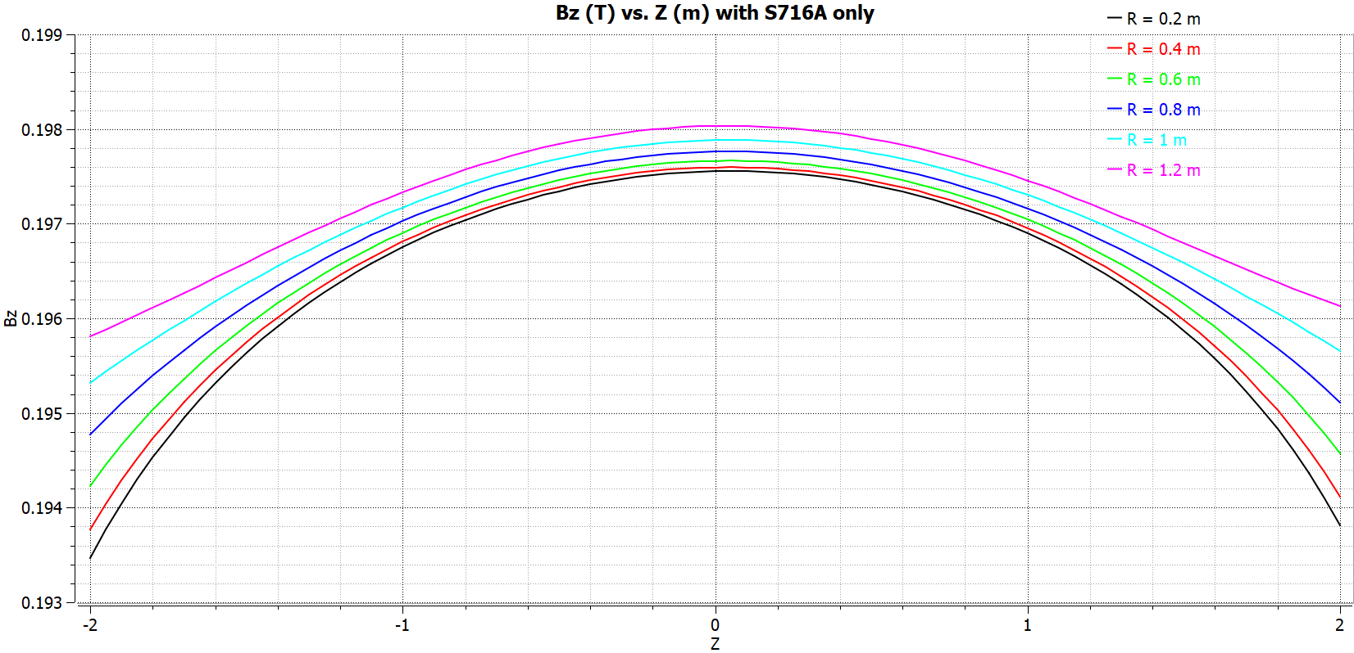
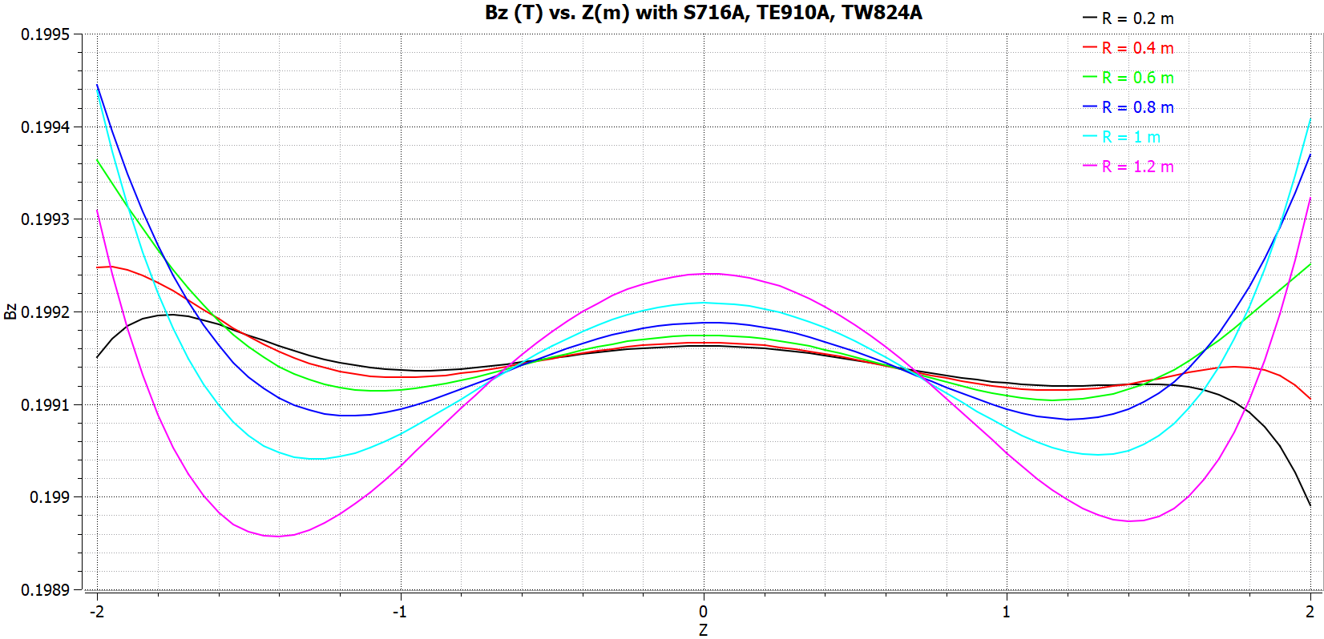
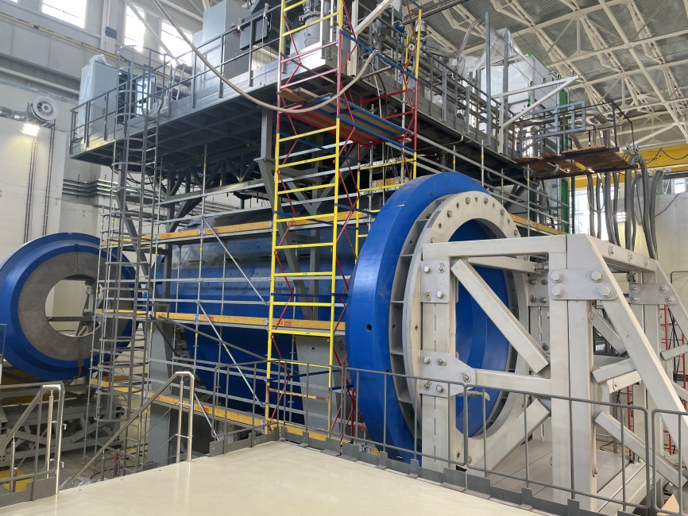
MPD magnet
Parameters of the magnet
Magnetic field | 0,57 T
Cryostat weight and size (diameter/length) mm | 66 tons 5443/7910
Yoke weight and size (diameter/length) mm | 630 tons 6583/8970
Current Voltage | 1835 A 10V
Each pole weight | 45 tons
Total weight with support equipment | 800 tons
Current TRIM coils (A) | 2688/2820
Homogeneity of field in magnet aperture | 3*10⁻⁴

Slide 11
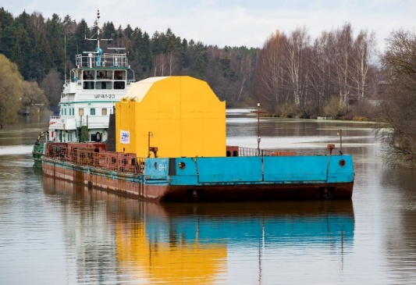
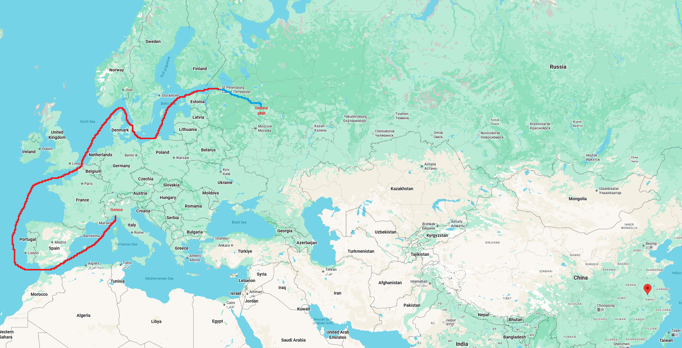
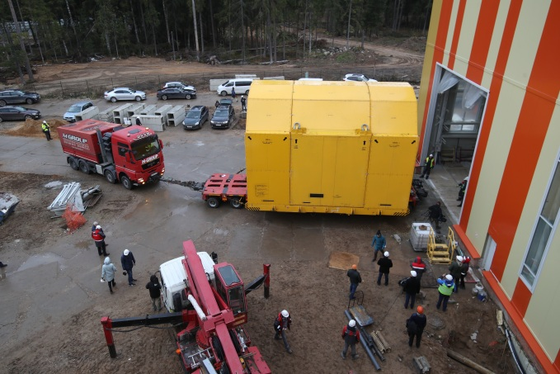
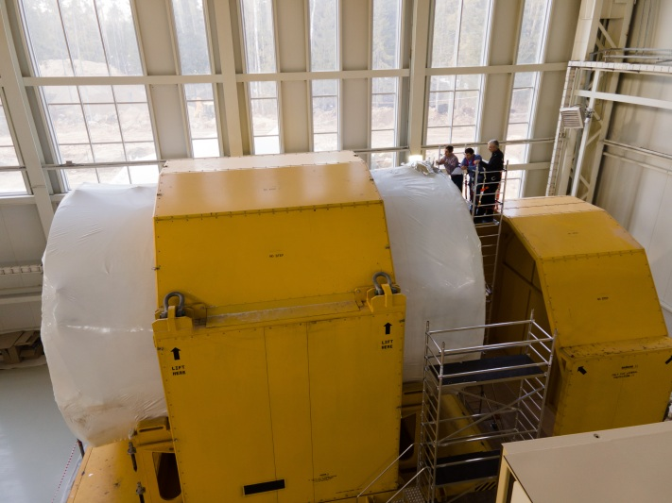
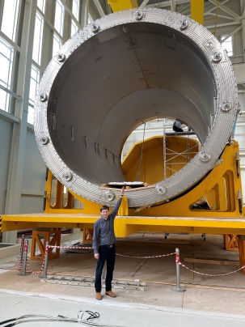
Magnet dimensions and delivery
Genoa (Italy) – St. Petersburg (Russia) – Ladoga and Onega lakes – Volga river – Dubna (JINR)
The parameters for the transport of the MPD Magnet are:
• MPD Magnet weight: 80 tons
• Shipping structure weight 45 tons
• MPD Magnet dimensions without Shipping Structure (L x Ø) 8.2 x 5.9 m
• Overall dimensions (L x W x H) 9.4 x 7.2 x 6.6 m
• Total weight 125 tons
• Max tilt allowed 1 degree

Slide 12
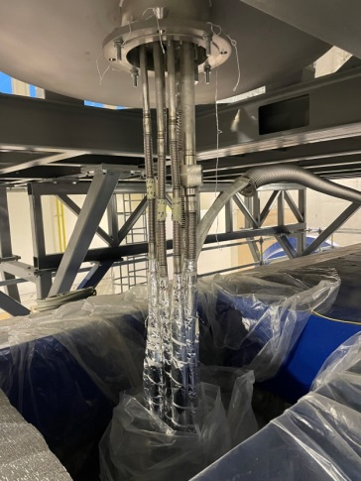
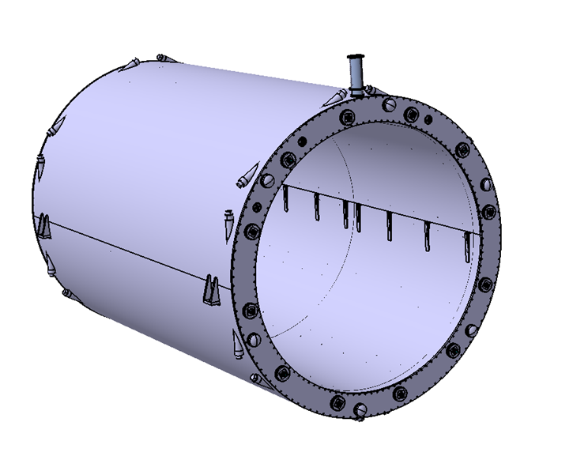
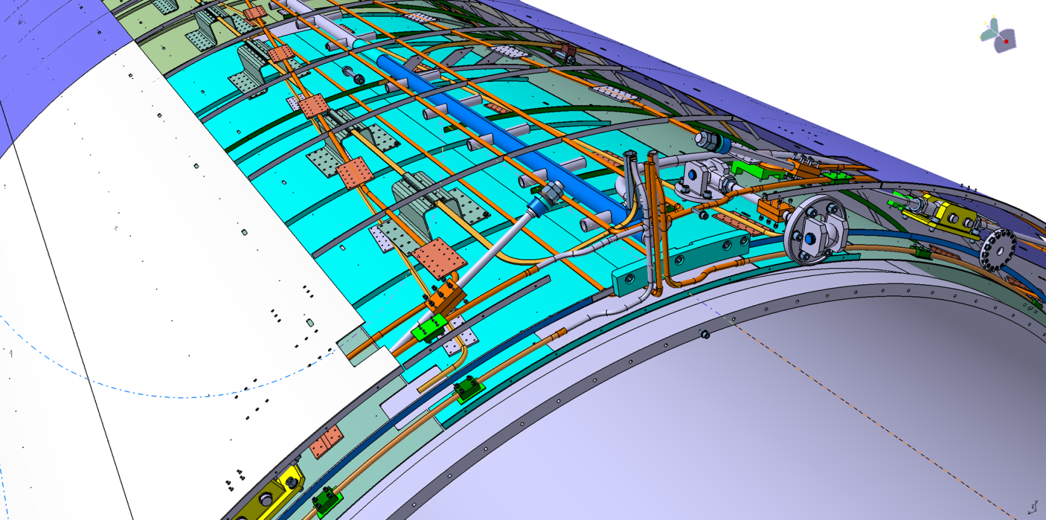
Solenoid construction
Solenoid with vacuum jacket
Solenoid without vacuum jacket
LN2 shield
4, 5
9
3
Vacuum jacket
Parameters of solenoid
Vacuum jacket (10-6 Torr in warm mode)
LN2 thermal shield (80K)
Cold mass (support cylinder for SC cables)
Superconductor cables (3 parts) total length 27 km, NbTi in pure aluminum matrix.
Cooling LN2 and LH pipes (cimmny area)
6. Number of turns – 1674
7. Operation temperature 4,5 – 5,5 K
8. Operation current / Rated induction – 1,79 A / 0,5 T.
9. 12 Radial and 6 axis cold mass suspensions
10. Total heat gain – 1056 W
Inner diameter is 4656 mm
Outer diameter is 5443 mm
Length is 7910 mm

Slide 13
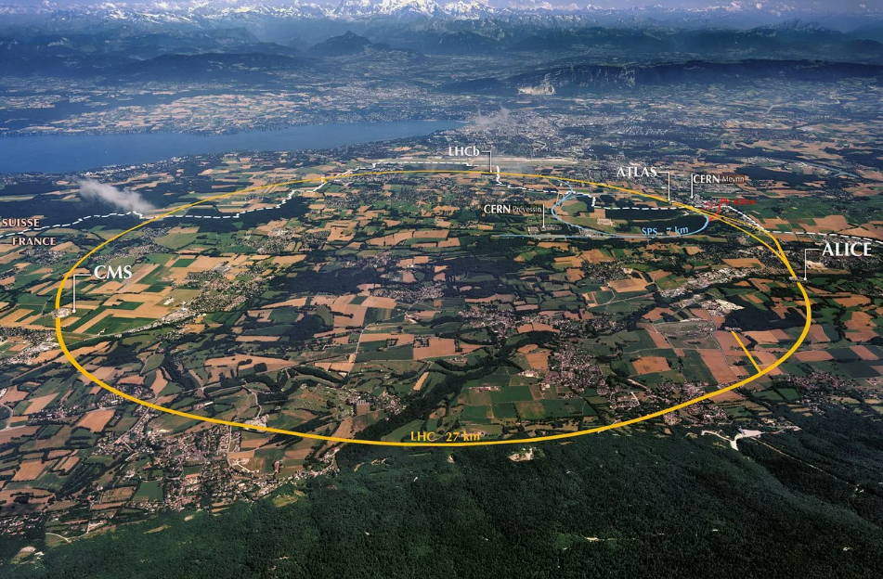
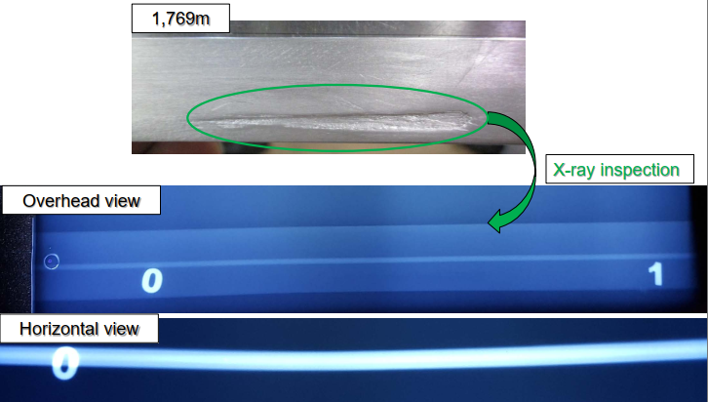
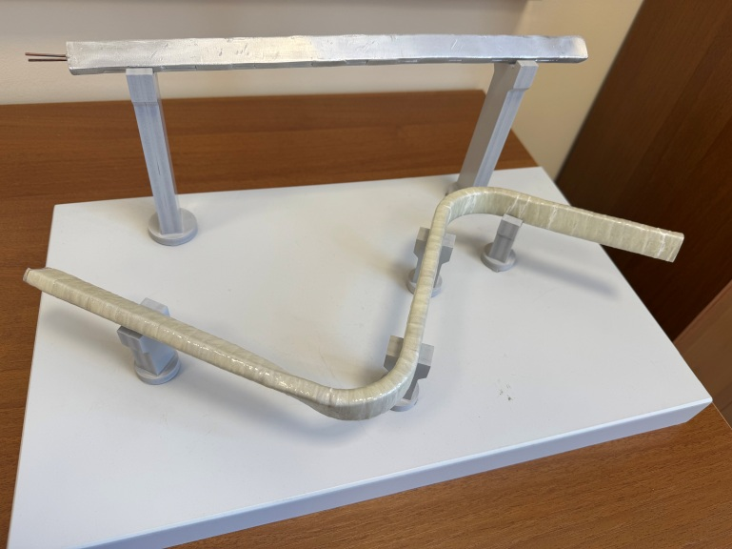
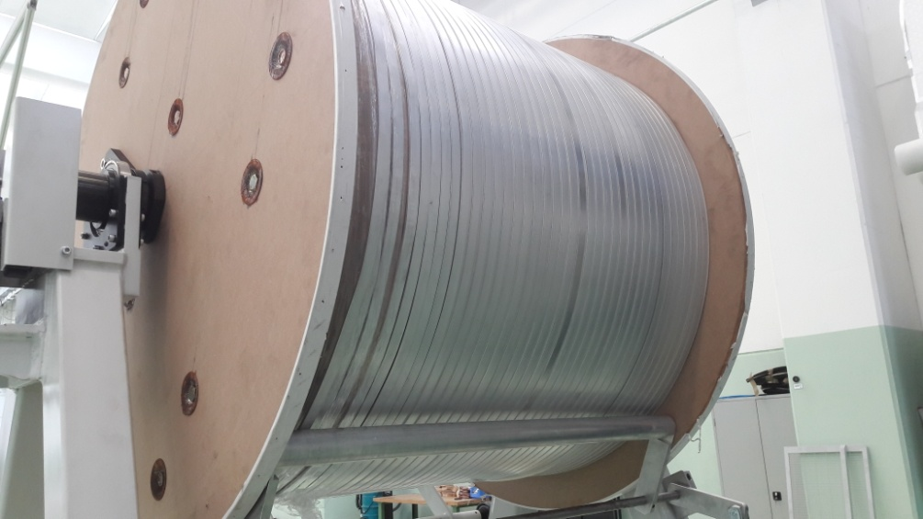
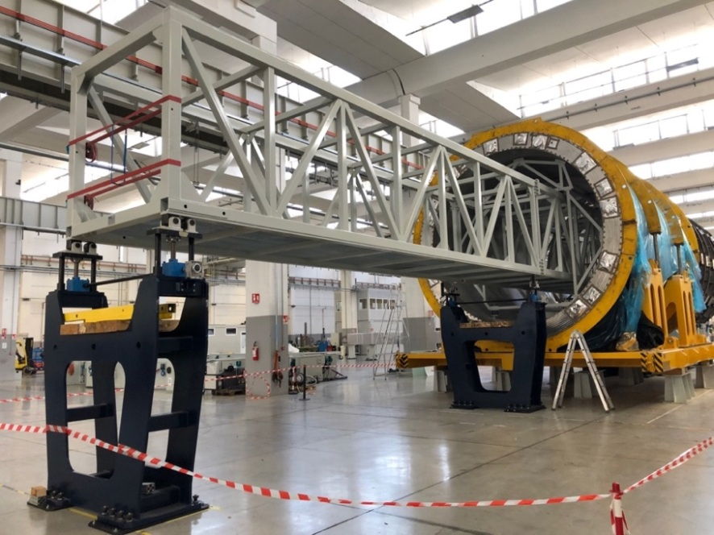
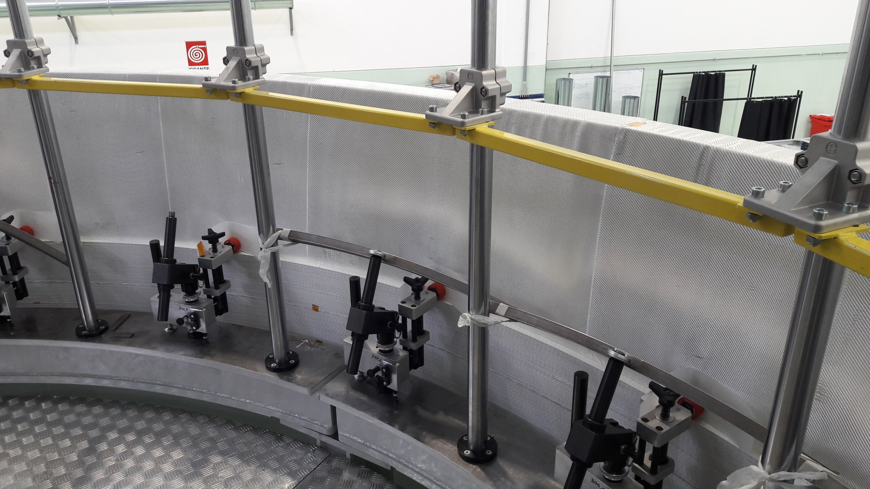
Superconductor cable
Original SC cables for MPD
Winding and tests of SC cable in ASG
LHC 27 km
SC cables parameters
SC Materials – NbTi/Cu.
Cable composition is pure aluminum matrix (4,1 x 20 mm) and inside string of Cu/SC ratio 0,9/1 (d – 1,5 mm).
Insulation – kapton tape, glass tape and epoxy resin.
Critical current (1,2 T, 4,5 K) – 6,9 kA
Cable length - 27 km.
Cable weight – 6,3 tons

Slide 14
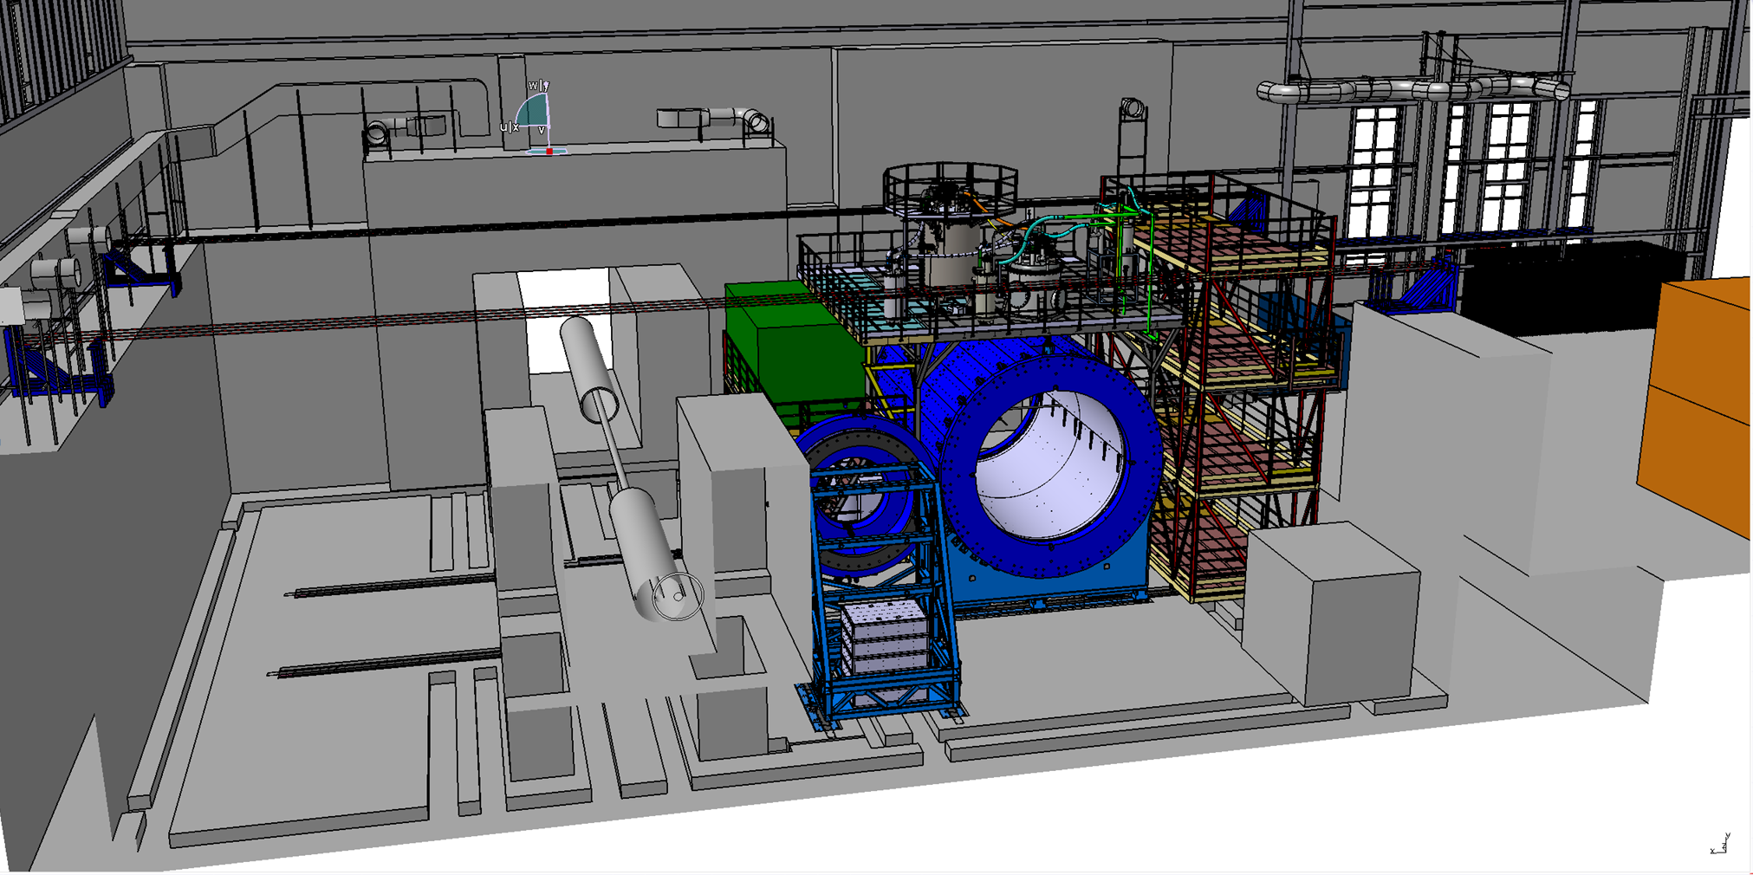
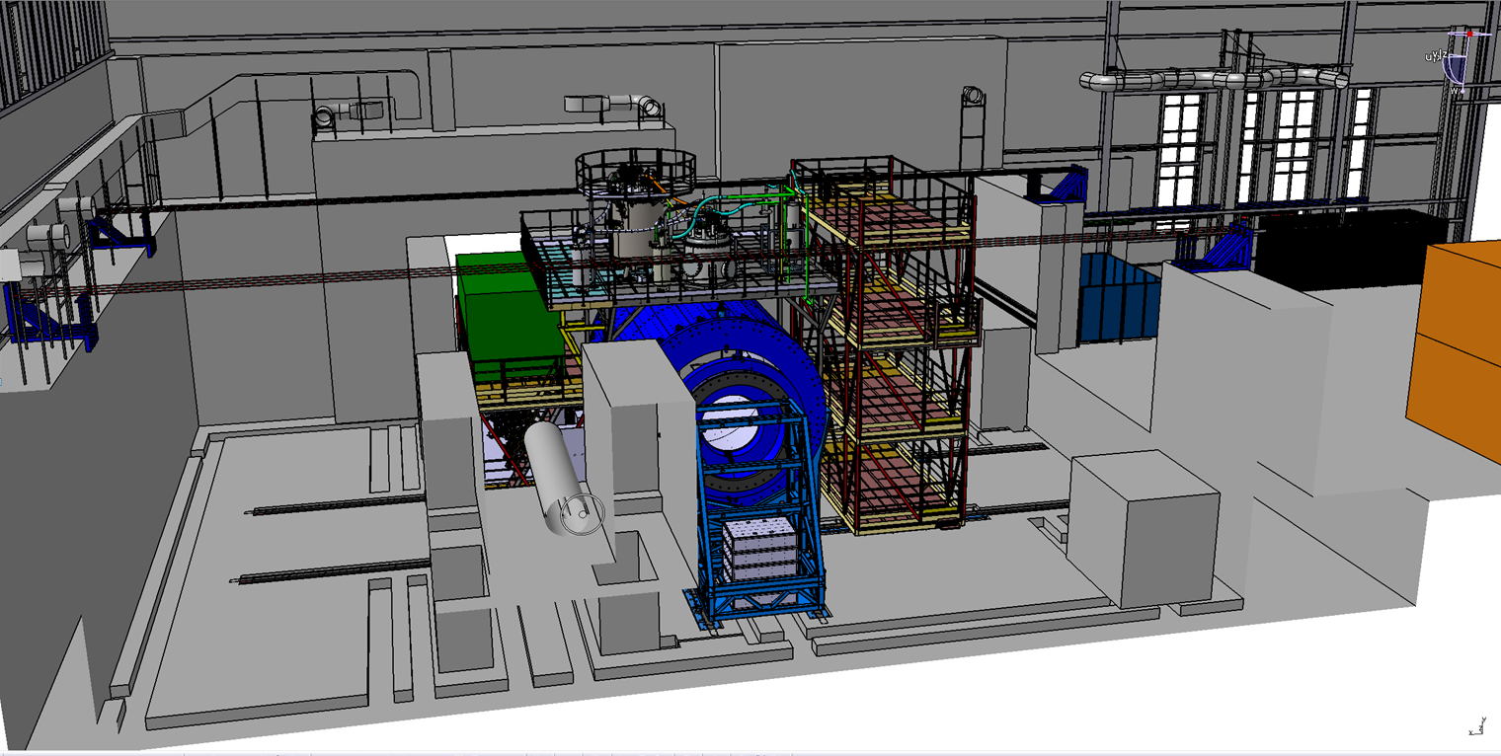
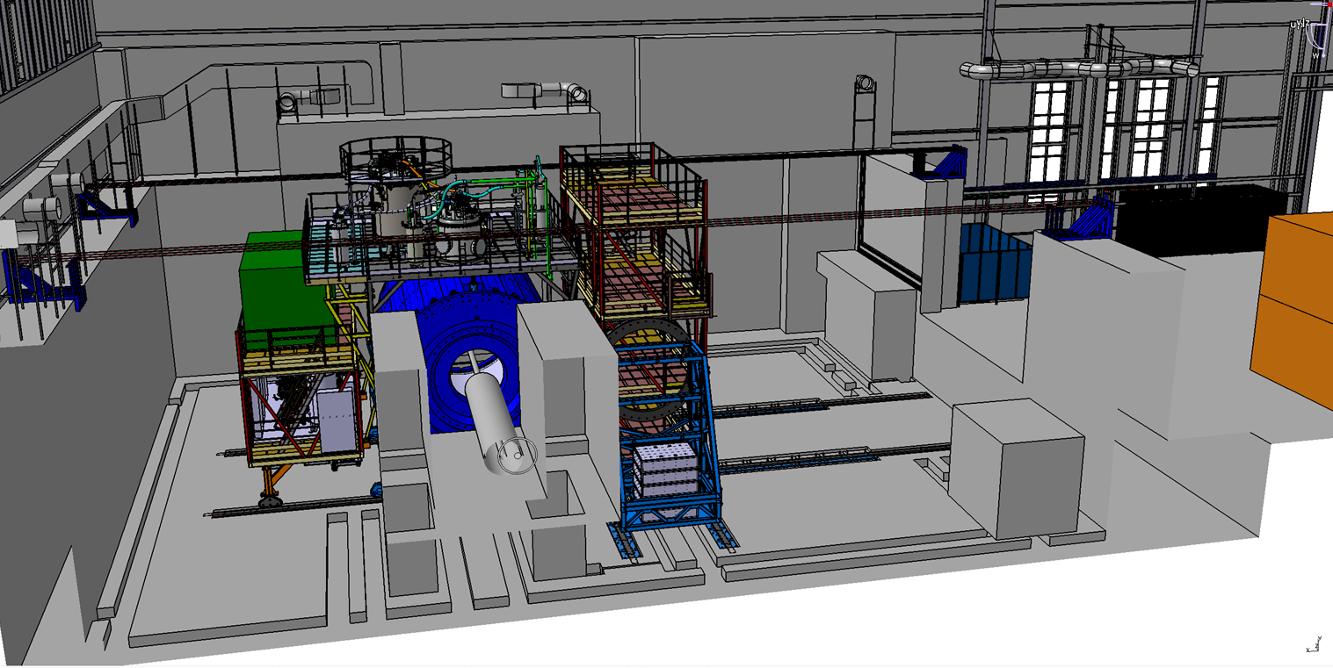
Possibility of magnet moving
Three main position
Assembling position
Trim coils installation position
Beam position
Distance – 12 m
Moving time about 5 hours
Speed 2 – 3 mm/s (for the final step 0,4-0,5 mm/s)

Slide 15
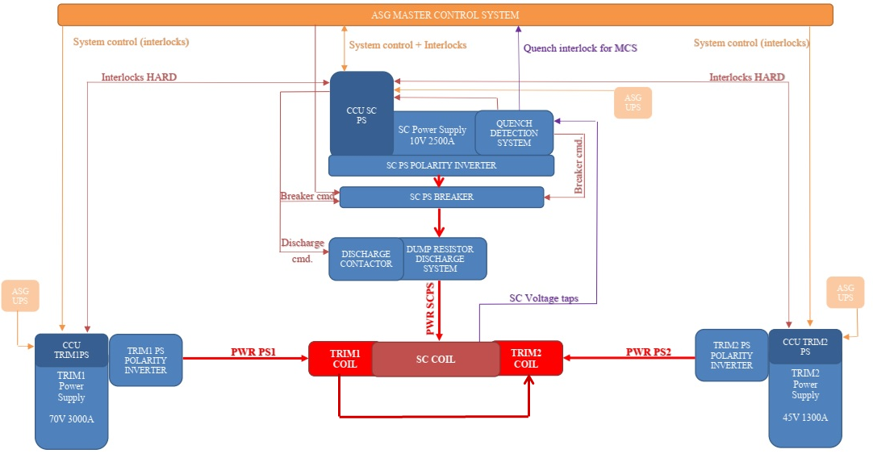
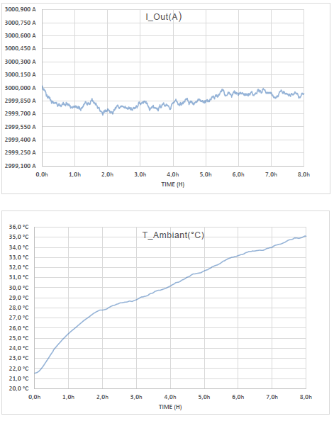
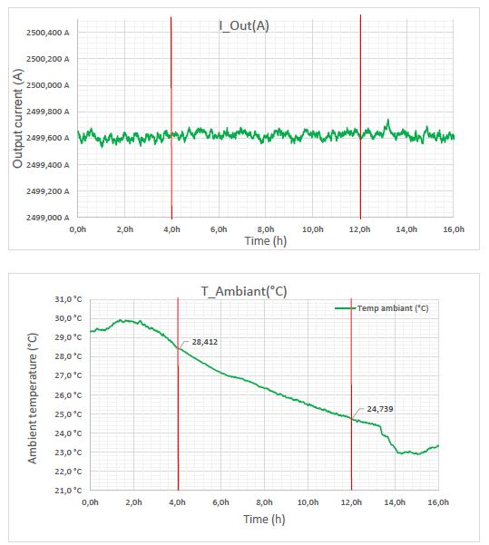
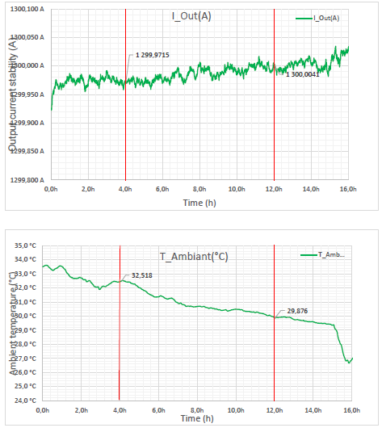
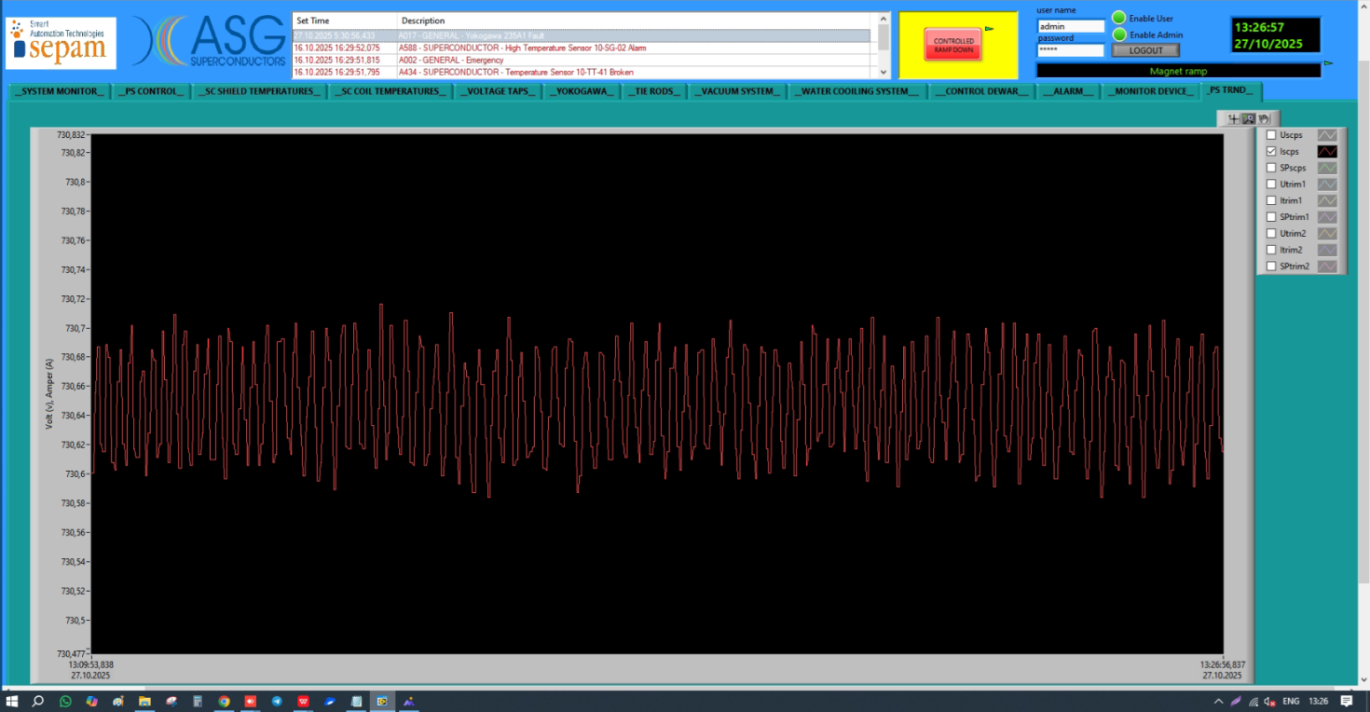
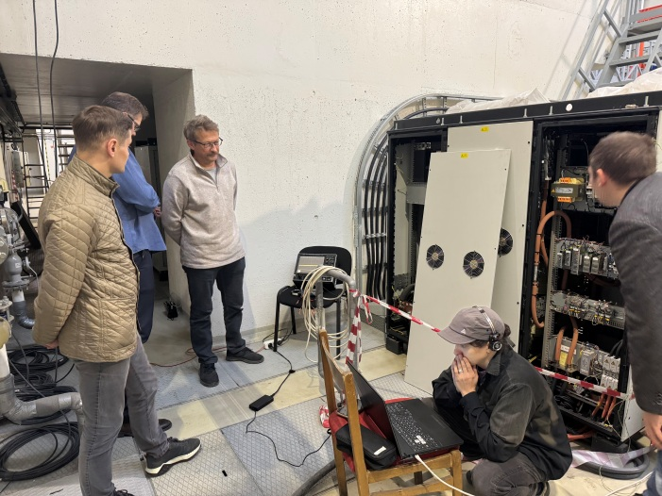
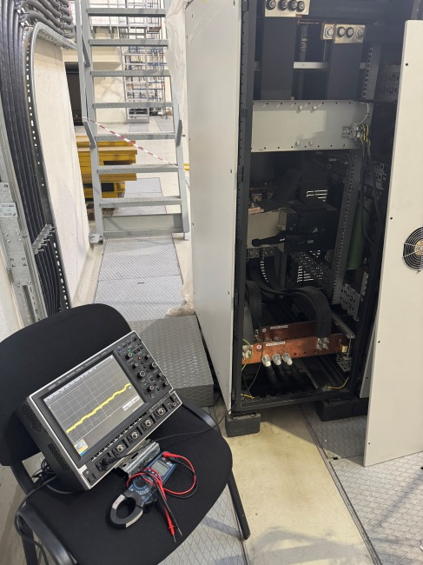





Power supply system
Power supply of TRIM1
I = 3000A V= 70V
Power supply of solenoid I = 2500A V= 10V
Power supply of TRIM2
I = 1300A V= 45V

Slide 16




Cryogenic infrastructure
Control Dewar
Refrigerator
NTCS (Nitrogen temperature correction system)
LN2 and LHe heaters
LHe pipe
Cryogenic flexible connection pipes
LN2 Tanks (2 pc)
LHe Tanks (2 pc)
LN2 transfer pipe 120 m
Warm pipes for He, N2 and instrumentation Air
Flexible warm pipes
Support system for flexible pipes

Slide 17





MPD cryogenic system

Slide 18




Cooling process scheduled
Mapping 0,2T
SC – 716A
TRIM 1 – 824 A
TRIM 2 – 1176 A
Mapping 0,5T
SC – 1835A
TRIM 1 – 2688 A
TRIM 2 – 2795 A

Slide 19










Stationary magnetic field monitors
720A
0,2T
1880A
0,5T
1120A
0,3T
2140A
0,57T
1000A
1520A
0,4T

Slide 20





Field mapper in solenoid
From 06/10/2025 assembling and test in MPD solenoid
16/07/2025 test mapper in Novosibirsk
26-27/10/2025
Measuring in one stationary point (730,6 A)

Slide 21



Two main attempts at measuring the magnetic field
15-16/12/2025
Measuring 0,2 Т with TRIM coils
01-28/07/2026
Measuring 0,5 Т with TRIM coils
SC – 716А, PS 1 – 824A, PS 2 – 352A
TRIM1 – 824A, TRIM2 – 1176A
Project parameters:
Total 16 000 points on 2 half. 16 plate at W, 13 plate at E.
Mapping process:
Start 15/12/2025 13-50
16/12/2025 02-00 – west side finish (6704 point, time to mapping 12 hours 10 minutes, 6,5 sec/point)
Rearranging the barbell – from 2 AM to 3 AM
3-00 – start of east side mapping
16/12/2025 14-10 – finish mapping of east side (5447 points, time to mapping 11 hours 10 minutes, 7,4 sec/point)
SC – 1835А, PS 1 – 2688A, PS 2 – 107A
TRIM1 – 2688A, TRIM2 – 2795A
Field mapping by project on big scan involved program of aperture TPC by Z +/- 2000 mm, R – 1200 mm, Phi 20⁰ . Step by Z – 50 mm, by R – 50 mm. Totally about 61 440 points.
Sort program of mapping:
Total 696 points on 2 half. 12 lines at W, 12 lines at E.
Angle of turn (0, 90, 180, 270)

Slide 22





Status and Plans.
2026
February – March – mapping, processing of results and confirmation of homogeneity (3*10-4) by 0,2 T. System of magnet stability operate.
March – April – Support Frame installation into Magnet
April – May – 100% ECal modules was installed. Cosmic testing.
May – June – 100 % of ToF modules installed. Testing.
June – 20th of July – mapping 0,5 T in TPC aperture.
August – October – TPC tests and installation
October – TRIM coils installation and moving to the beam point
From end of October 2026 – stat operation with NICA beam

Slide 23












Thank you for attention

