Slide 1




The Evolution of the LHCb RICH Detectors
Antonis Papanestis – STFC / RAL
On behalf of the LHCb RICH Collaboration

Slide 2
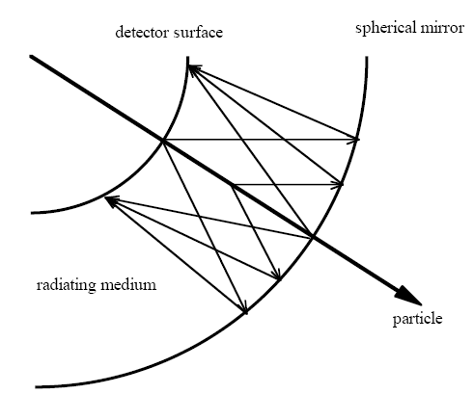
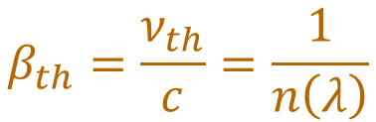
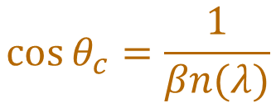
RICH Detector reminder
$$β_{th}=\frac{ν_{th}}{c}=\frac{1}{n\left(λ\right)}$$
Threshold:
$$\cos{θ_{c}=\frac{1}{βn(λ)}}$$
Cherenkov angle:
Main contributions to uncertainty:
Emission point error
Pixel size error
Chromatic error
Particle identification is achieved by combining beta with momentum from Tracking and calculating the mass

Slide 3
Outline
Introduction to the LHCb RICH detectors
Performance in Run 1 & 2 of the LHC
LHCb RICH Upgrade I
Performance after Upgrade I
The road to Upgrade II and LS3 enhancements
Current R&D

Slide 4
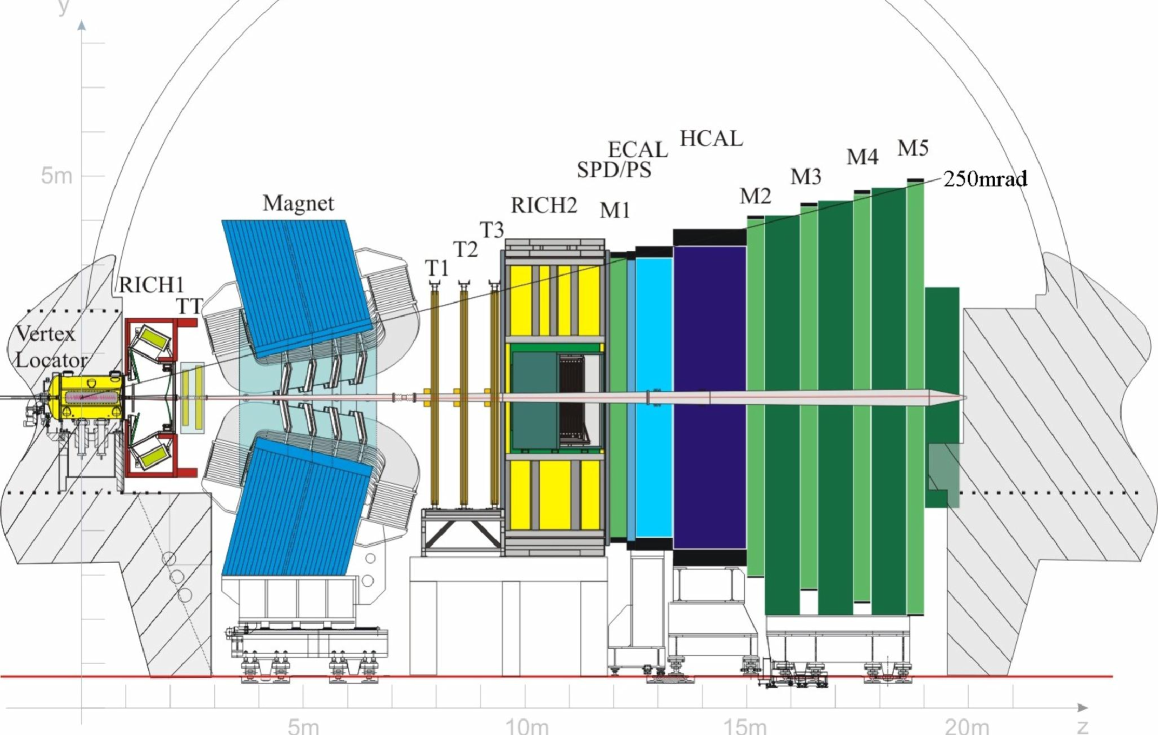
The (original) LHCb experiment
Forward spectrometer, studying the properties of particles with bottom and charm quarks
Exploring CP violation, rare decays and hadron spectroscopy

Slide 5
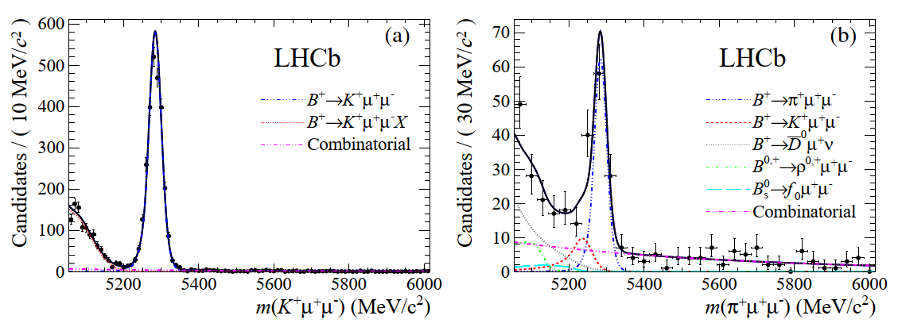
Physics impact of hadron PID
First measurement of the diﬀerential branching fraction and 𝐶𝑃 asymmetry of the
𝐵± → 𝜋± 𝜇+ 𝜇− decay, JHEP 10 (2015) 034 [arXiv:1509.00414]

Slide 6
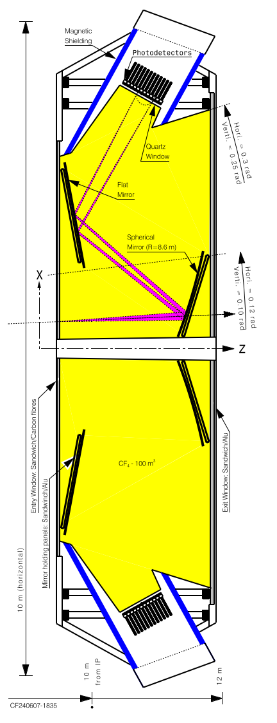
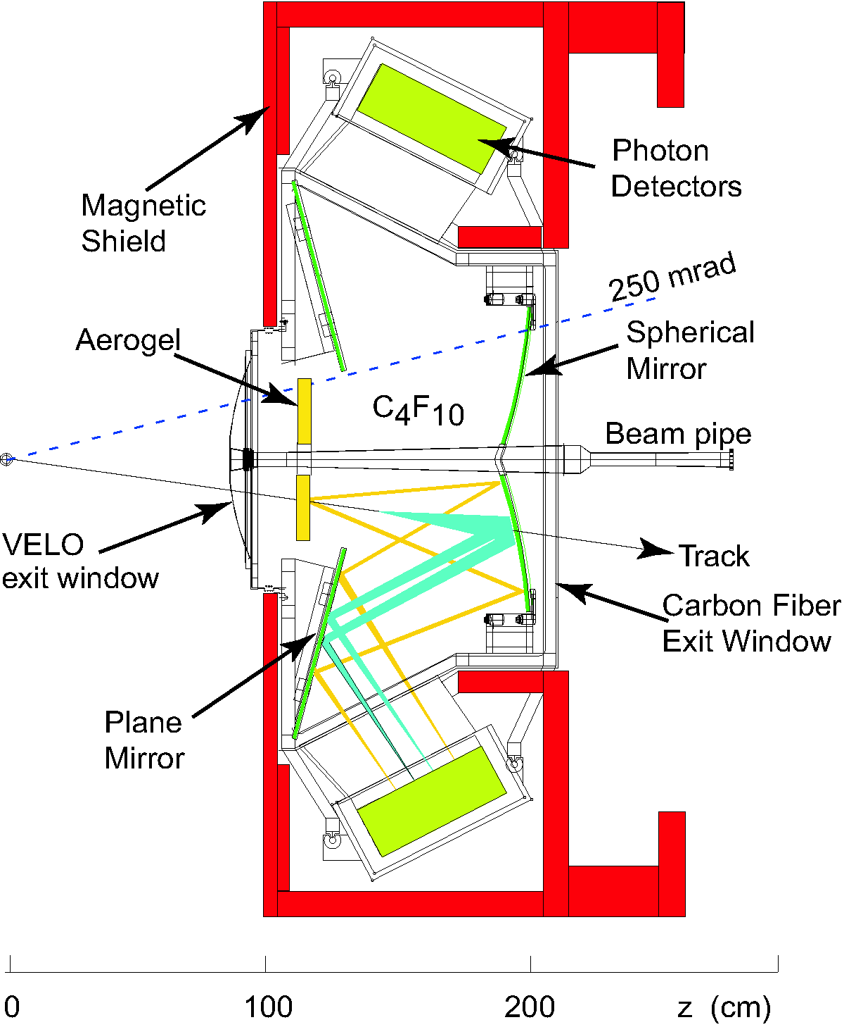
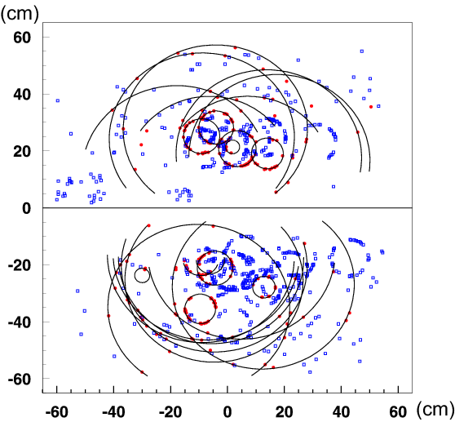
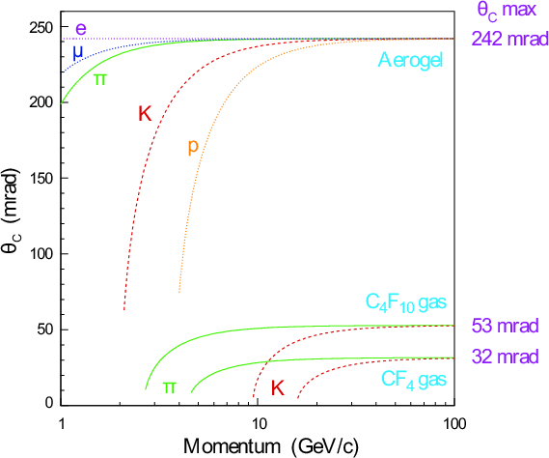
The (original) RICH detectors
RICH 1
Side view
Two radiators
Carbon fibre spherical mirrors
Extensive magnetic shielding
C₄F₁₀ gas radiator
RICH 2
Top view
CF₄ radiator (100 m³)
Simulation

Slide 7
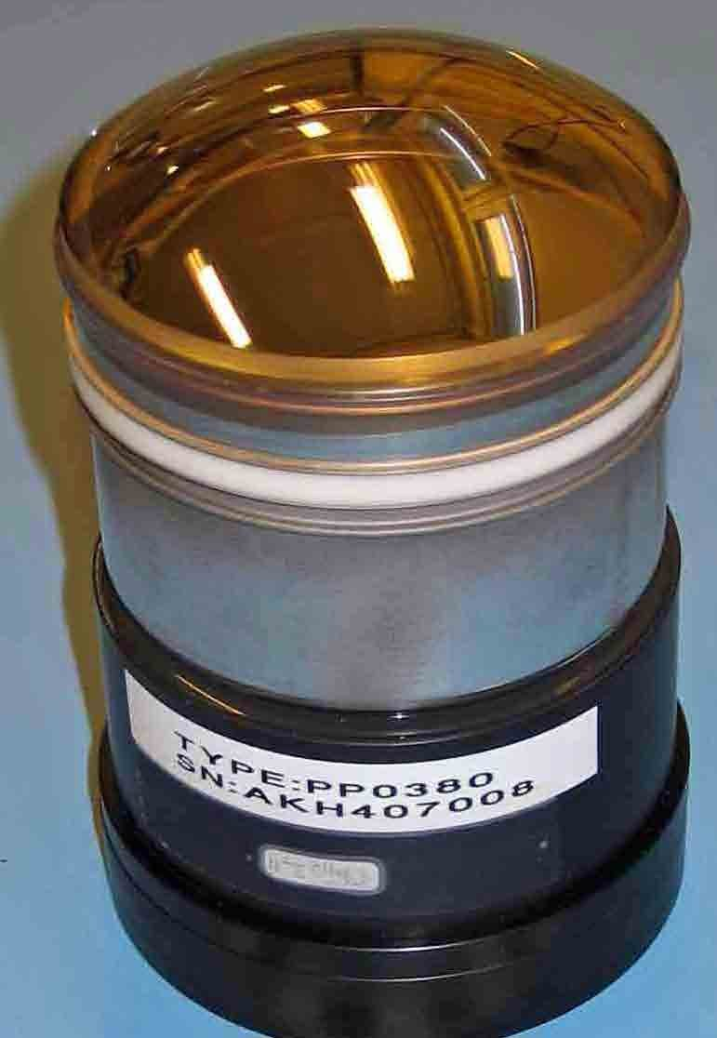
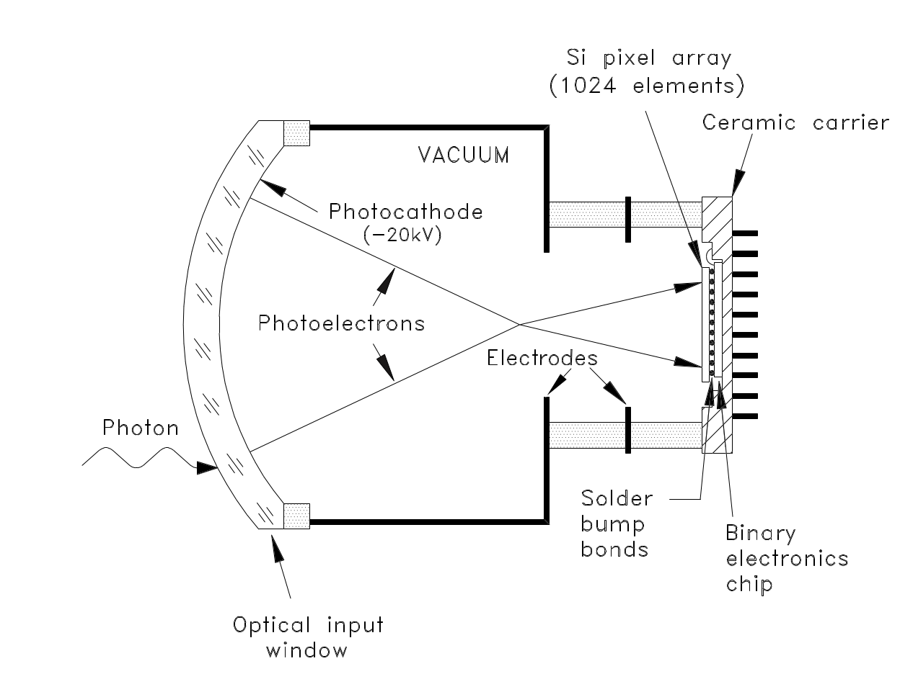
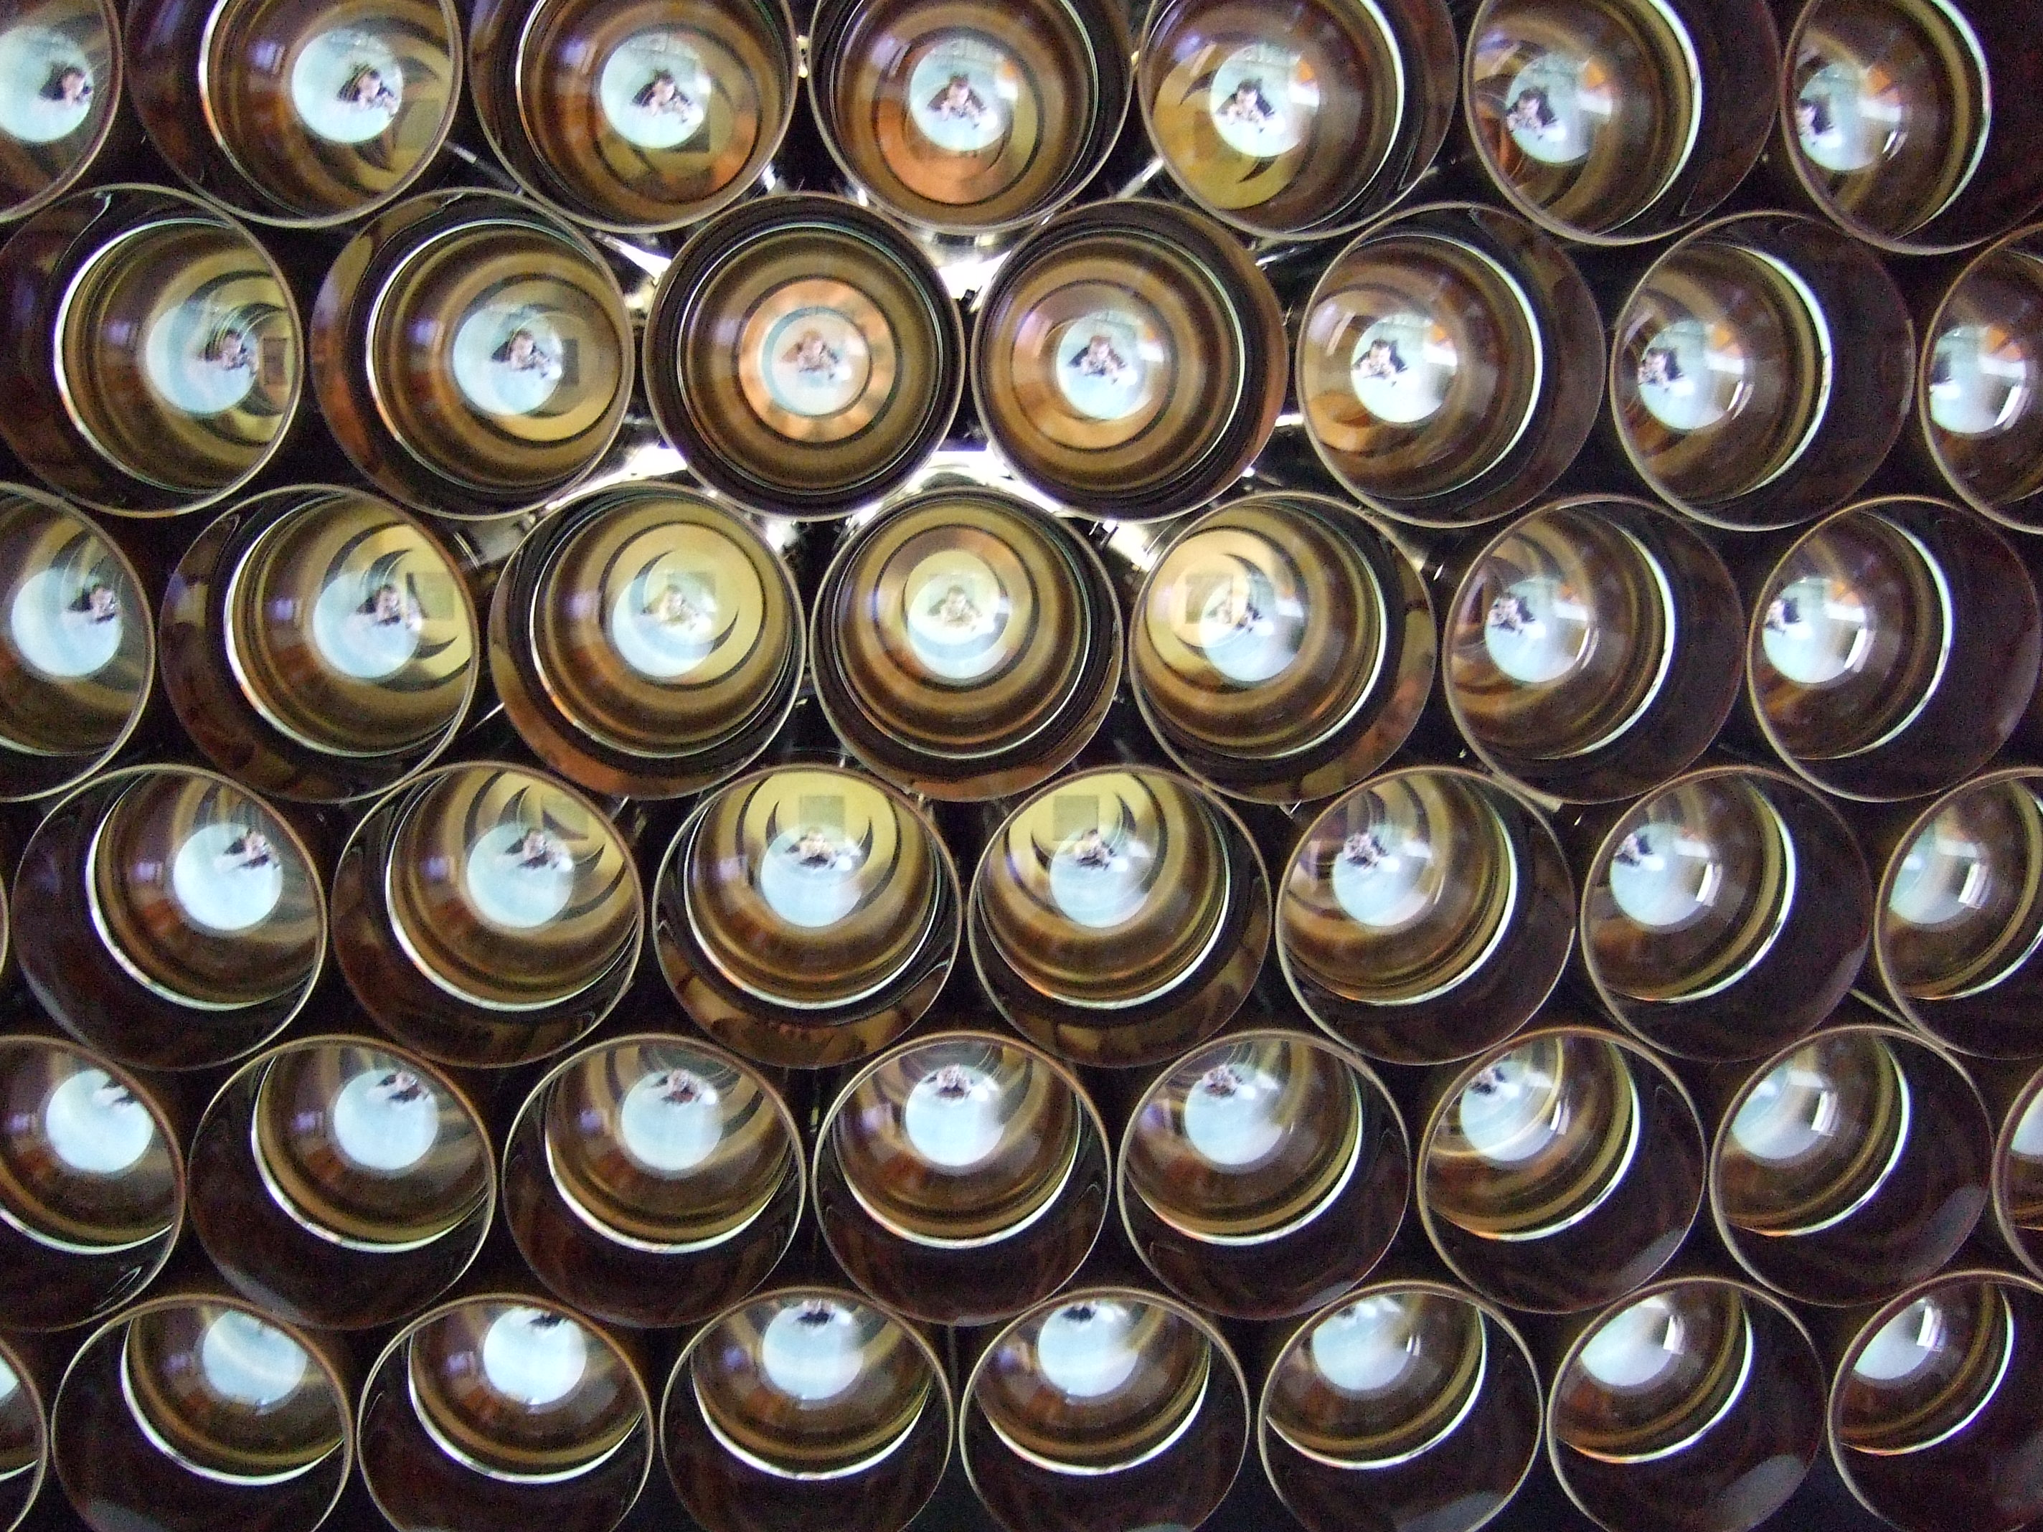
The Pixel Hybrid Photon Detectors
The encapsulated electronics operate at a maximum read-out rate of 1 MHz; not compatible with 40 MHz readout
HPDs for the LHCb RICH

Slide 8
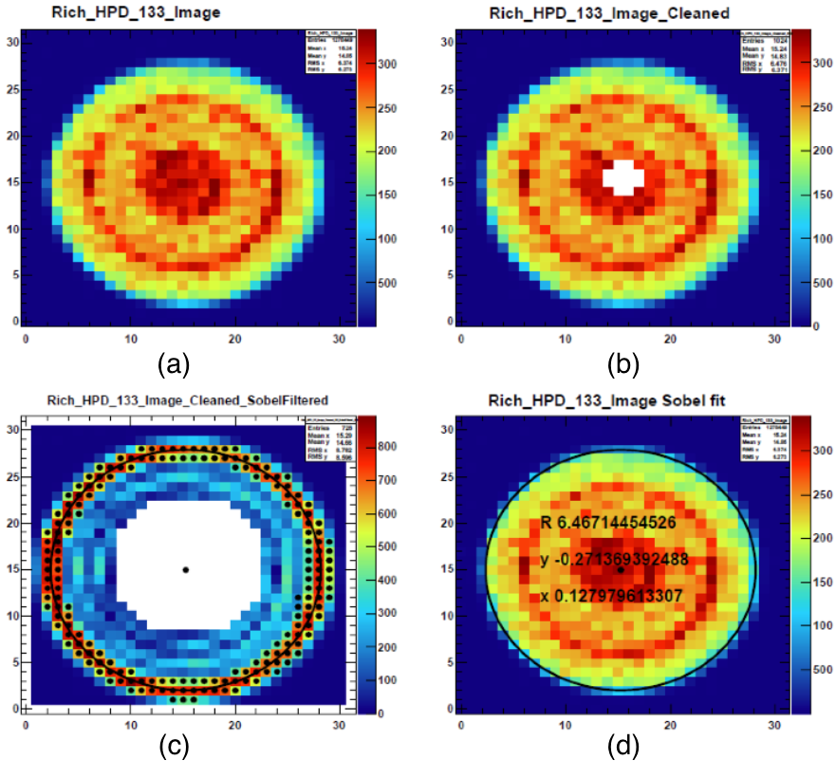
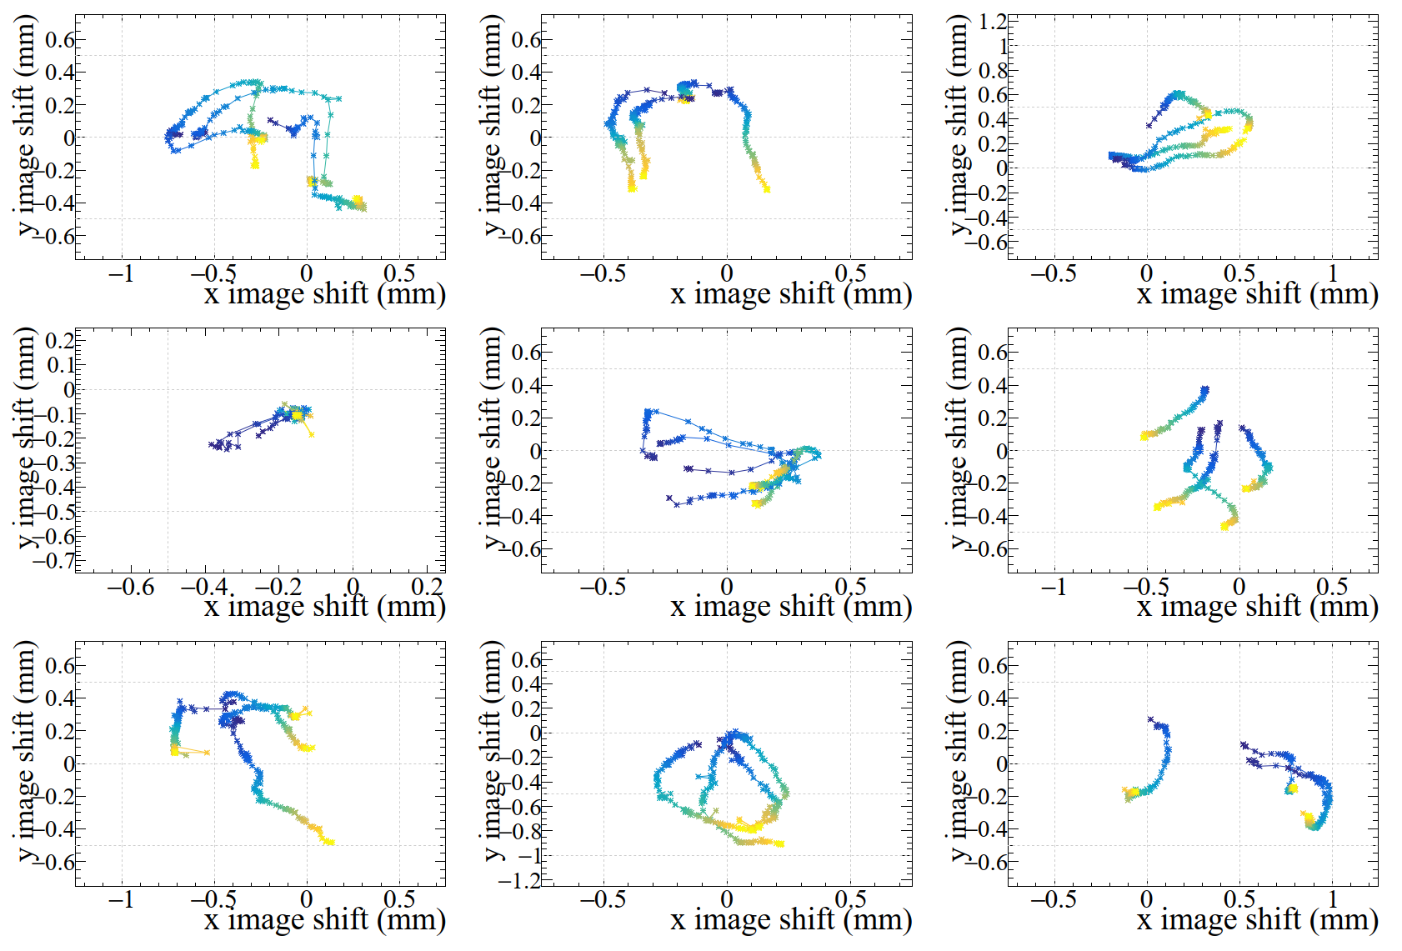
HPD photocathode position
One pixel
Automatic Online calibration for every run (max 1 hour)

Slide 9
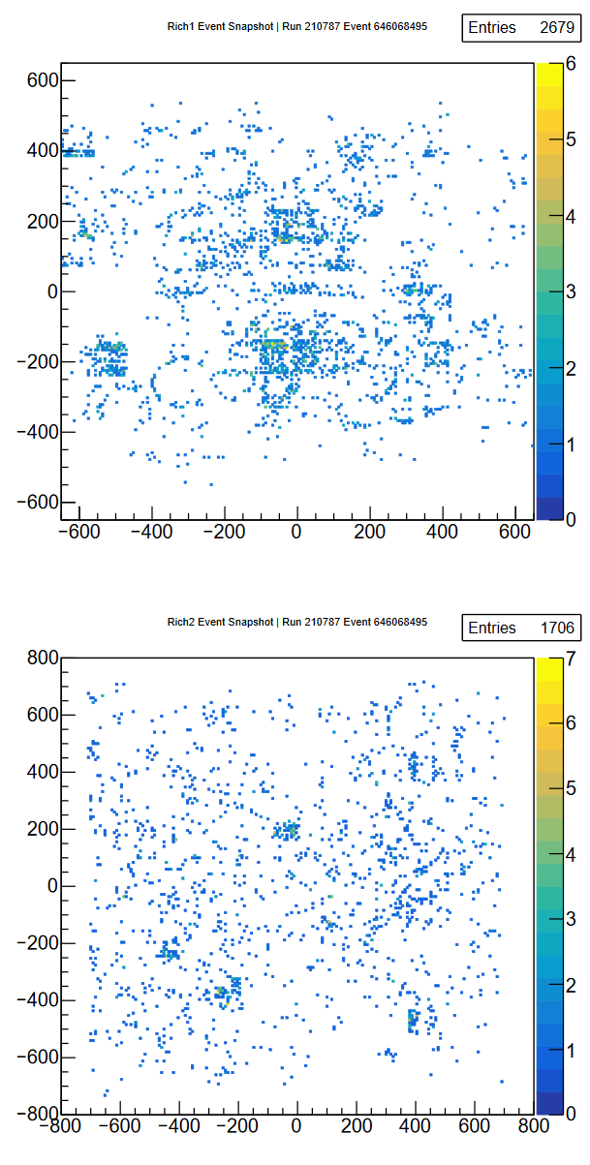
Global likelihood PID method
In the busy LHC environment, most of the “background” to the identification of a given track comes from signals of other tracks in the event
  make a global optimisation of the mass hypotheses
For each track in the event, for a given mass hypothesis, determine the expected distribution of Cherenkov photons on the detector plane using the knowledge of the geometry of the detector and its optical properties
Repeat for all the tracks in the event
From the photon distribution on the detector plane calculate the probability that a signal would be seen in each pixel of the detector from all tracks
Compare this with the observed set of photoelectron signal on the pixels and calculate a likelihood
Repeat the above, changing the set of mass hypothesis of the tracks to find the set of mass hypotheses which maximize the likelihood
RICH pattern recognition for LHCb

Slide 10
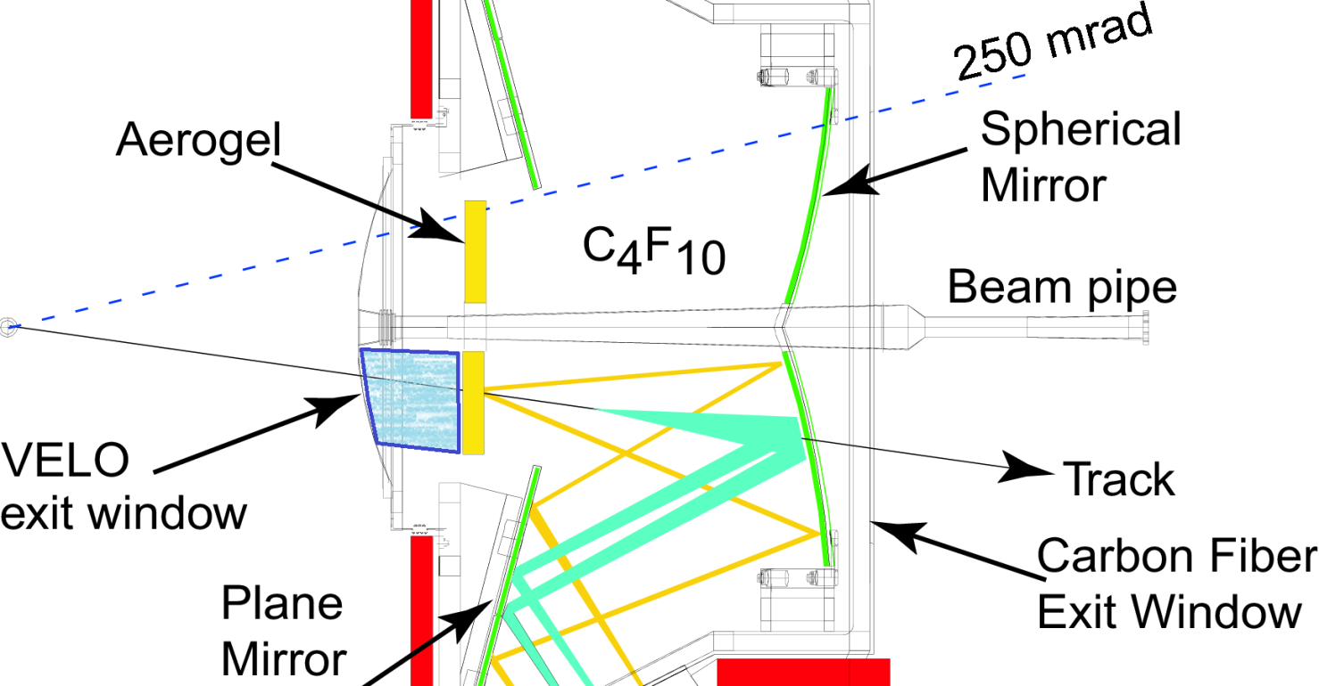
RICH 1: From 2 radiators to 1
Original design of RICH 1 was to accommodate 2 radiators to cover a wider momentum range:
  C₄F₁₀
  Aerogel
However:
  Increased luminosity compared to original design and increased background (and underestimate of track multiplicity) made aerogel photons difficult to identify
  The requirement for offline quality results from High-Level Trigger output put strict conditions for processing time
    Online alignment and calibration before HLT
Removal of aerogel extended the length of the gas radiator

Slide 11
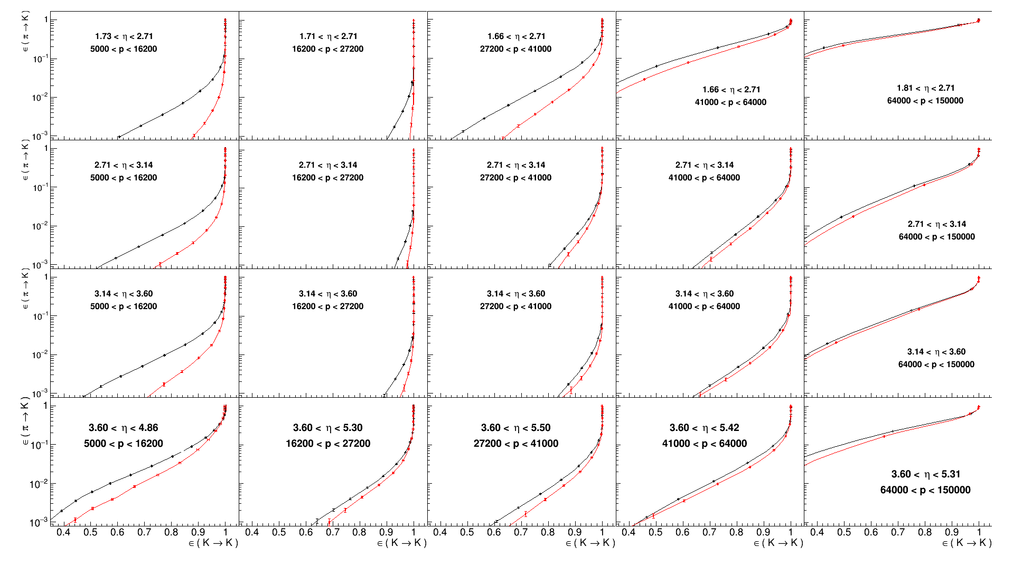
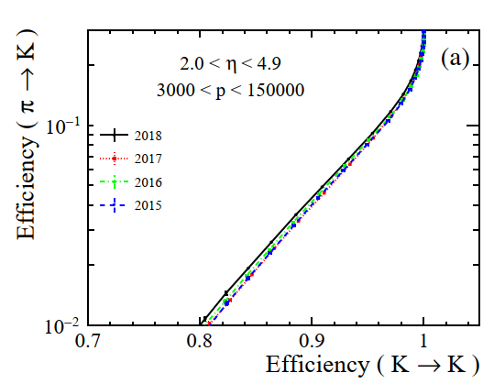
PID in Run 2
π/K PID 2012/2015
Mis-ID π→K
⇓ η
Better
Efficiency K→K
Momentum →

Slide 12
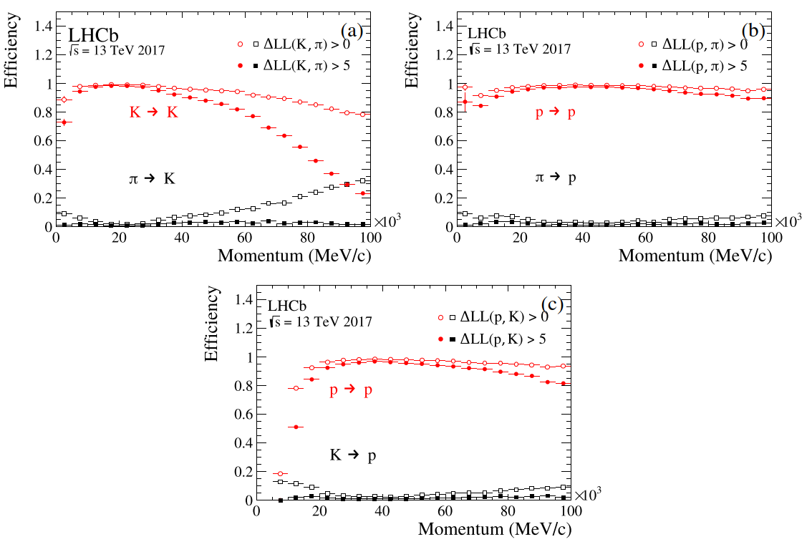
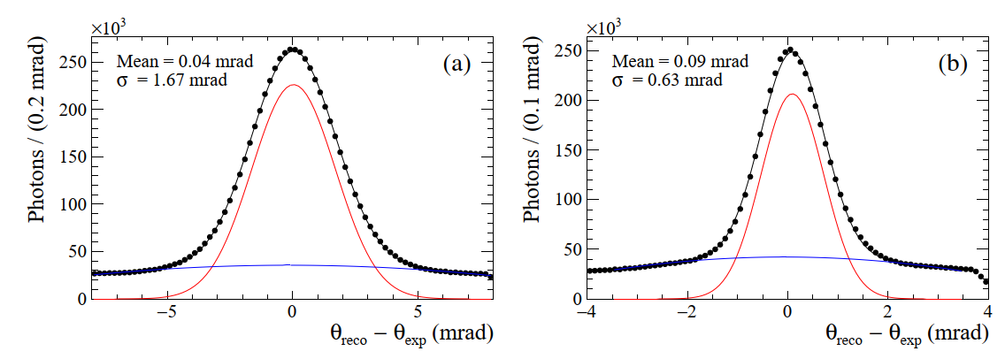
PID performance (2017)
RICH 1 angle resolution
RICH 2
resolution
Performance of the LHCb RICH detectors during LHC Run 2

Slide 13
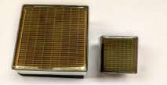
LHCb Upgrade I
(the current detector)
For the RICH detectors
Increase instantaneous luminosity by a factor of 5 to
2 x 10³³ cm⁻²s⁻¹
Remove hardware trigger and use a software trigger reading out the detector at 40 MHz (~30 MHz collision rate)
Re-optimise the geometry of RICH1
Replace photon detectors with MaPMTs
  Improved QE response
Develop electronics capable of 40 MHz readout
The LHCb Upgrade I
R13743 R13742

Slide 14
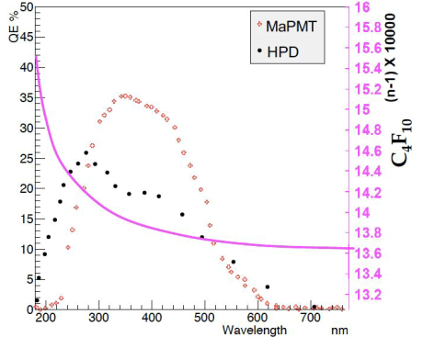
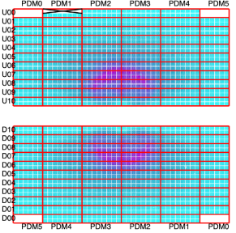
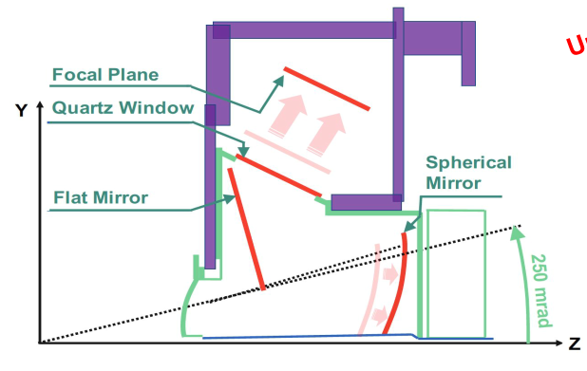
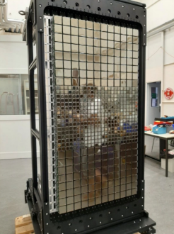
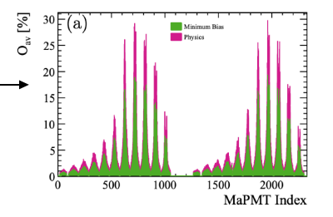
RICH Upgrade I
RICH 2 photon detectors
New RICH 1 optical geometry
RICH 1 accumulated hit map

Slide 15
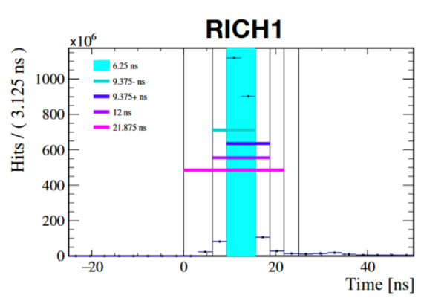
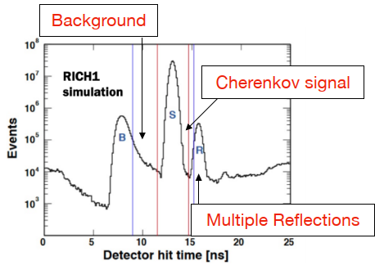
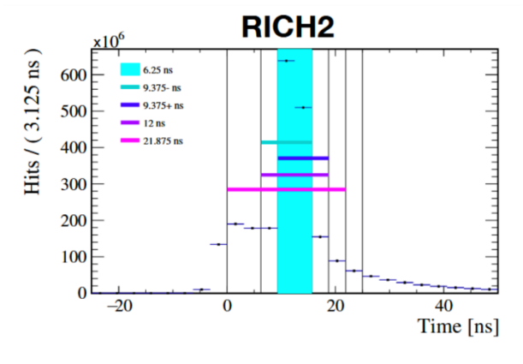
Time gating
Prompt Cherenkov light from all particles arrives at the photon detectors within a few nano seconds
Optimal noise rejection is achieved with a front-end gate of 6.25 ns (in steps of 3.125 ns)

Slide 16
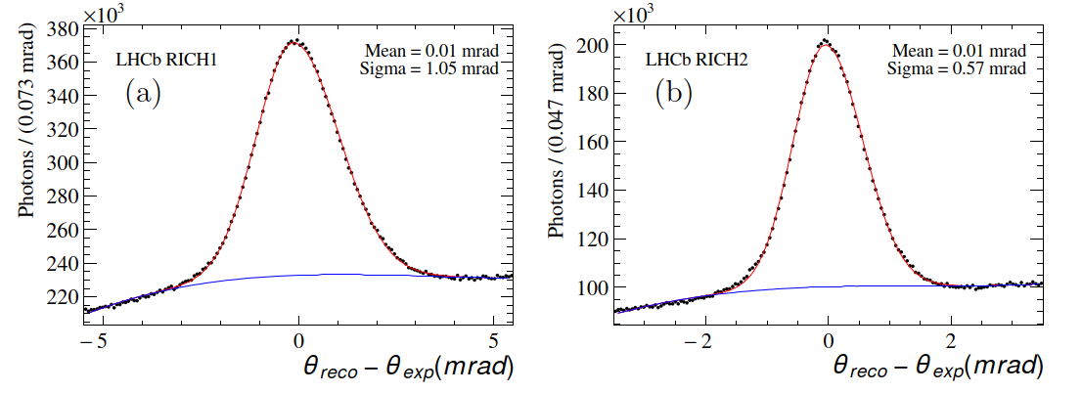
Cherenkov angle resolution
Run 2: 1.67 mrad
RICH 1
RICH 2
Run 2: 0.63 mrad

Slide 17
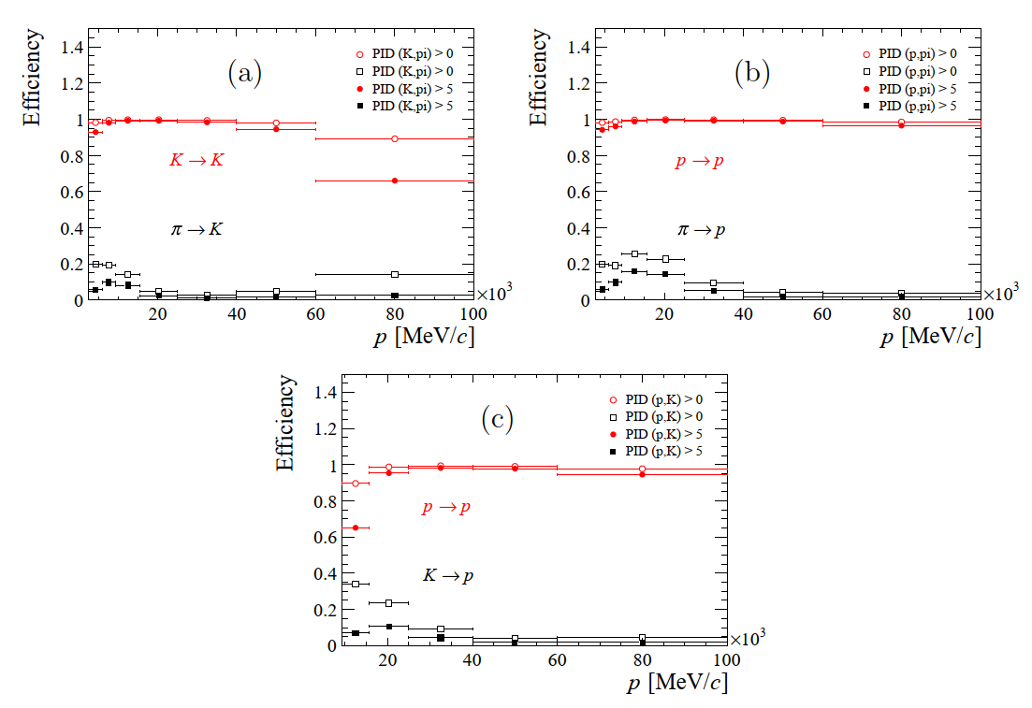
PID performance v momentum
Pion/kaon
Pion/proton
Kaon/proton

Slide 18
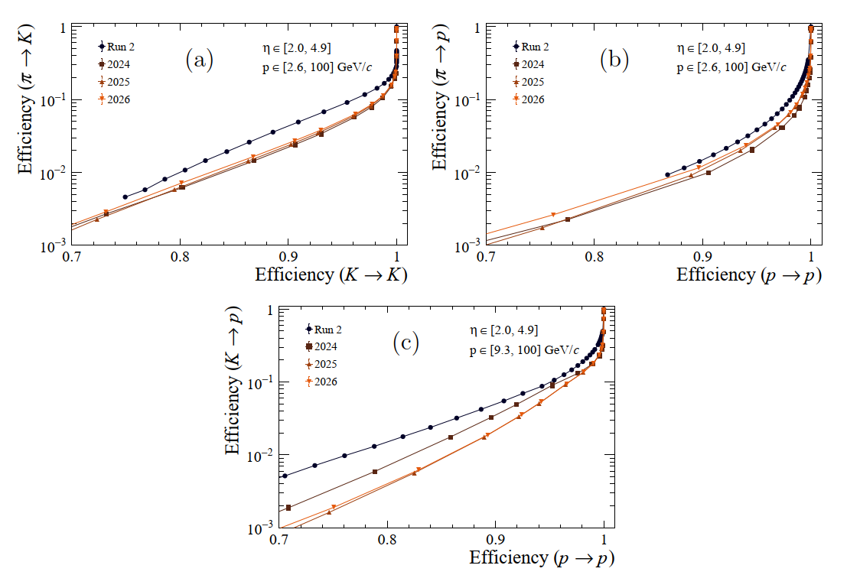
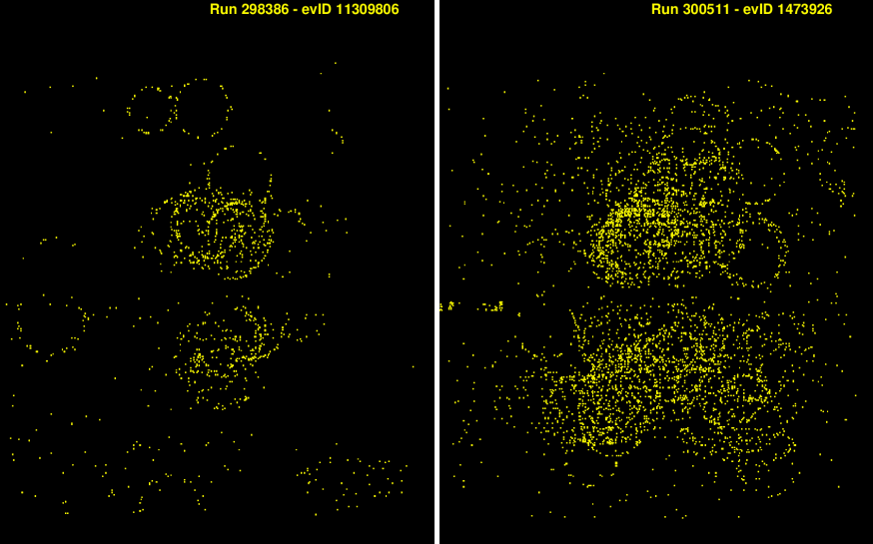
Comparison with Run 2
Run 2
Pion/proton
Pion/kaon
Run 3
Kaon/proton
Run 3 is at luminosity x5 times higher than Run 2
Run 2 like
Run 3

Slide 19
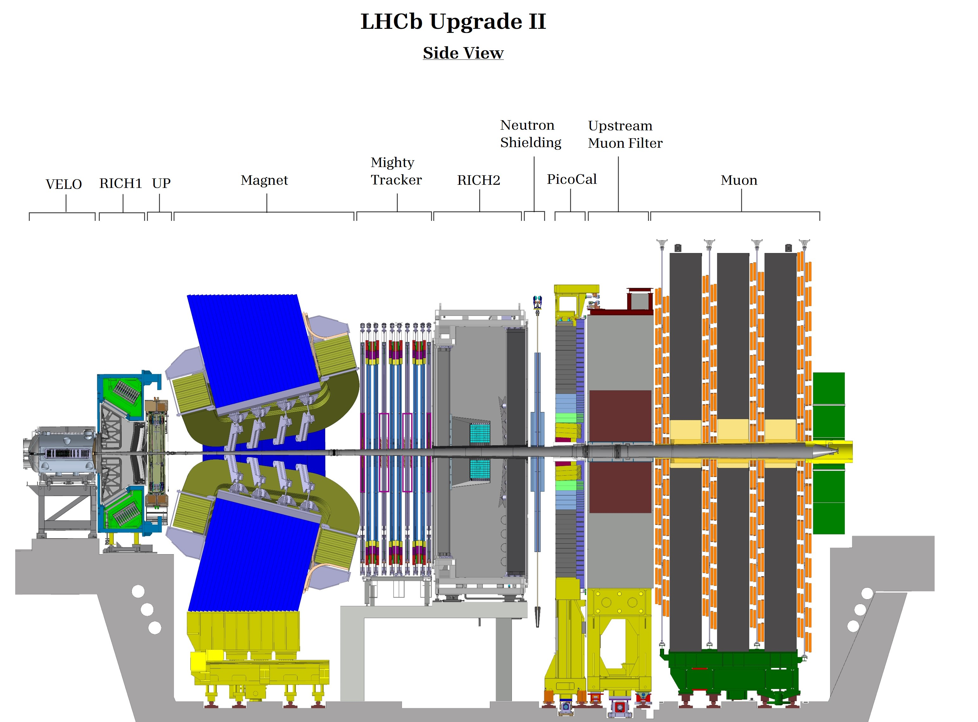
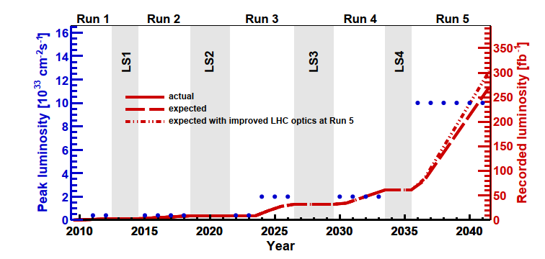
LHCb Upgrade II
Aim: increase the luminosity by a factor of 5 to collect a total of 300 fb⁻¹ before the end of the LHC

Slide 20
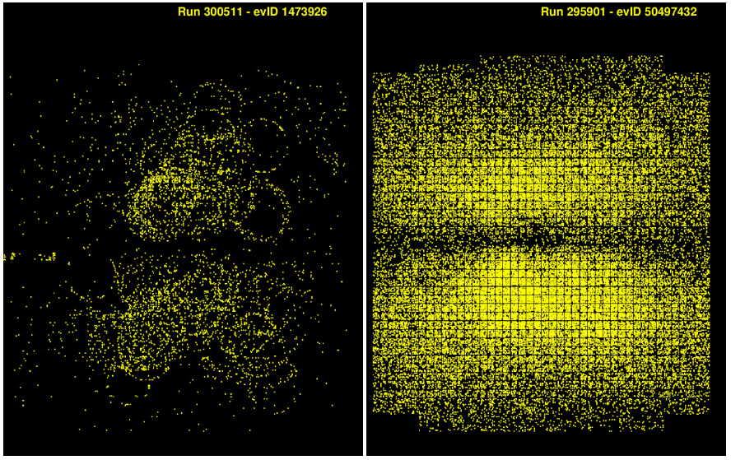
Upgrade II for the RICH detectors
Same challenges as Upgrade I
  Improve Cherenkov angle resolution
  Reduce detector occupancy
New detector geometry
New photon detectors
  Smaller pixels
Use of timing as an extra dimension to reduce event complexity
Expected in
Upgrade II
Upgrade I

Slide 21
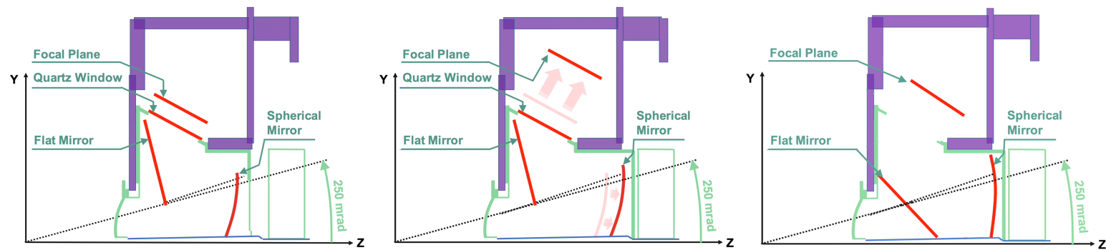
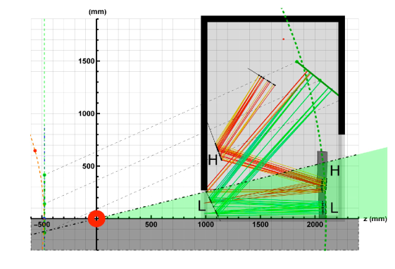
New Optics
Original
Upgrade I
Upgrade II
FTDR Design
Improve emission point error
Reduce occupancy
Split optics with two primary mirrors with different RoC

Slide 22
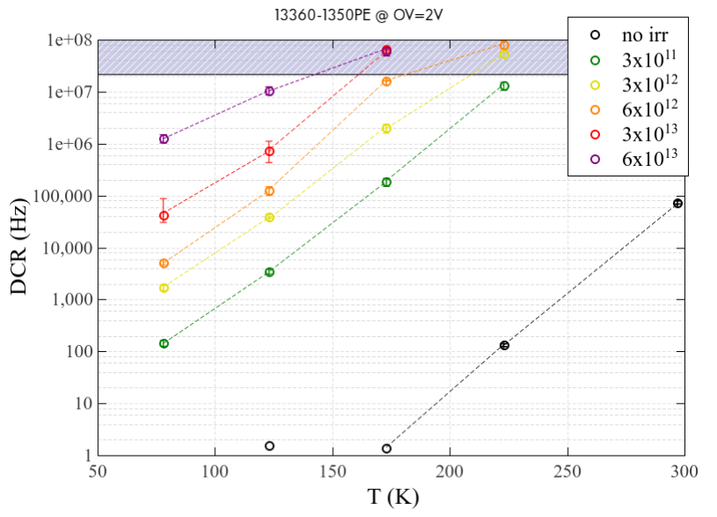
Photon Detectors – SiPMs
Pros:
  Excellent granularity
  Good QE
    Improving chromatic error
  Good timing (~ 100 ps)
  Insensitive to magnetic fields
Cons
  High dark count rates after radiation
    Requires operations at cryogenic temperature
    Regular annealing
Dark count rate versus temperature at OV = 2V
Characterization of SiPMs for the LHCb RICH Detectors Upgrade-II

Slide 23
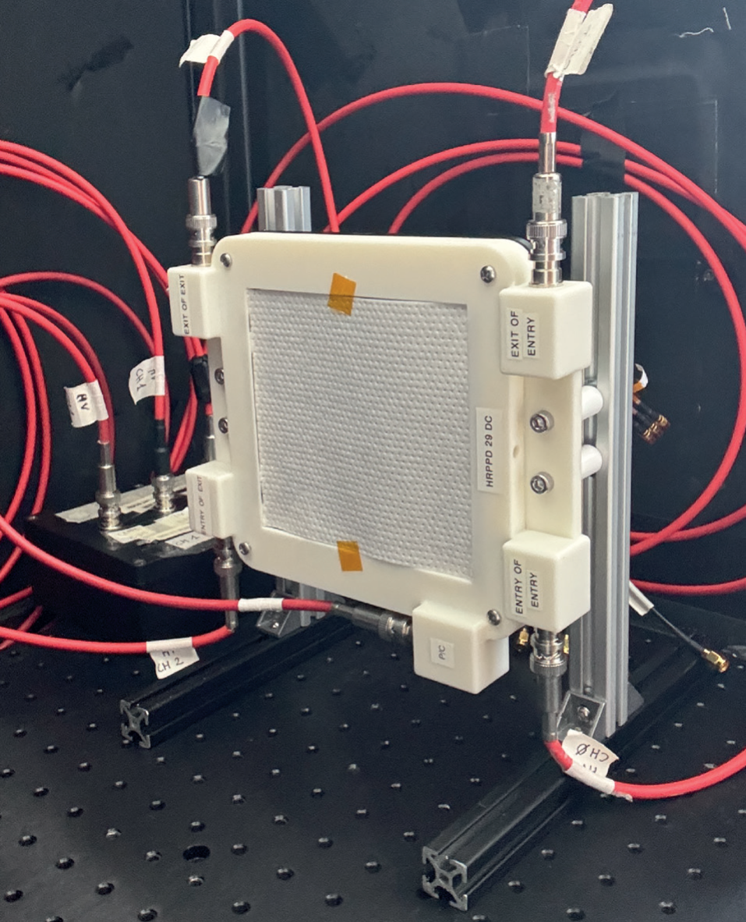
Photon Detectors – MCP-PMTs
Pros
  Excellent timing (~50 ps)
  Radiation hard
  Flexible granularity
Cons
  Currently saturate at photon rates too low for the high occupancy area of RICH1
  Limited integrated collected charge
Large area picosecond photodetector for the Upgrade II of the LHCb RICH

Slide 24
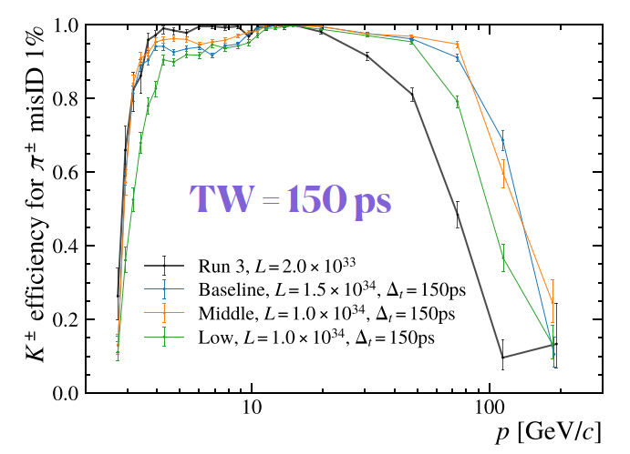
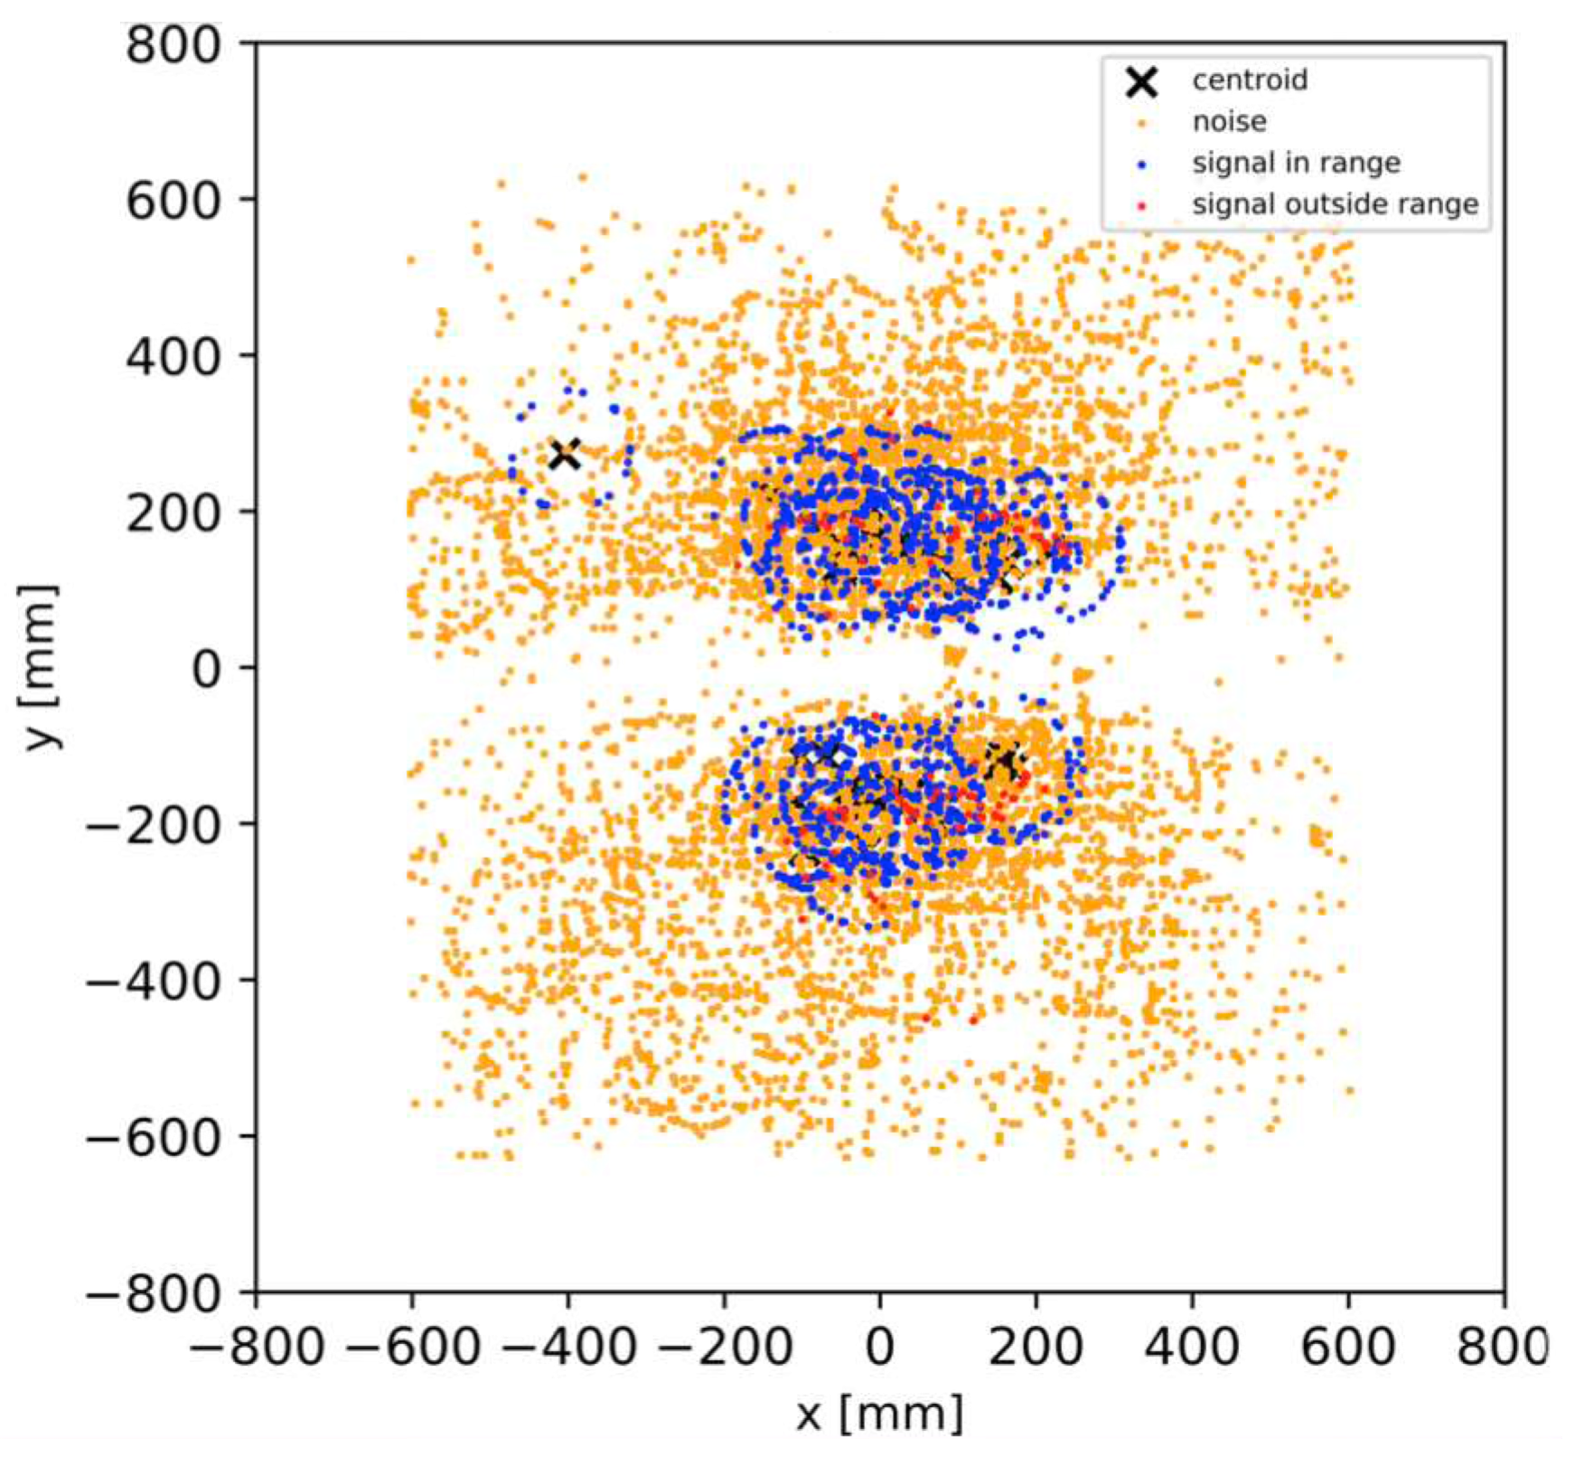
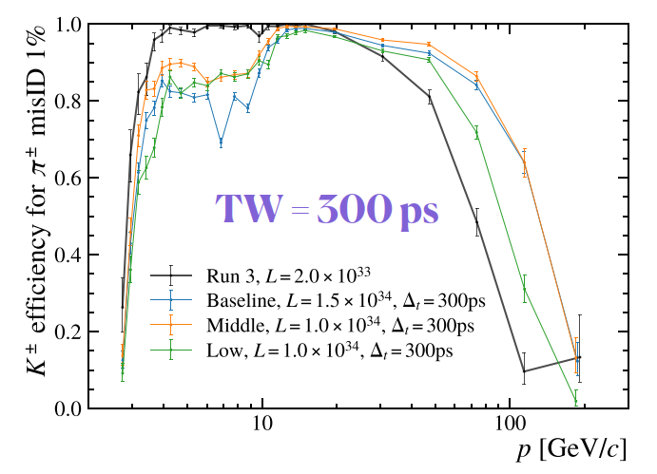
Introducing timing information
The time of arrival of a photon to the photon detectors can be predicted with an accuracy of a few ps
Time information can be used to reduce the complexity of RICH events, by selecting photons associated with particle tracks in both time and space
Requires timing information for the primary vertex
LHCb Upgrade II Scoping Document

Slide 25
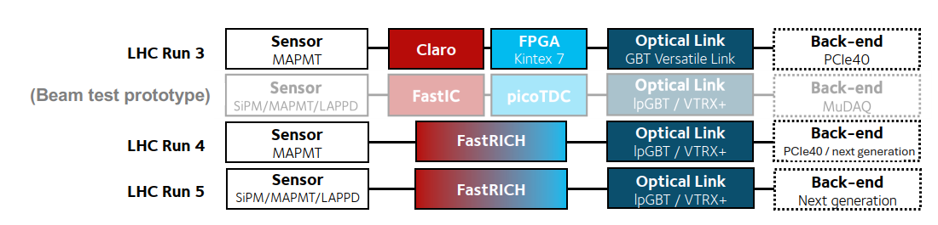
New Electronics
Taking advantage of LS3 to introduce electronics with timing capabilities
FastRICH ASIC
  16 channel with ~12 mW/ch power use
  24.4 ps TDC bins
  Better than 10 ns recovery time from typical signals
  Wide dynamic input range
    Compatible with MaPMT, MCP-PMT, SiPM
  Positive or negative polarity
Upgrade in steps

Slide 26
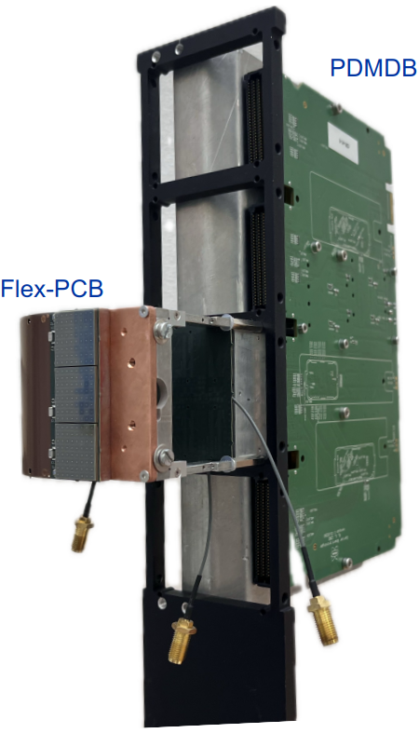
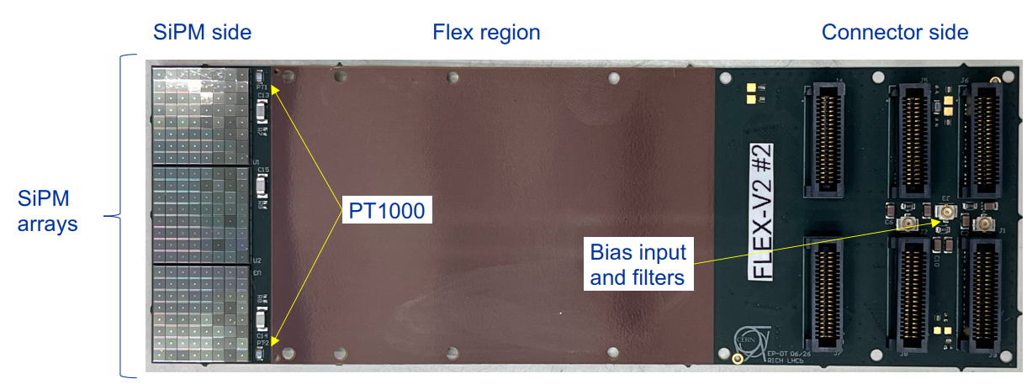
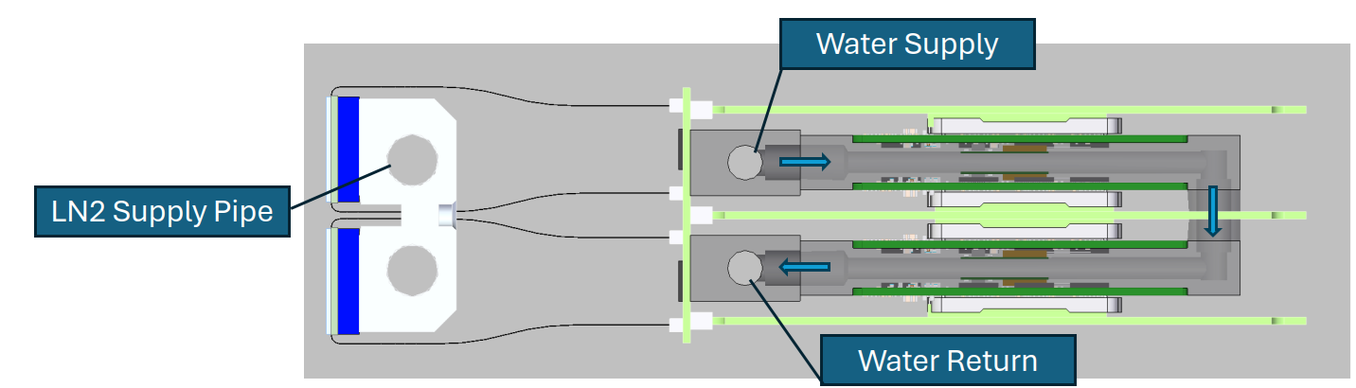
Latest Developments
Flex cable to thermally isolate photon detectors from readout electronics

Slide 27
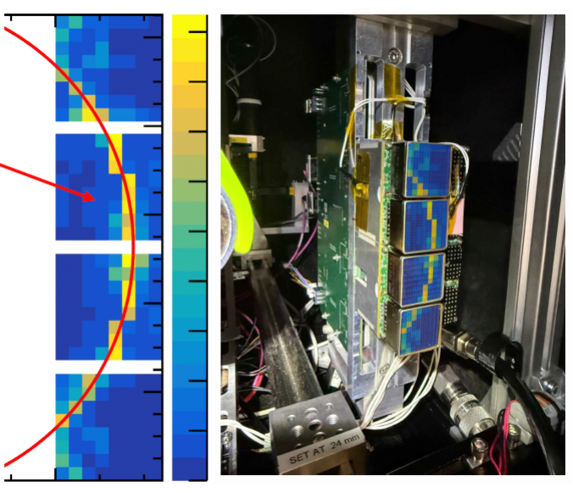
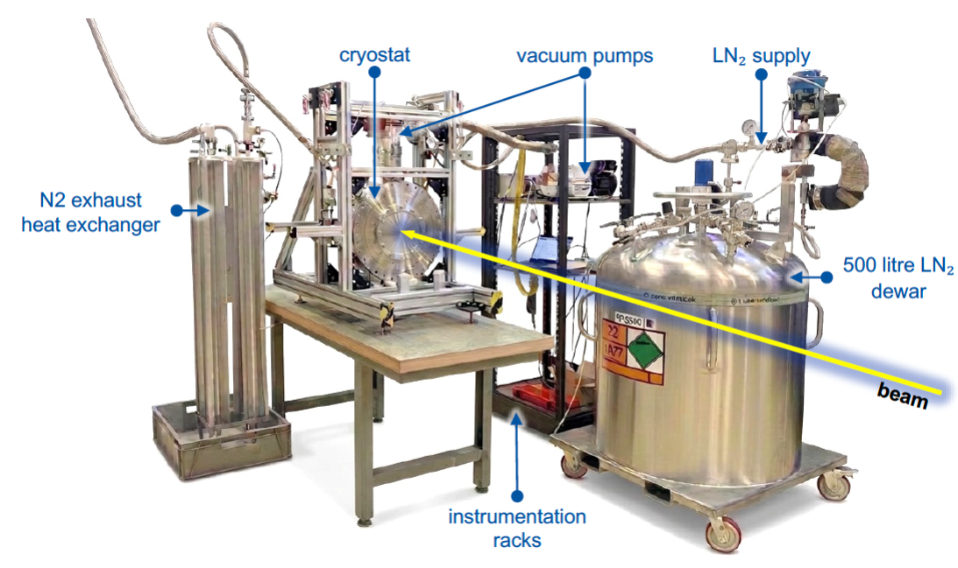
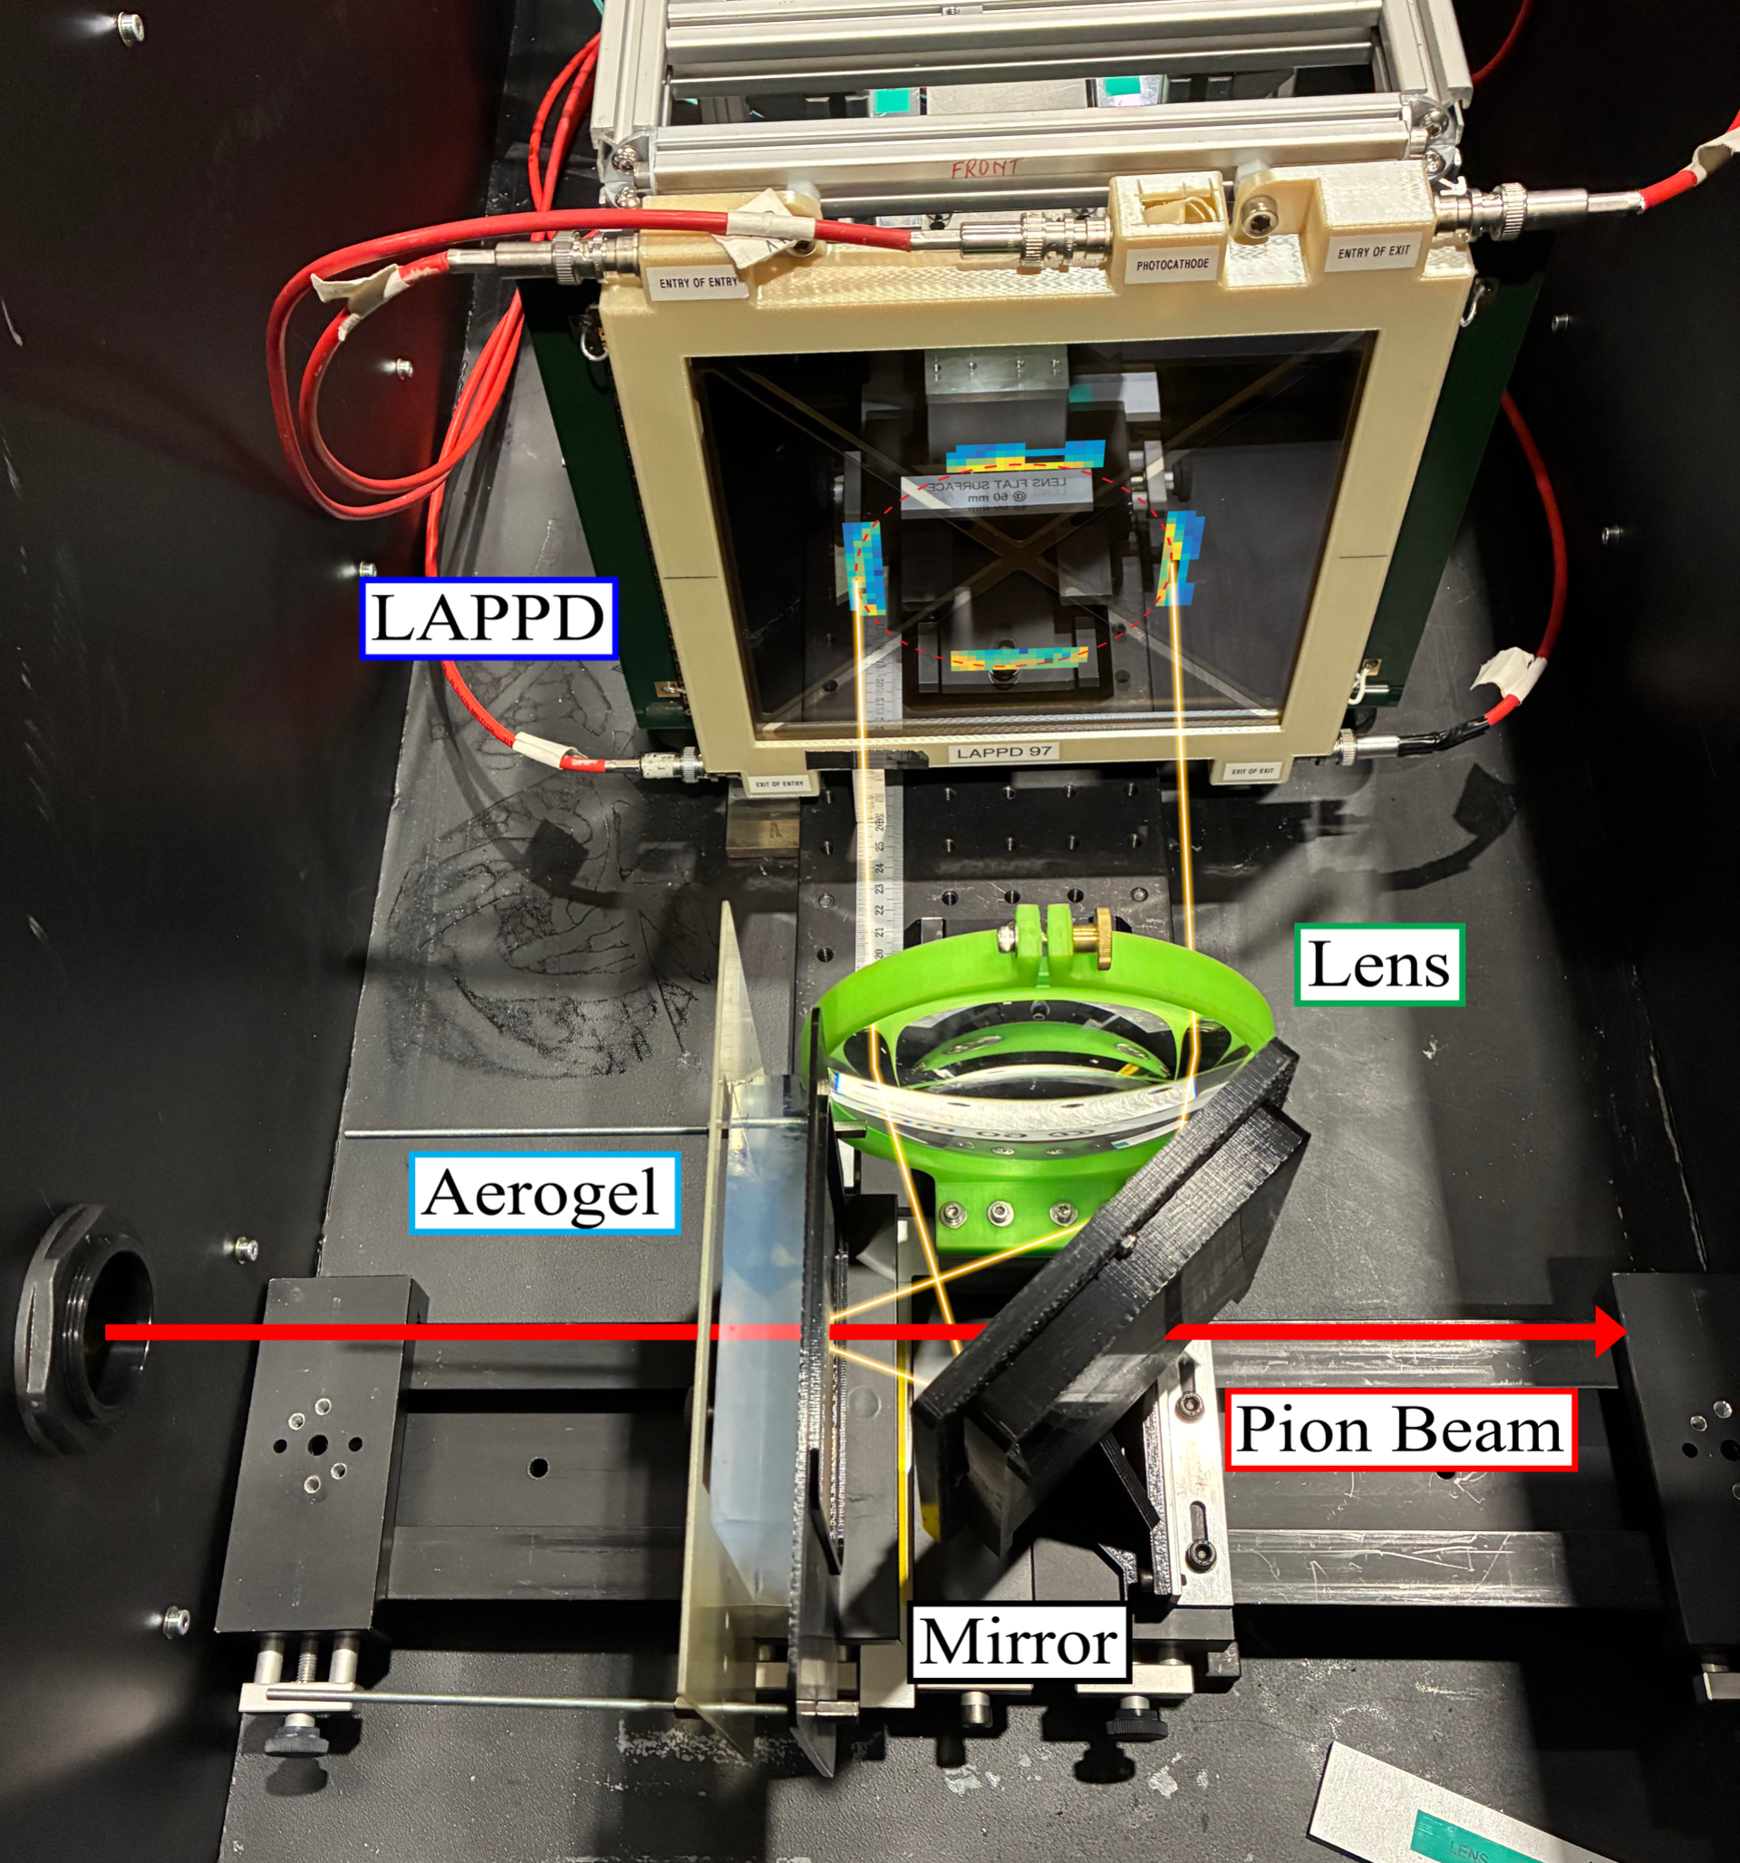
Test Beam Campaigns
Readout electronics and photon detector performance is being validated in beam tests at CERN PS and SPS with the use of solid and aerogel radiators testing for:
  Detector timing
  Number of photons
  Reliability of operation
Cryogenic SiPM test bench: integration and operation

Slide 28


Conclusions
RICH 2 mirrors
The LHCb RICH detectors have been providing excellent Particle ID performance since 2010, enabling the rich physics programme of LHCb
LHCb Upgrade I has successfully met the challenges of the increased luminosity, event complexity and radiation
LHCb Upgrade II is promising another big step in instantaneous luminosity providing new and exciting challenges

