Slide 1

R&D of the STCF Muon detector based on plastic scintillator
Jinghe Zhang, on behalf of STCF MUON Group
Lanzhou University
INSTR 2026 October 14, 2026

Slide 2
Contents
01
Introduction of STCF
02
Introduction of STCF Spectrometer
03
Design of Muon Detector
04
R&D of Plastic Scintillator Strip
05
R&D of Plastic Scintillator Detector Prototype
06
Summary

Slide 3
Introduction of STCF
01

Slide 4
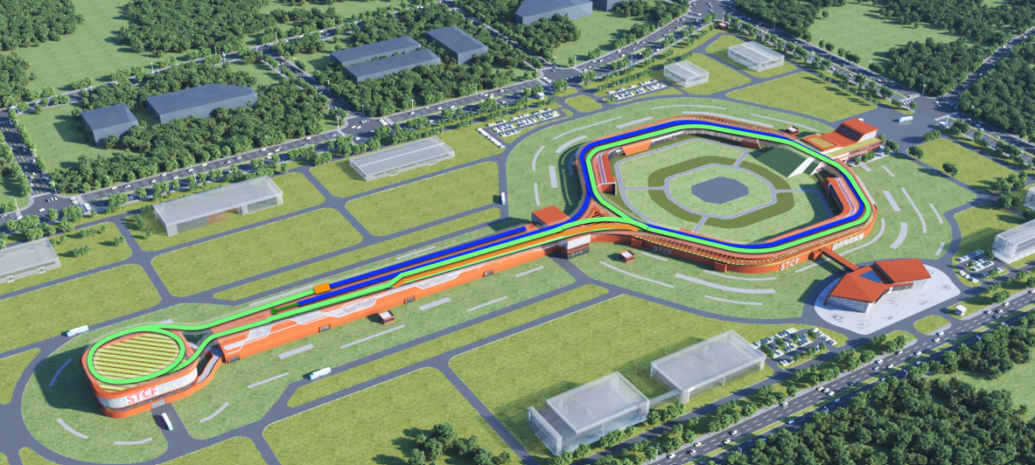
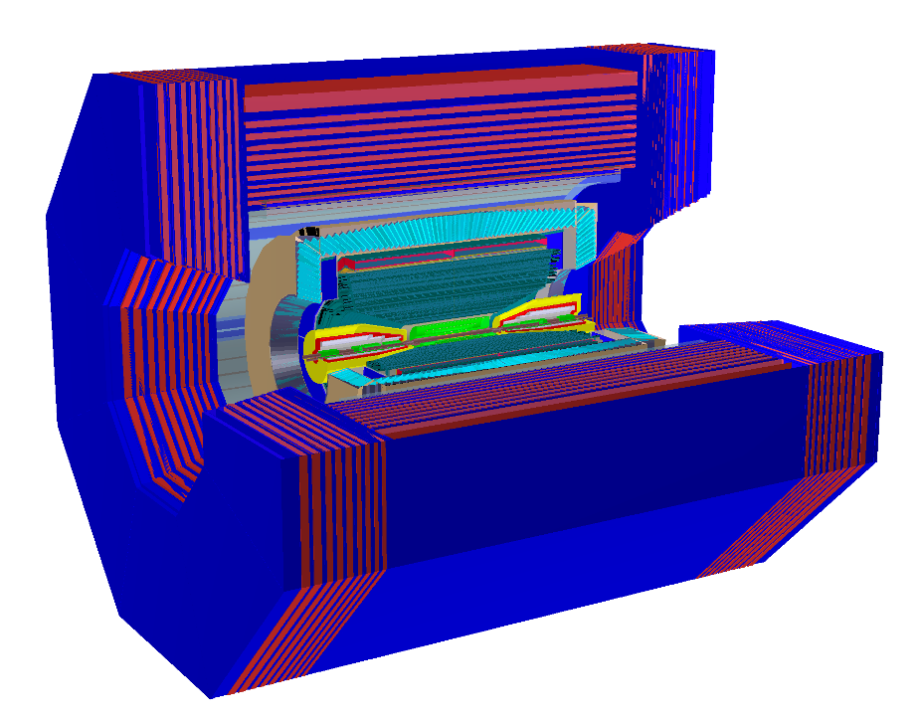
Introduction of STCF
New generation Spectrometer
Collider Ring
860 m
Multi-Linac
Total 550 m
Positron Damping Ring 150 m
Center-of-Mass energy coverage : 2-7 GeV;
Peak Luminosity > 0.5×10³⁵ cm⁻² s⁻¹ @ 4GeV
Potential to increase lumi. & realize beam polarization

Slide 5
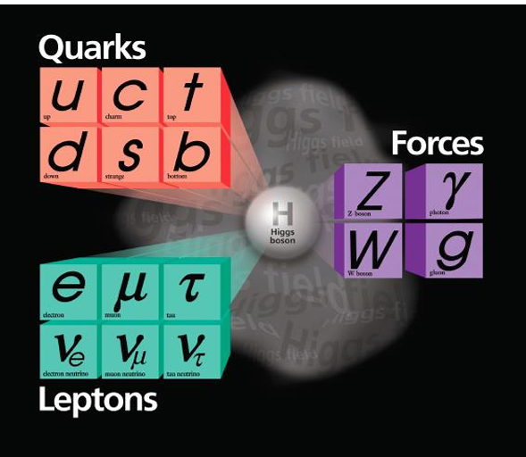
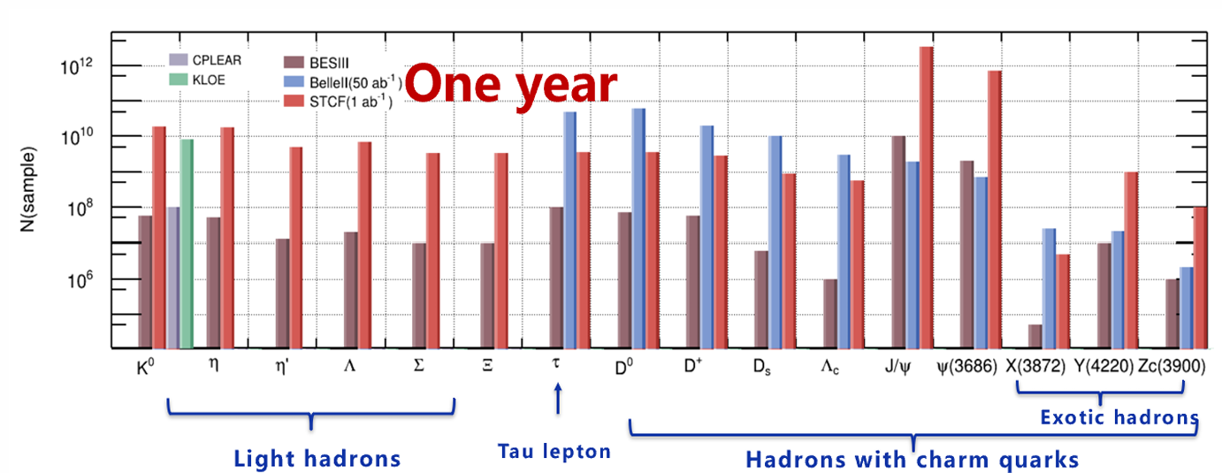
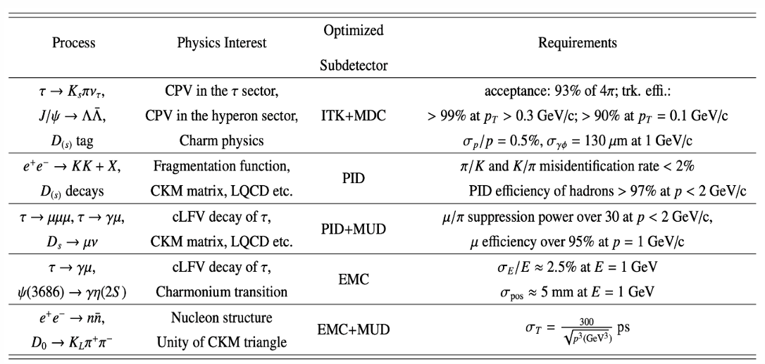
Introduction of STCF
Physics of the Tau-Charm Energy Region
Unique Wide Energy Coverage: The transition energy region between perturbative and non-perturbative QCD.
Rich Hadron Spectrum: Glueballs, multiquark states, hybrid states, etc.
Extremely High Production Cross Sections: Rich resonance structures, charmonium states, etc.
Threshold Production Effects: Hadron pairs and tau-lepton pairs, quantum correlations

Slide 6
STCF Spectrometer
02

Slide 7
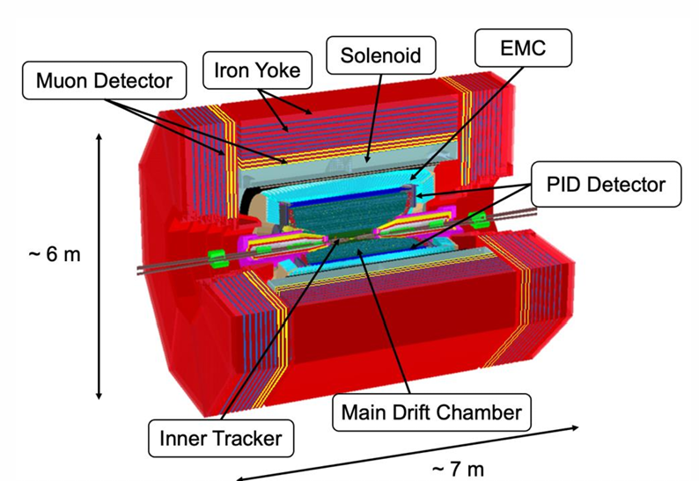
STCF Spectrometer
The spectrometer consists of Inner Tracker, Main Drift Chamber, PID Detector, EMC, solenoid magnet, iron yoke and Muon Detector.
Highly efficient and precise reconstruction of exclusive final states produced in 2-7 GeV e⁺e⁻ collisions.
High tracking efficiency.
high momentum resolution for low momentum charged particles.
precise measurement of low-energy photons.
Excellent PID：π/Κ and μ/ π separation in full momentum range

Slide 8
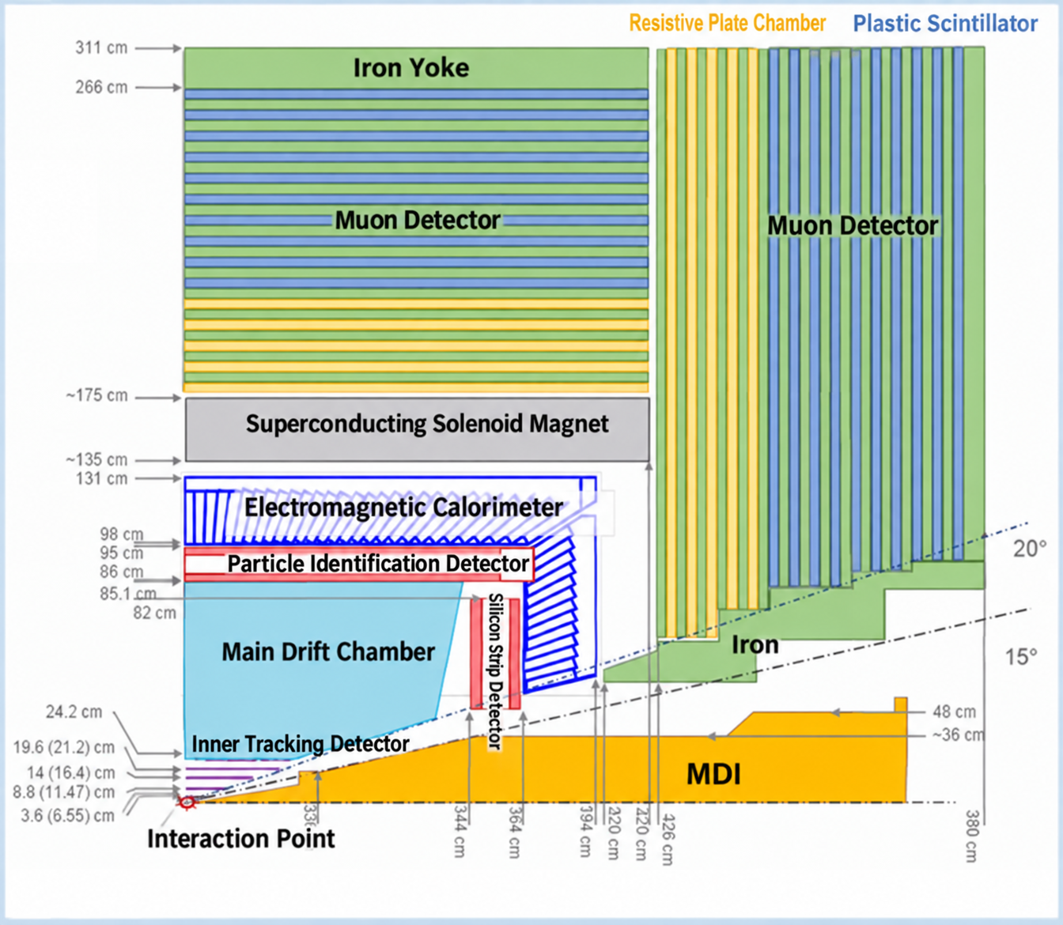
STCF Spectrometer
Inner Tracker (4 layers)
MPGD: cylindrical uRGroove, σ_{x} ~100μm
Silicon: low-mass MAPS, <0.3%X₀/layer
Main Drift Chamber (σ_{p}/p~0.5% @ 1GeV)
Small cells with helium-based gas, σ_{x} <130 μm
PID System (π/K ~4σ @ 2GeV, <0.3X₀)
Barrel: DIRC-like TOF - BTOF (σ_{t}~30 ps)
Endcap: RICH (<4mrad)
EMC
pCsI + APD + waveform readout: (σ_{E}/E~2.5%,
σ_{x}~5 mm @ 1GeV & ~1 MHz/crystal )
Solenoid ：1 T
Muon Detector (eff. >95%, mis-rate <3.3% @1GeV)

Slide 9
Design of the Muon Detector
03

Slide 10
Muon Detector design
Muon Detector (eff. >95%, mis-rate <3.3% @1GeV)
The planar detector is placed between the iron yokes.
Inner 5 layers : glass RPC，> 300 Hz/cm²
Outer 10 layers : plastic scintillator strip (WLS) + SiPM, ~ 2.4 m
Multilayer Iron + RPC/Scint. Hybrid system
RPC: fast response, not sensitive to neutral particles.
Plastic Scintillator: sensitive to neutral hadrons & background noise

Slide 11
R&D of Plastic Scintillator Strip
04

Slide 12
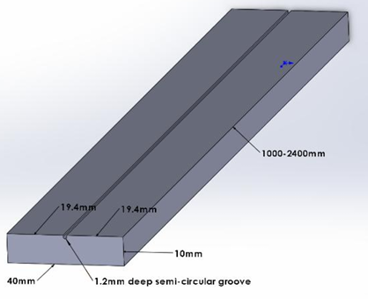
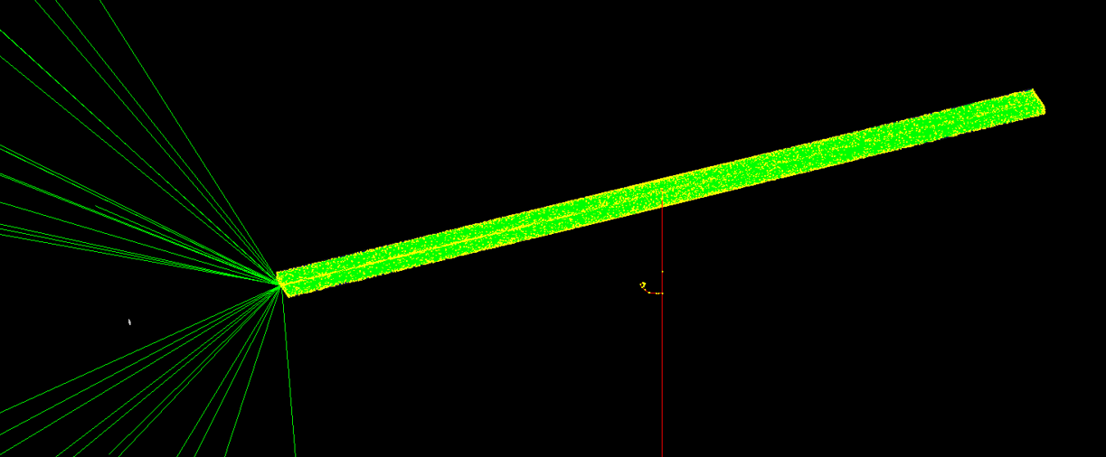
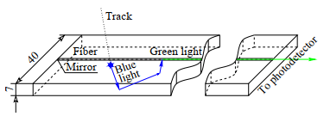
Plastic Scintillator Strip design and simulation
Single-ended SiPM readout
The end face of the plastic scintillator strip is 4 cm × 1 cm.
Embedded wavelength-shifting fiber.
Geant 4 simulation to optimize the design.

Slide 13
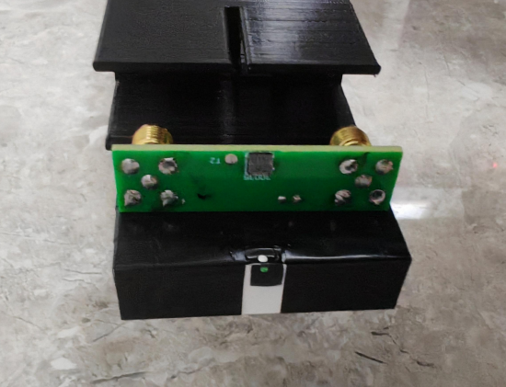
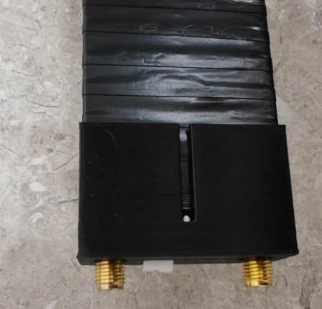
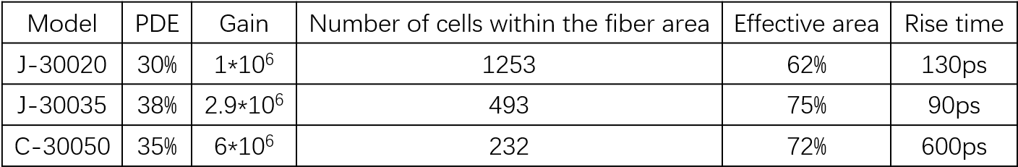
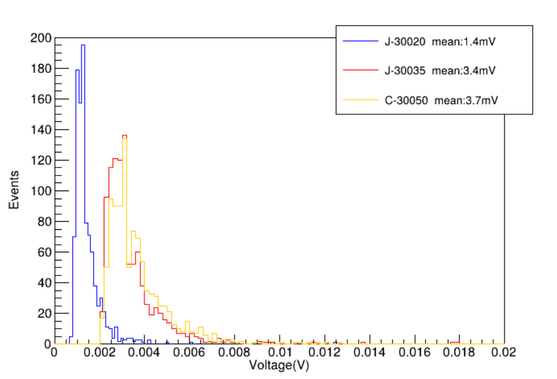
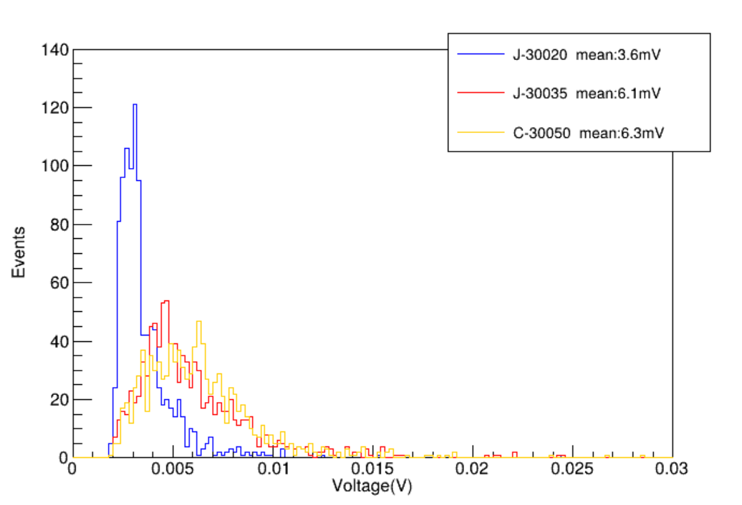
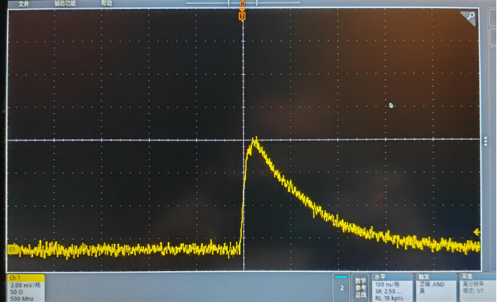
SiPM Selection Comparison
Compare the performance of three different SiPM models.
Compare the far-end and near-end energy spectra of cosmic-ray events.
Baseline selection: J-30035.

Slide 14
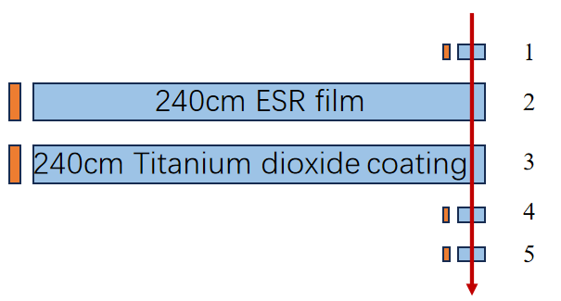
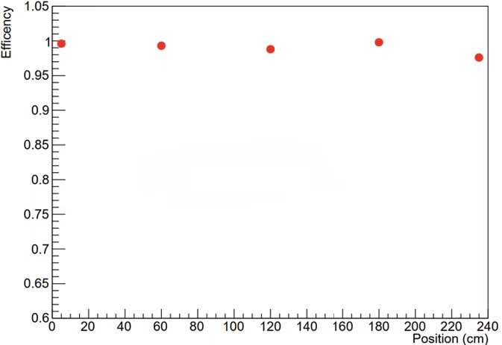
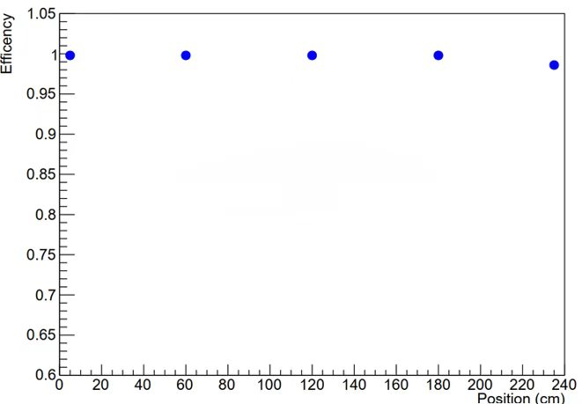
Plastic Scintillator Strip
Select vertically incident muon events.
Acquire waveform data using the DT5742 digitizer.
Carefully investigate accidental coincidences, noise, and threshold settings.
Detecting efficiency > 95%
Strip dimensions: 4 cm × 1 cm × 240cm
WLS: Kuraray Y-11, ϕ = 1 mm
Single‑end readout
240cm ESR film
240cm Titanium dioxide coating

Slide 15
R&D of Plastic Scintillator Detector Prototype
05

Slide 16
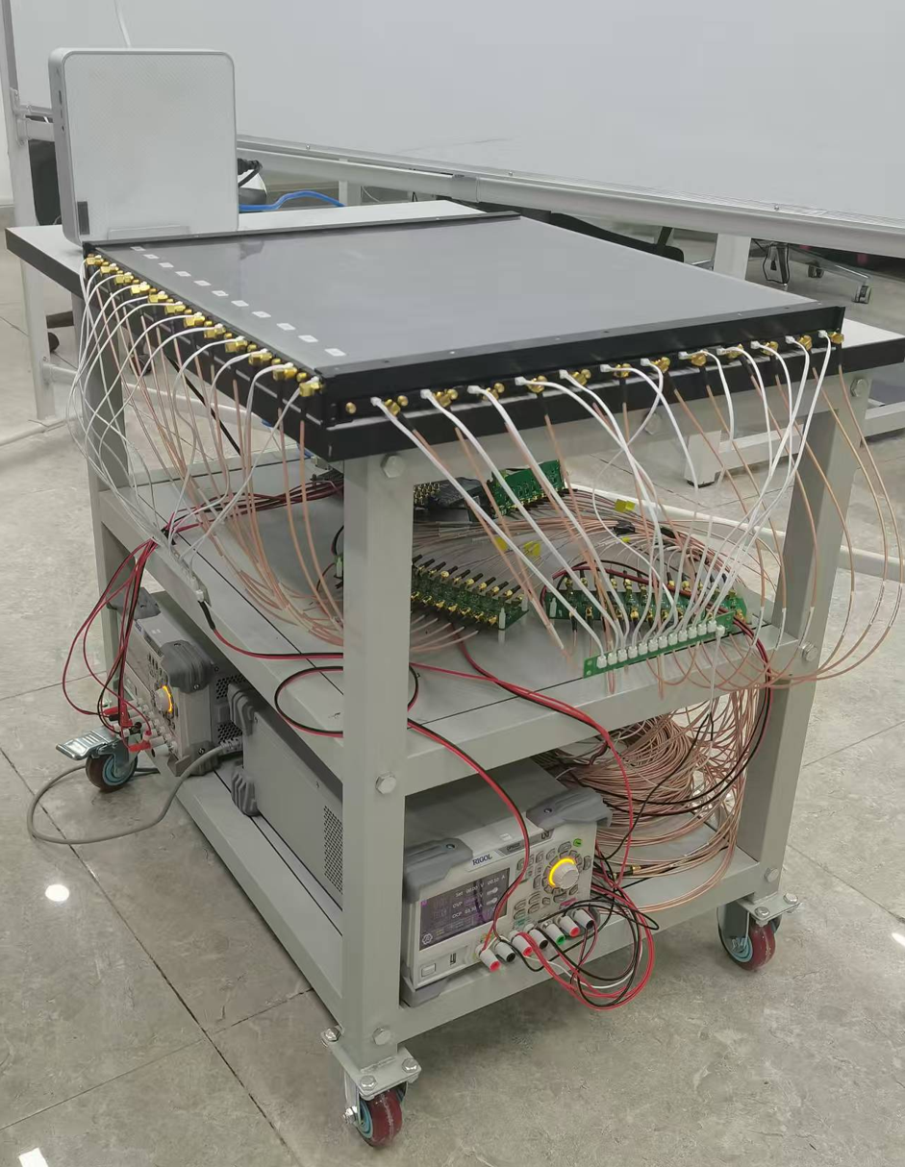
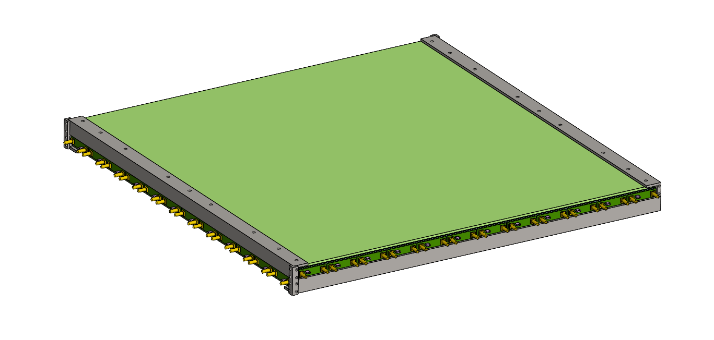
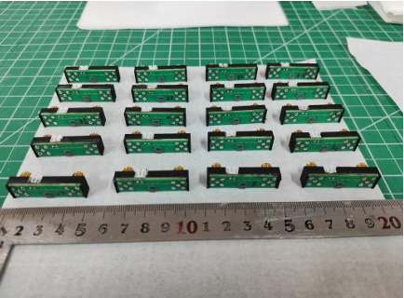
Plastic Scintillator Prototype
A small size prototype：50 cm × 50 cm
Iterative optimization of the mechanical support structure, interfaces, and components.
Two layers of single-ended readout plastic scintillator strips arranged in a crossed configuration.

Slide 17
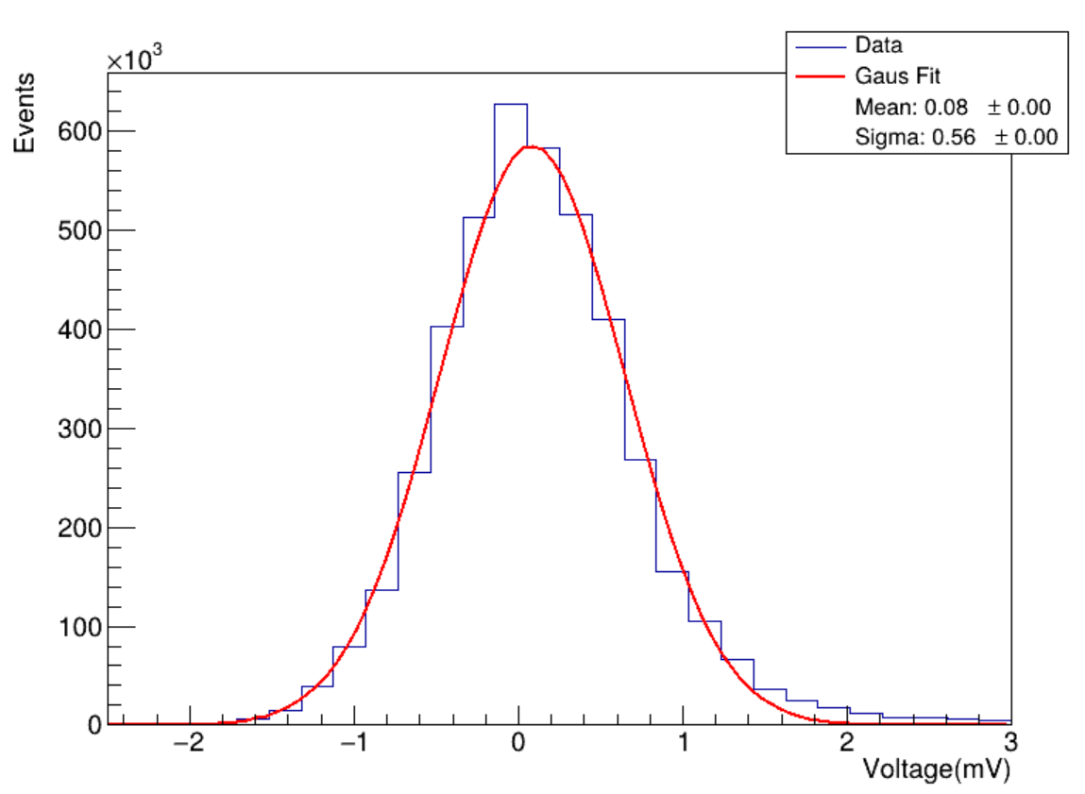
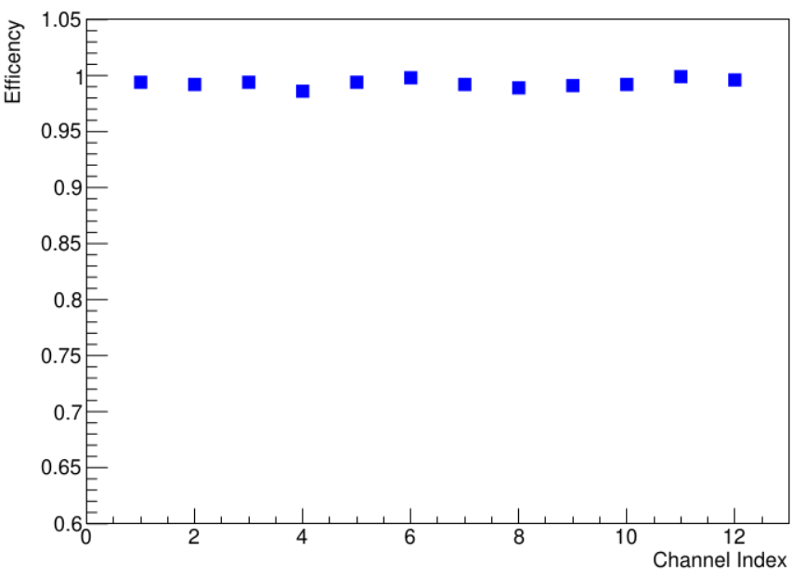
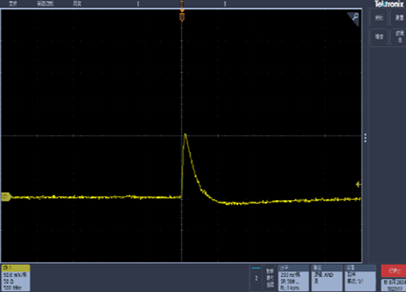
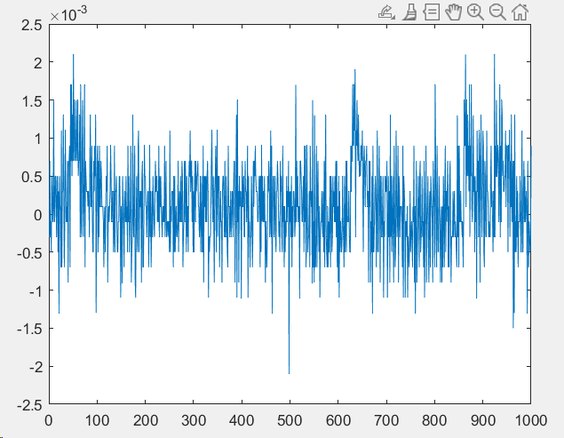
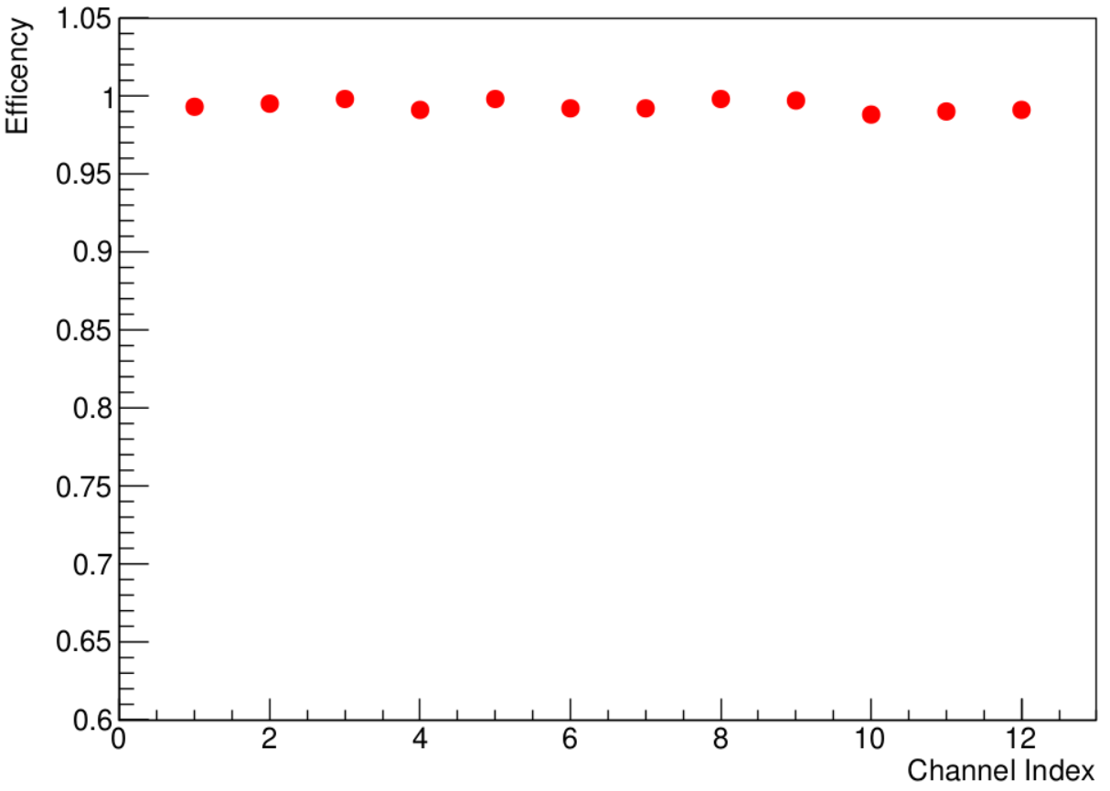
Plastic Scintillator Prototype
We studied the performance using cosmic rays.
Clear signal can be seen.
Noise level has been studied.
we can see high detection efficiency.
Cosmic ray test
Layer 1
Noise level
Cosmic ray test
Layer 2

Slide 18
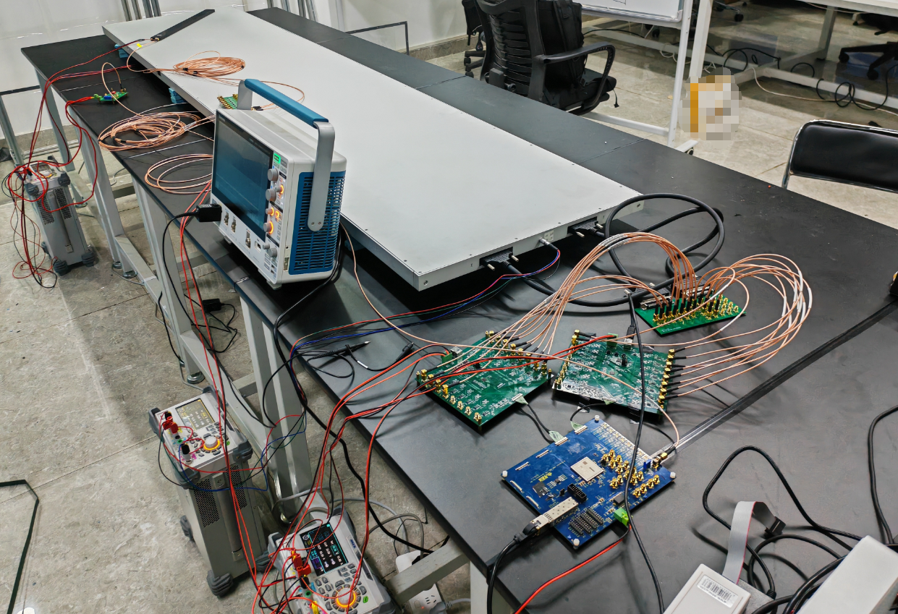
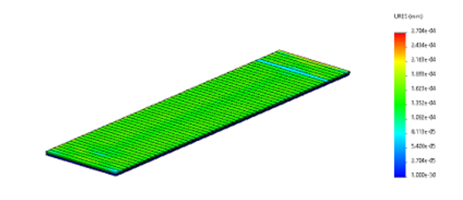
Plastic Scintillator Prototype
Planar prototype: 240 cm × 50 cm
two layers of crossed plastic scintillator strip
Focus on validating the performance of long scintillator strips, overall encapsulation, and mechanical fabrication techniques
PS Prototype
Simulation Analysis of Mechanical Stress
and Deformation of the Prototype
Data Acquisition in Cosmic-Ray Experiments
with the Prototype

Slide 19
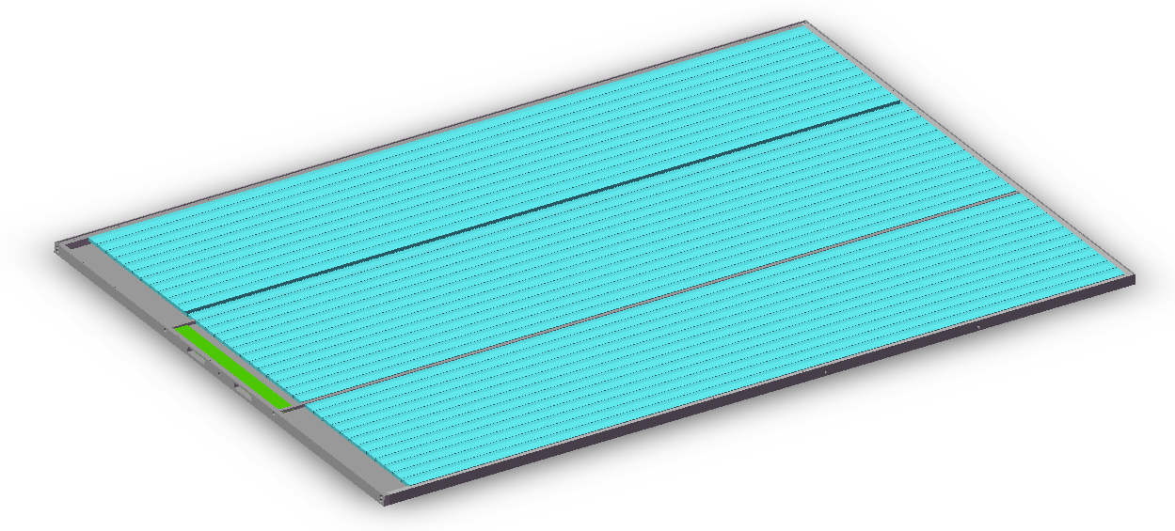
Plastic Scintillator Prototype
Planar prototype: 240 cm × 150 cm
Barrel 1:1 full-size module prototype
Mechanical Simulation on going
Optimizing supporting structure, interfaces

Slide 20
Summary
06

Slide 21
Summary
As a highly promising technology for the Muon Detector (MUD), the plastic scintillator detector has been adopted in the R&D of the STCF Muon Detector.
Design and prototyping are progressing smoothly, and several prototype versions have been successfully developed with performance satisfying the specification requirements.
We are currently conducting optimization and development of the full‑size detector‑module prototype.

Slide 22
Thanks for your attention!
2026/10/13

Slide 23
Backup

Slide 24
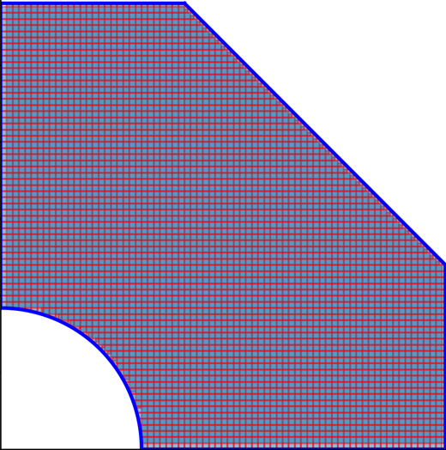
Plastic Scintillator Detector
Conceptual view of one super layer formed by plastic scintillator strips

Slide 25
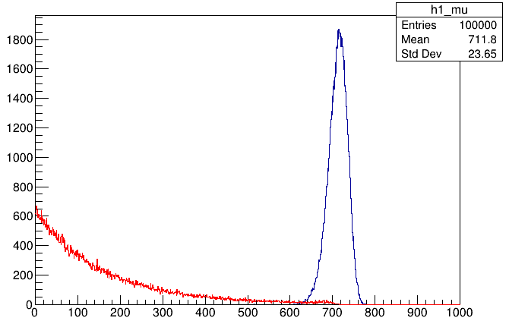
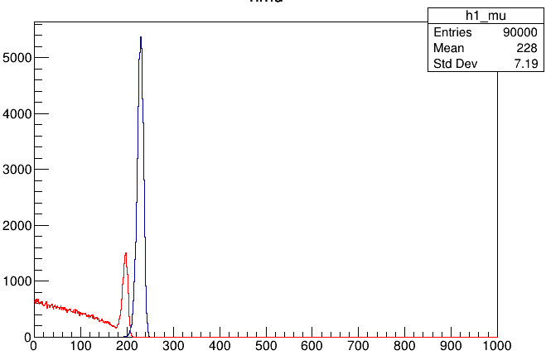
Principle of MUD
µ/π have similar masses
mµ=105.66MeV, mπ=139.57MeV
The π is different from µ for nuclear interaction and higher ionization energy loss
1000MeV
400MeV
The track length of muon/pion in iron
Track length (mm)
Track length (mm)

Slide 26
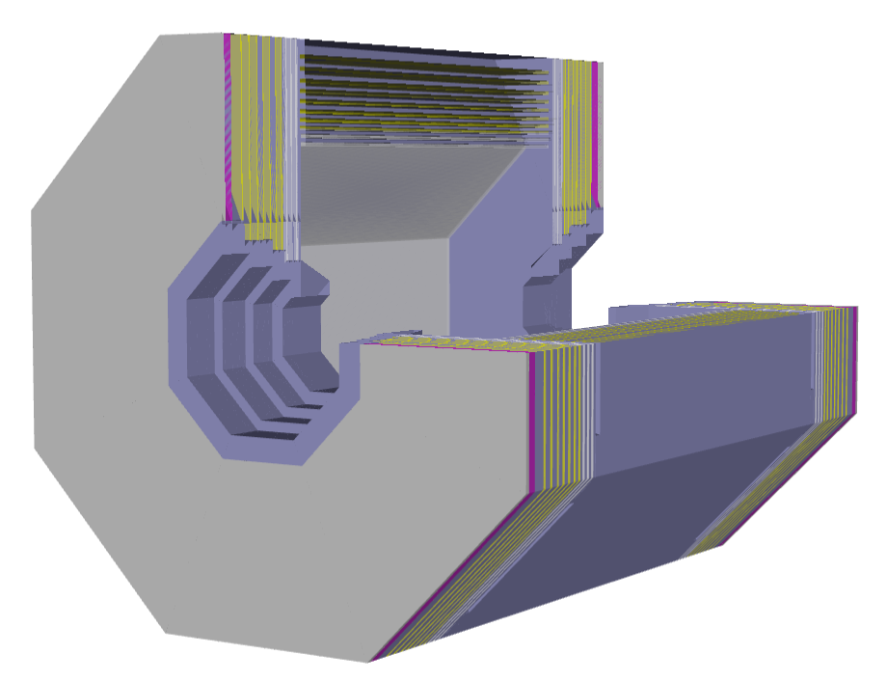
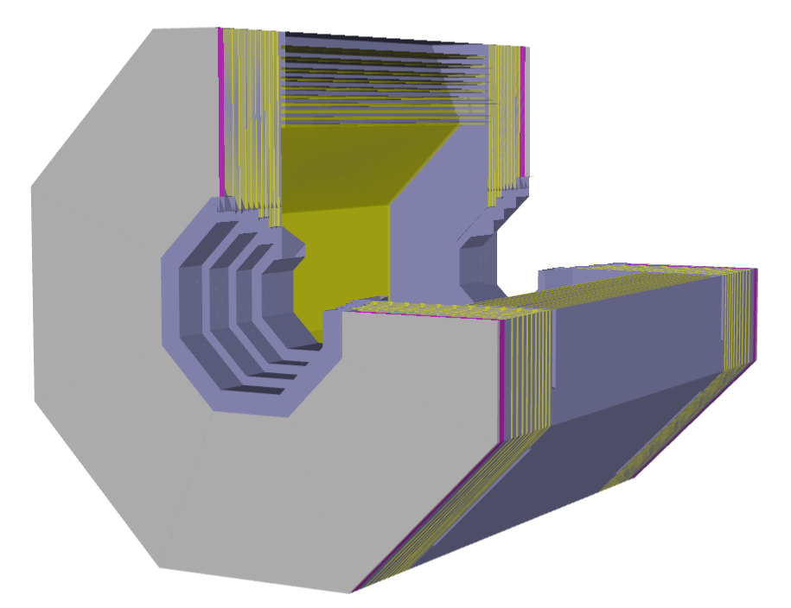
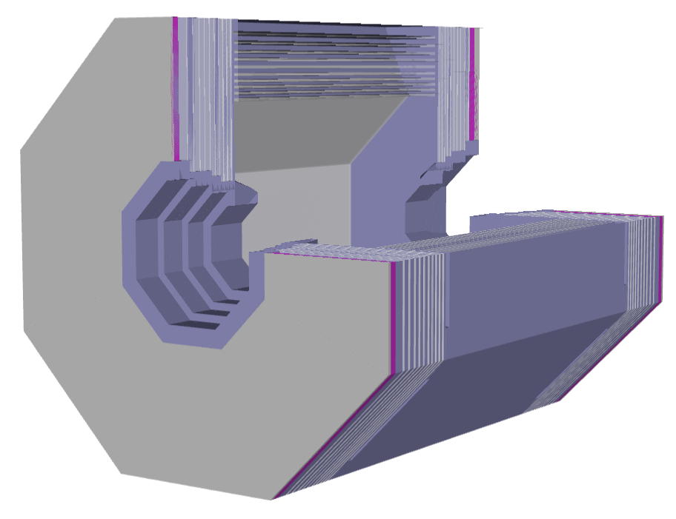
Muon Detector design
Three different detector design schemes are implemented in the official offline software framework OSCAR.
Hybrid 方案
Full PS 方案
Full RPC 方案

Slide 27
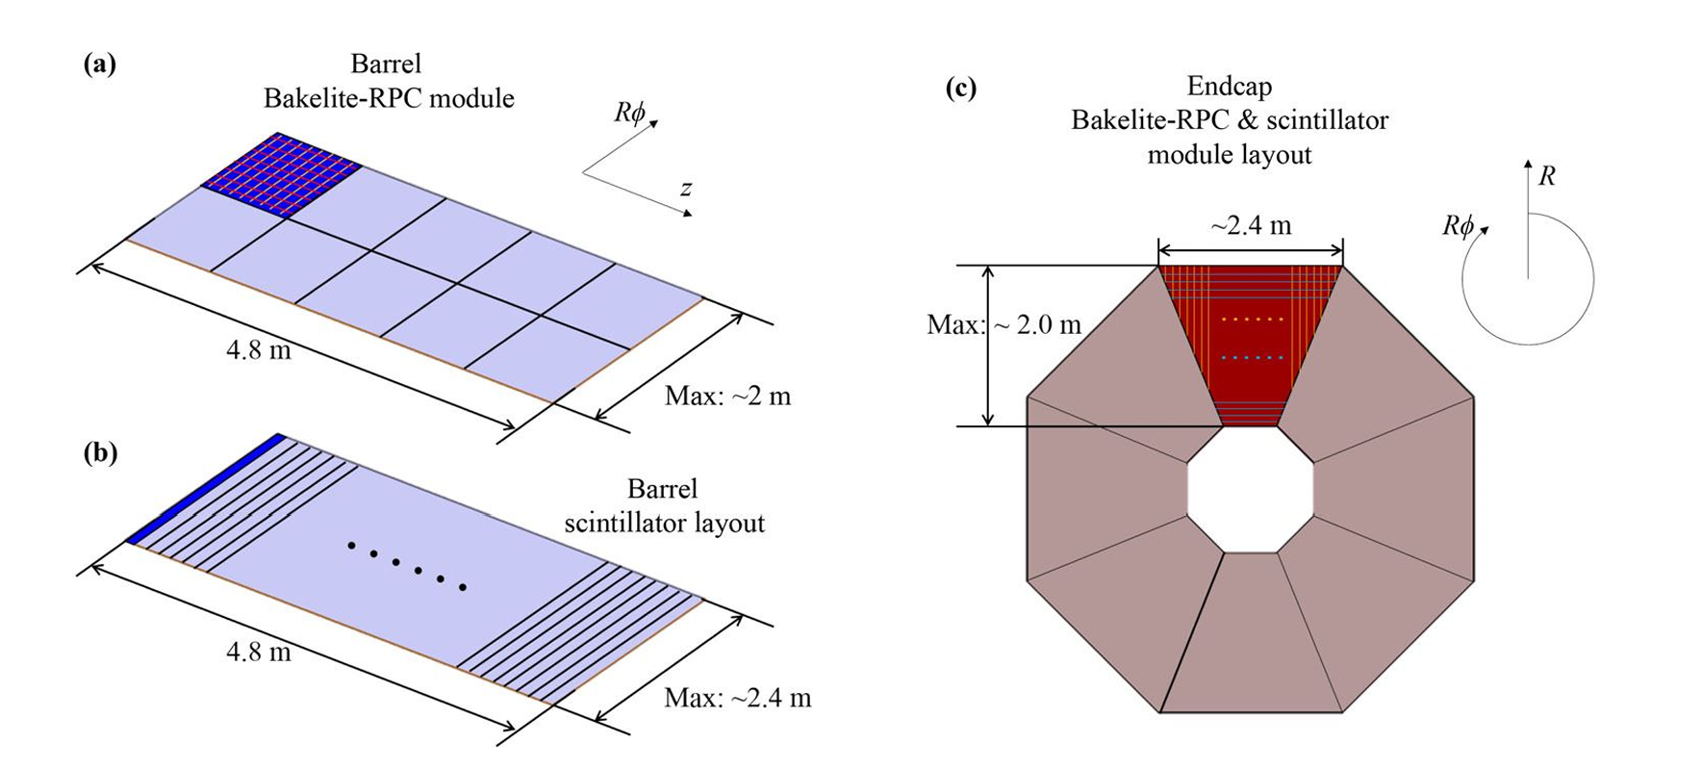
Design of Muon Detector from CDR

Slide 28
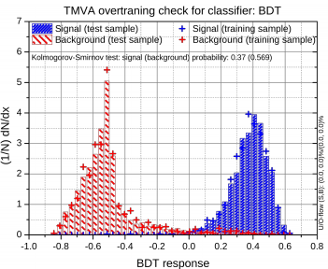
pion
muon
BDT cut
Distribution of BDT output

