Slide 1
Concept of Low-Material-Budget 4D Tracking System Based on Double-Sided LGAD Sensors
  Jerzy Pietraszkoª, Thomas Bergauer^{b}, Maurizio Boscardin^{d}, Jochen Frühaufª, Tetyana Galatyuk^{a,f,e}, Harald Handerkas^{b,g}, Henning Heggenª, Albert Hirtl^{g}, Mladen Kisª, Yevhen Kozymka^{f}, Sergey Linevª, Yanwen Liu^{c}, Giovanni Paternoster^{d}, Jiajun Qin^{c}, Christian Joachim Schmidtª, Michael Traxlerª, Michael Trägerª, Felix Ulrich-Pur^{b,g}, Matteo Centis Vignali^{d}, Robert Visinkaª, Lei Zhao^{c}
    ª GSI Helmholtzzentrum für Schwerionenforschung GmbH, Darmstadt, Germany
    ^{b} Austrian Academy of Sciences, Marietta-Blau-Institut for Particle Physics, Vienna, Austria
    ^{c} Department of Modern Physics, University of Science and Technology of China, Hefei, China
    ^{d} Fondazione Bruno Kessler, Trento, Italy
    ^{e} Helmholtz Forschungsakademie Hessen für FAIR
    ^{f} Technische Universität Darmstadt, Germany
    ^{g} TU Wien, Atominstitut, Vienna, Austria
Outline:
  Motivation: High-precision 4D tracking with a minimal material budget
  Applications:
  - Reaction T0 determination in fixed-target experiments: in-beam detector vs. timing layer
  - Pion beam tracking stations at SIS18
  - Ion CT systems for medical applications
  Detector Concept:
    - Sensor Technologies: Thin (<100 µm), double-sided TI-LGADs or AC-LGADs for 2D position measurement and precise timing
  - Low-Mass Interconnects: Polyimide/Al micro-cables based on CBM STS technology or Hyperon–Nucleon Spectrometer (H-NS) tracker
  - Dedicated Front-End Electronics: LATIC ASIC – low-noise analog front-end, TDC, and data concentrator
  Status & Outlook

Slide 2
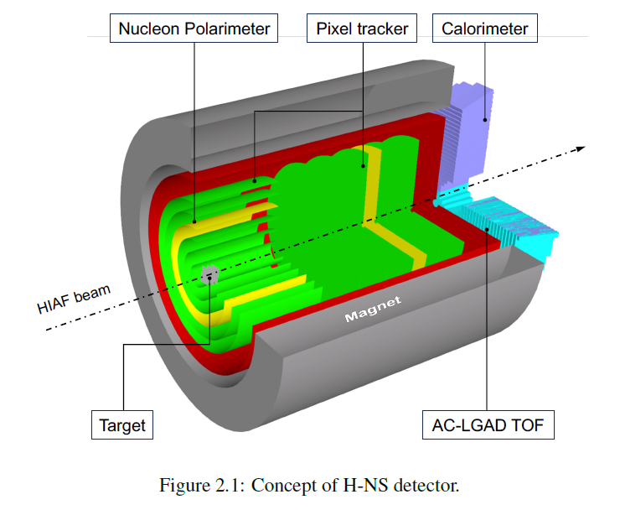
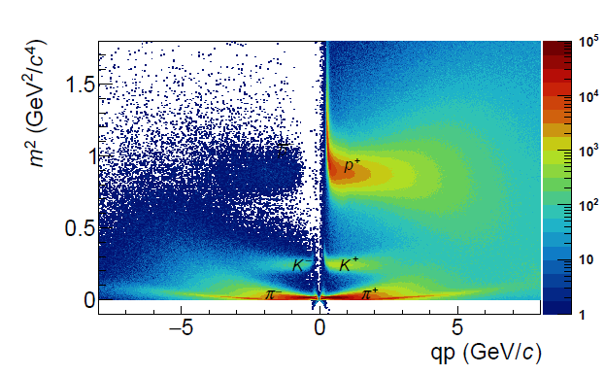
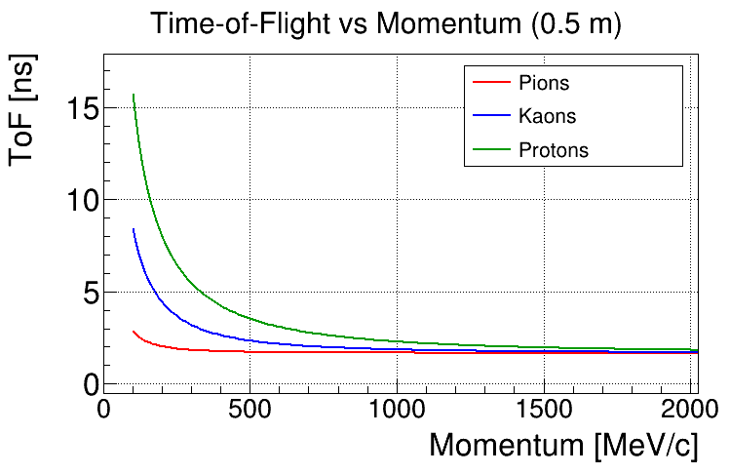
Fixed Target experiment - Precise T₀ determination
Timing layer (TL) instead of the first layer of the pixel tracker
Timing Layer (TL) vs. in-beam T₀ detector
  1% target interaction probability → rates on TL are ~100× lower than on in-beam T₀
  Small distance to the target → all tracks give the same T₀
  Example: 4 particles (100 ps resolution each) → event T₀ ≈ 100 ps / √4 = 50 ps
  Large area with adequate segmentation → no pile-up
  Very clean event selection up to 10⁹ beam particles/s → ~10 MHz interaction rate
  Low momenta → requires a low-material-budget TL
Can we realize a low-mass 4D tracking layer around the target?
In-beam T0 det
And/or a barrel-shaped timing layer (TL)
- Hyperon–Nucleon Spectrometer (H-NS) at the High-Intensity heavy-ion Accelerator Facility (HIAF).
- HADES at SIS18 (T₀ system and pion beam tracker)
- CBM at SIS100

Slide 3
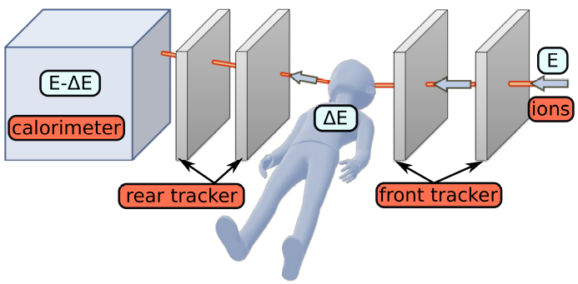
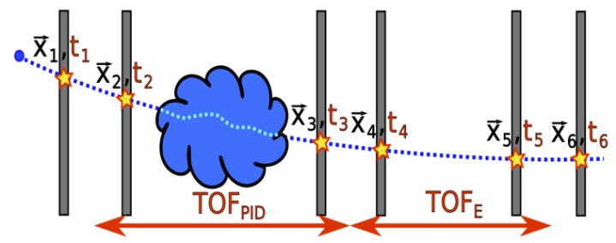
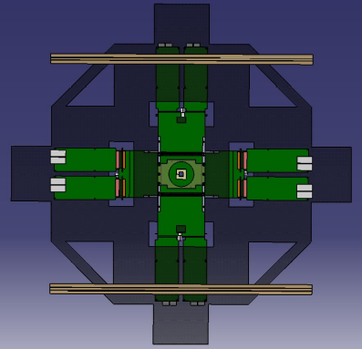
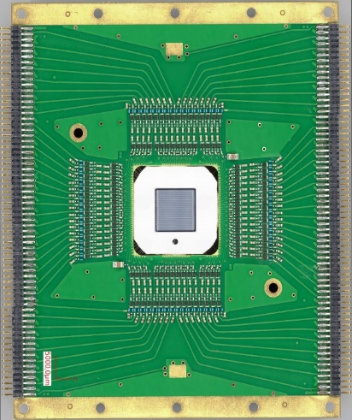
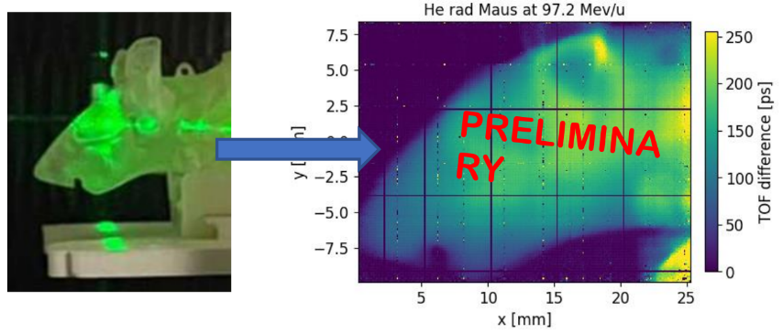
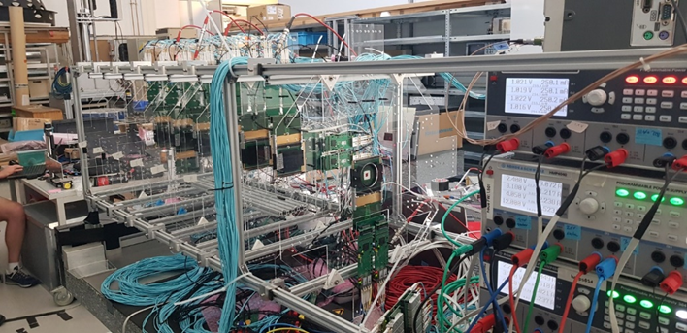
LGAD-based TOF-iCT – Medical Application
Ion Computed Tomography allows determining the relative stopping power (RSP) distribution inside a patient directly
  Improves treatment planning accuracy
  Requires tracking and energy measurement
Meeting all clinical requirements at once is challenging
  RSP accuracy < 1%
  energy resolution < 1%
  DAQ rate > 10⁶-10⁷ Hz
Low-Material-Budget 4D-tracking (LGAD-based) detectors would offer perfect solution
  Ulrich-Pur et al. 2022, https://doi.org/10.1088/1361-6560/ac628b
  Ulrich-Pur et al. 2023, https://doi.org/10.1088/1748-0221/18/02/C02062
  Ulrich-Pur et al. , https://indico.cern.ch/event/1455346/contributions/6323059/attachments/3009867/5306462/Ulrich-Pur_Felix_TOF-iCT_TREDI2025_250206_075654.pdf
TOF-iCT demonstrator - first experiments
First experimental TOF-based He radiography (TOF-HeRad) of a plastic mouse head
→ Larger active area urgently needed!
80mm
95mm
Sensor size: 2cm x 2cm max
→ ASIC needed !

Slide 4
Sensor Technologies: Thin (<100 µm), Double-sided Strip TI-LGADs or AC-LGADs for 2D Position Measurement and Precise Timing
  Advantages: Double-Sided LGAD Strips vs. Pixel Geometries
    Scaling: 2N channels (Strips) vs. N² (Pixels) for the same active area.
    Result: Drastic reduction in power consumption and front-end complexity.
    Ultrathin 50-100 μm Sensor Profile: reduced multiple scattering, critical for low-momentum (100 MeV/c) tracking.
    ASIC Thinning (≤100 μm): Readout chips can be thinned to match the sensor profile, maintaining a low X0.
  Thermal Management:
    Pixels: High power density directly on the sensor (LGAD/Silicon volume).
    Strips: Heat is dissipated through the peripheral cable/FEE, protecting sensor stability.
  Pixel/DS Strip Performance:
    Equivalent spatial resolution to a pixel matrix (40,000 pixel equivalents for 200+200 strips) in 2cm x 2cm Sensor with 100 μm pitch
    Ambiguity Resolution: "Ghost hits" are mitigated via high-precision timing (TDC) information.

Slide 5
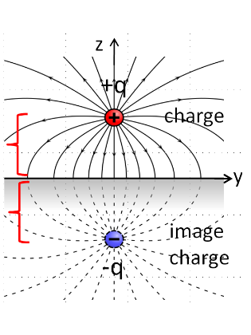


Double-Sided LGADs – The Principle of Operation
The classical electrostatic problem of a point charge near an infinite conducting plane and its movement
=
Surface charge density induced on an infinite conducting plane by a point charge Q located at distance h above it.
ρ = radial distance along the surface from the point closest to the charge
As ρ increases, denominator (ρ²+h²)^{3/2} grows rapidly
→ σ becomes smaller in magnitude
→ σ falls approximately as 1/ρ³ for large ρ
h
ρ
h
If we connect the conductor to a PS (constant potential) and if the charge moves from height h to h′ (even by a micron):
The electric field in space changes.
The surface charge density required on the conductor also changes.
Because the conductor must stay at exactly the same potential, charges must flow to/from the power supply to rearrange the surface charge.
This flow of charge is a measurable current — this is our signal.
The same mechanism as in Ramo's theorem and induced signals in detectors.

Slide 6
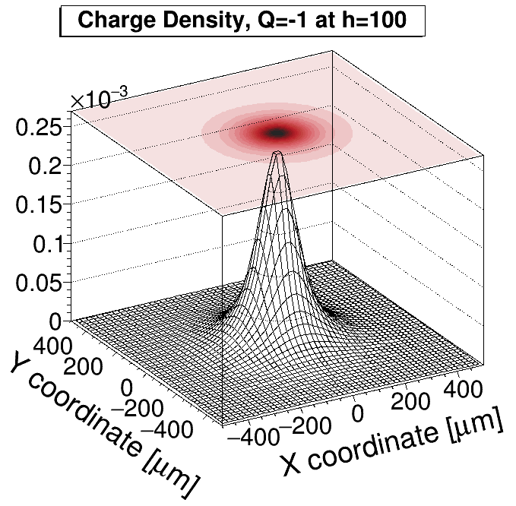
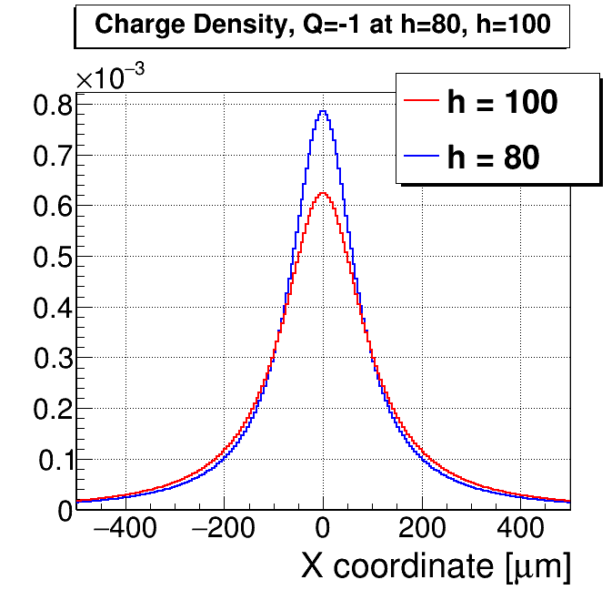
Double-Sided LGADs – The Principle of Operation
The classical electrostatic problem of a point charge near an infinite conducting plane and its movement
=
Surface charge density induced on an infinite conducting plane by a point charge Q located at distance h above it.
ρ = radial distance along the surface from the point closest to the charge
As ρ increases, denominator (ρ²+h²)^{3/2} grows rapidly
→ σ becomes smaller in magnitude
→ σ falls approximately as 1/ρ³ for large ρ
Small charge displacement matters:
Shifting a charge by 20 µm causes a strong redistribution of induced surface charge at constant potential.
Signal formation:
The redistribution produces a transient current measured by the FEE.
Polarity flip:
Electrodes above and below the charge see signals of opposite sign.
Constant charge used for illustration; real detector signals involve time-dependent charge.

Slide 7
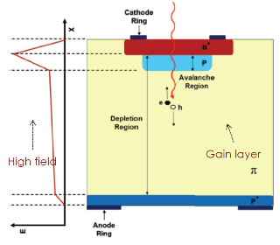
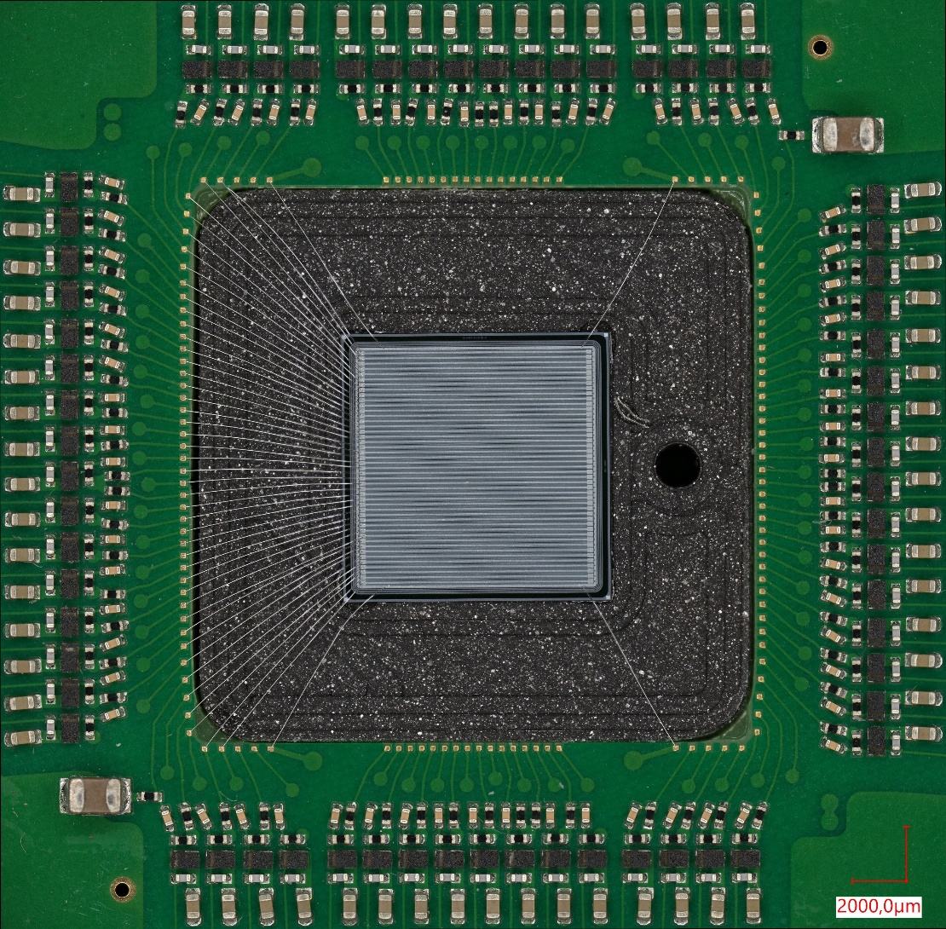
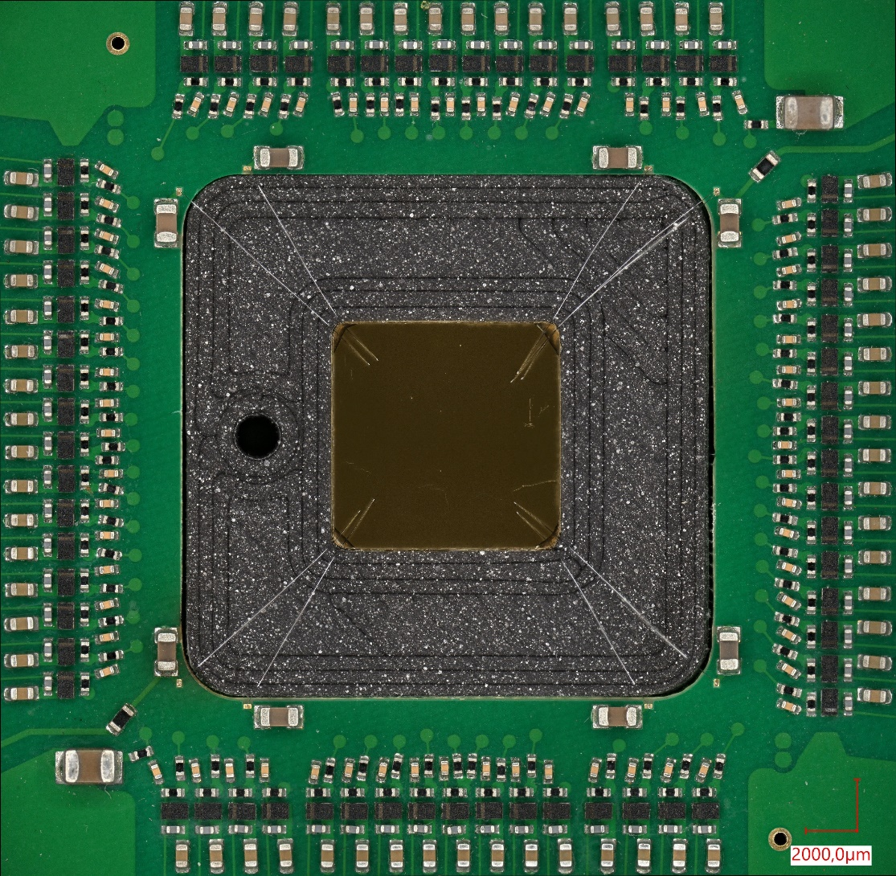
Double-Sided LGADs – From Single-Sided to Double-Sided
Sensors used for this prototyping: HADES LGAD sensors produced by FBK
200 µm total thickness / 85 µm active thickness; 100 µm pitch, size of 1cm x 1cm.
Strip geometry
HV Side – uniform Au layer
support Si layer p++
N. Cartiglia, Tredi 2015
G. Pellegrini, et al. NIM A765 (2014) 12–16
  Strip geometry: Segmented strip implants on top of segmented Gain Layer
  Active Volume: Drift Region: high-resistivity bulk: lightly doped silicon.
  Mechanical & Electrical support layer: low-resistivity, acting as the anode.
  Au Metallization: Uniform metal deposition on the backside, biasing
  For double-sided LGADs, segmentation on the HV backplane is essential.
  Nomenclature: Al side (gain-layer Al strips) and Au side (HV-side Au metallization).

Slide 8
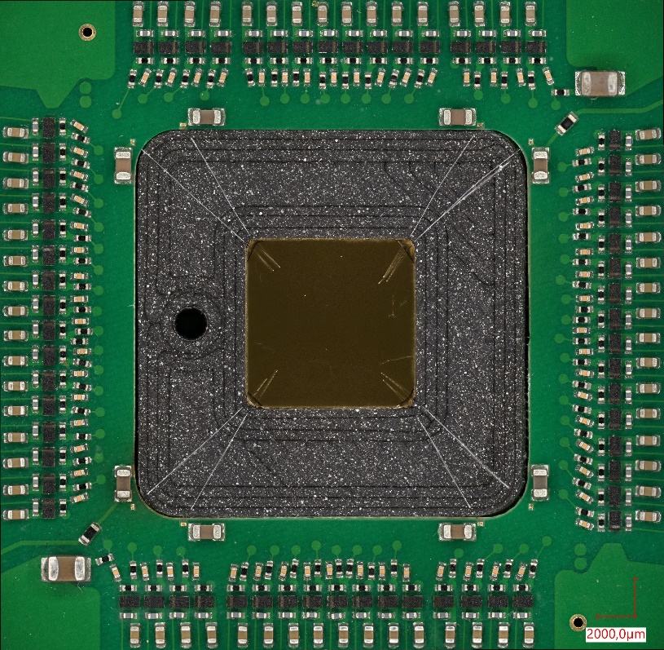

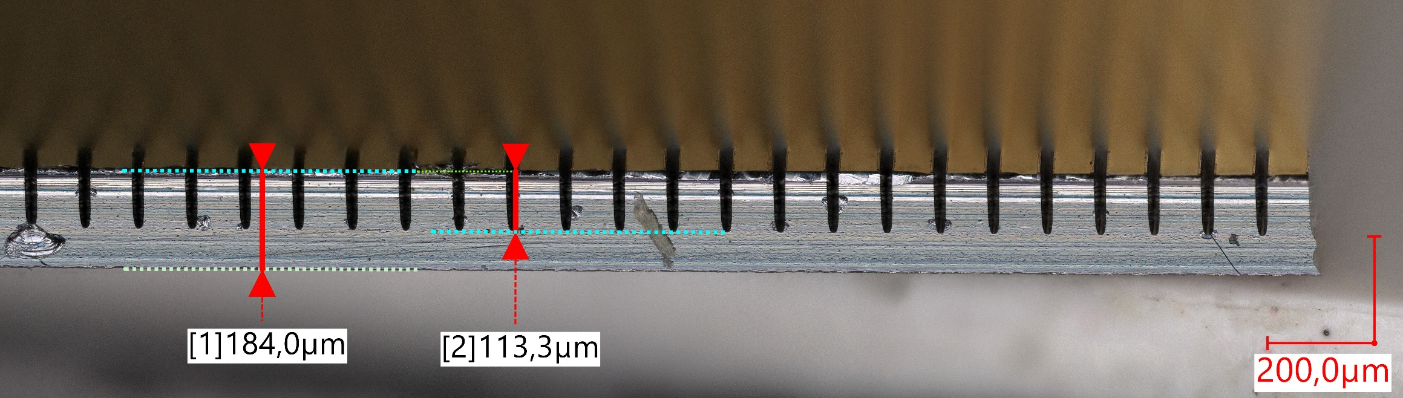
Double-Sided LGADs – The Principle of Operation - Segmentation
Sensors used for this prototyping: HADES LGAD sensors produced by FBK
200 µm total thickness / 85 µm active thickness; 100 µm pitch, size of 1cm x 1cm.
HV Side
uniform Au layer
Trenches on HV side
Trenches on HV side – Side view
  Conductive sensor surface on Au side is divided into parallel strips using insulating trenches
  ( machined at Hahn-Schickard Gesellschaft Villingen-Schwenningen, Germany )
  Each strip is biased to the same HV via an individual high-ohmic resistor.
  Additional high-ohmic resistance between strips ensures controlled potential equalization.
  Local charge deposition stays confined to individual strips → good position resolution, see previous slide
  Each strip is AC-coupled to its amplifier through a capacitor on PCB (HV is blocked).
  Readout electronics see only the fast signal, not the high-voltage bias.
  Result: Clean segmentation and precise position sensitivity; however, high dark current (100 µA @ 100 V). Trench machining requires optimization.

Slide 9
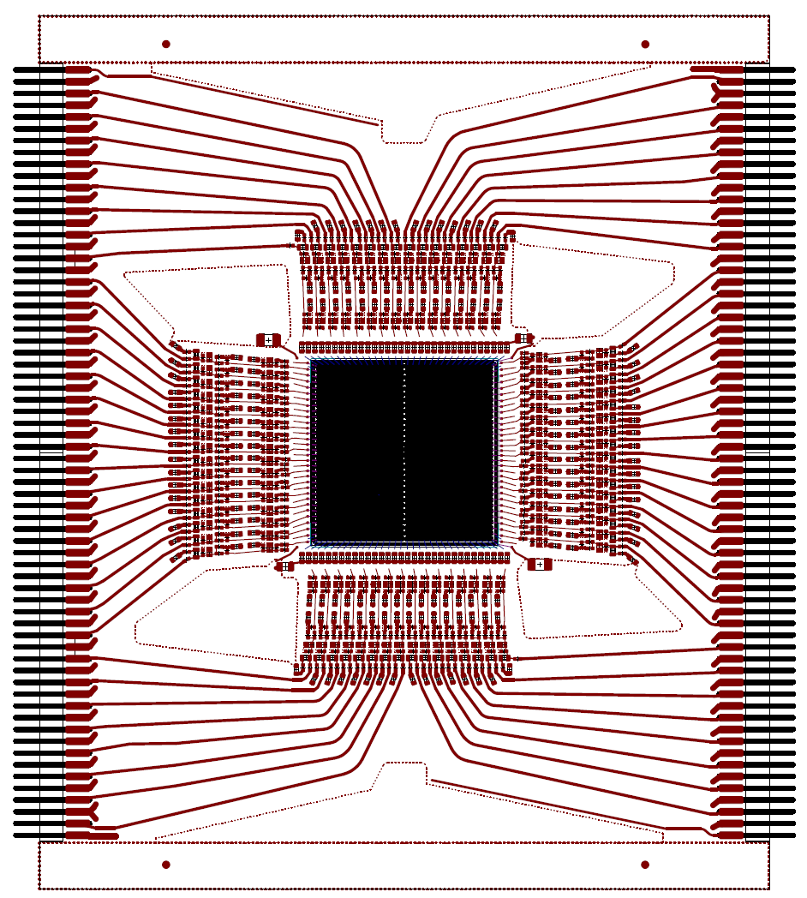
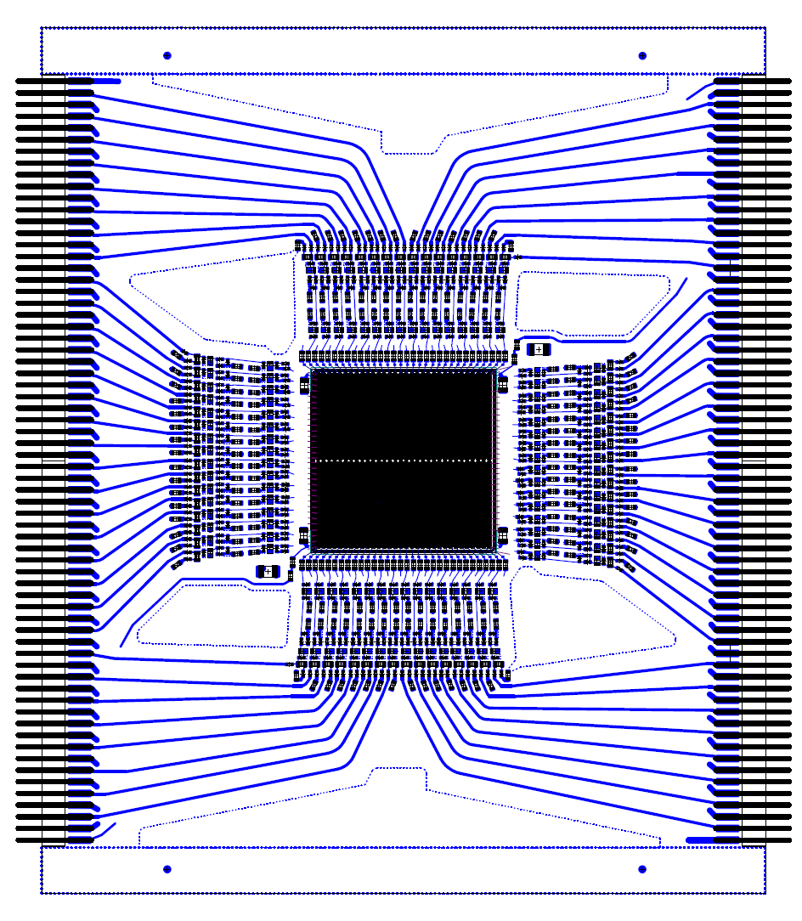
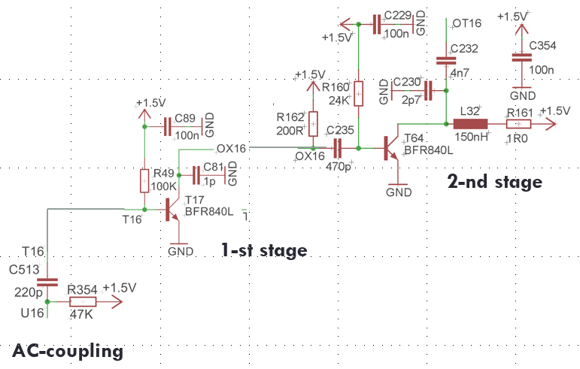
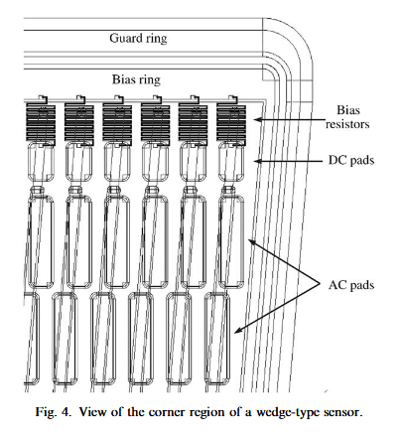
Double-Sided LGADs – A Dedicated FEE
The front-end electronics must provide three key functions:
  signal amplification,
  stable high-voltage biasing, -> can be done on sensor (CMS/CBM)
  reliable decoupling of the sensor signals -> can be done on sensor, AC coupling (CMS/CBM)
Jerzy Pietraszko et al 2025 JINST 20 C08007, https://doi.org/10.1088/1748-0221/20/08/C08007
© W.Koenig, GSI
Amplifiers (128 channels / 64 on each side)
  AC coupled
  Singe/Double sided (X/Y) measurement in one sensor possible (LGAD/Diamond)
  50-60ps for MIPs
  30ps for C ions
  Voltage gain: up to 400
+ HV biasing
+ AC signal decoupling
-> Can be done on the sensor (CMS/CBM)
M. Krammer et al., "The silicon sensors for the CMS tracker" Nucl. Instrum. Methods Phys. Res., A 531 (2004) 238-245
Resistor: Polysilicon Bias Resistor (The "Snake")
AC Coupling: Dielectric material (typically thermal Silicon Dioxide, SiO2​, combined with Silicon Nitride, Si3​N4​) and Al strip on top

Slide 10
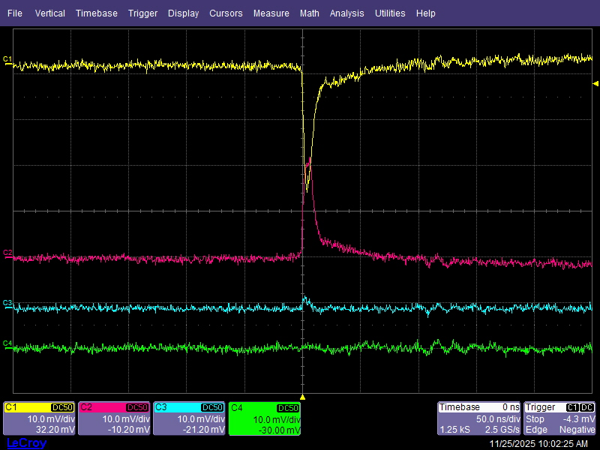
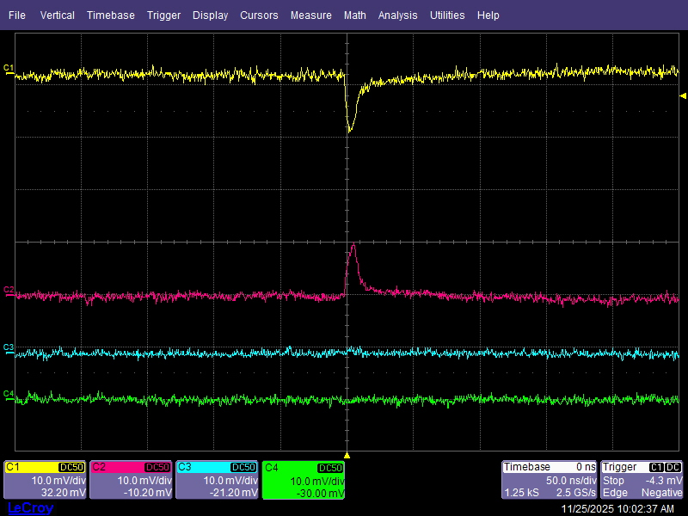
⁹⁰Sr radioactive source test
  Oscilloscope connection scheme:
  C1: negative signal, from the original strips (on the gain layer side – Al side)
  C2, C3, C4: positive signals from the strips on the HV side – Au side; the strips on both sides are parallel to each other
  The strips connected to C1 and C2 are positioned directly on top of each other.
Signal amplitudes of C1 and C2 clearly correlated

Slide 11
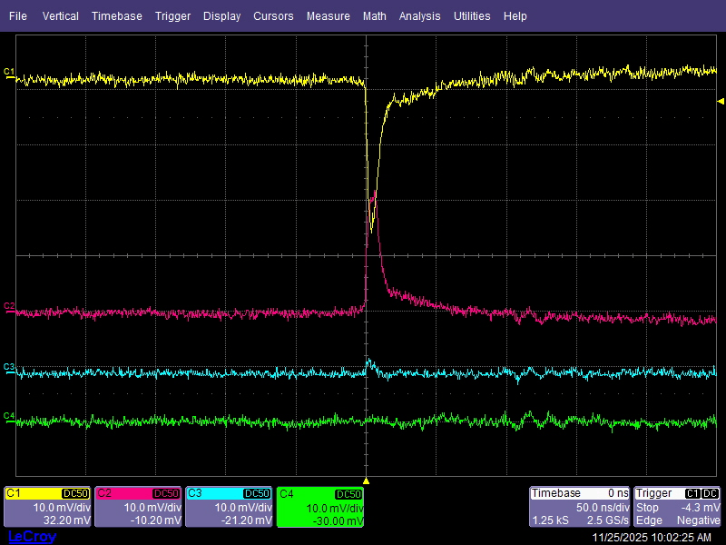
⁹⁰Sr radioactive source test
  Oscilloscope connection scheme:
  C1: negative signal, from the original strips (on the gain layer side – Al side)
  C2, C3, C4: positive signals from the strips on the HV side – Au side; the strips on both sides are parallel to each other
  The strips connected to C1 and C2 are positioned directly on top of each other.
Video: https://www.youtube.com/watch?v=5vi-WBQkZqw
Trigger on C1 → A corresponding signal is always visible on C2.

Slide 12
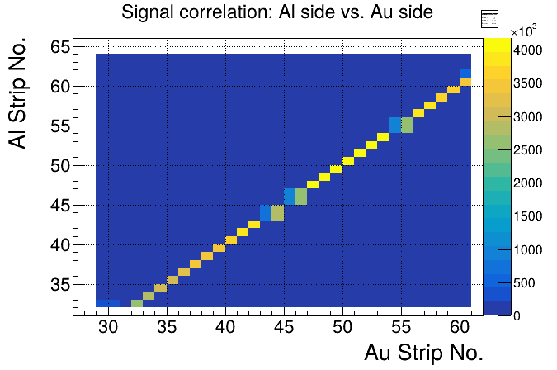
⁹⁰Sr radioactive source test
  Full sensor test analysis:
    Identify local maxima on the Al side and determine the channel number.
    Search for clusters in the corresponding Au-side strip region.
    Compute the Au-side cluster size, find local maxima
    Plot the correlation of local maximum positions: Al side vs. Au side
Video: https://www.youtube.com/watch?v=5vi-WBQkZqw
Strong linear correlation → excellent localization.
Trigger on C1 → A corresponding signal is always visible on C2.

Slide 13
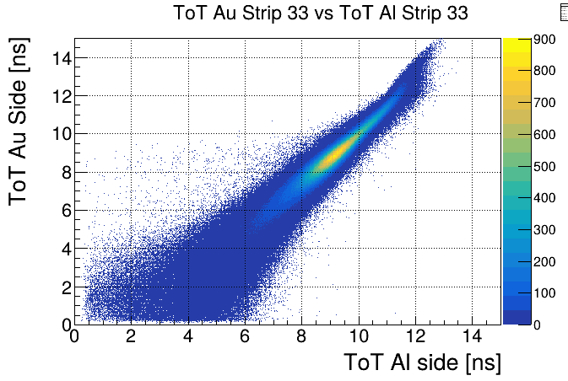
⁹⁰Sr radioactive source test
  Full sensor test analysis:
    Identify local maxima on the Al side and determine the channel number.
    Search for clusters in the corresponding Au-side strip region.
    Compute the Au-side cluster size, find local maxima
    Plot the correlation of the local-maximum ToT: Al side vs. Au side
Strong amplitude (ToT) correlation between Al and Au sides.
Trigger on C1 → A corresponding signal is always visible on C2.

Slide 14
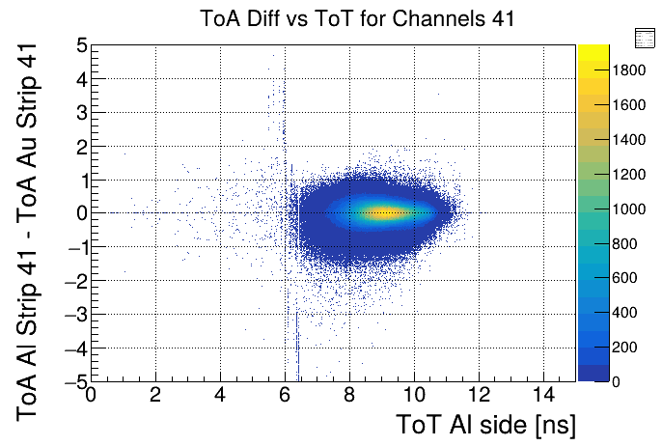
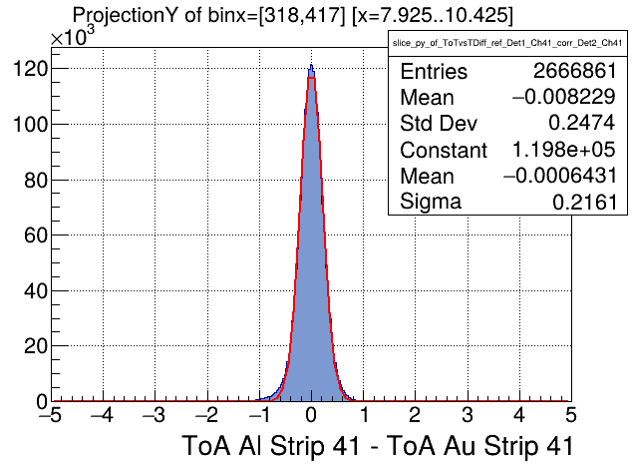
⁹⁰Sr radioactive source test
  Full sensor test:
  Match Al and Au signals event-by-event.
  Compute Δt (Al − Au).
  Apply offset and time-walk corrections.
  Plot corrected Δt vs. Al-side ToT (example channel pairs 44).
  Timing precision extracted from the Y-projection of Δt.
  Too low bias voltage and propagation effects along the strips broaden the distribution, as the strips are not bonded on the same side!

Slide 15
Dedicated Front-End Electronics: LATIC ASIC – low-noise analog front-end, TDC, and data concentrator

Slide 16
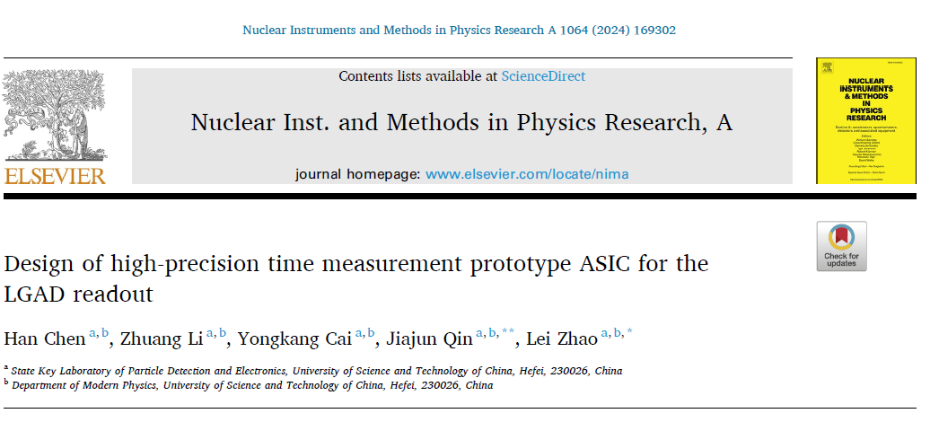
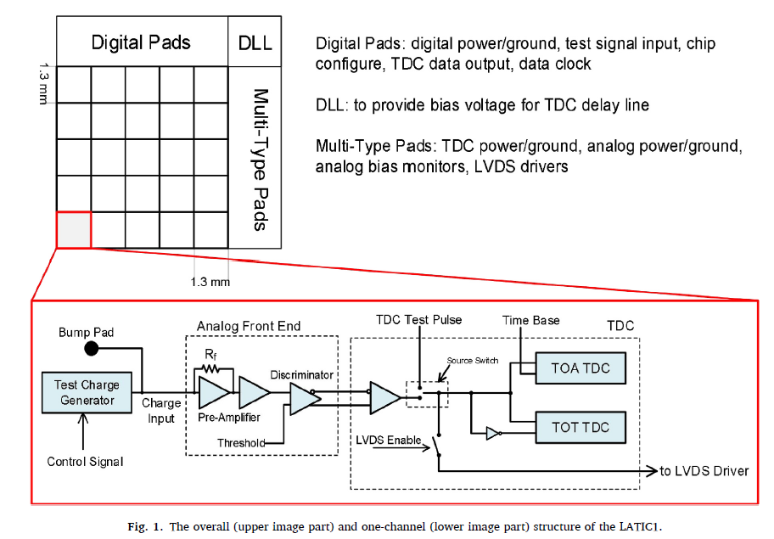

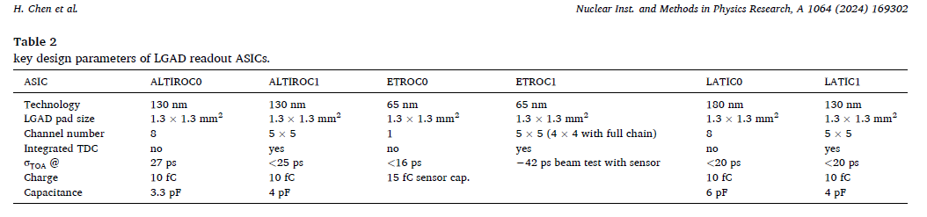
LATIC ASIC
  - Designed and produced by University of Science and Technology of China (USTC), Hefei, 230026, China
  - Current version: pad structure, 5 x 5 pads, 1.3mm pitch.
  - Performance comparable to ALTIROC (ATLAS) and ETROC (CMS)

Slide 17
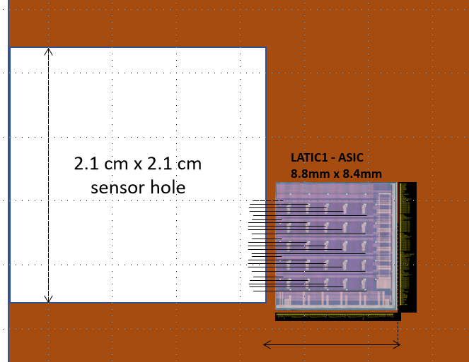
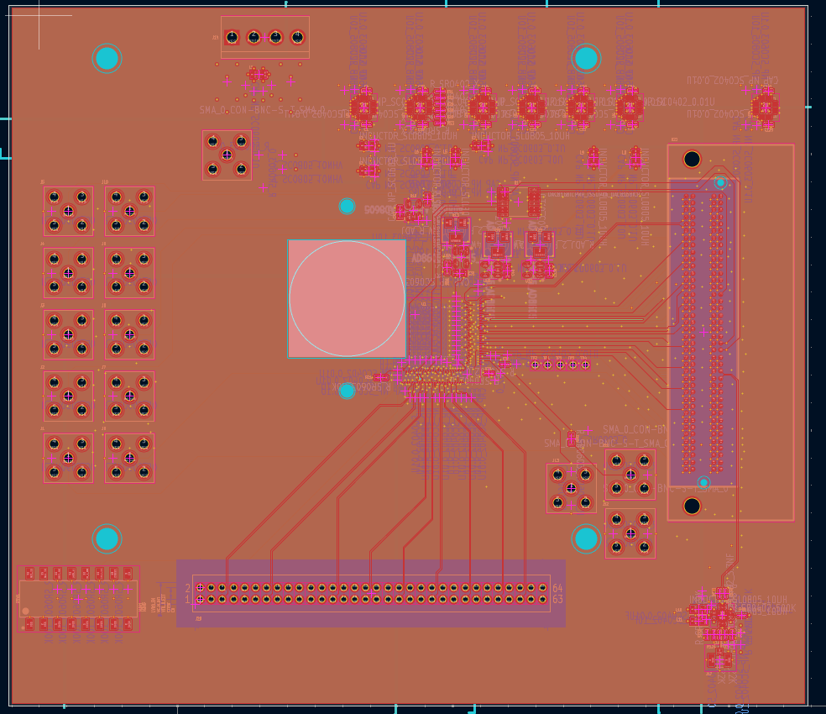
LATIC ASIC – Short- and Long-Term Plans
  - Designed and fabricated by the University of Science and Technology of China (USTC), Hefei
  - Current version: pad structure, 5 x 5 pads, 1.3mm pitch.
  - Test PCB board designed, should be ready in 1-2 months (USTC)
  - Tests with LGADs in preparation
Sensor-ASIC test board, 10cm x 10cm
  Next-Generation LATIC ASIC – Strip Readout Concept Under Discussion
    − ASIC redesign for double-sided strip LGAD sensors
    − Target strip pitch: 180–200 µm
    − Compact channel layout: 10 channels within 2 mm or 25 channels within 5 mm at 200 µm pitch
    − Next step: Define the channel layout and prepare the next ASIC version

Slide 18
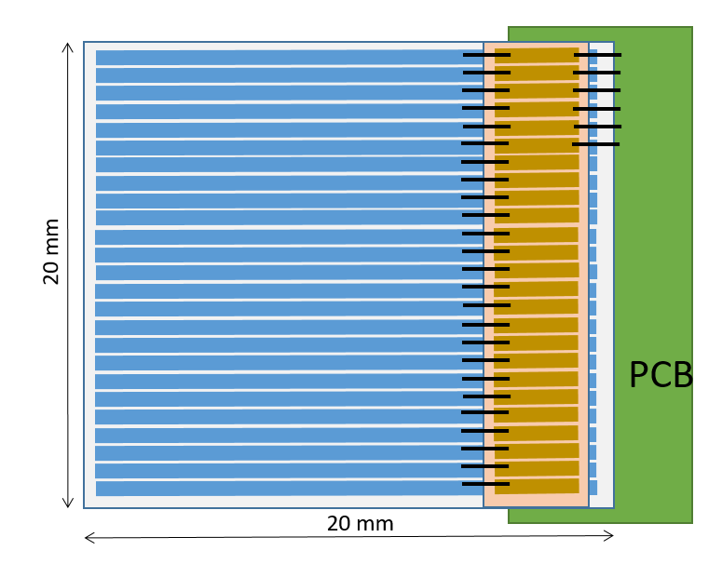
Timing Layer – Single-Module Integration Concept
    Strip LGAD sensor mounted on a low-mass Al/polyimide flex cable
    LATIC ASIC mounted directly onto the flex cable
    Direct wire bonding between LGAD strips and ASIC inputs
    Thermal management: ASIC heat dissipated through the flex cable rather than the LGAD sensor
    Digital readout: TDC data transmitted via low-mass flex interconnects
    Modular design: Compact, low-material-budget building block for a scalable 4D timing layer
Prototyping and R&D Scenario
ASIC (amplifier, discriminator, TDC) with a concentrator mounted on a flexible Al cable
→ Heat dissipation directed to the cable rather than the Si sensor
FPGA based
readout
Calibration
Walk correction
….
Flex Al cable
CBM STS type
ASIC – LATIC (Amp/Discriminator/TDC/Concentrator)
Nuclear Instruments and Methods in Physics Research A 1064 (2024) 169302
https://doi.org/10.1016/j.nima.2024.169302

Slide 19
Concept of Low-Material-Budget TL Based on Double-Sided LGAD Strip Sensors
– Summary and Outlook
  Summary
    Thin, double-sided LGAD concept potentially extendable to AC-LGAD and SiC sensors
    Low-mass 4D Timing Layer concept developed, with excellent expected timing and spatial performance
    Tracking performance potentially comparable to that of pixel detectors, with significantly reduced readout complexity
  Outlook
    Thin double-sided strip LGADs: Evaluate and establish mass-production capabilities
    LATIC ASIC: Test the current version with strip LGAD sensors
    Next-generation LATIC: Develop a dedicated strip-readout architecture
    Low-mass interconnects: Design and manufacture Al/polyimide flex cables
    Mechanical integration: Develop the module support and assembly concept
    Thermal management: Develop and validate the ASIC cooling concept

Slide 20
THANK YOU

