Slide 1
Micromegas development and production at JINR
D.Dedovich
Joint Institute for Nuclear Research, Dubna
INSTR 2026, October 12-16, 2026, Hefei, China

Slide 2
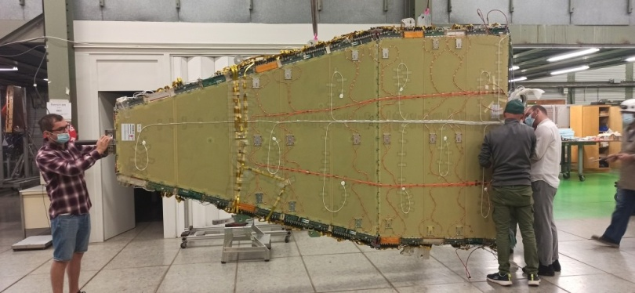
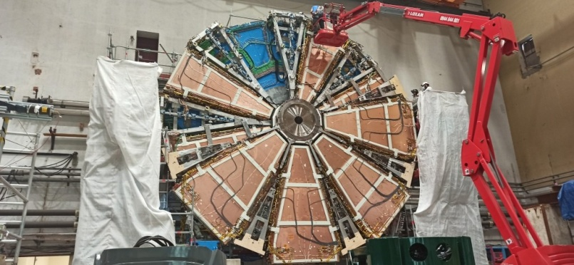
Micromegas production at JINR
Site development starts from production of MM for ATLAS upgrade
34 world-largest MM chamber – 3.1m² each were produced for ATLAS new small wheel. Chambers of similar size were also produced by Saclay group
Dubna and Saclay chambers prepared for installation

Slide 3
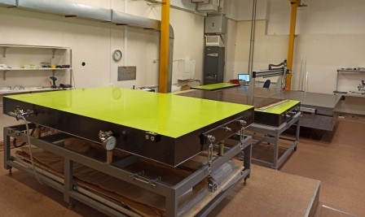
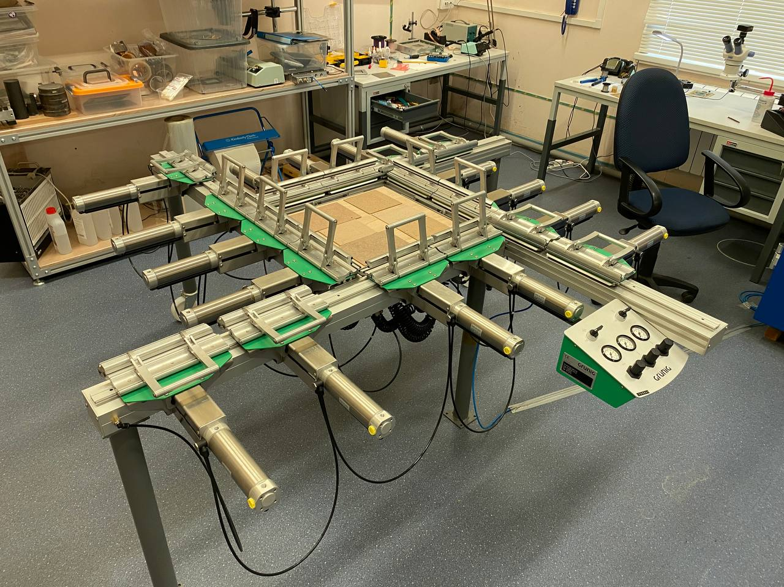
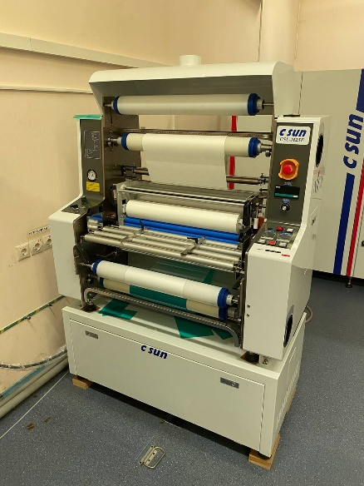
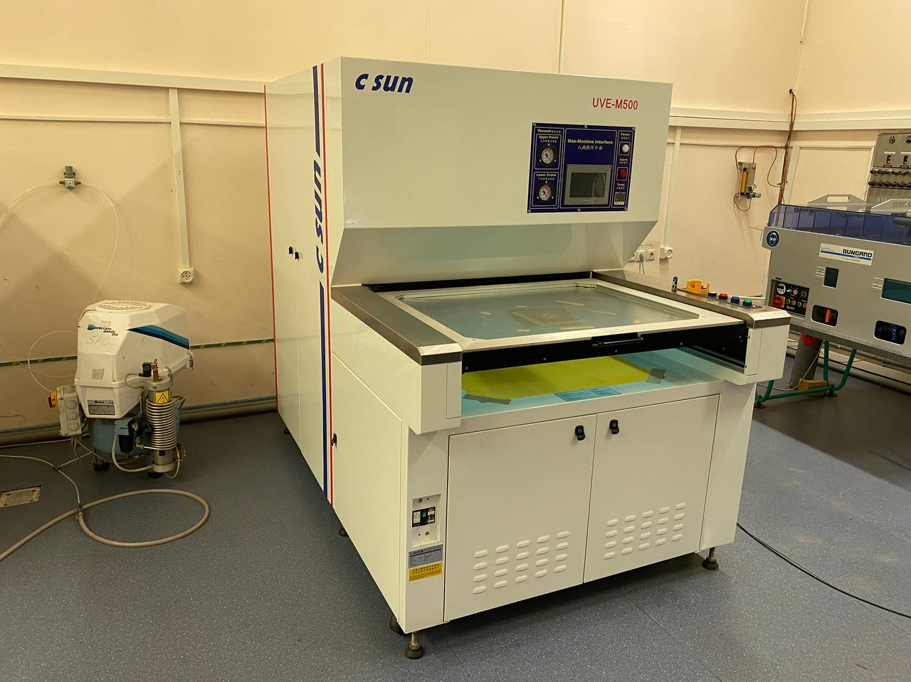
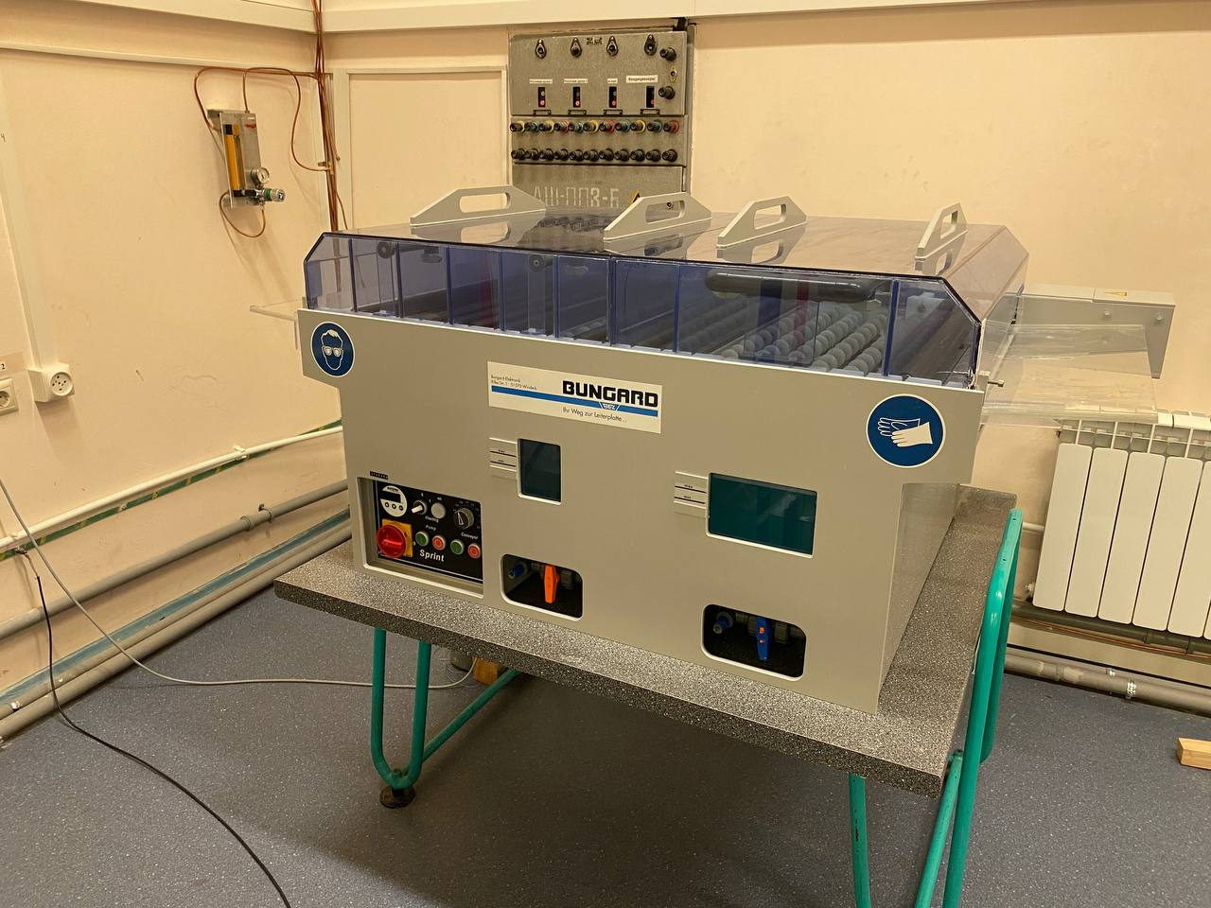
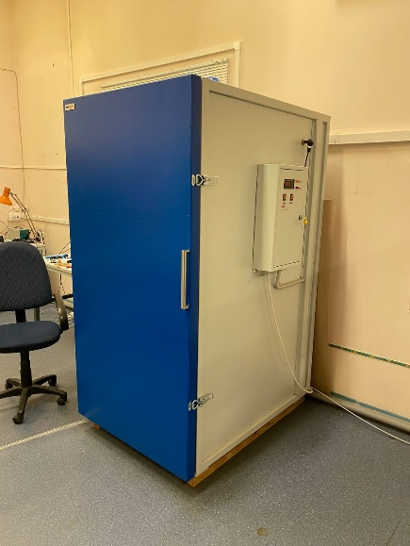
Micromegas production site at JINR
Current status
2 clean room
Granite table 3.2x2.6 m² with 3D scanner
2 precise vacuum table
Mesh stretcher
lithographic equipment, maximum board size is 90x55 cm²
We cant produce PCB and order it from commercial manufacturer

Slide 4
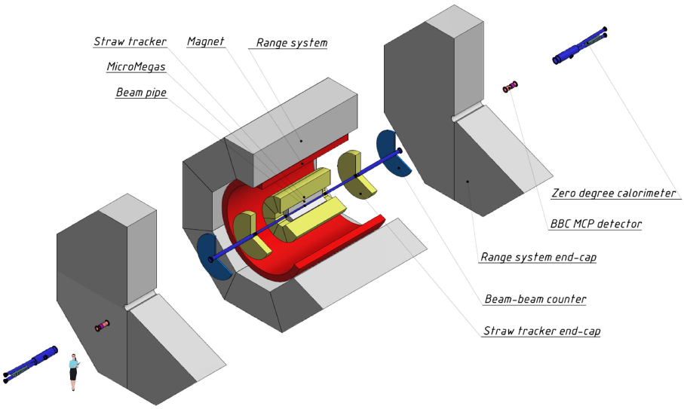
NICA/SPD Micromegas Central Tracker
The innermost part of tracking system
3 layers of cylindrical micromegas chamber
Key requirements:
  Resolution : <150µ
  Double track resolution ~ 1mm
  Minimal amount of material
Micromegas Central Tracker - simple&chip tracking detector, designed to improve performance of main tracker at phase 1 of experiment. Will be replaced by silicon vertex detector later

Slide 5

SPD Micromegas Central tracker
MicroMegas tracker:
3 Layers R=50-61 mm
4 half-cylindrical micromegas chambers in each layer
3mm drift gap, 120-150μ gain gap
Dead region
Straw tracker inner space R=280 mm
Beam pipe R=34 mm
Interaction region
800
MicroMegas tracker

Slide 6
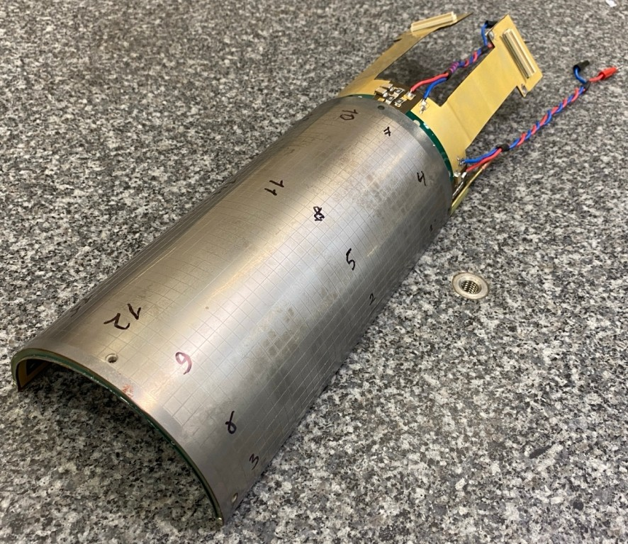
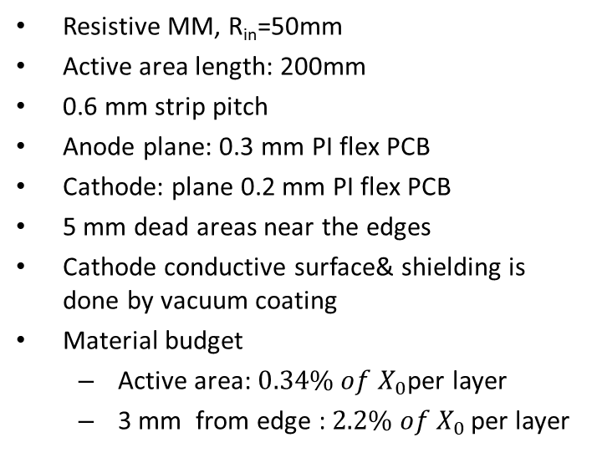
MCT@SPD : realistic prototype
Resistive MM, R_{in}=50mm
Active area length: 200mm
0.6 mm strip pitch
Anode plane: 0.3 mm PI flex PCB
Cathode: plane 0.2 mm PI flex PCB
5 mm dead areas near the edges
Cathode conductive surface& shielding is done by vacuum coating
Material budget
  Active area: ${0.34\% of X}_{0}$per layer
  3 mm from edge : ${2.2\% of X}_{0 }$per layer

Slide 7
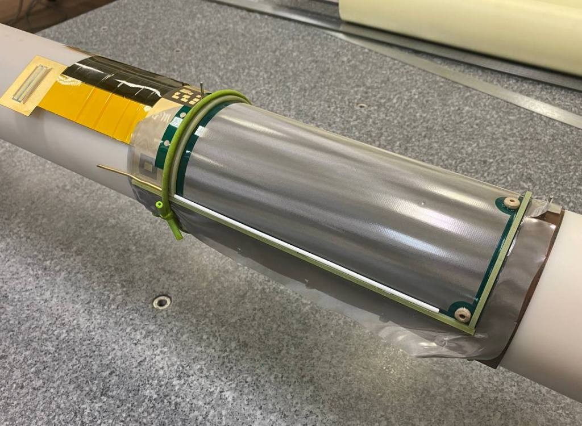
Cylindrical Micromegas: production cycle
Formation of the Micromegas structure (anode PCB, pillars, micromesh) using bulk technology, like for the plane chambers.
Bending on template
Gluing of force elements and cathode plane == shape fixation
Formation of the Micromegas structure (anode PCB, pillars, micromesh) using bulk technology, like for the flat chambers.
Bending on template
Gluing of the force elements and cathode plane == shape fixation
Cutting off extra materials

Slide 8
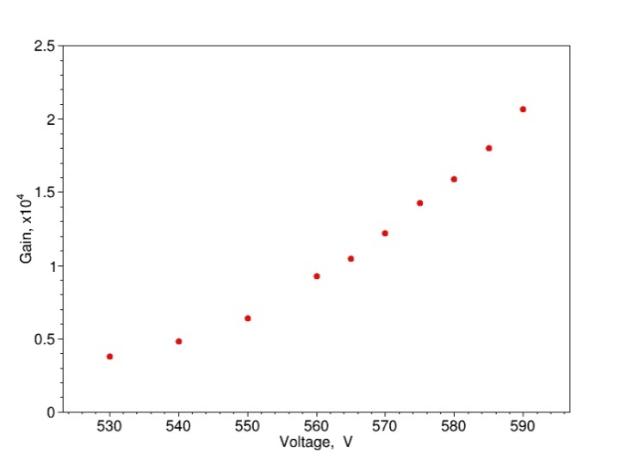
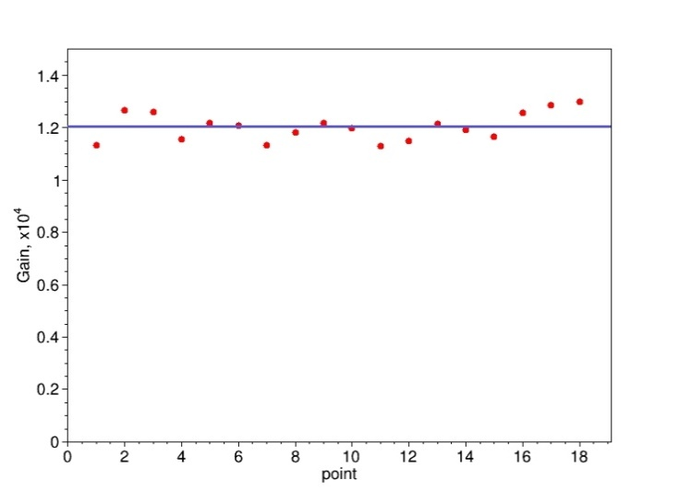
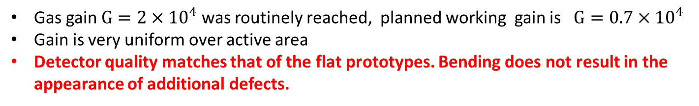
Cylindrical Micromegas: test results
Gain vs voltage
Ar(93)-CO2(7)
Gain uniformity check
Gas gain $G=2×{10}^{4}$ was routinely reached, planned working gain is $G=0.7×{10}^{4}$
Gain is very uniform over active area
Detector quality matches that of the flat prototypes. Bending does not result in the appearance of additional defects.

Slide 9
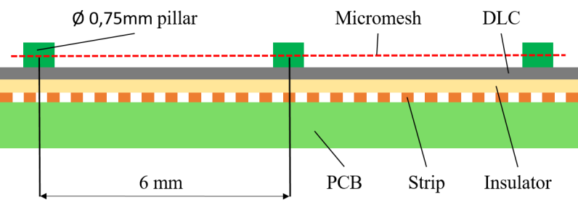
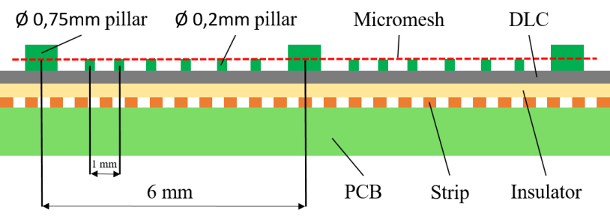
Cylindrical MM : pillar structure
Small bending radius require ~1mm pillar pitch => large dead area, low efficiency?
Possible solution: рerhaps very small pillars (comparable in size to the transverse diffusion length) will not significantly affect efficiency and accuracy?
Direct comparison was done at T9 beam at CERN:
Two very similar chambers were tested
  1st MM chamber with standard pillars: ⌀ 0.7mm, pitch 6mm
  2d MM chamber with additional small pillars : ⌀ 0.25mm, pitch 1mm
  Both chambers have ½ of area 0.45mm strip pitch, and ½ of area 0.7 mm pitch
“standard pillars”
“SPD pillars”

Slide 10
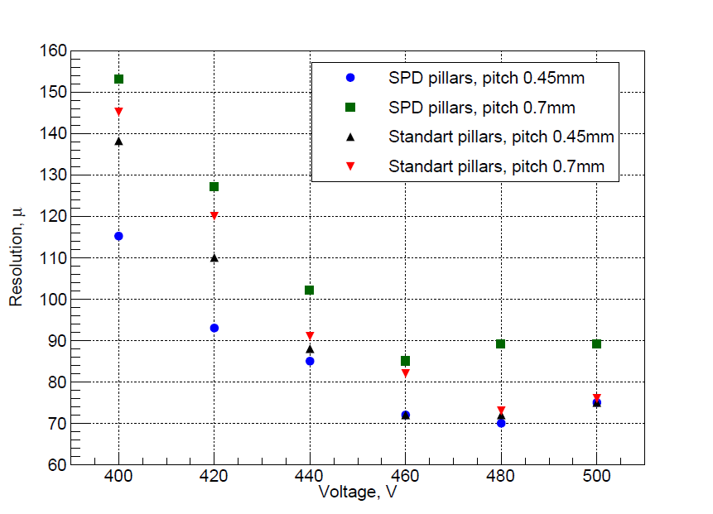
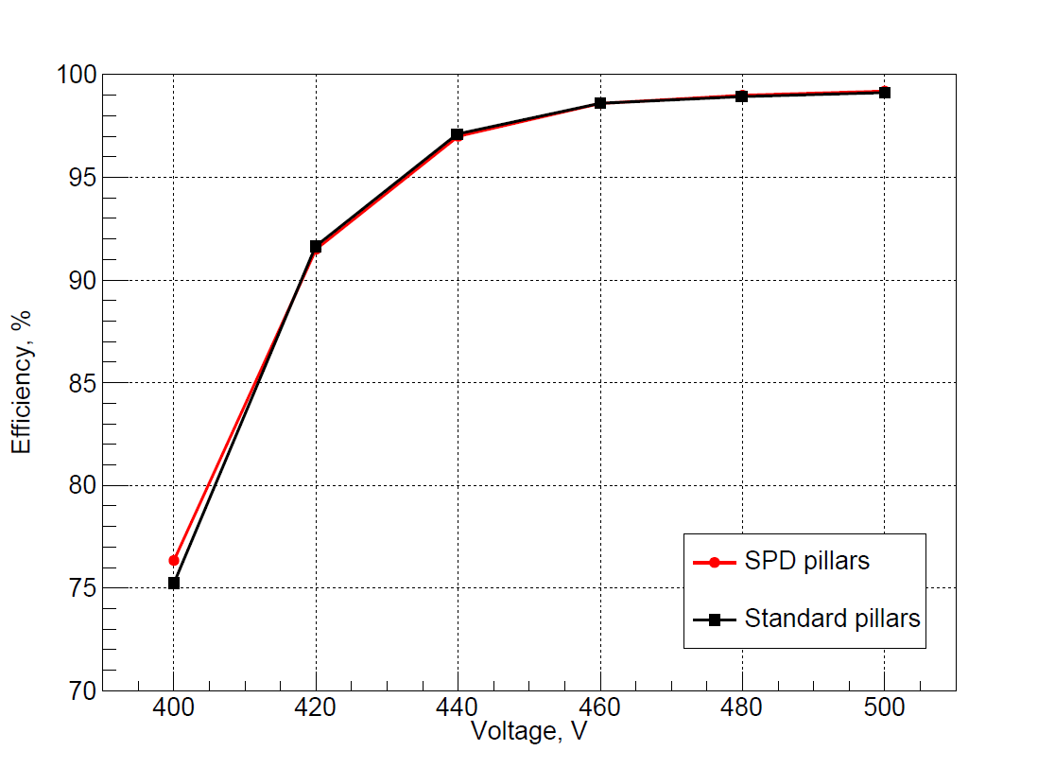
Pillar structure test results:
Resolution vs voltage scan
Efficiency vs voltage scan
Large number of small pillars don’t cause crucial degradation of micromegas efficiency and resolution

Slide 11
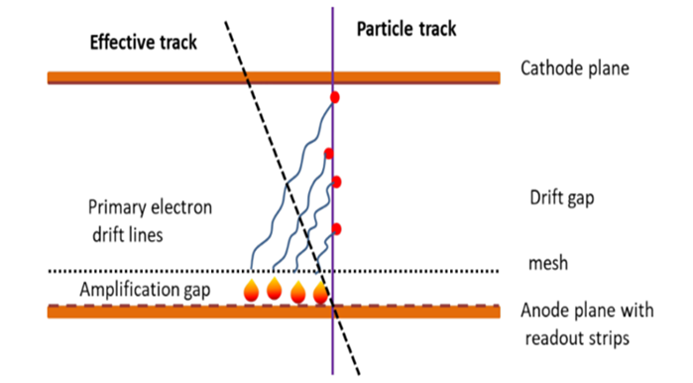
Gas mixture for operation in magnetic field
In crossed electric and magnetic fields, electrons drift at an angle to the direction of the electric field, known as the Lorentz angle.
For the formation of the detector signal, the track appears "effectively inclined," coordinate accuracy degrades and occupancy increases
We need:
  Space resolution better then 150 μ
  Double hit resolution about 1.5 mm
  Good amplitude to operate in triggerless mode

Slide 12
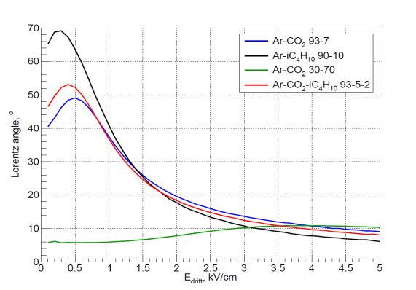
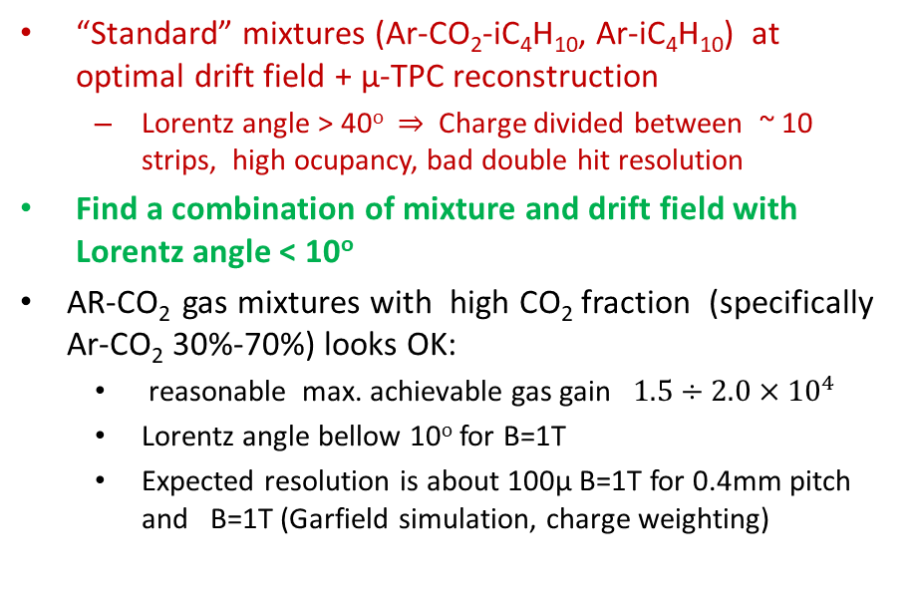
MM operation in magnetic field : ways to keep resolution
“Standard” mixtures (Ar-CO₂-iC₄H₁₀, Ar-iC₄H₁₀) at optimal drift field + μ-TPC reconstruction
  Lorentz angle > 40º $⇒$ Charge divided between ~ 10 strips, high ocupancy, bad double hit resolution
Find a combination of mixture and drift field with Lorentz angle < 10º
AR-CO₂ gas mixtures with high CO₂ fraction (specifically Ar-CO₂ 30%-70%) looks OK:
  reasonable max. achievable gas gain $1.5÷2.0×{10}^{4}$
  Lorentz angle bellow 10º for B=1T
  Expected resolution is about 100µ B=1T for 0.4mm pitch and B=1Т (Garfield simulation, charge weighting)

Slide 13
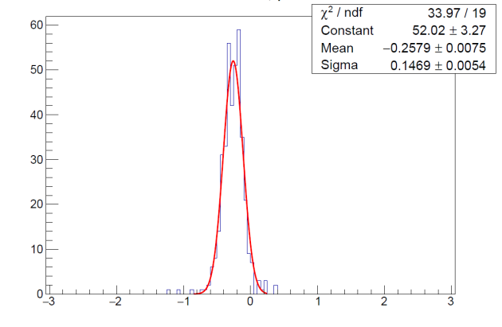
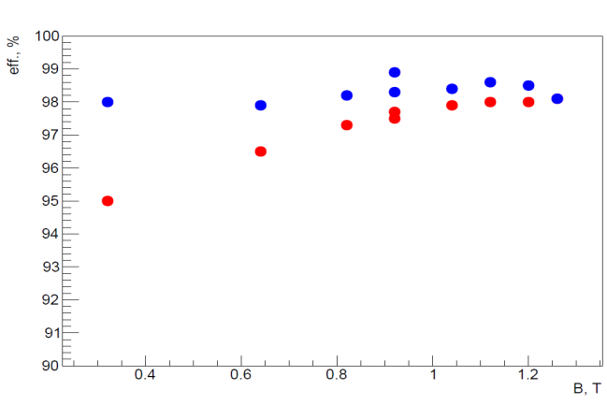
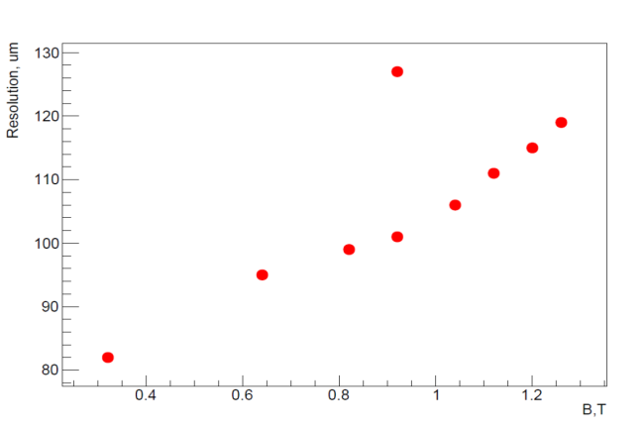
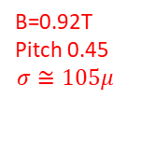
Gas mixture test in magnetic field: results
H4 beam & Goliath magnet, B_{MAX}=1.35T
Two very similar chambers, APV25/SRS readout, Ar-CO₂ (30%-70%) gas mixture
Small beam divergence(neglected)
Charge weighting for cluster coords reconstruction
Two chamber residual
Efficiency vs B
Resolution vs B
Pitch =0.7mm
Edrift=2kV/cm
B=0.92T
Pitch 0.45
$$σ≅105μ$$
chamber1
chamber2
Pitch =0.7mm
Edrift=2kV/cm
Better then in was expected!

Slide 14
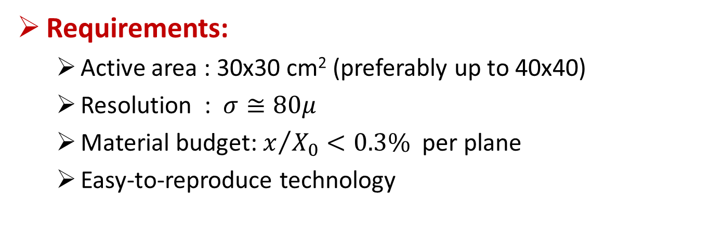
Development of low-material MM for AMBER small angle tracker
Requirements:
  Active area : 30x30 cm² (preferably up to 40x40)
  Resolution : $σ≅80μ$
  Material budget: $x/{X_{0}<0.3\% }$ per plane
  Easy-to-reproduce technology

Slide 15
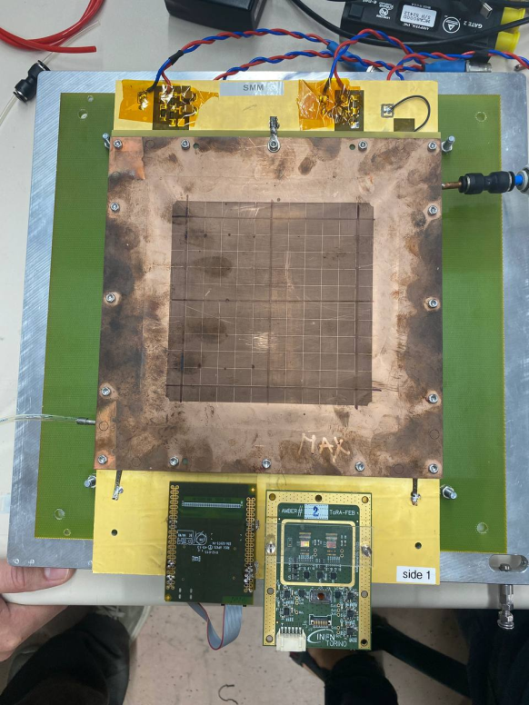
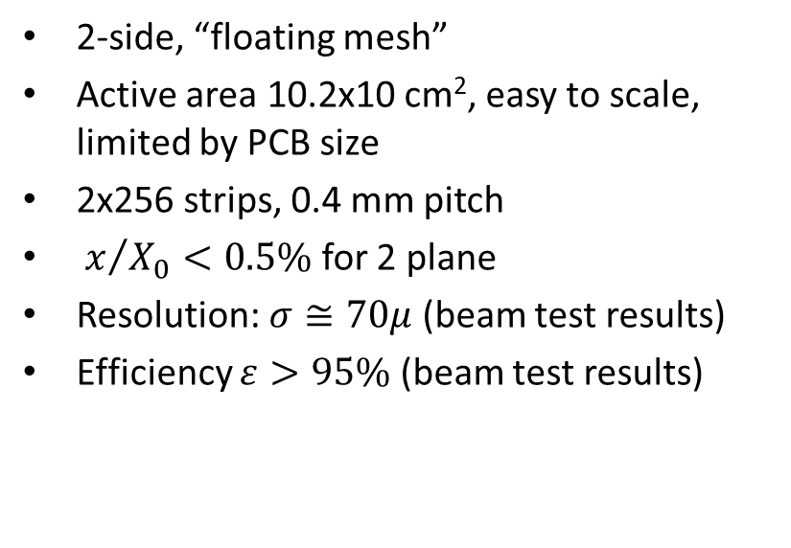
Low-material MM
2-side, “floating mesh”
Active area 10.2x10 cm², easy to scale, limited by PCB size
2x256 strips, 0.4 mm pitch
$x/{X_{0}<0.5\%}$ for 2 plane
Resolution: $σ≅70μ$ (beam test results)
Efficiency $ε>95\%$ (beam test results)

Slide 16
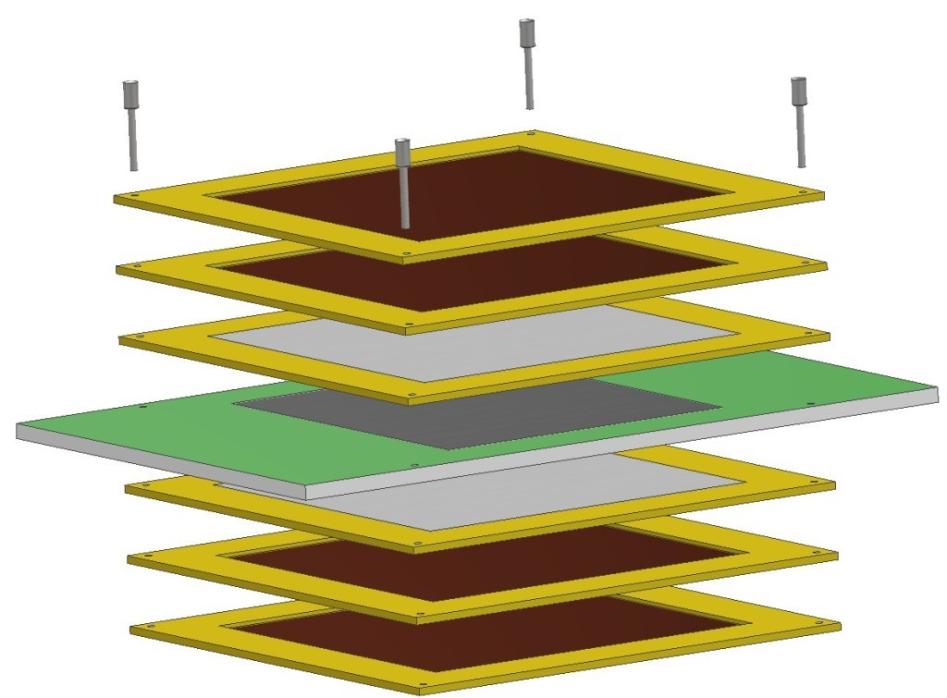
Low-material MM prototype
Outer wall – 25µ rigid-flex pcb.
Copper layer produced by vacuum coating for min material
Cathode – 25µ rigid-flex pcb
Mesh frame+mesh
Readout panel:
Sandwich 50μ flex PCB – 3mm Rohacell foam – 50μ flex PCB
withstands heating up to 130º and etching
Guard ring & pillars were produced after sandwich gluing

Slide 17
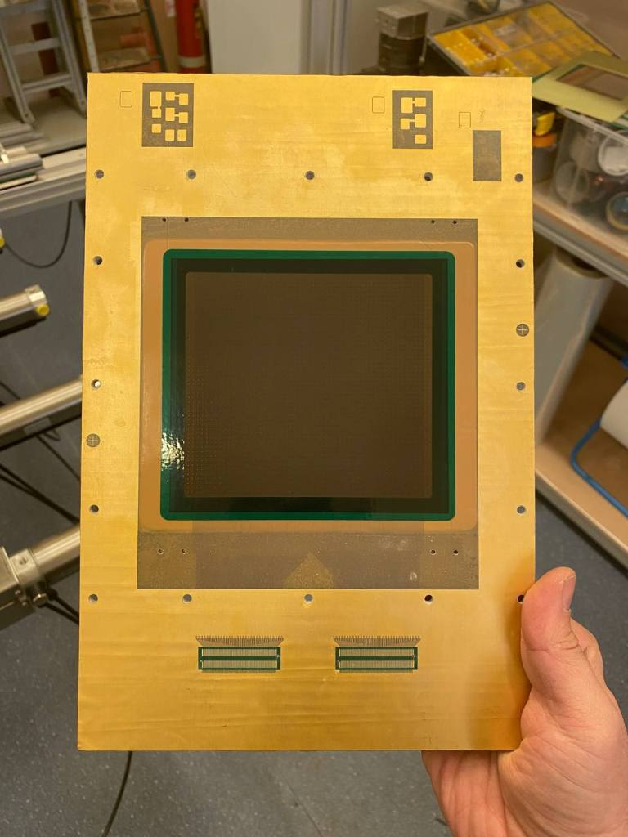
Low-material MM: readout panel
Sandwich 50μ flex PCB – 3mm Rohacell foam – 50μ flex PCB
Pillars cant be formed on raw readout PCB as polymerization of photoresist cause shrinking of thing (50μ) PCB
After gluing readout panel MUST withstand heating and etching (use suitable materials and glue)

Slide 18
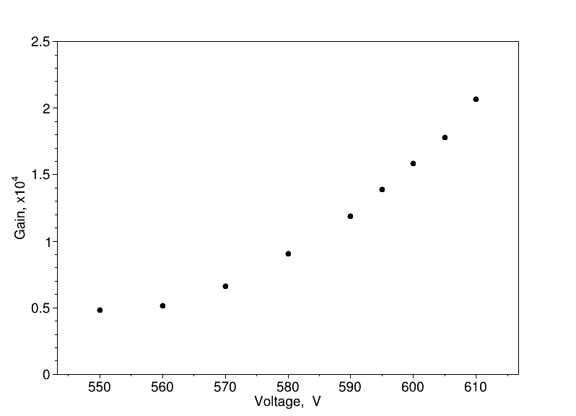
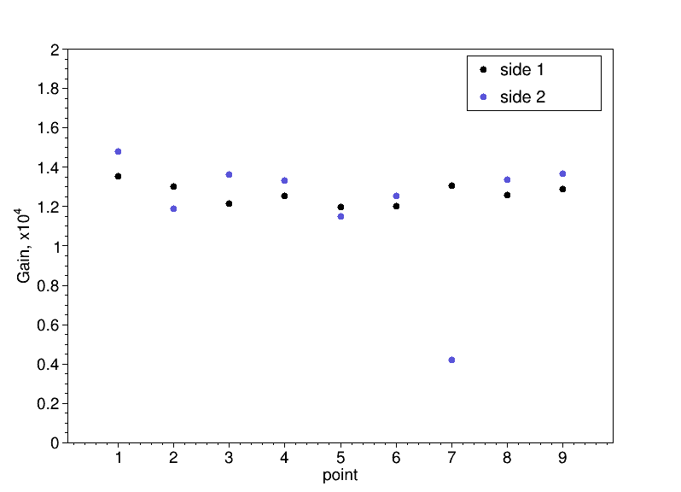
Low-material MM prototype
Gas gain and uniformity
Gain vs voltage
Gain uniformity

Slide 19
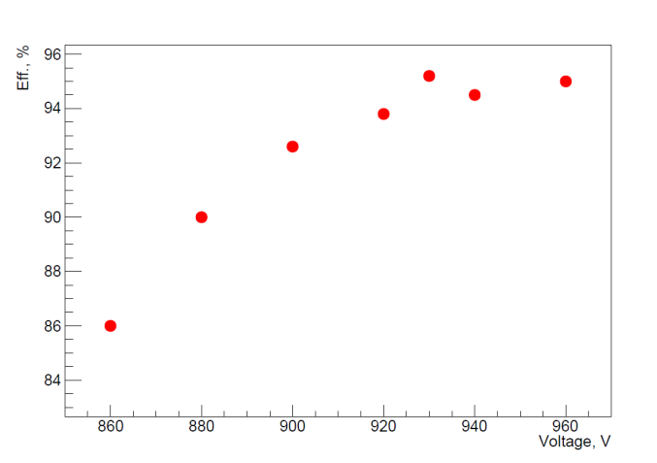
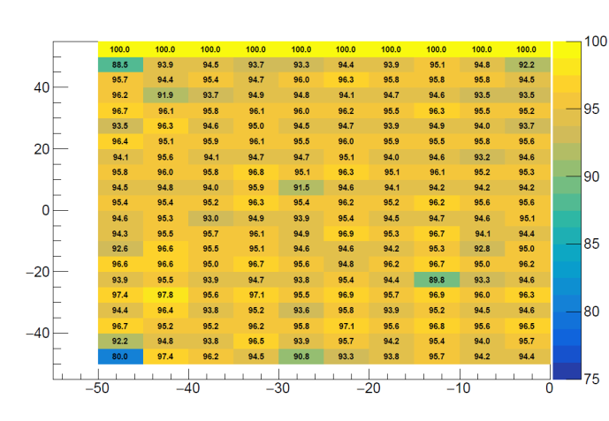
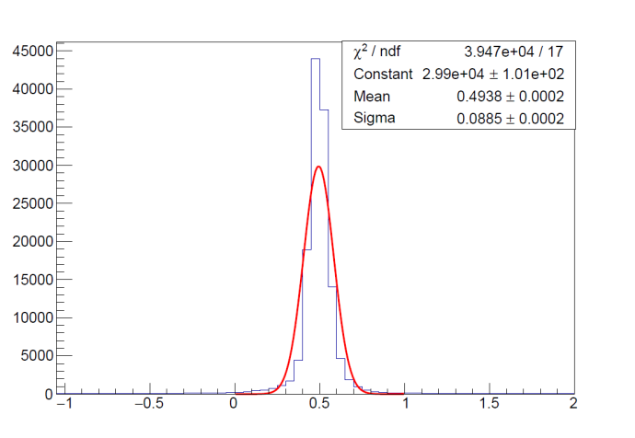
Low-material MM prototype
Beam test result
APV25/SRS readout, 2fQ thresold
Efficiency vs voltage
2D Efficiency map
Side1&side 2 residual
Pillars takes 4.9% of active area =>efficiency is near the limit

Slide 20
 | material | X0 (g/cm²) | Density (g/cm3) | Thikness, µ | Fill Factor | X0 (cm) | x/X0
shielding | Copper | 12,86 | 8,96 | 18 | 0,080 | 1,435 | 1,00E-04
Cover | Kapton | 40,58 | 1,42 | 25 | 1 | 28,577 | 8,75E-05
Cathod | Kapton | 40,58 | 1,42 | 50 | 1 | 28,577 | 1,75E-04
copper/cathode | Copper | 12,86 | 8,96 | 18 | 0,100 | 1,435 | 1,25E-04
mesh 63/18 | Inox | 14 | 7,93 | 25 | 0,448 | 1,765 | 6,34E-04
PCB | Kapton | 40,58 | 1,42 | 50 | 1 | 28,577 | 1,75E-04
PCB | Copper | 12,86 | 8,96 | 18 | 0,625 | 1,435 | 7,84E-04
core | Glue | 43,25 | 1,33 | 50 | 1 | 32,519 | 1,54E-04
 | rohacel |  |  | 3000 | 1 |  | 4,19E-04
 | Glue | 43,25 | 1,33 | 50 | 1 | 32,519 | 1,54E-04
PCB | Copper | 12,86 | 8,96 | 18 | 0,625 | 1,435 | 7,84E-04
PCB | Kapton | 40,58 | 1,42 | 50 | 1 | 28,577 | 1,75E-04
mesh 63/18 | Inox | 14 | 7,93 | 25 | 0,448 | 1,765 | 6,34E-04
copper/cathode | copper | 12,86 | 8,96 | 18 | 0,100 | 1,435 | 1,25E-04
Cathode | Kapton | 40,58 | 1,42 | 50 | 1 | 28,577 | 1,75E-04
Cover | Kapton | 40,58 | 1,42 | 25 | 1 | 28,577 | 8,75E-05
Shielding | Copper | 12,86 | 8,96 | 18 | 0,080 | 1,435 | 1,00E-04
 |  |  |  |  |  |  | 4,89E-03

Slide 21
Thanks

