Slide 1





The design and first test results
of Jadepix4 CMOS pixel sensor
INSTR 2026
Yongqi Wang^{1,3}，Yunpen Lu²，Ping Yang⁴，Sheng Dong³，Wei Zhang⁵，Yang Zhou³，Le Xiao⁴，Di Guo⁴，Xiangming Sun⁴，Qun Ouyang³
¹University of Electronic Science and Technology of China,Chengdu,611731,China
²Institute of High Energy Physics, Chinese Academy of Sciences,Beijing,100049,China
³Spallation Neutron Source Science Center,Dongguan,523803,China
⁴Central China Normal University, Wuhan,430079, China
⁵Wuhan Textile University, Wuhan,430200, China
Notes:
[~40 s]
Good afternoon, everyone. My name is Yongqi Wang. I am from the University of Electronic Science and Technology of China, and I also work at the Spallation Neutron Source Science Center. Today I will present the design and the first test results of the JadePix-4 CMOS pixel sensor. This is joint work with the Institute of High Energy Physics, Central China Normal University, and other institutes.

Slide 2
1
2
3
4
5
Motivation & Background
Design of JadePix-4
Test System & Laboratory Test
Beam Test & Results
Summary & Outlook
Outline
Notes:
[~30 s]
Here is the outline of my presentation, which consists of five parts.
First (1), I will introduce the motivation and background behind the JadePix-4 project.
Then (2), I will detail the design of the JadePix-4 chip.
Following that (3), we will look at the test system and laboratory tests.
The fourth part (4) covers the beam test and the results we obtained.
Finally (5), I will provide a summary and outlook for future work.
Let's begin with the background."

Slide 3
Motivation
CEPC vertex detector
Spatial resolution < 5 um
Time stamp precision < 100 ns
Power Consumption in sensitive area < 40 mW/cm2
Higgs & low-luminosity Z operation
Hit rate expected ~ 12 MHz/cm² (average)@ r_{min}=11 mm
Parameter | Design
Spatial Resolution | ~5 um
Detector material budget | ~ 0.8% X₀
First layer radius | 11.1 mm
Power Consumption | <40 mW/cm²
Time stamp precision | 100 ns
Fluence | ~2×10¹⁴ Neq/cm²
Operation temperature | ~5 ℃ to 30 ℃
Readout electronics | Fast, low-noise, low-power
Mechanical Support | Ultralight structures
Angular Coverage | |cos θ|<0.99
Notes:
[~40 s]
The CEPC is a Higgs factory, and it will also run at the Z pole with low luminosity. For heavy-flavour tagging, the vertex detector has strong requirements: spatial resolution better than 5 micrometers; time stamp precision better than 100 nanoseconds; power below 40 milliwatts per square centimeter in the sensitive area. The table shows the full design targets.

Slide 4
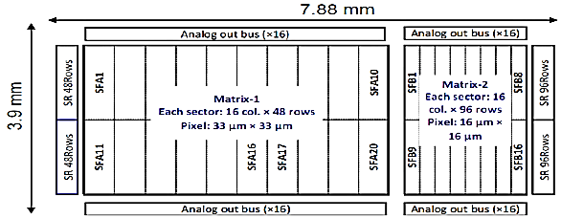
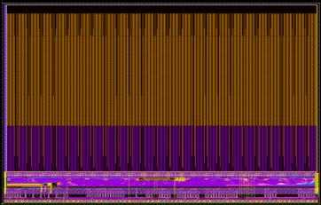
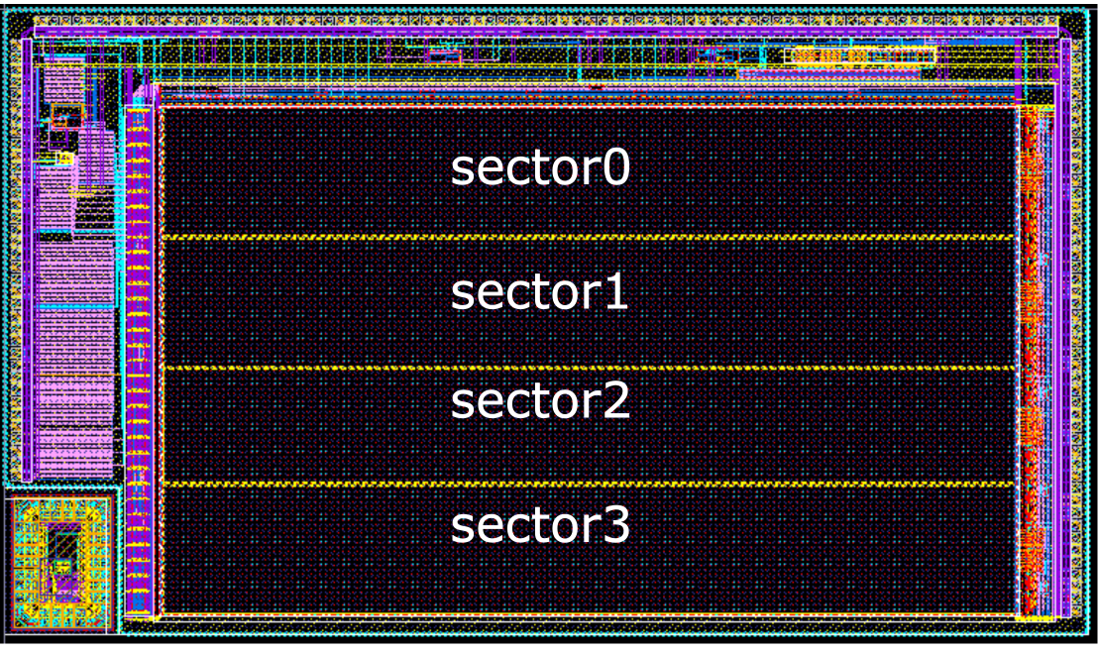
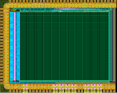
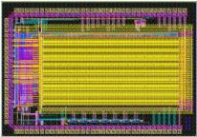
Jadepix Series Chip
Fast Readout
14.8×8.6mm²
10.4×6.1mm²
Jadepix-1
Jadepix-2/Mic4
Jadepix-3
Jadepix-4/Mic5
Sensor geometry optimization and radiation-tolerant design
Objective1:Design and verification of small-pitch digital pixels
Objective:
Objective2:First asynchronous readout for pixel arrays
Objective:
Full-function,small-pixel,low-power
~3μm spatial resolution
Objective:
Full-function,small-pixel,low-power
~1μs time granularity
16μm×16μm
33μm×33μm
22μm×22μm
26μm×26μm
16μm×23μm
16μm×26μm
20μm×29μm
Analog pixel front-end
Rolling Shutter
FPN<20e⁻
Power<100mW/cm²
FPN<20e⁻
Power<100mW/cm²
Integration time < 10 μs
Rolling Shutter
Rolling Shutter
AERD
Q1/2015
Q2/2017
Q3/2019
Q4/2021
Notes:
[~55 s]
This slide shows the evolution of the JadePix series. /
As the earliest prototypes, / JadePix-1 and JadePix-2 addressed the sensor side / and the analog front-end side, / respectively. /
JadePix-3 was a full-function, large-scale prototype, / achieving a position resolution of about 3 micrometers. /
Now, / JadePix-4 validates the AERD data-driven readout / for fast, low-power operation, / balancing position and time resolution / with ~1 microsecond time granularity. /
Importantly, / our beam telescope was built with JadePix-3 / and has been extensively validated. / We directly used it to test JadePix-4, / ensuring reliable beam test results.

Slide 5
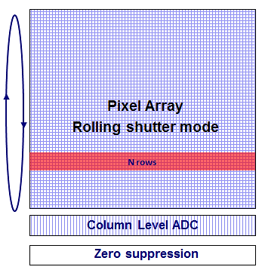
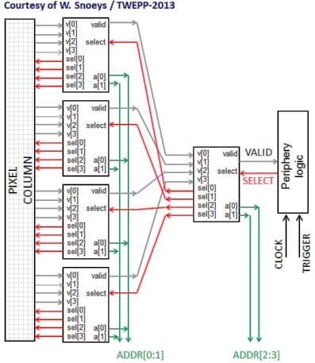
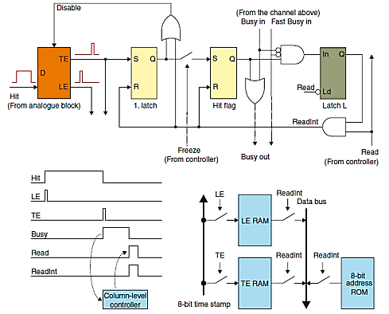
Readout Architecture
Rolling Shutter
MIMOSA-type
Column drain
FE-I3-type
AERD
ALPIDE-type
Row-by-row scan of the full array
Fine spatial resolution
Simple, but slow(Timing bounded by the frame period (~100 μs class))
Event-driven; each pixel has an independent address
Column-level storage
Parallel column readout
Event-driven; hierarchical tree arbitration
Only hit-related pixels read out
Sparse, fast, low power
Rolling shutter -MIMOSA Column drain -FE-I3 AERD –ALPIDE
JadePix-4: AERD readout architecture → compact pixels without in-pixel encoding logic
Notes:
[~50 s]
This slide explains why we chose AERD, by comparing three readout architectures.
On the left is Rolling Shutter, like MIMOSA and JadePix-3. It scans row by row, giving fine position resolution, but it's slow—timing is bounded by the frame period, around 100 microseconds.
In the middle is Column drain, like FE-I3. Each pixel has its own address, and the columns are read out in parallel.
On the right is our choice: AERD, like ALPIDE and Jadepix-4. It's event-driven with hierarchical/haɪəˈrɑːrkɪkl/ tree arbitration. Only hit-related pixels are read out, making it sparse, fast, and low power.

Slide 6
1
2
3
4
5
Motivation & Background
Design of JadePix-4
Test System & Laboratory Test
Beam Test & Results
Summary & Outlook
Outline
Notes:
[~5 s]
Now, let me show the design of JadePix-4.

Slide 7
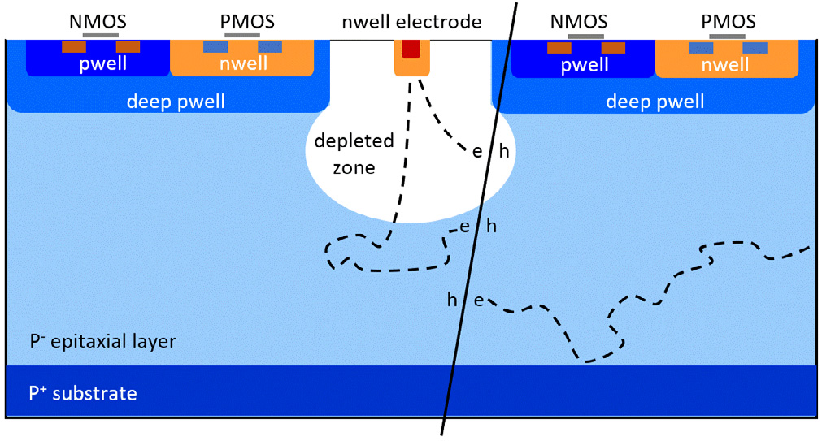
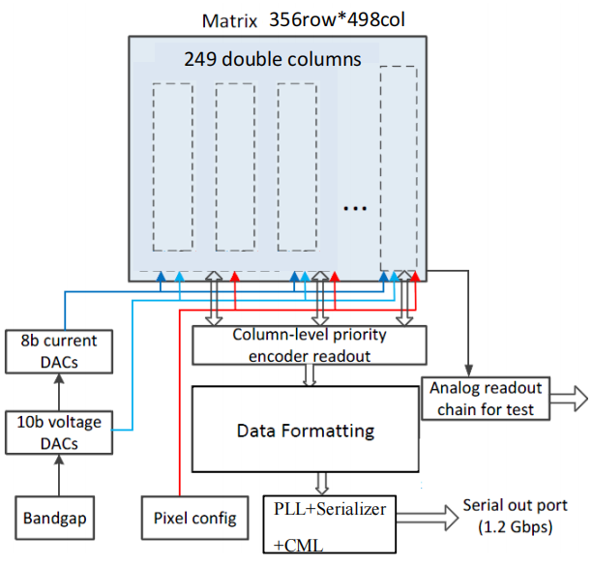
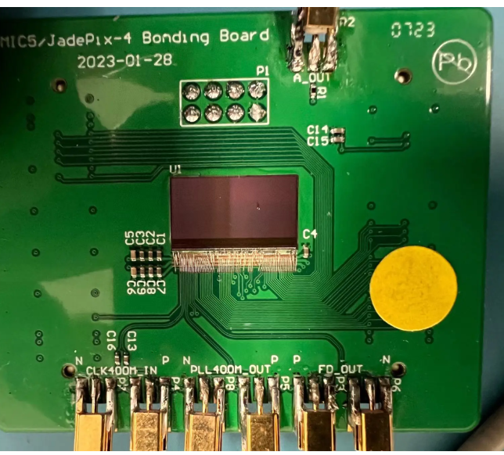
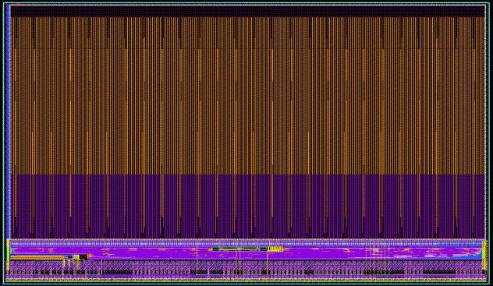
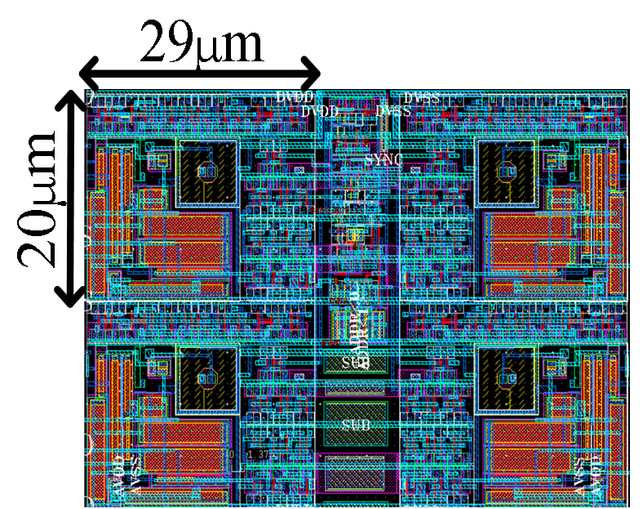
JadePix-4 Overview
Process: TowerJazz 180 nm CIS
  High-resistivity epitaxial layer
  deep p-well / n-well (PMOS allowed inside the pixel array)
  6 metal layers
Chip
  Size：14.8 mm × 8.6 mm
  Matrix：356(Row) × 498(Col) = 177,288 pixels
  pixel pitch：29 μm × 20 μm
Periphery
  Real-time digital readout
  Array level priority readout
  8B10B, serializer + CML
  10-bit voltage DACs
  8-bit current DAC
  Analog test chain on the last pixel row
Notes:
[~20 s]
This is the JadePix-4 chip. It is made in the TowerJazz 180 nanometer CMOS image sensor process.
The chip size is 14.8 millimeters by 8.6 millimeters. The matrix has 356 rows and 498 columns. The pixel pitch is 29 micrometers by 20 micrometers.

Slide 8
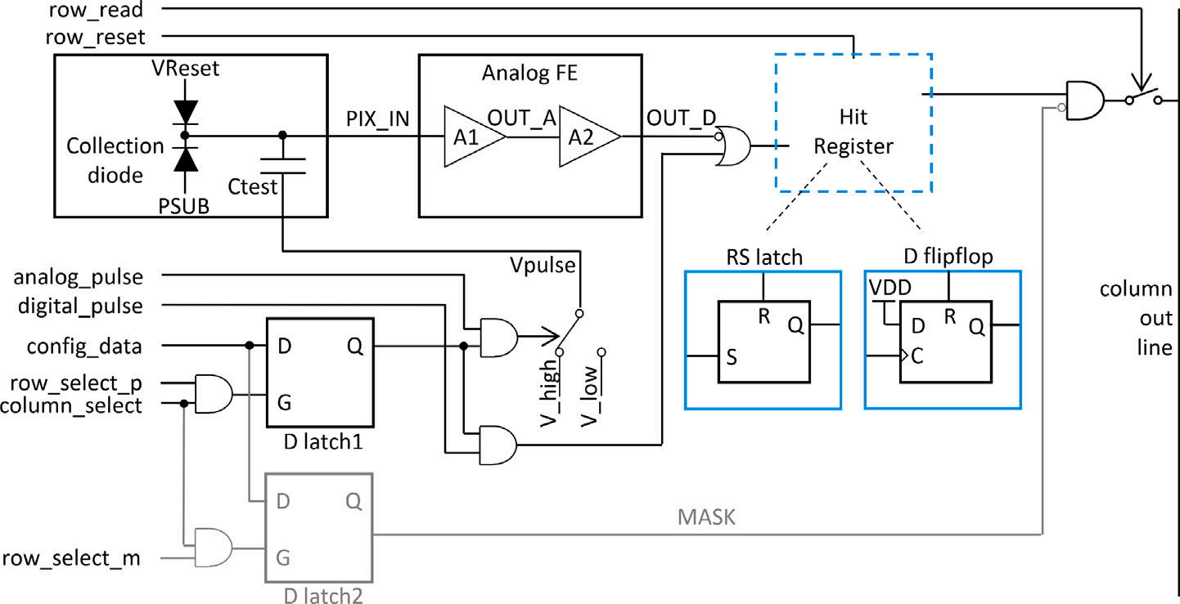
In-Pixel Logic
1 Charge collection
Collection diode (N-well / P-substrate) drifts charge to the sensing node
Ctest injects analog test pulses.
Hit
Register
2 Analog front-end
A1 preamplifier → A2 second stage
Test point：OUT_A
3 Digital logic & configuration
D latch1: Pulse mode—Turn on/off test input
D latch2: MASK mode—Turn on/off pixels output
Hit Register latches the hit,wait for readout
Pixel schematic of JadePix-4 (20 × 29 µm²)
Notes:
[~45 s]
This is the in-pixel logic, in three steps.
Step one, charge collection. The collection diode is an N-well to P-substrate junction. It drifts the charge to the sensing node. A small test capacitor can inject test pulses.
Step two, the analog front-end: a preamplifier A1, then a second stage A2.
Step three, the digital part. Here are two D latches: latch one is the pulse mode — it switches the test input on or off; latch two is the mask mode — it switches the pixel output on or off. When a particle hits, the Hit Register stores the hit and waits for the readout.

Slide 9
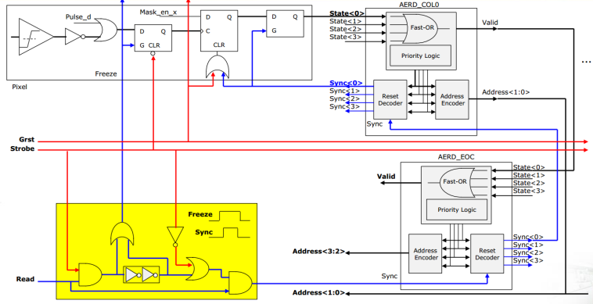
Pixel readout
1 In-pixel logic
Only 1-bit signal memory per pixel
STATE: front-end output → hit latch
VPULSE: test signal → FE / readout test
2 bit latches: MASK / PULSE mode
2 Event-driven sparse readout
Hit sets State → Fast-OR raises Valid
Priority Logic → Address Encoder
Reset Decoder clears read pixels → loop
3 Hierarchical arbitration tree
Double column = 712 pixels (2 × 356)
4 pixels → group — Address<1:0>
4 groups → super-group — Address<3:2>
4-to-1 merging repeats up the tree
Pixel + column-level AERD readout logic
Notes:
[~55 s]
Next is the pixel readout. Inside the pixel we store only one bit. The STATE branch stores the real hit signal.
Importantly, JadePix-4 does not need an external trigger. The hit is latched directly by the signal edge.
The readout is event-driven: a hit sets the state, a fast-OR raises a valid flag, the priority logic and the address encoder read out the address, then the reset decoder clears the pixel — and the loop continues.
The arbitration is a tree. One double column has 712 pixels. Four pixels form a group — this gives the two lowest address bits. Four groups form a super-group — the next two bits. This 4-to-1 merging repeats up the tree. So no address encoder inside the pixel, and the pixel stays small.

Slide 10
1
2
3
4
5
Motivation & Background
Design of JadePix-4
Test System & Laboratory Test
Beam Test & Results
Summary & Outlook
Outline
Notes:
[~5 s]
Next, the test system and the laboratory tests.

Slide 11
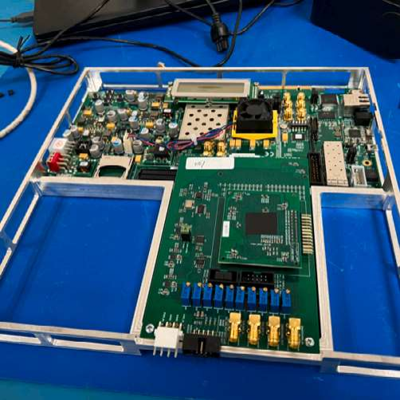
Test System
① Digital readout board:
Chip control: Provides control signals and clock, register configuration, operating mode selection
Data processing: data unpacking, FPGA timestamping, and error/overflow detection
Data transmission: receiving control data from the Control PC, transmitting chip data to the Control PC via the IPBus protocol.
② Adapter board: DAC, power supply, and FMC interface, etc.
①
②
③
③ Bonding board
Provides mechanical and electrical connections for Jadepix3/Jadepix4 chips
FPGA
Firmware
KC705
1G Eth
IP bus
Software
Daughter Board
FMC
HPC
PC
JadePix-3/4
UHAL
DAC
CLOCK
Notes:
[~40 s]
This is our test system, with three boards.
One, the digital readout board. It controls the chip — clock, control signals, register configuration — and it processes the data: unpacking, time stamping in the FPGA, and error detection. It talks to the control PC through the IPBus protocol.
Two, the adapter board: DAC, power supply, and the FMC interface.
Three, the bonding board: it holds the JadePix-3 or JadePix-4 chip, with the mechanical and electrical connections.
With this system we can control the chip, read the data, and run all the tests I will show next.

Slide 12
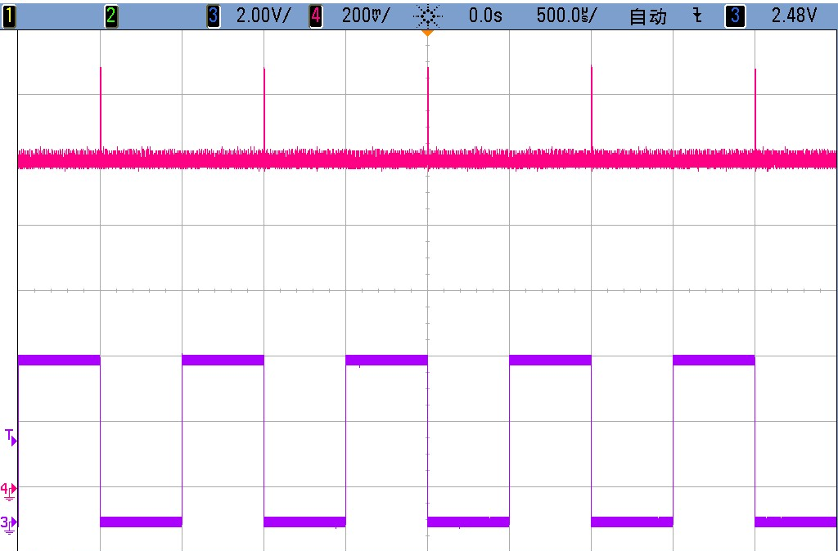
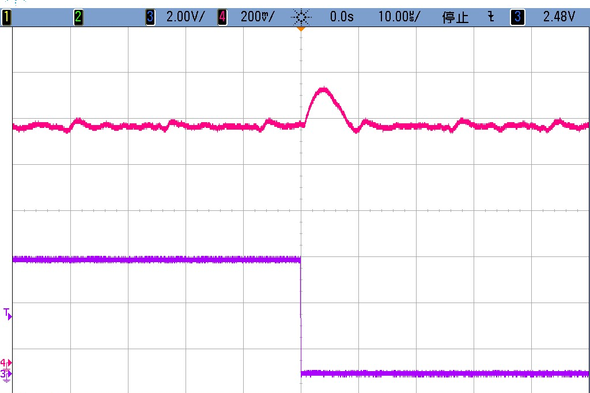
Analog Test
Pulse generator → injection capacitance → pixel (355,497) → Analog_out → oscilloscope
（Row，Col） | Col
Row | 0，0 | 0，1 | …… | 0，496 | 0，497
 | 1，0 | 1，1 | …… | …… | ……
 | …… | …… | …… | 354，496 | 354，497
 | 355，0 | 355，1 | …… | 355，496 | 355，497
Test pixels(Pulse=1,Mask=0)
Other pixels(Pulse=0,Mask=1)
Test charge injected electrically into any pixels
Verifies the full analog chain: injection capacitance → pixel front-end → Analog_out
Red：Output analog signal of pixel(355,497)
Purple：Input pulse(V=200mV，T=1ms)
Notes:
[~45 s]
we first tested the analog front-end response of JadePix-4.
The test method is: a pulse generator injects charge, the signal goes through the injection capacitance, into the target pixel, and finally out to the oscilloscope via Analog_out.
Look at the pixel matrix on the left. We only enabled pixel —the green one—while masking all others.
On the right is the captured waveform: purple is the input pulse, red is the output signal. As you can see, the output is clean and clearly responsive.
This verifies that the full signal chain—from injection capacitance to pixel front-end to analog output—is functioning correctly."

Slide 13
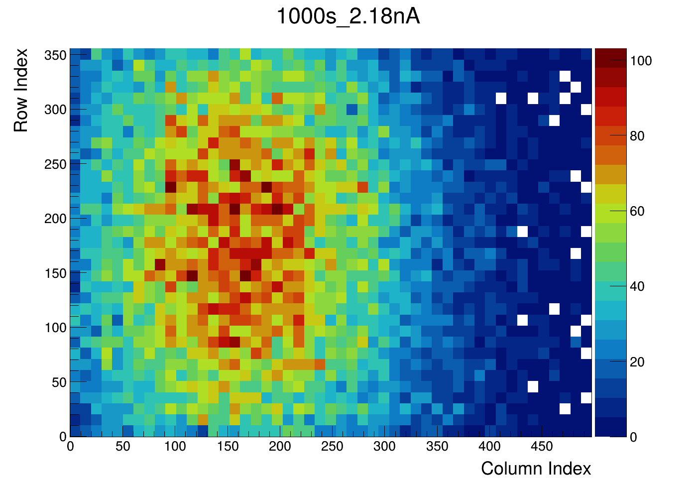
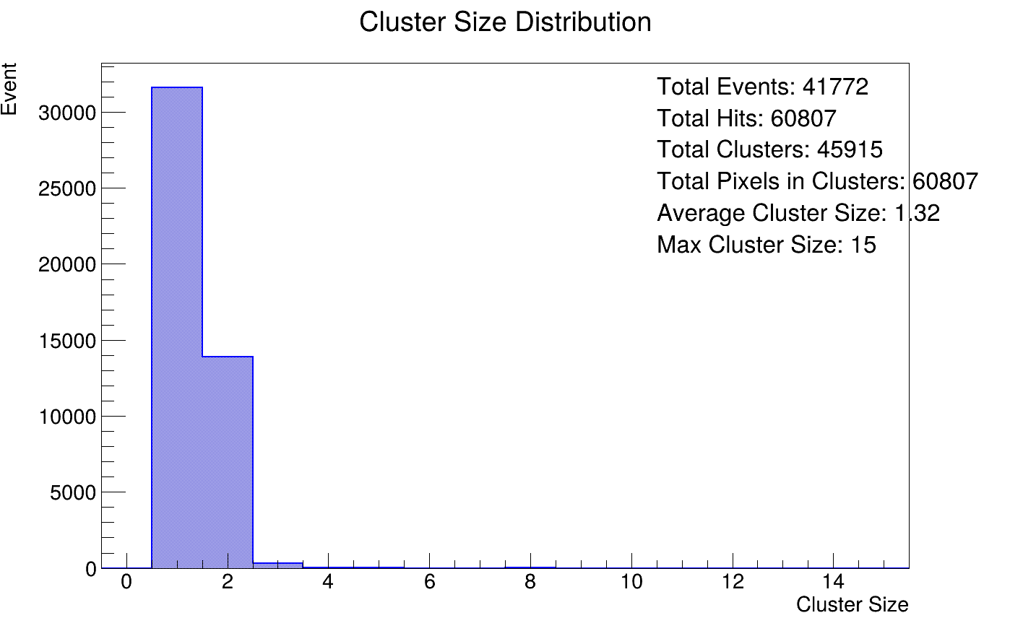
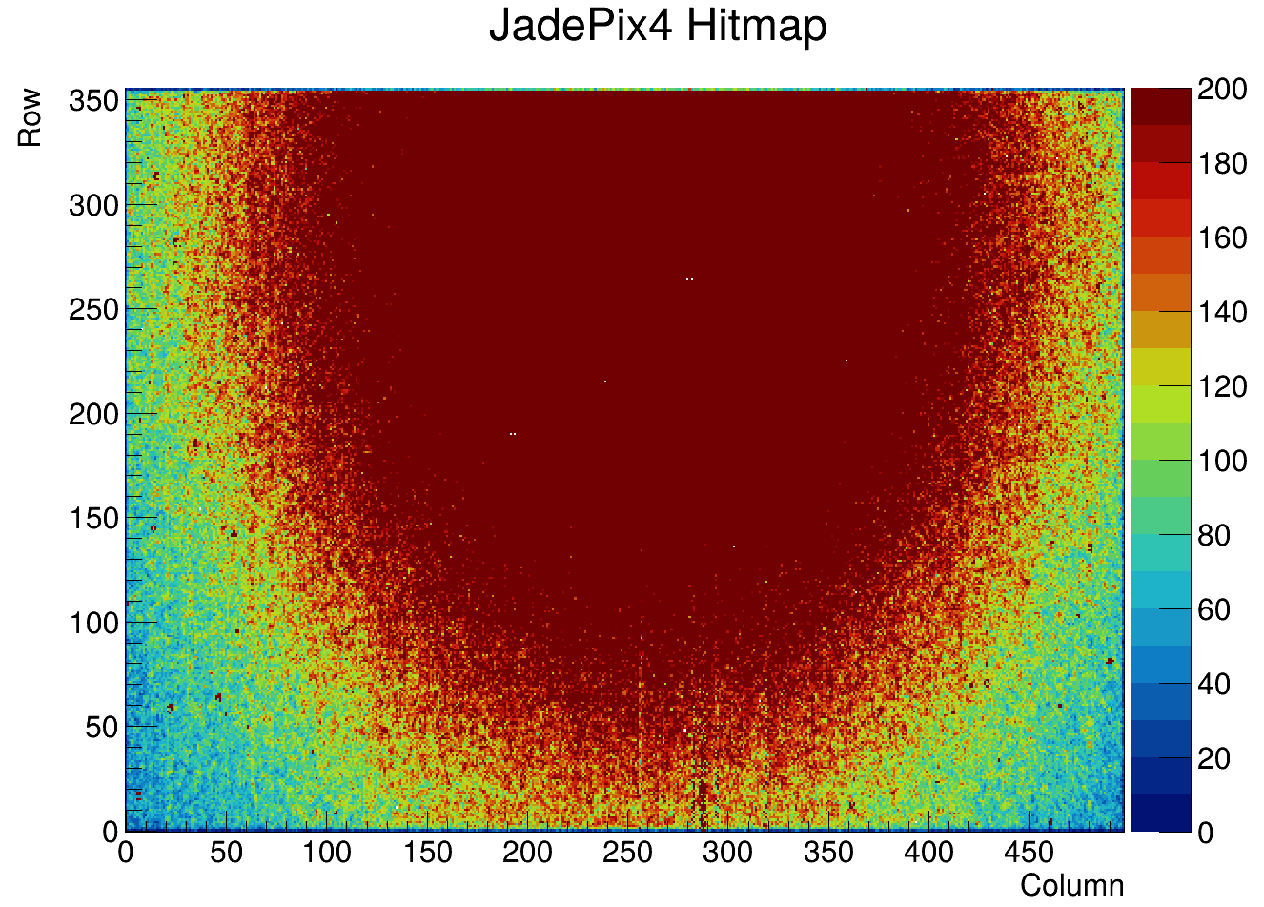
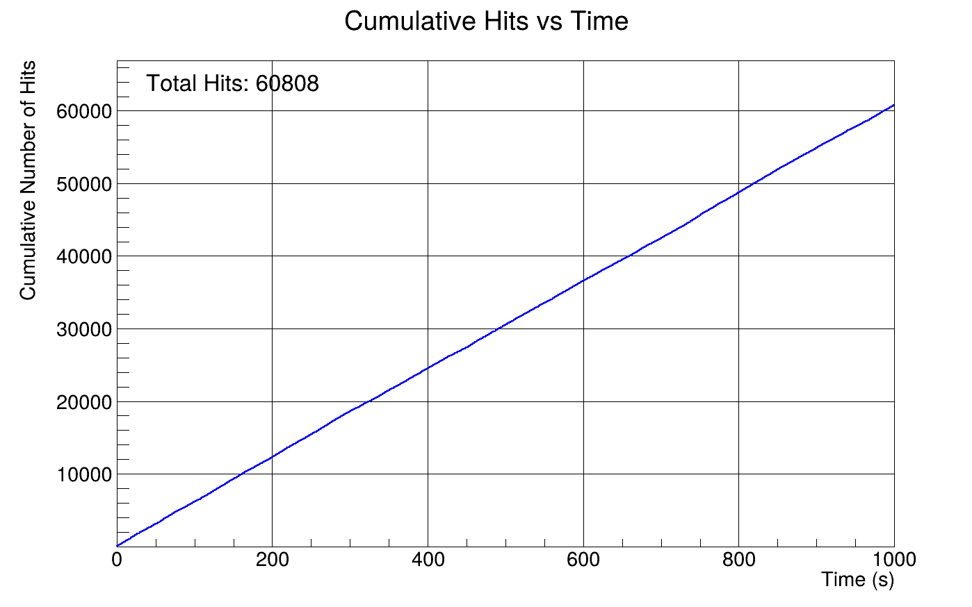
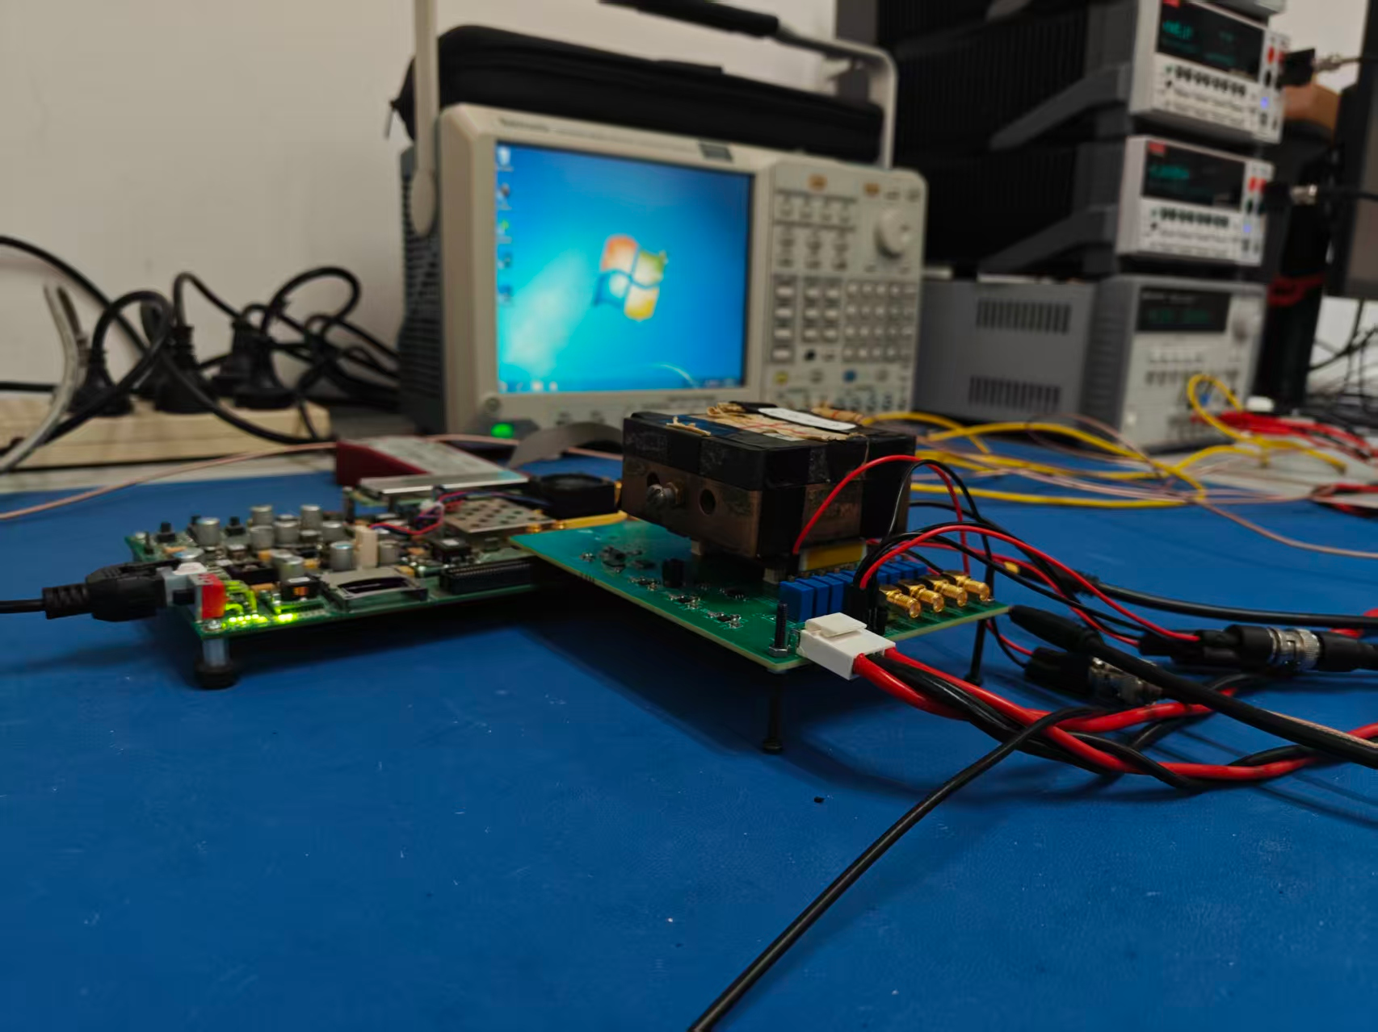
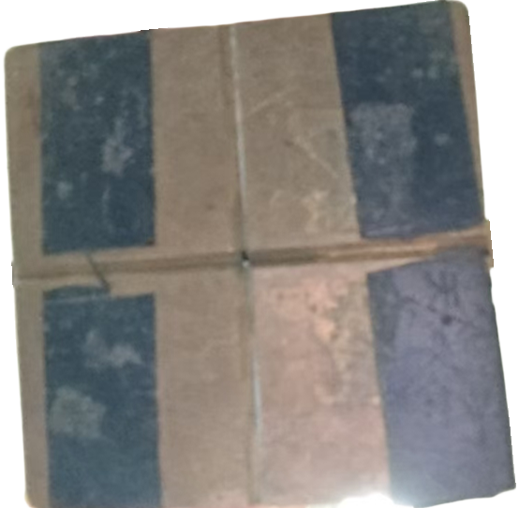
Sources Tests
(a)
(b)
⁵⁵Fe source test:
(a)Hit map
(b)Cluster size
(c)Cumulative hits
⁹⁰Sr source test — Hit map
(c)
⁵⁵Fe and ⁹⁰Sr source tests: clear hit detection and cluster formation
⁹⁰Sr long-run: 14 h continuous operation (with periodic / conditional chip reset)
Photo of the ⁹⁰Sr source test
Notes:
[~45 s]
"After the analog front-end test, we moved on to radioactive source tests.
On the left are the iron-55 results. Figure (a) is the hit map, showing clear signal response. Figure (b) is the cluster size distribution, with a mean of about 1.1 pixels. Figure (c) shows cumulative hits versus threshold, with good linearity—confirming the chip is working properly.
On the right are the strontium-90 results. This is the hit map, where the source illumination area is clearly visible. This is a 14-hour continuous operation test. The chip remained stable throughout, with no significant anomalies. This validates the reliability of JadePix-4 for long-term operation."

Slide 14
1
2
3
4
5
Motivation & Background
Design of JadePix-4
Test System & Laboratory Test
Beam Test & Results
Summary & Outlook
Outline
Notes:
[~5 s]
Next we moved on to the beam test

Slide 15
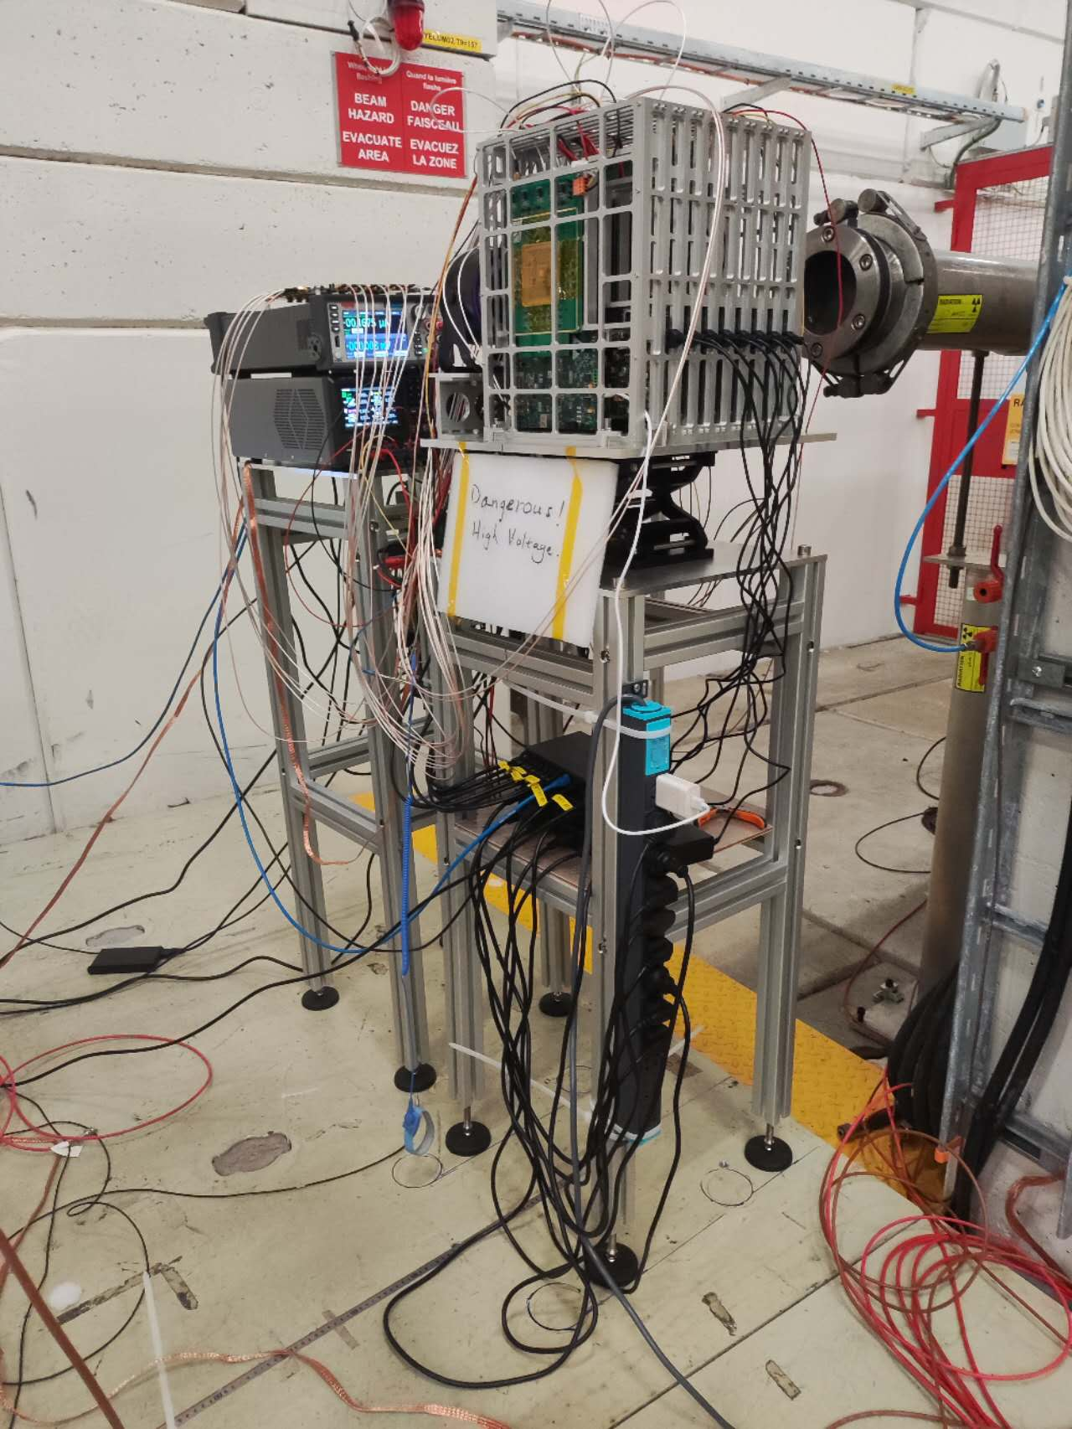
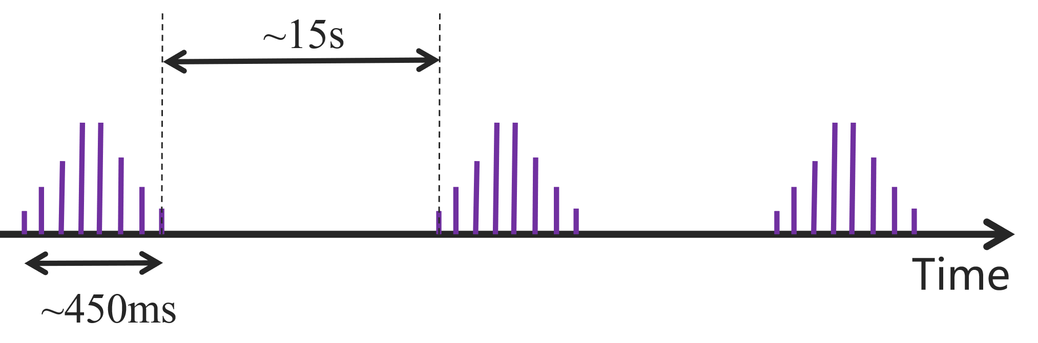
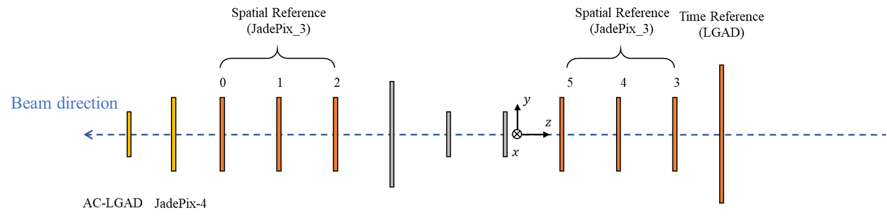
Beam Test at CERN
For this beam run, a common beam configuration was adopted after tuning.
Particle type: π⁺
Momentum: 10 GeV/c
Bunch interval: ~15 s
Data-taking time per run: 20-30 min
Number of tracks: ~500k per run
Telescope at the beam line
Beam-test layout (JadePix-3 tracking planes, LGAD timing reference)
Notes:
[~40 s]
We tested JadePix-4 in a test beam at CERN. The photo shows the telescope at the beam line: JadePix-3 planes for tracking, one LGAD plane as the timing reference, and JadePix-4 as the device under test.
The beam particles were positive pions at ten G-E-V over c. Bunch spacing about 15 seconds; one run is 20 to 30 minutes, about 500,000 tracks.

Slide 16
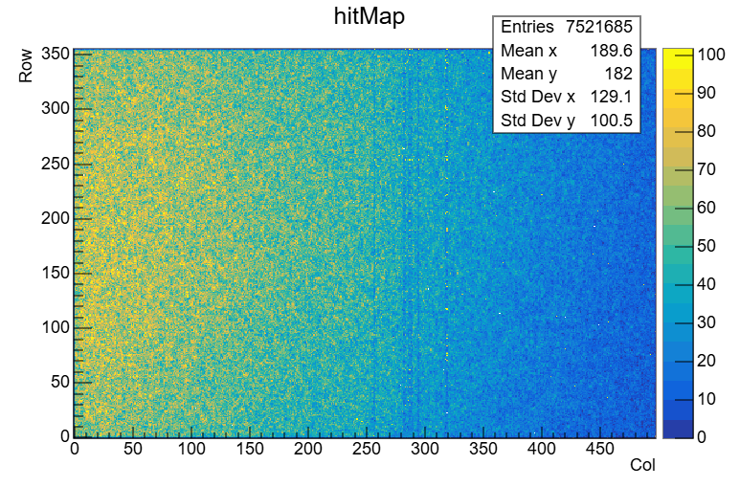
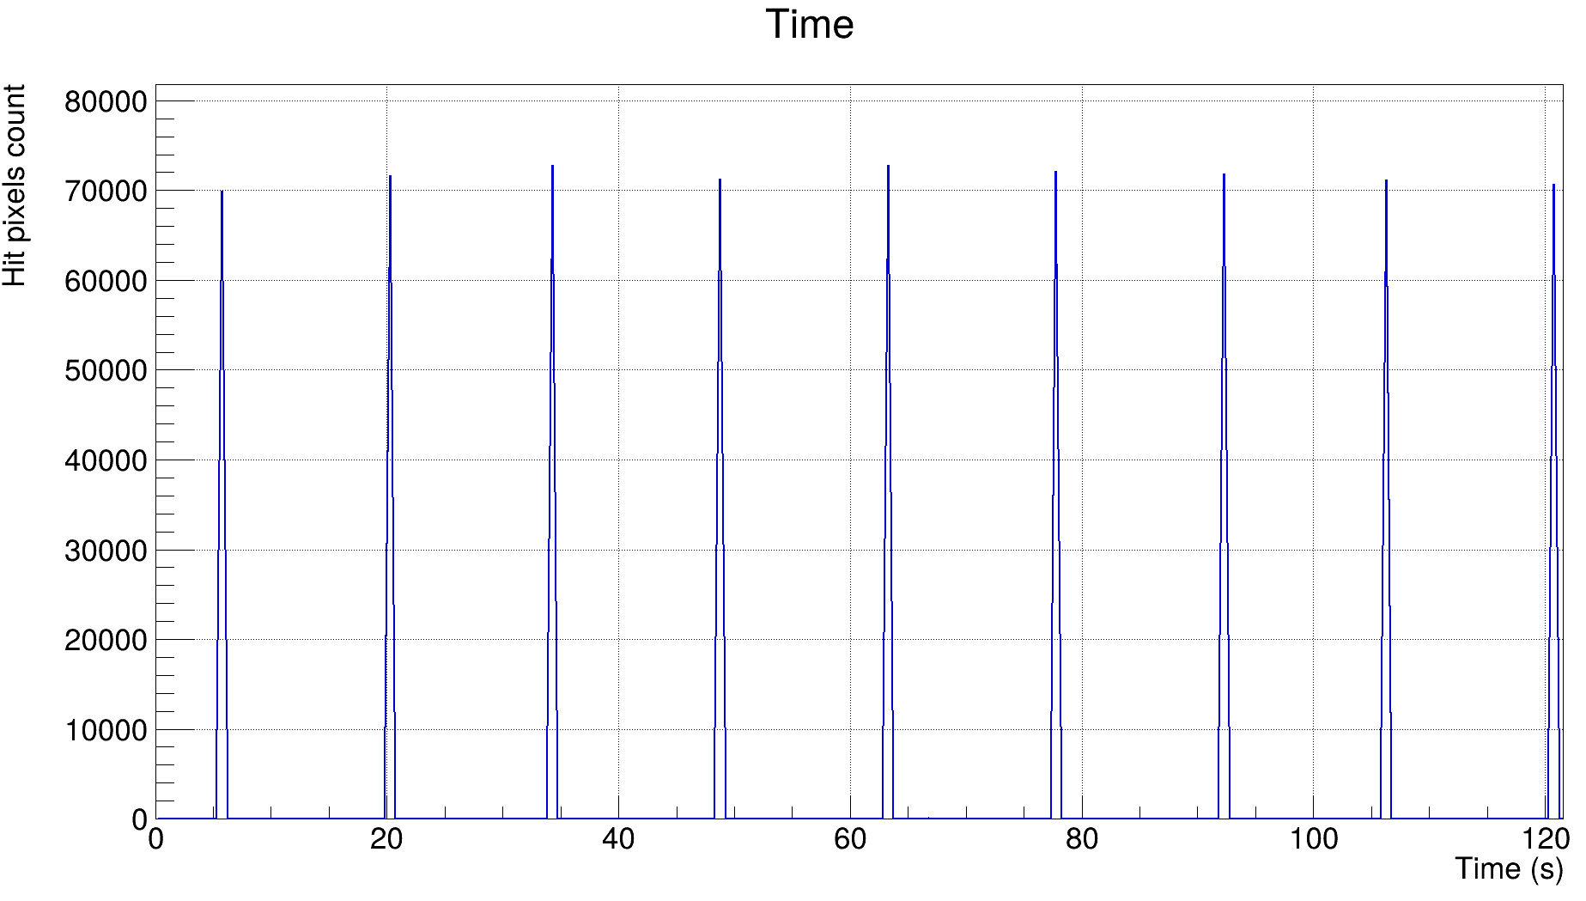
Beam Data Overview
PRELIMINARY
Hit count vs. time — clear spill structure
Beam centred on the JadePix-3 planes, on the left part of the JadePix-4 sensor
The JadePix4 hit rate over time is ~70k hits/spill, showing a clear beam time structure.
JadePix-4 hit map — beam covers the left part of the sensor
Notes:
[~40 s]
This is an overview of the beam data.
On the left we can see the JadePix-4 hit map. The beam covered only the left part of the sensor, because the beam was centered on the JadePix-3 telescope planes.
On the right is the hit count versus time. We clearly see the spill structure of the beam. The hit rate is about 70,000 hits per spill.
So the chip works in the beam, and the data quality is good enough for the analysis.

Slide 17
Corryvreckan-Based Data Analysis
Decoding & Clustering
            Decodes pixel hits from raw data and groups adjacent hits in space and time into clusters.
Alignment
            Includes pre-alignment and fine alignment (telescope and DUT).
Tracking
Reconstructs particle tracks by fitting clusters from aligned telescope layers.
DUT Association & Analysis
            Extrapolates reconstructed tracks to the DUT plane, matches them with DUT clusters, and computes performance metrics such as detection efficiency and spatial/temporal resolution.
Notes:
[~50 s]
After the beam test, we analyzed the data using the Corryvreckan framework in four steps.
First, decoding and clustering pixel hits into clusters in space and time.
Second, pre and fine alignment to synchronize the telescope and the DUT coordinate.
Third, track reconstruction via aligned telescope clusters.
Finally, DUT association and analysis—extrapolating tracks to the DUT plane, matching them with DUT clusters, and computing key metrics such as detection efficiency, spatial resolution, and temporal resolution."

Slide 18
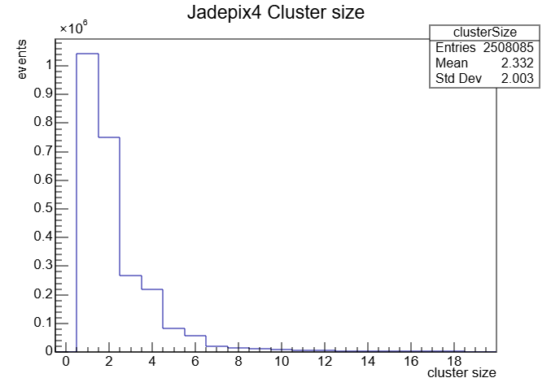
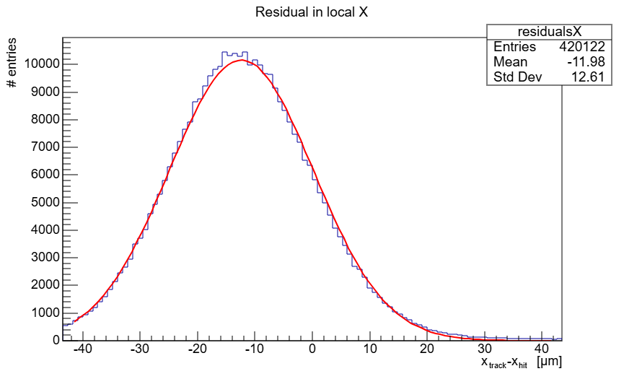
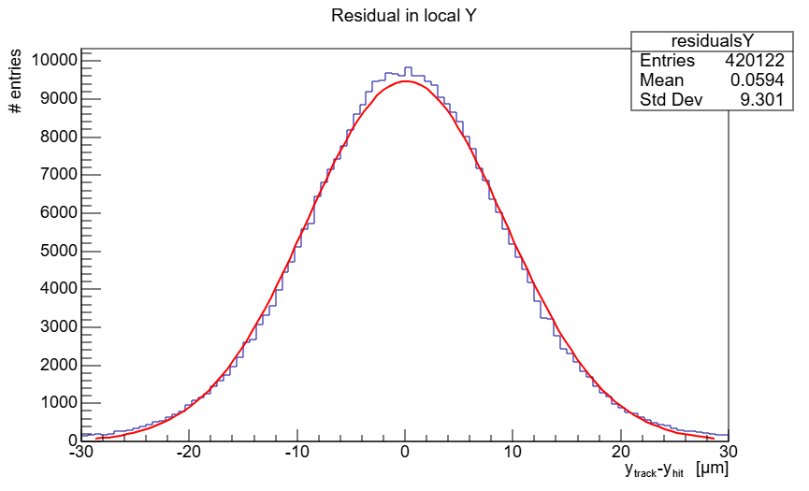
Data analysis results
PRELIMINARY
Residual in local X
Residual in local Y
Cluster-size distribution
Spatial resolution_X | Spatial resolution_Y | Mean cluster size
9.7μm | 6.37μm | 2.3 pixels
Binary readout with 29 μm × 20 μm pitch; charge sharing between neighbouring pixels
Notes:
[~50 s]
Here are the analysis results of Jadepix-4.
The left plot is the residual in X and Y direction. Both are fitted with a Gaussian function. The right plot is the cluster size distribution.
The spatial resolution is 9.7 micrometers in X and 6.37 micrometers in Y. The mean cluster size is 2.3 pixels.
This clearly did not reach the level we had expected.

Slide 19
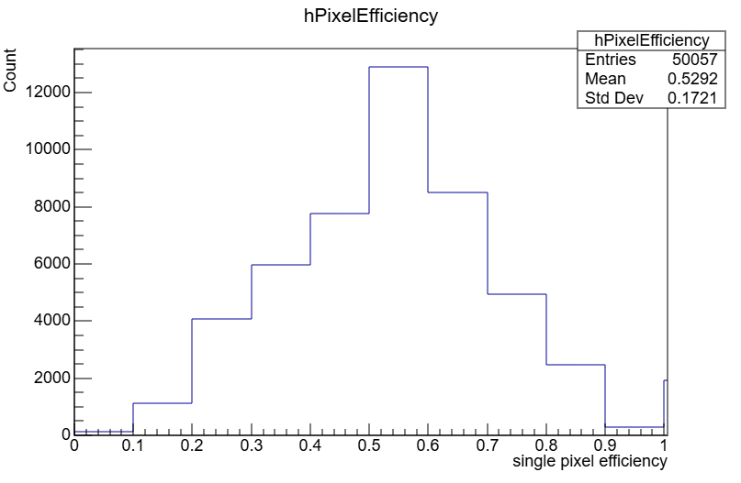
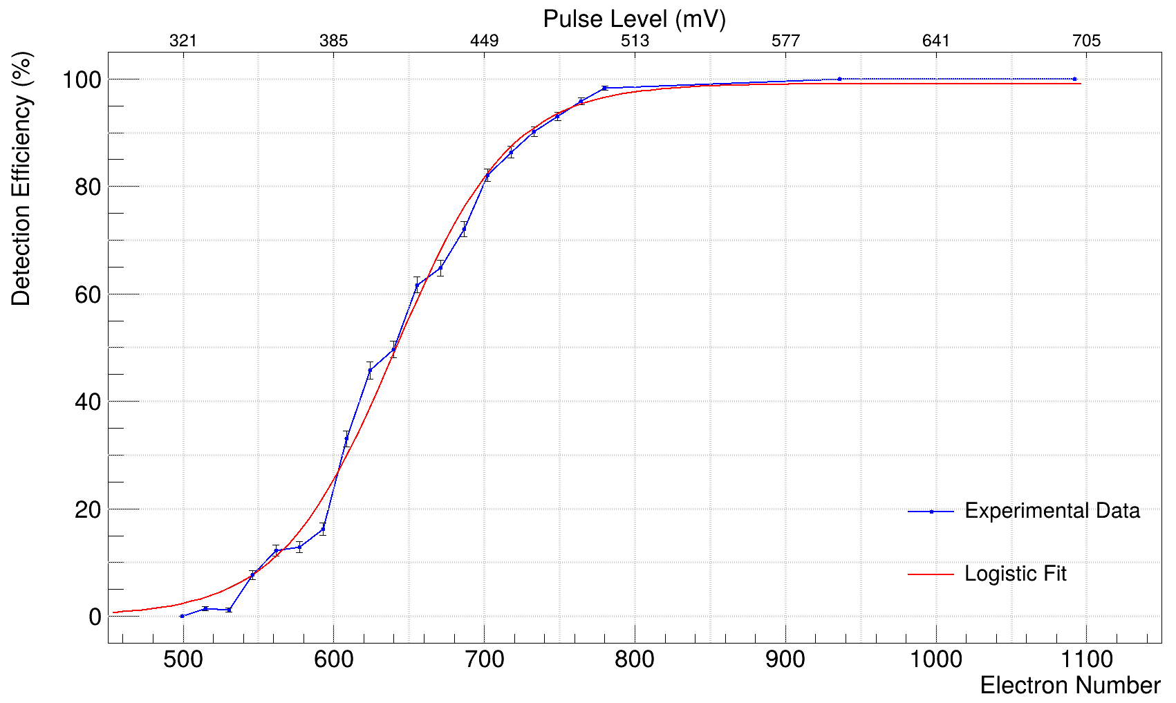
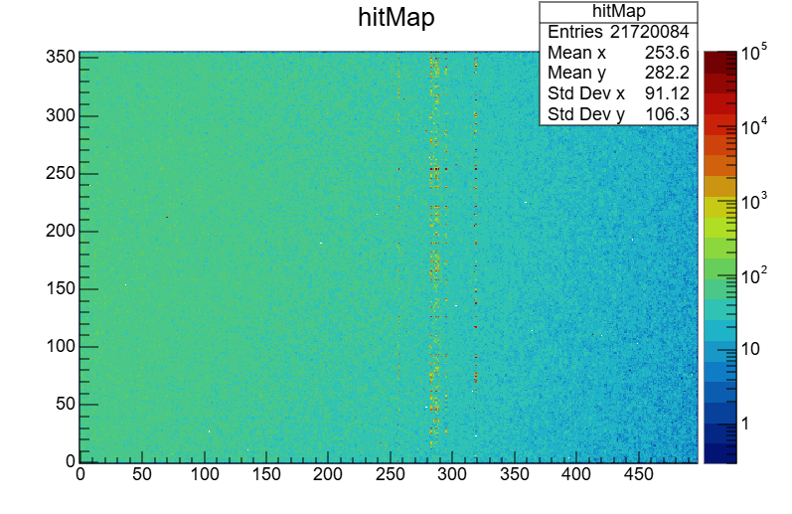
Detection Efficiency & Analysis
PRELIMINARY
Average detection efficiency 52.7% — below the > 99% expectation
Per-pixel efficiency distribution (beam data)
Efficiency vs. injected charge
(S-curve, pulse test)
Hitmap of Jadepix-4
（Some bad pixel columns）
Notes:
[~50 s]
Another analysis results is the average detection efficiency only is 52.7 percent — below our expectation of more than 99 percent. But we understand the losses, one by one.
Cause one is the threshold was too high. Through the post-test, we found that the threshold setting was incorrect during the beam test.
We set the threshold at around 600 to 700 electrons during the beam test (but normally 200 electrons)
The second reason is that some columns in the middle part of the chip are partially damaged.
Our next plan is to scan the chip’s threshold to determine its optimal operating point, and investigate the cause of these column damages.

Slide 20
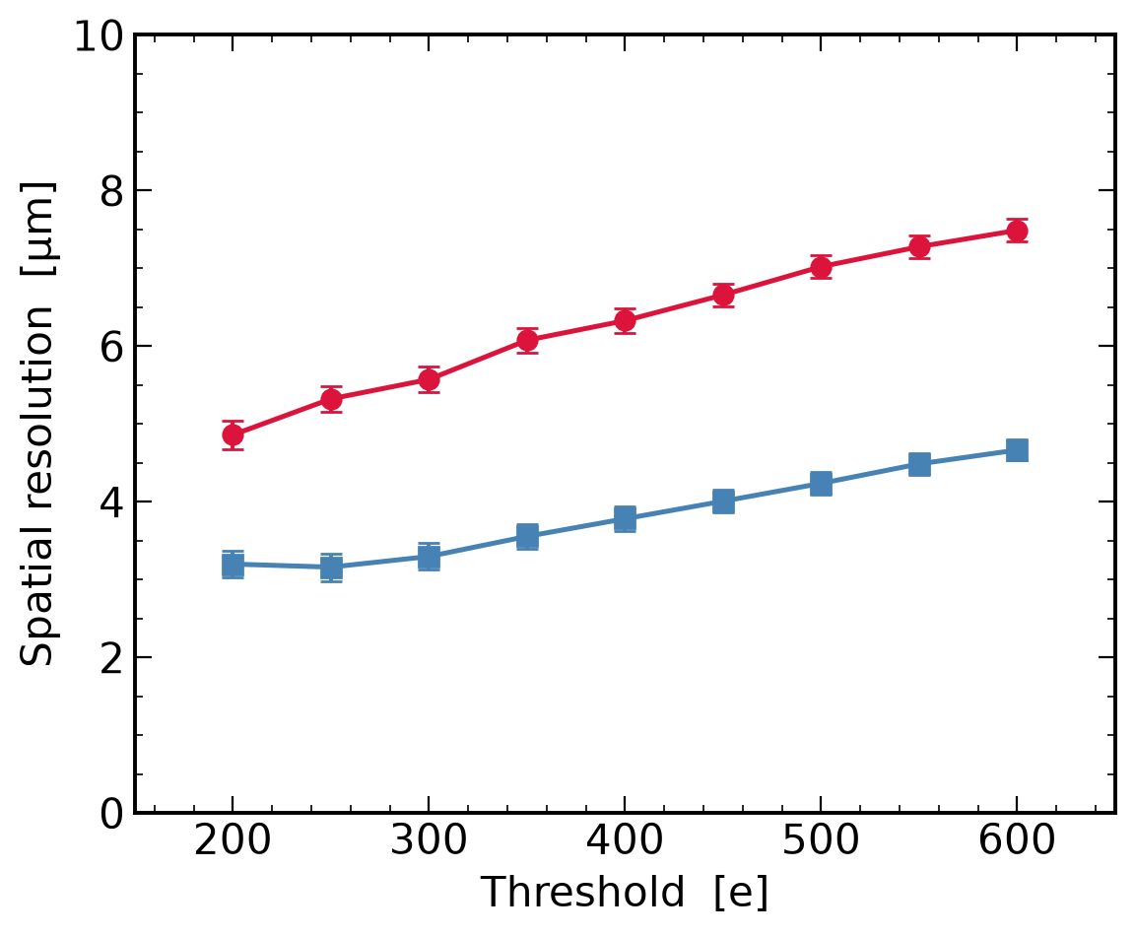
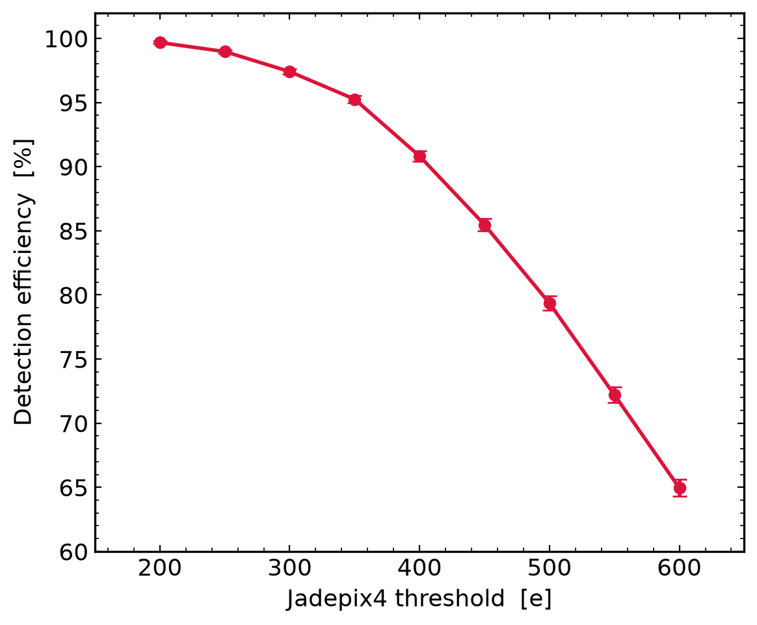
Simulation: threshold dependence of efficiency and resolution
Allpix² + Geant4 simulation reproducing the beam-test geometry and analysis chain
• σX / σY degrade from ~4.86 / 3.20 μm at 200 e⁻ to ~7.49 /4.67 μm at 600 e⁻
Efficiency falls from ~99% at 200 e⁻ to ~65% at 600 e⁻
Both the efficiency loss and the degraded resolution trace back to a single cause — the threshold was set too high
Notes:
[~45 s]
To confirm this, we made a full simulation with Allpix-squared and Geant4, copying the beam-test geometry and the same analysis chain.
Versus the threshold, the resolution becomes worse — from 4.86 and 3.20 micrometers at 200 electrons, to 7.49 and 4.67 micrometers at 600 electrons. The efficiency falls from about 99 percent to about 65 percent.
So both problems — low efficiency and worse resolution — have one main cause: the threshold was set too high. With a lower threshold, the chip will work much better.

Slide 21
1
2
3
4
5
Motivation & Background
Design of JadePix-4
Test System & Laboratory Test
Beam Test & Results
Summary & Outlook
Outline
Notes:
[~5 s]
Let me summarise.

Slide 22
Summary
JadePix-4 (MIC5): monolithic CMOS pixel sensor prototype for the CEPC vertex detector R&D, TowerJazz 180 nm CIS process
Novel combination of an ALPIDE-like binary front-end with AERD + 2-D-projection sparse readout enables 29 μm × 20 μm pixels
Complete FPGA-based test system developed for chip characterization——FPGA firmware, and offline analysis software
Item | Status
Binary front-end | Functional — source & beam tests
Sparse data-driven readout (AERD ) | Verified — lab & beam
Time stamping 800 ns; output up to 6.6 Mhit/s | Verified — continuous operation
Spatial resolution σX / σY = 9.7 / 6.37 μm; cluster size 2.3 | Measured (preliminary)
Efficiency 52.7% @ 680 e⁻ — cause-attributed, fixes defined | In progress
Notes:
[~55 s]
To summarise. JadePix-4 is a monolithic CMOS pixel sensor prototype for the CEPC vertex detector, in the TowerJazz 180 nanometer CIS process. It combines an ALPIDE-like binary front-end with AERD sparse readout, allowing 29 by 20 micrometer pixels. We also built the full test system — FPGA firmware and offline analysis software.
We have conducted extensive testing on this chip, including laboratory tests and beam tests. Currently, we have obtained spatial resolutions of 9.7 and 6.37 micrometer in the X and Y directions respectively. The detection efficiency is only half due to the threshold setting.

Slide 23
Outlook
S-curve tests of all chips (B3,B6,B10–B13) → optimal threshold working point
Next Beam Test: placed in the middle of the JadePix3 telescope, targeting efficiency > 99% and spatial resolution measurement
HPES (Dongguan) integration: Build a beam telescope based on JadePix4
Time | Milestone
2026 Q4 (Beijing) | S-curve tests B10–B13
2026 Q4 (KEK) | Beam test with JadePix-3 telescope: efficiency > 99%, spatial resolution
2027 (Dongguan, HPES) | Beam telescope
Notes:
[~40 s]
Here is the outlook.
First, S-curve tests of the all chips to find the best work point.
Second, the next beam test, at KEK in November: the chip in the middle of the JadePix-3 telescope, targeting efficiency above 99 percent and a clean spatial resolution measurement.
Third, in 2027, a full JadePix-4 beam telescope, integrated into HPES in Dongguan.
So JadePix-4 is on a clear path to become the reference telescope for HPES.

Slide 24
Thank you!
Yongqi Wang
INSTR 2026
Notes:
[~10 s]
That is all for my talk. Thank you for your attention. I am happy to take your questions.

