Slide 1

Recent LQCD studies on (heavy) flavor physics (for STCF)
Wei Wang
Shanghai Jiao Tong University
见微学术沙龙
2026年3月13日 合肥
Notes:
各位老师，同学，大家下午好，我是来自上海交通大学的谭金鑫，很荣幸能来到这次重味高精度计算研讨会和各位同行进行交流。我的报告题目是Collins-Soper Kernel from Lattice QCD
1

Slide 2
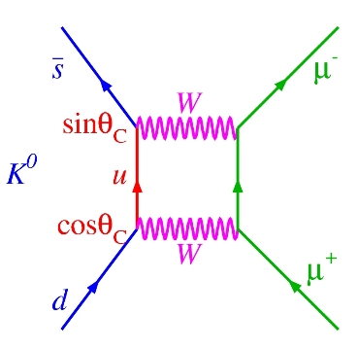
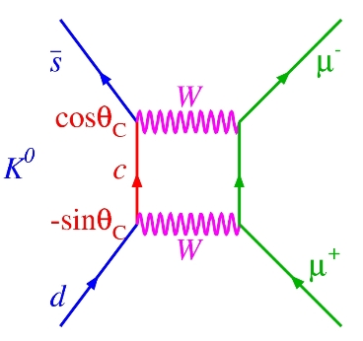
重味物理的部分历史
2
https://www.science20.com/quantum_diaries_survivor/continuing_quest_flavorchanging_neutral_currents
GIM
1970

Slide 3
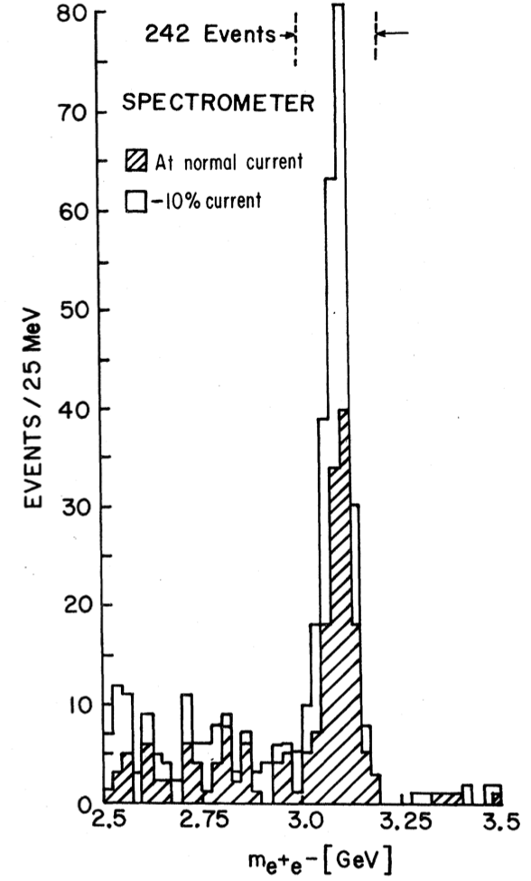
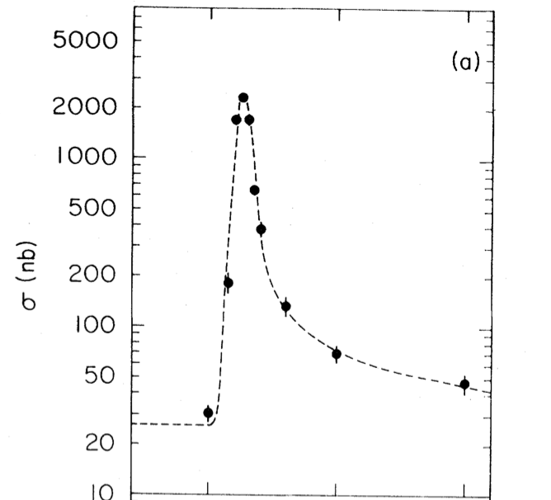
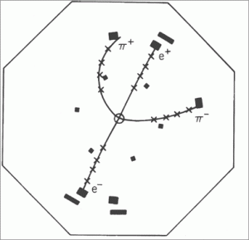

重味物理的部分历史
3
GIM
1970
PRL 33, 1404(1974)
PRL33, 1406(1974)
$$J/ψ$$
1974

Slide 4
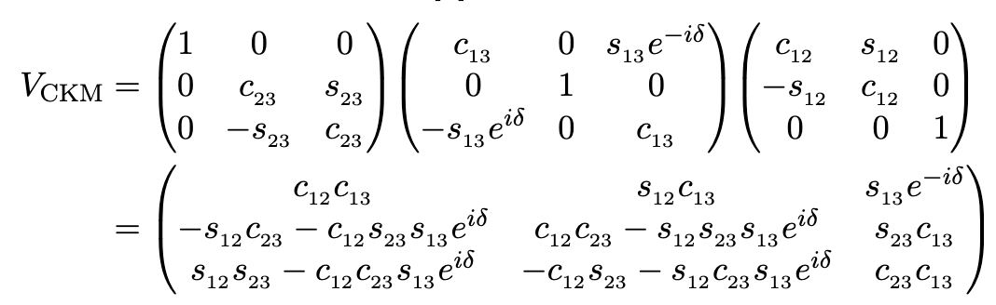
重味物理的部分历史
4
Prog. Theor. Phys.49, 652 (1973)
GIM
1970
KM
1973
$$J/ψ$$
1974

Slide 5
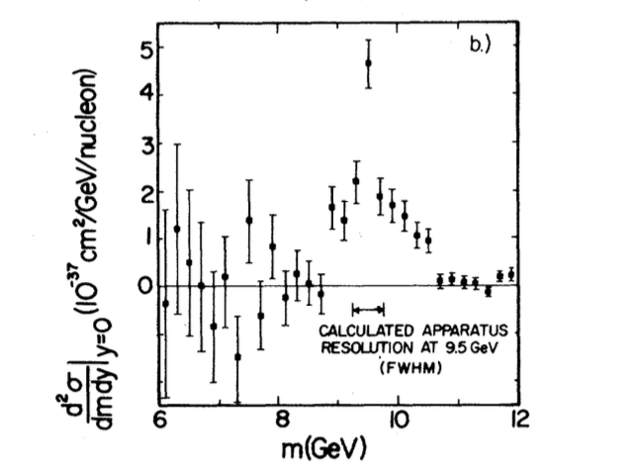
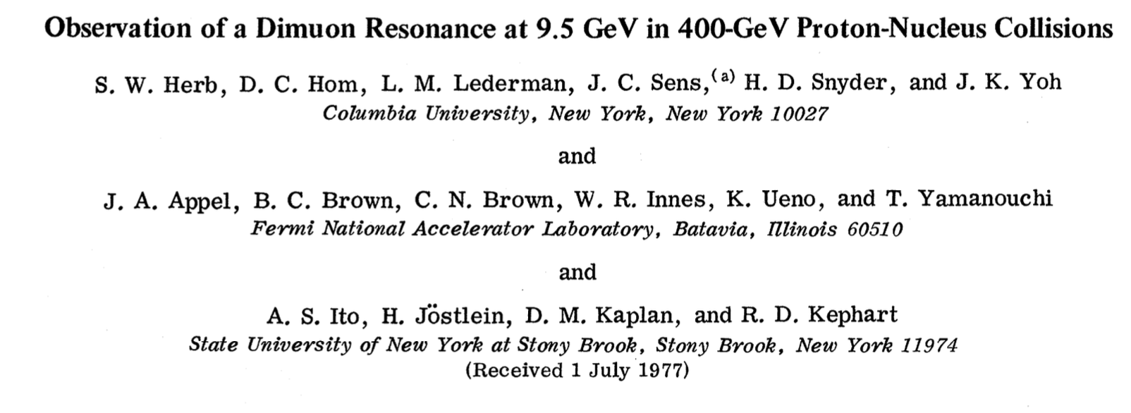

重味物理的部分历史
5
PRL 39 (1977) 252-255
GIM
1970
KM
1973
$$J/ψ$$
1974
$$Υ$$
1977

Slide 6
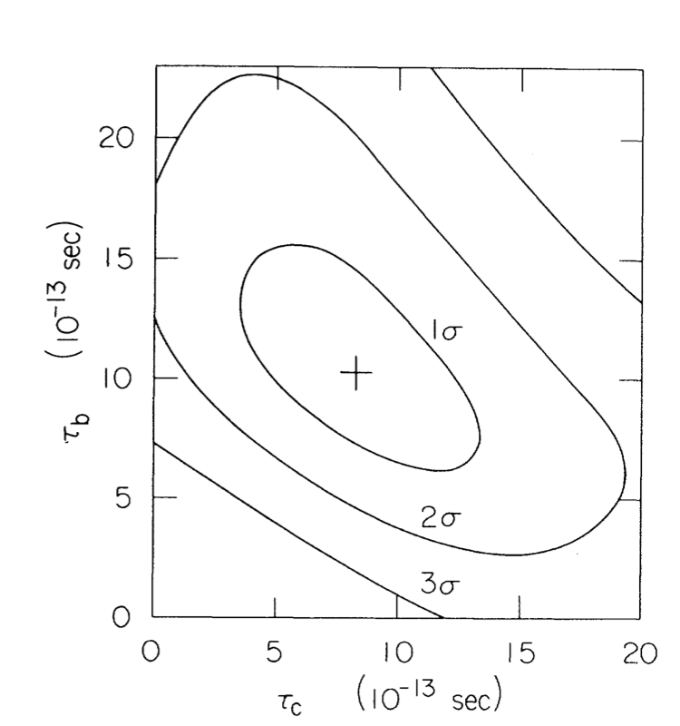


重味物理的部分历史
6
$$τ_{b}=\left({12.0}_{−3.6}^{+4.5}±3.0\right)×{10}^{−13}s$$
PRL 51,1316(1983)
GIM
1970
KM
1973
$$J/ψ$$
1974
$$Υ$$
1977
lifetime
1983

Slide 7
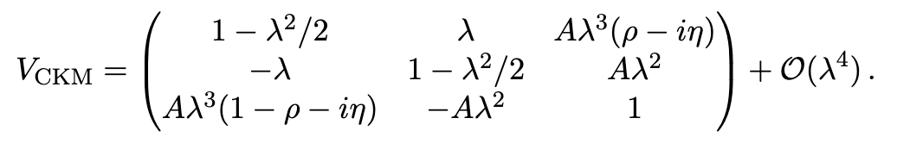

重味物理的部分历史
7
$$λ=0.22$$
GIM
1970
KM
1973
Wolfenstein
1983
$$J/ψ$$
1974
$$Υ$$
1977
lifetime
1977

Slide 8
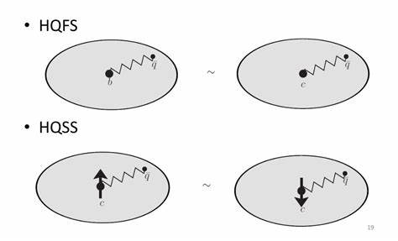
重味物理的部分历史
8
“Weak Decays of Heavy Mesons in the Static Quark Approximation”, Nathan Isgur, Mark B. Wise, Phys.Lett.B 232 (1989) 113-117
“Weak Transition form factors between heavy mesons”, Nathan Isgur, Mark B. Wise, Phys.Lett.B 237 (1990) 527-530
GIM
1970
KM
1973
Wolfenstein
1983
HQET
1989
$$J/ψ$$
1974
$$Υ$$
1977
lifetime
1977

Slide 9
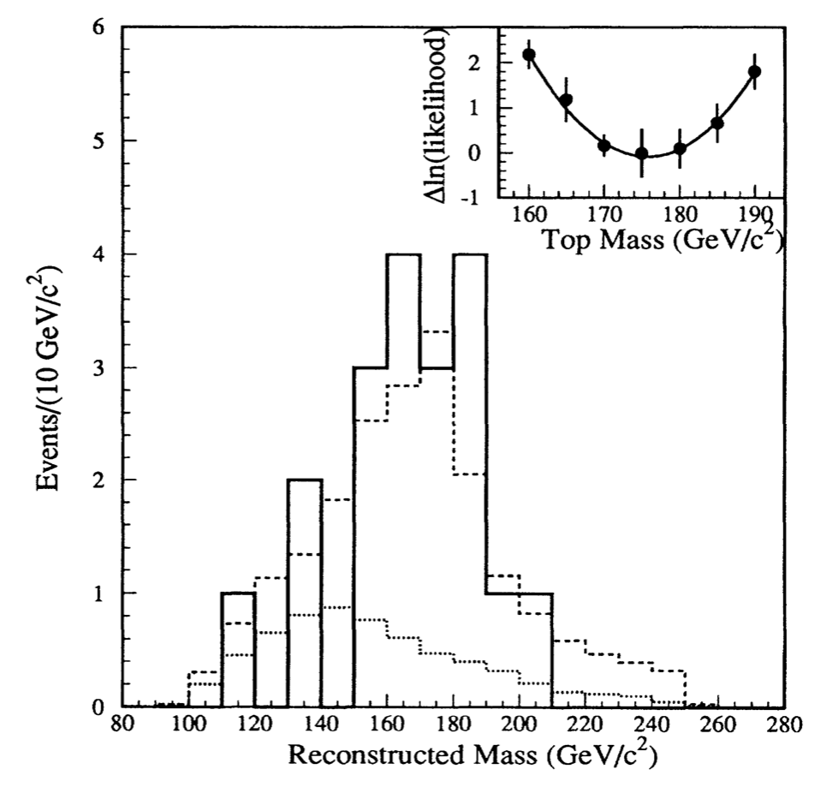





重味物理的部分历史
9
$$\overline{d}$$
$$\overline{b}$$
$$b$$
$$d$$
$B−\overline{B}$ mixing
CDF, PRL 74, 2626(1995)
GIM
1970
KM
1973
Wolfenstein
1983
HQET
1989
$$J/ψ$$
1974
$$Υ$$
1977
lifetime
1977
Top
1995

Slide 10
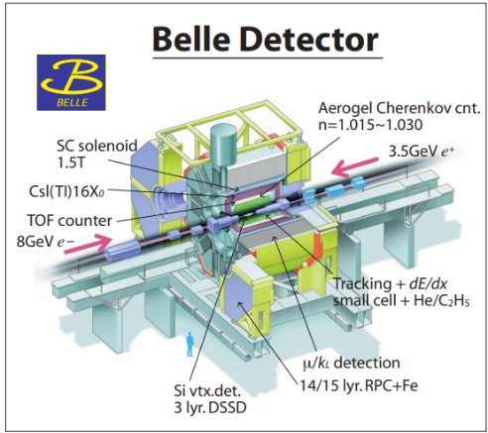




重味物理的部分历史
10
GIM
1970
KM
1973
Wolfenstein
1983
HQET
1989
Belle/Babar
1998/1999
$$J/ψ$$
1974
$$Υ$$
1977
lifetime
1977
Top
1995

Slide 11
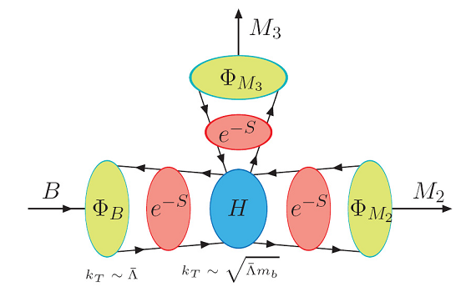
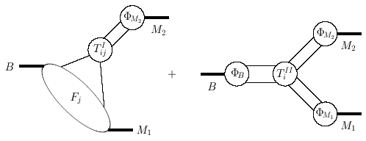
重味物理的部分历史
11
GIM
1970
KM
1973
Wolfenstein
1983
HQET
1989
Belle/Babar
1998/1999
$$J/ψ$$
1974
$$Υ$$
1977
lifetime
1977
Top
1995
QCDF/PQCD/SCET
2000

Slide 12
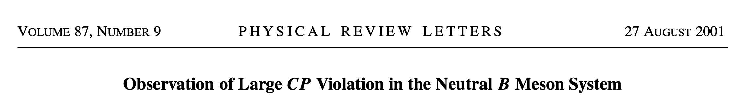
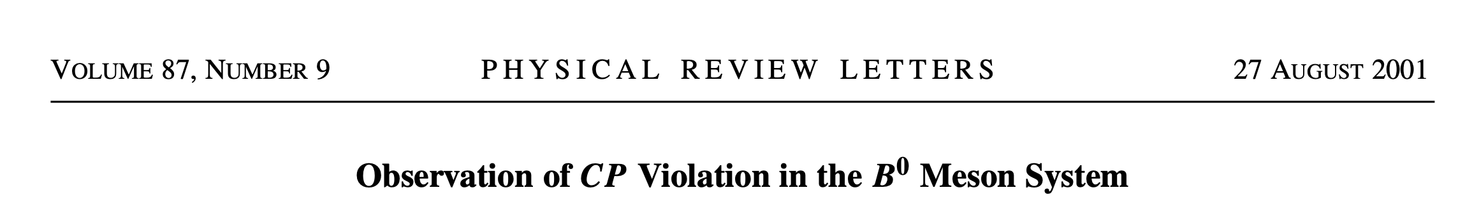
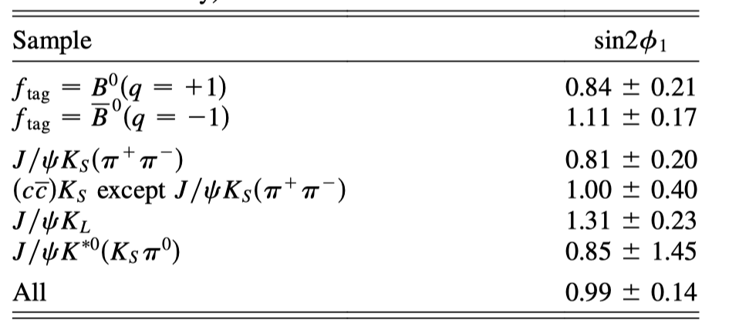
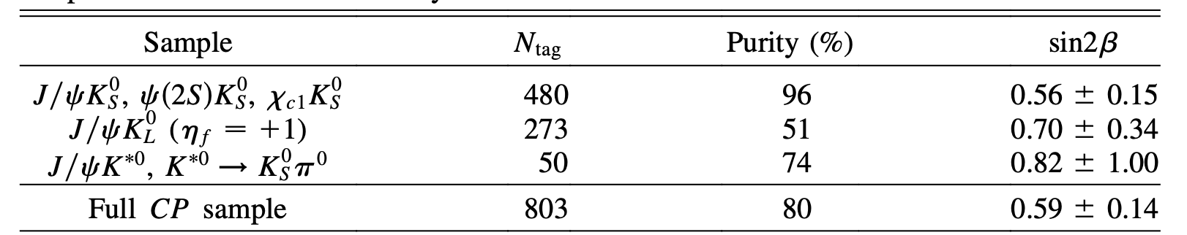
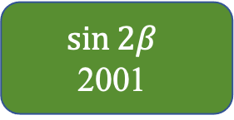
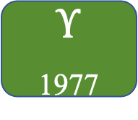
重味物理的部分历史
12
Babar, PRL 87,091801(2001)
Belle, PRL 87,091802(2001)
GIM
1970
KM
1973
Wolfenstein
1983
HQET
1989
Belle/Babar
1998/1999
$$\sin{2β}$$
2001
$$J/ψ$$
1974
$$Υ$$
1977
lifetime
1977
Top
1995
QCDF/PQCD/SCET
2000

Slide 13
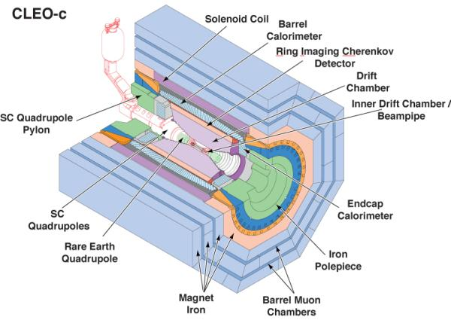
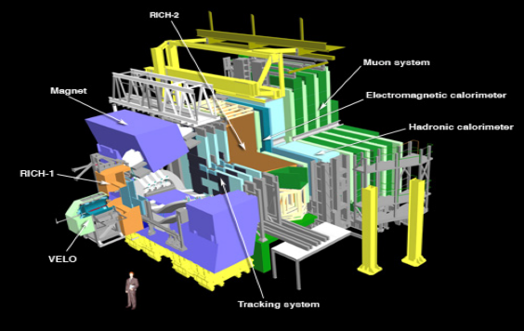
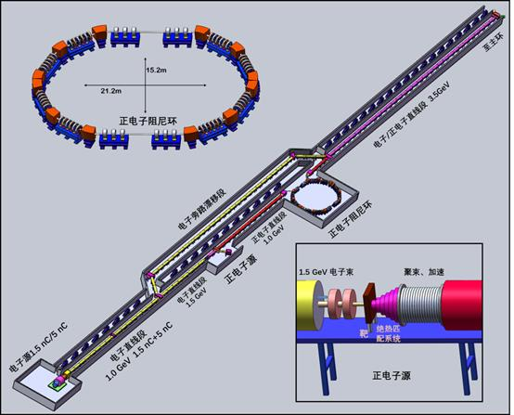

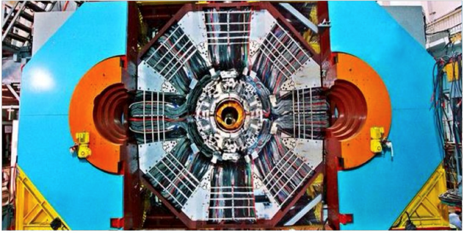
CLEO
超级陶粲工厂
国际上许多大型实验合作组研究重味物理

Slide 14

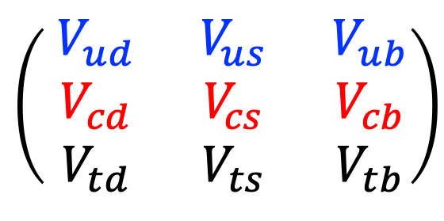
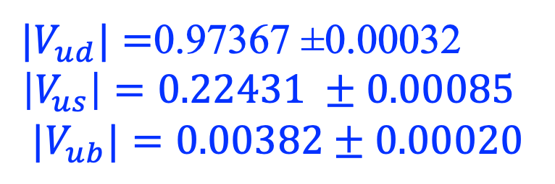


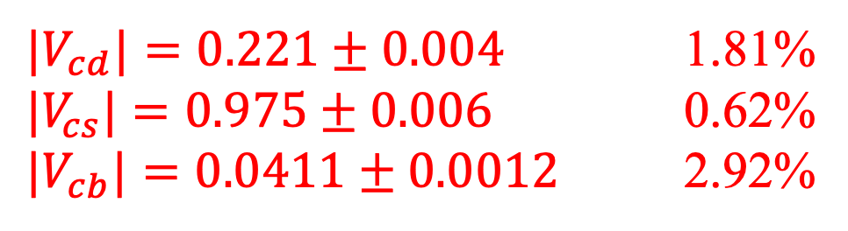

粲物理精确计算的(部分)核心理论困难
${|V}_{ud}|=$0.97367 ±0.00032
$$\left|V_{us}\right|=0.22431 ±0.00085$$
$${|V}_{ub}|=0.00382±0.00020$$
First row:
$$\left(\begin{matrix}{ V}_{ud} & { V}_{us} & { V}_{ub} \\ { V}_{cd} & { V}_{cs} & { V}_{cb} \\ { V}_{td} & { V}_{ts} & { V}_{tb}\end{matrix}\right)$$
$${10}^{−4} accuracy$$
${{ |V}_{ud}|}^{2}+{{ |V}_{us}|}^{2}$+ ${{ |V}_{ub}|}^{2}=0.9984±0.0007$
${|V}_{cd}|=0.221±0.004$ 1.81%
$|V_{cs}|=0.975±0.006$ 0.62%
${|V}_{cb}|=0.0411±0.0012$ 2.92%
PDG2024
Second row:
$${10}^{−2} accuracy$$
${{ |V}_{cd}|}^{2}+{{ |V}_{cs}|}^{2}$+ ${{ |V}_{cb}|}^{2}=1.001±0.012$
High precision determination of the second row provide strong tests of CKM unitarity, but this has to answered together with theoretical understanding!

Slide 15
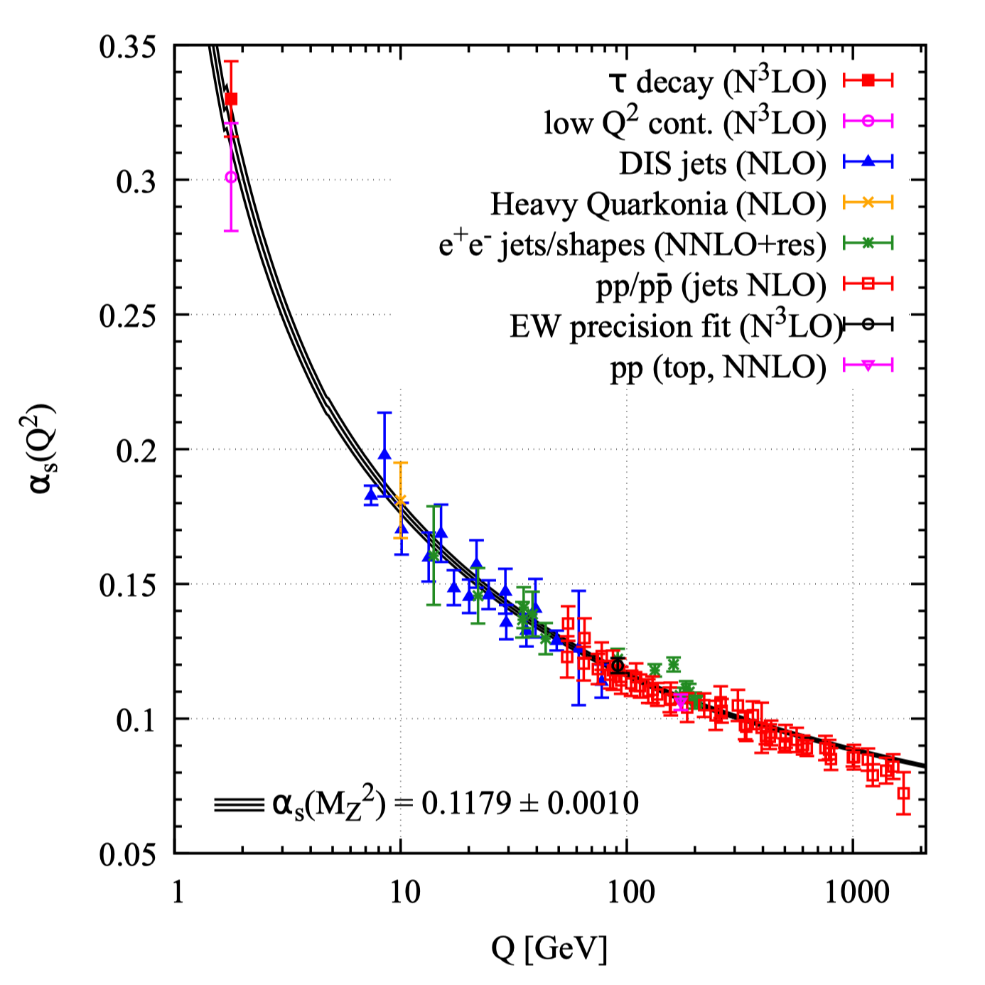
粲物理精确计算的(部分)核心理论困难
15
Around the proton radius scale (~1 GeV), QCD cannot be solved analytically, and the theoretical calculation at this scale is one of the seven Millennium Prize Problems.
CHARM is just in the region where the transition from perturbative to nonperturbative happens.
At scales much smaller than the proton radius: QCD has been rigorously verified by experimental measurements.
The Nobel Prize in Physics was awarded for this achievement in 2004.

Slide 16
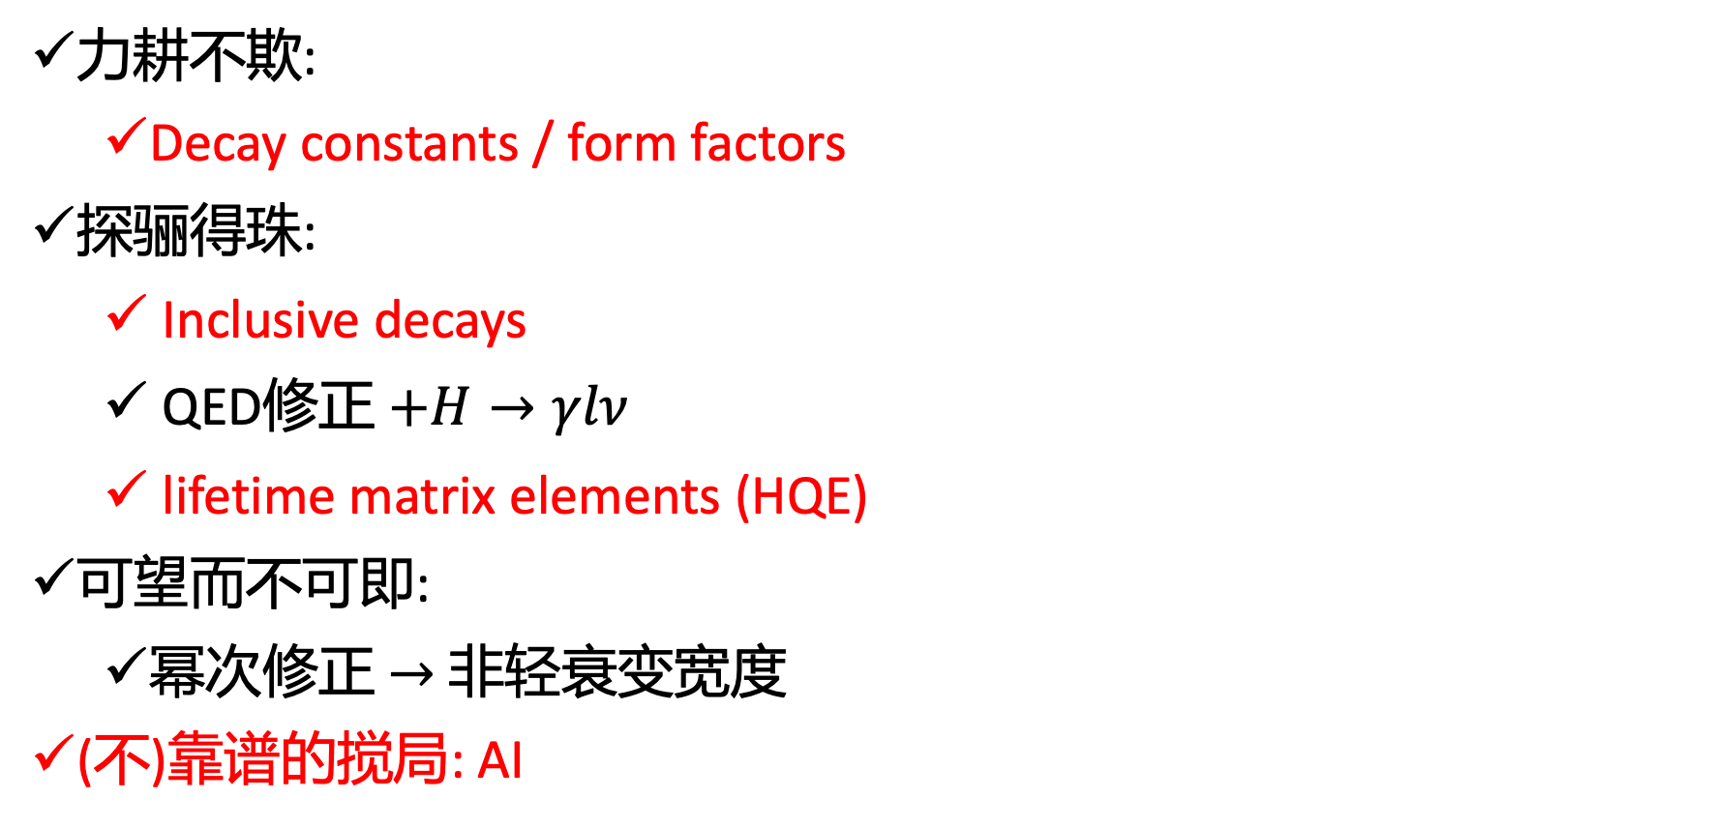
粲物理精确计算的(一些)机遇
16
力耕不欺:
Decay constants / form factors
探骊得珠:
Inclusive decays
QED修正 $+H→γlν$
lifetime matrix elements (HQE)
可望而不可即:
幂次修正 $→$ 非轻衰变宽度
(不)靠谱的搅局: AI

Slide 17
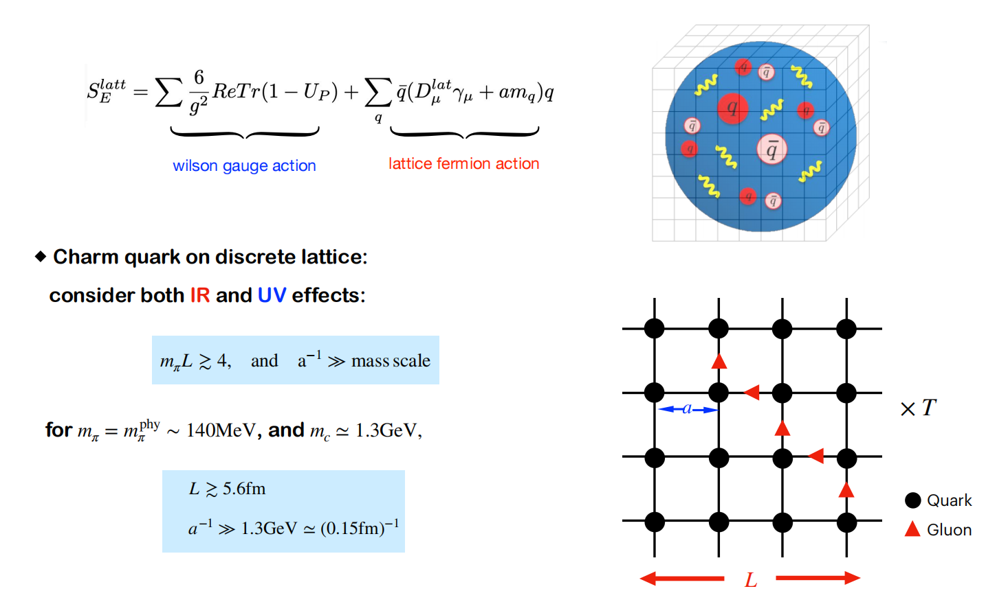
Lattice QCD
17

Slide 18
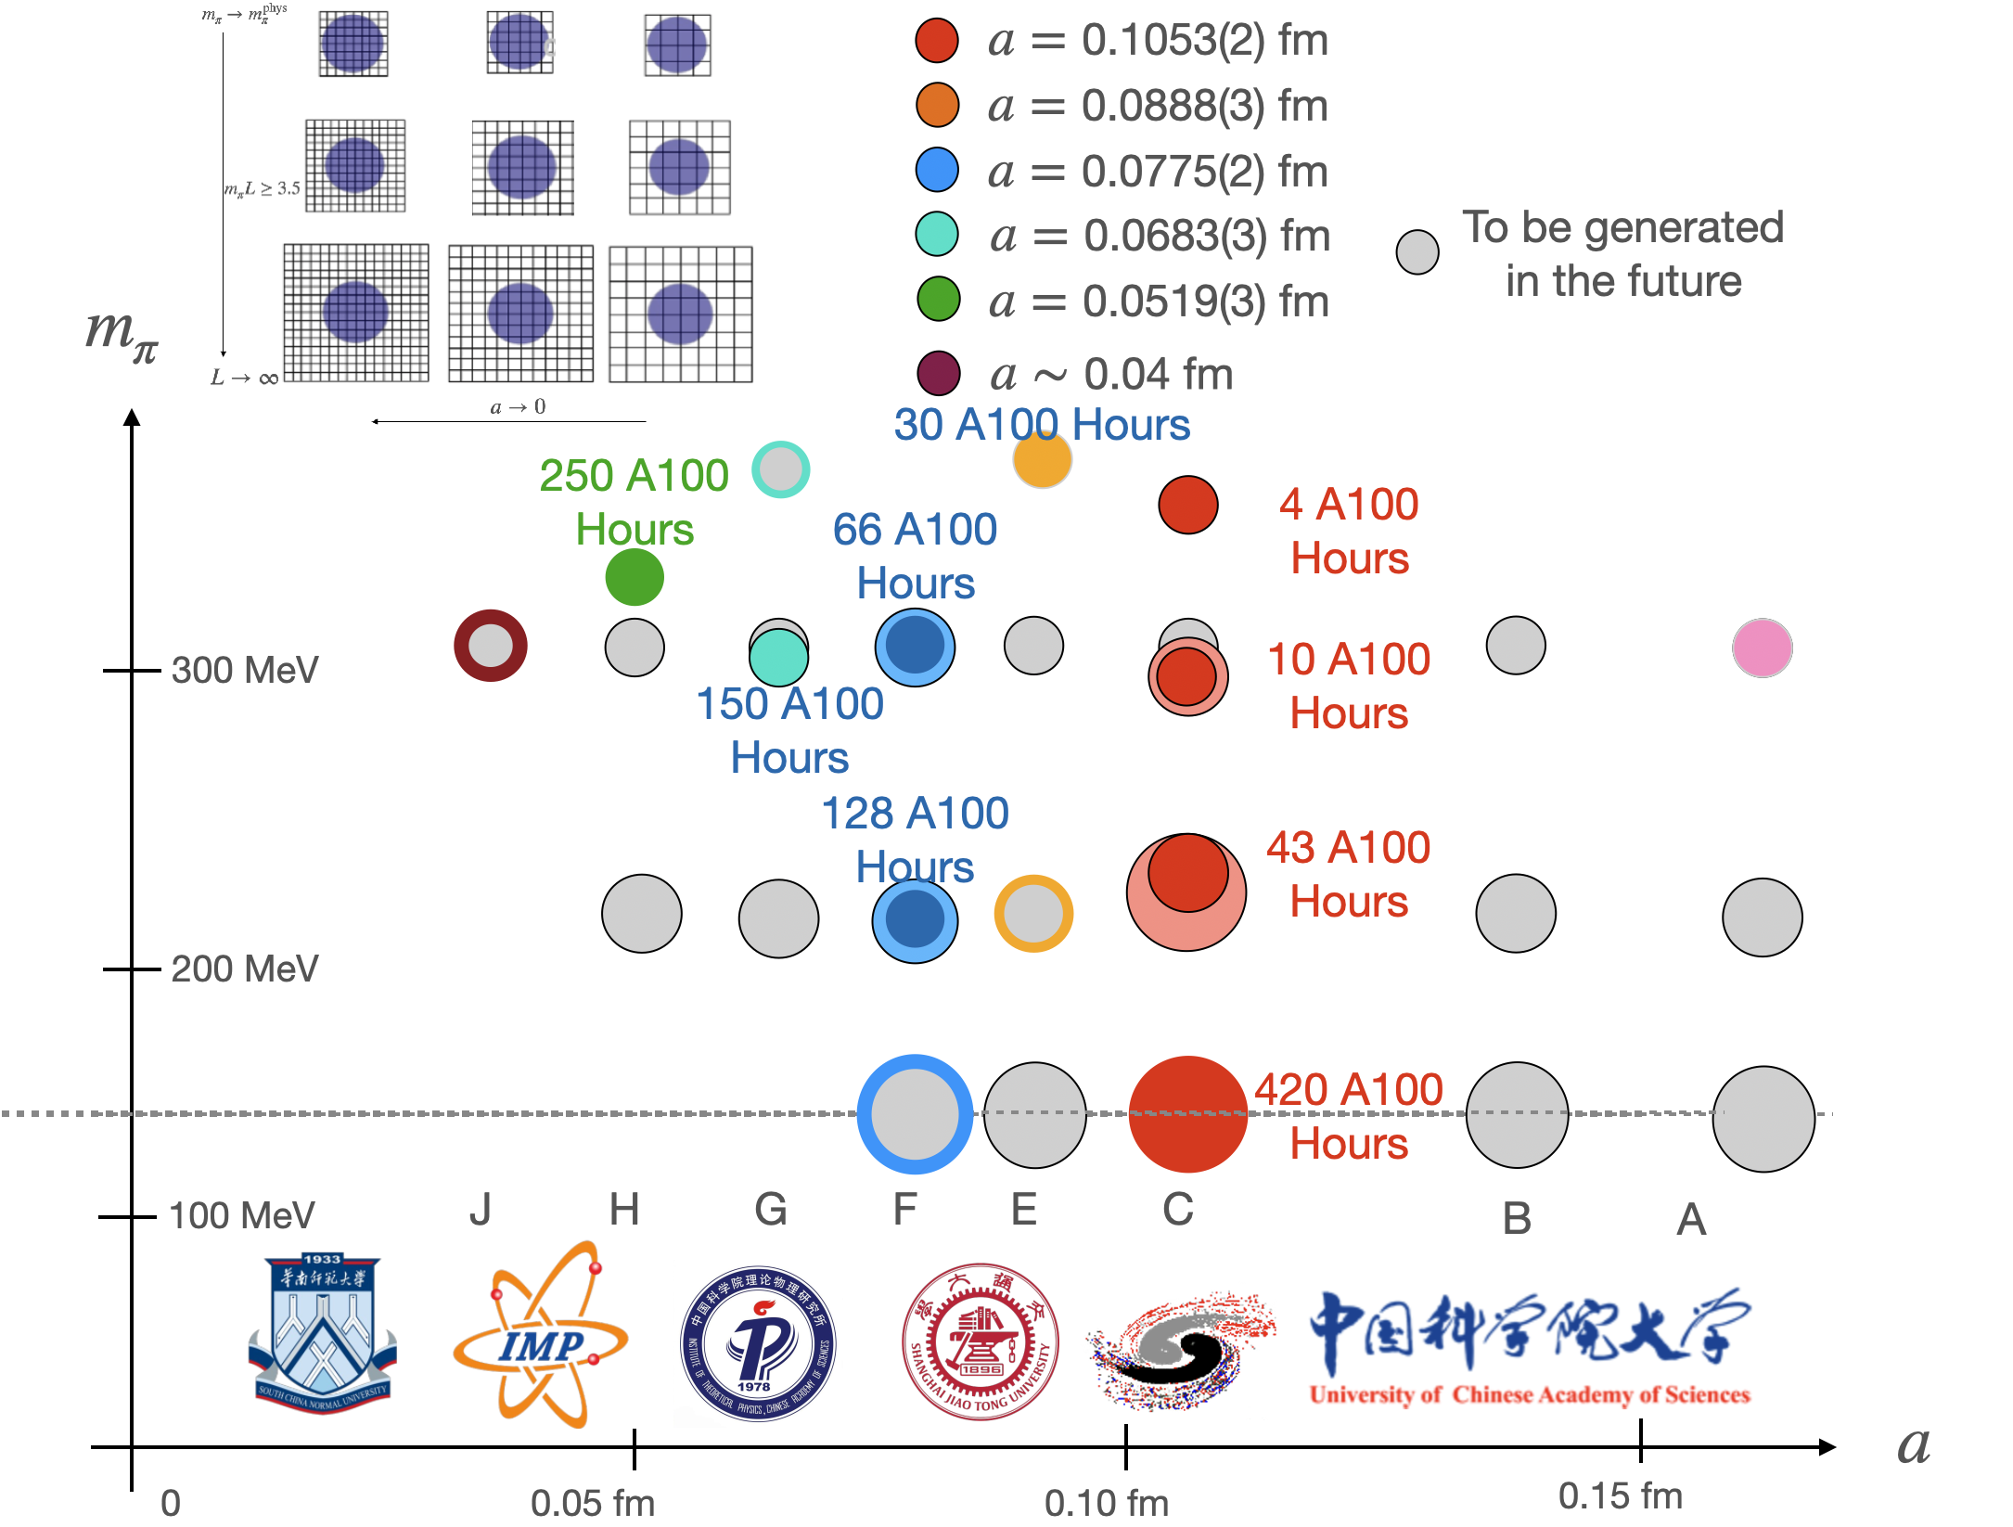
Lattice QCD configurations
18
In Lattice QCD, configurations refer to field distributions and are one of the necessary conditions for conducting numerical simulations.
Using domestic supercomputing platforms, we have, over a period of 4 years, generated a set of 2+1-flavor dynamical lattice configurations by adopting the tadpole-improved action.
dozens of scientific publications have made use of these configurations.
PRD 109, 054507 (2024), 49cites

Slide 19
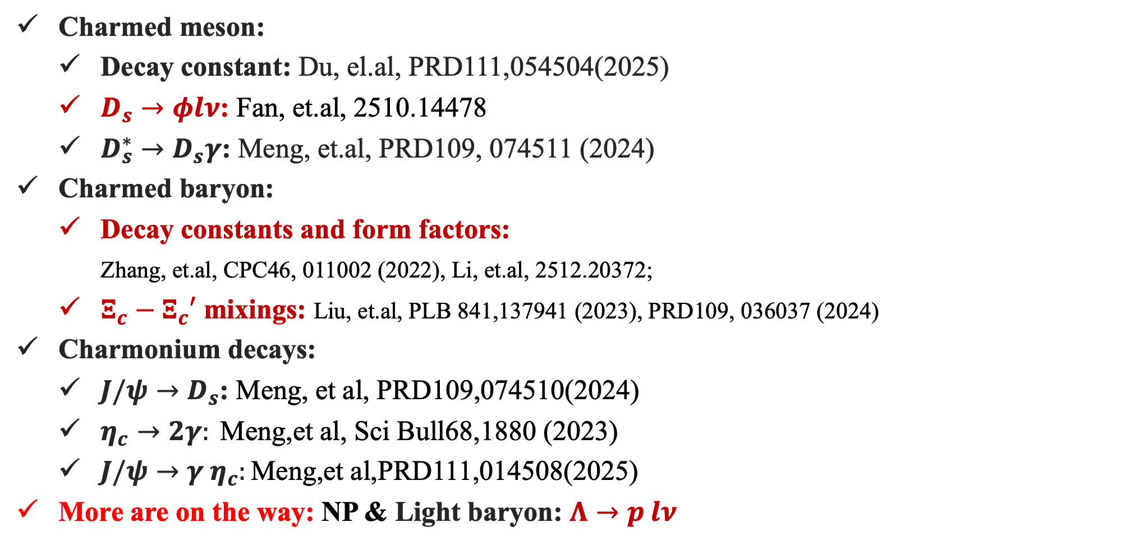
(Some) Recent Progress on Charm/Flavor from (Chinese) Lattice QCD
19
Charmed meson:
Decay constant: Du, el.al, PRD111,054504(2025)
$D_{s}→φlν$: Fan, et.al, 2510.14478
$D_{s}^{∗}→D_{s}γ$: Meng, et.al, PRD109, 074511 (2024)
Charmed baryon:
Decay constants and form factors:
Zhang, et.al, CPC46, 011002 (2022), Li, et.al, 2512.20372;
$Ξ_{c}−Ξ_{c}′$ mixings: Liu, et.al, PLB 841,137941 (2023), PRD109, 036037 (2024)
Charmonium decays:
$J/ψ→D_{s}$: Meng, et al, PRD109,074510(2024)
$η_{c}→2γ: \text{M}\text{eng}\text{,}\text{et} \text{al}\text{,} \text{Sci} \text{Bull}\text{68,1880} \text{(2023)}$
$J/ψ→γ η_{c}:\text{M}\text{eng}\text{,}\text{et} \text{al}\text{,}\text{PRD}\text{111,014508(2025)}$
More are on the way: NP & Light baryon: $Λ→p lν$

Slide 20
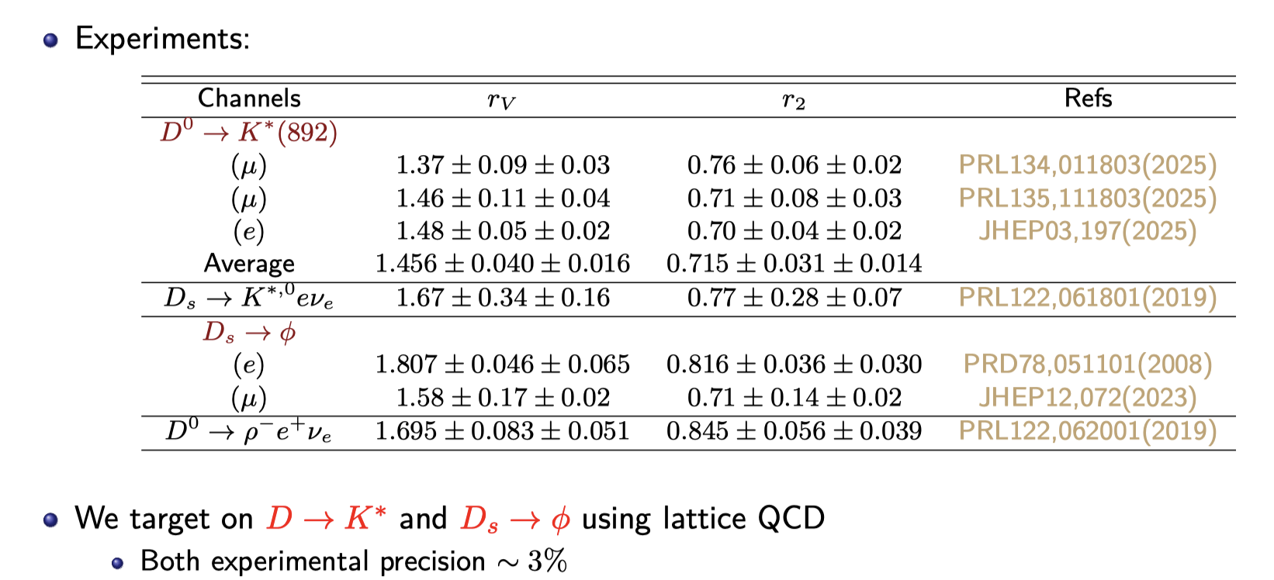
$$D_{s}→φ l ν$$
20
From Yu Meng

Slide 21
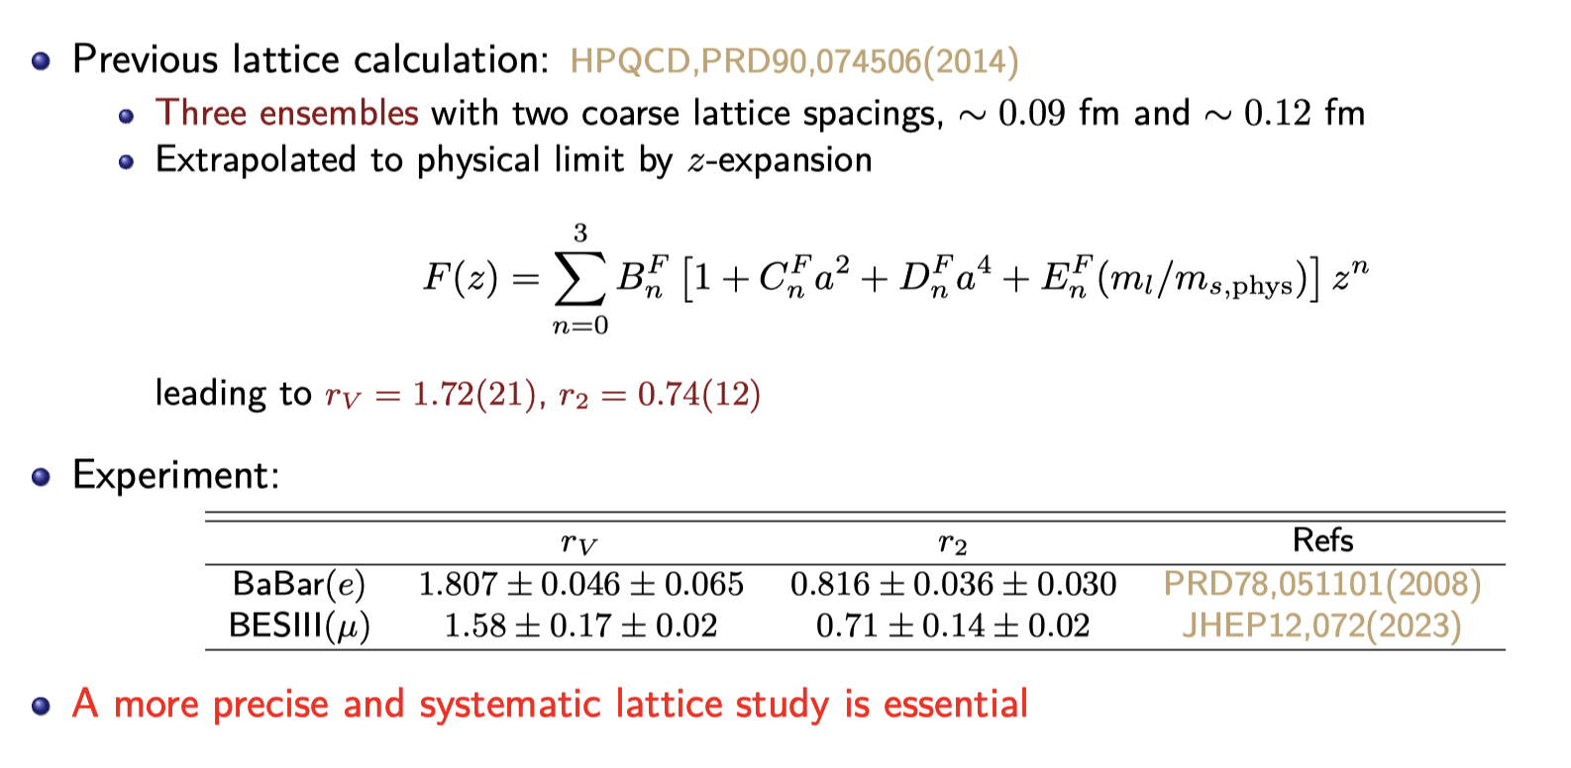
$$D_{s}→φ l ν$$
21
From Yu Meng

Slide 22
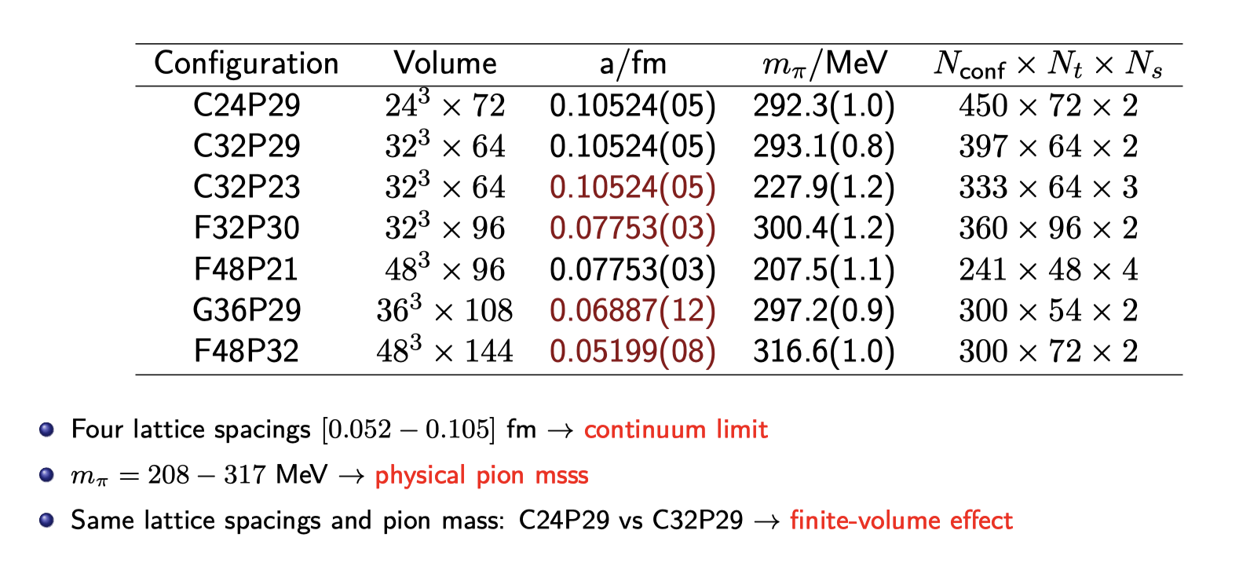
$$D_{s}→φ l ν$$
22

Slide 23
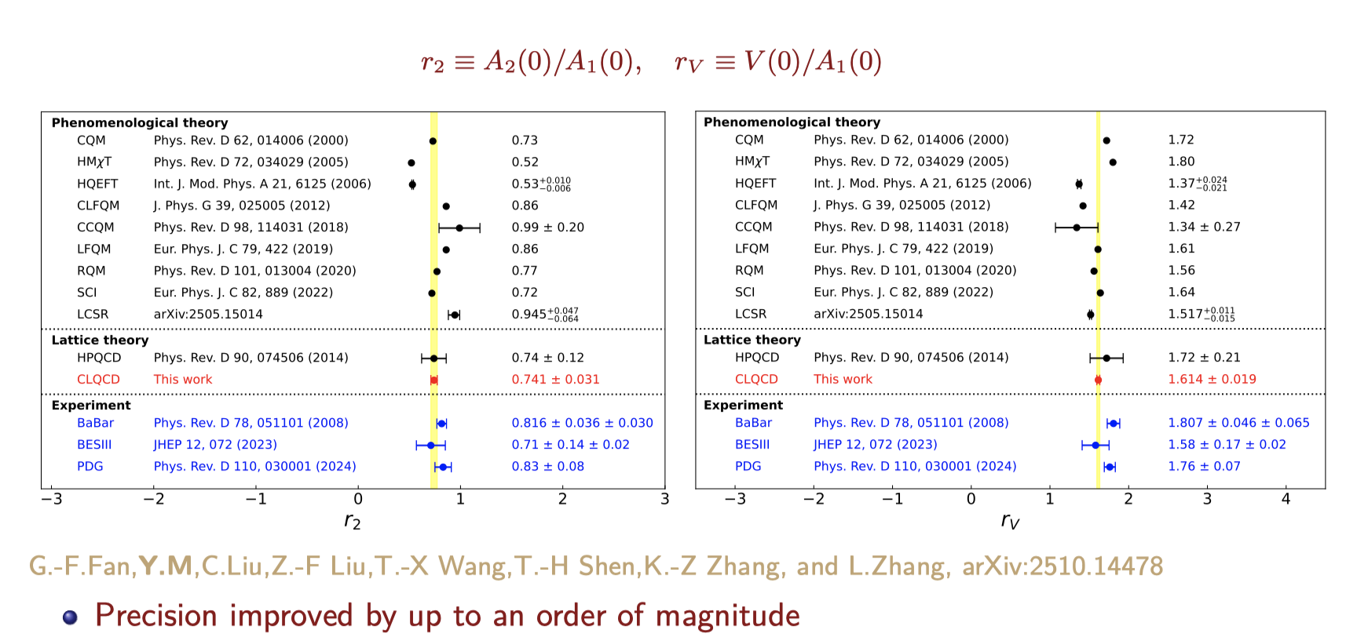
$$D_{s}→φ l ν$$
23

Slide 24
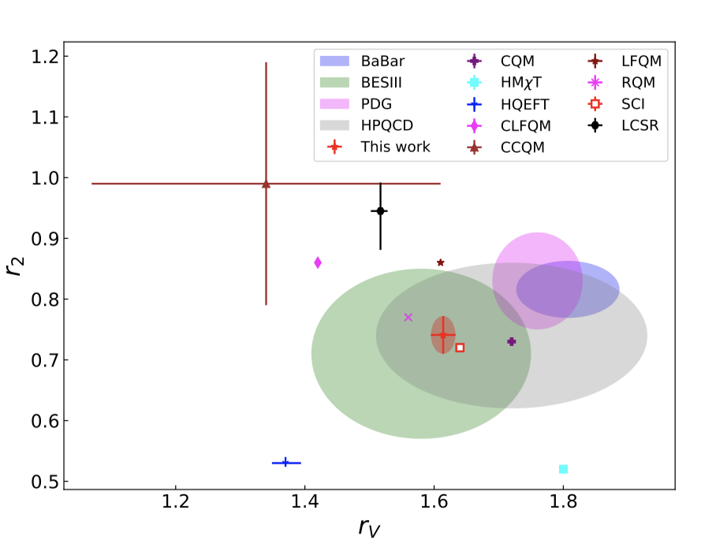
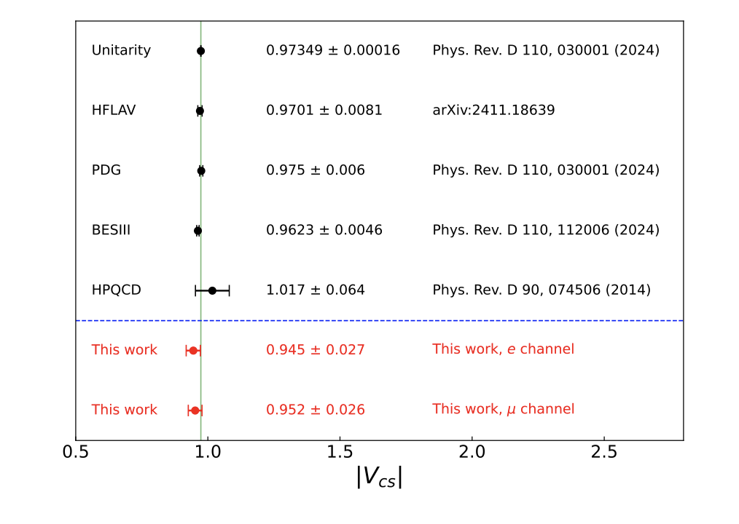
$$D_{s}→φ l ν$$
24
Fan, et.al, 2510.14478
目标：整合计算资源，推动高精度计算(连续极限、物理质量)，达到与未来实验相同或者超过实验的精度

Slide 25
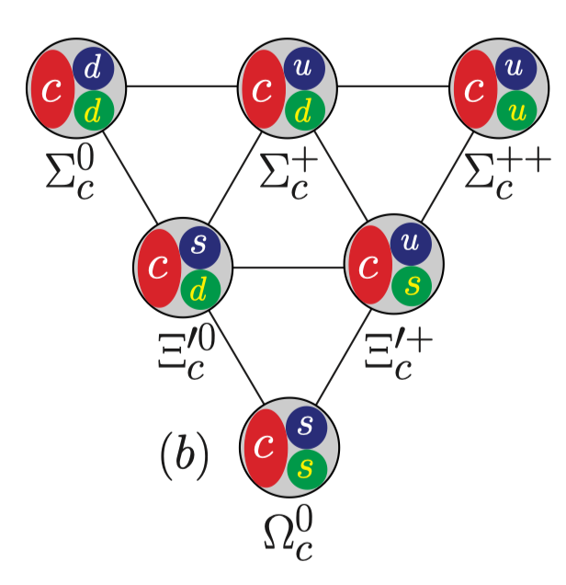
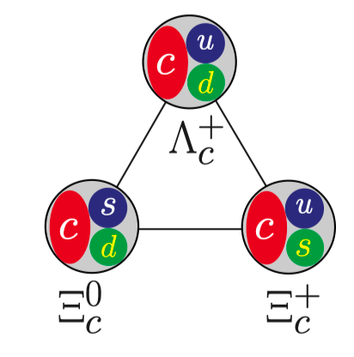
Challenges and Opportunities
Charmed baryon
25
25
Heavy quark symmetry
SU(3) symmetry
Lei-Yi Li
A number of decay form factors are yet to be explored with full sets of lattices!

Slide 26
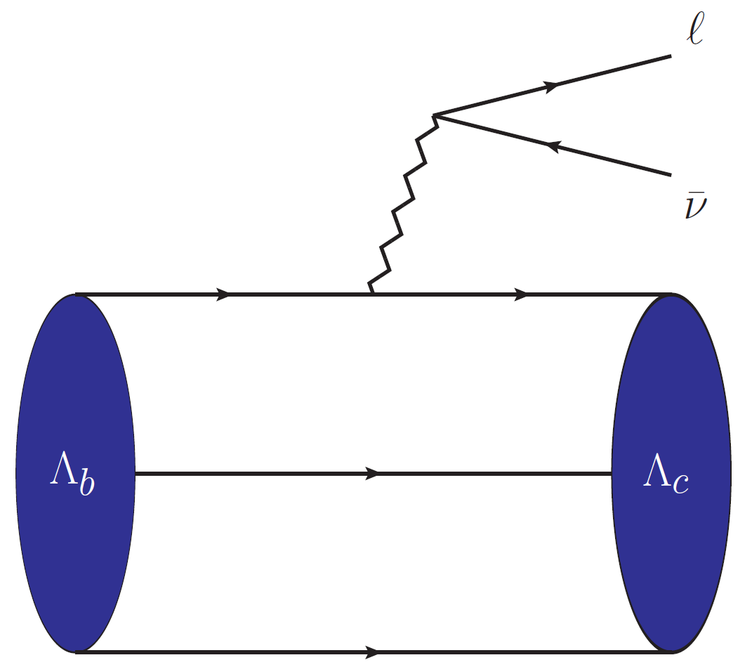
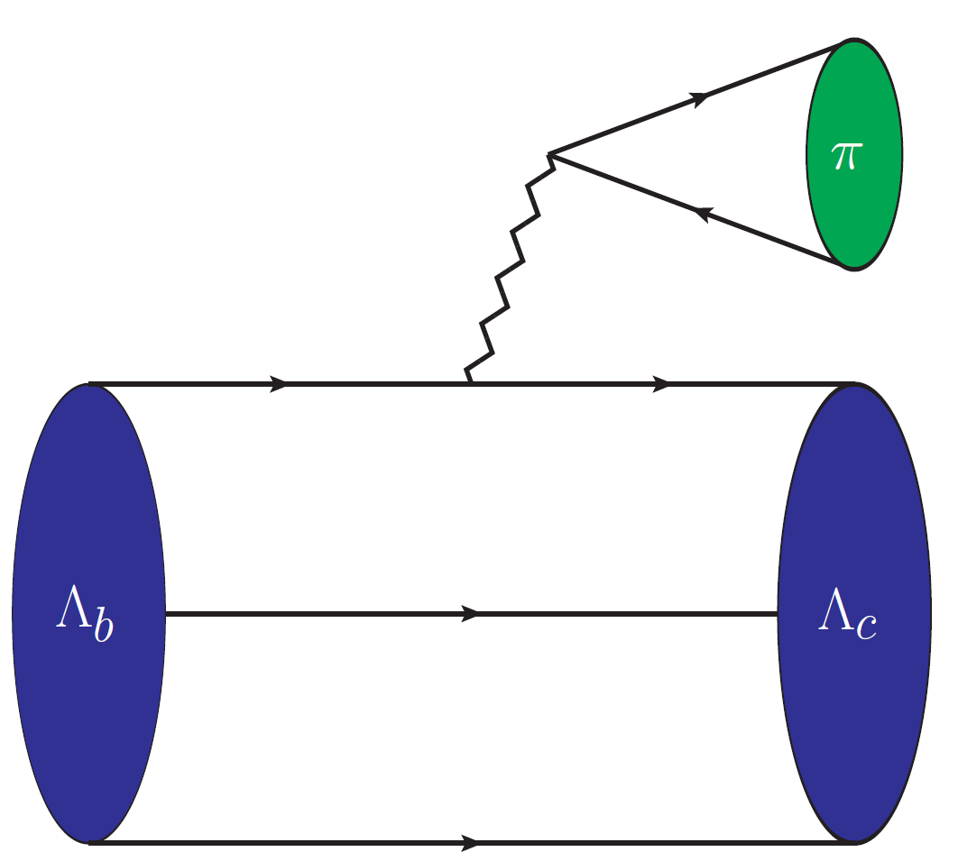
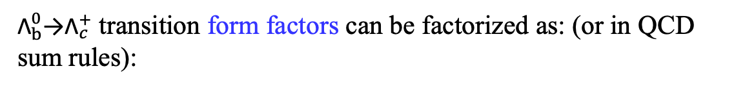

Challenges and Opportunities
Charmed baryon: Decay Constants
26
26
The semileptonic decay processes can be used to extract the CKM matrix element |$V_{cb}$|.
$$Br\left({\text{Λ}}_{b}^{0}\text{→}{\text{Λ}}_{c}^{+}l\overline{ν}\right)={6.2}_{−1.3}^{+1.4}\%$$
The two-body nonleptonic decay processes can be employed to search for new CP violation.
$$Br\left({\text{Λ}}_{b}^{0}\text{→}{\text{Λ}}_{c}^{+}π^{−}\right)={6.7}_{−2.2−2.8−1.3}^{+3.2+0.3+2.5} \text{\%}$$
${\text{Λ}}_{b}^{0}\text{→}{\text{Λ}}_{c}^{+}$ transition form factors can be factorized as: (or in QCD sum rules):
Lei-Yi Li
form factor
$$⟨Λ_{c}|iA\left|Λ_{b}\right\rangle \sim C⊗T⊗⟨Λ_{c}|O_{Λ_{c}}\left|0\right\rangle ⊗⟨0|O_{Λ_{b}}\left|Λ_{b}\right\rangle$$
$$f_{Λ_{c}}φ_{Λ_{c}}$$
The definition of charmed baryon decay constants：
$$\left\langle 0 | ε_{ijk}(q_{1,i}^{T}CΓ_{1}q_{2,j}\right)Γ_{2}c_{3,k} \left|ℬ_{c}\right\rangle =m_{ℬ_{c}}f_{ℬ_{c}}u_{ℬ_{c}}$$
Y.Miao, Y.L. Shen, et al. Chin. Phys. C 46, 113107 (2022)
C. Q. Zhang, Z. Rui, et al. Phys. Rev. D 105, 073005 (2022)
Two-body nonleptonic decays and semileptonic decays

Slide 27
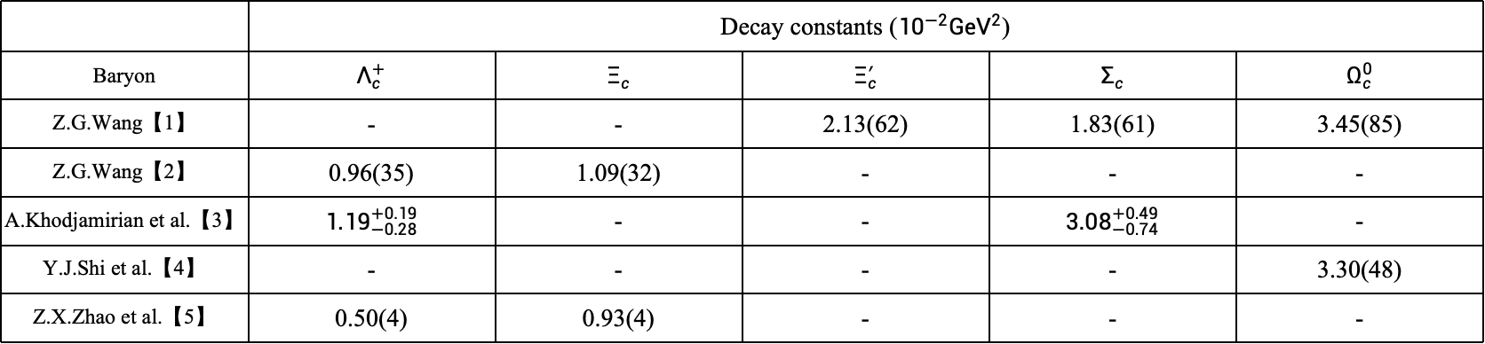
Challenges and Opportunities
Charmed baryon: Decay Constants
27
27
Currently, only QCD sum rules have provided results
 | Decay constants (${10}^{−2}GeV^{2}$)
Baryon | $$Λ_{c}^{+}$$ | $$Ξ_{c}$$ | $$Ξ_{c}^{′}$$ | $$Σ_{c}$$ | $$Ω_{c}^{0}$$
Z.G.Wang【1】 | - | - | 2.13(62) | 1.83(61) | 3.45(85)
Z.G.Wang【2】 | 0.96(35) | 1.09(32) | - | - | -
A.Khodjamirian et al.【3】 | $${1.19}_{−0.28}^{+0.19}$$ | - | - | $${3.08}_{−0.74}^{+0.49}$$ | -
Y.J.Shi et al.【4】 | - | - | - | - | 3.30(48)
Z.X.Zhao et al.【5】 | 0.50(4) | 0.93(4) | - | - | -
【1】Z.G.Wang, Phys. Lett. B 685, 59 (2010),
【2】Z.G.Wang, Eur. Phys. J. C 68, 479 (2010),
【3】A. Khodjamirian, Y. M. Wang, et al. JHEP 09, 106,
【4】Y.J. Shi, W. Wang, and Z. X. Zhao, Eur. Phys. J. C 80,568 (2020).
【5】Z.X.Zhao, R. H. Li, Y. L.Shen, Y.J.Shi and Y.S.Yang, Eur. Phys. J. C 80, 1181 (2020)
with an accuracy of 15%–20%
A number of decay form factors are yet to be explored with full sets of lattices!
making first-principles calculations necessary

Slide 28

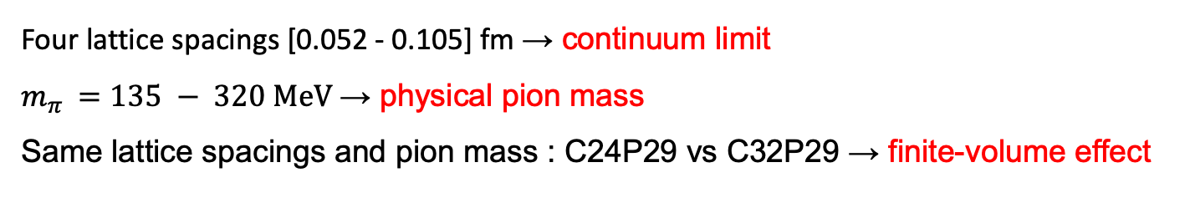
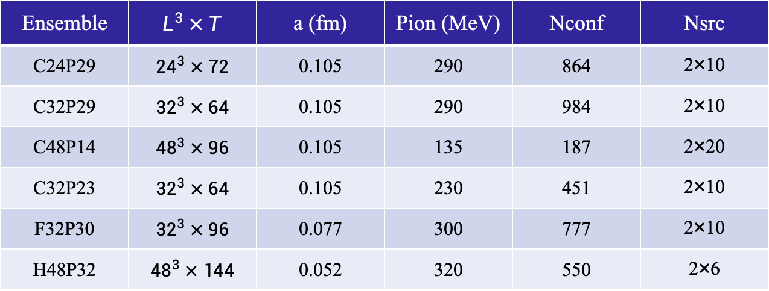
Challenges and Opportunities
Charmed baryon: Decay Constants
28
28
Ensemble | $$L^{3}×T$$ | a (fm) | Pion (MeV) | Nconf | Nsrc
C24P29 | $${24}^{3}×72$$ | 0.105 | 290 | 864 | 2×10
C32P29 | $${32}^{3}×64$$ | 0.105 | 290 | 984 | 2×10
C48P14 | $${48}^{3}×96$$ | 0.105 | 135 | 187 | 2×20
C32P23 | $${32}^{3}×64$$ | 0.105 | 230 | 451 | 2×10
F32P30 | $${32}^{3}×96$$ | 0.077 | 300 | 777 | 2×10
H48P32 | $${48}^{3}×144$$ | 0.052 | 320 | 550 | 2×6
Four lattice spacings [0.052 - 0.105] fm → continuum limit
$m_{π }=135 − 320 MeV$ → physical pion mass
Same lattice spacings and pion mass : C24P29 vs C32P29 → finite-volume effect
A number of decay form factors are yet to be explored with full sets of lattices!
Lei-Yi Li, Jie Ran, et.al, 2512.20372

Slide 29
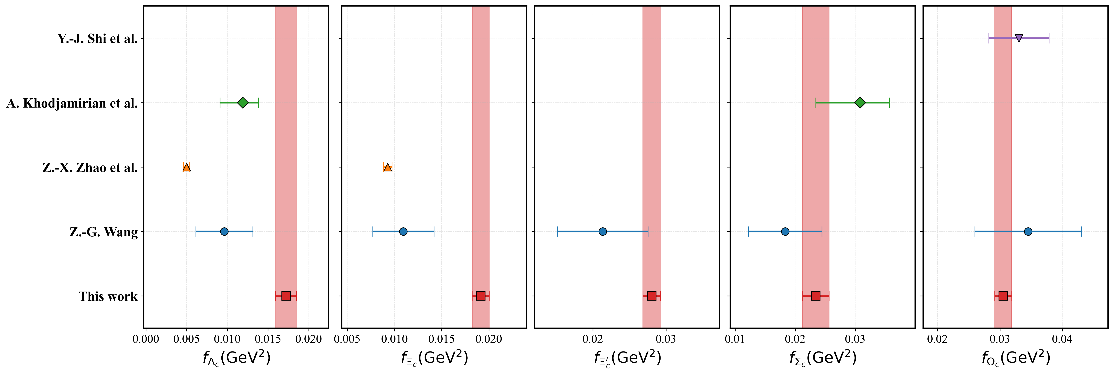
Challenges and Opportunities
Charmed baryon: Decay Constants
29
29
0.0172(12)
0.0191(9)
0.0280(11)
0.0234(22)
0.0305(13)
7.40%
4.71%
4.26%
9.47%
4.45%
Lei-Yi Li,Jie Ran, et.al, 2512.20372

Slide 30
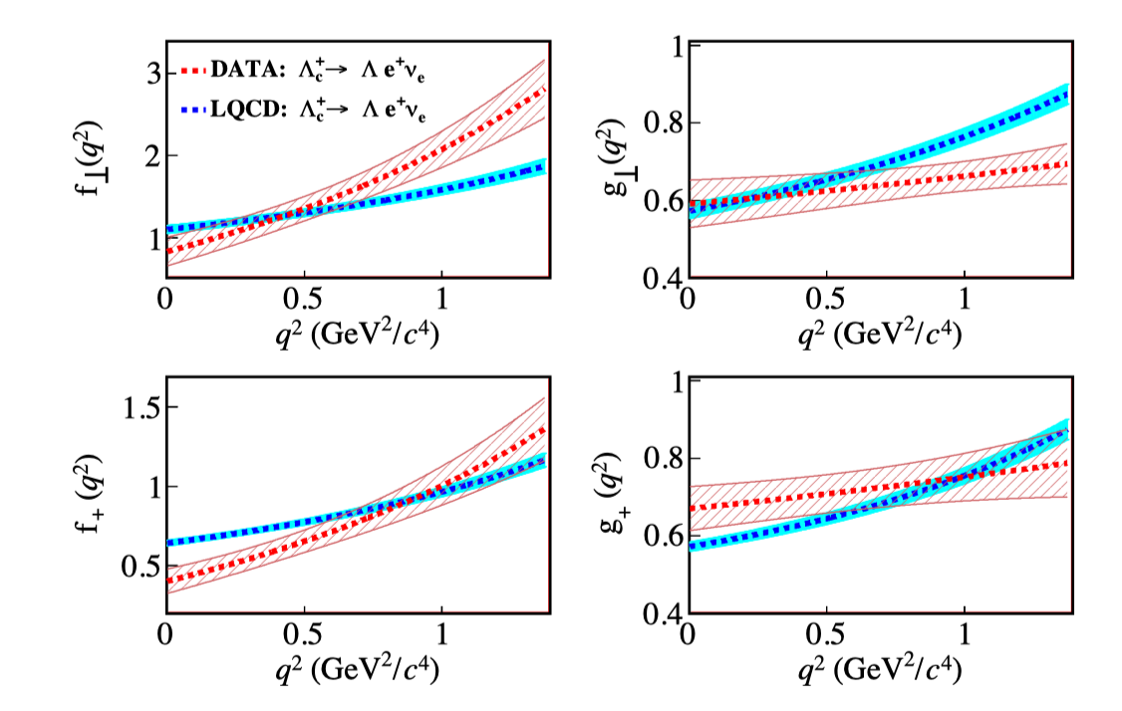
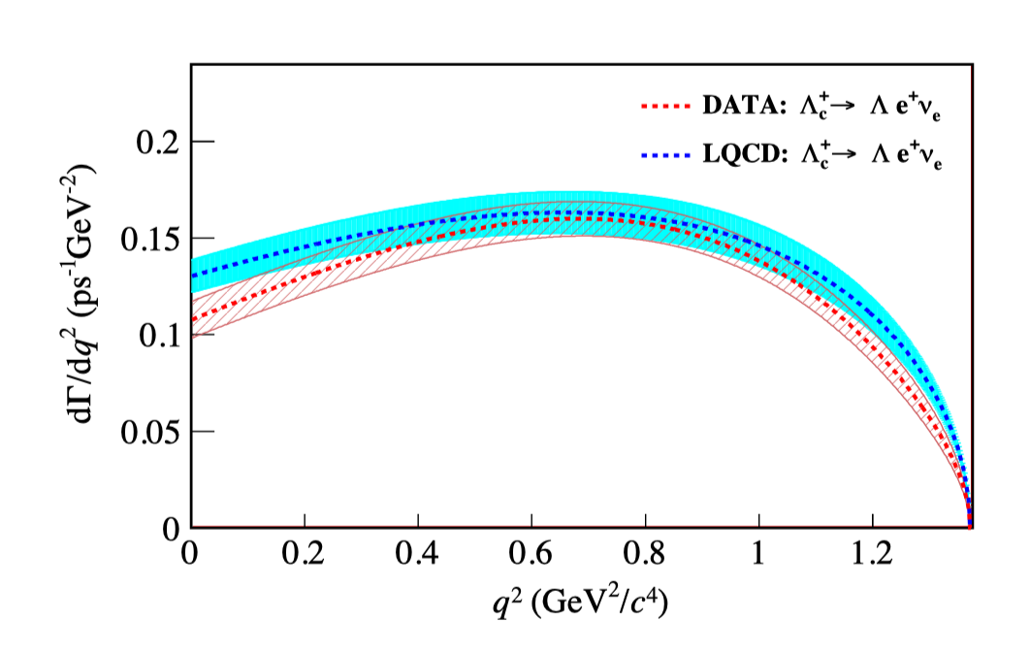

Charmed baryon: $Λ_{c}$ decay
30
30
BESIII: 2207.14149
LQCD: S. Meinel, PRL118, 082001 (2017)
A new LQCD calculation is conducted by Z.Liu
No clear difference is observed within uncertainties for the differential decay rate.
the dependences of measured FFs show different kinematic behavior compared to those predicted from LQCD calculations.

Slide 31








Charmed baryon: $Ξ_{c}$ decay
31
$Ξ_{c}$ contains more versatile decay modes
di-quark
iso-singlet
di-quark
iso-doublet
di-quark
A different pattern between inclusive and exclusive decays of $Λ_{c}$ and $D$
$$\frac{B\left(D^{0}→Xe^{+}ν_{e}\right)=\left(6.49±0.11\right)\% }{B\left(D^{0}→K^{−}e^{+}ν_{e}\right)=(3.542±0.035)\%}$$
$$\frac{B\left(Λ_{c}^{+}→Xe^{+}ν_{e}\right)=(3.95±0.34±0.09)\%}{B\left(Λ_{c}^{+}→Λe^{+}ν_{e}\right)=(3.63±0.38±0.20)\%}$$
$$\frac{B\left(Ξ_{c}^{+}→Xe^{+}ν_{e}\right)= ? }{B\left(Ξ_{c}^{+}→Ξ^{0}e^{+}ν_{e}\right)=(1.05±0.20)\%}$$
$$∼2$$
$$∼1$$
$$∼?$$
M,Ablikim et al. [BESIII],PRL121,251801(2018)

Slide 32








Charmed baryon: $Ξ_{c}$ decay
32
RBC
Discrepancies in decay rates of $Ξ_{c}^{0}→Ξ^{−}e^{+}ν_{e}$
$$2.6 σ$$
Belle
$$10.8 σ$$
ALICE
PDG average
$$1.3 σ$$
Zhang et al.
Farrel and Meinel
$$5.6 σ$$
ALICE’s result is updated to ($1.8±1.2)\%$
CLQCD
RBC

Slide 33




Charmed baryon: $Ξ_{c}$ Decay
33
33
F. Huang, et.al, 2110.04179/PLB 2021
1. PDG/PTEP 083C01 2020 ; 2. Belle, 2103.06496/PRL 2021
3. ALICE, 2105.05187/PRL 2021; 4. S. Meinel, 1611.09696/PRL 2017
5. Q.A.Zhang, et.al., 2103.07064/CPC 2022; 6. Farrel, et.al, 2504.07302/PRD (2025)
A new LQCD calculation using CLQCD configurations is under progress
An independent experimental measurement of $Ξ_{c}^{0}→Ξ^{−}π^{+}$ is needed. (?)

Slide 34







Charmed baryon: $Ξ_{c}−Ξ_{c}^{′}$ mixing
34
Mixing between mass eigenstates and flavor eigenstates:
He, Huang and Xing, PLB823, 136765 (2021)
Anti-Triplet
Sextet
Geng, Jin and Liu, PLB838, 137736 (2023)

Slide 35

Charmed baryon: $Ξ_{c}−Ξ_{c}^{′}$ mixing
35
Several works from various methods are controversial……
Sum rule | $$\text{5.}{\text{5}}^{\text{∘}}\text{±1.}{\text{8}}^{\text{∘}}$$ | Aliev, Ozpineci and Zamiralov, PRD83, 016008 (2011)
HQET | $${\text{8.12}}^{\text{∘}}\text{±0.}{\text{80}}^{\text{∘}}$$ | Matsui, NPA1008, 122139 (2021)
Quark model | $$\text{16.}{27}^{\text{∘}}\text{±2.}{\text{30}}^{\text{∘}}$$ | Ke and Li, PRD105, 096011 (2022)
 | $$\text{24.}{\text{66}}^{\text{∘}}\text{±0.}{\text{90}}^{\text{∘}}$$ | Geng, Jin and Liu, PLB838, 137736 (2023) Geng, Jin, Liu, Yu and Zhou, PLB839, 137831 (2023)
Lattice QCD | Negligibly small | Brown, Detmold, Meinel and Orginos, PRD90, 094507 (2014)

Slide 36







Charmed baryon: $Ξ_{c}−Ξ_{c}^{′}$ mixing
36
Strategy I: From matrix of correlation function
Strategy II: From the matrix of Hamiltonian
Liu, Wang, et al., PLB841, 137941 (2023)
Liu, Wang and Zhang, PRD109, 036037 (2024)
Lattice Calculation
Lattice Calculation
Theoretical Parametrization
Theoretical Parametrization
Results from LQCD (C11P29S) agree with each other:
A small mixing angle is not sufficient to explain $Ξ_{c}$ decays!

Slide 37






Challenges and Prospect
37
37
Up-down asymmetry in $B→K_{1}(→Kππ)γ$
Cos($θ_{K}):$Parity Odd
Positive and negative helicities contribute with different signs.
LHCb measured
non-perturbative quantity
$$A_{UD}=(6.9±1.7)×{10}^{−2}$$
at $m_{Kππ}=[1.1,1.3]$ GeV
desired: Photon polarization
LHCb, PRL112, 161801(2014)

Slide 38








Challenges and Prospect
38
38
$$D→K_{1}lν$$
$B→K_{1}γ$
Based on two lattices
Photon polarization can be
model-independently and reliably obtained by
if $A_{UD}^{′}inD→K_{1}eν$ is measured
Wang, Yu, Zhao, PRL125, 051802 (2020)

Slide 39

Challenges and Prospect
39
LQCD calculation of the required matrix elements are necessary to probe new physics beyond SM

Slide 40




Challenges and Prospect
40
Lepton Flavor violation:
Dark Matter production
$$D^{0}→\overline{p}e^{+}$$
$D^{0}→\overline{p}e^{+}$： $⟨\overline{p}|({\overline{u}}^{c}Γc)Γd|D⟩$
$$Λ→ξφ : ⟨0|(u^{T}CΓd)Γs|Λ⟩$$
LQCD calculation of the required matrix elements are necessary to probe new physics beyond SM
紧密结合实验，精确研究实验所关心的过程

Slide 41

粲物理精确计算的(一些)机遇
41
力耕不欺:
decay constants / form factors
探骊得珠:
Inclusive decays
QED修正 $→H→γlν$
lifetime matrix elements (HQE)
可望而不可即:
幂次修正 $→$ 非轻衰变宽度
(不)靠谱的搅局: AI

Slide 42


Inclusive decays of heavy mesons
42
Importance of inclusive decays:
measurement of CKM
|Vcb/Vub| puzzle, (|Vcs|?)

Slide 43

Inclusive decays of heavy mesons
43
构造虚时矩阵元，该矩阵元可以写成谱函数的卷积
反问题， 模型依赖
谱函数，无法直接格点计算.
Gambino and Hashimoto, PRL 125, 032001(2020)
De Santis, et.sl, PRL 135, 121901(2025)

Slide 44





Inclusive decays of heavy mesons
44
$$B→X_{c}lν$$
Gambino and Hashimoto, PRL 125, 032001(2020)
$$D_{s}→Xlν$$
De Santis, et.sl, PRL 135, 121901(2025)

Slide 45



QED: Radiative semileptonic decays
45
$K/π→γlν$
$D→γlν$
$B→γlν$
Virtual corrections

Slide 46






Radiative semileptonic decays of heavy mesons
46
Christ, et.al, 2510.26993

Slide 47

Radiative semileptonic decays of Heavy mesons
47
Infinite-Volume Reconstruction (IVR):
temporal reconstruction
spatial reconstruction
Christ, et.al, 2510.26993

Slide 48



Radiative semileptonic decays
48
$$D_{s}→γeν$$
PRD 108,074505(2023)

Slide 49

Lifetime matrix element:
49
HQE后，需要用HQET算符
多夸克算符的重整化
拓展理论方法的适用性，把之前不能做的变成能做，把做不好的变成做好
From A. Lenz

Slide 50

AI赋能理论物理研究：人工智能体PhysMaster
50
理论物理 & 计算物理领域科研痛点：
理论高度抽象，灵感产生高度依赖研究者的经验、直觉与洞察
重复性劳动占据研究时间
从想法到可验证结果的链条极长
2512.19799
PhysMaster：精通理论与计算的自主物理学家
模仿物理学家思维范式，实现任务拆分与物理图像的提取
在Paper Search Master的基础上，实现相关论文精确检索与信息提取
在ML Master的基础上，实现基于Monte Carlo树搜索（MCTS）与多智能体分级协作的子任务调度与迭代求解，平衡探索与效率
自进化知识库：
专家主动注入先验知识
成功案例总结，复用已验证的路径提升决策稳定性
从检索到的论文中提取的定性与定量信息

Slide 51
PhysMaster：极致“广度+深度”探索
Start(Input ):
0
Depth1:
1
2
Score
Depth2:
3
4
5
Score
Depth3:
6
7
8
Score
…
…
…
…

Slide 52


PhysMaster：极致“广度+深度”探索

Slide 53

PhysMaster：输入自然语言描述
53
理论背景
需要强调的定义
细化子任务
描述原始数据信息
结果要求
从2020年到2025年, CS 演化核一直是格点QCD研究的热点
核心困难就是其中的多维度和高复杂度

Slide 54

PhysMaster：多维度数据的高效化处理
arXiv:2511.22547
54
输入格点规范场数值模拟的原始数据，通过拟合数据之间的比值可以抽取物理可观测量；
为了得到完整可靠的分布，需要对多个空间维度、不同组态下的多维度数据进行处理；
以最新相关成果arXiv:2511.22547为例，需要重复拟合步骤超过6000次：
拟合次数 = 15个纵向距离$×$2个纵向方向$×$15个横向距离$×$3个动量$×$5套组态$≈$6750
PhysMaster 仅仅用几个小时可以得到真实工作约一个月的相同结果

Slide 55






PhysMaster：高复杂度流程的全链条实现
55
重复拟合高维度原始数据的比值
得到完整的坐标空间分布
对坐标空间分布重整化消除发散
PhysMaster一次运行可以得到PRL125,192001 (2020)中的格点结果
多次运行可以得到目前精度最高arXiv:2511.22547中的格点结果
用动量空间下的分布去抽取CS kernel
傅里叶变换得到动量空间分布
对分布中的硬截断做物理渐进的外推

Slide 56




PhysMaster：味道对称性的实现
粒子物理中存在6种不同味道的夸克，轻味道的三种夸克质量都很轻，被称为轻夸克，具有味道对称性，可以认为构成味道SU(3)群的三重态。粲和底夸克质量很大，被称为重夸克，可以认为是SU(3)的单态。重夸克可以弱衰变到轻味道的三重态，衰变振幅除了CKM矩阵元外，也具有SU(3)对称性，
半轻衰变中，重味粲夸克衰变到轻夸克、电子以及反电子中微子，末态轻夸克视为三重态。
粲介子由一个重夸克和一个反轻夸克构成，构成SU(3)的反三重态
轻介子由一个轻夸克和反轻夸克构成，基态轻介子可以构成SU(3)八重态。
请构造粲介子半轻衰变的SU(3)强子哈密顿量，并进行预言粲介子半轻衰变的衰变振幅。
$$l^{−}$$
c
$$V_{cq}$$
$$D^{+}$$
$$π^{+}$$

Slide 57






arXiv:2511.22547
PhysMaster：味道对称性的实现
粲介子半轻衰变的SU(3)哈密顿量：
$H=H_{i}M_{j}^{i}$ $D^{j}$
衰变道 | 衰变振幅
$$D^{0}→π^{−}ℓν$$ | $$V_{cd}$$
$$D^{0}→K^{−}ℓν$$ | $$V_{cs}$$
$$D^{+}→π^{0}ℓν$$ | $$−\frac{1}{\sqrt{2}}V_{cd}$$
$$D^{+}→η^{8}ℓν$$ | $$\frac{1}{\sqrt{6}}V_{cd}$$
$$D^{+}→{\overline{K}}^{0}ℓν$$ | $$V_{cs}$$
$$D_{s}^{+}→K^{0}ℓν$$ | $$V_{cd}$$
$$D_{s}^{+}→η^{8}ℓν$$ | $$−\frac{2}{\sqrt{6}}V_{cs}$$
$$M_{j}^{i}=\left[\begin{matrix}\frac{π^{0}}{√2}+\frac{η_{8}}{√6} & π^{+} & K^{+} \\ π^{−} & −\frac{π^{0}}{√2}+\frac{η_{8}}{√6} & K^{0} \\ K^{−} & {\overline{K}}^{0} & −\frac{2η_{8}}{√6}\end{matrix}\right]$$
$$l^{−}$$
c
$$V_{cq}$$
$$D^{j}=\left[D^{0},D^{+},D_{s}^{+}\right]$$
$$H_{i}=\left[0,V_{cd},V_{cs}\right]$$
$$D^{+}$$
$$π^{+}$$

Slide 58

arXiv:2511.22547
PhysMaster：味道对称性的实现
为减少以往文献的污染，选择一类简单但未被明确研究的例子：粲介子的半轻衰变
PhysMaster可根据味$SU(3)$对称性，自动构造强子味表示与衰变算符，确定有效哈密顿量，并给出所有衰变道的振幅预言。
PhysMaster结果
粲介子半轻衰变的SU(3)哈密顿量：
$H=H_{i}M_{j}^{i}$ $D^{j}$
衰变道 | 衰变振幅
$$D^{0}→π^{−}ℓν$$ | $$V_{cd}$$
$$D^{0}→K^{−}ℓν$$ | $$V_{cs}$$
$$D^{+}→π^{0}ℓν$$ | $$−\frac{1}{\sqrt{2}}V_{cd}$$
$$D^{+}→η^{8}ℓν$$ | $$\frac{1}{\sqrt{6}}V_{cd}$$
$$D^{+}→{\overline{K}}^{0}ℓν$$ | $$V_{cs}$$
$$D_{s}^{+}→K^{0}ℓν$$ | $$V_{cd}$$
$$D_{s}^{+}→η^{8}ℓν$$ | $$−\frac{2}{\sqrt{6}}V_{cs}$$
$$M_{j}^{i}=\left[\begin{matrix}\frac{π^{0}}{√2}+\frac{η_{8}}{√6} & π^{+} & K^{+} \\ π^{−} & −\frac{π^{0}}{√2}+\frac{η_{8}}{√6} & K^{0} \\ K^{−} & {\overline{K}}^{0} & −\frac{2η_{8}}{√6}\end{matrix}\right]$$
$$l^{−}$$
c
$$V_{cq}$$
$$D^{j}=\left[D^{0},D^{+},D_{s}^{+}\right]$$
$$H_{i}=\left[0,V_{cd},V_{cs}\right]$$
$$D^{+}$$
$$π^{+}$$
PhysMaster 可以正确的给出有效哈密顿量，以及相应的衰变振幅

Slide 59



Summary
59
重味(底和粲)物理研究内容不断丰富，研究精度不断提升
超级陶粲工厂
没有精确的实验数据，高精度的理论研究也就少了实际意义

Slide 60


Summary
60
力耕不欺:
decay constants / form factors/ LCDAs
探骊得珠:
Inclusive decays
QED修正 $→H→γlν$
lifetime matrix elements (HQE)
可望而不可即:
幂次修正 $→$ 非轻衰变宽度
(不)靠谱的搅局: AI
|Vub| 误差
现阶段急需要精确的理论计算，挑战与机遇并存

Slide 61






Summary
Wei Wang
Lei-Yi Li
Guangyu Wang
Jie Ran
Yu Meng
Fanrong Xu
Yu Gu
Qi-An Zhang
Jun Hua
Zhao-Feng Liu
Challenges request a new LQCD collaboration dedicated to heavy flavor physics especially at STCF.

Slide 62
Backup

Slide 63

Summary
Lattice QCD has provided a nonperturbative approach to explore charm physics:
Many progresses have been made in the charmed hadron:
Decay constants, form factors, $Ξ_{c}−Ξ_{c}′$ mixing
There are still many challenges:
Precise investigations: QED corrections
More quantities: form factors, hadron lifetimes
Thank you very much for your attention

Slide 64





Charmed baryon
64
$$Λ_{c}^{+}(udc)$$
$O_{Λ_{c}^{+}}^{(P)}=ε_{ijk}$($u_{i}^{T}$C$γ_{5}d_{j}$)$c_{k}$
$O_{Λ_{c}^{+}}^{(S)}=ε_{ijk}$($u_{i}^{T}$C$d_{j}$) $γ_{5}c_{k}$
$O_{Λ_{c}^{+}}^{(A)}=ε_{ijk}$($u_{i}^{T}$C$γ_{5}γ_{μ}d_{j}$) $γ^{μ}c_{k}$
$$Σ_{c}^{+}(udc)$$
$O_{Σ_{c}^{+}}^{(V)}=ε_{ijk}$($u_{i}^{T}$C$γ_{μ}d_{j}$) $γ^{μ}γ_{5}c_{k}$
$O_{Σ_{c}^{+}}^{(T)}=ε_{ijk}$($u_{i}^{T}$C$σ_{μν}d_{j}$)$σ^{μν}γ_{5}c_{k}$
$$Ξ_{c}(usc/dsc)$$
$$O_{Ξ_{c}}^{(V)}=ε_{ijk}\text{(}s_{i}^{T}\text{C}γ_{μ}c_{j}\text{)} γ^{μ}γ_{5}q_{k}$$
$O_{Ξ_{c}}=2βO_{Ξ_{c}}^{(S)}$+2$βO_{Ξ_{c}}^{(P)}+…$
$$Ω_{c}^{0}(ssc)$$
$O_{Ω_{c}^{0}}^{(V)}=ε_{ijk}$($s_{i}^{T}$C$γ_{μ}s_{j}$) $γ^{μ}γ_{5}c_{k}$

Slide 65
Reference
[1] Phys. Rev. D98 (2018) 074512
[2]PhysRevD.91(2015) 054507
[3]Eur. Phys. J. C 84 (2024) 506
[4]Phys. Rev. D92 (2015) 034517
[5]Phys.Rev. D86 (2012) 054510
[6] Phys.Rev. D85 (2012) 114506
[7]JHEP 12 (2017) 008
[8]Phys.Rev. D82 (2010) 114504
[9]Phys.Rev. D84 (2011) 114505
[10] Phys.Rev. D82 (2010) 114506
[11]Phys. Rev. D96 (2017) 054514
[12] Phys. Rev. D 107 (2023) 094516
[13]Phys. Rev. D 104 (2021) 034505
[14] Phys. Rev. Lett. 118 (2017) 082001
[15]Chin. Phys. C 46 (2022) 011002
[16] Phys. Rev. D97 (2018) 034511
[17]Phys. Rev. D 105 (2022) 054511

