Slide 1
Dilepton emission as a novel probe of QCD critical point
Gaoqing Cao
Sun Yat-sen University
Collaborators: Xiaofeng Luo and Weijie Fu
Phys.Rev.D 114 (2026) 5, 054041
2026.10.20 @ CCNU

Slide 2
Outline
QCD phase diagram and critical point
Extended Polyakov-quark-meson model
Dilepton emission rate
Integrated dilepton emission rate and moments
Experimental observables
Summary

Slide 3
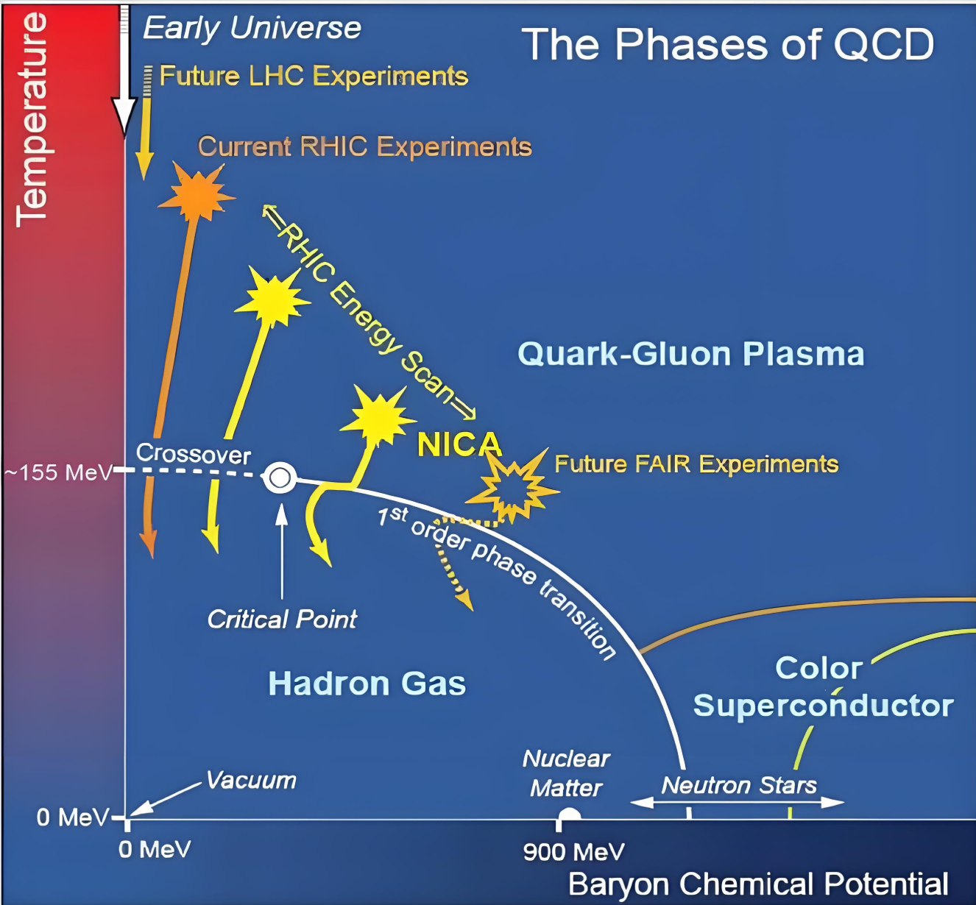
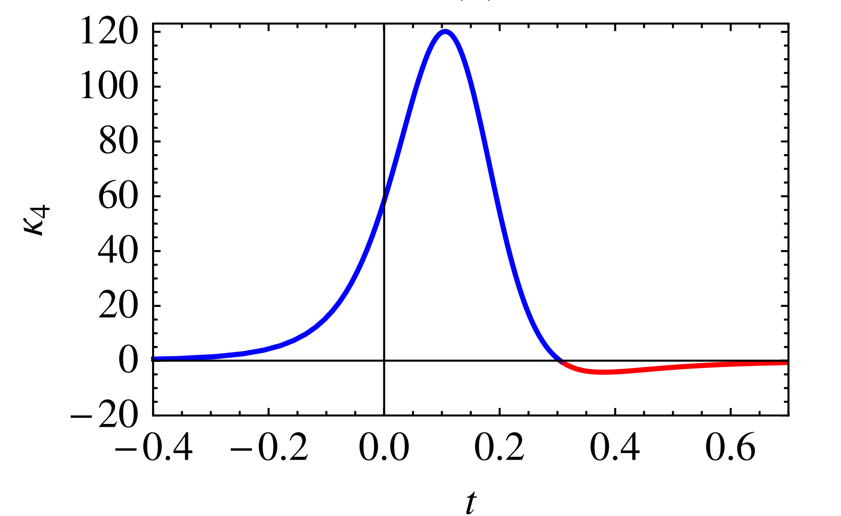
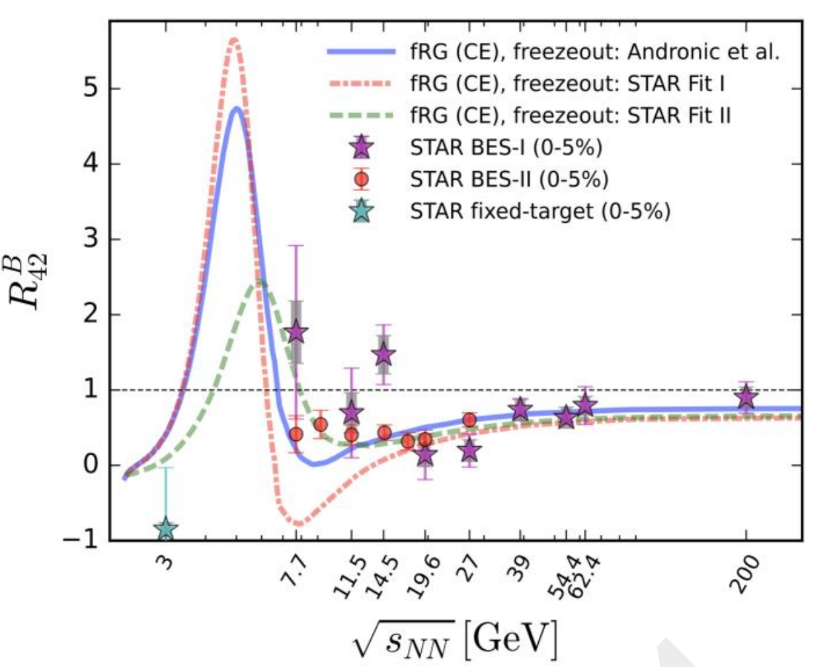
Critical point and baryon number fluctuations
M. A. Stephanov, PRL (2011)
W. Fu et. al., PRD (2025)

Slide 4
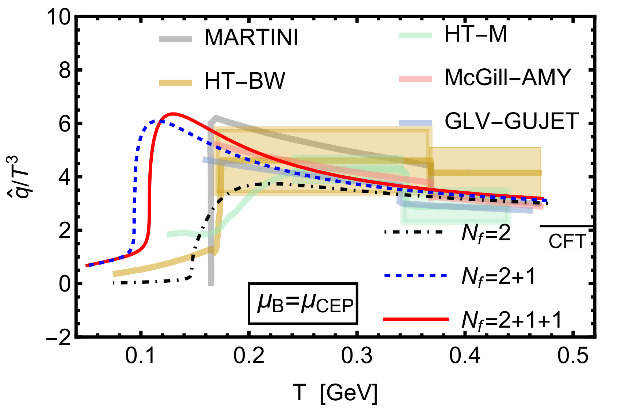
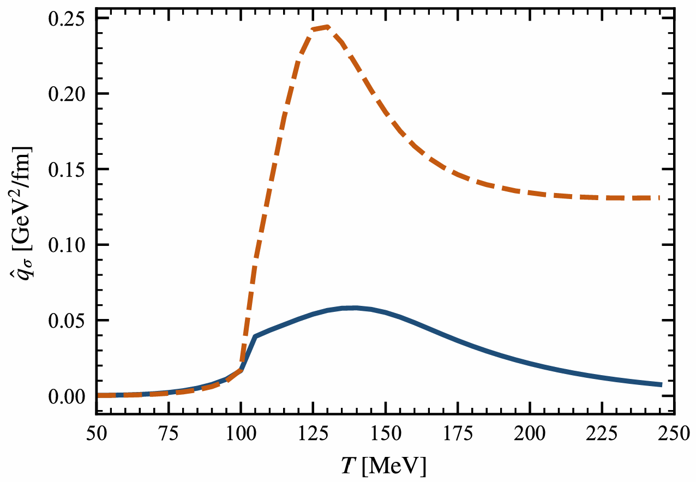


Novel probes --- cross check
Probes of quark-gluon plasma:
heavy quarkonia, jets, dileptons and photons
QCD critical opalescence?
Z. Li, D. Li and M. Huang, PRD (2025)
Y. Z. Huang et. al., arXiv:2605.30816

Slide 5
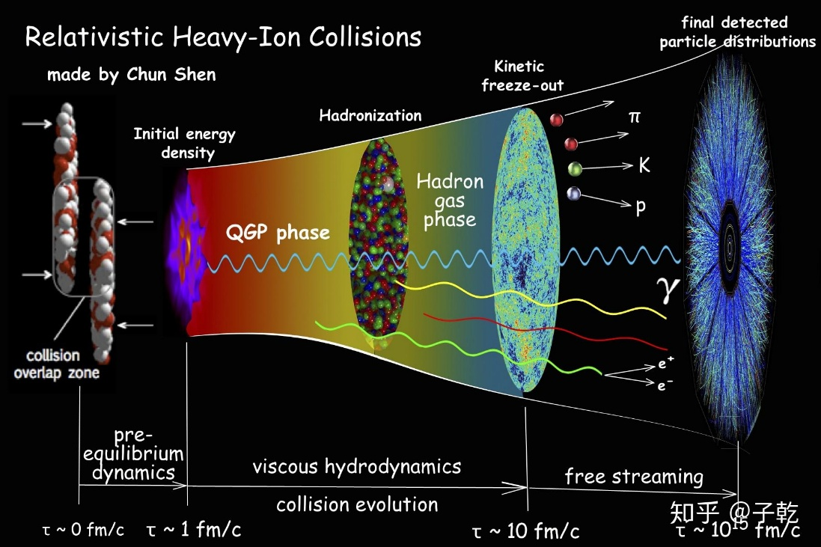
Novel probes --- cross check
Probes of quark-gluon plasma:
heavy quarkonia, jets, dileptons and photons
Easy to detect
Motivated by high illuminations in HIAF, NICA, and CBM

Slide 6





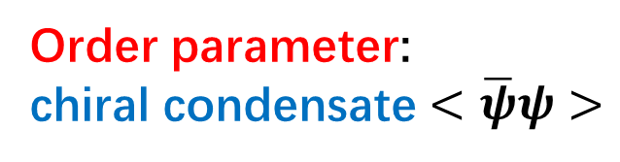




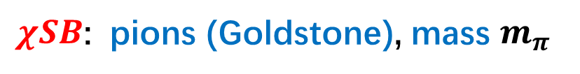


How do dileptons reflect criticality ?
$χSR$: quarks, mass $m_{q}\sim <\overline{ψ}ψ>$;
Order parameter:
chiral condensate $<\overline{ψ}ψ>$
$χSB$: pions (Goldstone), mass $m_{π}$
$$\overline{q}$$
$$l^{−}$$
$$π^{−}$$
$$l^{−}$$
$$γ$$
$$γ$$
$$q$$
$$l^{+}$$
$$π^{+}$$
$$l^{+}$$
vector mesons
K . Kajantie , J . I . Kapusta , L . D . McLerran and A . Mekjian , Phys. Rev. D 34, 2746 (1986)

Slide 7
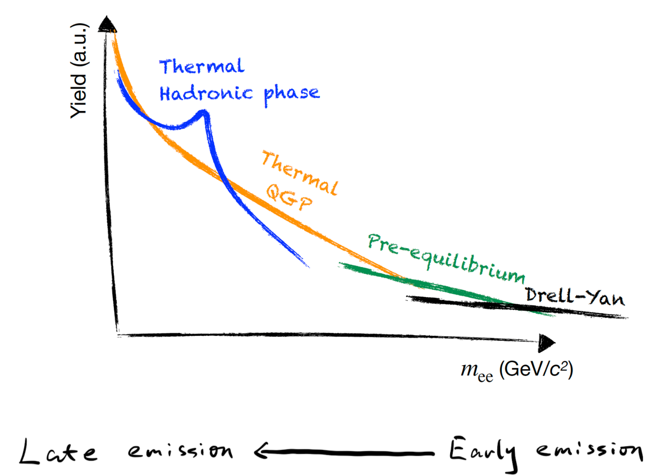
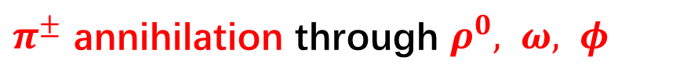
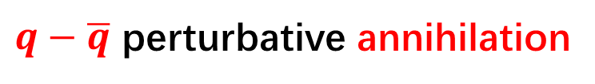
Dilepton Emission mechanisms
C. Yang’s talk (2005)
Final state cocktail background
well subtracted,
(2) Bremsstrahlung and Drell-Yan
at large mass regions,
(3) Thermal dilepton emission
mainly at low and intermediate
mass regions.
$π^{±}$ annihilation through $ρ^{0}, ω, φ$
Thermal hadronic phase
$q−\overline{q}$ perturbative annihilation

Slide 8
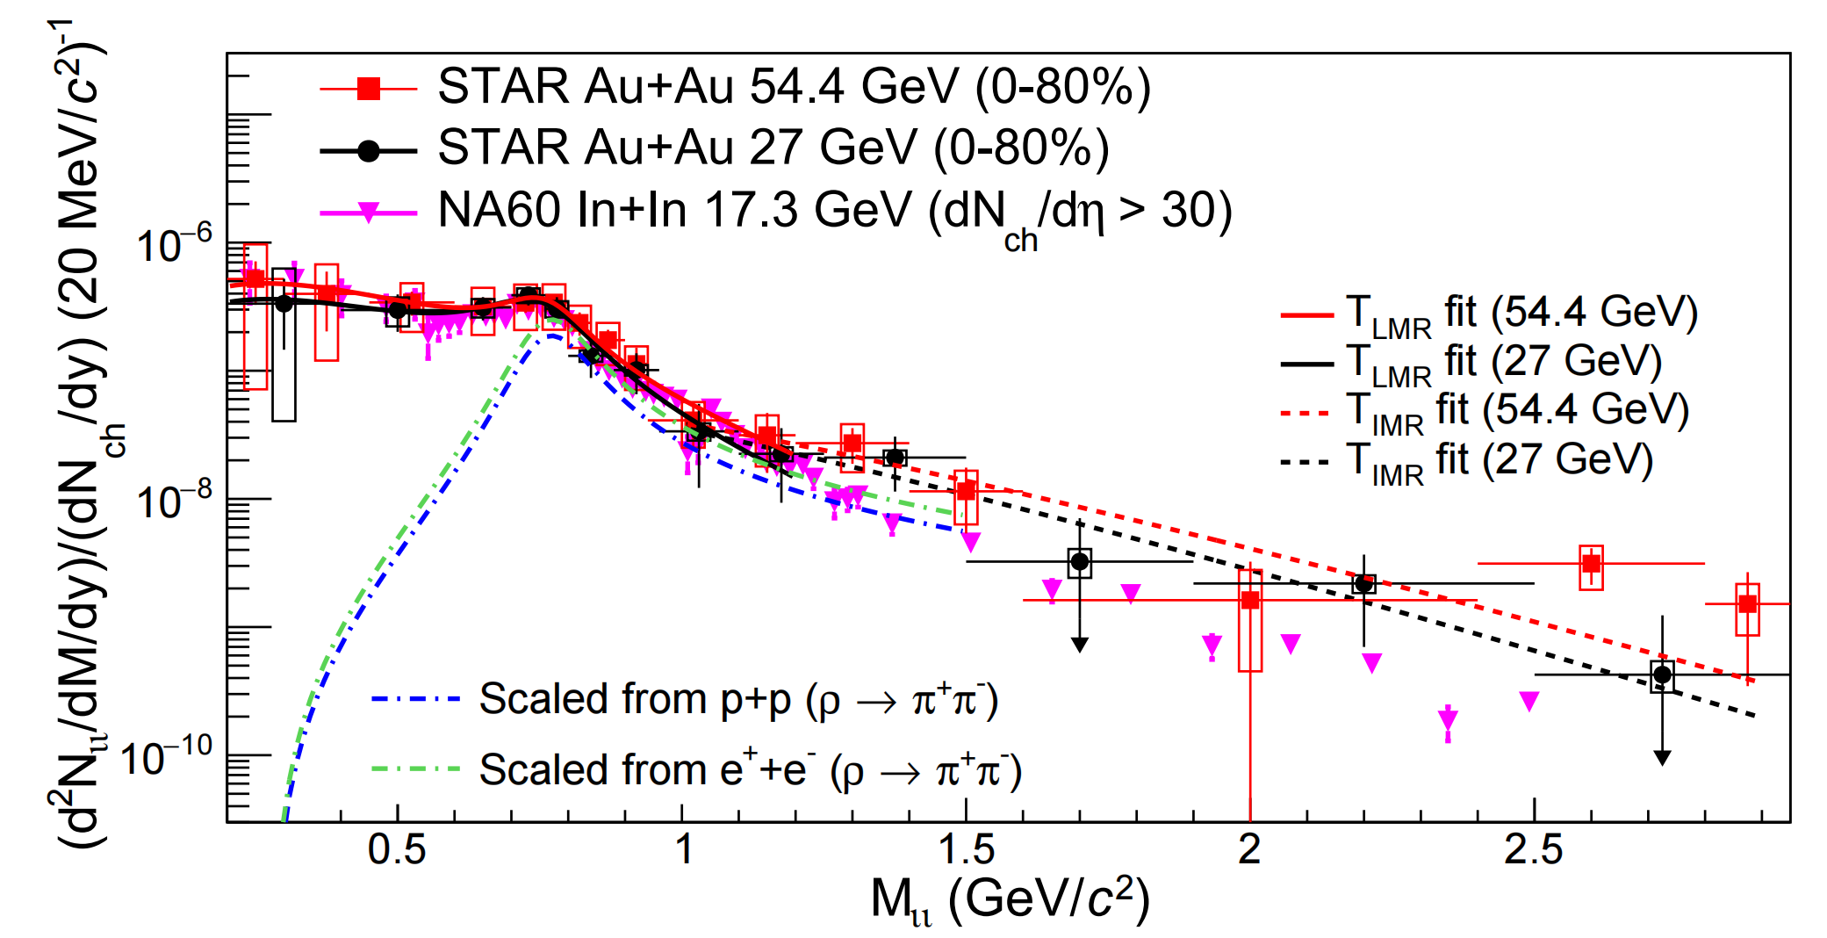
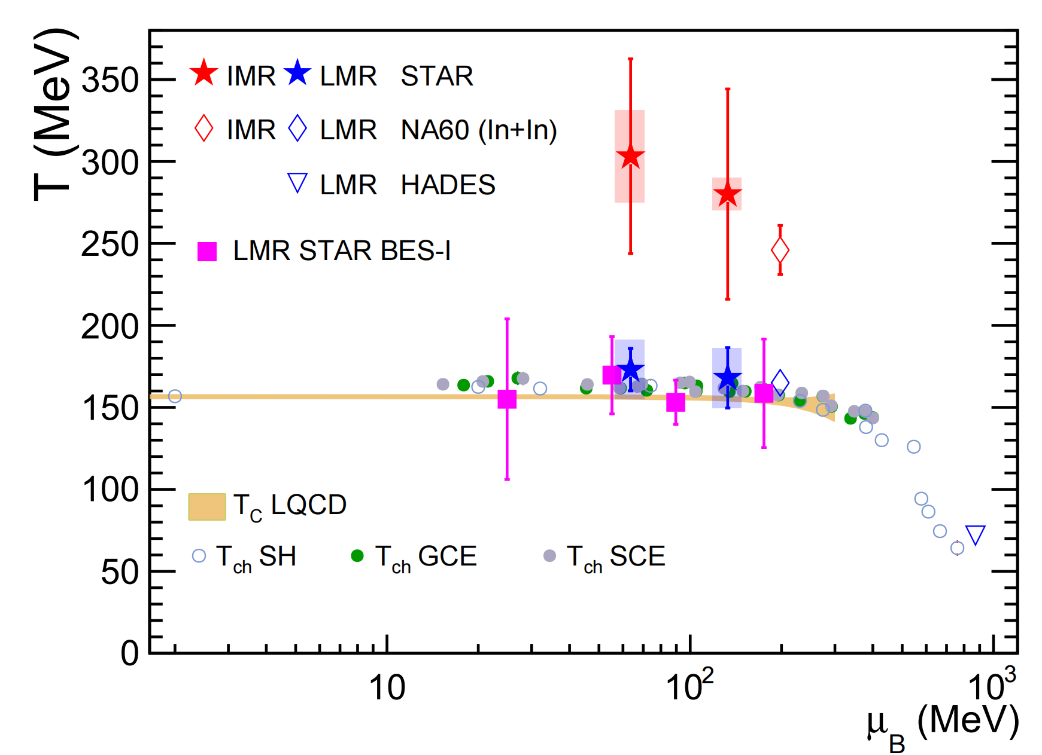

Dilepton Emission Temperature
B. E. Aboona et al. [STAR], Nature Commun. (2025)
Suitable to study criticality by following the freeze-out curve
Low mass region $(0.4−1.2 GeV)$ consistent with chemical freeze-out temperature

Slide 9
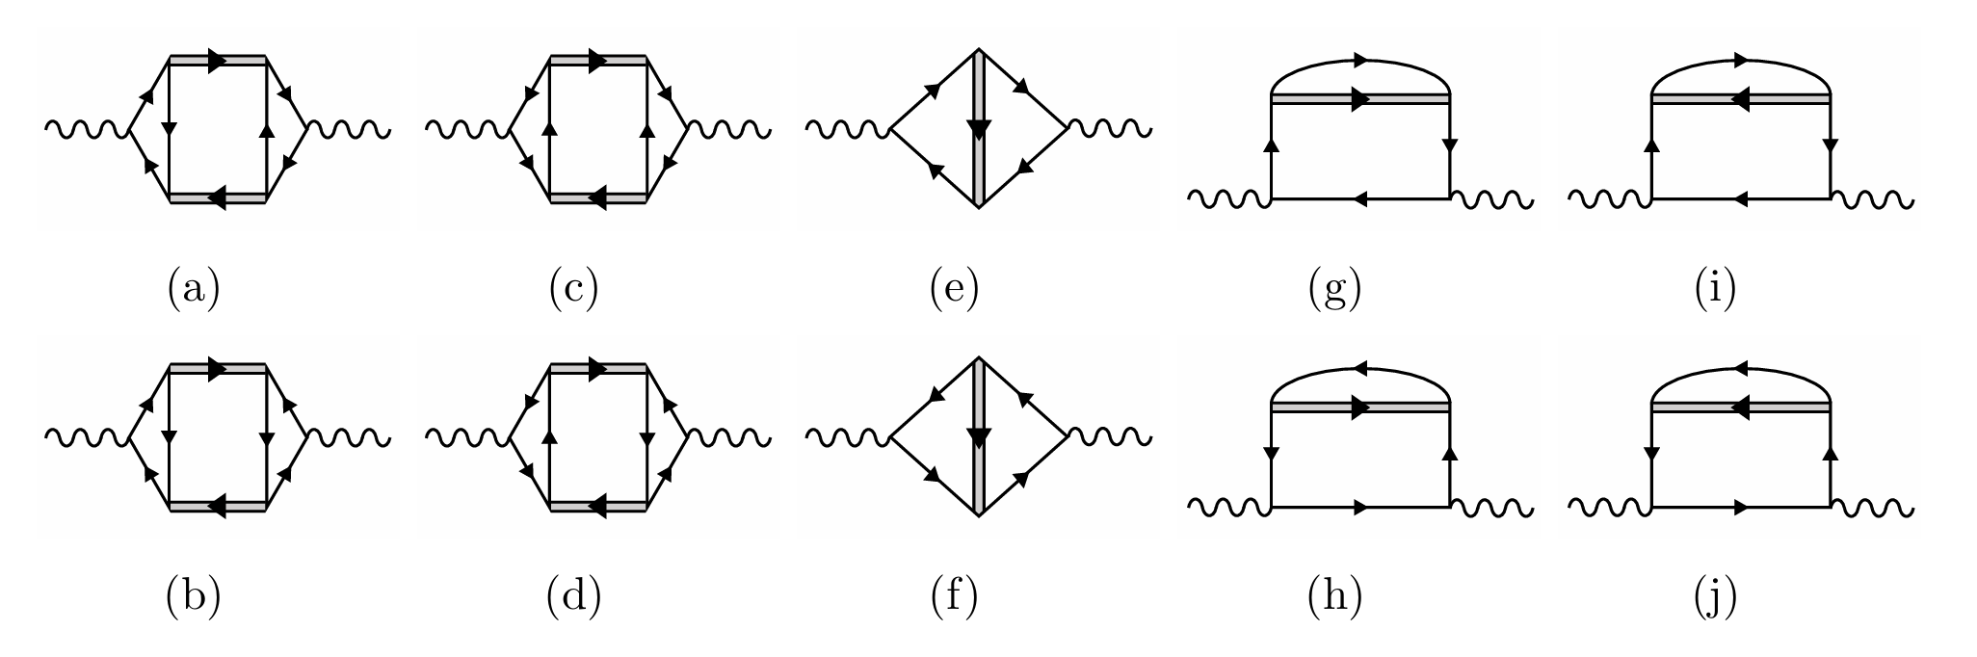
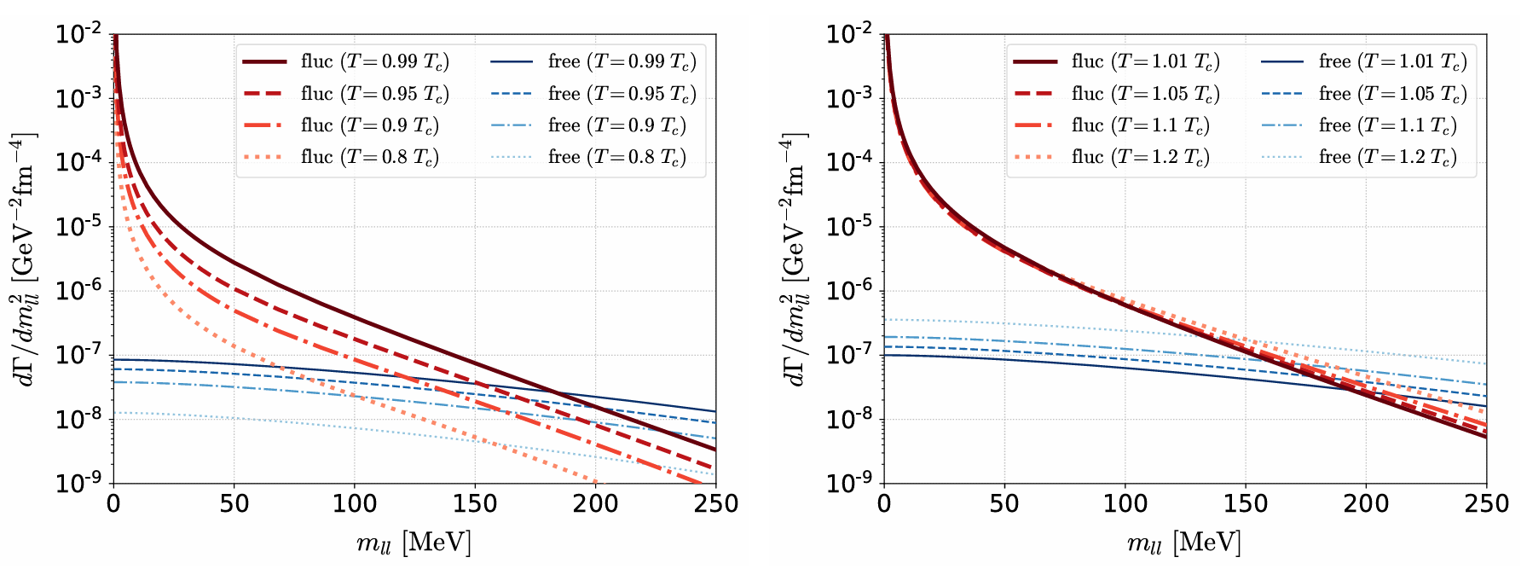
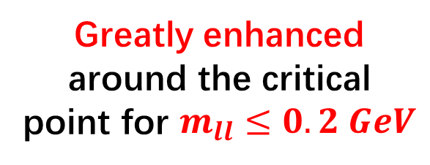



Previous studies with soft-mode
$$σ$$
$$γ$$
$$q$$
Aslamazov-Larkin
Maki-Thompson
Density of states
Greatly enhanced around the critical point for $m_{ll}≤0.2 GeV$
T. Nishimura, M. Kitazawa and T. Kunihiro, PTEP 2023, 053D01 (2023).

Slide 10
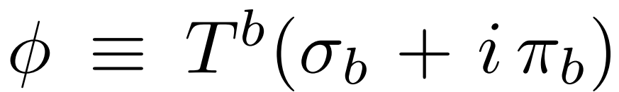
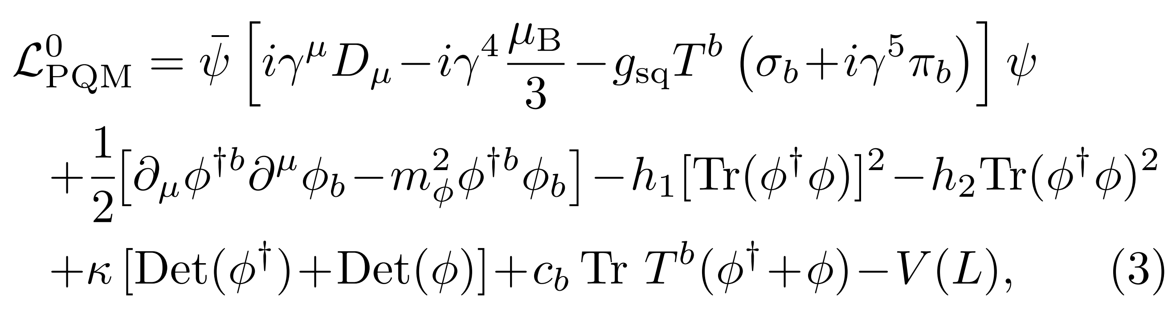
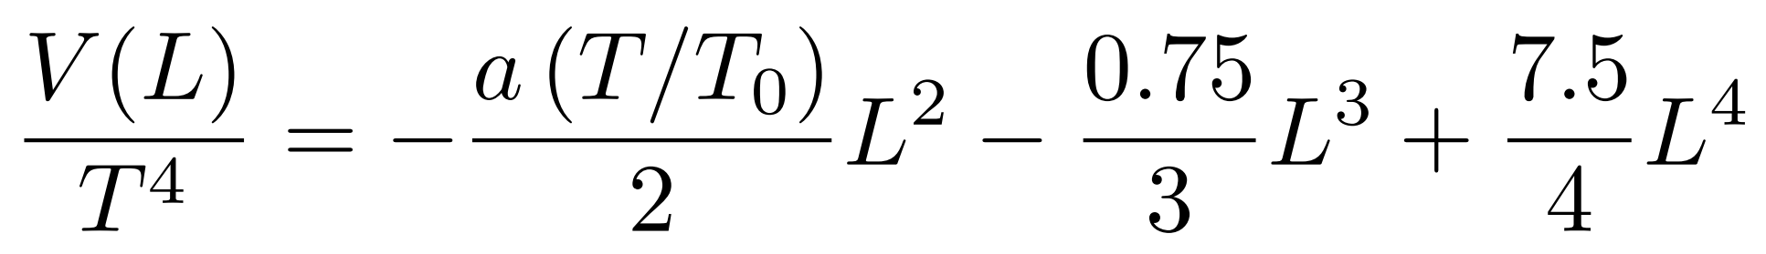
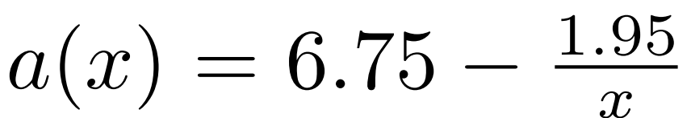
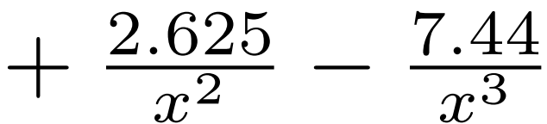
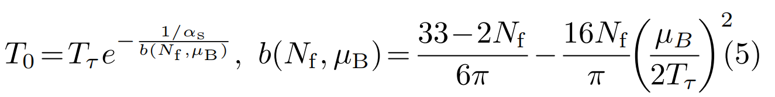

Extending the three-flavor PQM model
Original Lagrangian
B. J. Schaefer et. al., (2010).
Gluon potential
Polyakov loop
C. Ratti et. al., PRD (2006).
T. K. Herbst et. al., PLB (2011).

Slide 11
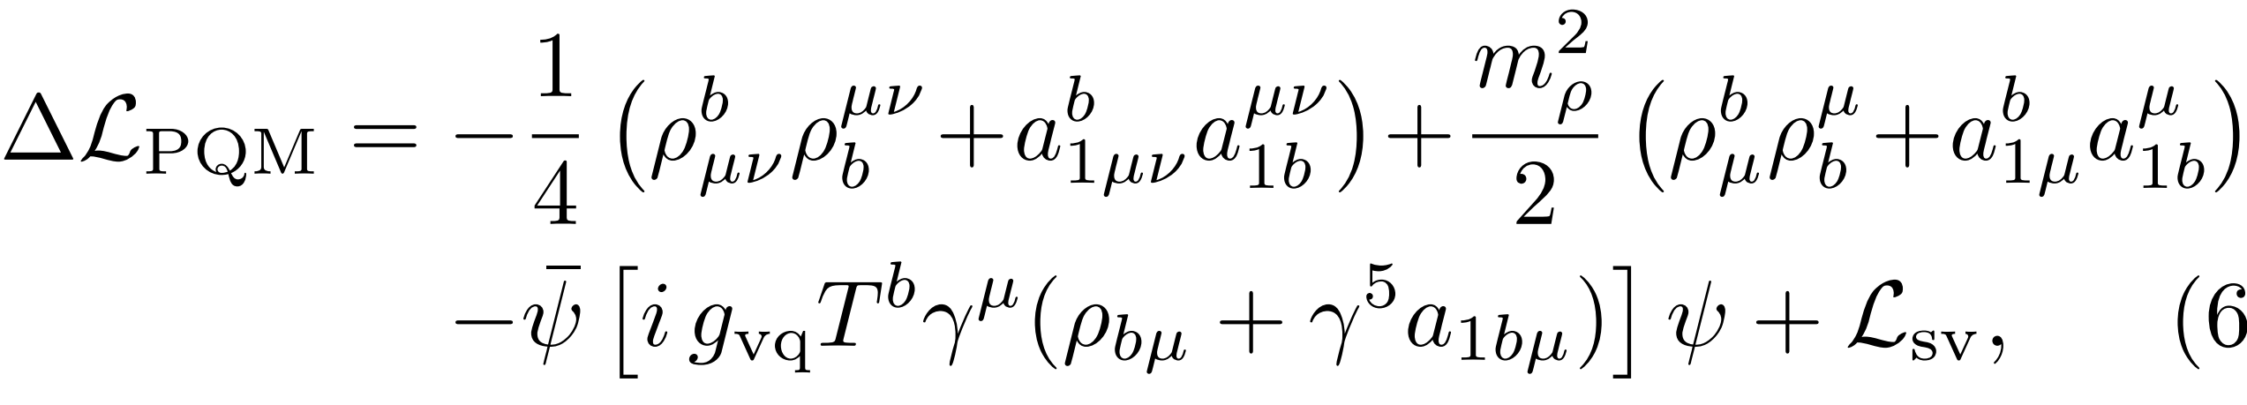
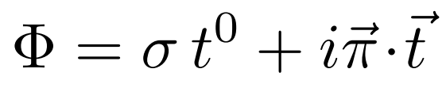
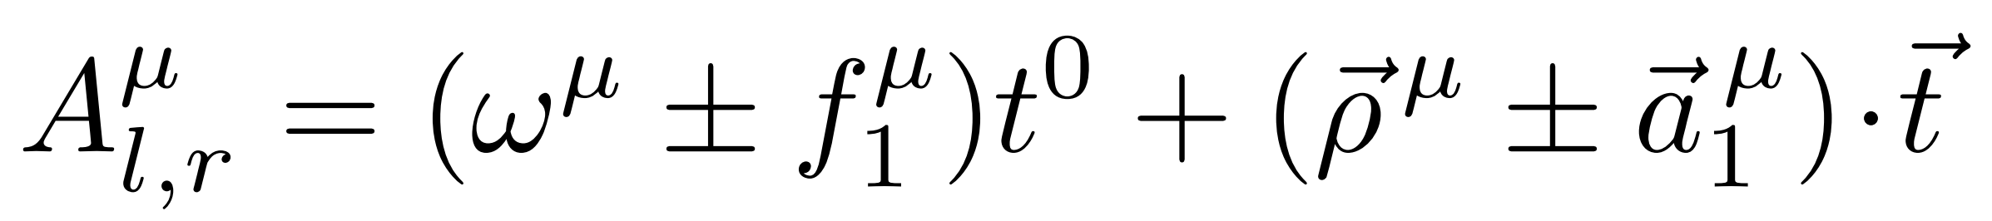


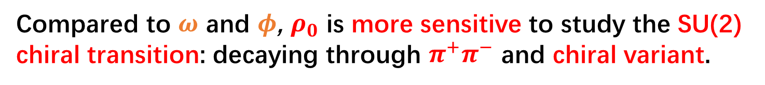
Vector dominance model
R. D. Pisarski, PRD (1995).
$$Φ→e^{±i \vec{θ}⋅\vec{t}} Φ e^{±i \vec{θ}⋅\vec{t}}$$
$$A_{l,r}→e^{±i \vec{θ}⋅\vec{t}} A_{l,r}e^{∓i \vec{θ}⋅\vec{t}}$$
Compared to $ω$ and $φ$, $ρ_{0}$ is more sensitive to study the SU(2) chiral transition: decaying through $π^{+}π^{−}$ and chiral variant.

Slide 12
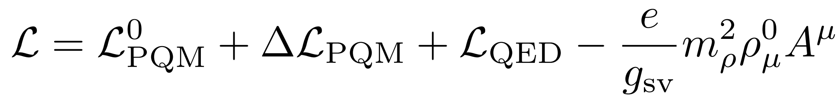
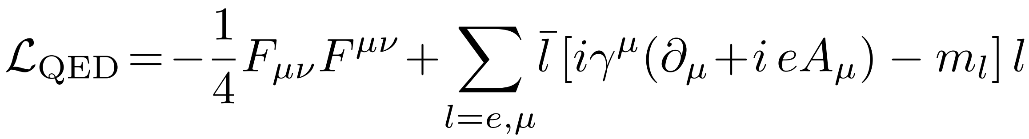
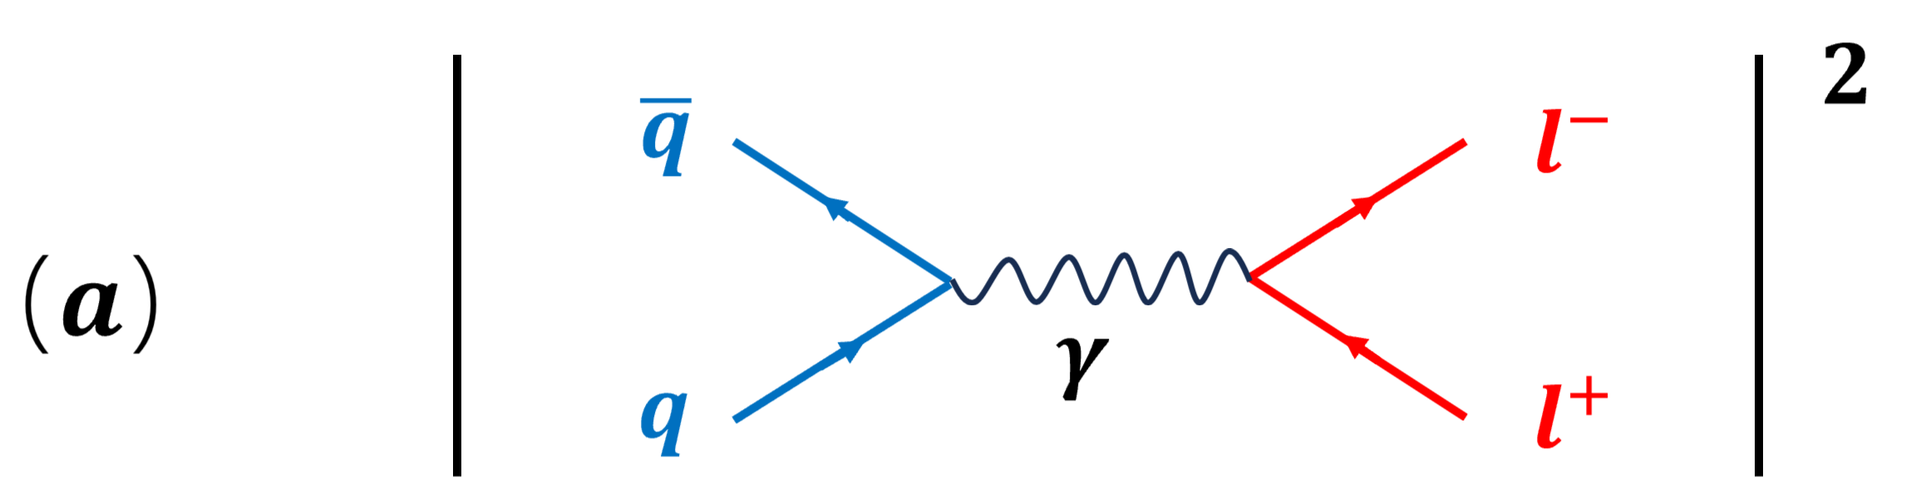
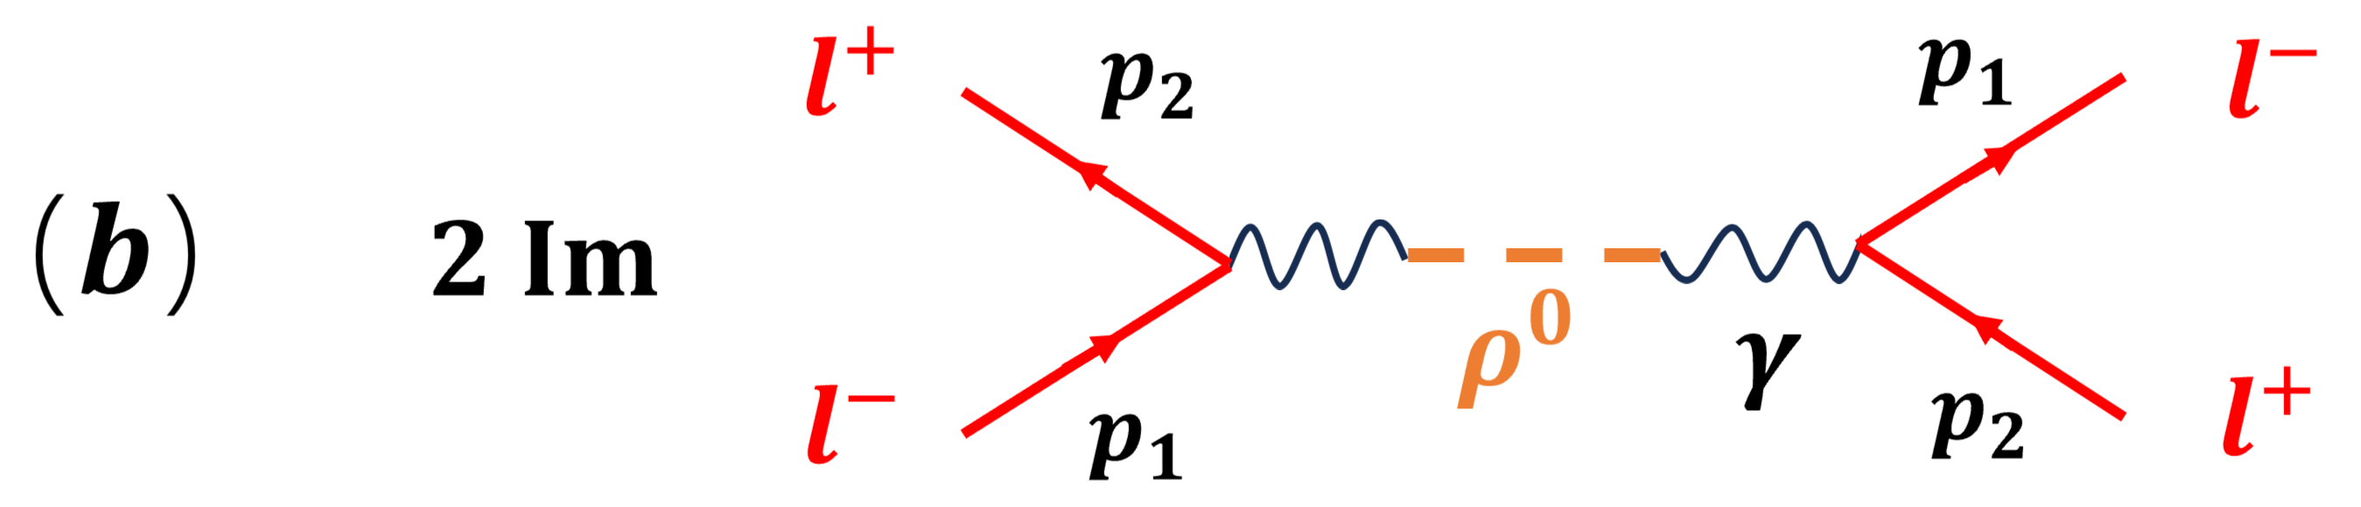
The mechanisms of dilepton production
Total Lagrangian
Perturbative contribution
Nonperturbative contribution
(optical theorem)
K. Kajantie et. al., (1986)
C. Gale and J. I. Kapusta, NPB (1991).

Slide 13
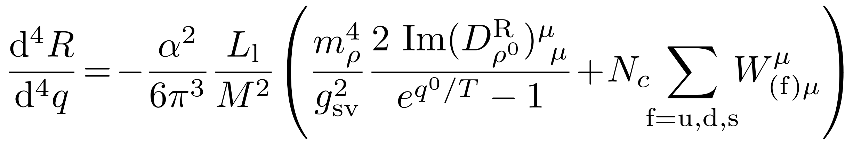
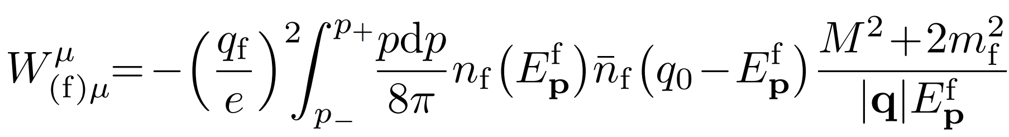
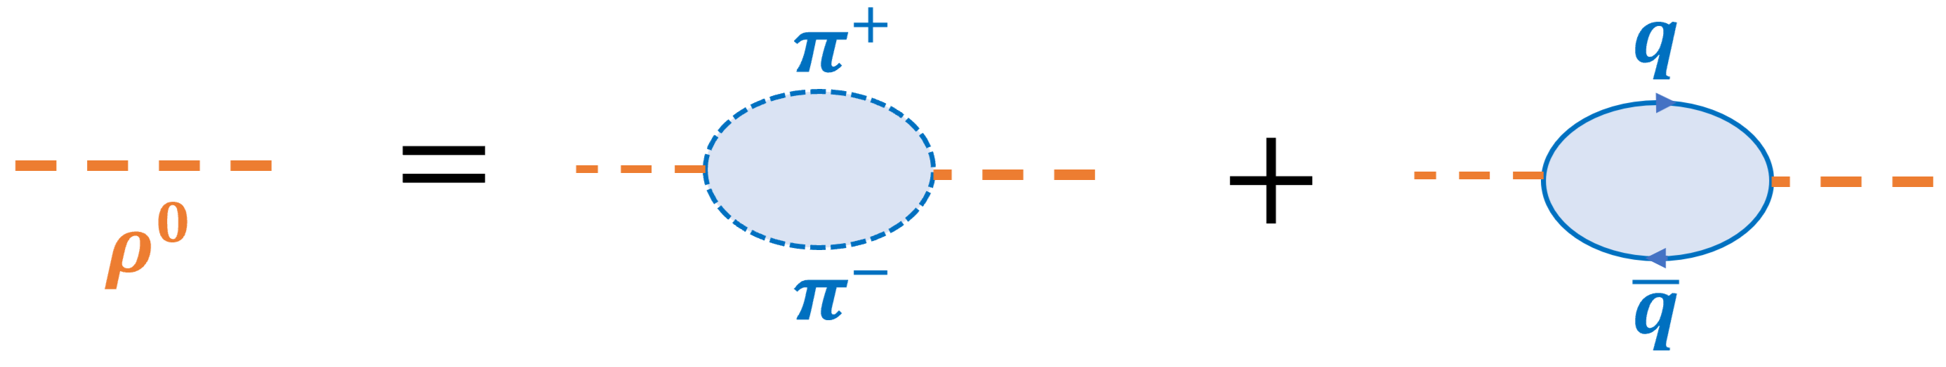
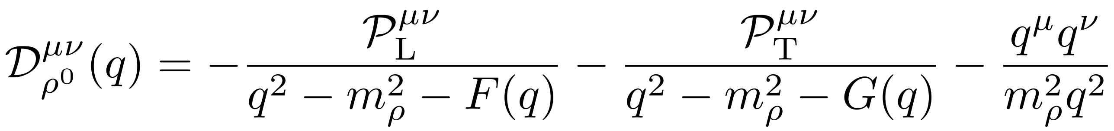



Dilepton emission rate
$$(b)$$
$$(a)$$
L. D. McLerran, PRD (1987).
(a) QED effect
(b) $π^{±}$ and quark loops

Slide 14
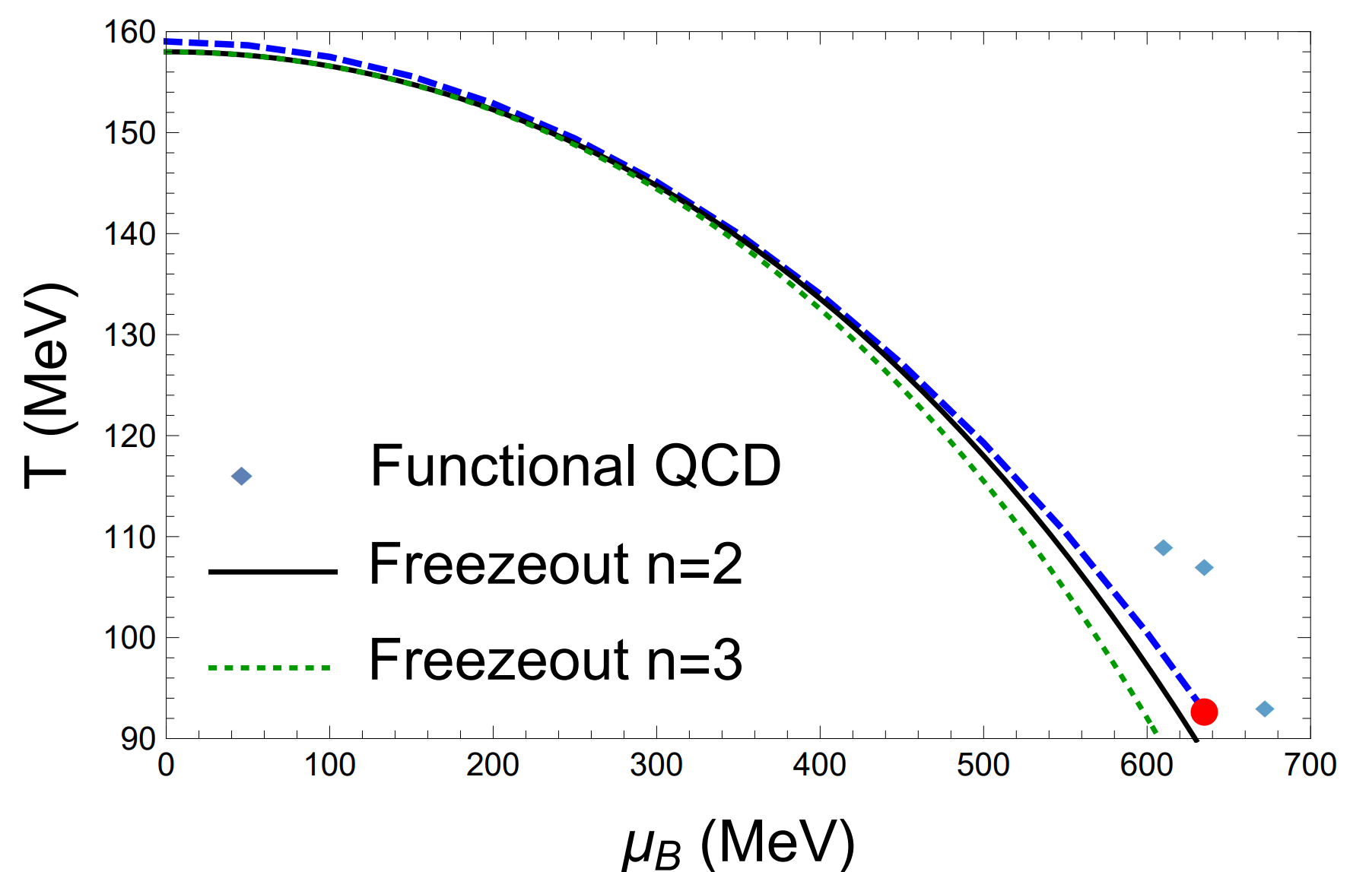

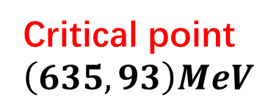
The phase diagram at mean field approximation
$$T_{ps}=159 MeV$$
Critical point
$$\left(635, 93\right)MeV$$
In good agreement with LQCD and functional QCD
The Freezeout lines
X. Luo and N. Xu, NST (2017)

Slide 15
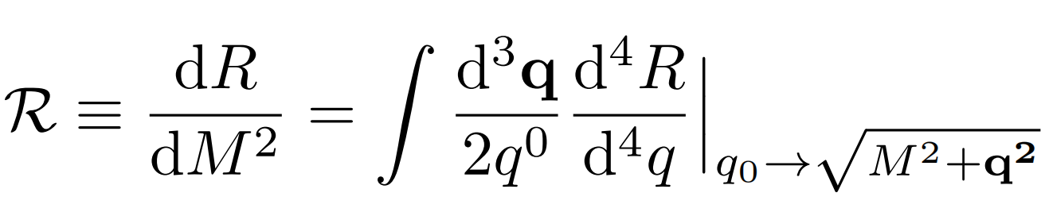
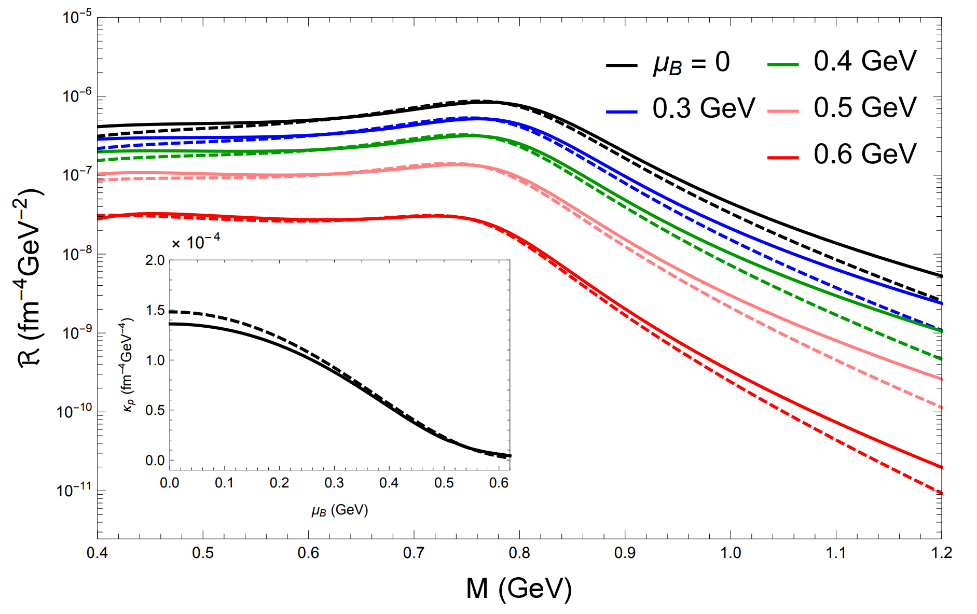
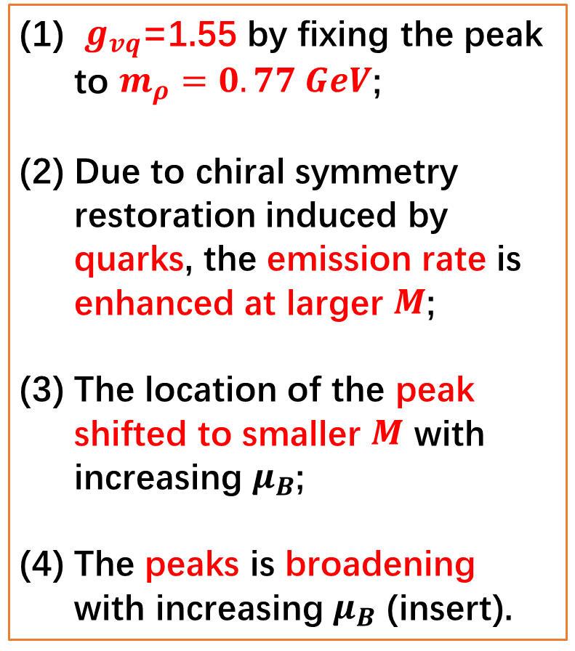
Integrated dilepton emission rate
$g_{vq}$=1.55 by fixing the peak to $m_{ρ}=0.77 GeV$;
Due to chiral symmetry restoration induced by quarks, the emission rate is enhanced at larger $M$;
The location of the peak shifted to smaller $M$ with increasing $μ_{B}$;
The peaks is broadening with increasing $μ_{B}$ (insert).

Slide 16
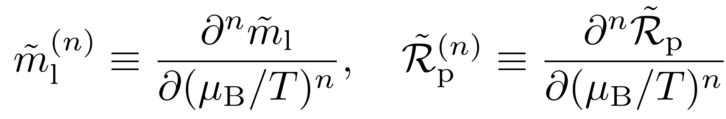
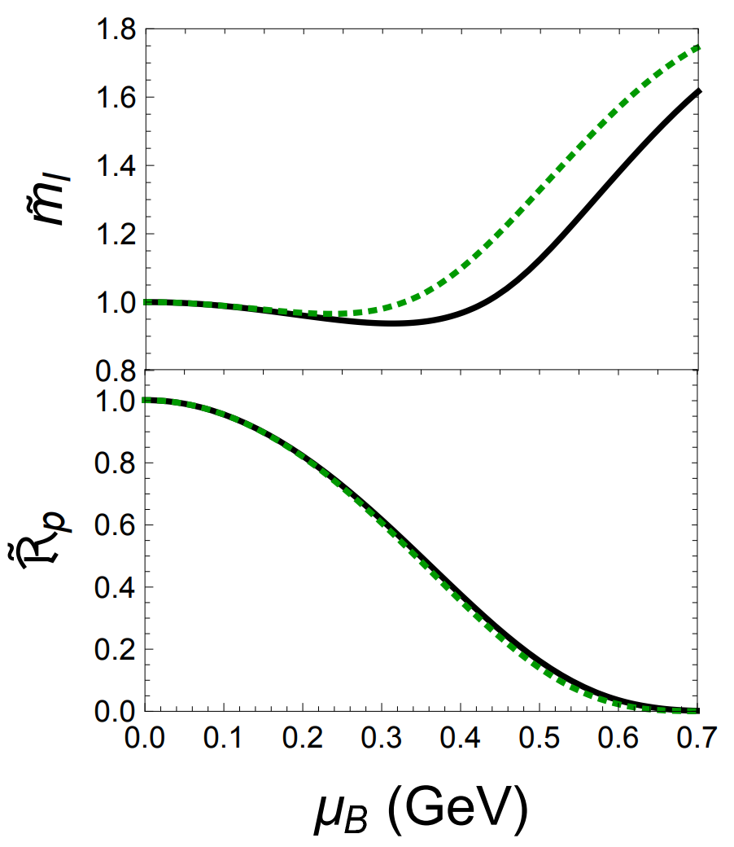
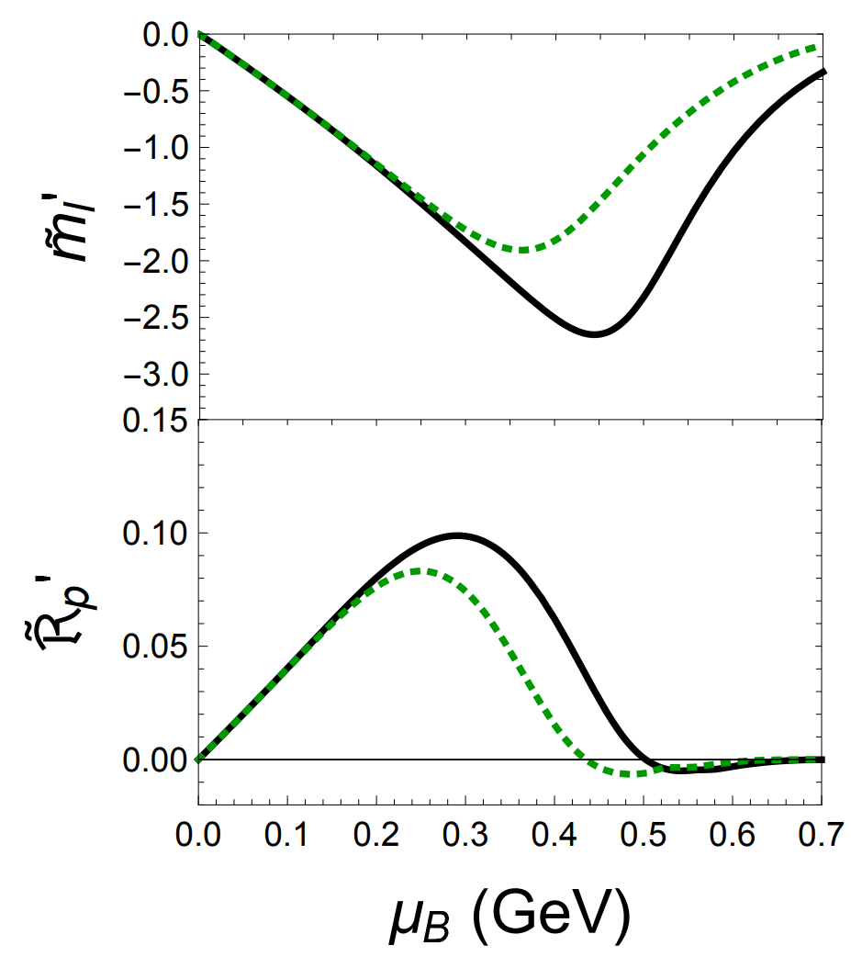
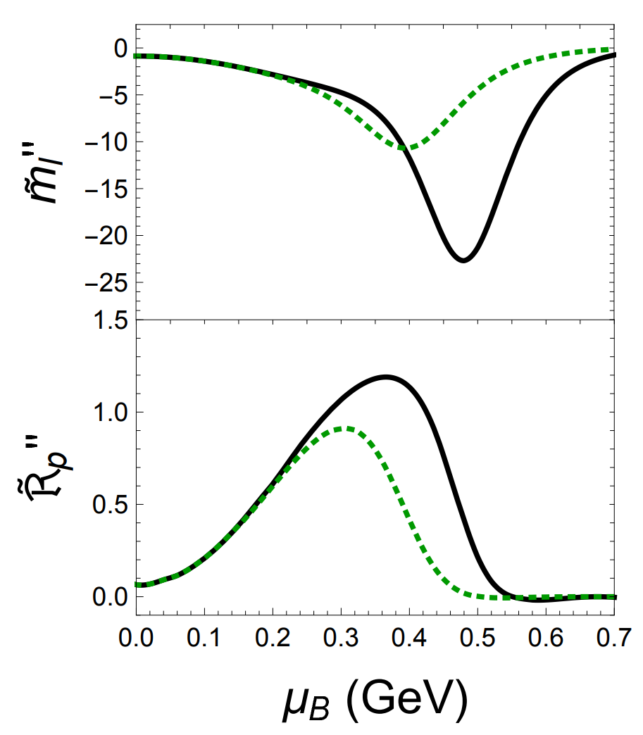
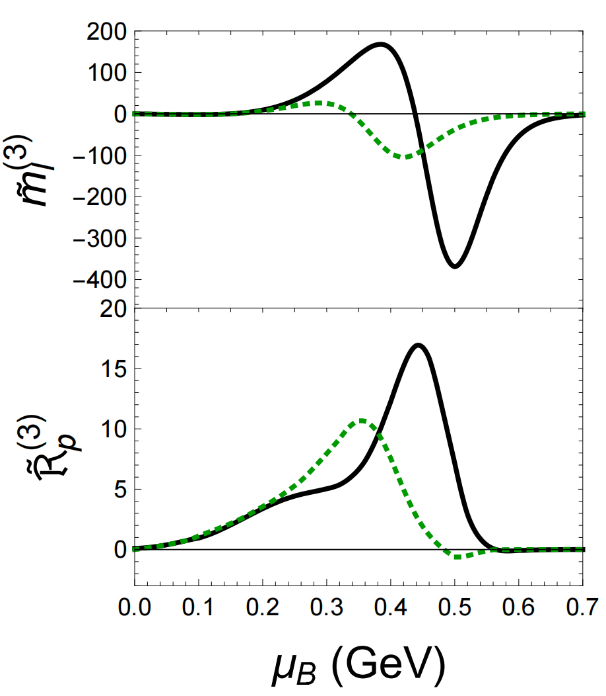
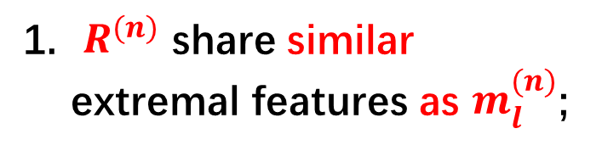
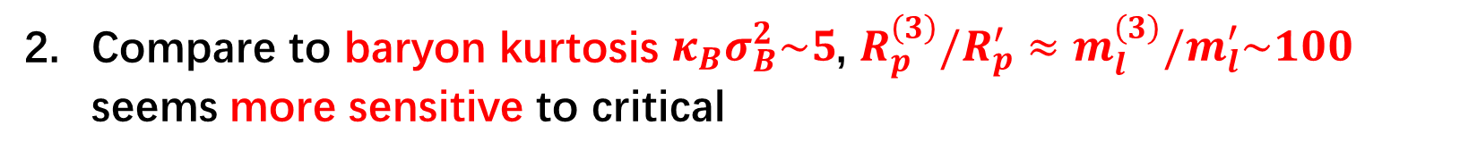
The moments of quark mass and DER
$R^{(n)}$ share similar extremal features as $m_{l}^{(n)}$;
Compare to baryon kurtosis $κ_{B}σ_{B}^{2}\sim 5$, $R_{p}^{\left(3\right)}/R_{p}^{′}≈m_{l}^{\left(3\right)}/m_{l}^{′}\sim 100$ seems more sensitive to critical

Slide 17
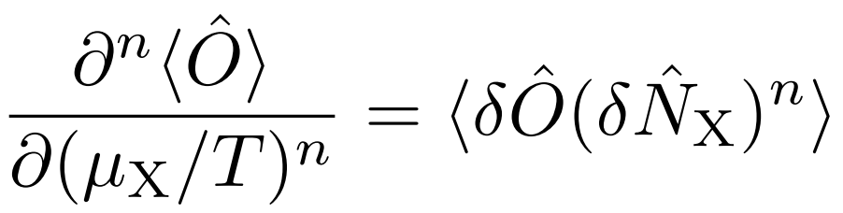
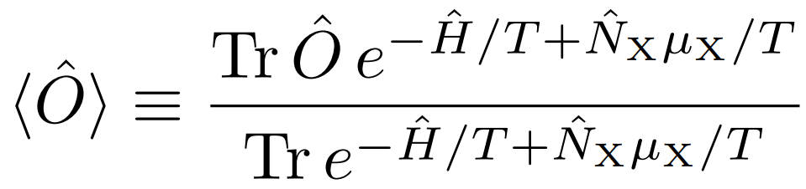
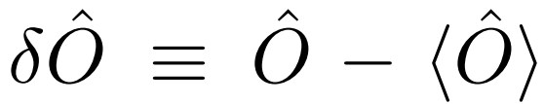
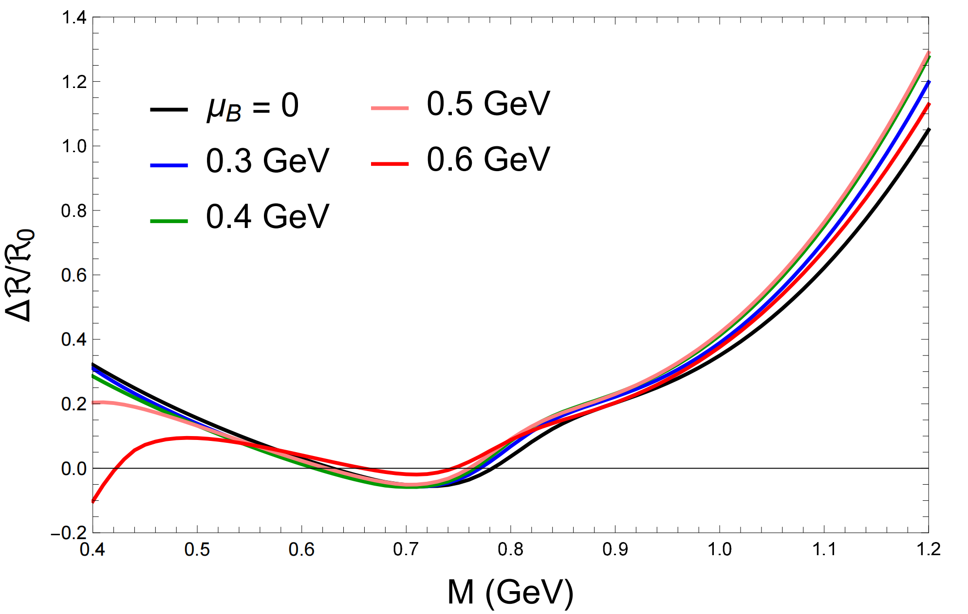



Experimental observables
$$n=1,2$$
baseline subtracted
Experimental observables for the DER moments
Smaller mass: negative,
Intermediate mass: shallower dip,
Larger mass: decreasing with $μ_{B}$.

Slide 18

Spectra with colliding energy
The region $\sqrt{S_{NN}}∈\left(3,7.7\right)$ is indeed important

Slide 19
Summary
Dilepton emission rate is a sensitive probe of QCD critical point
Thanks!

