Slide 1



Hadron–Quark Transition at High Baryon Density from Neutron-Star Observations and Prospects for Kilohertz Gravitational Waves
Yong-Jia Huang
Purple Mountain Observatory / RIKEN
C3NT Workshop on QCD CEP and EFT Method
22 Oct. 2026

Slide 2
Outline
● Multi-messenger Information for Neutron Star
● The Non-parametric Equation of State Realizes a Generalized Quark-Hadron Crossover
● Explore the QCD Phase Boundary with Kilohertz Gravitational Wave

Slide 3
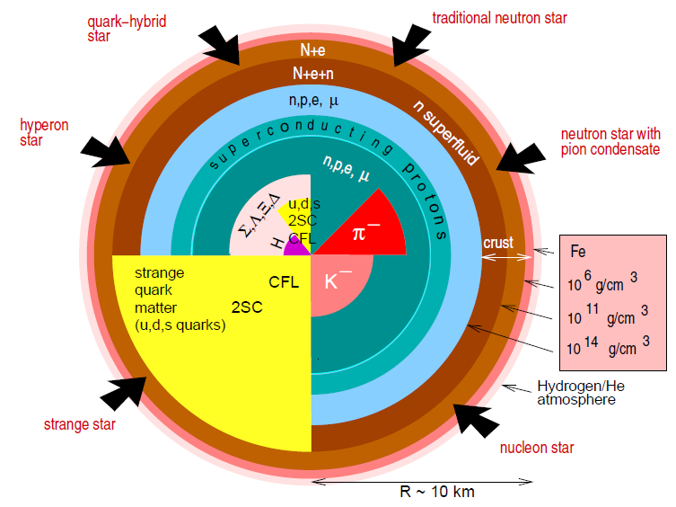
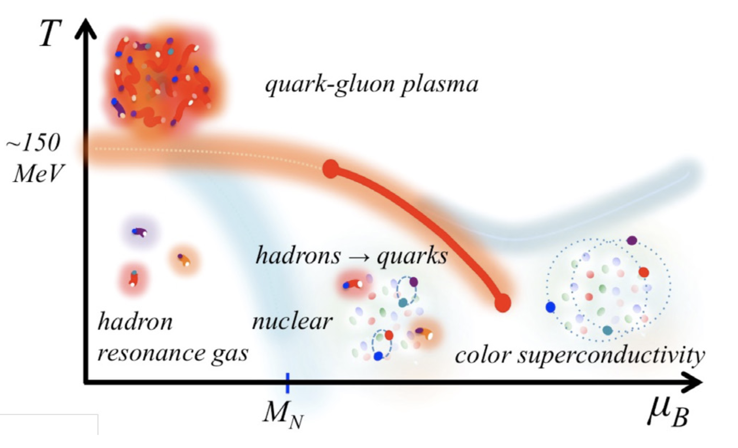
Baym et al. 2018
Neutron star merger
Zero temperature
Neutron star observation (mass, radius, tidal deformability …)
Equation of State
Finite temperature
Binary neutron star merger

Slide 4
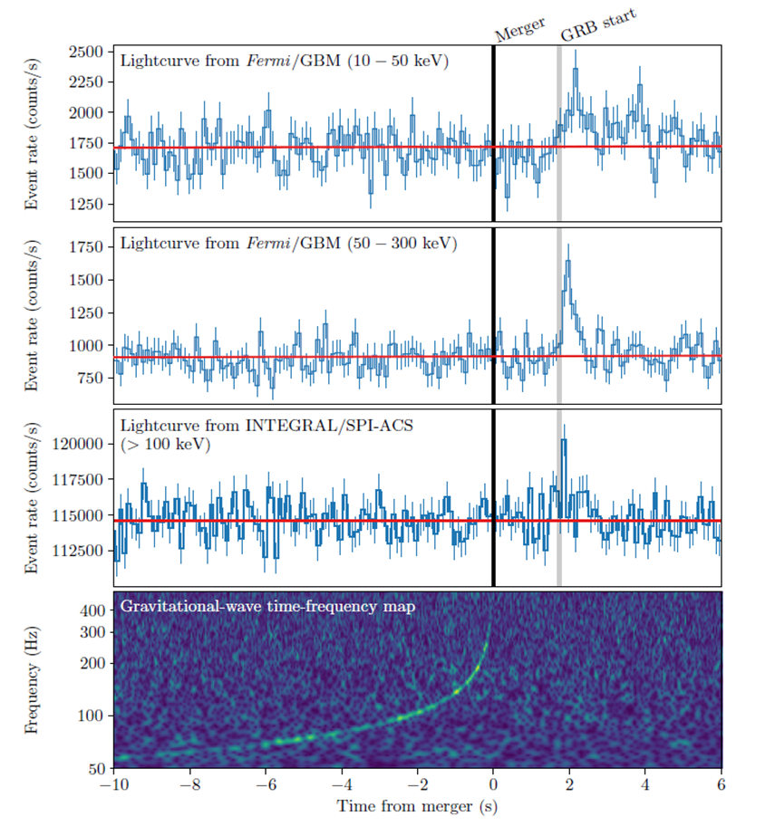

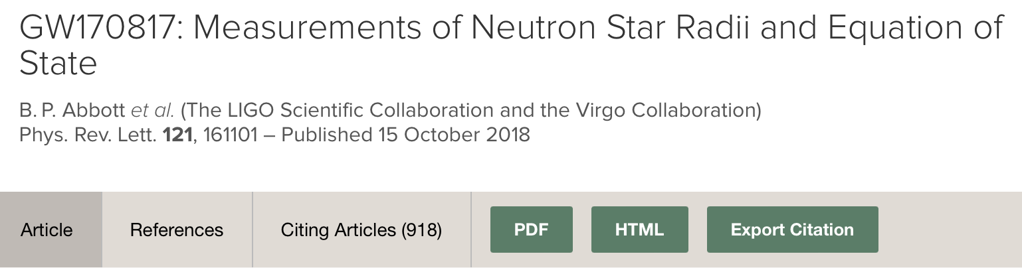
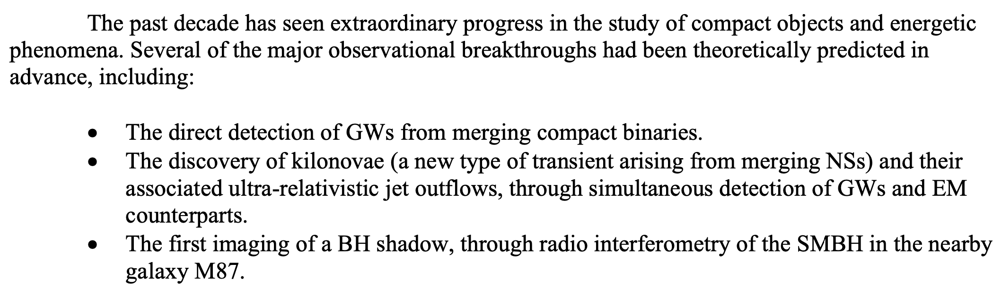

GW170817
DNS mergers: one of great breakthroughs in 2010s

Slide 5
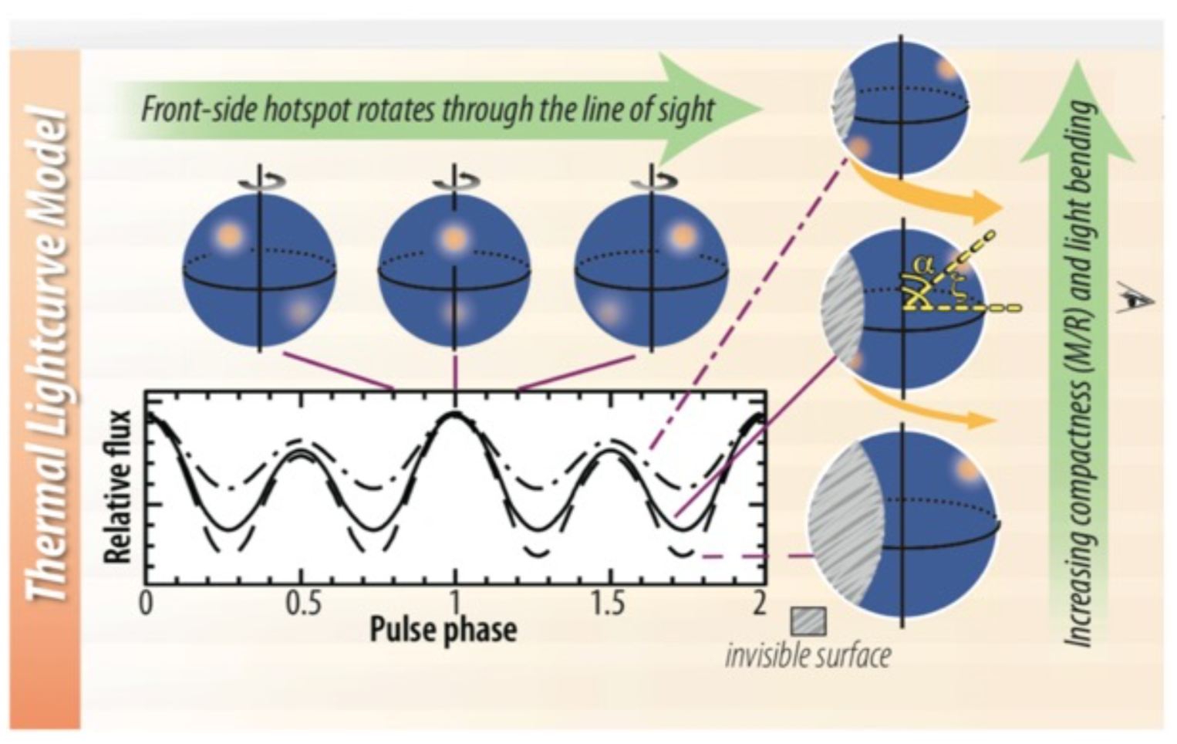
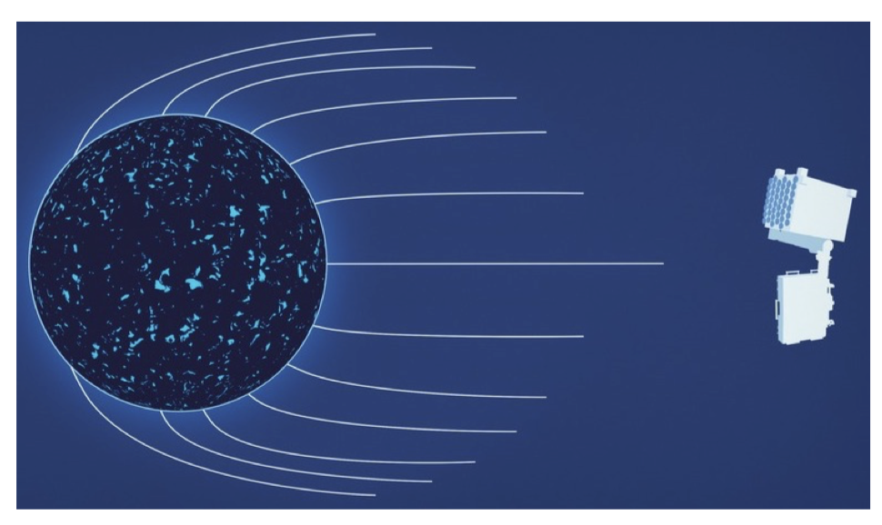
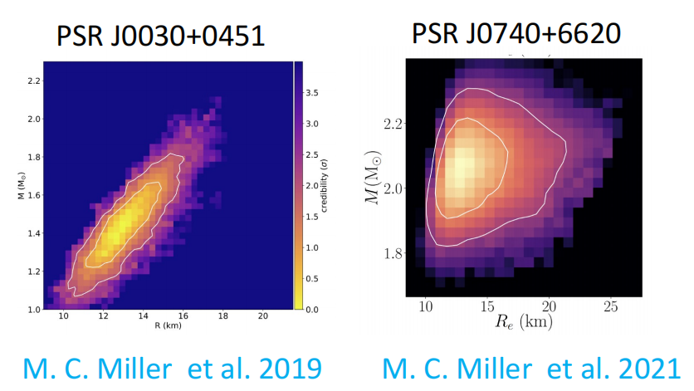
Multi-messenger information
The existence of ~2 solar mass neutron star
J3048+0432 (2.01±0.04 solar mass), J0740+6620 (2.08±0.07 solar mass)
Tidal deformability from gravitational waves
GW170817
Compactness(mass/radius) from NICER observation
J0030+0451, J0740+6620, J0614–3329, J0437–4715

Slide 6
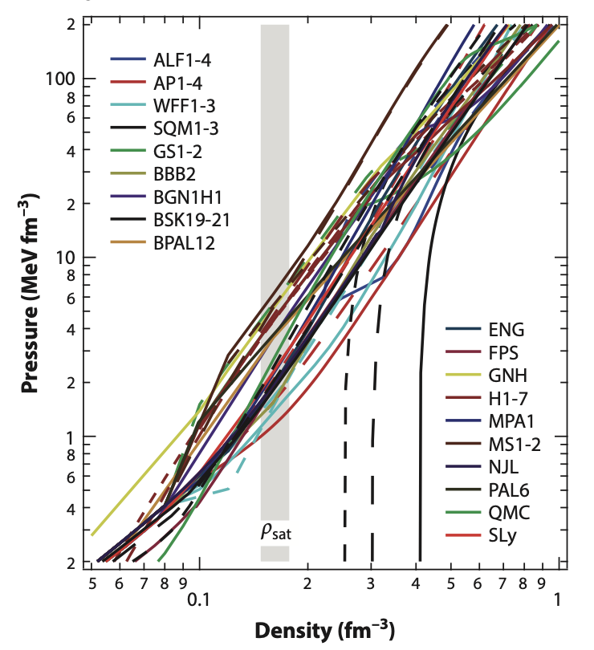
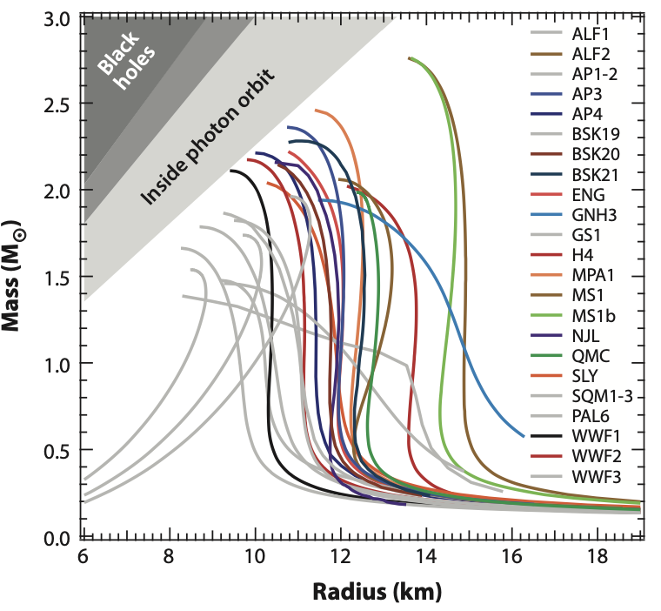
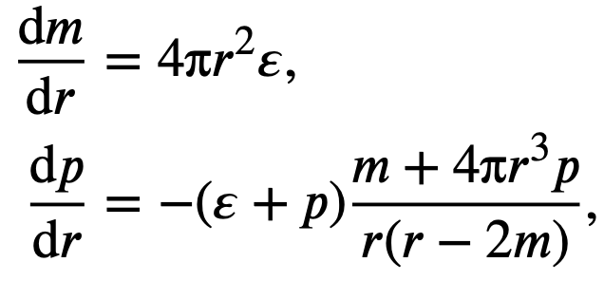
Micro vs. Macro
Equation of state: nuclear physics
Mass-Radius relation: astrophysics
Get M-R with models
Constraining the range of EOS with statistics
（Ozel et al. 2016 ARA&A）

Slide 7
Outline
● Multi-messenger Information for Neutron Star
● The Non-parametric Equation of State Realizes a Generalized Quark-Hadron Crossover
● Explore the QCD Phase Boundary with Kilohertz Gravitational Wave

Slide 8
EOS Construction
Model-agnostic method
No nuclear interaction
Flexible representation
Phenomenology method
Effective nuclear interaction
Parameterized
Ab-initio method
Realistic nuclear interaction
Parameter-constrained
Observation Driven
Microscopic
• Too many possible of composition inside the NS, limiting the reliability of ab-initio extrapolations.
• NS observation data can always be fitted with enough parameters.
Non-parametric EOSs + ab-initio calculation as boundary condition
Observations do not determine a few parameters but induce a probability measure on a function space

Slide 9
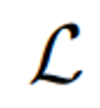
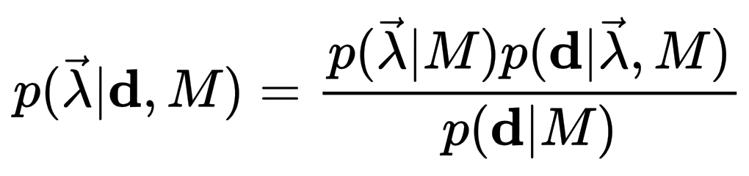

Bayesian Inference
Conditional on a given model 𝑀, the posterior distribution of the parameter vector λ is obtained by combining data d from multiple sources
Probability density of prior
Likelihood
Probability density of posterior

Slide 10
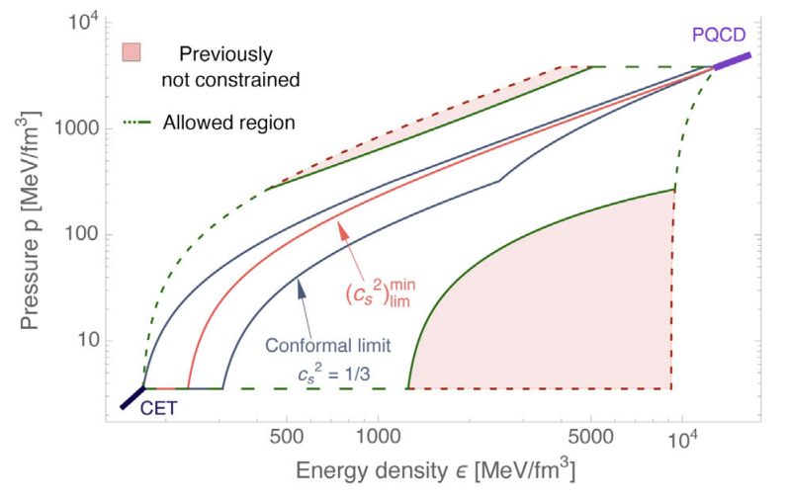
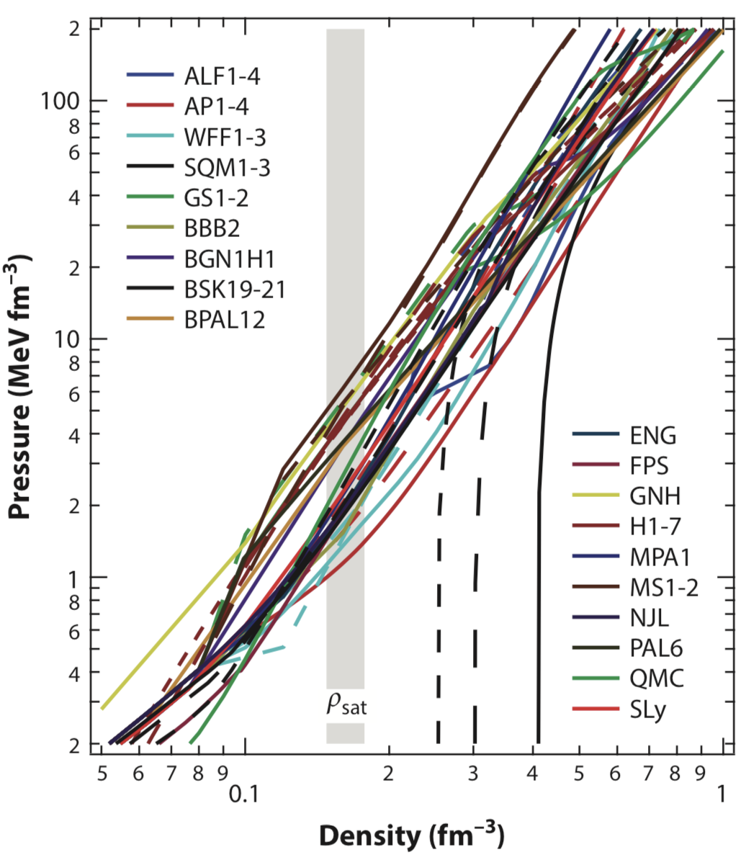
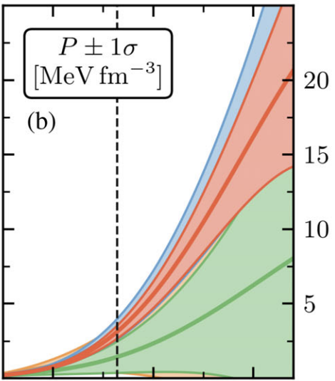
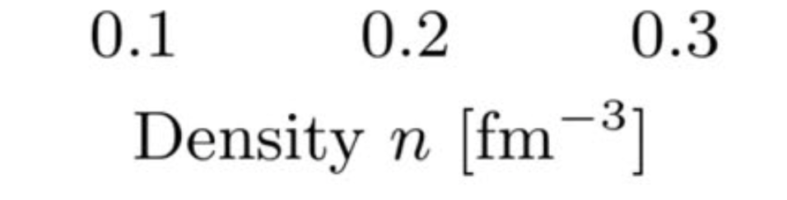
Additional physical information/constraints
NS data
pQCD
χEFT
Chiral effective field theory: yields reliable EoS up to near the nuclear saturation density n_{s}
The boundary constraint from pQCD: valid at ultra-high densities, can be reasonably extrapolated to low densities, say 5-10n_{s}, under the conditions of causality and microscopic stability (0≤c_{s}²≤1)
(Drischler et al. 2021 PRL; Gorda et al. 2022 PRL)
Notes:
The mass and radius data of neutron stars mainly govern /ˈɡʌv.ɚn/ the EoS in the middle density regime. In the low density region,
the chiral /ˈkaɪrəl/ effective field theory calculation has reached a high accuracy in recent years, which yields reliable EoS up to the nuclear saturation density. Although dense matter cannot be described with a perturbative theory until ultra-high density (∼ 40n0)，under the conditions of causality [kɔˈzæləti] and microscopic stability, the pQCD constraint can be reasonably extrapolated to the low density region.
In our inference, both the NS mass and radius data and the theoretical information have been taken into account.

Slide 11
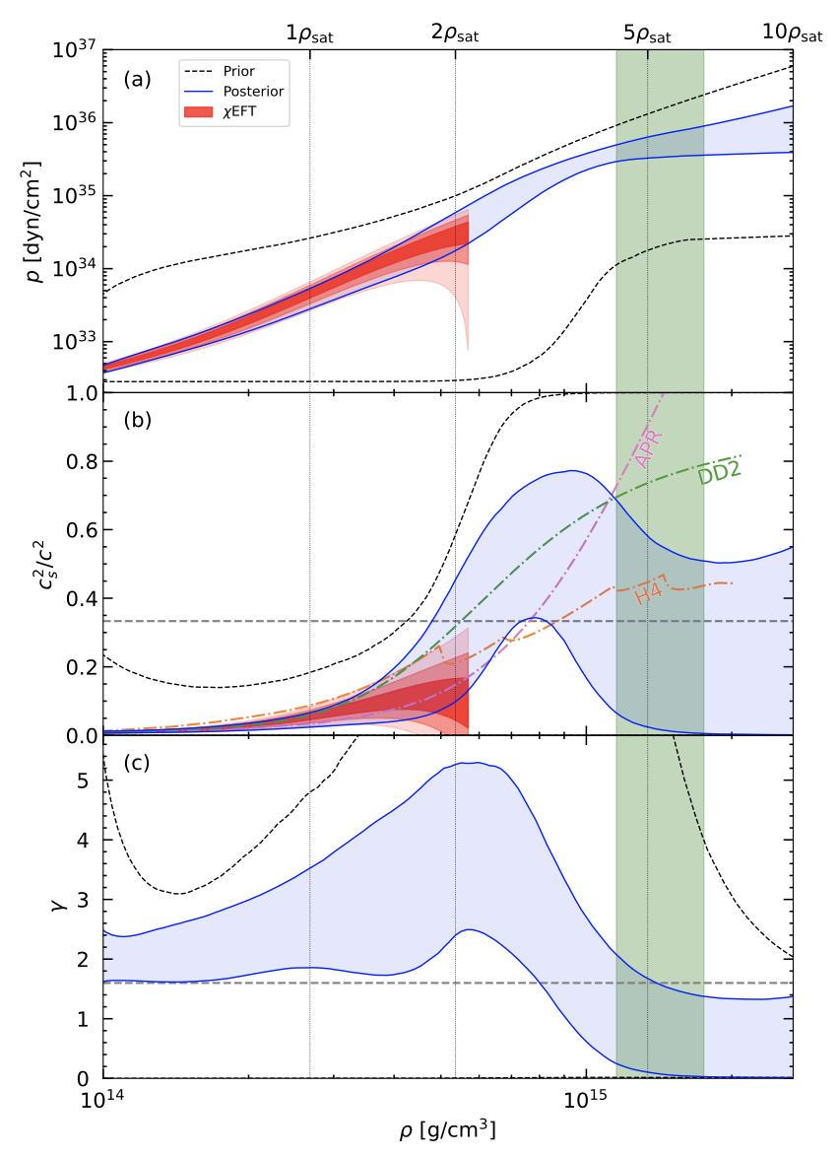
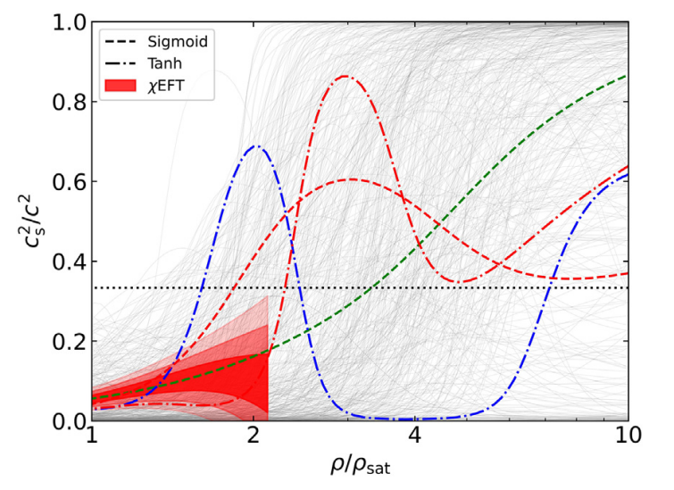
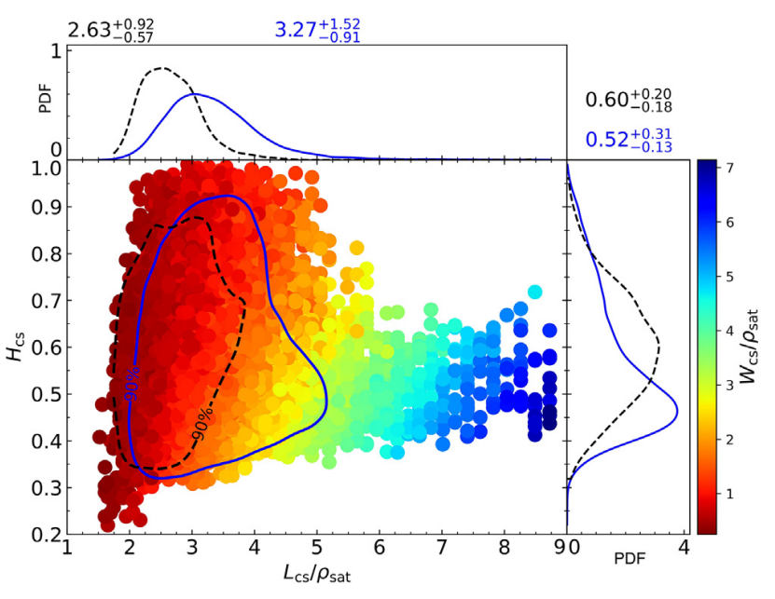
Peak structure in CS2
Prior
Posterior
NS observation
Rapidly stiffening
Chiral EFT, pQCD
EOSs seems stiffer than ChiEFT calculation in 1~2 n0, and peak generally presents in the posterior.
EOS tends to be soft near the center of most massive NS.
Han, Huang, Tang & Fan, Science Bulletin 2023

Slide 12
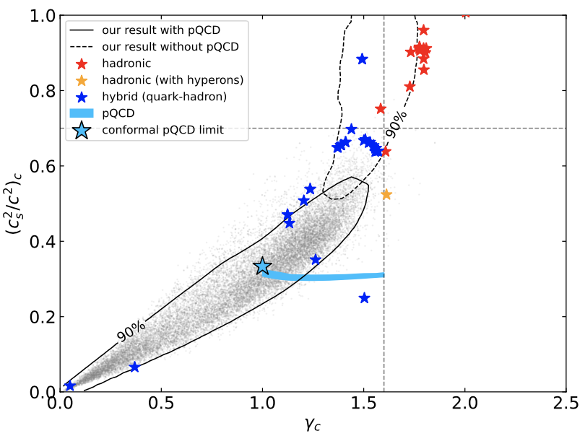
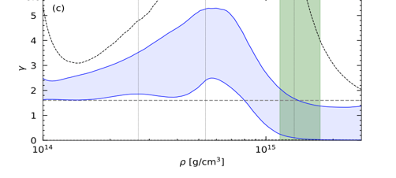
Quark matter inside NS
Han, Huang, Tang & Fan, Science Bulletin 2023

Slide 13
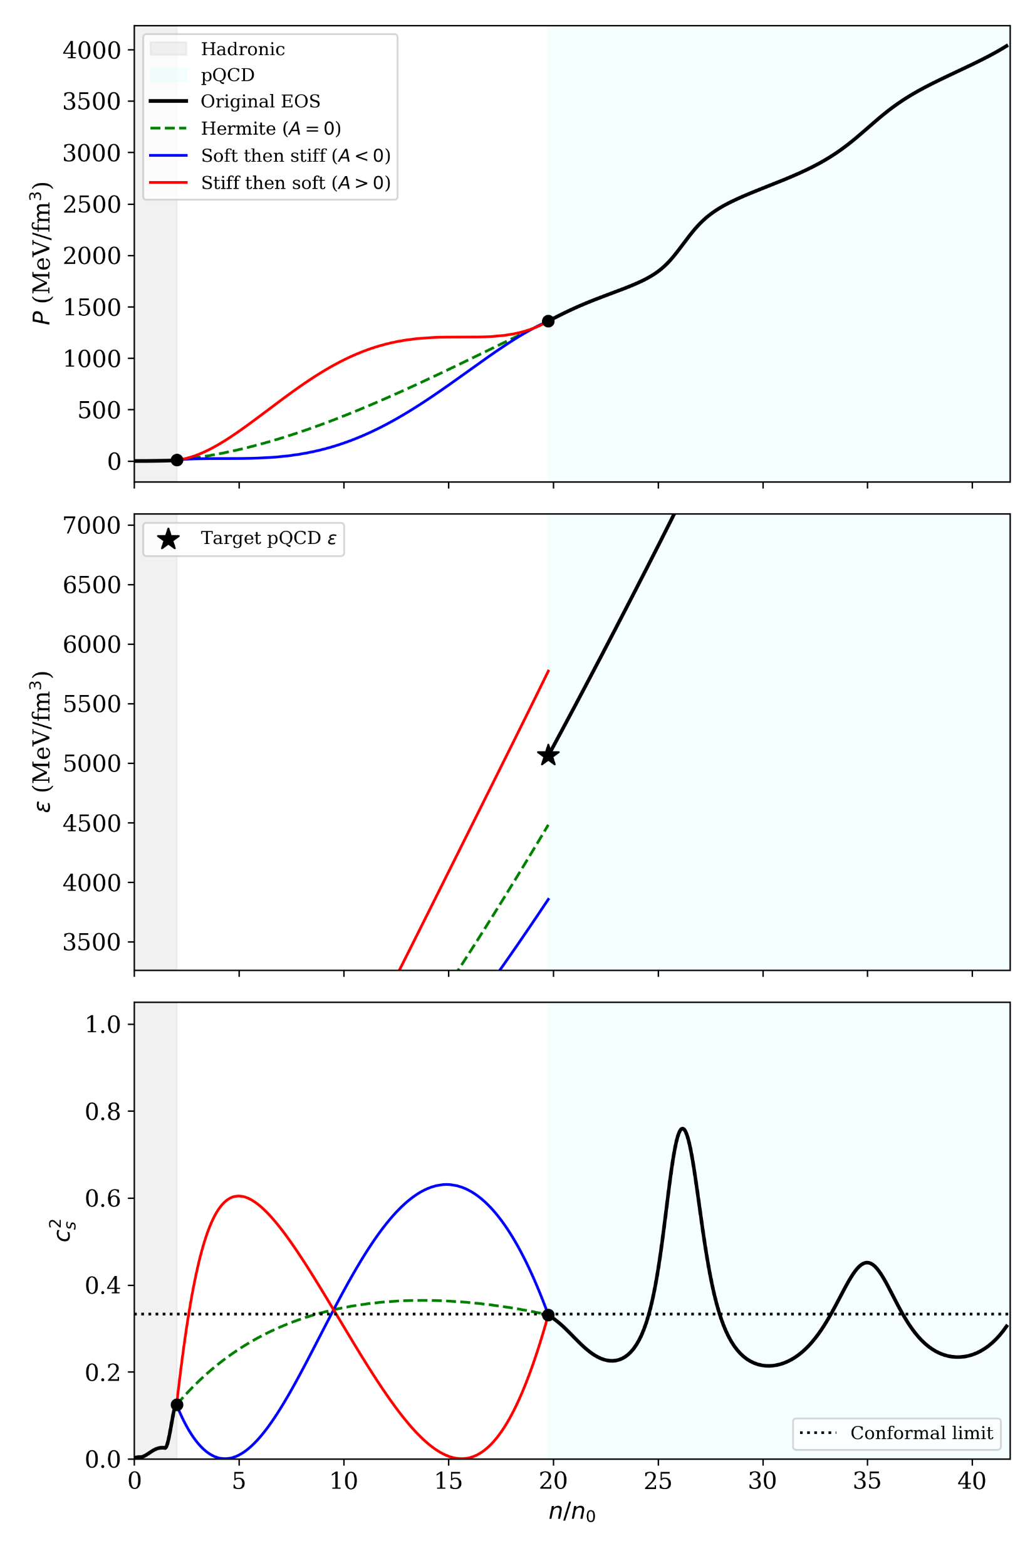


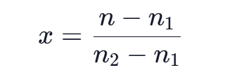
Origin of the cs2 Structure: Peak & Softening
The sound speed profile is not arbitrarily.
A=0 (green dashed): A standard interpolation.
A < 0, (blue): The EOS is initially softer than the standard interpolation, requiring a rapid stiffening near the high-density end.
A > 0, (red): The EOS exhibits pronounced early stiffening, followed by a much softer state to meet the final pressure target.

Slide 14
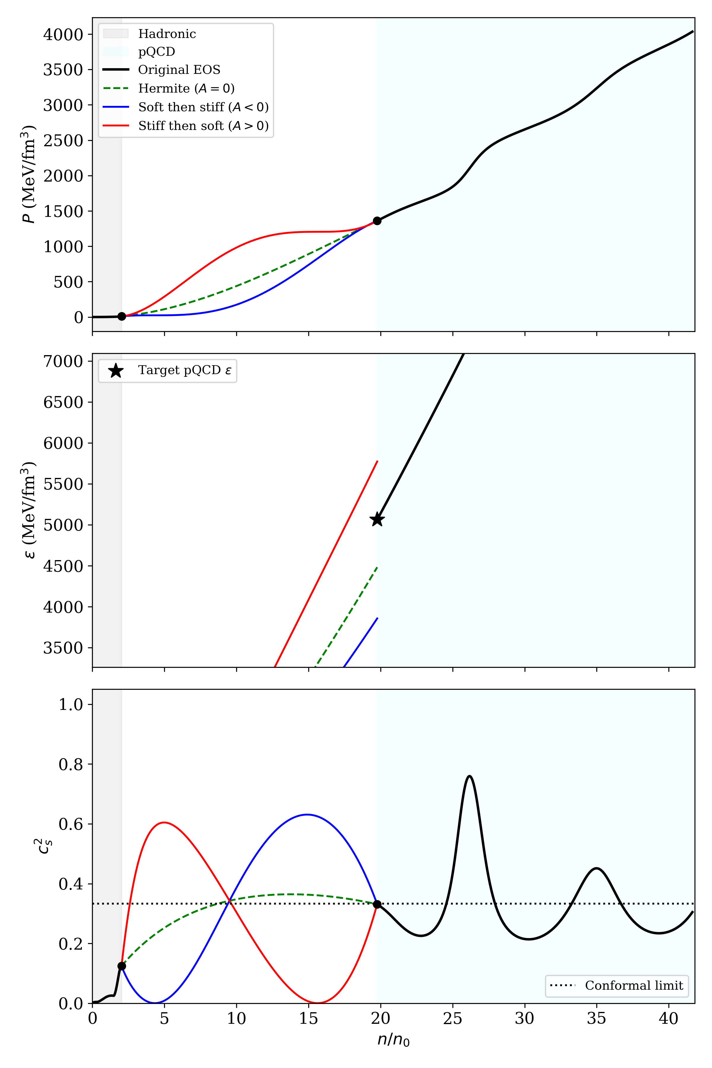
Origin of the cs2 Structure: Peak & Softening
Coupled Boundary Mechanics
• Astrophysical Demand (A > 0): To support 2.0 M_⊙ pulsars (J0740+6620) with a soft low-density hadronic EOS (GW170817 Λ₁.₄ ≤ 580), dense matter MUST stiffen rapidly at 2–4 n₀ (cs² > 1/3, peak ~ 0.6–0.7).
• Thermodynamic Accumulation: dϵ/dn = (ϵ + P)/n ⟹ ϵ accumulates as the integral of pressure. Early high pressure builds up energy density ϵ at an accelerated rate.
• Microscopic pQCD Limit: At high density (μ_B = 2.6 GeV, ~40 n₀), matter becomes conformally soft (cs² → 1/3) with exact endpoint (P_pQCD, ϵ_pQCD).
• Compulsory Softening: If intermediate stiffening persisted, ϵ would drastically overshoot ϵ_pQCD (A > 0). To match pQCD, early stiffening MUST be followed by extended softening!
• Unified Mechanism: The peak and subsequent softening are a thermodynamic necessity reconciling 2 M_⊙ support with pQCD asymptotic freedom.

Slide 15
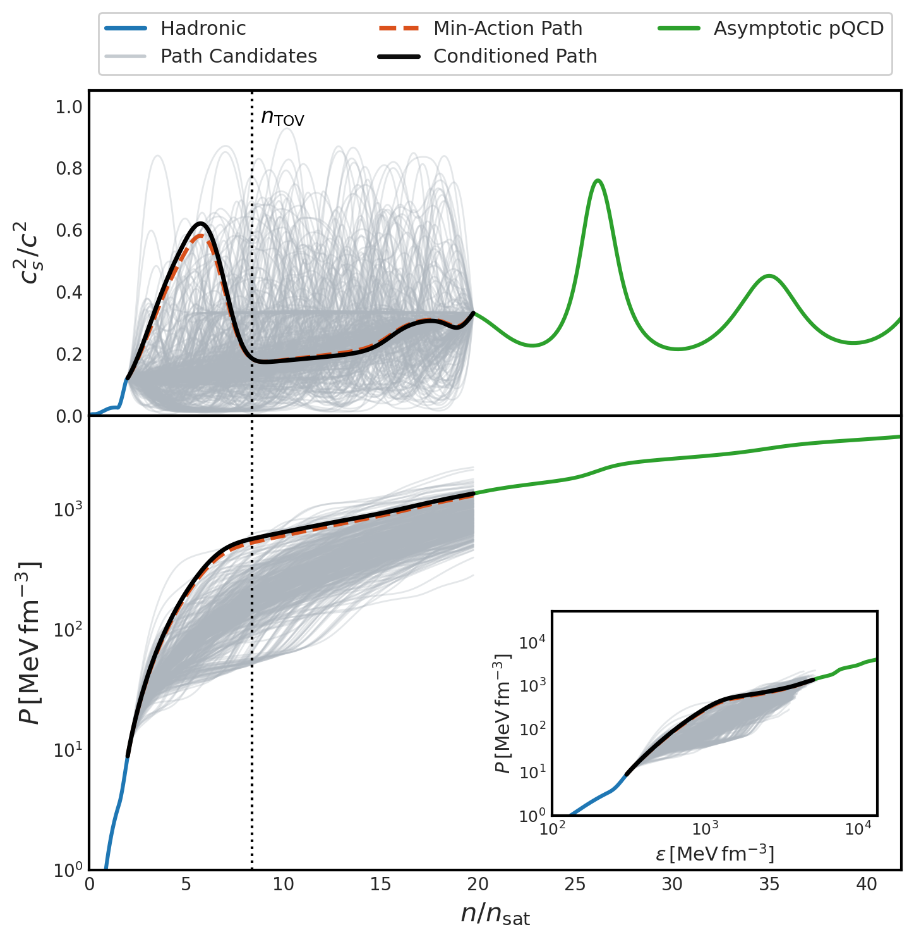
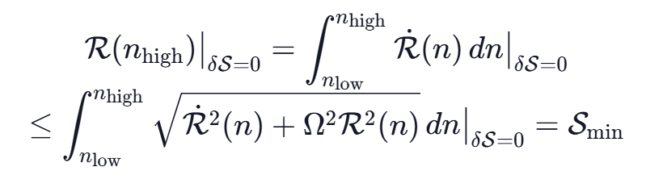
Action-Optimized Construction
Huang, Tang, & Fan (arxiv: 2605.08584)
• Non-Local Boundary Dilemma: Both P and ϵ at high density are non-local path integrals of cs²(n). Unconstrained random sampling has vanishing probability to match both endpoints simultaneously.
• Transverse Residual R(n): R(n) ≈ [ (P - Ptar) - cs,tar² (ϵ - ϵtar) ] / Phigh.
• R > 0 ⟹ cs,rem² < 0 (Instability.)
• R < 0 ⟹ cs,rem² > 1 (Causality Violation.)
⟹ cs,tar² is the unique causal and stable reference.
• Arc-Length Type Action S: S = ∫ [ Ṙ²(n) + Ω² R²(n) ]^(1/2) dn, Ω = 2π / (nhigh - nlow)
Balances local variation Ṙ against cumulative drift R, ensuring

Slide 16
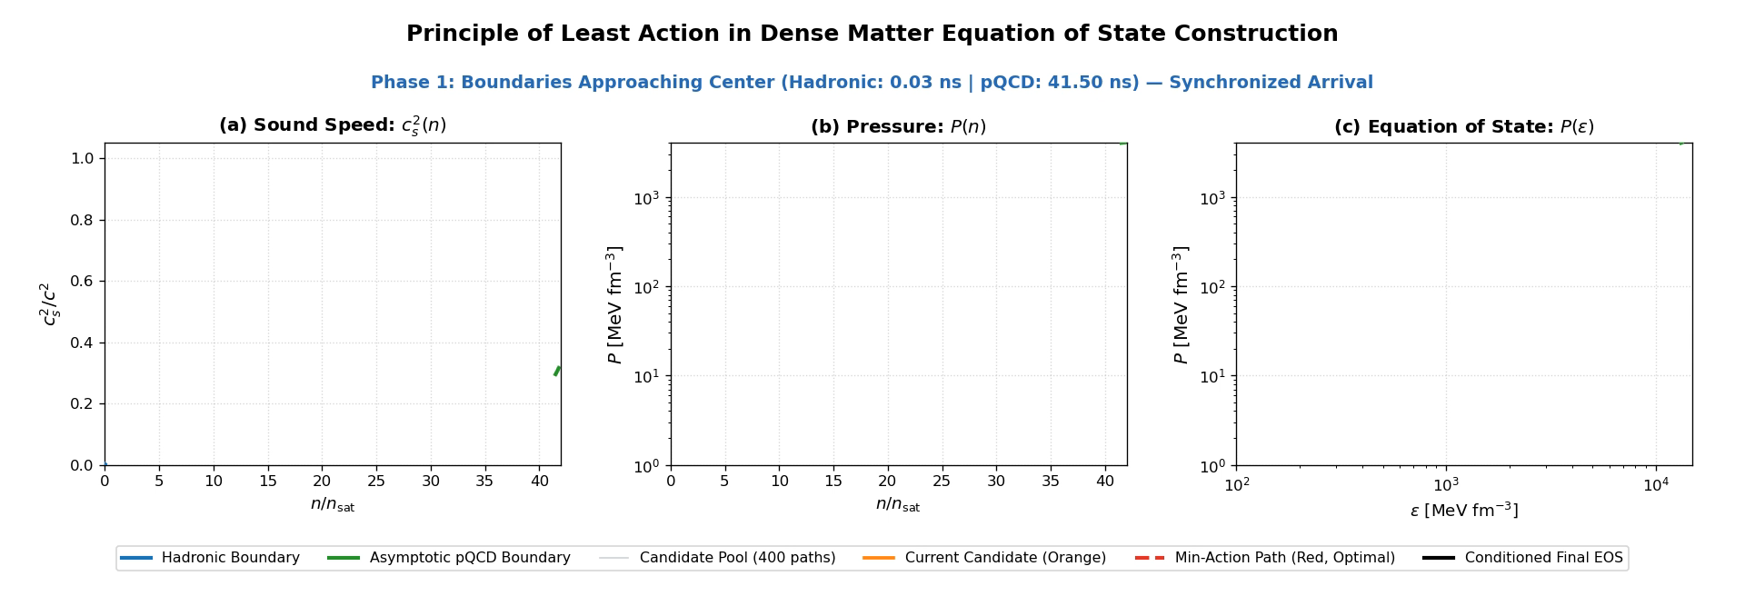
Action-Optimized Construction
cs²(t; A, B) = cs,ref²(t) + A Δcs,base²(t) + B b(t), where b(t) ∝ t(1-t)(2t-1). Starting from (A,B) = (1,0), and stopping at endpoint residual < 10⁻³.
Huang, Tang, & Fan (arxiv: 2605.08584)

Slide 17
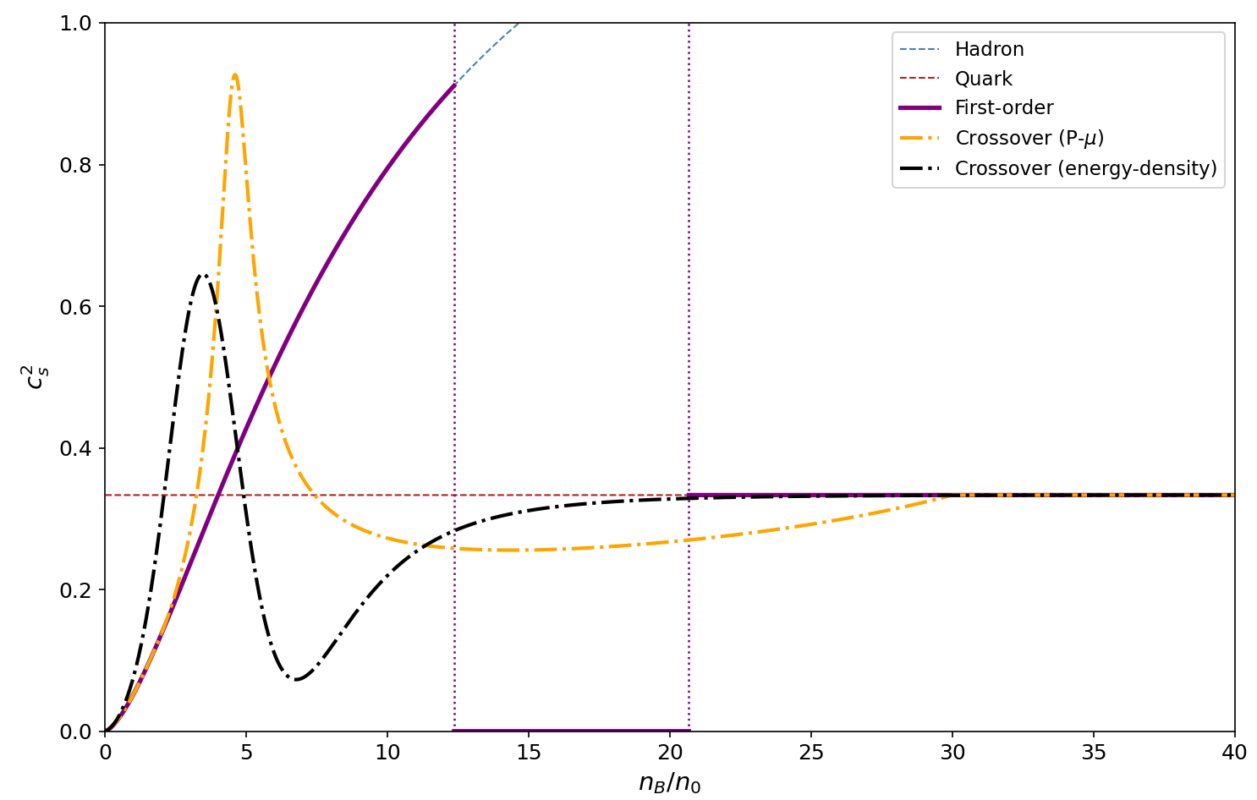
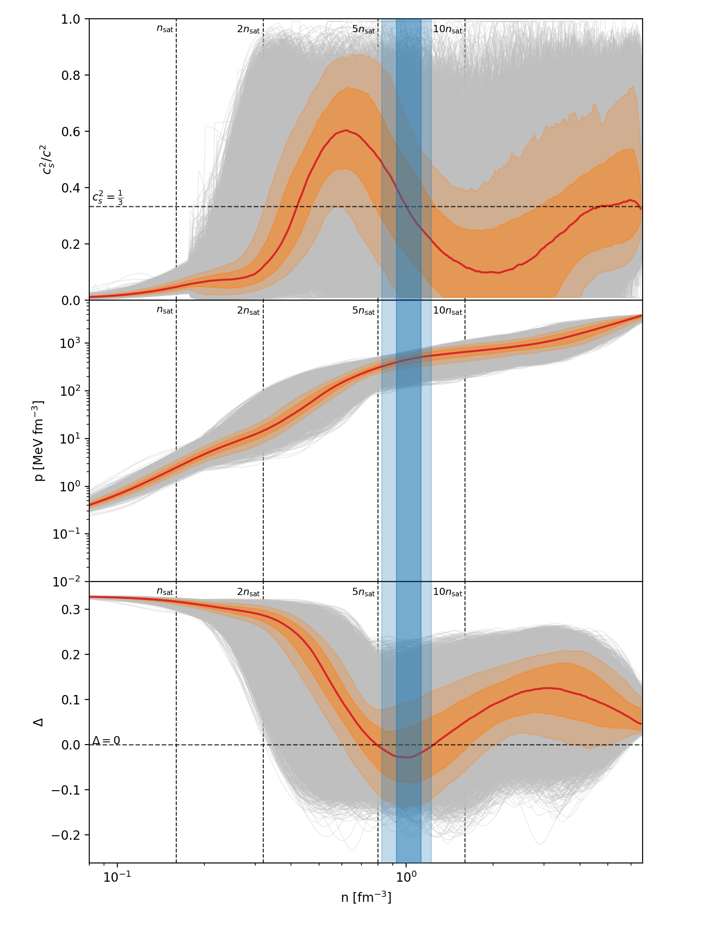
Statistical EOS Realizes a Generalized Quark-Hadron Crossover
• Baseline Models: Hadronic EOS (polynomial) + Quark EOS (MIT bag, B = 210 MeV).
• First-Order PT: Traditional phase transition occurs at chemical potential where P_H = P_Q.
• Crossover Constructions:
- Fixed-boundary: 5th-order polynomial in P-μ space, matched to quark matter at 30 nsat.
- Boundary-free: Energy-density interpolation via w(n) = (n/n_c)^γ / [1 + (n/n_c)^γ] (n_c = 5 nsat, γ = 4).
Δ = 1/3 – P/e

Slide 18
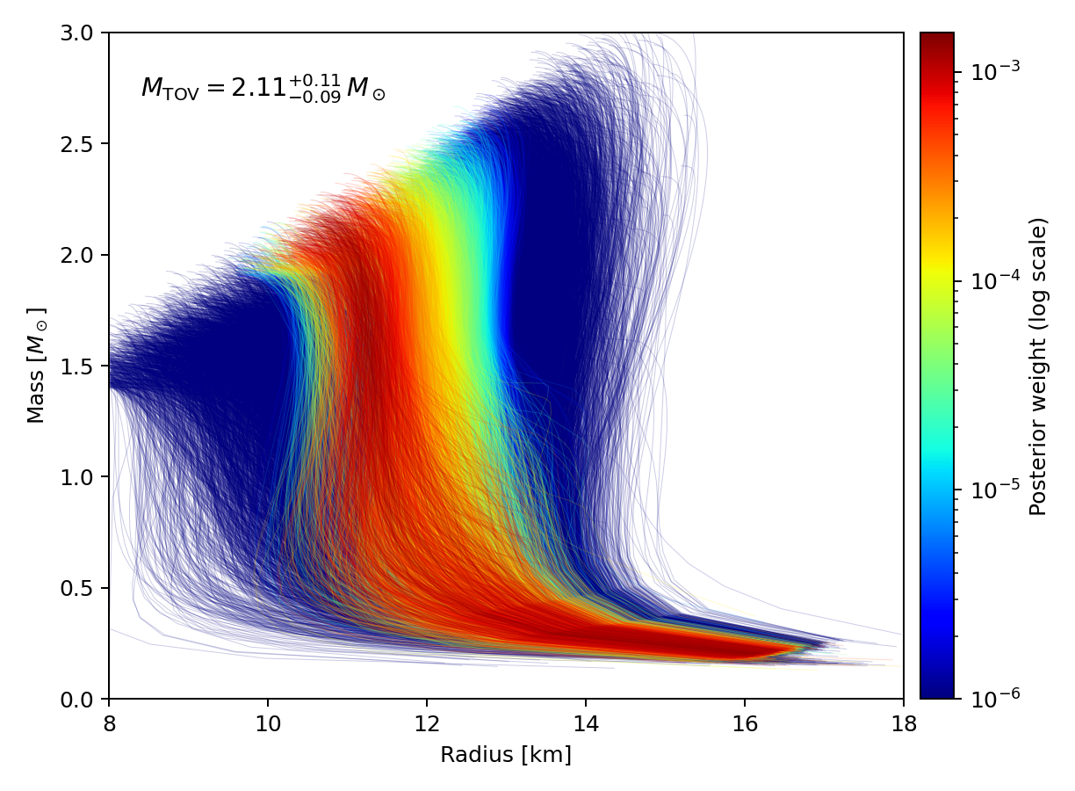
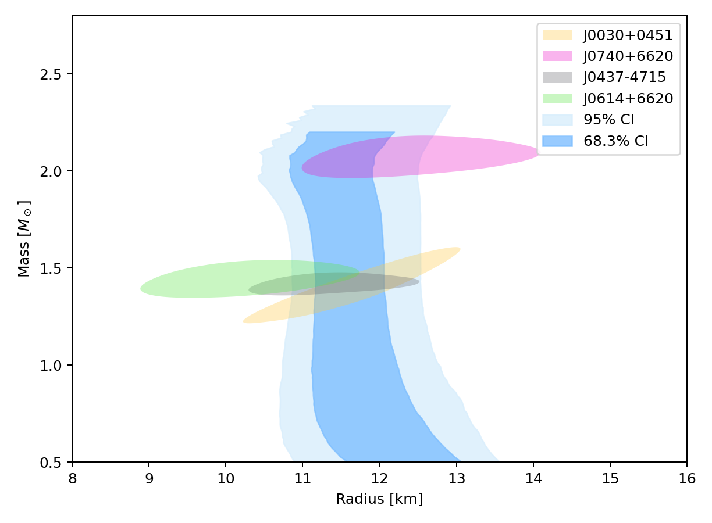
Multi-messenger Constraints
A new observation for PSR J1614-2230
M = 1.937 (+0.012 / -0.013) M_sun
R_eq = 10.06 (+1.25 / -0.87) km

Slide 19
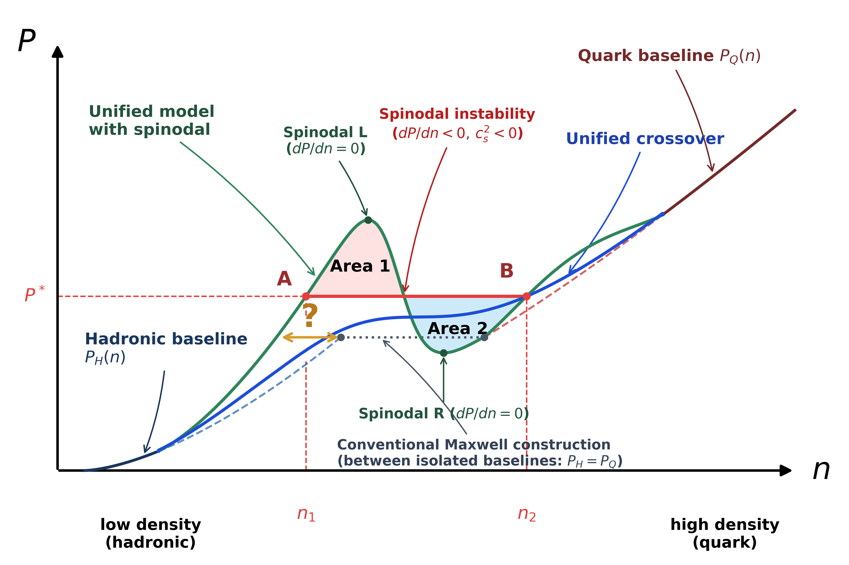
Statistical Evidence: Continuous Crossover vs. 1st-Order PT
Huang & Gao (arxiv: 2609.22450 , Evidence for Continuous Hadron-Quark Transition)
- Unified Framework:
Hadron: Parity Doublet Model (PDM) with chiral partner N(1535) and chiral-invariant mass M_0.
Quark: NJL in Color-Flavor Locked (CFL) phase with pairing gap Δ_CFL.
- Decisive Bayesian Evidence:
Confronting models with observationally constrained non-parametric EOS:
- Δ ln Z = +7.20 (Bayesian factor) over Maxwell 1st-order phase transition.
- Δ ln Z = +5.16 over Poly5 fixed-boundary crossover.
- Origin of Nucleon Mass:
Inferred M_0 = 834(+28/-92) MeV proves that substantial nucleon mass originates from chiral-invariant mechanisms rather than spontaneous chiral breaking alone.
- Pairing Gap:
Inferred Δ_CFL = 88(+28/-22) MeV reveals moderate color superconducting pairing in cold dense quark matter.

Slide 20
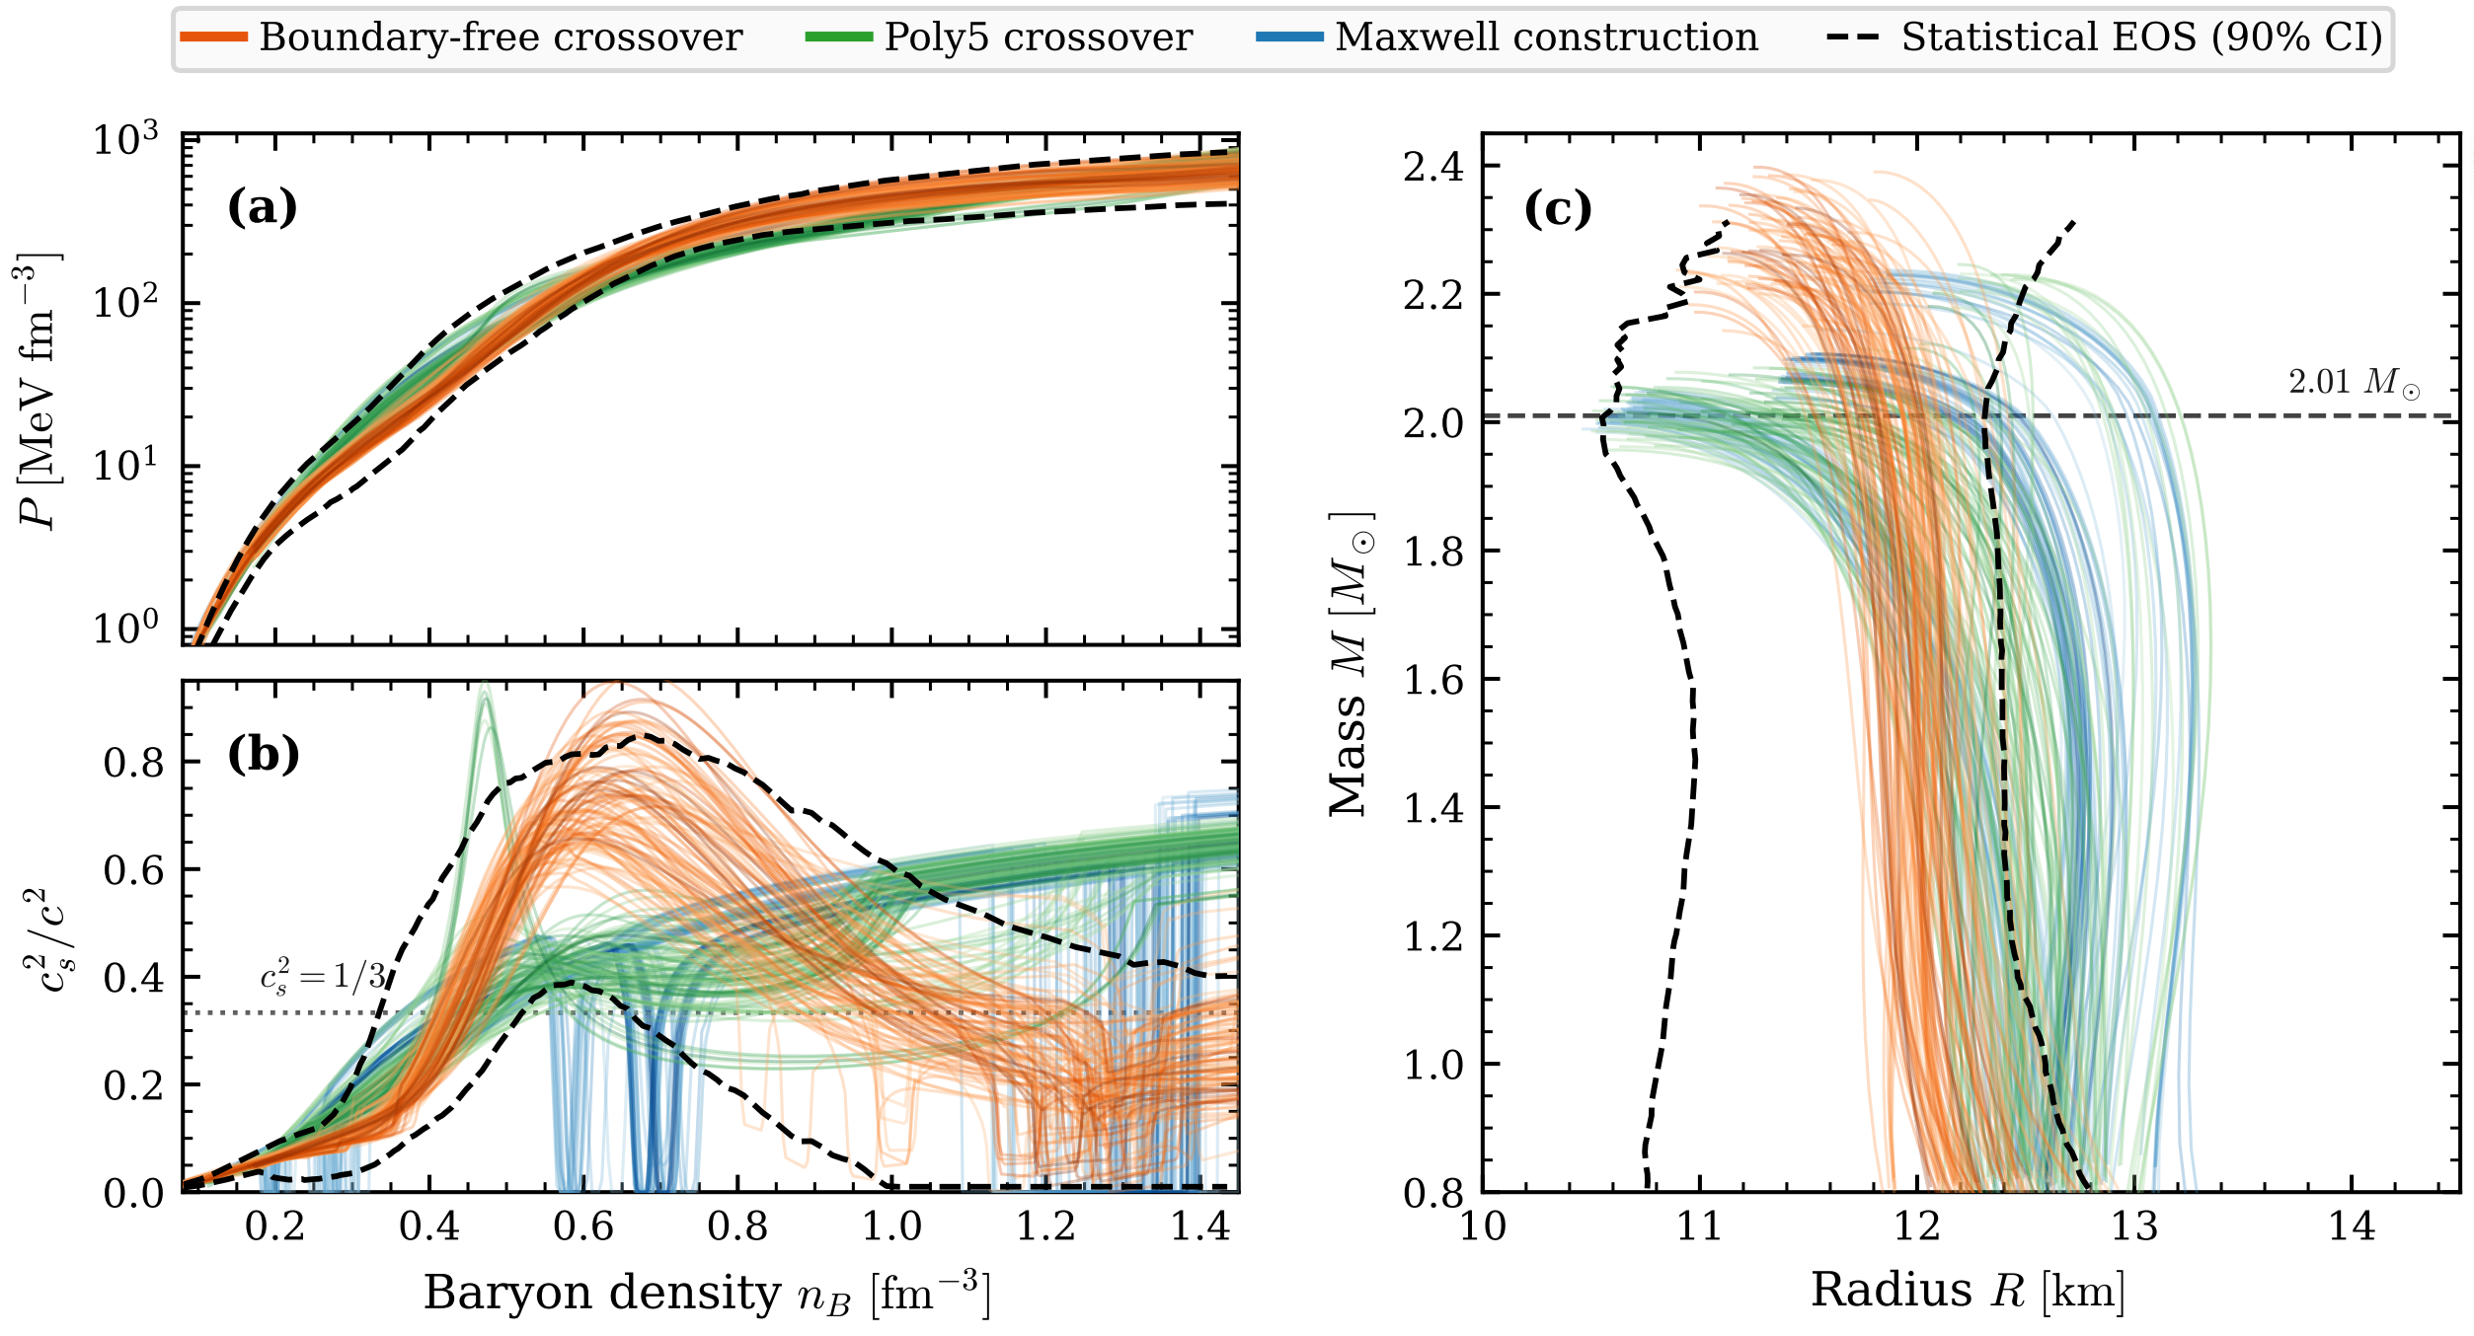
Statistical Evidence: Continuous Crossover vs. 1st-Order PT

Slide 21
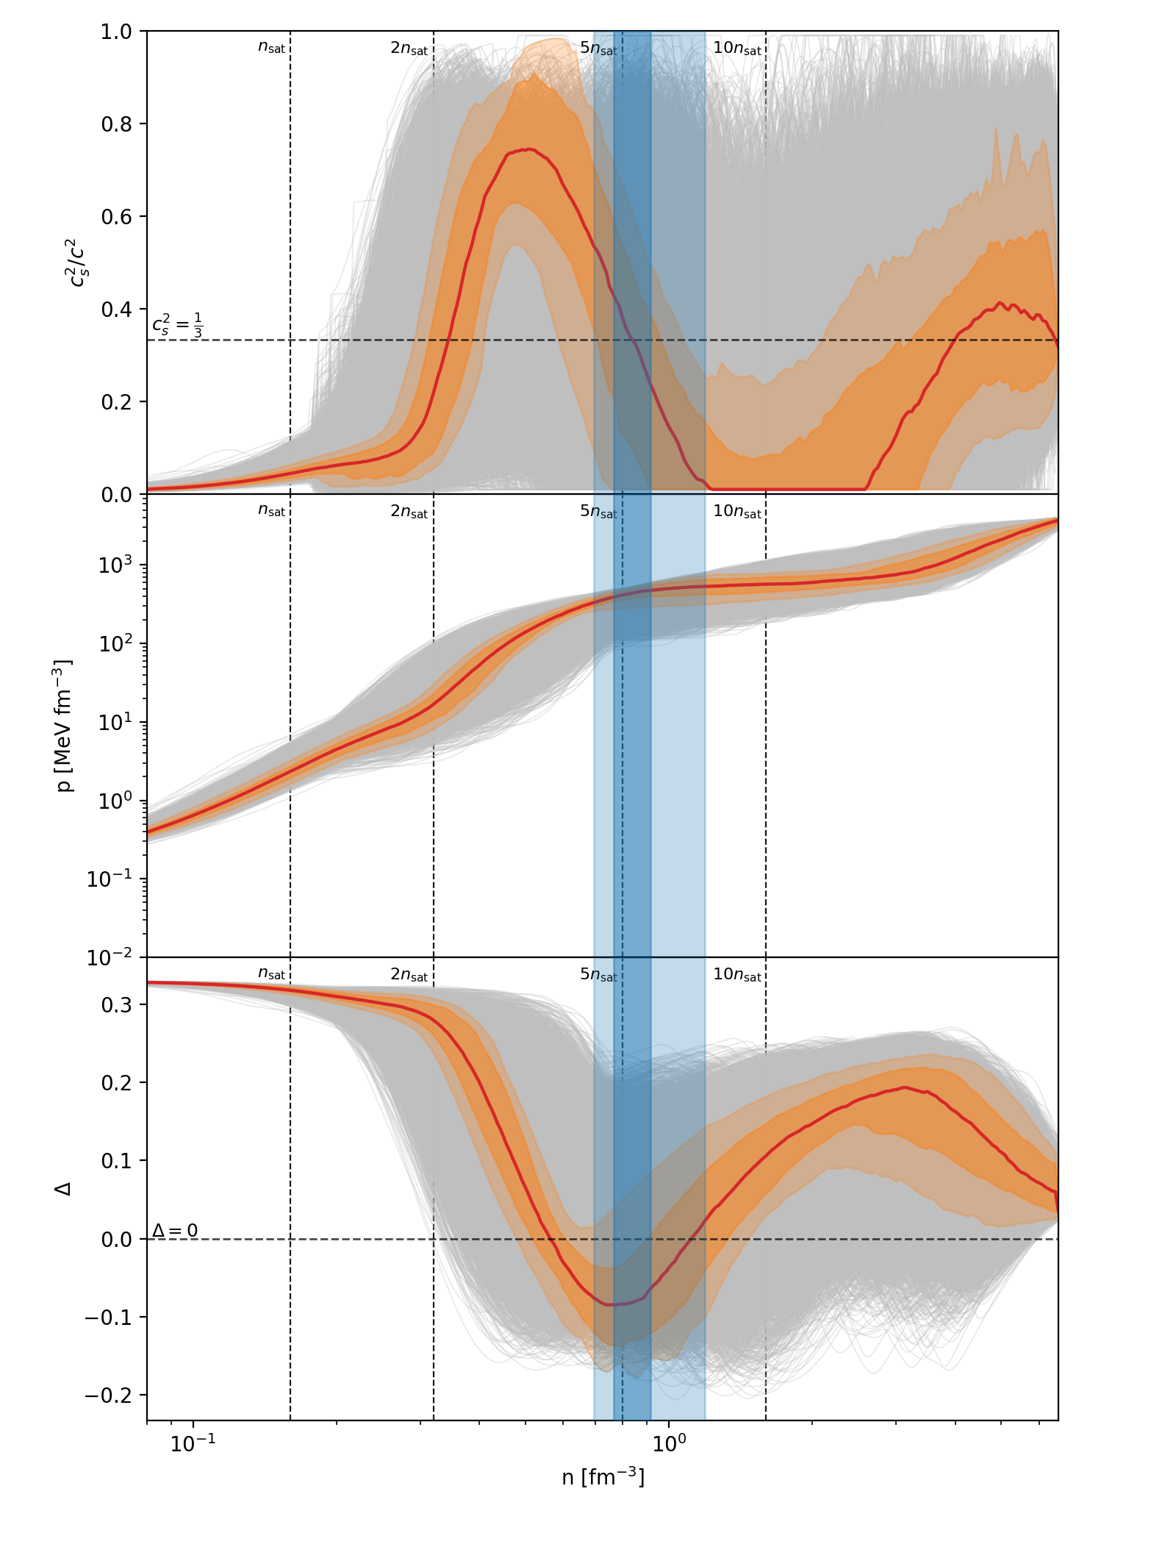
Result with ~2.5M_sun NS observed
Assuming a neutron star (NS) with a mass of 2.5 M_sun is observed with a mass uncertainty of 0.08 M_sun. It is more like a first-order phase transition.
The maximum mass of non-rotation NS (M_TOV) is important!

Slide 22
Outline
● Multi-messenger Information for Neutron Star
● The Non-parametric Equation of State Realizes a Generalized Quark-Hadron Crossover
● Explore the QCD Phase Boundary with Kilohertz Gravitational Wave

Slide 23
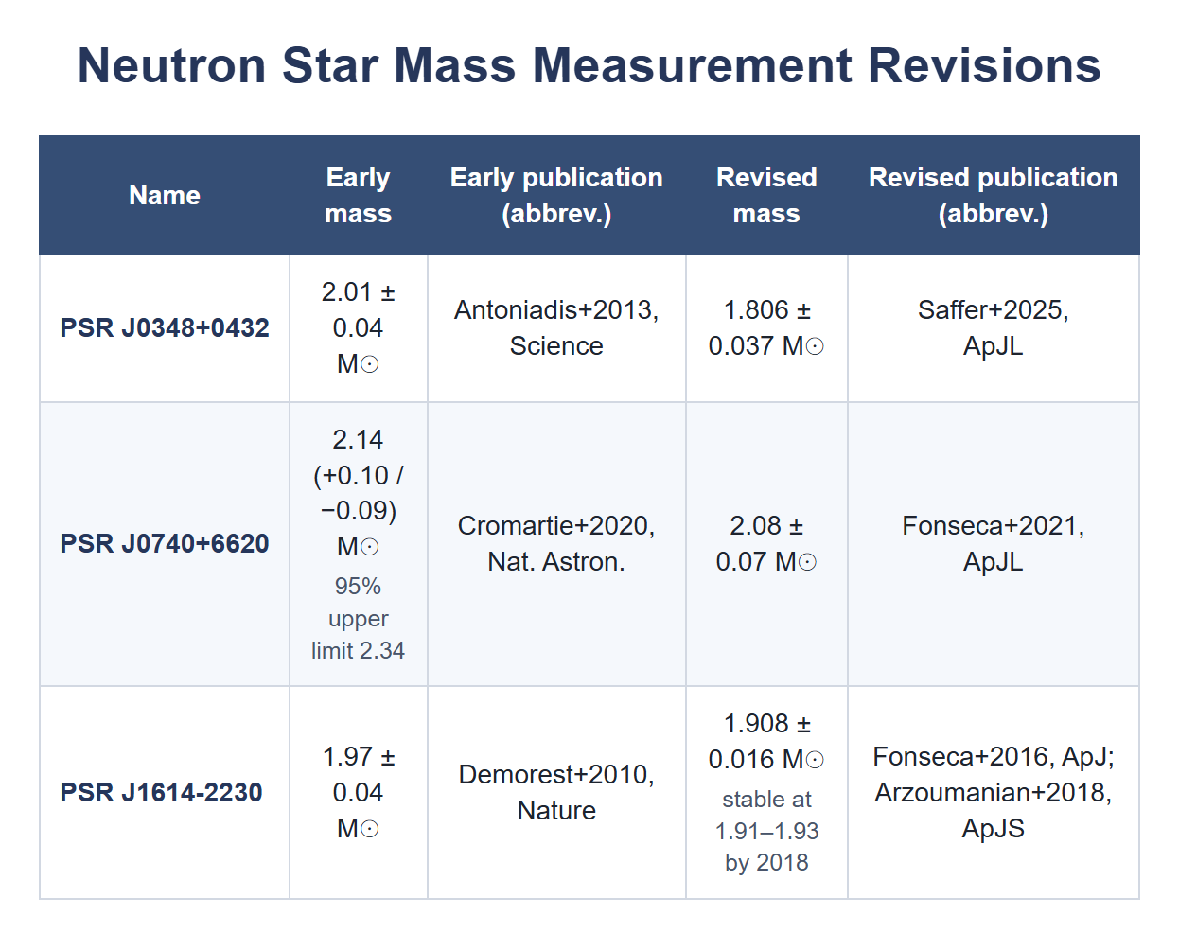
Why M_TOV Cannot Be Directly Observed in Astronomy
Observational Roadblocks
• Lower Bound Only: Radio timing of massive pulsars (PSR J0740+6620 at 2.08 ± 0.07 M_⊙) provides a strict lower bound, not the true collapse limit M_TOV.
• Rotational Centrifugal Masking: Fastest candidate pulsars (PSR J0952-0607, f = 707 Hz, 2.35 ± 0.17 M_⊙) receive ~15–20% centrifugal support, obscuring non-rotating M_TOV.
• M_TOV may not reach: The theoretical calculation of M_TOV is derived from the TOV equation; however, there is no guarantee that such a neutron star can actually form.

Slide 24
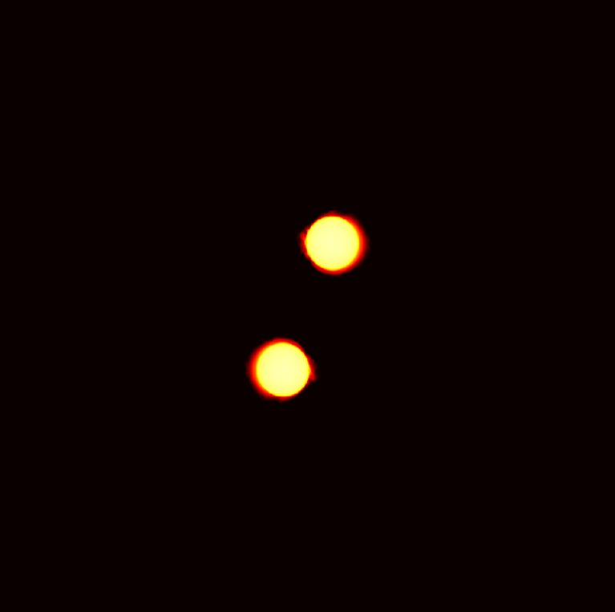
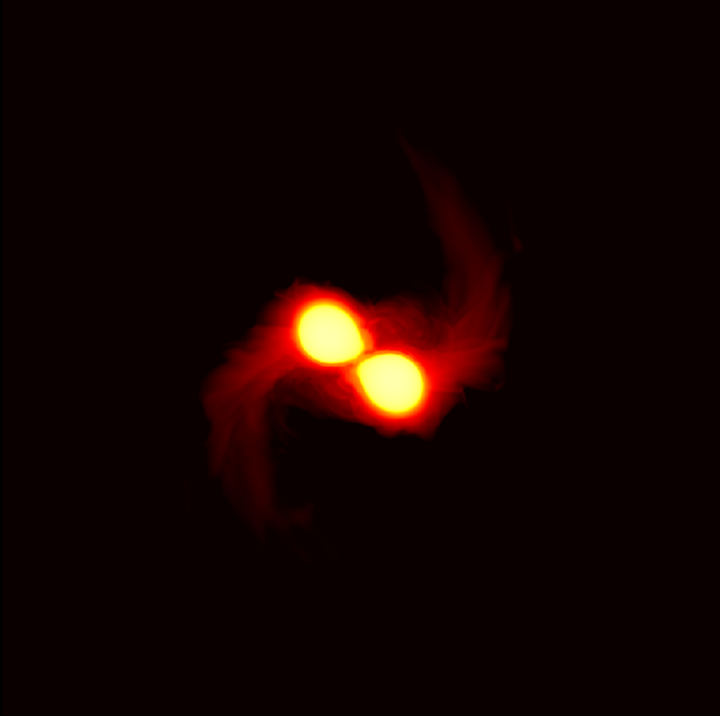
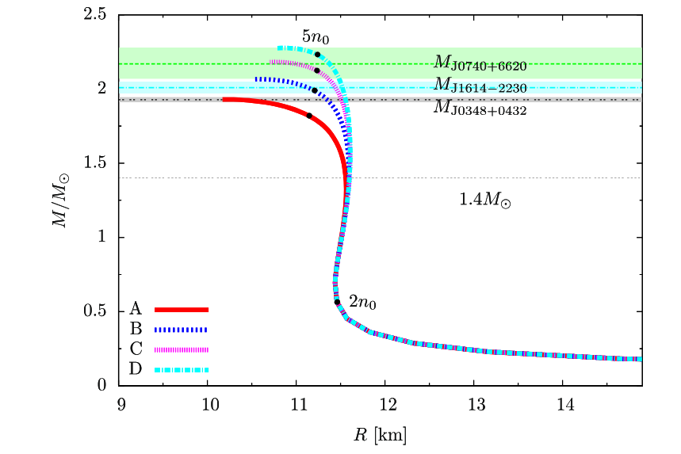
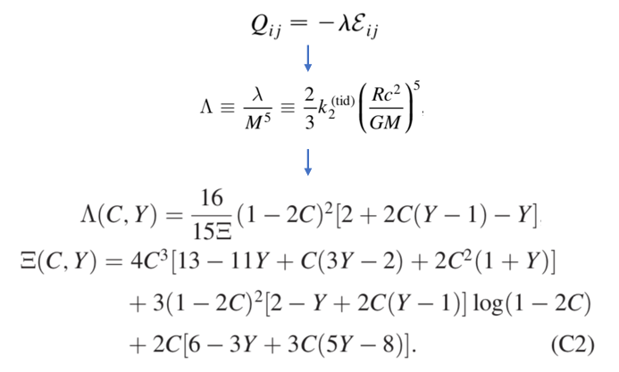
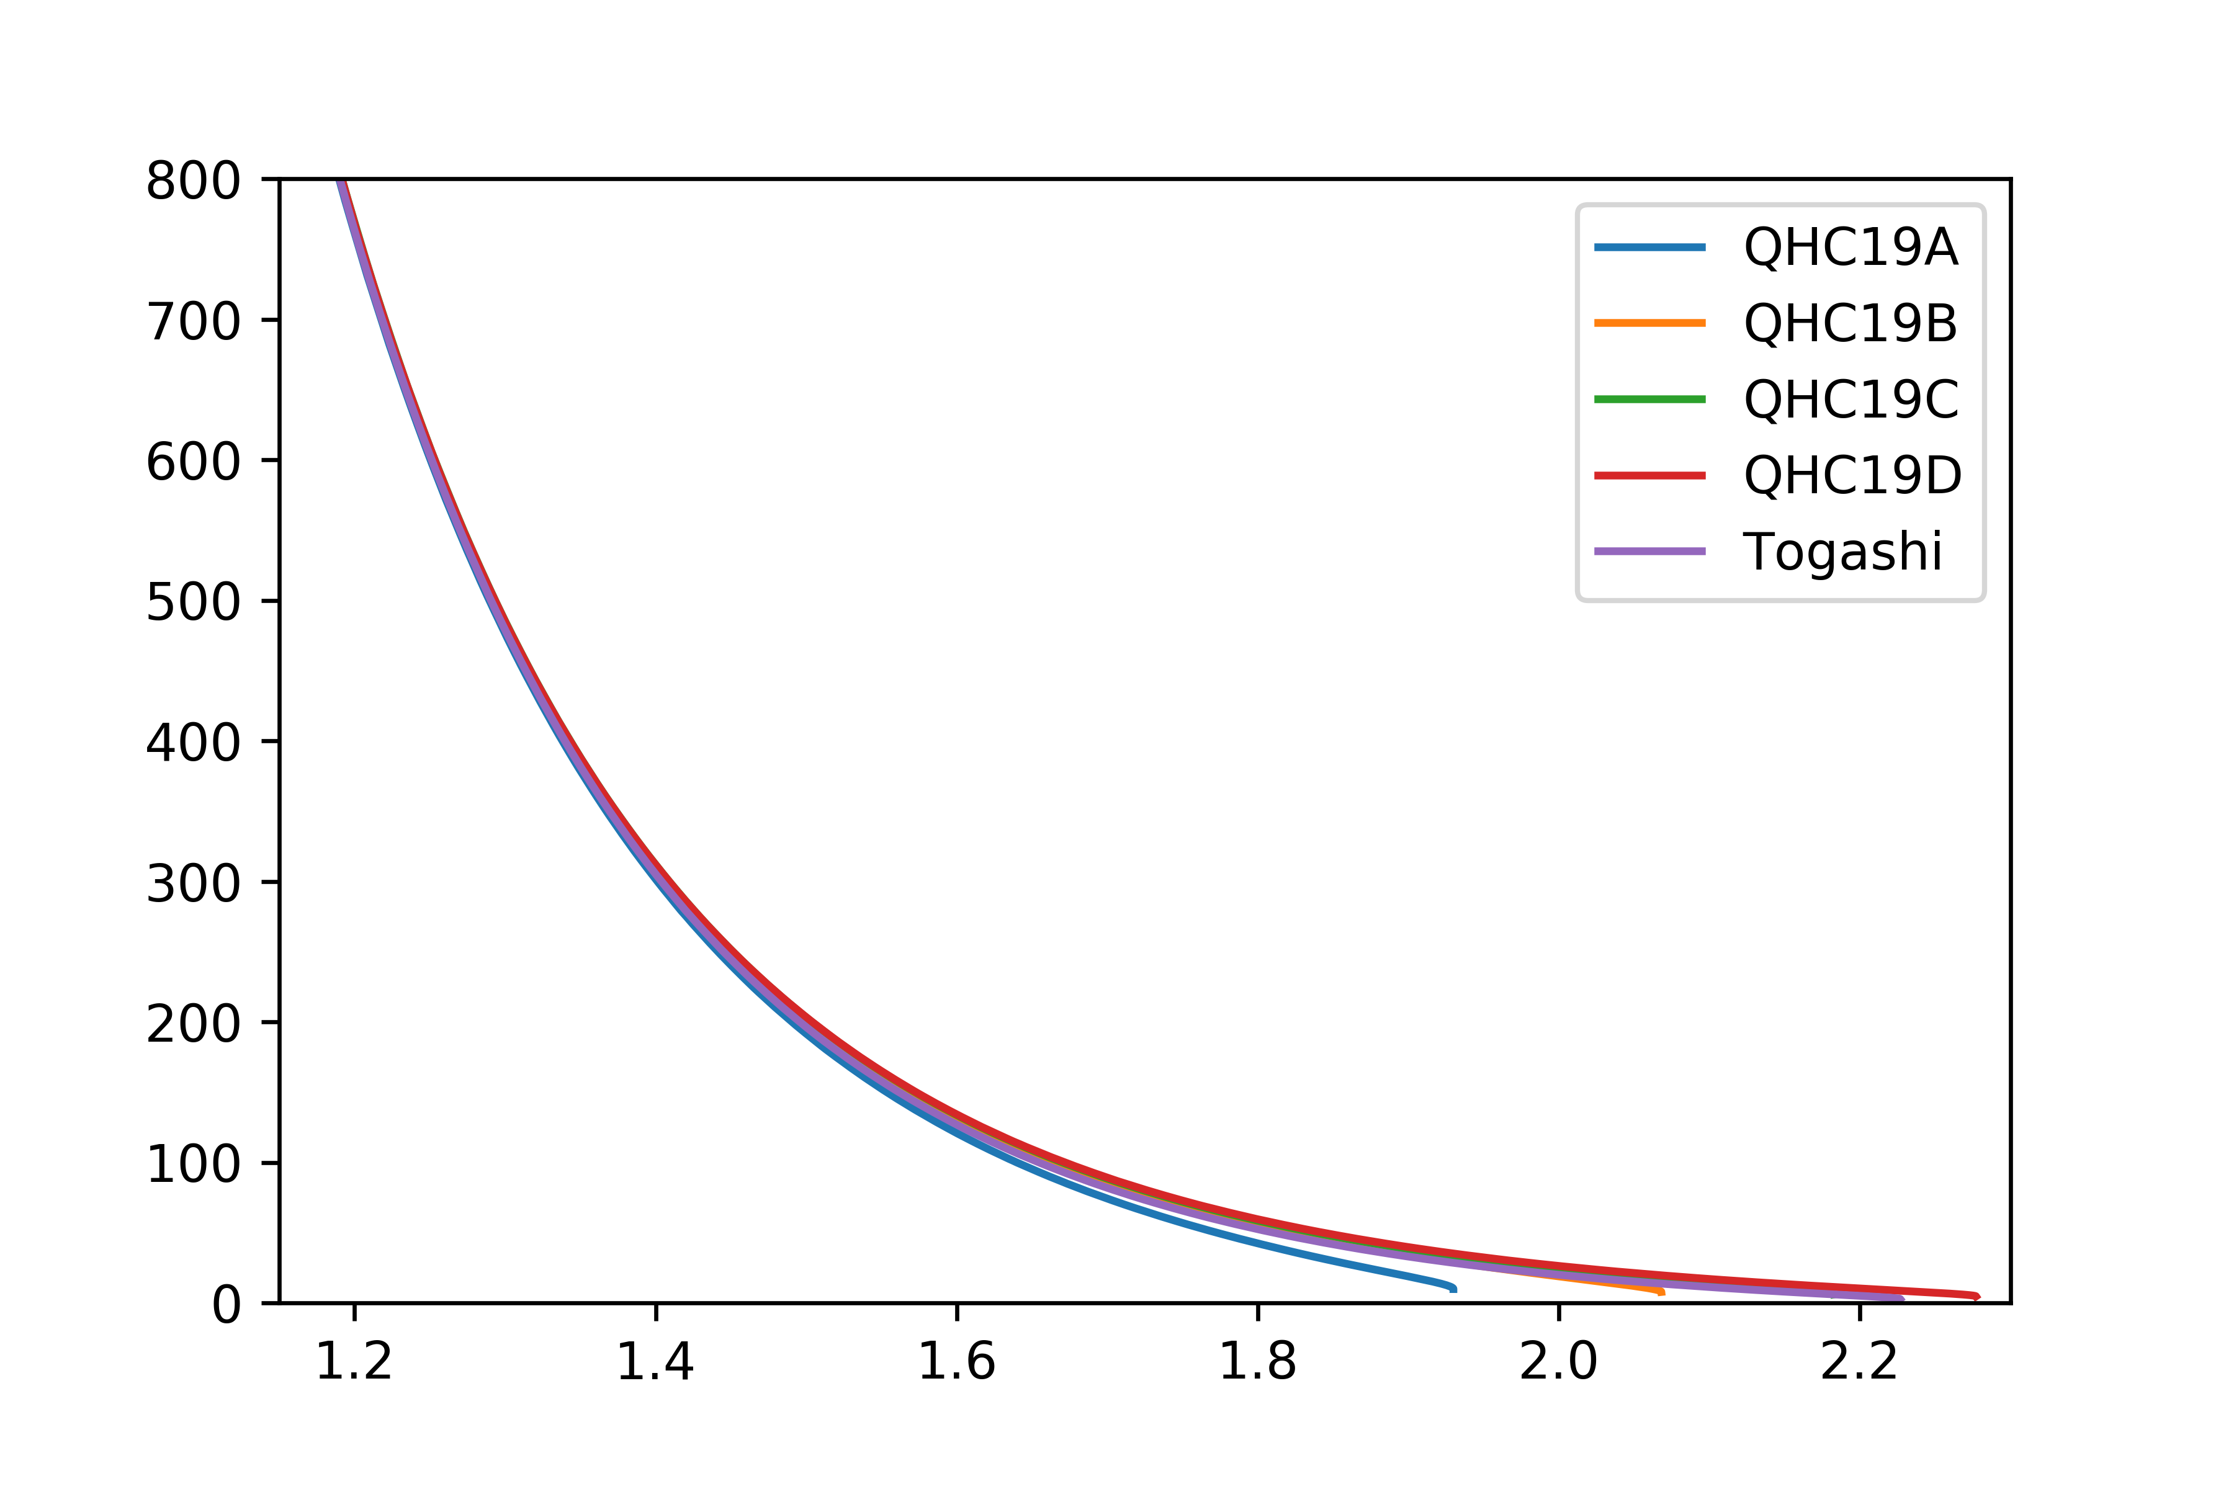
Quadrupolar tidal deformability
∨
Strongly correlated with the compactness(C) of NS
Not sensitive to the state of matter near the center
M
QHC19 EOS (Quark-Hadron crossover)

Slide 25
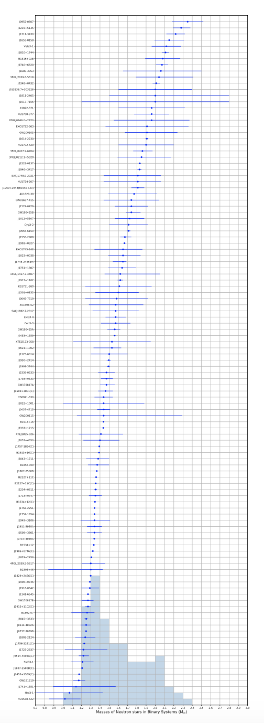
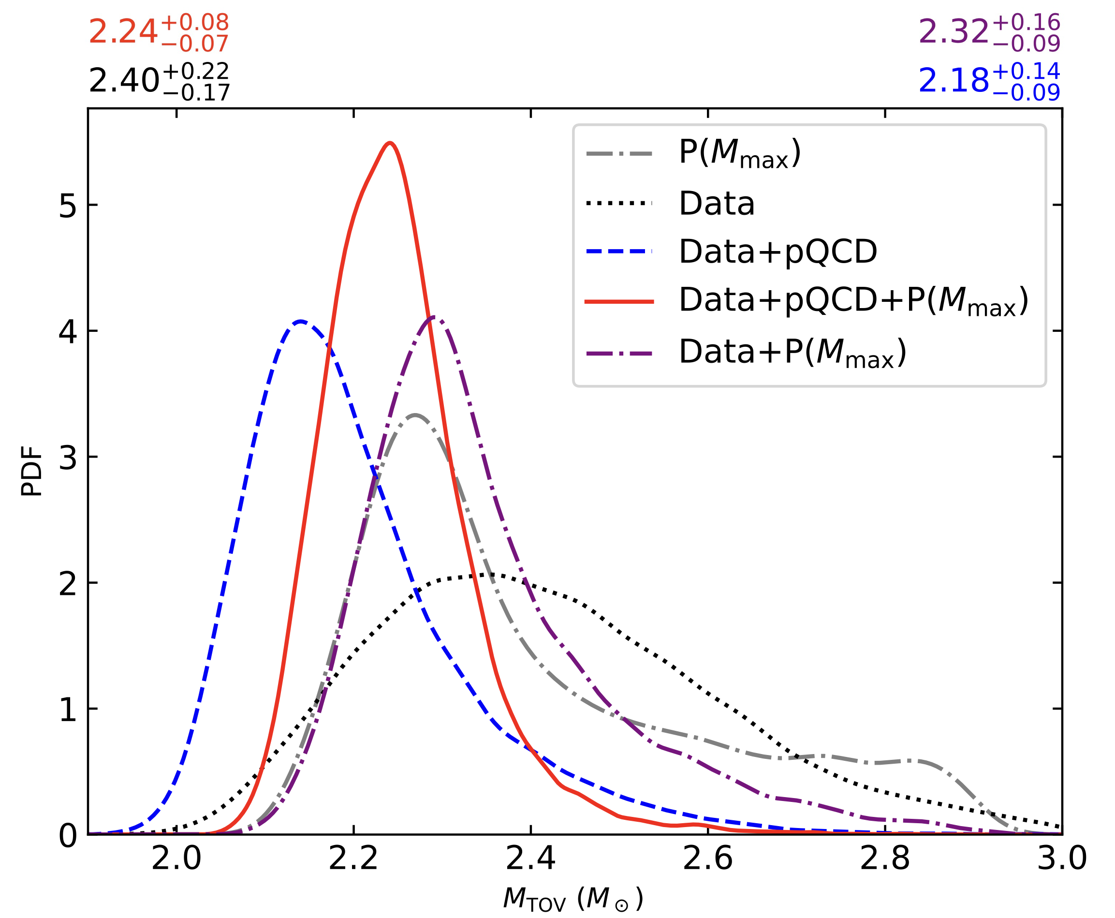
Maximum mass of non-rotating NS
Fan et al. 2024 PRD: GW170817+NICER+χEFT+pQCD+mass function P(Mmax)+Bayesian inference yields a M_{TOV} at a precision of ~3%.

Slide 26
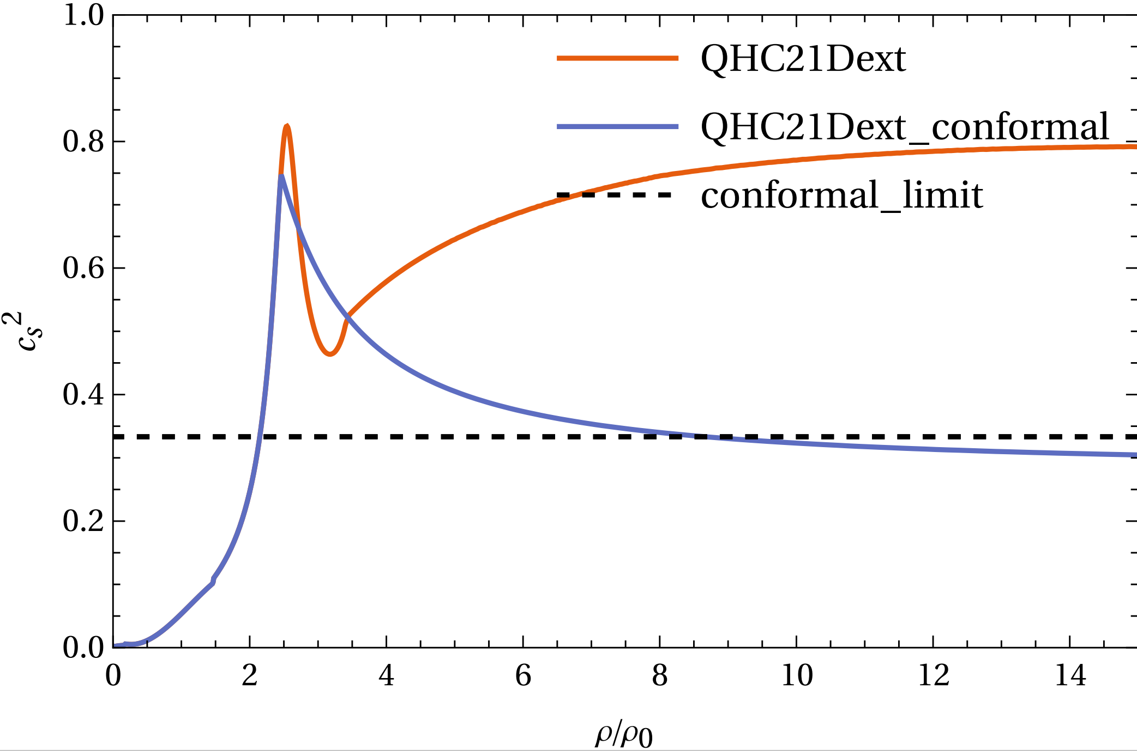
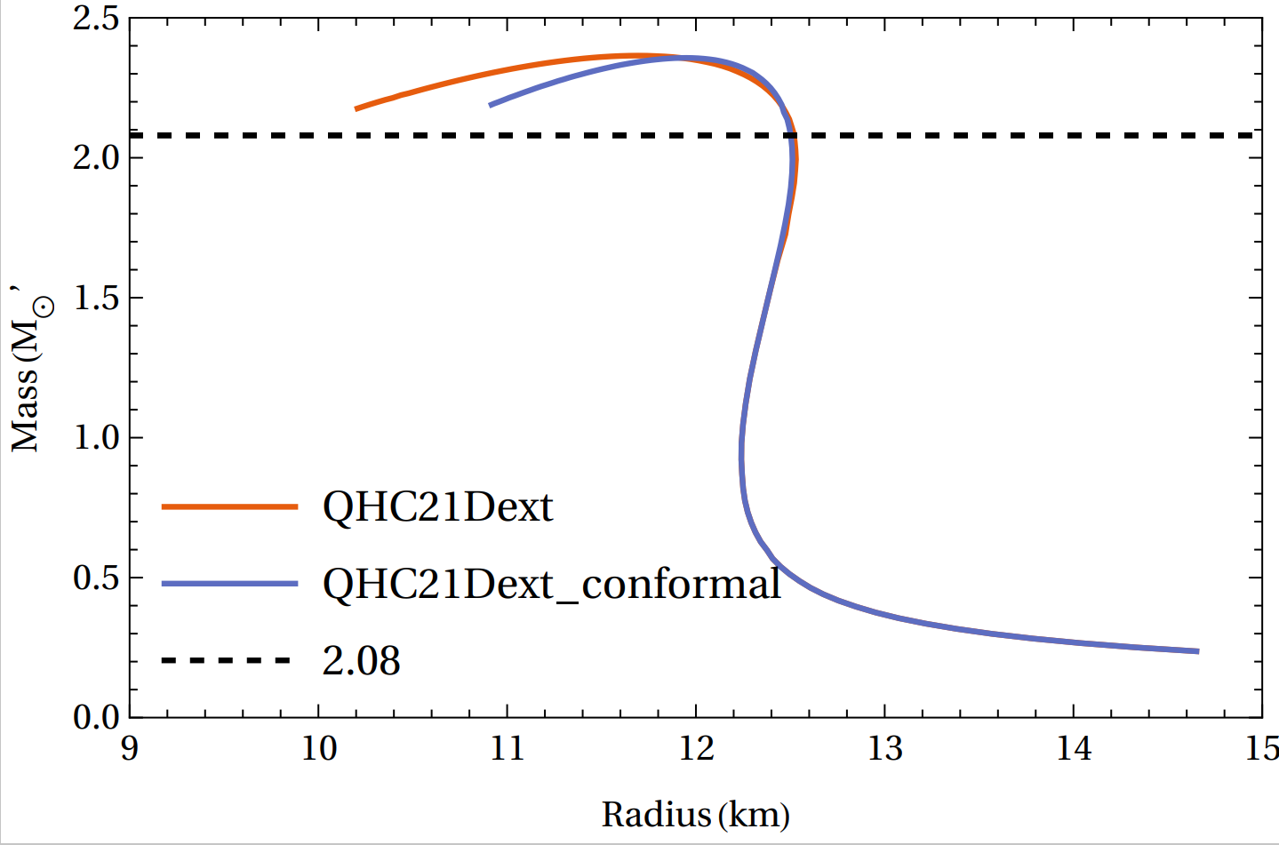
Degeneracy
Very different sound-speed profiles can yield nearly the same neutron-star mass–radius relation, which is why pQCD input is essential when discussing matter near the cores of massive neutron stars.
How can we know more about the state of matter near the center of NS?
NS in equilibrium Dynamical merger

Slide 27
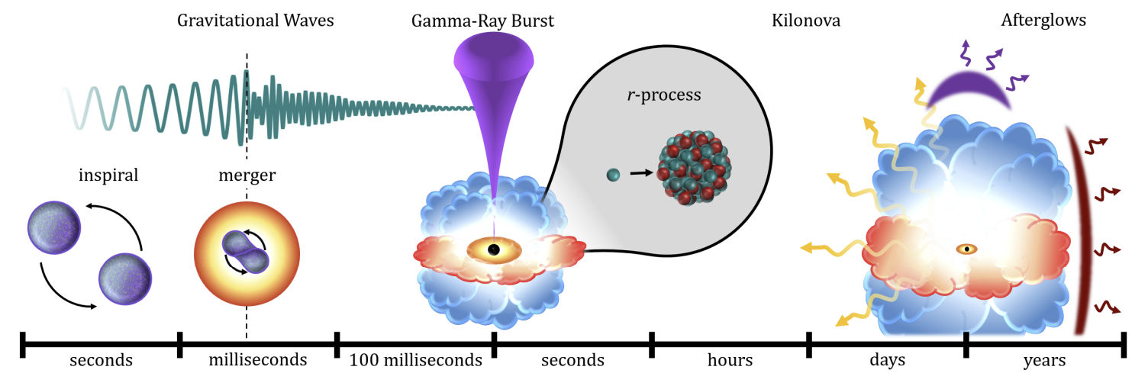
Binary Neutron Star Merger
Neuweiler et al. arxiv:2510.14850
Exotic matter? (hyperon, quark...)
Finite temperature (high temperature and high chemical potential)?
Neutrino effect?
Magnetic fields?

Slide 28
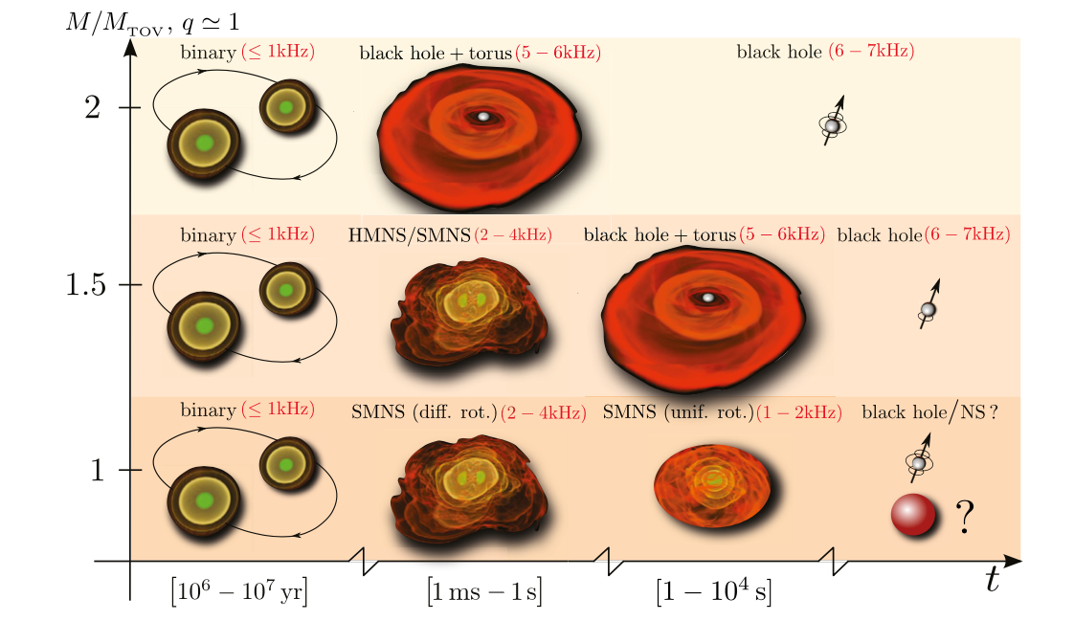
Binary Neutron Star Merger
Baiotti et al. (2017)

Slide 29
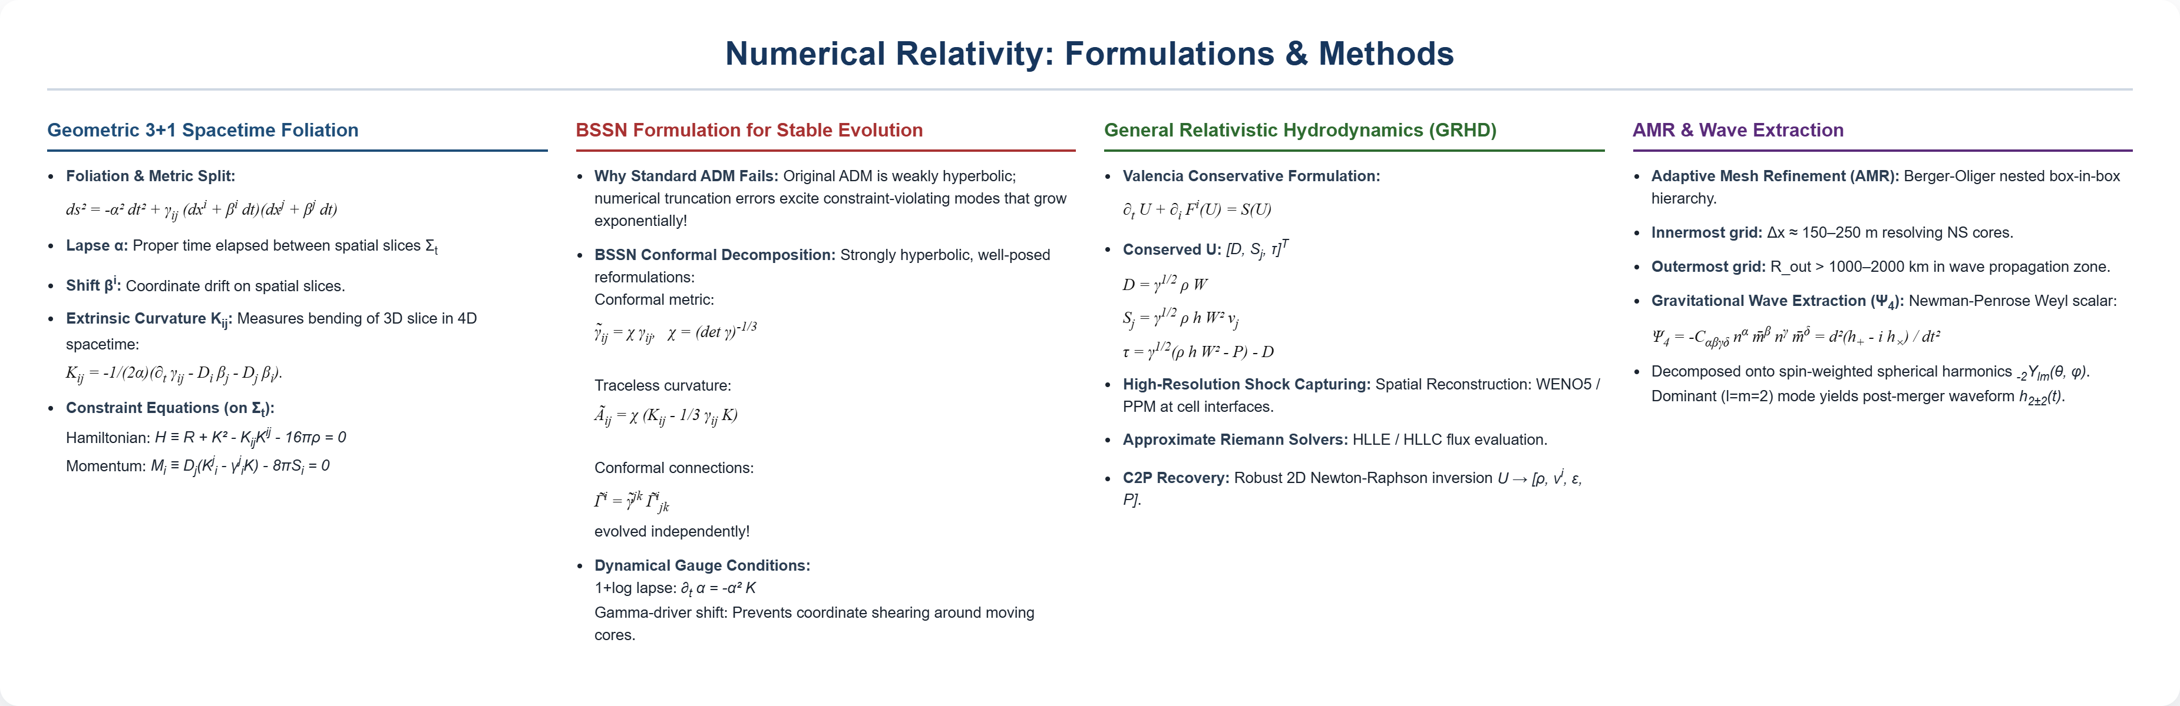
Numerical Relativity: Brief Introduction

Slide 30
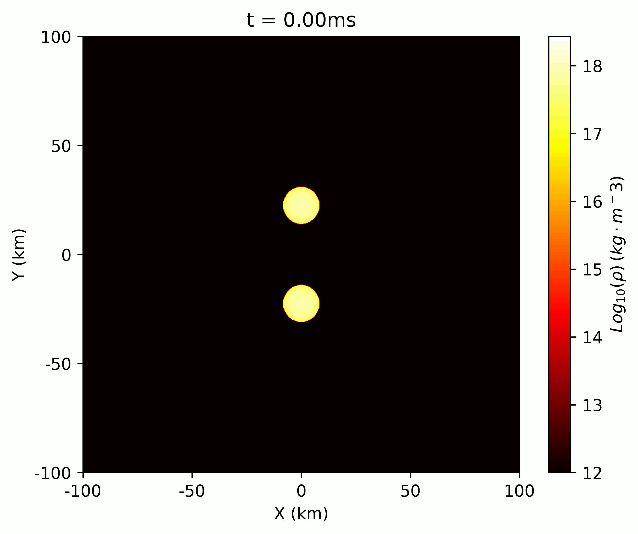
Binary Neutron Star Merger

Slide 31
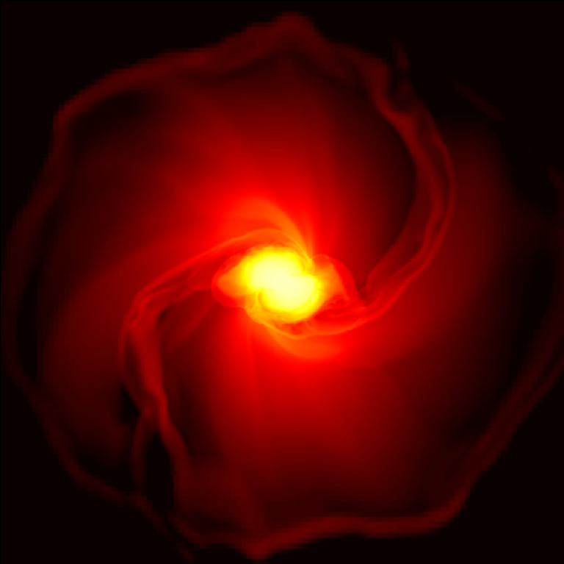

Binary Neutron Star Merger
Inspiral
Post-merger
Numerical simulation(GRHD) result for binary neutron star merger

Slide 32

Gravitational wave
Post-merger
Transient phase
(peaks in GW spectrum)
Post-merger
Quasi-stationary
(instantaneous frequency)
Early inspiral
(mass, spin)
late inspiral
(tidal deformability))
BH (quasi-normal mode)

Slide 33



Post-merger
Rotational curve
NS 1
NS 2
without viscosity
Shibata and Kiuchi (2017) with artificial viscosity
Touched
Not touched, small radius high contact frequency

Slide 34


GW Spectrum
Hanauske et al. PRD 2017
GW spectrum during the BNS merger, several peaks were present because of the post-merger oscillation. f1 and f3 vanish quickly as they are coupled with radial oscillation. f2 is fully rotation-driven.

Slide 35


Post-Merger GW Uncertainties under Multi-Messenger Constraints
Huang & Baiotti (Class. Quantum Grav. 2026)
• Multi-Messenger Calibrated Initial Data: Confronting full 3+1 GRHD simulations with 82 EOSs strictly constrained by multi-messenger data (radio pulsars, NICER, GW170817) and theoretical bounds (χEFT, pQCD).
• Dramatically Narrowed Frequency Scatter: Multi-messenger EOS constraints compress predicted post-merger peak frequency scatter from > 500 Hz down to ~100 Hz, significantly enhancing detection prospects!
• Quasi-Universal Peak Frequency Relation: (f₁ + f₃) / 2 ≈ f₂,mean
Directly couples secondary oscillation peaks (f₁, f₃) to the dominant quadrupolar post-merger mode (f₂).
• Blueprint for 3G GW Detectors: Establishes accurate target frequency bands for Einstein Telescope (ET) and Cosmic Explorer (CE) to observe hadron-quark phase transitions in the 2030s.

Slide 36

QCD phase diagram
Fujimoto et al. 2023; Fukushima and Hatsuda 2011
How the hadron-quark transition takes place in zero temperature but high chemical potential?

Slide 37


QCD phase diagram
· For $n_{B}< 2n_{0}$, the dominant interactions occur via a few (~1-2) meson or quark exchanges, and description of the matter in terms of interacting nucleons is valid.
· For $2n_{0}<n_{B} <(4−7)n_{0}$, many-quark exchanges dominate and the system gradually changes from hadronic to quark matter.
· For $n_{B}> (4−7)n_{0}$, the matter is percolated and quarks no longer belong to specific baryons.

Slide 38


1PT vs. QHC
Strong 1st phase transition
Quark-hadron crossover

Slide 39


QHC in BNS Merger
Two versions of QHC19 EOS based on Togashi EOS:
· Smooth crossover
· Small deviation near quark saturation density(2 n0)
· Peak/bump sturcture (stiffer than the hadronic baseline)
· Same radius for low-mass neutron star
· The stiffening from crossover can support more
massive neutron star

Slide 40



QHC in BNS Merger
Huang et al. PRL 2022
· The EOS properties are well shown in the f2 frequency.
· Lower $f_{2}$ in low-mass BNS merger, independent of the height of such peak.（on the contrary with the first-order phase transition）

Slide 41





QHC in BNS Merger
Third-generation gravitational wave dectector
2030s
Chatziioannou et al. 2017
SNR~5 Δf2 < 20Hz
Srivastava et al. 2022

Slide 42


Constraint on strong 1PT
The phase transition (if so) is expected to occur either at densities below the central density of the least massive neutron stars, or near the center of the most massive ones.
Tang, Huang, Fan PRD (2025)

Slide 43


Neutron-quark star
Observationally confirming quark degrees of freedom in stable NSs usually requires signaling a transition from conventional hadronic stars to hybrid stars with quark cores. In other words, the scenarios where quarks are always or never present in NSs cannot be distinguished with observations of stars in equilibrium.
Neutron-quark star: quark effects emerge at masses below the lowest observed neutron-star mass

Slide 44


Neutron-quark star
QHC-stiff
Crossover start
QHC-soft
Deconfined
Not fully Deconfined
No f2-mode GW
M1.25 M1.375 M1.48 M1.55 M1.60 M1.65 M1.70
Mass
>20ms >20ms >20ms >20ms 2.0ms 1.8ms 1.7ms
Lifetime

Slide 45

Neutron-quark star
The rapidly stiffening of EOS could be observed by combining the observation of BNS in inspiral and post-merger

Slide 46



Post-merger GW energy vs. frequency

Slide 47
Phase boundary?
One critical point? Two critical point? No phase boundary?

Slide 48
Conclusion
• Current constraints on the NS EOS have been significantly tightened by combining gravitational-wave data with electromagnetic observations, together with fundamental boundary conditions from chiral effective field theory at low densities and perturbative QCD at high densities.
• Non-parametric approaches enable us to explore the EOS space without imposing specific functional forms, thereby uncovering potential structures in the EOS. From an action-based perspective bridging the crust directly to pQCD, the results reveal a pronounced intermediate sound-speed peak (cs,peak² ~ 0.67) followed by extended softening, favoring a generalized quark-hadron crossover realized inside massive NS cores, which is decisively supported over first-order phase transitions.
• Observations of stable neutron stars have inherent limitations, as the true collapse limit M_TOV cannot be directly observed and global stellar properties remain insensitive to the innermost core. Numerical-relativity simulations of binary NS mergers are therefore indispensable, where dynamical compression and post-merger kilohertz gravitational waves (particularly the dominant f₂ oscillation) break static core degeneracy.
Multi-messenger Observation --- Numerical Relativity --- Nuclear Physics

