Slide 1
To do

Slide 2
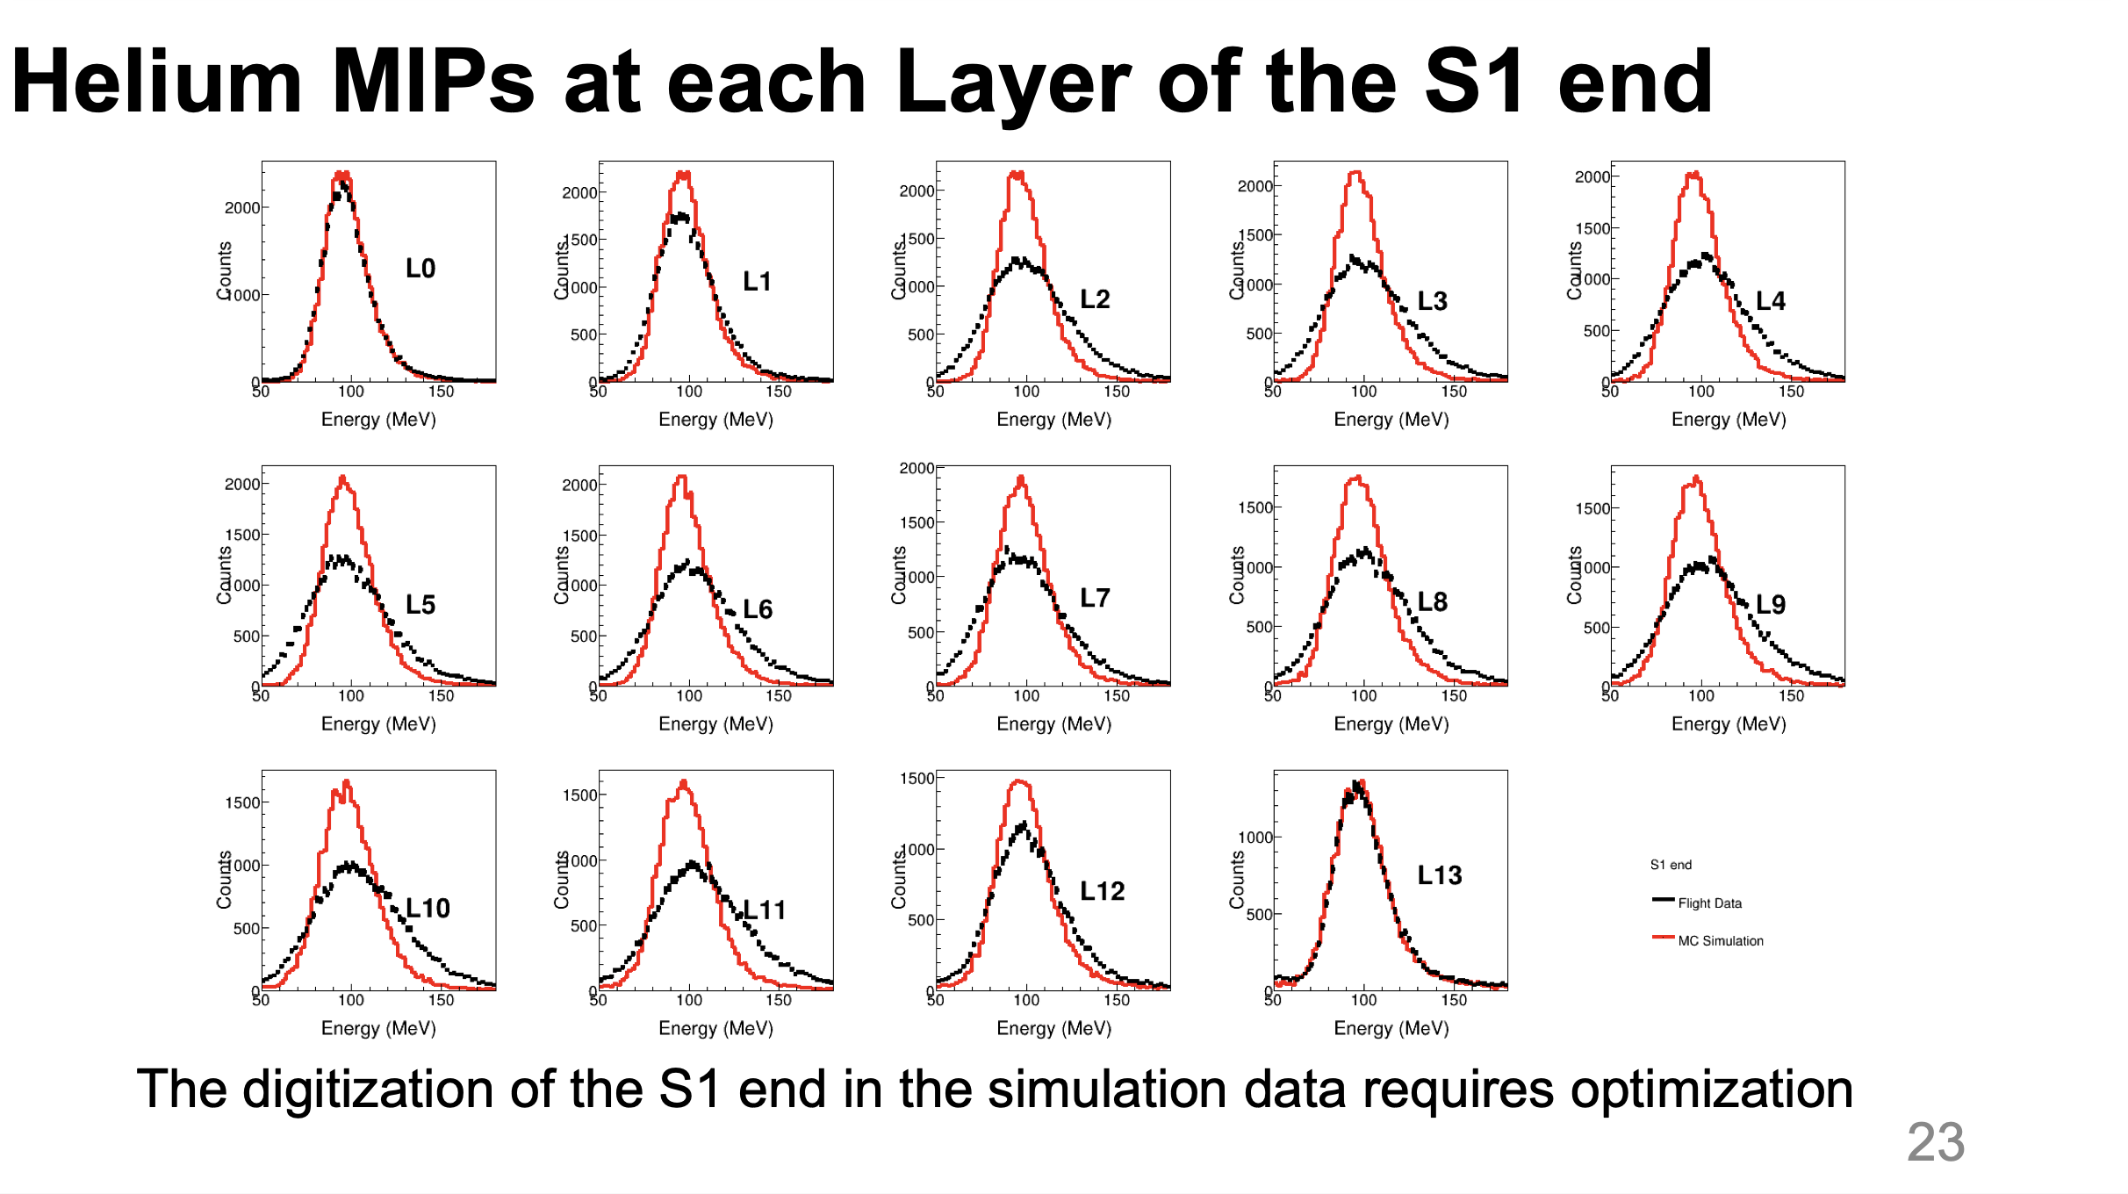
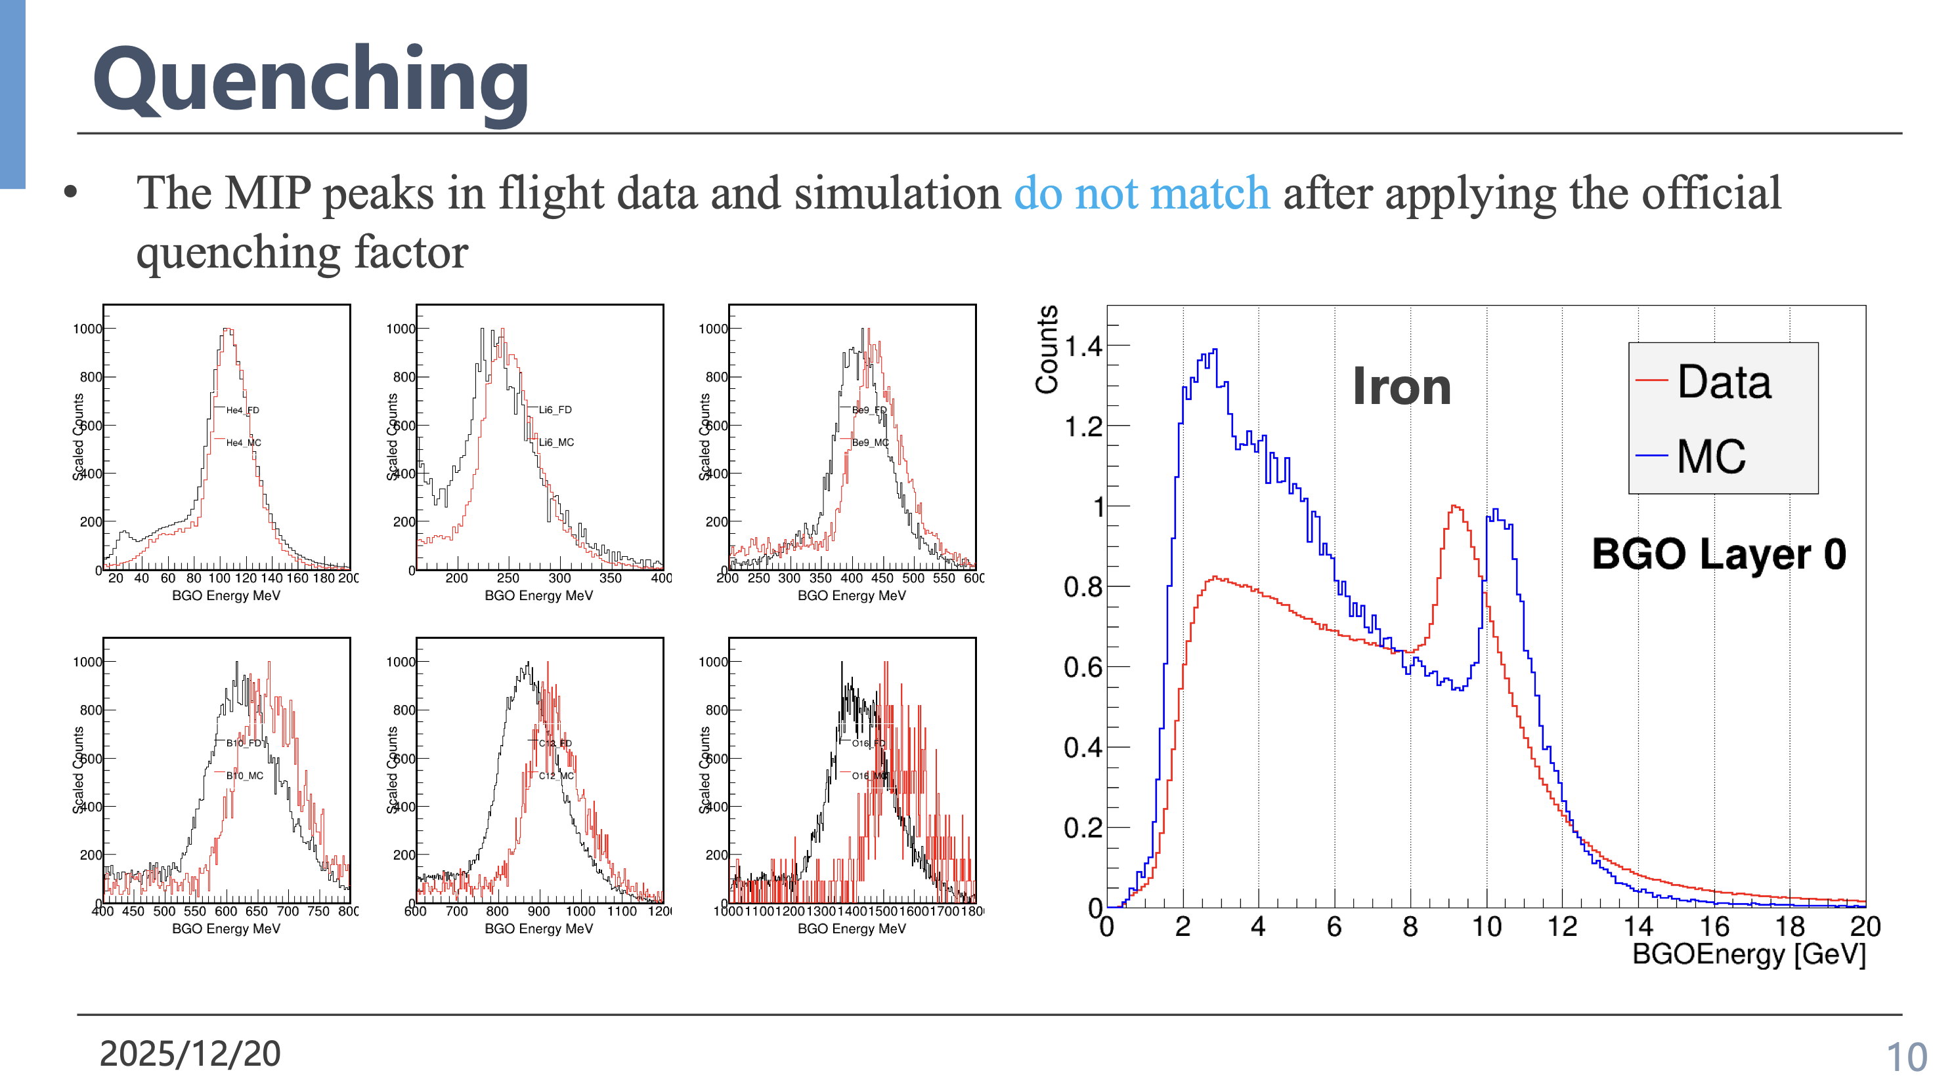
To do... I
Calibration and Data re-production
Fix the calibration parameters and production process
trial production ONE YEAR data ?
Time: 15th Feb?
Digitization
Quenching factor

Slide 3
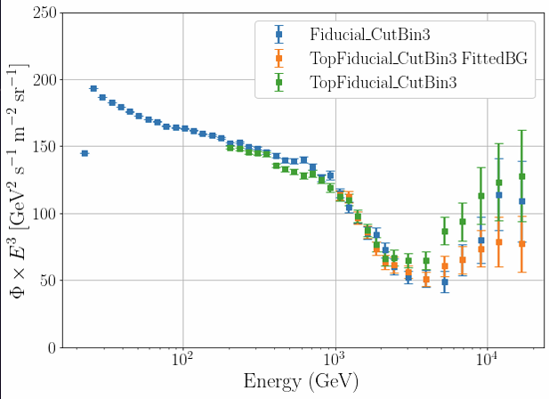
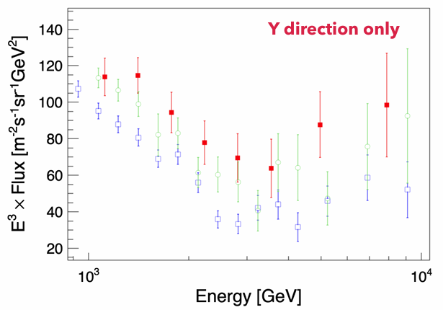
To do... II
TeV electron/positron
Increase acceptance
Fiducial of 2017
Top fiducial
Side incident
How to merge?
More MC samples to evaluate the contamination
Geant4
Fluka
Total counts ?

Slide 4
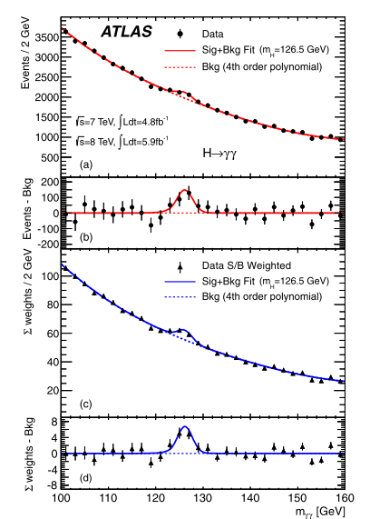
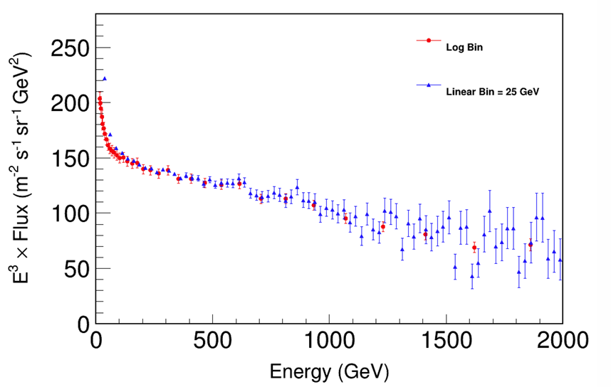
To do... III
ATLAS
600 GeV structure check

Slide 5
To do... IV
Paper prepare
Schedule ?

