Slide 1


Cosmic Ray Electron Flux Analysis with DAMPE
Wenaho Li, Xiang Li, Chuan Yue, Jingjing Zang
Feb. 2026 @ USTC

Slide 2
Catalog
Background and motivation
Preselection and NUD cut
PID and flux estimate
Summary

Slide 3
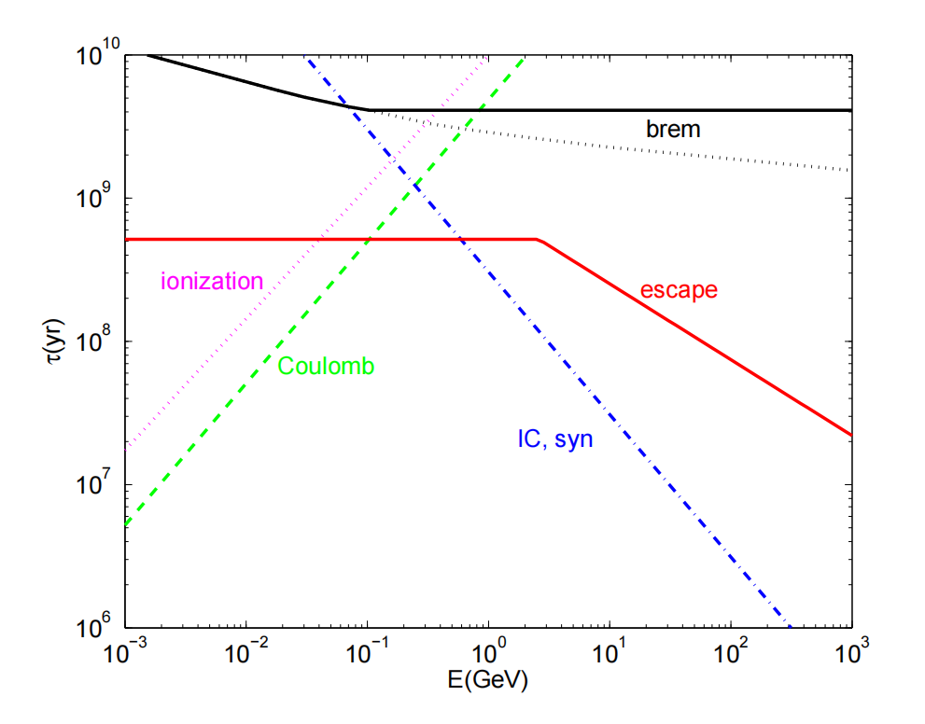
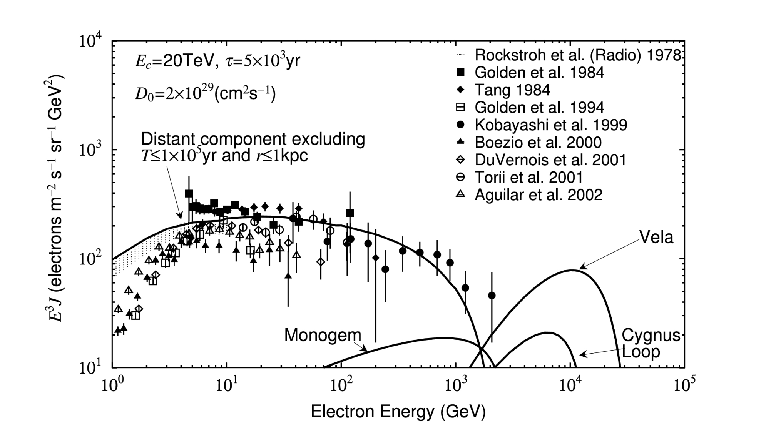
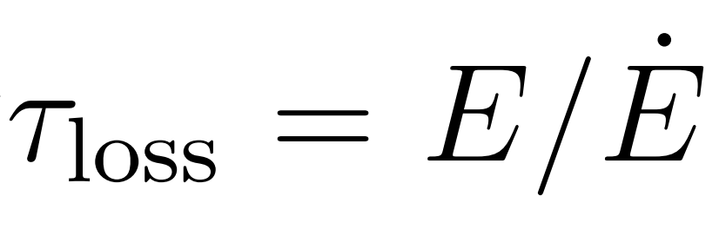
Motivation
Qiang Yuan，2010
KOBAYASHI et. al., ApJ, 2004
Cosmic ray electrons suffers strong energy loss during propogation
CRE spectrum: nearby kpc TeV sources, DM search, solar modulation
Notes:
科学意义清楚

Slide 4
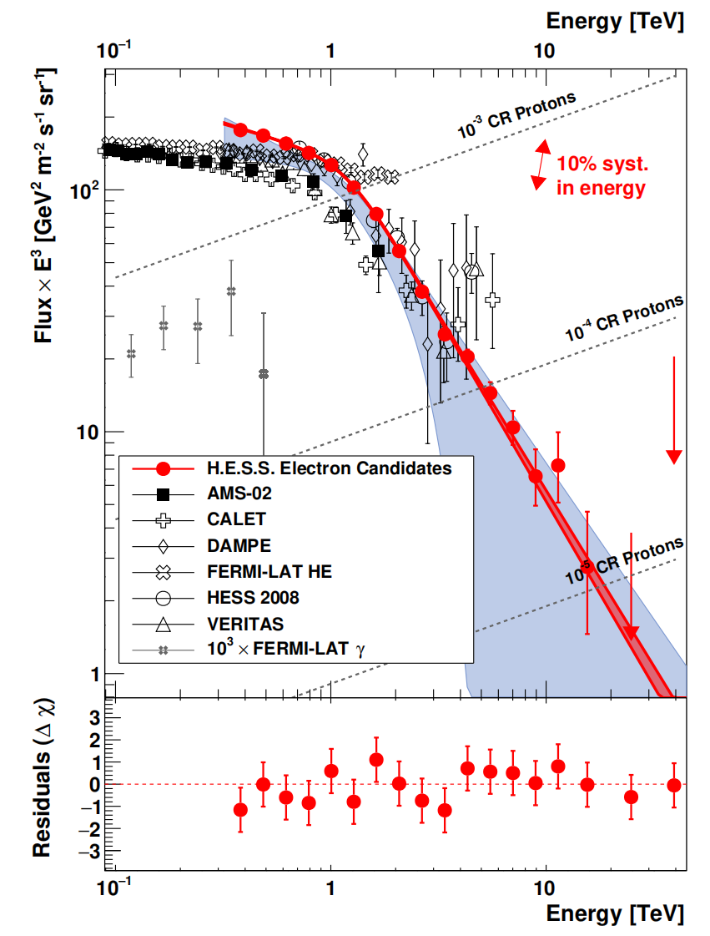
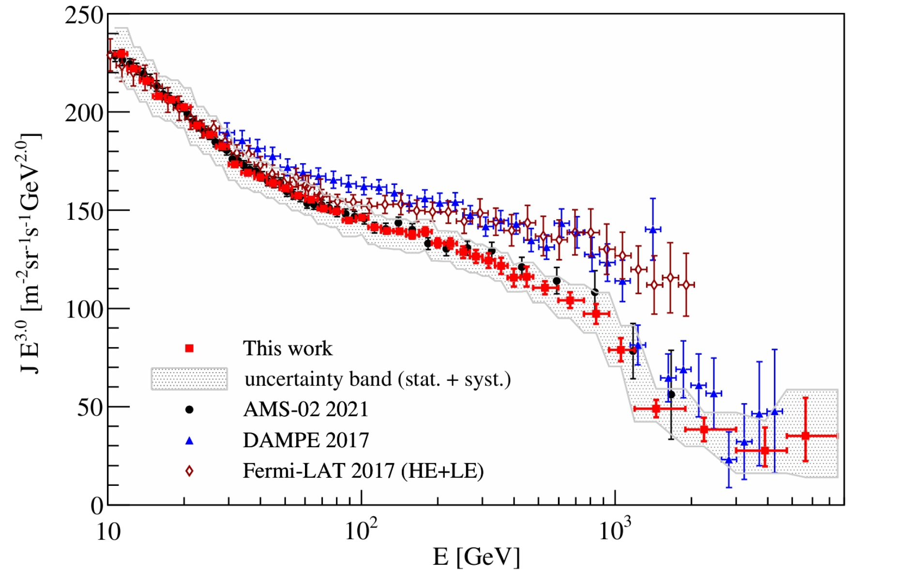
Measurements on CRE spectrum
Phys. Rev. Lett. 131, 191001
Ground based and spaced experiments
Energy resolution: 1.5%@800 GeV, wide energy range
Phys.Rev.Lett. 133 ,221001

Slide 5
Catalog
Background and motivation
Calibration and selections
a.Energy calibration using Helium MIPs
b.Selection cuts
Flux estimate
Summary

Slide 6
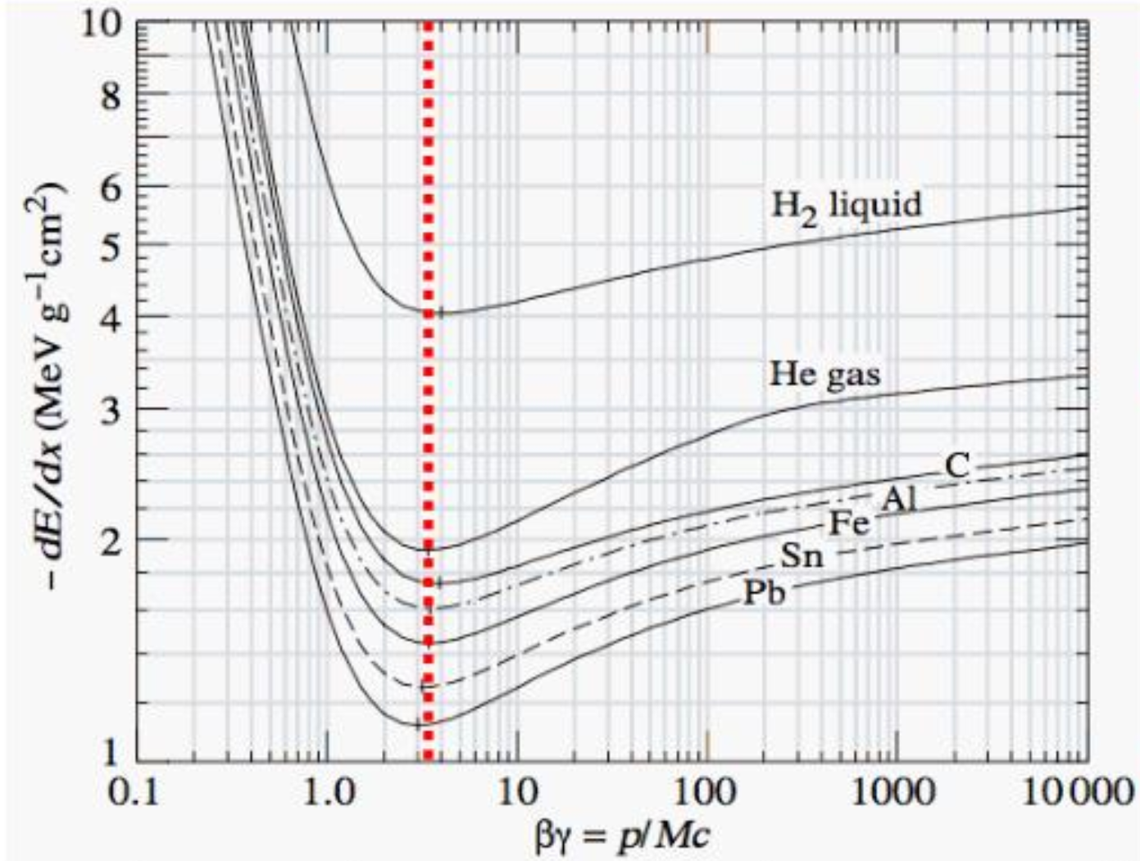
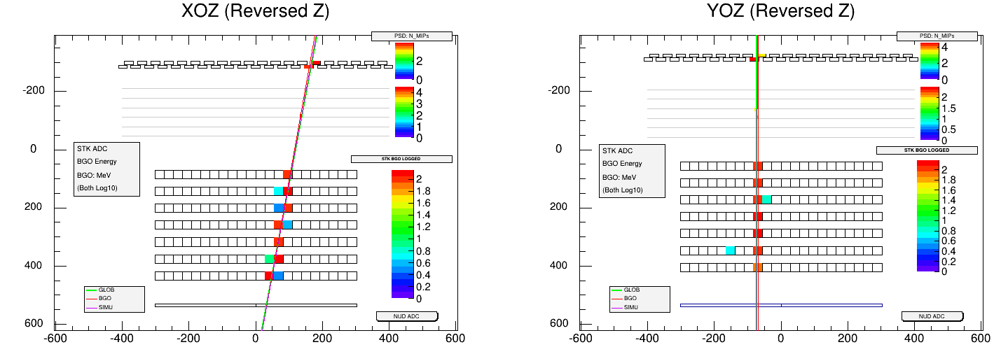
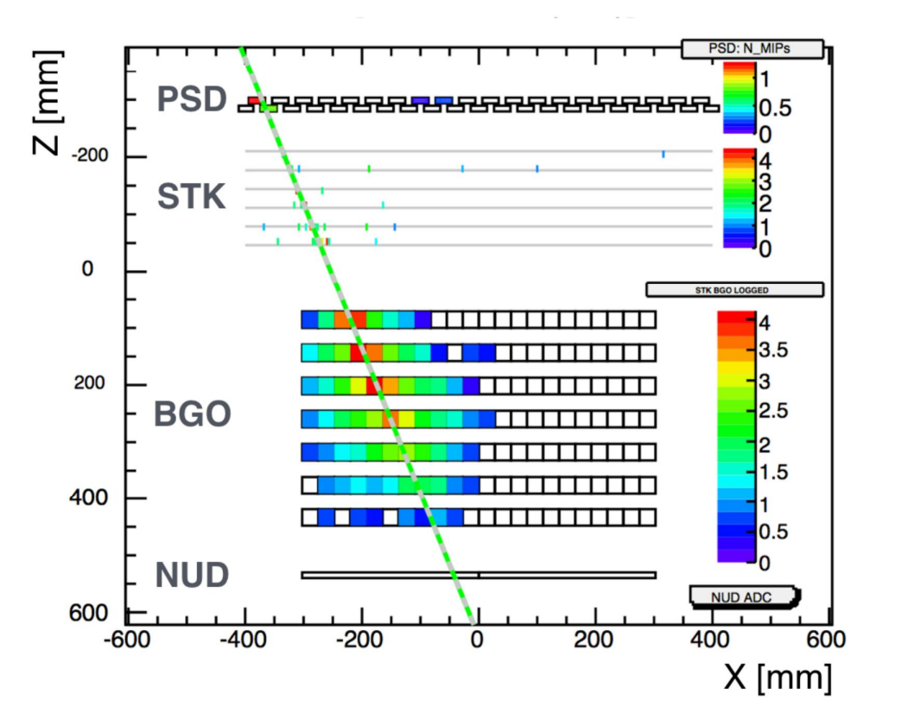
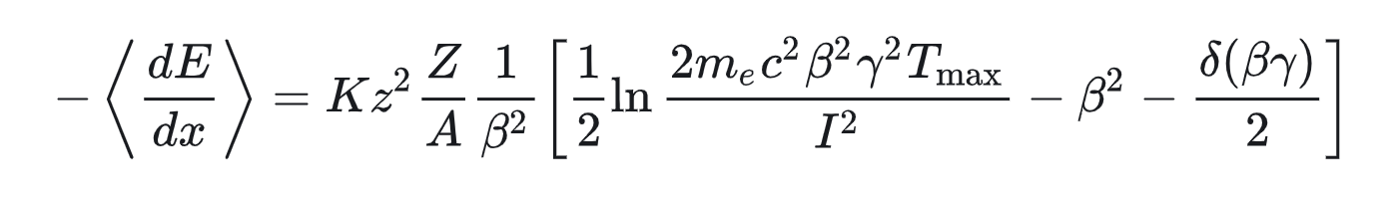
Energy calibration: Helium MIPs
Eloss of charged particles
Helium MIPs
Electromagnetic shower

Slide 7
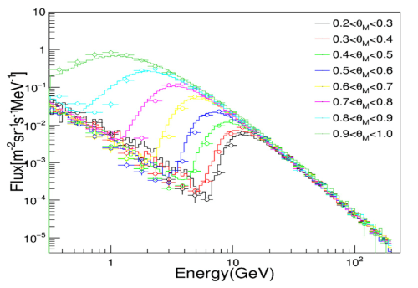
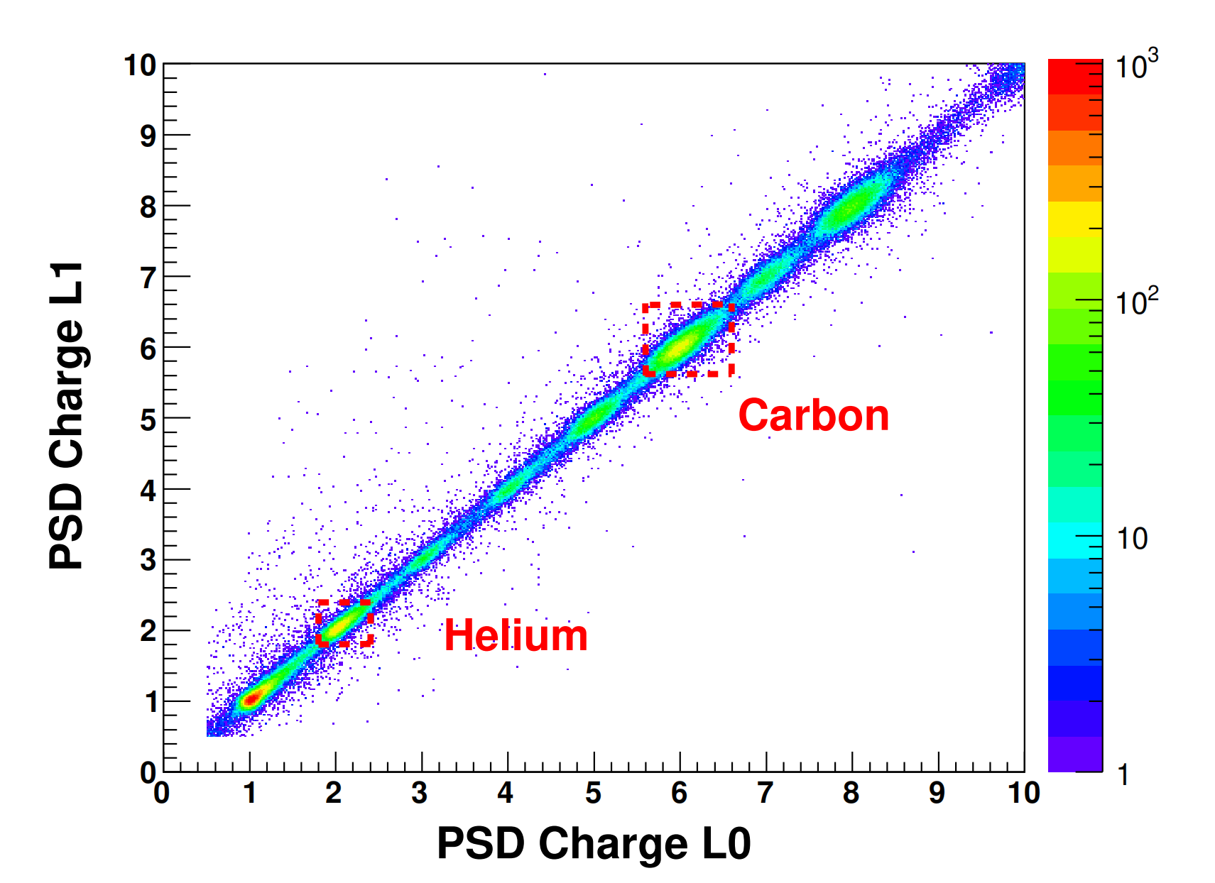
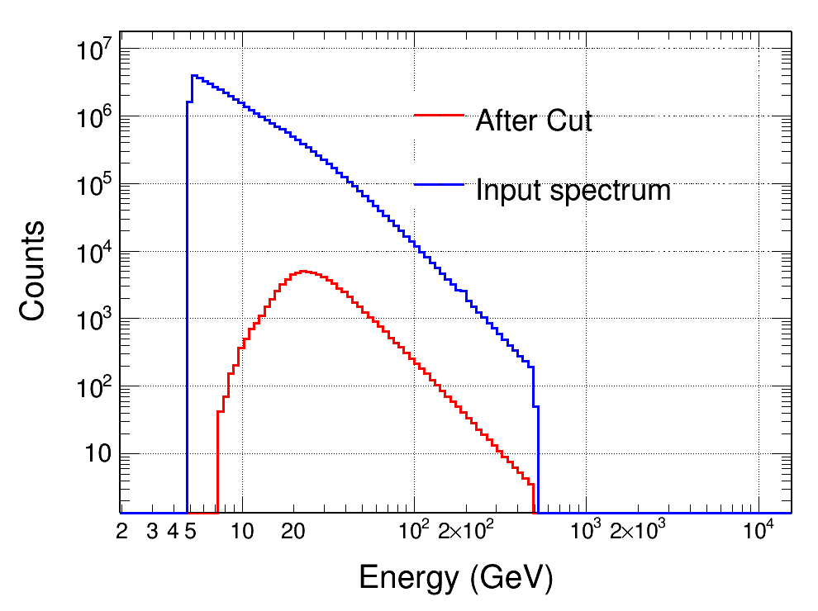
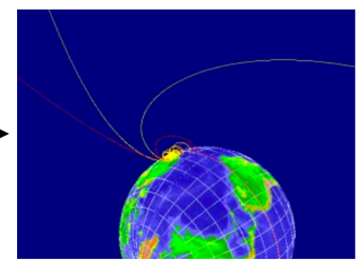
Energy calibration: Helium MIPs
Proton:primary+secondaries
Helium: primary
Backtracing method for MIPs prodution, DAMPE orbit information added
SAA excluded，within N/S 20 degrees for MIPs
Global or STK track
2D PSD charge: 1.8 - 2.6（5.5-6.5）

Slide 8
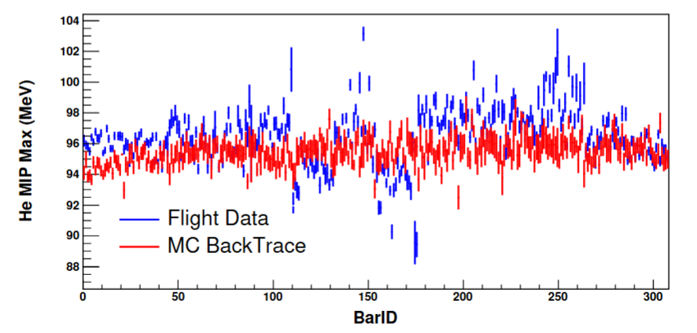
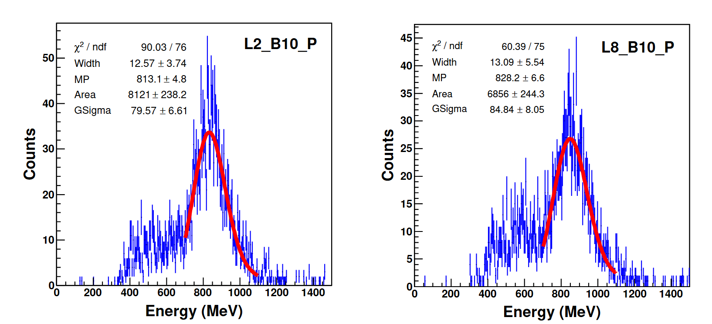
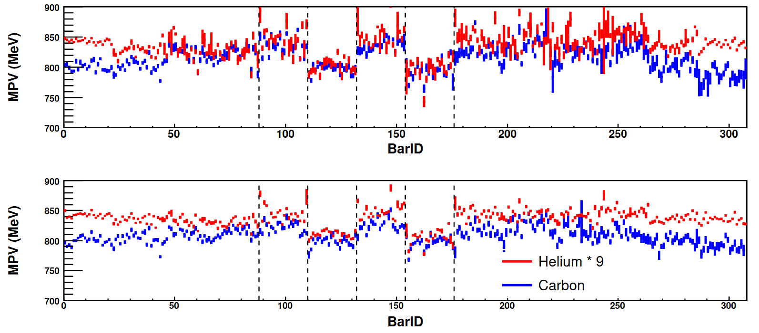
Energy calibration: Helium MIPs
Erec for on-orbit data:1.01% high
Same tendency for helium and Oxygen MIPs

Slide 9
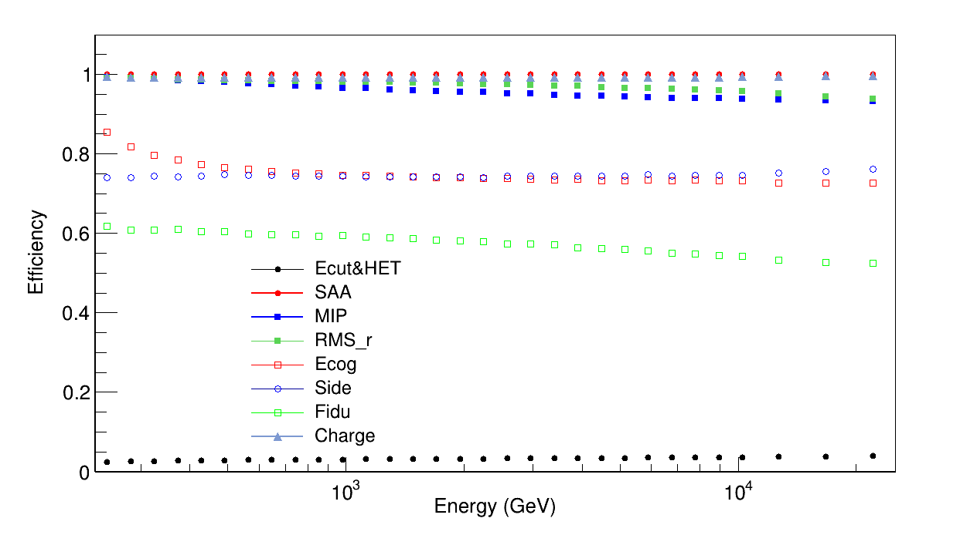
Preselection and efficiency
Flight Data: reconstruction from Chuan(2016.01.01-2025.11.30, >200 GeV)
Lt=2.40908e+08s
MC data:FTFP-BERT-HP proton/electron
Ecut&HET: Edep > 150 GeV && HET
SAA region particles rejection
MIP : L1-L7 maxbar-E/Elayer not over 96%
Ecog: L2-L5 Emaxbar not edge
Side :all layers Elayer ratio <0.35
Fidu: selected Track at L0/L12 within ±285mm
Charge: average charge from 2 PSD layers < 1.7

Slide 10
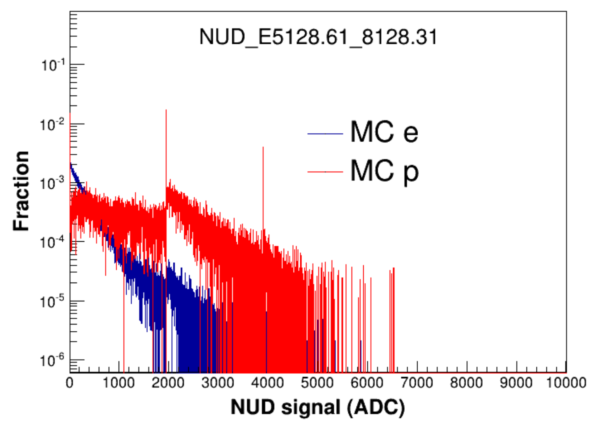
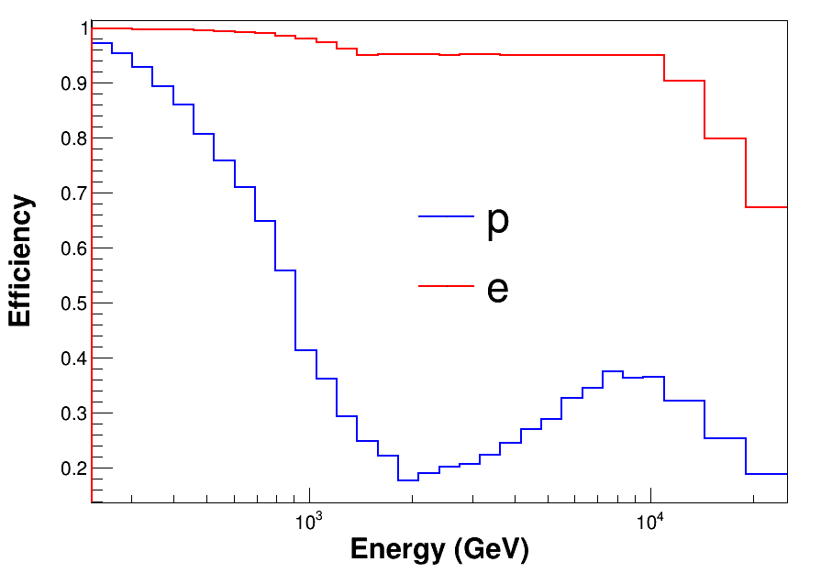
NUD cut
cut =50
cut =95%
cut =1950
Keep 95% efficiency of MC electron, require cut threshold >= 50 ADC
To avoid the saturation effect, cut threshold should <1950 ADC

Slide 11
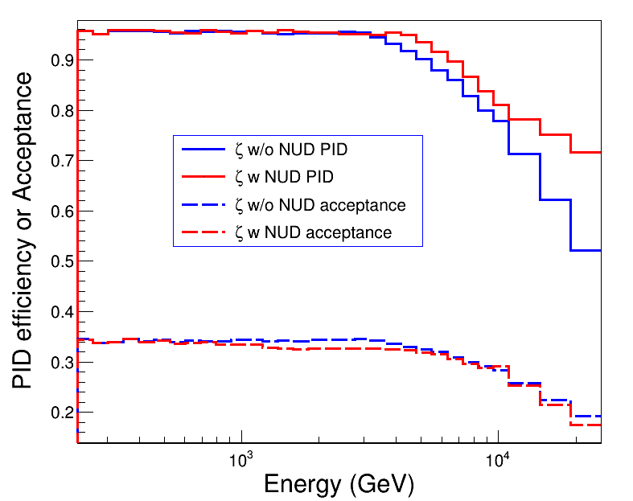
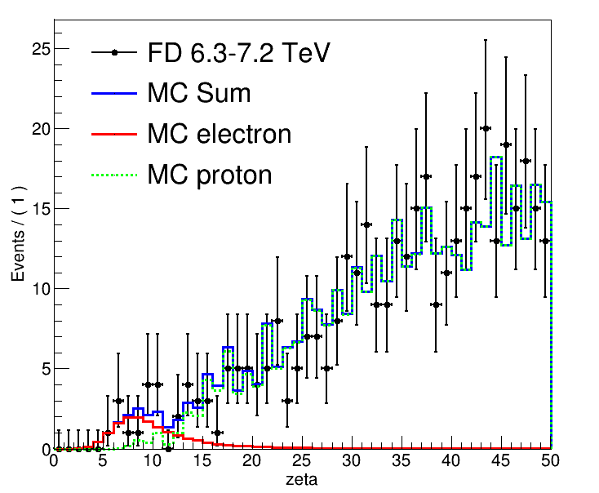
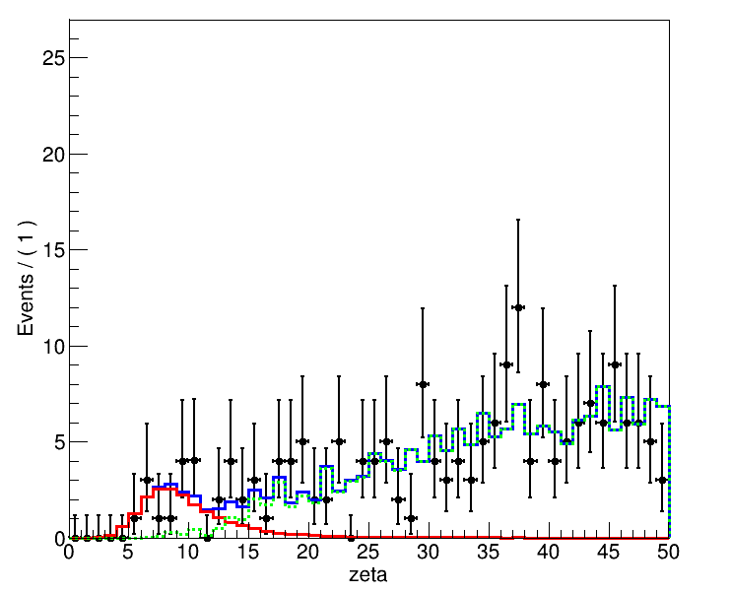
NUD cut
NUD cut: keep 95% efficiency of MC electron, require cut threshold >= 50 ADC
To avoid the saturation effect, cut threshold should <1950 ADC

Slide 12
Catalog
Background and motivation
Preselection and NUD cut
PID and flux estimate
Summary

Slide 13
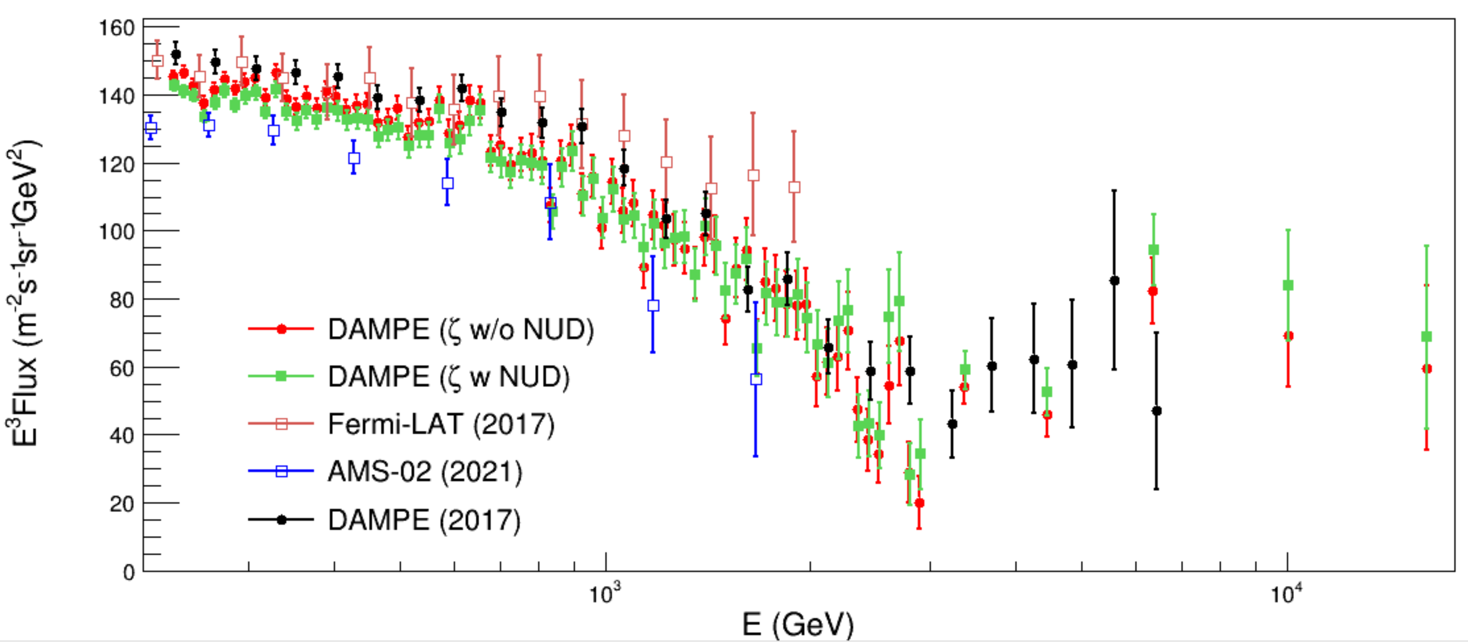
Flux measurements from ζ
Electron spectrum from 200 GeV to 20 TeV. On orbit data from 2016.01 - 2025.11

Slide 14
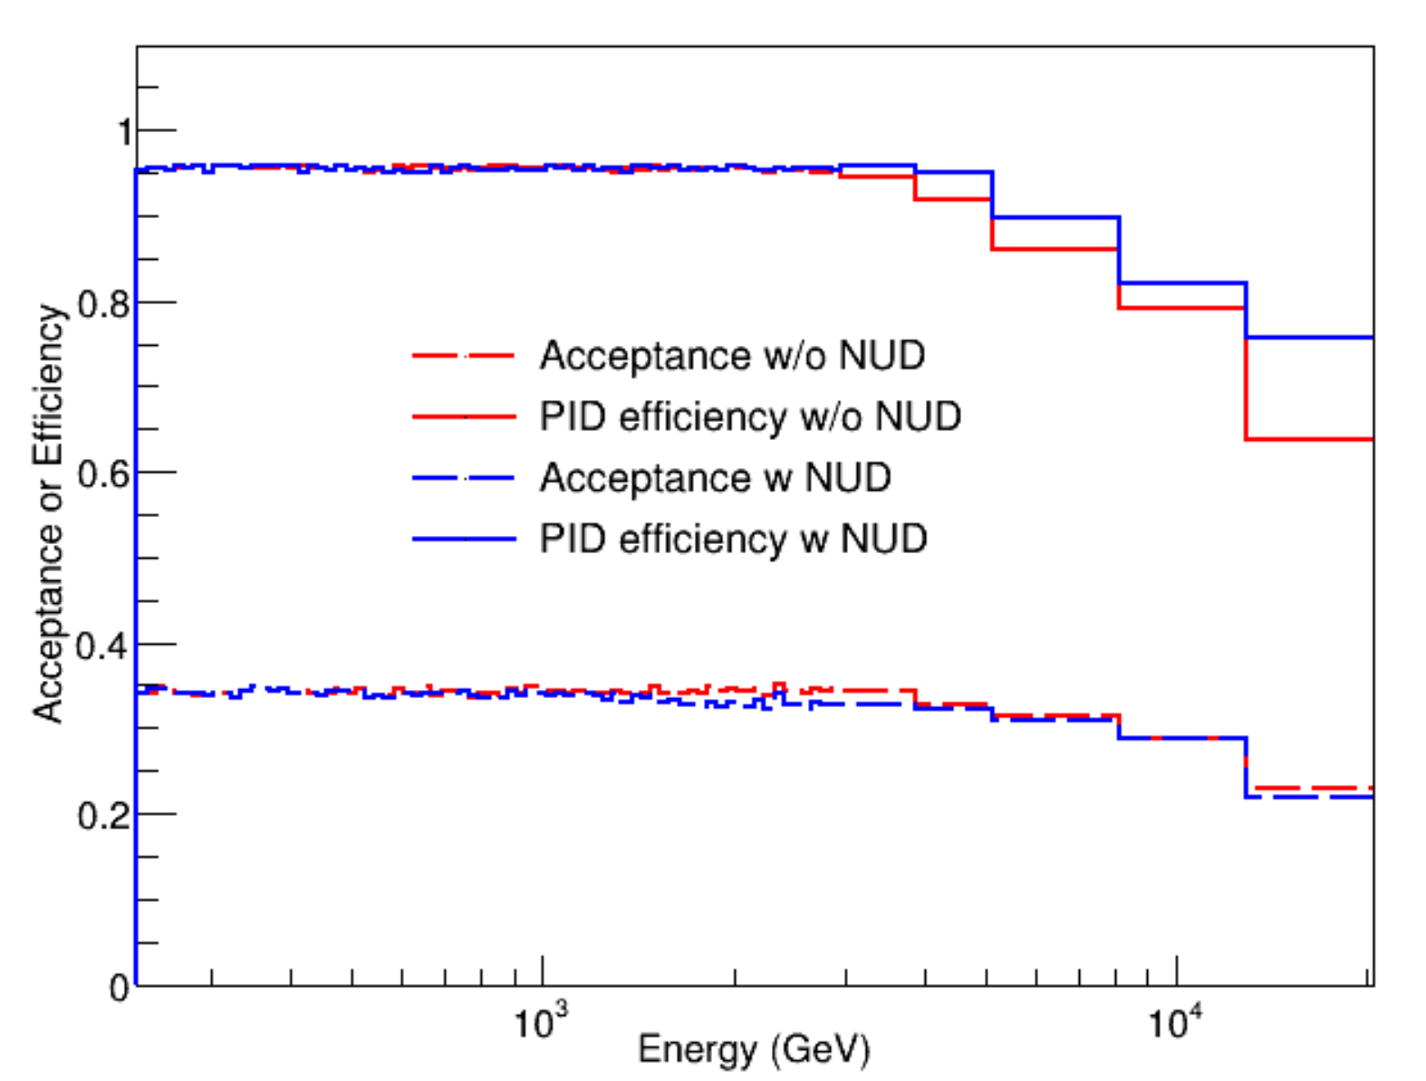
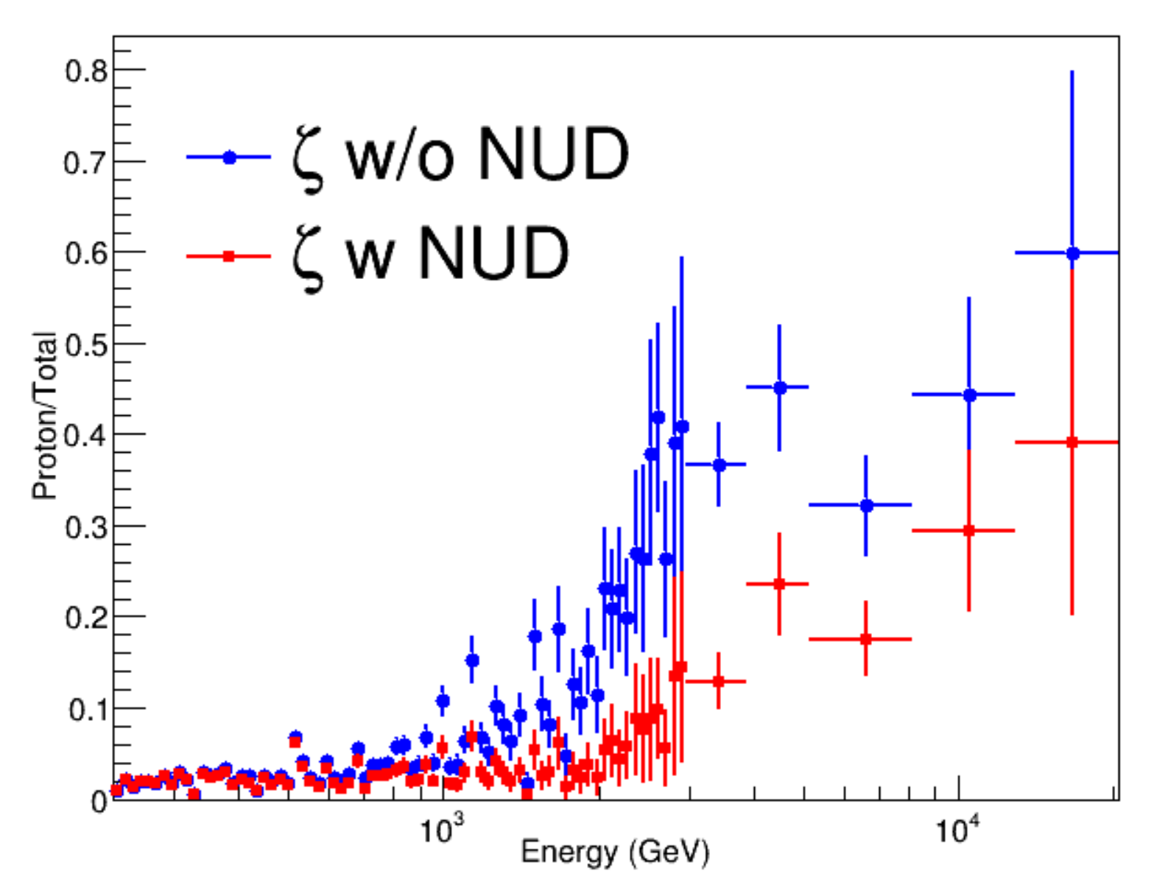

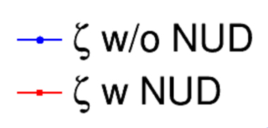
Acceptance and bkg (ζ)
zeta efficiency 95%
PID efficiency ~ 95%, but zeta cut < 15
BGK fraction supressed by NUD

Slide 15
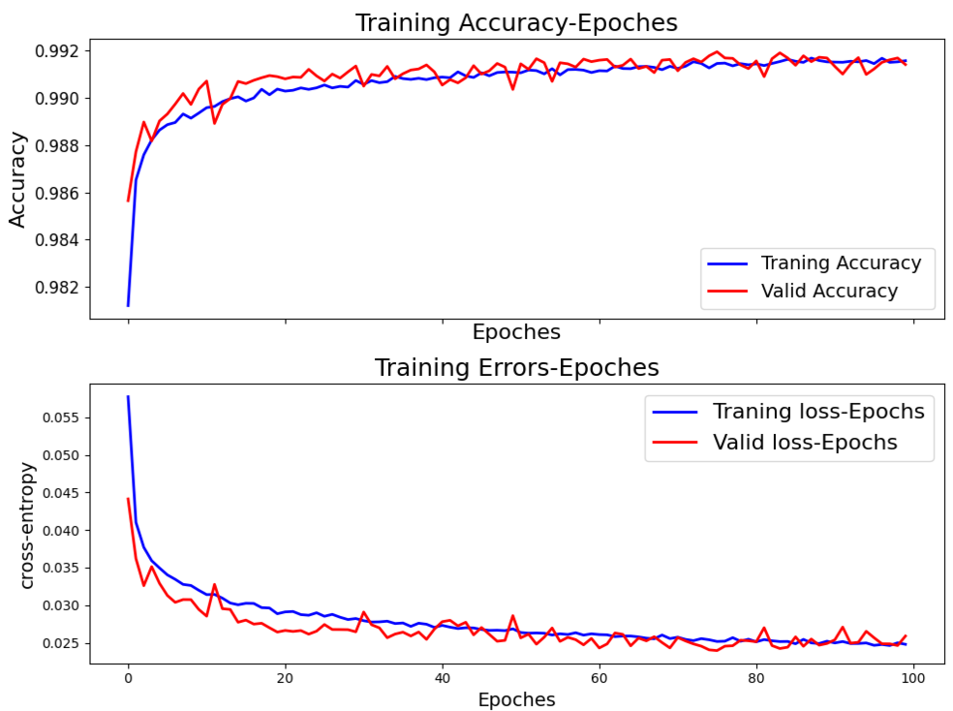
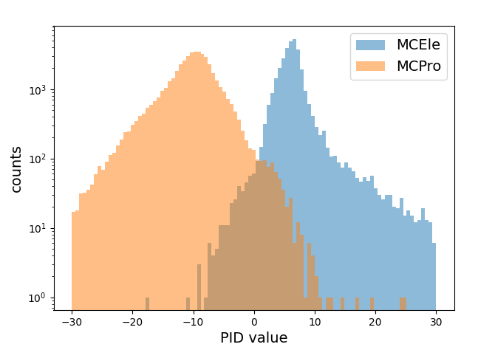
Systematic Uncertainty
DNN model roughly similar as David et. al.
Modified hyper-parameters such as train epochs and dropout
Input marameters: RMS, Eratio, θ，Φ，ζ.(regard 5 MeV as noise)
Energy-related corrections on RMS parameters

Slide 16
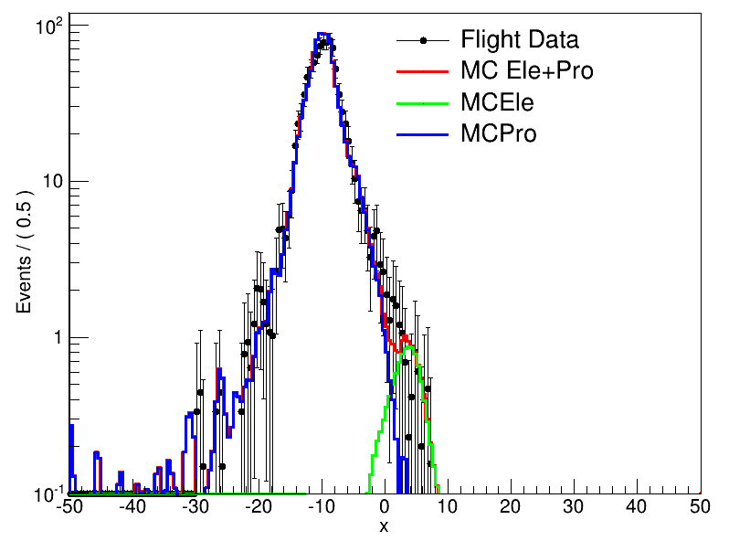
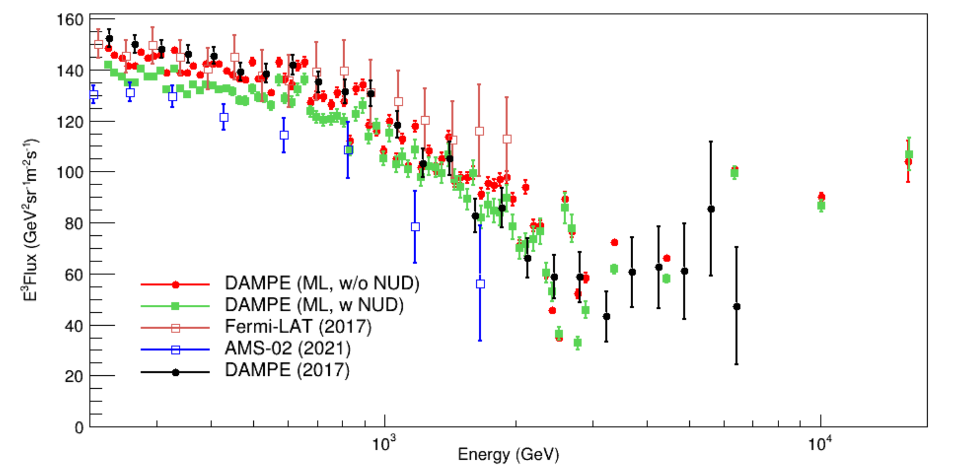
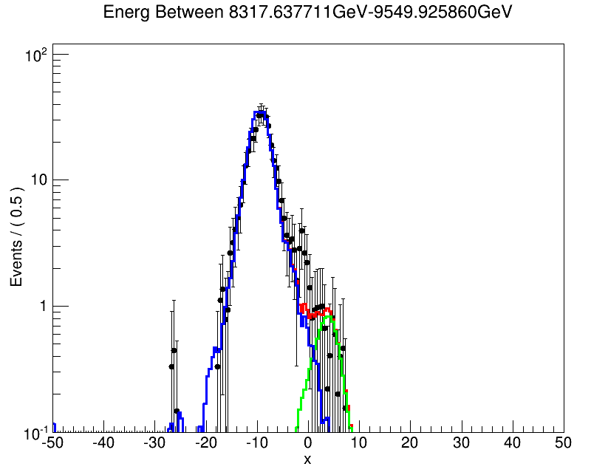
Flux measurements from ML
Template Fit from 8 TeV to 11 TeV

Slide 17
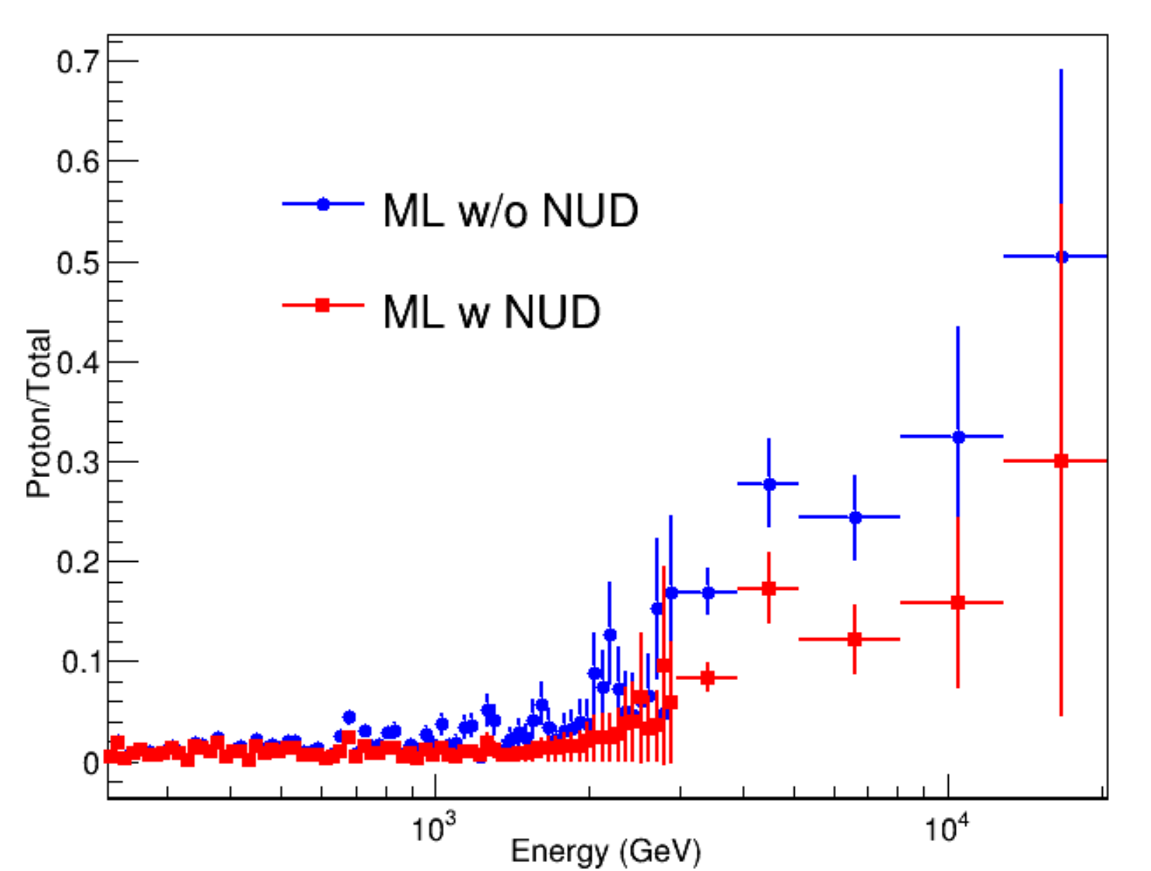
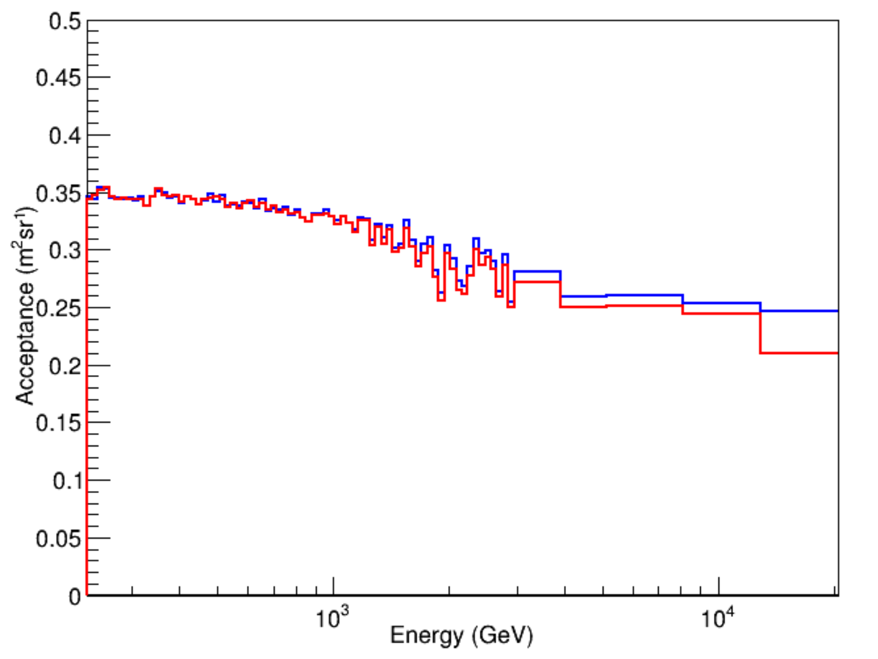
Acceptance and bkg（ML）
PID efficiency ~ 95%, but ML cut >2
BGK fraction supressed by NUD

Slide 18
Summary
Electron spectrum from 200 GeV to 20 TeV. On orbit data from 2016.01 - 2025.11
The results shows clear break of CRE spectrum around 600 GeV
Different PID methods with NUD cut is applied
The ML method needs further check

Slide 19
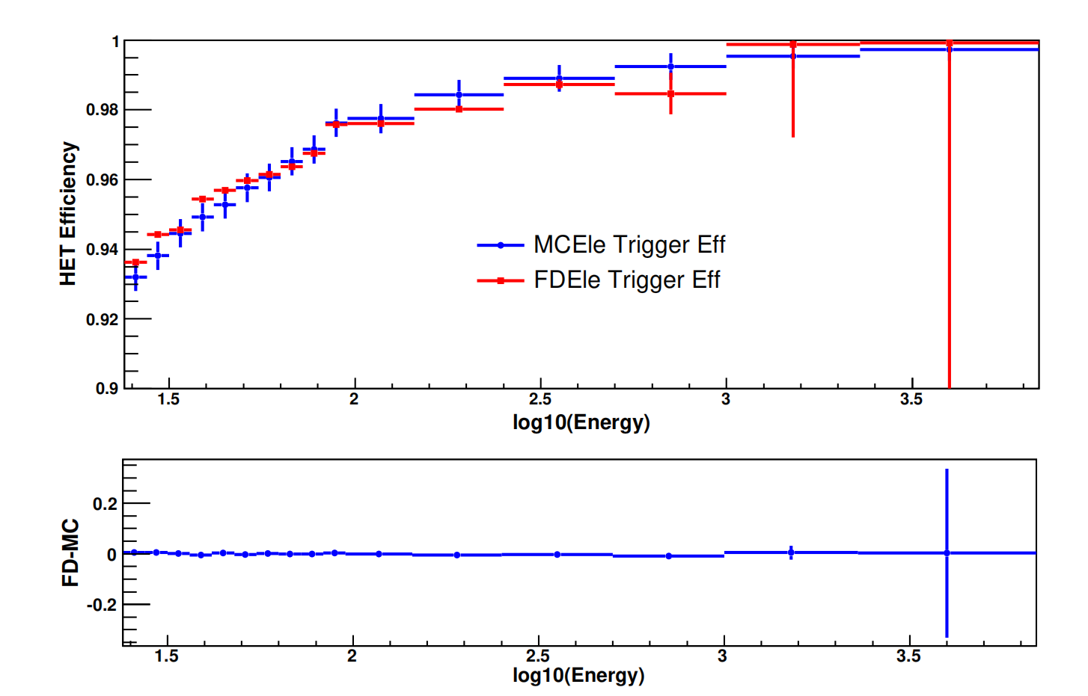
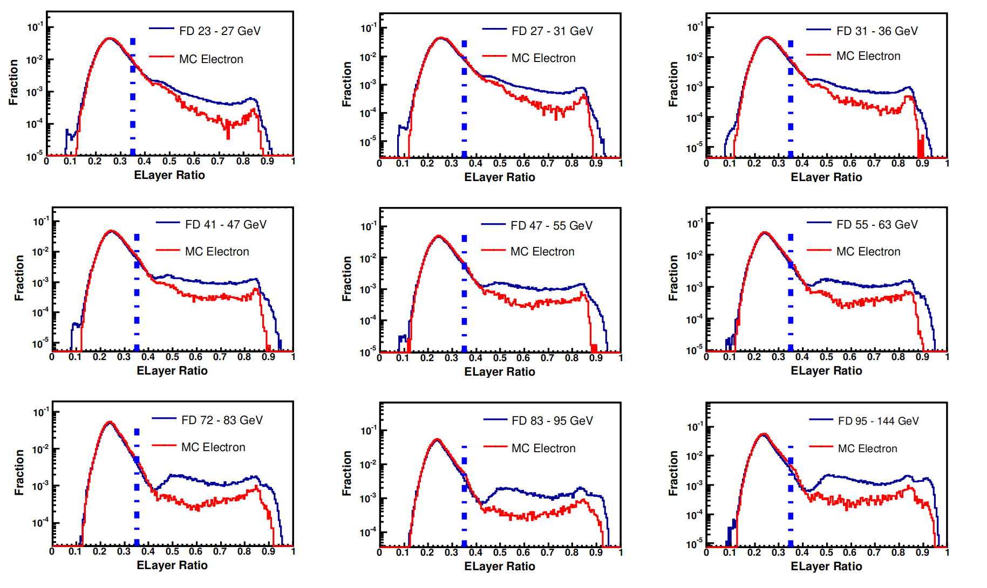

Systematic Uncertainty
HET systematic efficiency:
$$ε = \frac{N_{LET,HET}}{N_{HET}}$$
ELayer Syatematic error estiamte: change cut value by one bin: <0.5%

Slide 20
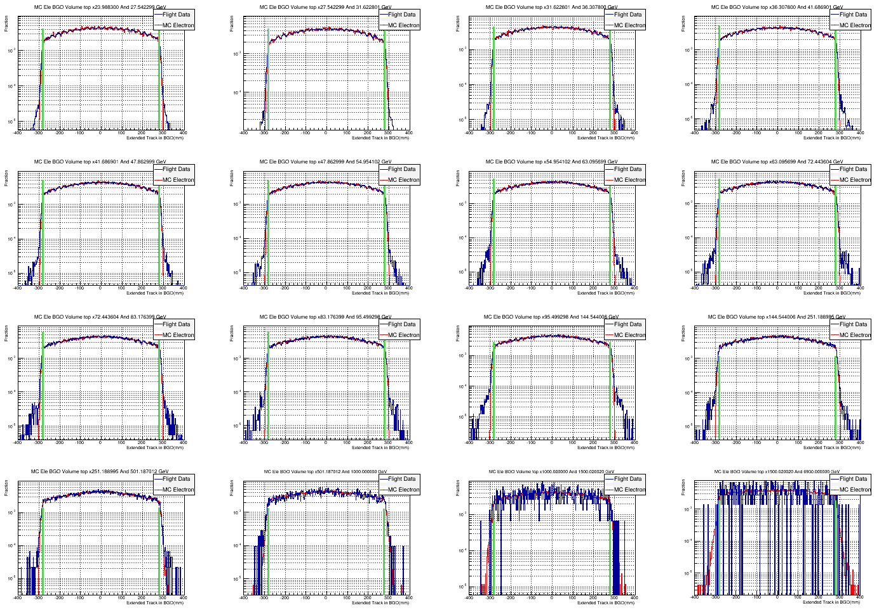
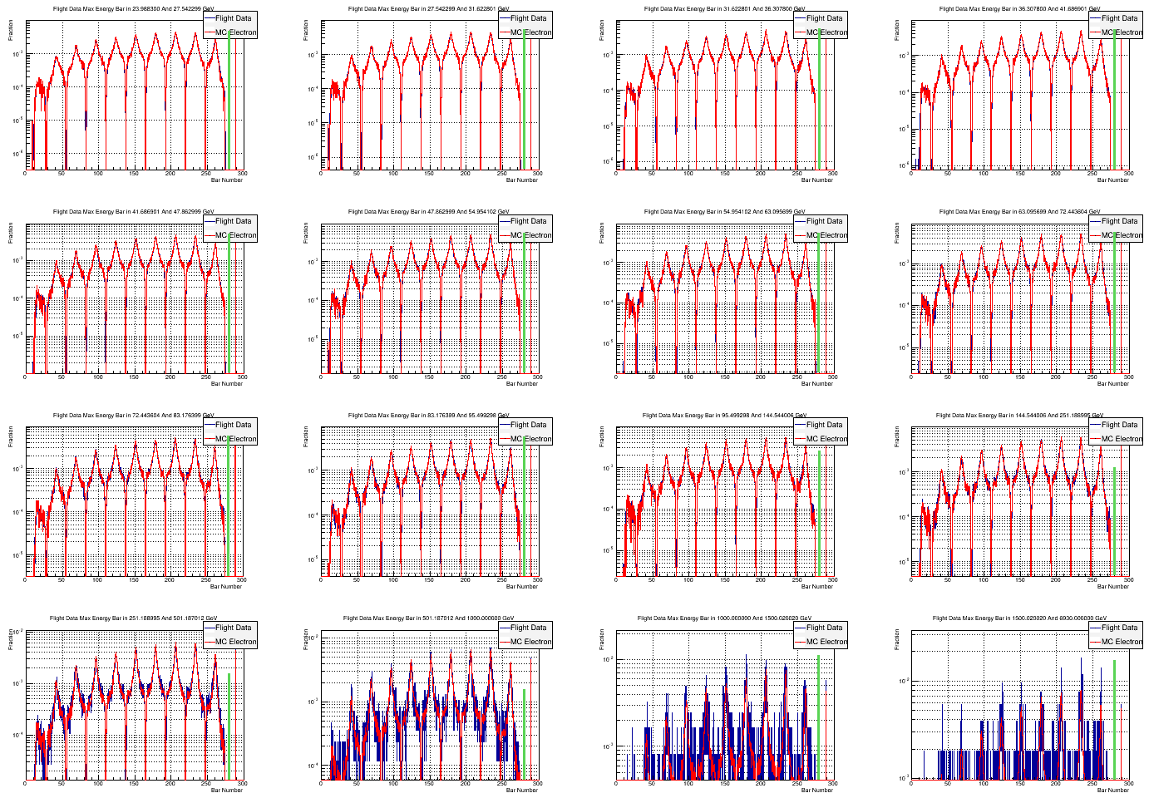
Systematic Uncertainty
Systematic uncertainty from fiducial cuts (left) and Ecog (right), <1% each

Slide 21
Systematic Uncertainty

