Slide 1


Consistency verification of DAMPE NUD data
Wenhao Li , Xiang Li, Zunlei Xu,Chuan Yue
Feb, 2026 @ USTC

Slide 2
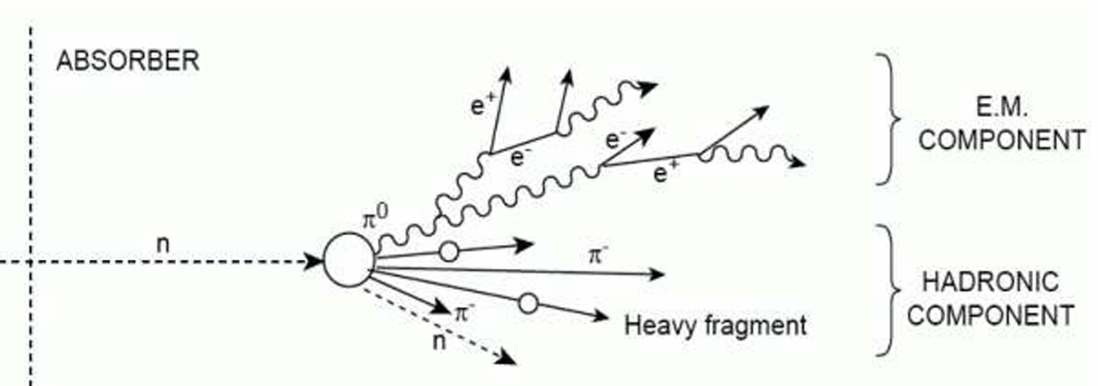
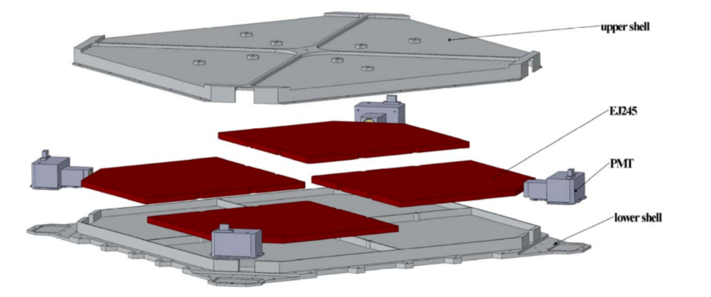
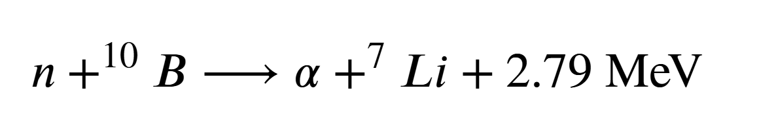
Motivation
NUD: plastic scintillator with boron + PMT readout
hadronic shower profile: neutrons; but also signal from photonuclear effect

Slide 3
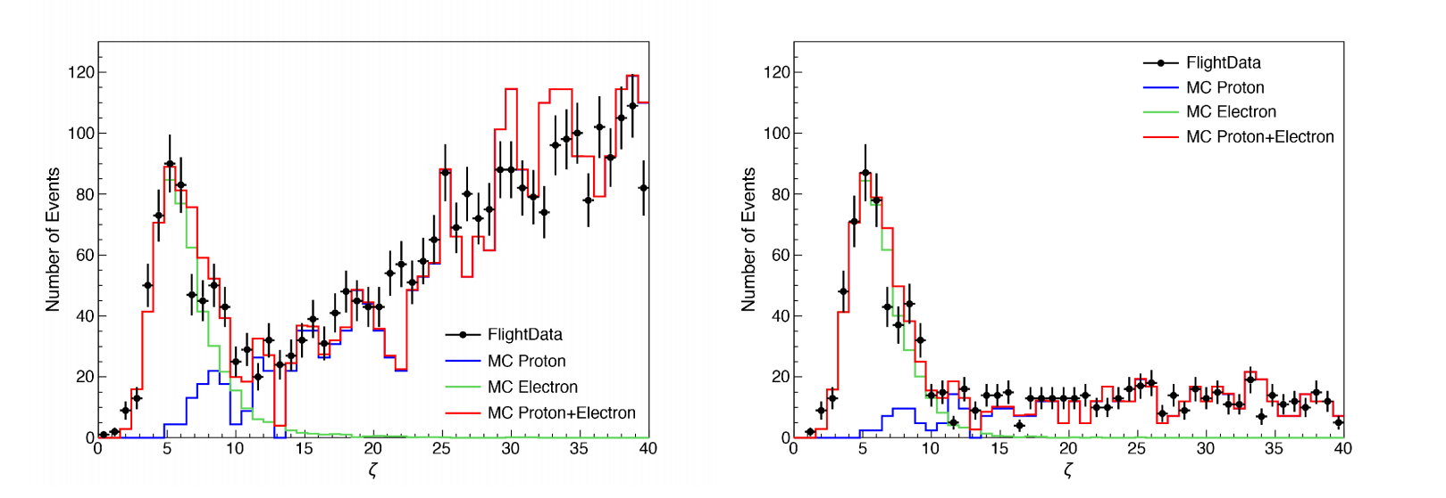
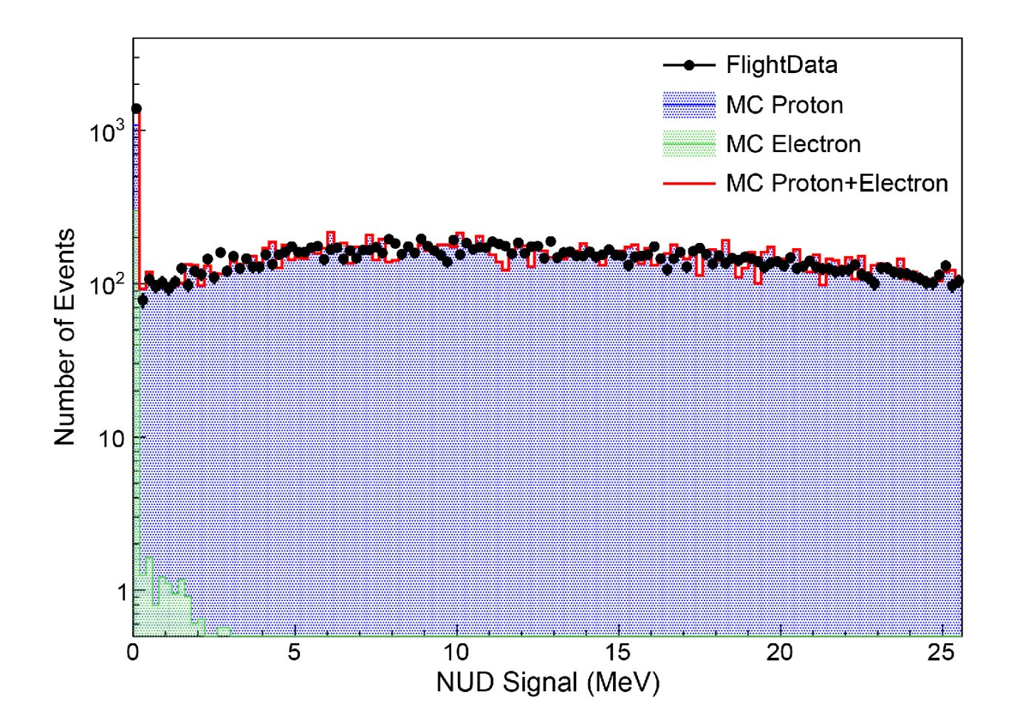
Movitation
Huang et. al. 2020
Composite: zeta; ML:DNN, BDT et. al.
Separations depend mainly on the BGO shower profiles
Problem: efficiency consisitency/systematic error between MC and Flight data

Slide 4
NUD Research
Calibrations
Verification of NUD response
Saturation effect
Uniformity check
γ-ray NUD signal verification
statistics/
acceptance
channel/
Time variations
STK track
events
BGO track events
γ-rays selection algorithm
ML BGO track

Slide 5
NUD Research
Calibrations
Verification of NUD response
Saturation effect
Uniformity check
γ-ray NUD signal verification
channel/
Time variations
STK track
events
BGO track events
γ-rays selection algorithm
ML BGO track

Slide 6
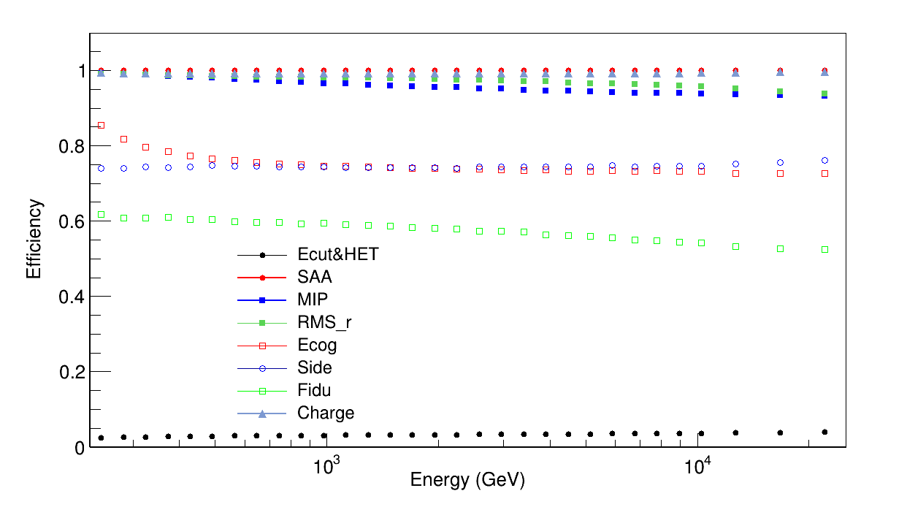
Calibration:The saturation effect
Flight Data: reconstruction from Chuan
MC data:FTFP-BERT-HP proton/electron
HET & SAA region particles rejection
MIP : L1-L7 maxbar-E/Elayer not over 96%
Ecog: L2-L5 Emaxbar not edge
Side :all layers Elayer ratio <0.35
Fidu: selected Track at L0/L12 within ±285mm
Charge: average charge from 2 PSD layers < 1.7
MC Electron selection efficiency

Slide 7
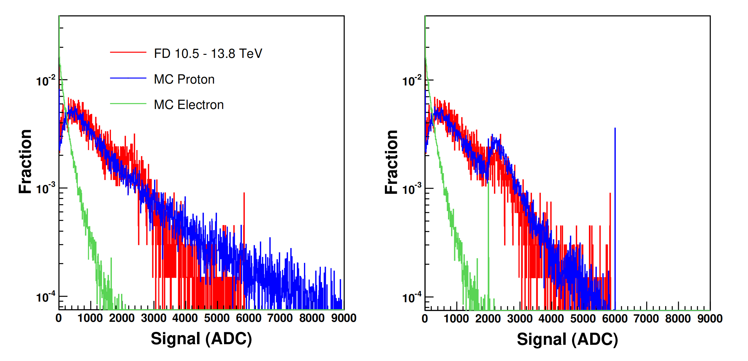
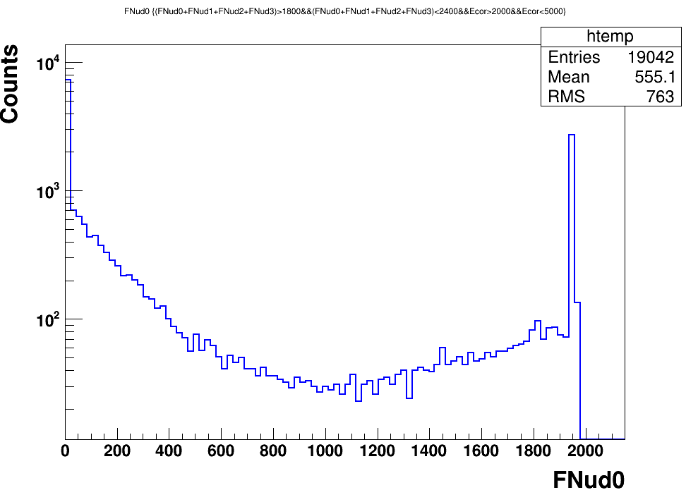
Calibration:The saturation effect
Signals from 4 channels of NUD, saturation value is set to 1950 ADC (MC)
To avoid the effect, the NUD cut threshold should be less than saturation value

Slide 8
The Uniformity check: Proton selection
Flight Data: reconstruction from Chuan
HET & SAA region particles rejection
MIP : L1-L7 maxbar-E/Elayer not over 96%
Ecog: L2-L5 Emaxbar not edge
Side :all layers Elayer ratio <0.35
Fidu: selected Track at L0/L12 within ±285mm
Charge: average charge from 2 PSD layers < 1.7
ζ>50, selected global Track not for lepton

Slide 9
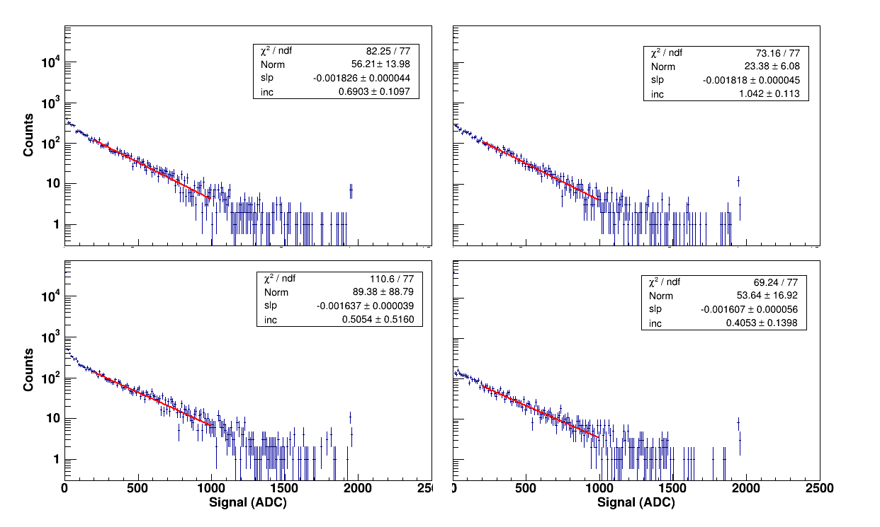
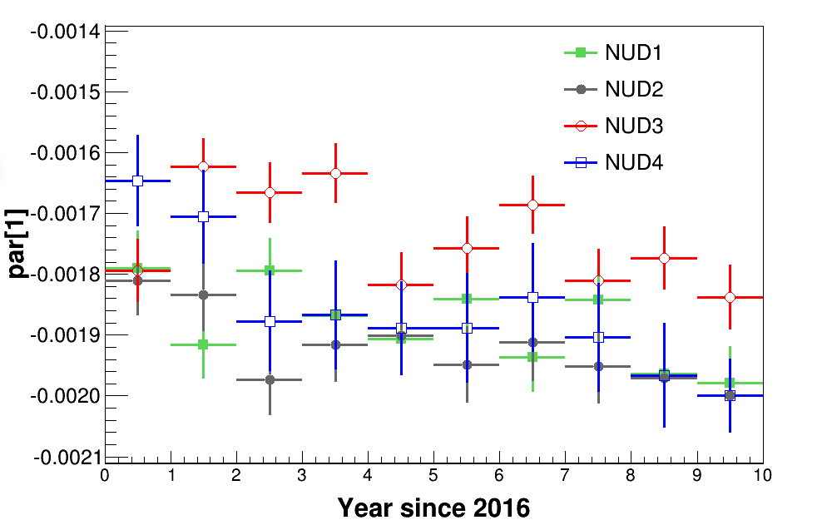
The Uniformity check
Selection: proton samples with Edep in 500 GeV - 1 TeV
Different NUD channels fit with a power law function
Yearly variations on the power index: decline over time

Slide 10
NUD Research
Calibrations
Verification of NUD response
Saturation effect
Uniformity check
γ-ray NUD signal verification
channel/
Time variations
STK track
events
BGO track events
γ-rays selection algorithm
ML BGO track

Slide 11
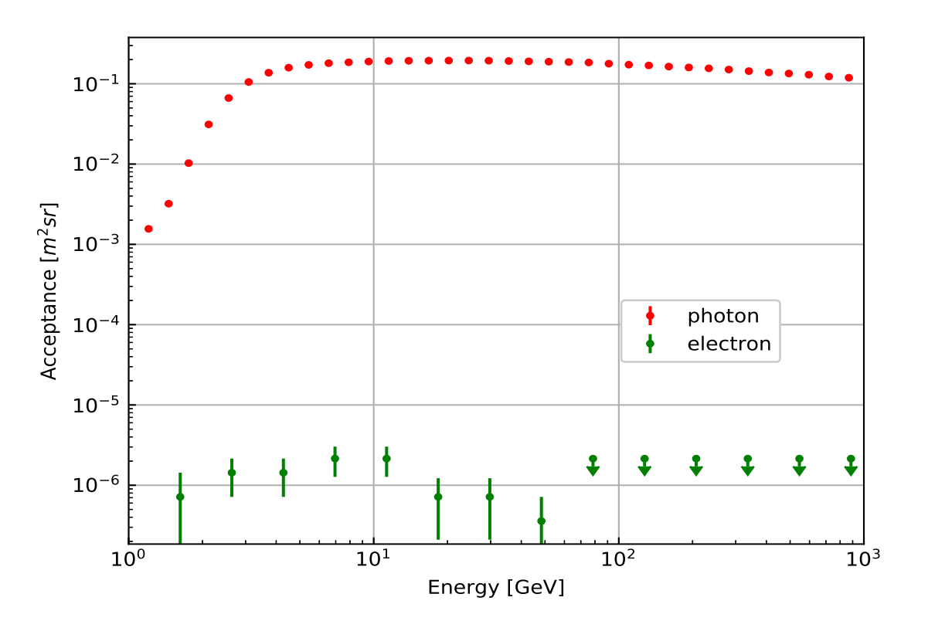
Verification of NUD response - γ rays
Huang et. al. 2020
Xu et. al. 2018
Gamma rays: high purity(charge), similar singal distribution
Long tail from electrons
γ-rays vs proton:PID methods & charge rejections
proton background in electrons:1% to 15%

Slide 12
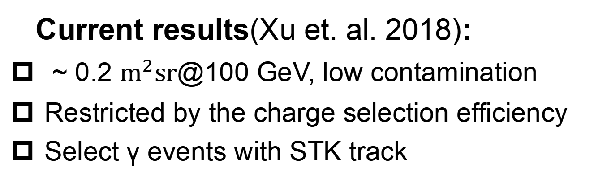
Verification of NUD response - γ rays
Current results(Xu et. al. 2018):
~ 0.2 $m^{2}sr$@100 GeV, low contamination
Restricted by the charge selection efficiency
Select γ events with STK track
Possible Solutions:
Update on STK track selections
STK Q information/update PSD Q selections
Accept BGO track events

Slide 13
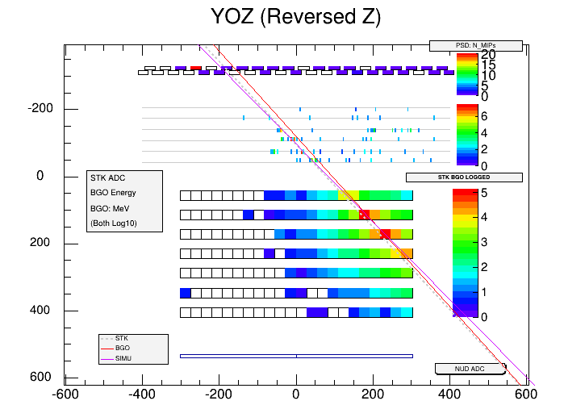
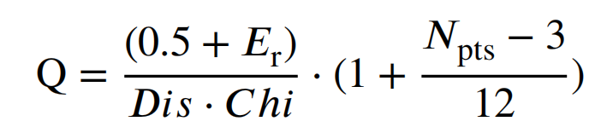
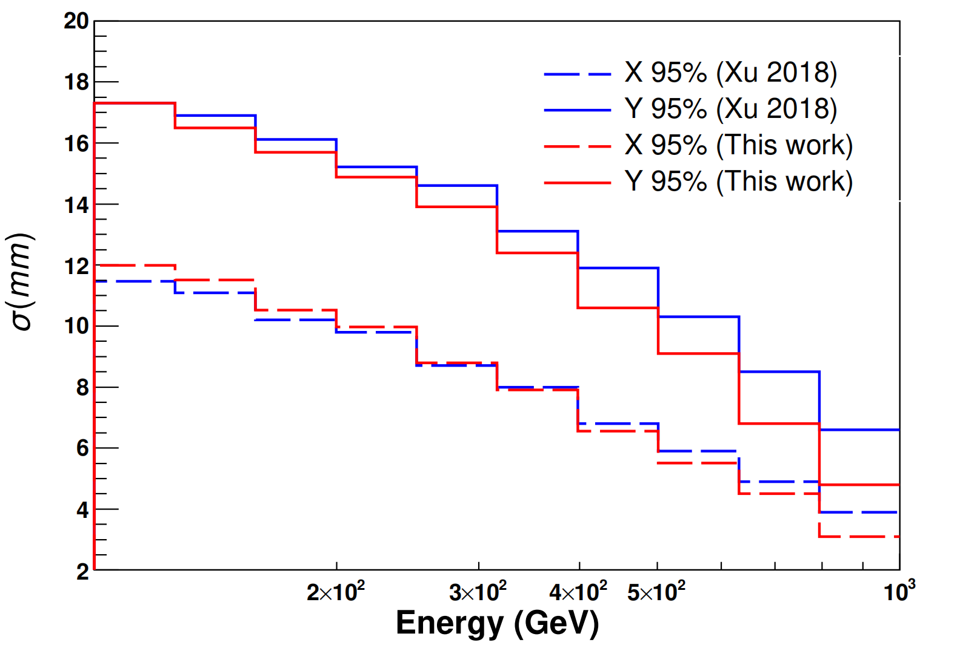
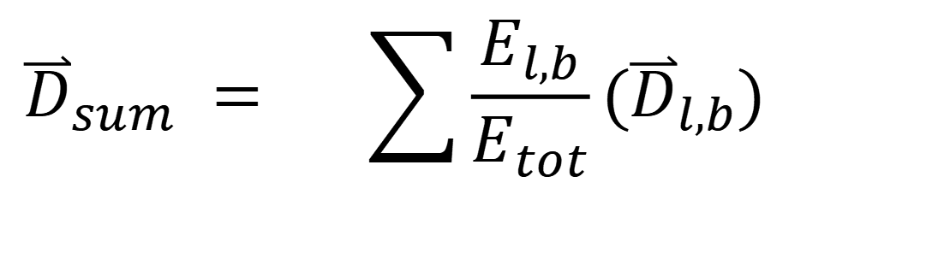
γ-rays selection algorithm
LET & SAA execlusion
STK Track selection(3D distance)：
electron/proton cut:
rms_r<30 , fiducial cuts, MIPs cut et. al.
$${\overset{⃑}{D}}_{sum} = \sum{\frac{E_{l,b}}{E_{tot}}}({\overset{⃑}{D}}_{l,b}) ^{ }$$
STK signal ratio within 5 mm
Quality of STK track

Slide 14
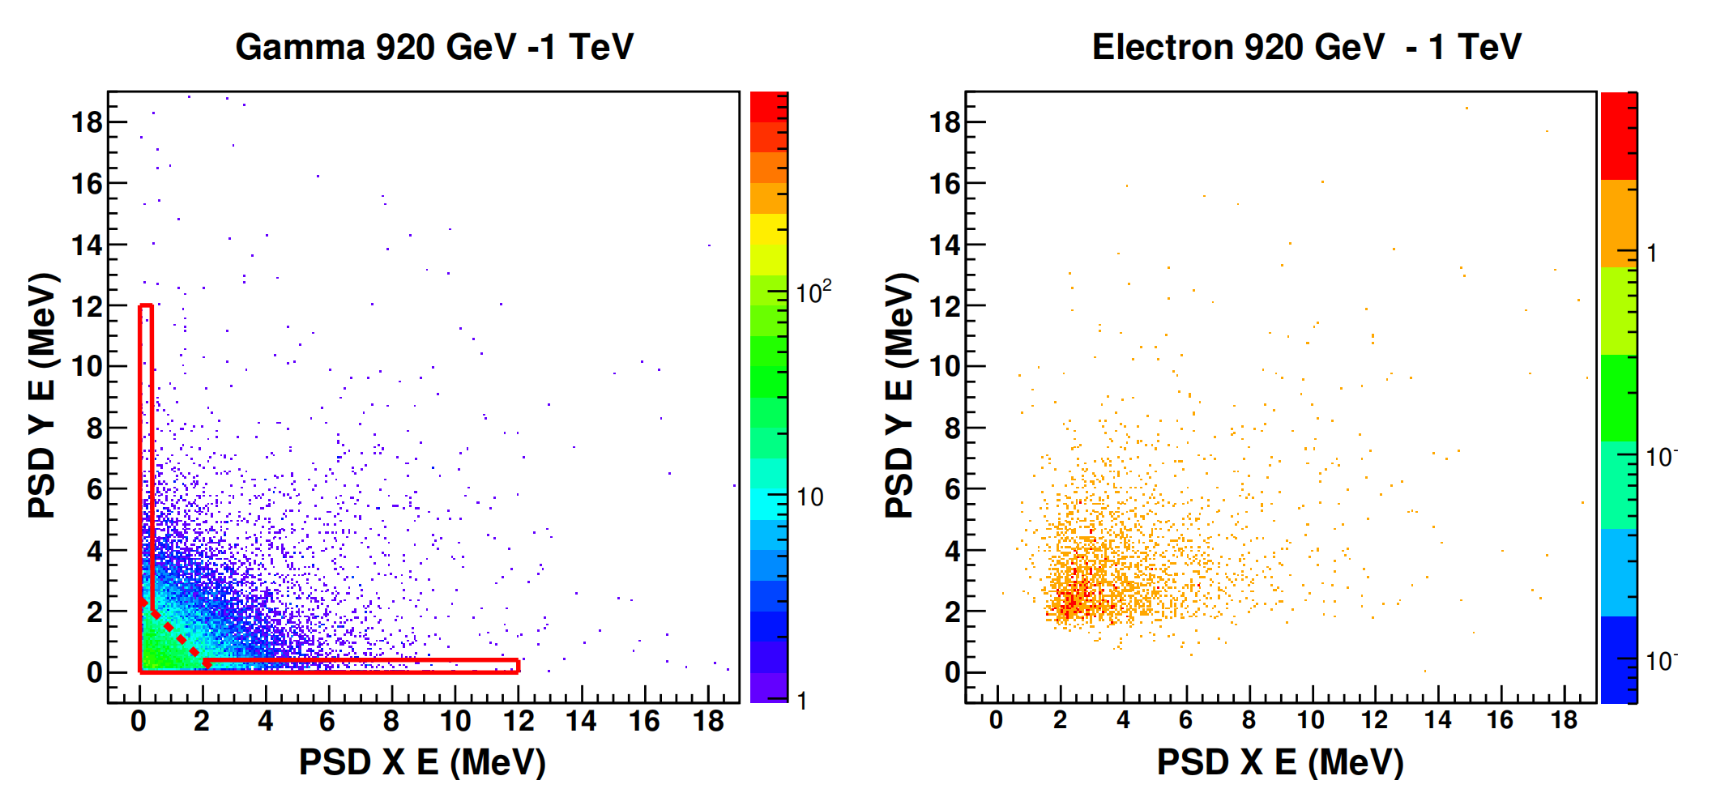
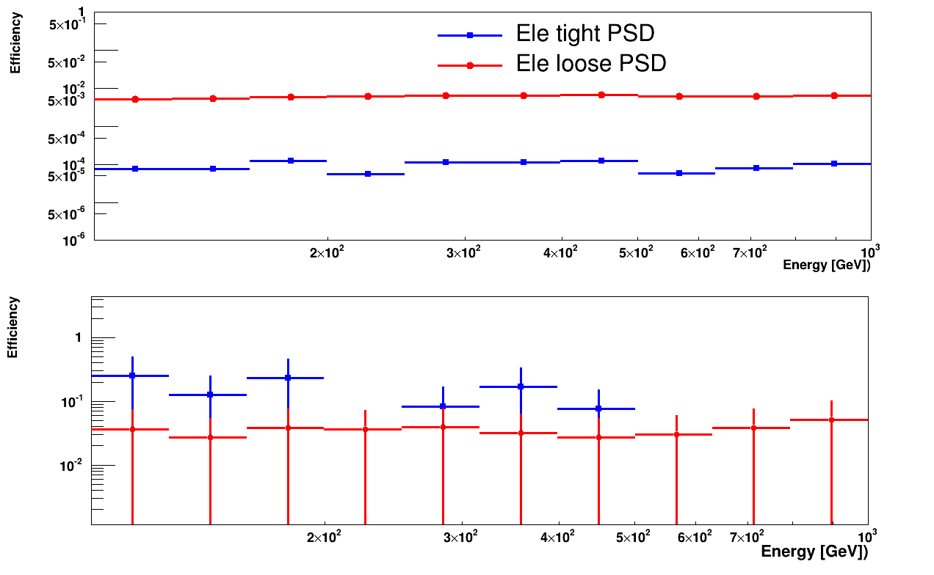
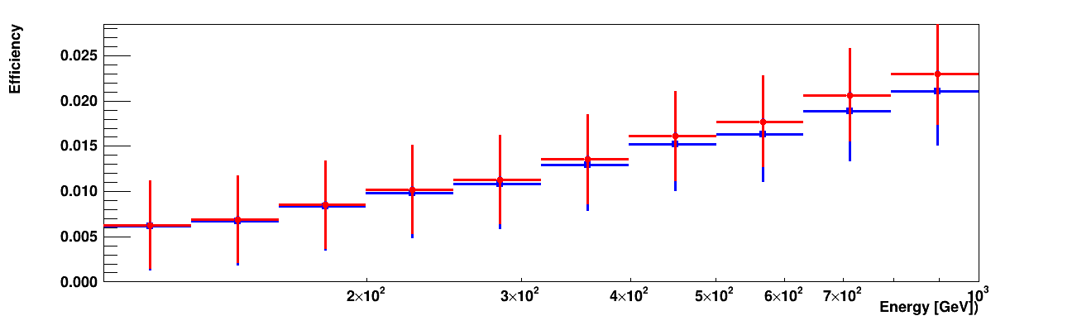
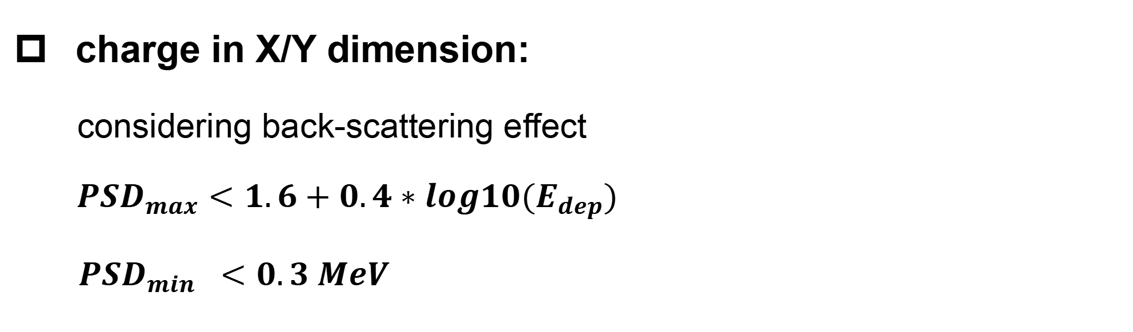
The Charge selections：PSD and STK
γ pass PSD selection
γ not pass PSD selection
e pass PSD selection
e not pass PSD selection
charge in X/Y dimension:
considering back-scattering effect
${PSD}_{max}<1.6+0.4∗log10(E_{dep})$
${ PSD}_{min} <0.3 MeV$
calculate STK L0 total signal within 2 mm of STK track hit position, threshold: 10 ADC
γ-rays have low signal efficiency;electrons with low efficiency

Slide 15
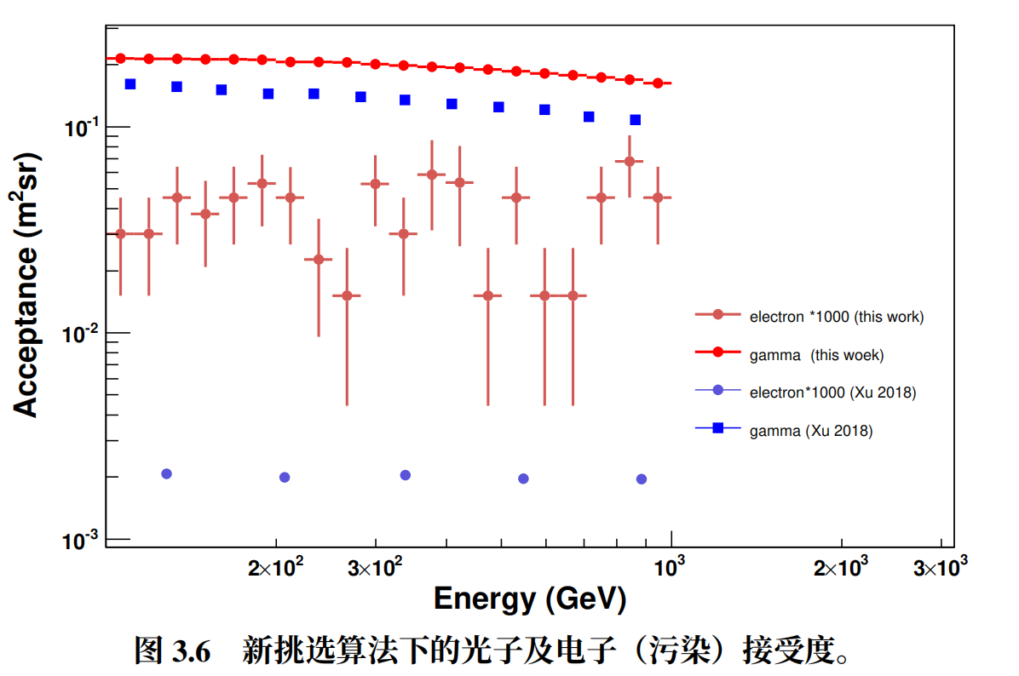
Increase in selections acceptance
STK only events selections
γ-rays acceptance increased over 30% from 100 GeV to 1 TeV
electron contaminations: from <1% to 8%

Slide 16
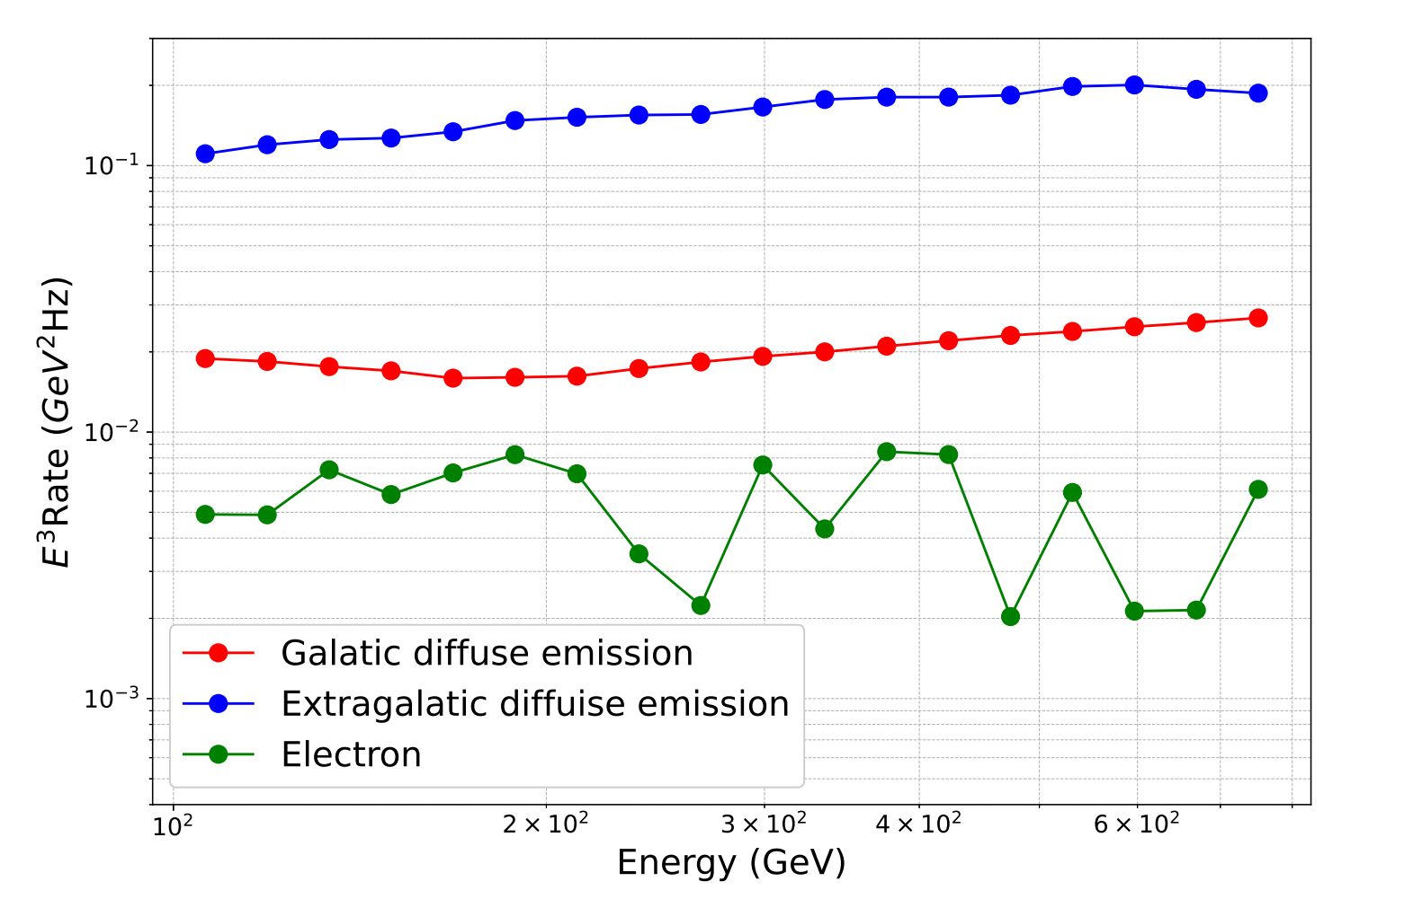
The γ-ray count rates
More statistics fo NUD validation but higher e- background for γ-ray scientific analysis.
New selections method will soon be applied to on orbit data

Slide 17
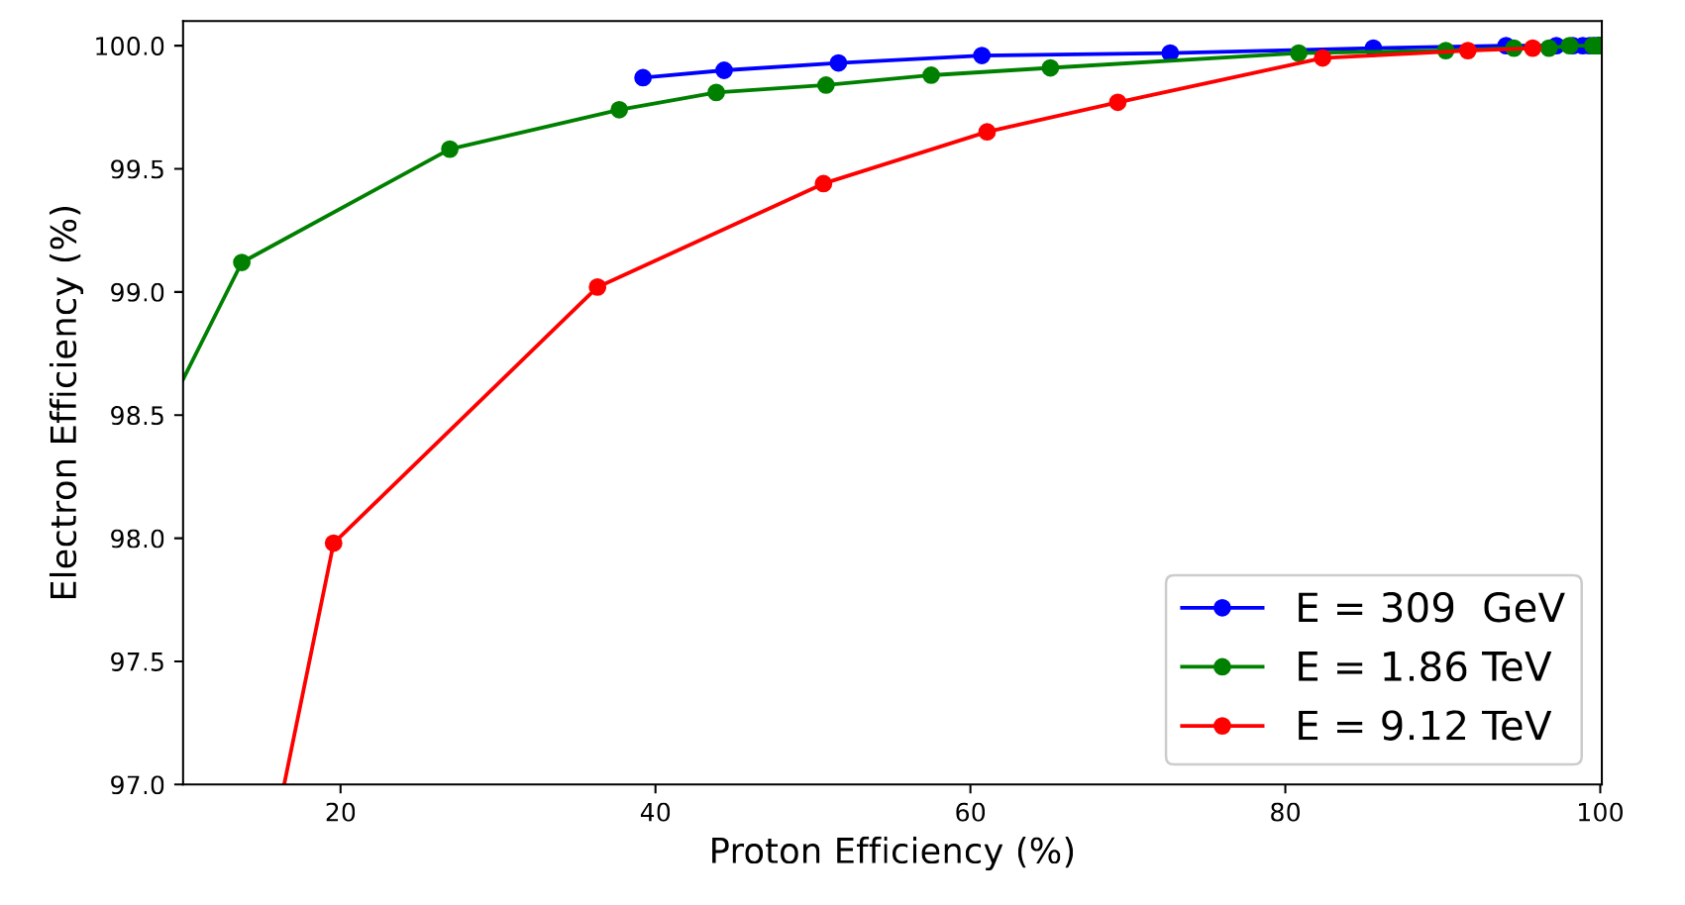
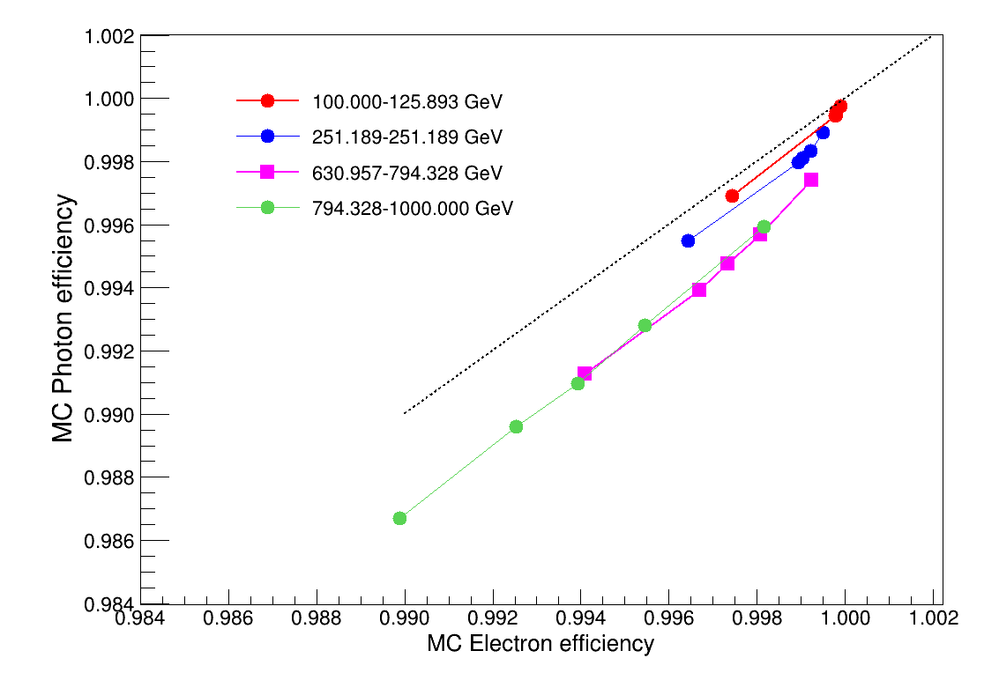
MC efficiency results and comparison
Electron and proton HP MC data: NUD signal efficiency
MC electron and photon efficiency in different E range

Slide 18
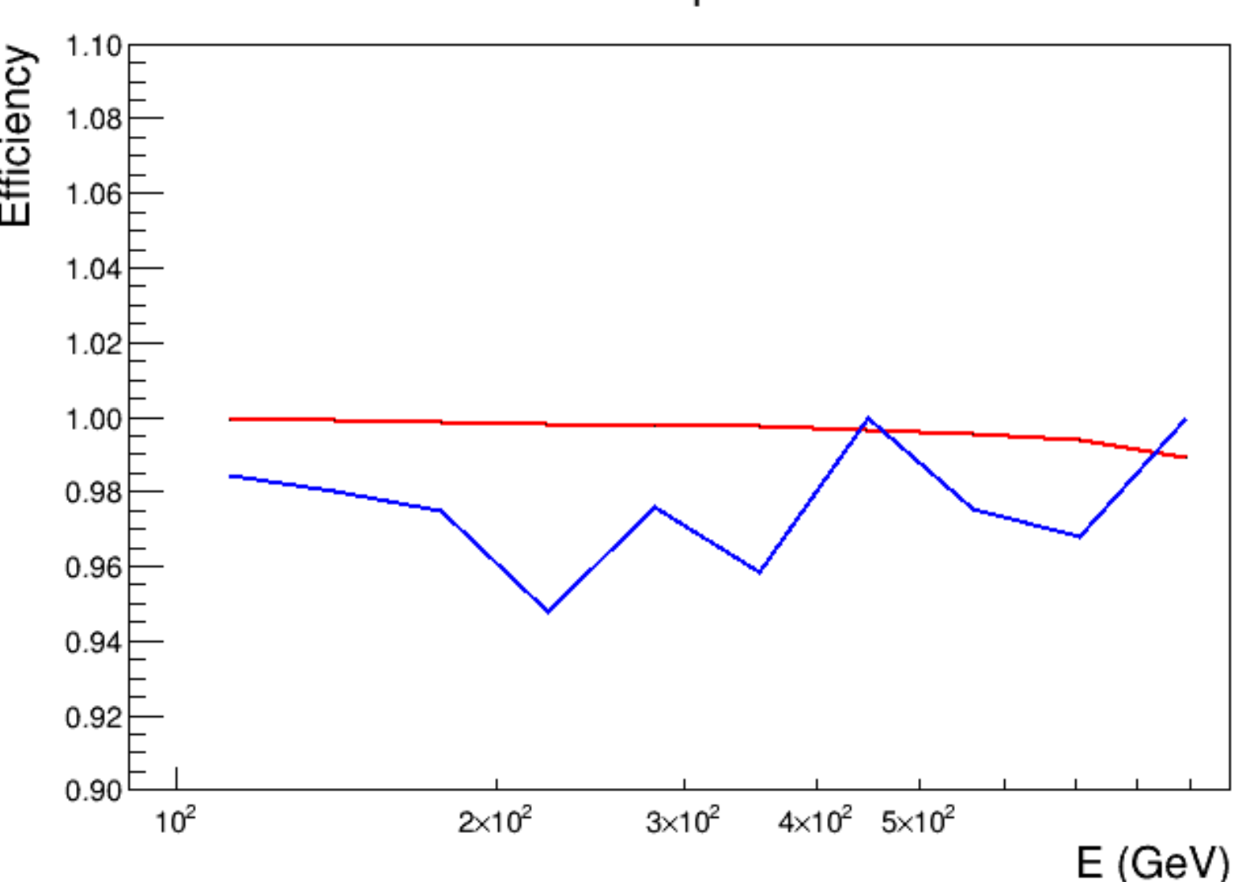
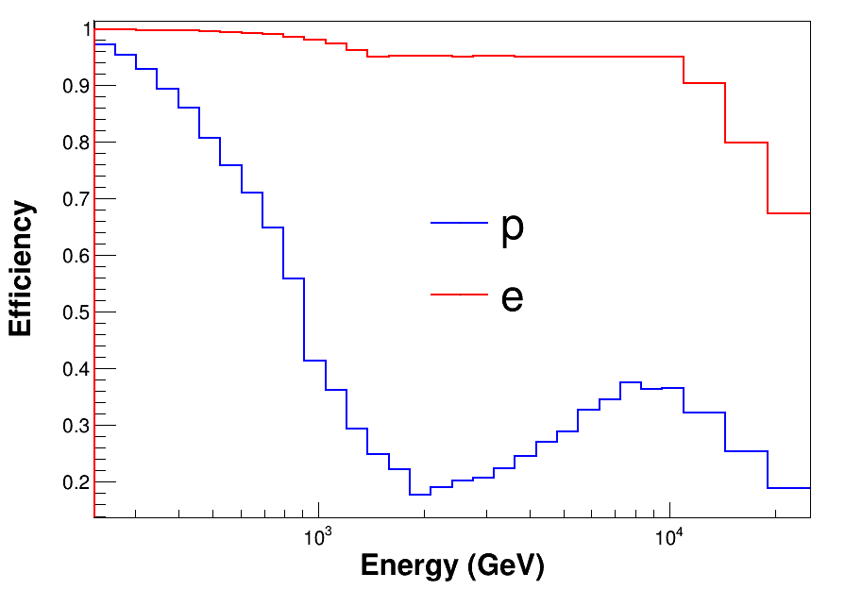
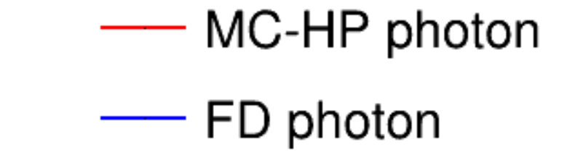
MC efficiency results and comparison
MC-HP
MC-HP
Keep 95% efficiency of MC electron, require cut threshold >= 50 ADC
To avoid the saturation effect, cut threshold should <1950 ADC

Slide 19
NUD Research
Calibrations
Verification of NUD response
Saturation effect
Uniformity check
γ-ray NUD signal verification
channel/
Time variations
STK track
events
BGO track events
γ-rays selection algorithm
ML BGO track

Slide 20
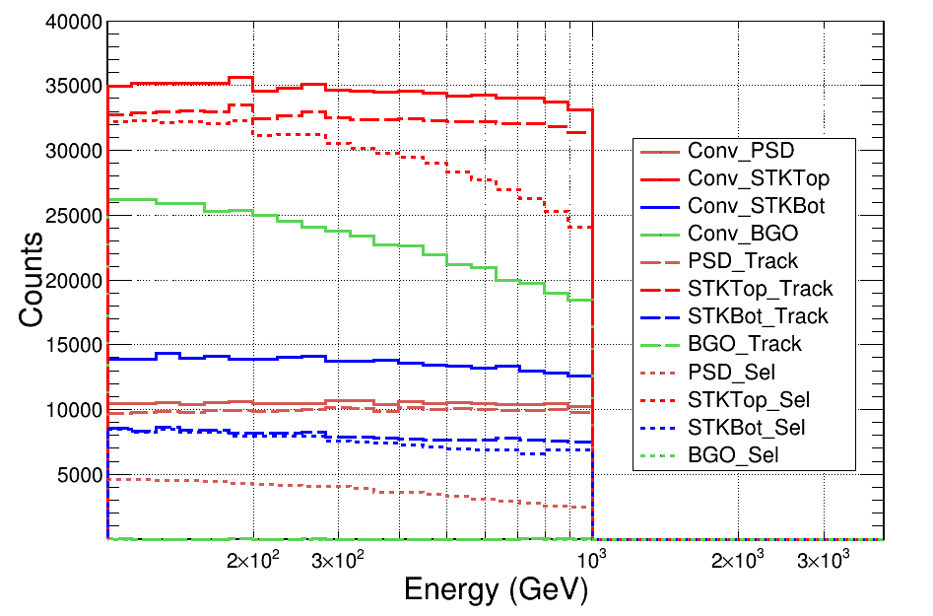
ML BGO trk
MC gamma ray convert position/ with STK track/ pass Q selection
BGO convert/STK bottom 3 layer events mekes up 40% of total events
ML parameters: the Xpoint/Ypoing when z=0; dy/dz and dx/dz

Slide 21
BGO track reconstruction model
Conv2D,c=64,k=3x3
BatchNorm2D
Flatten Data
Physical Params（28）
14x22
logE
14x22 pixels
ResidualBlock,c=128,
CBAM, MaxPool（2，2）
Neu=512, BatchNorm1D，dropout=0.1
14x22
norm
ResidualBlock,c=256,
CBAM, MaxPool（2，2）
Neu=128, BatchNorm1D，dropout=0.1
Data Processing
ResidualBlock,c=128,
CBAM, MaxPool（2，2）
Neu=64, BatchNorm1D，dropout=0.1
Training samples:MC gamma preselection, the same as page 5
Using data from BGO Edep: 14*22 pixels
Flatten = 128*3*5
Neu=4（slp, intercept）
Conv Model
Neuron network

Slide 22
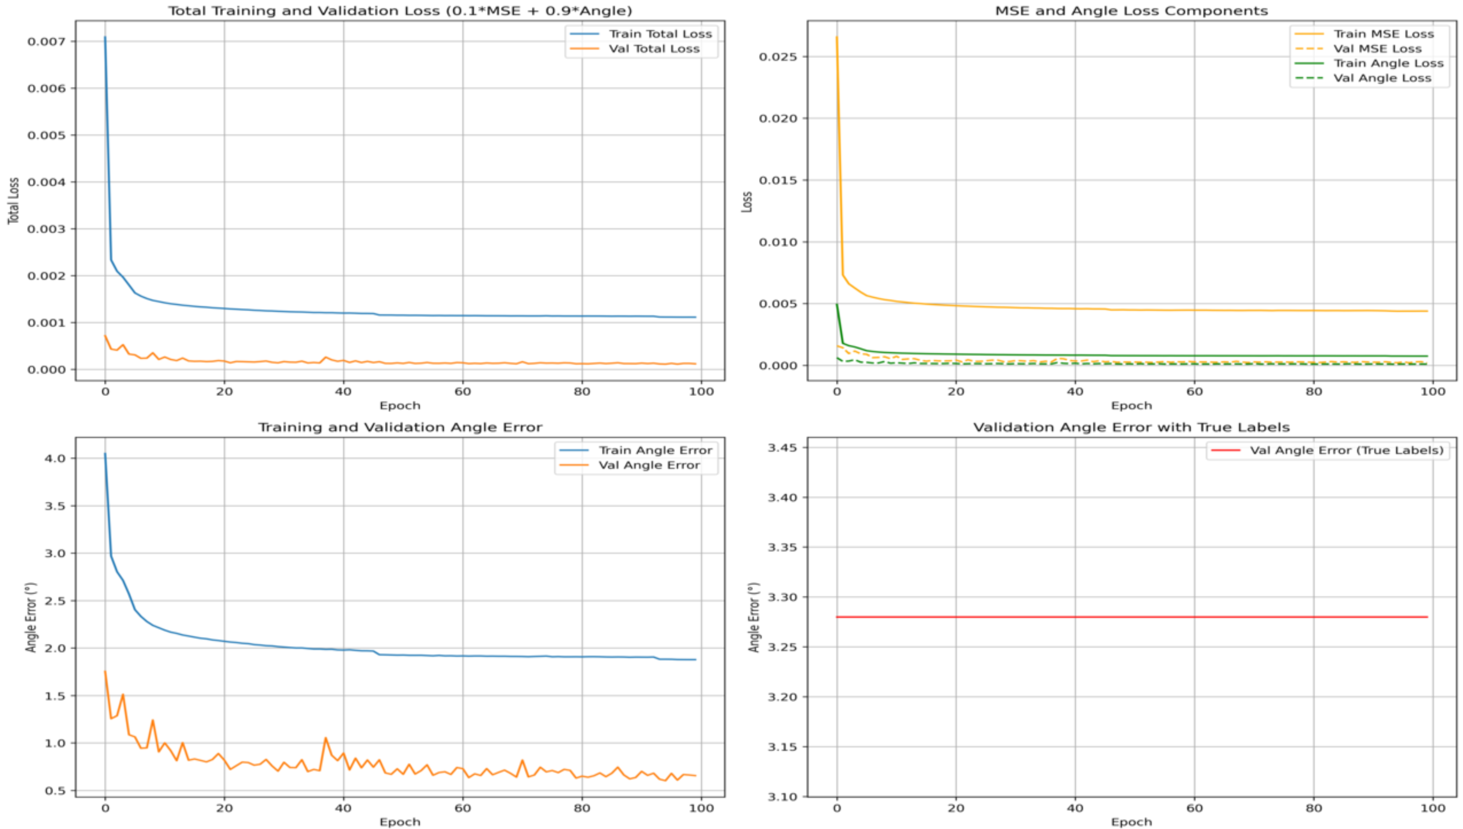
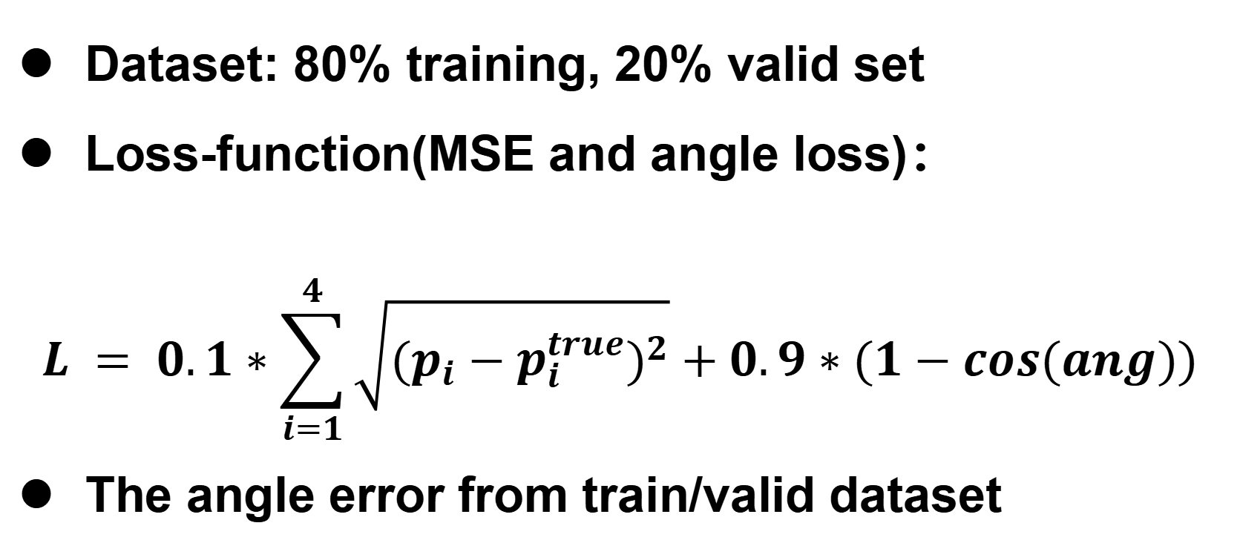
Training Results
Dataset: 80% training, 20% valid set
Loss-function(MSE and angle loss)：
$$L = 0.1∗\sum_{i=1}^{4}{\sqrt{{(p_{i}−p_{i}^{true})}^{2}}}+0.9∗(1−cos(ang))$$
The angle error from train/valid dataset

Slide 23
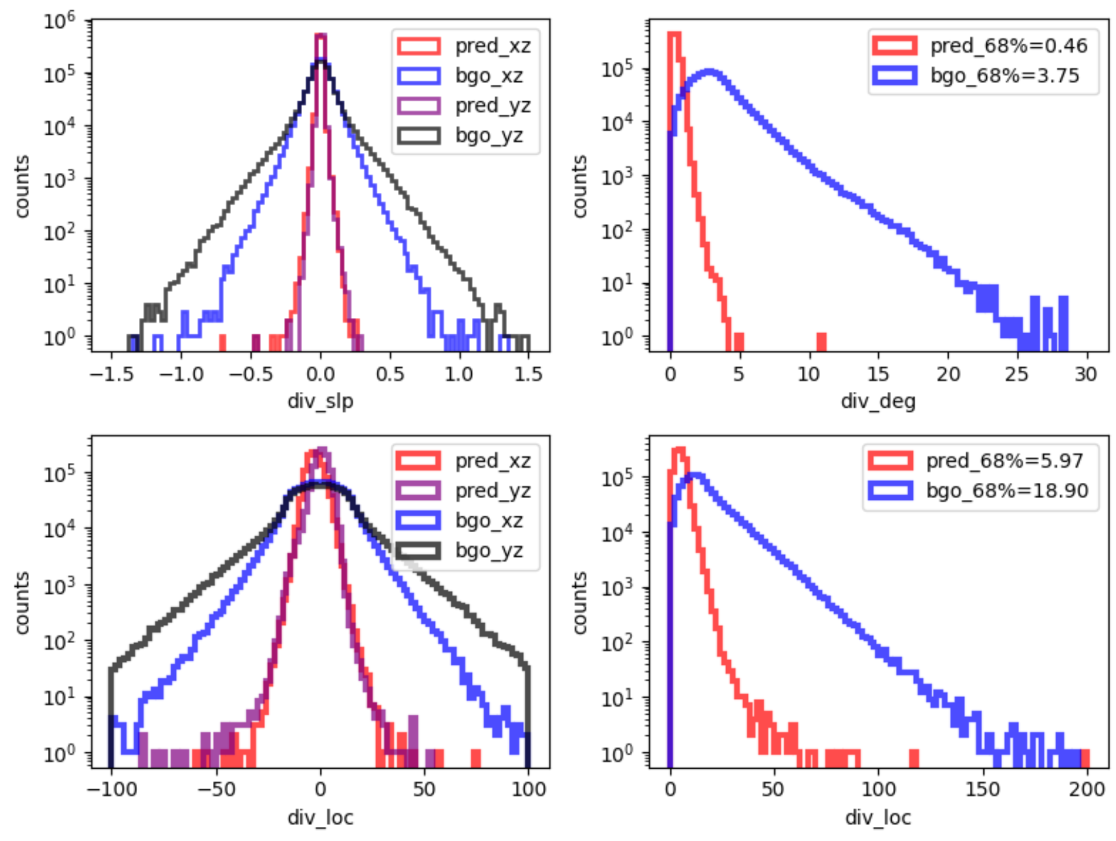
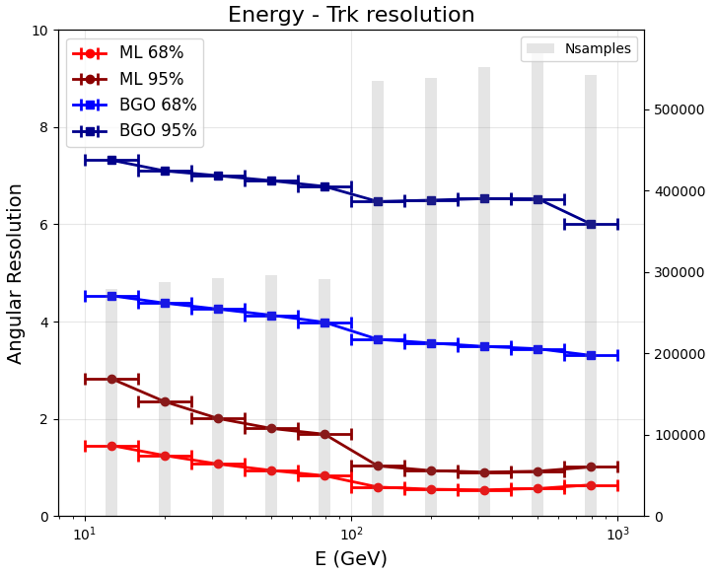
BGO ML results
Summary of BGO track reconstruction results: output 4 parameters and track resolution from 10 GeV to 1 TeV

Slide 24
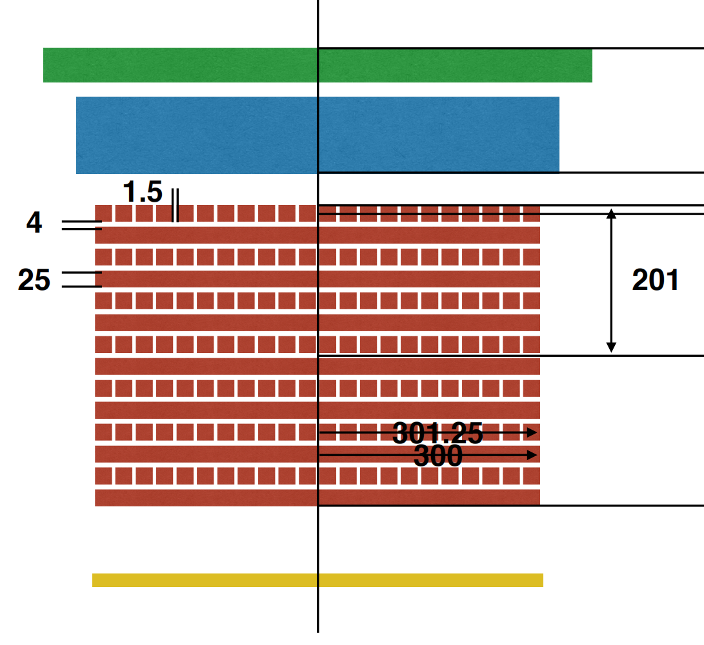
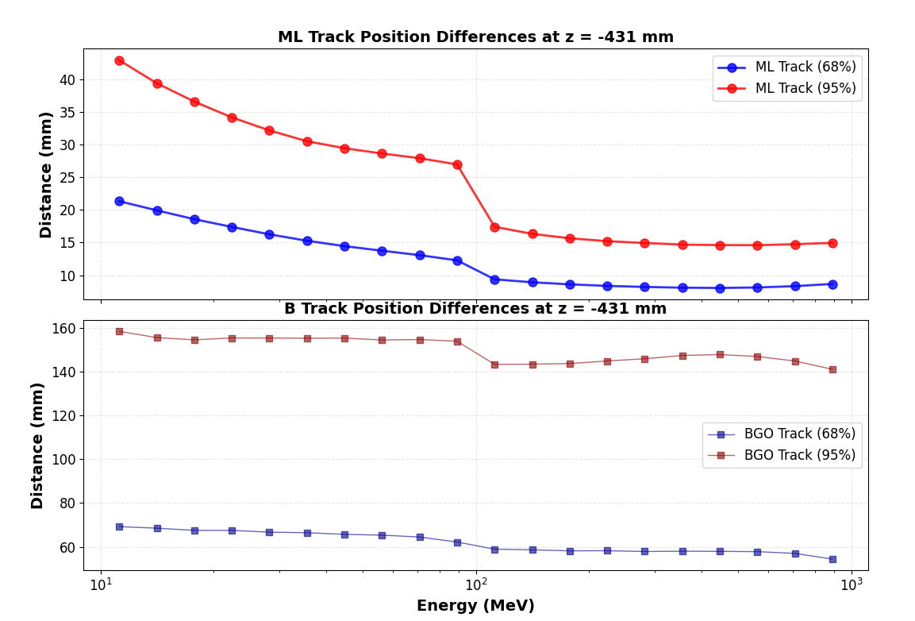
BGO ML results
Pri track
ML track
ML track gives batter angular resolution
Hit point at PSD L0 errors: from 20 mm to < 10 mm
Further estimation of increase on acceptance needs to be done

Slide 25
Summary
Updated γ-ray selection methods, including STK track and charge selection methods
The saturation effect of the NUD: around 1950 ADC
Preliminary NUD efficiency validation from MC electron and γ-rays
New ML BGO track for further γ-ray analysis

Slide 26
MC efficiency results and comparison

