Slide 1


Simulation update for HNS0
Jiangpeng Zhou，Yaping Wang, Zhihui Xu, Aiqiang Guo
CCNU & IMP
2026.02.10

Slide 2
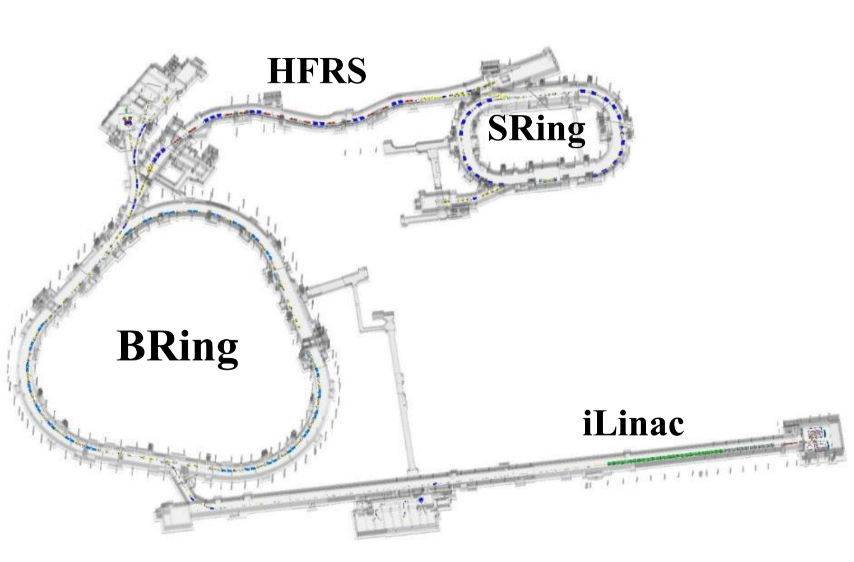
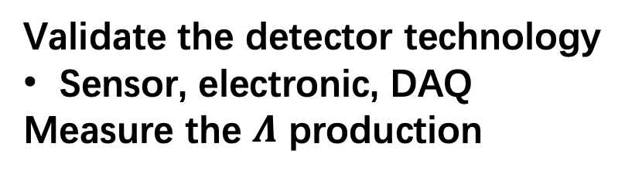

The introduction of $HNS∅$
T0 detctor
Beam
target
Tracker (MIC6)
TOF (LGAD)
Validate the detector technology
Sensor, electronic, DAQ
Measure the $Λ$ production

Slide 3
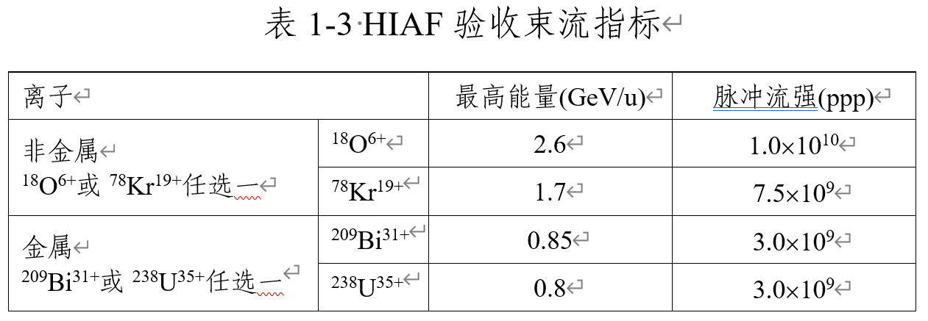
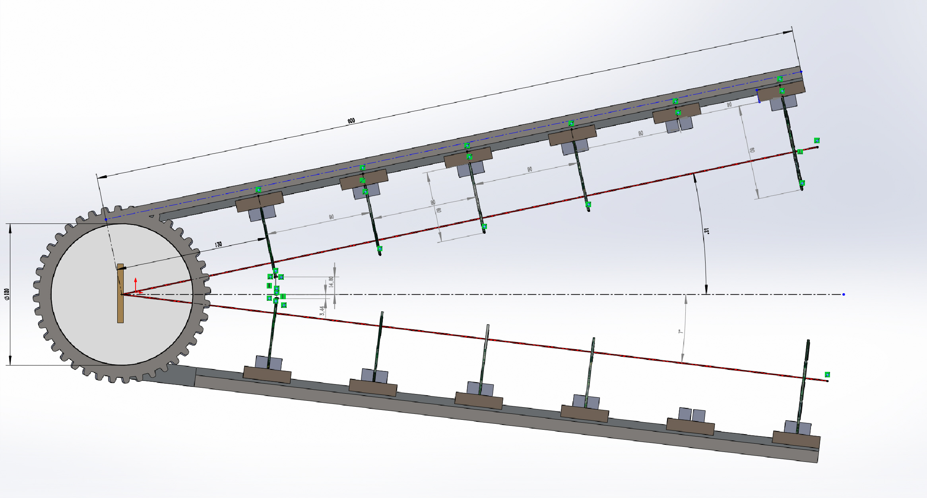
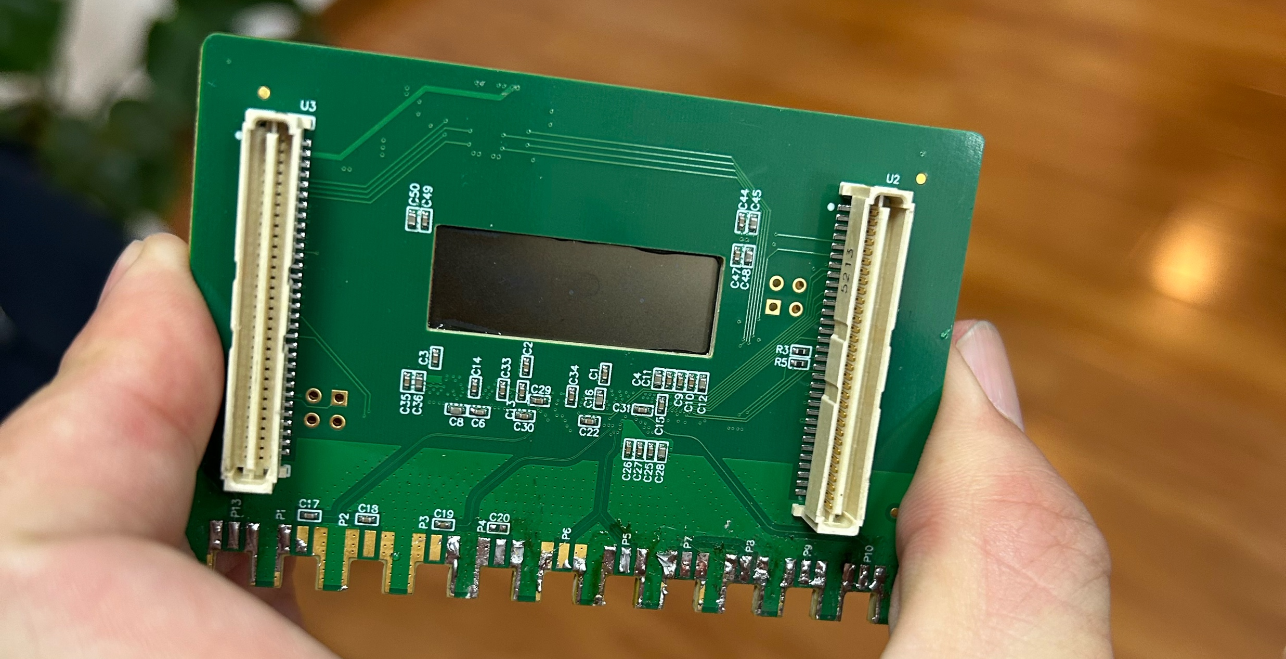
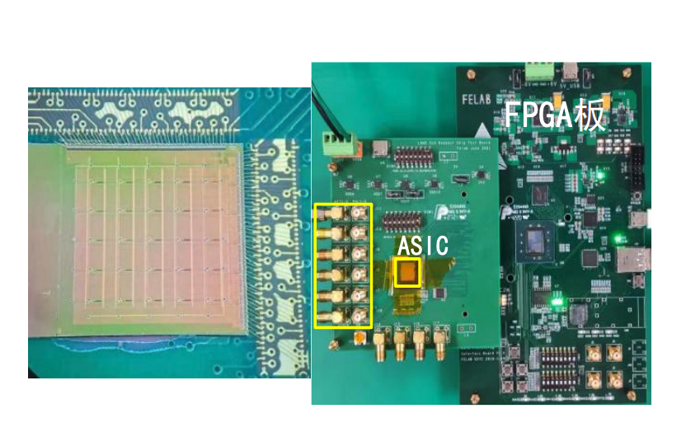


The mechanical design of $HNS∅$
MAPS (MIC6)
LGAD
1.3$×3$ cm

Slide 4
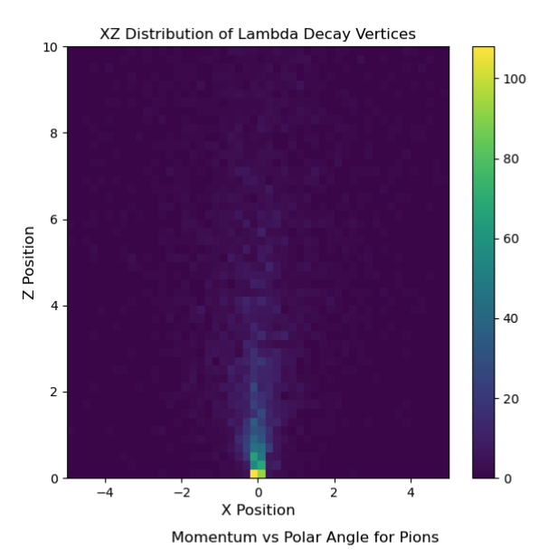
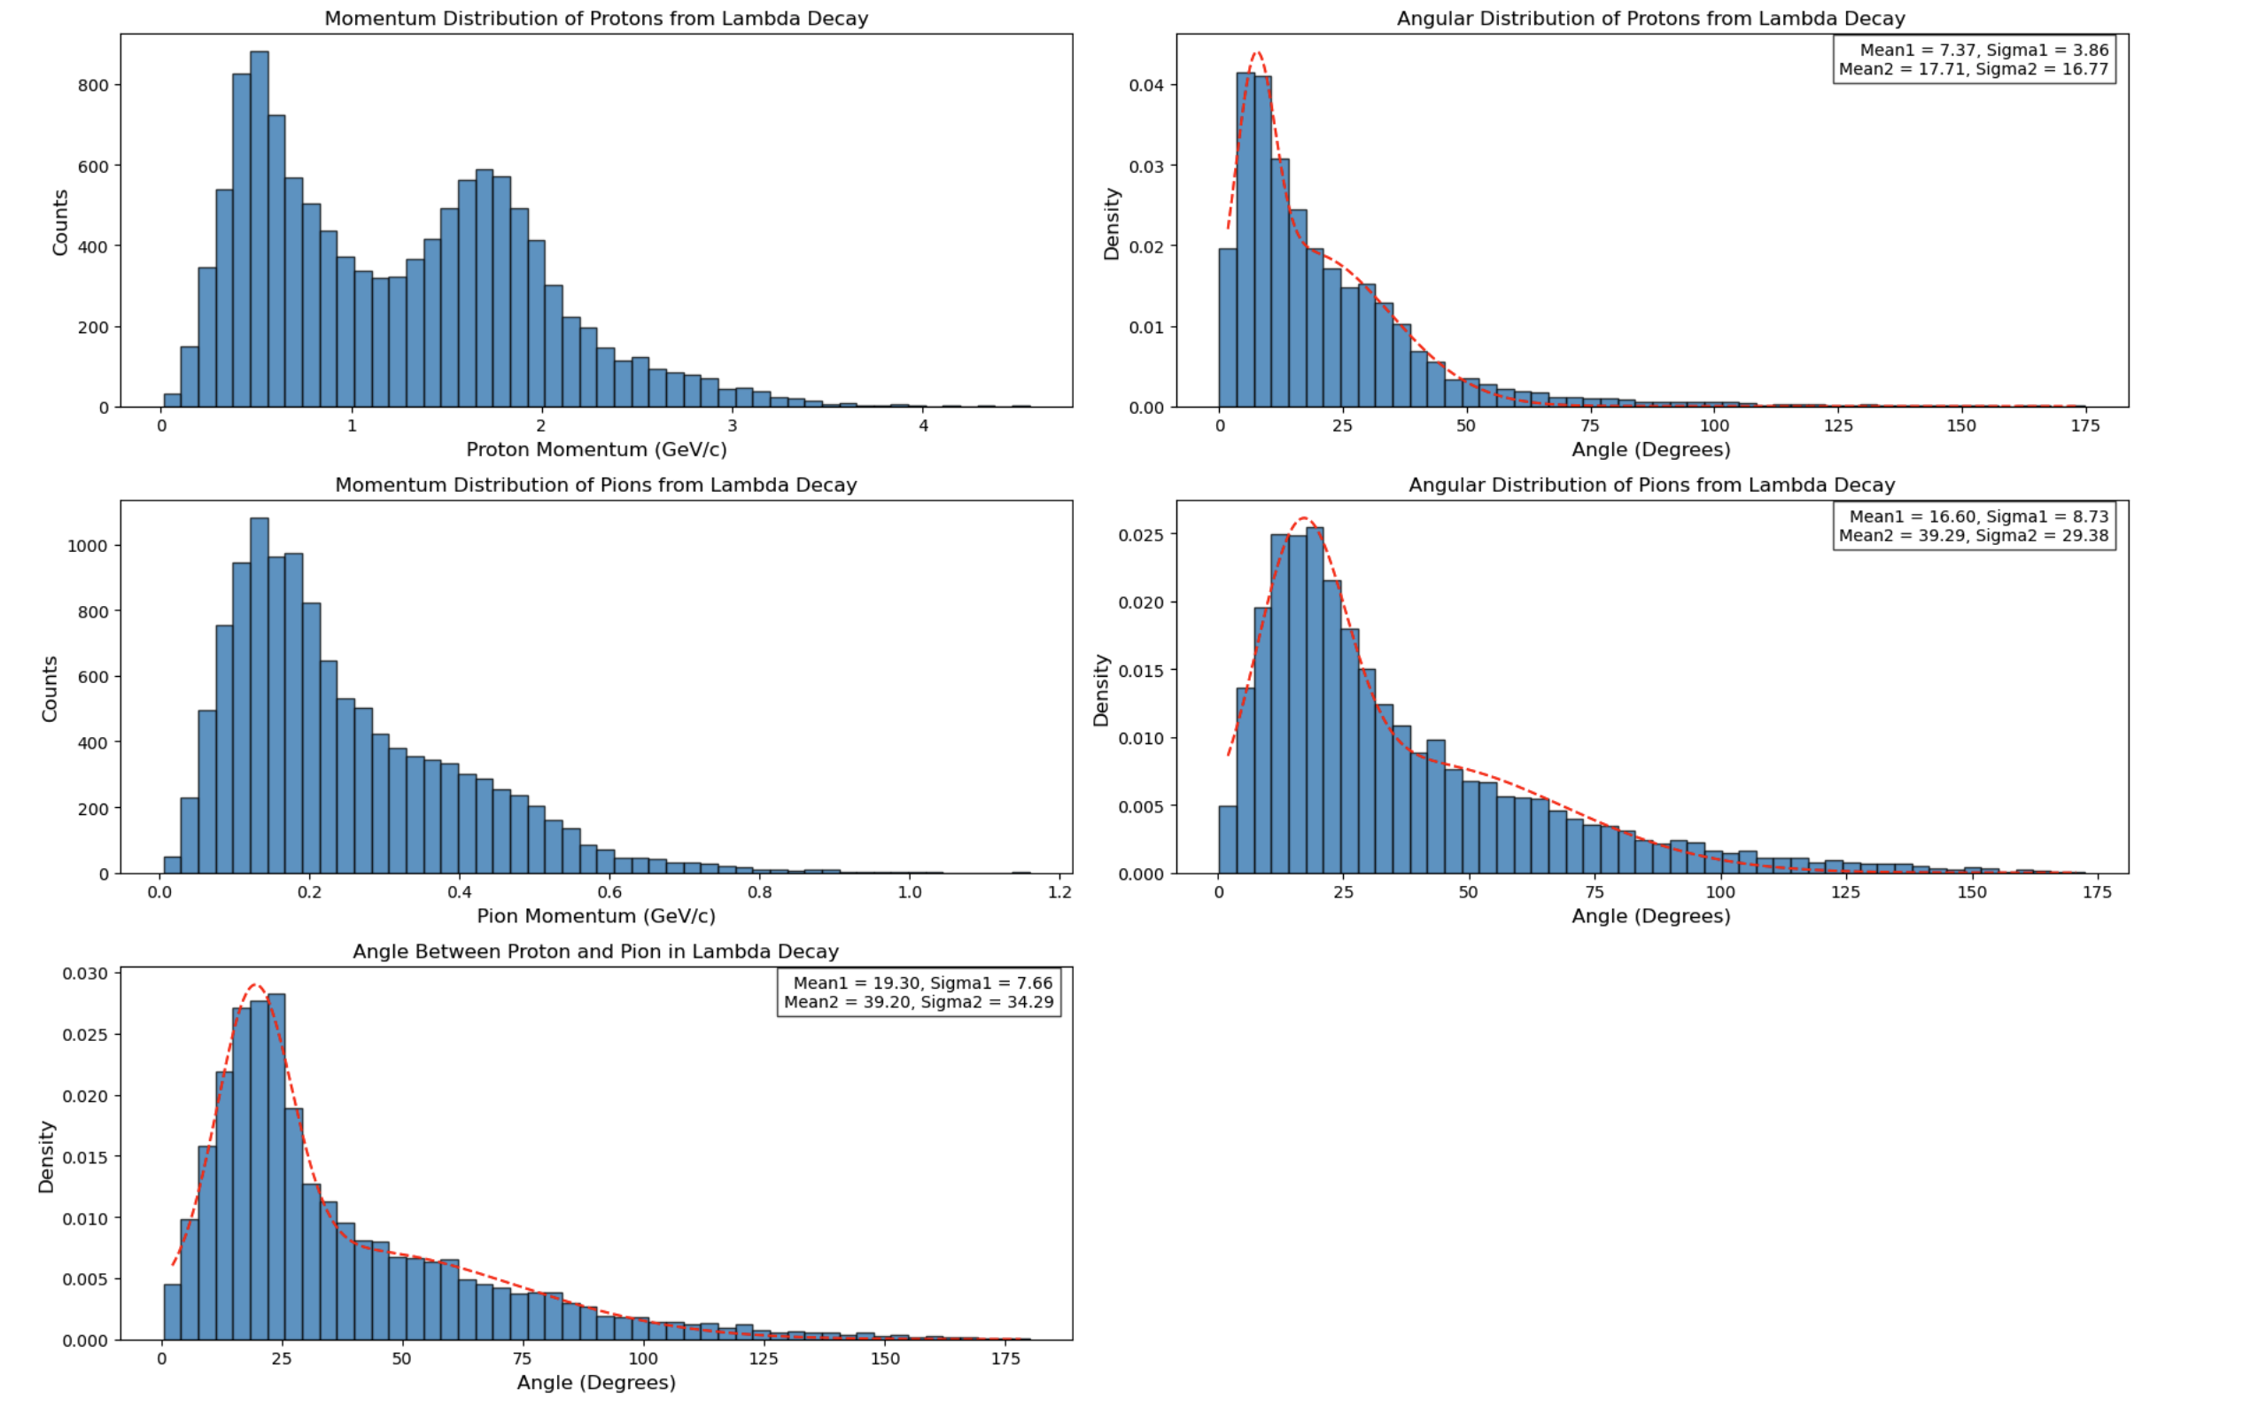




Simulation of O+C interaction
Mom. of p from $Λ$
Polar angle p
[cm]
Mom. of $π$ from $Λ$
Polar angle $π$
Open angle $π$&p
[cm]

Slide 5
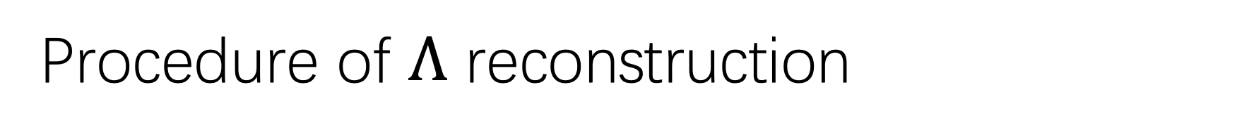

Procedure of $Λ$ reconstruction
Select the event, in which there are track on both the proton and pion arm
Assume the track on proton arm is proton, and pion on another arm
Determine the momentum according to the measured velocity by LGAD
Calcaulate the invariant mass of the found two particles
Beam direction
Pion arm
Proton arm
12º
7º
Proton arm
$$v=L/t$$
$$p=γmv$$
Pion arm

Slide 6
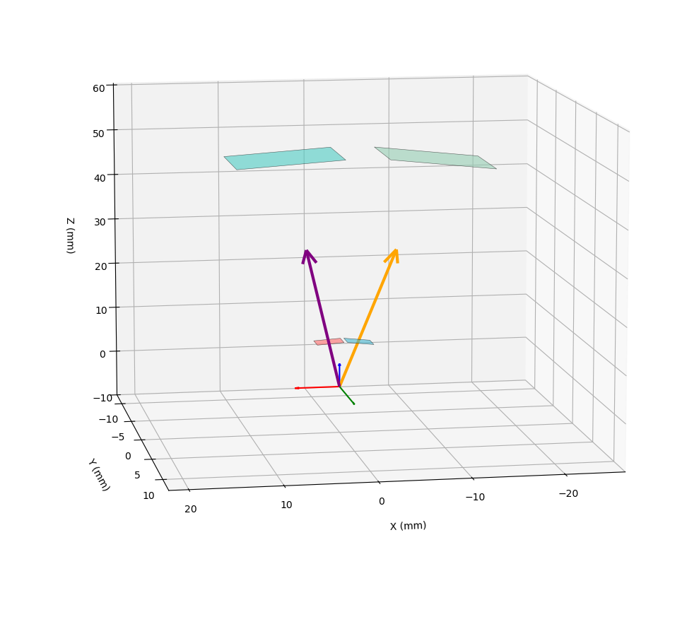
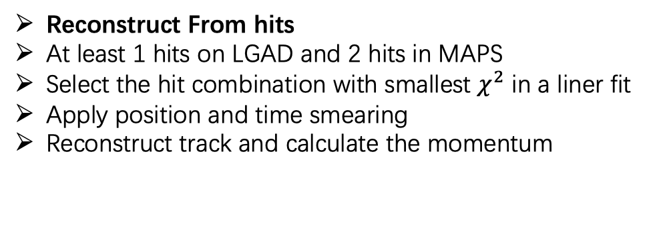
Two methods for simulation
Proton arm
$$v=L/t$$
$$p=γmv$$
Pion arm
Reconstruct From True Track
Select the tracks that pass through the first and the last detector
Apply Momentum & DCA smearing
Calcaulate the invariant mass
Reconstruct From hits
At least 1 hits on LGAD and 2 hits in MAPS
Select the hit combination with smallest $χ^{2}$ in a liner fit
Apply position and time smearing
Reconstruct track and calculate the momentum

Slide 7
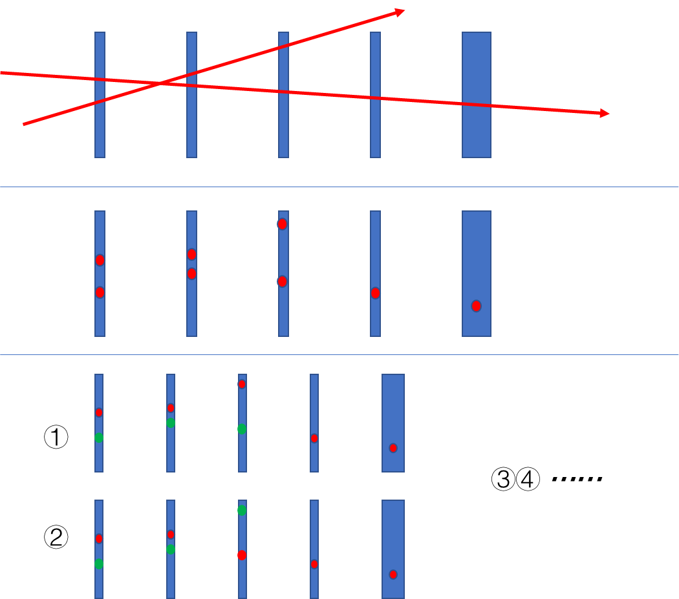

Reconstruction with Hits
Open Angle[deg] : 7 + 12
Module Distance[cm] : 10,20,30,40,45,50(LGAD)
At Least 1 Hit on LGAD & 2 Hits on MAPS
MAPS Resolution: 5um
LGAD Resolution: 50ps
820M O+C 2.6GeV Events From Jam
Geant4 Geometry

Slide 8
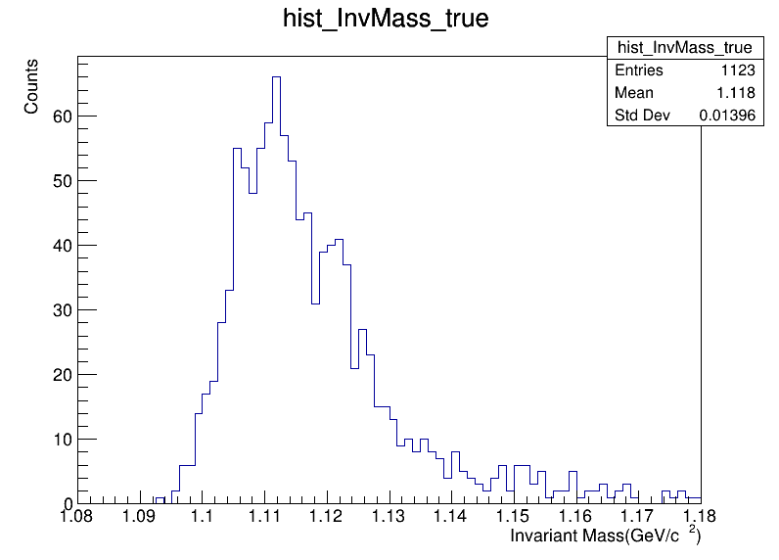
P-Pi Invariant Mass From True Lambda
Invariant Mass From True Lambda Decay
About 1100 Lambda
Invariant Mass is relatively small.

Slide 9
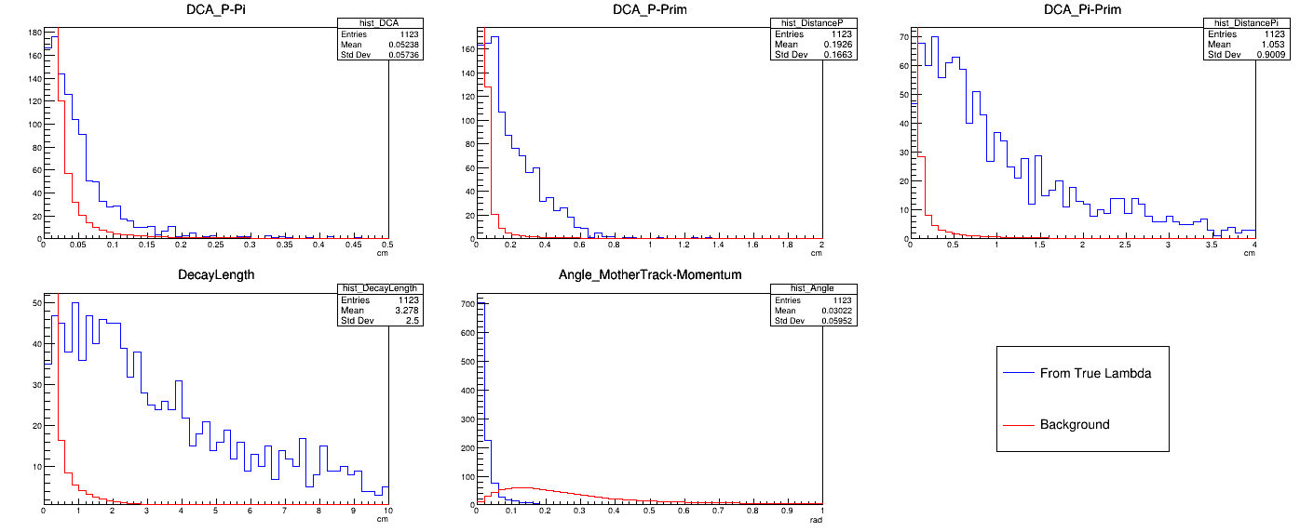
Topological Difference between Λ / Non-Λ Events

Slide 10
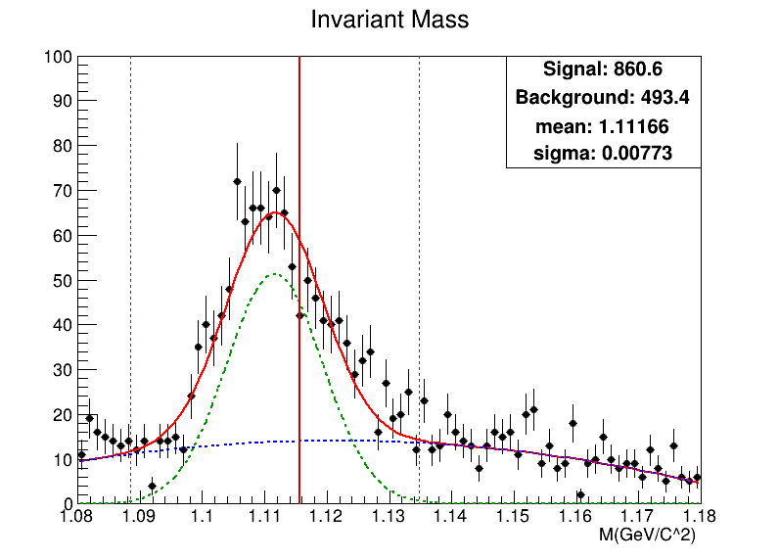
Invariant Mass From Hits Reconstruction
Cuts:
Decay Length > 0.5cm
DCA p-π < 0.5cm
DCA p-prim > 0.1cm
DCA π-prim > 0.3cm
Angle < 0.3 rad
Around 860 Lambda

Slide 11
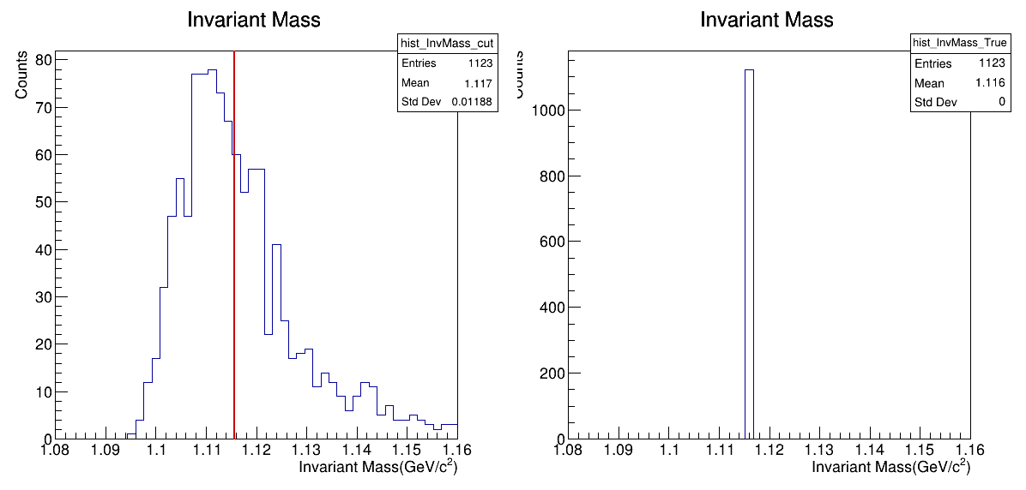
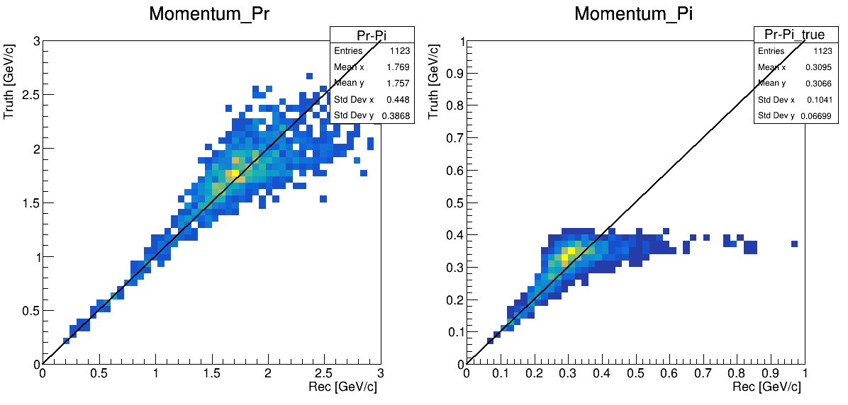
Reconstruct Momentum vs Truth Momentum
Truth with smearing
Truth without smearing
x3 = 50cm
x1+ x2 > x3
距离偏小，动量偏小，导致不变质量偏小
Pion
Proton
proton
pion
x1
x3
x2
Lambda
重建动量 vs 真实动量

Slide 12
Reconstruction From True Track (MCTrack)
Reconstruct From True Track
Select the tracks that pass through the first and the last detector
Apply Momentum & DCA smearing
Calcaulate the invariant mass

Slide 13
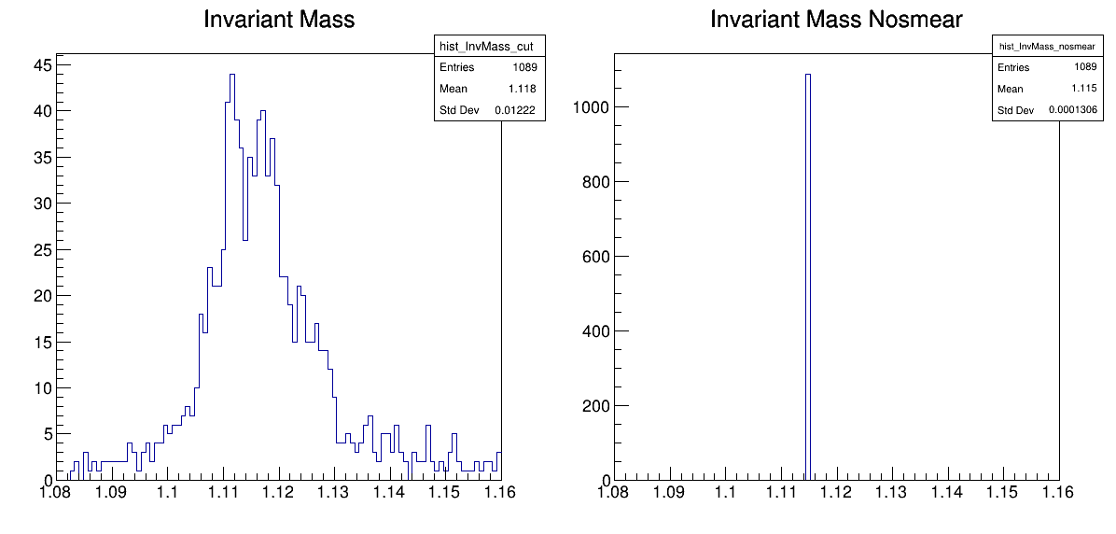
P-Pi Invariant Mass From True Lambda Decay (MCTrack)
接受度范围内总Lambda数量和Hit Reconstruction的结果一致

Slide 14
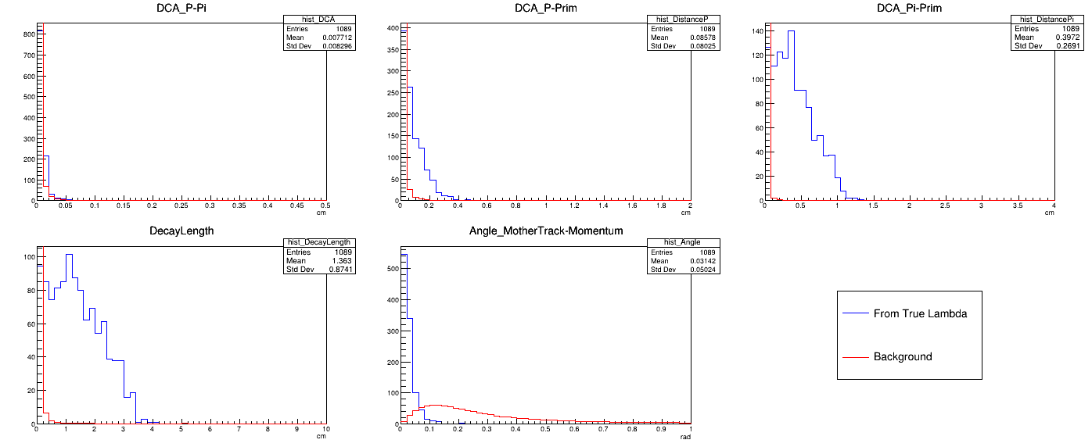
Difference between Λ / Non-Λ Events（MCTrack）
基于Smear后的MCTrack信息计算的拓扑量差别

Slide 15
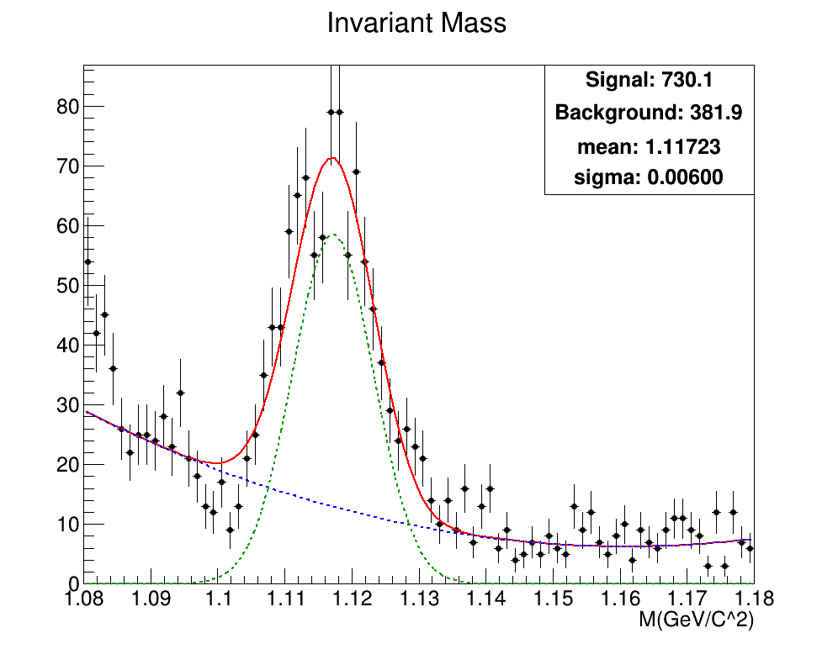
Invariant Mass From Tracks Reconstruction with new cut
Cuts:
Decay Length > 0.2cm
DCA p-π < 0.5cm
DCA p-prim > 0.01cm
DCA π-prim > 0.05cm
Angle < 0.15 rad
重建了接近的信号数

Slide 16


Invariant Mass From Tracks Reconstruction with new cut
Beam: | 1X10⁸ (pps)
Target: | 1% C target
Cross section ratio σ(Λ)/σ(tot): | ~ 0.1 %
From Hits
$\frac{S}{\sqrt{S+B}}$= 23.38
Acceptance is enlarged by a factor of 10
700~800 Lambda in 820M O+C Events(2.6GeV)
~Total 0.2 M Lambda in 10M Events
Efficiency ~ 5 * 10⁻⁶
From Tracks
$\frac{S}{\sqrt{S+B}}$= 21.90
10000 Lambda ~ 23 Days

Slide 17
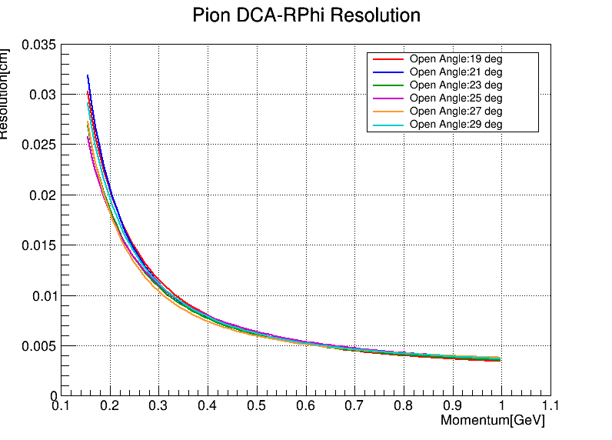
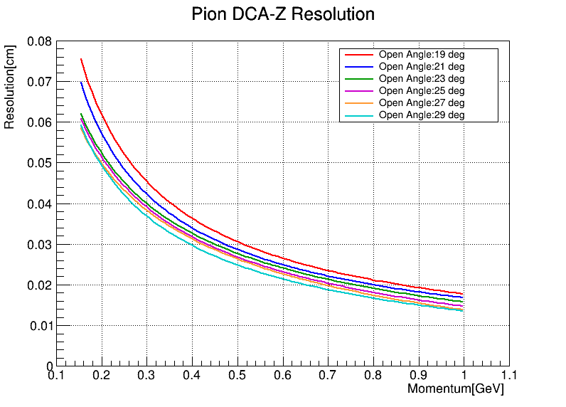
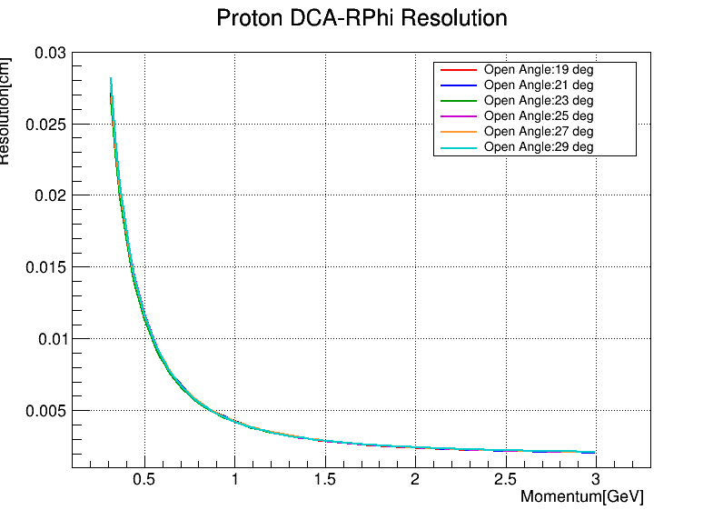
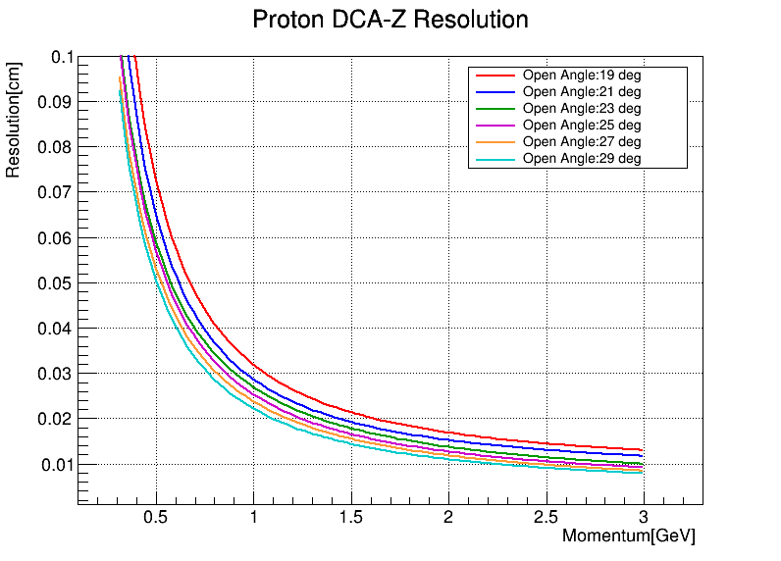
Different Open Angle Set

Slide 18
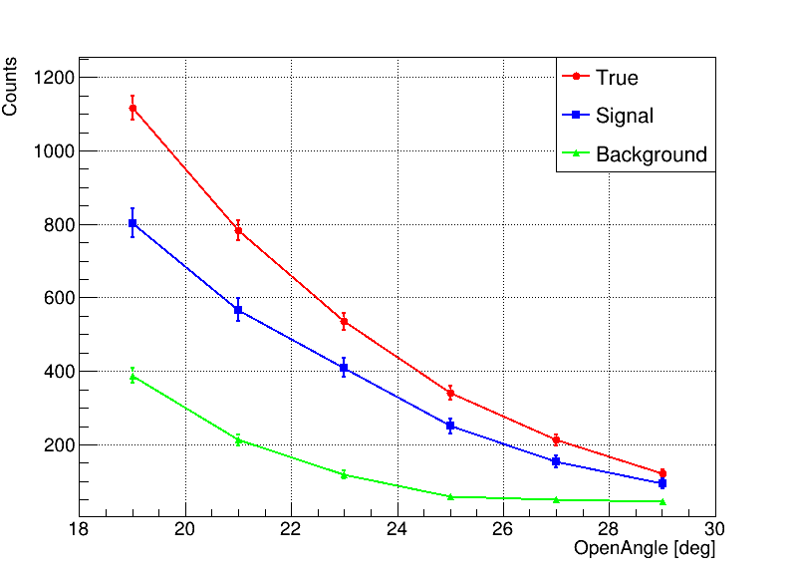
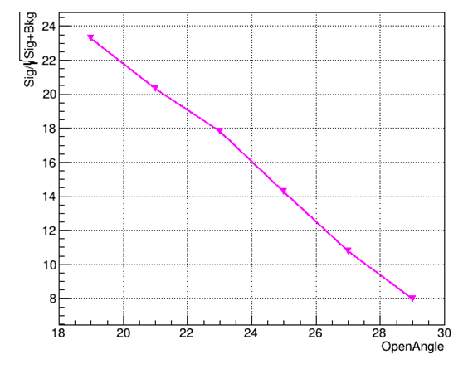
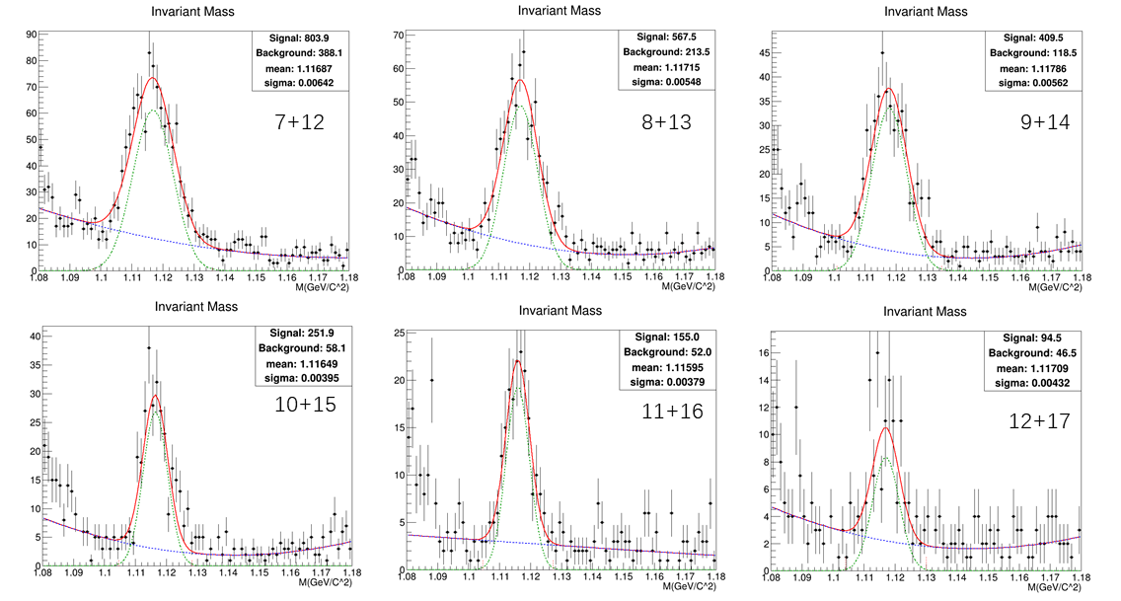
Different Open Angle Set
7° Proton Arm + 12° Pion Arm is the best geometry set

Slide 19
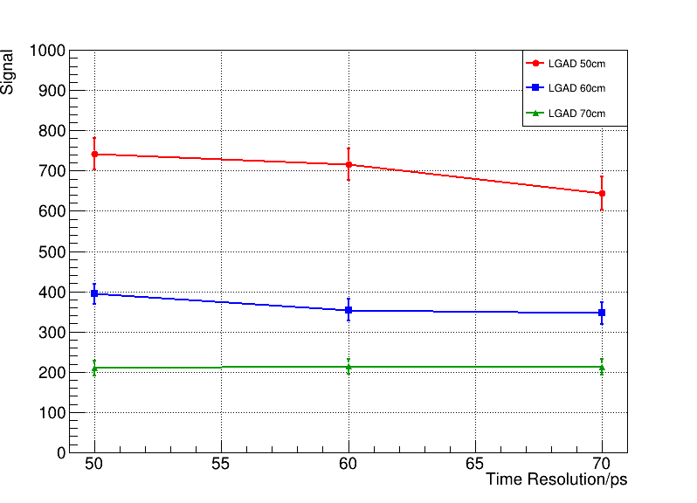
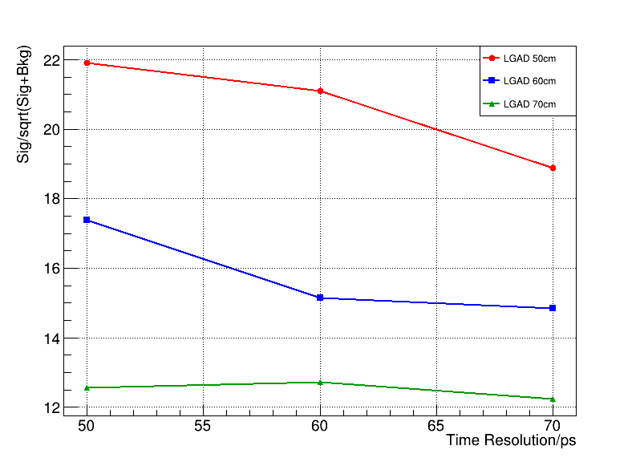
LGAD Time Resolution: 50~70ps
不同LGAD时间分辨率/位置下的重建信号数
不同LGAD时间分辨率/位置下的重建显著度
模拟了LGAD不同时间分辨率&距离靶位置下的Lambda重建情况
Time Resolution: 50, 60, 70 ps
Distance of LGAD: 50, 60, 70 cm

Slide 20
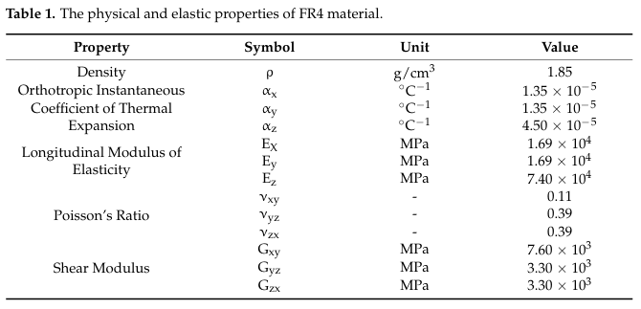

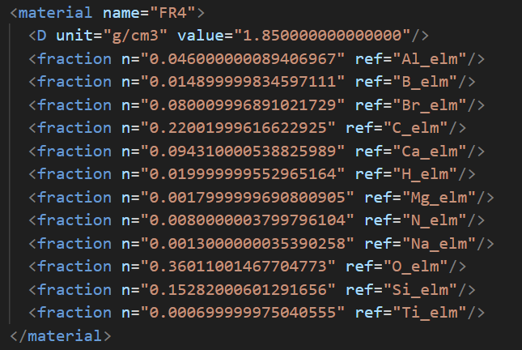
LGAD covered by PCB
模拟了LGAD被前端的电子学板遮挡导致的影响
在第五层MAPS后和LGAD前各设置了2.2mm的FR4材料
加入FR4板材后的几何
FR4 材料参数

Slide 21
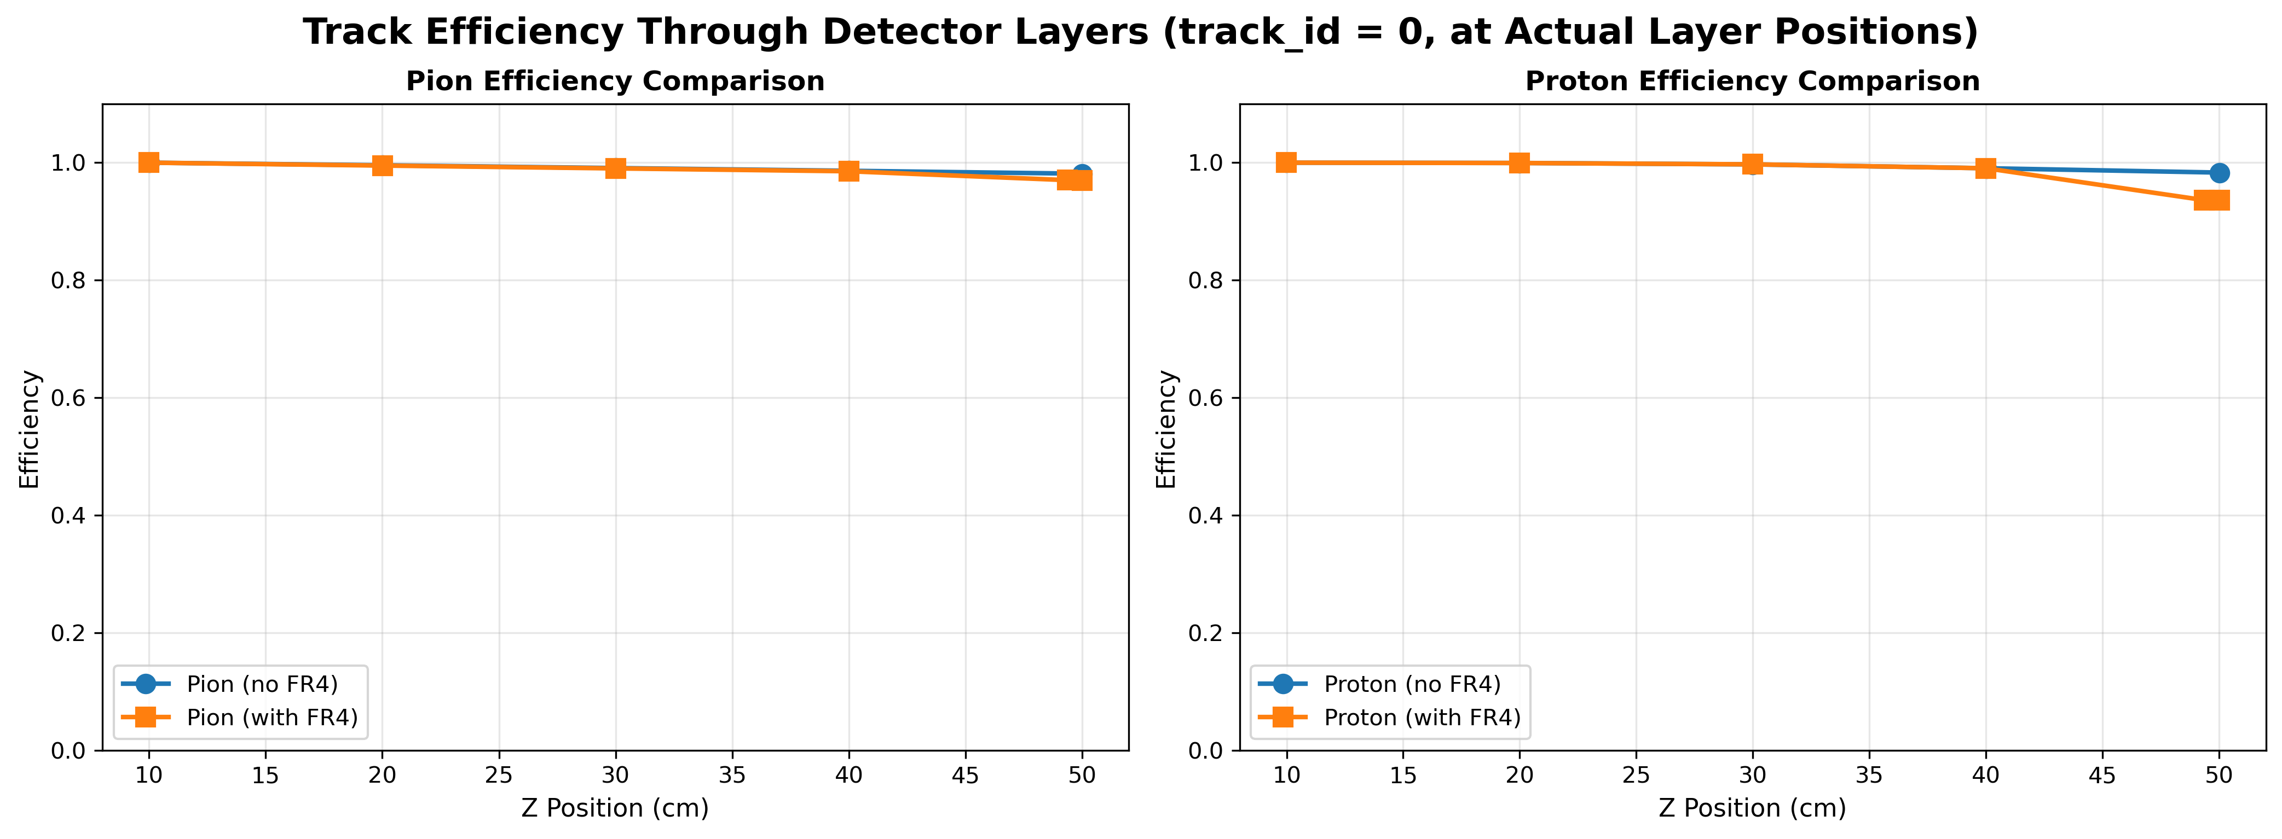
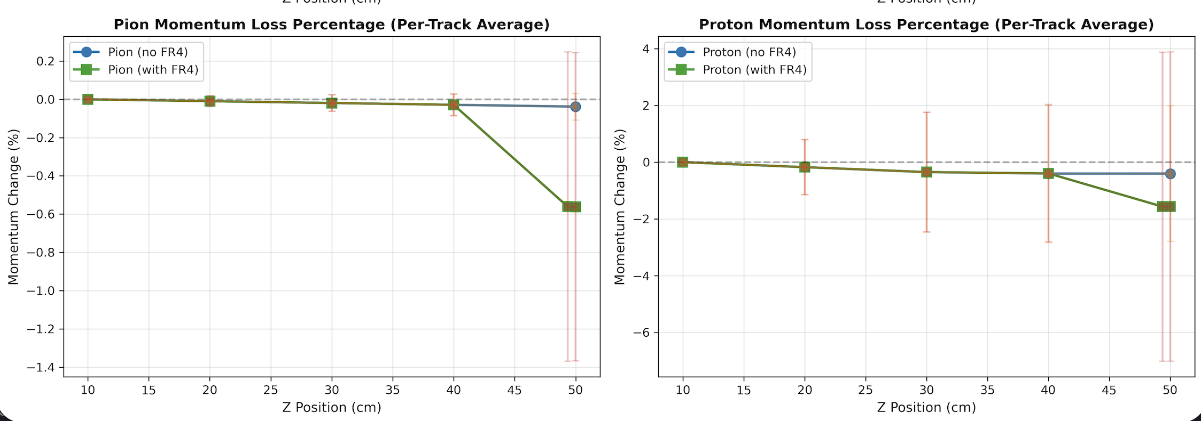
LGAD FR4 cover effect
0.5GeV
1.2GeV
Efficiency at each layer
Momentum change at each layer

Slide 22
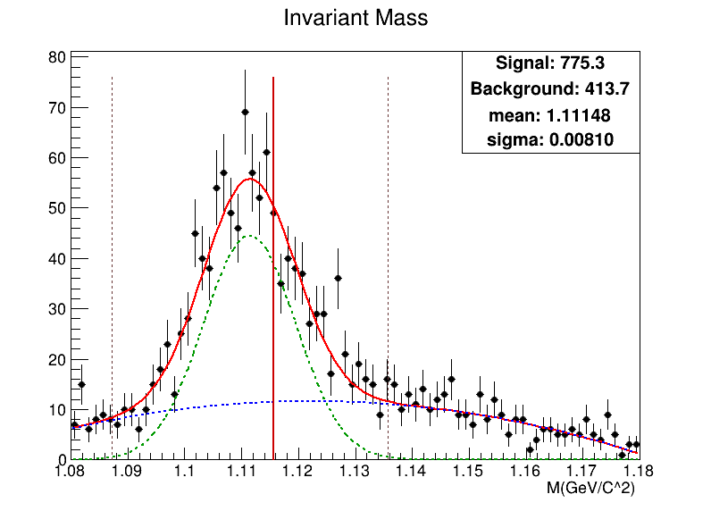


LGAD covered by PCB
From Hits
$\frac{S}{\sqrt{S+B}}$= 23.38
From Hits
$\frac{S}{\sqrt{S+B}}$= 22.48
无FR4遮挡
有FR4遮挡
重建信号数损失约10%
显著度略降低
认为该影响有限，可以接受

Slide 23
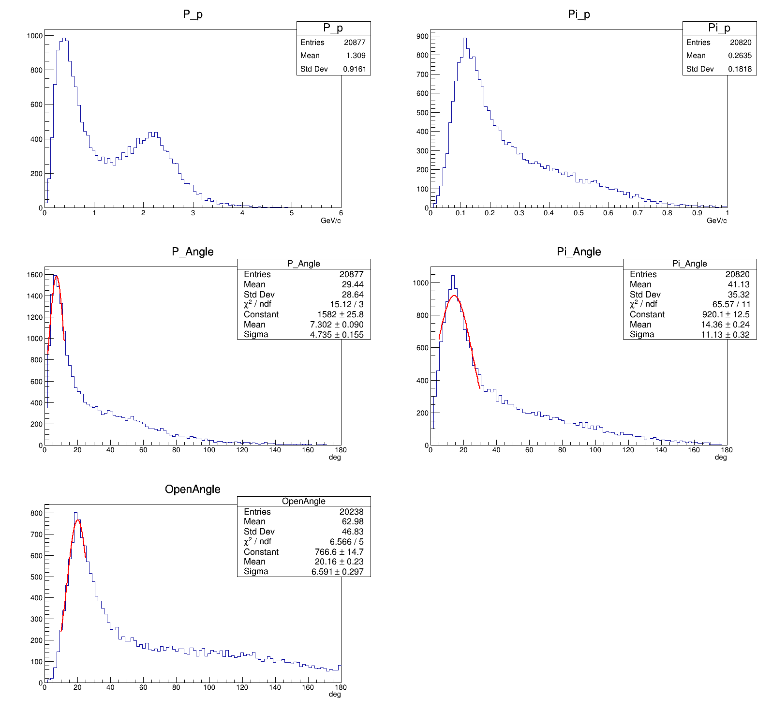
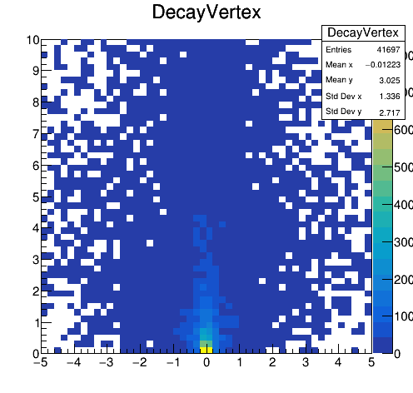
4.25GeV/u simulation
Lambda衰变顶点
phi (deg) | 2.6GeV | 4.25GeV
proton | 7.37 | 7.30
pion | 16.60 | 14.36
p-pi夹角 | 19.30 | 20.16
束流能量4.25GeV下，来自Lambda的proton角分布与p-pi夹角分布和2.6GeV相差在1°以内
可以沿用原几何设置。
4.25GeV Lambda衰变产生的p&pi的动力学分布

Slide 24
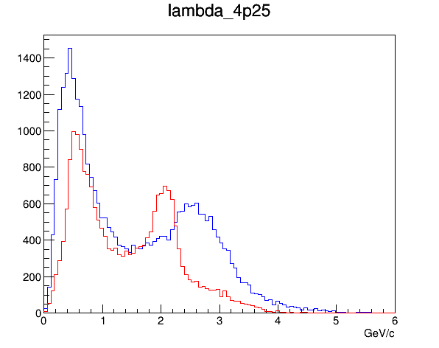
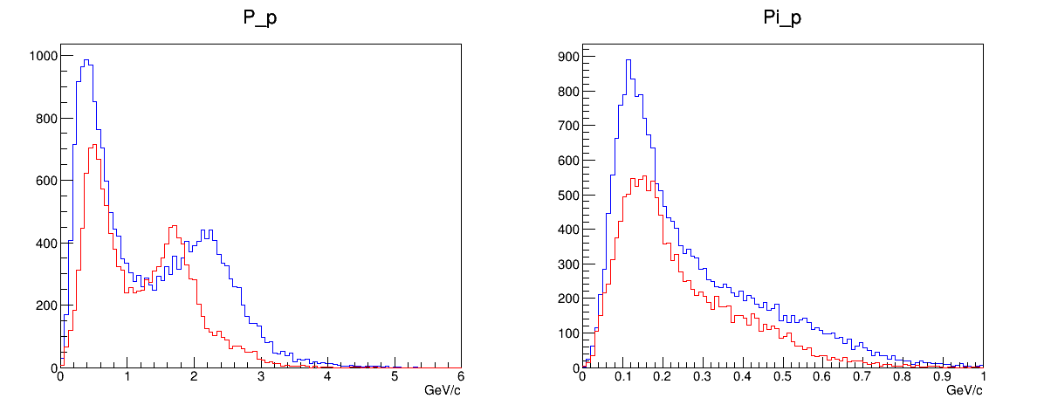
4.25GeV/u simulation
proton momentum
2.6 GeV：
~21572 Lambda
4.25 GeV：
~32779 Lambda
Total 1 M Event
pion momentum
Lambda Momentum
Jam2 模型中的Lambda产额，4.25GeV比2.6GeV提高约50%
真实产额需要计算截面
限于目前4.25GeV的统计量较少（24.6 M），重建无显著信号
正在产生更多的数据…

Slide 25
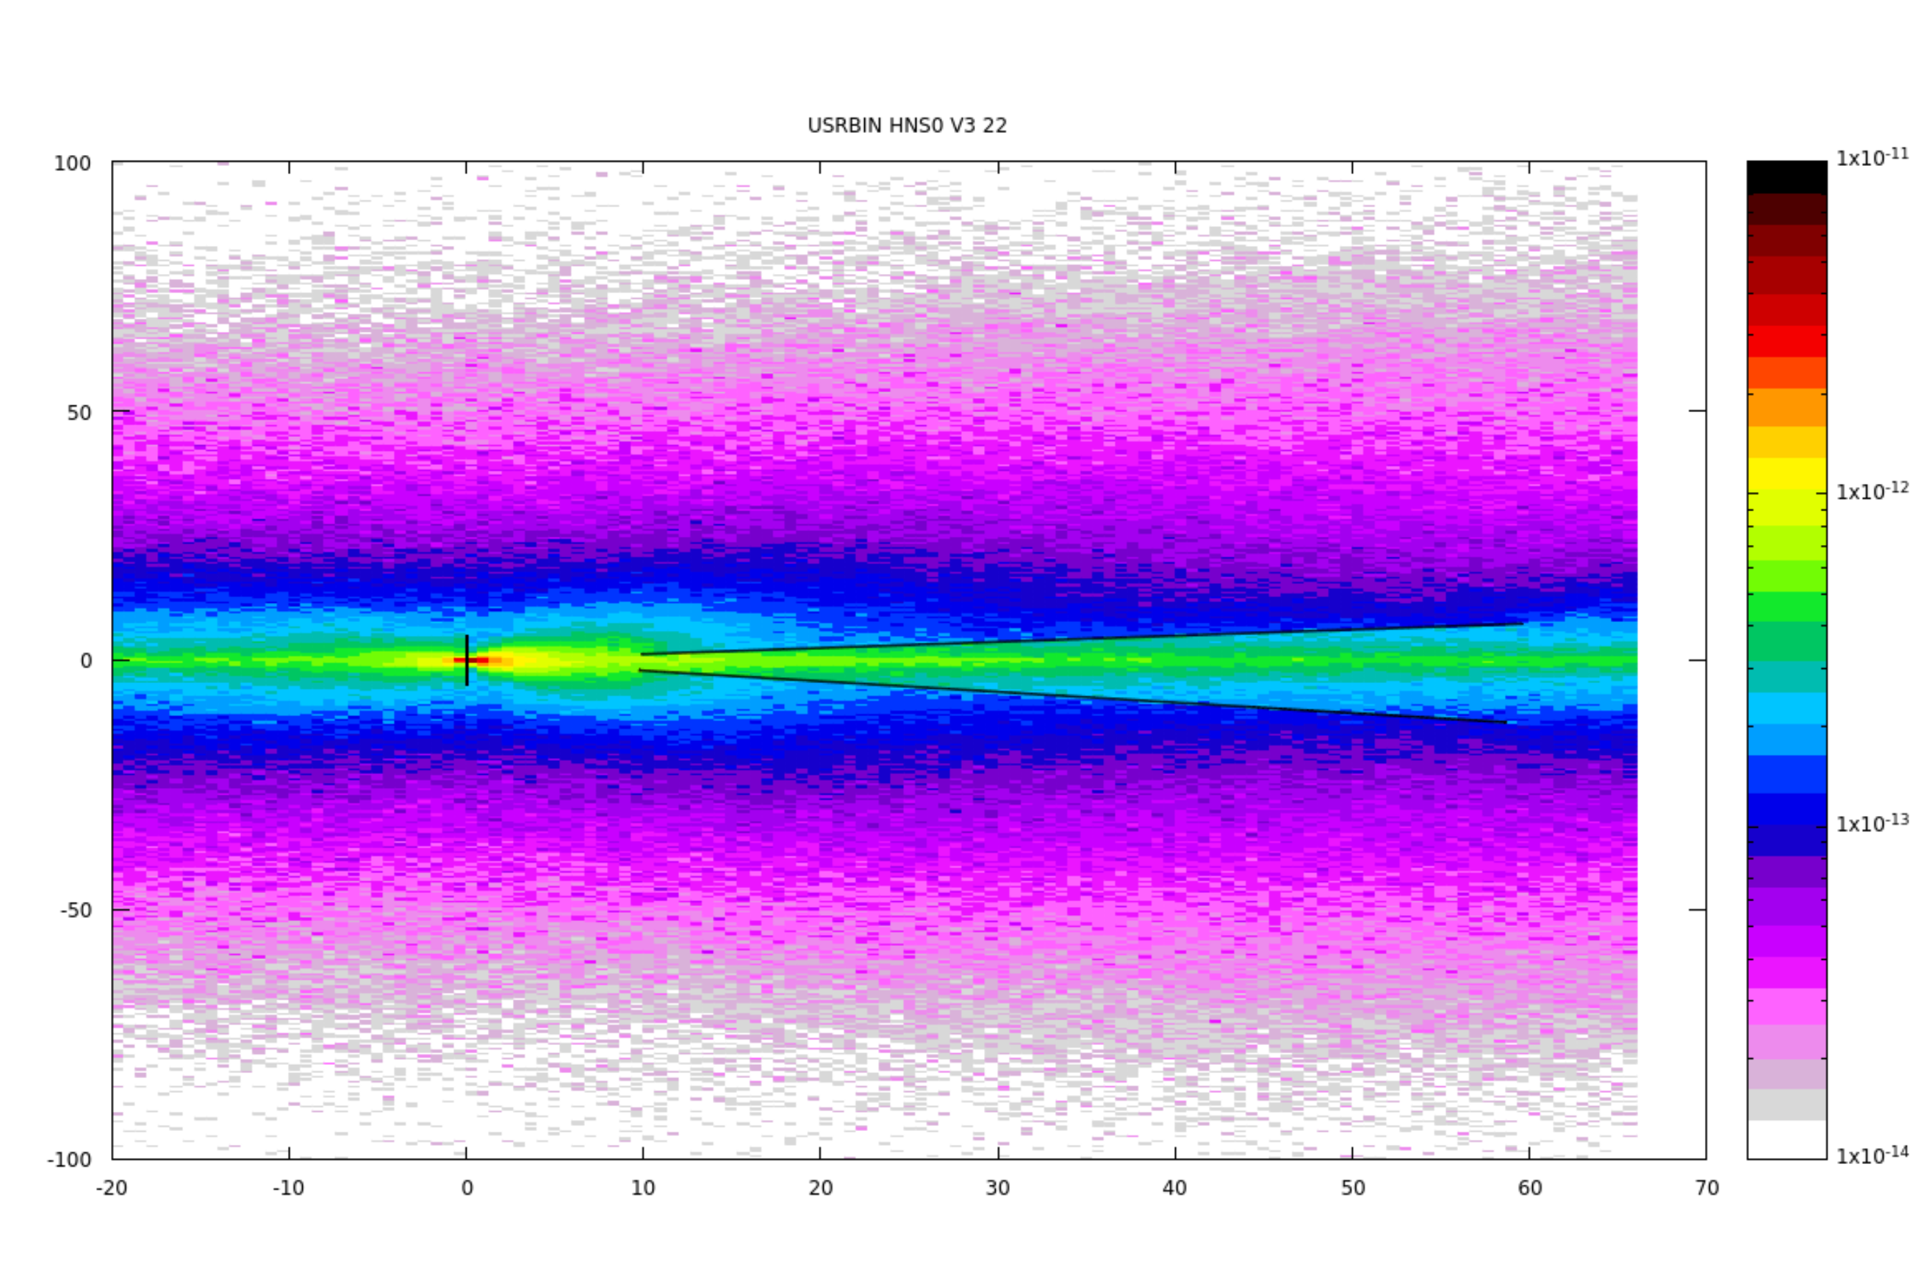
Beam BG shielding
By Zhihui Xu
2mm AL shielder
Radiation dose distribution
GeV/cm³

Slide 26
Summary
模拟了HNS0原理样机重新Lambda的性能，基于现有设计可以重建出Lambda信号。
2.6GeV/u束流能量下，10000个Lambda信号需要约3周束流时间。
HNS0张角设置为7° + 12°效果最佳。
检查了 LGAD 被 PCB 板遮挡产生的影响。对Lambda信号数和显著度的影响有限。
模拟束流能量 4.25GeV/u O+C的情况。末态proton，pion的角分布相较2.6GeV时基本一致。可以沿用几何设置。
模拟中，4.25GeV/u下 Lambda产额相较2.6GeV/u 提高 约50%。真实产额需要计算截面。
4.25GeV 统计量有限，重建无明显信号。正在产生更多数据。

Slide 27
Back up

Slide 28
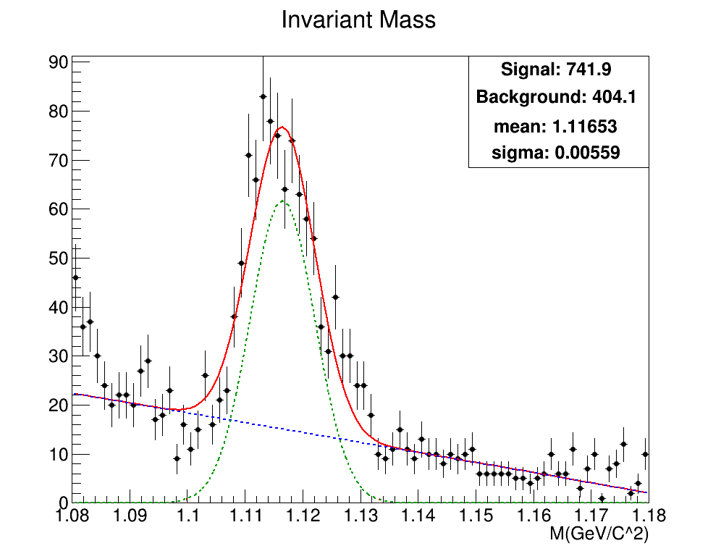
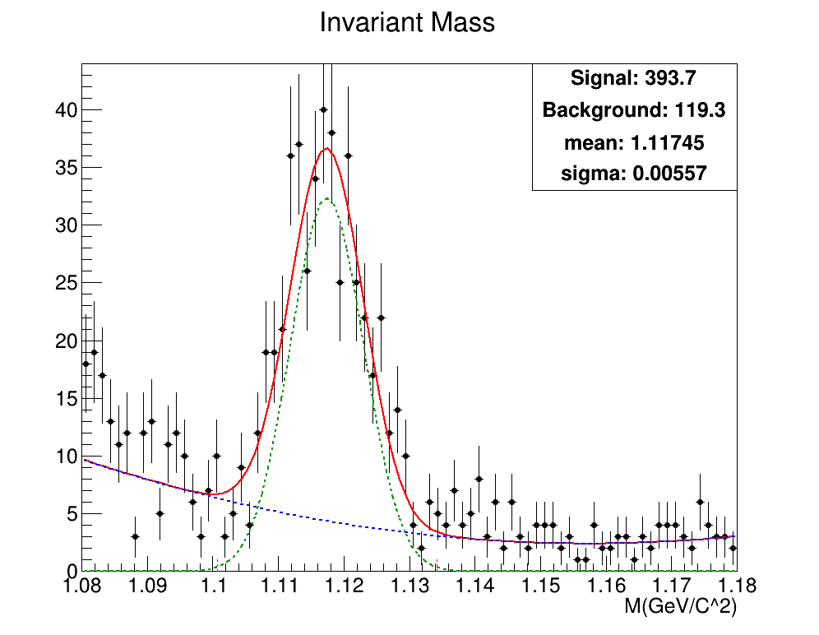
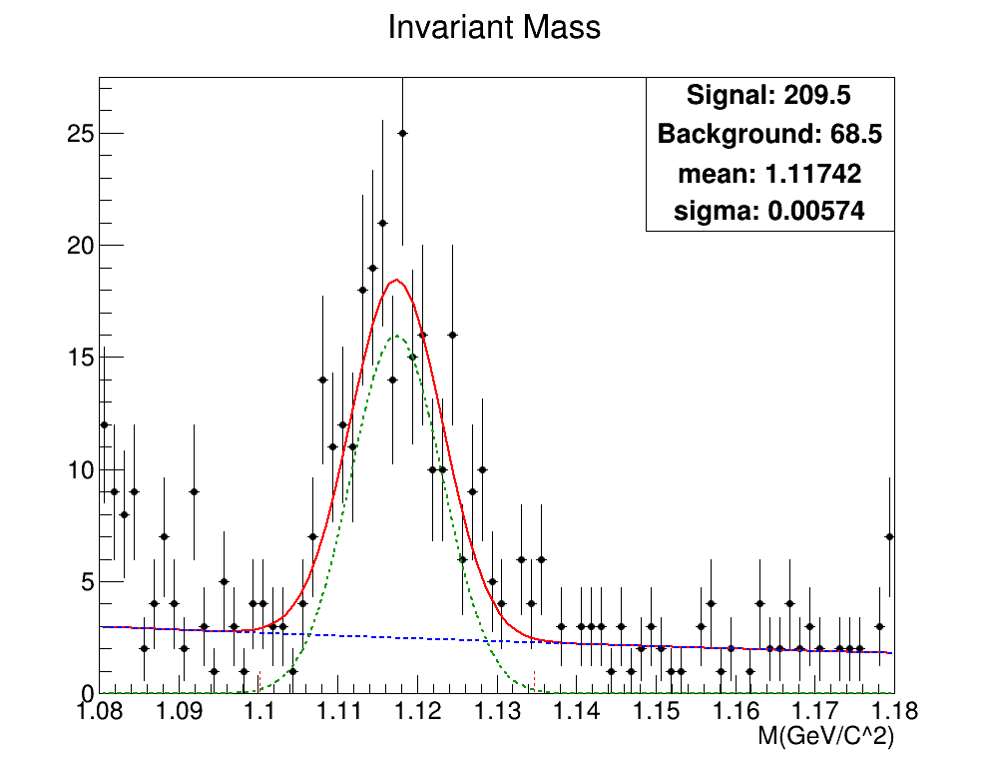
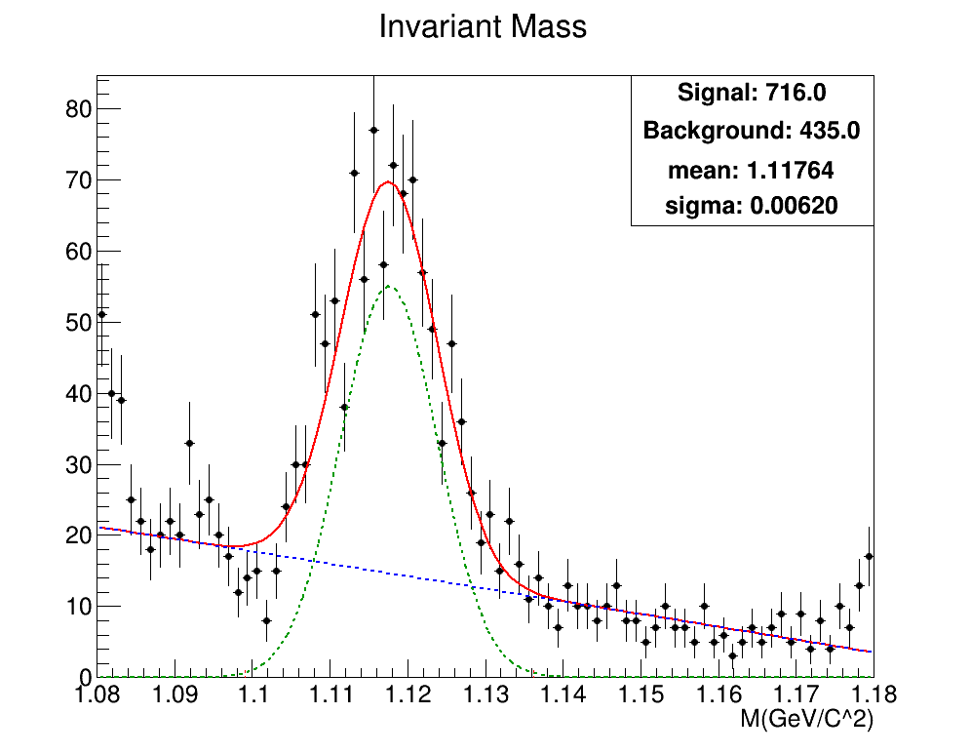
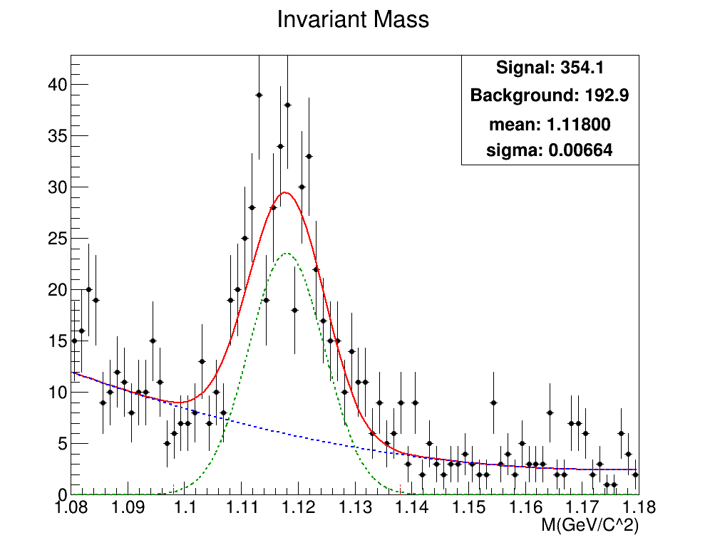
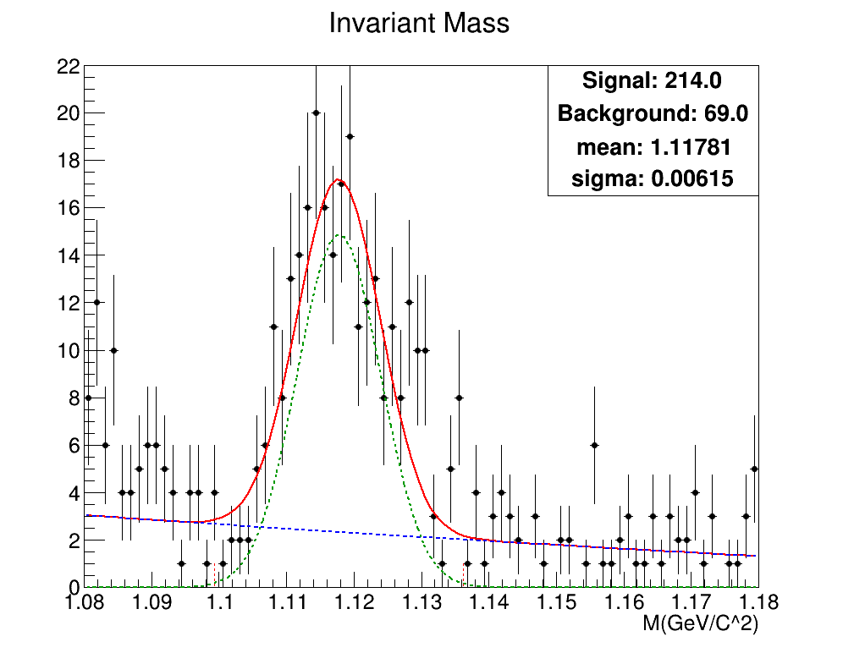
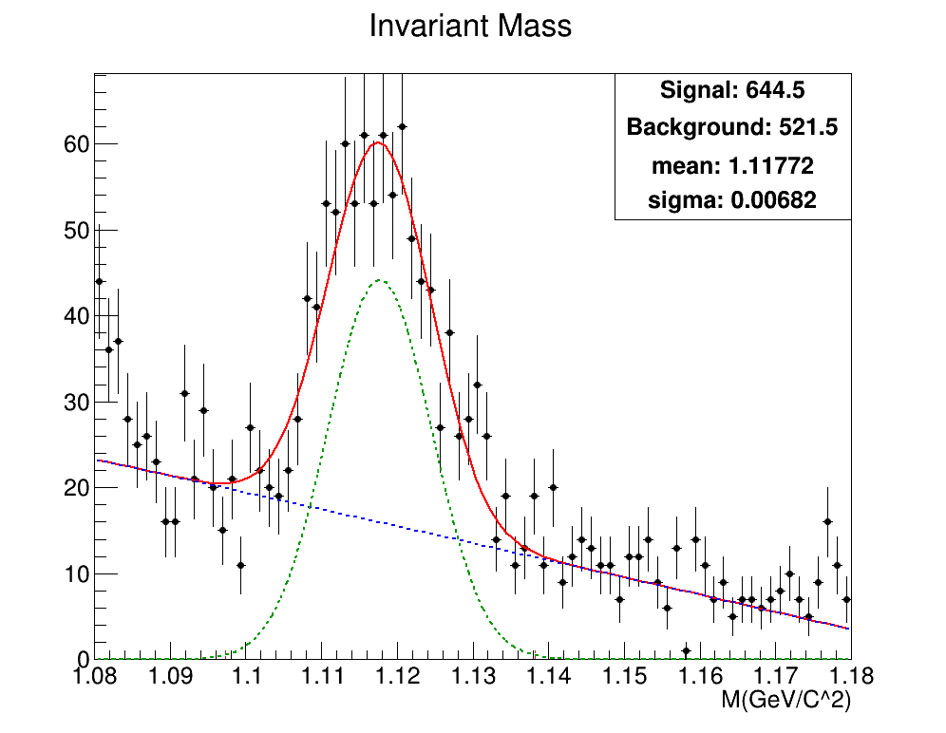


Time Resolution
50 ps
60 ps
70 ps
LGAD Distance
50cm
60cm
70cm

Slide 29

Difference between Λ / Non-Λ Events（MCTrack）
Proton
Pion
MCTrack信息（StartXYZ）中的DCA差别

Slide 30
Difference between Λ / Non-Λ Events（MCTrack）
基于Smear后的MCTrack信息计算的拓扑量差别

Slide 31


Different Open Angle Set
7+12
8+13

Slide 32


Different Open Angle Set
9+14
10+15

Slide 33


Different Open Angle Set
11+16
12+17

Slide 34

4.25GeV

Slide 35

4.25GeV

Slide 36



Procedure of $Λ$ reconstruction
Select the event, in which there are track on both the proton and pion arm
Assume the track on proton arm is proton, and pion on another arm
Determine the momentum according to the measured velocity by LGAD
Calcaulate the invariant mass of the found two particles

