Slide 1
Quantum Anomaly Induced Transport in Global Equilibrium
Jian-Hua Gao | Shandong University
S. Z. Yang, JHG, Z. T. Liang, Q. Wang, Phys. Rev. D 102,116024 (2020) ...... e-Print: 2003.04517
S. Z. Yang, JHG, Z. T. Liang, Symmetry 14,5, 948 (2022)……………………………. e-Print: 2203.14023
S. Z. Yang, JHG, S. Pu, Phys. Rev. D 111,036013 (2025) ................................ e-Print: 2409.00456
S. Z. Yang, JHG, Z. T. Liang, G. Prokhorov, S. Pu, O. Teryaev, V. Zakharov ….. e-Print: 2604.23849
International Symposium on Spin Polarization in Relativistic Heavy Ion Collisions, Hefei, May 11-14, 2026

Slide 2
Outline
Introduction
Quantum anomaly induced transport from Wigner function
From constant to varying EM fields in global equilibrium
Quantum anomaly induced transport from hydrodynamics
From constant to varying EM fields in global equilibrium
Weyl anomaly induced transport
Summary and outlook

Slide 3
Introduction

Slide 4
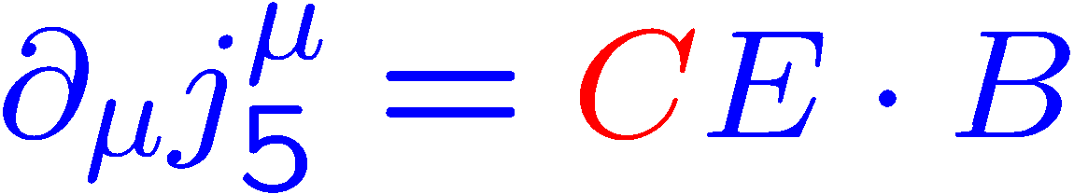
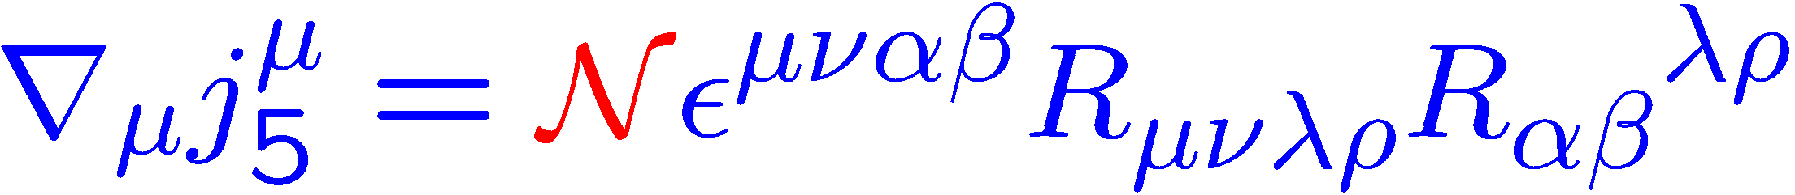
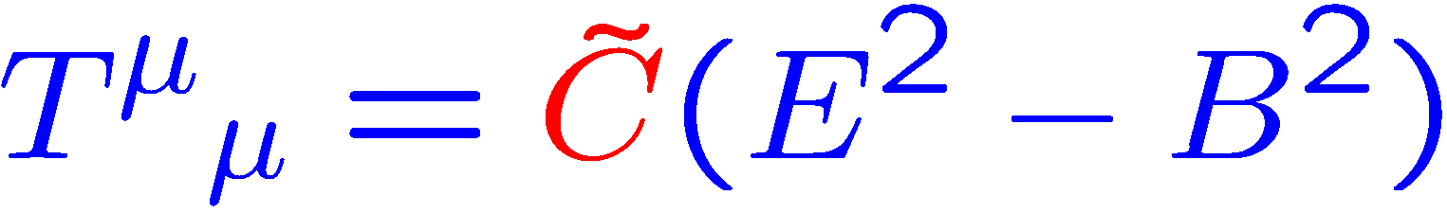
A variety of quantum anomalies
Gauge chiral anomaly:
Gravitational chiral anomaly:
Weyl ( trace ) anomaly:

Slide 5
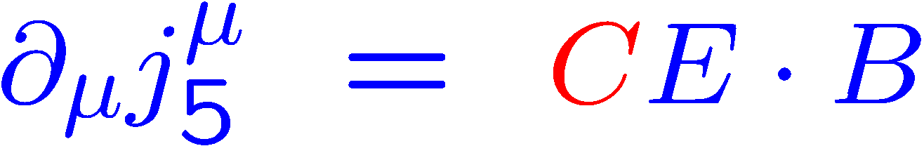
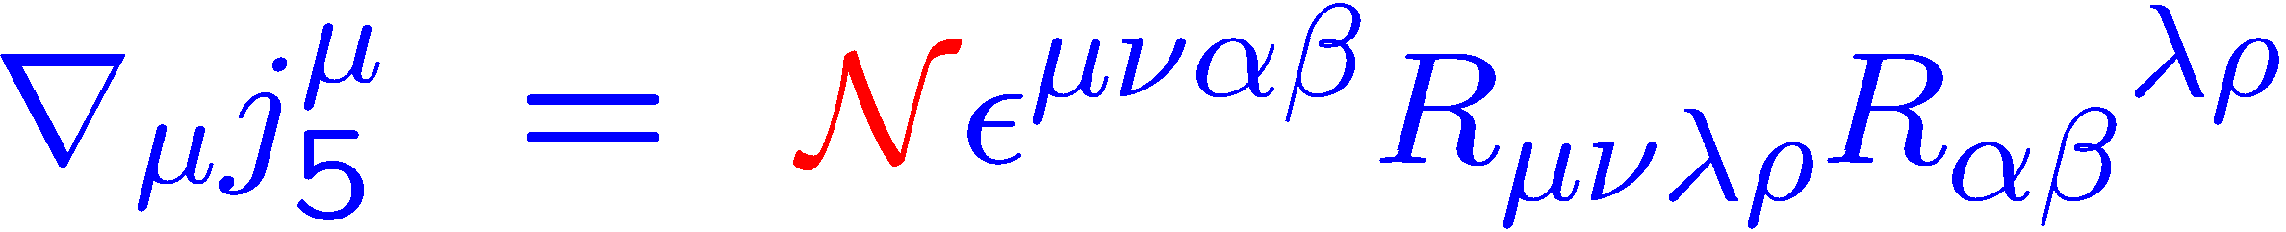


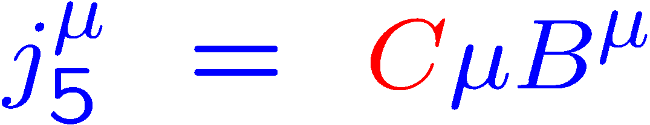
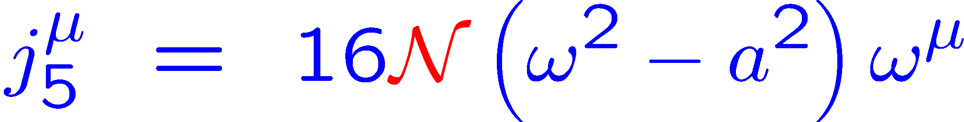
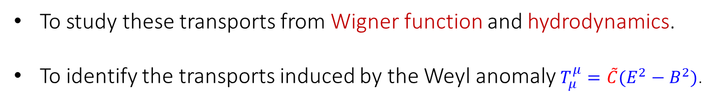
Quantum anomalies induce anomalous transport
chiral anomaly
chiral magnetic effect
chiral vortical effect
chiral separate effect
kinematical vortical effect
Phys. Rev. Lett. 103, 191601 (2009); 107,021601 (2011); 109,232301 (2012) ; 129, 151601 (2022)
To study these transports from Wigner function and hydrodynamics.
To identify the transports induced by the Weyl anomaly $T_{μ}^{μ}=\tilde{C}(E^{2}−B^{2})$.

Slide 6
Global equilibrium conditions
Quantum anomaly induced transports can be non-dissipative $∂_{μ}s^{μ}=0$ !
Quantum anomaly induced transports can be studied in global equilibrium !
Global equilibrium conditions from quantum statistics or kinetic theory
F. Becattini, L. Bucciantini, E. Grossi, L. Tinti EPJC 75 (2015) 5, 191; JHG, Z. T. Liang, Q. Wang, X. N. Wang PRL. 109 (2012) 232301

Slide 7
Quantum anomaly induced transport from Wigner function

Slide 8
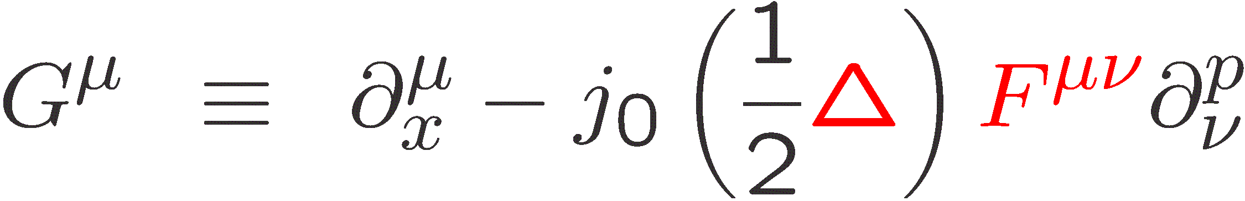
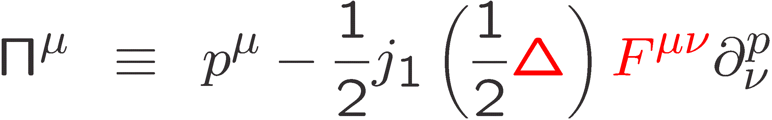
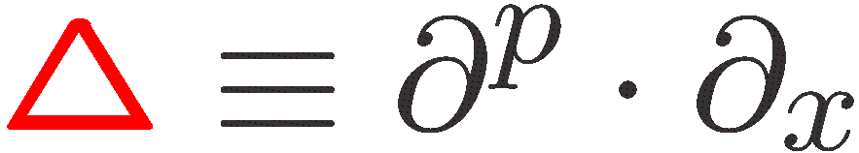


Wigner function and equation at chiral limit
Chiral Wigner function:
Right-handed:$s=+1$
Left-handed:$s=−1$
Chiral Wigner equation:

Slide 9


Semiclassical expansion
Semiclassical $ℏ$ expansion:
Chiral Wigner equations order by order under constant EM field ：
n^{th} kinetic equation
n^{th} on-shell condition
iterative equation

Slide 10
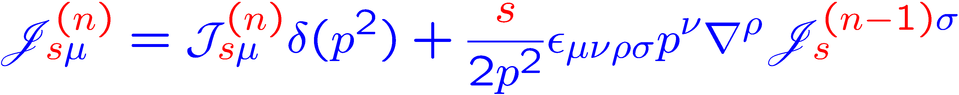
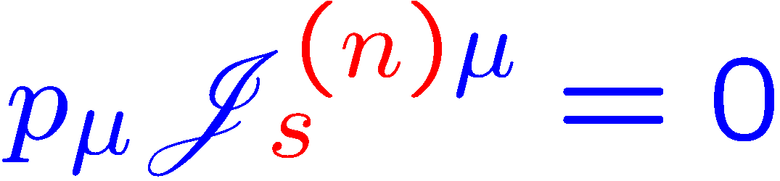
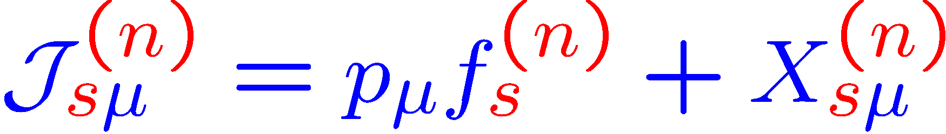
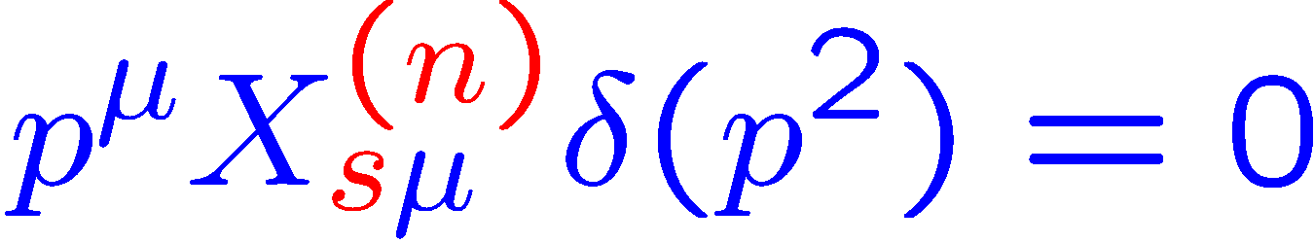
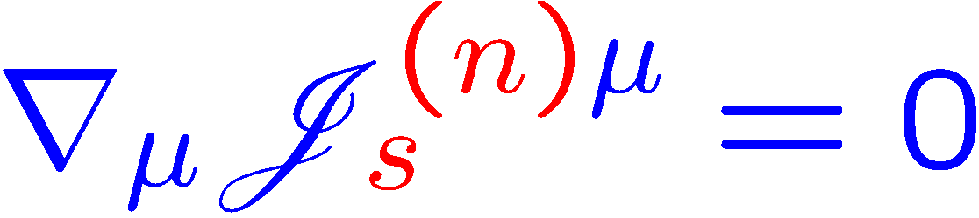
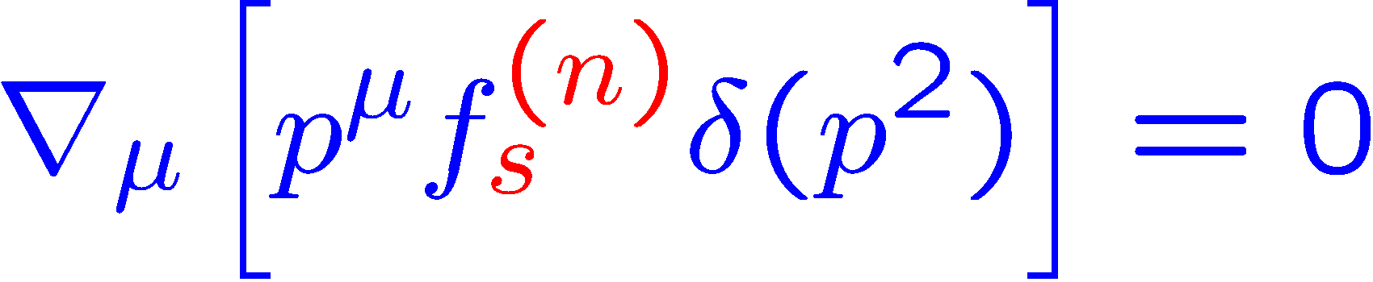

Solve Wigner equations in global equilibrium
Iterative equations:
General expressions:
Determine unknown functions $f_{ s}^{\left(n\right)}$:

Slide 11
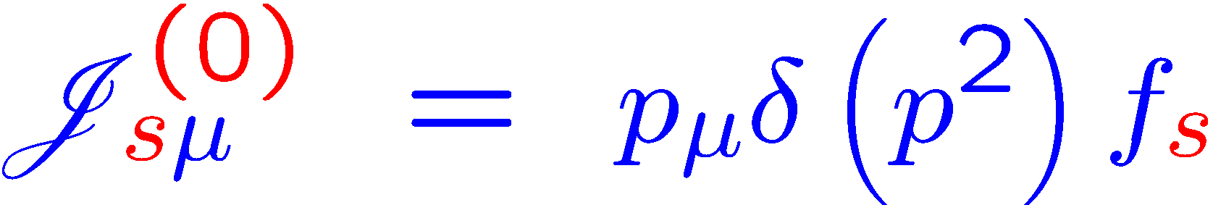
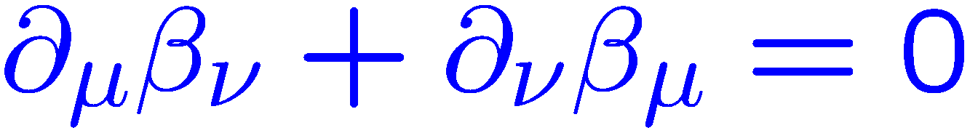
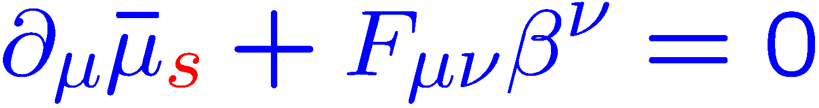
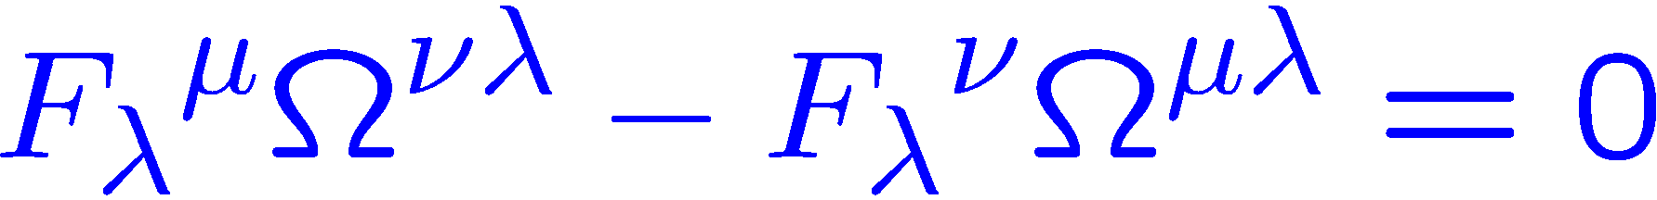
Zeroth order under constant EM field
Zeroth-order Wigner function as input：
Fermi-Dirac distribution:
Zeroth-order distribution satisfies Wigner equations under global equilibrium conditions:
constant thermal vorticity:
integrability condition:

Slide 12
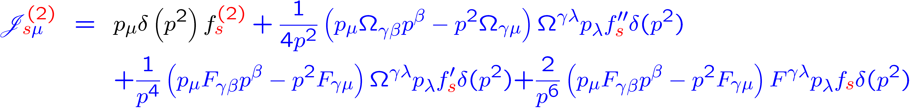
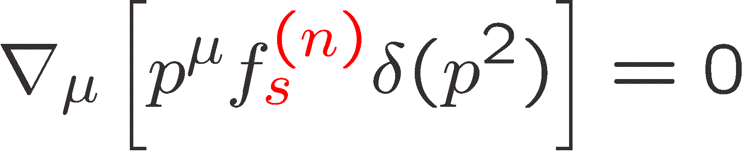


First- and second-order under constant EM field
First-order：
Second-order：
Determine unknown functions $f_{ s}^{\left(n\right)}$ by :
Trivial solutions $f_{ s}^{\left(n\right)}=0$
S.Z. Yang, JHG, Z.T. Liang, Q. Wang, Phys.Rev.D 102 (2020) 116024

Slide 13
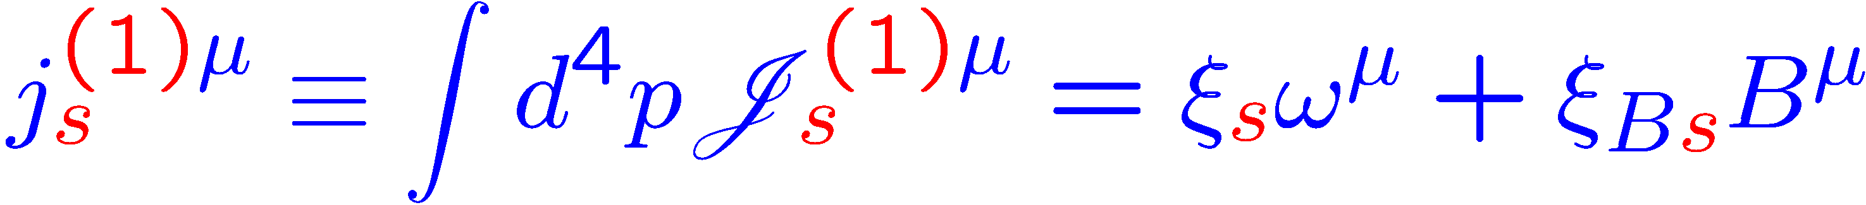
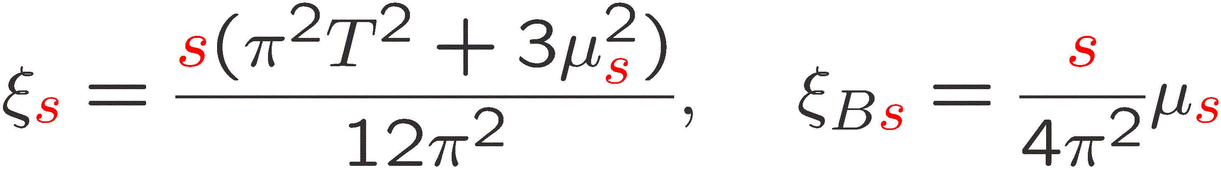
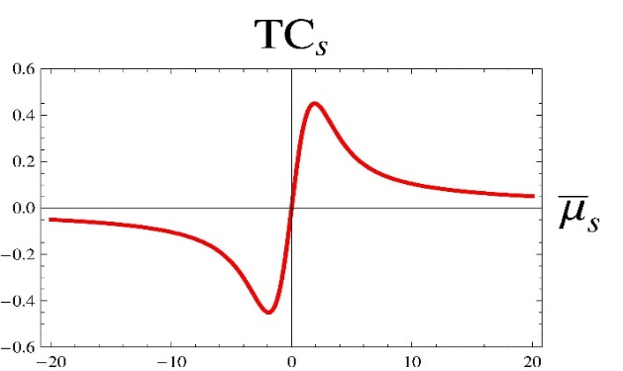
Chiral currents under constant EM field
Chiral currents at 1st order:
Chiral currents at 2nd order:
K. Hattori, Y. Yin PRL2016; K. Fukushima, K. Hattori, K. Mameda PRL2025 (strong B)
Charge density
Hall currents
N. Yamamoto, D.L. Yang PRD2021
S. Lin, L. Yang PRD2020 (strong B)
S.Z. Yang, JHG, Z.T. Liang, Q. Wang, Phys.Rev.D 102 (2020) 116024

Slide 14
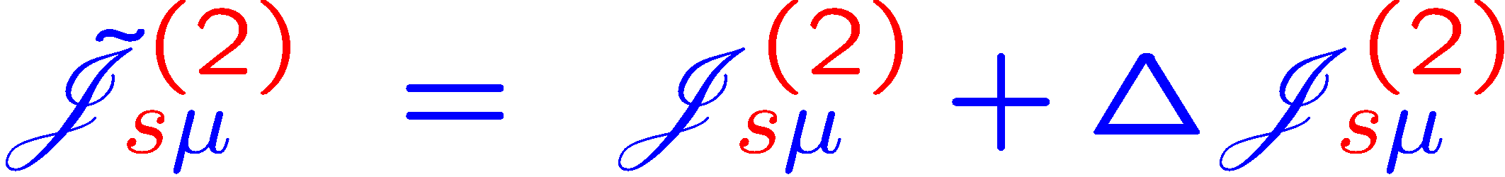
Second order under varying EM field
Global equilibrium conditions with varying EM fields：
constant thermal vorticity:
integrability condition:
Second-order Wigner function：
S.Z. Yang, JHG, S. Pu, PRD 111 (2025) 036013; in K. Mameda PRD 108 (2023) 016001

Slide 15
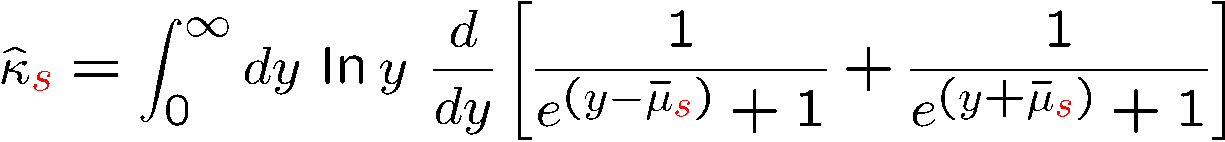
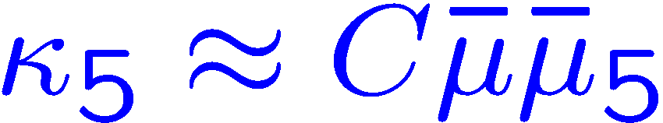

Chiral currents under varying EM field
Chiral current from EM field gradient：
S.Z. Yang, JHG, Z.T. Liang, Q. Wang, Phys.Rev.D 102 (2020) 116024
Electric current from EM field gradient：
S. Z. Yang, JHG, S. Pu, Phys. Rev. D 111 (2025) 036013
Axial current from EM field gradient：
Small $\overline{μ}$ and ${\overline{μ}}_{5}$

Slide 16
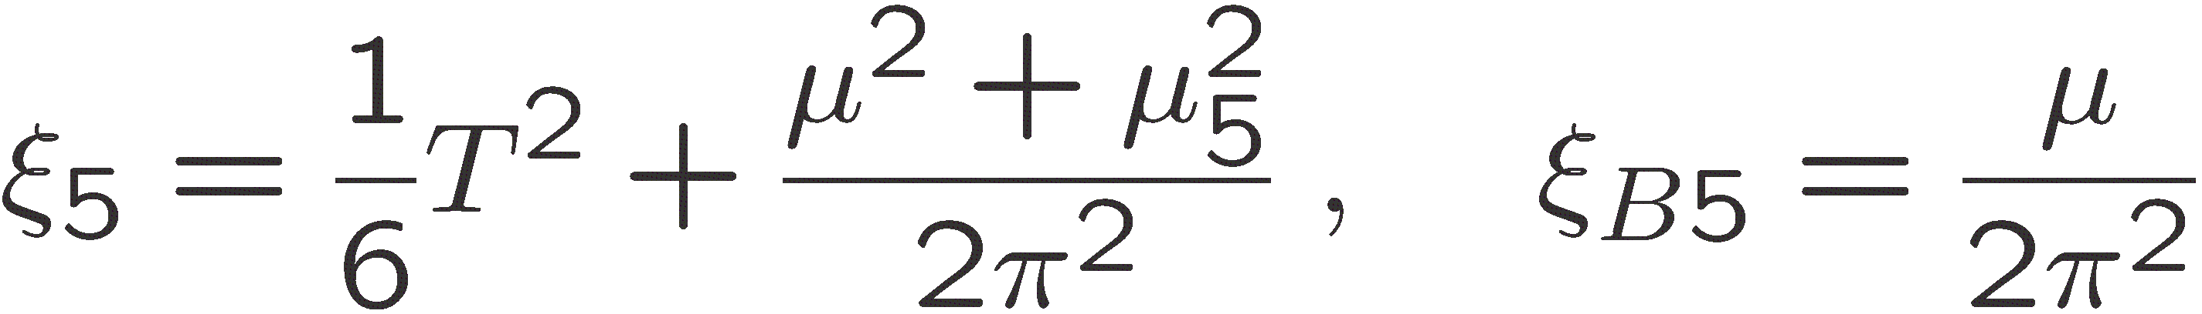
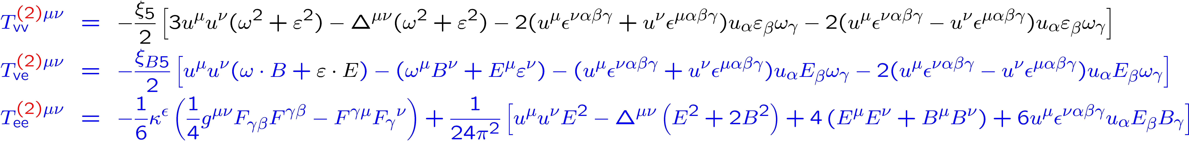
Energy-momentum tensor
Energy-momentum tensor under constant EM field：
S.Z. Yang, JHG, Z.T. Liang, Q. Wang, Phys.Rev.D 102 (2020) 116024
Energy-momentum tensor under varying EM field：
S. Z. Yang, JHG, S. Pu, Phys. Rev. D 111 (2025) 036013

Slide 17
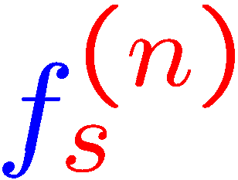
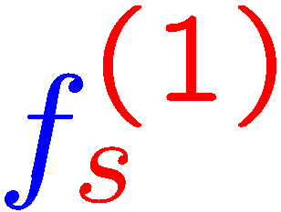
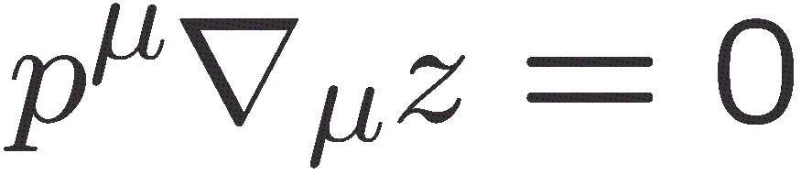
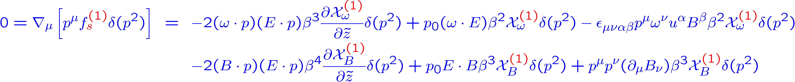
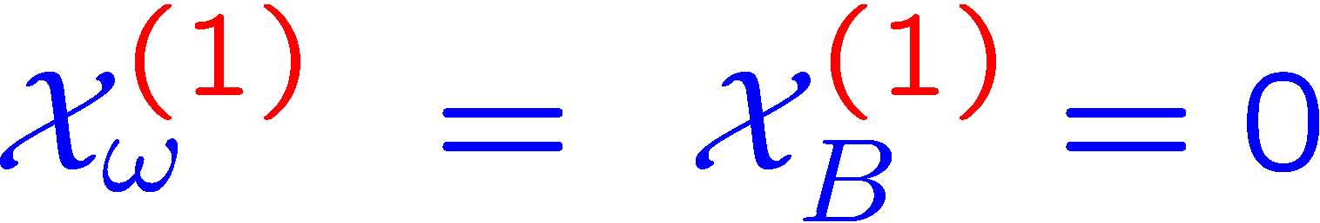
Determine unknown distribution functions
The general expressions for :
Substitute into kinetic equations under global equilibrium conditions
Such process can be generalized to any higher order!

Slide 18
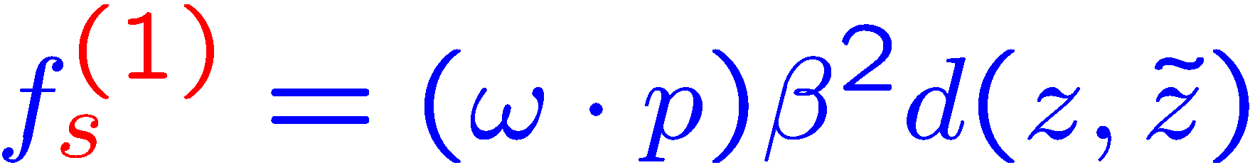
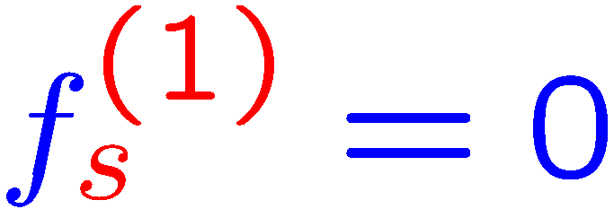
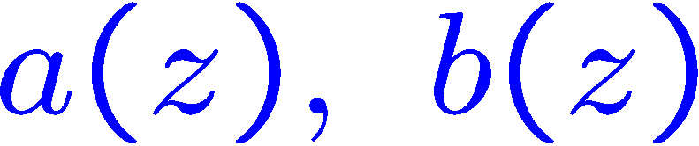
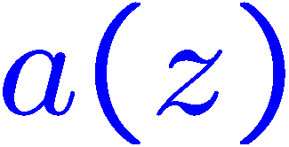
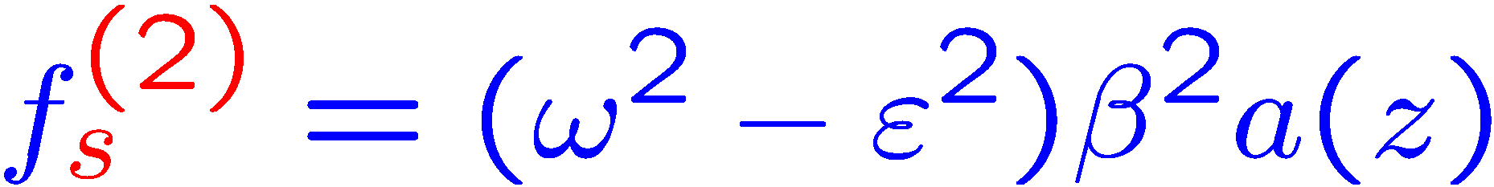
The constraint increases
Vanishing EM field:
4 undetermined functions:
Constant EM field:
2 undetermined functions:
S.Z. Yang, JHG, Z.T. Liang, Q. Wang,
Phys.Rev.D 102 (2020) 116024
Varying EM field:
1 undetermined functions:
S.Z. Yang, JHG, S. Pu, Phys.Rev.D 111 (2025) 036013
Only thermal vorticity terms undetermined!

Slide 19
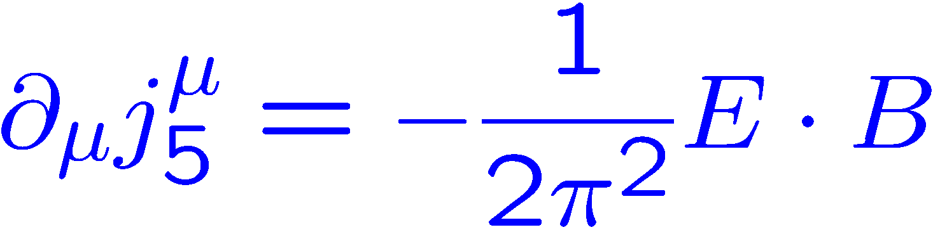
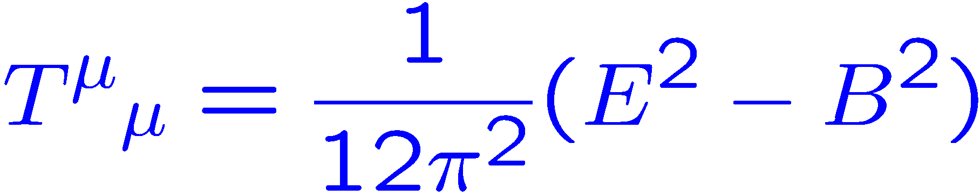
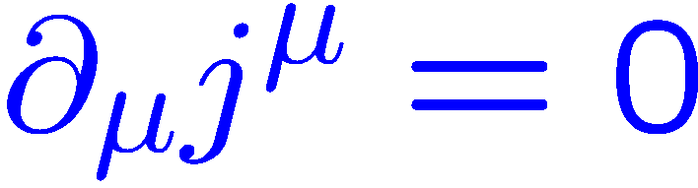
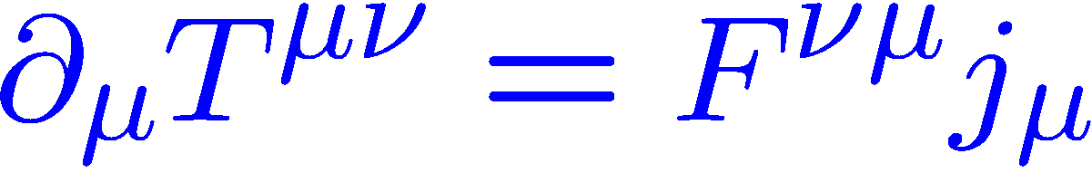
Wigner function VS Hydrodynamics
Wigner functions can give the conservation laws and quantum anomaly automatically:
Wigner functions can not give explicit relations between transport coefficients and anomaly!
Hydrodynamics method can do it!

Slide 20
Quantum anomaly induced transport from hydrodynamics

Slide 21
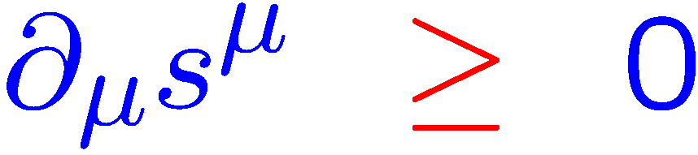
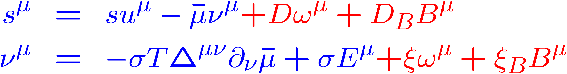
Principle of entropy increase
Hydrodynamic equations with chiral anomaly:
D.T. Son, P. Surowka PRL103:191601,2009
Principle of entropy increase requires:
The anomalous transport coefficients can be determined by chiral anomaly:

Slide 22
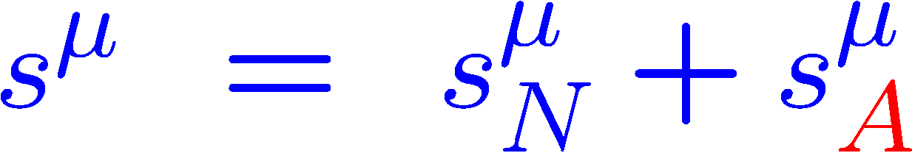
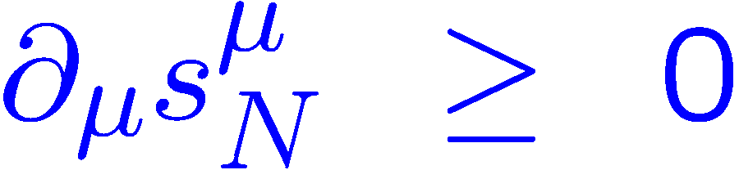
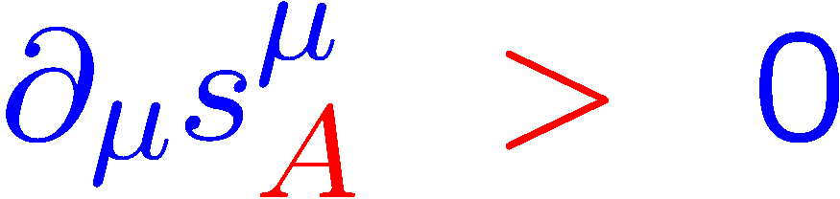


Anomalous transport is non-dissipative
Entropy current includes normal and anomalous terms:
Entropy production from normal terms is positive semi-definite:
Entropy production from anomalous terms is indefinite: or or
Principle of entropy increase requires:
D.T. Son, P. Surowka PRL103:191601,2009
Anomalous transport is non-dissipative and can exist in global equilibrium!
Can we determine these coefficients without invoking the principle of entropy increase?

Slide 23


First order under constant EM field
Hydrodynamics in global equilibrium
+
Conservation laws
Global equilibrium
General expressions at 1st order:
Simple algebra and integration:

Slide 24









Second order under constant EM field
General expressions at 2nd order :
Equilibrium conditions
Dimensional analysis
S. Z. Yang, JHG, Z. T. Liang, Symmetry 14,5, 948 (2022)

Slide 25







Second order under varying EM field
General expressions at second order :
Equilibrium conditions
Dimensional analysis
Weyl anomaly induced transport
S. Z. Yang, JHG, Z. T. Liang, G. Prokhorov, S. Pu, O. Teryaev, V. Zakharov e-Print: 2604.23849

Slide 26







Weyl anomaly induced transport from BQFT
Weyl anomaly induced current from boundary quantum field theory (BQFT):
$$x$$
$$n_{μ}$$
0
C.S. Chu, R. X. Miao Phys.Rev. Lett. 121,251602 (2018)
Treat Rindler horizon in an accelerated frame as a boundary:
Rindler coordinates:
Horizon:
Stretched horizon:
The inward unit normal vector:
S. Z. Yang, JHG, Z. T. Liang, G. Prokhorov, S. Pu, O. Teryaev, V. Zakharov e-Print: 2604.23849

Slide 27




Weyl anomaly induced transport from BQFT
In the local rest frame of the fluid
S. Z. Yang, JHG, Z. T. Liang, G. Prokhorov, S. Pu, O. Teryaev, V. Zakharov e-Print: 2604.23849
Global equilibrium:
Nernst-like current

Slide 28
Summary and Outlook
Wigner function & hydrodynamics: Both determine quantum anomaly-induced transport;
the constraint increases from vanishing to constant to varying EM fields.
Weyl anomaly: Uniquely fixes the second-order transport coefficient coupling EM field and fluid acceleration, as consistently verified by both hydrodynamics and BQFT
Principle of entropy increase: Can it determine the Weyl anomaly induced transport?
Gravitational fields: Can they further constrain quantum anomaly-induced transport ?
Heavy-ion collisions: Apply Weyl anomaly-induced transport to phenomenology.
Thank you for your attention !

