Slide 1

CEPC ECAL Energy Resolution
李想
2025.12.29
Notes:
Today, I will present my work on improving the ECAL energy resolution using machine learning.

Slide 2
motivation：
Attempt to improve the ECAL energy resolution using an MLP
strategy:
Use the layer-wise energy feature as inputs;
Train an MLP to directly regress the true particle energy;
Evaluate the performance in terms of energy resolution and linearity, and compare with the standard energy-sum method.
Notes:
So, the motivation is to improve the ECAL energy resolution using an MLP.
Here is my strategy: I take the layer-wise energies as inputs and train the model to predict the true particle energy. In the end, I compare the MLP's resolution and linearity with the standard energy-sum method to see the improvement.

Slide 3
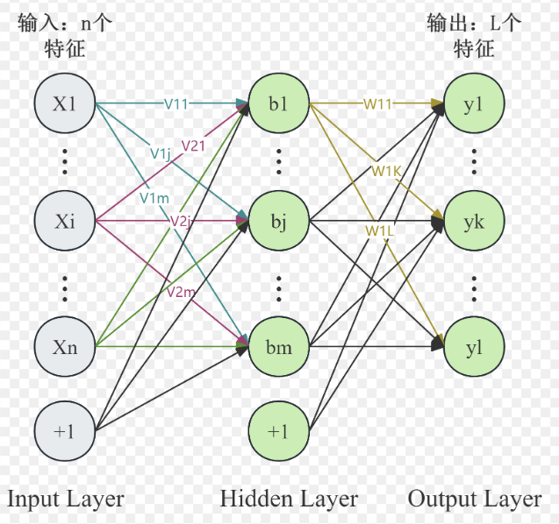
M(ulti) L(ayer) P(erceptron)
Input:
Energy(E) of per layer(32)
Hit_no(N) of per layer(32)
E/N of perlayer(32)
Total_deposited_energy(1)
Output:
Predicted Energy
Data:
MC: 1-80GeV (120000)
train_frac = 0.7
val_frac = 0.15
test_frac = 0.15
[1024,512,256,128]
lr =0.5e-4
batch_size =64
epochs =100
weight_decay =1e-4
optimizer ="adamw"
Notes:
This slide shows the MLP we use for ECAL energy reconstruction.
As inputs, we use the energy deposited in each ECAL layer, the number of hits per layer, the energy per hit, and also the total deposited energy.
These inputs describe how the electromagnetic shower develops along the detector.
The model is trained on Monte Carlo samples from 1 to 35 GeV, with about 120,000 events，which were divided into training, validation, and test sets.

Slide 4
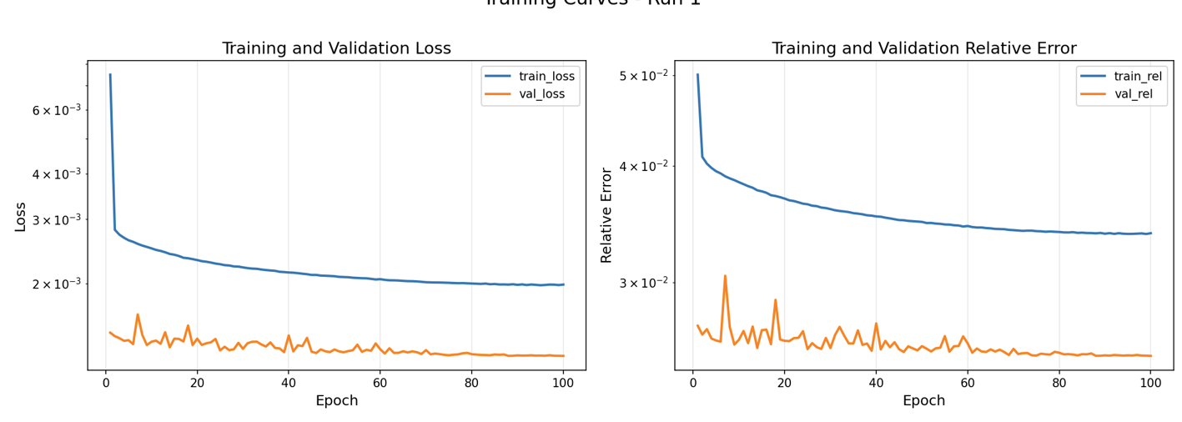
M(ulti) L(ayer) P(erceptron)
train_frac = 0.7
val_frac = 0.15
test_frac = 0.15
Loss=[(pred - true)/ture]²
Relative_error=[(pred - true)/ture]
Notes:
During training, we monitor the loss and the relative error using train data and validation data.
Both of them decrease and become stable as the epochs increase, which indicates that the training is finished.

Slide 5
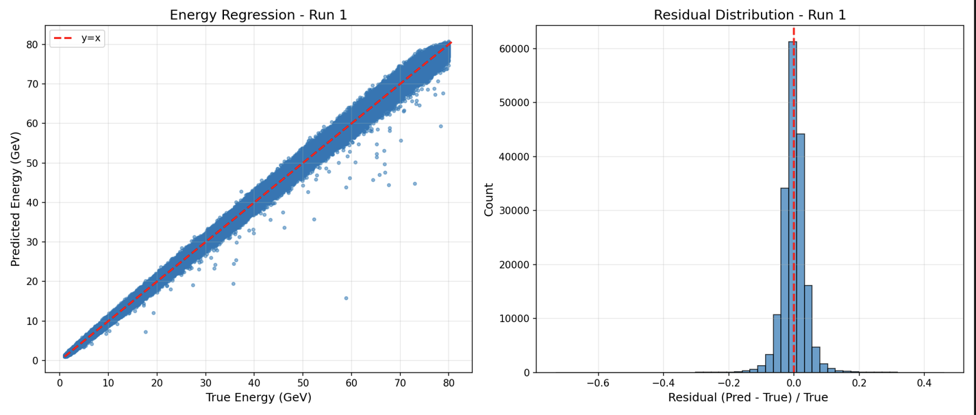
M(ulti) L(ayer) P(erceptron)
train_frac = 0.7
val_frac = 0.15
test_frac = 0.15
Notes:
We used the test data to check the model. You can see from the graph that the regression accuracy is 0.2。

Slide 6
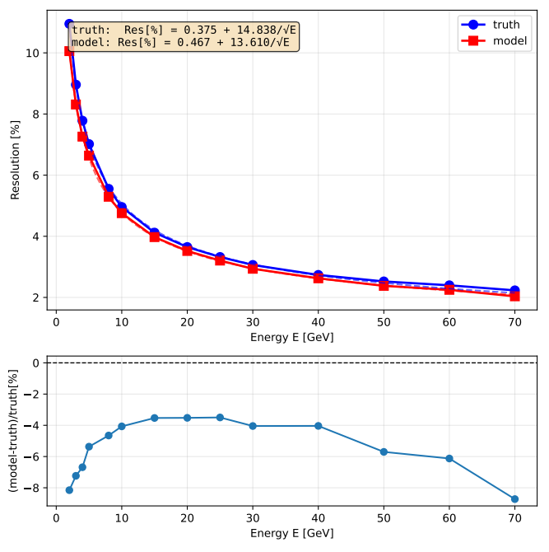
M(ulti) L(ayer) P(erceptron)
Energy Resolution
Discrete energy points：
[2.0, 3.0, 4.0, 5.0, 6.0, 7.0, 8.0, 9.0, 10.0, 15.0, 20.0, 25.0, 30.0, 40.0, 50.0, 60.0, 70.0]GeV
Truth = Total deposited energy (MC)
Improvement:
discrete energy points: 6%
total resolution boost: 8%
Notes:
As you can see here, the MLP model gives much better energy resolution than the baseline, which I labeled as 'truth'. If you look at the bottom panel,we see a consistent improvement of about 5% across discrete energy points. Overall, this gives us a total resolution boost of 9%.

Slide 7
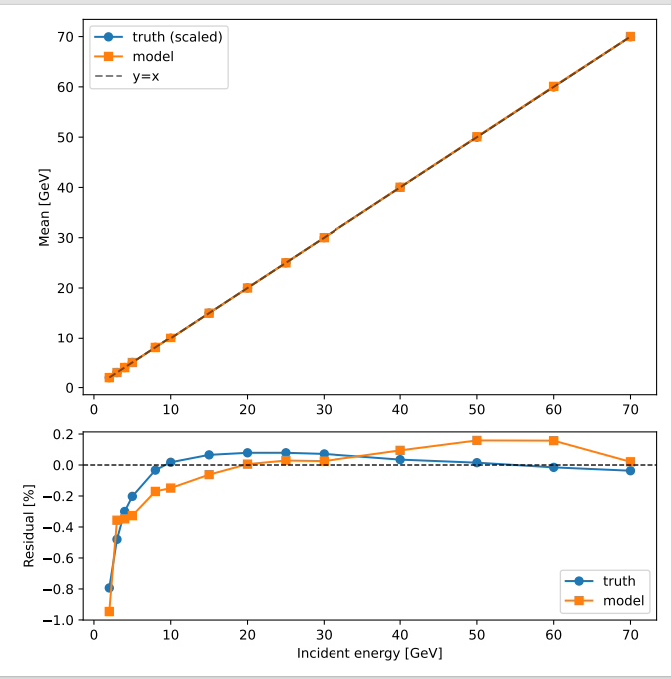
M(ulti) L(ayer) P(erceptron)
Linearity
Discrete energy points：
[2.0, 3.0, 4.0, 5.0, 6.0, 7.0, 8.0, 9.0, 10.0, 15.0, 20.0, 25.0, 30.0, 40.0, 50.0, 60.0, 70.0]GeV
Truth = Total deposited energy (MC)
No Improvement
Notes:
In contrast to the resolution, no comparable enhancement was observed in the energy linearity.

Slide 8
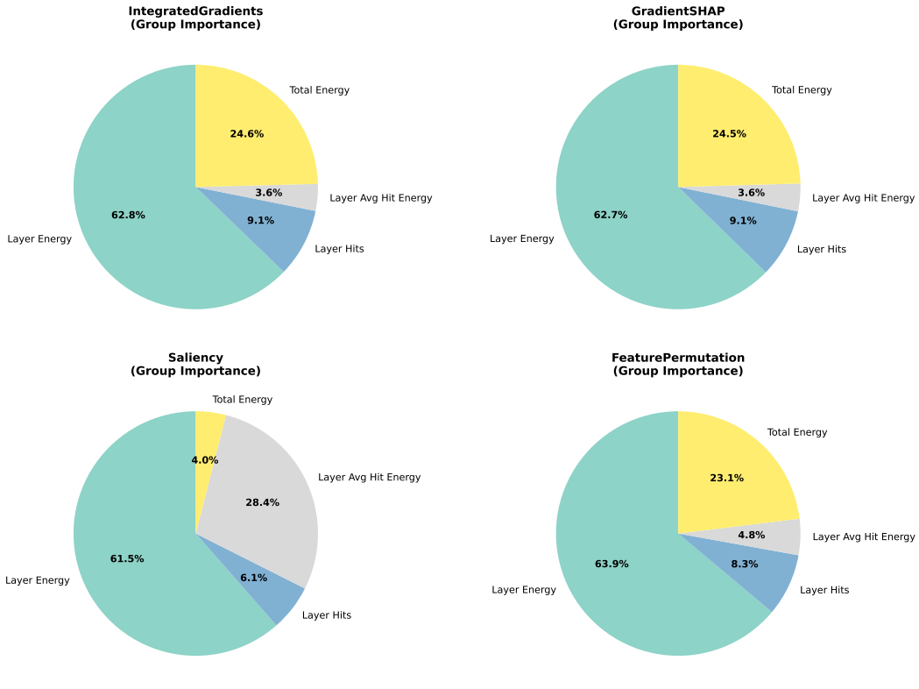
M(ulti) L(ayer) P(erceptron)
Method | What you are asking the model
Integrated Gradients | “Along the path from nothing to this input, who helped you the most?”
Gradient SHAP | “If I repeat the experiment many times, who is important on average?”
Saliency | “If I slightly touch you right now, who reacts the most?”
Permutation | “If I remove you, does the model fall apart?”
Notes:
In contrast to the resolution, no comparable enhancement was observed in the energy linearity.

Slide 9
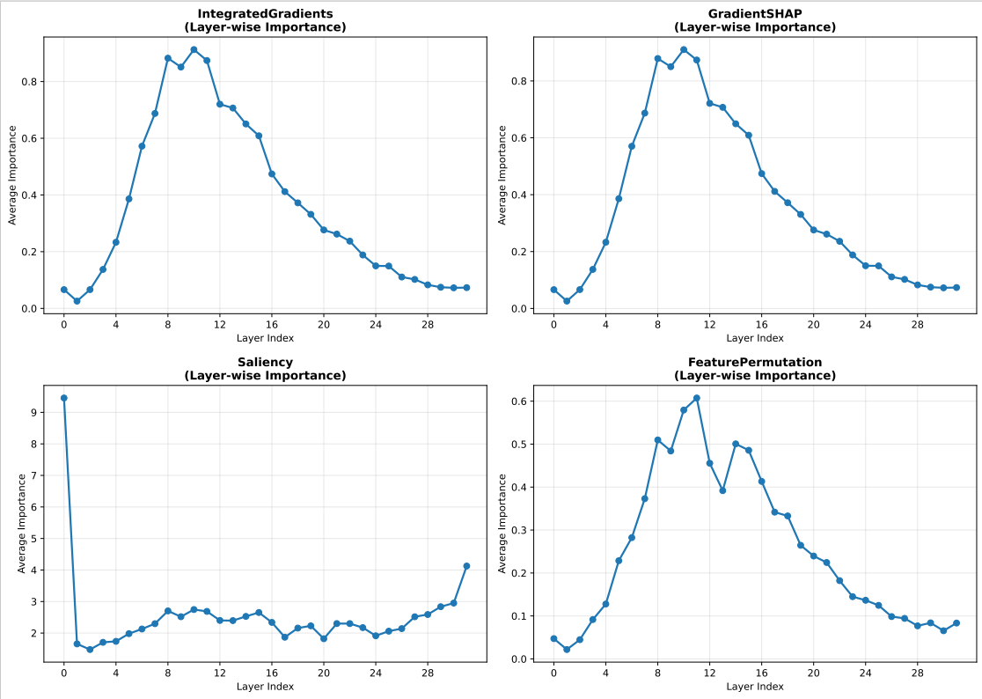
M(ulti) L(ayer) P(erceptron)
Method | What you are asking the model
Integrated Gradients | “Along the path from nothing to this input, who helped you the most?”
Gradient SHAP | “If I repeat the experiment many times, who is important on average?”
Saliency | “If I slightly touch you right now, who reacts the most?”
Permutation | “If I remove you, does the model fall apart?”
Notes:
In contrast to the resolution, no comparable enhancement was observed in the energy linearity.

Slide 10
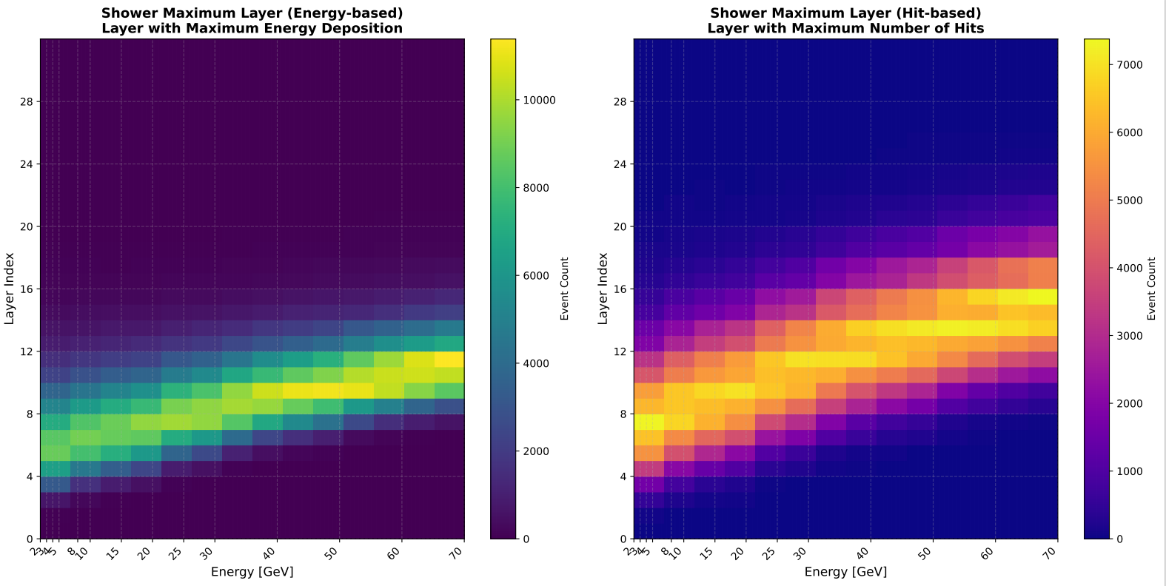
M(ulti) L(ayer) P(erceptron)
Notes:
In contrast to the resolution, no comparable enhancement was observed in the energy linearity.

Slide 11
Summary
Energy Resolution: Improved by ~9% using the MLP.
Energy Linearity: Did not show a similar improvement .
Machine learning is capable of learning the physical process of particle shower development.
Next step
Improve Energy Linearity: Focus on addressing the linearity issue.
Model Optimization: Refine the model architecture and perform hyperparameter tuning.
Notes:
The application of an MLP to the ECAL energy reconstruction resulted in an approximate 9% improvement in energy resolution. However, the energy linearity did not exhibit a similar enhancement. In the next step, we aim to improve the energy linearity. To achieve this, we plan to extend the training energy range to 80 GeV.

Slide 12
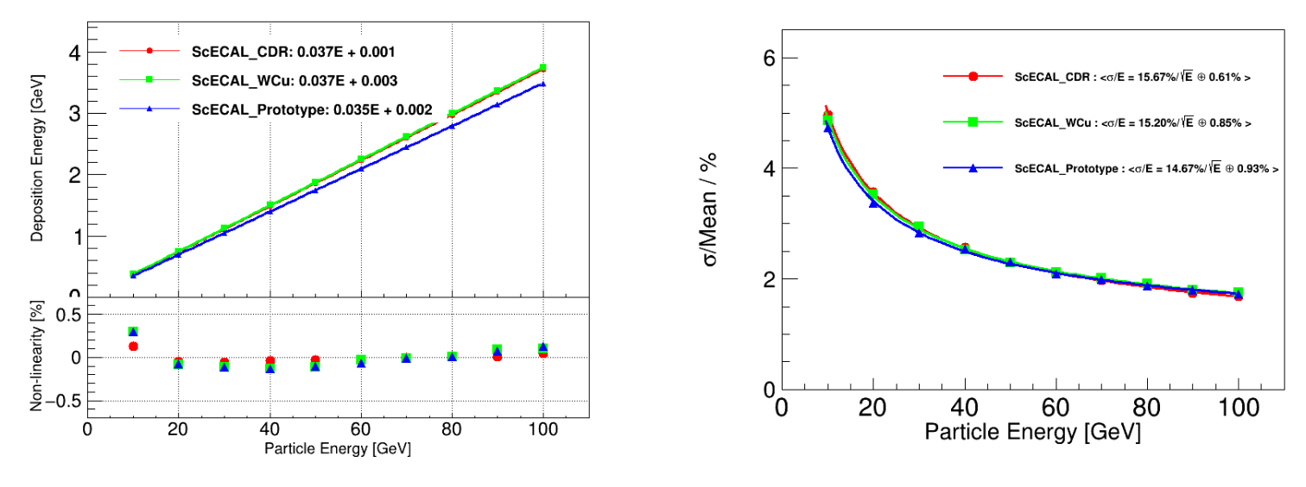
back up
Notes:
Since several layers have no data, the total number of channels is over 4000. After applying the Hough transform, more than 3000 channels have data entries exceeding 2200. However, after the fitting procedure, the number of good channels drops to fewer than 200.

Slide 13
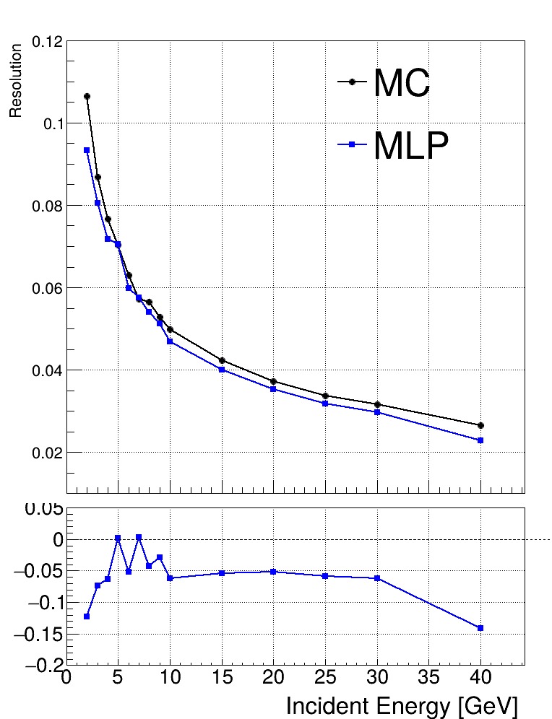
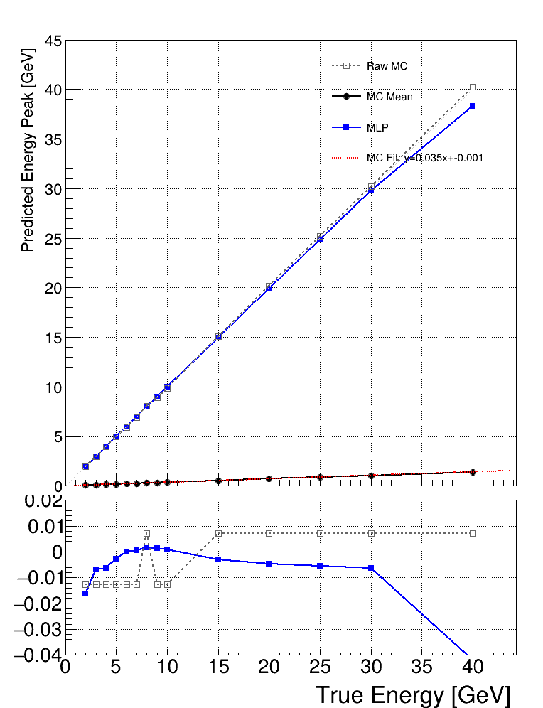
back up
[256,128,64]
Notes:
Since several layers have no data, the total number of channels is over 4000. After applying the Hough transform, more than 3000 channels have data entries exceeding 2200. However, after the fitting procedure, the number of good channels drops to fewer than 200.

Slide 14
back up
Notes:
Since several layers have no data, the total number of channels is over 4000. After applying the Hough transform, more than 3000 channels have data entries exceeding 2200. However, after the fitting procedure, the number of good channels drops to fewer than 200.

