Slide 1
PCB Modeling
Hongbin Diao
State key laboratory of particle detection and electronics
University of Science and Technology of China

Slide 2
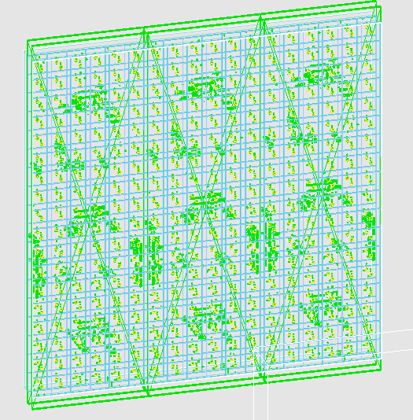
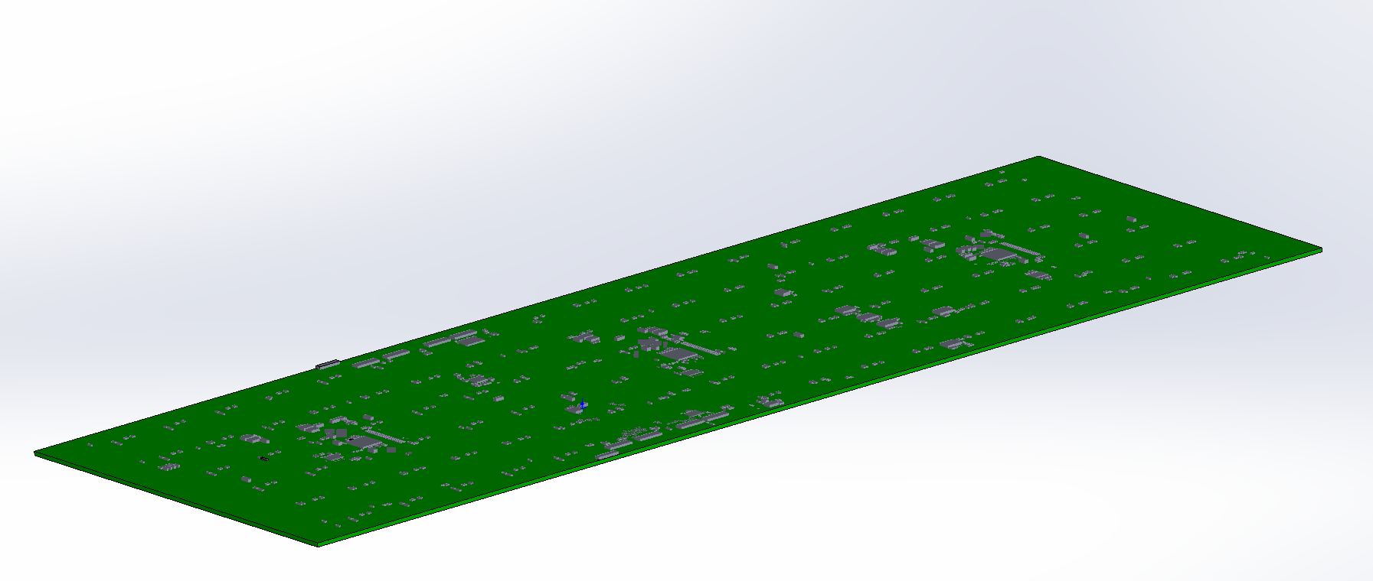
PCB Board Modeling
3D model of PCB board (xxx.stp) from electronics colleague
convert .stp file to .stl file
import .stl file to Geant4 using CADmesh
using their respective materials for components

Slide 3
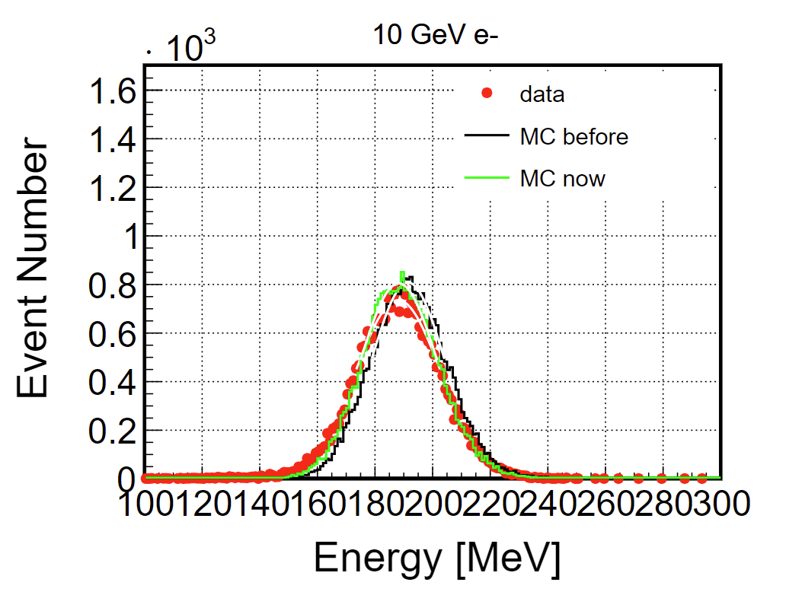
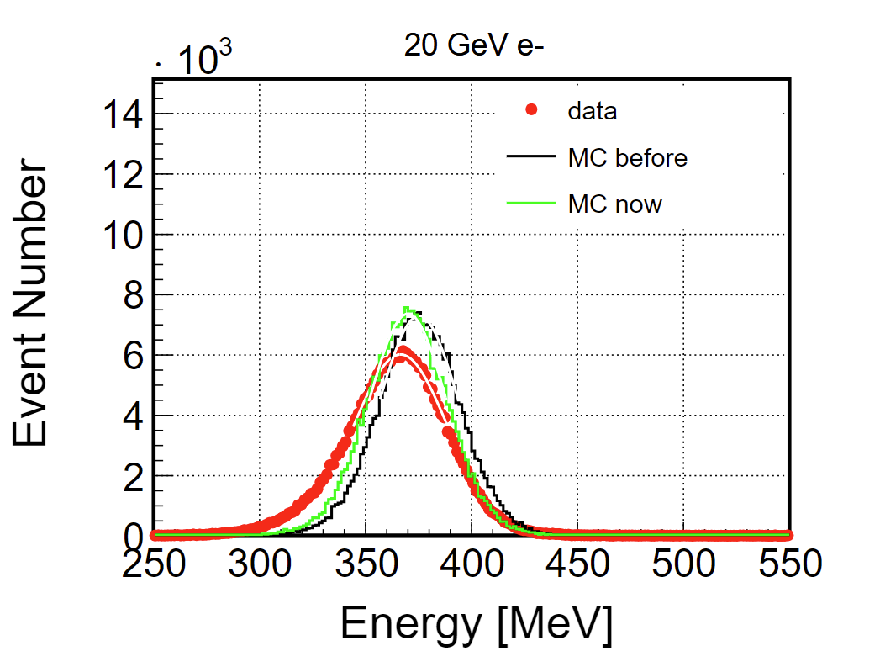
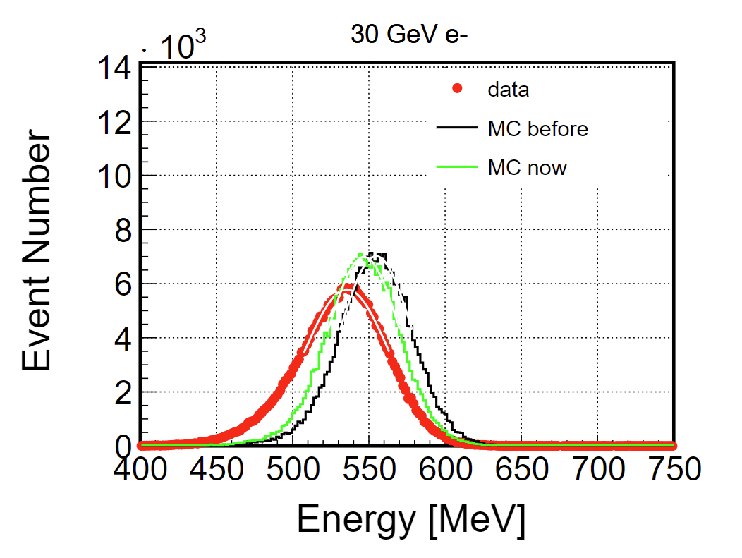
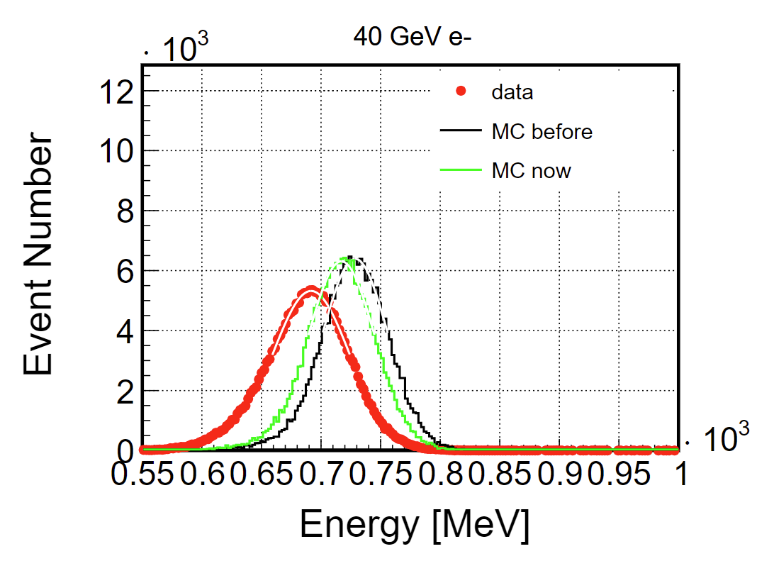
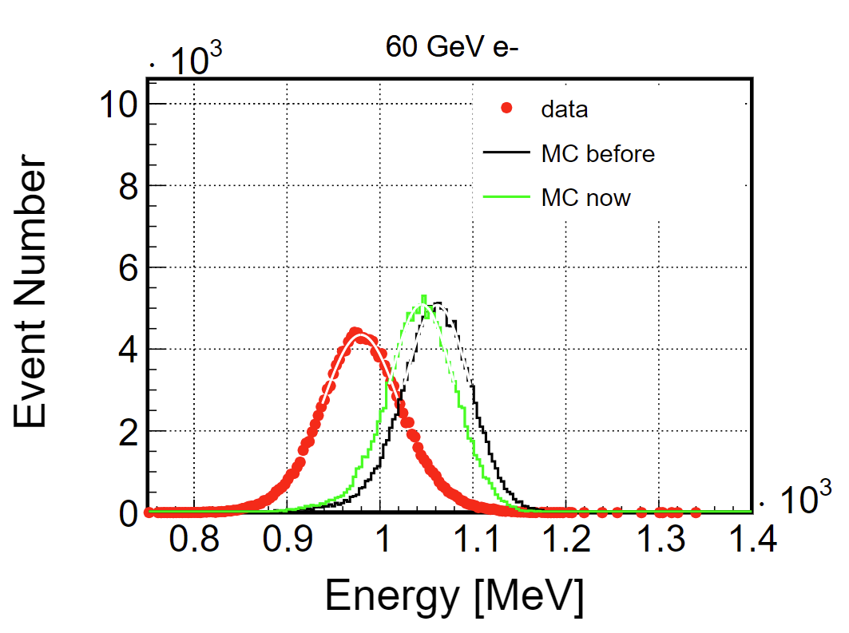
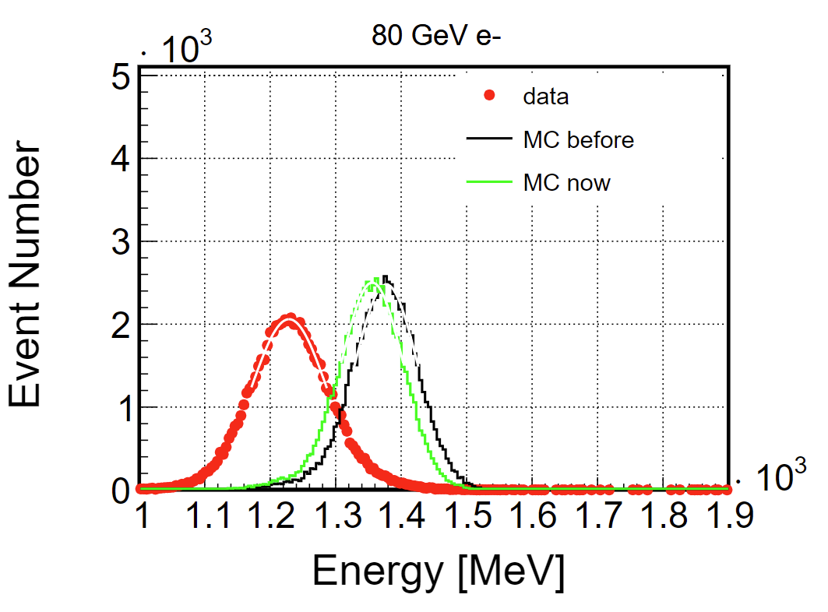
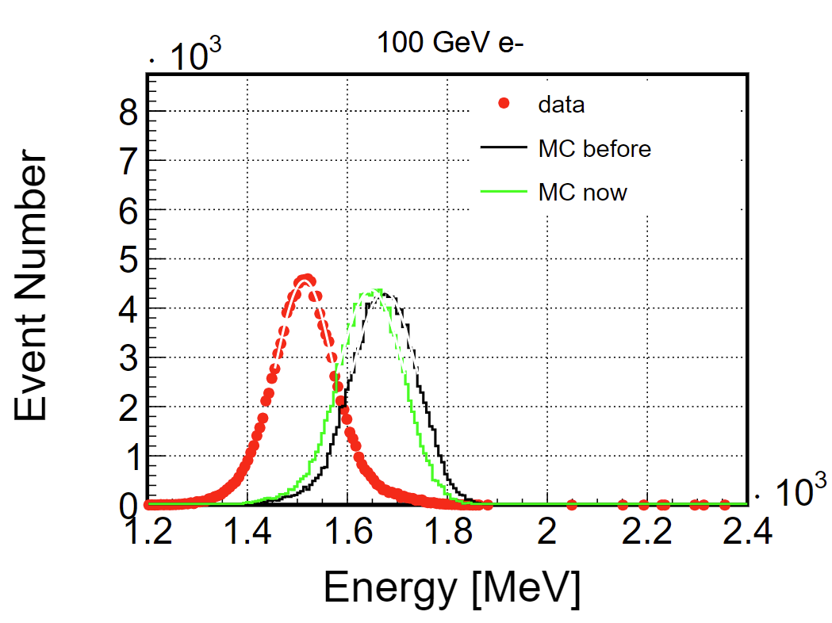
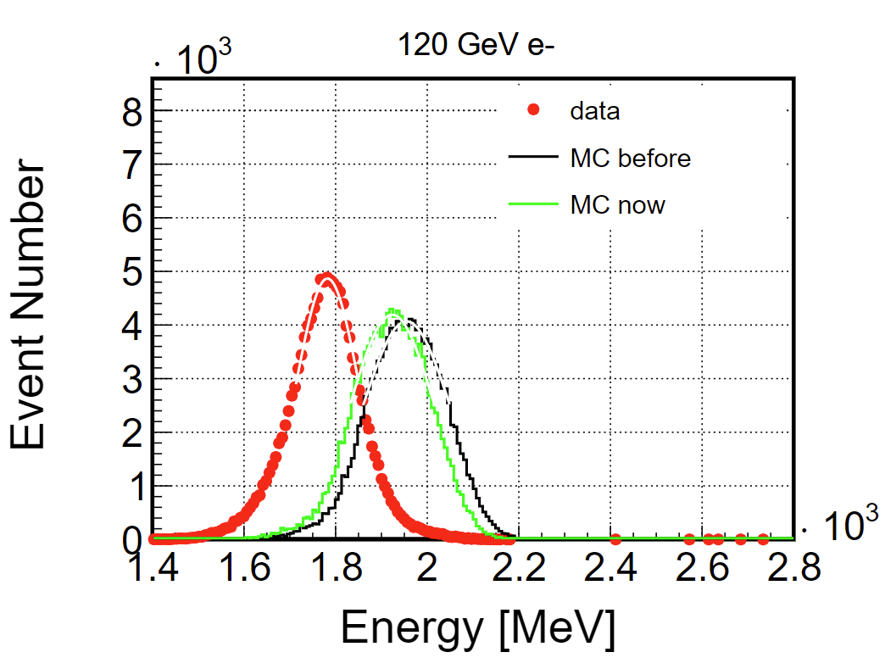
SPS electron energy
without lowgain non-linearity in digitization

Slide 4
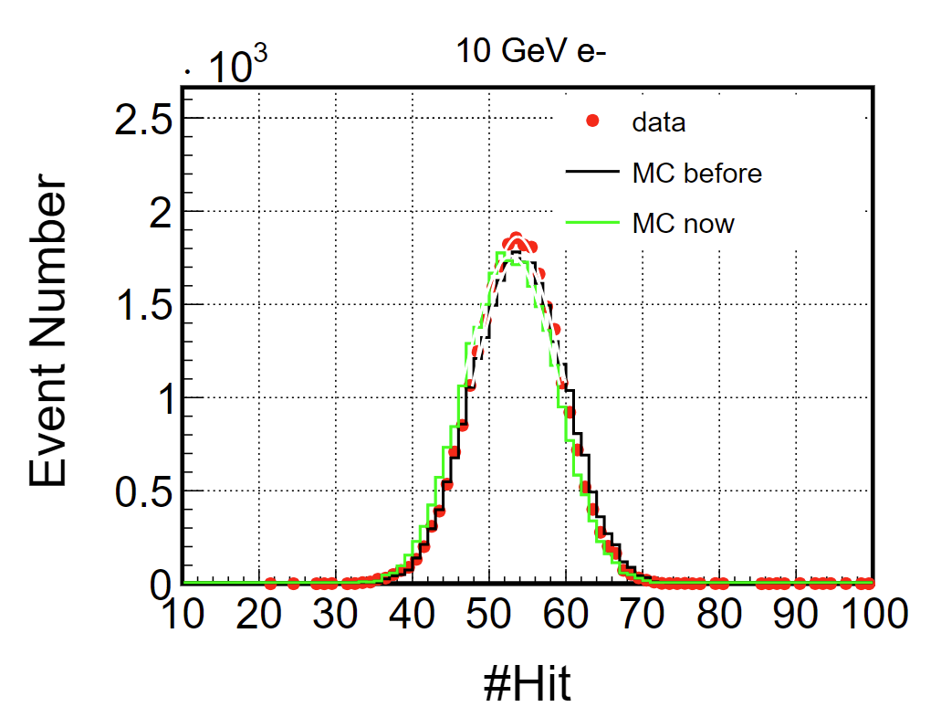
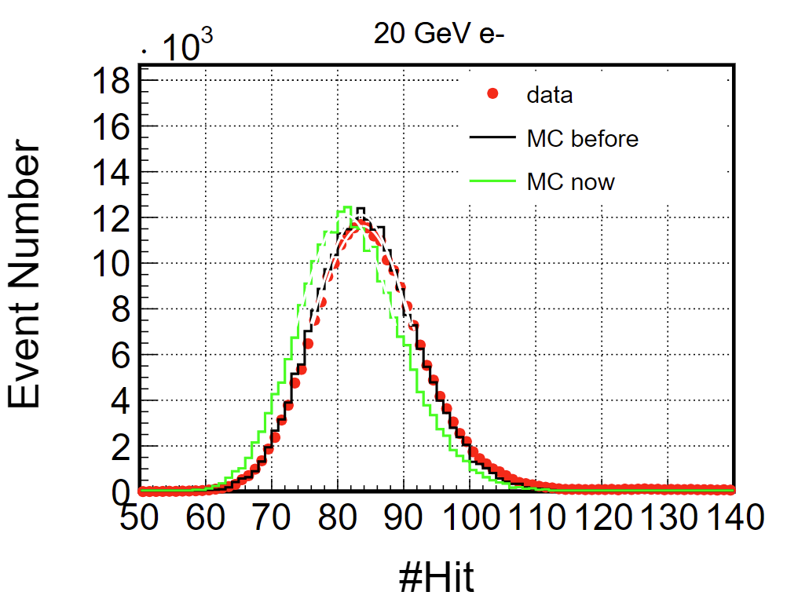
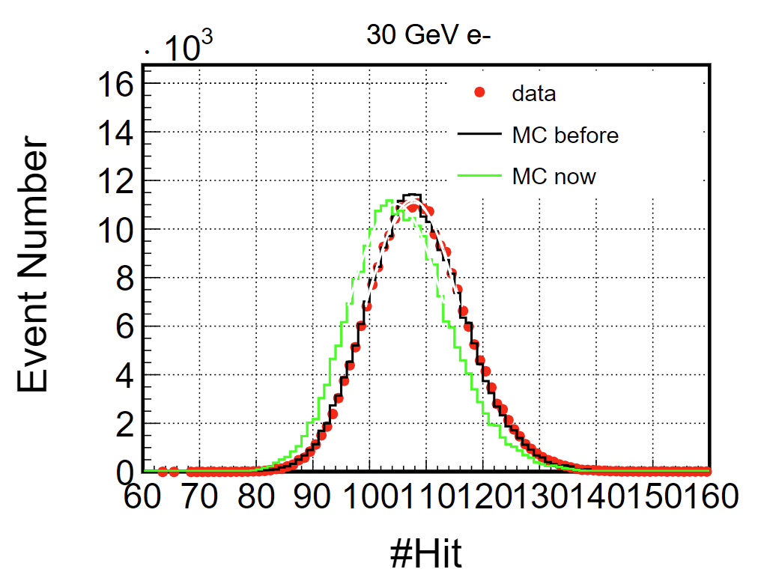
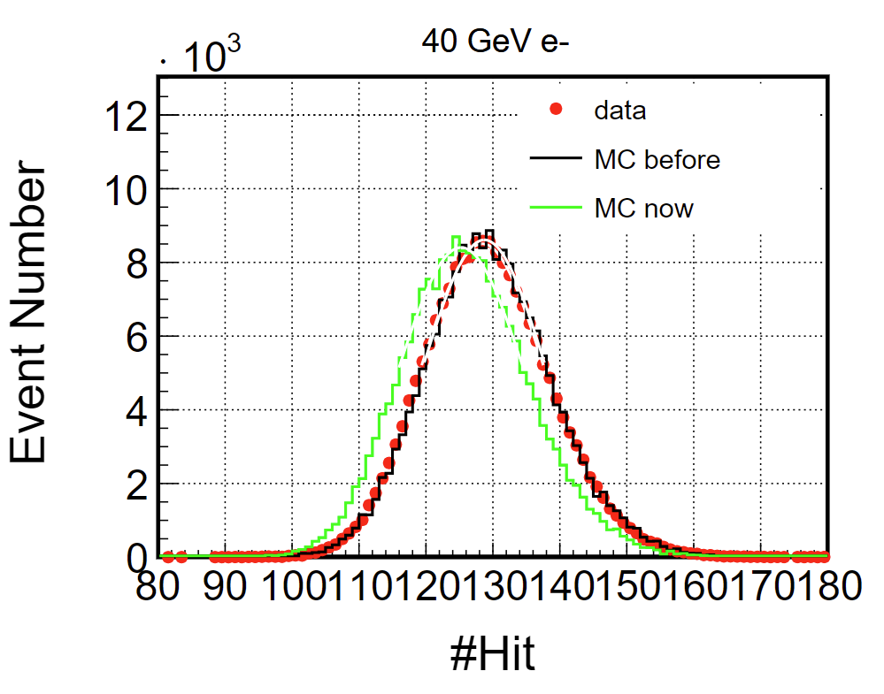
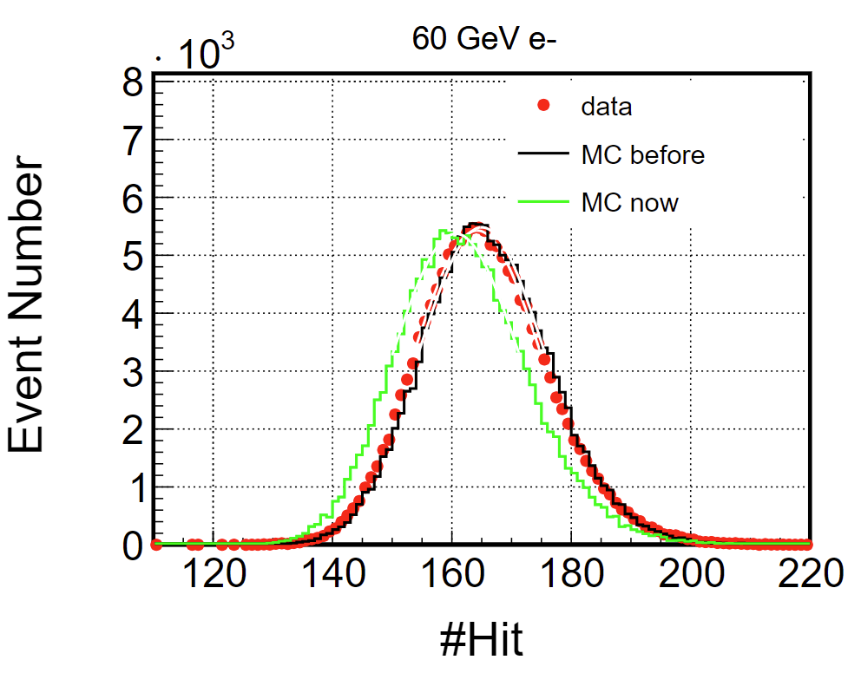
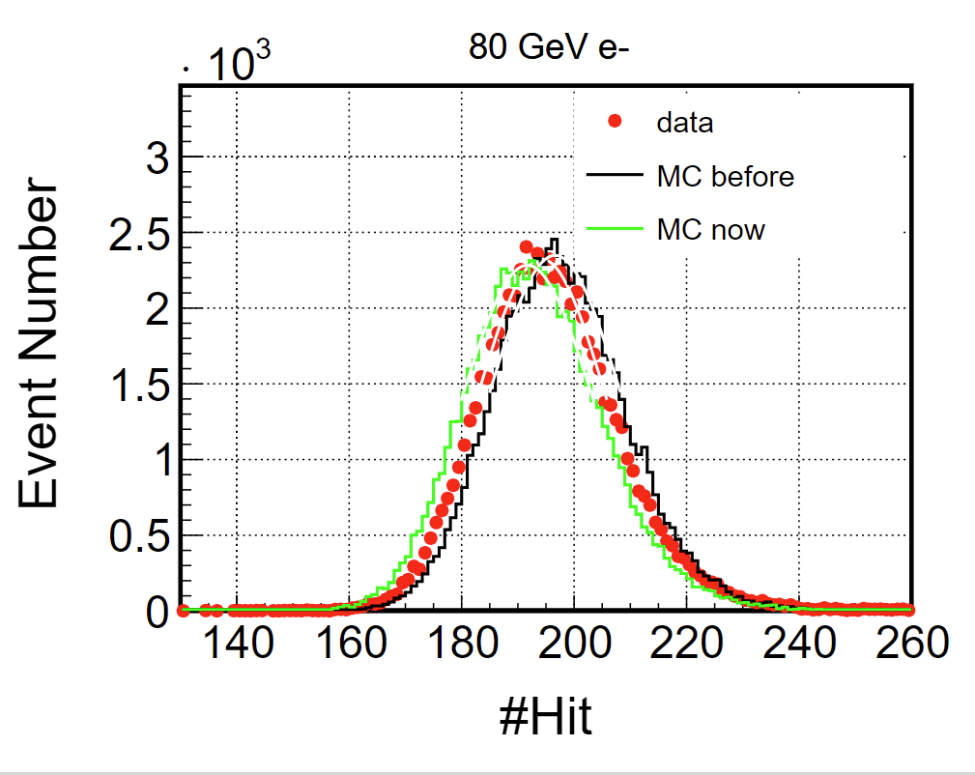
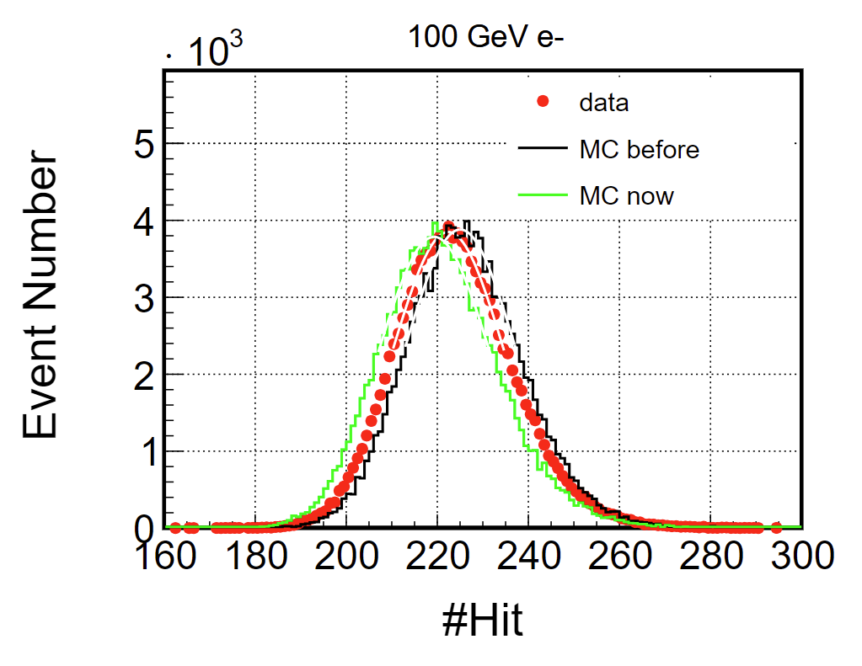
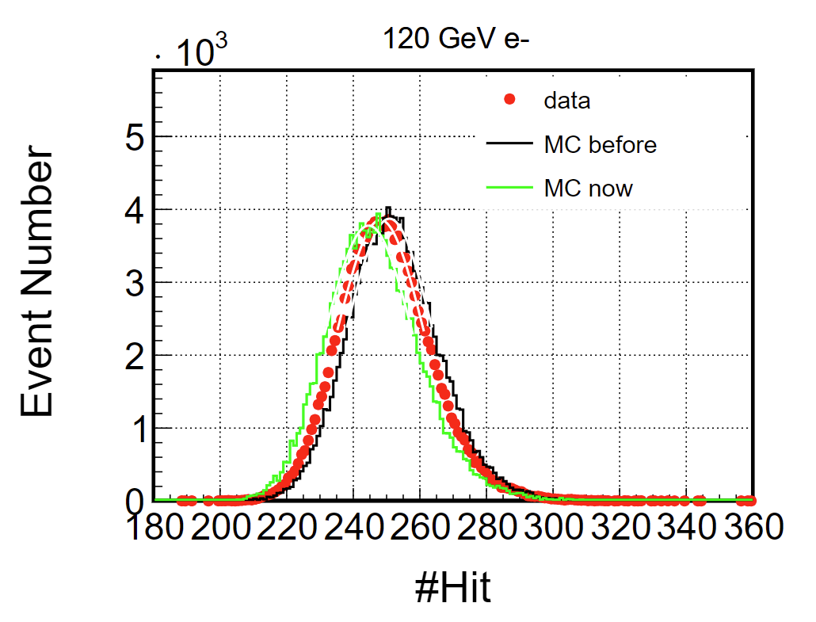
SPS electron #Hit

Slide 5
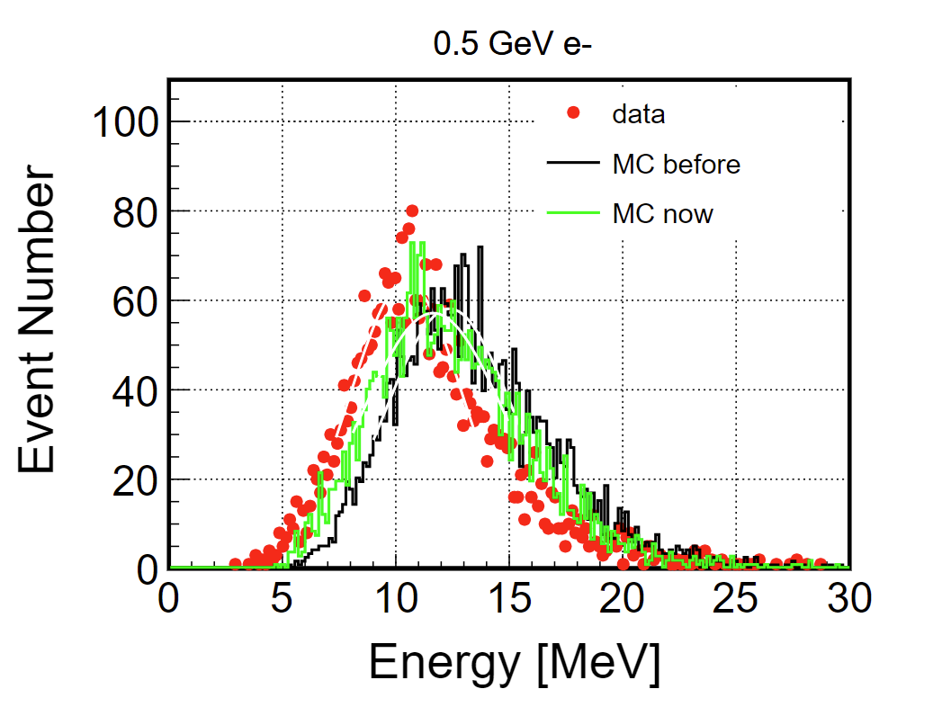
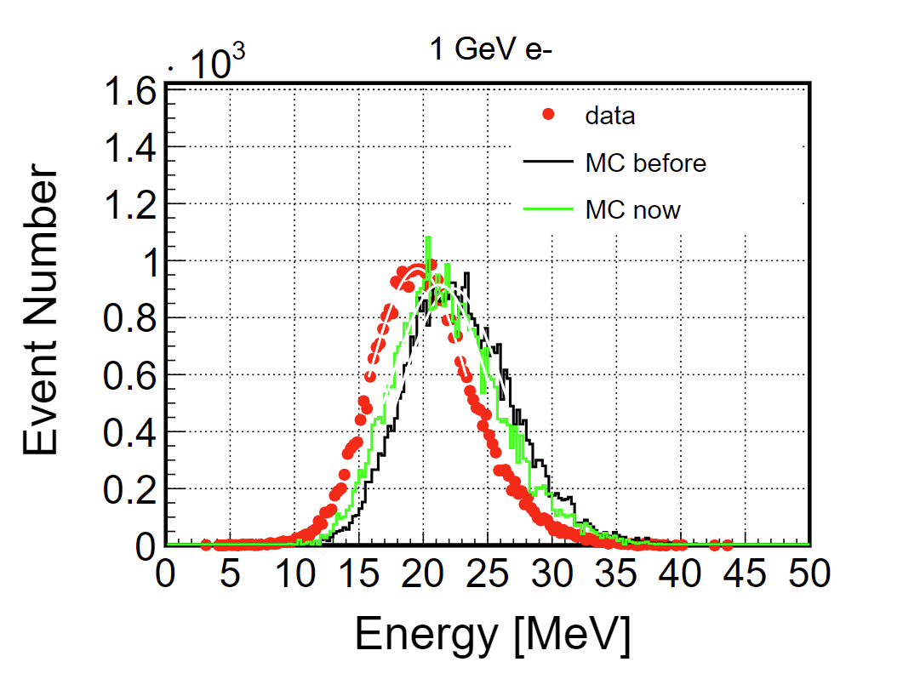
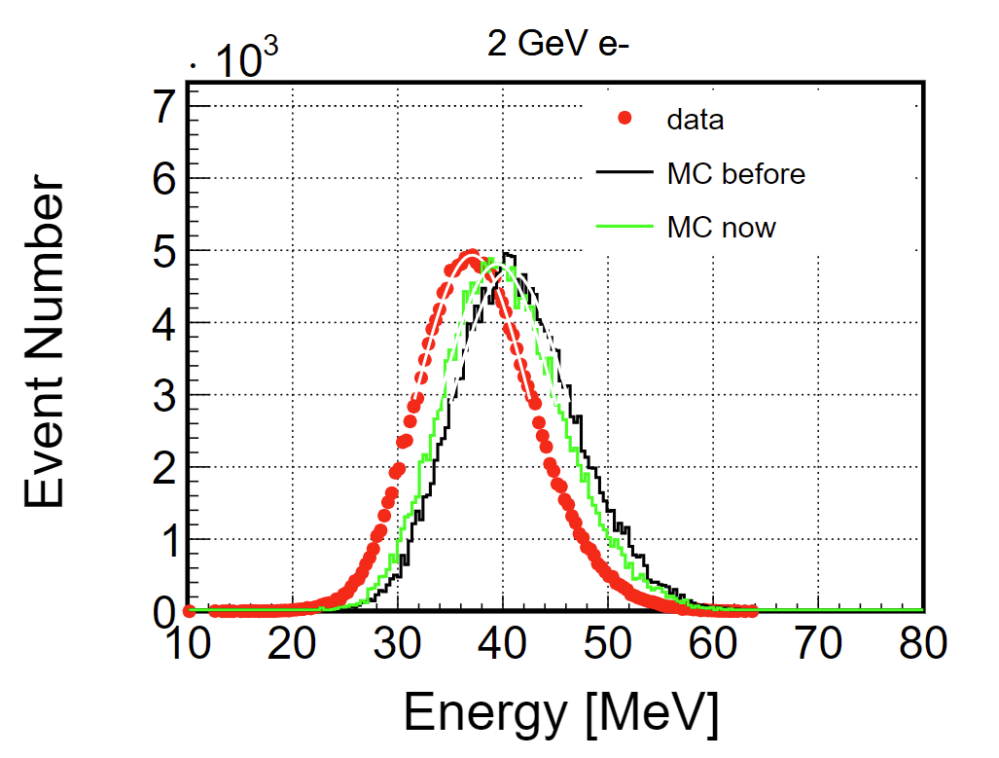
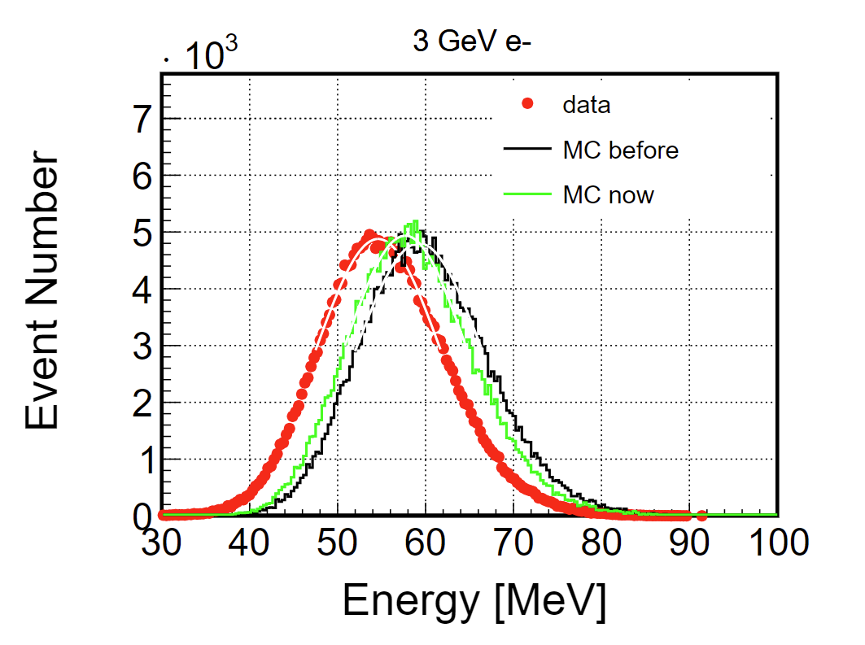
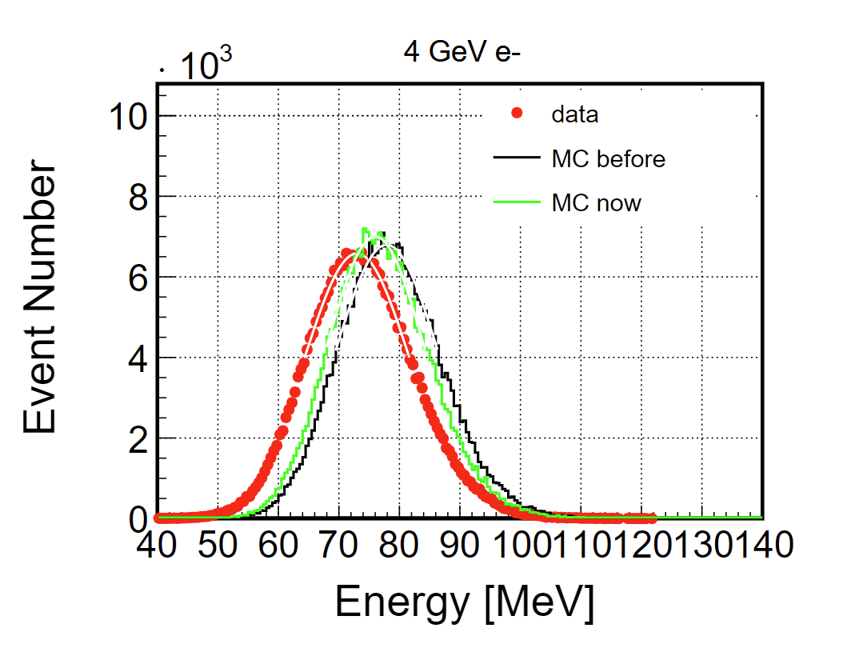
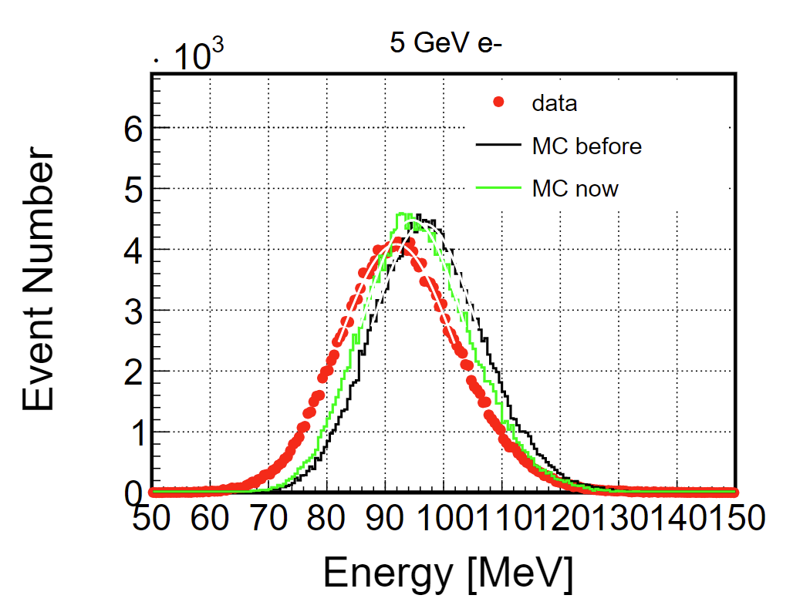
PS electron energy

Slide 6
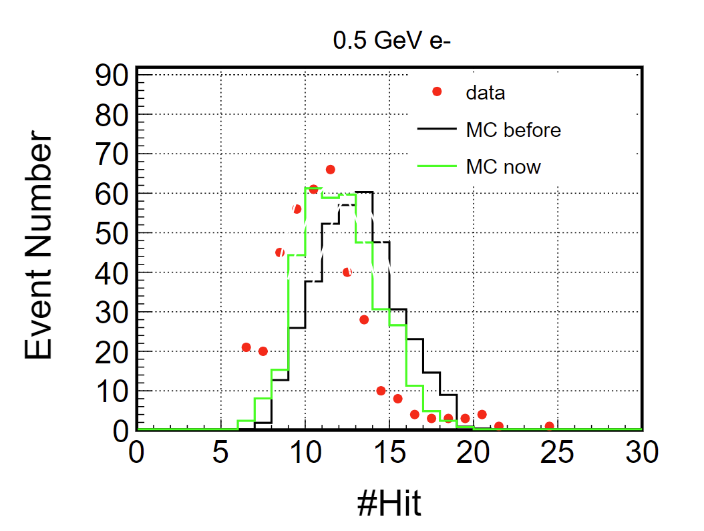
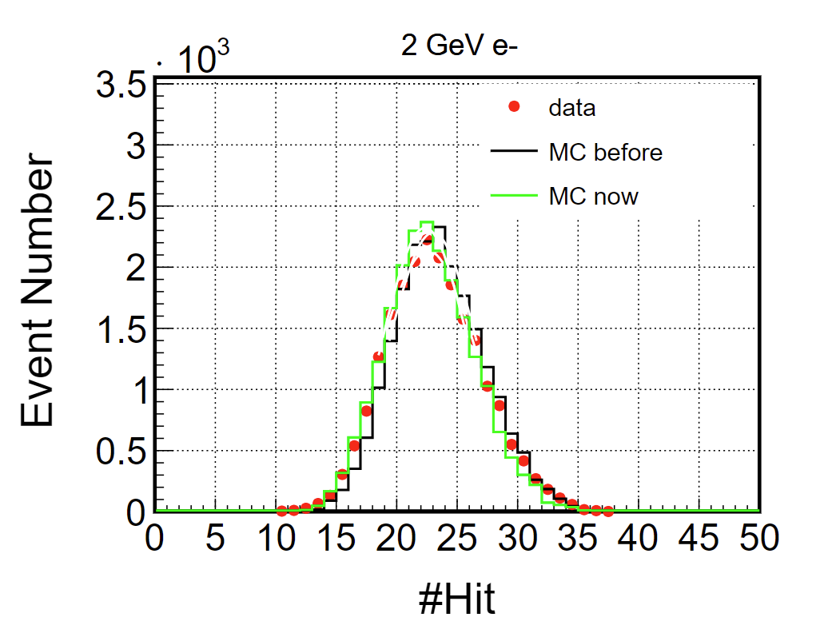
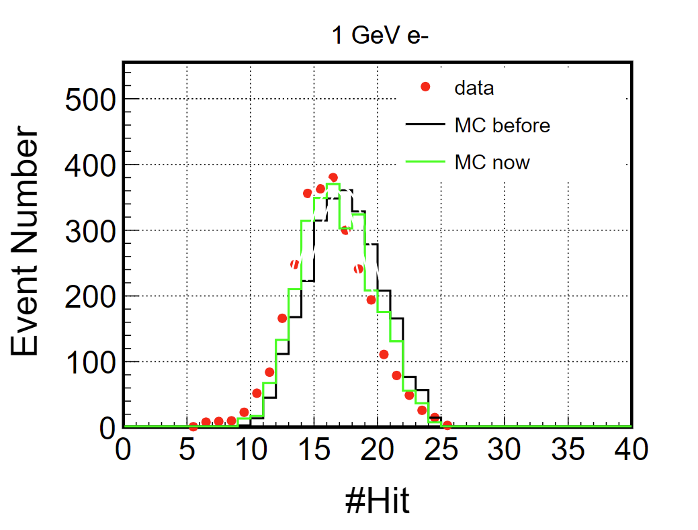
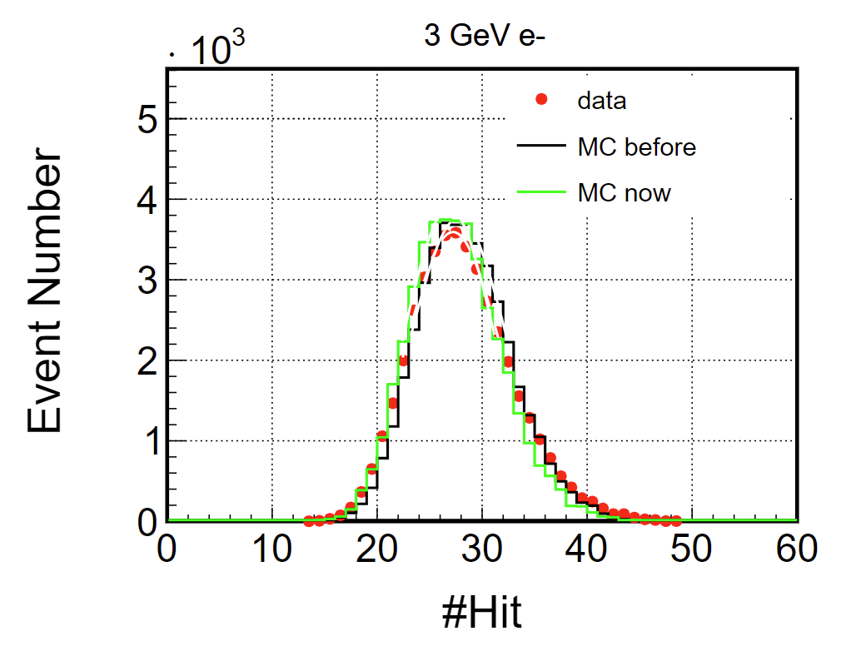
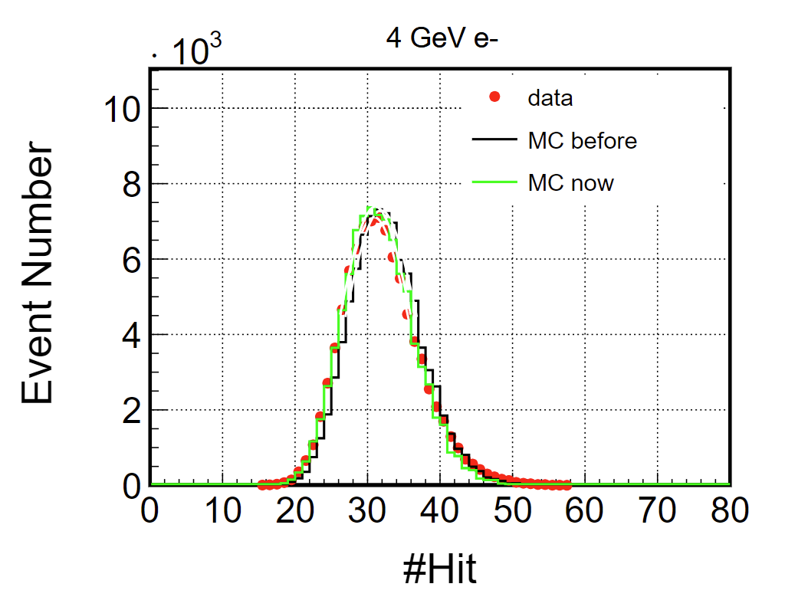
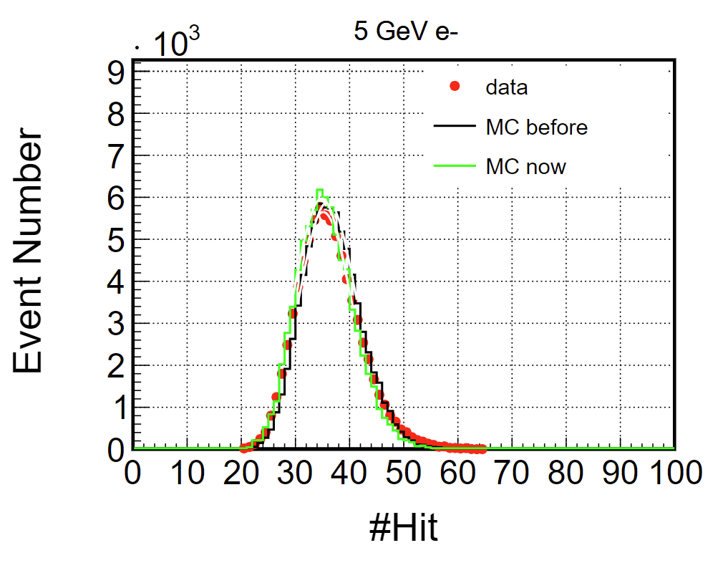
PS electron #Hit

Slide 7
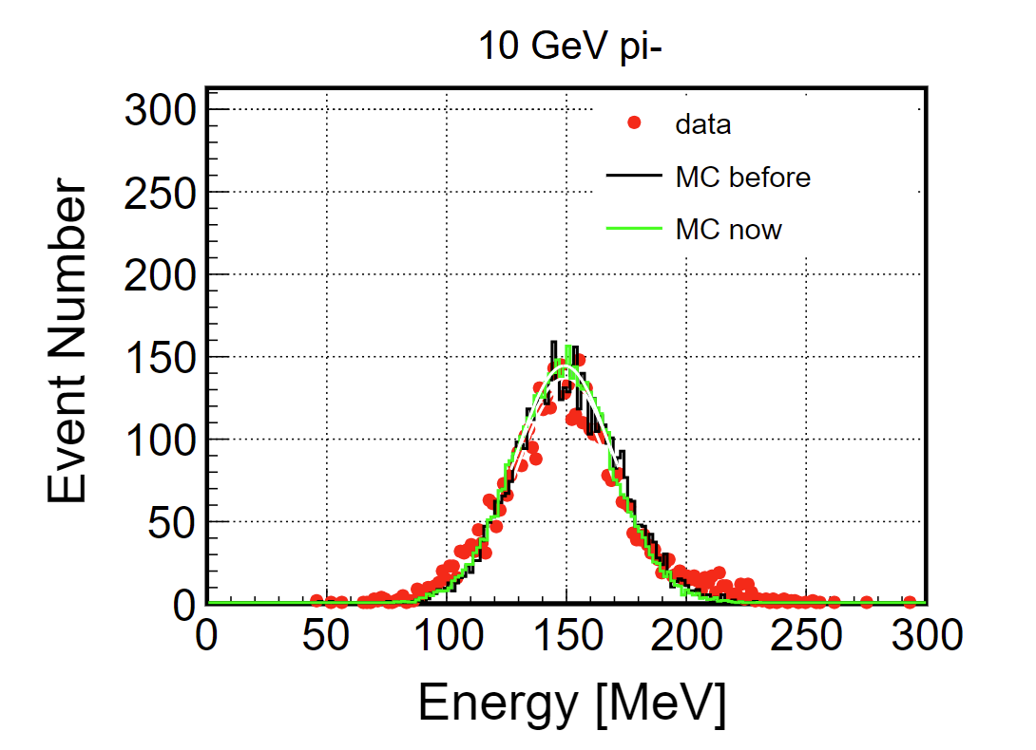
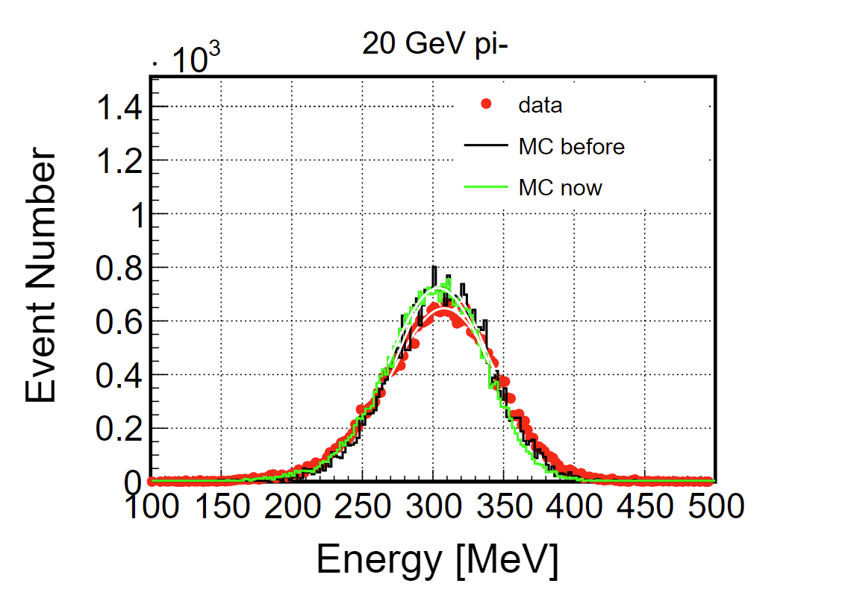
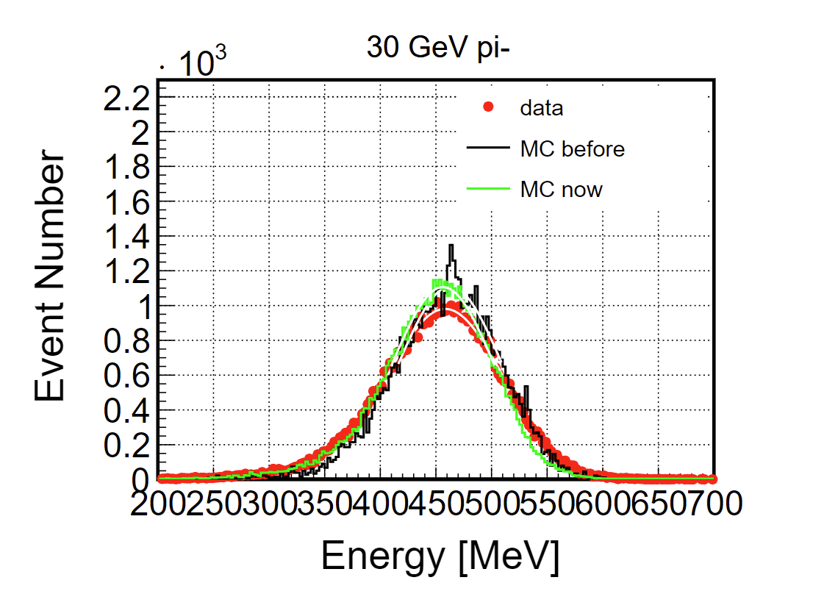
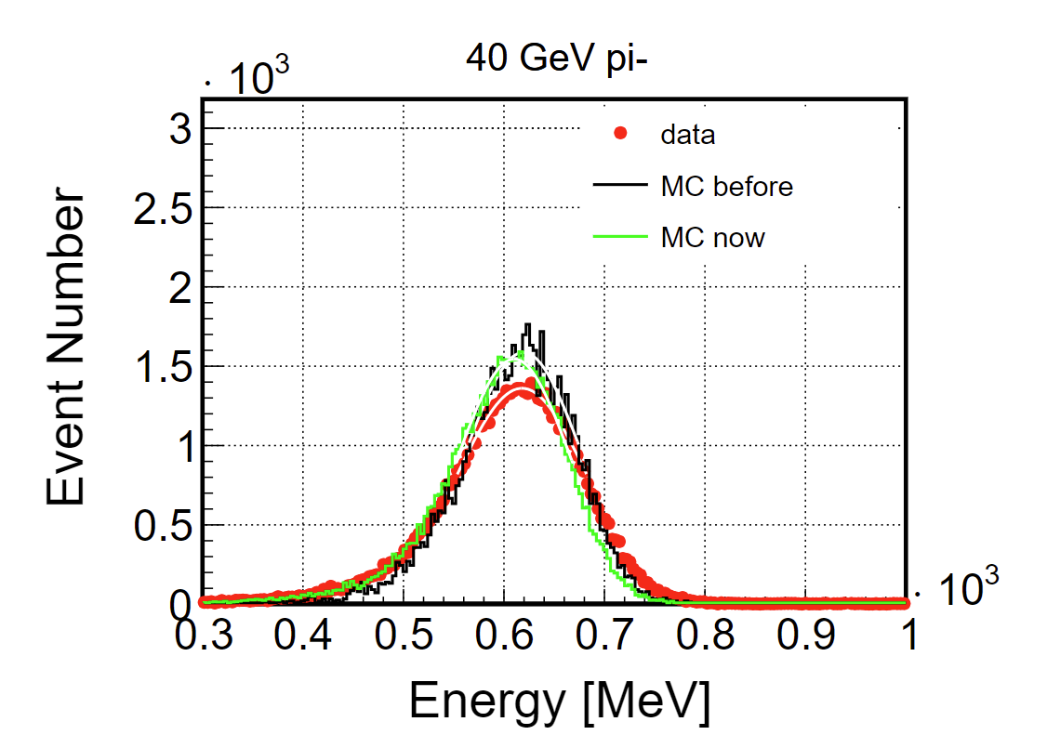
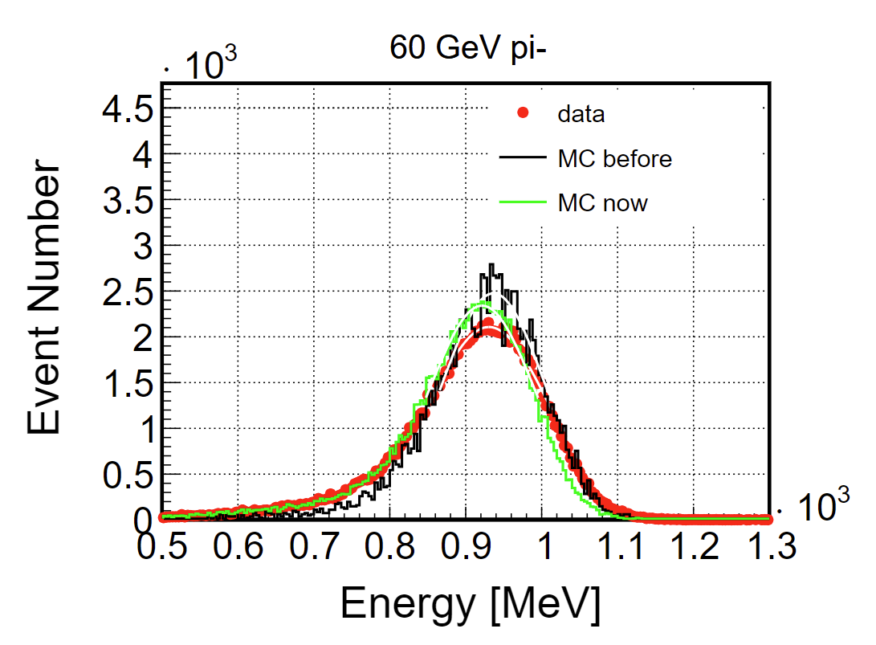
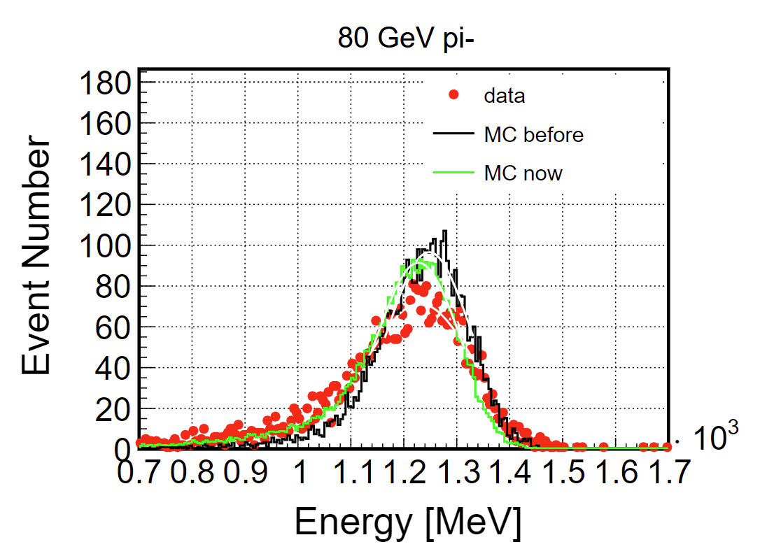
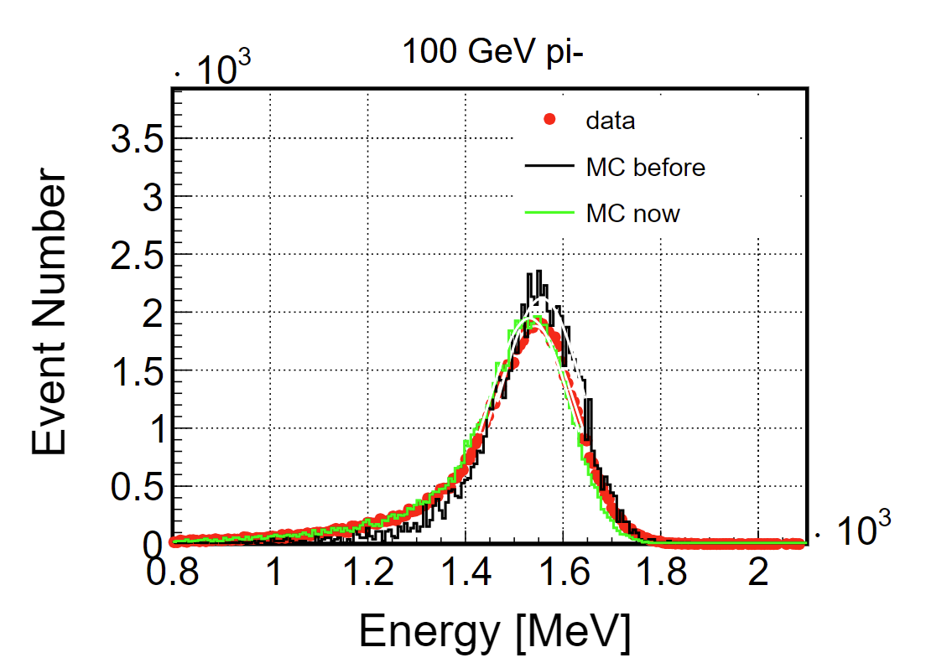
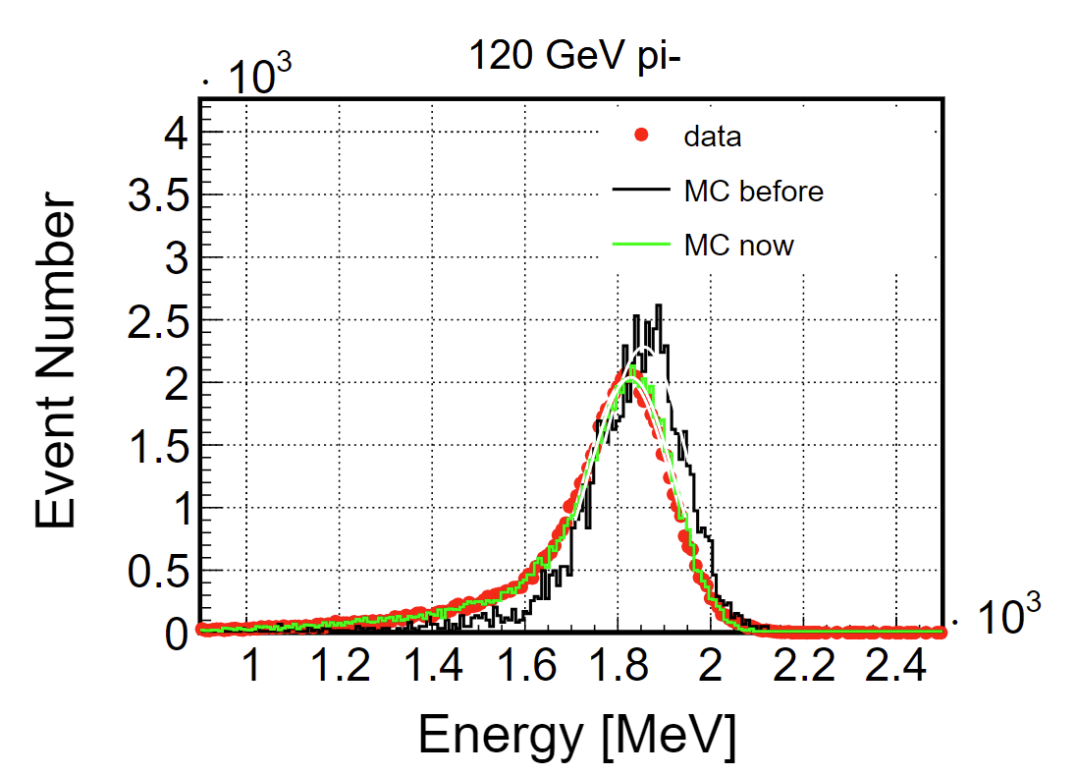
SPS pion energy

Slide 8
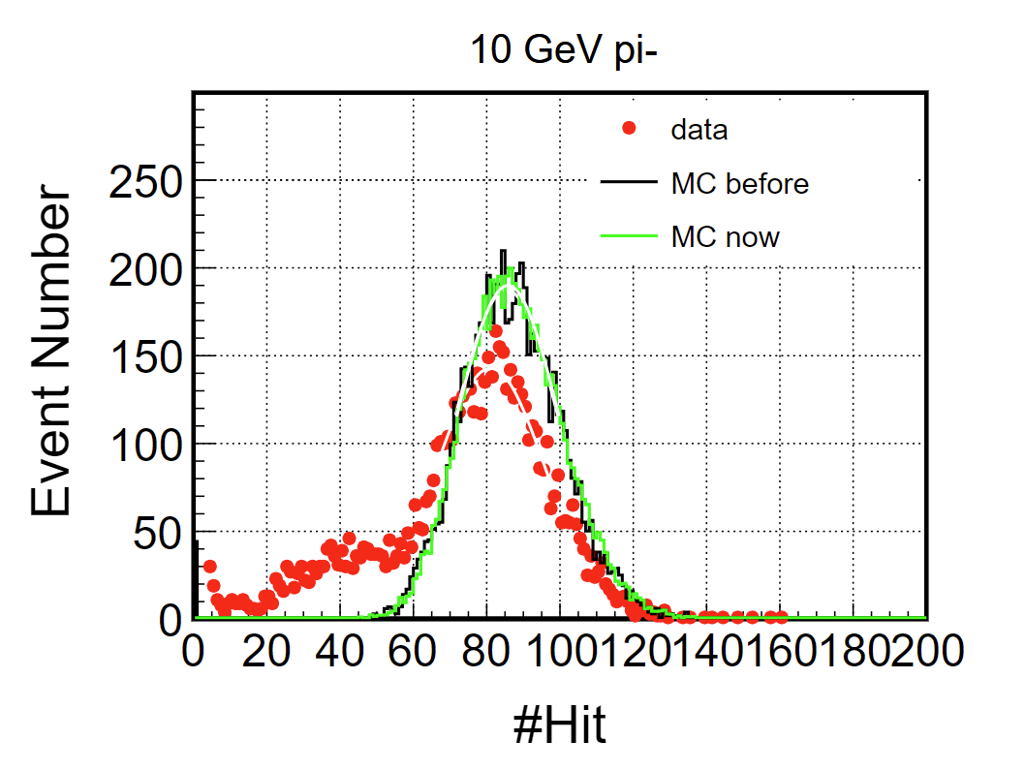
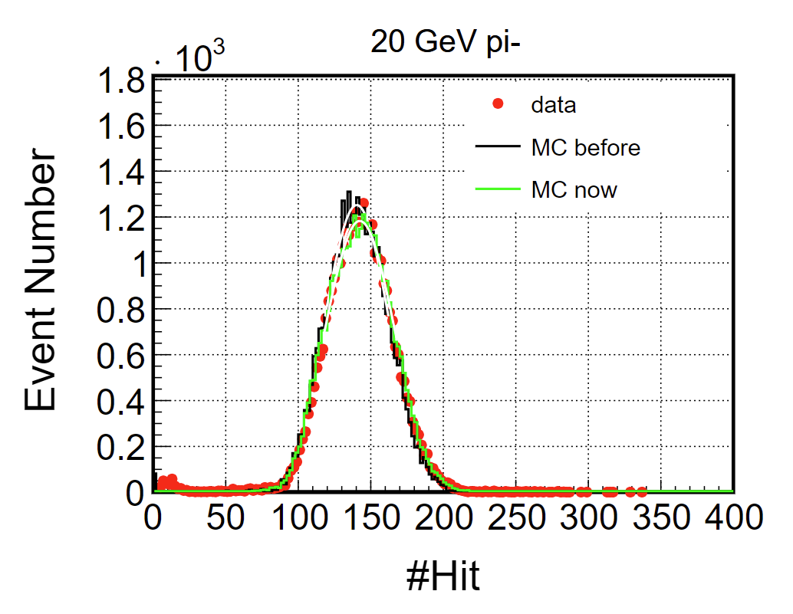
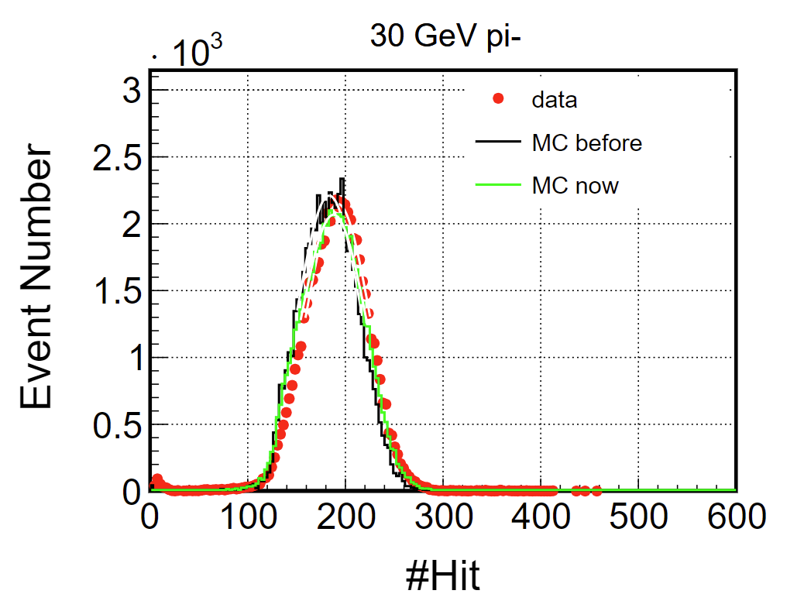
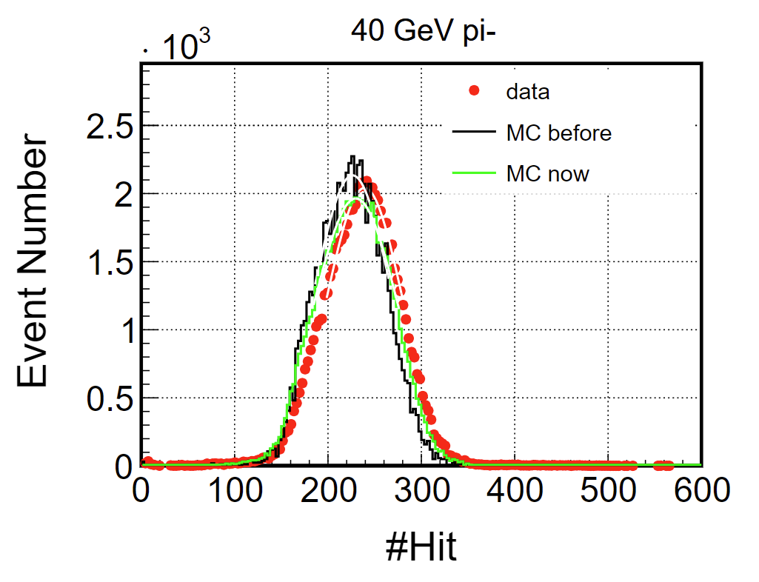
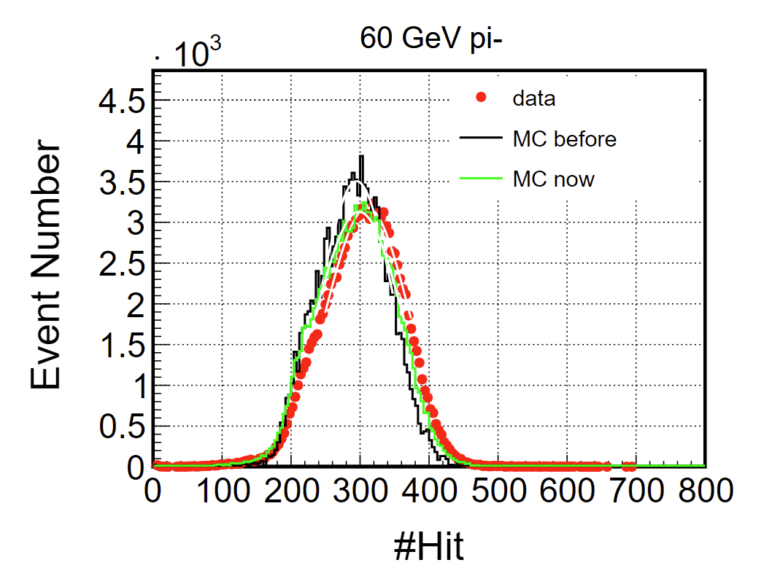
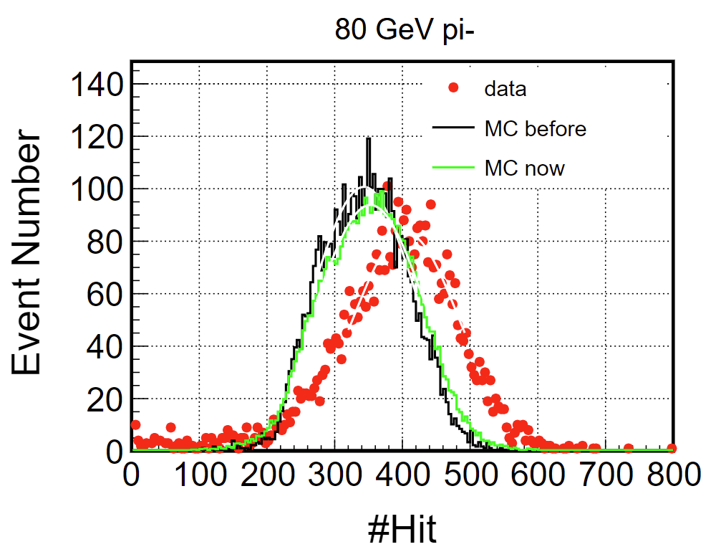
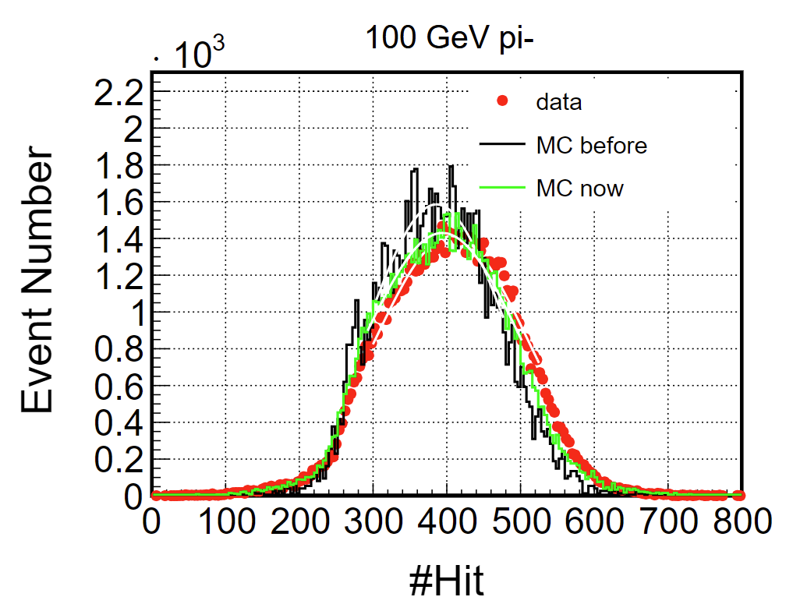
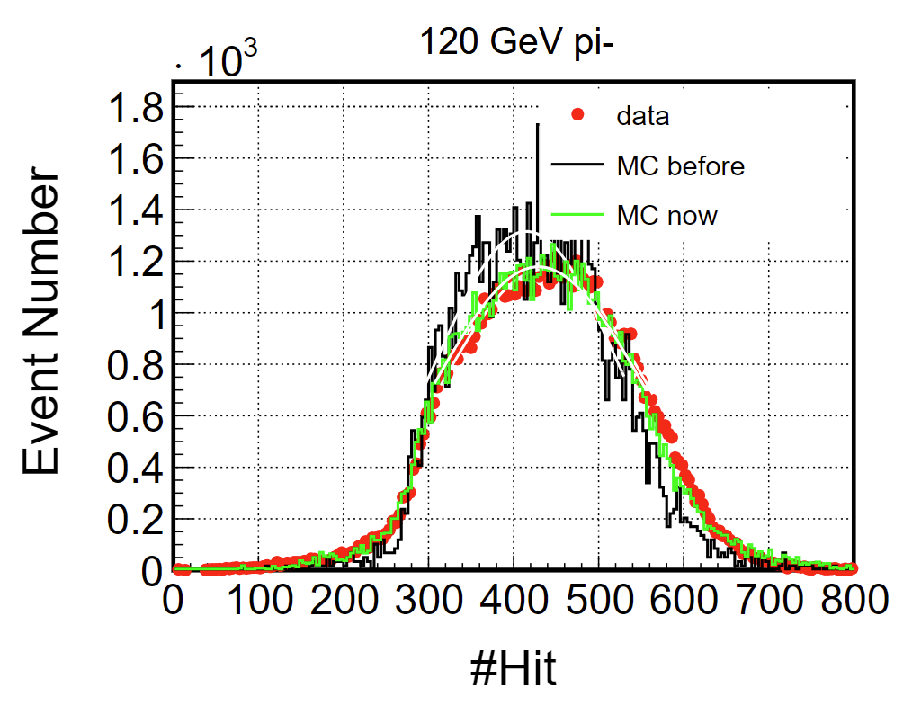
SPS pion #Hit

Slide 9
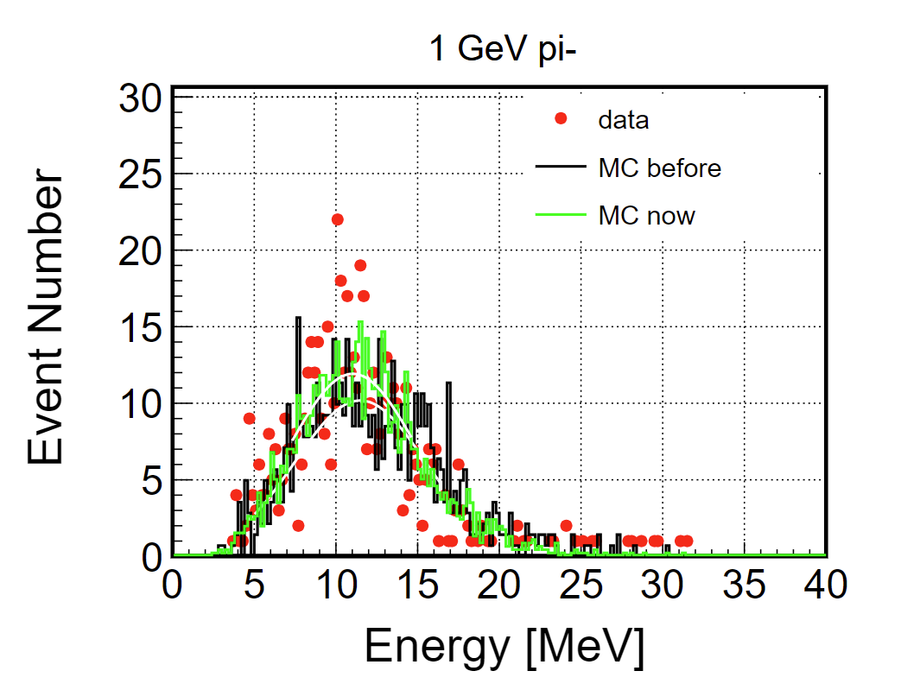
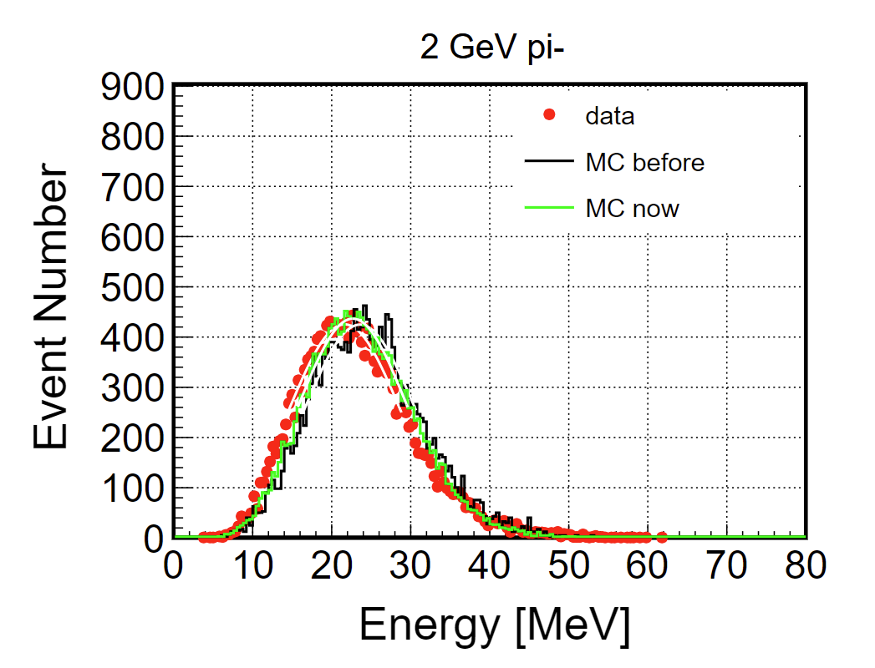
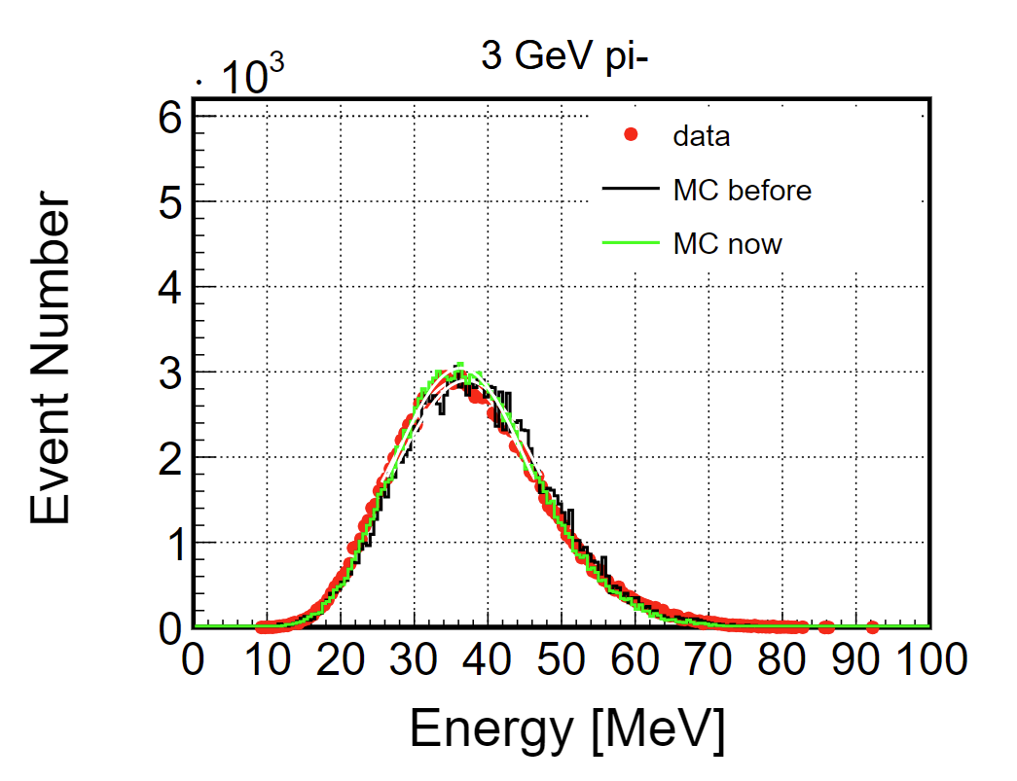
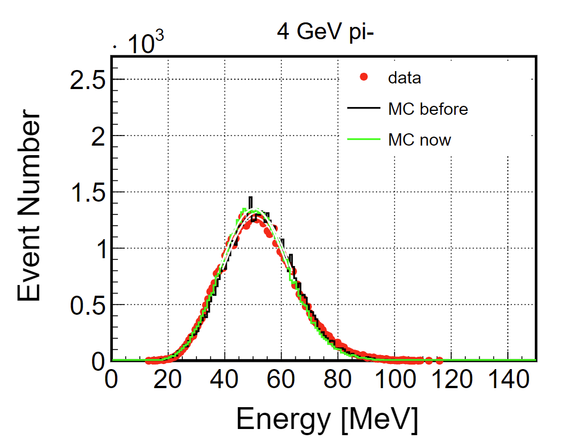




PS pion energy

Slide 10








PS pion #Hit

Slide 11




Temperature
monitor 1
blue: pion
green: electron
magenta: muon
monitor 2
SPS
PS

Slide 12


MIP Calibration
PS: calibrated by muon beam
SPS: calibrated by muon beam
PS: calibrated by muon in pion beam
SPS: calibrated by muon beam

Slide 13
Backup
PW0016A | 0.34 | 0 | 0 | 0 | 0.25 | 0 | 46.86 | 7.32 | 0 | 1.13 | 0 | 0 | 0.16 | 0.04 | 0 | 43.84 | 0 | 0 | 0 | 0.06
PW24 | 0 | 0 | 0.59 | 0 | 0.09 | 0 | 49.35 | 4.85 | 0 | 1.18 | 0 | 0 | 0.56 | 0.01 | 0 | 43.3 | 0 | 0 | 0 | 0.07
SC0402 | 0 | 0 | 0 | 83.57 | 0 | 0 | 4.29 | 0 | 0 | 0 | 0 | 0 | 7.14 | 0 | 0 | 0 | 0 | 5 | 0 | 0
SC0603 | 0 | 0 | 0 | 76.73 | 0 | 0 | 5.4 | 0 | 0 | 0 | 0 | 0 | 13.49 | 0 | 0 | 0 | 0 | 4.38 | 0 | 0
SC1206 | 0 | 0 | 0 | 84.58 | 0 | 0 | 4.12 | 0 | 0 | 0 | 0 | 0 | 9.96 | 0 | 0 | 0 | 0 | 1.34 | 0 | 0
SN74LVC125A | 0.07 | 0 | 0.02 | 0 | 0.23 | 0 | 50.03 | 6.44 | 0 | 1.33 | 0 | 0 | 2.25 | 0.01 | 0.09 | 39.53 | 0 | 0 | 0 | 0
SOIC127P600 | 0.44 | 0 | 0 | 0 | 0.33 | 0 | 29.61 | 9.48 | 0 | 0.79 | 0 | 0 | 0.11 | 0.04 | 0 | 59.14 | 0 | 0 | 0 | 0.06
SOIC8 | 0.17 | 0 | 0 | 0 | 0.3 | 0 | 37 | 8.43 | 0 | 0.81 | 0 | 0 | 1.83 | 0.01 | 0 | 51.4 | 0 | 0 | 0 | 0.05
SOP58P810 | 0.16 | 0 | 0 | 0 | 0.16 | 0 | 42.5 | 7.5 | 0 | 1 | 0 | 0 | 1.12 | 0.01 | 0.05 | 47.46 | 0 | 0 | 0 | 0.04
SR0402 | 2 | 66.48 | 0 | 0 | 0 | 0.42 | 17.55 | 2.34 | 0 | 0 | 0.35 | 0 | 4.39 | 0 | 0.16 | 0 | 2.01 | 4.3 | 0 | 0
SR0603 | 1.51 | 74.04 | 0 | 0 | 0 | 4.62 | 10.24 | 1.12 | 0 | 0 | 0.38 | 0 | 2.55 | 0 | 0.12 | 0 | 2.91 | 2.51 | 0 | 0
STC3528 | 7.44 | 0 | 0 | 0 | 9.88 | 0 | 7.79 | 0 | 0.06 | 0.36 | 0 | 14.34 | 2.31 | 0 | 0 | 0 | 32.68 | 1.21 | 21.86 | 2.07
TMP117 | 2.01 | 0 | 0.02 | 0 | 0.09 | 0 | 58.44 | 4.04 | 0 | 1.38 | 0 | 0 | 1.58 | 0.02 | 0.07 | 32.26 | 0 | 0 | 0 | 0.09
_8SOP | 1.66 | 0 | 0.43 | 0 | 0.1 | 0 | 43.36 | 4.86 | 0 | 0 | 0 | 0 | 1.45 | 0 | 0 | 44.31 | 0 | 0 | 0 | 3.84
SD0805（LED） | FR4+Cu (do not find the ditail, same as PCB board)
RJ6
RT3
BB02
FH29BW
BGA
MCH

