Slide 1



Parton distribution function on Lattice QCD
第一届中国电子离子对撞机相关物理年会
Peng Sun
Institute of Modern Physics,
Chinese Academy of Sciences
Lattice Parton
collaboration
Chinese Lattice
collaboration
2026/04/22

Slide 2
Outline
Background
Results from Lattice Parton collaboration (LPC)
summary

Slide 3
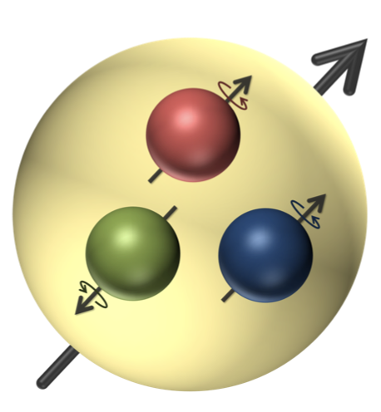
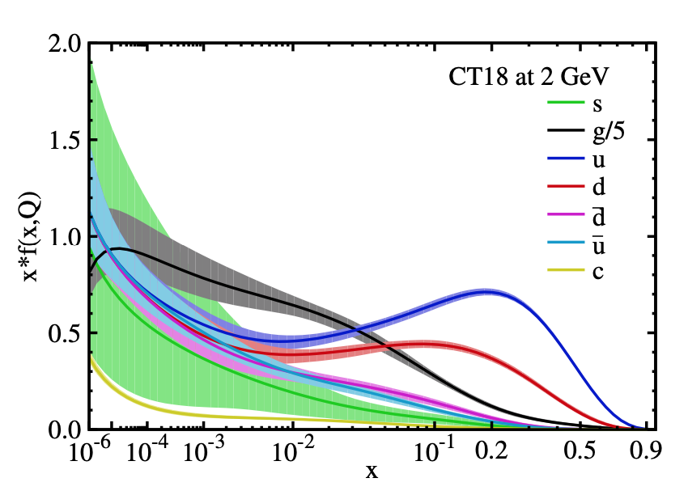
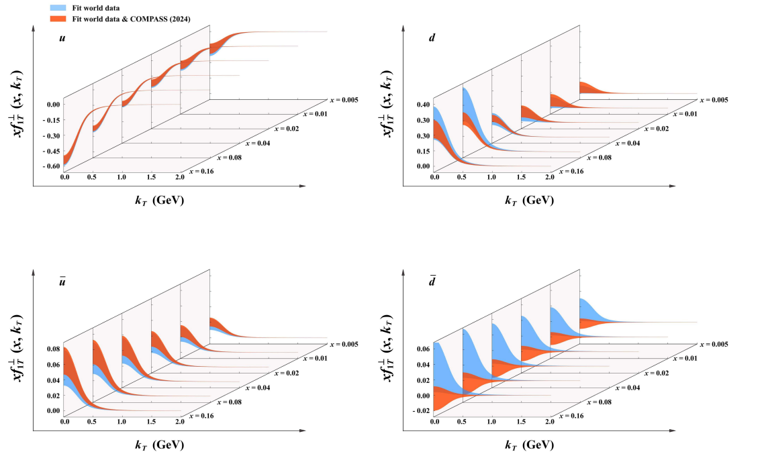

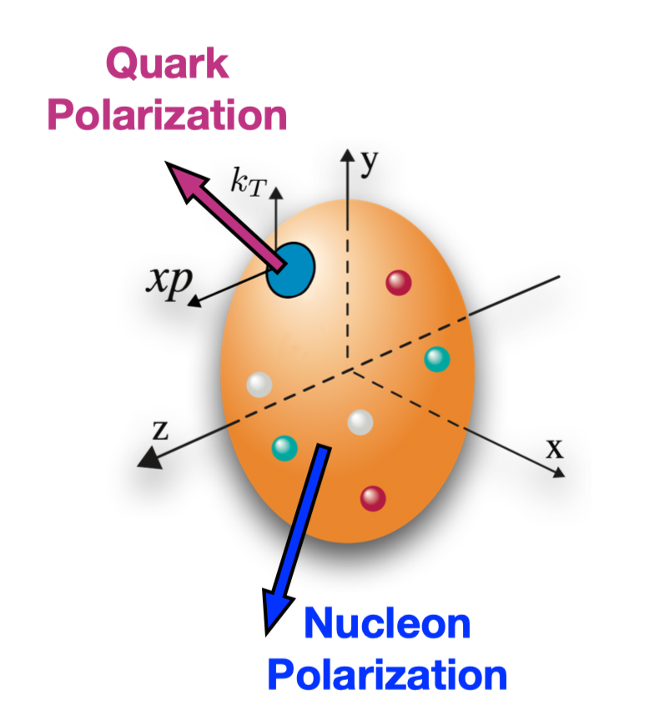

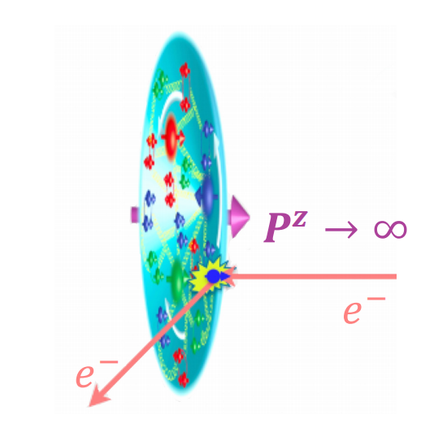


PDF
PRD103, 014013 (2021)
0D: spin and mass
1D: PDF
3D: TMDs

Slide 4
Reconstruct the PDF from Lattice QCD
The direct calculation of the hadronic tensor on the lattice which can be used to reconstruct the structure functions through the Laplace transform
K. Liu, S. Dong, Phys.Rev.Lett. 72 1790 (1994)
J. Liang, et.al, Phys. Rev. D 101, 114503 (2020)
The quasi-PDF proposed by Ji: Reconstruct the PDF through Fourier transform
X.D. Ji, Phys.Rev.Lett 110 262002 (2013)
X. Xiong, et.al, Phys.Rev. D 90 014051 (2014)
Lattice cross section: the hadronic matrix elements which are calculable in lattice QCD and factorizable in terms of PDFs
Y.Q. Ma and J.-W. Qiu, Phys.Rev.Lett 120 022003 (2018)
The pseudo-PDF is similar as quasi-PDF, and it is renormalized by hadron matrix elements
A. V. Radyushkin, Phys.Rev. D 96, 034025 (2017)

Slide 5

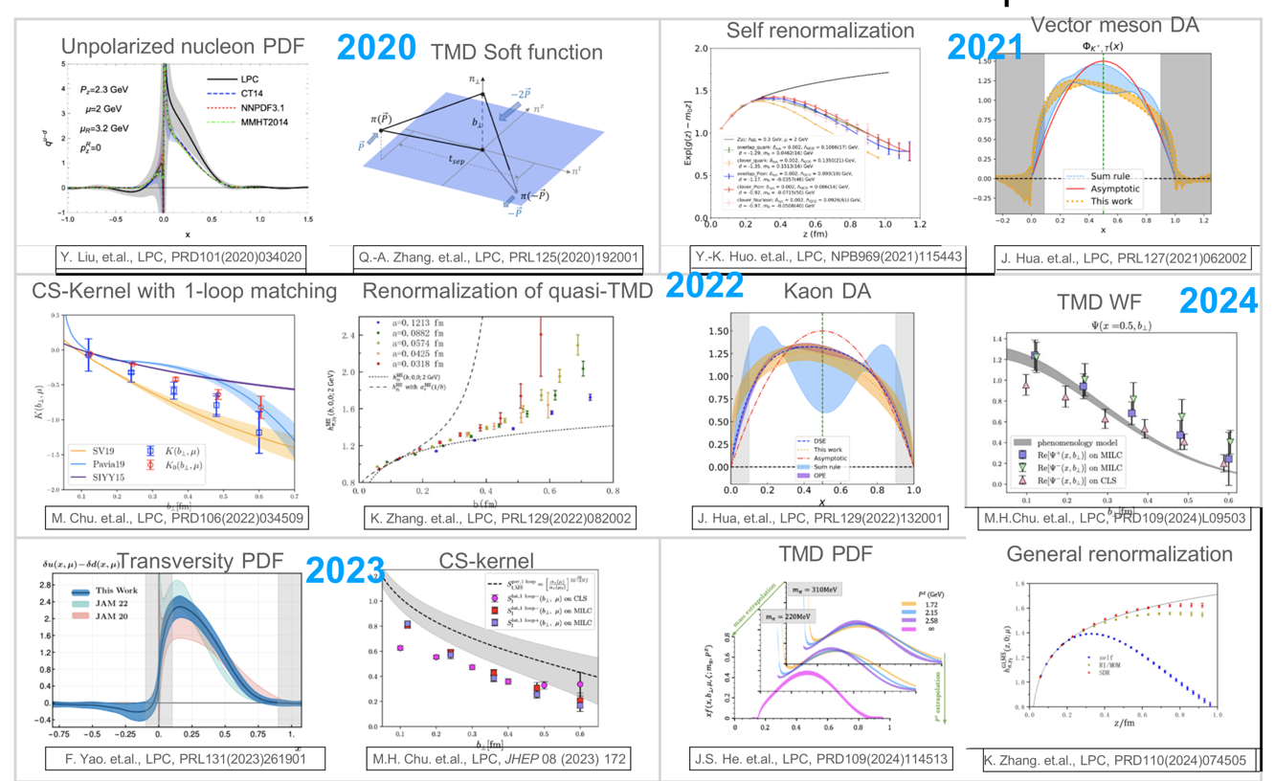
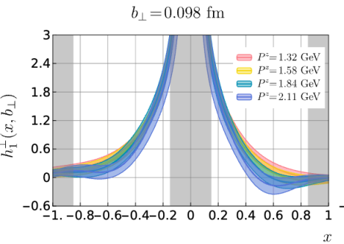
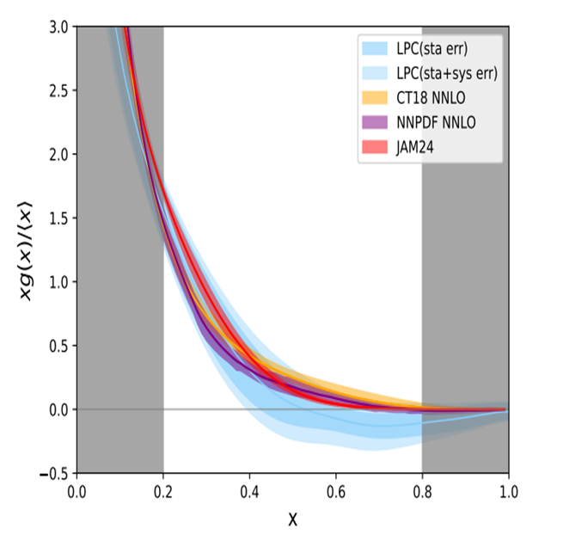
Lattice Parton Collaboration
2025
Boer-Mulders TMDPDF
Gluon PDF

Slide 6
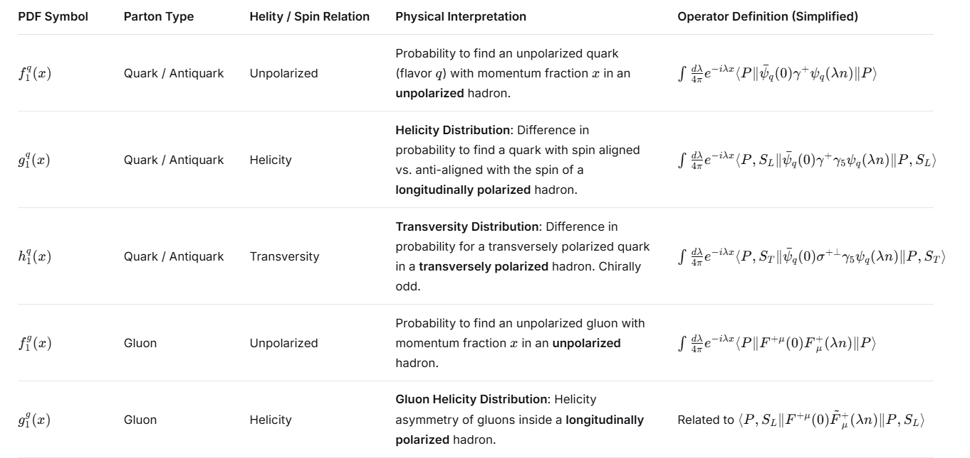
Leading twist light-cone PDF

Slide 7
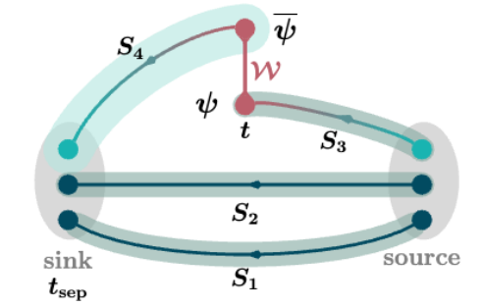
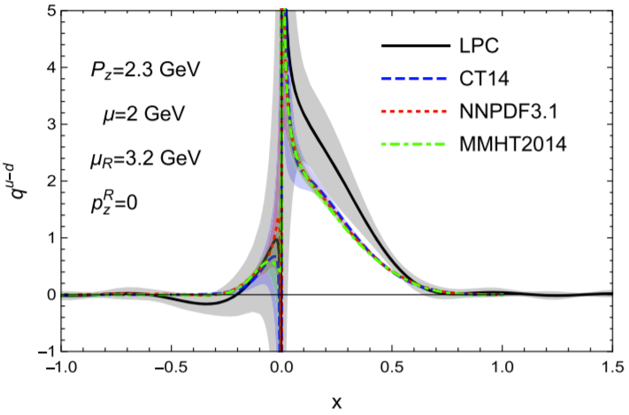
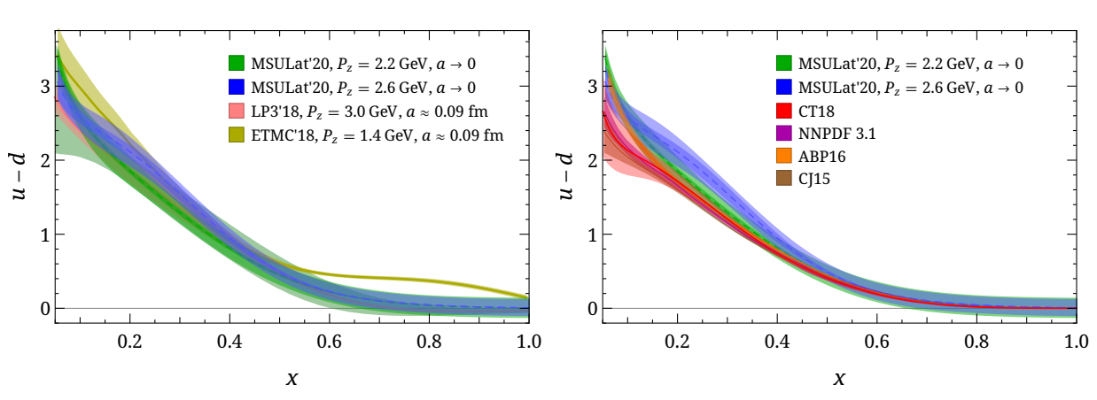
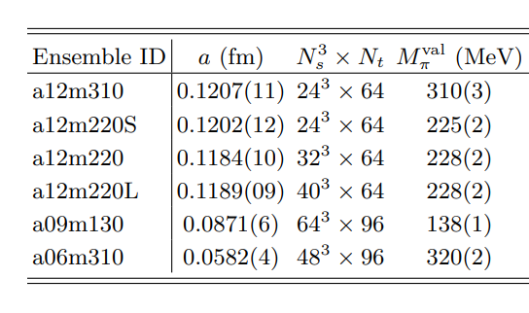
Unpolarized PDF on Lattice
Using CLS 32x96 2+1 flavor clover fermion ensemble H102 Lattice spacing a=0.086 fm, Mπ= 356MeV
Y. Liu, et.al., LPC, PRD101(2020)034020
HW. Lin arXiv:2011.14971 (2020)

Slide 8
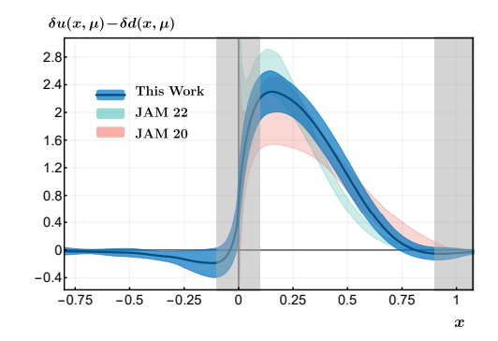
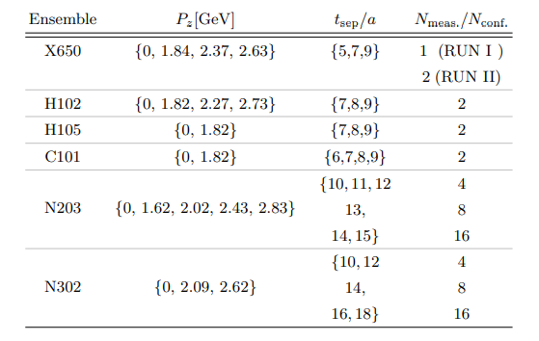
Transversity PDF on Lattice
Pion mass = {354, 281, 222} MeV
F Yao et al LPC Phys. Rev. Lett. 131, 261901

Slide 9
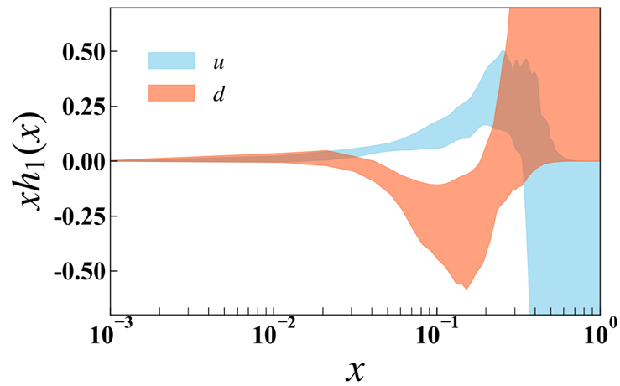
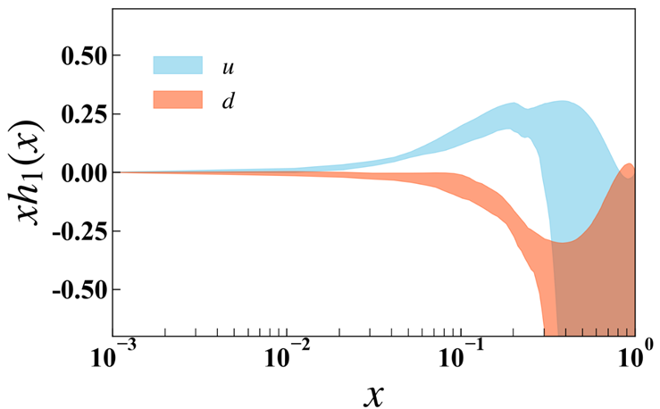
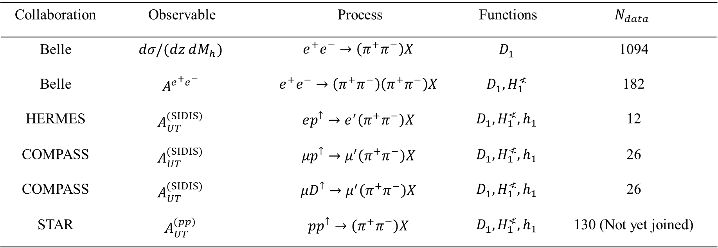
World SIDIS datasets
World SIDIS datasets & Lattice datasets
preliminary
preliminary

Slide 10
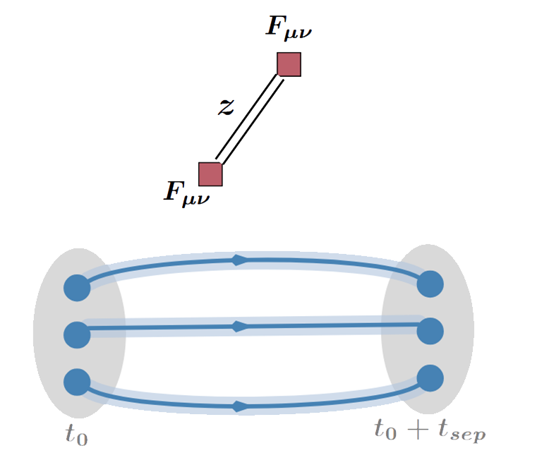
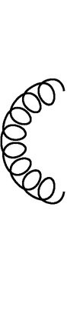
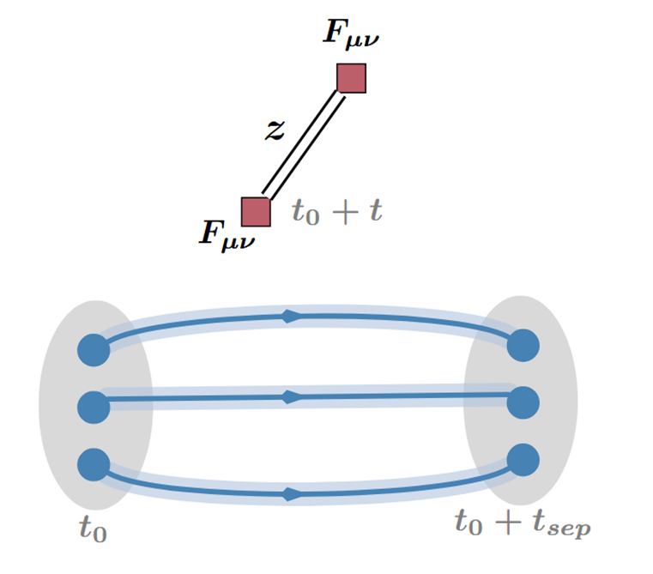

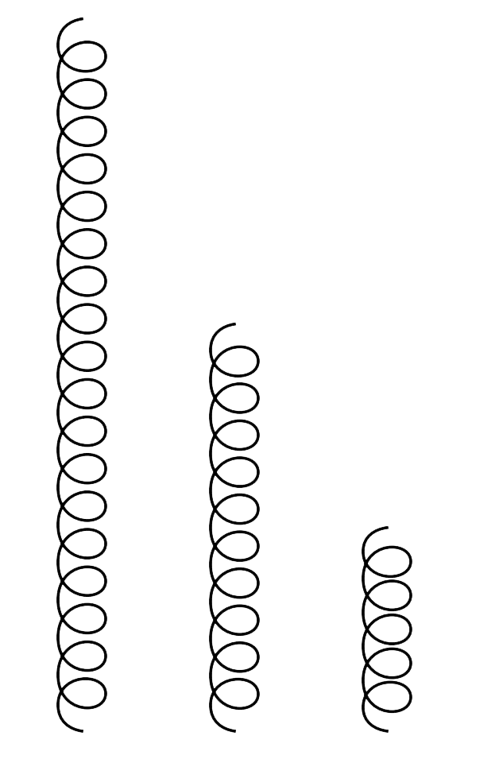
Unpolarized Gluon PDF on Lattice
Lattice QCD calculation :
An illustration of gluon’s three-point correlator

Slide 11

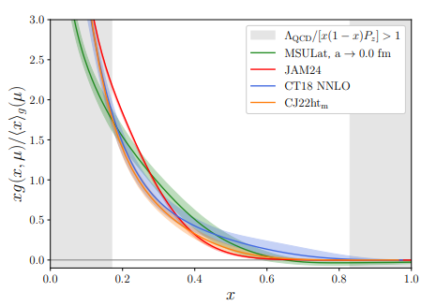
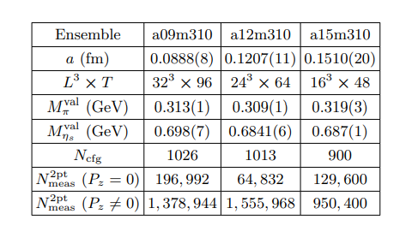
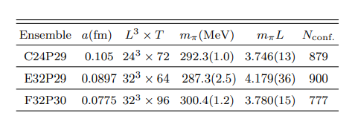
Unpolarized Gluon PDF on Lattice
Distillation method is used.
arXiv:2510.26425
arXiv:2510.17758

Slide 12
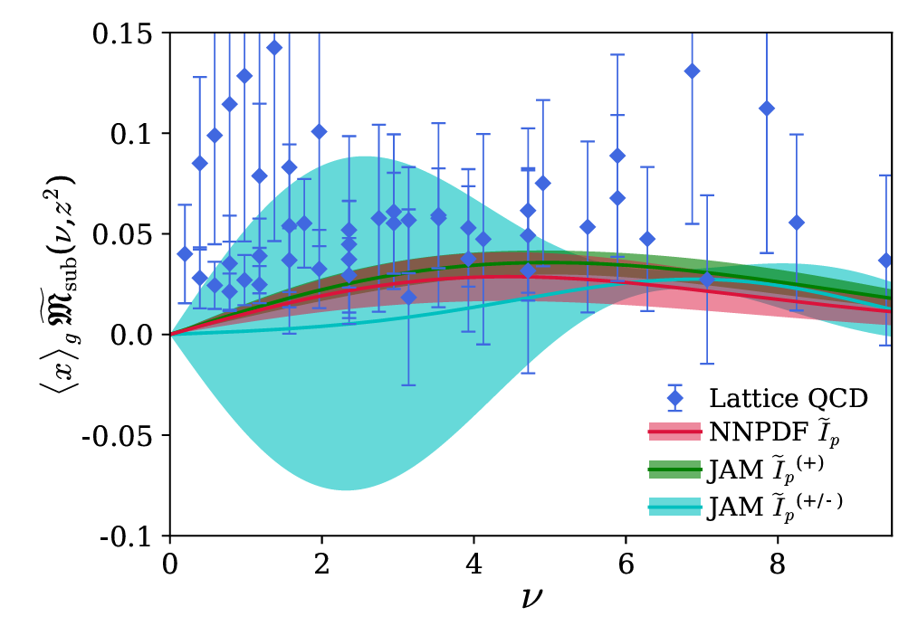
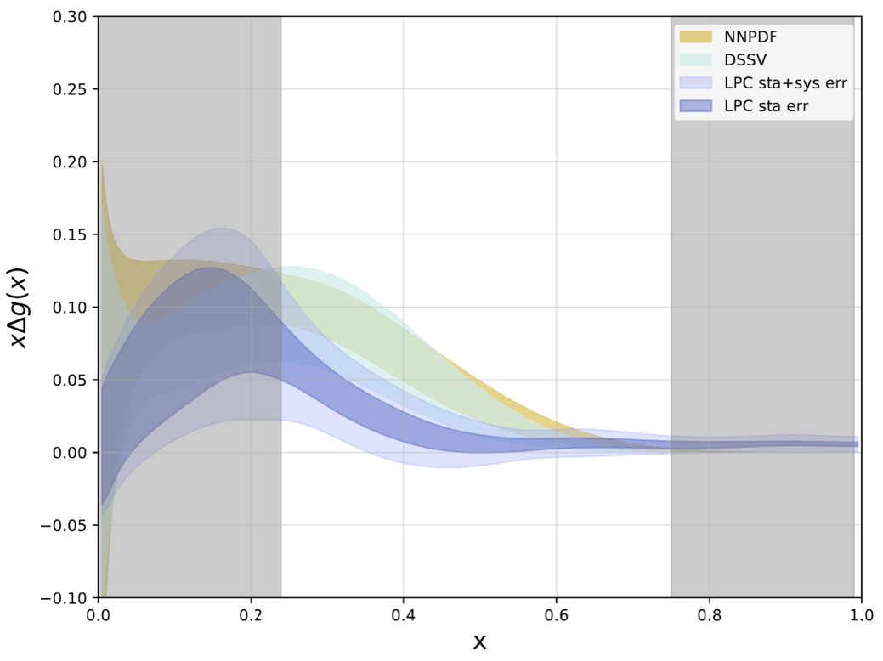
Helicity Gluon PDF on Lattice
preliminary
HadStruc Collaboration
Phys.Rev.D 106 (2022) 9, 094511
LPC Collaboration

Slide 13
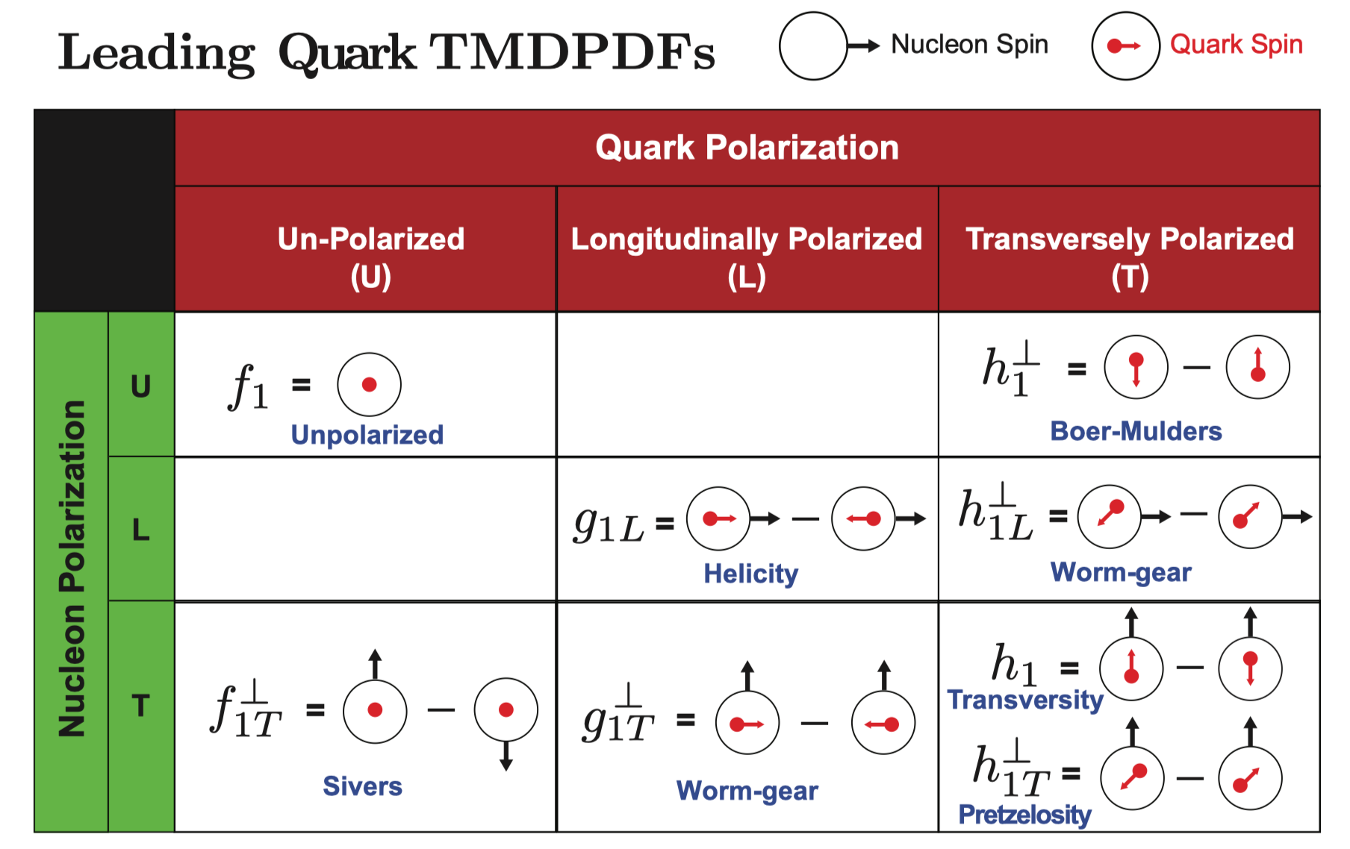
TMDs: 3D hadron Structure
Spin-dependent TMDPDFs
Figure Credit:
TMD Handbook, 2304.03302

Slide 14
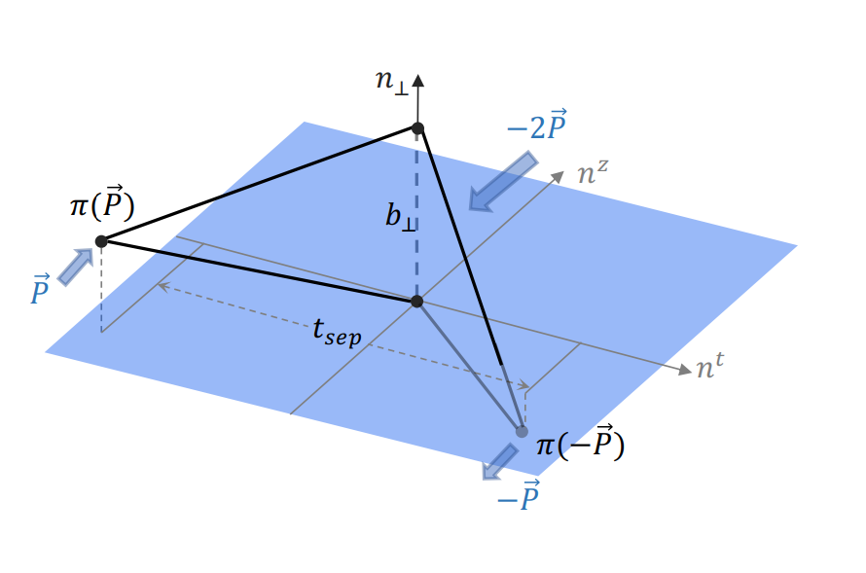
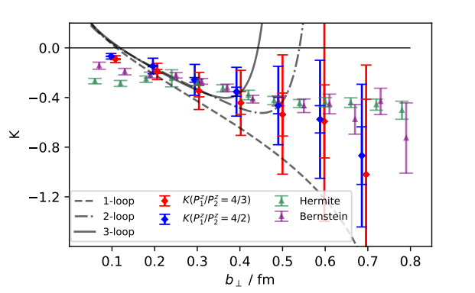
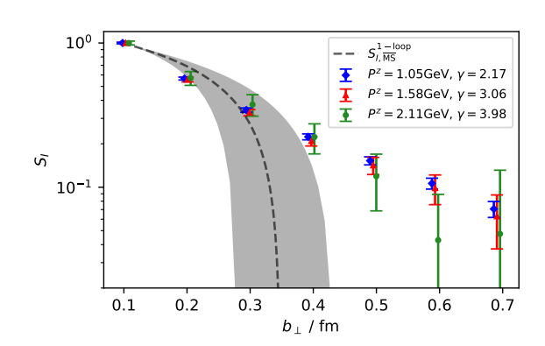
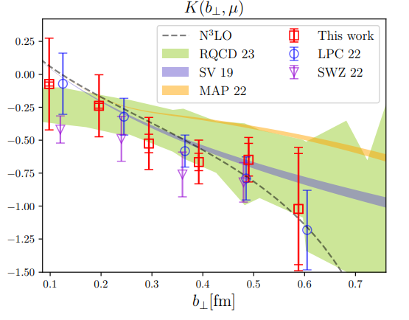
Soft Factor on Lattice QCD
Q.-A. Zhang. et.al., LPC, PRL125(2020)192001
M.H. Chu. et.al., LPC, JHEP 08 (2023) 172

Slide 15
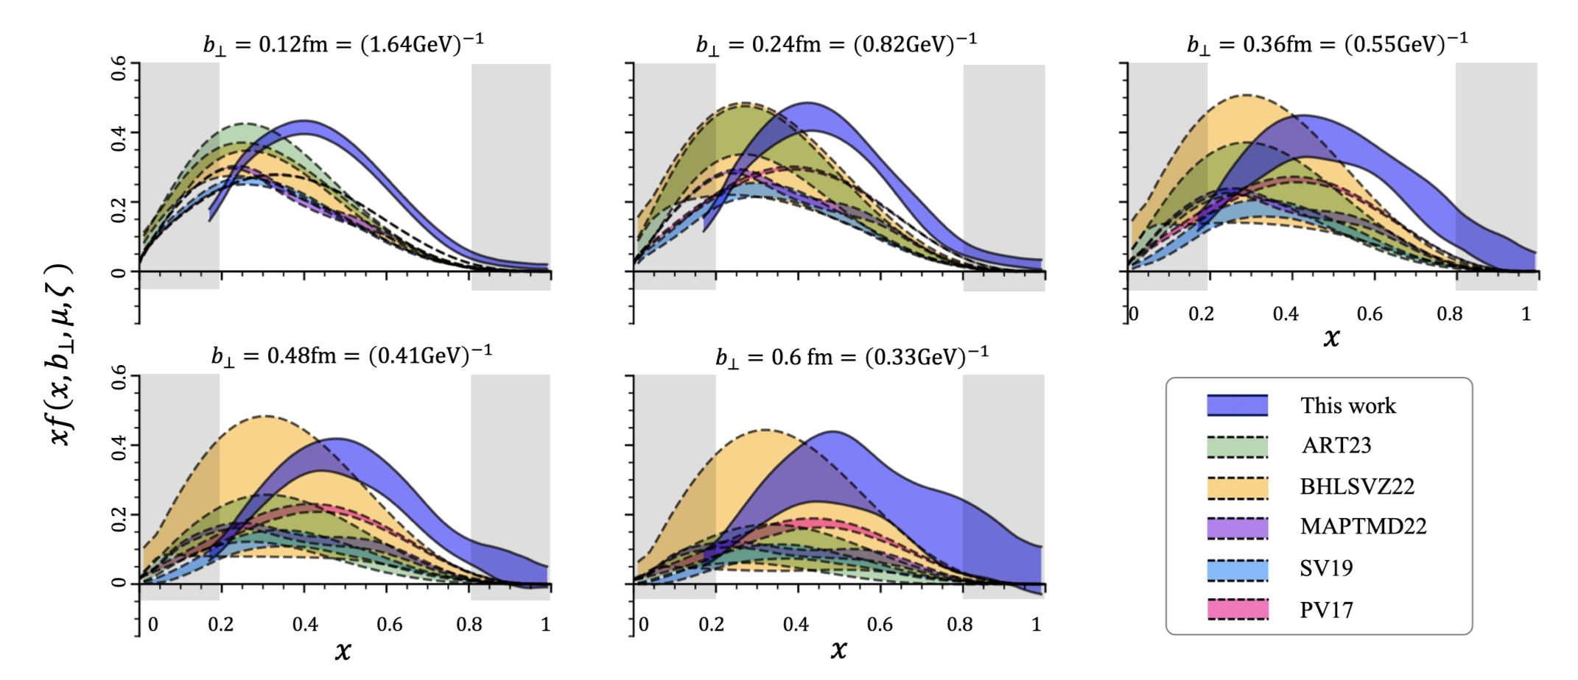
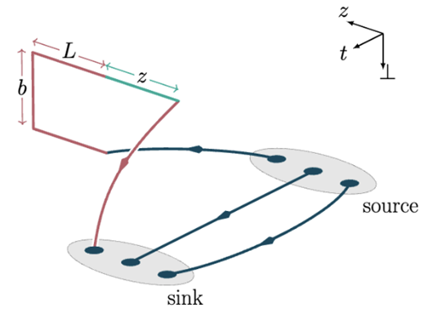
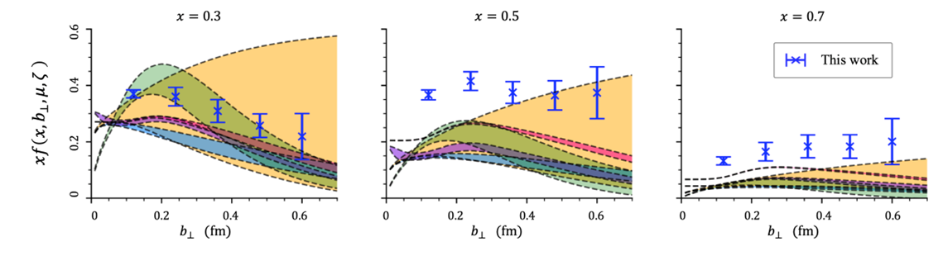
Unpolarized TMD PDF on Lattice QCD
Compare the $b_{⊥}$-dependence of lattice and phenomenological results:
Moos, JHEP2024
Bury, JHEP2022
Bacchetta, JHEP2022
Scimemi, JHEP2020
Bacchetta, JHEP2019
J.S. He. et.al., LPC, PRD109(2024)114513

Slide 16
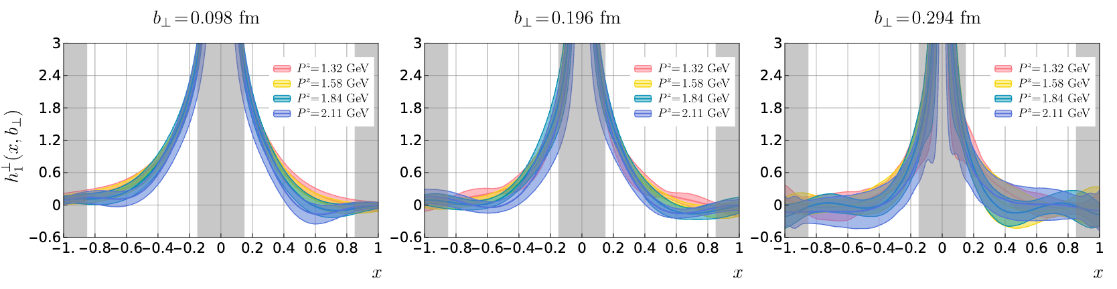

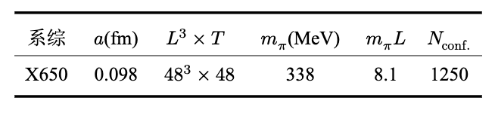
Boer-Mulders TMDPDF
LY. Ma, et. al, JHEP 08 (2025) 086

Slide 17
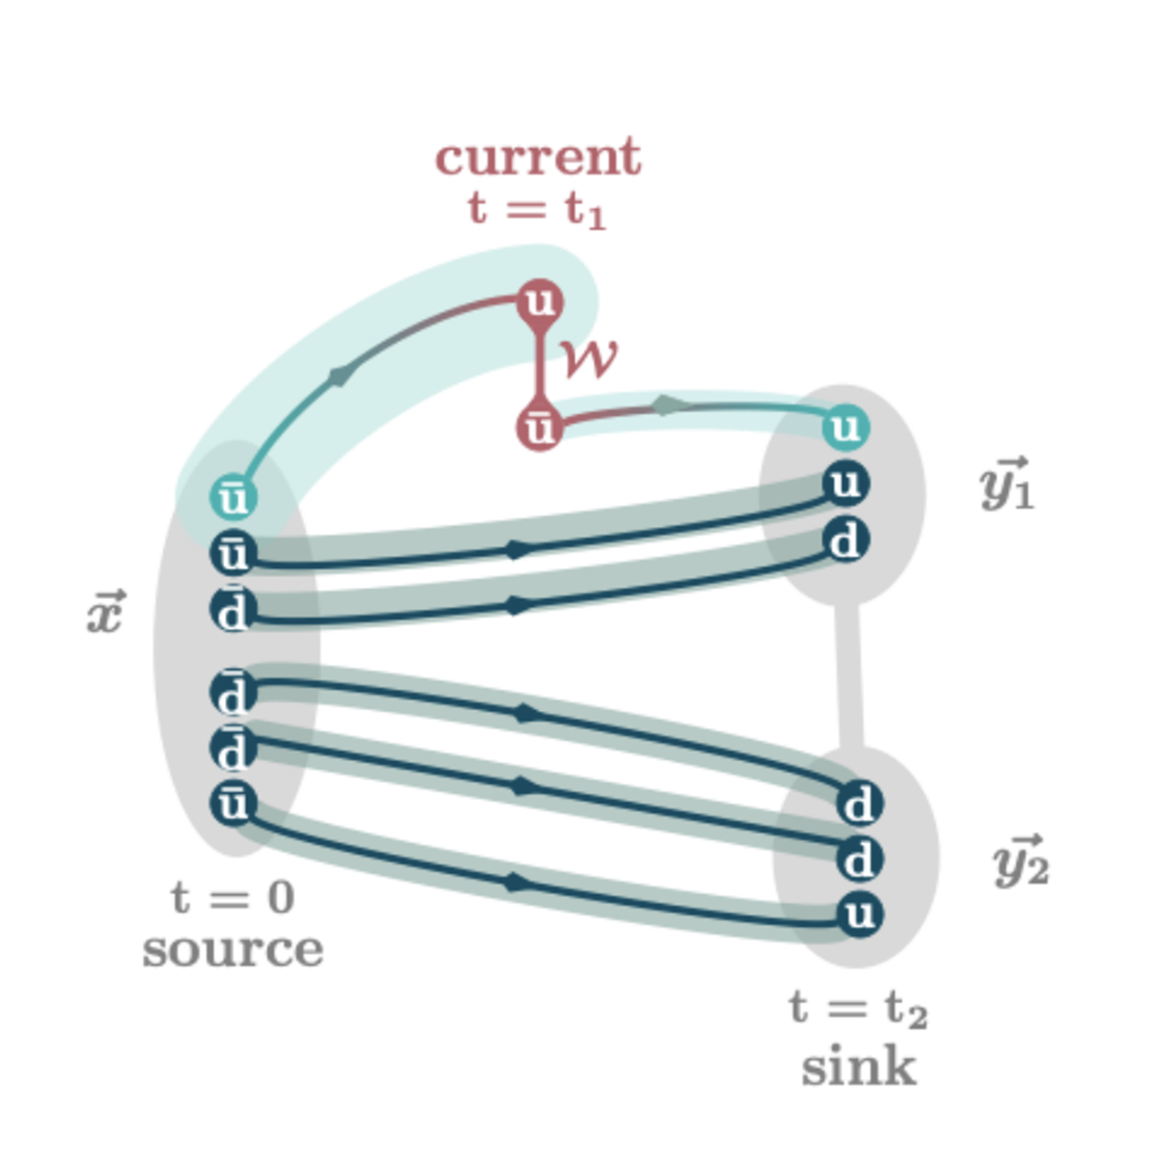
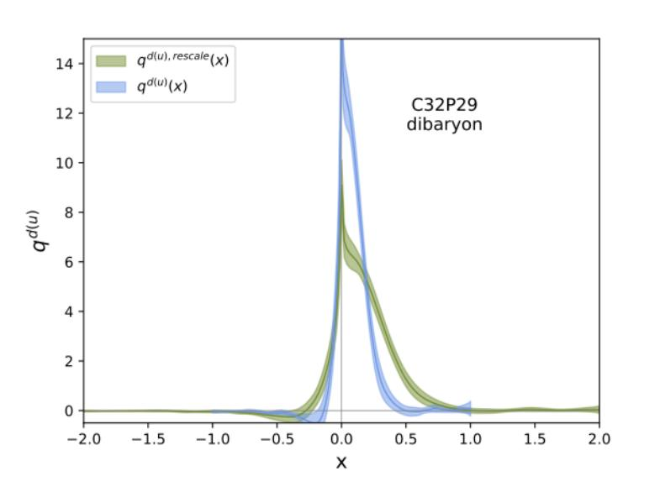
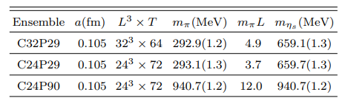
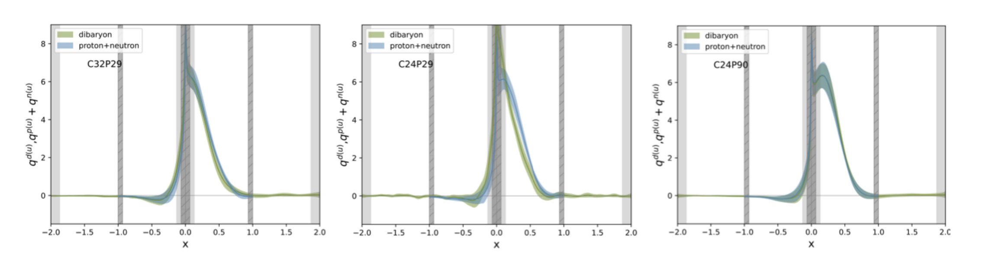
Dibaryon PDF on the lattice
C. Chen, et.al.,LPC Phys.Rev.D 111.7 (2025)
m_{π} = 290 MeV, L = 3.3 fm m_{π} = 290 MeV, L = 2.5 fm m_{π} = 900 MeV, L = 2.5 fm
17

Slide 18
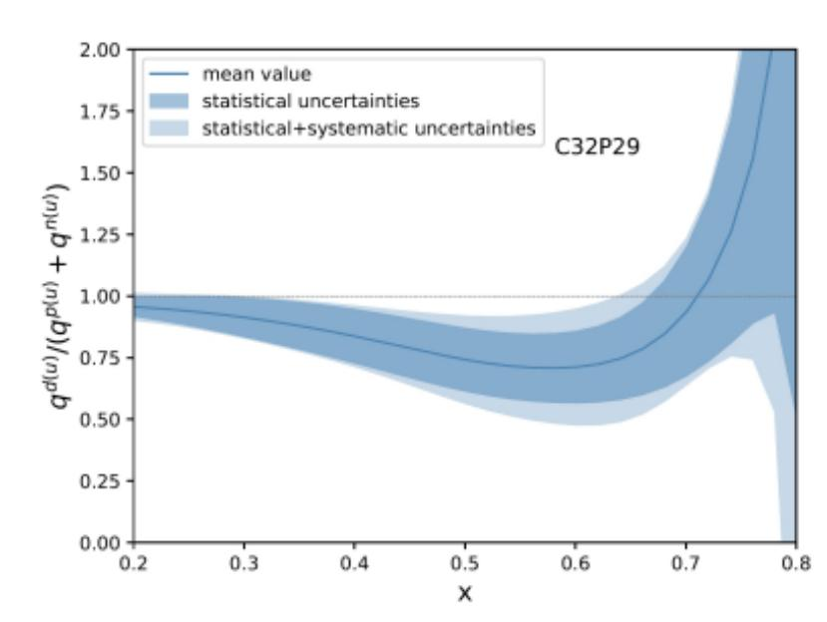
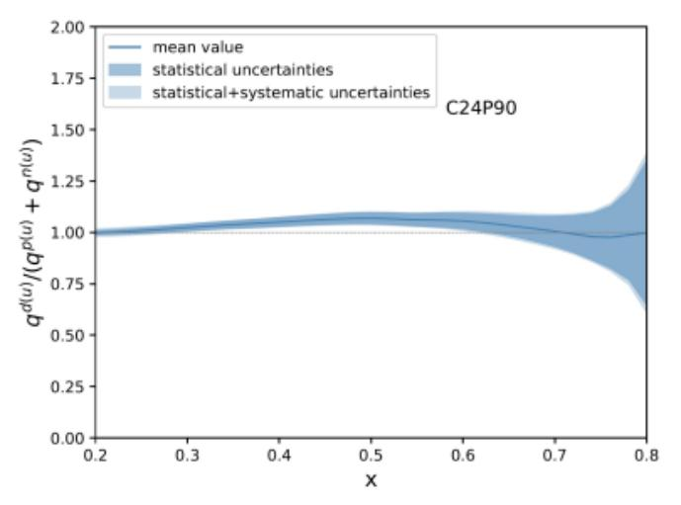
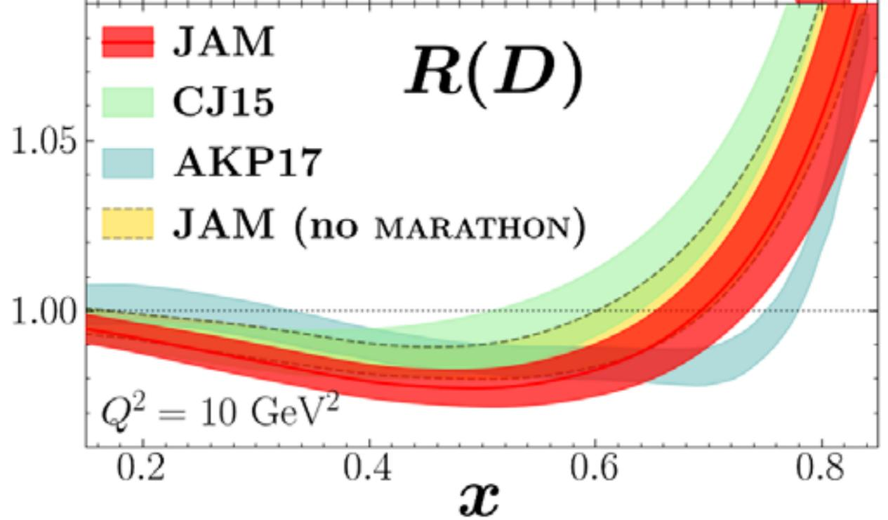
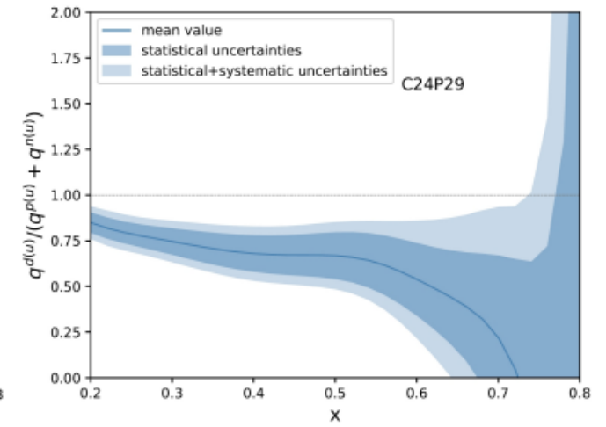
Dibaryon PDF on the lattice
m_{π} = 290 MeV, L = 3.3 fm
m_{π} = 900 MeV, L = 2.5 fm
m_{π} = 290 MeV, L = 2.5 fm
After we take the ratio f_{D}(2x)/(2f_{N}(x)):
• Deviation from 1 is still tiny with m_{π} ~ 900 MeV;
• It becomes larger at m_{π} ~ 290 MeV with large uncertainty,
and shows similar tendency as that in the experiment.
C. Chen, et.al.,LPC Phys.Rev.D 111.7 (2025)
18

Slide 19
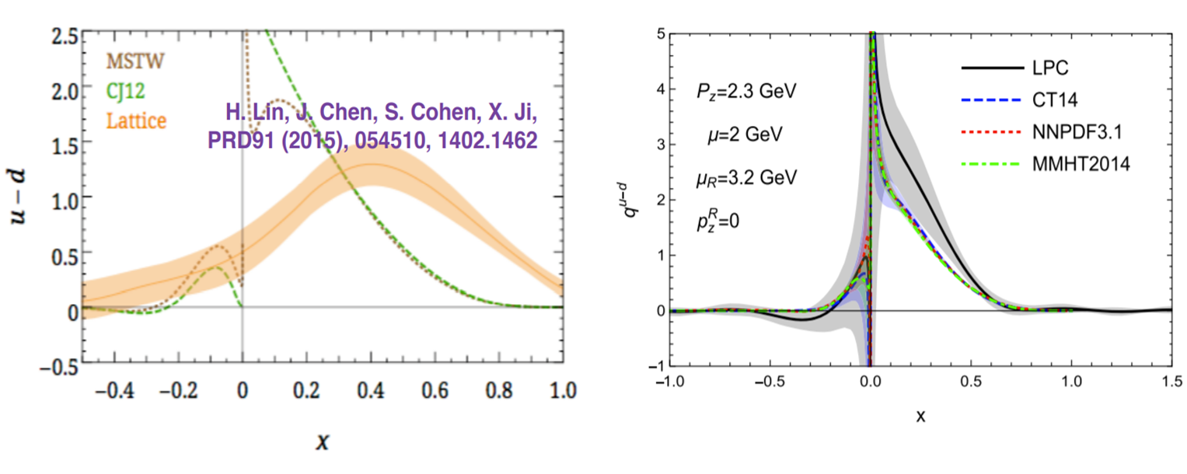
Summary
We have completed many works on the lattice calculation of PDFs.
• Improved operator definition;
• Improved renormalization;
• higher loop matching;
• Better systematic and statistical error control
LPC 2020
However, a lot of much more difficult works need to do, like sea quark PDF, TMD, GPD and so on.
Applying lattice PDFs into phenomenology, it is still a long way to go.

Slide 20
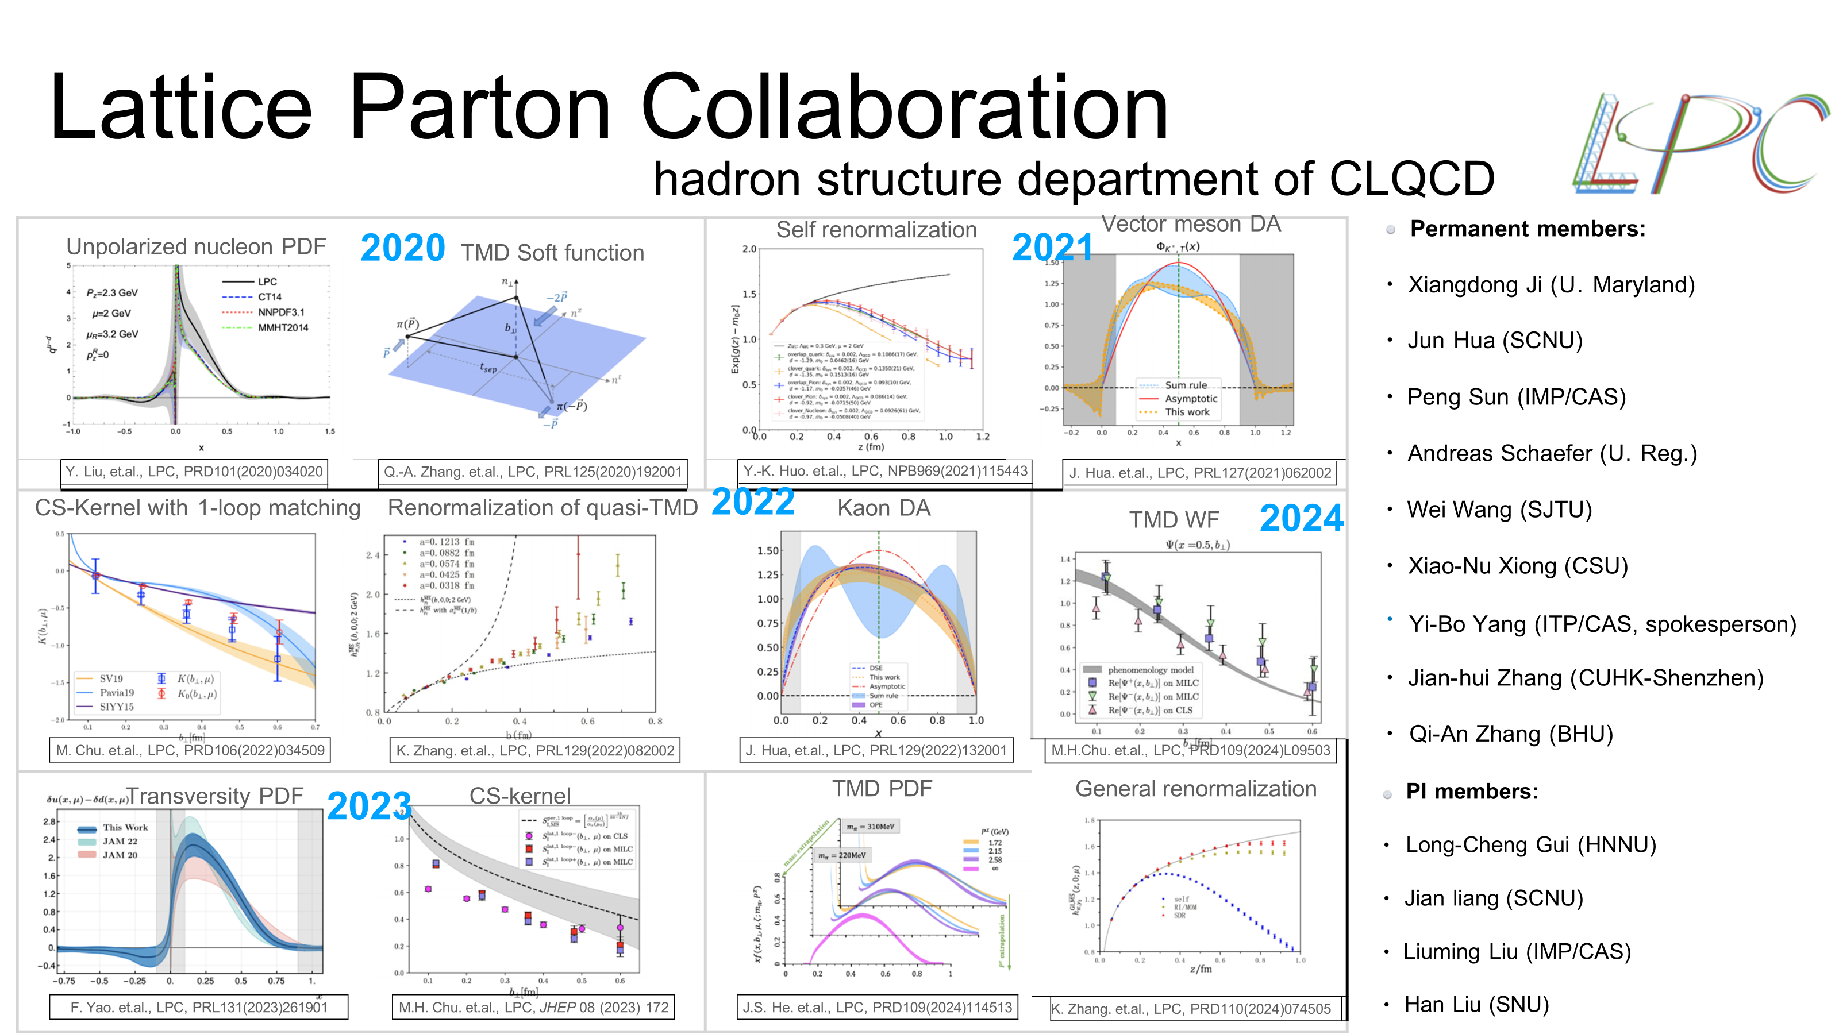



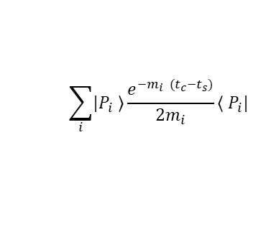
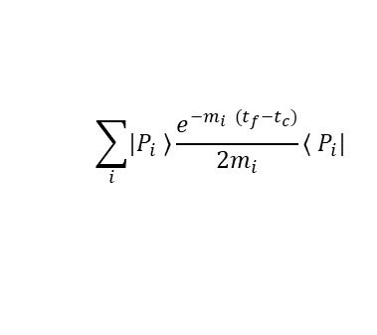


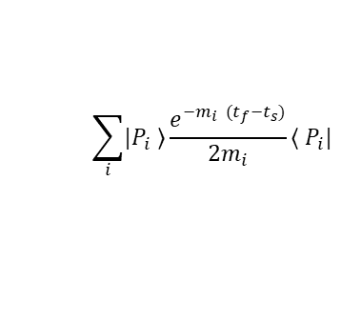
Picture of Qausi-PDF on Lattice
Propagate
Z-direction
gauge link
u
u
d
u
u
d
u
u
d
u
u
d

Slide 21





Pseudoscalar and vector meson LCDAs
$π$ LCDA:
$K$ LCDA:
3 lattice spacings：
(0.12,0.09,0.06)fm,
largest volume(96³×192)
3 momentum：
(1.29, 1.72, 2.15)GeV
mass:
$π:0.13GeV, K:0.49GeV$
Hybrid scheme(Self renormalization)
J.Hua et.al. LPC PRL129. 132001(2022)
There are uncontrolled systematic uncertainty in the endpoint region

Slide 22







Pseudoscalar and vector meson LCDAs
$K^{∗}$ LCDA
3 lattice spacings：
(0.12,0.09,0.06)fm,
largest volume(96³×192)
3 momentum：
(1.29, 1.72, 2.15)GeV
mass:
$$K^{∗}:0.89GeV, φ:1.02GeV$$
Hybrid scheme (based on RI/MOM)
$φ$ LCDA
J.Hua et.al. LPC PRL127. 062002(2021)

Slide 23












Lattice QCD
+
+
=

Slide 24






PDF
Factorization
Universality
$$σ \sim H ⊗f$$

Slide 25


Large-Momentum Effective Theory (LaMET)
X. D. Ji, Phys.Rev.Lett 110 (2013) 262002
X. Ji, Y.-S. Liu, Y. Liu, J.-H. Zhang and Y Zhao , Rev. Mod. Phys. 93, 35005 (2021).
Light-cone PDF : Cannot be
calculated on the lattice
Quasi-PDF : Directly
calculable on the lattice

Slide 26

Matching between Qausi-PDF and LC-PDF
Factorization formula rigorously proven in the momentum space in MS scheme
*The qausi-PDF and LC-PDF share the same IR physics in x,y=[0, 1]
Then we can build the matching relationship:
Y.-Q. Ma and J. Qiu, Phys.Rev. D 98 (2018)
X. Ji, Y.-S. Liu, Y. Liu, J.-H. Zhang and Y. Zhao, Rev. Mod. Phys. 93, 35005 (2021)

Slide 27



Unpolarized Gluon PDF on Lattice
mom smearing + distillation
Blue：no-momsmear
Red：momsmear
27

Slide 28



Helicity PDF on Lattice
Lattice spacing a = 0.09 fm, and with Mπ ≈ 135 MeV highly improved staggered dynamical quarks
HW Lin et al Phys.Rev.Lett. 121 (2018) 24, 242003
J Holligan, HW Lin Phys.Lett.B 854 (2024) 138731

