Slide 1
核物质中的标度对称性 与核子质量起源
马永亮
南京大学
第一届中国电子离子对撞机相关物理年会，青岛，2026.04.19-22。

Slide 2
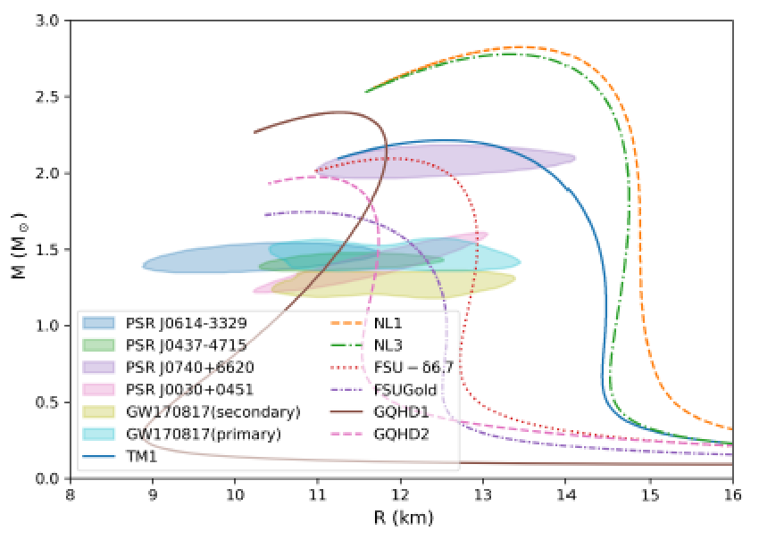
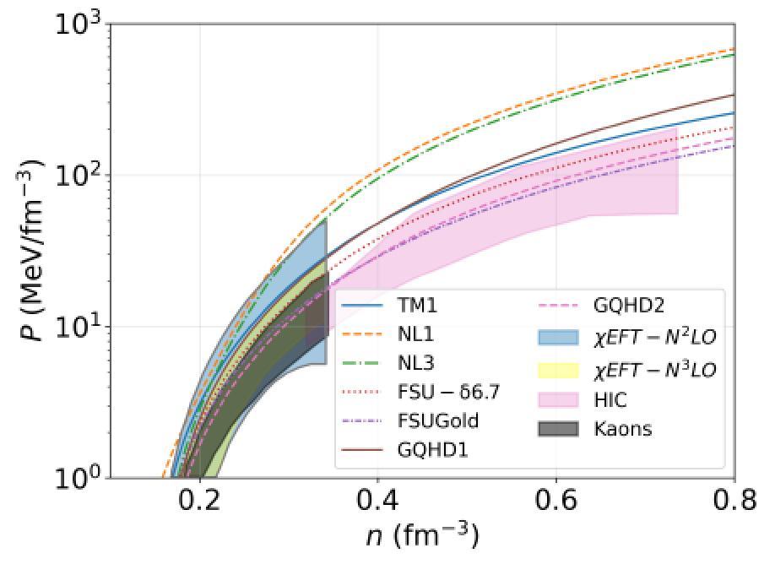
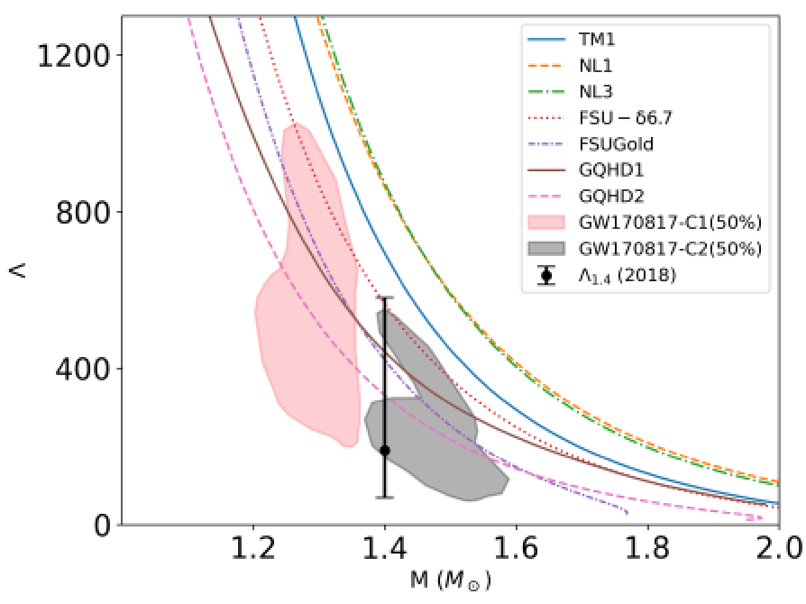
Scale symmetry implemented EFTs
标度对称性的展现形式及效应

Slide 3
Outline
Introduction
Scale symmetry in dense nuclear matter
Conformal sound velocity
Peak of sound velocity
Chiral invariant mass of nucleon
Summary and discussion

Slide 4
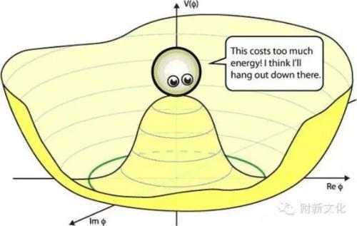
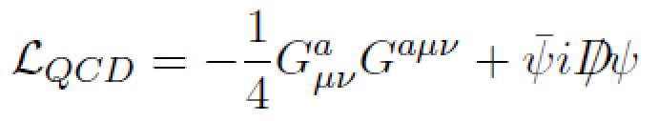


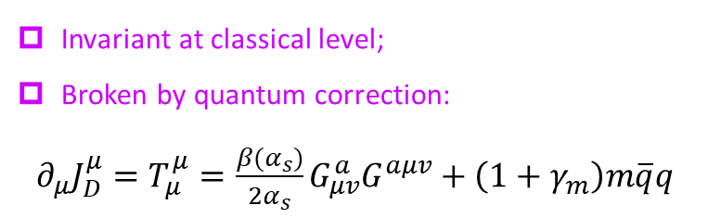
Introduction
Symmetry and symmetry breaking play dominant roles in particle and nuclear physics.
Scale symm. of QCD does not paid enough attention as chiral symm.
Scale symmetry and scale symmetry breaking:
Scale transformation: $x_{μ}→λ^{−1}x_{μ}$
$$A_{μ}^{a}→λA_{μ}^{a}, ψ→λ^{3/2}ψ$$
Invariant at classical level;
Broken by quantum correction:
$∂_{μ}J_{D}^{μ}=T_{μ}^{μ}=\frac{β(α_{s})}{2α_{s}}G_{μv}^{a}G^{aμv}+\left(1+γ_{m}\right)m\overline{q}q$
Sidney Coleman, “Aspect of symmetry” (Cambridge Univ. Press , 1985) .

Slide 5

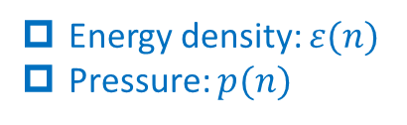
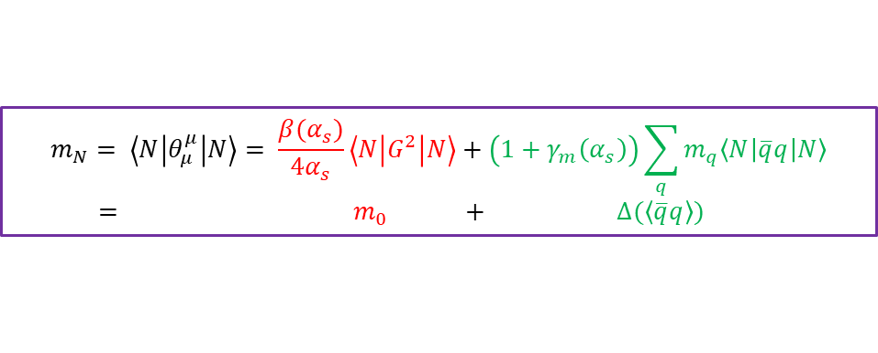
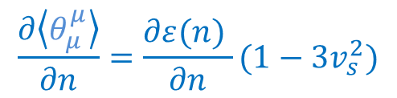
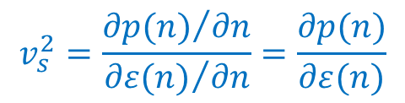
Introduction
(Emergent) Scale symmetry in medium is drawing more and more attentions.
Energy density: $ε(n)$
Pressure: $p(n)$
Trace of energy momentum tensor
$θ_{μ}^{μ}(n)=ε\left(n\right)−3p(n)$
$$\frac{∂\left\langle θ_{μ}^{μ}\right\rangle }{∂n}=\frac{∂ε(n) }{∂n}(1−3v_{s}^{2})$$
$$v_{s}^{2}=\frac{{∂p(n)}/{∂n}}{{∂ε(n)}/{∂n}}=\frac{∂p(n)}{∂ε(n)}$$
Stiffness of EOS, behavior of SV, interaction among quasiparticles！
Origin of nucleon mass:
Irrelevant to chiral symm.
ChSB Contribution
$$m_{N}= \left\langle N\left|θ_{μ}^{μ}\right|N\right\rangle = \frac{β(α_{s})}{4α_{s}}\left\langle N\left|G^{2}\right|N\right\rangle +\left(1+γ_{m}\left(α_{s}\right)\right)\sum_{q}{m_{q}\left\langle N\left|\overline{q}q\right|N\right\rangle }$$
$= m_{0} + ∆(\left\langle \overline{q}q\right\rangle )$

Slide 6
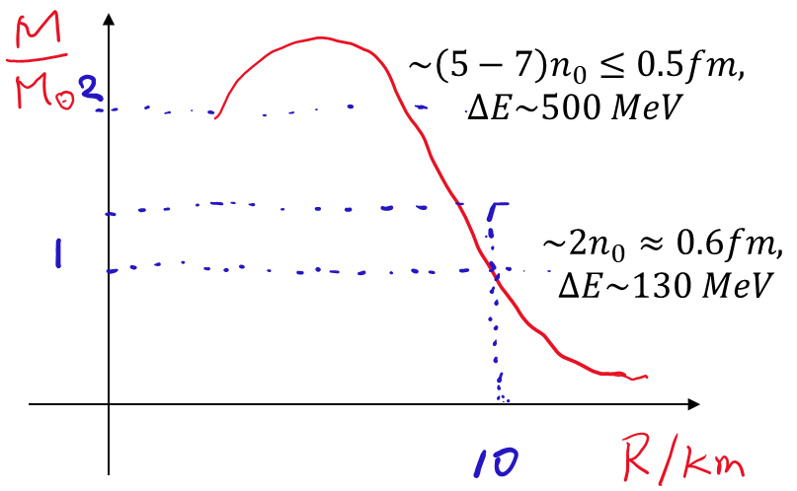
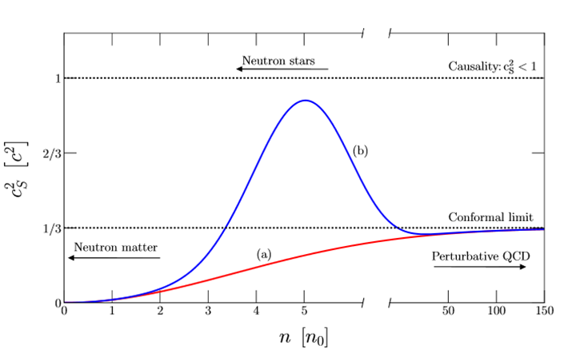
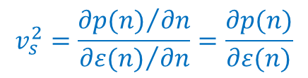
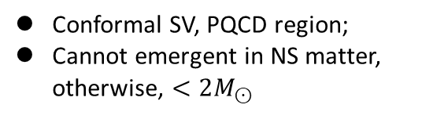
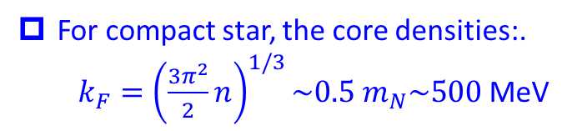
Introduction
Cold strongly-interacting fermion matter:
Sound velocity:
$$v_{s}^{2}=\frac{{∂p(n)}/{∂n}}{{∂ε(n)}/{∂n}}=\frac{∂p(n)}{∂ε(n)}$$
S. Reddy et al, 2018
For compact star, the core densities:.
$k_{F}={\left(\frac{3π^{2}}{2}n\right)}^{1/3}\sim 0.5 m_{N}\sim 500$ MeV
Conformal SV, PQCD region;
Cannot emergent in NS matter, otherwise, $<2M_{⊙}$
Can conformality emerge in cold NS matter?
Notes:
Check 一下此式

Slide 7
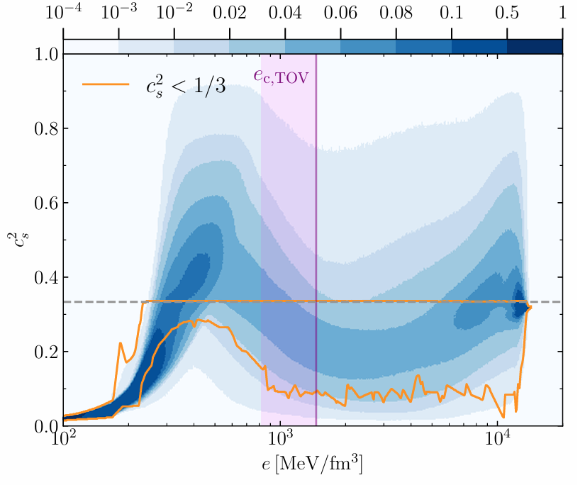
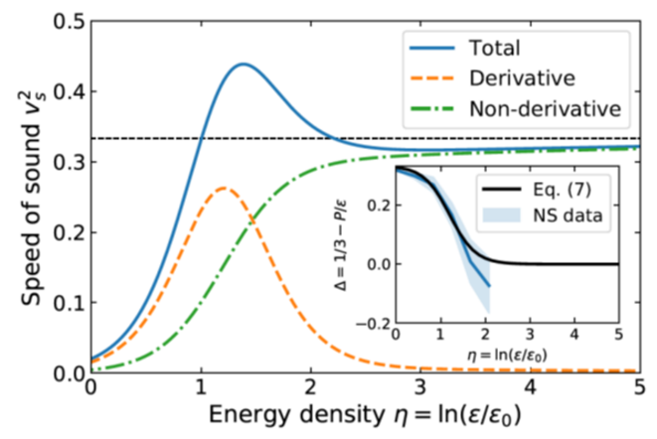
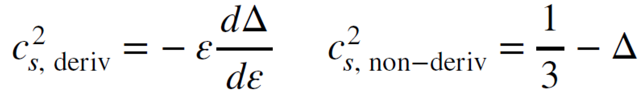

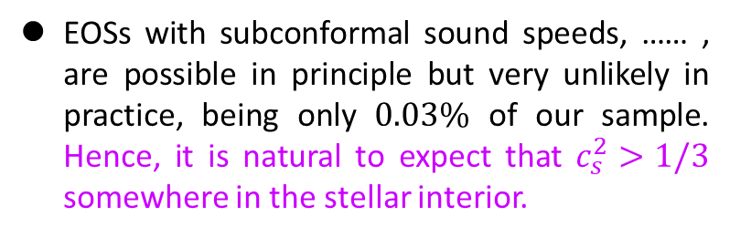
Introduction
Density dependence of SV in cold nuclear matter
EOSs with subconformal sound speeds, …… , are possible in principle but very unlikely in practice, being only $0.03\%$ of our sample. Hence, it is natural to expect that $c_{s}^{2}>1/3$ somewhere in the stellar interior.
S. Altiparmak, C. Ecker, L. Rezzolla, ApJL. 939 (2022) 2, L34.
the peak in the sound velocity is attributed to the derivative contribution from the trace anomaly that steeply approaches the conformal limit.
$$ε_{0}≈155 MeV/{fm}^{3}$$
Y. Fujimoto, K. Fukushima, L. D. McLerran, M. Praszalowicz, PRL.Lett. 129 (2022) 25, 252702.

Slide 8
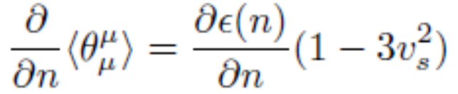
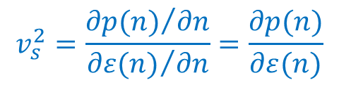







Introduction
$$v_{s}^{2}=\frac{{∂p(n)}/{∂n}}{{∂ε(n)}/{∂n}}=\frac{∂p(n)}{∂ε(n)}$$
$$v_{s}^{2}$$
1
At least one peak!
Conformal SV in NS?
pQCD region
$$1/3$$
$$\sim 2n_{0}$$
$$\sim 10 n_{0}$$
$$\sim 100n_{0}$$

Slide 9
Introduction
Origin of nucleon mass:
Ji’s decomposition
Constraints on the chiral-(in)variant part of nucleon mass?

Slide 10

Introduction
ChPT (Chiral EFT), anchored on the fundamental symmetriess of QCD, self-consistent power counting, achieved great successes in the description of hadron dynamics;
R. Machleidt, D.R. Entem, Phys.Rept. 503 (2011) 1-75.
It is interesting to study the manifestation/effect of scale in hadronic phase in dense system using EFTs of QCD.
Nuclear force up to $Λ\sim 10n_{0}\sim 700$ MeV

Slide 11
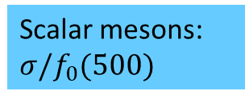



Dominant symmetries
Hadron DoFs
Effective theories
1 GeV
Chiral
Chiral EFT including nucleon;
Baryons: $p, n$
Hidden local flavor symmetry
Hidden local symmetry
Vector mesons: $ρ,ω$
bsHLS
Scalar mesons: $σ/f_{0}(500)$
Scale
Chiral-scale EFT
Pseudoscalar mesons: $π$
Chiral
ChPT

Slide 12

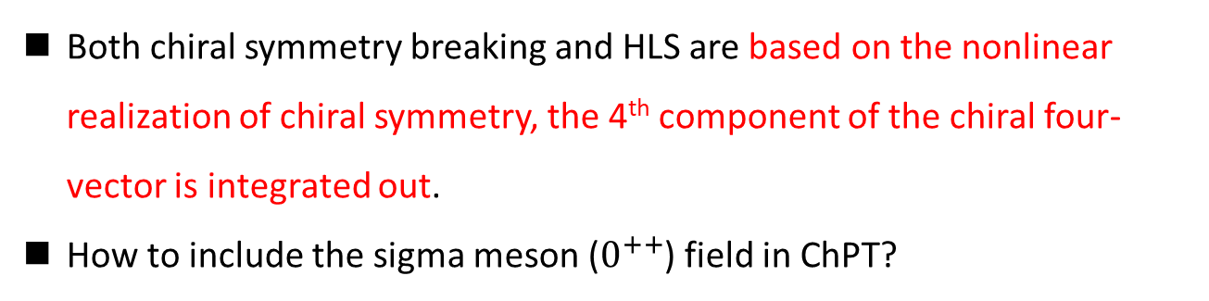

Introduction
Both chiral symmetry breaking and HLS are based on the nonlinear realization of chiral symmetry, the 4th component of the chiral four-vector is integrated out.
How to include the sigma meson ($0^{++}$) field in ChPT?
Trace anomaly in effective models：
anomaly match
Trace anomaly in QCD
Trace anomaly EFT
$$θ_{μ}^{μ}=\frac{β(g)}{2g}G_{μv}G^{μv}∝χ^{4}$$
Dilaton compensator;
A source of scalar meson in EFT
$$δ_{D}V(χ) ∝χ^{4}$$

Slide 13
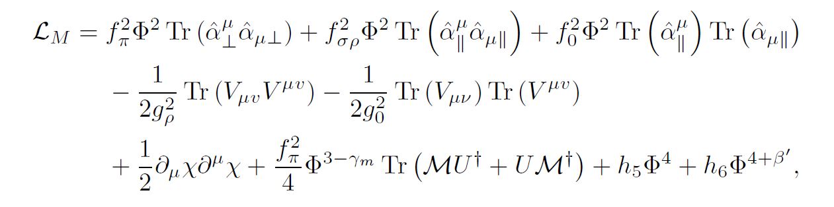
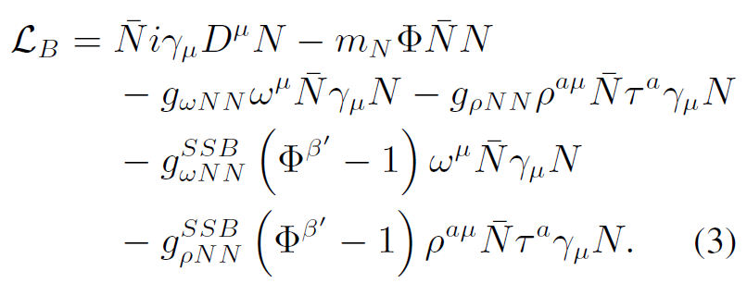
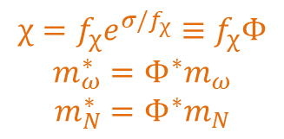
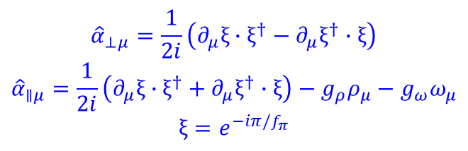
Introduction
$$χ=f_{χ}e^{σ/f_{χ}}≡f_{χ}Φ$$
$$m_{ω}^{∗}=Φ^{∗}m_{ω}$$
$$m_{N}^{∗}=Φ^{∗}m_{N}$$
Trace anomaly
$${\hat{α}}_{⊥μ}=\frac{1}{2i}\left(∂_{μ}ξ∙ξ^{†}−∂_{μ}ξ^{†}∙ξ\right)$$
$${\hat{α}}_{∥μ}=\frac{1}{2i}\left(∂_{μ}ξ∙ξ^{†}+∂_{μ}ξ^{†}∙ξ\right)−g_{ρ}ρ_{μ}−g_{ω}ω_{μ}$$
$$ξ=e^{−iπ/f_{π}}$$
Crewther and Tunstall , PRD91(2015), 034016;
Y. L. Li, YLM, M. Rho, PRD95 (2017), 114011.
W. G. Paeng, T. T. S. Kuo, H. K. Lee, YLM, M. Rho, PRD96 (2017) 1, 014031 ;
YLM, M. Rho, PPNP113 (2020) 103791;

Slide 14

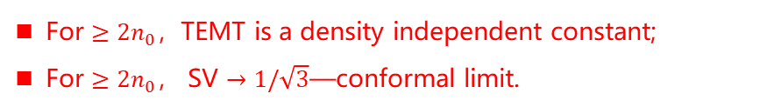
Conformal sound velocity
调节理论参数满足核饱和点附近核物质的性质
Peak due to topology change
For $≥2n_{0}$，TEMT is a density independent constant;
For $≥2n_{0}$， SV $→1/\sqrt{3}$—conformal limit.
Relevant to the core of NS
Pseudoconformal structure
A feature not observed before.
($v_{s}^{2}=1/3, θ_{μ}^{μ}≠0$)
W. G. Paeng, T. T. S. Kuo, H. K. Lee, YLM, M. Rho, PRD96 (2017) 1, 014031, arXiv: 1704.02775.

Slide 15
Conformal sound velocity
The results saturate all the nuclear physics, astrophysics and GW detection:
W. G. Paeng, T. T. S. Kuo, H. K. Lee, YLM, M. Rho, PRD96 (2017) 1, 014031 ;
YLM, H. K. Lee, W. G. Paeng, M. Rho, SCPMA62 (2019) 11, 112011;
YLM, M. Rho, PRD99 (2019) 1, 014034;
YLM, M. Rho, PRD100 (2019) 11, 114003;
The PCM changed the previous understanding of the EoS：
The model where the sound velocity saturating the conformal limit at asymptotic density, cannot predicted the maximum value of the NS mass satisfying the observation of the massive NSs.
S. Reddy et al, 2018
Later, observed in other calculations, e.g.,
J.I. Kapusta, T. Welle, PRC104 (2021) 1, L012801;
T. Zhao, J. M. Lattimer, PRD102 (2020) 2, 023021;
J. Margueron, H. Hansen, P. Proust, G. Chanfray, PRC104 (2021) 5, 055803.

Slide 16
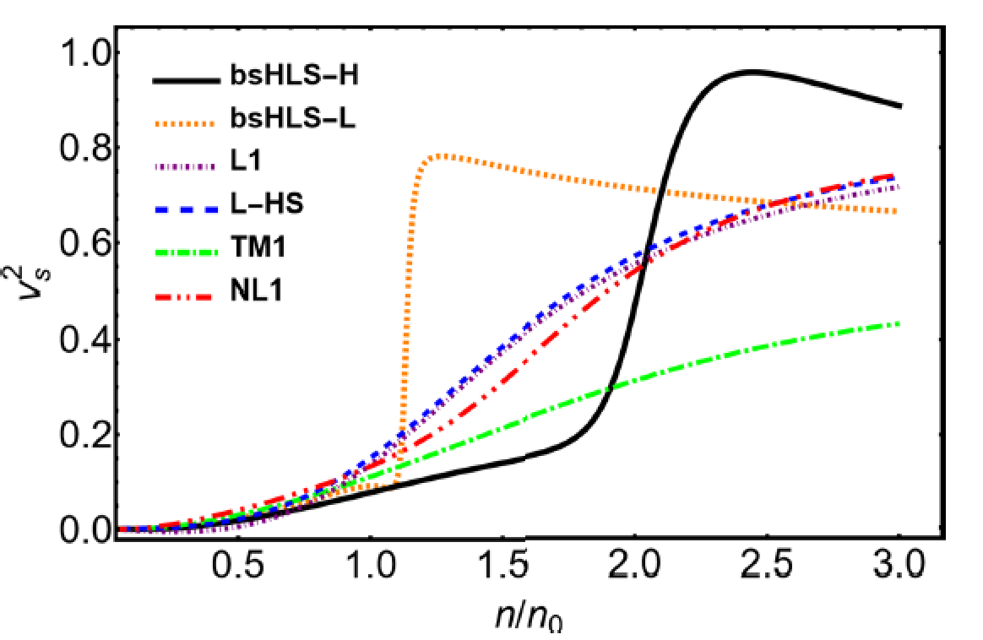
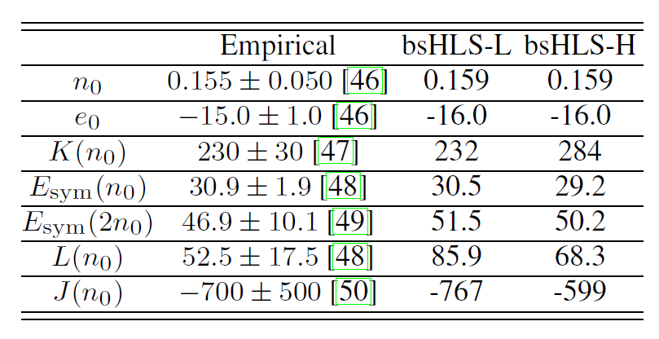

Peak of sound velocity
Self-consistent mean field calculation
Peak of SV, not far from $n_{0}$
Linear model
The peak in the SV is due to the nonlinear realization of scale symmetry, NOT observed in Walecka-type models!

Slide 17
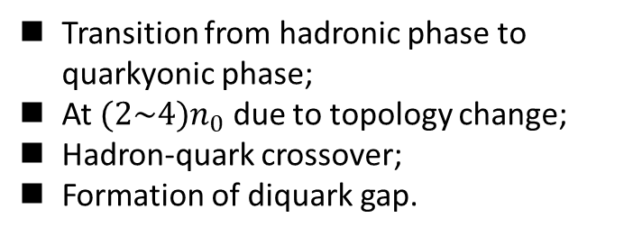
Peak of sound velocity
Emerges in the transition from a phase with broken chiral symmetry to one with gapped Fermi surface with the condensation of diquarks and dibaryons.
Transition from hadronic phase to quarkyonic phase;
At $(2\sim 4)n_{0}$ due to topology change;
Hadron-quark crossover;
Formation of diquark gap.
Hadronic phase
L. McLerran and S. Reddy, PRL122 (2019), 122701.
T. Zhao and J. M. Lattimer, PRD102 (2020), 023021.
YLM and M. Rho, PRD99 (2019), 014034; PPNP113 (2020), 103791;
G. Baym, S. Furusawa, et al., APJ 885 (2019), 42;
M. Leonhardt, M. Pospiech, et al., PRL125 (2020), 142502 (2020).
Hippert, et al. , 2105.04535
Chiral-scale EFT, NO phase transition/configuration change!

Slide 18
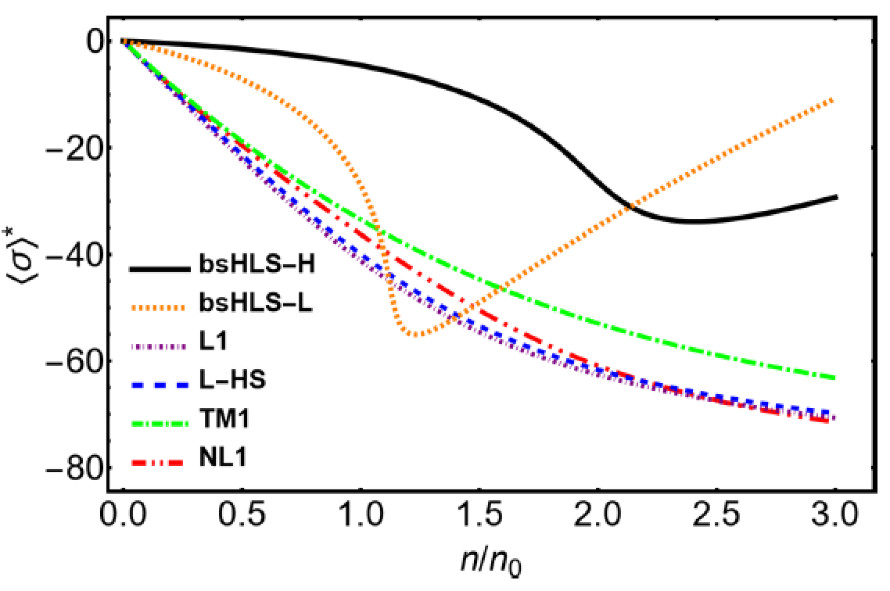
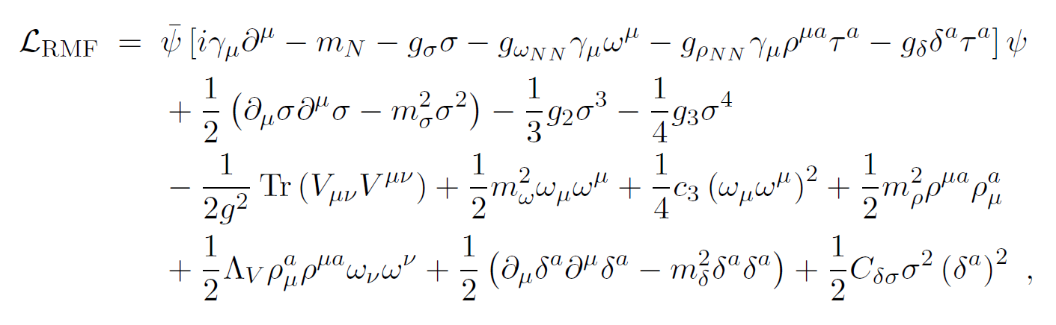
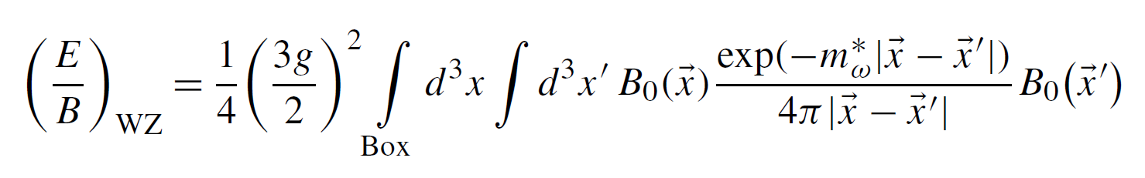
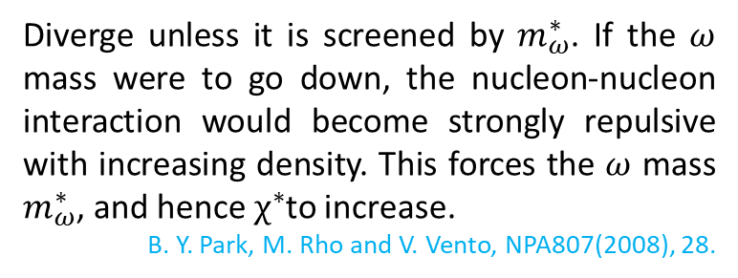
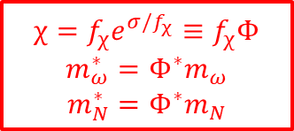
Peak of sound velocity
Why in Chiral-scale EFT?
Scale symmetry is first partially restored with density, but then stops after a critical density.
The nonlinear realization of scale symmetry gives a natural explanation of the peak in the SV, WITHOUT retrospect to phase transition/configuration change!
Diverge unless it is screened by $m_{ω}^{∗}$. If the $ω$ mass were to go down, the nucleon-nucleon interaction would become strongly repulsive with increasing density. This forces the $ω$ mass $m_{ω}^{∗}$, and hence $χ^{∗}$to increase.
B. Y. Park, M. Rho and V. Vento, NPA807(2008), 28.
$$χ=f_{χ}e^{σ/f_{χ}}≡f_{χ}Φ$$
$$m_{ω}^{∗}=Φ^{∗}m_{ω}$$
$$m_{N}^{∗}=Φ^{∗}m_{N}$$

Slide 19
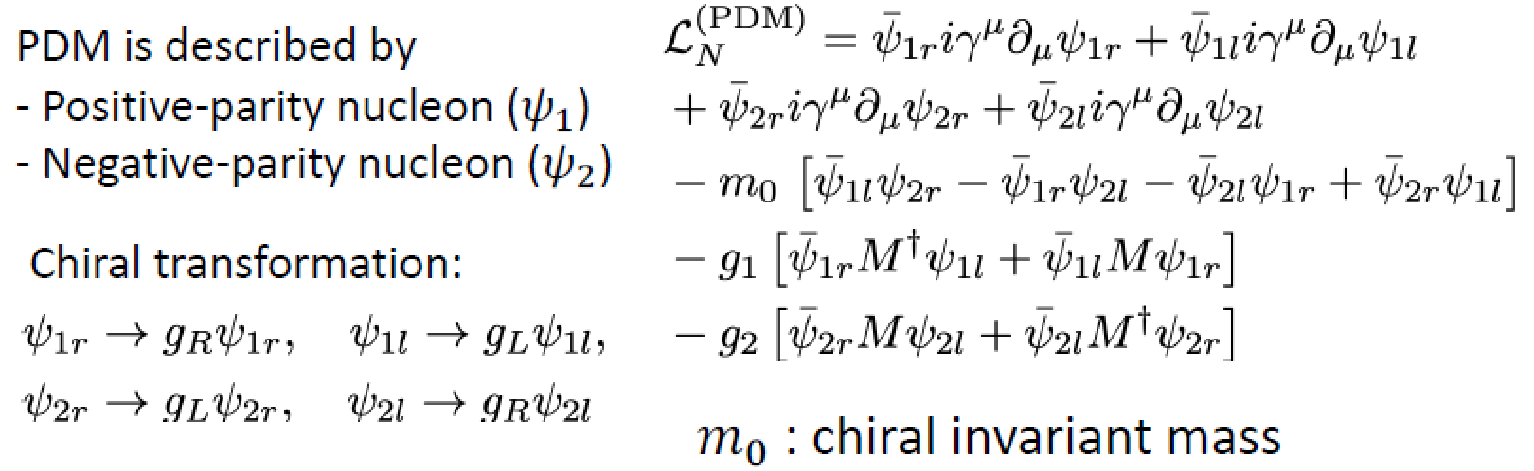
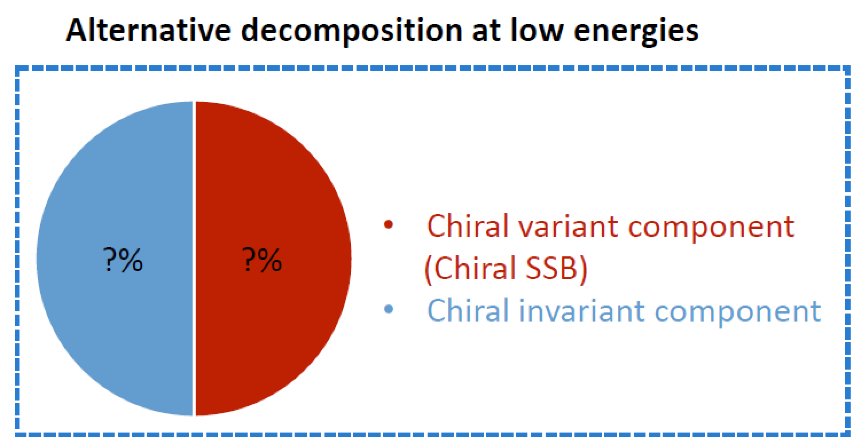

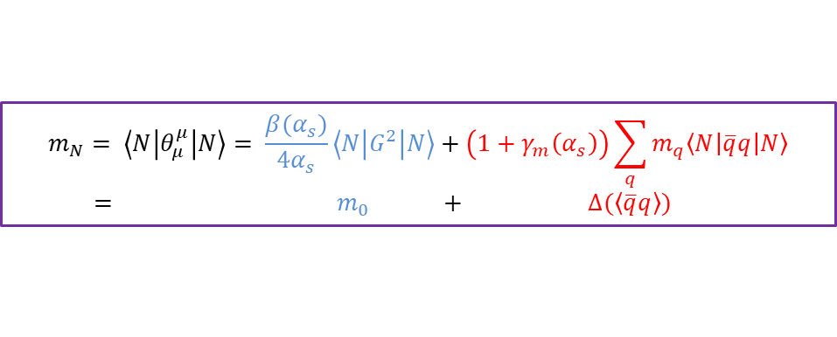
Origin of nuclear mass
Nucleon mass includes a large of chiral invariant component. Gluon/Dilaton condensate.
Irrelevant to chiral symm.
ChSB Contribution
Origin of nucleon mass:
$$m_{N}= \left\langle N\left|θ_{μ}^{μ}\right|N\right\rangle = \frac{β(α_{s})}{4α_{s}}\left\langle N\left|G^{2}\right|N\right\rangle +\left(1+γ_{m}\left(α_{s}\right)\right)\sum_{q}{m_{q}\left\langle N\left|\overline{q}q\right|N\right\rangle }$$
$= m_{0} + ∆(\left\langle \overline{q}q\right\rangle )$

Slide 20
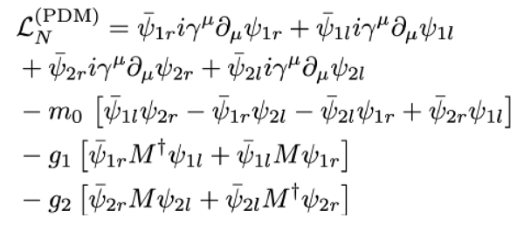
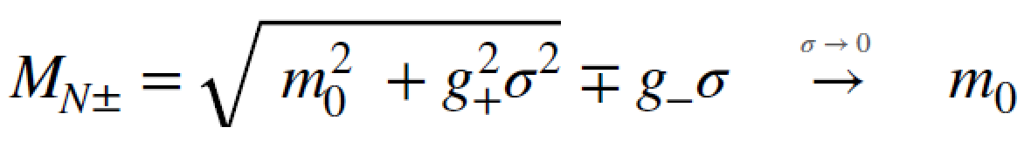
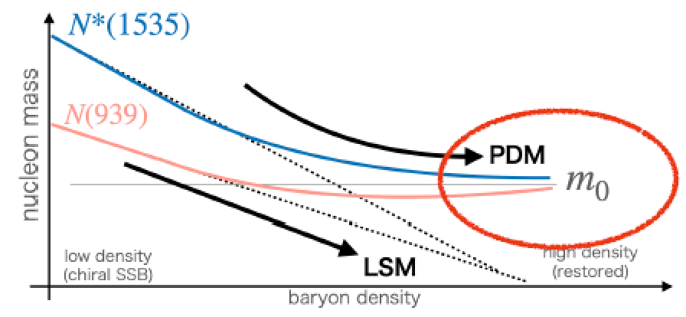
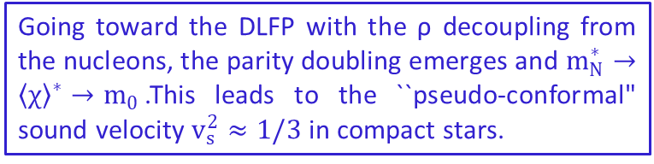
Origin of nuclear mass
Going toward the DLFP with the ρ decoupling from the nucleons, the parity doubling emerges and $m_{N}^{∗}→{\left\langle χ\right\rangle }^{∗}→m_{0}$.This leads to the ``pseudo-conformal" sound velocity $v_{s}^{2}≈1/3$ in compact stars.
Paeng, Lee, Rho and Sasaki, PRD 13’;
YLM, M. Rho, PPNP113 (2020) 103791.

Slide 21
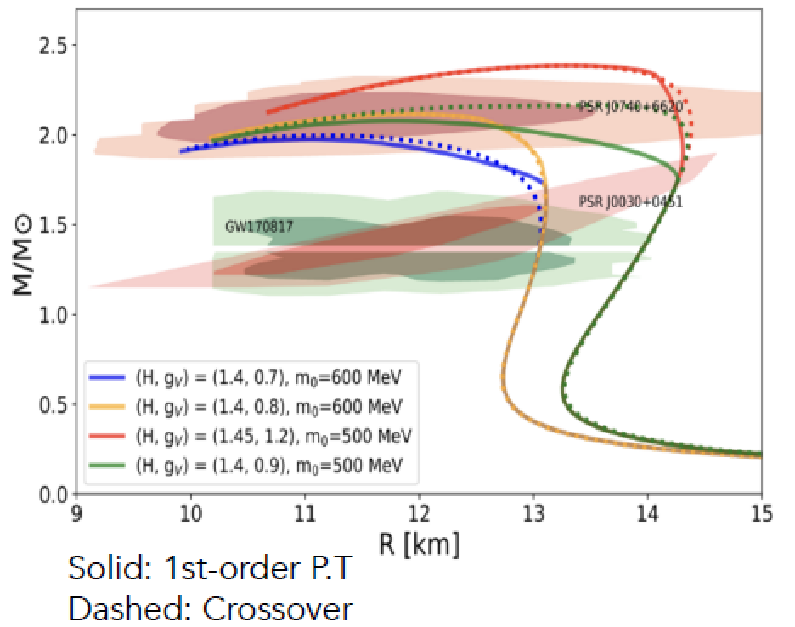
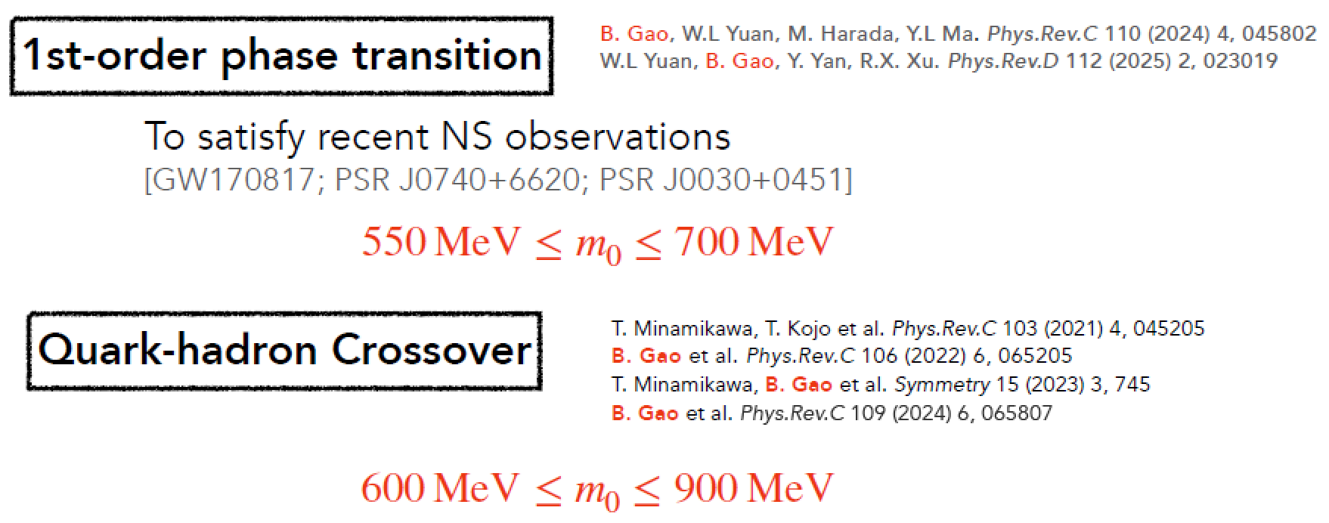
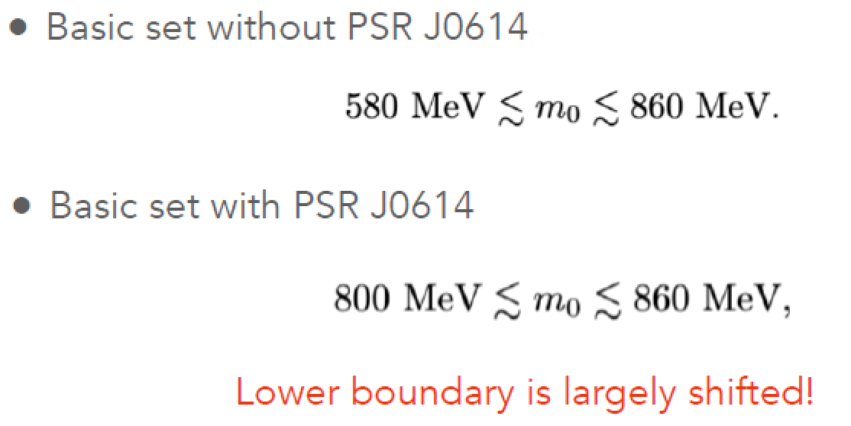
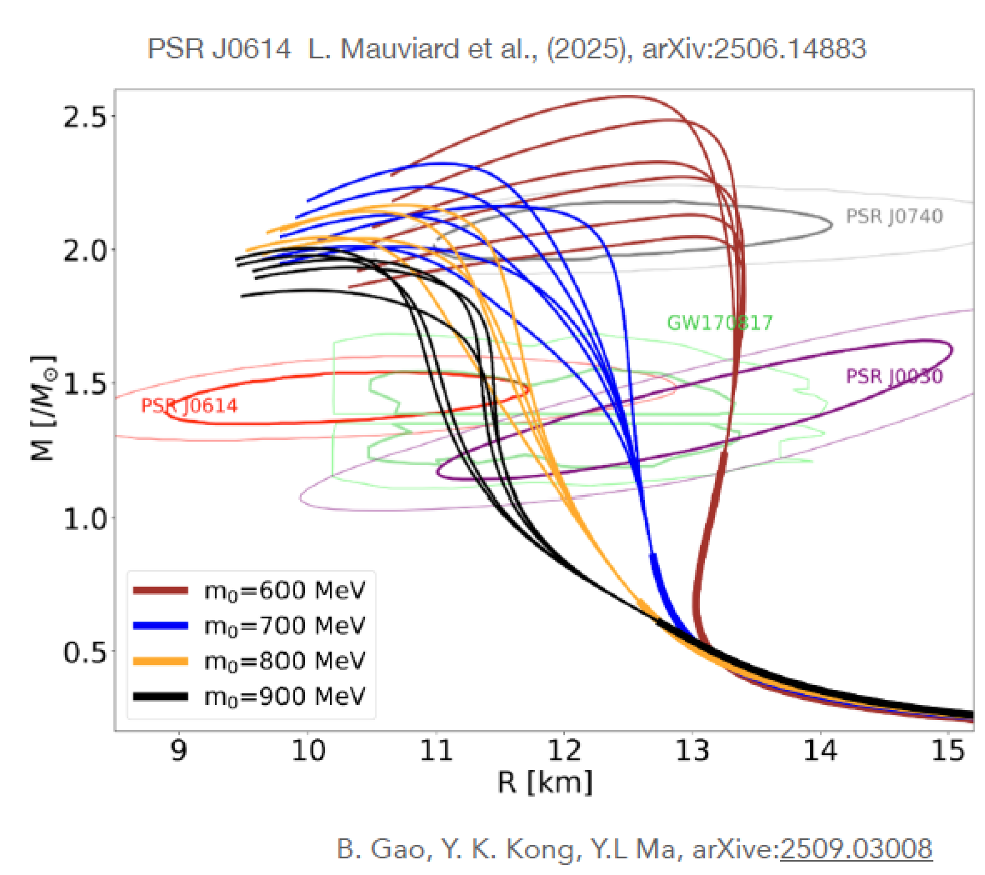
Notes:
其他参考文献？

Slide 22
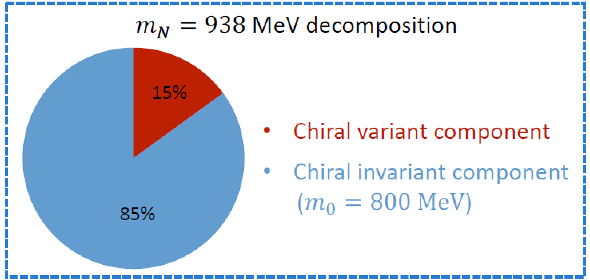
Origin of nuclear mass
Chiral invariant mass is the primary origin of nucleon mass!

Slide 23
Summary and discussion
The SV can saturates the conformal limit in the core of massive stars, BUT matter is not conformal---pseudoconformal. Conformal SV may not be due to the deconfinement phase transition;
The nonlinear realization of scale symmetry provides a mechanism for generating the peak of SV in nuclear matter, NOT the hadron-quark transition or other configuration change;
The predictions of the theory agree with all the observations obtained so far. Cannot be excluded.
Notes:
其他参考文献？

Slide 24

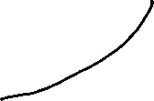
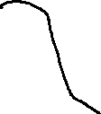

Summary and discussion
状态方程及声速与观测量的关联
测量中等质量区中子星的$dM\left(R\right)dR$对理解对称性的展现形式非常重要！
Notes:
其他参考文献？

Slide 25


Summary and discussion
目前位置，基于强子自由度的模型可以描述所有已知的数据，不存在确切的理由引入奇异自由度、夸克物质等。
Y. Ma, YLM, J. Y. Xiong, arXiv:2603.01933
Notes:
其他参考文献？

Slide 26


Summary and discussion
目前为止，基于强子自由度的模型可以描述所有已知的数据，不存在确切的理由引入奇异自由度、夸克物质等。
Y. Ma, YLM, J. Y. Xiong, arXiv:2603.01933
Notes:
其他参考文献？

Slide 27
Acknowledgement:
B. K. Gao (Nagoya), M. Harada (Nagoya), T. S. Kuo (郭子斯, Stony Brook) , H. K. Lee (Hanyang), Y. L. Li (李艳玲，Jilin), Yao Ma (马垚, Nanjing), W. G. Paeng (Hanyang), B. Y. Park (Daejon), M. Rho (Saclay) , J. Y. Xiong (熊佳颖, Hangzhou), L. Q. Zhang (张璐琦, Nanjing), ……
Based on some works since 2015

Slide 28
Thank you for your attention!

