Slide 1

核子精确成像的新方法
邵鼎煜
复旦大学
第一届中国电子离子对撞机相关物理年会 青岛 2026年4月21日

Slide 2
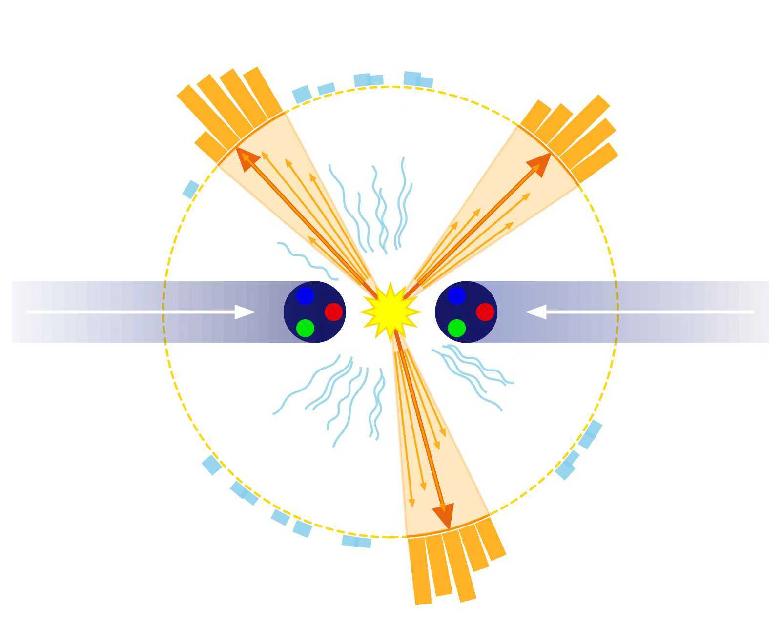
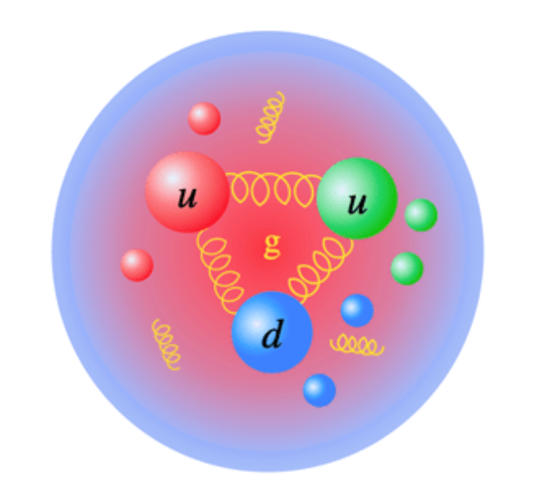
QCD中两类重要的演生现象
强子结构
喷注产生
色禁闭
渐近自由
红外奇点
……

Slide 3
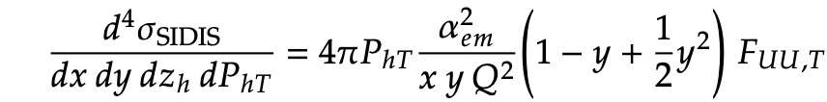
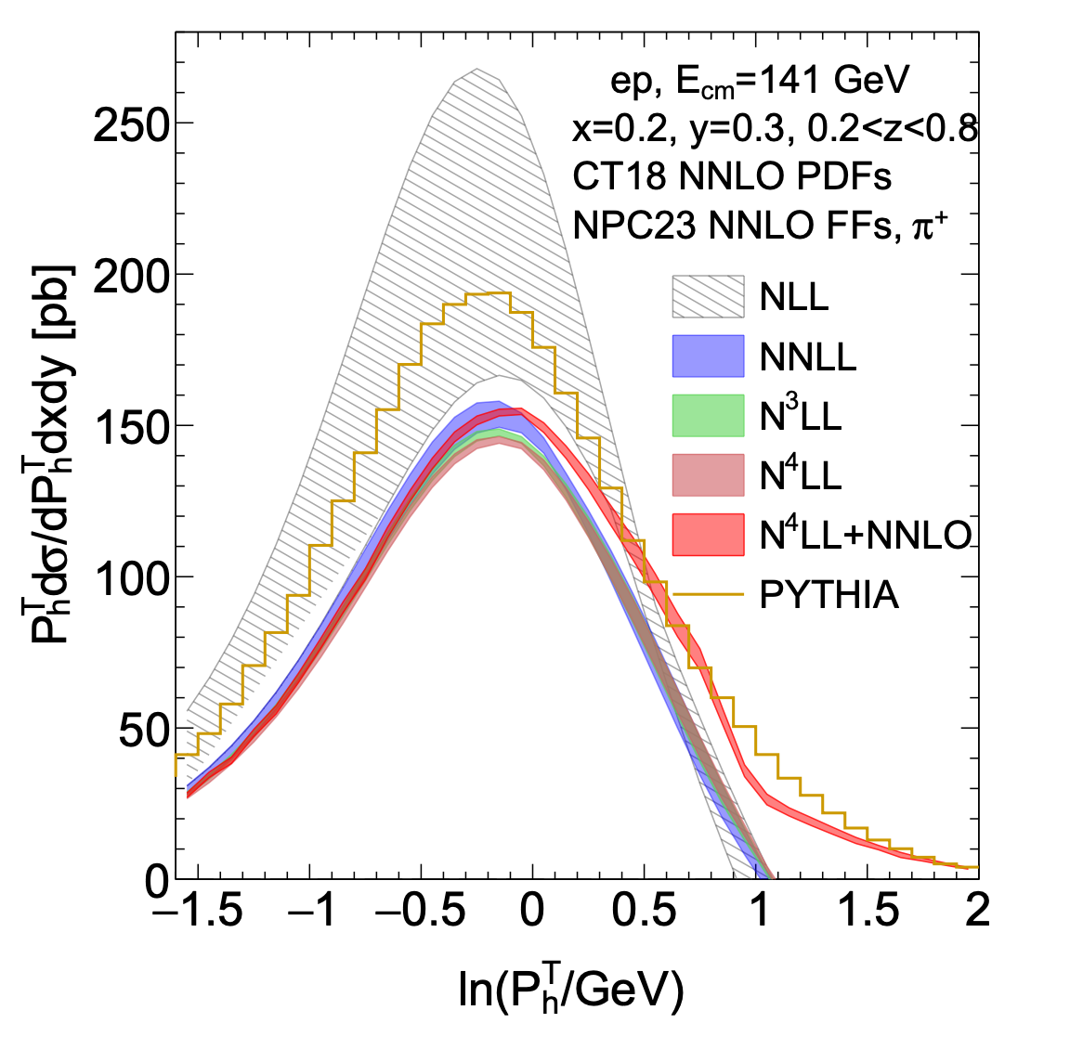
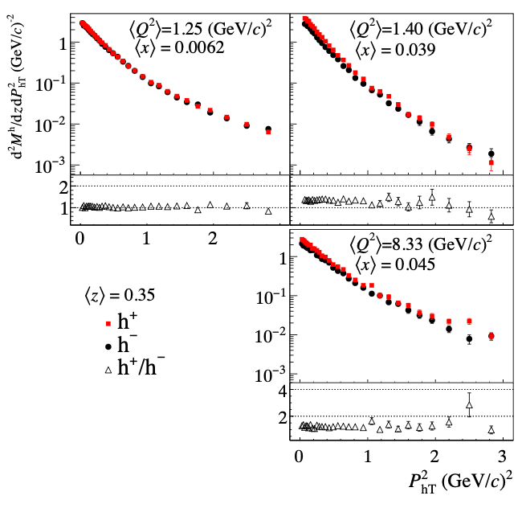
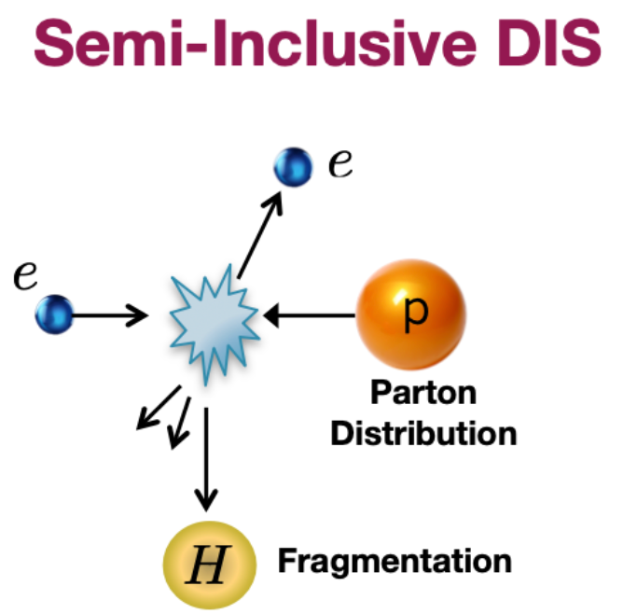
Quark TMDs in e-p collisions
One of the most fundamental measurements in SIDIS related to TMDs is the study of the unpolarized 𝑃_{ℎ𝑇} differential cross section
See J.Gao’s talk

Slide 4
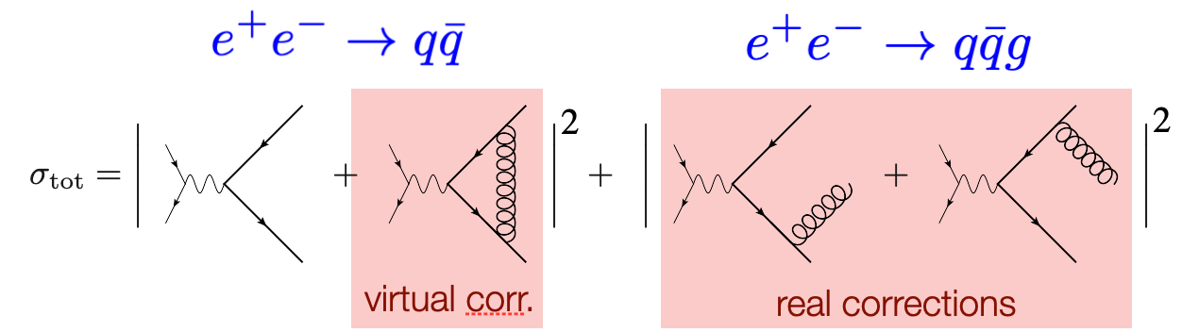
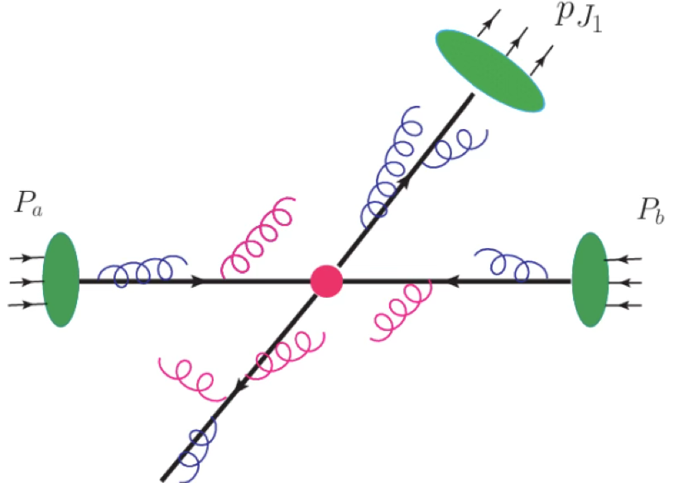
NNLO QCD corrections for 𝑃_{ℎ𝑇} distribution
A key challenge is handling infrared (IR) divergences, which must cancel between real and virtual configurations.
FMNLO framework for hadron production at NLO Liu, Shen, Zhou, Gao ‘23
Transverse momentum (qT) subtraction for hadron production at NNLO Gao, Li, Zhu, Zhu ‘26
qT subtraction works well for colorless or colored (but massive) system
N3LO Drell-Yan Chen, Gehrmann, Glover, Huss, Yang, Zhu ’23
N3LO di-photon Czakon, Eschment, Generet, Poncelet ‘26
For processes with jets, qT is unsuitable because qT=0 for radiation emitted inside jets.
Hadron + jets @ NNLO
P_{h}
𝛾*
P_{J}

Slide 5
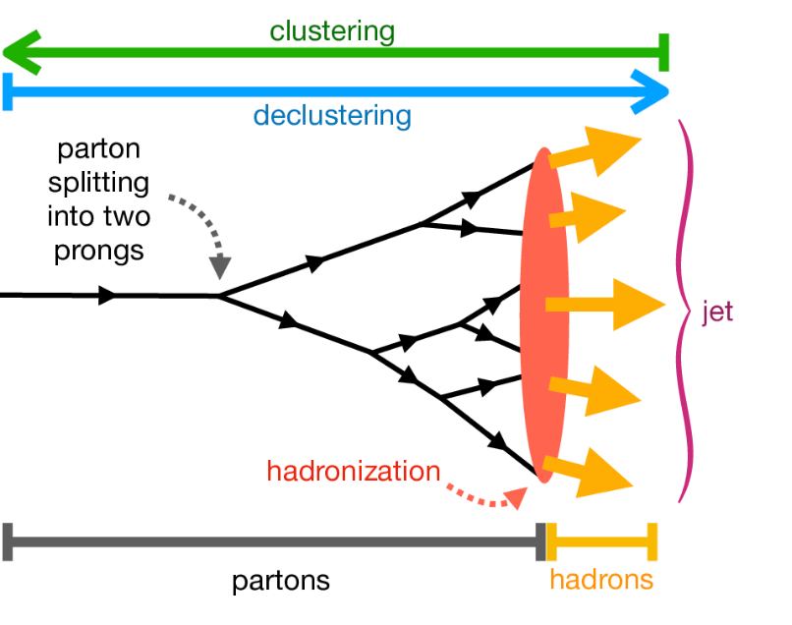
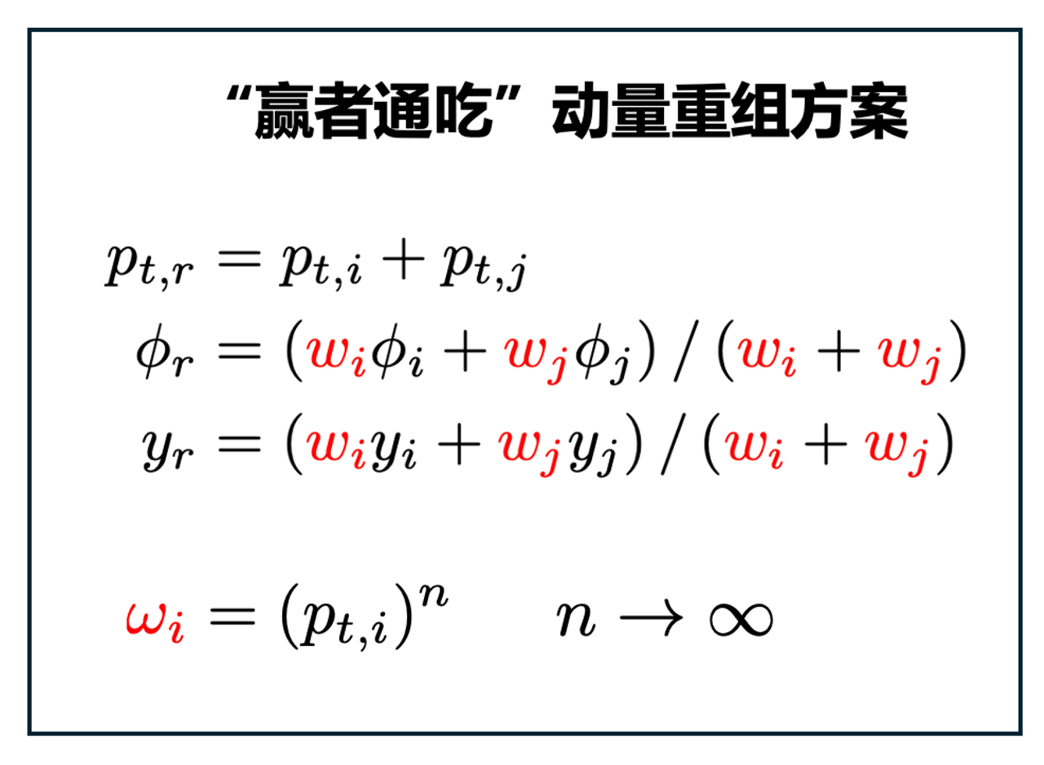
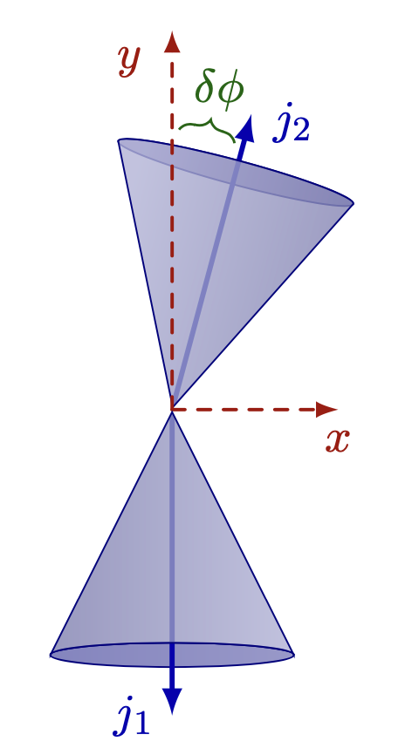

Winner-take-all qT subtraction for jets
Fu(符荣峻), Rahn, DYS, Waalewijn, Wu PRL135 (2025) 171903
Winner-take-all recombination scheme Bertolini, Chan, Thaler ‘13
Factorization theorem is significantly simplified Chien, Rahn, DYS, Waalewijn & Wu ’22 JHEP + Schrignder ’21 PLB
NNLL resummation for $δφ$ @ ep & eA Fang(方申), Ke, DYS, Terry ’24 JHEP
N3LL + NNLO resummation for $δφ$@ ep Fang(方申), Gao(高梅森), Li, DYS ’25 JHEP

Slide 6
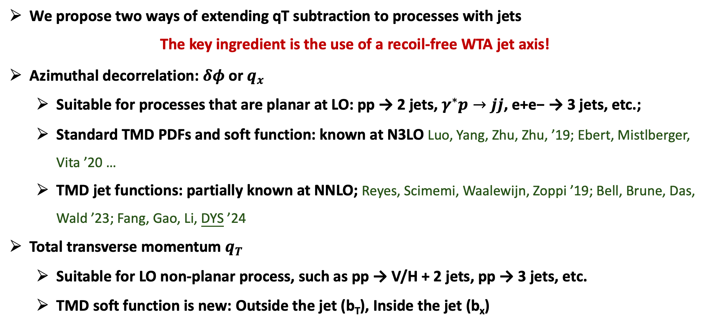
Winner-take-all qT subtraction for jets
Fu(符荣峻), Rahn, DYS, Waalewijn, Wu PRL135 (2025) 171903
We propose two ways of extending qT subtraction to processes with jets
The key ingredient is the use of a recoil-free WTA jet axis!
Azimuthal decorrelation: $δφ$ or $q_{x}$
Suitable for processes that are planar at LO: pp → 2 jets, $γ^{∗}p→jj$, e+e− → 3 jets, etc.;
Standard TMD PDFs and soft function: known at N3LO Luo, Yang, Zhu, Zhu, ’19; Ebert, Mistlberger, Vita ’20 …
TMD jet functions: partially known at NNLO; Reyes, Scimemi, Waalewijn, Zoppi ’19; Bell, Brune, Das, Wald ’23; Fang, Gao, Li, DYS ’24
Total transverse momentum $q_{T}$
Suitable for LO non-planar process, such as pp → V/H + 2 jets, pp → 3 jets, etc.
TMD soft function is new: Outside the jet (b_{T}), Inside the jet (b_{x})

Slide 7
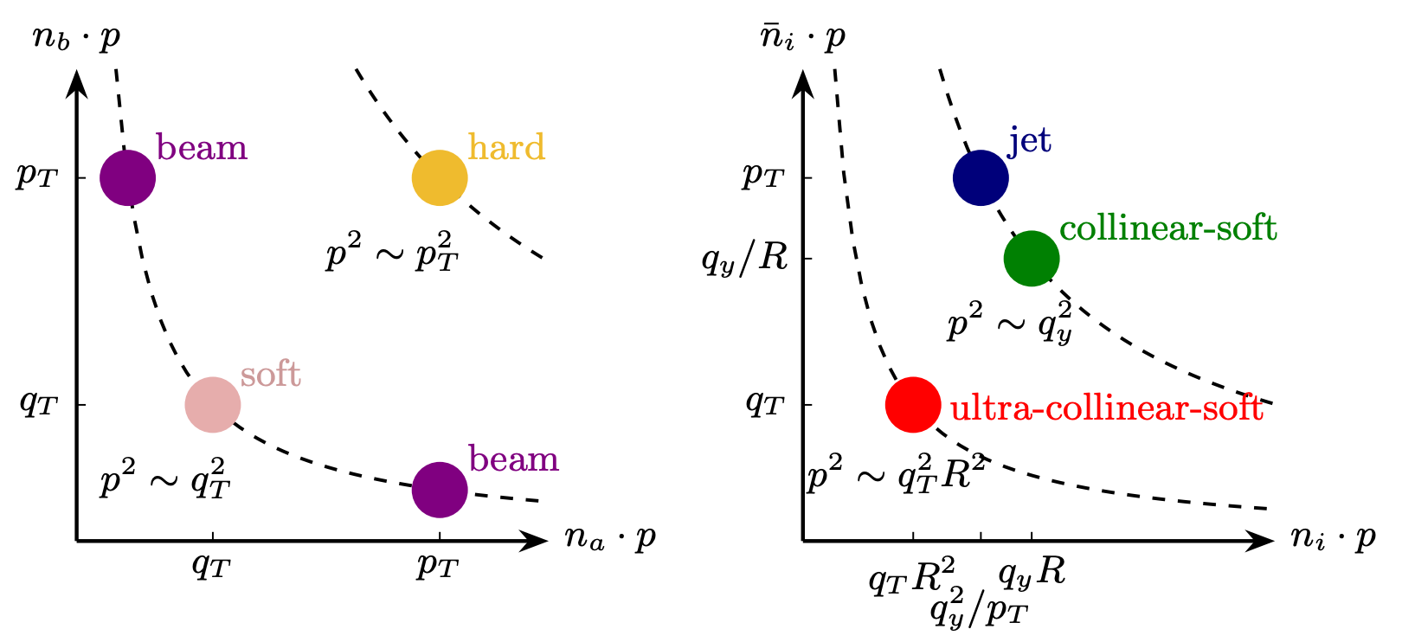
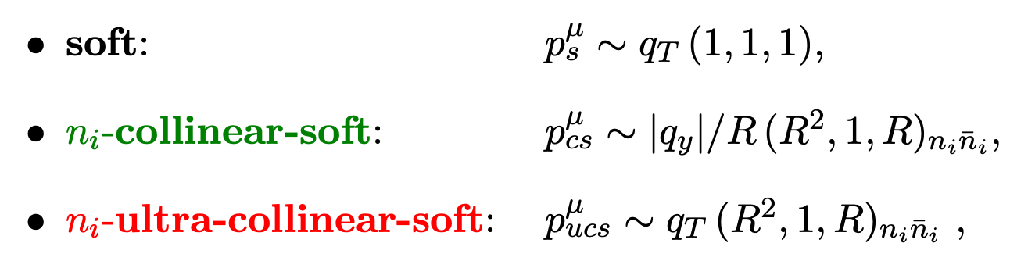
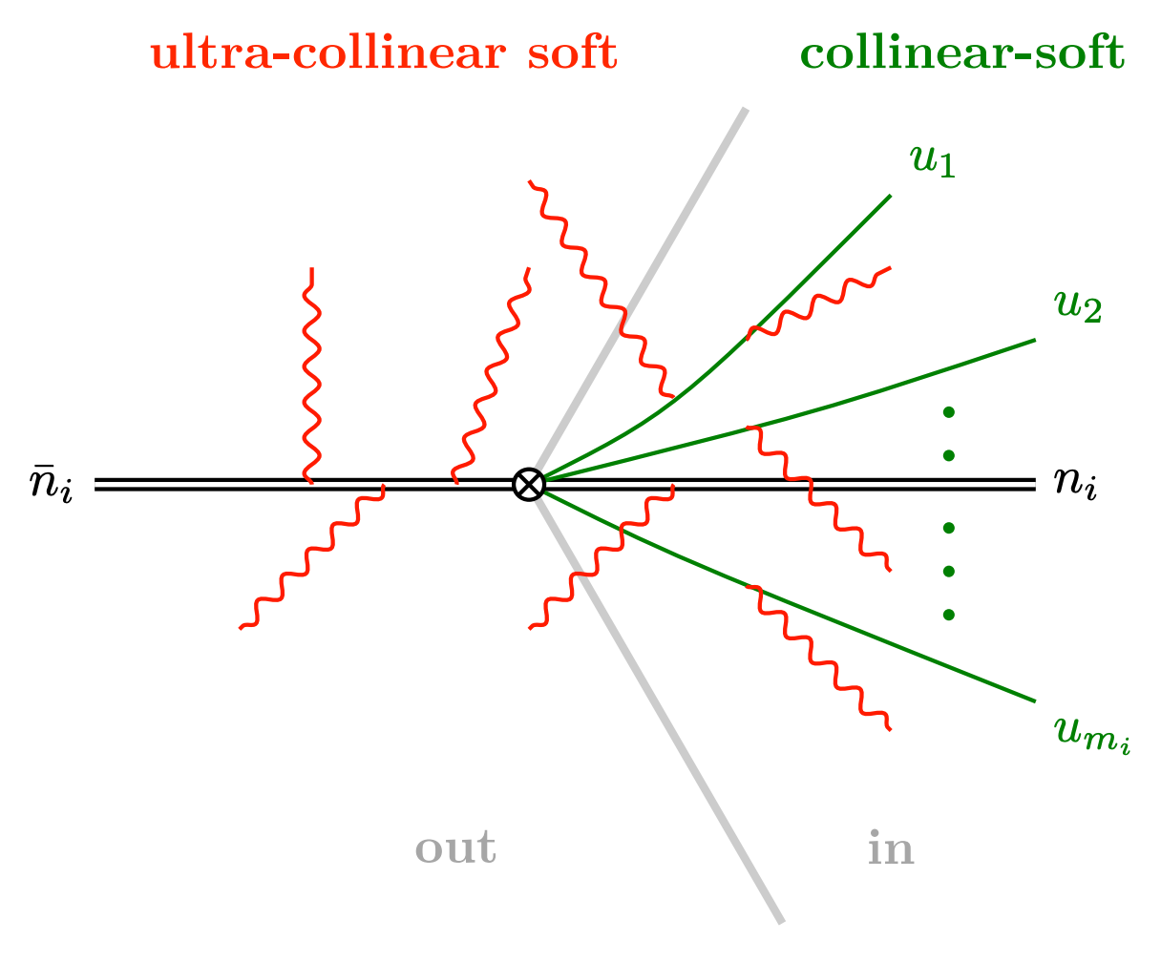
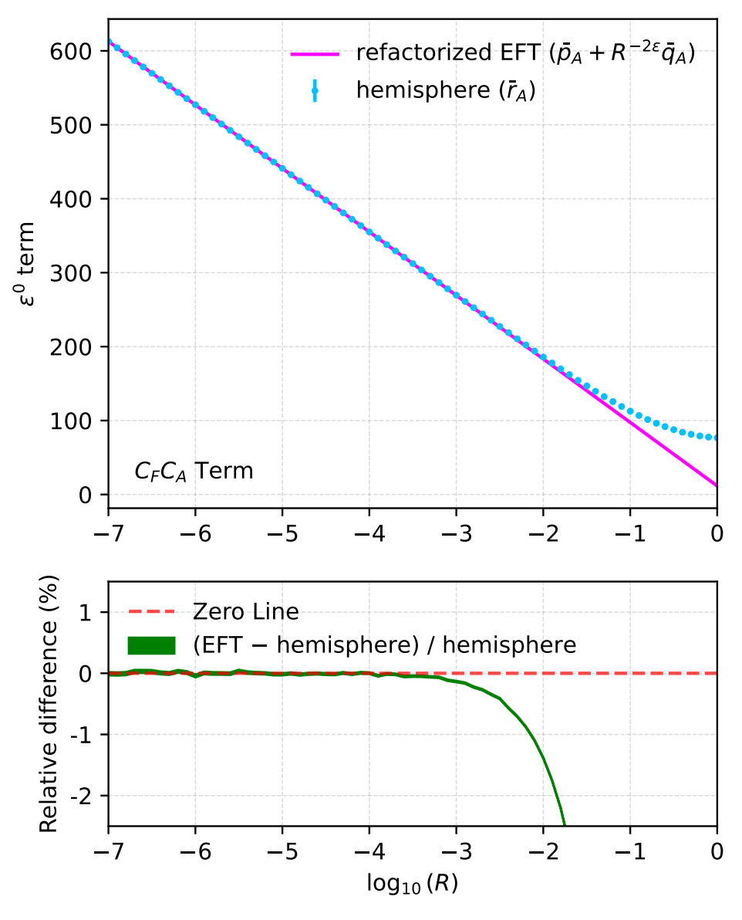
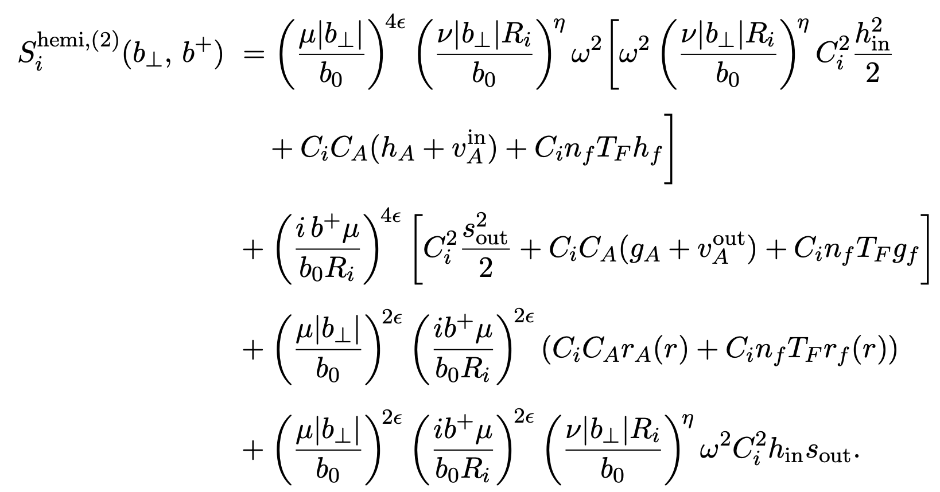
Winner-take-all qT subtraction for jets
Fu(符荣峻), Rahn, DYS, Waalewijn, Wu 2602.20249
In small R limit, soft function refactorizes into simpler global and (ultra)-collinear-soft contributions
Two-loop collinear-soft function
Multi-Wilson lines: Becher, Neubert, Rothen, DYS ’16 PRL

Slide 8
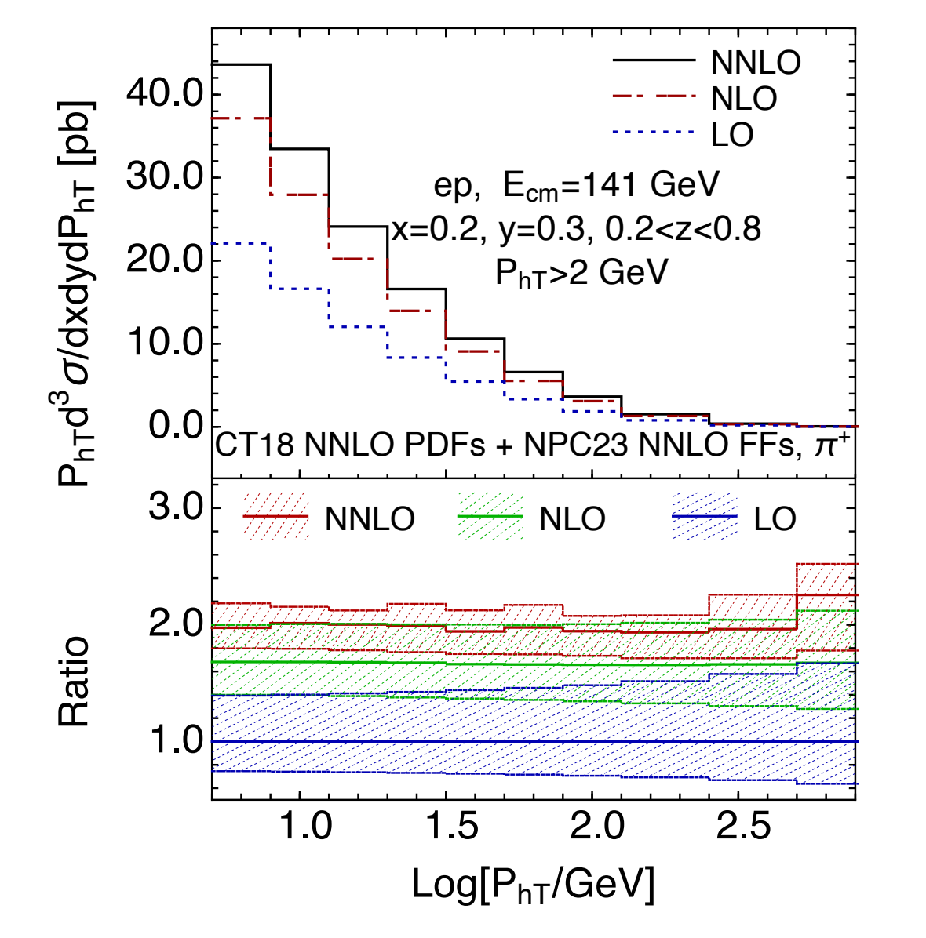
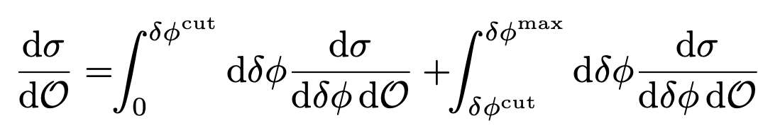
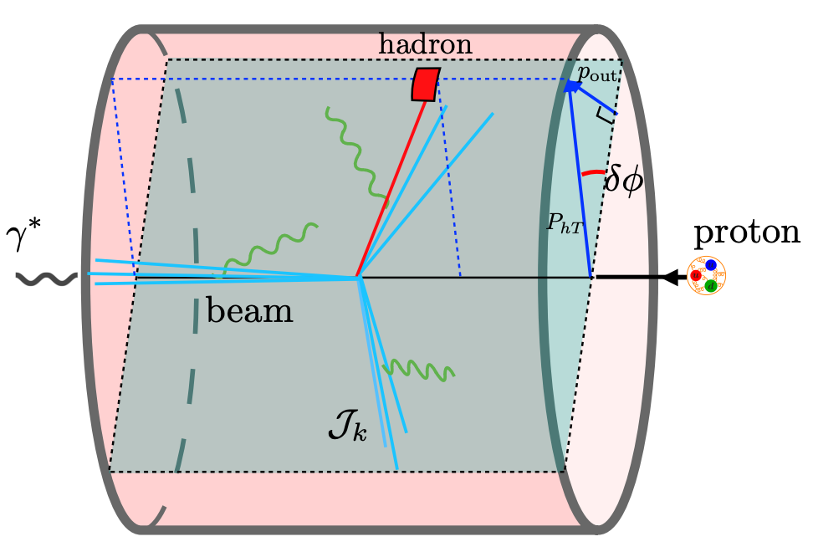
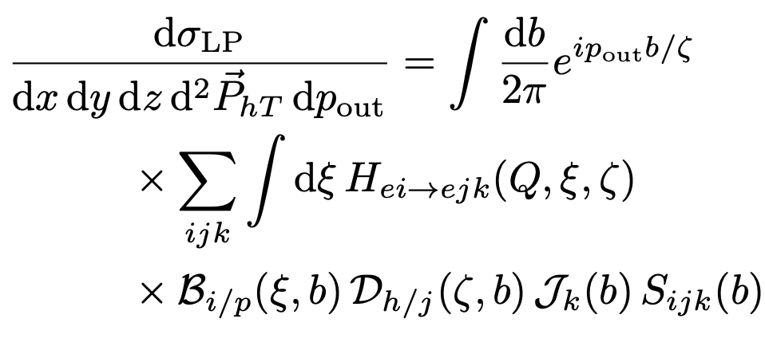
NNLO QCD corrections for 𝑃_{ℎ𝑇} distribution
Dong(董亮), Fang(方申), Gao, DYS, Li, Zhu (朱雨蛟) 2602.22972
We present the first complete calculation of hadron production in DIS at finite transverse momentum to NNLO
First N3LO SIDIS Dong(董亮), Fang(方申), Gao, DYS, Li, Zhu (朱雨蛟), Zhu 2603.29673

Slide 9
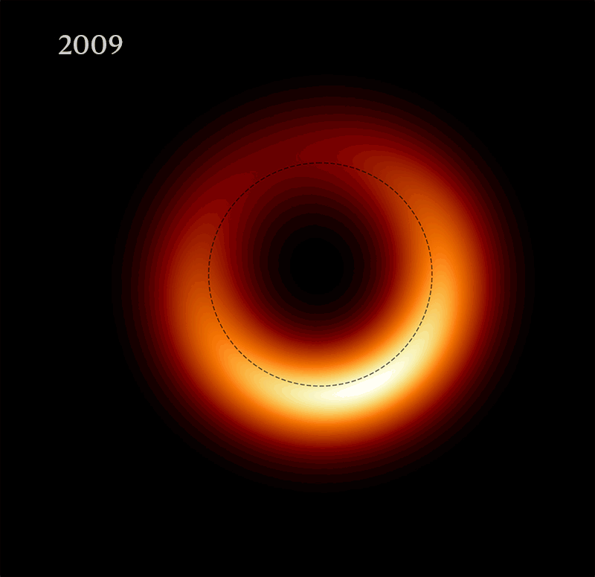
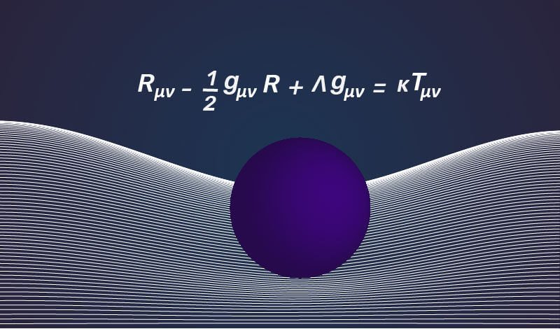
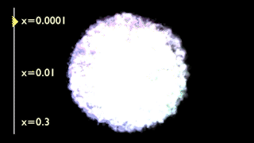
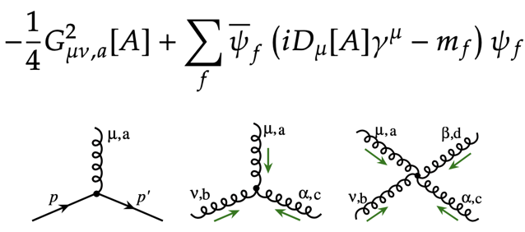
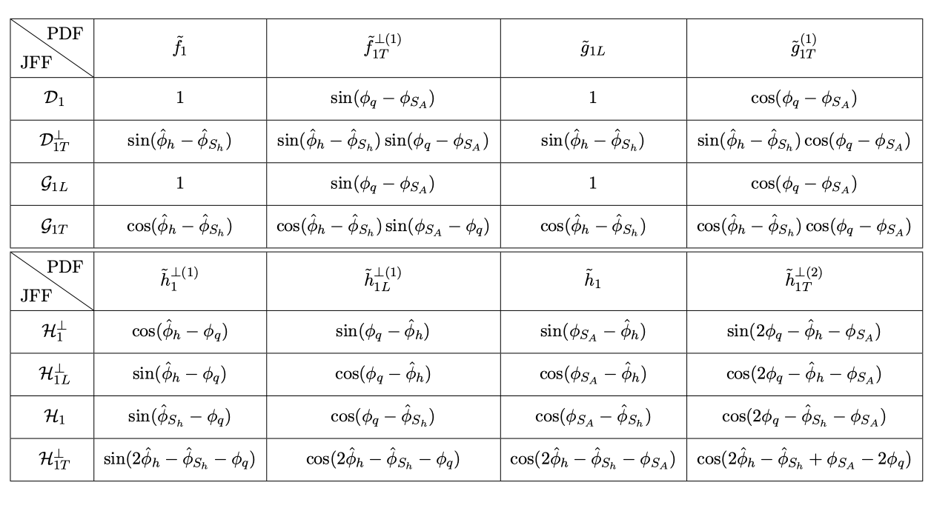
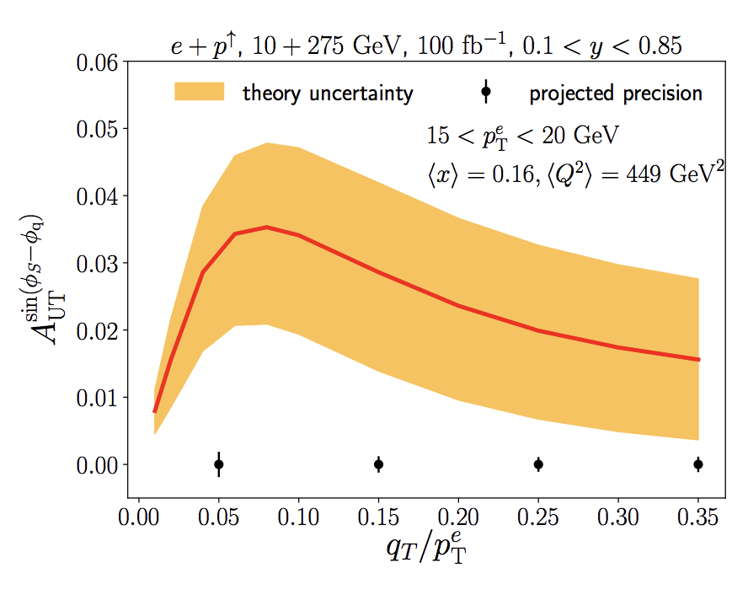
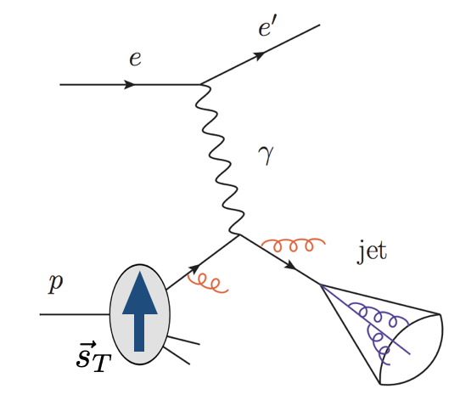
核子成像与喷注探针
核子成像
黑洞成像将深化人类对引力的理解
核子成像将深化人类对强力的理解
喷注及其精细结构为抽取核子分布函数提供了新的探针
与传统SIDIS观测量相比可以有效分离出末态的非微扰信息
Liu, Ringer, Vogelsang, Yuan 19
Arratia, Kang, Prokudin, Ringer 19
Kang, Lee, DYS, Zhao ‘21

Slide 10
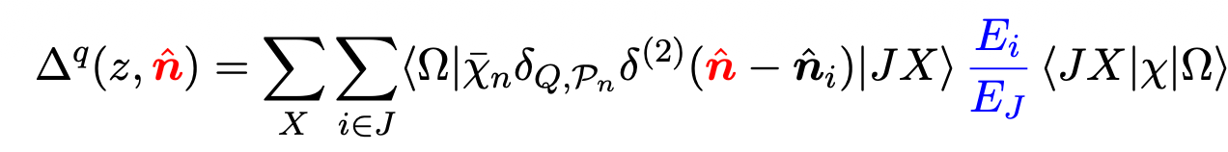
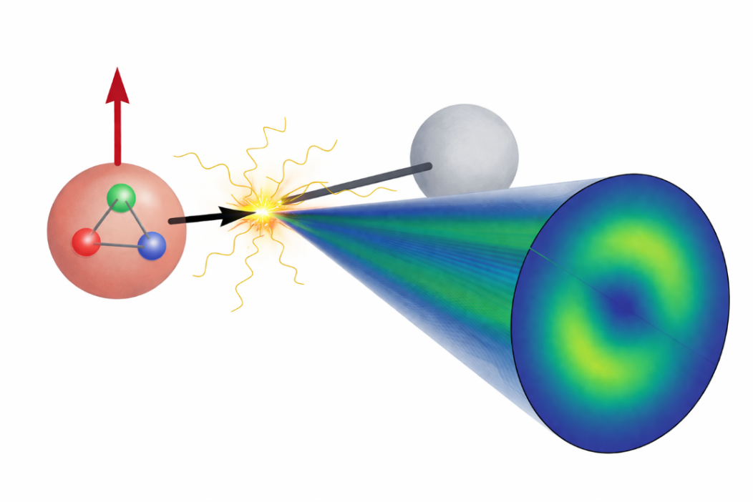
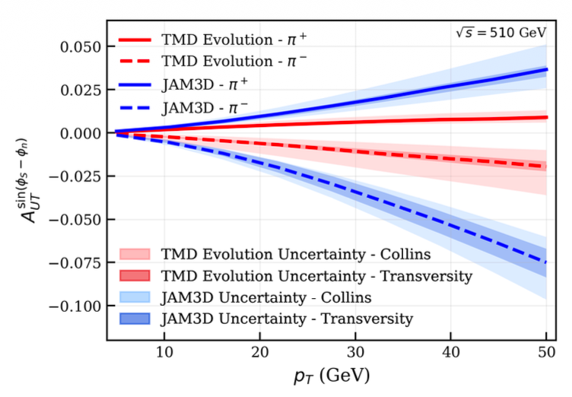
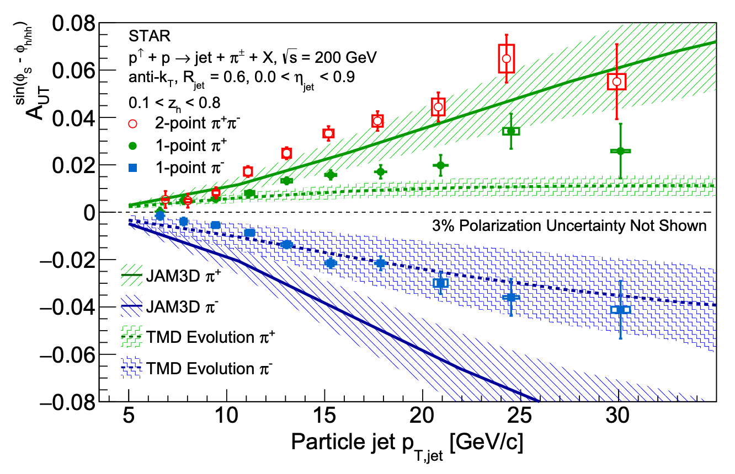

Accessing Nucleon Transversity via One-Point Energy Correlators
Gao(高梅森), Kang, Li(李婉辰), DYS PRL 136 (2026) 151902
Transversity distribution $h_{1}^{q}$ is a fundamental, yet less known, parton distribution.
Its chiral-odd nature prevents access via inclusive DIS
Nucleon tensor charge $δq$ is essential for BSM search, Lattice QCD benchmarks
We introduce the one-point energy correlator (OPEC) to probe the nucleon transversity
RHIC 2604.15543

Slide 11
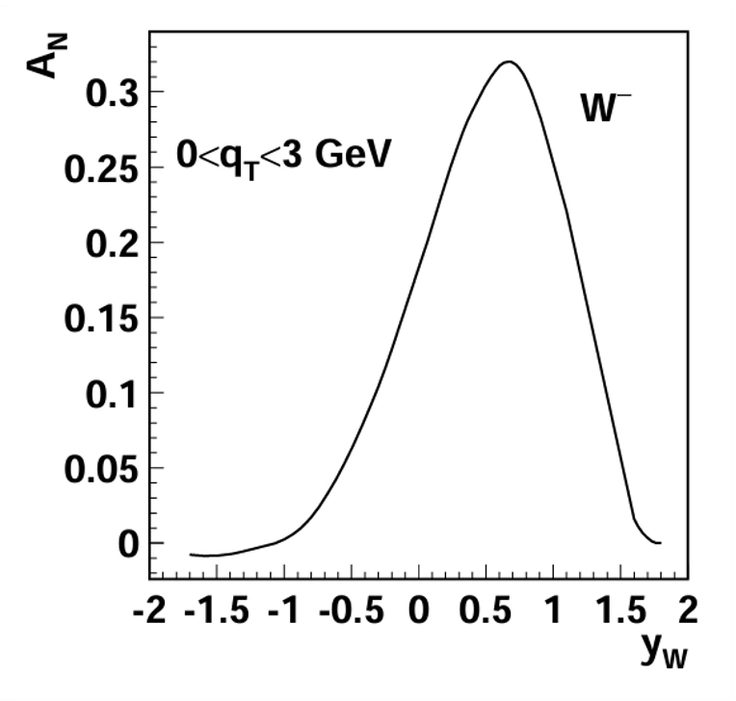
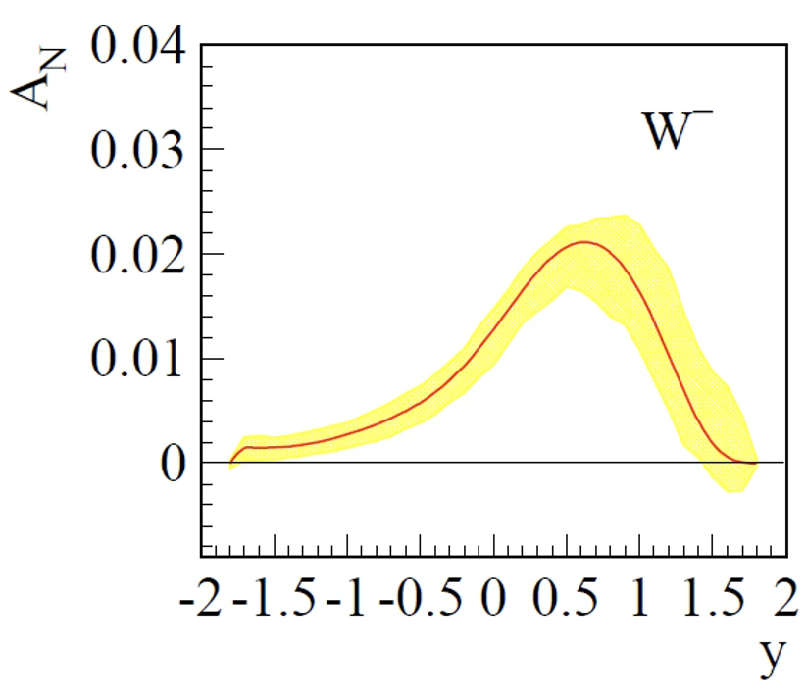
Spin asymmetry and QCD evolution
Without evolution
With evolution
Soft and collinear radiation destroy superposition
Soft radiation decohere the directions of the momenta and the gauge representations of the particles
Collinear radiation decohere the energies and the spin
Carney, Chaurette, Neuenfeld, Semenof ’17
Neill, Waalewijn ’19
S.J. Lin, M.J. Liu, DYS, S.Y. Wei ‘25
J.Y. Gu, S.J. Lin, DYS, S.X. Yang, L.T Wang ‘25
Kang & Qiu ‘09
Echevarria, Idilbi, Kang, Vitev ’14
Evolution reduces the asymmetry

Slide 12
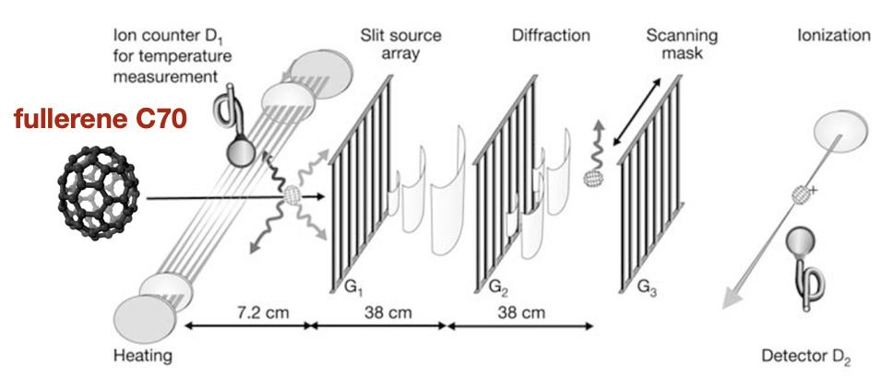
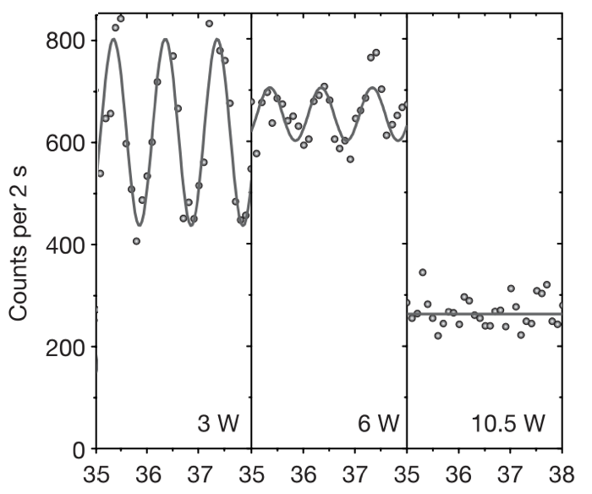
热光子辐射引起的退相干
Hackermuller, Hornberger, Brezger, Zeilinger, Arndt Nature ‘04
塔尔博特-劳厄干涉仪
在进入干涉仪之前，C70分子会穿过一束激光以提高温度
温度调节范围从低于1000K（低温）至3000K（高温）
低温：
分子辐射可忽略不计
结果：观测到清晰的干涉条纹
高温：
分子发射携带路径信息的热光子
结果：干涉条纹可见度降至0%
辐射可以导致退相干

Slide 13
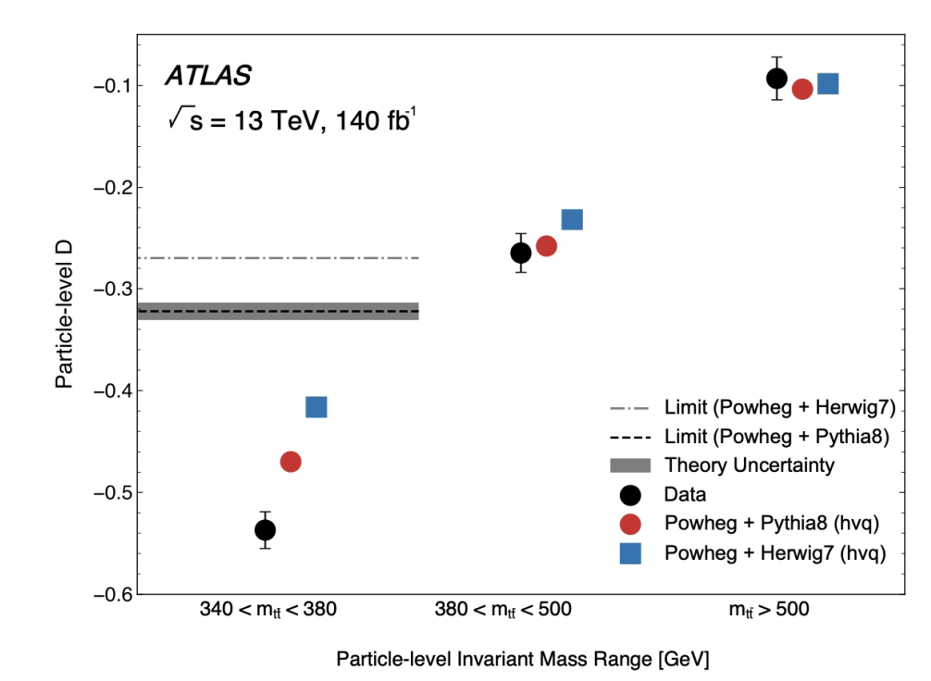
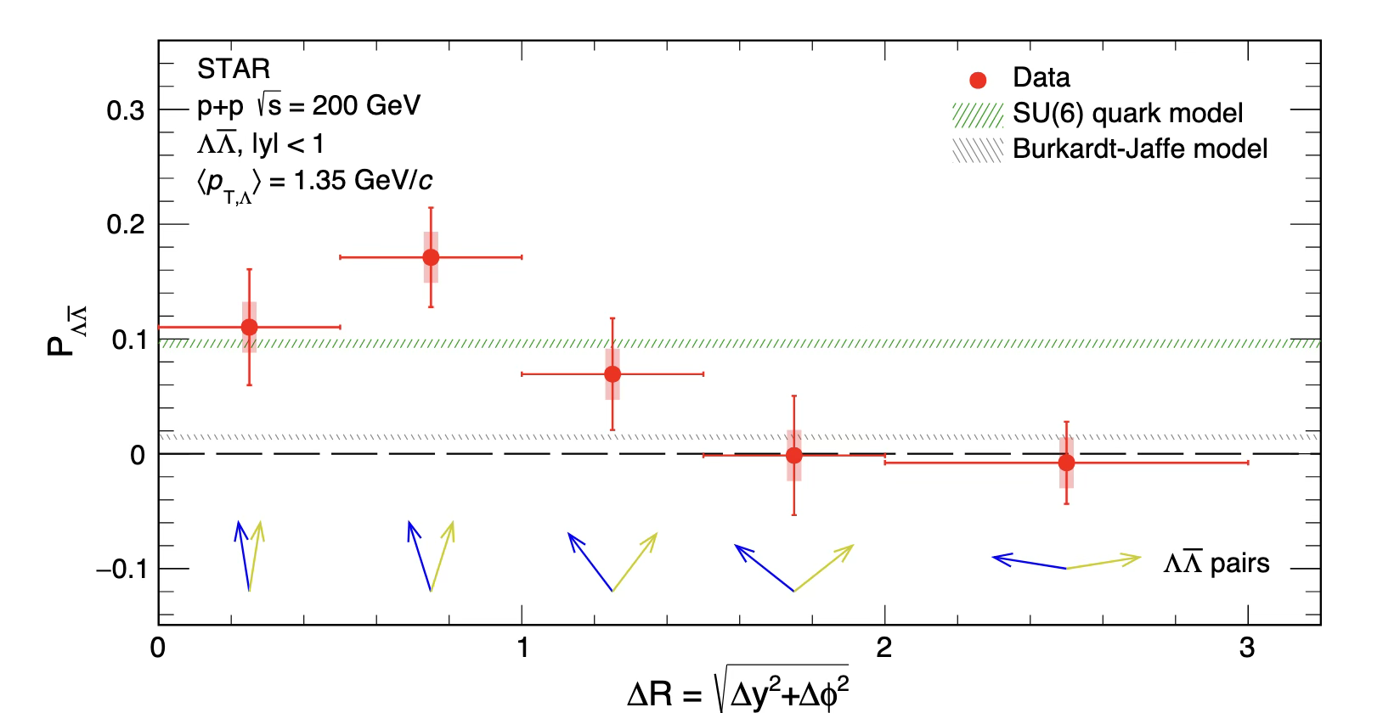
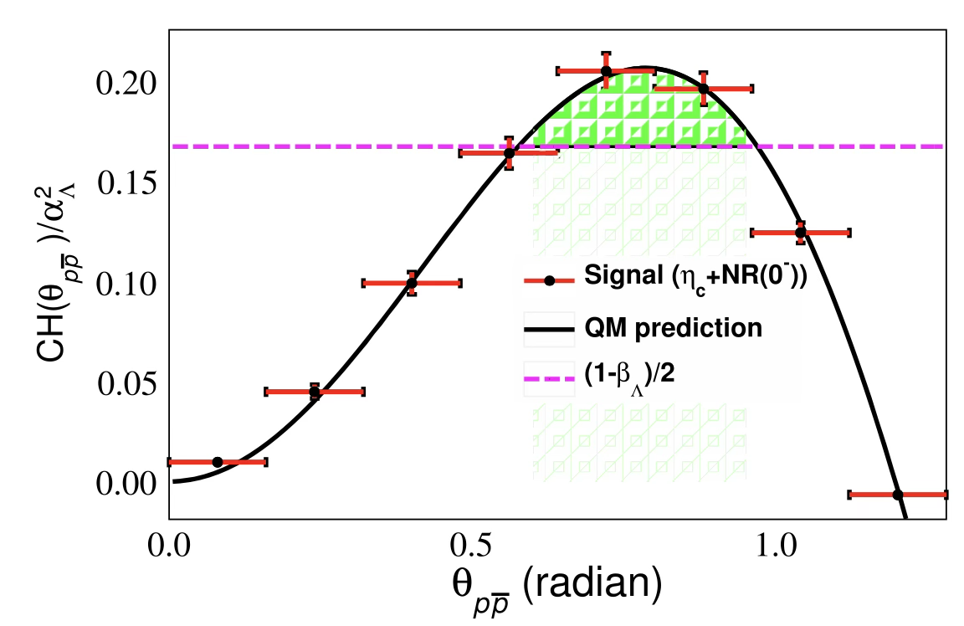
Quantum information science meets high energy physics
The study of quantum information in high-energy collider physics is rapidly transitioning from a theoretical curiosity to an experimental reality.
See H.F. Li’s talk
“Measuring spin correlation between quarks during QCD confinement”
RHIC Nature 2026
ATLAS Nature 2024
See J.L. Zhang’s talk
BESIII Nature Communications 2025

Slide 14
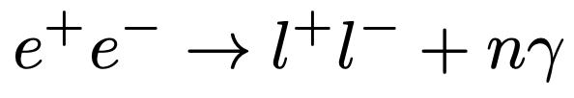
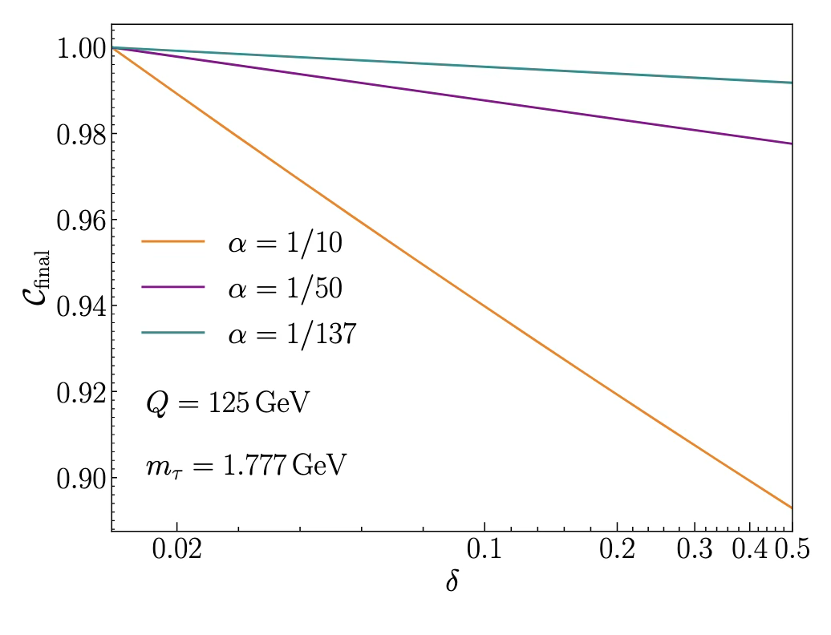

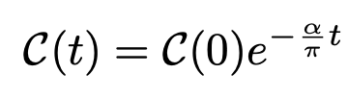
Effective field theory for decoherence
S.J. Lin, M.J. Liu, DYS, S.Y. Wei 25 JHEP; J.Y. Gu, S.J. Lin, DYS, S.X. Yang, L.T Wang 25
A systematic framework calculating decoherence in high energy collisions by combing SCET with the formalism of open quantum systems.
The renormalization group evolution constitutes a quantum channel, where the RG flow parameter, rather than time, drives a Markovian loss of quantum coherence.
E.g. Applications in QED processes
Lindblad equation and jump operators
Each “jump” corresponds to an unresolved collinear photon emission from either of the fermion legs, which induces a stochastic phase-flip quantum channel
Reduction of the concurrence
decoherence = RG flow
anomalous dimensions in RGE determine the information loss

Slide 15
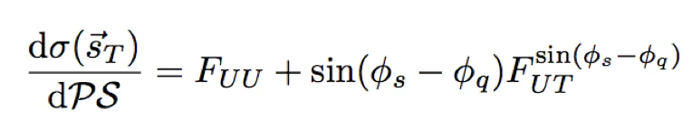
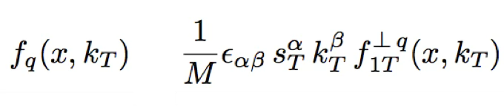
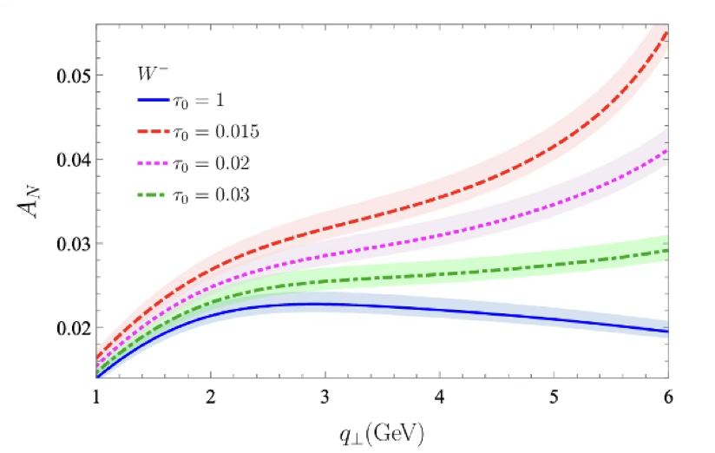
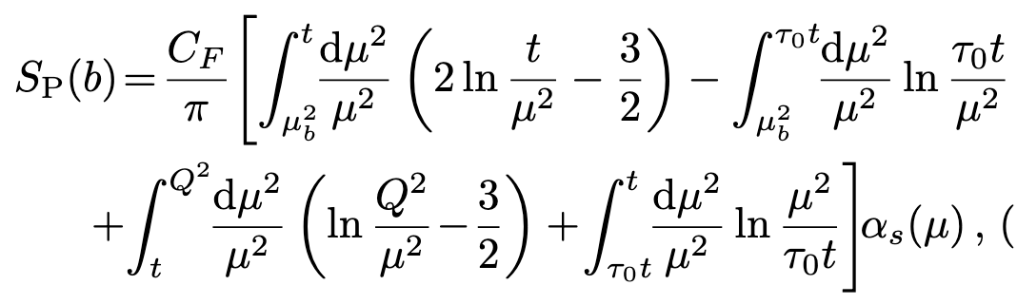
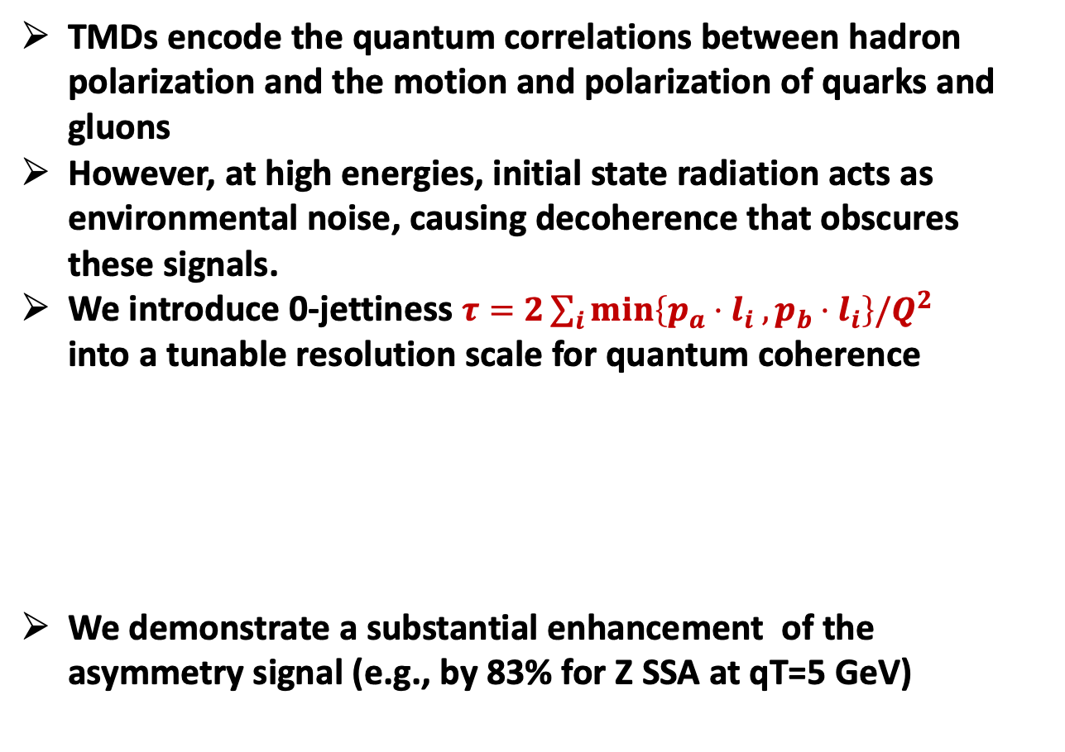
Nucleon tomography with zero-jettiness
Fang(方申), Lin(林硕), DYS, Zhou PRL136 (2026)021901
TMDs encode the quantum correlations between hadron polarization and the motion and polarization of quarks and gluons
However, at high energies, initial state radiation acts as environmental noise, causing decoherence that obscures these signals.
We introduce 0-jettiness $τ=2\sum_{i}{min\left\{p_{a}⋅l_{i} ,p_{b}⋅l_{i}\right\}/Q^{2}}$ into a tunable resolution scale for quantum coherence
We demonstrate a substantial enhancement of the asymmetry signal (e.g., by 83% for Z SSA at qT=5 GeV)
Modified Sukakov factor

Slide 16
总结与展望
QCD 研究从“总截面”的宏观成功，迈向“微分与极化”的微观精密时代
核子结构与自旋物理
喷注物理与精确计算
电子离子对撞机物理
纠缠
退相干
量子信息科学的新视角

Slide 17
谢谢

