Slide 1
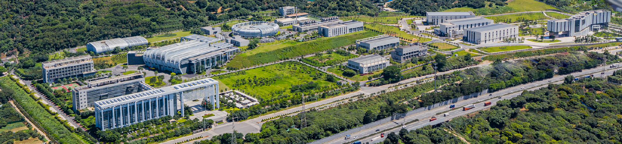



Report of Dongguan Branch
极化氦三和极化中子
Polarized ³He and Polarized Neutron
王天昊，童欣
中国科学院高能物理研究所
中国散裂中子源
2026.04.20 （青岛） 第一届中国电子粒子对撞机相关物理年会

Slide 2
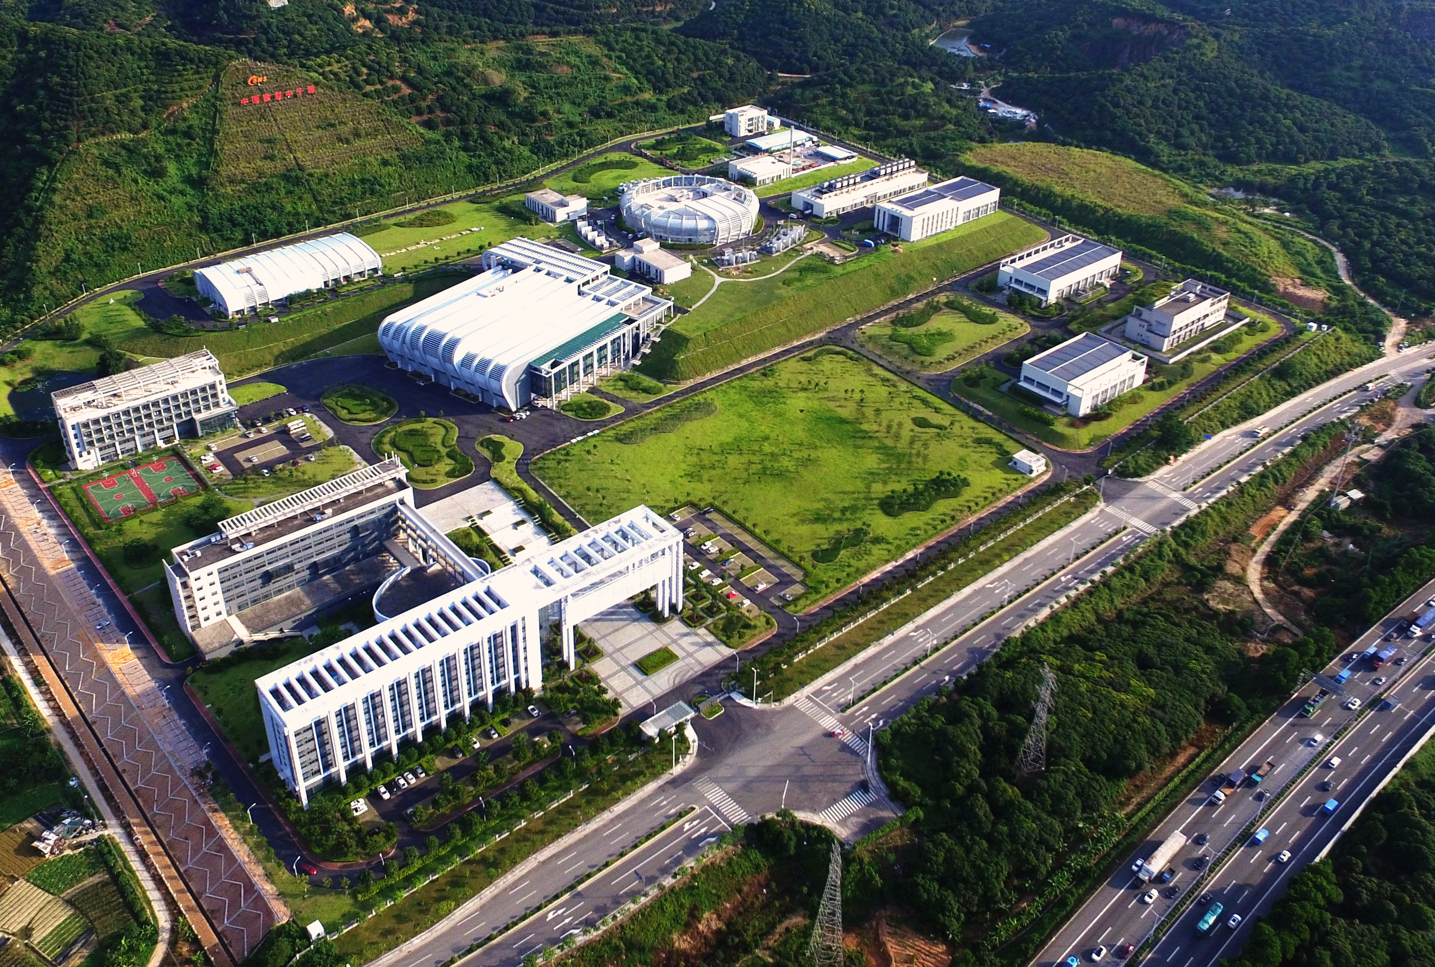
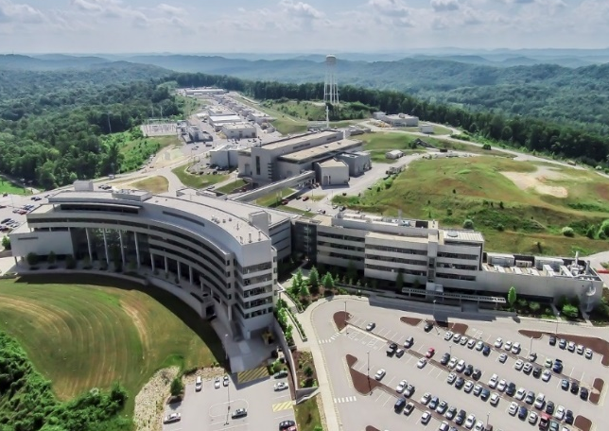
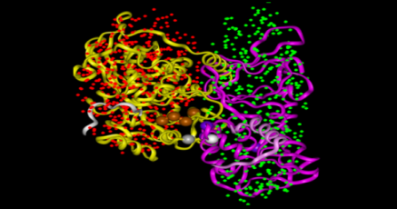
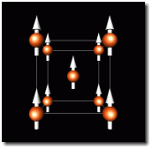
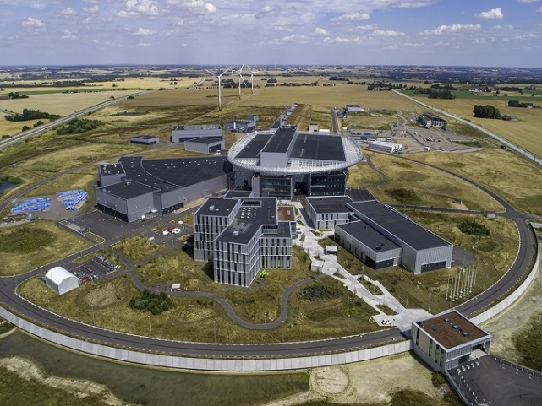
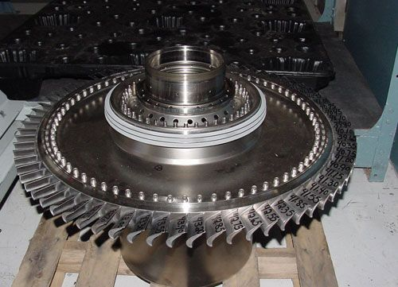
中国散裂中子源
散裂中子源为材料科学技术、物理、化学化工、资源环境、新能源、纳米、生命科学、国家安全等前沿研究和国家重大需求，提供先进的中子散射多学科研究平台。
对轻元素敏感
中国散裂中子源，东莞，广东
SNS, Oak Ridge US
中子有磁矩
ESS, Lund, Sweden
强穿透力
2011-2018年，投资23亿元
2018-2023年，运行、新建线站~20亿元
2024~2029年，二期升级投资30亿元
Notes:
The development polarized neutron techniques at the CSNS started in 2019, one year after the commission of CSNS in 2018. This is an early phase of a large-scale neutron source, majority of the beamlines are under construction, and polarized neutron techniques is yet to be built.
Under this background, the development work focuses on establishing the initial capability. By the end of 2019, we setup a SEOP laser lab in the target station, a ³He glass cell workshop in the development building. A testing platform is also established is also set up on the current development beamline.

Slide 3
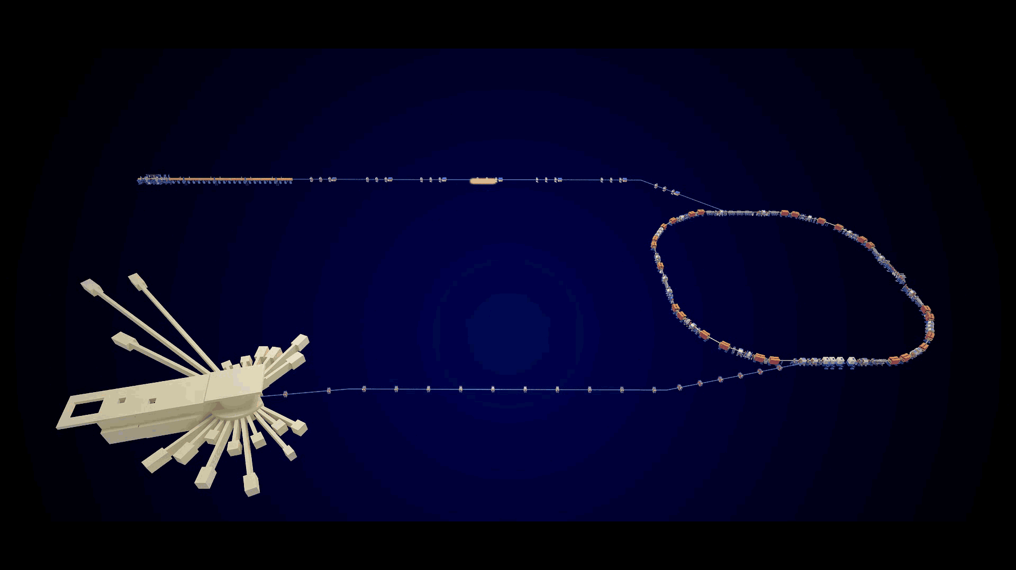
散裂中子源产：自由中子产生过程
通过加速器加速质子，轰击靶体（钨）产生散射实验的中子
质子源
直线加速器
回旋加速器
中子靶站
80MeV（300MeV）直线加速器和 1.6GeV 回旋加速器
一号靶站（现建成）共有20个中子束窗
Notes:
The development polarized neutron techniques at the CSNS started in 2019, one year after the commission of CSNS in 2018. This is an early phase of a large-scale neutron source, majority of the beamlines are under construction, and polarized neutron techniques is yet to be built.
Under this background, the development work focuses on establishing the initial capability. By the end of 2019, we setup a SEOP laser lab in the target station, a ³He glass cell workshop in the development building. A testing platform is also established is also set up on the current development beamline.

Slide 4
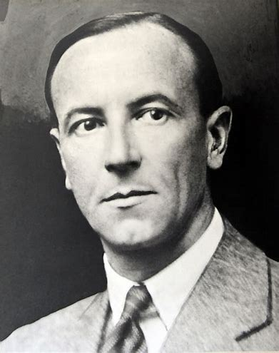
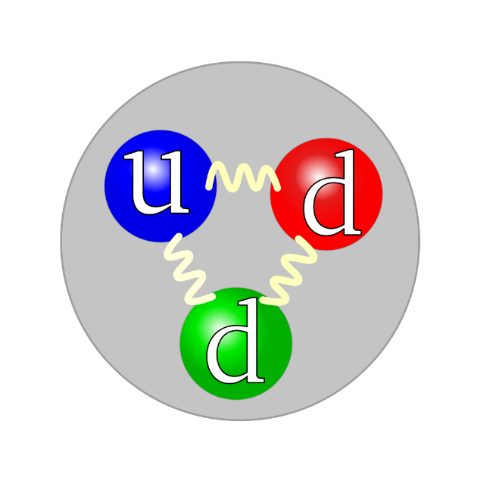
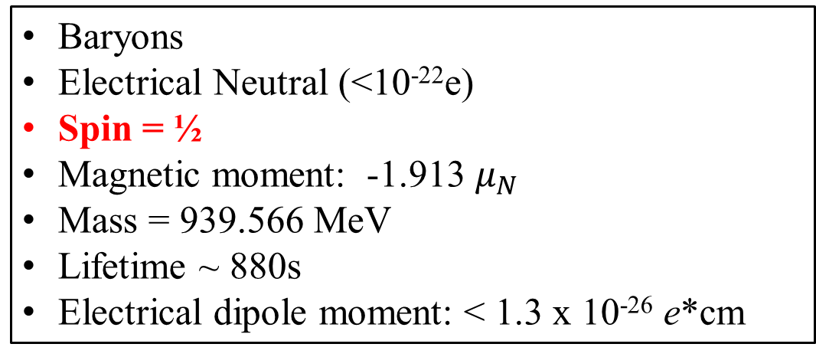
自由中子的性质
Baryons
Electrical Neutral (<10⁻²²e)
Spin = ½
Magnetic moment: -1.913 $μ_{N}$
Mass = 939.566 MeV
Lifetime ~ 880s
Electrical dipole moment: < 1.3 x 10⁻²⁶ e*cm
James Chadwick
1932 discovery，1935 Nobel Prize
Difficult to handle, can’t accelerate/guide/focus
Destruction to detect
Low flux
Respond to all four forces, and possibly “fifth” force
Simpler compare to nucleus
Polarization is a unique feature
Neutron
Notes:
The development polarized neutron techniques at the CSNS started in 2019, one year after the commission of CSNS in 2018. This is an early phase of a large-scale neutron source, majority of the beamlines are under construction, and polarized neutron techniques is yet to be built.
Under this background, the development work focuses on establishing the initial capability. By the end of 2019, we setup a SEOP laser lab in the target station, a ³He glass cell workshop in the development building. A testing platform is also established is also set up on the current development beamline.

Slide 5

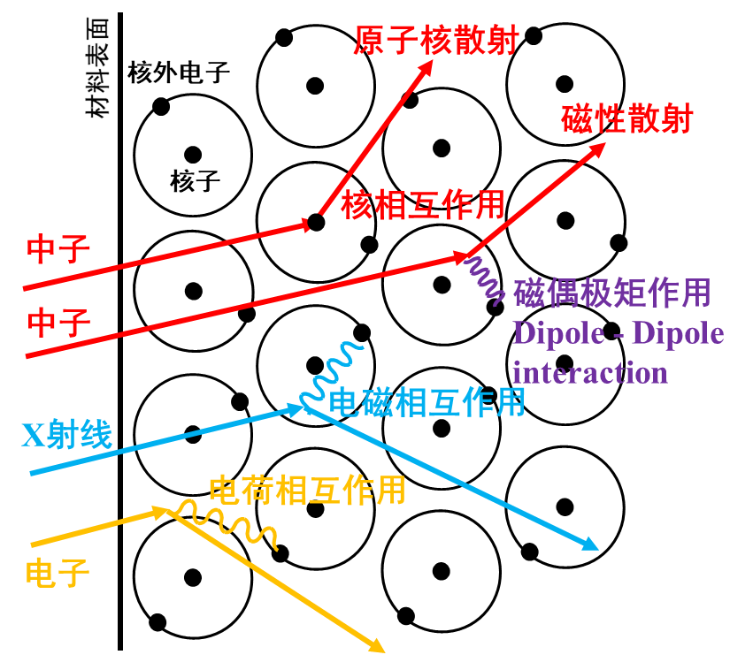


中子、X-ray、电子和物质的相互作用
波长(wavelength)~ Å
能量(Energy) ~ meV

Slide 6
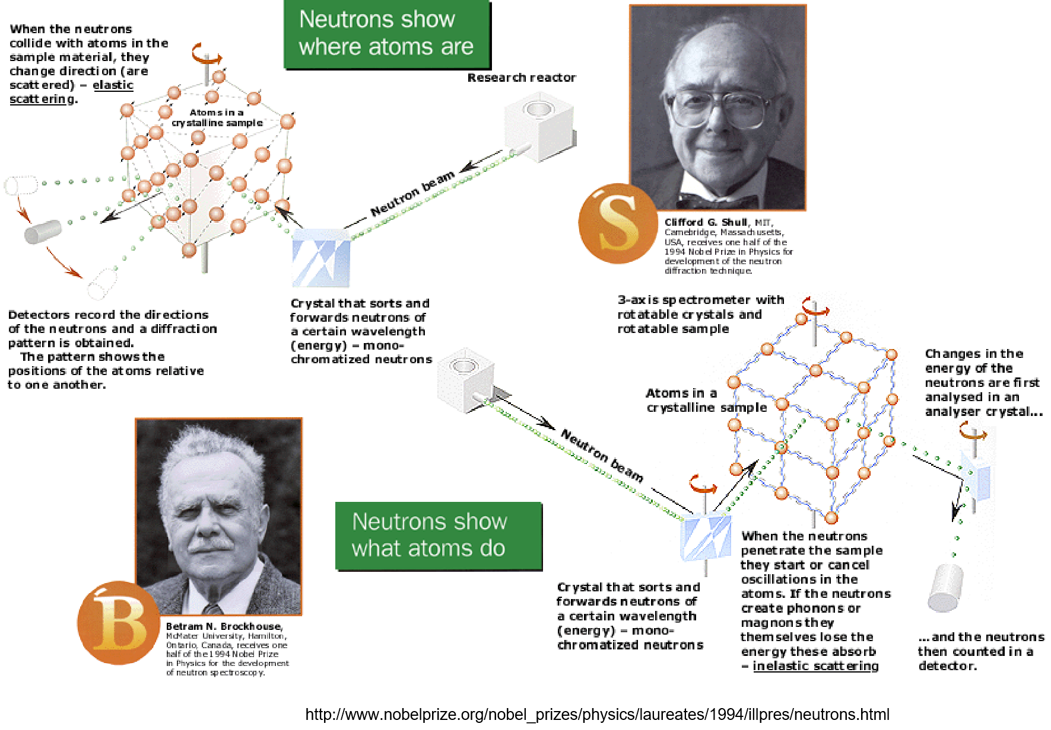
中子散射，1994年物理系诺贝尔奖
通过中子散射探测原子的结构与动力学性质：1994 Nobel in Physics （Shull & Brockhouse）
Notes:
The development polarized neutron techniques at the CSNS started in 2019, one year after the commission of CSNS in 2018. This is an early phase of a large-scale neutron source, majority of the beamlines are under construction, and polarized neutron techniques is yet to be built.
Under this background, the development work focuses on establishing the initial capability. By the end of 2019, we setup a SEOP laser lab in the target station, a ³He glass cell workshop in the development building. A testing platform is also established is also set up on the current development beamline.

Slide 7
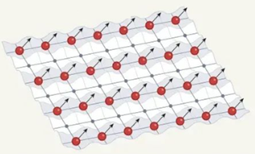
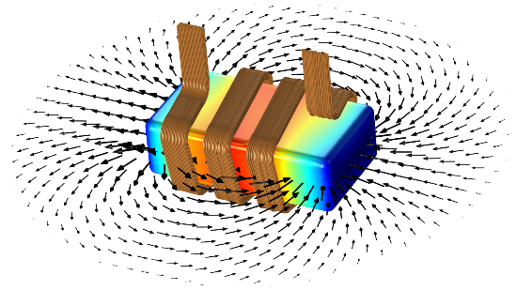
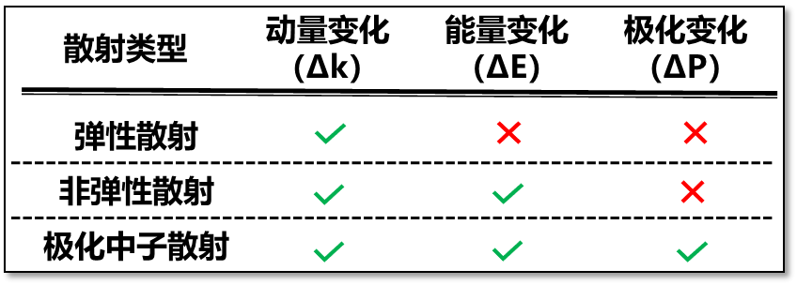
中子技术和极化中子技术
从常规中子散射到极化中子散射
k_{i}
原子的磁性排布
P_{i}
E_{i}
常规中子
P_{f}
宏观磁场分布
样品
k_{f}
E_{f}
❖ 测量材料磁性结构
❖ 对磁场进行成像
❖ 通过拉莫尔标定提升测量确度与尺度
❖ 进行基础物理学常数测量
极化中子
Notes:
The development polarized neutron techniques at the CSNS started in 2019, one year after the commission of CSNS in 2018. This is an early phase of a large-scale neutron source, majority of the beamlines are under construction, and polarized neutron techniques is yet to be built.
Under this background, the development work focuses on establishing the initial capability. By the end of 2019, we setup a SEOP laser lab in the target station, a ³He glass cell workshop in the development building. A testing platform is also established is also set up on the current development beamline.

Slide 8
极化氦三与极化中子
用于中子源的极化氦三
极化中子应用
Notes:
The development polarized neutron techniques at the CSNS started in 2019, one year after the commission of CSNS in 2018. This is an early phase of a large-scale neutron source, majority of the beamlines are under construction, and polarized neutron techniques is yet to be built.
Under this background, the development work focuses on establishing the initial capability. By the end of 2019, we setup a SEOP laser lab in the target station, a ³He glass cell workshop in the development building. A testing platform is also established is also set up on the current development beamline.

Slide 9
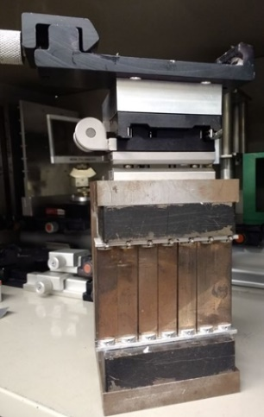
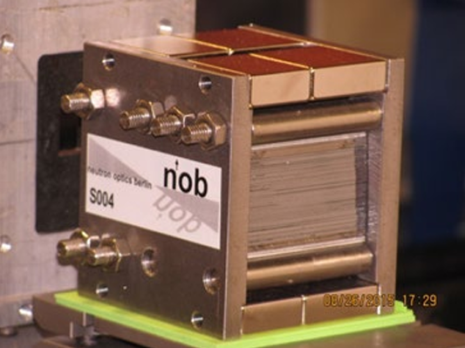
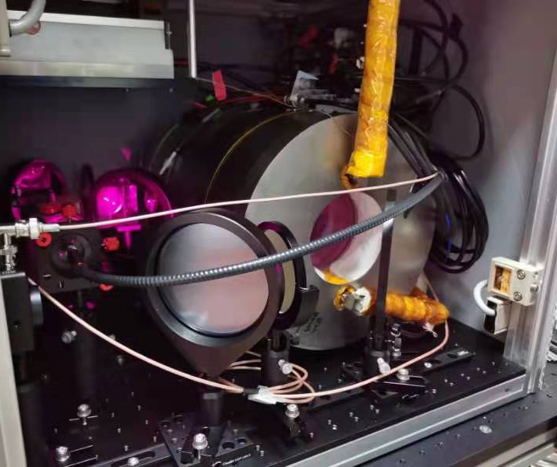
极化中子产生的关键技术：极化氦三气体
通过极化氦三气体原子核对于中子的选择性吸收，产生极化中子
极化单晶
极化超镜
极化氦三气体
未极化
中子束
极化
中子束
过滤
优点：
优点：
覆盖热中子能量范围
中子透射率高
插入谱仪光路方便
缺点：
缺点：
优点：
缺点：
仅限于单波长中子
使用时需要外加较高磁场
需要切换装置
需要预留足够的空间
中子极化率对波长依赖性大
覆盖中子波长范围窄
覆盖的散射角度小
需要预留足够的空间
多波长，且适用波长范围广
覆盖散射角度大（~180°）
空间均匀性好
极化率随时间衰减
– 可通过原位系统解决
9
Notes:
The development polarized neutron techniques at the CSNS started in 2019, one year after the commission of CSNS in 2018. This is an early phase of a large-scale neutron source, majority of the beamlines are under construction, and polarized neutron techniques is yet to be built.
Under this background, the development work focuses on establishing the initial capability. By the end of 2019, we setup a SEOP laser lab in the target station, a ³He glass cell workshop in the development building. A testing platform is also established is also set up on the current development beamline.

Slide 10
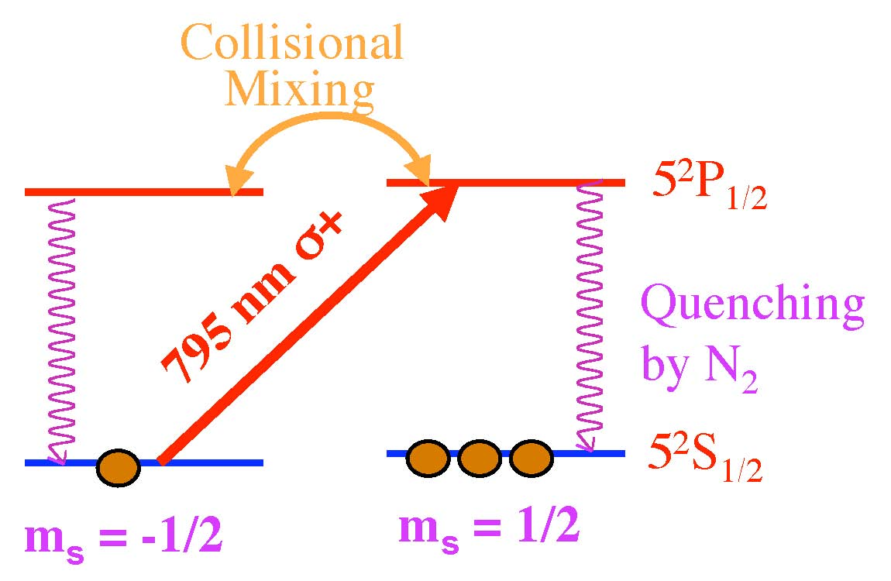
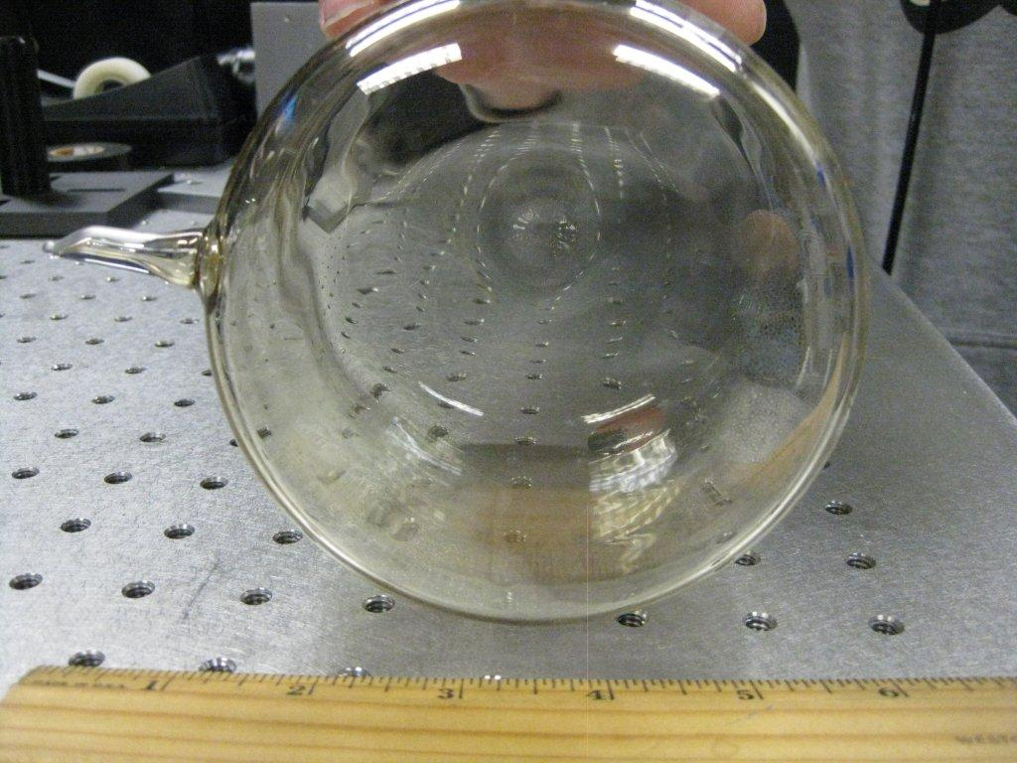
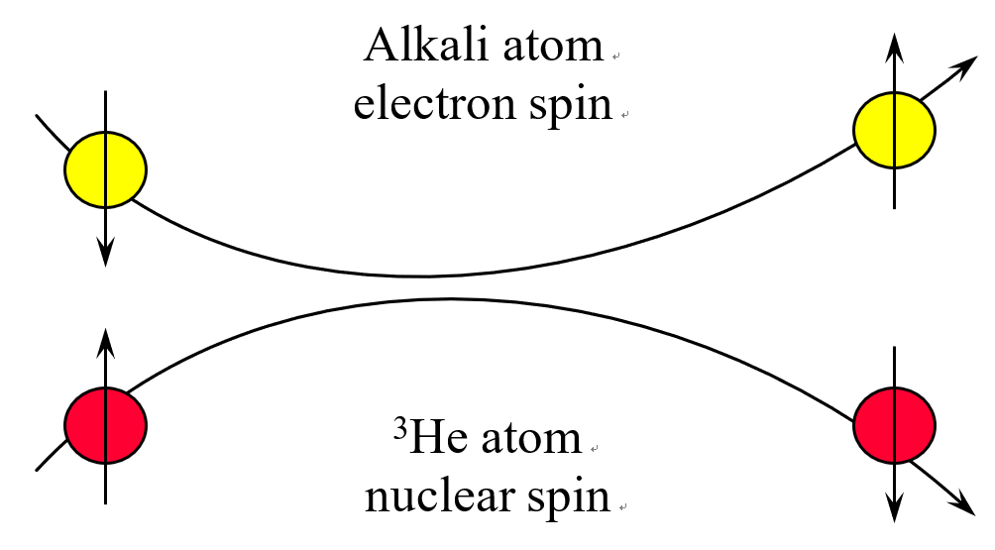
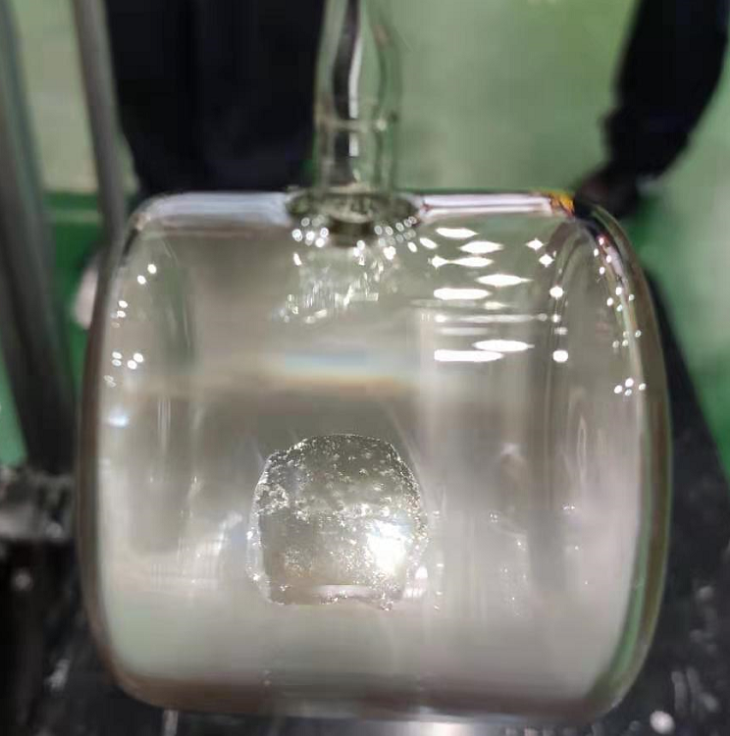
极化氦三自旋交换光泵技术（SEOP）
氦三容器制作技术
氦三极化技术
❖ 无硼玻璃
❖ ³He (0.8~3 bar)
❖ N₂ (40~60 Torr)
❖ 碱金属(K, Rb)
❖ 795 nm偏振激光
❖ 极化碱金属价电子
❖ 自旋交换
❖ 极化氦三原子核
非极化中子束流
极化中子束流
极化氦三玻璃气室
Notes:
The development polarized neutron techniques at the CSNS started in 2019, one year after the commission of CSNS in 2018. This is an early phase of a large-scale neutron source, majority of the beamlines are under construction, and polarized neutron techniques is yet to be built.
Under this background, the development work focuses on establishing the initial capability. By the end of 2019, we setup a SEOP laser lab in the target station, a ³He glass cell workshop in the development building. A testing platform is also established is also set up on the current development beamline.

Slide 11
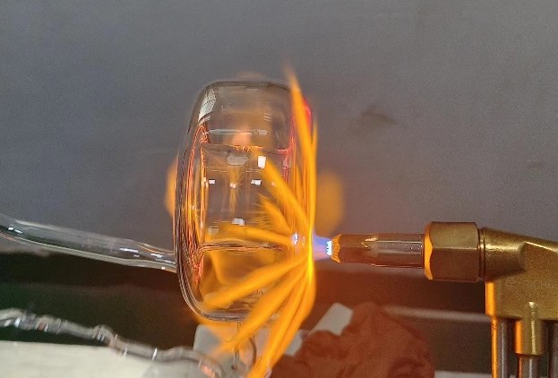
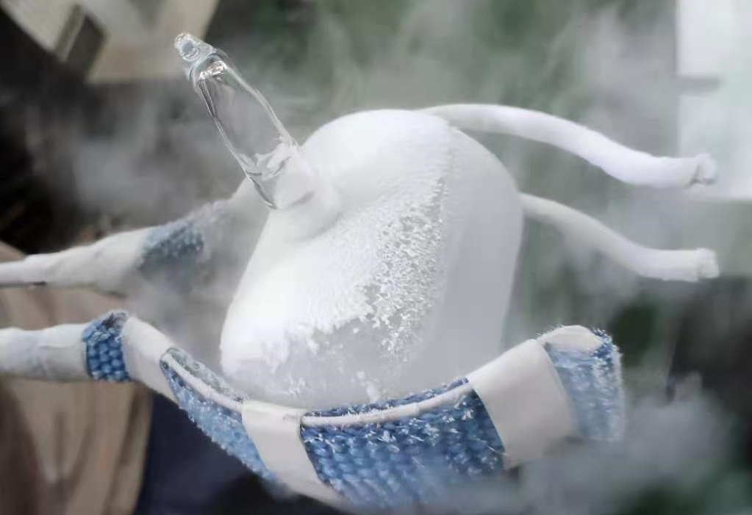
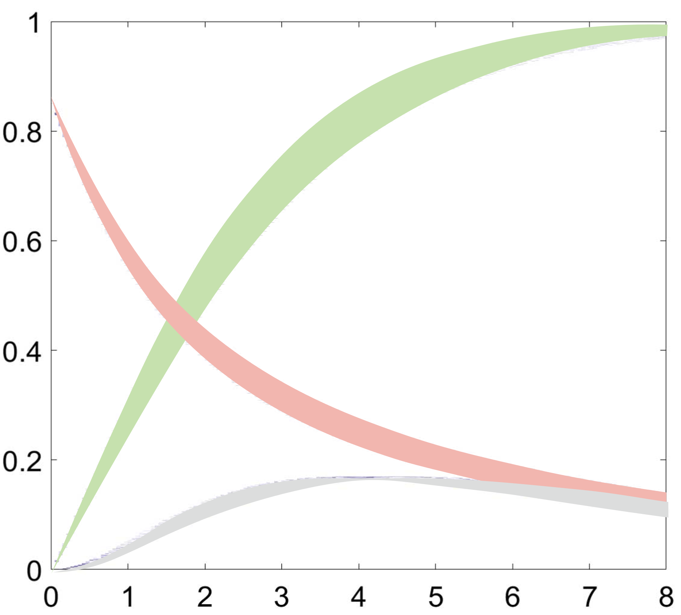
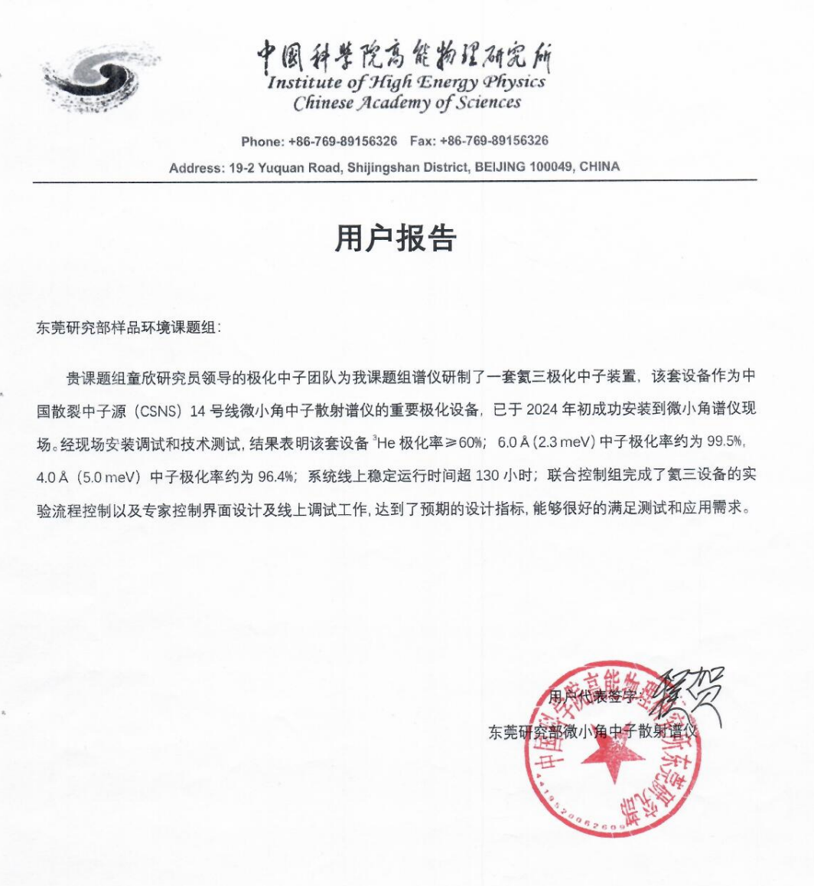
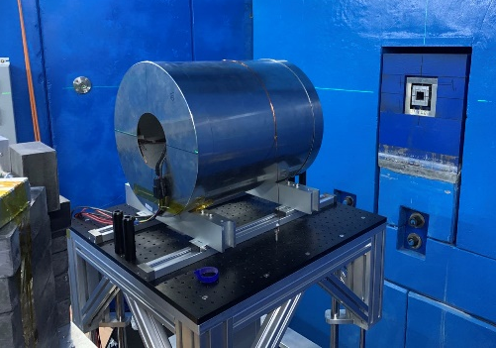
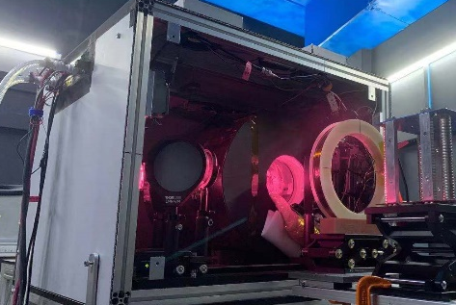
极化中子产生的关键技术：自旋交换光泵
建立国内氦三中子极化装备的全链条技术，兼备原件制造、运行和应用
每条中子谱仪使用极化氦三时所需的研制步骤
极化氦三系统性能
极化率
氦三气体极化率 [%]
透射率
连续加工40小时
120小时高纯气体灌装
实现6Å中子极化率99.5%，稳定运行130小时…很好的满足测试和应用需求
1. GE180玻璃容器烧制
2. 氦三气体封装
综合性能
中子波长 [Å]
Chin. Phys. Lett. 38 052801 (2021) ; 共同通讯作者
Chin. Phys. Lett. 38 092801 (2021); 共同通讯作者
NUCL SCI TECH (2022) 33:145; 共同通讯作者
Sci. China Phys. Mech. Astron. 65, 241011 (2022); 共同通讯作者
Nuclear Science and Techniques 34:146 (2023); 共同一作
Journal of Physics: Conference Series(2023); 共同通讯作者
200小时测试
6-12个月适配和调试
3. 中子性能标定
4. 中子谱仪线适配
Notes:
The development polarized neutron techniques at the CSNS started in 2019, one year after the commission of CSNS in 2018. This is an early phase of a large-scale neutron source, majority of the beamlines are under construction, and polarized neutron techniques is yet to be built.
Under this background, the development work focuses on establishing the initial capability. By the end of 2019, we setup a SEOP laser lab in the target station, a ³He glass cell workshop in the development building. A testing platform is also established is also set up on the current development beamline.

Slide 12
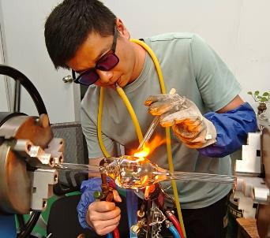
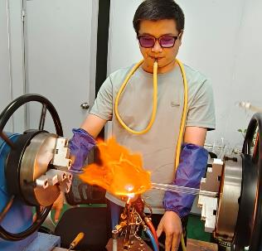
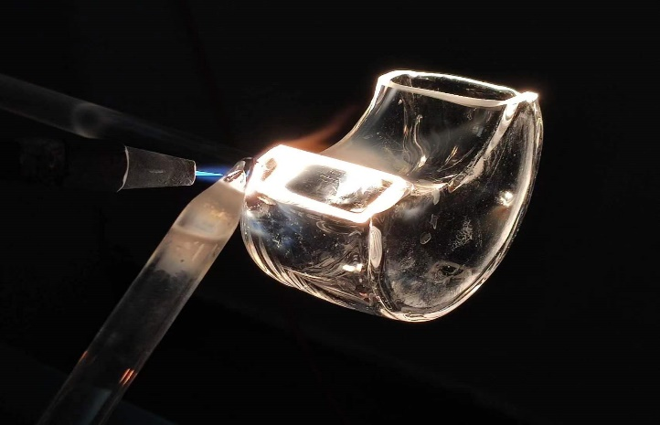
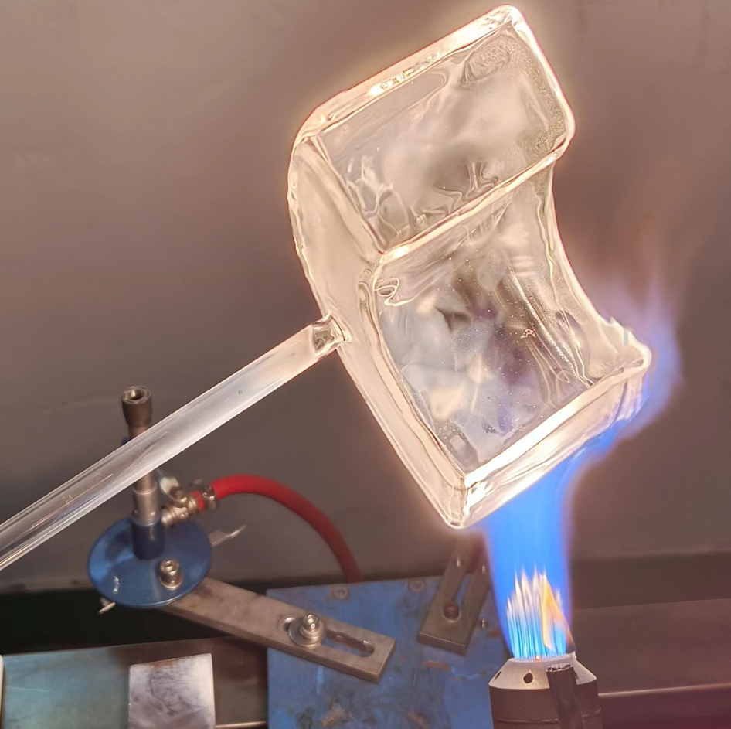
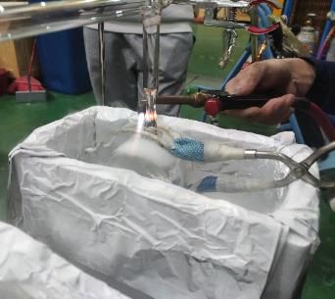
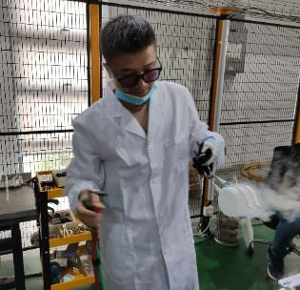
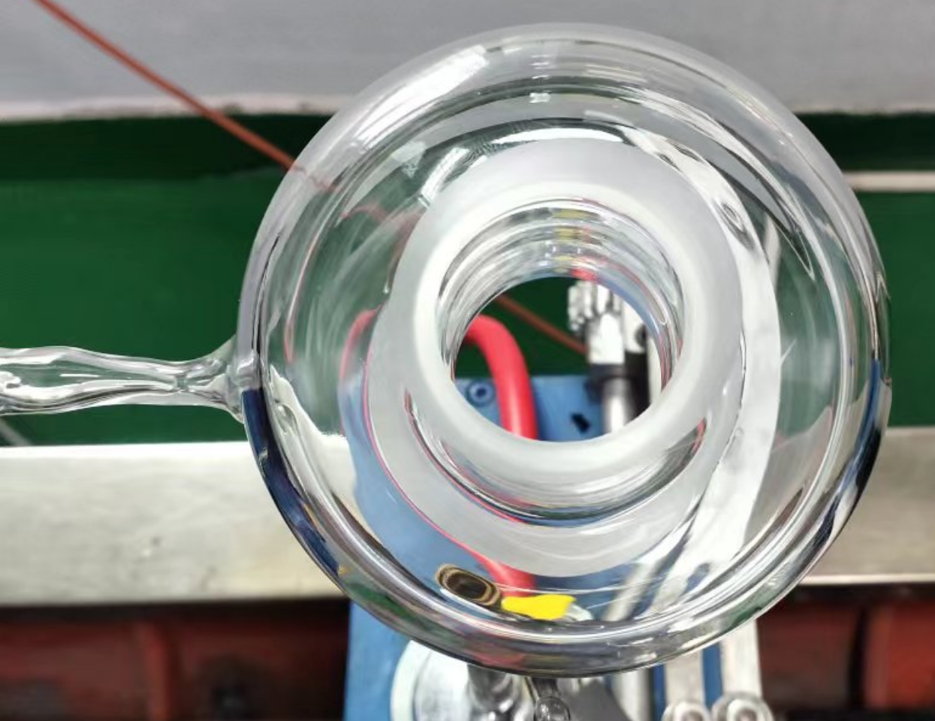
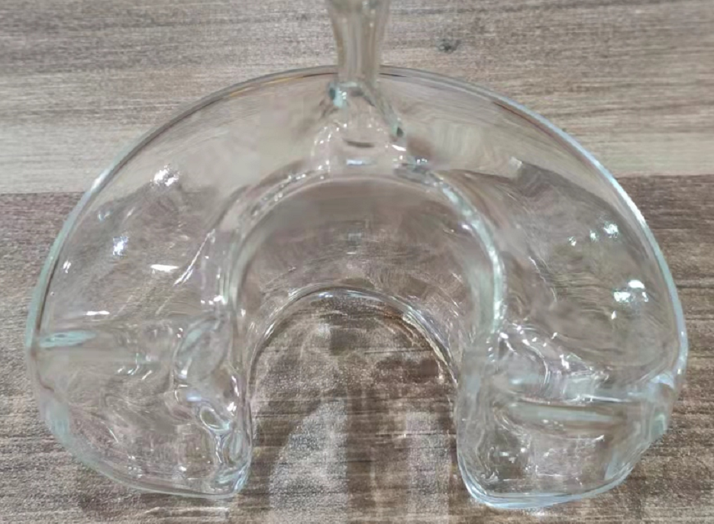
极化中极化氦三气体关键工艺：玻璃容器制作
大尺寸高极化率长寿命的氦三玻璃容器是世界中子源共同的难题
玻璃容器烧制与灌装
大尺寸（＞10cm直径）与广角（＞180°）容器
12cm
≥180°
Z.C. Qin, T.H. Wang, X. Tong et. al.; Development of a He-3 Gas Filling Station at the China Spallation Neutron Source, Chinese Phys Lett, 38 (2021).
Notes:
The development polarized neutron techniques at the CSNS started in 2019, one year after the commission of CSNS in 2018. This is an early phase of a large-scale neutron source, majority of the beamlines are under construction, and polarized neutron techniques is yet to be built.
Under this background, the development work focuses on establishing the initial capability. By the end of 2019, we setup a SEOP laser lab in the target station, a ³He glass cell workshop in the development building. A testing platform is also established is also set up on the current development beamline.

Slide 13
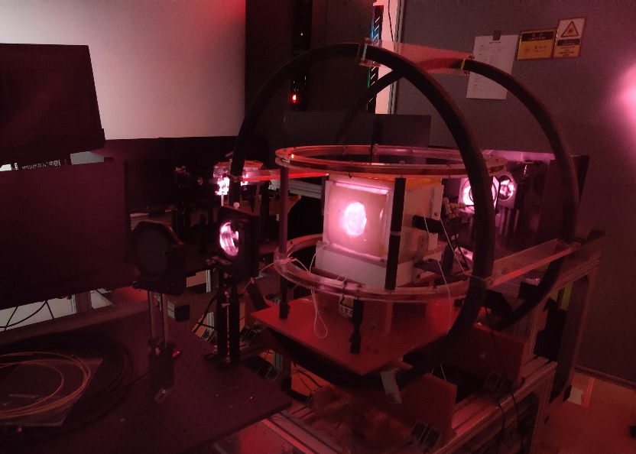
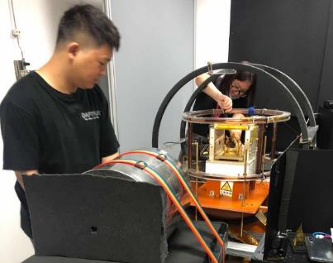
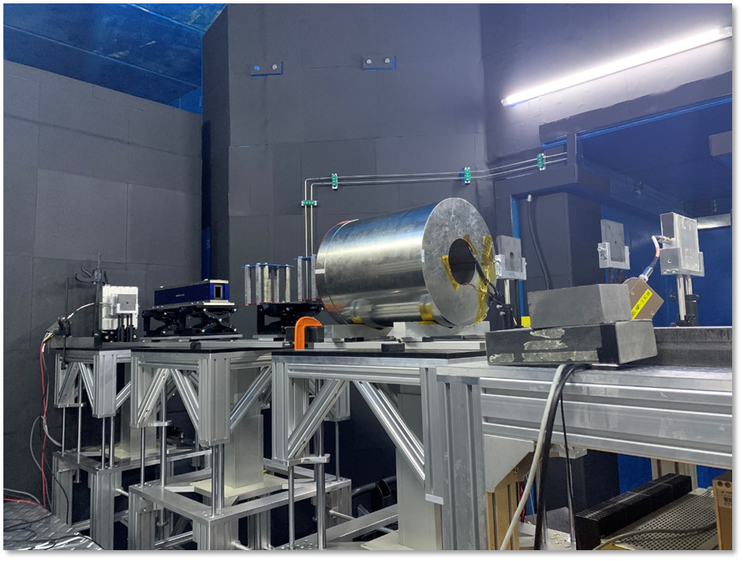
极化中极化氦三气体关键工艺：极化泵浦
在靶站大厅的实验室产生极化氦三气体，运输至谱仪线上进行实验
1. SEOP ³He 极化泵浦
2. 极化气体转运
3. 谱仪线上安装使用
设备运行关键指标
³He 极化寿命 | ³He 极化率 | 转运时间 | 容器置换率
100 - 200 hrs. | 60% - 77% | <30 min | 24 – 48 hrs.
Chin Phys Lett, 38 (2021), DOI: 10.1088/0256-307x/38/9/092801
Notes:
The development polarized neutron techniques at the CSNS started in 2019, one year after the commission of CSNS in 2018. This is an early phase of a large-scale neutron source, majority of the beamlines are under construction, and polarized neutron techniques is yet to be built.
Under this background, the development work focuses on establishing the initial capability. By the end of 2019, we setup a SEOP laser lab in the target station, a ³He glass cell workshop in the development building. A testing platform is also established is also set up on the current development beamline.

Slide 14
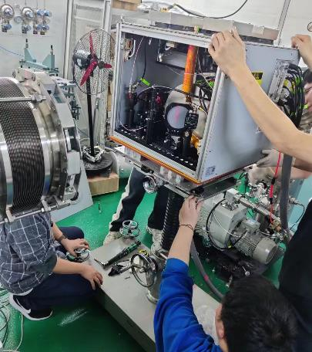
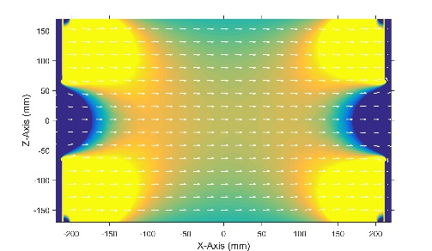
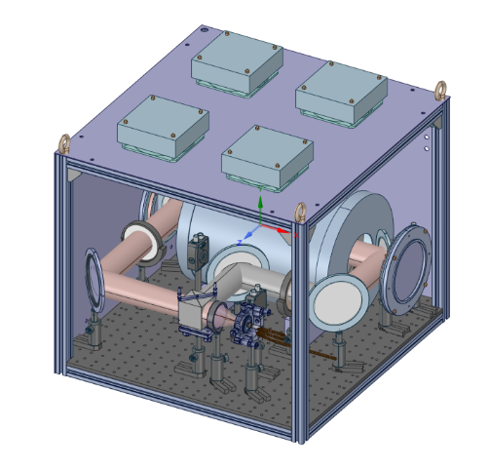
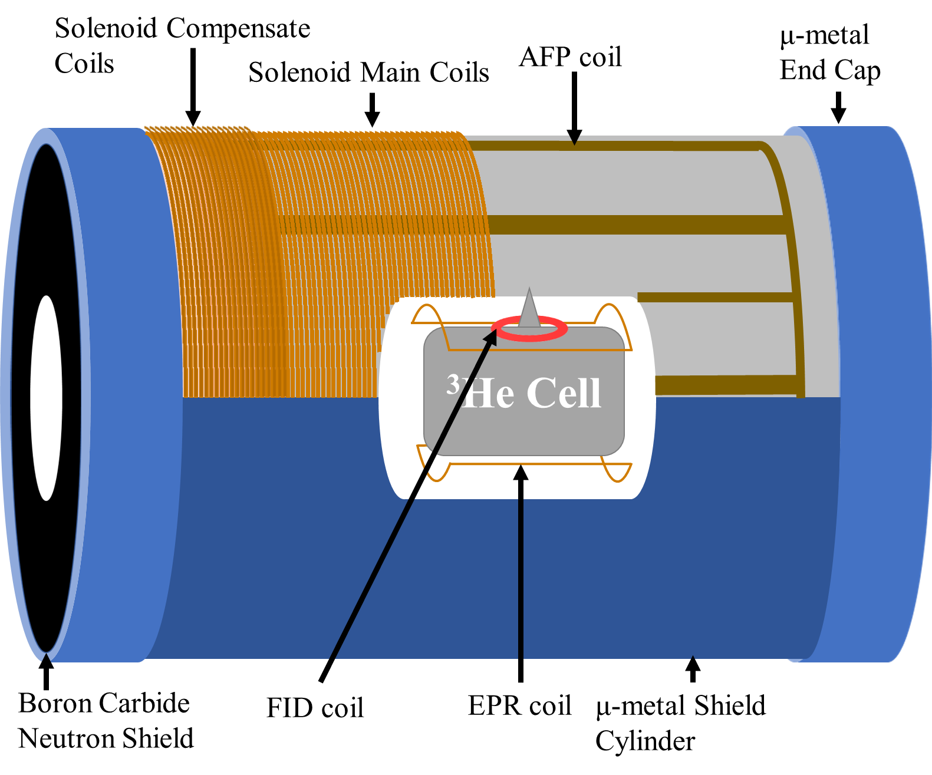
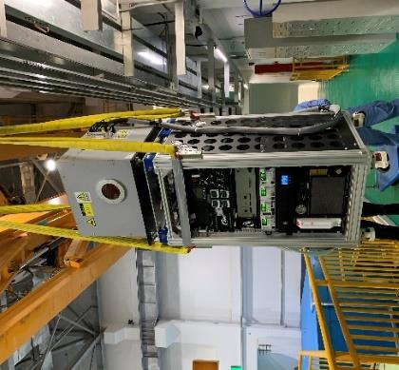
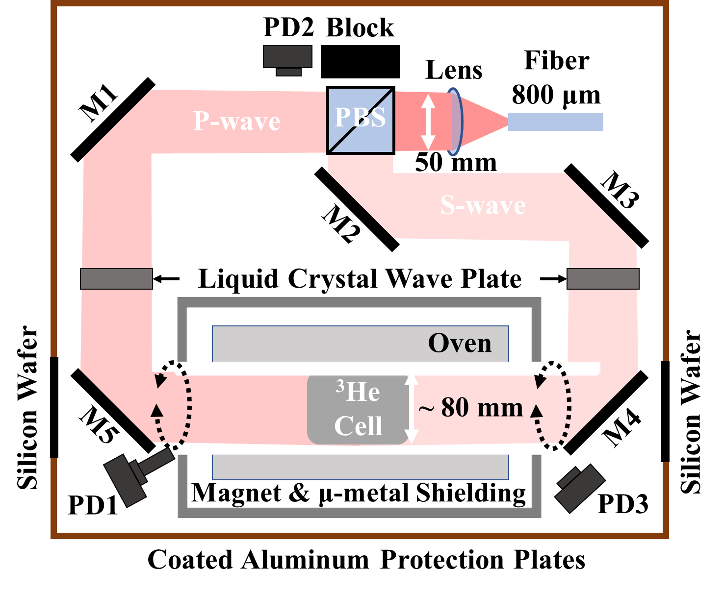
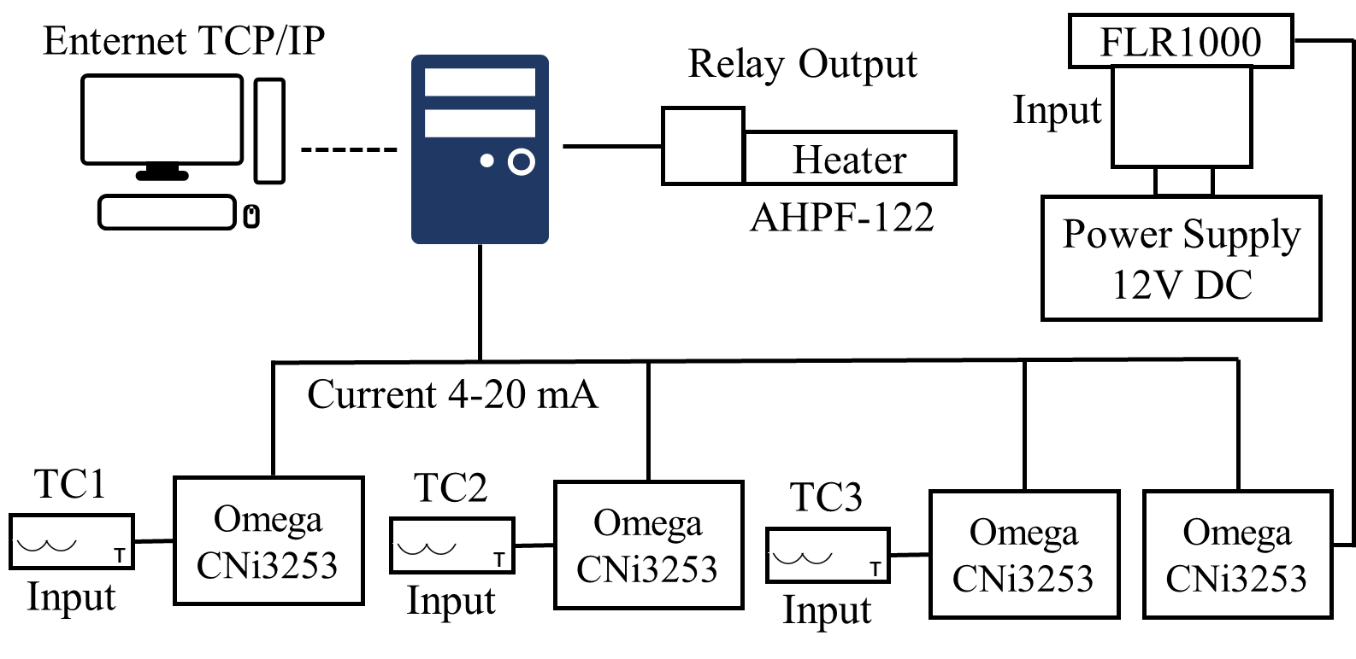
极化中极化氦三气体关键工艺：在线极化
通过将极化系统集成在中子束线上，产生极化率稳定的极化氦三/中子
1. 系统整体吊装
2. 谱仪安装、准直与预启动
高均匀磁场系统
核磁共振测量系统
圆偏振自旋交换激光系统
精确温度控制系统
安全运行连锁系统
设备运行关键指标
³He 极化率 | 稳定运行时间 | 中子极化率 | ³He 极化翻转损失
65% - 75% | > 240h (10days) | >99% (4Ang) | <0.1%
Notes:
The development polarized neutron techniques at the CSNS started in 2019, one year after the commission of CSNS in 2018. This is an early phase of a large-scale neutron source, majority of the beamlines are under construction, and polarized neutron techniques is yet to be built.
Under this background, the development work focuses on establishing the initial capability. By the end of 2019, we setup a SEOP laser lab in the target station, a ³He glass cell workshop in the development building. A testing platform is also established is also set up on the current development beamline.

Slide 15
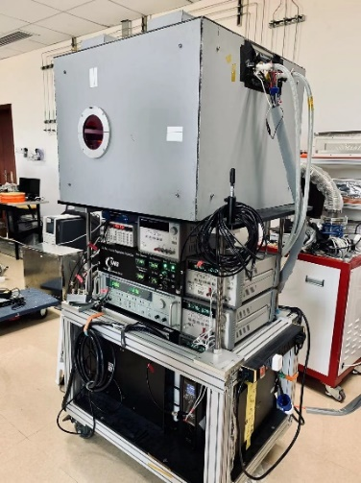
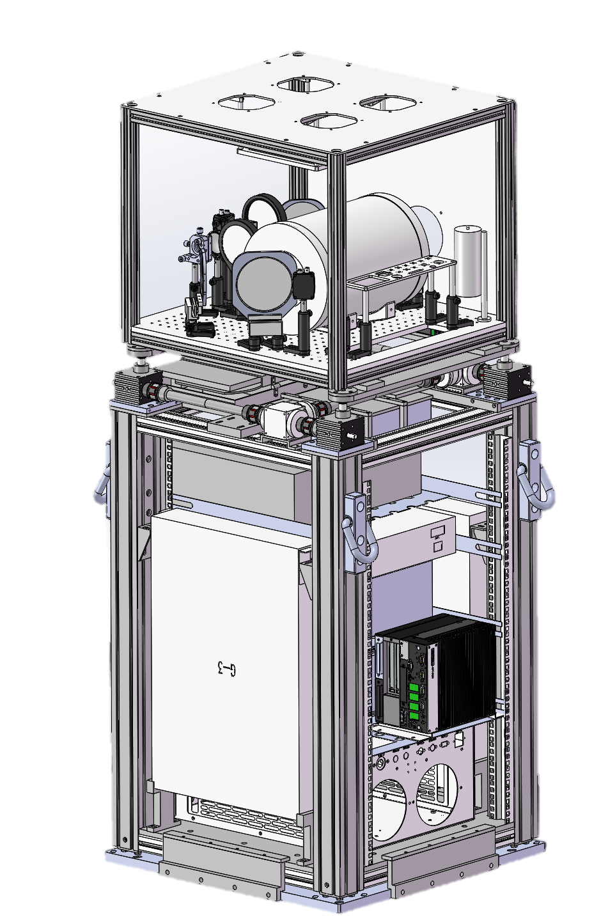
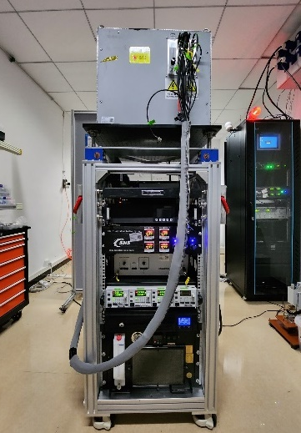



极化氦三设备的技术迭代
持续提升自主建造的极化氦三系统性能与应用范围
在线极化氦三成为我国中子源自主具有且广泛使用的极化技术
更高的³He气体极化率 (65% - 75%)
更轻便、更易于安装的系统，符合谱仪未来应用需求
in-situ 1
in-situ 2
in-situ 3
离线极化氦三系统作为轻便选择，具有更长的寿命，支持更多的用户应用
提升氦三极化气体的极化率与寿命
(65% - 75%, >200h life time)
支持大角度散射与广角几何
(wide-angle cell and large cell)
Notes:
The development polarized neutron techniques at the CSNS started in 2019, one year after the commission of CSNS in 2018. This is an early phase of a large-scale neutron source, majority of the beamlines are under construction, and polarized neutron techniques is yet to be built.
Under this background, the development work focuses on establishing the initial capability. By the end of 2019, we setup a SEOP laser lab in the target station, a ³He glass cell workshop in the development building. A testing platform is also established is also set up on the current development beamline.

Slide 16
散裂中子源的自选交换光泵（SEOP）
主要指标达到国际先进水平，发展和应用方向得到国际同行评估和支持
中子源 | 国家 | 气室制备 | 充装密封 | 在线极化 | 极化率 | 弛豫时间 (小时）
CSNS | 中国 | ✓ | ✓ | ✓ | 77.4% | 200
SNS | 美国 | ✓ | ✓ | ✓ | 75-80% | 200
ISIS | 英国 | ✗ | ✗ | ✗ | 70% | 100
J-PARC | 日本 | ✓ | ✓ | ✗ | 70% | 100
NIST | 美国 | ✓ | ✓ | ✗ | 80% | 200
ILL | 法国 | ✓ | ✓ | ✗ | 75% | 200
FRM II | 德国 | ✓ | ✓ | ✓ | 75% | 100
ANSTO | 澳大利亚 | ✗ | ✗ | ✗ | 75% | 100
PSI | 瑞士 | ✗ | ✗ | ✗ | 70% | 100
极化氦三及技术研发代表性文章
Chin. Phys. Lett. 38 052801 (2021) ; Z. Qin, C. Huang, Z. Buck, W. Kreuzpaintner, S. M. Amir, A. Salman, F. Ye, J.i Zhang, C. Jiang, T. Wang and X. Tong
Chin. Phys. Lett. 38 092801 (2021); C. Huang; J. Zhang; F. Ye; Z. Qin; S. M. Amir; Z. . Buck; A. Salman; W. Kreuzpaintner; X. Qi; T. Wang; X. Tong
NUCL SCI TECH (2022) 33:145; L. Tian, A. Salman, C.-Y. Huang, Y.-C. Dong, F. Ye, Z.-C. Qin, W. Kreuzpaintner, J.-P. Zhang, T. Wang, X. Tong*
Sci. China Phys. Mech. Astron. 65, 241011 (2022); J. Zhang; C. Huang, Z. Qin; F. Ye; S. M. Amir; A. Salman, Y. Dong; L. Tian; Z. Buck; W. Kreuzpaintner; M. Musgrave; X. Qi; T. Wang, X. Tong
Nuclear Science and Techniques (2023) 34:146; Y. Dong; T. Wang; W. Kreuzpaintner; X. Liu; Z. Li; Y. Kang; J. Zhang; L. Tian; C. Huang; B. Bai; X. Tong
Journal of Physics: Conference Series(2023); L. Tian, C. Huang, Y. Dong, A. Salman, J. Zhang, Z. Qin, F. Ye, W. Kreuzpaintner, T. Wang, X. Tong
三套装置入选中科院自主仪器设备，所研发设备和技术支持广东省重点实验室获批，支持CSNS、CARR和CMRR中子源谱仪线升级

Slide 17

自选交换光泵极化氦三技术项目
依托中科院重大仪器项目与重点研发计划建立极化中子实验平台
中科院院级重大仪器项目
“氦三中子极化装置研制”
国家重点研发计划
“基于氦三极化的先进极化中子技术研发”
实现具有我国自主知识产权的极化中子技术和工程化，装置综合指标达到国际先进水平
综合绩效评价：93.8分（A档），择优通过
综合绩效评价：通过
评价意见：……不仅打破了国外技术垄断，并且在国际上首次实现….跨越式发展，使得我国在该领域实现对国外中子源的赶超
Notes:
The development polarized neutron techniques at the CSNS started in 2019, one year after the commission of CSNS in 2018. This is an early phase of a large-scale neutron source, majority of the beamlines are under construction, and polarized neutron techniques is yet to be built.
Under this background, the development work focuses on establishing the initial capability. By the end of 2019, we setup a SEOP laser lab in the target station, a ³He glass cell workshop in the development building. A testing platform is also established is also set up on the current development beamline.

Slide 18



亚稳态交换光泵（MEOP）
CSNS已搭建MEOP实验系统
Cell尺寸：直径5 cm，长度10 cm
Cell压强：~1 mbar
泵浦功率：4 W
极化率：~（66.5±0.2）%
Notes:
The development polarized neutron techniques at the CSNS started in 2019, one year after the commission of CSNS in 2018. This is an early phase of a large-scale neutron source, majority of the beamlines are under construction, and polarized neutron techniques is yet to be built.
Under this background, the development work focuses on establishing the initial capability. By the end of 2019, we setup a SEOP laser lab in the target station, a ³He glass cell workshop in the development building. A testing platform is also established is also set up on the current development beamline.

Slide 19






亚稳态交换光泵（MEOP）
正在搭建用于中子极化的大型可压缩MEOP系统
压缩泵主体设计
磁场模块的设计
优化活塞头及波纹管、端盖死区体积、气动阀等设计
线圈数量：9个
磁场强度：10 G
均匀区域：直径1.2 m，长度2.5 m
相对磁场梯度： < 1.5× 10⁻⁴ cm⁻¹
Notes:
The development polarized neutron techniques at the CSNS started in 2019, one year after the commission of CSNS in 2018. This is an early phase of a large-scale neutron source, majority of the beamlines are under construction, and polarized neutron techniques is yet to be built.
Under this background, the development work focuses on establishing the initial capability. By the end of 2019, we setup a SEOP laser lab in the target station, a ³He glass cell workshop in the development building. A testing platform is also established is also set up on the current development beamline.

Slide 20
极化氦三与极化中子
用于中子源的极化氦三
极化中子应用
Notes:
The development polarized neutron techniques at the CSNS started in 2019, one year after the commission of CSNS in 2018. This is an early phase of a large-scale neutron source, majority of the beamlines are under construction, and polarized neutron techniques is yet to be built.
Under this background, the development work focuses on establishing the initial capability. By the end of 2019, we setup a SEOP laser lab in the target station, a ³He glass cell workshop in the development building. A testing platform is also established is also set up on the current development beamline.

Slide 21

中国散裂中子源当前的极化中子应用
持续自主发展（In-house）极化中子技术，全面覆盖中子散射的全部应用
在建和已运行的20条中子谱仪中，最终有14条谱仪将具有极化中子实验能力
BL-01 | Small Angle Neutron Scattering instrument
BL-02 | Multi-Purpose Reflectometer
BL-18 | General-Purpose Powder Diffractometer
BL-05 | High-Energy Direct-Geometry Inelastic Spectrometer
BL-09 | High-Resolution Neutron Diffractometer
BL-13 | Energy-Resolved Neutron Imaging Instrument
BL-14 | Very Small-Angle Neutron Scattering instrument
BL-04 | Cold Neutron Inelastic Spectrometer
BL-8A | Neutron Technology Development beamline
BL-10 | Neutron Backscattering Spectrometer
BL-12 | Neutron Physics and Application Spectrometer
BL-17 | Elastic Diffuse Scattering neutron Diffractometer
BL-19 | Macromolecular Single-Crystal Neutron Diffractometer
BL-20 | Direct-Geometry Polarized Inelastic Spectrometer
http://english.ihep.cas.cn/csns/fa/in
衍射/结构 非弹/动力学 其他
Notes:
The development polarized neutron techniques at the CSNS started in 2019, one year after the commission of CSNS in 2018. This is an early phase of a large-scale neutron source, majority of the beamlines are under construction, and polarized neutron techniques is yet to be built.
Under this background, the development work focuses on establishing the initial capability. By the end of 2019, we setup a SEOP laser lab in the target station, a ³He glass cell workshop in the development building. A testing platform is also established is also set up on the current development beamline.

Slide 22
极化中子实验
进行极化中子实验需要多种设备配合，产生、控制并分析散射过程中的极化中子
中子
极化中子
入射极化 P_{i}
散射极化 P_{f}
翻转器
极化器
引导磁场
样品
分析器
引导磁场
翻转器
探测器
产生极化中子
调整入射中子的极化态
调整入射中子的极化方向
极化中子与样品散射
选择散射中子的极化方向
选择要测量的散射中子极化态
测量所选方向上极化态中子的数量
中子极化需要被全程控制 极化矢量追踪模拟
中子源只产生非极化中子 极化器/翻转器
探测器不区分中子极化 分析器/翻转器
地磁场扰动中子极化 引导磁场
Notes:
The development polarized neutron techniques at the CSNS started in 2019, one year after the commission of CSNS in 2018. This is an early phase of a large-scale neutron source, majority of the beamlines are under construction, and polarized neutron techniques is yet to be built.
Under this background, the development work focuses on establishing the initial capability. By the end of 2019, we setup a SEOP laser lab in the target station, a ³He glass cell workshop in the development building. A testing platform is also established is also set up on the current development beamline.

Slide 23



国内中子源极化中子技术整合（2020重点研发计划）
通过国家重点研发极化“基于氦三极化的先进极化中子技术研发”与中国先进研究反应堆（CARR）和中国绵阳研究反应堆(CMRR)联合研发极化中子技术和应用
SEOP极化技术在三大中子源皆得已实现
协同技术合作，支持各个中子源开展极化中子实验
1-2天完成谱仪线安装，可以使用12-14天
CMRR在自旋回波谱仪上安装极化氦三系统
CSNS与CARR成像谱仪联合完成极化中子成像实验能力建设
CSNS 在线系统吊装至谱仪线
Notes:
The development polarized neutron techniques at the CSNS started in 2019, one year after the commission of CSNS in 2018. This is an early phase of a large-scale neutron source, majority of the beamlines are under construction, and polarized neutron techniques is yet to be built.
Under this background, the development work focuses on establishing the initial capability. By the end of 2019, we setup a SEOP laser lab in the target station, a ³He glass cell workshop in the development building. A testing platform is also established is also set up on the current development beamline.

Slide 24





极化中子实验的主要技术设备
支持散裂中子源二期工程所需极化中子设备设备全部实现国产化
中子散射谱仪主要极化设备
完全极化分析技术
中子射频翻转器
XYZ极化分析技术
极化中子导管
Nucl Sci Tech 33 (11) (2022)；Y. Dong, T Wang, W. Kreuzpaintner, X.. Liu, Z. Li, Y. Kang, J. Zhang, L. Tian, C. Huang, B. Bai, X. Tong.
Chinese Phys Lett 39 (6) (2022)；A. Salman, J. R. Zhou, J. Q. Yang, J. P. Zhang, C. Y. Huang, F. Ye, Z. C. Qin, X. F. Jiang, S. M. Amir, W. Kreuzpaintner, Z. J. Sun, T. Wang, X. Tong
Nucl Instrum Meth A 1073 (2025)； A. Salman, J. Tang, S. Q. Meng, J. P. Zhang, L. J. Hao, L. Tian, Z. Y. Li, X. Qin, L. F. He, T. Wang, X. Tong
Nucl Sci Tech 34 (10) (2023). L. Tian, A. Salman, C. Y. Huang, Y. C. Dong, F. Ye, Z. C. Qin, W. Kreuzpaintner, J. P. Zhang, T. Wang, X. Tong
Notes:
The development polarized neutron techniques at the CSNS started in 2019, one year after the commission of CSNS in 2018. This is an early phase of a large-scale neutron source, majority of the beamlines are under construction, and polarized neutron techniques is yet to be built.
Under this background, the development work focuses on establishing the initial capability. By the end of 2019, we setup a SEOP laser lab in the target station, a ³He glass cell workshop in the development building. A testing platform is also established is also set up on the current development beamline.

Slide 25



极化中子散射应用：极化中子反射
在多功能反射谱仪线上测试原位氦三中子过滤系统
通过极化中子反射测量薄膜样品沿深度与反射平面反向的分布
Notes:
The development polarized neutron techniques at the CSNS started in 2019, one year after the commission of CSNS in 2018. This is an early phase of a large-scale neutron source, majority of the beamlines are under construction, and polarized neutron techniques is yet to be built.
Under this background, the development work focuses on establishing the initial capability. By the end of 2019, we setup a SEOP laser lab in the target station, a ³He glass cell workshop in the development building. A testing platform is also established is also set up on the current development beamline.

Slide 26




极化中子散射应用：极化小角中子散射
极化小角中子散射可以用来精确表征表征纳米材料的磁性，或者去除本底
极化小角中子散射（PSANS）的实验设置
三维磁性结构纳米阵列
样品
ACS Nano 11, 8311–8319 (2017)
中子极化器
极化翻转器
极化氦三过滤器
无序铁磁合金
铁磁核/壳纳米小球
AIP Advances 10, 015036 (2020)
Notes:
The development polarized neutron techniques at the CSNS started in 2019, one year after the commission of CSNS in 2018. This is an early phase of a large-scale neutron source, majority of the beamlines are under construction, and polarized neutron techniques is yet to be built.
Under this background, the development work focuses on establishing the initial capability. By the end of 2019, we setup a SEOP laser lab in the target station, a ³He glass cell workshop in the development building. A testing platform is also established is also set up on the current development beamline.

Slide 27















极化中子散射应用：极化小角中子散射
在国内首次实现极化小角散射分析，向国内外用户开放运行（散裂中子源微小角谱仪)
散射覆盖角度：2θ ≈ 2×4.8 °
$$y$$
样品
$$q$$
飞行管
在线氦三中子自旋过滤器
$$q$$
$$−z$$
$$x$$
中子
探测器4
探测器3
$$B$$
翻转器
永磁铁
电磁铁
探测器2
支撑平台
样品
探测器1
氦三中子自旋过滤装置
$$k_{f}$$
极化中子分离非相干散射（二十二酸银）
电磁铁导向场
$$y$$
永磁铁导向场
$σ_{SF}$ ~ $M_{⊥⊥}$
射频中子自旋翻转器
θ
$$−z$$
$$q$$
中子
极化超镜
$σ_{NonSF}$ ~ $M_{⊥∥}$
$$k_{i}$$
$$x$$
NST-2025-0455; Polarization-analyzed small-angle neutron scattering with an in-situ 3He neutron spin filter at the China Spallation Neutron Source; L. Tian; T. Wang, et. al., H. Cheng, X. Tong
Notes:
The development polarized neutron techniques at the CSNS started in 2019, one year after the commission of CSNS in 2018. This is an early phase of a large-scale neutron source, majority of the beamlines are under construction, and polarized neutron techniques is yet to be built.
Under this background, the development work focuses on establishing the initial capability. By the end of 2019, we setup a SEOP laser lab in the target station, a ³He glass cell workshop in the development building. A testing platform is also established is also set up on the current development beamline.

Slide 28





极化中子散射应用：极化中子成像
极化中子成像技术可以直接观察空间中的磁场分布
通过在线极化氦三系统产生的选择性过滤产生大视野的磁场观测
极化中子成像实验原理
透射成像
极化成像
极化氦三
Nat Phys, 4 (2008) 399-403.
观测超导体内部的钉扎磁场分布
观测铁磁性样品相变分布
Nat Commun, 9 (2018).
J Phys D Appl Phys, 52 (2019).
Notes:
The development polarized neutron techniques at the CSNS started in 2019, one year after the commission of CSNS in 2018. This is an early phase of a large-scale neutron source, majority of the beamlines are under construction, and polarized neutron techniques is yet to be built.
Under this background, the development work focuses on establishing the initial capability. By the end of 2019, we setup a SEOP laser lab in the target station, a ³He glass cell workshop in the development building. A testing platform is also established is also set up on the current development beamline.

Slide 29





极化中子散射应用：极化中子成像
极化中子成像技术：从定性测量到定量重塑
极化中子成像测量磁场分布
通过极化中子成像进行三维磁场重塑流程
与实验对比
中子极化成像测量结果
数值计算
中子极化分布计算
初始建模
三维磁场分布
磁性样品
统计误差
不可见磁场
定性可视磁场
定量三维磁场
模型修正
（2008）
（2022）
Rev. Sci. Instrum., 90 3 (2019); T. Wang, et. al, X. Tong
Chin. Phys. Lett., 39 062901 (2022); A. Salman, et. al. T. Wang, X. Tong
Nucl. Instr. Meth. A.,1073 170233 (2025)；Z. Li, et. at. L. He, X. Tong, D. Chen
NST-2024-0519.R2 （2025). A. Salman, et. al., T. Wang, X. Tong
模拟磁场分布的实验结果检验
通过机器学习加速磁场修正过程
Notes:
The development polarized neutron techniques at the CSNS started in 2019, one year after the commission of CSNS in 2018. This is an early phase of a large-scale neutron source, majority of the beamlines are under construction, and polarized neutron techniques is yet to be built.
Under this background, the development work focuses on establishing the initial capability. By the end of 2019, we setup a SEOP laser lab in the target station, a ³He glass cell workshop in the development building. A testing platform is also established is also set up on the current development beamline.

Slide 30






极化中子散射应用：极化中子成像
解决共性科学问题：电磁器件模拟与实际结果存在差异，且无法直接实验
定量极化中子成像观测
同类型电动机研究文章
…… Experimental measurements of electrical machine performances reveal a significant difference between simulations and measurements. It is known that the manufacturing processes of machines, particularly, the cutting of core laminations adversely affects material properties. The current techniques for considering the effects of cutting lack accuracy, computation efficiency and applicability for finite element (FE) software.
Notes:
The development polarized neutron techniques at the CSNS started in 2019, one year after the commission of CSNS in 2018. This is an early phase of a large-scale neutron source, majority of the beamlines are under construction, and polarized neutron techniques is yet to be built.
Under this background, the development work focuses on establishing the initial capability. By the end of 2019, we setup a SEOP laser lab in the target station, a ³He glass cell workshop in the development building. A testing platform is also established is also set up on the current development beamline.

Slide 31



极化中子散射应用：极化中子成像
解决原理性问题：在迈斯纳效应隔绝外界磁场的条件下,观测到内部的磁场
极化中子对磁性敏感且可以穿透样品，可以原位观测迈斯纳效应
第一类与第二类超导体迈斯纳效应
展示实验：定量观测第一类与第二类超导体迈斯纳效应
磁感线
感应电流
磁感线
感应电流
Notes:
The development polarized neutron techniques at the CSNS started in 2019, one year after the commission of CSNS in 2018. This is an early phase of a large-scale neutron source, majority of the beamlines are under construction, and polarized neutron techniques is yet to be built.
Under this background, the development work focuses on establishing the initial capability. By the end of 2019, we setup a SEOP laser lab in the target station, a ³He glass cell workshop in the development building. A testing platform is also established is also set up on the current development beamline.

Slide 32





极化中子在高能物理中的应用
在国内首次实现1eV极化中子实验，为高能粒子物理与核物理研究打开新路径
（Neutron Optics Time-reversal violation experiment）
极化中子与原子核的前向散射包含时间反演不对称信息
宇称不守恒实验测量原理
Notes:
The development polarized neutron techniques at the CSNS started in 2019, one year after the commission of CSNS in 2018. This is an early phase of a large-scale neutron source, majority of the beamlines are under construction, and polarized neutron techniques is yet to be built.
Under this background, the development work focuses on establishing the initial capability. By the end of 2019, we setup a SEOP laser lab in the target station, a ³He glass cell workshop in the development building. A testing platform is also established is also set up on the current development beamline.

Slide 33




极化中子在高能物理中的应用
研制了中子极化传输系统，成功压制本底与系统性误差
本底压制前
本底压制后
共振峰
共振峰
共振峰
共振峰
1/v线
成功测量NOPTREX实验中的P-Odd/T-even项导致的n-γ信号不对称（4.64%±1.27%）
中子-伽马射线测量中的”1/v线”（由于速度越慢的中子在原子核附近停留的时间越长导致其被俘获的概率跟其本身的运动速度成反比，在E<10eV产生的一条曲线）由完全淹没在本底变为清晰可见。
Notes:
The development polarized neutron techniques at the CSNS started in 2019, one year after the commission of CSNS in 2018. This is an early phase of a large-scale neutron source, majority of the beamlines are under construction, and polarized neutron techniques is yet to be built.
Under this background, the development work focuses on establishing the initial capability. By the end of 2019, we setup a SEOP laser lab in the target station, a ³He glass cell workshop in the development building. A testing platform is also established is also set up on the current development beamline.

Slide 34











极化中子技术现状及应用总结
以科学需求驱动（Science Driven）开展自主（In-house）关键技术研发
氦三核心玻璃容器制作与灌装
SEOP 和 MEOP 氦三极化气体生产
谱仪线应用：科学研究与工业/医学检测
凝聚态物理
核物理
工业/医学应用
Notes:
As a summary of the status of CSNS and its polarized neutron demand, here are the two major focus for our current work. The first is to develop key polarized neutron techniques in house. Under this category, we have developed the first generation Spin exchange optical pumping or SEOP polarized ³He system, including the manufacturing of its glass cell, setting up an off-line pumping station for beamline support, and construct in-situ ³He spin filter system capable of beamline support. Neutron spin flippers and guide fields are also developed customized to the CSNS TOF beamline
The other focus is to keep the polarized neutron development in-sync with the current and future beamline. To do so, test experiment has been carried out on the current reflectometry beamline, and setup for polarized neutron imaging, time of flight neutron polarization control and wide-angle techniques is currently being studied.

Slide 35
总结与展望
中国散裂中子源建立了一套极化氦三设备与技术用于极化中子研究
中国散裂中子源研发自旋交换光泵（SEOP）与亚稳态交换光泵（MEOP）
自旋交换光泵（SEOP）氦三气体容器灌装
离线与在线自旋交换光泵（SEOP）极化泵浦用于中子极化产生与分析
研发亚稳态自旋光泵与氦气回收技术
通过极化氦三自旋过滤产生极化中子开展物理实验
极化中子衍射测量磁性结构（中子衍射、中子反射与小角散射）
极化中子能谱测量材料动力学（非弹性散射）
极化中子成像观测磁场分布
极化白光中子用于宇称/时间反演不守恒测量
Notes:
The development polarized neutron techniques at the CSNS started in 2019, one year after the commission of CSNS in 2018. This is an early phase of a large-scale neutron source, majority of the beamlines are under construction, and polarized neutron techniques is yet to be built.
Under this background, the development work focuses on establishing the initial capability. By the end of 2019, we setup a SEOP laser lab in the target station, a ³He glass cell workshop in the development building. A testing platform is also established is also set up on the current development beamline.

Slide 36

总结与展望
感谢各位领导与专家
敬请批评指正
Notes:
The development polarized neutron techniques at the CSNS started in 2019, one year after the commission of CSNS in 2018. This is an early phase of a large-scale neutron source, majority of the beamlines are under construction, and polarized neutron techniques is yet to be built.
Under this background, the development work focuses on establishing the initial capability. By the end of 2019, we setup a SEOP laser lab in the target station, a ³He glass cell workshop in the development building. A testing platform is also established is also set up on the current development beamline.

Slide 37




极化中子散射应用：极化中子非弹性散射
通过极化中子能谱研究声子与磁振子之间的耦合
XYZ中子极化分析方法
精确解析磁散射沿轴向分量特征
定量分析三维磁性特征
Notes:
The development polarized neutron techniques at the CSNS started in 2019, one year after the commission of CSNS in 2018. This is an early phase of a large-scale neutron source, majority of the beamlines are under construction, and polarized neutron techniques is yet to be built.
Under this background, the development work focuses on establishing the initial capability. By the end of 2019, we setup a SEOP laser lab in the target station, a ³He glass cell workshop in the development building. A testing platform is also established is also set up on the current development beamline.

