Slide 1
Hyperon-Nucleon Spectrometer at HIAF
Yutie Liang
Institute of Modern Physics, CAS
第一届中国EIC相关物理年会
2026.04.20 青岛

Slide 2
Outline
Introduction
Hyperon-Nucleon Spectrometer
Physics highlights and potentials
Summary

Slide 3
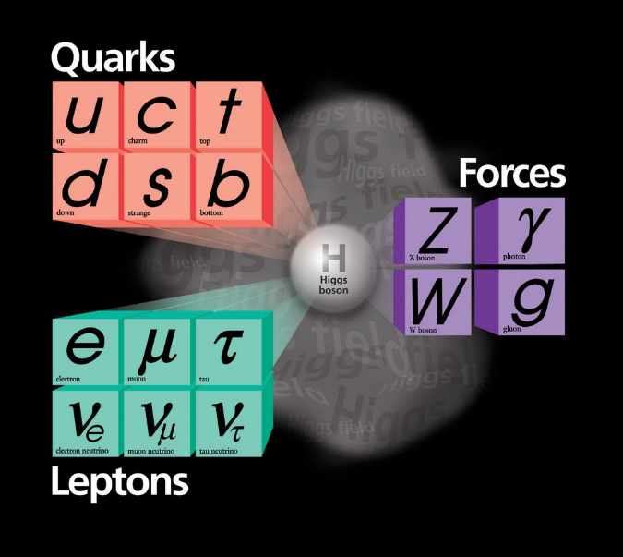
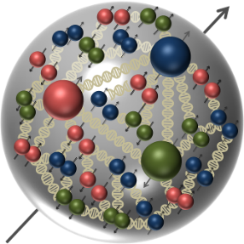

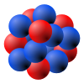

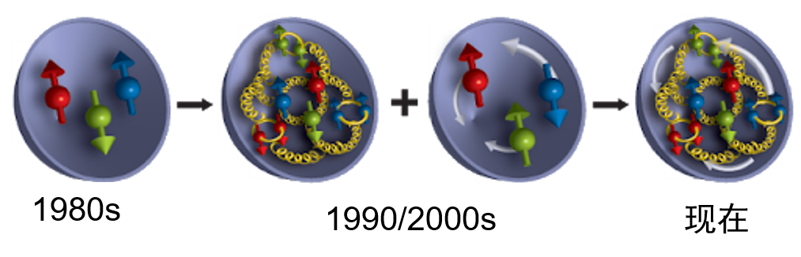

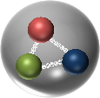
21世纪基本物理谜题之一：核子内部结构
质子自旋结构？
质子质量来源？
质量
自旋
Higgs mechanism
Gell-Mann
夸克模型
Dynamics of gluons
~99%
质子质量
轻味夸克质量
~1%质子质量

Slide 4
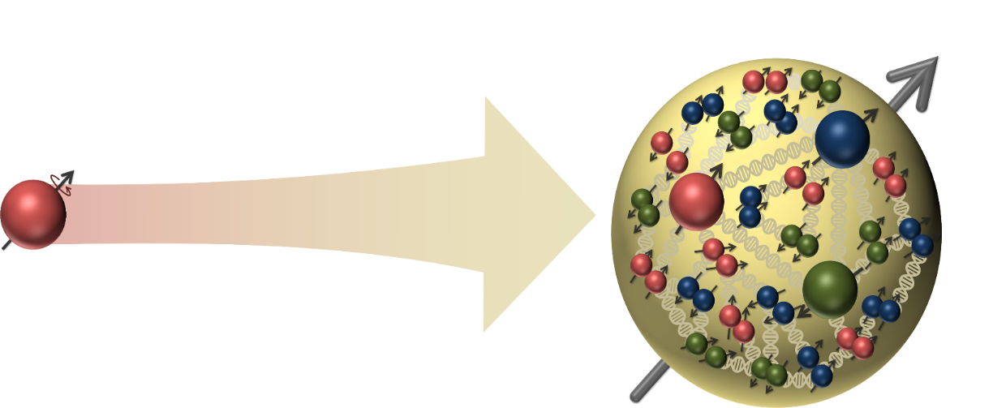


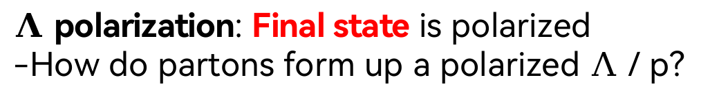
Hadron structure with “Spin”
EIC: Initial state is polarized
-How do partons form up a polarized nucleon?
$Λ$ polarization: Final state is polarized
-How do partons form up a polarized $Λ$ / p?
Final state
Initial state
Polarized by device
$Λ$ serves as its own spin analyzer through the decay $Λ^{0}→p+π^{−}$
origin of nucleon spin VS origin of $Λ$ or p polarization
物理上紧密相连

Slide 5
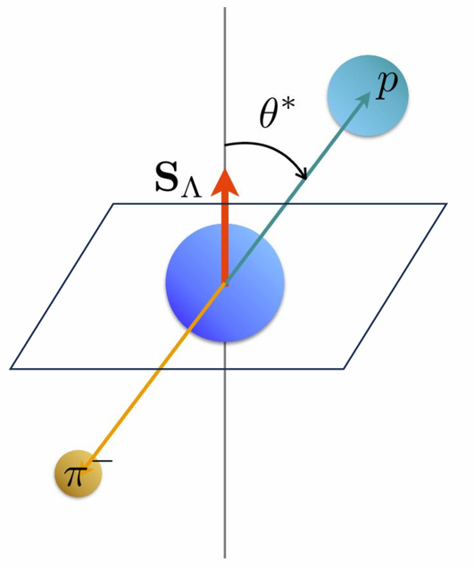
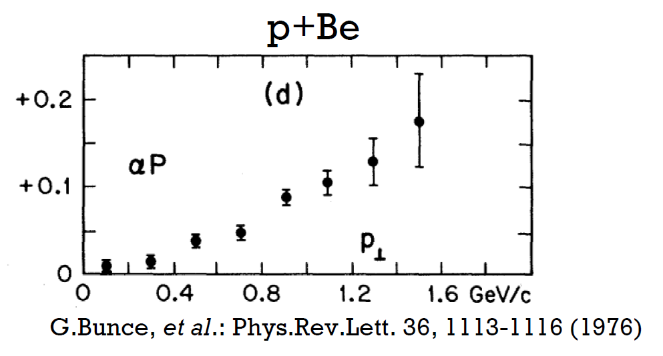
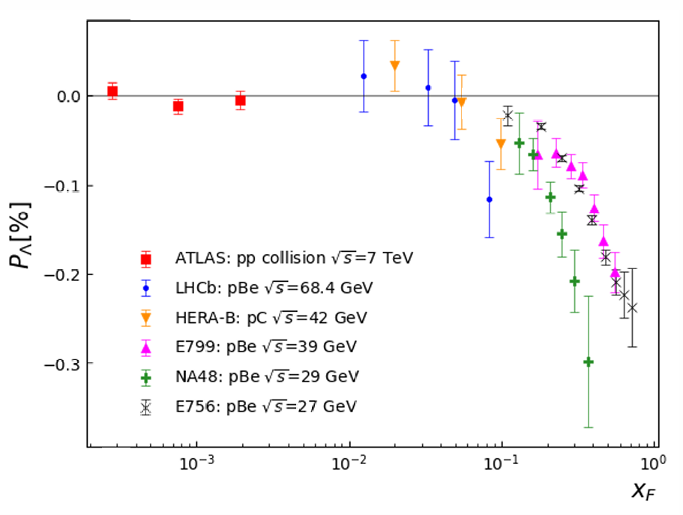
First observation of Λ polarization in the 1970’s
First observation:
In 1976 at Fermi-Lab, Hyperons were produced polarized in p + Be collisions: 300 GeV protons on Beryllium target

Slide 6
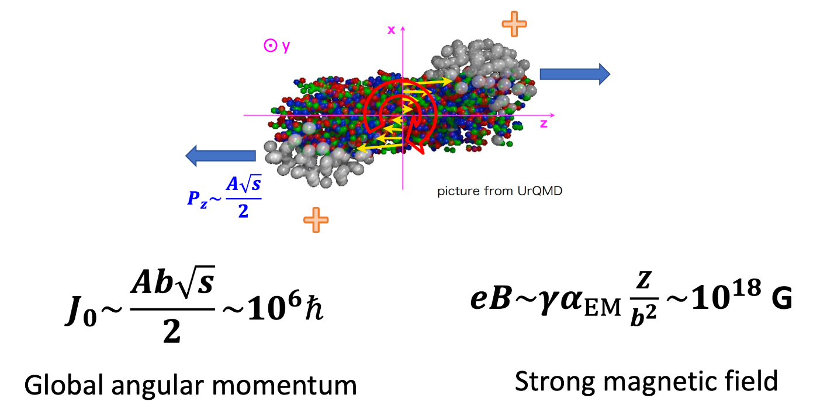
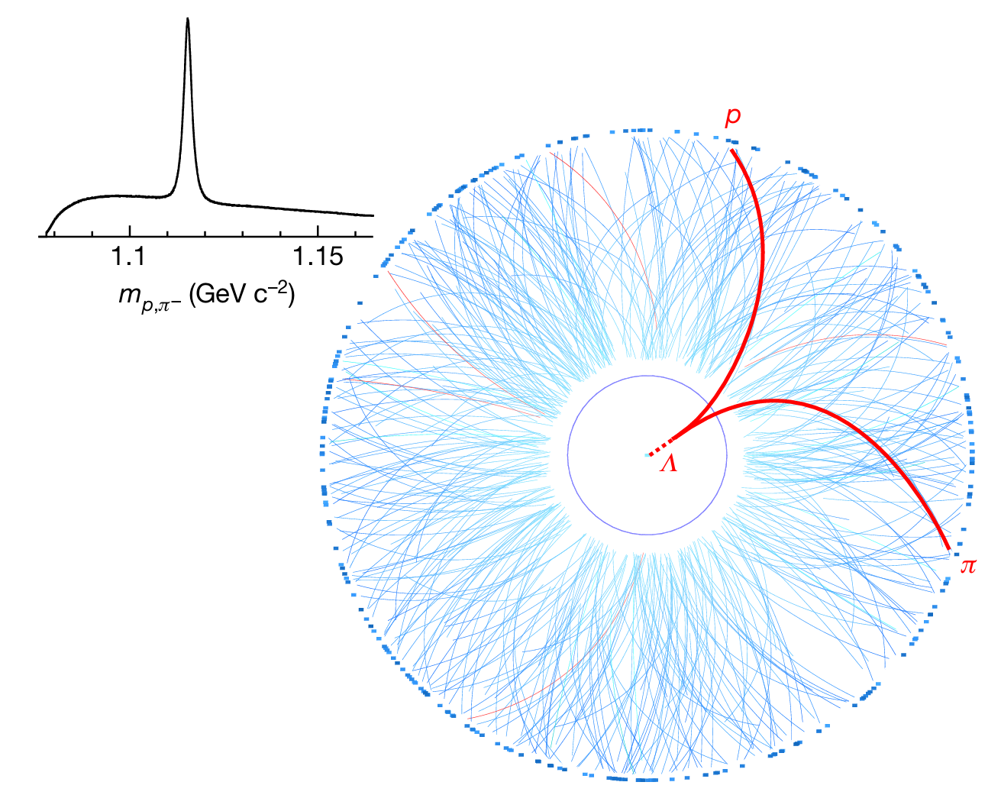
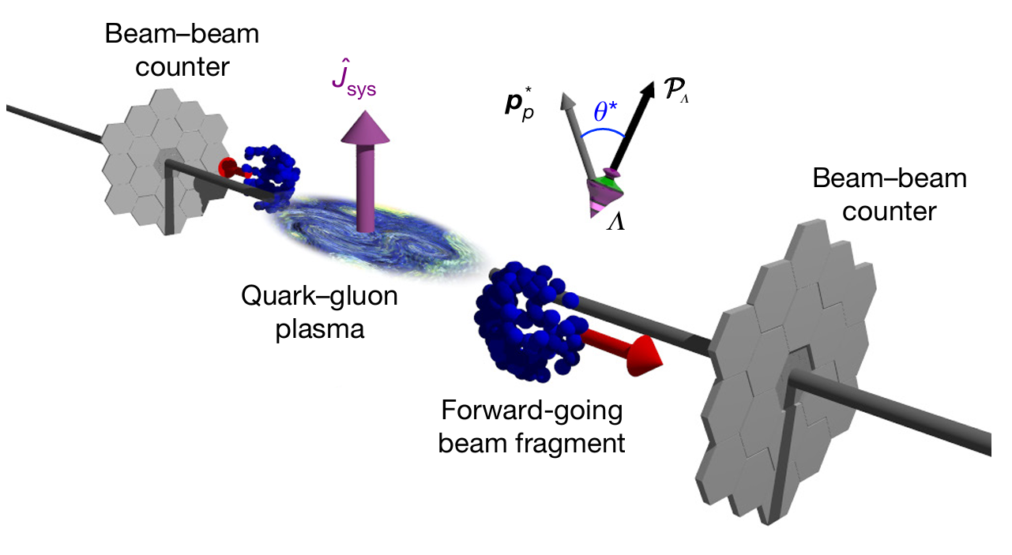
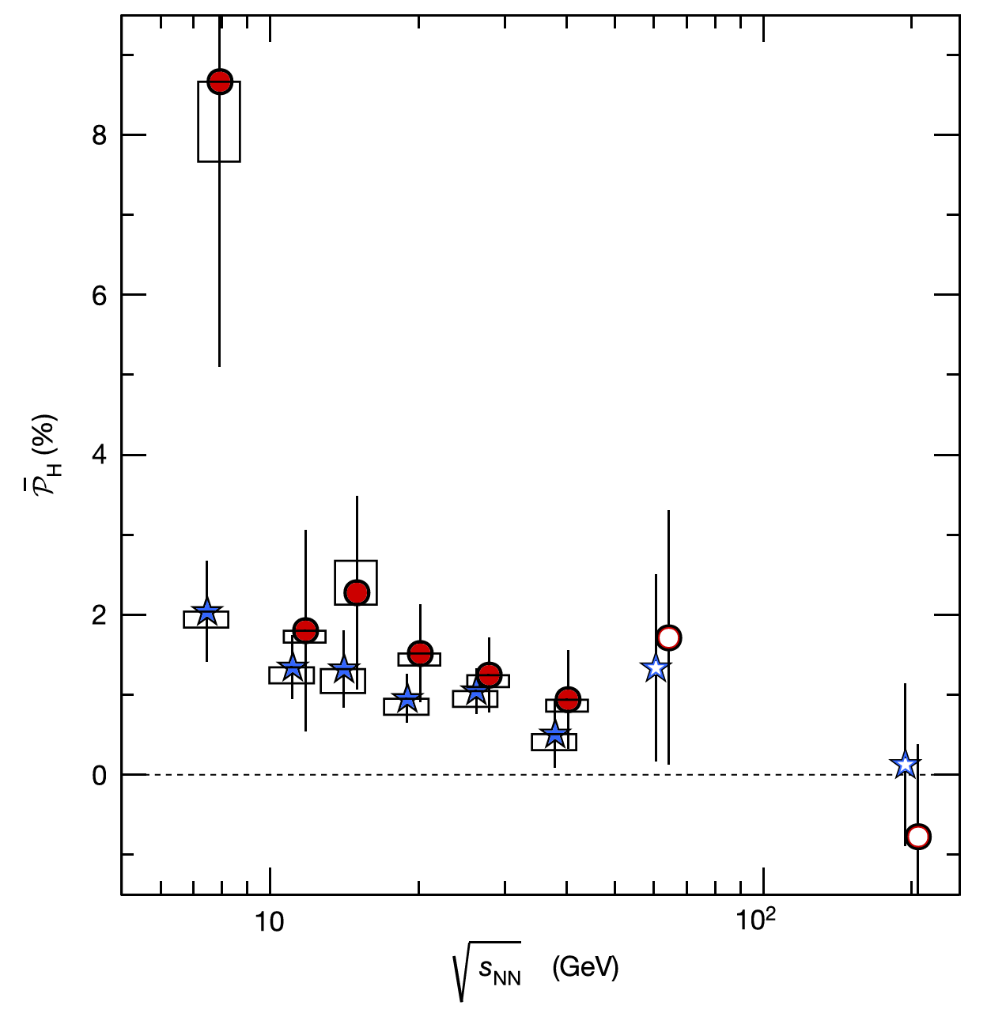
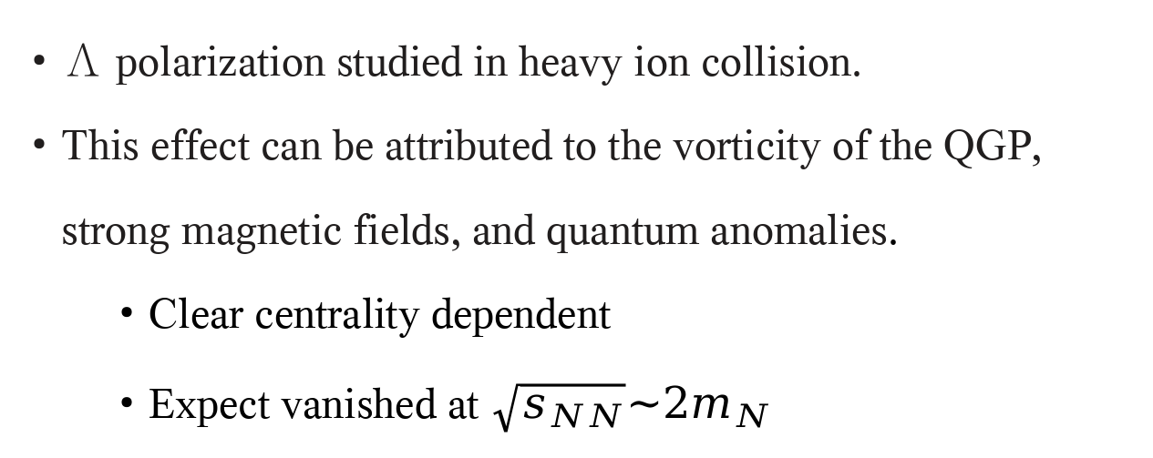
Λ polarization in heavy ion collision
Λ polarization studied in heavy ion collision.
This effect can be attributed to the vorticity of the QGP, strong magnetic fields, and quantum anomalies.
Clear centrality dependent
Expect vanished at $\sqrt{s_{NN}}\sim 2m_{N}$
STAR, Nature 548, 62 (2017)
Z. T. Liang and X. N. Wang, Phys. Rev. Lett. 94, 102301 (2005); 96, 039901(E) (2006).

Slide 7
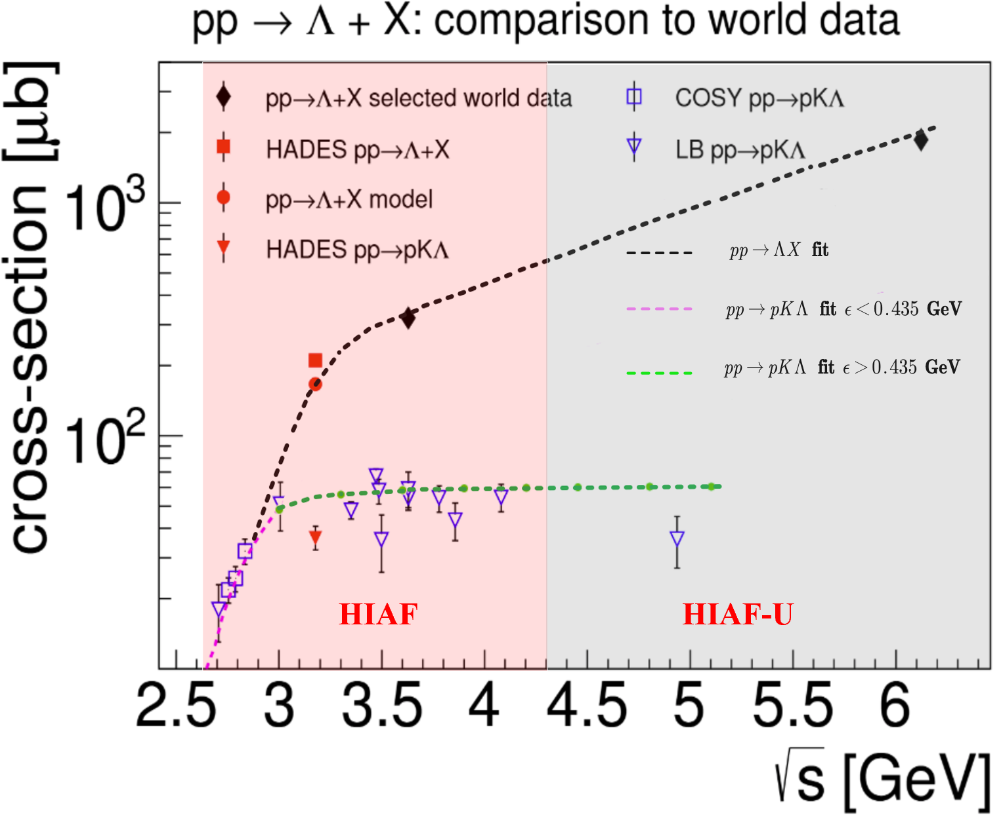
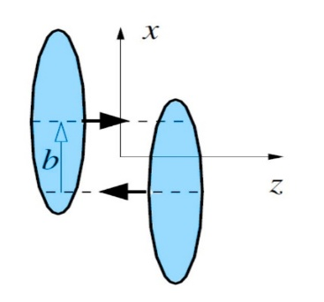





丰富的强子物理与重离子物理：跨能区、跨反应过程
$$pp\left(A\right)→Λ+X$$
polarization through hadronization
Zuo-tang Liang, and C. Boros, Phys. Rev. Lett. 79, 3608 (1997); PRD 61, 117503 (2000).
H. Dong and Zuo-tang Liang, PRD 70, 014019 (2004); PRD 72, 033006 (2005).
$$pp→p+K+Λ$$
$Λ$ polarization in exclusive processes
R. Machleidt, K. Holinde and C. Elster, Phys. Rept. 149, 1 (1987).
B. C. Liu, B. S. Zou, PRL 96, 042002 (2006).
$$AA→Λ+X$$
Global polarization
non-central relativistic
heavy ion collisions
Zuo-Tang Liang, Xin-Nian Wang, PRL 94,102301 (2005); PLB 629, 20 (2005).
Jian-Hua Gao, Shou-Wan Chen, Wei-tian Deng, Zuo-Tang Liang, Qun Wang, Xin-Nian Wang, PRC 77, 044902 (2008).

Slide 8
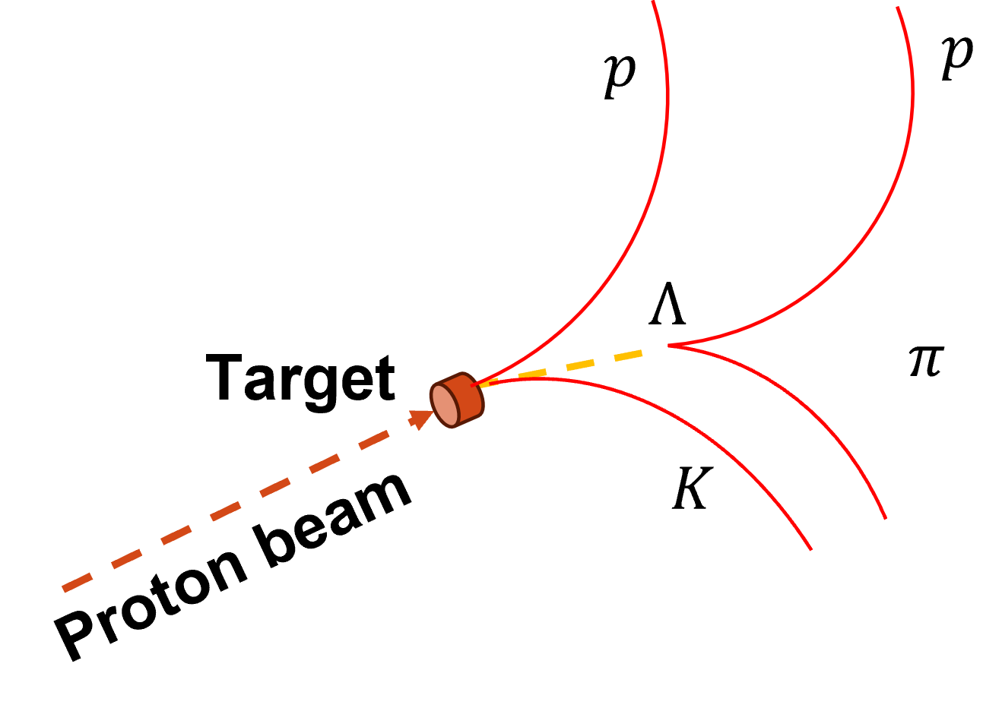
新问题: Is proton polarized ?
pp → p K Λ
Pol.?
Pol.?
pp → p/Λ + X
H-NS上专门设计了相关的探测器进行直接测量

Slide 9
Hyperon-Nucleon Spectrometer (H-NS)

Slide 10
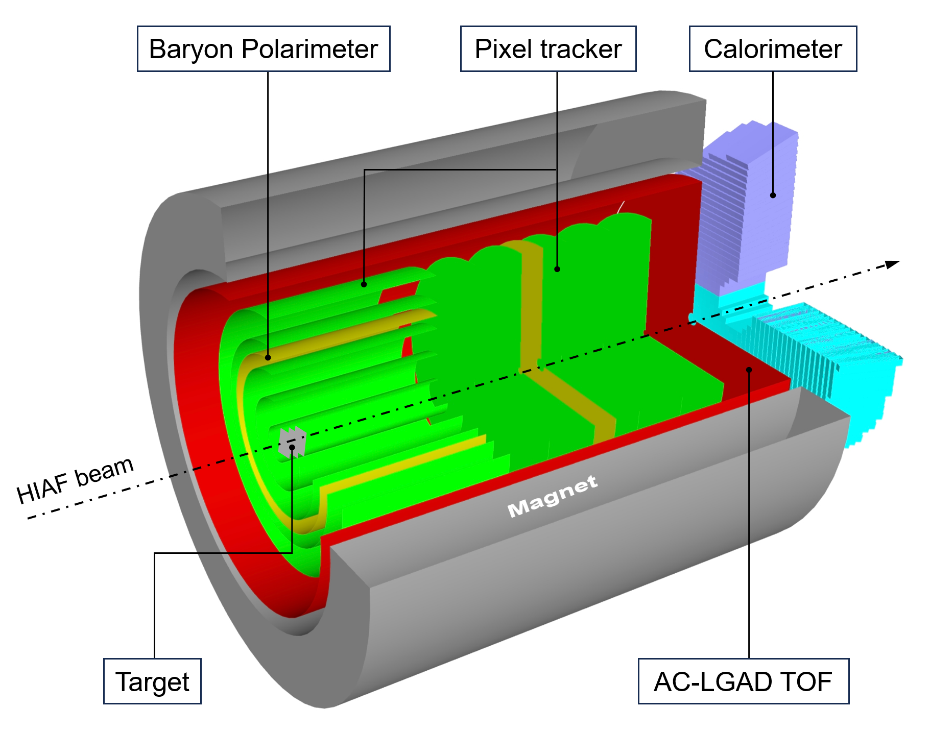
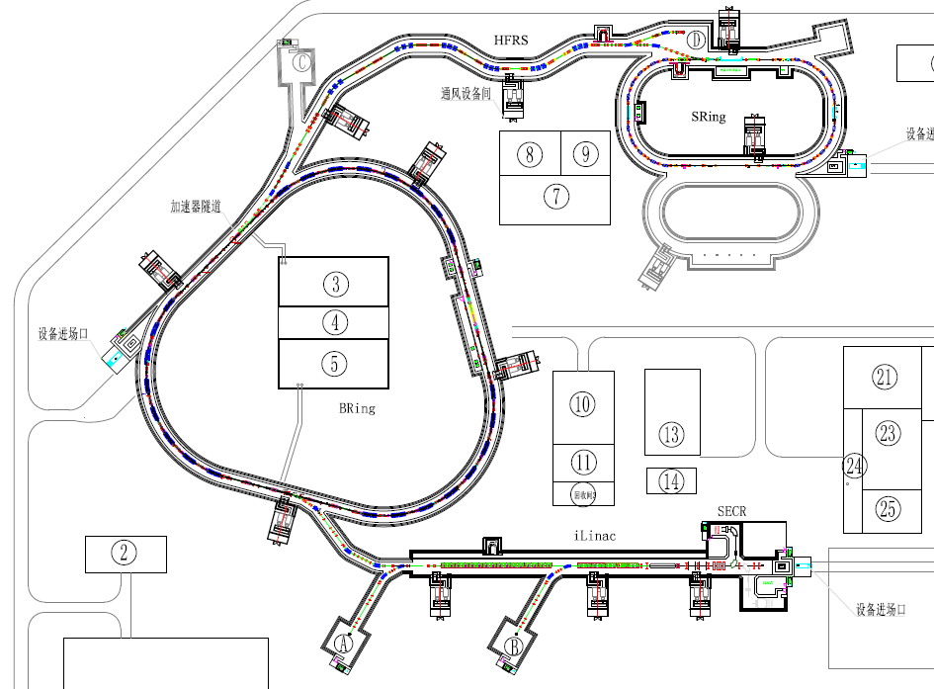
Hyperon-Nucleon Spectrometer (H-NS)
Mag. Field: 1.5 Tesla
Tracker: MIC6, 30X30 μm², 0.35%X/X₀
LGAD: σ_{t} ~ 30 ps , 300X300 μm²
Calorimeter: σ_{E} ~ 3% @ 1GeV
Polarimeter: nucleon and photon polarization
High Energy Nuclear Physics Terminal
MIC6 MAPS

Slide 11
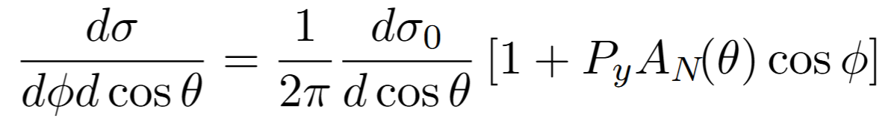
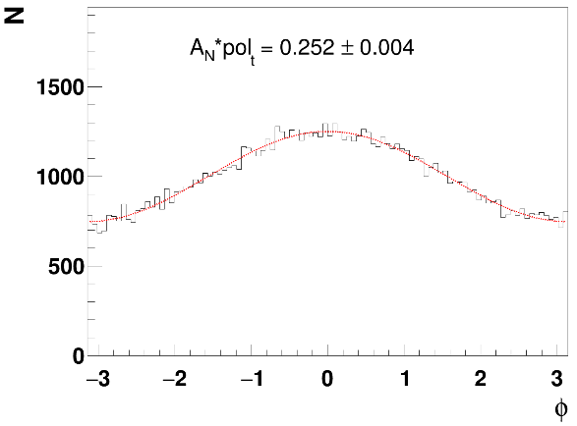
Principle of proton polarimeter
Relation between the spin-dependent cross-section of p + p/C scattering and the asymmetries
y
Transversely polarized protons
Carbon foil
x
Ф
C
More protons to the left:
Left-right asymmetry
Widely used as polarimetric reaction to measure proton beam polarization (PSI, TRIMUF, LAMPF, COSY, SATURNE, ZGS, KEK-PS, AGS, RHIC …)

Slide 12
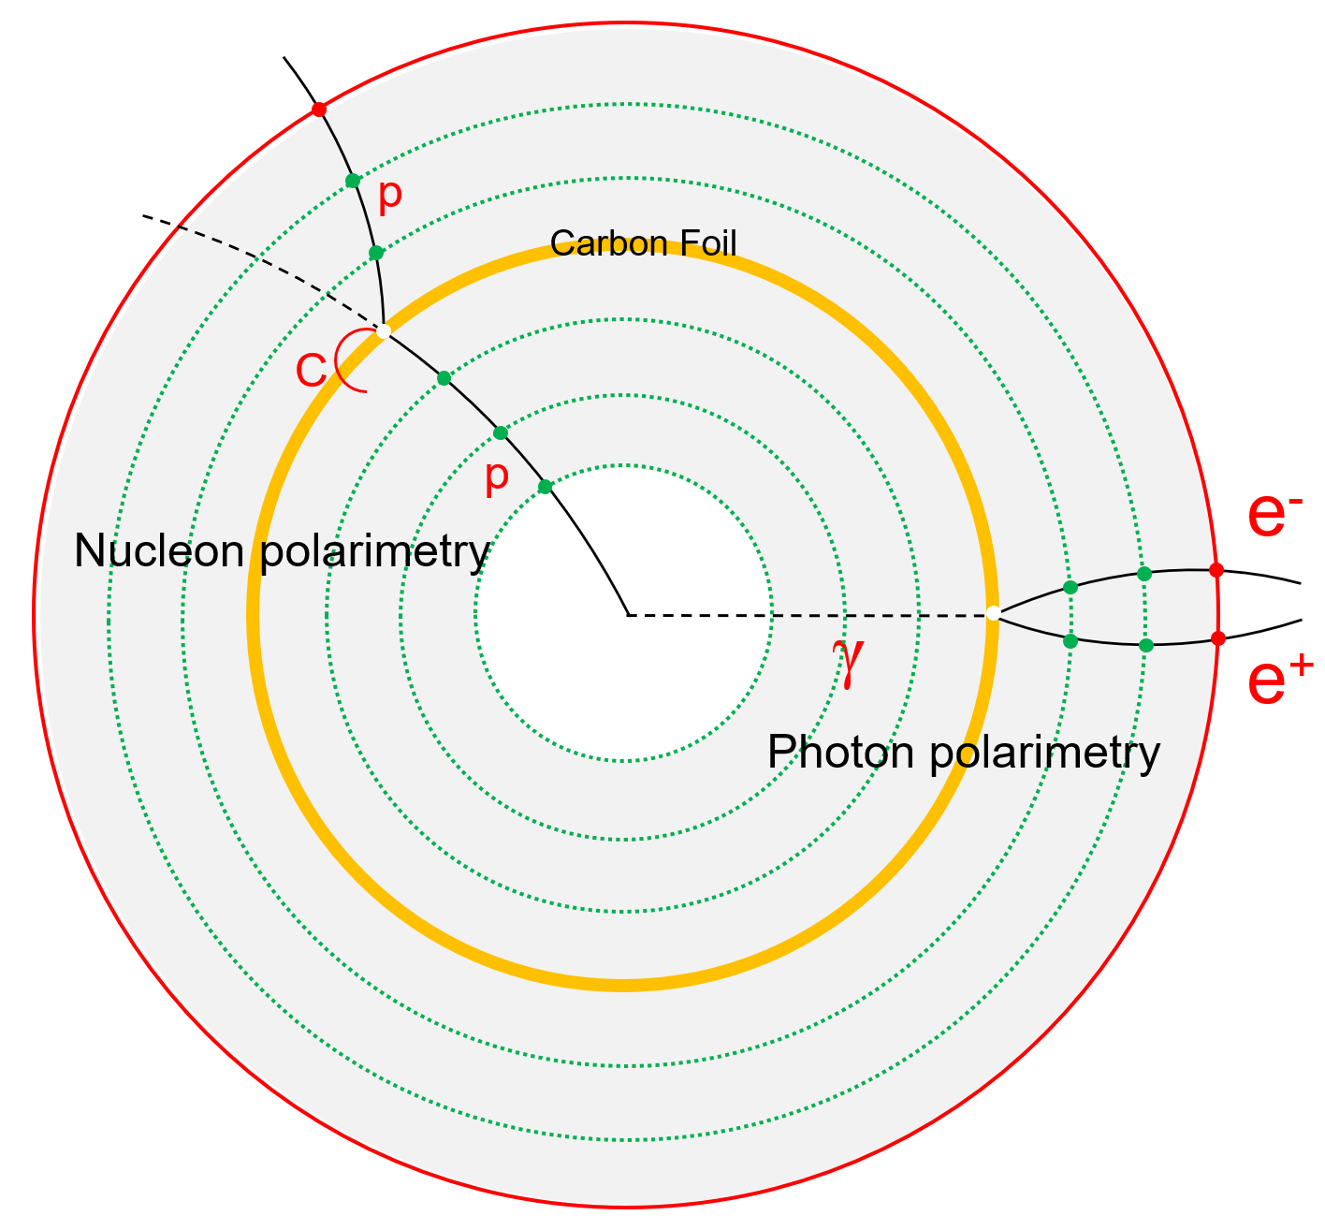
An extra scattering layer serve as polarimeter
Carbon foil
0.5-1 mm thickness ( <1% X/X₀ )
R: 20-30 cm
Probability: pC / pp , γ-conversion(1E-3)
Tiny influence to conventional performance
Position : in-between the tracking devices
Appliable in all reactions: ee/ep/pp/pA/AA
Appliable in high energy machines
Yutie Liang, et. al., Phys. Rev. D 112, L031502
NST in press, arXiv: 2512.02804
NST in press, arXiv: 2601.21325

Slide 13
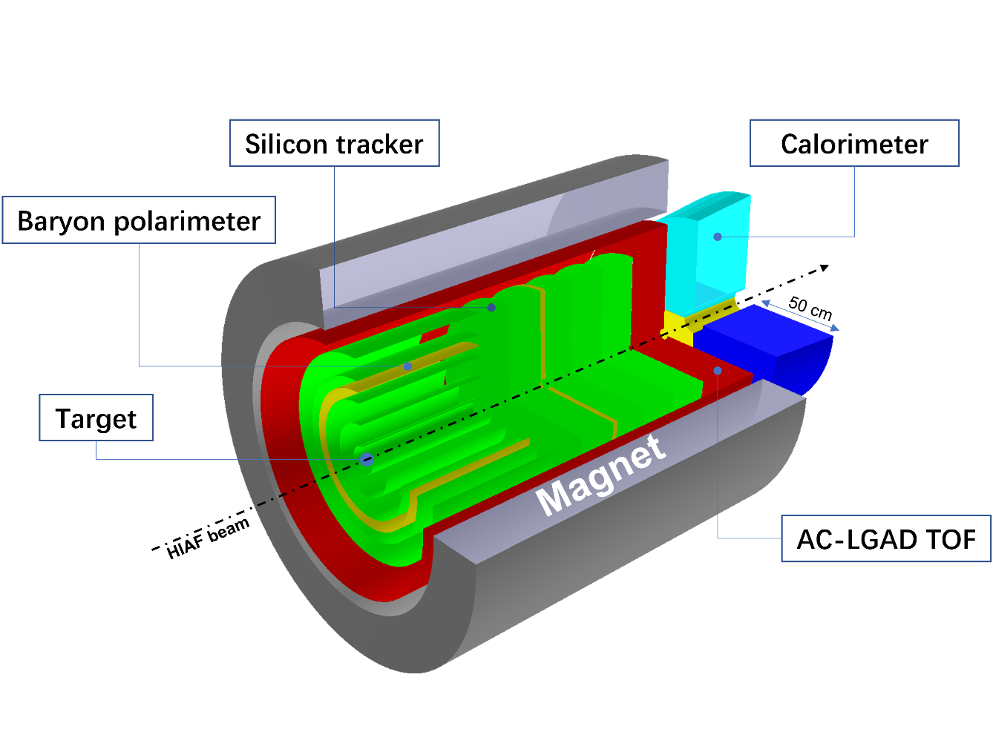
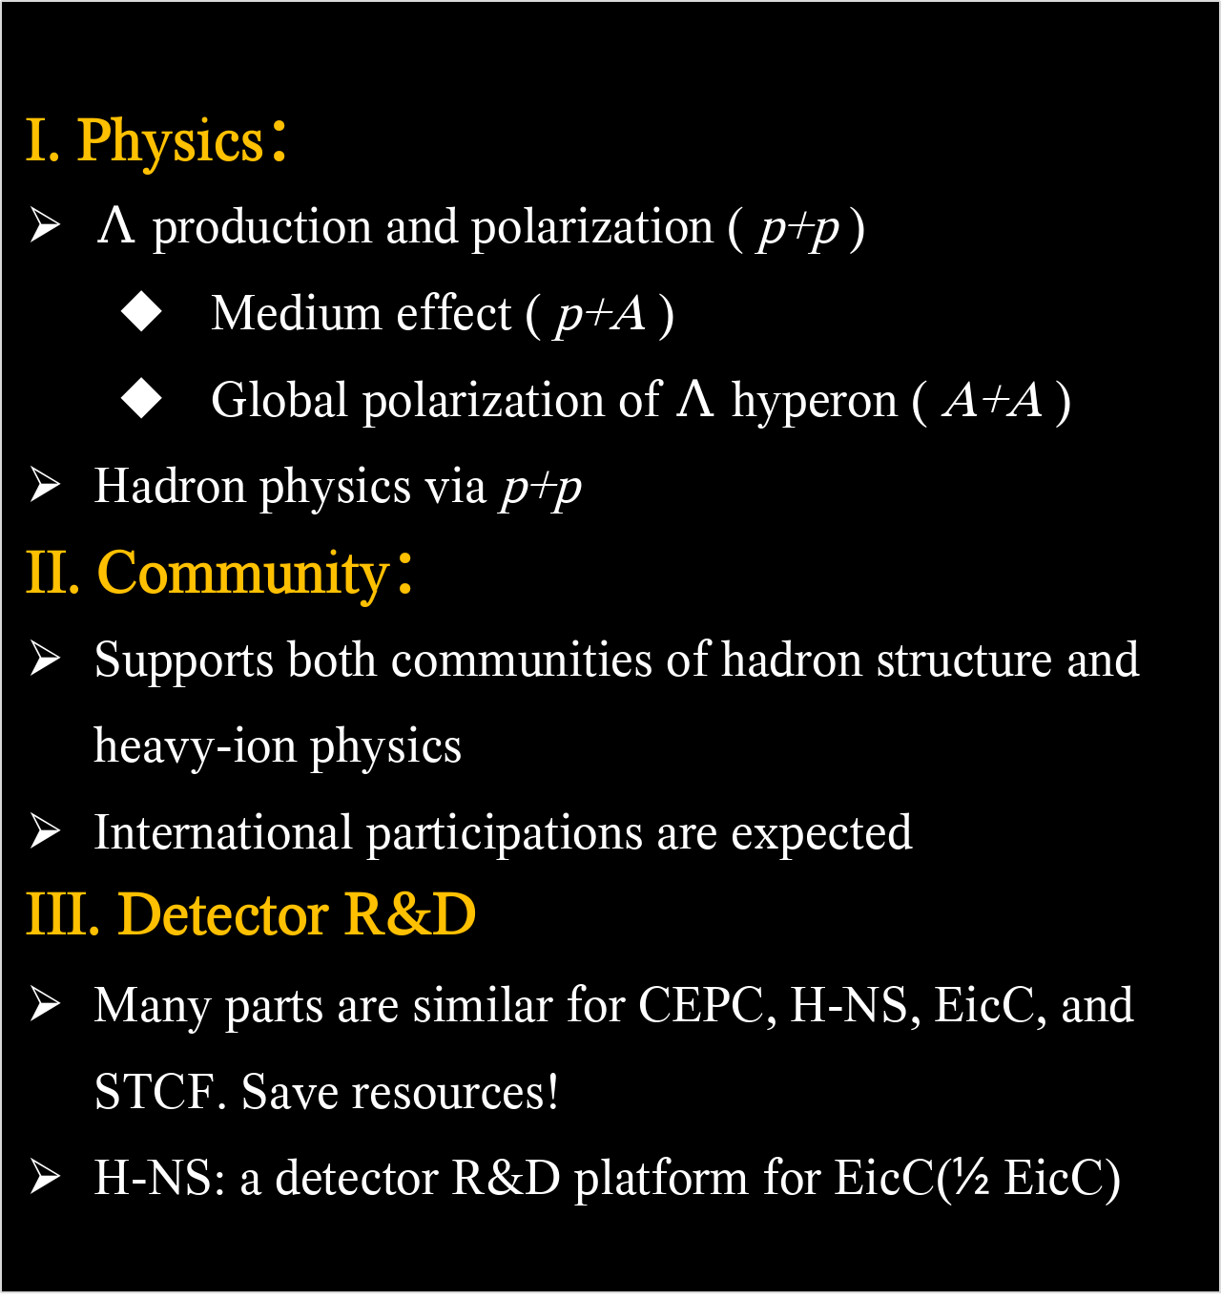
Hyperon-Nucleon Spectrometer
I. Physics：
$Λ$ production and polarization ( p+p )
Medium effect ( p+A )
Global polarization of $Λ$ hyperon ( A+A )
Hadron physics via p+p
II. Community：
Supports both communities of hadron structure and heavy-ion physics
International participations are expected
III. Detector R&D
Many parts are similar for CEPC, H-NS, EicC, and STCF. Save resources!
H-NS: a detector R&D platform for EicC(½ EicC)
Participating Institute：近代物理研究所、高能物理研究所、清华大学、山东大学、北京航空航天大学、复旦大学、国科大、华中师范大学、华南师范大学、北京师范大学、香港中文大学（深圳）、中科大、 中国原子能研究院、中山大学、湖州师范学院、 …
Subsystems：Silicon tracker, AC-LGAD, Target, Baryon polarimeter, Calorimeter, Electronics, DAQ, Magnet, Beamline, Mechanics + Engineering

Slide 14
Physics highlights and potentials

Slide 15
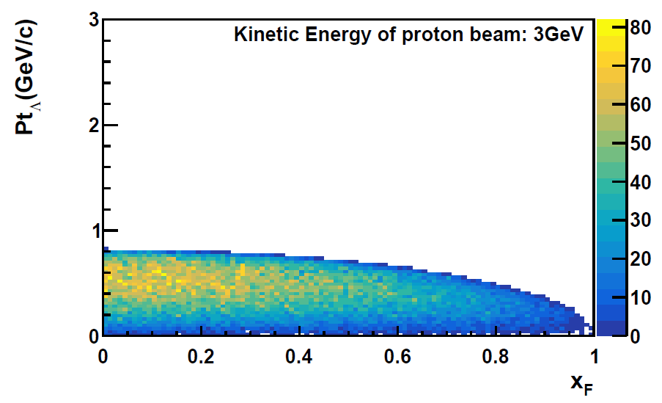
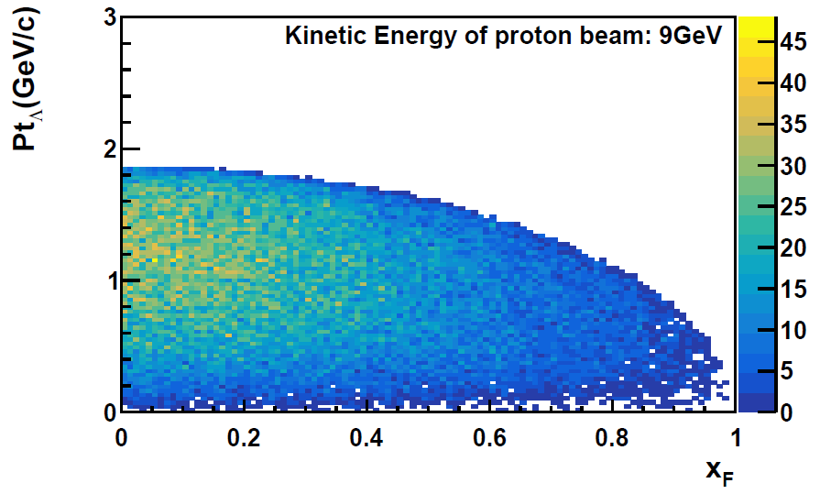
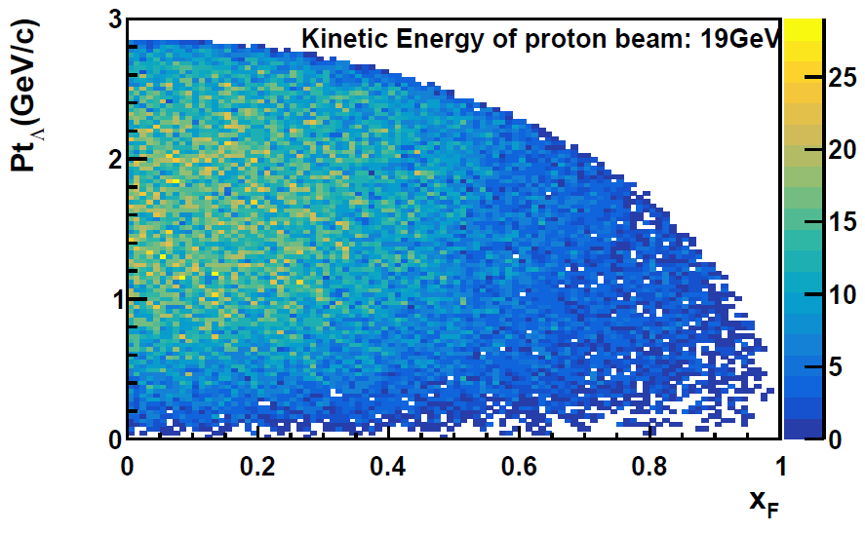
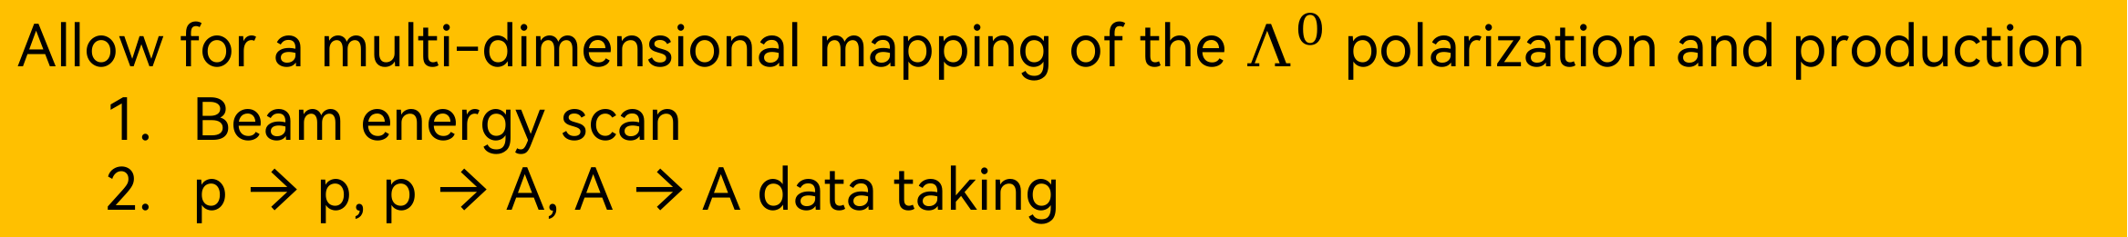
The opportunity of H-NS
3 GeV → 9 GeV → 20 GeV
Allow for a multi-dimensional mapping of the $Λ^{0}$ polarization and production
Beam energy scan
p → p, p → A, A → A data taking

Slide 16
Uncertainty projection of the polarization measurement
pp → p/Λ + X
σ_{stat.} < 0.01 for Λ 400 bins σ_{stat.} < 0.02 for p 400 bins
H-NS
Reaction: p+p
Event rate:1MHz
Time: 3 months
pp →Λ+X N ~ 10¹¹
pp → p+X N ~ 10¹³
pp → pKΛ N ~ 10¹⁰
pC scattering ~ 10¹³ * 4*10⁻⁴ = 4*10⁹
σ_{stat.} < 0.01
σ_{stat.} < 0.02

Slide 17
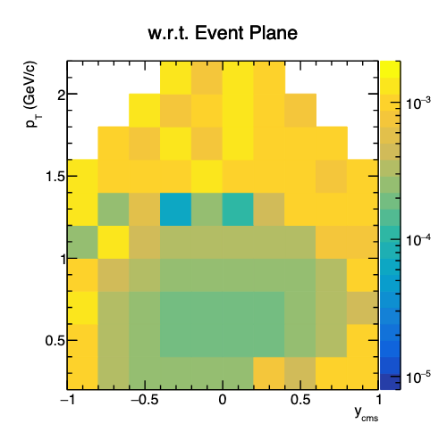
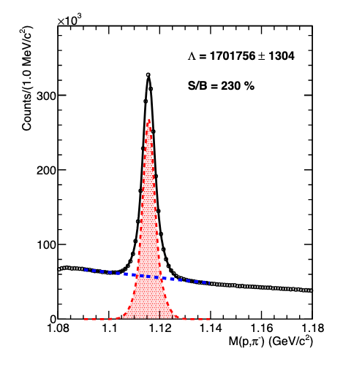
Uncertainty projection of the Global polarization in A-A
Au+Au events at beam kinetic energy of 2.8 GeV/u
σ_{stat.} < 0.001
2D uncertainty of Λ polarization using 10¹¹ Au+Au events,
few weeks data taking

Slide 18
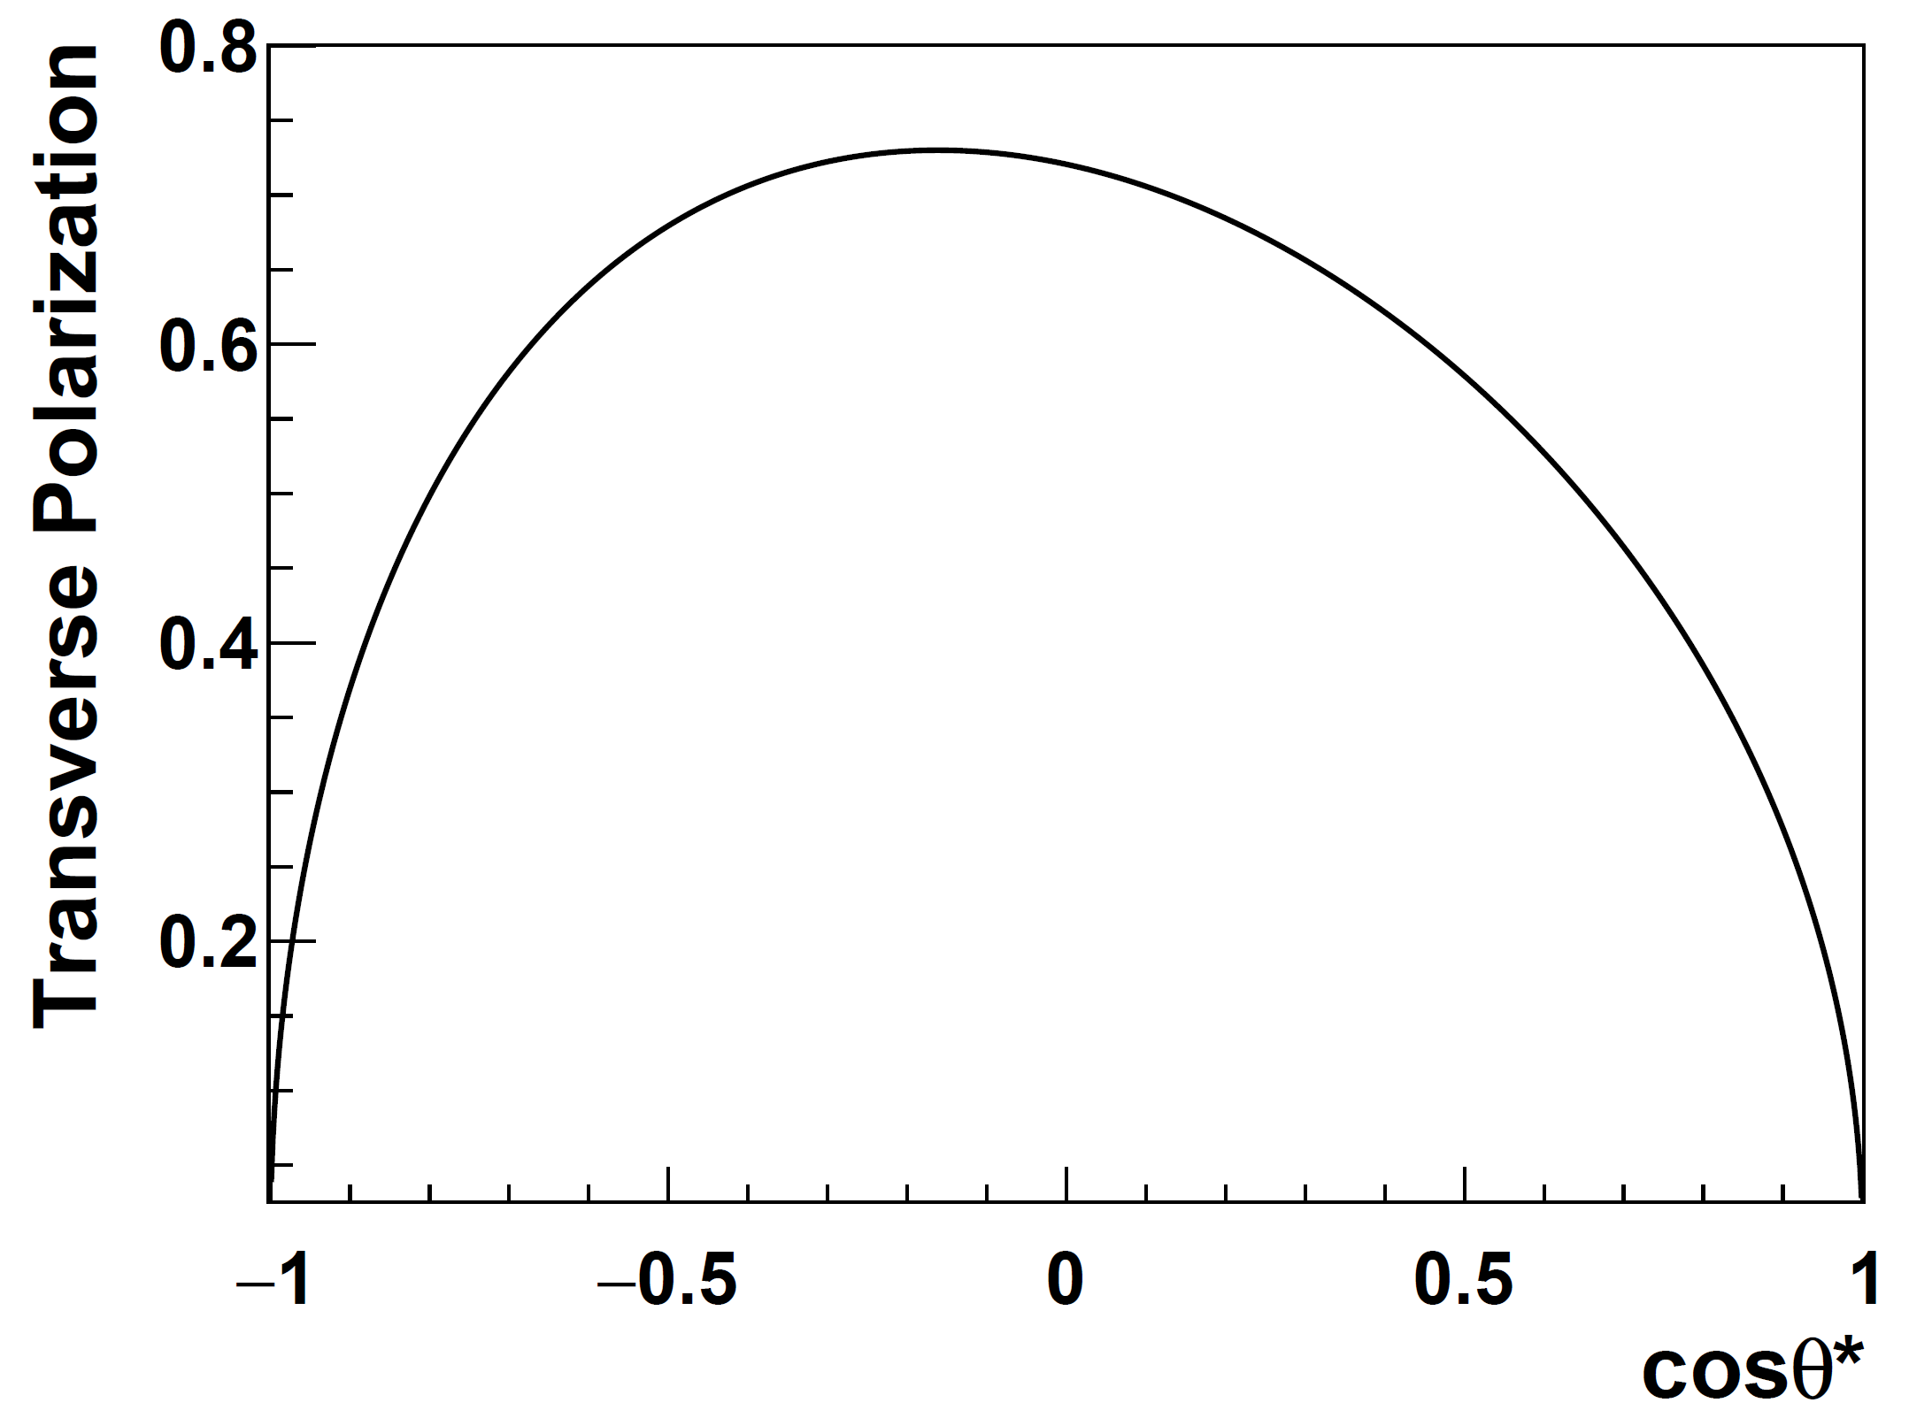
Polarized experiments at H-NS
Potential at H-NS
H-NS detector
π⁻
p beam: 3-9.3 GeV
Λ
p
target
target
p + p → Λ+ X
K⁺
p + p → Λ+ X
p
Polarized proton experiment: polarization transfer from beam?
Average transverse polarization of proton, pol = 0.57
Polarized proton beam intensity: 1 KHz
Yutie Liang, et. al., Phys. Rev. D 112, L031502

Slide 19
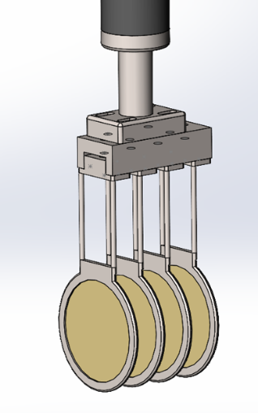
Y-N interaction -- hyperon beam
Potential at H-NS
H-NS detector
target
p beam: 3-9.3 GeV
Λ
I_max = 5*10¹² ppp
I =10⁸ ppp, 1% target
Event rate : 1 MHz
target
K⁺
pp → pKΛ | ΛN → X
p
参考CEE 4层靶设计
Event rate : 1 MHz → Λ beam from pKΛ : 1 KHz
Λ N interaction (0.1% target): 1 Hz
N ~ 10⁷ signals in 3 months; N_obs ~ 10⁶ (assuming efficiency of 10%)
Statistics can be improved by implementing a hyperon trigger

Slide 20
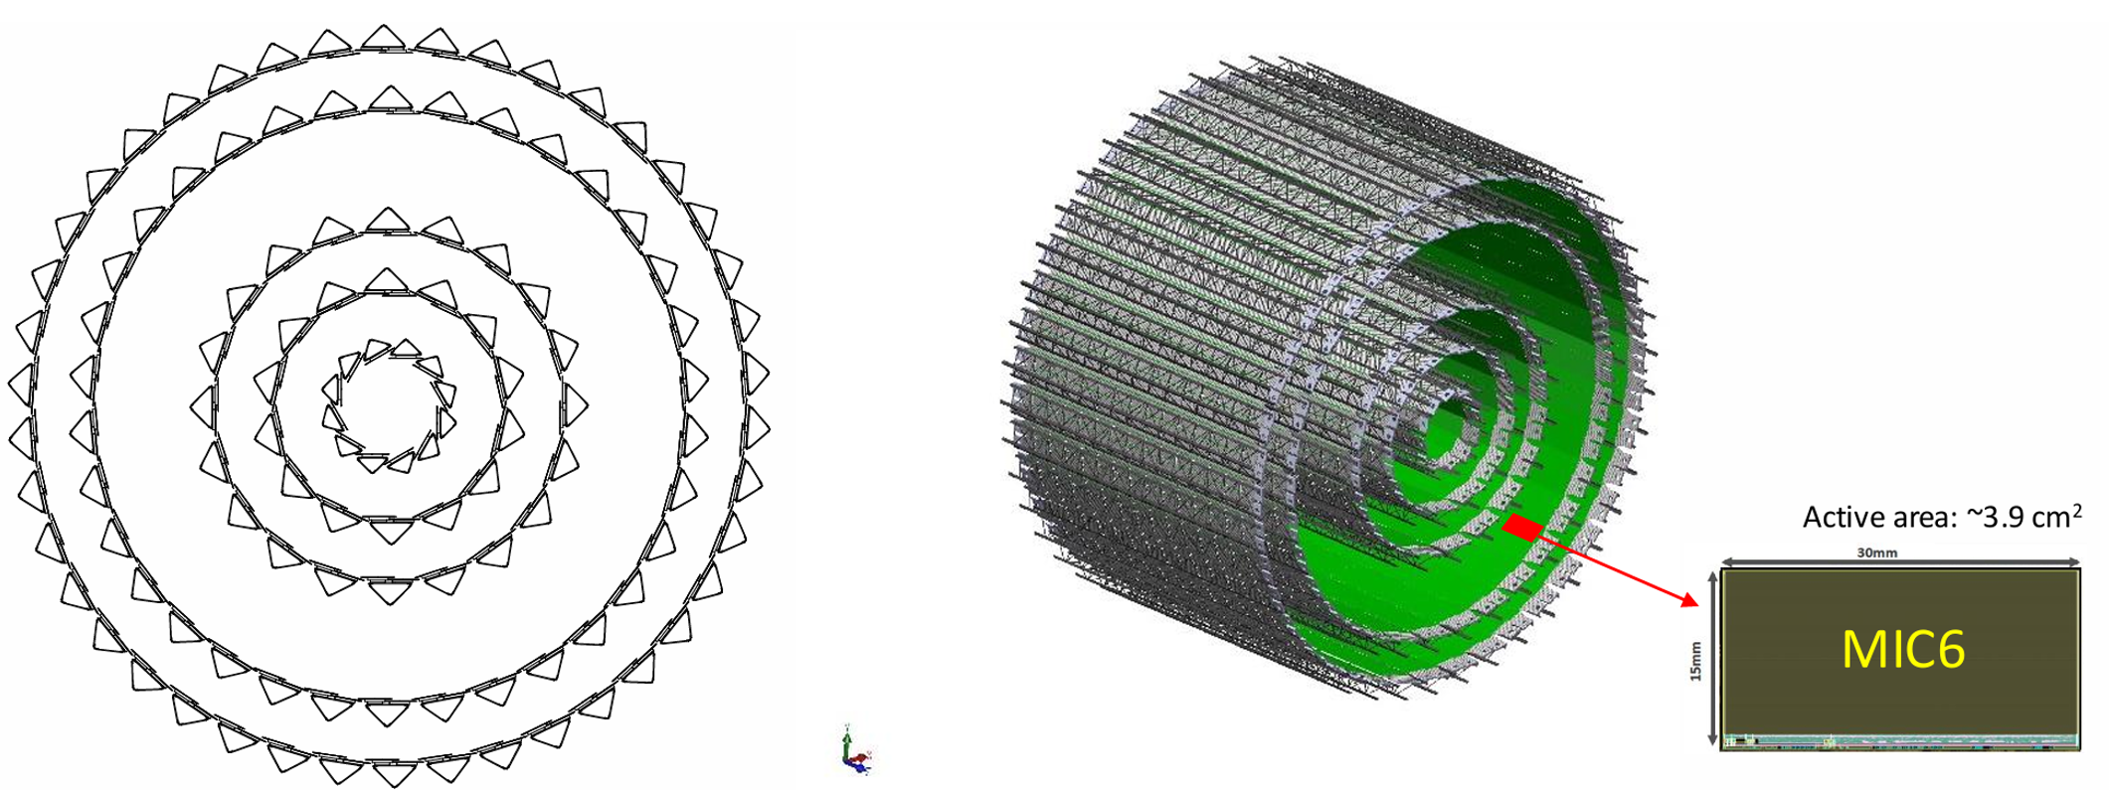
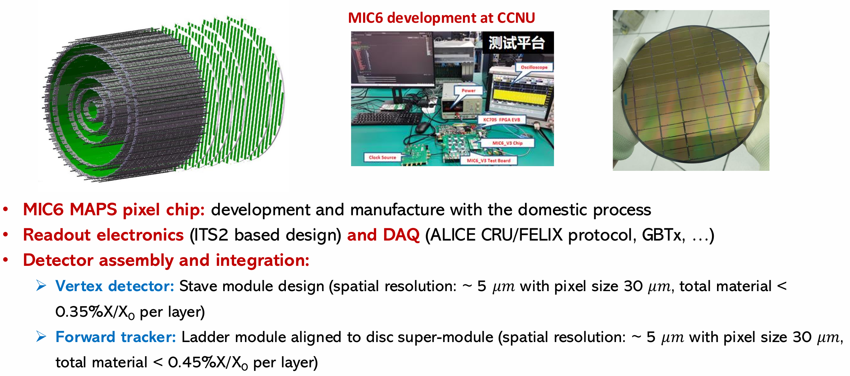
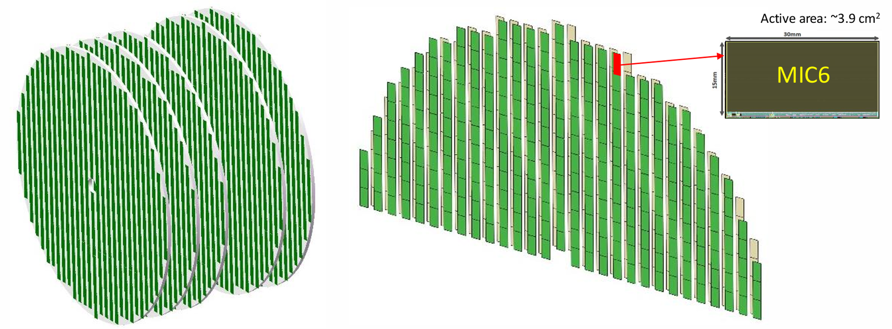
Silicon tracker at H-NS
See talk of Yaping.

Slide 21
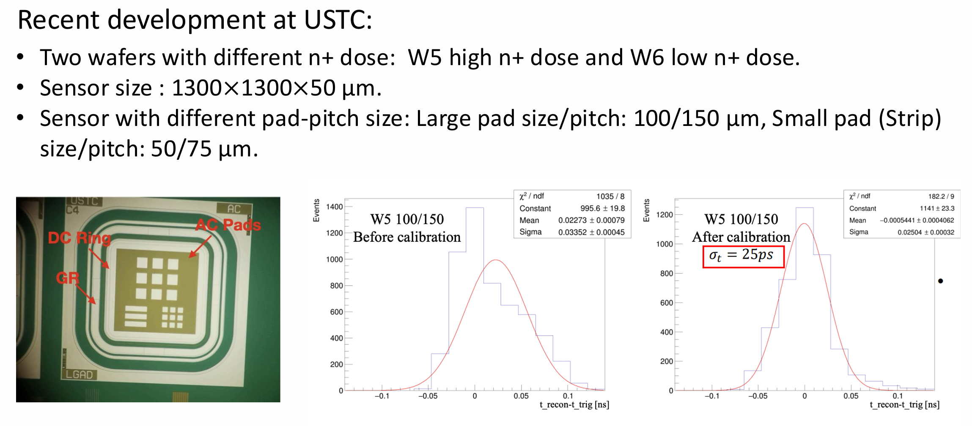
AC-LGAD at H-NS
See talk of Yanwen.

Slide 22
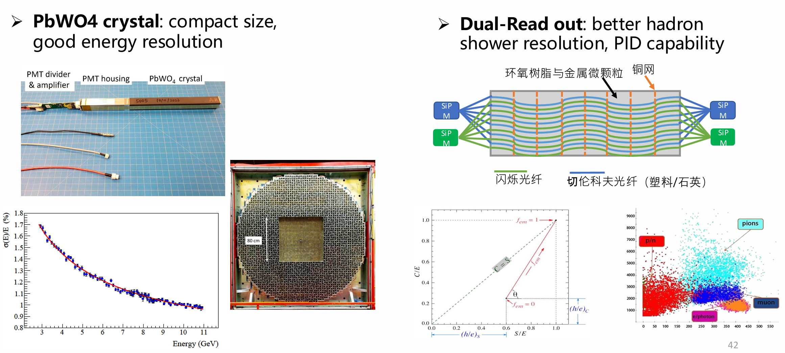
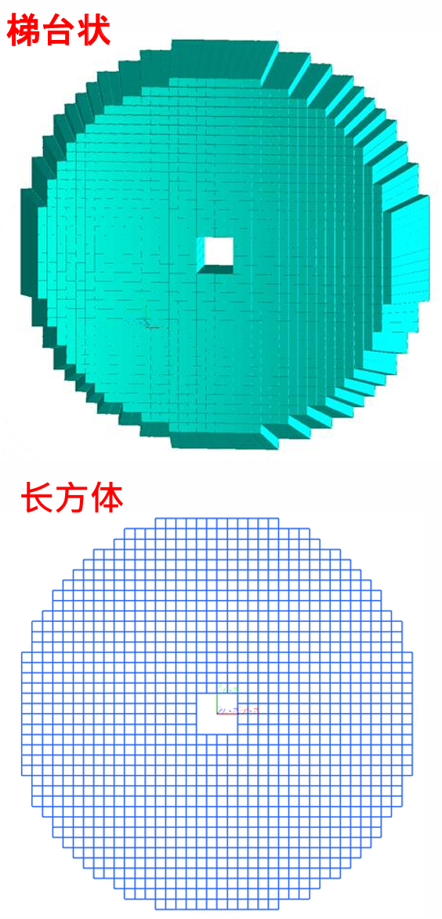
Endcap EMCal design
See talk of Dexu.

Slide 23
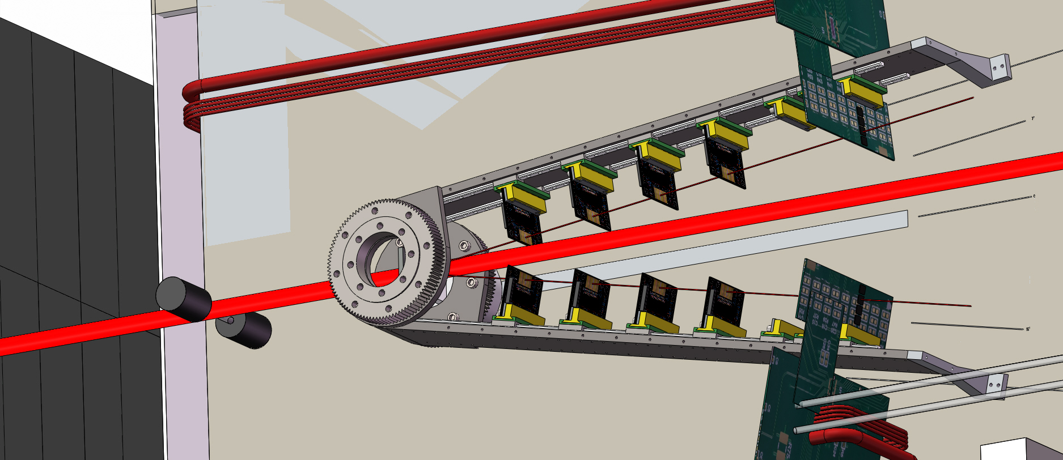
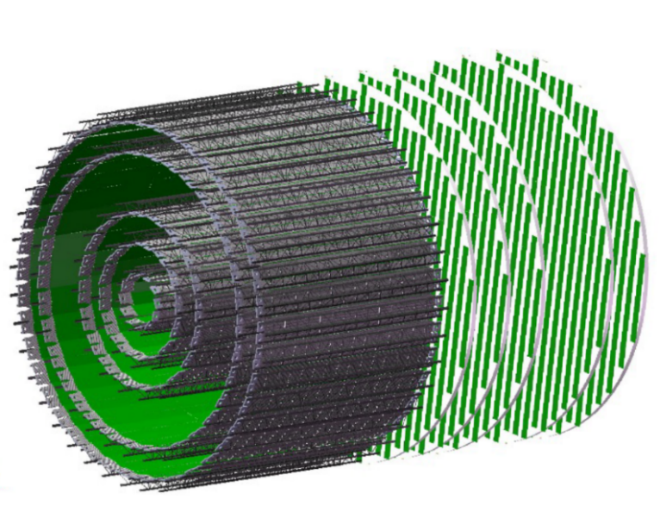
Timeline
18 | 19 | 20 | 21 | 22 | 23 | 24 | 25 | 26 | 27 | 28 | 29 | 30 | 31 | 32 | 33 | 34 | 35 | 36 | 37 | 38 | 39 | 40
十三五 |  |  | 十四五 |  |  |  |  | 十五五 |  |  |  |  | 十六五 |  |  |  |  | 十七五
HIAF
Accelerator
HIAF-U
EicC
CEE@CSR
Detector
H-NS DEMO
H-NS construction
H-NS run
EicC

Slide 24
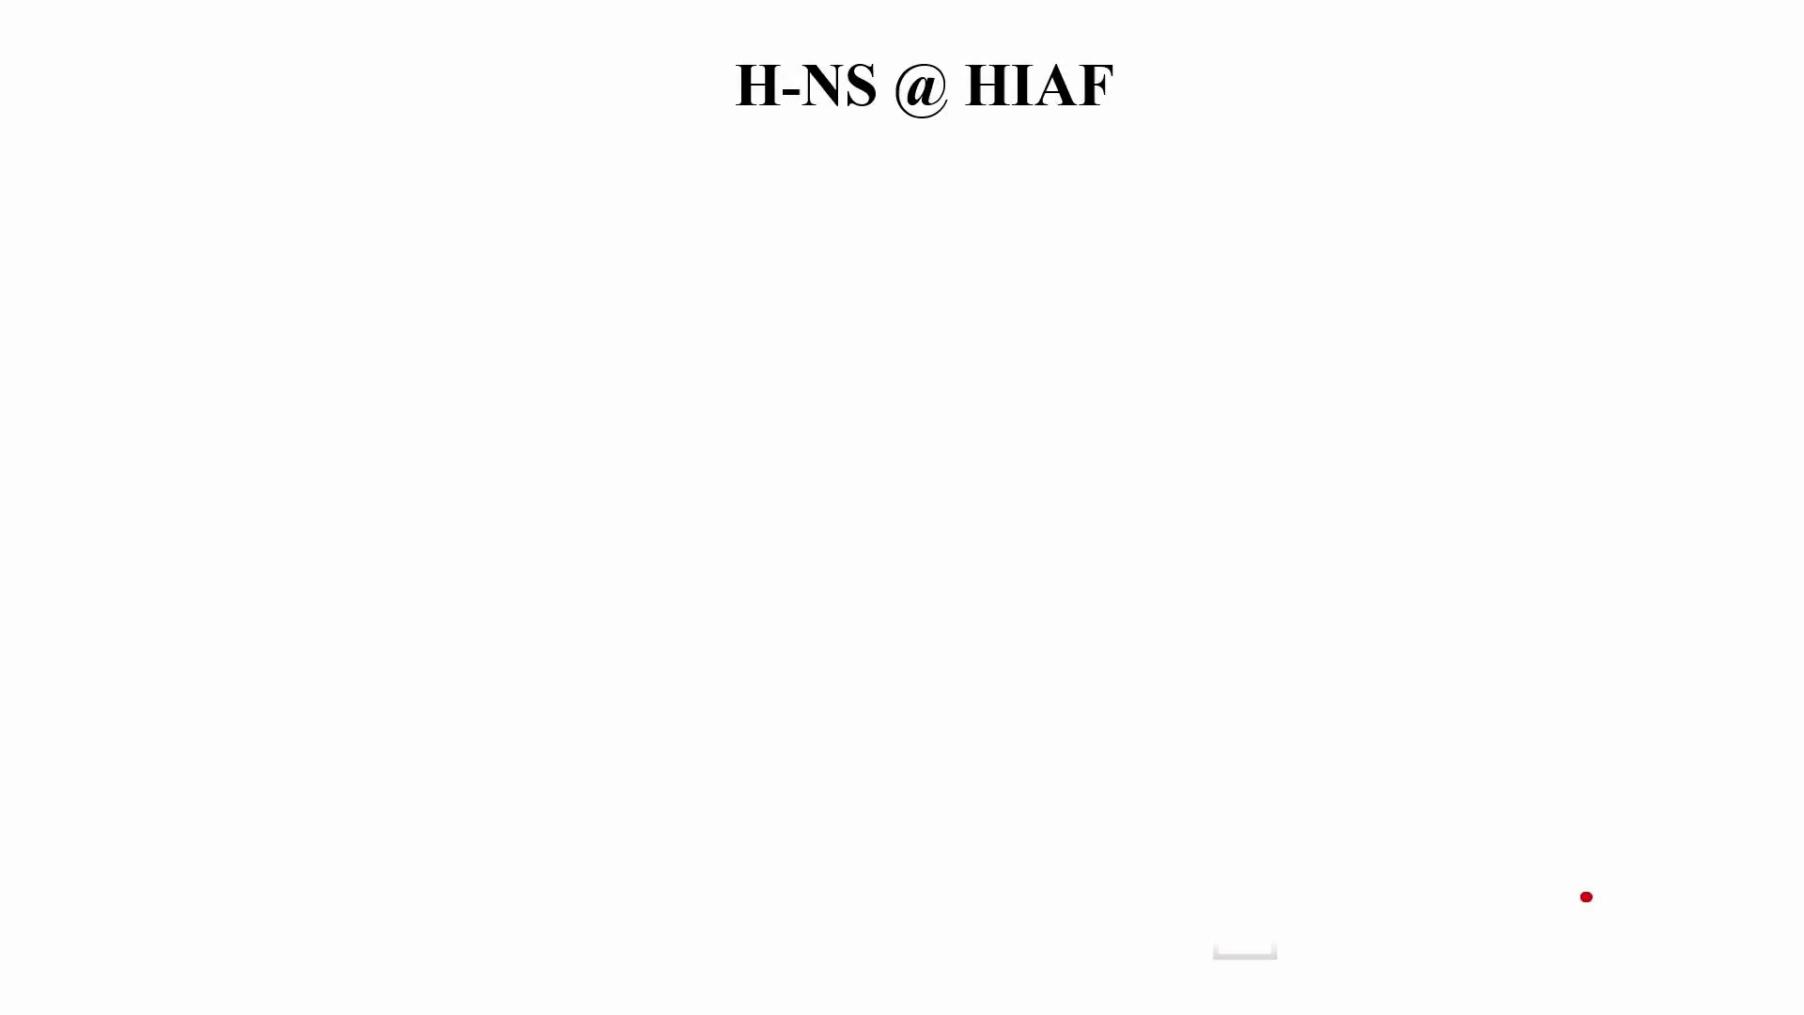

Slide 25
Summary
Long range plan of high energy nuclear physics at HIAF: from H-NS to EicC
Focus on the spin structure of baryon (H-NS & EicC)
H-NS as ½ of EicC in many aspects, and way ahead of EicC
H-NS supports both communities of hadron physics and heavy ion physics.
Thank You

Slide 27
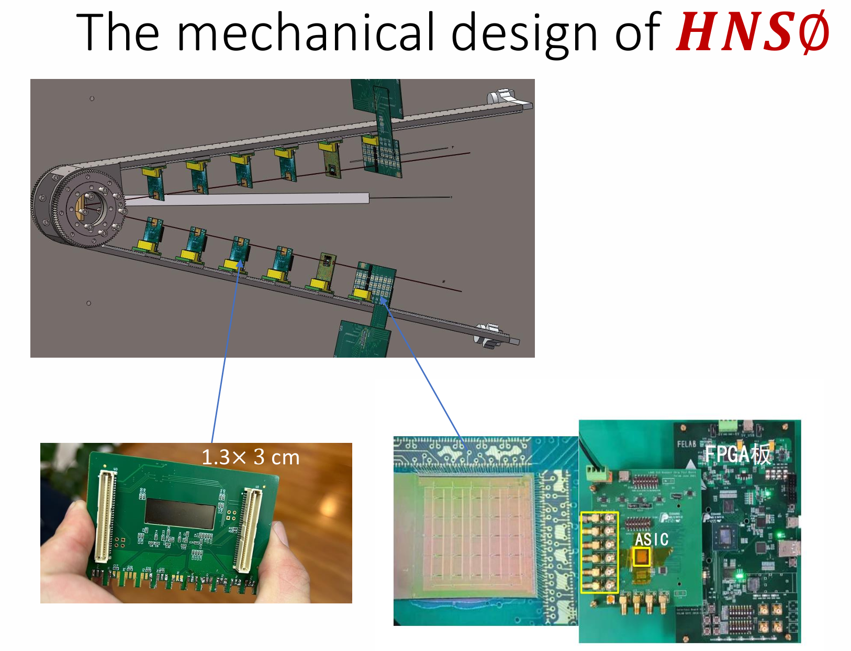
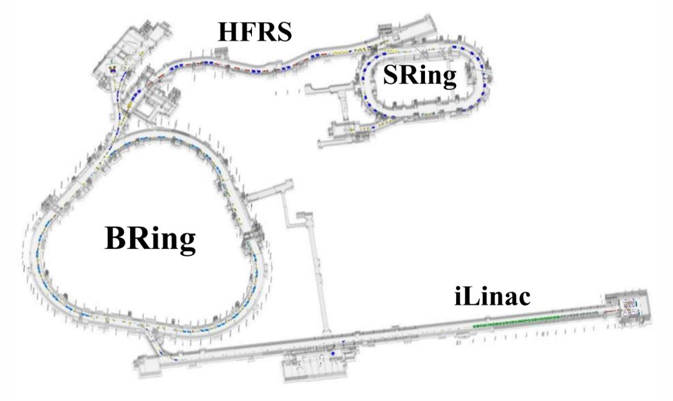
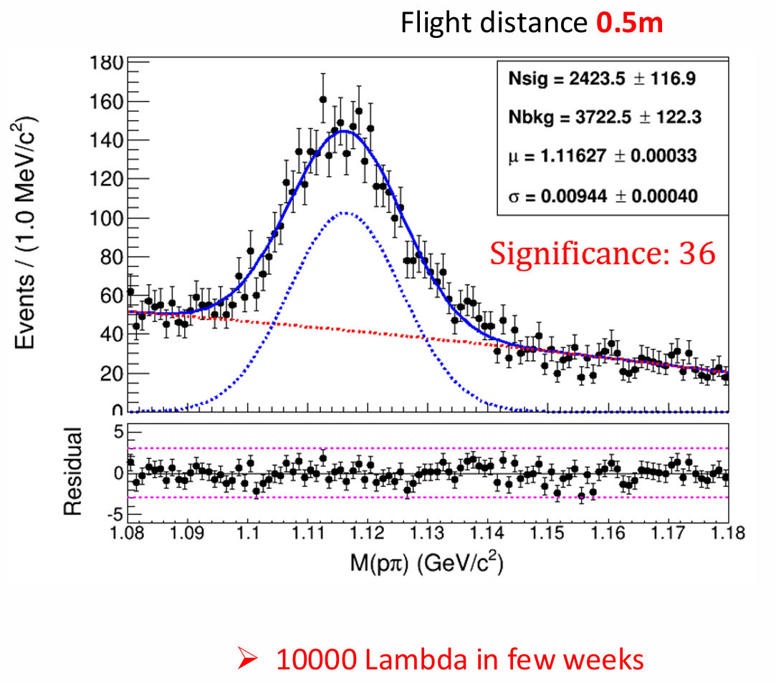
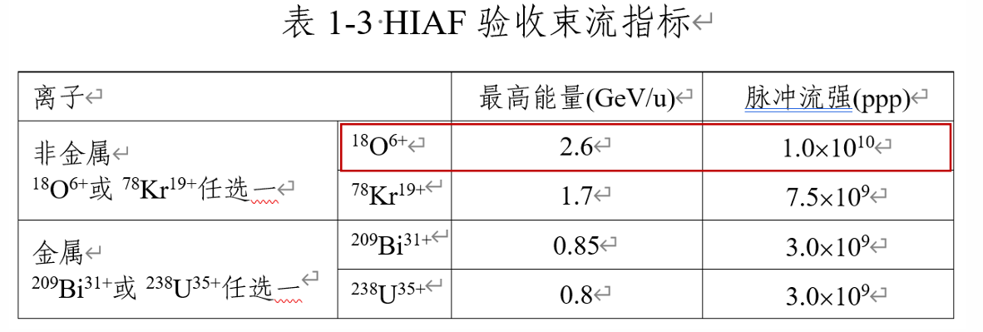
H-NS0 prototype

Slide 28
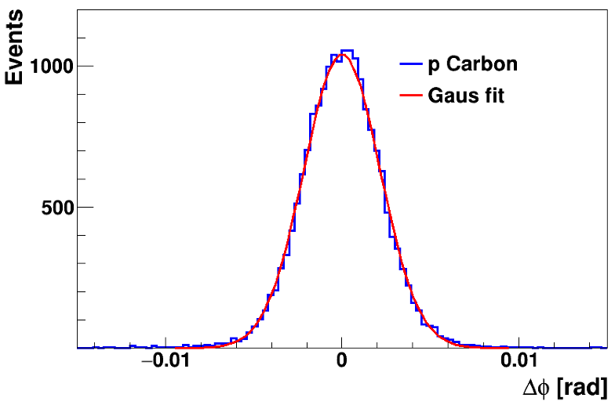
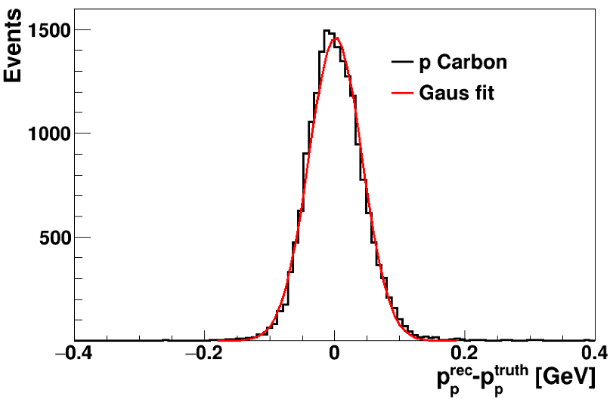
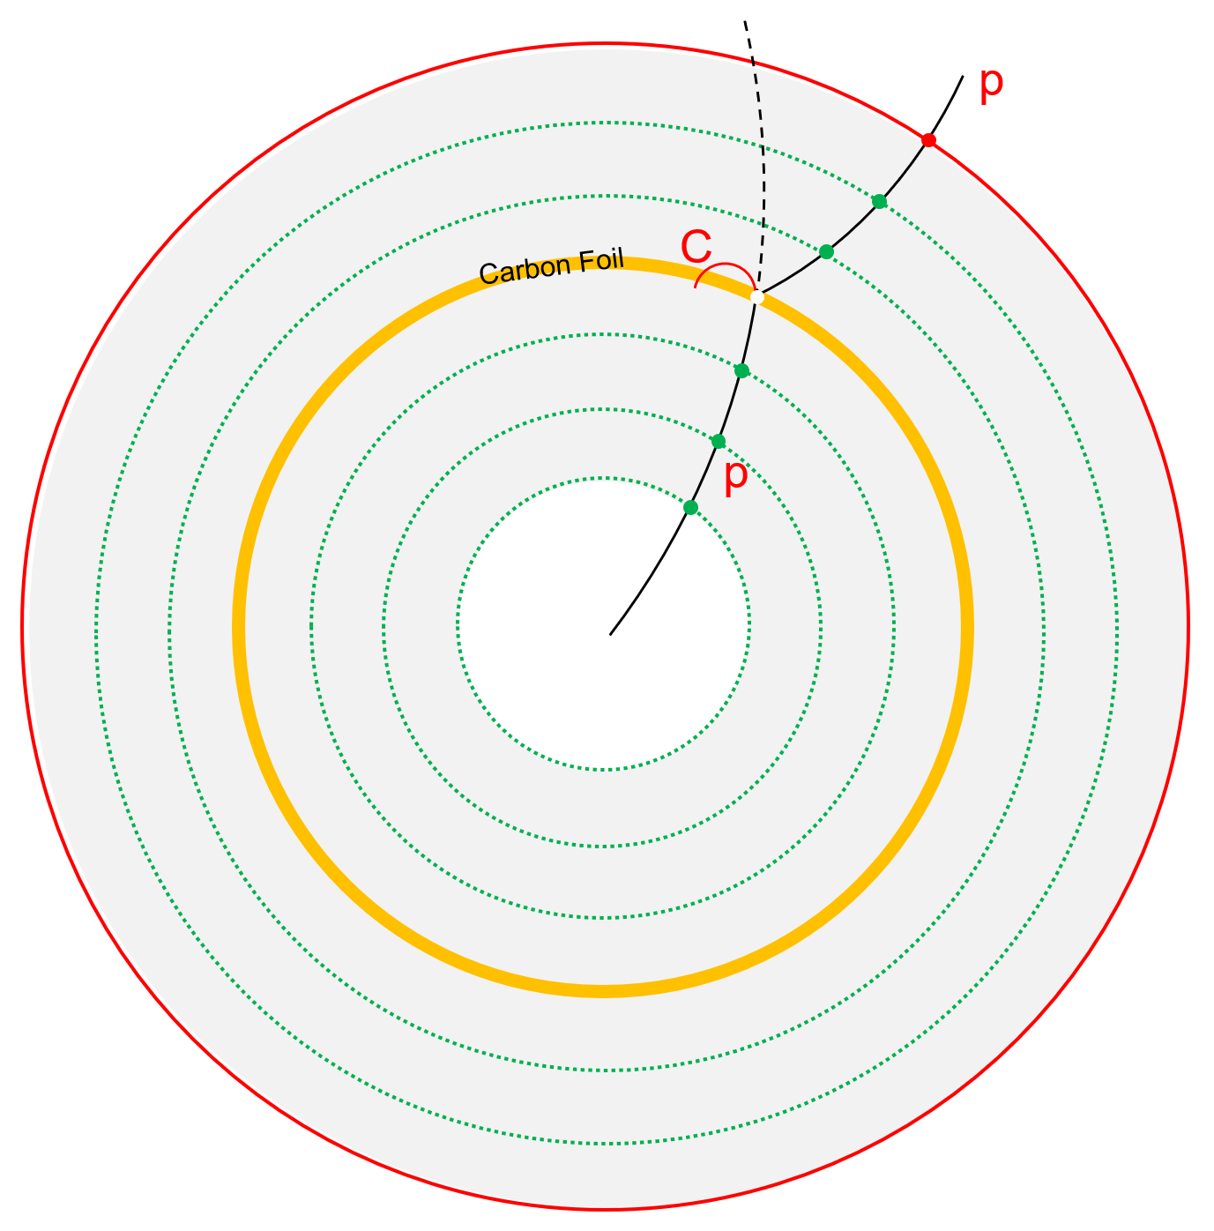
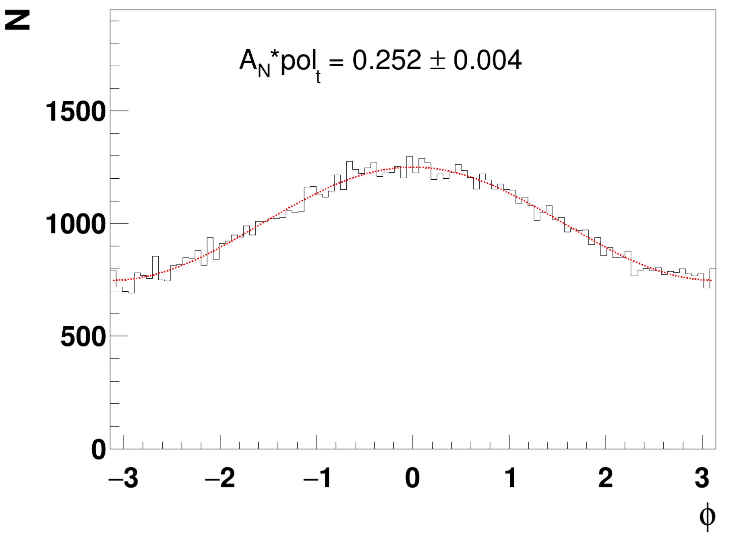


Precision measurement of proton polarization
$$σ=2.16 mrad$$
$$σ=0.041 GeV$$
Input: 0.250
Reconstruction effi: > 70%
Low background contamination!
High precision measurement!
NST in press, arXiv: 2512.02804

Slide 29





Parameters of hyperon decay
Potential at H-NS
H-NS detector
Carbon layer
π⁻
p beam: 3-9.3 GeV
Λ
p
target
K⁺
p
3 months data | 9.3 GeV | 25 GeV
pp → Λ+X | N_Λ ~ 10¹¹ N_pC ~ 10⁸ | N_Λ ~ 10¹¹ N_pC ~ 10⁸
pp → $\overline{Λ}$+X | N_$\overline{Λ}$ ~ 10⁷ N_$\overline{p}$C ~ 10⁴ | N_Λ ~ 10⁹ N_pC ~ 10⁶
Measure decay parameters of hyperon/anti-hyperon
Systematic uncertainties dominate

Slide 30


An interesting question: Is proton polarized as well?
pp/ee/ep → Λ + X
pp/ee/ep → p + X

Slide 31





Λ polarization in $e^{+}e^{−}$ machine
BESIII, Nature Physics, 15, 631 (2019)
First observation of the spontaneous polarization of Λ hyperons in $e^{+}e^{−}$ annihilation
Clear environment to study the polarization due to fragmentation of the partons, free of initial state effect
Extract the polarized fragmentation function
Relative phase of G_{E}/G_{M}

Slide 32



Hadron spectroscopy
Λ*, Σ*, Ξ*, Ω*, resonance
m < 3.1 GeV/c²
m < 3.1 GeV/c²
m < 2.6 GeV/c²
m < 2.1 GeV/c²
$\sqrt{s} =$4.6 GeV @ E_{beam} = 9.3 GeV
$\sqrt{s} =$7.1 GeV @ E_{beam} = 25 GeV
https://doi.org/10.1007/s00601-022-01756-y

Slide 33






Heavy ion physics
HICs@HIAF (T<100 MeV, ρ≤3 ρ₀)
H-NS
Reaction: A+A
Event rate:?
Time:
AA →Λ+X
AA → p+X
QCD Phase Structure
A new probe with proton polarization?
Global polarization of proton?
UU@HIAF
$2.2≤\sqrt{s_{NN}} ≤2.9$GeV
3.0-7.7 GeV
BES-II、FAIR、
NICA、HIAF-U

Slide 34






H-NS 阶段规划
TOF，ECal 未显示
TOF，ECal 未显示
H-NS0 样机
部分探测器，可扩展性
1 MHz，全尺寸探测器
$$Λ质量谱$$
丰富的物理：
高精度、多维度超子极化测量
轻强子物理、奇特强子态…
核介质效应
超核物理，核物质相结构
重点研发项目，2024YFA1611000
参与单位支持：山大、清华、华中师大、等
缺少：全尺寸磁铁、高能终端束线
2025.12.24@惠州
MIC6芯片+电子学+DAQ 技术验证，2026年HIAF束流测试
300万￥
全尺寸磁铁，部分立体角覆盖探测器；HIAF高能终端运行
1亿￥
全尺寸磁铁，全尺寸径迹与飞行时间探测器，前向量能器
3.5亿￥
2026
2026-2030
2030-

Slide 35




Y-N interaction -- hyper-nuclei
Property of neutron star?
Y-N interaction is not well constrained due to short lifetime of the hyperons.
Hyper-nuclei provide a “laboratory” to study YN interaction.
Massive heavy-ion reactions provide an abundant source of strangeness
One way to tackle the YN interaction is study the formation of hyper-nuclei in heavy-ion collisions
Maximum yield for (multi)hyper-nuclei production around several GeV
U+U at HIAF $\sqrt{s_{NN}}$= 2.2-4.5GeV
Notes:
The heavy ion collision offers an ideal environment for generating hypernuclei, because these massive heavy-ion reactions provide an abundant supply of strangeness. One effective way to explore the YN interactions is to study how the hyper nuclei are formed in the dense nuclear medium.
The left-hand figure illustrates theoretical calculations for different hypernuclei yield as a function of collision energy. The yield of hypernuclei reaches its maximum around several GeV, due to the interplay of baryon density and hyperon production rate. This energy range corresponds to the high baryon density regime.
For instance, the STAR experiment achieves precise measurements of hypernuclei lifetime at 3 GeV, thanks to its high yield(right figure).
The U+U collisions in the future HIAF covers an energy range of 2.2-4.5 GeV, making it an optimal range for the production of hypernuclei.

Slide 36


Various baryons at H-NS
Beam energy @ 9.3 GeV
Number of hyperons relative to Λ
$Σ^{−}$~ 0.05 $Σ^{0}$ ~ 0.15 $Σ^{+}$ ~ 0.25 2D √
$Ξ^{−}$ ~ 1E-2 $Ξ^{0}$ ~ 1E-2 1D √
Number of anti-hyperons relative to Λ
$\overline{\text{Λ}}$ ~ 5E-4
${\overline{Σ}}^{+}$ ${\overline{Σ}}^{0}$ ${\overline{Σ}}^{−}$ ~ 1E-4 1D √
${\overline{Ξ}}^{+}$ ~ 1E-6
Number of anti-proton relative to p
$\overline{p}$ ~ 1E-4 1D √
(udd)
(uud)
(uds)
(dds)
(uus)
(uds)
(dss)
(uss)

