Slide 1

Update of CEPC ECAL
Xiang Li, Jiaxuan Wang
2025.11.25
Notes:
Thank you for joining me today. This presentation focuses on the energy calibration data processing of the CEPC ECAL. I will explain the challenges we faced with muon-based MIP calibration and how we transitioned to using electrons for a more accurate and reliable calibration.

Slide 2
Motivation:
The 10 µm SiPM has a poor signal-to-noise ratio, which affects the data quality.
Strategy:
Replace all 10 µm SiPMs with 15 µm SiPMs.
Notes:
Initially, we attempted to use muons for MIP calibration。but they are not optimal for achieving the desired accuracy. To address this, electrons are used as a substitute.
First, we examine the energy and ADC distribution of central cells to understand their response. Based on this analysis, we determine scale factors to rescale individual channels, ensuring uniformity and accuracy across the system.
This approach allows us to improve calibration precision and achieve more reliable results moving forward.

Slide 3
Compare old SIM & new SIM:
 | S12571-010P | S12571-015P | S14160-1315（new）
Photosensitive area | 1mmx1mm | 1mmx1mm | 1.3mm×1.3mm
Package size | 1.9 mm x2.4 mm | 1.9 mm x2.4 mm | 2.63mm×2.1mm
Number of pixels | 10000 | 4489 | 7284
Pixel pitch | 10um | 15 um | 15 um
Gain | 1.35 x10⁵ | 2.3 x10⁵ | 3.6 ×10⁵
Peak sensitivity wavelength | 470nm | 460 nm | 460nm
PDE | 10% | 25 % | 32%
DCR | 100 kHz | 100 kHz | 120 KHz
Crosstalk | ~ 13% | ~ 13% | <1%
Vop | V_{BR} +4.5 V | V_{BR} +4 V | V_{BR} +4V
More pixels
More crosstalk
Higher gain
Better photon detection efficiency
Notes:
The new SiPM has more pixels, more crosstalk, higher gain, and better photon detection efficiency.

Slide 4
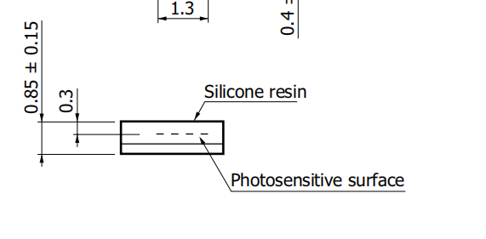
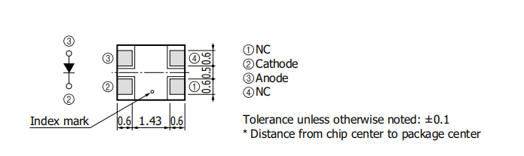
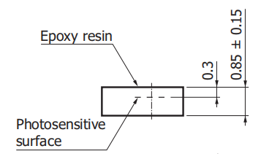
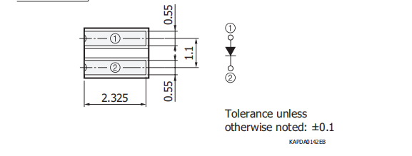
Problem:
Different packaging
S14160-1315 (new)
S12571-010P (old)
Notes:
The new SiPM has more pixels, more crosstalk, higher gain, and better photon detection efficiency.

Slide 5
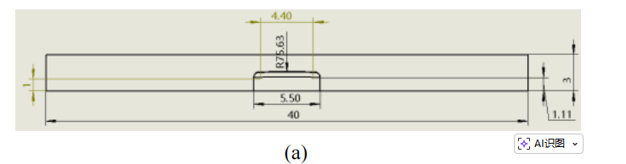
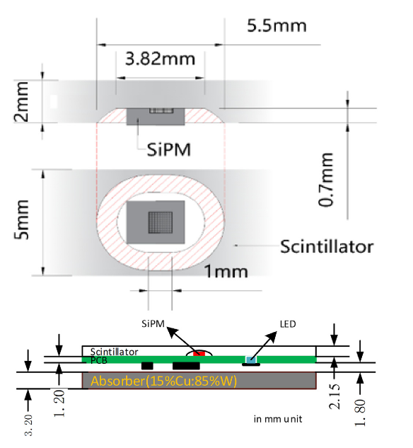
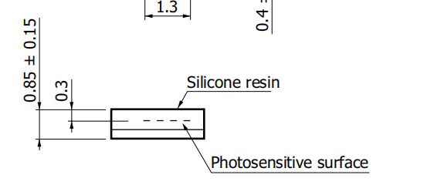
Problem:
HCAL
Different packaging
ECAL
S14160-1315 (new)
Notes:
The new SiPM has more pixels, more crosstalk, higher gain, and better photon detection efficiency.

Slide 6
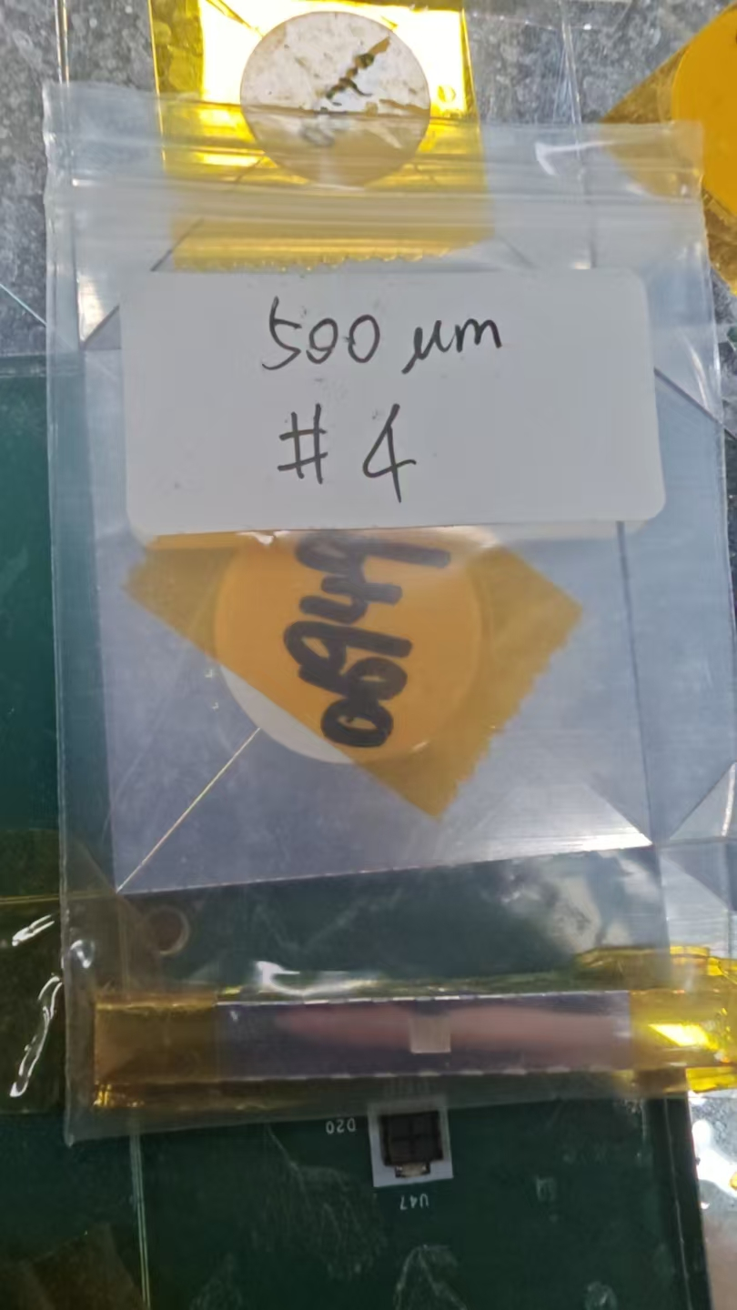
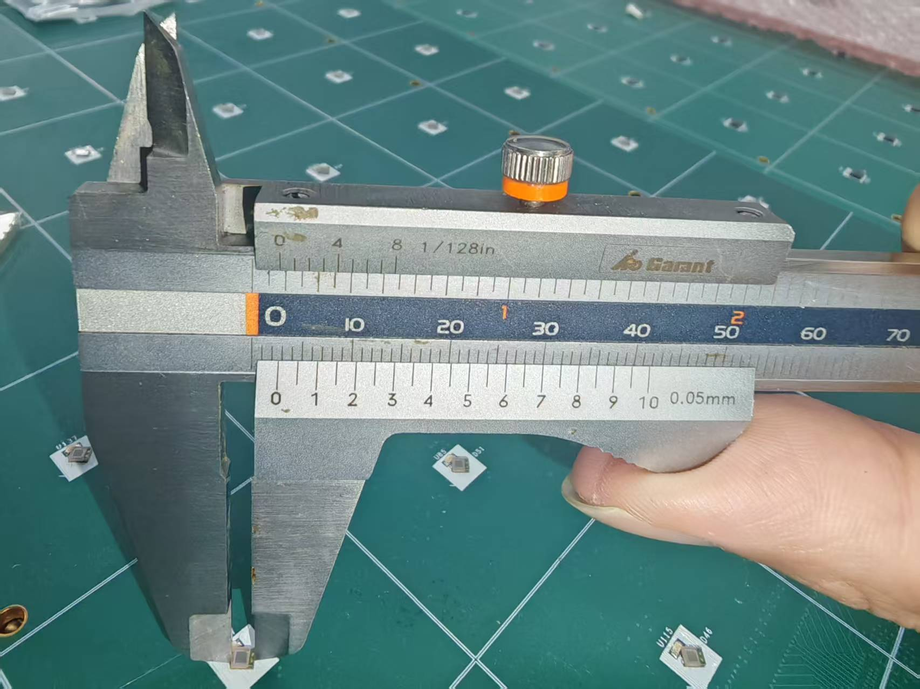
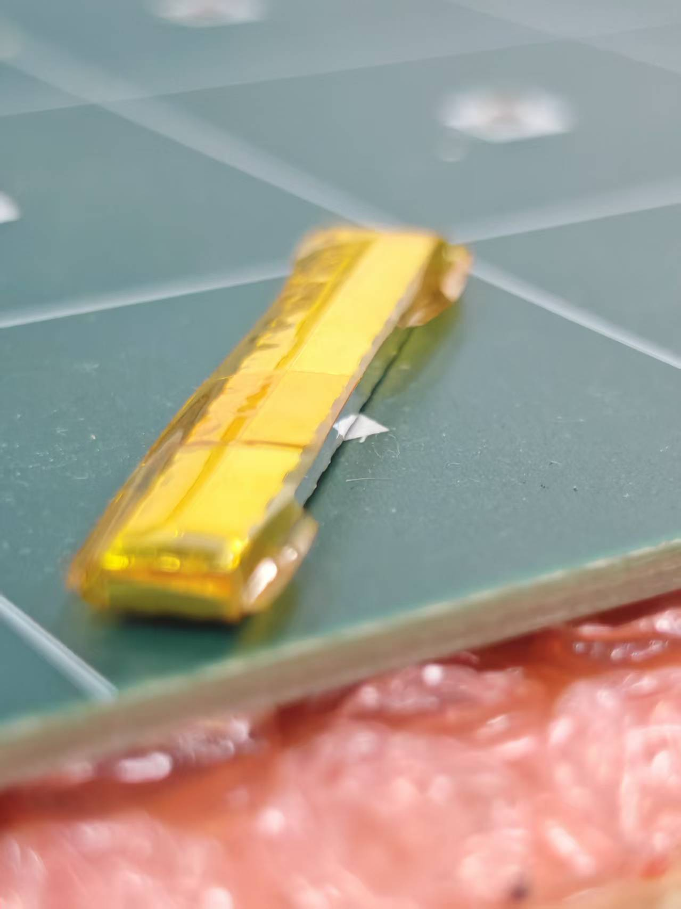
Problem:
Different packaging
Notes:
The new SiPM has more pixels, more crosstalk, higher gain, and better photon detection efficiency.

