Slide 1
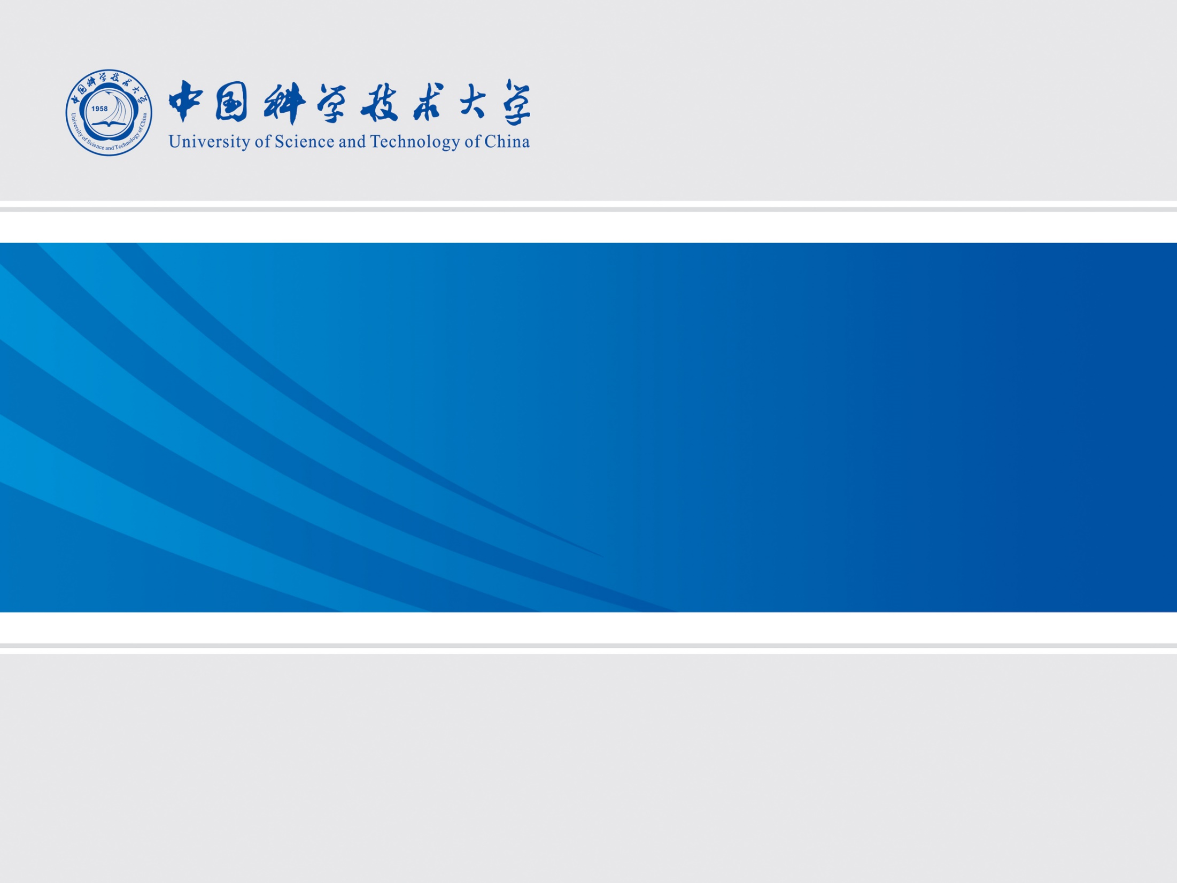
线圈优化
2025年11月11日
叶昌庆

Slide 2
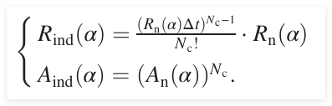
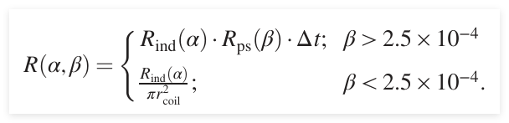
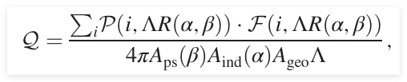
线圈探测灵敏度
多层线圈误触发率和接收率
单位面积误触发率（目前考虑纯线圈阵列，针对低速如1e-5c 的磁单极子）
灵敏度
整理之后
$$Q=\frac{g\left(ΛR\left(α,β\right)\right)}{{{4πA}_{ind}A}_{geo}Λ}=\frac{g\left(Λ\frac{{\left(R_{n}∆t\right)}^{N_{c}}}{π{r_{coil}}^{2}N_{c}!∆t}\right)}{4πA_{geo}Λ{A_{n}}^{N_{c}}}=\frac{g\left(Λ\frac{{R_{x}}^{N_{c}}}{π{r_{coil}}^{2}N_{c}!∆t}\right)}{4\tan^{−1}{\frac{r_{coil}}{H}}Λ{A_{n}}^{N_{c}}}=\frac{g\left(Λ\frac{{FPR}^{N_{c}}}{π{r_{coil}}^{2}N_{c}!∆t}\right)}{4\tan^{−1}{\frac{r_{coil}}{H}}Λ{\left(1−FNR\right)}^{N_{c}}}$$
$R_{n}:$误触发频率
$A_{n}:$接收率
$R_{x}=R_{n}∆t$: 误触发率
 | 预测 = 1 | 预测 = 0
真实 = 1 | TP | FN
真实 = 0 | FP | TN
$$R_{x}=\frac{FP}{FP+TN}≡FPR$$
$$A_{n}=\frac{TP}{TP+FN}≡1−FNR$$

Slide 3
思路
Air-core coil
Solid-wire air-core coil
Ferrite-core coil
Solid-wire ferrite-core coil

Slide 4

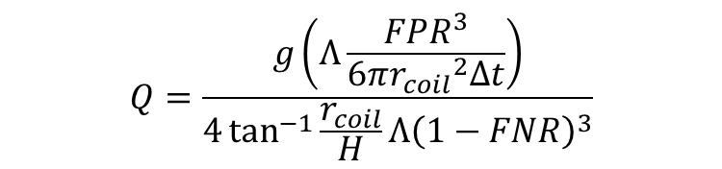


优化流程
$$Q=\frac{g\left(Λ\frac{{FPR}^{3}}{6π{r_{coil}}^{2}∆t}\right)}{4\tan^{−1}{\frac{r_{coil}}{H}}Λ{\left(1−FNR\right)}^{3}}$$
$$FPR\left(SNR, threshold\right)$$
$$FNR\left(SNR, threshold\right)$$
$$Areal_channel=\frac{1}{π{r_{coil}}^{2}}$$
$$Areal_density=\frac{weight}{π{r_{coil}}^{2}}$$
基于方案一考虑了完整的系统噪声（包含pink 噪声）

Slide 5

相关参数
参数范围
遍历上述格点，并进行排序得到Pareto 前沿
筛选条件：
$\frac{d_{wire}}{\sqrt{d_{real}}}≥0.0796\sqrt{mm}$，线圈交流电阻的有限元分析结果和实测结果符合较好，保证交流电阻可信
线圈高度不超过线圈直径
SNR>1
Parameter | Range | Step | Unit
r_coil_inner | 20 – 200 | 10 | mm
d_wire | 0.1 – 1.5 | 0.1 | mm
num_coil | 10 – 500 | 10 | —
num_layer | 1 – 51 | 1 | —

Slide 6
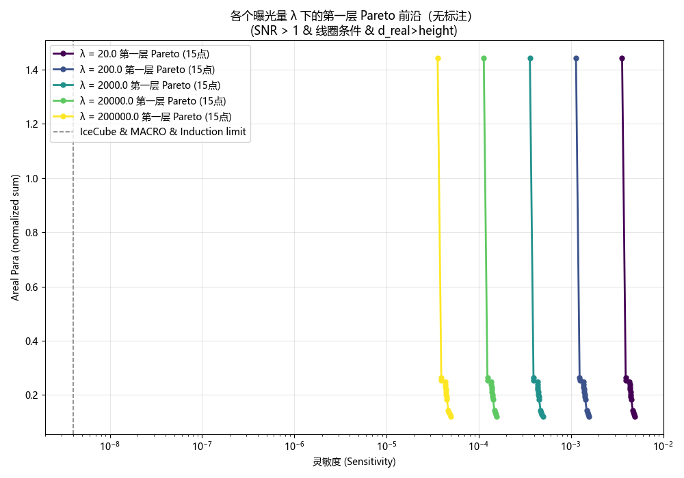
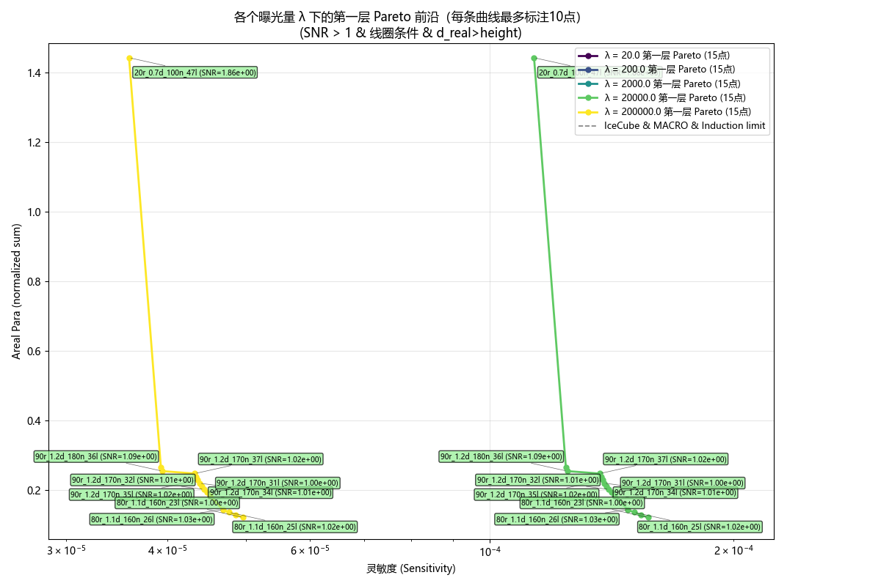
结果
各个曝光之下，Pareto 前沿的线圈设计一致
空气芯线圈的优化结果不理想，距离现有limit 差三个量级，考虑使用相同线圈设计的磁芯线圈

Slide 7
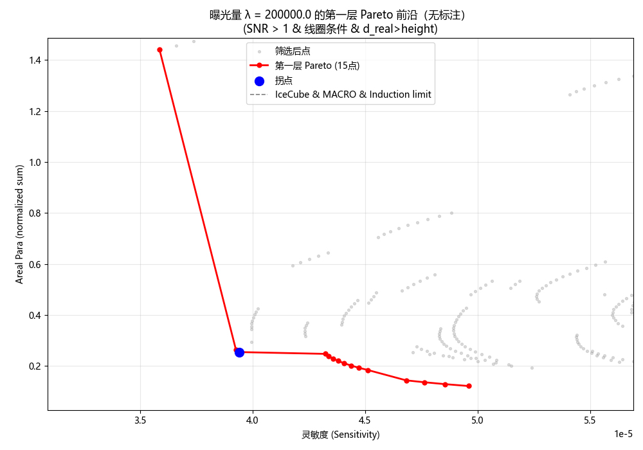
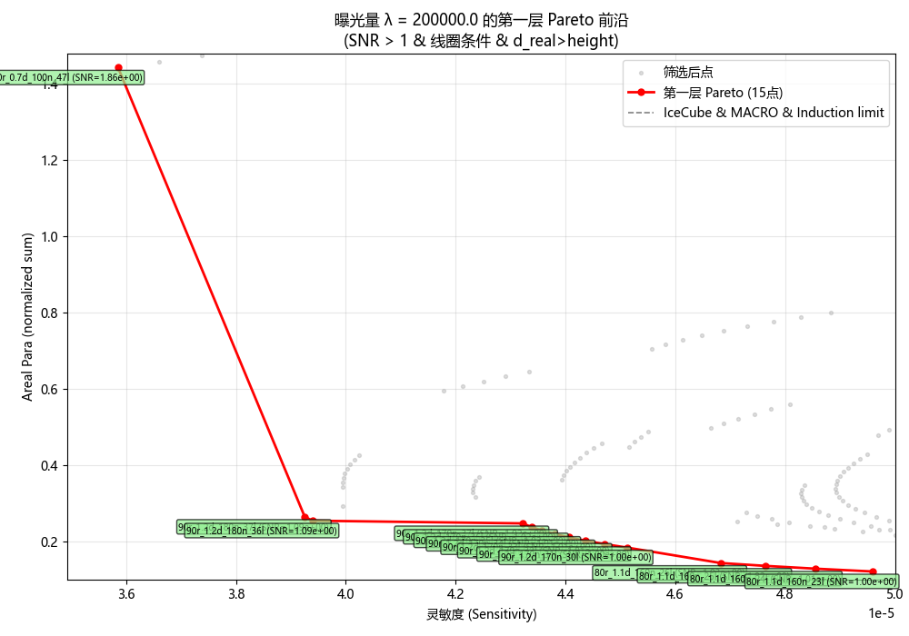
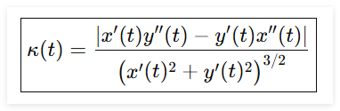
拐点求解
曲率：
寻找曲率最大位置处
Parameter | Value | Unit
r_coil_inner | 90 | mm
d_wire | 1.2 | mm
num_coil | 180 | —
num_layer | 36 | —

Slide 8
思路
Air-core coil
Solid-wire air-core coil
Ferrite-core coil
Solid-wire ferrite-core coil

Slide 9
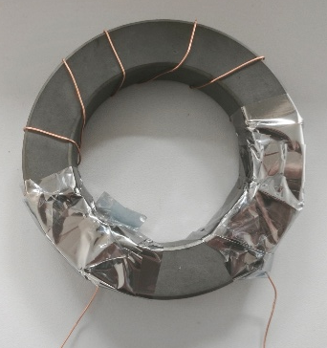
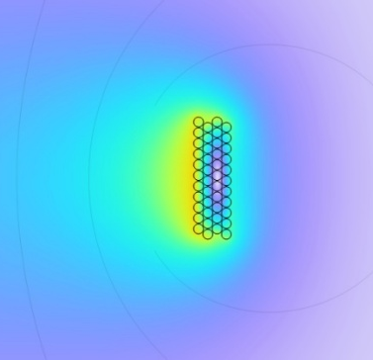
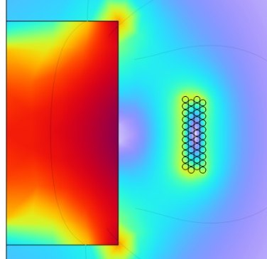
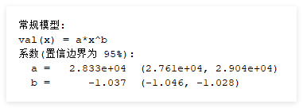
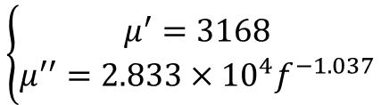
磁芯线圈模型
Research Method: Measure the material’s magnetic permeability and assign the complex permeability in finite element simulations to model the signal and noise behavior.
Toroidal coil for ferrite permeability measurement
Measured vs. datasheet permeability of the ferrite core
$$\left\{\begin{aligned}μ^{′}=3168 \\ μ^{′′}=2.833×{10}^{4}f^{−1.037}\end{aligned}\right.$$
Magnetic flux density distribution with and without the core (axisymmetric model)

Slide 10
测试样本
线圈参数
 | 线圈内径（mm） | 层数 | 单层匝数 | 线径（mm） | 线圈高度（mm） | 线圈个数
Coil1 | 36 | 14 | 50 | 0.6 | 30 | 3
Coil2 | 36 | 14 | 75 | 0.6 | 45 | 3
Coil3 | 36 | 14 | 100 | 0.6 | 60 | 3
Coil4 | 96 | 14 | 100 | 0.6 | 60 | 3
Coil5 | 146 | 14 | 100 | 0.6 | 60 | 3
交流电阻仿真和实测对应不上
磁芯参数
 | 磁芯直径（mm） | 磁芯高度 | 磁芯个数
Core1 | 33.5 | 40 | 3
Core2 | 33.5 | 60 | 4
Core3 | 93.5 | 60 | 3
Core4 | 143.5 | 60 | 3

Slide 11
结果
 | Coil1 |  | Coil2 |  | coil3
 | Core1 | Core2 | Coil1 | Core2 | Core1 | core2
Gain Deviation | 5.17% | 5.36% | 3.39% | 3.75% | 3.04% | 3.58%
AC Resistance
SNR0 Deviation | 12.88% | 17.55% | 12.68% | 20.06% | 18.28% | 24.31%
SNR0 Deviation modified | 3.64% | 8.46% | 6.66% | 13.94% | 13.24% | 18.78%
 | test | simu | test | simu
coil1_air | 1.71E-02 | 1.71E-02
coil1_core1 | 4.53E-02 | 0.047643 | 2.65E+00 | 2.79E+00 | 5.17%
coil1_core2 | 0.060329 | 0.063564 | 3.53E+00 | 3.72E+00 | 5.36%
coil2_air | 3.09E-02 | 3.09E-02
coil2_core1 | 0.079802 | 0.082509 | 2.58E+00 | 2.67E+00 | 3.39%
coil2_core2 | 0.115322 | 0.11965 | 3.73E+00 | 3.87E+00 | 3.75%
coil3_air | 4.53E-02 | 4.53E-02
coil3_core1 | 0.108832 | 0.11214 | 2.40E+00 | 2.48E+00 | 3.04%
coil3_core2 | 0.167988 | 0.17401 | 3.71E+00 | 3.84E+00 | 3.58%
SNR
 | test | simu
coil1_core1 | 1.23E+01 | 14.09472 | 12.88%
coil1_core2 | 21.08228 | 25.56836 | 17.55%
coil2_core1 | 13.81114 | 15.81662 | 12.68%
coil2_core2 | 27.06717 | 33.85803 | 20.06%
coil3_core1 | 14.06472 | 17.2114 | 18.28%
coil3_core2 | 28.05417 | 37.06338 | 24.31%
磁芯线圈增益的仿真结果略大于测试结果，可能和几何偏差以及仿真模型的非真实性有关（二维旋转轴对称模型）
磁芯线圈交流电阻的仿真结果和测试结果仍然存在差距，但是对于磁芯线圈的SNR，高频信号的贡献较小，所以对于信噪比的影响较小

Slide 12
分析
不同参数下，交流电阻测试结果和仿真结果之间测差距
差距的比值近似为一个常数
不是由误差导致的，可能存在未考虑的物理效应

Slide 13
磁芯线圈
基于空气芯得到的优化线圈设计，加入不同高度的磁芯
参数
Parameter | Value | Unit
r_coil_inner | 90 | mm
d_wire | 1.2 | mm
num_coil | 180 | —
num_layer | 36 | —
r_core | 0.98 * r_coil_inner
h_core | 0.2 * h_coil ~ 1.4 * h_coil

Slide 14
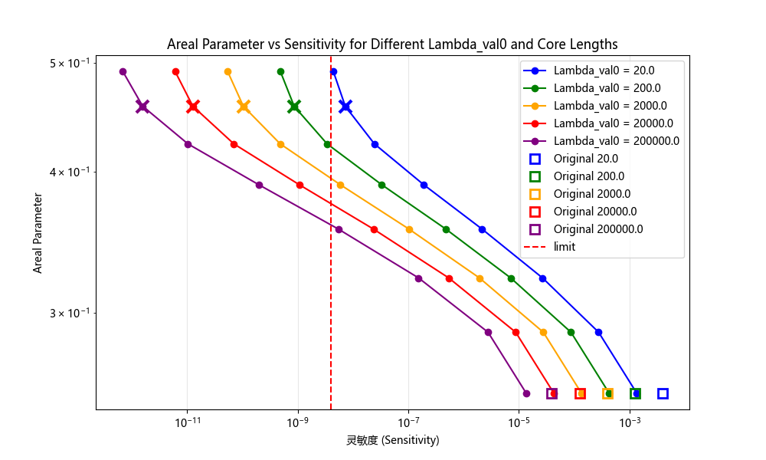
优化结果
能在曝光率为200 $year∙m^{2}$ 达到现有通量界限，通道数约为2.36w （3层）
r_coil_inner_mm | d_wire_mm | num_coil | num_layer | core_height | Sensitivity | areal_density | areal_ch
90 | 1.2 | 180 | 36 | 1.2 h_coil | 8.59E-10 | 3081.678 | 39.29752

Slide 15
多通道读出

