Slide 1

CEPC ECAL KEK ANALYSIS
李想，刁洪滨
2025.9.11

Slide 2
motivation：
Due to the low signal-to-noise ratio at CEPC, the MPV calibration results are not very good.
strategy:
Try to use a digital or semi-digital approach.

Slide 3
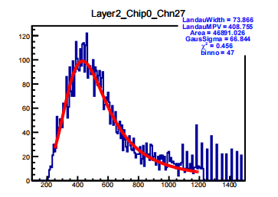
Channel Selection Strategy
For central layers (4 ≤ i ≤ 27):
A channel is considered good if either of the following conditions is satisfied:
Condition 1:
Landau width (par0) > 45,
χ² < 0.85,
and Gaussian σ (par3) is between 45 and 200.
Condition 2:
χ² < 1.0 and the number of bins used in the fit (binno) > 40.
For edge layers (i ≤ 3 or i ≥ 28):
The criteria are slightly relaxed to account for boundary effects:
Condition 1:
Landau width (par0) > 45,
χ² < 0.85,
and Gaussian σ (par3) is between 45 and 250.
Condition 2:
χ² < 0.8 and binno > 35.
layer_except_10_11_14_15_20_21_26_27
Data source：KEK P=5GeV e-
binNo: number of bins between 0.6*MPV and MPV
chi2: calculated within the same range (0.6*MPV to MPV)
Notes:
Since several layers have no data, the total number of channels is over 4000. After applying the Hough transform, more than 3000 channels have data entries exceeding 2200. However, after the fitting procedure, the number of good channels drops to fewer than 200.

Slide 4
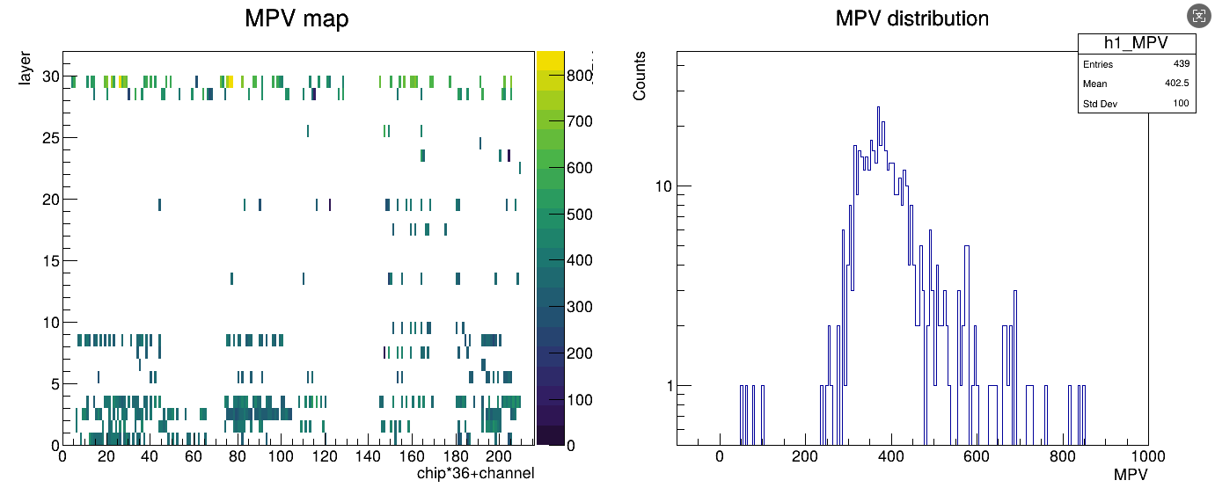
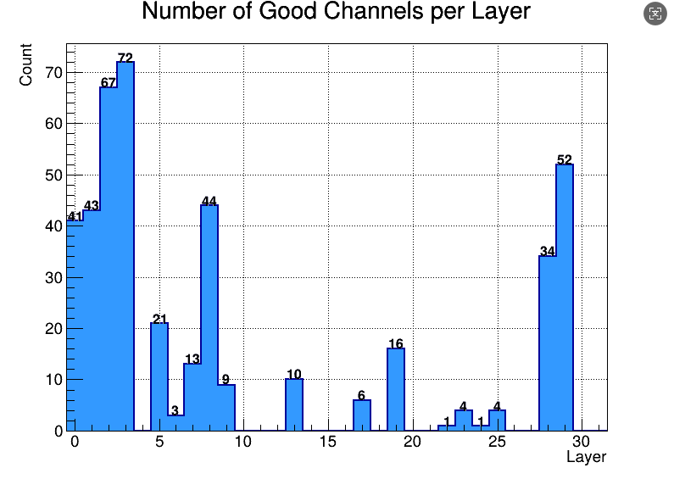
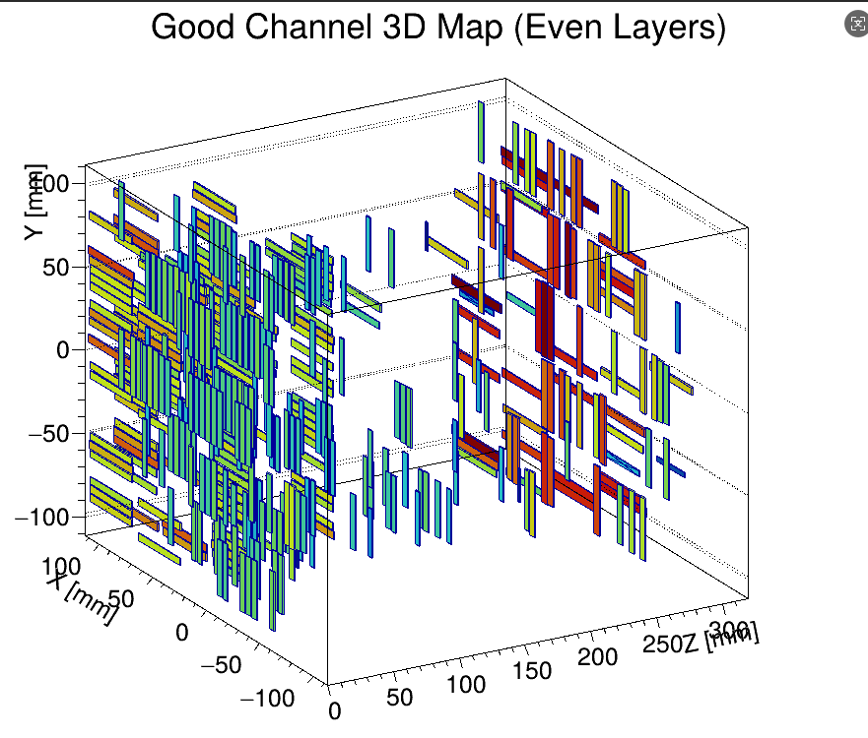
Selection Results
Totel channels:4608
Channels (statistics exceed 2200): 3304
Good channels:441
Good channels(15mm):309
Good channels(10mm):132
Notes:
Since several layers have no data, the total number of channels is over 4000. After applying the Hough transform, more than 3000 channels have data entries exceeding 2200. However, after the fitting procedure, the number of good channels drops to fewer than 200.

Slide 5
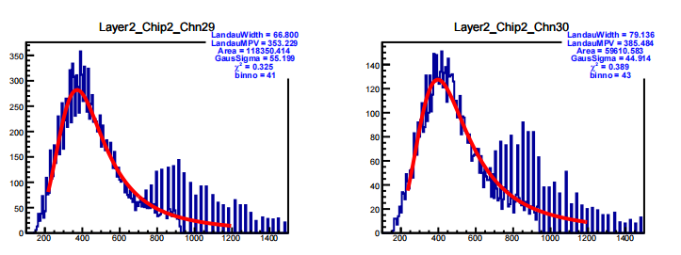
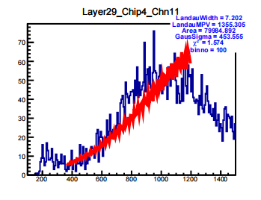
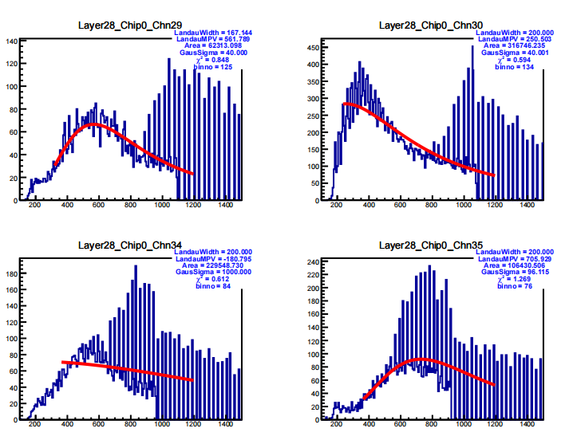
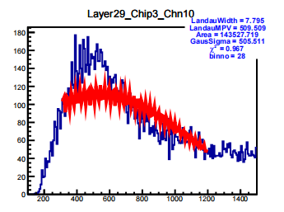
Optimization direction
1. HL_ratio probelem
2.Oscillation issue
Notes:
Since several layers have no data, the total number of channels is over 4000. After applying the Hough transform, more than 3000 channels have data entries exceeding 2200. However, after the fitting procedure, the number of good channels drops to fewer than 200.

Slide 6
Summary
Due to the low signal-to-noise ratio at CEPC, the MPV calibration results are not very good.
Try to use a digital or semi-digital approach.

Slide 7
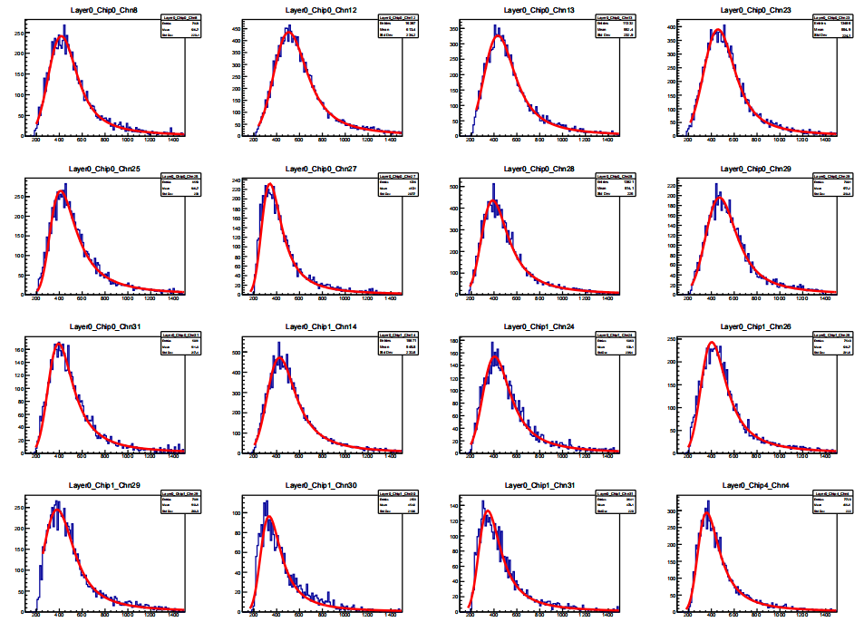
KEK Data MPV_Calibration
Notes:
To obtain the MPV map, we merged the ROOT files from all layers except 10, 11, 14, 15, 20, 21, 26, and 27.
After merging, we observed significant variations in the MPV values across different layers and chips.
To include some shower events in the rear layers, we also kept events with fewer than 2 hits per layer, and loosened the total hit count requirement.

Slide 8
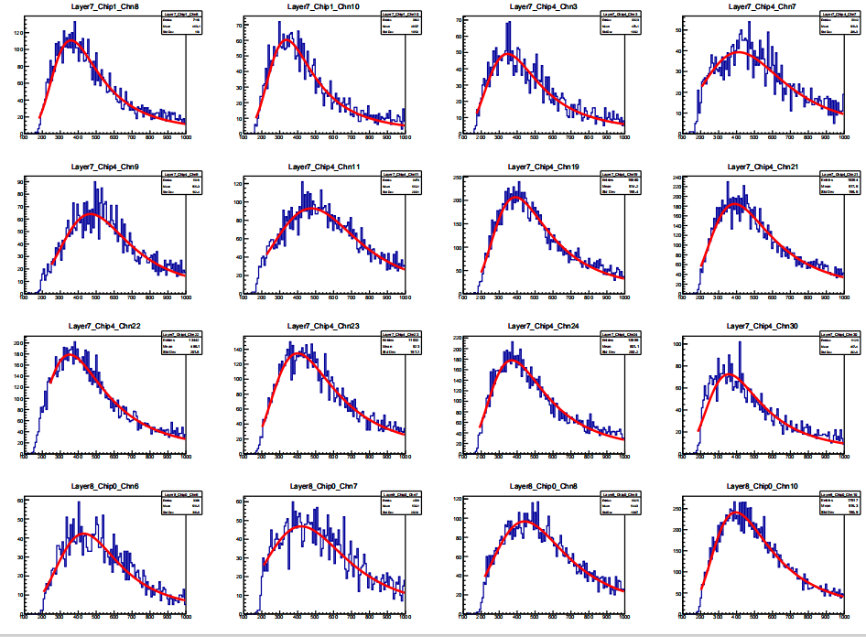
KEK Data MPV_Calibration
Notes:
To obtain the MPV map, we merged the ROOT files from all layers except 10, 11, 14, 15, 20, 21, 26, and 27.
After merging, we observed significant variations in the MPV values across different layers and chips.
To include some shower events in the rear layers, we also kept events with fewer than 2 hits per layer, and loosened the total hit count requirement.

Slide 9
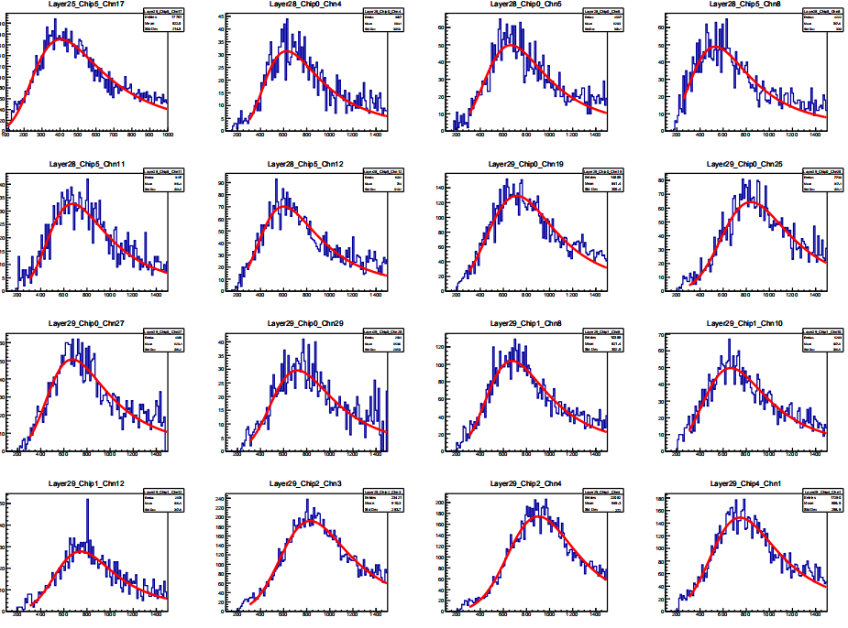
KEK Data MPV_Calibration
Notes:
To obtain the MPV map, we merged the ROOT files from all layers except 10, 11, 14, 15, 20, 21, 26, and 27.
After merging, we observed significant variations in the MPV values across different layers and chips.
To include some shower events in the rear layers, we also kept events with fewer than 2 hits per layer, and loosened the total hit count requirement.

Slide 10
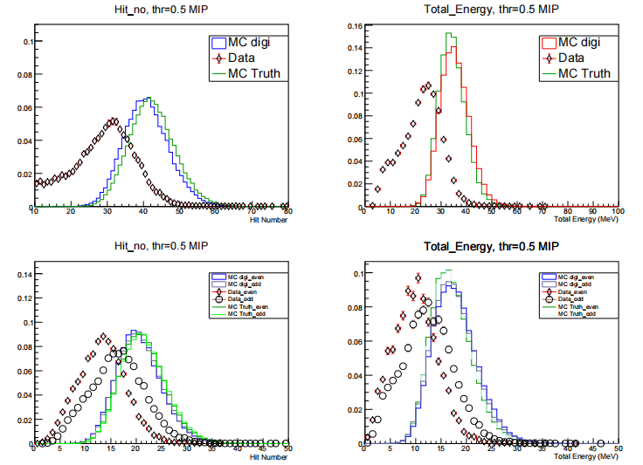
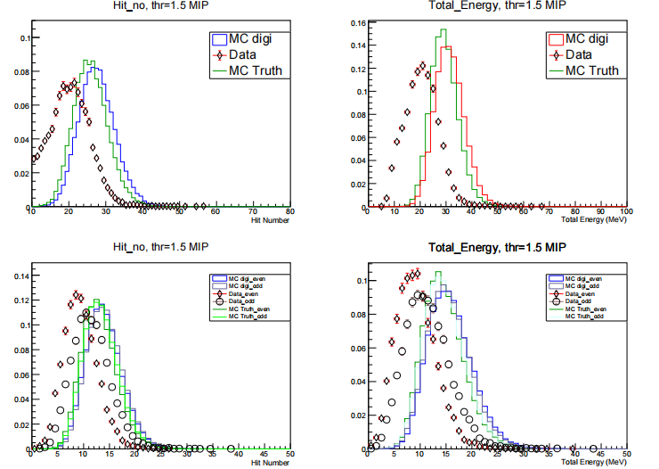
Digital or Semi-digital
Data source：PS
1GeV，threshold：0.5 MIP
1GeV，threshold：1.5 MIP
Notes:
For each run, we picked out the good channels — the ones with a clear rising edge. The table shows how many good channels we found in each run, and in total it’s about 200.

Slide 11
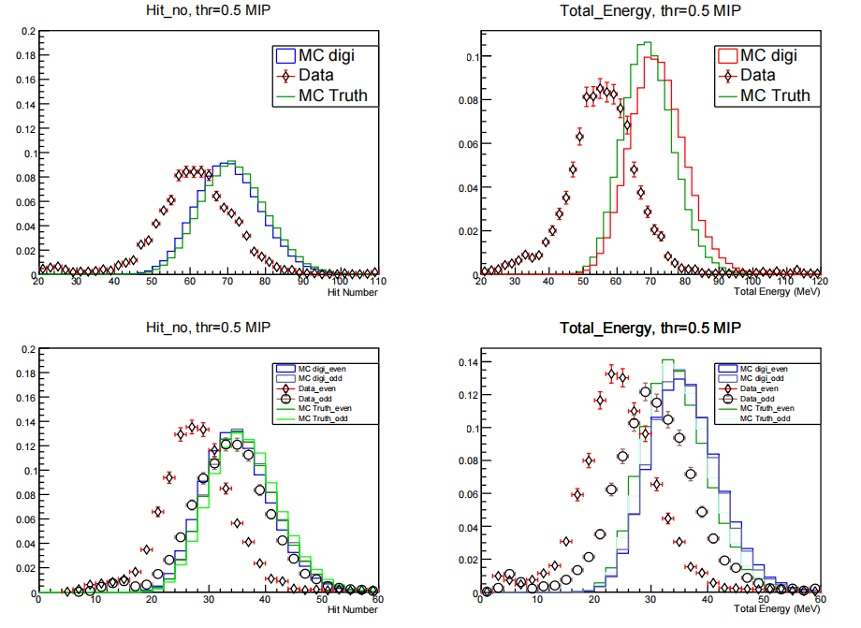
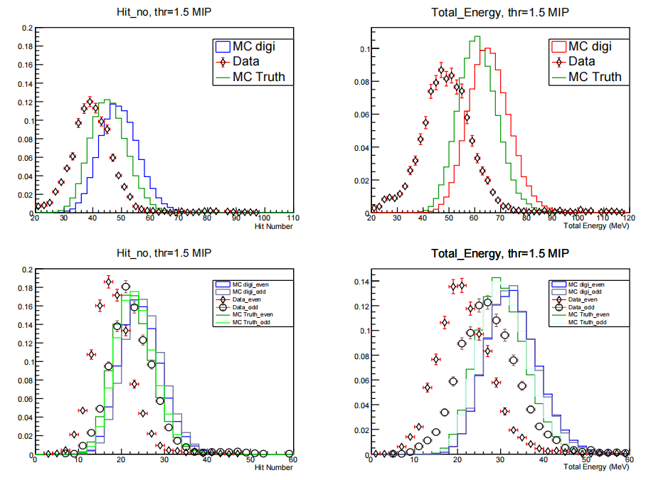
Digital or Semi-digital
Data source：PS
2GeV，threshold：0.5 MIP
2GeV，threshold：1.5 MIP
Notes:
For each run, we picked out the good channels — the ones with a clear rising edge. The table shows how many good channels we found in each run, and in total it’s about 200.

Slide 12
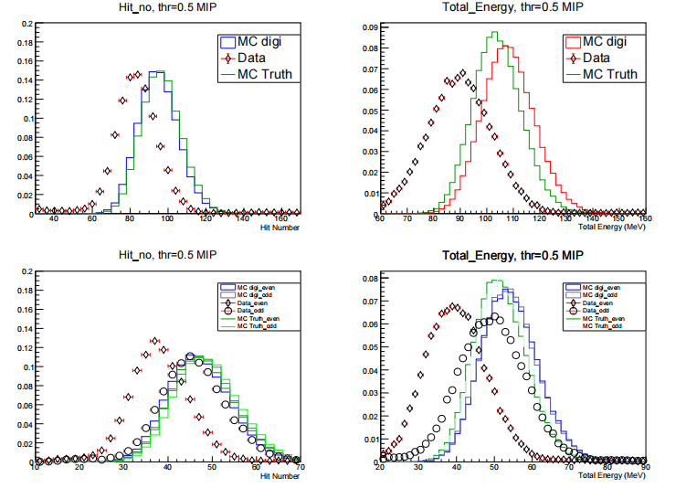
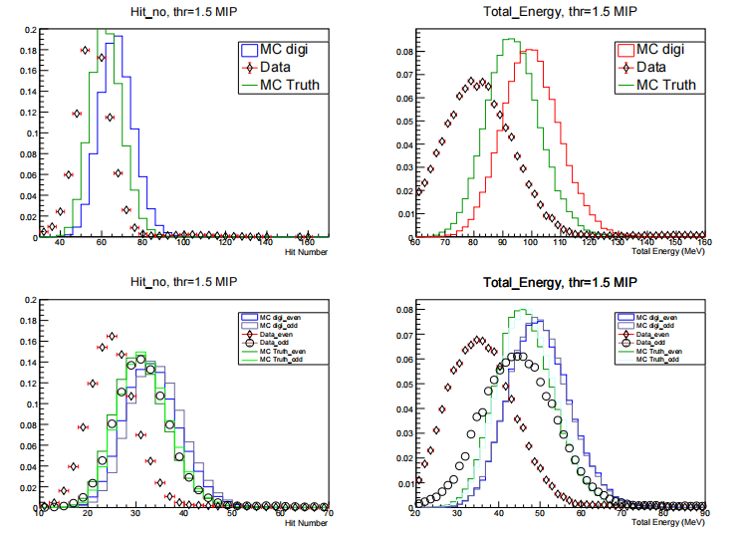
Digital or Semi-digital
Data source：PS
3GeV，threshold：0.5 MIP
3DGeV，threshold：1.5 MIP
Notes:
For each run, we picked out the good channels — the ones with a clear rising edge. The table shows how many good channels we found in each run, and in total it’s about 200.

Slide 13
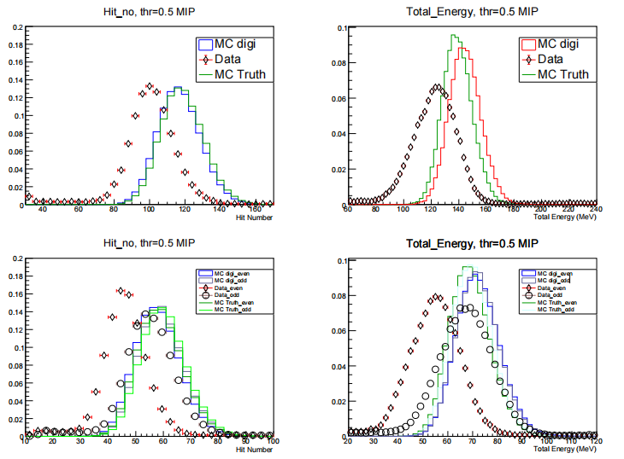
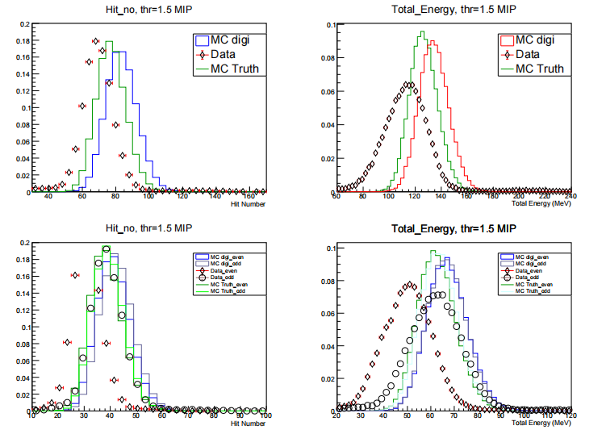
Digital or Semi-digital
Data source：PS
4GeV，threshold：0.5Mip
4GeV，threshold：1.5Mip
Notes:
For each run, we picked out the good channels — the ones with a clear rising edge. The table shows how many good channels we found in each run, and in total it’s about 200.

